Slide 1
A LEVEL · TOPICS 12–25
GIOPHYSICS PRACTICE PAPER
A Level · Physics 9702 · for examination in 2025, 2026 and 2027
A Level · Topics 12–25
Circular motion and gravitational fields, temperature, ideal gases and thermodynamics, oscillations, electric fields and capacitance, magnetic fields and alternating currents, quantum and nuclear physics.
MIRRORS
Paper 4 (A Level structured questions), closing in the style of Paper 5
MARKS
82 in total — all A Level
TIME
100 minutes · 12 questions
DEMAND
Recall 1 · Routine 2 · Demanding 6 · Discriminating 3
SYLLABUS
12, 13, 14, 15, 16, 17, 18, 19, 20, 21, 22, 23
Written by GioPhysics from the published syllabus. These are practice papers in the style of Cambridge International AS & A Level Physics 9702; they are not Cambridge papers, contain no past-paper questions, and the official syllabus and specimen materials remain the authority.
Cambridge International AS & A Level Physics — A Level · Topics 12–25. Written by GioPhysics from Cambridge International AS & A Level Physics 9702 syllabus; not an awarding body's document.
1 / 36
Notes:
[Format] Paper 1 is 40 multiple-choice items on AS content. Paper 2 is AS structured questions. Paper 3 is a practical exam taken in a laboratory. Paper 4 is A Level structured questions, 100 marks in two hours, and carries the largest single share of the qualification. Paper 5 is planning, analysis and evaluation — 30 marks, no recall, and the paper on which candidates most often underperform. A data sheet is provided in Papers 1, 2 and 4.
[Demand] Written to the real level of Paper 4, which is a hard paper. Multi-step calculations where nothing tells you which equation comes first; "show that" parts with the answer given so that partial credit depends on the working; explanations marked for the mechanism, not the name of the effect. The last question on each paper is in Paper 5's format, where the marks are for the design and the uncertainty treatment rather than for physics recall.
[Source] Cambridge International AS & A Level Physics 9702 syllabus — https://www.cambridgeinternational.org/Images/664565-2025-2027-syllabus.pdf
[Disclaimer] Written by GioPhysics from the published syllabus. These are practice papers in the style of Cambridge International AS & A Level Physics 9702; they are not Cambridge papers, contain no past-paper questions, and the official syllabus and specimen materials remain the authority.

Slide 2
A LEVEL · TOPICS 12–25
GIOPHYSICS PRACTICE PAPER
Question 1
Multiple choice
A Level
Routine
1 mark
Syllabus 13 · AO2
A satellite is in a circular orbit at a height above the Earth's surface equal to the radius R of the Earth. The gravitational field strength at the Earth's surface is g. What is the acceleration of the satellite?
A
g
B
g/2
C
g/4
D
g/8
Cambridge International AS & A Level Physics — A Level · Topics 12–25. Written by GioPhysics from Cambridge International AS & A Level Physics 9702 syllabus; not an awarding body's document.
2 / 36
Notes:
[Demand] Routine — The standard application — the named equation, the usual graph read.

Slide 3
A LEVEL · TOPICS 12–25
GIOPHYSICS PRACTICE PAPER
Answer 1
Multiple choice
A Level
Routine
1 mark
Mark scheme
C
g/4
Why the other three are there
B halves rather than squaring — the error of a candidate who remembers that the distance has doubled but not that the field follows an inverse square law. The distance from the centre, not from the surface, is what enters the law, and it has gone from R to 2R.
Cambridge International AS & A Level Physics — A Level · Topics 12–25. Written by GioPhysics from Cambridge International AS & A Level Physics 9702 syllabus; not an awarding body's document.
3 / 36
Notes:
[Answer] C — g/4
[Distractors] B halves rather than squaring — the error of a candidate who remembers that the distance has doubled but not that the field follows an inverse square law. The distance from the centre, not from the surface, is what enters the law, and it has gone from R to 2R.

Slide 4
A LEVEL · TOPICS 12–25
GIOPHYSICS PRACTICE PAPER
Question 2
Multiple choice
A Level
Demanding
1 mark
Syllabus 15 · AO2
An ideal gas is at a thermodynamic temperature of 300 K. To what temperature must it be raised to double the root-mean-square speed of its molecules?
A
424 K
B
600 K
C
1200 K
D
2400 K
Cambridge International AS & A Level Physics — A Level · Topics 12–25. Written by GioPhysics from Cambridge International AS & A Level Physics 9702 syllabus; not an awarding body's document.
4 / 36
Notes:
[Demand] Demanding — Several steps, and you have to choose them. Nothing says which comes first.

Slide 5
A LEVEL · TOPICS 12–25
GIOPHYSICS PRACTICE PAPER
Answer 2
Multiple choice
A Level
Demanding
1 mark
Mark scheme
C
1200 K
Why the other three are there
B doubles the temperature, which doubles the mean kinetic energy but multiplies the r.m.s. speed by only √2 — and A is that √2 factor applied to the temperature instead. Since ½m⟨c²⟩ ∝ T, the speed goes as √T, so doubling the speed needs four times the temperature.
Cambridge International AS & A Level Physics — A Level · Topics 12–25. Written by GioPhysics from Cambridge International AS & A Level Physics 9702 syllabus; not an awarding body's document.
5 / 36
Notes:
[Answer] C — 1200 K
[Distractors] B doubles the temperature, which doubles the mean kinetic energy but multiplies the r.m.s. speed by only √2 — and A is that √2 factor applied to the temperature instead. Since ½m⟨c²⟩ ∝ T, the speed goes as √T, so doubling the speed needs four times the temperature.

Slide 6
A LEVEL · TOPICS 12–25
GIOPHYSICS PRACTICE PAPER
Question 3
Multiple choice
A Level
Routine
1 mark
Syllabus 17 · AO2
A body moves with simple harmonic motion of amplitude 2.0 cm and frequency 5.0 Hz. What is the magnitude of its maximum acceleration?
A
0.63 m s⁻²
B
3.1 m s⁻²
C
20 m s⁻²
D
200 m s⁻²
Cambridge International AS & A Level Physics — A Level · Topics 12–25. Written by GioPhysics from Cambridge International AS & A Level Physics 9702 syllabus; not an awarding body's document.
6 / 36
Notes:
[Demand] Routine — The standard application — the named equation, the usual graph read.

Slide 7
A LEVEL · TOPICS 12–25
GIOPHYSICS PRACTICE PAPER
Answer 3
Multiple choice
A Level
Routine
1 mark
Mark scheme
C
20 m s⁻²
Why the other three are there
B uses f rather than ω = 2πf, which loses a factor of (2π)² ≈ 39. The amplitude must also be converted to metres; leaving it in centimetres gives D.
Cambridge International AS & A Level Physics — A Level · Topics 12–25. Written by GioPhysics from Cambridge International AS & A Level Physics 9702 syllabus; not an awarding body's document.
7 / 36
Notes:
[Answer] C — 20 m s⁻²
[Distractors] B uses f rather than ω = 2πf, which loses a factor of (2π)² ≈ 39. The amplitude must also be converted to metres; leaving it in centimetres gives D.

Slide 8
A LEVEL · TOPICS 12–25
GIOPHYSICS PRACTICE PAPER
Question 4
Multiple choice
A Level
Demanding
1 mark
Syllabus 19 · AO2
A capacitor of capacitance 470 μF, charged to a potential difference V₀, is discharged through a resistor of resistance 22 kΩ. After what time has the charge on the capacitor fallen to 25% of its initial value?
A
3.6 s
B
7.2 s
C
14 s
D
21 s
Cambridge International AS & A Level Physics — A Level · Topics 12–25. Written by GioPhysics from Cambridge International AS & A Level Physics 9702 syllabus; not an awarding body's document.
8 / 36
Notes:
[Demand] Demanding — Several steps, and you have to choose them. Nothing says which comes first.

Slide 9
A LEVEL · TOPICS 12–25
GIOPHYSICS PRACTICE PAPER
Answer 4
Multiple choice
A Level
Demanding
1 mark
Mark scheme
C
14 s
Why the other three are there
D is two time constants, which is the answer of a candidate who assumes the charge falls to 1/e² rather than to a quarter. The time constant is 10.3 s and t = RC ln 4 = 14.3 s.
Cambridge International AS & A Level Physics — A Level · Topics 12–25. Written by GioPhysics from Cambridge International AS & A Level Physics 9702 syllabus; not an awarding body's document.
9 / 36
Notes:
[Answer] C — 14 s
[Distractors] D is two time constants, which is the answer of a candidate who assumes the charge falls to 1/e² rather than to a quarter. The time constant is 10.3 s and t = RC ln 4 = 14.3 s.

Slide 10
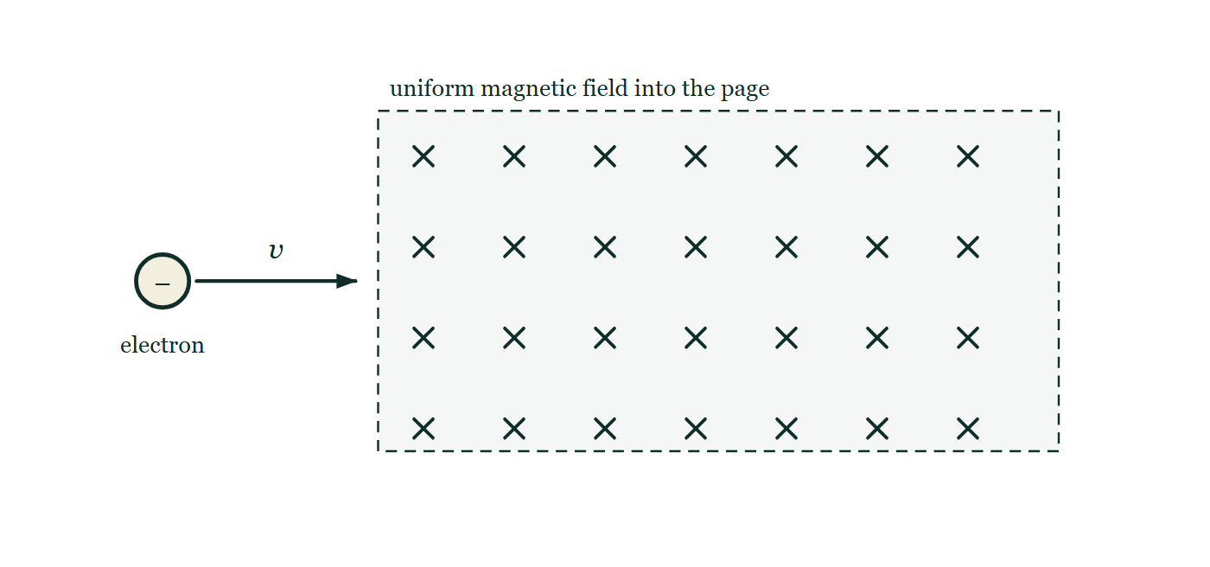
A LEVEL · TOPICS 12–25
GIOPHYSICS PRACTICE PAPER
Question 5
Multiple choice
A Level
Recall
1 mark
Syllabus 20 · AO1
An electron enters a uniform magnetic field with its velocity perpendicular to the field. What is its subsequent path within the field?
Fig. 5.1 — An electron, drawn as a small circle marked with a negative sign, travels horizontally to the right, and an arrow labelled v gives its velocity. Ahead of it lies a large rectangular region with a dashed boundary, filled with a regular array of crosses and labelled as a uniform magnetic field directed into the page. The electron is shown outside that region, at the instant before it crosses the boundary, with its velocity lying in the plane of the page.
A
a straight line at constant speed
B
a straight line with increasing speed
C
a circular arc at constant speed
D
a parabolic arc with increasing speed
Cambridge International AS & A Level Physics — A Level · Topics 12–25. Written by GioPhysics from Cambridge International AS & A Level Physics 9702 syllabus; not an awarding body's document.
10 / 36
Notes:
[Demand] Recall — One idea, one step. The mark is for knowing it.
[Figure] Fig. 5.1. An electron, drawn as a small circle marked with a negative sign, travels horizontally to the right, and an arrow labelled v gives its velocity. Ahead of it lies a large rectangular region with a dashed boundary, filled with a regular array of crosses and labelled as a uniform magnetic field directed into the page. The electron is shown outside that region, at the instant before it crosses the boundary, with its velocity lying in the plane of the page.

Slide 11
A LEVEL · TOPICS 12–25
GIOPHYSICS PRACTICE PAPER
Answer 5
Multiple choice
A Level
Recall
1 mark
Mark scheme
C
a circular arc at constant speed
Why the other three are there
D is the path in a uniform electric field, and is the answer of a candidate who has not separated the two cases. The magnetic force is always perpendicular to the velocity, so it does no work: the speed cannot change, only the direction.
Cambridge International AS & A Level Physics — A Level · Topics 12–25. Written by GioPhysics from Cambridge International AS & A Level Physics 9702 syllabus; not an awarding body's document.
11 / 36
Notes:
[Answer] C — a circular arc at constant speed
[Distractors] D is the path in a uniform electric field, and is the answer of a candidate who has not separated the two cases. The magnetic force is always perpendicular to the velocity, so it does no work: the speed cannot change, only the direction.
[Figure] Fig. 5.1. An electron, drawn as a small circle marked with a negative sign, travels horizontally to the right, and an arrow labelled v gives its velocity. Ahead of it lies a large rectangular region with a dashed boundary, filled with a regular array of crosses and labelled as a uniform magnetic field directed into the page. The electron is shown outside that region, at the instant before it crosses the boundary, with its velocity lying in the plane of the page.

Slide 12
A LEVEL · TOPICS 12–25
GIOPHYSICS PRACTICE PAPER
Question 6
Multiple choice
A Level
Demanding
1 mark
Syllabus 22 · AO2
Light of wavelength 450 nm is incident on a metal surface of work function 2.0 eV. What is the maximum kinetic energy of the emitted photoelectrons?
A
0.76 eV
B
2.0 eV
C
2.8 eV
D
4.8 eV
Cambridge International AS & A Level Physics — A Level · Topics 12–25. Written by GioPhysics from Cambridge International AS & A Level Physics 9702 syllabus; not an awarding body's document.
12 / 36
Notes:
[Demand] Demanding — Several steps, and you have to choose them. Nothing says which comes first.

Slide 13
A LEVEL · TOPICS 12–25
GIOPHYSICS PRACTICE PAPER
Answer 6
Multiple choice
A Level
Demanding
1 mark
Mark scheme
A
0.76 eV
Why the other three are there
C is the photon energy itself, hc/λ = 2.76 eV, offered to candidates who stop before subtracting the work function. D adds the work function instead of subtracting it.
Cambridge International AS & A Level Physics — A Level · Topics 12–25. Written by GioPhysics from Cambridge International AS & A Level Physics 9702 syllabus; not an awarding body's document.
13 / 36
Notes:
[Answer] A — 0.76 eV
[Distractors] C is the photon energy itself, hc/λ = 2.76 eV, offered to candidates who stop before subtracting the work function. D adds the work function instead of subtracting it.

Slide 14
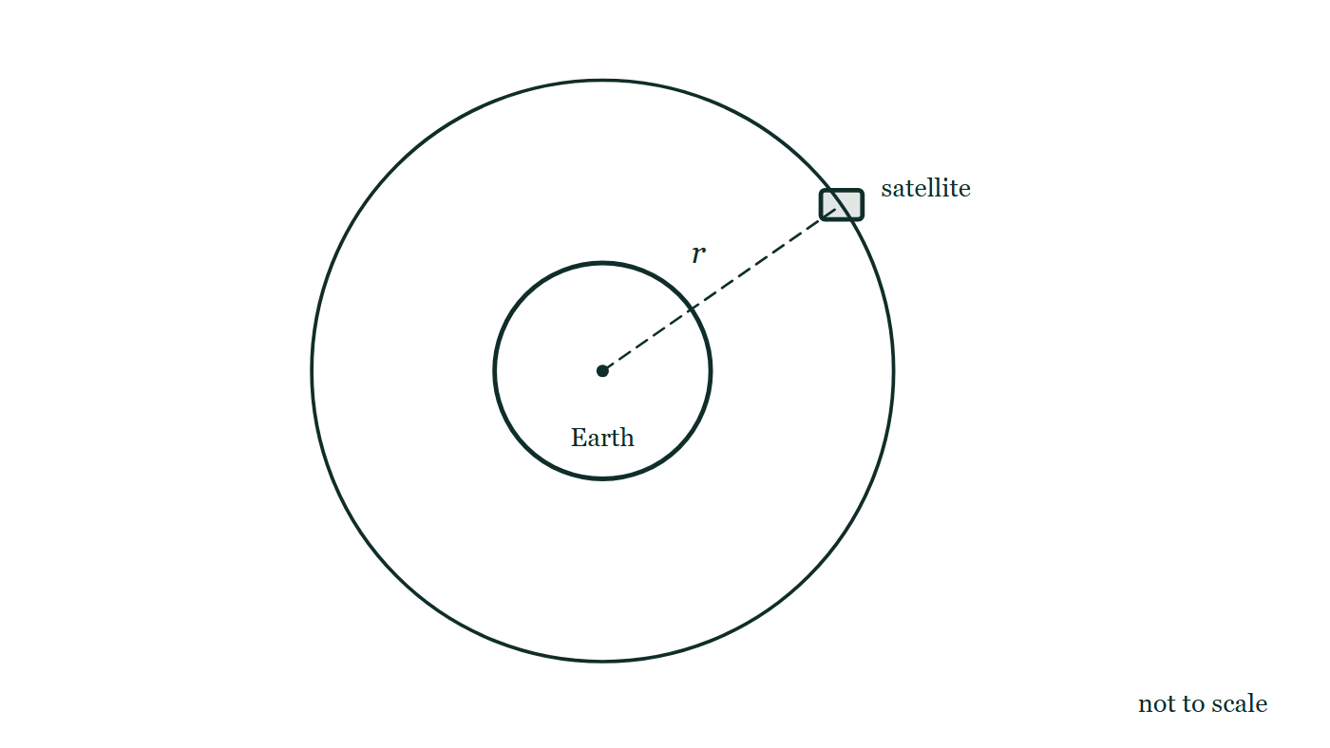
A LEVEL · TOPICS 12–25
GIOPHYSICS PRACTICE PAPER
Question 7
Structured
A Level
Discriminating
12 marks
Syllabus 12, 13
A satellite is in a circular geostationary orbit about the Earth. The product GM for the Earth is 3.99 × 10¹⁴ m³ s⁻², and one day may be taken as 24 hours.
Fig. 7.1 — The Earth is drawn as a circle, labelled, with a dot marking its centre. A second, larger circle drawn concentric with it is the satellite's circular orbit. The satellite itself is a small block sitting on that larger circle, above and to the right of the Earth, and a dashed straight line runs from the dot at the centre of the Earth out to the satellite, labelled r. The figure is marked not to scale.
Cambridge International AS & A Level Physics — A Level · Topics 12–25. Written by GioPhysics from Cambridge International AS & A Level Physics 9702 syllabus; not an awarding body's document.
14 / 36
Notes:
[Demand] Discriminating — The part that separates the top grade: an unfamiliar context, a derivation, or an argument that has to hold together to earn anything.
[Figure] Fig. 7.1. The Earth is drawn as a circle, labelled, with a dot marking its centre. A second, larger circle drawn concentric with it is the satellite's circular orbit. The satellite itself is a small block sitting on that larger circle, above and to the right of the Earth, and a dashed straight line runs from the dot at the centre of the Earth out to the satellite, labelled r. The figure is marked not to scale.

Slide 15
A LEVEL · TOPICS 12–25
GIOPHYSICS PRACTICE PAPER
Question 7 (cont.)
Structured
A Level
Discriminating
12 marks
continued from the previous slide
(a) Explain
3 marks
Explain what is meant by a geostationary orbit.
(b) Show (that)
4 marks
The gravitational force provides the centripetal force. Show that the radius of a geostationary orbit is approximately 4.2 × 10⁷ m.
(c) Calculate
2 marks
Calculate the linear speed of the satellite in this orbit.
(d) Explain
3 marks
A student suggests placing a geostationary satellite in orbit above London. Explain why this is not possible.
Cambridge International AS & A Level Physics — A Level · Topics 12–25. Written by GioPhysics from Cambridge International AS & A Level Physics 9702 syllabus; not an awarding body's document.
15 / 36
Notes:
[Demand] Discriminating — The part that separates the top grade: an unfamiliar context, a derivation, or an argument that has to hold together to earn anything.
[Figure] Fig. 7.1. The Earth is drawn as a circle, labelled, with a dot marking its centre. A second, larger circle drawn concentric with it is the satellite's circular orbit. The satellite itself is a small block sitting on that larger circle, above and to the right of the Earth, and a dashed straight line runs from the dot at the centre of the Earth out to the satellite, labelled r. The figure is marked not to scale.
[Reminder] Fig. 7.1 is on the previous slide.

Slide 16
A LEVEL · TOPICS 12–25
GIOPHYSICS PRACTICE PAPER
Answer 7
Structured
A Level
Discriminating
12 marks
Mark scheme
(a) Explain — 3 marks
AO1
✓
the satellite has a period of 24 hours, equal to the Earth's period of rotation
✓
it orbits in the same direction as the Earth's rotation, in the plane of the equator
✓
so it remains vertically above the same point on the Earth's surface
All three conditions are required, and the equatorial plane is the one candidates omit. An orbit of 24-hour period inclined to the equator does not stay above one point.
(b) Show (that) — 4 marks
AO2
✓
GMm/r² = mrω², so GM = r³ω²
✓
ω = 2π/T = 2π/86400 = 7.27 × 10⁻⁵ rad s⁻¹
✓
r³ = GM/ω² = 3.99 × 10¹⁴ / (7.27 × 10⁻⁵)² = 7.55 × 10²²
✓
r = 4.2 × 10⁷ m
A "show that" with the answer printed: every line of the working has to be there, because a candidate who writes only the final number earns one mark at most.
(c) Calculate — 2 marks
AO2
✓
v = 2πr/T = 2π × 4.2 × 10⁷ / 86400
✓
v = 3.1 × 10³ m s⁻¹
Cambridge International AS & A Level Physics — A Level · Topics 12–25. Written by GioPhysics from Cambridge International AS & A Level Physics 9702 syllabus; not an awarding body's document.
16 / 36
Notes:
[Marking] One line per mark, awarded independently unless a point says otherwise.
[Examiner note (a)] All three conditions are required, and the equatorial plane is the one candidates omit. An orbit of 24-hour period inclined to the equator does not stay above one point.
[Examiner note (b)] A "show that" with the answer printed: every line of the working has to be there, because a candidate who writes only the final number earns one mark at most.
[Examiner note (d)] The hardest three marks on the paper, and worth setting: the geometry of the orbit follows from the direction of the force, which is a point candidates rarely have to use explicitly.
[Figure] Fig. 7.1. The Earth is drawn as a circle, labelled, with a dot marking its centre. A second, larger circle drawn concentric with it is the satellite's circular orbit. The satellite itself is a small block sitting on that larger circle, above and to the right of the Earth, and a dashed straight line runs from the dot at the centre of the Earth out to the satellite, labelled r. The figure is marked not to scale.

Slide 17
A LEVEL · TOPICS 12–25
GIOPHYSICS PRACTICE PAPER
Answer 7 (cont.)
Structured
A Level
Discriminating
12 marks
Mark scheme, continued
(d) Explain — 3 marks
AO2
✓
the centre of a circular orbit must be at the centre of the Earth, because that is where the gravitational force is directed
✓
an orbit whose plane passes above London at a fixed latitude would have its centre away from the Earth's centre
✓
so the satellite would have to be held up by some force other than gravity, which there is none to provide
The hardest three marks on the paper, and worth setting: the geometry of the orbit follows from the direction of the force, which is a point candidates rarely have to use explicitly.
Cambridge International AS & A Level Physics — A Level · Topics 12–25. Written by GioPhysics from Cambridge International AS & A Level Physics 9702 syllabus; not an awarding body's document.
17 / 36
Notes:
[Marking] One line per mark, awarded independently unless a point says otherwise.
[Examiner note (a)] All three conditions are required, and the equatorial plane is the one candidates omit. An orbit of 24-hour period inclined to the equator does not stay above one point.
[Examiner note (b)] A "show that" with the answer printed: every line of the working has to be there, because a candidate who writes only the final number earns one mark at most.
[Examiner note (d)] The hardest three marks on the paper, and worth setting: the geometry of the orbit follows from the direction of the force, which is a point candidates rarely have to use explicitly.
[Figure] Fig. 7.1. The Earth is drawn as a circle, labelled, with a dot marking its centre. A second, larger circle drawn concentric with it is the satellite's circular orbit. The satellite itself is a small block sitting on that larger circle, above and to the right of the Earth, and a dashed straight line runs from the dot at the centre of the Earth out to the satellite, labelled r. The figure is marked not to scale.

Slide 18
A LEVEL · TOPICS 12–25
GIOPHYSICS PRACTICE PAPER
Question 8
Structured
A Level
Demanding
12 marks
Syllabus 15, 16
A sealed cylinder contains an ideal gas of volume 2.0 × 10⁻³ m³ at a pressure of 1.5 × 10⁵ Pa and a temperature of 290 K. The Boltzmann constant is 1.38 × 10⁻²³ J K⁻¹.
(a) Calculate
3 marks
Calculate the number of molecules of gas in the cylinder.
(b) Determine
3 marks
Determine the total kinetic energy of the molecules in the cylinder.
(c) Deduce
4 marks
The gas is now compressed slowly at a constant temperature of 290 K. During the compression, 120 J of work is done on the gas. Deduce the change in internal energy of the gas and the thermal energy transferred to or from it.
(d) Explain
2 marks
Explain why the internal energy of an ideal gas depends only on its temperature, whereas that of a real gas does not.
Cambridge International AS & A Level Physics — A Level · Topics 12–25. Written by GioPhysics from Cambridge International AS & A Level Physics 9702 syllabus; not an awarding body's document.
18 / 36
Notes:
[Demand] Demanding — Several steps, and you have to choose them. Nothing says which comes first.

Slide 19
A LEVEL · TOPICS 12–25
GIOPHYSICS PRACTICE PAPER
Answer 8
Structured
A Level
Demanding
12 marks
Mark scheme
(a) Calculate — 3 marks
AO2
✓
pV = NkT
✓
N = pV/kT = (1.5 × 10⁵ × 2.0 × 10⁻³) / (1.38 × 10⁻²³ × 290)
✓
N = 7.5 × 10²²
(b) Determine — 3 marks
AO2
✓
mean kinetic energy per molecule = (3/2)kT = 1.5 × 1.38 × 10⁻²³ × 290 = 6.0 × 10⁻²¹ J
✓
total = N × 6.0 × 10⁻²¹
✓
total = 4.5 × 10² J (450 J)
Also obtainable as (3/2)pV, and a candidate who spots that earns full marks in one line.
(c) Deduce — 4 marks
AO2
✓
the temperature is unchanged, so the mean kinetic energy per molecule is unchanged
✓
the internal energy of an ideal gas is entirely kinetic, so ΔU = 0
✓
first law: ΔU = q + w, so 0 = q + 120
✓
q = −120 J: 120 J of thermal energy is transferred out of the gas to the surroundings
Cambridge International AS & A Level Physics — A Level · Topics 12–25. Written by GioPhysics from Cambridge International AS & A Level Physics 9702 syllabus; not an awarding body's document.
19 / 36
Notes:
[Marking] One line per mark, awarded independently unless a point says otherwise.
[Examiner note (b)] Also obtainable as (3/2)pV, and a candidate who spots that earns full marks in one line.

Slide 20
A LEVEL · TOPICS 12–25
GIOPHYSICS PRACTICE PAPER
Answer 8 (cont.)
Structured
A Level
Demanding
12 marks
Mark scheme, continued
(d) Explain — 2 marks
AO1
✓
an ideal gas is defined to have no forces between its molecules except during collisions, so there is no potential energy contribution and the internal energy is the total random kinetic energy alone
✓
a real gas has intermolecular forces, so its internal energy also includes potential energy, which depends on the separation of the molecules and hence on the volume
Cambridge International AS & A Level Physics — A Level · Topics 12–25. Written by GioPhysics from Cambridge International AS & A Level Physics 9702 syllabus; not an awarding body's document.
20 / 36
Notes:
[Marking] One line per mark, awarded independently unless a point says otherwise.
[Examiner note (b)] Also obtainable as (3/2)pV, and a candidate who spots that earns full marks in one line.

Slide 21
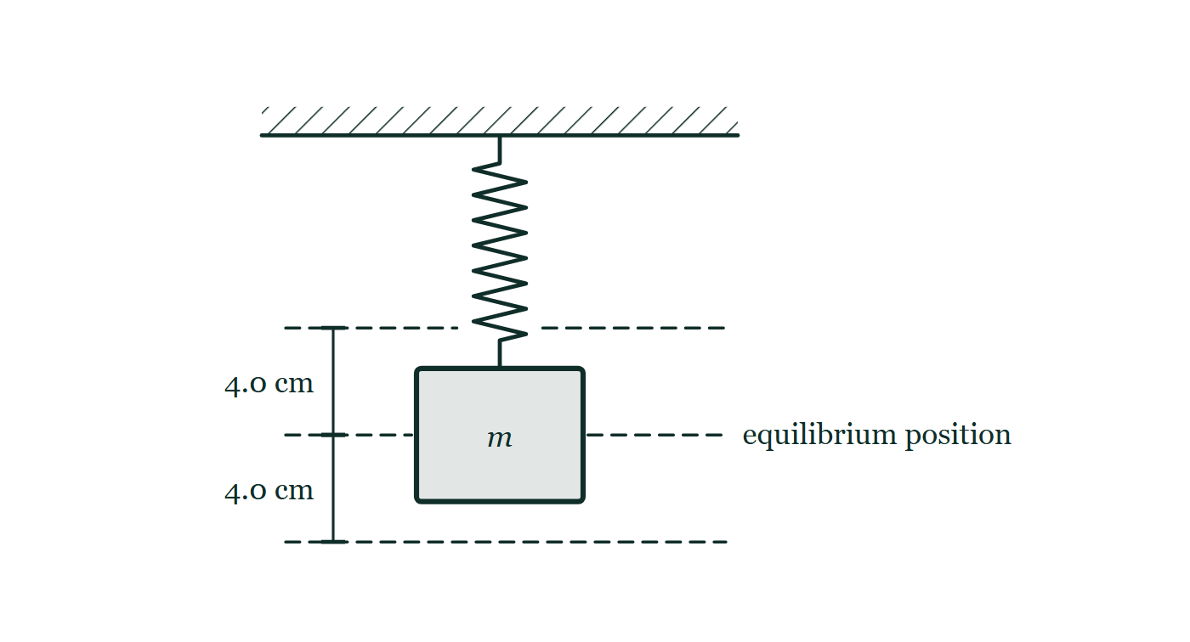
A LEVEL · TOPICS 12–25
GIOPHYSICS PRACTICE PAPER
Question 9
Structured
A Level
Demanding
12 marks
Syllabus 17
A mass suspended from a spring oscillates vertically with simple harmonic motion of amplitude 4.0 cm and period 0.80 s.
Fig. 9.1 — A spring hangs vertically from a rigid horizontal support drawn with hatching above it, and a block labelled m is attached to the lower end of the spring. A dashed horizontal line level with the centre of the block is labelled equilibrium position. Two further dashed horizontal lines, one above it and one below it, mark the highest and lowest positions the block reaches, and the distance from the equilibrium line to each of them is marked 4.0 cm.
(a) Define
2 marks
Define simple harmonic motion.
Cambridge International AS & A Level Physics — A Level · Topics 12–25. Written by GioPhysics from Cambridge International AS & A Level Physics 9702 syllabus; not an awarding body's document.
21 / 36
Notes:
[Demand] Demanding — Several steps, and you have to choose them. Nothing says which comes first.
[Figure] Fig. 9.1. A spring hangs vertically from a rigid horizontal support drawn with hatching above it, and a block labelled m is attached to the lower end of the spring. A dashed horizontal line level with the centre of the block is labelled equilibrium position. Two further dashed horizontal lines, one above it and one below it, mark the highest and lowest positions the block reaches, and the distance from the equilibrium line to each of them is marked 4.0 cm.

Slide 22
A LEVEL · TOPICS 12–25
GIOPHYSICS PRACTICE PAPER
Question 9 (cont.)
Structured
A Level
Demanding
12 marks
continued from the previous slide
(b) Calculate
3 marks
Calculate the maximum speed of the mass.
(c) Calculate
3 marks
Calculate the speed of the mass when its displacement from the equilibrium position is 2.0 cm.
(d) Explain
4 marks
The mass is now made to oscillate by a driver whose frequency can be varied, and the system is lightly damped. Describe how the amplitude of the oscillations varies with the driving frequency, and explain what happens to the response curve if the damping is increased.
Cambridge International AS & A Level Physics — A Level · Topics 12–25. Written by GioPhysics from Cambridge International AS & A Level Physics 9702 syllabus; not an awarding body's document.
22 / 36
Notes:
[Demand] Demanding — Several steps, and you have to choose them. Nothing says which comes first.
[Figure] Fig. 9.1. A spring hangs vertically from a rigid horizontal support drawn with hatching above it, and a block labelled m is attached to the lower end of the spring. A dashed horizontal line level with the centre of the block is labelled equilibrium position. Two further dashed horizontal lines, one above it and one below it, mark the highest and lowest positions the block reaches, and the distance from the equilibrium line to each of them is marked 4.0 cm.
[Reminder] Fig. 9.1 is on the previous slide.

Slide 23
A LEVEL · TOPICS 12–25
GIOPHYSICS PRACTICE PAPER
Answer 9
Structured
A Level
Demanding
12 marks
Mark scheme
(a) Define — 2 marks
AO1
✓
motion in which the acceleration is proportional to the displacement from a fixed point
✓
and is always directed towards that point (opposite in direction to the displacement)
(b) Calculate — 3 marks
AO2
✓
ω = 2π/T = 2π/0.80 = 7.85 rad s⁻¹
✓
v_max = ωx₀ = 7.85 × 0.040
✓
v_max = 0.31 m s⁻¹
(c) Calculate — 3 marks
AO2
✓
v = ω√(x₀² − x²)
✓
v = 7.85 × √(0.040² − 0.020²) = 7.85 × 0.0346
✓
v = 0.27 m s⁻¹
Cambridge International AS & A Level Physics — A Level · Topics 12–25. Written by GioPhysics from Cambridge International AS & A Level Physics 9702 syllabus; not an awarding body's document.
23 / 36
Notes:
[Marking] One line per mark, awarded independently unless a point says otherwise.
[Examiner note (d)] The shift of the peak to a lower frequency is the fourth mark and is regularly omitted from teaching. The first three are available to any candidate who has drawn the curve.
[Figure] Fig. 9.1. A spring hangs vertically from a rigid horizontal support drawn with hatching above it, and a block labelled m is attached to the lower end of the spring. A dashed horizontal line level with the centre of the block is labelled equilibrium position. Two further dashed horizontal lines, one above it and one below it, mark the highest and lowest positions the block reaches, and the distance from the equilibrium line to each of them is marked 4.0 cm.

Slide 24
A LEVEL · TOPICS 12–25
GIOPHYSICS PRACTICE PAPER
Answer 9 (cont.)
Structured
A Level
Demanding
12 marks
Mark scheme, continued
(d) Explain — 4 marks
AO2
✓
the amplitude is small at low driving frequencies, rises to a sharp maximum when the driving frequency equals the natural frequency of the system, then falls again
✓
this maximum is resonance, and at it the driver transfers energy to the system most efficiently
✓
increasing the damping lowers the peak amplitude and makes the peak broader (flatter)
✓
and the peak occurs at a slightly lower frequency than the undamped natural frequency
The shift of the peak to a lower frequency is the fourth mark and is regularly omitted from teaching. The first three are available to any candidate who has drawn the curve.
Cambridge International AS & A Level Physics — A Level · Topics 12–25. Written by GioPhysics from Cambridge International AS & A Level Physics 9702 syllabus; not an awarding body's document.
24 / 36
Notes:
[Marking] One line per mark, awarded independently unless a point says otherwise.
[Examiner note (d)] The shift of the peak to a lower frequency is the fourth mark and is regularly omitted from teaching. The first three are available to any candidate who has drawn the curve.
[Figure] Fig. 9.1. A spring hangs vertically from a rigid horizontal support drawn with hatching above it, and a block labelled m is attached to the lower end of the spring. A dashed horizontal line level with the centre of the block is labelled equilibrium position. Two further dashed horizontal lines, one above it and one below it, mark the highest and lowest positions the block reaches, and the distance from the equilibrium line to each of them is marked 4.0 cm.

Slide 25
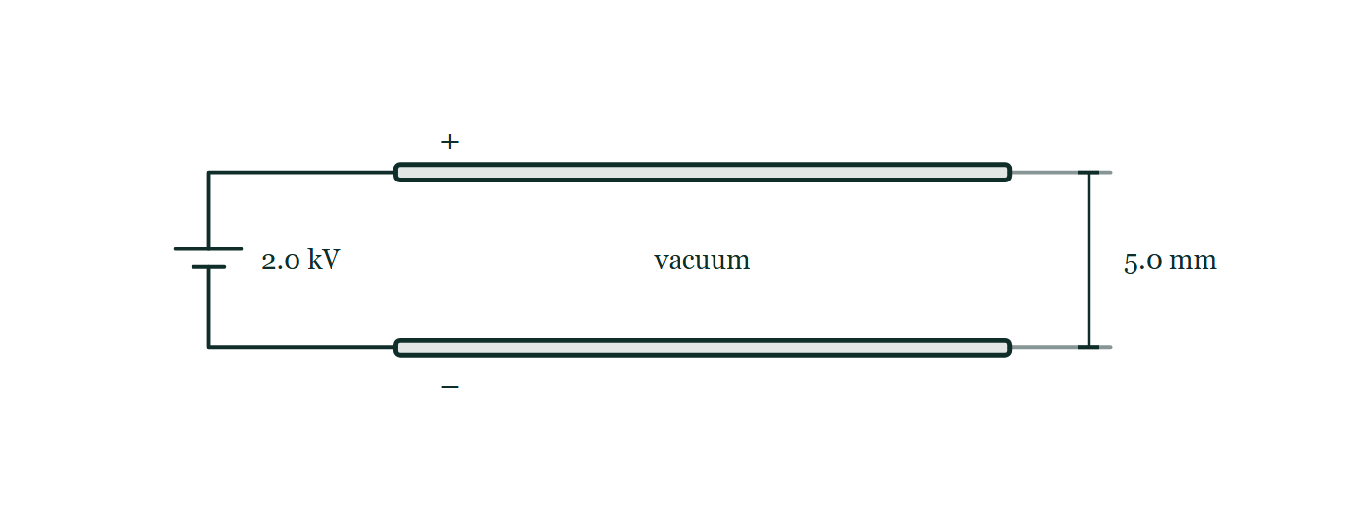
A LEVEL · TOPICS 12–25
GIOPHYSICS PRACTICE PAPER
Question 10
Structured
A Level
Demanding
11 marks
Syllabus 18, 19, 20
Two large parallel metal plates are 5.0 mm apart in a vacuum. A potential difference of 2.0 kV is maintained between them. A separate circuit contains a capacitor of capacitance 22 μF charged to a potential difference of 12 V.
Fig. 10.1 — Two long horizontal metal plates are drawn one directly above the other and connected by wires at their left-hand ends to a battery labelled 2.0 kV; the upper plate carries a plus sign and the lower plate a minus sign. The space between the plates is empty and labelled vacuum, and a dimension at the right-hand end gives the separation of the plates as 5.0 mm. No field lines are drawn between the plates.
Cambridge International AS & A Level Physics — A Level · Topics 12–25. Written by GioPhysics from Cambridge International AS & A Level Physics 9702 syllabus; not an awarding body's document.
25 / 36
Notes:
[Demand] Demanding — Several steps, and you have to choose them. Nothing says which comes first.
[Figure] Fig. 10.1. Two long horizontal metal plates are drawn one directly above the other and connected by wires at their left-hand ends to a battery labelled 2.0 kV; the upper plate carries a plus sign and the lower plate a minus sign. The space between the plates is empty and labelled vacuum, and a dimension at the right-hand end gives the separation of the plates as 5.0 mm. No field lines are drawn between the plates.

Slide 26
A LEVEL · TOPICS 12–25
GIOPHYSICS PRACTICE PAPER
Question 10 (cont.)
Structured
A Level
Demanding
11 marks
continued from the previous slide
(a) Calculate
2 marks
Calculate the magnitude of the electric field strength between the parallel plates.
(b) Explain
3 marks
Compare the field between the parallel plates with the field around an isolated point charge, and explain the difference in how each varies with position.
(c) Calculate
2 marks
Calculate the energy stored in the 22 μF capacitor.
(d) Determine
4 marks
The charged capacitor is discharged through a 150 kΩ resistor. Determine the time taken for the potential difference across it to fall to 3.0 V.
Cambridge International AS & A Level Physics — A Level · Topics 12–25. Written by GioPhysics from Cambridge International AS & A Level Physics 9702 syllabus; not an awarding body's document.
26 / 36
Notes:
[Demand] Demanding — Several steps, and you have to choose them. Nothing says which comes first.
[Figure] Fig. 10.1. Two long horizontal metal plates are drawn one directly above the other and connected by wires at their left-hand ends to a battery labelled 2.0 kV; the upper plate carries a plus sign and the lower plate a minus sign. The space between the plates is empty and labelled vacuum, and a dimension at the right-hand end gives the separation of the plates as 5.0 mm. No field lines are drawn between the plates.
[Reminder] Fig. 10.1 is on the previous slide.

Slide 27
A LEVEL · TOPICS 12–25
GIOPHYSICS PRACTICE PAPER
Answer 10
Structured
A Level
Demanding
11 marks
Mark scheme
(a) Calculate — 2 marks
AO2
✓
E = V/d = 2000 / 5.0 × 10⁻³
✓
E = 4.0 × 10⁵ V m⁻¹
(b) Explain — 3 marks
AO1
✓
the field between the plates is uniform — the field lines are parallel and equally spaced, so E has the same magnitude and direction everywhere between them
✓
the field of a point charge is radial, with lines spreading out from the charge
✓
so the point-charge field falls off as 1/r², while the field between the plates does not vary with position at all
(c) Calculate — 2 marks
AO2
✓
W = ½CV² = ½ × 22 × 10⁻⁶ × 12²
✓
W = 1.6 × 10⁻³ J
(d) Determine — 4 marks
AO2
✓
time constant RC = 150 × 10³ × 22 × 10⁻⁶ = 3.3 s
✓
V = V₀e^(−t/RC), so 3.0 = 12e^(−t/3.3)
✓
t = RC ln(V₀/V) = 3.3 × ln 4
✓
t = 4.6 s
Cambridge International AS & A Level Physics — A Level · Topics 12–25. Written by GioPhysics from Cambridge International AS & A Level Physics 9702 syllabus; not an awarding body's document.
27 / 36
Notes:
[Marking] One line per mark, awarded independently unless a point says otherwise.
[Figure] Fig. 10.1. Two long horizontal metal plates are drawn one directly above the other and connected by wires at their left-hand ends to a battery labelled 2.0 kV; the upper plate carries a plus sign and the lower plate a minus sign. The space between the plates is empty and labelled vacuum, and a dimension at the right-hand end gives the separation of the plates as 5.0 mm. No field lines are drawn between the plates.

Slide 28
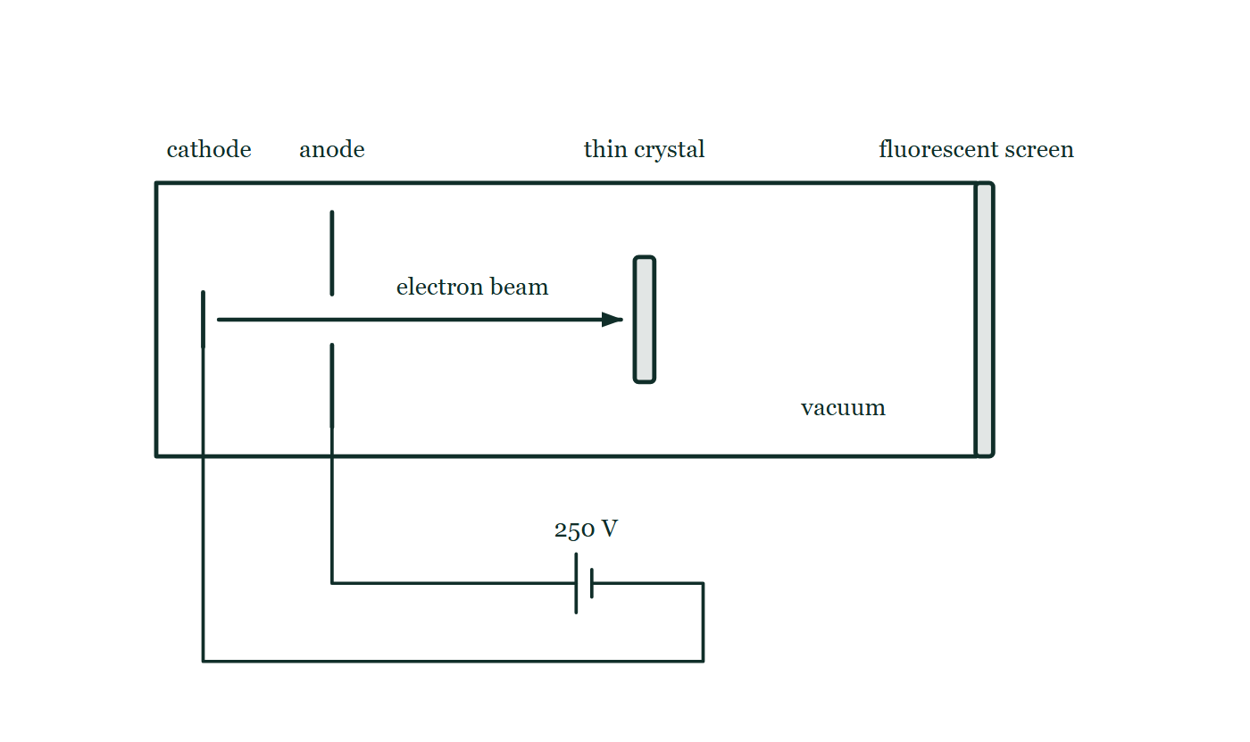
A LEVEL · TOPICS 12–25
GIOPHYSICS PRACTICE PAPER
Question 11
Structured
A Level
Discriminating
14 marks
Syllabus 22, 23
Electrons are accelerated from rest through a potential difference of 250 V. Separately, a nucleus of ⁵⁶₂₆Fe has a nuclear mass of 55.9206 u. The mass of a proton is 1.00728 u, the mass of a neutron is 1.00867 u, and 1 u is equivalent to 931.5 MeV.
Fig. 11.1 — An evacuated tube is drawn as a long horizontal rectangle, closed at its right-hand end by a bar labelled fluorescent screen. Near the left-hand end is a short vertical cathode, and beyond it a vertical anode plate with a gap at its centre; leads from both pass out of the tube to a cell labelled 250 V, whose positive terminal is joined to the anode. An arrow along the axis shows a beam of electrons passing through the gap in the anode and travelling to a thin crystal mounted upright across the middle of the tube. The screen is drawn blank.
Cambridge International AS & A Level Physics — A Level · Topics 12–25. Written by GioPhysics from Cambridge International AS & A Level Physics 9702 syllabus; not an awarding body's document.
28 / 36
Notes:
[Demand] Discriminating — The part that separates the top grade: an unfamiliar context, a derivation, or an argument that has to hold together to earn anything.
[Figure] Fig. 11.1. An evacuated tube is drawn as a long horizontal rectangle, closed at its right-hand end by a bar labelled fluorescent screen. Near the left-hand end is a short vertical cathode, and beyond it a vertical anode plate with a gap at its centre; leads from both pass out of the tube to a cell labelled 250 V, whose positive terminal is joined to the anode. An arrow along the axis shows a beam of electrons passing through the gap in the anode and travelling to a thin crystal mounted upright across the middle of the tube. The screen is drawn blank.

Slide 29
A LEVEL · TOPICS 12–25
GIOPHYSICS PRACTICE PAPER
Question 11 (cont.)
Structured
A Level
Discriminating
14 marks
continued from the previous slide
(a) Calculate
4 marks
Calculate the de Broglie wavelength of the accelerated electrons.
(b) Explain
3 marks
Explain how the diffraction of a beam of such electrons by a thin crystal provides evidence for the wave nature of matter.
(c) Determine
4 marks
Determine the binding energy per nucleon of ⁵⁶₂₆Fe, in MeV.
(d) Explain
3 marks
Iron-56 lies near the peak of the binding energy per nucleon curve. Explain why energy is released both when light nuclei fuse and when heavy nuclei undergo fission.
Cambridge International AS & A Level Physics — A Level · Topics 12–25. Written by GioPhysics from Cambridge International AS & A Level Physics 9702 syllabus; not an awarding body's document.
29 / 36
Notes:
[Demand] Discriminating — The part that separates the top grade: an unfamiliar context, a derivation, or an argument that has to hold together to earn anything.
[Figure] Fig. 11.1. An evacuated tube is drawn as a long horizontal rectangle, closed at its right-hand end by a bar labelled fluorescent screen. Near the left-hand end is a short vertical cathode, and beyond it a vertical anode plate with a gap at its centre; leads from both pass out of the tube to a cell labelled 250 V, whose positive terminal is joined to the anode. An arrow along the axis shows a beam of electrons passing through the gap in the anode and travelling to a thin crystal mounted upright across the middle of the tube. The screen is drawn blank.
[Reminder] Fig. 11.1 is on the previous slide.

Slide 30
A LEVEL · TOPICS 12–25
GIOPHYSICS PRACTICE PAPER
Answer 11
Structured
A Level
Discriminating
14 marks
Mark scheme
(a) Calculate — 4 marks
AO2
✓
kinetic energy = eV = 1.60 × 10⁻¹⁹ × 250 = 4.0 × 10⁻¹⁷ J
✓
p = √(2mE_k) = √(2 × 9.11 × 10⁻³¹ × 4.0 × 10⁻¹⁷)
✓
p = 8.5 × 10⁻²⁴ kg m s⁻¹
✓
λ = h/p = 6.63 × 10⁻³⁴ / 8.5 × 10⁻²⁴ = 7.8 × 10⁻¹¹ m
Candidates who find the speed first and then use λ = h/mv reach the same answer and earn the same marks. Those who set eV = hc/λ have used the photon relation on a particle with mass and earn nothing.
(b) Explain — 3 marks
AO1
✓
the beam produces a pattern of rings or maxima and minima rather than a single spot
✓
diffraction and interference are effects that only waves show
✓
the spacing of the pattern agrees with the de Broglie wavelength calculated from the electrons' momentum, so the wavelength is a property of the particles themselves
(c) Determine — 4 marks
AO2
✓
total mass of separate nucleons = 26 × 1.00728 + 30 × 1.00867 = 56.4494 u
✓
mass defect Δm = 56.4494 − 55.9206 = 0.5288 u
✓
binding energy = 0.5288 × 931.5 = 492.6 MeV
✓
per nucleon = 492.6 / 56 = 8.8 MeV
Cambridge International AS & A Level Physics — A Level · Topics 12–25. Written by GioPhysics from Cambridge International AS & A Level Physics 9702 syllabus; not an awarding body's document.
30 / 36
Notes:
[Marking] One line per mark, awarded independently unless a point says otherwise.
[Examiner note (a)] Candidates who find the speed first and then use λ = h/mv reach the same answer and earn the same marks. Those who set eV = hc/λ have used the photon relation on a particle with mass and earn nothing.
[Examiner note (d)] The argument has to run through the same curve twice, in opposite directions. Answers that treat fusion and fission as unrelated processes with separate explanations do not earn the third mark.
[Figure] Fig. 11.1. An evacuated tube is drawn as a long horizontal rectangle, closed at its right-hand end by a bar labelled fluorescent screen. Near the left-hand end is a short vertical cathode, and beyond it a vertical anode plate with a gap at its centre; leads from both pass out of the tube to a cell labelled 250 V, whose positive terminal is joined to the anode. An arrow along the axis shows a beam of electrons passing through the gap in the anode and travelling to a thin crystal mounted upright across the middle of the tube. The screen is drawn blank.

Slide 31
A LEVEL · TOPICS 12–25
GIOPHYSICS PRACTICE PAPER
Answer 11 (cont.)
Structured
A Level
Discriminating
14 marks
Mark scheme, continued
(d) Explain — 3 marks
AO2
✓
energy is released whenever the products have a greater binding energy per nucleon than the reactants, because the nucleons end up more tightly bound and the surplus mass is released as energy
✓
light nuclei lie to the left of the peak, so fusing them moves the nucleons up the curve towards iron
✓
heavy nuclei lie to the right of the peak, so splitting them also moves the nucleons up the curve towards iron
The argument has to run through the same curve twice, in opposite directions. Answers that treat fusion and fission as unrelated processes with separate explanations do not earn the third mark.
Cambridge International AS & A Level Physics — A Level · Topics 12–25. Written by GioPhysics from Cambridge International AS & A Level Physics 9702 syllabus; not an awarding body's document.
31 / 36
Notes:
[Marking] One line per mark, awarded independently unless a point says otherwise.
[Examiner note (a)] Candidates who find the speed first and then use λ = h/mv reach the same answer and earn the same marks. Those who set eV = hc/λ have used the photon relation on a particle with mass and earn nothing.
[Examiner note (d)] The argument has to run through the same curve twice, in opposite directions. Answers that treat fusion and fission as unrelated processes with separate explanations do not earn the third mark.
[Figure] Fig. 11.1. An evacuated tube is drawn as a long horizontal rectangle, closed at its right-hand end by a bar labelled fluorescent screen. Near the left-hand end is a short vertical cathode, and beyond it a vertical anode plate with a gap at its centre; leads from both pass out of the tube to a cell labelled 250 V, whose positive terminal is joined to the anode. An arrow along the axis shows a beam of electrons passing through the gap in the anode and travelling to a thin crystal mounted upright across the middle of the tube. The screen is drawn blank.

Slide 32
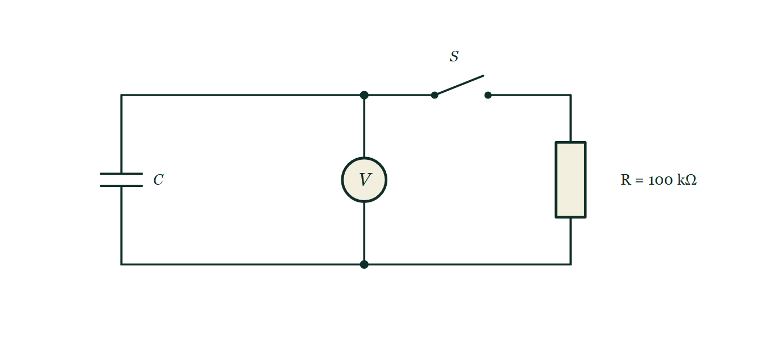
A LEVEL · TOPICS 12–25
GIOPHYSICS PRACTICE PAPER
Question 12
Data analysis
A Level
Discriminating
15 marks
Analysis, conclusions and evaluation — Paper 5 style · Syllabus 19, 23
A student investigates the discharge of a capacitor of capacitance C through a resistor of resistance R = 100 kΩ. The potential difference V across the capacitor is recorded at intervals, and ln(V/V) is calculated. The student expects V = V₀e^(−t/RC).
The student's processed results
t / s | 0.0 | 10.0 | 20.0 | 30.0 | 40.0
V / V | 9.00 | 6.05 | 4.07 | 2.73 | 1.84
ln (V / V) | 2.197 | 1.800 | 1.404 | 1.004 | 0.610
Fig. 12.1 — A circuit with three branches between an upper and a lower horizontal wire. On the left is a capacitor labelled C; in the middle is a voltmeter connected permanently across it, with junction dots where its branch joins each of the two wires; on the right is a resistor labelled R = 100 kΩ. An open switch S lies in the upper wire between the voltmeter branch and the resistor branch, so that closing it connects the resistor across the capacitor.
Cambridge International AS & A Level Physics — A Level · Topics 12–25. Written by GioPhysics from Cambridge International AS & A Level Physics 9702 syllabus; not an awarding body's document.
32 / 36
Notes:
[Demand] Discriminating — The part that separates the top grade: an unfamiliar context, a derivation, or an argument that has to hold together to earn anything.
[Figure] Fig. 12.1. A circuit with three branches between an upper and a lower horizontal wire. On the left is a capacitor labelled C; in the middle is a voltmeter connected permanently across it, with junction dots where its branch joins each of the two wires; on the right is a resistor labelled R = 100 kΩ. An open switch S lies in the upper wire between the voltmeter branch and the resistor branch, so that closing it connects the resistor across the capacitor.

Slide 33
A LEVEL · TOPICS 12–25
GIOPHYSICS PRACTICE PAPER
Question 12 (cont.)
Data analysis
A Level
Discriminating
15 marks
continued from the previous slide
(a) Explain
4 marks
Explain why a graph of ln V against t should be a straight line if the discharge is exponential, and state what its gradient and intercept represent.
(b) Determine
4 marks
Use the first and last data points to determine the gradient of the line, and hence determine the capacitance C.
(c) Determine
4 marks
The resistance is quoted as 100 ± 2 kΩ, and the uncertainty in the gradient is ±1.5%. Determine the percentage uncertainty in C, and state the value of C with its absolute uncertainty.
(d) Suggest
3 marks
The voltmeter used has a finite resistance connected across the capacitor throughout the experiment. Suggest how this affects the value obtained for C, and suggest an improvement.
Cambridge International AS & A Level Physics — A Level · Topics 12–25. Written by GioPhysics from Cambridge International AS & A Level Physics 9702 syllabus; not an awarding body's document.
33 / 36
Notes:
[Demand] Discriminating — The part that separates the top grade: an unfamiliar context, a derivation, or an argument that has to hold together to earn anything.
[Figure] Fig. 12.1. A circuit with three branches between an upper and a lower horizontal wire. On the left is a capacitor labelled C; in the middle is a voltmeter connected permanently across it, with junction dots where its branch joins each of the two wires; on the right is a resistor labelled R = 100 kΩ. An open switch S lies in the upper wire between the voltmeter branch and the resistor branch, so that closing it connects the resistor across the capacitor.
[Reminder] Fig. 12.1 is on the previous slide.

Slide 34
A LEVEL · TOPICS 12–25
GIOPHYSICS PRACTICE PAPER
Answer 12
Data analysis
A Level
Discriminating
15 marks
Mark scheme
(a) Explain — 4 marks
AO3
✓
taking natural logarithms of V = V₀e^(−t/RC) gives ln V = ln V₀ − t/(RC)
✓
this is of the form y = mx + c with ln V as y and t as x, so the points lie on a straight line if the model holds
✓
the gradient is −1/(RC)
✓
the intercept on the ln V axis is ln V₀
(b) Determine — 4 marks
AO2
✓
gradient = (0.610 − 2.197) / (40.0 − 0.0) = −1.587 / 40.0
✓
gradient = −0.0397 s⁻¹
✓
RC = −1/gradient = 25.2 s
✓
C = 25.2 / 100 × 10³ = 2.5 × 10⁻⁴ F (250 μF)
(c) Determine — 4 marks
AO3
✓
percentage uncertainty in R = (2/100) × 100 = 2%
✓
C is found by dividing by the gradient and by R, so the percentage uncertainties add: 1.5% + 2% = 3.5%
✓
absolute uncertainty = 0.035 × 250 = 8.75 ≈ 9 μF
✓
C = 250 ± 9 μF
Percentage uncertainties add for a product or a quotient, whichever way round the quantities appear. Candidates who subtract because one quantity is in a denominator lose all four marks, and it is a common enough error that Paper 5 sets it deliberately.
Cambridge International AS & A Level Physics — A Level · Topics 12–25. Written by GioPhysics from Cambridge International AS & A Level Physics 9702 syllabus; not an awarding body's document.
34 / 36
Notes:
[Marking] One line per mark, awarded independently unless a point says otherwise.
[Examiner note (c)] Percentage uncertainties add for a product or a quotient, whichever way round the quantities appear. Candidates who subtract because one quantity is in a denominator lose all four marks, and it is a common enough error that Paper 5 sets it deliberately.
[Examiner note (d)] Naming the direction of the systematic error is where the marks are. This is the standard Paper 5 evaluation question and it rewards a candidate who traces the fault all the way through to the final quantity.
[Figure] Fig. 12.1. A circuit with three branches between an upper and a lower horizontal wire. On the left is a capacitor labelled C; in the middle is a voltmeter connected permanently across it, with junction dots where its branch joins each of the two wires; on the right is a resistor labelled R = 100 kΩ. An open switch S lies in the upper wire between the voltmeter branch and the resistor branch, so that closing it connects the resistor across the capacitor.

Slide 35
A LEVEL · TOPICS 12–25
GIOPHYSICS PRACTICE PAPER
Answer 12 (cont.)
Data analysis
A Level
Discriminating
15 marks
Mark scheme, continued
(d) Suggest — 3 marks
AO3
✓
the voltmeter provides a second discharge path in parallel with R, so the effective resistance is less than 100 kΩ
✓
the capacitor therefore discharges faster than the model assumes; the measured time constant is too small, and since C is calculated using R = 100 kΩ, the value obtained for C is too small
✓
improvement: use a voltmeter (or digital multimeter) of much higher resistance, or a data logger with a high-impedance input
Naming the direction of the systematic error is where the marks are. This is the standard Paper 5 evaluation question and it rewards a candidate who traces the fault all the way through to the final quantity.
Cambridge International AS & A Level Physics — A Level · Topics 12–25. Written by GioPhysics from Cambridge International AS & A Level Physics 9702 syllabus; not an awarding body's document.
35 / 36
Notes:
[Marking] One line per mark, awarded independently unless a point says otherwise.
[Examiner note (c)] Percentage uncertainties add for a product or a quotient, whichever way round the quantities appear. Candidates who subtract because one quantity is in a denominator lose all four marks, and it is a common enough error that Paper 5 sets it deliberately.
[Examiner note (d)] Naming the direction of the systematic error is where the marks are. This is the standard Paper 5 evaluation question and it rewards a candidate who traces the fault all the way through to the final quantity.
[Figure] Fig. 12.1. A circuit with three branches between an upper and a lower horizontal wire. On the left is a capacitor labelled C; in the middle is a voltmeter connected permanently across it, with junction dots where its branch joins each of the two wires; on the right is a resistor labelled R = 100 kΩ. An open switch S lies in the upper wire between the voltmeter branch and the resistor branch, so that closing it connects the resistor across the capacitor.

Slide 36
A LEVEL · TOPICS 12–25
GIOPHYSICS PRACTICE PAPER
Command words
Cambridge International AS & A Level Physics — the board's own definitions
Calculate
Suggest
Work out from given facts, figures or information.
Apply knowledge and understanding to situations where there is a range of valid responses in order to make proposals.
Deduce
Conclude from available information.
Define
Give the precise meaning.
Describe
State the points of a topic; give characteristics and main features.
Determine
Establish an answer using the information available.
Explain
Set out purposes or reasons; make relationships evident; give why and/or how.
Show (that)
Provide structured evidence that leads to a given result.
State
Express in clear terms.
Cambridge International AS & A Level Physics — A Level · Topics 12–25. Written by GioPhysics from Cambridge International AS & A Level Physics 9702 syllabus; not an awarding body's document.
36 / 36
Notes:
[Objectives] AO1 Knowledge with understanding: Recall and use scientific ideas, terminology, conventions, instruments and apparatus. AO2 Handling, applying and evaluating information: Select and translate information, manipulate numerical data, solve problems, make predictions and reasoned judgements, and apply physics to unfamiliar contexts. AO3 Experimental skills and investigations: Plan an investigation, identify and control variables, analyse and evaluate data and methods, handle uncertainties, and draw conclusions.
[Source] Cambridge International AS & A Level Physics 9702 syllabus — https://www.cambridgeinternational.org/Images/664565-2025-2027-syllabus.pdf
[Disclaimer] Written by GioPhysics from the published syllabus. These are practice papers in the style of Cambridge International AS & A Level Physics 9702; they are not Cambridge papers, contain no past-paper questions, and the official syllabus and specimen materials remain the authority.

