Slide 1
A LEVEL · AS · TOPICS 1–11
GIOPHYSICS PRACTICE PAPER
A Level · Physics 9702 · for examination in 2025, 2026 and 2027
AS · Topics 1–11
Physical quantities, kinematics, dynamics, forces and pressure, work and energy, deformation of solids, waves, superposition, electricity, d.c. circuits and particle physics.
MIRRORS
Paper 1 (multiple choice) and Paper 2 (AS structured questions), closing in the style of Paper 5
MARKS
74 in total — all AS
TIME
75 minutes · 11 questions
DEMAND
Recall 1 · Routine 3 · Demanding 5 · Discriminating 2
SYLLABUS
1, 2, 3, 4, 5, 6, 7, 8, 9, 10, 11
Written by GioPhysics from the published syllabus. These are practice papers in the style of Cambridge International AS & A Level Physics 9702; they are not Cambridge papers, contain no past-paper questions, and the official syllabus and specimen materials remain the authority.
Cambridge International AS & A Level Physics — AS · Topics 1–11. Written by GioPhysics from Cambridge International AS & A Level Physics 9702 syllabus; not an awarding body's document.
1 / 33
Notes:
[Format] Paper 1 is 40 multiple-choice items on AS content. Paper 2 is AS structured questions. Paper 3 is a practical exam taken in a laboratory. Paper 4 is A Level structured questions, 100 marks in two hours, and carries the largest single share of the qualification. Paper 5 is planning, analysis and evaluation — 30 marks, no recall, and the paper on which candidates most often underperform. A data sheet is provided in Papers 1, 2 and 4.
[Demand] Written to the real level of Paper 4, which is a hard paper. Multi-step calculations where nothing tells you which equation comes first; "show that" parts with the answer given so that partial credit depends on the working; explanations marked for the mechanism, not the name of the effect. The last question on each paper is in Paper 5's format, where the marks are for the design and the uncertainty treatment rather than for physics recall.
[Source] Cambridge International AS & A Level Physics 9702 syllabus — https://www.cambridgeinternational.org/Images/664565-2025-2027-syllabus.pdf
[Disclaimer] Written by GioPhysics from the published syllabus. These are practice papers in the style of Cambridge International AS & A Level Physics 9702; they are not Cambridge papers, contain no past-paper questions, and the official syllabus and specimen materials remain the authority.

Slide 2
A LEVEL · AS · TOPICS 1–11
GIOPHYSICS PRACTICE PAPER
Question 1
Multiple choice
AS
Routine
1 mark
Syllabus 1 · AO2
What is the Young modulus expressed in SI base units?
A
kg m s⁻²
B
kg m⁻¹ s⁻²
C
kg m⁻¹ s⁻¹
D
kg m² s⁻²
Cambridge International AS & A Level Physics — AS · Topics 1–11. Written by GioPhysics from Cambridge International AS & A Level Physics 9702 syllabus; not an awarding body's document.
2 / 33
Notes:
[Demand] Routine — The standard application — the named equation, the usual graph read.

Slide 3
A LEVEL · AS · TOPICS 1–11
GIOPHYSICS PRACTICE PAPER
Answer 1
Multiple choice
AS
Routine
1 mark
Mark scheme
B
kg m⁻¹ s⁻²
Why the other three are there
The Young modulus is a stress, so it has the base units of pressure. A is a force and D is an energy. C is Pa s, the unit of viscosity, and catches candidates who lose one power of time.
Cambridge International AS & A Level Physics — AS · Topics 1–11. Written by GioPhysics from Cambridge International AS & A Level Physics 9702 syllabus; not an awarding body's document.
3 / 33
Notes:
[Answer] B — kg m⁻¹ s⁻²
[Distractors] The Young modulus is a stress, so it has the base units of pressure. A is a force and D is an energy. C is Pa s, the unit of viscosity, and catches candidates who lose one power of time.

Slide 4
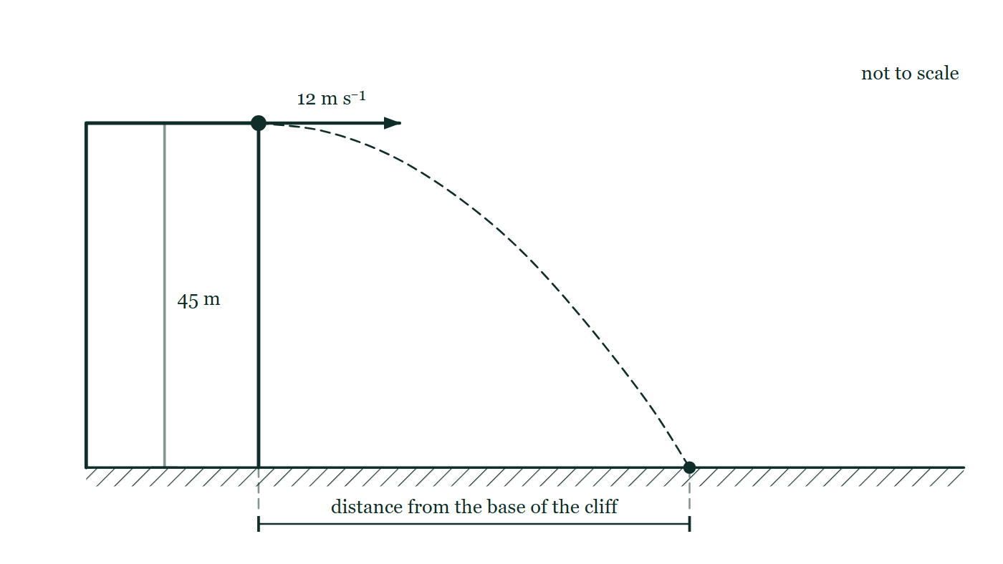
A LEVEL · AS · TOPICS 1–11
GIOPHYSICS PRACTICE PAPER
Question 2
Multiple choice
AS
Demanding
1 mark
Syllabus 2 · AO2
A stone is thrown horizontally at 12 m s⁻¹ from the top of a cliff 45 m high. Air resistance is negligible. How far from the base of the cliff does it land?
Fig. 2.1 — A cliff of height 45 m rises vertically from level ground. A stone leaves the very edge of the cliff top moving horizontally, its initial velocity shown by an arrow labelled 12 m s⁻¹ pointing away from the cliff, and a dashed curve traces its path down to the ground. The height of the cliff is marked 45 m; the horizontal distance from the base of the cliff to the point where the stone lands is marked by a dimension line but is given no value. The figure is not to scale.
A
27 m
B
36 m
C
45 m
D
110 m
Cambridge International AS & A Level Physics — AS · Topics 1–11. Written by GioPhysics from Cambridge International AS & A Level Physics 9702 syllabus; not an awarding body's document.
4 / 33
Notes:
[Demand] Demanding — Several steps, and you have to choose them. Nothing says which comes first.
[Figure] Fig. 2.1. A cliff of height 45 m rises vertically from level ground. A stone leaves the very edge of the cliff top moving horizontally, its initial velocity shown by an arrow labelled 12 m s⁻¹ pointing away from the cliff, and a dashed curve traces its path down to the ground. The height of the cliff is marked 45 m; the horizontal distance from the base of the cliff to the point where the stone lands is marked by a dimension line but is given no value. The figure is not to scale.

Slide 5
A LEVEL · AS · TOPICS 1–11
GIOPHYSICS PRACTICE PAPER
Answer 2
Multiple choice
AS
Demanding
1 mark
Mark scheme
B
36 m
Why the other three are there
D takes t = 2h/g without the square root — the single commonest projectile slip. C is the height of the cliff itself, offered to candidates who lose track of which quantity they are finding. The horizontal velocity never changes, so the only work in the question is finding the time of the fall: t = √(2 × 45 / 9.81) = 3.03 s.
Cambridge International AS & A Level Physics — AS · Topics 1–11. Written by GioPhysics from Cambridge International AS & A Level Physics 9702 syllabus; not an awarding body's document.
5 / 33
Notes:
[Answer] B — 36 m
[Distractors] D takes t = 2h/g without the square root — the single commonest projectile slip. C is the height of the cliff itself, offered to candidates who lose track of which quantity they are finding. The horizontal velocity never changes, so the only work in the question is finding the time of the fall: t = √(2 × 45 / 9.81) = 3.03 s.
[Figure] Fig. 2.1. A cliff of height 45 m rises vertically from level ground. A stone leaves the very edge of the cliff top moving horizontally, its initial velocity shown by an arrow labelled 12 m s⁻¹ pointing away from the cliff, and a dashed curve traces its path down to the ground. The height of the cliff is marked 45 m; the horizontal distance from the base of the cliff to the point where the stone lands is marked by a dimension line but is given no value. The figure is not to scale.

Slide 6
A LEVEL · AS · TOPICS 1–11
GIOPHYSICS PRACTICE PAPER
Question 3
Multiple choice
AS
Demanding
1 mark
Syllabus 3 · AO2
A ball of mass 0.20 kg strikes a wall at right angles with a speed of 8.0 m s⁻¹ and rebounds along the same line at 6.0 m s⁻¹. The ball is in contact with the wall for 0.050 s. What is the magnitude of the average force exerted on the ball?
A
8.0 N
B
24 N
C
56 N
D
112 N
Cambridge International AS & A Level Physics — AS · Topics 1–11. Written by GioPhysics from Cambridge International AS & A Level Physics 9702 syllabus; not an awarding body's document.
6 / 33
Notes:
[Demand] Demanding — Several steps, and you have to choose them. Nothing says which comes first.

Slide 7
A LEVEL · AS · TOPICS 1–11
GIOPHYSICS PRACTICE PAPER
Answer 3
Multiple choice
AS
Demanding
1 mark
Mark scheme
C
56 N
Why the other three are there
A subtracts the speeds instead of recognising that the velocity has reversed, so the change in momentum is 0.20 × 14 and not 0.20 × 2. That one sign is the whole item, and it costs more marks across a real Paper 1 than any other single idea.
Cambridge International AS & A Level Physics — AS · Topics 1–11. Written by GioPhysics from Cambridge International AS & A Level Physics 9702 syllabus; not an awarding body's document.
7 / 33
Notes:
[Answer] C — 56 N
[Distractors] A subtracts the speeds instead of recognising that the velocity has reversed, so the change in momentum is 0.20 × 14 and not 0.20 × 2. That one sign is the whole item, and it costs more marks across a real Paper 1 than any other single idea.

Slide 8
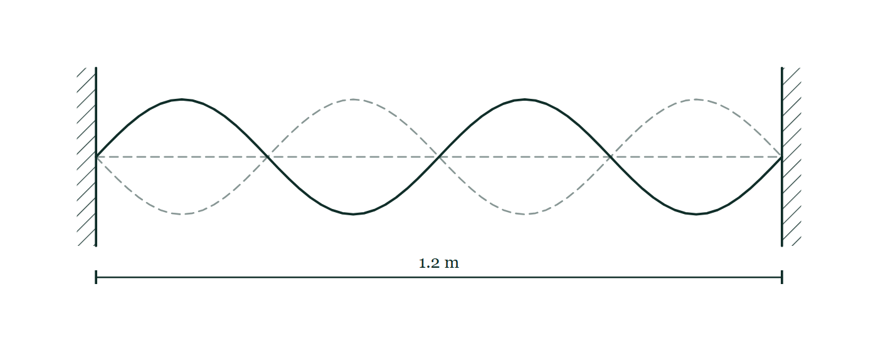
A LEVEL · AS · TOPICS 1–11
GIOPHYSICS PRACTICE PAPER
Question 4
Multiple choice
AS
Routine
1 mark
Syllabus 8 · AO2
A stationary wave is set up on a stretched string of length 1.2 m fixed at both ends. Four loops are seen between the fixed ends and the frequency is 150 Hz. What is the speed of the progressive waves on the string?
Fig. 4.1 — A string is stretched horizontally between two fixed supports drawn as hatched blocks, with the distance between them marked 1.2 m. The stationary wave on the string is drawn as a solid curve showing four loops between the supports, and the opposite extreme of the motion is drawn dashed over it, so the string is still at the two fixed ends and at three points in between while the loops vibrate.
A
22.5 m s⁻¹
B
45 m s⁻¹
C
90 m s⁻¹
D
180 m s⁻¹
Cambridge International AS & A Level Physics — AS · Topics 1–11. Written by GioPhysics from Cambridge International AS & A Level Physics 9702 syllabus; not an awarding body's document.
8 / 33
Notes:
[Demand] Routine — The standard application — the named equation, the usual graph read.
[Figure] Fig. 4.1. A string is stretched horizontally between two fixed supports drawn as hatched blocks, with the distance between them marked 1.2 m. The stationary wave on the string is drawn as a solid curve showing four loops between the supports, and the opposite extreme of the motion is drawn dashed over it, so the string is still at the two fixed ends and at three points in between while the loops vibrate.

Slide 9
A LEVEL · AS · TOPICS 1–11
GIOPHYSICS PRACTICE PAPER
Answer 4
Multiple choice
AS
Routine
1 mark
Mark scheme
C
90 m s⁻¹
Why the other three are there
Each loop is half a wavelength, so four loops make two wavelengths and λ = 0.60 m. D treats each loop as a whole wavelength; B and A halve again.
Cambridge International AS & A Level Physics — AS · Topics 1–11. Written by GioPhysics from Cambridge International AS & A Level Physics 9702 syllabus; not an awarding body's document.
9 / 33
Notes:
[Answer] C — 90 m s⁻¹
[Distractors] Each loop is half a wavelength, so four loops make two wavelengths and λ = 0.60 m. D treats each loop as a whole wavelength; B and A halve again.
[Figure] Fig. 4.1. A string is stretched horizontally between two fixed supports drawn as hatched blocks, with the distance between them marked 1.2 m. The stationary wave on the string is drawn as a solid curve showing four loops between the supports, and the opposite extreme of the motion is drawn dashed over it, so the string is still at the two fixed ends and at three points in between while the loops vibrate.

Slide 10
A LEVEL · AS · TOPICS 1–11
GIOPHYSICS PRACTICE PAPER
Question 5
Multiple choice
AS
Routine
1 mark
Syllabus 10 · AO2
A battery of e.m.f. 9.0 V and internal resistance 1.5 Ω is connected to a resistor of resistance 6.0 Ω. What is the potential difference across the 6.0 Ω resistor?
A
1.8 V
B
6.0 V
C
7.2 V
D
9.0 V
Cambridge International AS & A Level Physics — AS · Topics 1–11. Written by GioPhysics from Cambridge International AS & A Level Physics 9702 syllabus; not an awarding body's document.
10 / 33
Notes:
[Demand] Routine — The standard application — the named equation, the usual graph read.

Slide 11
A LEVEL · AS · TOPICS 1–11
GIOPHYSICS PRACTICE PAPER
Answer 5
Multiple choice
AS
Routine
1 mark
Mark scheme
C
7.2 V
Why the other three are there
A is the lost volts across the internal resistance. D is the answer of a candidate who treats e.m.f. and terminal p.d. as the same thing, which they are only when no current flows.
Cambridge International AS & A Level Physics — AS · Topics 1–11. Written by GioPhysics from Cambridge International AS & A Level Physics 9702 syllabus; not an awarding body's document.
11 / 33
Notes:
[Answer] C — 7.2 V
[Distractors] A is the lost volts across the internal resistance. D is the answer of a candidate who treats e.m.f. and terminal p.d. as the same thing, which they are only when no current flows.

Slide 12
A LEVEL · AS · TOPICS 1–11
GIOPHYSICS PRACTICE PAPER
Question 6
Multiple choice
AS
Recall
1 mark
Syllabus 11 · AO1
Which combination of quarks forms a neutron?
A
up, up, down
B
up, down, down
C
up, up, strange
D
down, down, down
Cambridge International AS & A Level Physics — AS · Topics 1–11. Written by GioPhysics from Cambridge International AS & A Level Physics 9702 syllabus; not an awarding body's document.
12 / 33
Notes:
[Demand] Recall — One idea, one step. The mark is for knowing it.

Slide 13
A LEVEL · AS · TOPICS 1–11
GIOPHYSICS PRACTICE PAPER
Answer 6
Multiple choice
AS
Recall
1 mark
Mark scheme
B
up, down, down
Why the other three are there
A is the proton. The check is the charge: (+2/3) + (−1/3) + (−1/3) = 0, and D would give −1.
Cambridge International AS & A Level Physics — AS · Topics 1–11. Written by GioPhysics from Cambridge International AS & A Level Physics 9702 syllabus; not an awarding body's document.
13 / 33
Notes:
[Answer] B — up, down, down
[Distractors] A is the proton. The check is the charge: (+2/3) + (−1/3) + (−1/3) = 0, and D would give −1.

Slide 14
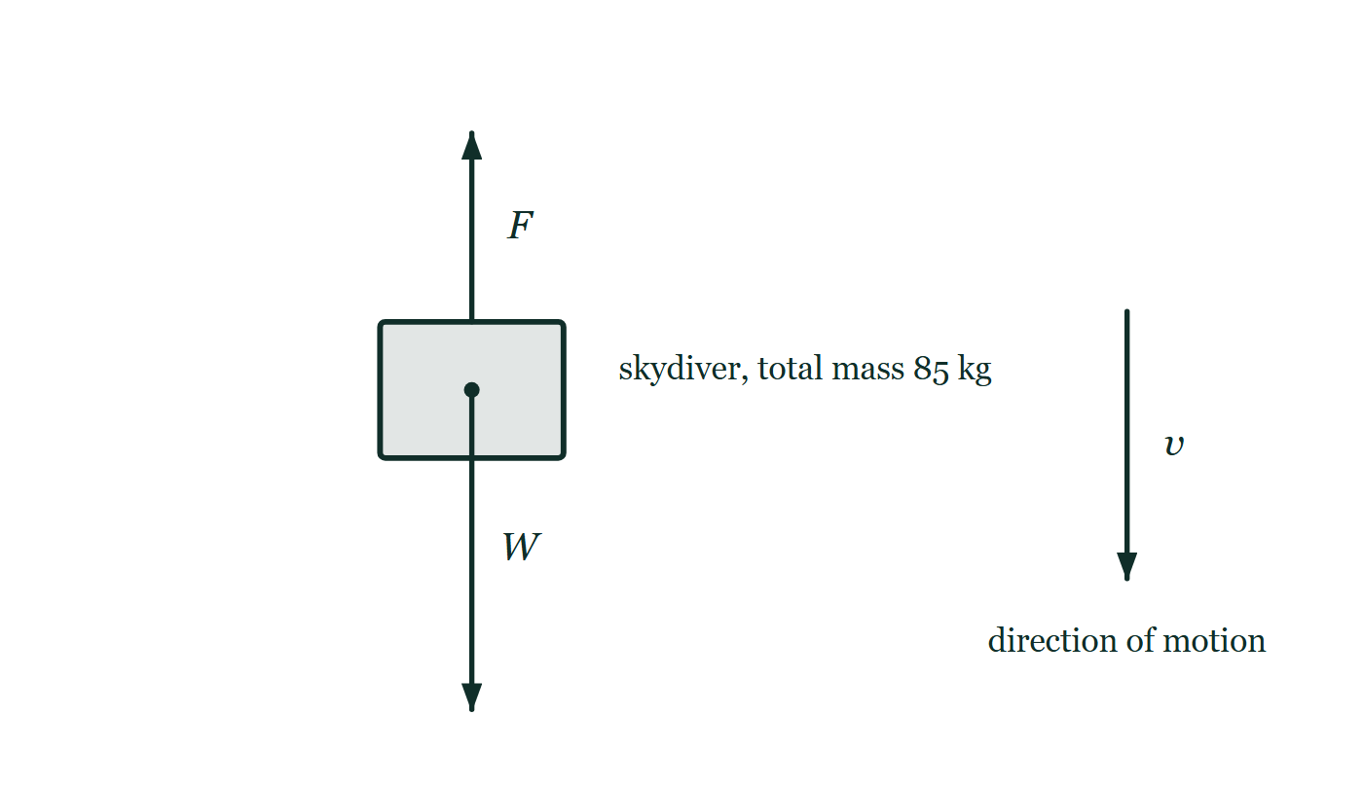
A LEVEL · AS · TOPICS 1–11
GIOPHYSICS PRACTICE PAPER
Question 7
Structured
AS
Demanding
14 marks
Syllabus 2, 3, 4
A skydiver of total mass 85 kg falls from rest from a stationary balloon. The drag force F on the skydiver is related to her speed v by F = kv², where k is a constant. She reaches a terminal velocity of 55 m s⁻¹ before opening her parachute.
Fig. 7.1 — The falling skydiver is drawn as a block with a dot at her centre of mass, labelled as having a total mass of 85 kg. A long arrow labelled W starts at that dot and points vertically downwards. A shorter arrow labelled F starts at her upper surface and points vertically upwards. To one side, a separate arrow labelled v points downwards to show her direction of motion.
(a) State
2 marks
State what is meant by terminal velocity.
Cambridge International AS & A Level Physics — AS · Topics 1–11. Written by GioPhysics from Cambridge International AS & A Level Physics 9702 syllabus; not an awarding body's document.
14 / 33
Notes:
[Demand] Demanding — Several steps, and you have to choose them. Nothing says which comes first.
[Figure] Fig. 7.1. The falling skydiver is drawn as a block with a dot at her centre of mass, labelled as having a total mass of 85 kg. A long arrow labelled W starts at that dot and points vertically downwards. A shorter arrow labelled F starts at her upper surface and points vertically upwards. To one side, a separate arrow labelled v points downwards to show her direction of motion.

Slide 15
A LEVEL · AS · TOPICS 1–11
GIOPHYSICS PRACTICE PAPER
Question 7 (cont.)
Structured
AS
Demanding
14 marks
continued from the previous slide
(b) Explain
3 marks
Explain, with reference to Newton's laws, why the acceleration of the skydiver decreases as her speed increases.
(c) Determine
3 marks
Determine the value of k, and state its SI base units.
(d) Calculate
3 marks
Calculate the acceleration of the skydiver at the instant when her speed is 30 m s⁻¹.
(e) Explain
3 marks
The skydiver opens her parachute while travelling at the terminal velocity of 55 m s⁻¹. Explain what happens to her motion immediately afterwards, and describe the new terminal velocity she reaches.
Cambridge International AS & A Level Physics — AS · Topics 1–11. Written by GioPhysics from Cambridge International AS & A Level Physics 9702 syllabus; not an awarding body's document.
15 / 33
Notes:
[Demand] Demanding — Several steps, and you have to choose them. Nothing says which comes first.
[Figure] Fig. 7.1. The falling skydiver is drawn as a block with a dot at her centre of mass, labelled as having a total mass of 85 kg. A long arrow labelled W starts at that dot and points vertically downwards. A shorter arrow labelled F starts at her upper surface and points vertically upwards. To one side, a separate arrow labelled v points downwards to show her direction of motion.
[Reminder] Fig. 7.1 is on the previous slide.

Slide 16
A LEVEL · AS · TOPICS 1–11
GIOPHYSICS PRACTICE PAPER
Answer 7
Structured
AS
Demanding
14 marks
Mark scheme
(a) State — 2 marks
AO1
✓
the constant (maximum) velocity reached by a falling body
✓
when the drag force has grown to equal the weight, so the resultant force and the acceleration are zero
(b) Explain — 3 marks
AO1
✓
the weight is constant, but the drag force increases as the speed increases
✓
so the resultant force, weight minus drag, decreases
✓
and by Newton's second law a = F/m, so the acceleration decreases while the speed still increases
The mark most often lost is the last: candidates state that the acceleration falls but then say the skydiver slows down. She does not — she is still speeding up, just less quickly.
(c) Determine — 3 marks
AO2
✓
at terminal velocity, kv² = mg, so k = 85 × 9.81 / 55²
✓
k = 0.276
✓
units kg m⁻¹
(d) Calculate — 3 marks
AO2
✓
drag F = 0.276 × 30² = 248 N
✓
resultant = 834 − 248 = 586 N
✓
a = 586 / 85 = 6.9 m s⁻²
Cambridge International AS & A Level Physics — AS · Topics 1–11. Written by GioPhysics from Cambridge International AS & A Level Physics 9702 syllabus; not an awarding body's document.
16 / 33
Notes:
[Marking] One line per mark, awarded independently unless a point says otherwise.
[Examiner note (b)] The mark most often lost is the last: candidates state that the acceleration falls but then say the skydiver slows down. She does not — she is still speeding up, just less quickly.
[Examiner note (e)] A deceleration produced by an upward resultant force, not by "the parachute pushing her up" as a separate agent. Candidates who never say the resultant force reverses direction cannot earn the second mark.
[Figure] Fig. 7.1. The falling skydiver is drawn as a block with a dot at her centre of mass, labelled as having a total mass of 85 kg. A long arrow labelled W starts at that dot and points vertically downwards. A shorter arrow labelled F starts at her upper surface and points vertically upwards. To one side, a separate arrow labelled v points downwards to show her direction of motion.

Slide 17
A LEVEL · AS · TOPICS 1–11
GIOPHYSICS PRACTICE PAPER
Answer 7 (cont.)
Structured
AS
Demanding
14 marks
Mark scheme, continued
(e) Explain — 3 marks
AO2
✓
opening the parachute increases k sharply, so at 55 m s⁻¹ the drag now greatly exceeds the weight
✓
the resultant force acts upwards, so she decelerates
✓
the drag falls as she slows until it again equals the weight, giving a new, much lower terminal velocity
A deceleration produced by an upward resultant force, not by "the parachute pushing her up" as a separate agent. Candidates who never say the resultant force reverses direction cannot earn the second mark.
Cambridge International AS & A Level Physics — AS · Topics 1–11. Written by GioPhysics from Cambridge International AS & A Level Physics 9702 syllabus; not an awarding body's document.
17 / 33
Notes:
[Marking] One line per mark, awarded independently unless a point says otherwise.
[Examiner note (b)] The mark most often lost is the last: candidates state that the acceleration falls but then say the skydiver slows down. She does not — she is still speeding up, just less quickly.
[Examiner note (e)] A deceleration produced by an upward resultant force, not by "the parachute pushing her up" as a separate agent. Candidates who never say the resultant force reverses direction cannot earn the second mark.
[Figure] Fig. 7.1. The falling skydiver is drawn as a block with a dot at her centre of mass, labelled as having a total mass of 85 kg. A long arrow labelled W starts at that dot and points vertically downwards. A shorter arrow labelled F starts at her upper surface and points vertically upwards. To one side, a separate arrow labelled v points downwards to show her direction of motion.

Slide 18
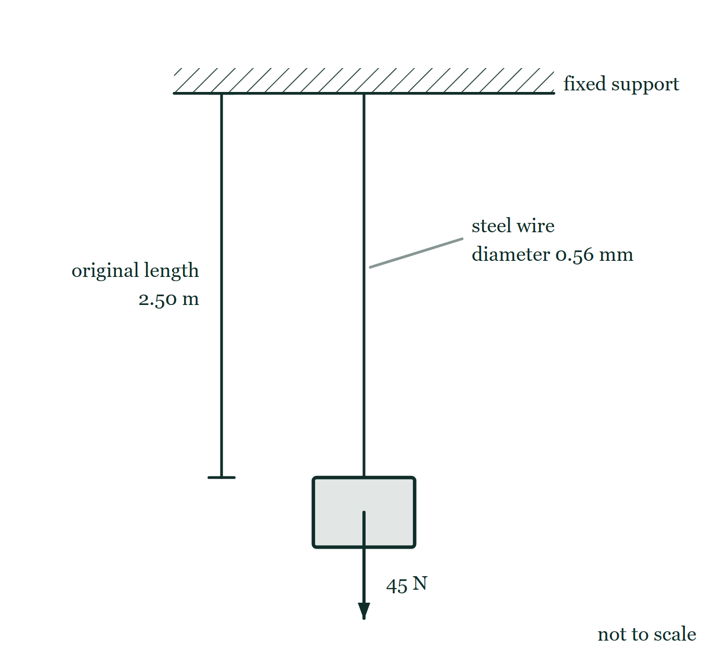
A LEVEL · AS · TOPICS 1–11
GIOPHYSICS PRACTICE PAPER
Question 8
Structured
AS
Discriminating
13 marks
Syllabus 5, 6
A vertical steel wire of original length 2.50 m and diameter 0.56 mm hangs from a fixed support. A load of 45 N is attached to its lower end. The Young modulus of steel is 2.0 × 10¹¹ Pa and the wire does not exceed its limit of proportionality.
Fig. 8.1 — A steel wire hangs vertically from a rigid support drawn as a hatched ceiling, and a block is attached to its lower end. An arrow starting at the centre of that block points vertically downwards and is labelled 45 N. A dimension line to the left of the wire marks its original length as 2.50 m, and a leader line to the wire labels it as a steel wire of diameter 0.56 mm. The figure is not to scale.
Cambridge International AS & A Level Physics — AS · Topics 1–11. Written by GioPhysics from Cambridge International AS & A Level Physics 9702 syllabus; not an awarding body's document.
18 / 33
Notes:
[Demand] Discriminating — The part that separates the top grade: an unfamiliar context, a derivation, or an argument that has to hold together to earn anything.
[Figure] Fig. 8.1. A steel wire hangs vertically from a rigid support drawn as a hatched ceiling, and a block is attached to its lower end. An arrow starting at the centre of that block points vertically downwards and is labelled 45 N. A dimension line to the left of the wire marks its original length as 2.50 m, and a leader line to the wire labels it as a steel wire of diameter 0.56 mm. The figure is not to scale.

Slide 19
A LEVEL · AS · TOPICS 1–11
GIOPHYSICS PRACTICE PAPER
Question 8 (cont.)
Structured
AS
Discriminating
13 marks
continued from the previous slide
(a) Define
2 marks
Define the Young modulus.
(b) Calculate
4 marks
Calculate the extension of the wire produced by the 45 N load.
(c) Calculate
2 marks
Calculate the elastic potential energy stored in the wire under this load.
(d) Determine
3 marks
The diameter is measured with a micrometer as 0.56 ± 0.01 mm. Determine the percentage uncertainty this contributes to the calculated extension.
(e) Explain
2 marks
The load is increased until the wire is stretched beyond its elastic limit and then removed. Explain how the wire's behaviour differs from that described above.
Cambridge International AS & A Level Physics — AS · Topics 1–11. Written by GioPhysics from Cambridge International AS & A Level Physics 9702 syllabus; not an awarding body's document.
19 / 33
Notes:
[Demand] Discriminating — The part that separates the top grade: an unfamiliar context, a derivation, or an argument that has to hold together to earn anything.
[Figure] Fig. 8.1. A steel wire hangs vertically from a rigid support drawn as a hatched ceiling, and a block is attached to its lower end. An arrow starting at the centre of that block points vertically downwards and is labelled 45 N. A dimension line to the left of the wire marks its original length as 2.50 m, and a leader line to the wire labels it as a steel wire of diameter 0.56 mm. The figure is not to scale.
[Reminder] Fig. 8.1 is on the previous slide.

Slide 20
A LEVEL · AS · TOPICS 1–11
GIOPHYSICS PRACTICE PAPER
Answer 8
Structured
AS
Discriminating
13 marks
Mark scheme
(a) Define — 2 marks
AO1
✓
the ratio of tensile stress to tensile strain
✓
for a material obeying Hooke's law / below the limit of proportionality
(b) Calculate — 4 marks
AO2
✓
A = π(0.28 × 10⁻³)² = 2.46 × 10⁻⁷ m²
✓
stress = F/A = 45 / 2.46 × 10⁻⁷ = 1.83 × 10⁸ Pa
✓
strain = stress / E = 1.83 × 10⁸ / 2.0 × 10¹¹ = 9.14 × 10⁻⁴
✓
e = strain × L = 9.14 × 10⁻⁴ × 2.50 = 2.3 × 10⁻³ m (2.3 mm)
Halving the diameter to get the radius is worth a mark on its own, and is the step that quarters a candidate's area when they miss it.
(c) Calculate — 2 marks
AO2
✓
E = ½Fe = ½ × 45 × 2.3 × 10⁻³
✓
E = 0.051 J
The factor of a half is the mark. The load was not 45 N throughout the stretching — it rose from zero — so the work done is the area under the force–extension line, not Fe.
Cambridge International AS & A Level Physics — AS · Topics 1–11. Written by GioPhysics from Cambridge International AS & A Level Physics 9702 syllabus; not an awarding body's document.
20 / 33
Notes:
[Marking] One line per mark, awarded independently unless a point says otherwise.
[Examiner note (b)] Halving the diameter to get the radius is worth a mark on its own, and is the step that quarters a candidate's area when they miss it.
[Examiner note (c)] The factor of a half is the mark. The load was not 45 N throughout the stretching — it rose from zero — so the work done is the area under the force–extension line, not Fe.
[Examiner note (d)] The discriminating part of the paper. A power in a formula multiplies the percentage uncertainty by that power; candidates who carry the 1.8% straight through have not registered that the diameter enters squared.
[Figure] Fig. 8.1. A steel wire hangs vertically from a rigid support drawn as a hatched ceiling, and a block is attached to its lower end. An arrow starting at the centre of that block points vertically downwards and is labelled 45 N. A dimension line to the left of the wire marks its original length as 2.50 m, and a leader line to the wire labels it as a steel wire of diameter 0.56 mm. The figure is not to scale.

Slide 21
A LEVEL · AS · TOPICS 1–11
GIOPHYSICS PRACTICE PAPER
Answer 8 (cont.)
Structured
AS
Discriminating
13 marks
Mark scheme, continued
(d) Determine — 3 marks
AO3
✓
percentage uncertainty in d = (0.01 / 0.56) × 100 = 1.8%
✓
e is inversely proportional to d², so the percentage uncertainty is doubled
✓
percentage uncertainty in e = 3.6%
The discriminating part of the paper. A power in a formula multiplies the percentage uncertainty by that power; candidates who carry the 1.8% straight through have not registered that the diameter enters squared.
(e) Explain — 2 marks
AO1
✓
the wire no longer returns to its original length when the load is removed
✓
it retains a permanent (plastic) extension, because layers of atoms have slipped past one another rather than simply being pulled further apart
Cambridge International AS & A Level Physics — AS · Topics 1–11. Written by GioPhysics from Cambridge International AS & A Level Physics 9702 syllabus; not an awarding body's document.
21 / 33
Notes:
[Marking] One line per mark, awarded independently unless a point says otherwise.
[Examiner note (b)] Halving the diameter to get the radius is worth a mark on its own, and is the step that quarters a candidate's area when they miss it.
[Examiner note (c)] The factor of a half is the mark. The load was not 45 N throughout the stretching — it rose from zero — so the work done is the area under the force–extension line, not Fe.
[Examiner note (d)] The discriminating part of the paper. A power in a formula multiplies the percentage uncertainty by that power; candidates who carry the 1.8% straight through have not registered that the diameter enters squared.
[Figure] Fig. 8.1. A steel wire hangs vertically from a rigid support drawn as a hatched ceiling, and a block is attached to its lower end. An arrow starting at the centre of that block points vertically downwards and is labelled 45 N. A dimension line to the left of the wire marks its original length as 2.50 m, and a leader line to the wire labels it as a steel wire of diameter 0.56 mm. The figure is not to scale.

Slide 22
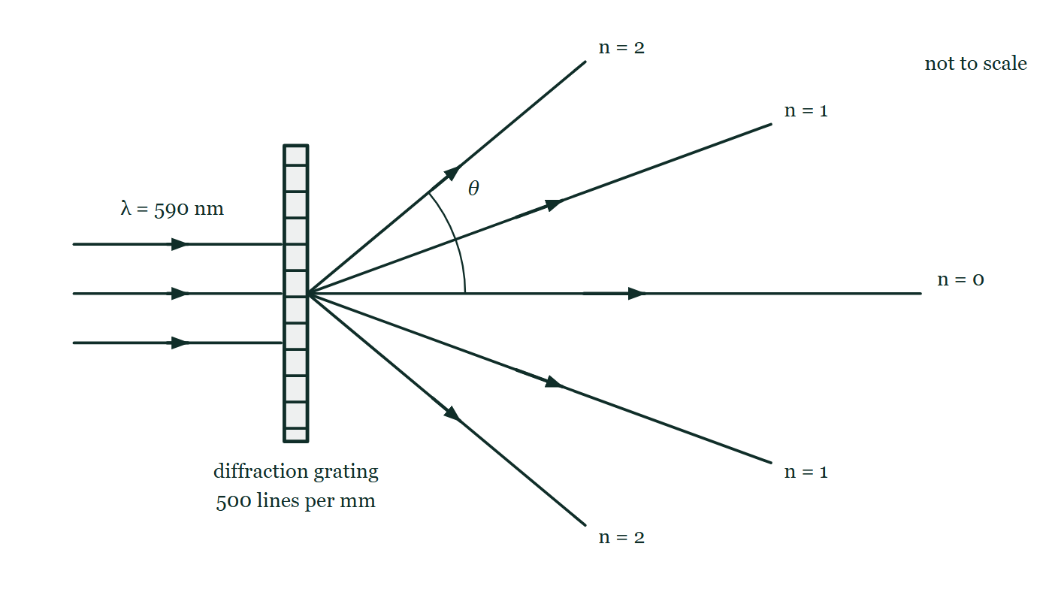
A LEVEL · AS · TOPICS 1–11
GIOPHYSICS PRACTICE PAPER
Question 9
Structured
AS
Demanding
11 marks
Syllabus 7, 8
Coherent light of wavelength 590 nm is incident normally on a diffraction grating with 500 lines per millimetre. The diffracted light is observed on a screen a long way from the grating.
Fig. 9.1 — A parallel beam of light of wavelength 590 nm travels from the left and meets a diffraction grating at normal incidence; the grating is drawn edge-on as a narrow ruled strip and labelled 500 lines per mm. On the far side five beams spread from the grating: one continues straight through and is labelled n = 0, and above and below it lie beams labelled n = 1 and, at larger angles, n = 2. An arc marks the angle θ between the straight-through direction and the upper second-order beam. The angles drawn are not to scale.
Cambridge International AS & A Level Physics — AS · Topics 1–11. Written by GioPhysics from Cambridge International AS & A Level Physics 9702 syllabus; not an awarding body's document.
22 / 33
Notes:
[Demand] Demanding — Several steps, and you have to choose them. Nothing says which comes first.
[Figure] Fig. 9.1. A parallel beam of light of wavelength 590 nm travels from the left and meets a diffraction grating at normal incidence; the grating is drawn edge-on as a narrow ruled strip and labelled 500 lines per mm. On the far side five beams spread from the grating: one continues straight through and is labelled n = 0, and above and below it lie beams labelled n = 1 and, at larger angles, n = 2. An arc marks the angle θ between the straight-through direction and the upper second-order beam. The angles drawn are not to scale.

Slide 23
A LEVEL · AS · TOPICS 1–11
GIOPHYSICS PRACTICE PAPER
Question 9 (cont.)
Structured
AS
Demanding
11 marks
continued from the previous slide
(a) State
2 marks
State what is meant by coherent.
(b) Calculate
3 marks
Calculate the angle between the second-order maximum and the straight-through direction.
(c) Determine
3 marks
Determine the highest order of maximum that can be observed with this grating and this light.
(d) Explain
3 marks
The grating is replaced by one with 300 lines per millimetre. Explain, without calculation, how this changes the pattern observed.
Cambridge International AS & A Level Physics — AS · Topics 1–11. Written by GioPhysics from Cambridge International AS & A Level Physics 9702 syllabus; not an awarding body's document.
23 / 33
Notes:
[Demand] Demanding — Several steps, and you have to choose them. Nothing says which comes first.
[Figure] Fig. 9.1. A parallel beam of light of wavelength 590 nm travels from the left and meets a diffraction grating at normal incidence; the grating is drawn edge-on as a narrow ruled strip and labelled 500 lines per mm. On the far side five beams spread from the grating: one continues straight through and is labelled n = 0, and above and below it lie beams labelled n = 1 and, at larger angles, n = 2. An arc marks the angle θ between the straight-through direction and the upper second-order beam. The angles drawn are not to scale.
[Reminder] Fig. 9.1 is on the previous slide.

Slide 24
A LEVEL · AS · TOPICS 1–11
GIOPHYSICS PRACTICE PAPER
Answer 9
Structured
AS
Demanding
11 marks
Mark scheme
(a) State — 2 marks
AO1
✓
the waves have a constant phase difference
✓
which requires them to have the same frequency (and, in practice, the same wavelength)
(b) Calculate — 3 marks
AO2
✓
d = 1 / (500 × 10³) = 2.0 × 10⁻⁶ m
✓
sin θ = nλ/d = 2 × 590 × 10⁻⁹ / 2.0 × 10⁻⁶ = 0.590
✓
θ = 36.2°
(c) Determine — 3 marks
AO2
✓
the maximum possible value of sin θ is 1, so n ≤ d/λ
✓
d/λ = 2.0 × 10⁻⁶ / 590 × 10⁻⁹ = 3.39
✓
n must be a whole number, so the highest order observed is the third
Answering 3.39 scores two of the three marks. An order is a count of whole wavelengths of path difference and cannot be fractional — the physics is in rounding down, not in the division.
(d) Explain — 3 marks
AO2
✓
the slit separation d is larger
✓
so for each order sin θ = nλ/d is smaller and every maximum moves closer to the centre
✓
and because d/λ is larger, more orders can be seen
Cambridge International AS & A Level Physics — AS · Topics 1–11. Written by GioPhysics from Cambridge International AS & A Level Physics 9702 syllabus; not an awarding body's document.
24 / 33
Notes:
[Marking] One line per mark, awarded independently unless a point says otherwise.
[Examiner note (c)] Answering 3.39 scores two of the three marks. An order is a count of whole wavelengths of path difference and cannot be fractional — the physics is in rounding down, not in the division.
[Figure] Fig. 9.1. A parallel beam of light of wavelength 590 nm travels from the left and meets a diffraction grating at normal incidence; the grating is drawn edge-on as a narrow ruled strip and labelled 500 lines per mm. On the far side five beams spread from the grating: one continues straight through and is labelled n = 0, and above and below it lie beams labelled n = 1 and, at larger angles, n = 2. An arc marks the angle θ between the straight-through direction and the upper second-order beam. The angles drawn are not to scale.

Slide 25
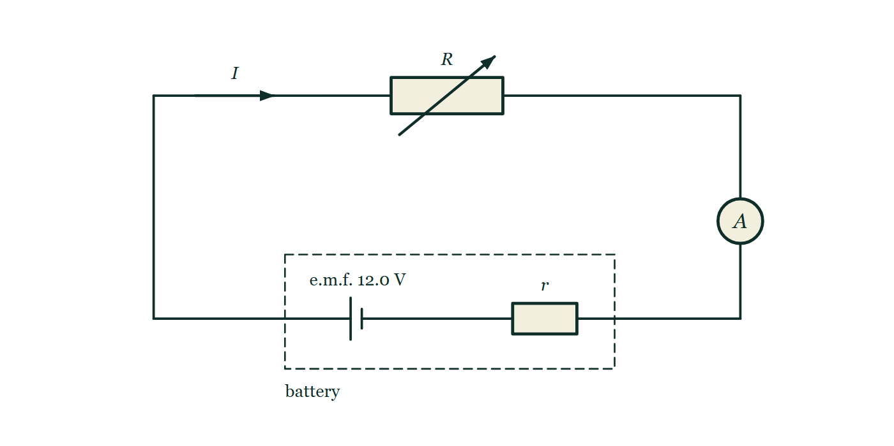
A LEVEL · AS · TOPICS 1–11
GIOPHYSICS PRACTICE PAPER
Question 10
Structured
AS
Demanding
13 marks
Syllabus 9, 10
A battery of e.m.f. 12.0 V and internal resistance r is connected in series with a variable resistor R and an ammeter of negligible resistance. When R is set to 4.0 Ω, the ammeter reads 2.0 A.
Fig. 10.1 — A single series loop. Along the bottom, a cell with its long plate on the left and a small resistor labelled r sit together inside a dashed rectangle labelled battery, the cell marked e.m.f. 12.0 V. From the dashed box the wire runs to the left, up the left-hand side and along the top through a resistor labelled R that has an arrow drawn across it to show that it is variable, then down the right-hand side through a circle marked A, and back along the bottom into the box. An arrow on the top wire labelled I shows the direction of the conventional current.
Cambridge International AS & A Level Physics — AS · Topics 1–11. Written by GioPhysics from Cambridge International AS & A Level Physics 9702 syllabus; not an awarding body's document.
25 / 33
Notes:
[Demand] Demanding — Several steps, and you have to choose them. Nothing says which comes first.
[Figure] Fig. 10.1. A single series loop. Along the bottom, a cell with its long plate on the left and a small resistor labelled r sit together inside a dashed rectangle labelled battery, the cell marked e.m.f. 12.0 V. From the dashed box the wire runs to the left, up the left-hand side and along the top through a resistor labelled R that has an arrow drawn across it to show that it is variable, then down the right-hand side through a circle marked A, and back along the bottom into the box. An arrow on the top wire labelled I shows the direction of the conventional current.

Slide 26
A LEVEL · AS · TOPICS 1–11
GIOPHYSICS PRACTICE PAPER
Question 10 (cont.)
Structured
AS
Demanding
13 marks
continued from the previous slide
(a) Define
2 marks
Define the electromotive force of a source.
(b) Determine
3 marks
Determine the internal resistance r of the battery.
(c) Calculate
3 marks
Calculate the ratio of the power dissipated inside the battery to the total power produced by the battery.
(d) Determine
3 marks
R is now increased to 12.0 Ω. Determine the new terminal potential difference of the battery.
(e) Explain
2 marks
Explain why the terminal potential difference increased when R was increased, even though the e.m.f. of the battery did not change.
Cambridge International AS & A Level Physics — AS · Topics 1–11. Written by GioPhysics from Cambridge International AS & A Level Physics 9702 syllabus; not an awarding body's document.
26 / 33
Notes:
[Demand] Demanding — Several steps, and you have to choose them. Nothing says which comes first.
[Figure] Fig. 10.1. A single series loop. Along the bottom, a cell with its long plate on the left and a small resistor labelled r sit together inside a dashed rectangle labelled battery, the cell marked e.m.f. 12.0 V. From the dashed box the wire runs to the left, up the left-hand side and along the top through a resistor labelled R that has an arrow drawn across it to show that it is variable, then down the right-hand side through a circle marked A, and back along the bottom into the box. An arrow on the top wire labelled I shows the direction of the conventional current.
[Reminder] Fig. 10.1 is on the previous slide.

Slide 27
A LEVEL · AS · TOPICS 1–11
GIOPHYSICS PRACTICE PAPER
Answer 10
Structured
AS
Demanding
13 marks
Mark scheme
(a) Define — 2 marks
AO1
✓
the energy transferred from chemical (or other non-electrical) form to electrical form
✓
per unit charge driven through the source
"The voltage of the battery" earns nothing. E.m.f. and potential difference are both energy per unit charge; what distinguishes them is the direction of the transfer.
(b) Determine — 3 marks
AO2
✓
E = I(R + r), so 12.0 = 2.0 × (4.0 + r)
✓
4.0 + r = 6.0
✓
r = 2.0 Ω
(c) Calculate — 3 marks
AO2
✓
power in r = I²r = 2.0² × 2.0 = 8.0 W
✓
total power = EI = 12.0 × 2.0 = 24 W
✓
ratio = 8.0 / 24 = 0.33 (33%)
(d) Determine — 3 marks
AO2
✓
I = 12.0 / (12.0 + 2.0) = 0.857 A
✓
V = IR = 0.857 × 12.0
✓
V = 10.3 V
Cambridge International AS & A Level Physics — AS · Topics 1–11. Written by GioPhysics from Cambridge International AS & A Level Physics 9702 syllabus; not an awarding body's document.
27 / 33
Notes:
[Marking] One line per mark, awarded independently unless a point says otherwise.
[Examiner note (a)] "The voltage of the battery" earns nothing. E.m.f. and potential difference are both energy per unit charge; what distinguishes them is the direction of the transfer.
[Figure] Fig. 10.1. A single series loop. Along the bottom, a cell with its long plate on the left and a small resistor labelled r sit together inside a dashed rectangle labelled battery, the cell marked e.m.f. 12.0 V. From the dashed box the wire runs to the left, up the left-hand side and along the top through a resistor labelled R that has an arrow drawn across it to show that it is variable, then down the right-hand side through a circle marked A, and back along the bottom into the box. An arrow on the top wire labelled I shows the direction of the conventional current.

Slide 28
A LEVEL · AS · TOPICS 1–11
GIOPHYSICS PRACTICE PAPER
Answer 10 (cont.)
Structured
AS
Demanding
13 marks
Mark scheme, continued
(e) Explain — 2 marks
AO2
✓
increasing R decreases the current in the circuit
✓
so the lost volts Ir across the internal resistance are smaller, and V = E − Ir is closer to E
Cambridge International AS & A Level Physics — AS · Topics 1–11. Written by GioPhysics from Cambridge International AS & A Level Physics 9702 syllabus; not an awarding body's document.
28 / 33
Notes:
[Marking] One line per mark, awarded independently unless a point says otherwise.
[Examiner note (a)] "The voltage of the battery" earns nothing. E.m.f. and potential difference are both energy per unit charge; what distinguishes them is the direction of the transfer.
[Figure] Fig. 10.1. A single series loop. Along the bottom, a cell with its long plate on the left and a small resistor labelled r sit together inside a dashed rectangle labelled battery, the cell marked e.m.f. 12.0 V. From the dashed box the wire runs to the left, up the left-hand side and along the top through a resistor labelled R that has an arrow drawn across it to show that it is variable, then down the right-hand side through a circle marked A, and back along the bottom into the box. An arrow on the top wire labelled I shows the direction of the conventional current.

Slide 29
A LEVEL · AS · TOPICS 1–11
GIOPHYSICS PRACTICE PAPER
Question 11
Practical skills
AS
Discriminating
17 marks
Planning, analysis and evaluation — Paper 5 style · Syllabus 1, 5
A student investigates how the period T of the vertical oscillations of a mass m hanging from a spring depends on m. The student suggests that T and m are related by T = km^p, where k and p are constants. She measures T for five values of m and calculates lg(T/s) and lg(m/kg).
The student's processed results
m / kg | 0.100 | 0.200 | 0.400 | 0.600 | 0.800
T / s | 0.397 | 0.562 | 0.795 | 0.973 | 1.124
lg (m / kg) | −1.000 | −0.699 | −0.398 | −0.222 | −0.097
lg (T / s) | −0.401 | −0.250 | −0.100 | −0.012 | 0.051
(a) State
3 marks
State the independent variable, the dependent variable, and two quantities that must be kept constant in this investigation.
(b) Describe
3 marks
Describe how the student should measure T so that the uncertainty in each value is as small as possible.
(c) Explain
4 marks
Explain why a graph of lg T against lg m tests the suggested relationship, and state what the gradient and the y-intercept of that graph represent.
Cambridge International AS & A Level Physics — AS · Topics 1–11. Written by GioPhysics from Cambridge International AS & A Level Physics 9702 syllabus; not an awarding body's document.
29 / 33
Notes:
[Demand] Discriminating — The part that separates the top grade: an unfamiliar context, a derivation, or an argument that has to hold together to earn anything.

Slide 30
A LEVEL · AS · TOPICS 1–11
GIOPHYSICS PRACTICE PAPER
Question 11 (cont.)
Practical skills
AS
Discriminating
17 marks
continued from the previous slide
(d) Determine
4 marks
Use the first and last data points to determine values for p and for k. Give k to two significant figures.
(e) Deduce
3 marks
Theory predicts T = 2π√(m/k_s), where k_s is the spring constant. Deduce a value for k_s and comment on whether the student's results support the theory.
Cambridge International AS & A Level Physics — AS · Topics 1–11. Written by GioPhysics from Cambridge International AS & A Level Physics 9702 syllabus; not an awarding body's document.
30 / 33
Notes:
[Demand] Discriminating — The part that separates the top grade: an unfamiliar context, a derivation, or an argument that has to hold together to earn anything.

Slide 31
A LEVEL · AS · TOPICS 1–11
GIOPHYSICS PRACTICE PAPER
Answer 11
Practical skills
AS
Discriminating
17 marks
Mark scheme
(a) State — 3 marks
AO3
✓
independent variable: the mass m hanging from the spring
✓
dependent variable: the period T of the oscillations
✓
constants: the same spring (same spring constant) and the same amplitude of oscillation — accept also the same support and no additional damping
(b) Describe — 3 marks
AO3
✓
time a number of complete oscillations — at least 10 or 20 — and divide by that number
✓
start and stop the timing at the centre of the oscillation, where the mass moves fastest, using a fiducial marker
✓
repeat the timing and take a mean
Timing at the centre rather than at the extremes is a real marking point on Paper 5 and comes up rarely in teaching: at the extremes the mass is momentarily at rest, so the eye cannot judge the instant.
(c) Explain — 4 marks
AO3
✓
taking logarithms of T = km^p gives lg T = p lg m + lg k
✓
this has the form y = mx + c, so if the relationship holds the points lie on a straight line
✓
the gradient of the line is p
✓
the y-intercept is lg k, so k = 10^(intercept)
Cambridge International AS & A Level Physics — AS · Topics 1–11. Written by GioPhysics from Cambridge International AS & A Level Physics 9702 syllabus; not an awarding body's document.
31 / 33
Notes:
[Marking] One line per mark, awarded independently unless a point says otherwise.
[Examiner note (b)] Timing at the centre rather than at the extremes is a real marking point on Paper 5 and comes up rarely in teaching: at the extremes the mass is momentarily at rest, so the eye cannot judge the instant.
[Examiner note (e)] The last question on Paper 5 almost always asks for a judgement, not just a number. A comment that names the agreement in the exponent as the reason for the conclusion earns the mark; "yes it supports it" on its own does not.

Slide 32
A LEVEL · AS · TOPICS 1–11
GIOPHYSICS PRACTICE PAPER
Answer 11 (cont.)
Practical skills
AS
Discriminating
17 marks
Mark scheme, continued
(d) Determine — 4 marks
AO2
✓
gradient p = (0.051 − (−0.401)) / (−0.097 − (−1.000)) = 0.452 / 0.903
✓
p = 0.50
✓
intercept: lg k = −0.401 − 0.50 × (−1.000) = 0.099
✓
k = 10^0.099 = 1.3 (accept 1.26)
(e) Deduce — 3 marks
AO3
✓
the theory predicts p = 0.5, which matches the gradient found, so the form of the relationship is supported
✓
comparing constants, k = 2π/√k_s, so k_s = (2π/k)² = (2π/1.26)²
✓
k_s = 25 N m⁻¹
The last question on Paper 5 almost always asks for a judgement, not just a number. A comment that names the agreement in the exponent as the reason for the conclusion earns the mark; "yes it supports it" on its own does not.
Cambridge International AS & A Level Physics — AS · Topics 1–11. Written by GioPhysics from Cambridge International AS & A Level Physics 9702 syllabus; not an awarding body's document.
32 / 33
Notes:
[Marking] One line per mark, awarded independently unless a point says otherwise.
[Examiner note (b)] Timing at the centre rather than at the extremes is a real marking point on Paper 5 and comes up rarely in teaching: at the extremes the mass is momentarily at rest, so the eye cannot judge the instant.
[Examiner note (e)] The last question on Paper 5 almost always asks for a judgement, not just a number. A comment that names the agreement in the exponent as the reason for the conclusion earns the mark; "yes it supports it" on its own does not.

Slide 33
A LEVEL · AS · TOPICS 1–11
GIOPHYSICS PRACTICE PAPER
Command words
Cambridge International AS & A Level Physics — the board's own definitions
Calculate
Suggest
Work out from given facts, figures or information.
Apply knowledge and understanding to situations where there is a range of valid responses in order to make proposals.
Deduce
Conclude from available information.
Define
Give the precise meaning.
Describe
State the points of a topic; give characteristics and main features.
Determine
Establish an answer using the information available.
Explain
Set out purposes or reasons; make relationships evident; give why and/or how.
Show (that)
Provide structured evidence that leads to a given result.
State
Express in clear terms.
Cambridge International AS & A Level Physics — AS · Topics 1–11. Written by GioPhysics from Cambridge International AS & A Level Physics 9702 syllabus; not an awarding body's document.
33 / 33
Notes:
[Objectives] AO1 Knowledge with understanding: Recall and use scientific ideas, terminology, conventions, instruments and apparatus. AO2 Handling, applying and evaluating information: Select and translate information, manipulate numerical data, solve problems, make predictions and reasoned judgements, and apply physics to unfamiliar contexts. AO3 Experimental skills and investigations: Plan an investigation, identify and control variables, analyse and evaluate data and methods, handle uncertainties, and draw conclusions.
[Source] Cambridge International AS & A Level Physics 9702 syllabus — https://www.cambridgeinternational.org/Images/664565-2025-2027-syllabus.pdf
[Disclaimer] Written by GioPhysics from the published syllabus. These are practice papers in the style of Cambridge International AS & A Level Physics 9702; they are not Cambridge papers, contain no past-paper questions, and the official syllabus and specimen materials remain the authority.

