Slide 1
AP PHYSICS 1 · ALGEBRA-BASED
GIOPHYSICS PRACTICE PAPER
AP · College Board AP Physics · frameworks first examined in 2025
AP Physics 1 · Algebra-Based
Kinematics, translational dynamics, work and energy, linear momentum, torque and rotational dynamics, rotational energy and momentum, oscillations, and fluids.
MIRRORS
Section I (single-select multiple choice) and Section II (four free-response task types)
MARKS
53 in total — all Algebra
TIME
70 minutes · 10 questions
DEMAND
Routine 3 · Demanding 5 · Discriminating 2
SYLLABUS
1, 2, 3, 4, 5, 6, 7, 8
Written by GioPhysics from the published course frameworks. These are practice exams in the style of AP Physics; they are not College Board materials, contain no released exam questions, and the official course and exam descriptions remain the authority. AP is a trademark of the College Board, which is not affiliated with and does not endorse GioPhysics.
AP Physics — AP Physics 1 · Algebra-Based. Written by GioPhysics from College Board AP Physics course and exam descriptions; not an awarding body's document.
1 / 29
Notes:
[Format] Every AP Physics exam has two sections of equal weight. Section I is single-select multiple choice with four options and no penalty for a wrong answer. Section II is free response, scored in points, and every question is built on one of four published task types. A table of equations and a table of constants are supplied for both sections, so nothing on an AP exam tests whether you can recall a formula.
[Demand] Written to the standard the free-response rubrics actually apply. A numerical answer that appears without the symbolic expression behind it earns partial credit at best; a claim without reasoning earns nothing at all, however correct the claim is. The C courses are set at calculus level throughout — moments of inertia by integration, drag and RC problems as differential equations — because that is what separates them from Physics 1 and 2.
[Source] College Board AP Physics course and exam descriptions — https://apcentral.collegeboard.org/courses
[Disclaimer] Written by GioPhysics from the published course frameworks. These are practice exams in the style of AP Physics; they are not College Board materials, contain no released exam questions, and the official course and exam descriptions remain the authority. AP is a trademark of the College Board, which is not affiliated with and does not endorse GioPhysics.

Slide 2
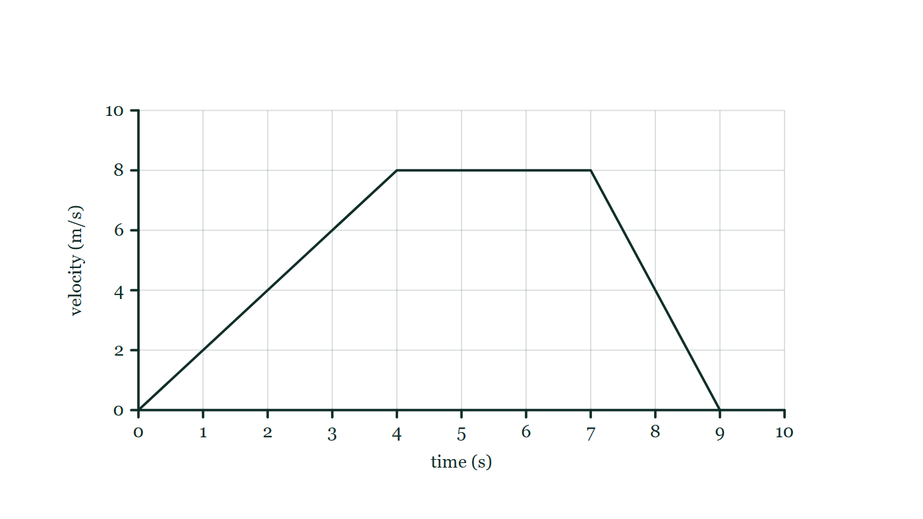
AP PHYSICS 1 · ALGEBRA-BASED
GIOPHYSICS PRACTICE PAPER
Question 1
Multiple choice
Algebra
Routine
1 mark
Syllabus 1 · SP1
An object moves along a straight line. Its velocity increases uniformly from 0 to 8.0 m/s during the first 4.0 s, stays at 8.0 m/s for the next 3.0 s, then decreases uniformly to 0 during the final 2.0 s. What total distance does the object travel?
Fig. 1.1 — A velocity–time graph on a gridded pair of axes. The horizontal axis is time in seconds, marked at every second from 0 to 10; the vertical axis is velocity in metres per second, marked 0, 2, 4, 6, 8 and 10. The plotted line is a straight rise from the origin to 8.0 m/s at 4.0 s, then a horizontal segment held at 8.0 m/s until 7.0 s, then a straight fall back to zero at 9.0 s.
A
40 m
B
48 m
C
56 m
D
72 m
AP Physics — AP Physics 1 · Algebra-Based. Written by GioPhysics from College Board AP Physics course and exam descriptions; not an awarding body's document.
2 / 29
Notes:
[Demand] Routine — The standard application — the named equation, the usual graph read.
[Figure] Fig. 1.1. A velocity–time graph on a gridded pair of axes. The horizontal axis is time in seconds, marked at every second from 0 to 10; the vertical axis is velocity in metres per second, marked 0, 2, 4, 6, 8 and 10. The plotted line is a straight rise from the origin to 8.0 m/s at 4.0 s, then a horizontal segment held at 8.0 m/s until 7.0 s, then a straight fall back to zero at 9.0 s.

Slide 3
AP PHYSICS 1 · ALGEBRA-BASED
GIOPHYSICS PRACTICE PAPER
Answer 1
Multiple choice
Algebra
Routine
1 mark
Mark scheme
B
48 m
Why the other three are there
The distance is the area under the velocity–time graph: a triangle of 16 m, a rectangle of 24 m, and a triangle of 8 m, giving 48 m. C treats the final stage as a rectangle rather than a triangle, and A drops it altogether. D multiplies 8.0 by the whole 9.0 s, treating the graph as if the object moved at its maximum speed throughout.
AP Physics — AP Physics 1 · Algebra-Based. Written by GioPhysics from College Board AP Physics course and exam descriptions; not an awarding body's document.
3 / 29
Notes:
[Answer] B — 48 m
[Distractors] The distance is the area under the velocity–time graph: a triangle of 16 m, a rectangle of 24 m, and a triangle of 8 m, giving 48 m. C treats the final stage as a rectangle rather than a triangle, and A drops it altogether. D multiplies 8.0 by the whole 9.0 s, treating the graph as if the object moved at its maximum speed throughout.
[Figure] Fig. 1.1. A velocity–time graph on a gridded pair of axes. The horizontal axis is time in seconds, marked at every second from 0 to 10; the vertical axis is velocity in metres per second, marked 0, 2, 4, 6, 8 and 10. The plotted line is a straight rise from the origin to 8.0 m/s at 4.0 s, then a horizontal segment held at 8.0 m/s until 7.0 s, then a straight fall back to zero at 9.0 s.

Slide 4
AP PHYSICS 1 · ALGEBRA-BASED
GIOPHYSICS PRACTICE PAPER
Question 2
Multiple choice
Algebra
Demanding
1 mark
Syllabus 2 · SP2
A person of mass m stands on a bathroom scale in an elevator. The elevator is moving downward and slowing down. What does the scale read?
A
less than mg
B
exactly mg
C
greater than mg
D
zero
AP Physics — AP Physics 1 · Algebra-Based. Written by GioPhysics from College Board AP Physics course and exam descriptions; not an awarding body's document.
4 / 29
Notes:
[Demand] Demanding — Several steps, and you have to choose them. Nothing says which comes first.

Slide 5
AP PHYSICS 1 · ALGEBRA-BASED
GIOPHYSICS PRACTICE PAPER
Answer 2
Multiple choice
Algebra
Demanding
1 mark
Mark scheme
C
greater than mg
Why the other three are there
A is chosen by almost everyone who reasons from the direction of motion rather than the direction of the acceleration. Moving down while slowing down means the acceleration points upward, so the normal force must exceed the weight.
AP Physics — AP Physics 1 · Algebra-Based. Written by GioPhysics from College Board AP Physics course and exam descriptions; not an awarding body's document.
5 / 29
Notes:
[Answer] C — greater than mg
[Distractors] A is chosen by almost everyone who reasons from the direction of motion rather than the direction of the acceleration. Moving down while slowing down means the acceleration points upward, so the normal force must exceed the weight.

Slide 6
AP PHYSICS 1 · ALGEBRA-BASED
GIOPHYSICS PRACTICE PAPER
Question 3
Multiple choice
Algebra
Routine
1 mark
Syllabus 3 · SP2
A car traveling at speed v brakes to rest in a distance d. Assuming the same constant braking force, what distance is required to bring the same car to rest from a speed of 2v?
A
d√2
B
2d
C
4d
D
8d
AP Physics — AP Physics 1 · Algebra-Based. Written by GioPhysics from College Board AP Physics course and exam descriptions; not an awarding body's document.
6 / 29
Notes:
[Demand] Routine — The standard application — the named equation, the usual graph read.

Slide 7
AP PHYSICS 1 · ALGEBRA-BASED
GIOPHYSICS PRACTICE PAPER
Answer 3
Multiple choice
Algebra
Routine
1 mark
Mark scheme
C
4d
Why the other three are there
B is the answer of a candidate reasoning proportionally without noticing that kinetic energy goes as v². The work–energy theorem gives Fd = ½mv², so d ∝ v².
AP Physics — AP Physics 1 · Algebra-Based. Written by GioPhysics from College Board AP Physics course and exam descriptions; not an awarding body's document.
7 / 29
Notes:
[Answer] C — 4d
[Distractors] B is the answer of a candidate reasoning proportionally without noticing that kinetic energy goes as v². The work–energy theorem gives Fd = ½mv², so d ∝ v².

Slide 8
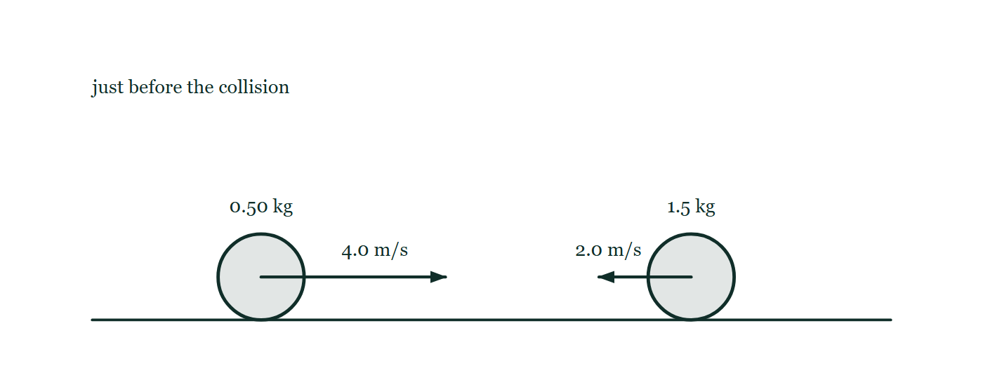
AP PHYSICS 1 · ALGEBRA-BASED
GIOPHYSICS PRACTICE PAPER
Question 4
Multiple choice
Algebra
Demanding
1 mark
Syllabus 4 · SP2
A 0.50 kg ball moving at 4.0 m/s to the right collides head-on with a 1.5 kg ball moving at 2.0 m/s to the left. The two balls stick together. What is the velocity of the combined object immediately after the collision?
Fig. 4.1 — Two balls of equal size rest on a straight horizontal track, well apart from one another. The left-hand ball is labelled 0.50 kg and carries a horizontal arrow drawn from its centre pointing to the right, labelled 4.0 m/s. The right-hand ball is labelled 1.5 kg and carries a horizontal arrow drawn from its centre pointing to the left, labelled 2.0 m/s, so the two arrows point towards each other along the same line. A note on the figure states that this is the instant just before the collision.
A
0.50 m/s to the left
B
0.50 m/s to the right
C
2.5 m/s to the left
D
2.5 m/s to the right
AP Physics — AP Physics 1 · Algebra-Based. Written by GioPhysics from College Board AP Physics course and exam descriptions; not an awarding body's document.
8 / 29
Notes:
[Demand] Demanding — Several steps, and you have to choose them. Nothing says which comes first.
[Figure] Fig. 4.1. Two balls of equal size rest on a straight horizontal track, well apart from one another. The left-hand ball is labelled 0.50 kg and carries a horizontal arrow drawn from its centre pointing to the right, labelled 4.0 m/s. The right-hand ball is labelled 1.5 kg and carries a horizontal arrow drawn from its centre pointing to the left, labelled 2.0 m/s, so the two arrows point towards each other along the same line. A note on the figure states that this is the instant just before the collision.

Slide 9
AP PHYSICS 1 · ALGEBRA-BASED
GIOPHYSICS PRACTICE PAPER
Answer 4
Multiple choice
Algebra
Demanding
1 mark
Mark scheme
A
0.50 m/s to the left
Why the other three are there
Total momentum is (0.50)(+4.0) + (1.5)(−2.0) = −1.0 kg·m/s, and the combined mass is 2.0 kg. B gets the size right and the sign wrong, which on a real exam is a wrong answer, not a near miss.
AP Physics — AP Physics 1 · Algebra-Based. Written by GioPhysics from College Board AP Physics course and exam descriptions; not an awarding body's document.
9 / 29
Notes:
[Answer] A — 0.50 m/s to the left
[Distractors] Total momentum is (0.50)(+4.0) + (1.5)(−2.0) = −1.0 kg·m/s, and the combined mass is 2.0 kg. B gets the size right and the sign wrong, which on a real exam is a wrong answer, not a near miss.
[Figure] Fig. 4.1. Two balls of equal size rest on a straight horizontal track, well apart from one another. The left-hand ball is labelled 0.50 kg and carries a horizontal arrow drawn from its centre pointing to the right, labelled 4.0 m/s. The right-hand ball is labelled 1.5 kg and carries a horizontal arrow drawn from its centre pointing to the left, labelled 2.0 m/s, so the two arrows point towards each other along the same line. A note on the figure states that this is the instant just before the collision.

Slide 10
AP PHYSICS 1 · ALGEBRA-BASED
GIOPHYSICS PRACTICE PAPER
Question 5
Multiple choice
Algebra
Demanding
1 mark
Syllabus 5, 6 · SP3
A solid disk and a thin hoop have the same mass and the same radius. Both are released from rest at the top of the same incline and roll down without slipping. Which reaches the bottom first?
A
the disk, because a smaller fraction of its energy goes into rotation
B
the hoop, because its mass is farther from the axis
C
neither — they arrive together, because they have the same mass
D
neither — they arrive together, because gravity acts equally on both
AP Physics — AP Physics 1 · Algebra-Based. Written by GioPhysics from College Board AP Physics course and exam descriptions; not an awarding body's document.
10 / 29
Notes:
[Demand] Demanding — Several steps, and you have to choose them. Nothing says which comes first.

Slide 11
AP PHYSICS 1 · ALGEBRA-BASED
GIOPHYSICS PRACTICE PAPER
Answer 5
Multiple choice
Algebra
Demanding
1 mark
Mark scheme
A
the disk, because a smaller fraction of its energy goes into rotation
Why the other three are there
C and D are the answers of a candidate applying the free-fall result, where mass genuinely does cancel. It does cancel here too — but the rotational inertia does not, and the hoop's larger I/MR² leaves less of the released energy available as translational kinetic energy.
AP Physics — AP Physics 1 · Algebra-Based. Written by GioPhysics from College Board AP Physics course and exam descriptions; not an awarding body's document.
11 / 29
Notes:
[Answer] A — the disk, because a smaller fraction of its energy goes into rotation
[Distractors] C and D are the answers of a candidate applying the free-fall result, where mass genuinely does cancel. It does cancel here too — but the rotational inertia does not, and the hoop's larger I/MR² leaves less of the released energy available as translational kinetic energy.

Slide 12
AP PHYSICS 1 · ALGEBRA-BASED
GIOPHYSICS PRACTICE PAPER
Question 6
Multiple choice
Algebra
Routine
1 mark
Syllabus 8 · SP2
A solid block of density 600 kg/m³ floats at rest in water of density 1000 kg/m³. What fraction of the block's volume is below the surface?
A
0.40
B
0.60
C
1.00
D
1.67
AP Physics — AP Physics 1 · Algebra-Based. Written by GioPhysics from College Board AP Physics course and exam descriptions; not an awarding body's document.
12 / 29
Notes:
[Demand] Routine — The standard application — the named equation, the usual graph read.

Slide 13
AP PHYSICS 1 · ALGEBRA-BASED
GIOPHYSICS PRACTICE PAPER
Answer 6
Multiple choice
Algebra
Routine
1 mark
Mark scheme
B
0.60
Why the other three are there
A is the fraction above the surface. D inverts the ratio and should be rejected on sight — a fraction of a volume cannot exceed 1.
AP Physics — AP Physics 1 · Algebra-Based. Written by GioPhysics from College Board AP Physics course and exam descriptions; not an awarding body's document.
13 / 29
Notes:
[Answer] B — 0.60
[Distractors] A is the fraction above the surface. D inverts the ratio and should be rejected on sight — a fraction of a volume cannot exceed 1.

Slide 14
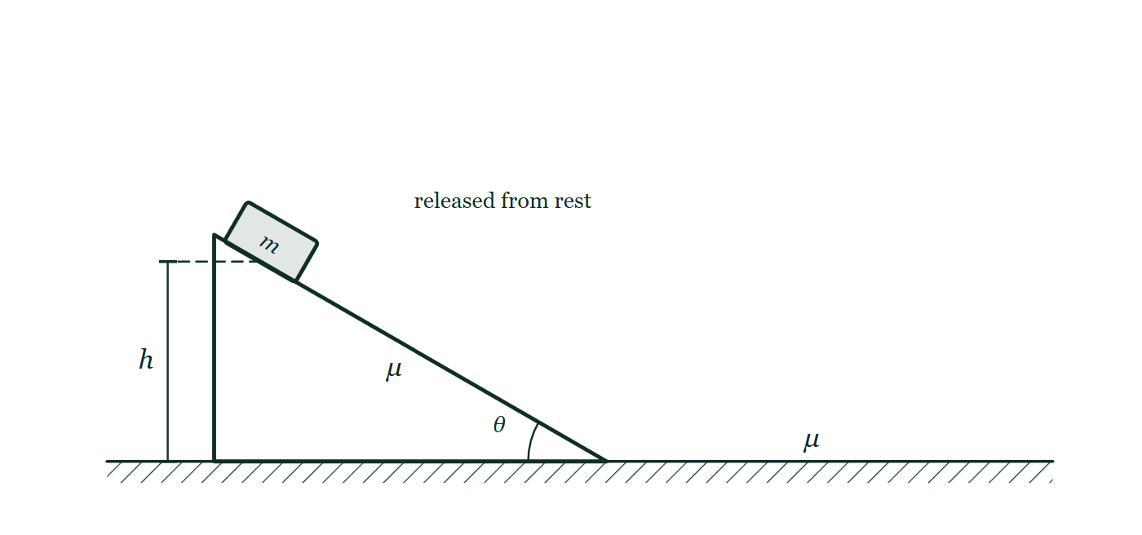
AP PHYSICS 1 · ALGEBRA-BASED
GIOPHYSICS PRACTICE PAPER
Question 7
Free response
Algebra
Demanding
12 marks
Mathematical Routines · Syllabus 2, 3
A block of mass m is released from rest at a height h on an incline that makes an angle θ with the horizontal. The coefficient of kinetic friction between the block and the incline is μ. The block slides down the incline and then continues onto a horizontal surface with the same coefficient of kinetic friction.
Fig. 7.1 — A wedge-shaped incline stands on a horizontal floor with its sloping face rising from right to left, and the angle between the sloping face and the floor at the foot of the slope is marked θ. A block labelled m rests on the sloping face near the top and is noted as released from rest, with a dimension line to the left of the wedge marking its height h above the floor. The symbol μ is printed on the wedge below the sloping face and again on the floor beyond the foot of the slope, showing that the same coefficient of kinetic friction applies to both surfaces, which run into one another at the bottom of the incline.
AP Physics — AP Physics 1 · Algebra-Based. Written by GioPhysics from College Board AP Physics course and exam descriptions; not an awarding body's document.
14 / 29
Notes:
[Demand] Demanding — Several steps, and you have to choose them. Nothing says which comes first.
[Figure] Fig. 7.1. A wedge-shaped incline stands on a horizontal floor with its sloping face rising from right to left, and the angle between the sloping face and the floor at the foot of the slope is marked θ. A block labelled m rests on the sloping face near the top and is noted as released from rest, with a dimension line to the left of the wedge marking its height h above the floor. The symbol μ is printed on the wedge below the sloping face and again on the floor beyond the foot of the slope, showing that the same coefficient of kinetic friction applies to both surfaces, which run into one another at the bottom of the incline.

Slide 15
AP PHYSICS 1 · ALGEBRA-BASED
GIOPHYSICS PRACTICE PAPER
Question 7 (cont.)
Free response
Algebra
Demanding
12 marks
continued from the previous slide
(a) Derive
4 marks
Derive an expression for the speed of the block at the bottom of the incline, in terms of m, h, θ, μ and physical constants.
(b) Calculate
3 marks
Calculate the speed of the block at the bottom of the incline for m = 2.0 kg, h = 1.5 m, θ = 30°, and μ = 0.25.
(c) Determine
3 marks
Determine the distance the block travels along the horizontal surface before coming to rest.
(d) Justify
2 marks
A student claims that doubling the mass of the block would double the distance found in part (c). Justify why the student is incorrect, referring to your expression.
AP Physics — AP Physics 1 · Algebra-Based. Written by GioPhysics from College Board AP Physics course and exam descriptions; not an awarding body's document.
15 / 29
Notes:
[Demand] Demanding — Several steps, and you have to choose them. Nothing says which comes first.
[Figure] Fig. 7.1. A wedge-shaped incline stands on a horizontal floor with its sloping face rising from right to left, and the angle between the sloping face and the floor at the foot of the slope is marked θ. A block labelled m rests on the sloping face near the top and is noted as released from rest, with a dimension line to the left of the wedge marking its height h above the floor. The symbol μ is printed on the wedge below the sloping face and again on the floor beyond the foot of the slope, showing that the same coefficient of kinetic friction applies to both surfaces, which run into one another at the bottom of the incline.
[Reminder] Fig. 7.1 is on the previous slide.

Slide 16
AP PHYSICS 1 · ALGEBRA-BASED
GIOPHYSICS PRACTICE PAPER
Answer 7
Free response
Algebra
Demanding
12 marks
Mark scheme
(a) Derive — 4 marks
SP2
✓
1 point: uses energy conservation with a friction term, ΔK = mgh − f·L
✓
1 point: identifies the distance along the incline as L = h / sin θ and the friction force as f = μmg cos θ
✓
1 point: friction work = μmg cos θ · (h / sin θ) = μmgh cot θ
✓
1 point: v = √(2gh(1 − μ cot θ)), with m correctly cancelling
A numerical answer with no symbolic expression scores at most one point on this task type. The expression is the task.
(b) Calculate — 3 marks
SP2
✓
1 point: cot 30° = 1.73, so 1 − 0.25(1.73) = 0.567
✓
1 point: v = √(2 × 9.8 × 1.5 × 0.567)
✓
1 point: v = 4.1 m/s, with unit
(c) Determine — 3 marks
SP2
✓
1 point: on the horizontal surface the only horizontal force is friction, μmg
✓
1 point: ½mv² = μmg·d, so d = v²/(2μg)
✓
1 point: d = 16.7 / (2 × 0.25 × 9.8) = 3.4 m
(d) Justify — 2 marks
SP3
✓
1 point: mass appears in both the kinetic energy and the friction force and cancels from d = v²/(2μg)
✓
1 point: v itself is also independent of m, so the distance is unchanged when the mass is doubled
AP Physics — AP Physics 1 · Algebra-Based. Written by GioPhysics from College Board AP Physics course and exam descriptions; not an awarding body's document.
16 / 29
Notes:
[Marking] One line per mark, awarded independently unless a point says otherwise.
[Examiner note (a)] A numerical answer with no symbolic expression scores at most one point on this task type. The expression is the task.
[Figure] Fig. 7.1. A wedge-shaped incline stands on a horizontal floor with its sloping face rising from right to left, and the angle between the sloping face and the floor at the foot of the slope is marked θ. A block labelled m rests on the sloping face near the top and is noted as released from rest, with a dimension line to the left of the wedge marking its height h above the floor. The symbol μ is printed on the wedge below the sloping face and again on the floor beyond the foot of the slope, showing that the same coefficient of kinetic friction applies to both surfaces, which run into one another at the bottom of the incline.

Slide 17
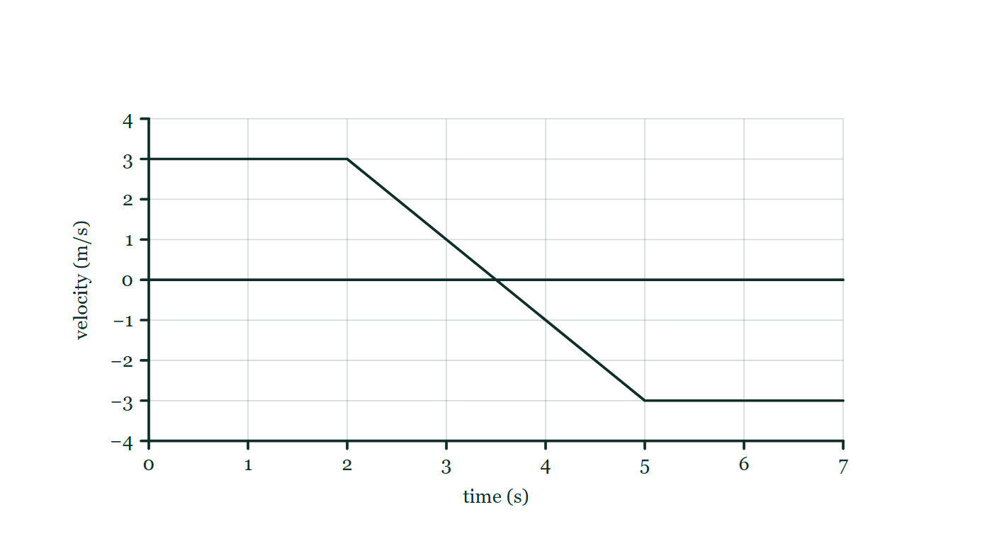
AP PHYSICS 1 · ALGEBRA-BASED
GIOPHYSICS PRACTICE PAPER
Question 8
Free response
Algebra
Demanding
12 marks
Translation Between Representations · Syllabus 1
A cart moves along a straight horizontal track. Its velocity as a function of time is described as follows: from t = 0 to t = 2.0 s the velocity is constant at +3.0 m/s; from t = 2.0 s to t = 5.0 s the velocity decreases uniformly from +3.0 m/s to −3.0 m/s; from t = 5.0 s to t = 7.0 s the velocity is constant at −3.0 m/s.
Fig. 8.1 — The cart's velocity–time graph. The time axis is drawn horizontally through velocity zero and is marked in seconds from 1 to 7; the vertical velocity axis is marked in metres per second from −4 to +4. The plotted line runs horizontally at +3.0 m/s from t = 0 to t = 2.0 s, then falls as a single straight sloping segment, passing through zero, to −3.0 m/s at t = 5.0 s, and then runs horizontally at −3.0 m/s until t = 7.0 s.
AP Physics — AP Physics 1 · Algebra-Based. Written by GioPhysics from College Board AP Physics course and exam descriptions; not an awarding body's document.
17 / 29
Notes:
[Demand] Demanding — Several steps, and you have to choose them. Nothing says which comes first.
[Figure] Fig. 8.1. The cart's velocity–time graph. The time axis is drawn horizontally through velocity zero and is marked in seconds from 1 to 7; the vertical velocity axis is marked in metres per second from −4 to +4. The plotted line runs horizontally at +3.0 m/s from t = 0 to t = 2.0 s, then falls as a single straight sloping segment, passing through zero, to −3.0 m/s at t = 5.0 s, and then runs horizontally at −3.0 m/s until t = 7.0 s.

Slide 18
AP PHYSICS 1 · ALGEBRA-BASED
GIOPHYSICS PRACTICE PAPER
Question 8 (cont.)
Free response
Algebra
Demanding
12 marks
continued from the previous slide
(a) Sketch
3 marks
Sketch a graph of the cart's acceleration as a function of time from t = 0 to t = 7.0 s. Label the value of the acceleration on each interval.
(b) Determine
3 marks
Determine the time at which the cart is farthest from its starting point, and determine that distance.
(c) Sketch
3 marks
Sketch a graph of the cart's position as a function of time over the same interval, taking the starting position as zero.
(d) Describe
3 marks
Describe the motion of the cart in words, making clear the difference between the interval in which it is slowing down and the interval in which it is speeding up.
AP Physics — AP Physics 1 · Algebra-Based. Written by GioPhysics from College Board AP Physics course and exam descriptions; not an awarding body's document.
18 / 29
Notes:
[Demand] Demanding — Several steps, and you have to choose them. Nothing says which comes first.
[Figure] Fig. 8.1. The cart's velocity–time graph. The time axis is drawn horizontally through velocity zero and is marked in seconds from 1 to 7; the vertical velocity axis is marked in metres per second from −4 to +4. The plotted line runs horizontally at +3.0 m/s from t = 0 to t = 2.0 s, then falls as a single straight sloping segment, passing through zero, to −3.0 m/s at t = 5.0 s, and then runs horizontally at −3.0 m/s until t = 7.0 s.
[Reminder] Fig. 8.1 is on the previous slide.

Slide 19
AP PHYSICS 1 · ALGEBRA-BASED
GIOPHYSICS PRACTICE PAPER
Answer 8
Free response
Algebra
Demanding
12 marks
Mark scheme
(a) Sketch — 3 marks
SP1
✓
1 point: a = 0 on 0 ≤ t < 2.0 s and on 5.0 s < t ≤ 7.0 s
✓
1 point: a constant and negative between 2.0 s and 5.0 s
✓
1 point: value stated as −2.0 m/s², from (−3.0 − 3.0)/(5.0 − 2.0)
(b) Determine — 3 marks
SP2
✓
1 point: the cart is farthest away when the velocity changes sign, at t = 3.5 s
✓
1 point: area under the graph from 0 to 3.5 s = (3.0)(2.0) + ½(1.5)(3.0)
✓
1 point: distance = 6.0 + 2.25 = 8.25 m
The point most often lost is the first. Candidates look for where the acceleration changes rather than where the velocity crosses zero, and place the maximum at t = 5.0 s.
(c) Sketch — 3 marks
SP1
✓
1 point: straight line of positive constant slope from the origin to (2.0 s, 6.0 m)
✓
1 point: curve that flattens to a maximum at t = 3.5 s and then falls, with curvature downward throughout 2.0–5.0 s
✓
1 point: straight line of constant negative slope after t = 5.0 s
AP Physics — AP Physics 1 · Algebra-Based. Written by GioPhysics from College Board AP Physics course and exam descriptions; not an awarding body's document.
19 / 29
Notes:
[Marking] One line per mark, awarded independently unless a point says otherwise.
[Examiner note (b)] The point most often lost is the first. Candidates look for where the acceleration changes rather than where the velocity crosses zero, and place the maximum at t = 5.0 s.
[Examiner note (d)] The distinction is the whole point of the question: a negative acceleration slows an object down only while the object is moving forward.
[Figure] Fig. 8.1. The cart's velocity–time graph. The time axis is drawn horizontally through velocity zero and is marked in seconds from 1 to 7; the vertical velocity axis is marked in metres per second from −4 to +4. The plotted line runs horizontally at +3.0 m/s from t = 0 to t = 2.0 s, then falls as a single straight sloping segment, passing through zero, to −3.0 m/s at t = 5.0 s, and then runs horizontally at −3.0 m/s until t = 7.0 s.

Slide 20
AP PHYSICS 1 · ALGEBRA-BASED
GIOPHYSICS PRACTICE PAPER
Answer 8 (cont.)
Free response
Algebra
Demanding
12 marks
Mark scheme, continued
(d) Describe — 3 marks
SP3
✓
1 point: moves in the positive direction at constant speed for the first 2.0 s
✓
1 point: from 2.0 s to 3.5 s it still moves in the positive direction but slows, because velocity and acceleration have opposite signs
✓
1 point: from 3.5 s onward it moves in the negative direction and speeds up until 5.0 s, because velocity and acceleration now have the same sign, then travels at constant speed
The distinction is the whole point of the question: a negative acceleration slows an object down only while the object is moving forward.
AP Physics — AP Physics 1 · Algebra-Based. Written by GioPhysics from College Board AP Physics course and exam descriptions; not an awarding body's document.
20 / 29
Notes:
[Marking] One line per mark, awarded independently unless a point says otherwise.
[Examiner note (b)] The point most often lost is the first. Candidates look for where the acceleration changes rather than where the velocity crosses zero, and place the maximum at t = 5.0 s.
[Examiner note (d)] The distinction is the whole point of the question: a negative acceleration slows an object down only while the object is moving forward.
[Figure] Fig. 8.1. The cart's velocity–time graph. The time axis is drawn horizontally through velocity zero and is marked in seconds from 1 to 7; the vertical velocity axis is marked in metres per second from −4 to +4. The plotted line runs horizontally at +3.0 m/s from t = 0 to t = 2.0 s, then falls as a single straight sloping segment, passing through zero, to −3.0 m/s at t = 5.0 s, and then runs horizontally at −3.0 m/s until t = 7.0 s.

Slide 21
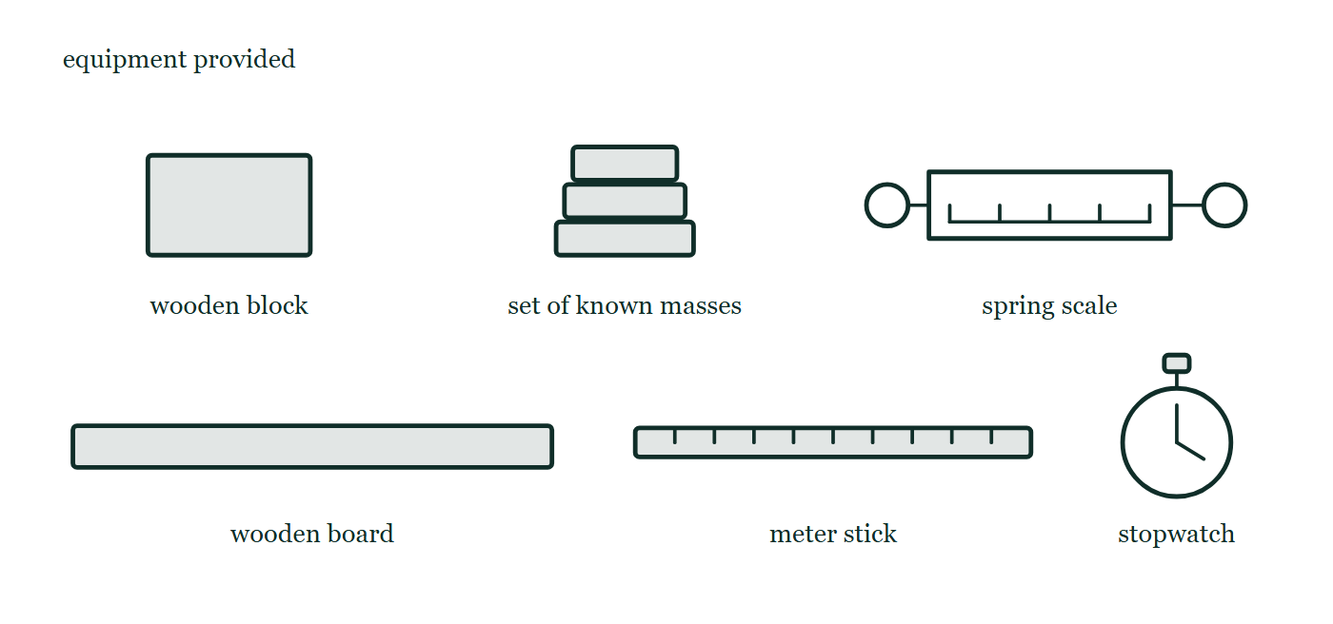
AP PHYSICS 1 · ALGEBRA-BASED
GIOPHYSICS PRACTICE PAPER
Question 9
Free response
Algebra
Discriminating
12 marks
Experimental Design and Analysis · Syllabus 2
A student is given a wooden block, a horizontal board of the same material, a set of known masses, a spring scale, a meter stick, and a stopwatch. The student wants to determine the coefficient of kinetic friction μ between the block and the board.
Fig. 9.1 — The equipment provided, drawn as six separate labelled items laid out side by side rather than as an assembled apparatus: a rectangular wooden block; a set of known masses drawn as a stack of three flat slabs; a spring scale drawn as a barrel with a graduated face and a ring at each end for pulling and for attaching; a long flat wooden board; a meter stick divided by evenly spaced marks; and a stopwatch drawn as a circular dial with two hands and a button on top.
AP Physics — AP Physics 1 · Algebra-Based. Written by GioPhysics from College Board AP Physics course and exam descriptions; not an awarding body's document.
21 / 29
Notes:
[Demand] Discriminating — The part that separates the top grade: an unfamiliar context, a derivation, or an argument that has to hold together to earn anything.
[Figure] Fig. 9.1. The equipment provided, drawn as six separate labelled items laid out side by side rather than as an assembled apparatus: a rectangular wooden block; a set of known masses drawn as a stack of three flat slabs; a spring scale drawn as a barrel with a graduated face and a ring at each end for pulling and for attaching; a long flat wooden board; a meter stick divided by evenly spaced marks; and a stopwatch drawn as a circular dial with two hands and a button on top.

Slide 22
AP PHYSICS 1 · ALGEBRA-BASED
GIOPHYSICS PRACTICE PAPER
Question 9 (cont.)
Free response
Algebra
Discriminating
12 marks
continued from the previous slide
(a) Describe
4 marks
Describe an experimental procedure the student could use to collect the data needed. Include the quantity that is deliberately varied, the quantity measured in response, and at least two quantities held constant.
(b) Describe
3 marks
Describe how the student should graph the data so that the coefficient of friction can be determined from a straight line, and state what quantity the slope of that line represents.
(c) Determine
3 marks
The student's best-fit line has a slope of 0.32 when friction force is plotted against normal force, and a vertical intercept of +0.15 N rather than zero. Determine the coefficient of kinetic friction, and explain what the non-zero intercept suggests about the experiment.
(d) Explain
2 marks
Explain why taking the slope of the best-fit line gives a more reliable value for μ than calculating f/N from a single pair of readings.
AP Physics — AP Physics 1 · Algebra-Based. Written by GioPhysics from College Board AP Physics course and exam descriptions; not an awarding body's document.
22 / 29
Notes:
[Demand] Discriminating — The part that separates the top grade: an unfamiliar context, a derivation, or an argument that has to hold together to earn anything.
[Figure] Fig. 9.1. The equipment provided, drawn as six separate labelled items laid out side by side rather than as an assembled apparatus: a rectangular wooden block; a set of known masses drawn as a stack of three flat slabs; a spring scale drawn as a barrel with a graduated face and a ring at each end for pulling and for attaching; a long flat wooden board; a meter stick divided by evenly spaced marks; and a stopwatch drawn as a circular dial with two hands and a button on top.
[Reminder] Fig. 9.1 is on the previous slide.

Slide 23
AP PHYSICS 1 · ALGEBRA-BASED
GIOPHYSICS PRACTICE PAPER
Answer 9
Free response
Algebra
Discriminating
12 marks
Mark scheme
(a) Describe — 4 marks
SP4
✓
1 point: pull the block along the board with the spring scale at constant velocity, so that the applied force equals the friction force
✓
1 point: vary the total mass by adding known masses on top of the block — this is the independent variable
✓
1 point: record the spring-scale reading for each total mass — this is the dependent variable
✓
1 point: hold constant the surfaces in contact and the surface area, and keep the pull horizontal for every trial
"At constant velocity" is worth a point on its own. If the block accelerates, the scale reading exceeds the friction force and every value of μ comes out too large.
(b) Describe — 3 marks
SP4
✓
1 point: plot the friction force (spring-scale reading) on the vertical axis against the normal force, or against the total mass, on the horizontal axis
✓
1 point: the relationship f = μN is linear through the origin
✓
1 point: the slope equals μ if the horizontal axis is the normal force, or μg if the horizontal axis is the mass
(c) Determine — 3 marks
SP4
✓
1 point: μ = 0.32, the slope, which is dimensionless
✓
1 point: the model predicts an intercept of zero, since zero normal force means zero friction
✓
1 point: a positive intercept indicates a systematic error — for example the spring scale reads high at zero, or the pull was not horizontal, adding a constant component to every reading
Reading μ from a single data point instead of from the slope scores nothing here. The design of the graph is what the task type is assessing.
AP Physics — AP Physics 1 · Algebra-Based. Written by GioPhysics from College Board AP Physics course and exam descriptions; not an awarding body's document.
23 / 29
Notes:
[Marking] One line per mark, awarded independently unless a point says otherwise.
[Examiner note (a)] "At constant velocity" is worth a point on its own. If the block accelerates, the scale reading exceeds the friction force and every value of μ comes out too large.
[Examiner note (c)] Reading μ from a single data point instead of from the slope scores nothing here. The design of the graph is what the task type is assessing.
[Figure] Fig. 9.1. The equipment provided, drawn as six separate labelled items laid out side by side rather than as an assembled apparatus: a rectangular wooden block; a set of known masses drawn as a stack of three flat slabs; a spring scale drawn as a barrel with a graduated face and a ring at each end for pulling and for attaching; a long flat wooden board; a meter stick divided by evenly spaced marks; and a stopwatch drawn as a circular dial with two hands and a button on top.

Slide 24
AP PHYSICS 1 · ALGEBRA-BASED
GIOPHYSICS PRACTICE PAPER
Answer 9 (cont.)
Free response
Algebra
Discriminating
12 marks
Mark scheme, continued
(d) Explain — 2 marks
SP4
✓
1 point: the slope uses every data point, so random errors in individual readings tend to average out
✓
1 point: a systematic offset such as the intercept above shifts a single-point ratio but does not change the slope, so the slope is insensitive to it
AP Physics — AP Physics 1 · Algebra-Based. Written by GioPhysics from College Board AP Physics course and exam descriptions; not an awarding body's document.
24 / 29
Notes:
[Marking] One line per mark, awarded independently unless a point says otherwise.
[Examiner note (a)] "At constant velocity" is worth a point on its own. If the block accelerates, the scale reading exceeds the friction force and every value of μ comes out too large.
[Examiner note (c)] Reading μ from a single data point instead of from the slope scores nothing here. The design of the graph is what the task type is assessing.
[Figure] Fig. 9.1. The equipment provided, drawn as six separate labelled items laid out side by side rather than as an assembled apparatus: a rectangular wooden block; a set of known masses drawn as a stack of three flat slabs; a spring scale drawn as a barrel with a graduated face and a ring at each end for pulling and for attaching; a long flat wooden board; a meter stick divided by evenly spaced marks; and a stopwatch drawn as a circular dial with two hands and a button on top.

Slide 25
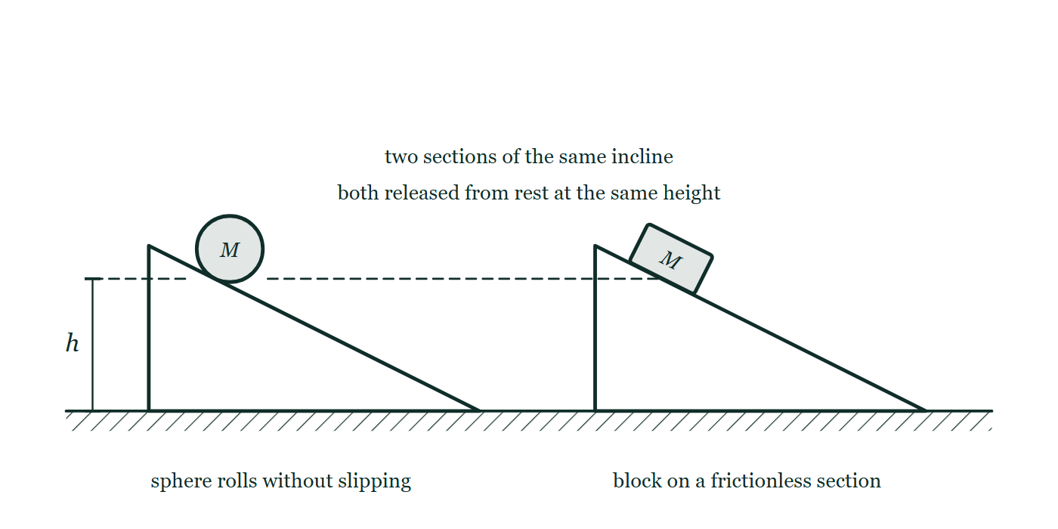
AP PHYSICS 1 · ALGEBRA-BASED
GIOPHYSICS PRACTICE PAPER
Question 10
Free response
Algebra
Discriminating
11 marks
Qualitative/Quantitative Translation · Syllabus 3, 5, 6
A solid sphere and a block have the same mass. Both are released from rest at the same height at the top of an incline. The sphere rolls down without slipping. The block slides down a frictionless section of the same incline. The moment of inertia of a solid sphere about its center is (2/5)MR².
Fig. 10.1 — Two identical wedge-shaped inclines stand side by side on the same horizontal floor, labelled as two sections of the same incline. A solid sphere of mass M rests on the sloping face of the left wedge, and a block of mass M rests at the same point up the sloping face of the right wedge. A dashed horizontal line runs across the figure at the level of both objects, and a dimension line at the far left marks their common release height h above the floor. A note states that both are released from rest at the same height; a label under the left ramp reads that the sphere rolls without slipping, and one under the right ramp that the block is on a frictionless section.
AP Physics — AP Physics 1 · Algebra-Based. Written by GioPhysics from College Board AP Physics course and exam descriptions; not an awarding body's document.
25 / 29
Notes:
[Demand] Discriminating — The part that separates the top grade: an unfamiliar context, a derivation, or an argument that has to hold together to earn anything.
[Figure] Fig. 10.1. Two identical wedge-shaped inclines stand side by side on the same horizontal floor, labelled as two sections of the same incline. A solid sphere of mass M rests on the sloping face of the left wedge, and a block of mass M rests at the same point up the sloping face of the right wedge. A dashed horizontal line runs across the figure at the level of both objects, and a dimension line at the far left marks their common release height h above the floor. A note states that both are released from rest at the same height; a label under the left ramp reads that the sphere rolls without slipping, and one under the right ramp that the block is on a frictionless section.

Slide 26
AP PHYSICS 1 · ALGEBRA-BASED
GIOPHYSICS PRACTICE PAPER
Question 10 (cont.)
Free response
Algebra
Discriminating
11 marks
continued from the previous slide
(a) Indicate
1 mark
Indicate which object reaches the bottom of the incline with the greater translational speed, or whether they arrive with the same speed. No justification is required in this part.
(b) Derive
4 marks
Derive expressions for the translational speed of each object at the bottom of the incline, in terms of g and the height h.
(c) Justify
2 marks
Use your expressions to justify the answer you gave in part (a).
(d) Explain
4 marks
Explain, without using equations, why the sphere arrives more slowly, and explain why the answer does not depend on the mass or the radius of the sphere.
AP Physics — AP Physics 1 · Algebra-Based. Written by GioPhysics from College Board AP Physics course and exam descriptions; not an awarding body's document.
26 / 29
Notes:
[Demand] Discriminating — The part that separates the top grade: an unfamiliar context, a derivation, or an argument that has to hold together to earn anything.
[Figure] Fig. 10.1. Two identical wedge-shaped inclines stand side by side on the same horizontal floor, labelled as two sections of the same incline. A solid sphere of mass M rests on the sloping face of the left wedge, and a block of mass M rests at the same point up the sloping face of the right wedge. A dashed horizontal line runs across the figure at the level of both objects, and a dimension line at the far left marks their common release height h above the floor. A note states that both are released from rest at the same height; a label under the left ramp reads that the sphere rolls without slipping, and one under the right ramp that the block is on a frictionless section.
[Reminder] Fig. 10.1 is on the previous slide.

Slide 27
AP PHYSICS 1 · ALGEBRA-BASED
GIOPHYSICS PRACTICE PAPER
Answer 10
Free response
Algebra
Discriminating
11 marks
Mark scheme
(a) Indicate — 1 mark
SP3
✓
1 point: the block
(b) Derive — 4 marks
SP2
✓
1 point: block — Mgh = ½Mv², so v = √(2gh)
✓
1 point: sphere — energy is shared between translation and rotation, Mgh = ½Mv² + ½Iω²
✓
1 point: applies the rolling condition ω = v/R and substitutes I = (2/5)MR², giving Mgh = (7/10)Mv²
✓
1 point: v = √(10gh/7)
(c) Justify — 2 marks
SP3
✓
1 point: compares the coefficients — 10/7 = 1.43 is smaller than 2, so the sphere's speed is smaller
✓
1 point: states the ratio explicitly, v_sphere / v_block = √(5/7) = 0.85
AP Physics — AP Physics 1 · Algebra-Based. Written by GioPhysics from College Board AP Physics course and exam descriptions; not an awarding body's document.
27 / 29
Notes:
[Marking] One line per mark, awarded independently unless a point says otherwise.
[Examiner note (d)] The last point is the hardest on the exam and is the reason this task type exists: the candidate has to say in words what the algebra in part (b) did, and identify which symbol survived the cancellation and why.
[Figure] Fig. 10.1. Two identical wedge-shaped inclines stand side by side on the same horizontal floor, labelled as two sections of the same incline. A solid sphere of mass M rests on the sloping face of the left wedge, and a block of mass M rests at the same point up the sloping face of the right wedge. A dashed horizontal line runs across the figure at the level of both objects, and a dimension line at the far left marks their common release height h above the floor. A note states that both are released from rest at the same height; a label under the left ramp reads that the sphere rolls without slipping, and one under the right ramp that the block is on a frictionless section.

Slide 28
AP PHYSICS 1 · ALGEBRA-BASED
GIOPHYSICS PRACTICE PAPER
Answer 10 (cont.)
Free response
Algebra
Discriminating
11 marks
Mark scheme, continued
(d) Explain — 4 marks
SP3
✓
1 point: both objects convert the same gravitational potential energy per unit mass
✓
1 point: the sphere must also spin as it moves, so part of that energy goes into rotational kinetic energy and less is left for translation
✓
1 point: the mass appears in every energy term and cancels, so it cannot affect the result
✓
1 point: the radius cancels because the rolling condition ties ω to v through the same R that appears in the moment of inertia — only the shape factor 2/5 survives
The last point is the hardest on the exam and is the reason this task type exists: the candidate has to say in words what the algebra in part (b) did, and identify which symbol survived the cancellation and why.
AP Physics — AP Physics 1 · Algebra-Based. Written by GioPhysics from College Board AP Physics course and exam descriptions; not an awarding body's document.
28 / 29
Notes:
[Marking] One line per mark, awarded independently unless a point says otherwise.
[Examiner note (d)] The last point is the hardest on the exam and is the reason this task type exists: the candidate has to say in words what the algebra in part (b) did, and identify which symbol survived the cancellation and why.
[Figure] Fig. 10.1. Two identical wedge-shaped inclines stand side by side on the same horizontal floor, labelled as two sections of the same incline. A solid sphere of mass M rests on the sloping face of the left wedge, and a block of mass M rests at the same point up the sloping face of the right wedge. A dashed horizontal line runs across the figure at the level of both objects, and a dimension line at the far left marks their common release height h above the floor. A note states that both are released from rest at the same height; a label under the left ramp reads that the sphere rolls without slipping, and one under the right ramp that the block is on a frictionless section.

Slide 29
AP PHYSICS 1 · ALGEBRA-BASED
GIOPHYSICS PRACTICE PAPER
Command words
AP Physics — the board's own definitions
Calculate
Justify
Perform mathematical steps to arrive at a final answer, including an algebraic expression, correctly substituted numbers, and units.
Provide evidence to support or defend a claim, and reasoning to explain how that evidence supports the claim.
Derive
Sketch
Perform a series of mathematical steps from a fundamental law or relationship to arrive at the desired result.
Draw a shape or trend line, without requiring exact plotted values.
Describe
Provide the relevant characteristics of a specified topic.
Determine
Arrive at a conclusion after reasoning, observation, or applying mathematical routines.
Explain
Provide information about how or why a relationship, situation or outcome occurs, using evidence and reasoning.
Indicate
Select the correct option from those provided, before giving any reasoning that is asked for.
AP Physics — AP Physics 1 · Algebra-Based. Written by GioPhysics from College Board AP Physics course and exam descriptions; not an awarding body's document.
29 / 29
Notes:
[Objectives] SP1 Creating representations: Describe, create and use models, diagrams, graphs and free-body diagrams to represent a physical situation. SP2 Mathematical routines: Determine and apply mathematical relationships, working symbolically before substituting, and check the reasonableness of a result. SP3 Scientific questioning and argumentation: Make and justify a claim with evidence and reasoning, and evaluate the claims and reasoning of others. SP4 Experimental method and data analysis: Design an experimental procedure, identify and control variables, analyse data including linearisation, and evaluate sources of error.
[Source] College Board AP Physics course and exam descriptions — https://apcentral.collegeboard.org/courses
[Disclaimer] Written by GioPhysics from the published course frameworks. These are practice exams in the style of AP Physics; they are not College Board materials, contain no released exam questions, and the official course and exam descriptions remain the authority. AP is a trademark of the College Board, which is not affiliated with and does not endorse GioPhysics.

