Slide 1
AP PHYSICS 2 · ALGEBRA-BASED
GIOPHYSICS PRACTICE PAPER
AP · College Board AP Physics · frameworks first examined in 2025
AP Physics 2 · Algebra-Based
Thermodynamics, electric force, field and potential, circuits, magnetism and electromagnetism, geometric optics, waves and physical optics, and modern physics.
MIRRORS
Section I (single-select multiple choice) and Section II (four free-response task types)
MARKS
54 in total — all Algebra
TIME
70 minutes · 10 questions
DEMAND
Routine 3 · Demanding 5 · Discriminating 2
SYLLABUS
9, 10, 11, 12, 13, 14, 15
Written by GioPhysics from the published course frameworks. These are practice exams in the style of AP Physics; they are not College Board materials, contain no released exam questions, and the official course and exam descriptions remain the authority. AP is a trademark of the College Board, which is not affiliated with and does not endorse GioPhysics.
AP Physics — AP Physics 2 · Algebra-Based. Written by GioPhysics from College Board AP Physics course and exam descriptions; not an awarding body's document.
1 / 29
Notes:
[Format] Every AP Physics exam has two sections of equal weight. Section I is single-select multiple choice with four options and no penalty for a wrong answer. Section II is free response, scored in points, and every question is built on one of four published task types. A table of equations and a table of constants are supplied for both sections, so nothing on an AP exam tests whether you can recall a formula.
[Demand] Written to the standard the free-response rubrics actually apply. A numerical answer that appears without the symbolic expression behind it earns partial credit at best; a claim without reasoning earns nothing at all, however correct the claim is. The C courses are set at calculus level throughout — moments of inertia by integration, drag and RC problems as differential equations — because that is what separates them from Physics 1 and 2.
[Source] College Board AP Physics course and exam descriptions — https://apcentral.collegeboard.org/courses
[Disclaimer] Written by GioPhysics from the published course frameworks. These are practice exams in the style of AP Physics; they are not College Board materials, contain no released exam questions, and the official course and exam descriptions remain the authority. AP is a trademark of the College Board, which is not affiliated with and does not endorse GioPhysics.

Slide 2
AP PHYSICS 2 · ALGEBRA-BASED
GIOPHYSICS PRACTICE PAPER
Question 1
Multiple choice
Algebra
Routine
1 mark
Syllabus 9 · SP2
An ideal gas expands at a constant pressure of 2.0 × 10⁵ Pa from a volume of 1.0 × 10⁻³ m³ to 3.0 × 10⁻³ m³. How much work is done by the gas?
A
200 J
B
400 J
C
600 J
D
800 J
AP Physics — AP Physics 2 · Algebra-Based. Written by GioPhysics from College Board AP Physics course and exam descriptions; not an awarding body's document.
2 / 29
Notes:
[Demand] Routine — The standard application — the named equation, the usual graph read.

Slide 3
AP PHYSICS 2 · ALGEBRA-BASED
GIOPHYSICS PRACTICE PAPER
Answer 1
Multiple choice
Algebra
Routine
1 mark
Mark scheme
B
400 J
Why the other three are there
C uses the final volume rather than the change in volume. Work at constant pressure is the area under the isobar, PΔV, and only the change matters.
AP Physics — AP Physics 2 · Algebra-Based. Written by GioPhysics from College Board AP Physics course and exam descriptions; not an awarding body's document.
3 / 29
Notes:
[Answer] B — 400 J
[Distractors] C uses the final volume rather than the change in volume. Work at constant pressure is the area under the isobar, PΔV, and only the change matters.

Slide 4
AP PHYSICS 2 · ALGEBRA-BASED
GIOPHYSICS PRACTICE PAPER
Question 2
Multiple choice
Algebra
Demanding
1 mark
Syllabus 10 · SP1
Two point charges, +Q and −Q, are held a distance d apart. What are the electric field and the electric potential at the midpoint between them, taking the potential to be zero at infinity?
A
field zero, potential zero
B
field zero, potential non-zero
C
field non-zero, potential zero
D
field non-zero, potential non-zero
AP Physics — AP Physics 2 · Algebra-Based. Written by GioPhysics from College Board AP Physics course and exam descriptions; not an awarding body's document.
4 / 29
Notes:
[Demand] Demanding — Several steps, and you have to choose them. Nothing says which comes first.

Slide 5
AP PHYSICS 2 · ALGEBRA-BASED
GIOPHYSICS PRACTICE PAPER
Answer 2
Multiple choice
Algebra
Demanding
1 mark
Mark scheme
C
field non-zero, potential zero
Why the other three are there
A is the commonest answer and gets exactly one of the two wrong. The field contributions are vectors that both point from the positive charge towards the negative one, so they add; the potentials are scalars of equal size and opposite sign, so they cancel.
AP Physics — AP Physics 2 · Algebra-Based. Written by GioPhysics from College Board AP Physics course and exam descriptions; not an awarding body's document.
5 / 29
Notes:
[Answer] C — field non-zero, potential zero
[Distractors] A is the commonest answer and gets exactly one of the two wrong. The field contributions are vectors that both point from the positive charge towards the negative one, so they add; the potentials are scalars of equal size and opposite sign, so they cancel.

Slide 6
AP PHYSICS 2 · ALGEBRA-BASED
GIOPHYSICS PRACTICE PAPER
Question 3
Multiple choice
Algebra
Demanding
1 mark
Syllabus 11 · SP3
Three identical light bulbs are connected to a battery of negligible internal resistance: bulb X is in series with a parallel combination of bulbs Y and Z. Bulb Z then burns out, breaking its branch. What happens to the brightness of bulb X?
A
It becomes brighter.
B
It becomes dimmer.
C
It is unchanged.
D
It goes out.
AP Physics — AP Physics 2 · Algebra-Based. Written by GioPhysics from College Board AP Physics course and exam descriptions; not an awarding body's document.
6 / 29
Notes:
[Demand] Demanding — Several steps, and you have to choose them. Nothing says which comes first.

Slide 7
AP PHYSICS 2 · ALGEBRA-BASED
GIOPHYSICS PRACTICE PAPER
Answer 3
Multiple choice
Algebra
Demanding
1 mark
Mark scheme
B
It becomes dimmer.
Why the other three are there
Removing Z raises the total resistance of the circuit from 1.5R to 2R, so the current through X falls and X dims. A is chosen by candidates who reason that "fewer bulbs means more current for each", which is true for bulb Y's share but not for the total.
AP Physics — AP Physics 2 · Algebra-Based. Written by GioPhysics from College Board AP Physics course and exam descriptions; not an awarding body's document.
7 / 29
Notes:
[Answer] B — It becomes dimmer.
[Distractors] Removing Z raises the total resistance of the circuit from 1.5R to 2R, so the current through X falls and X dims. A is chosen by candidates who reason that "fewer bulbs means more current for each", which is true for bulb Y's share but not for the total.

Slide 8
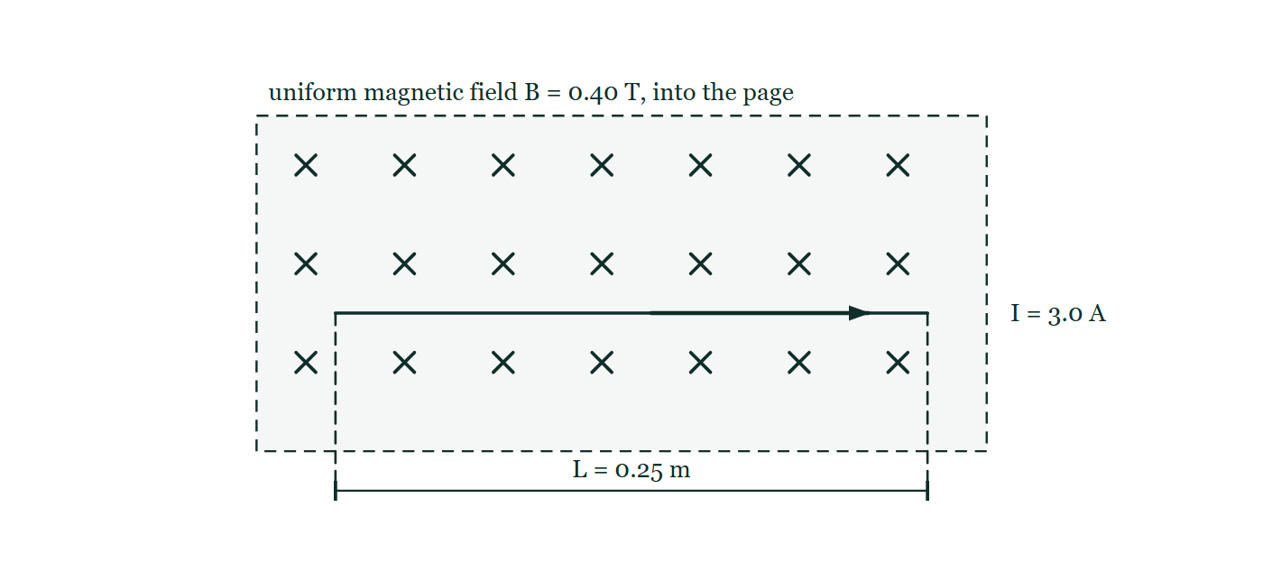
AP PHYSICS 2 · ALGEBRA-BASED
GIOPHYSICS PRACTICE PAPER
Question 4
Multiple choice
Algebra
Routine
1 mark
Syllabus 12 · SP2
A straight wire of length 0.25 m carries a current of 3.0 A at right angles to a uniform magnetic field of magnitude 0.40 T. What is the magnitude of the magnetic force on the wire?
Figure 1 — A rectangular region of uniform magnetic field is shown by a grid of small crosses, marking a field of magnitude 0.40 T directed into the page. A straight wire lies horizontally across the region, in the plane of the page and therefore at right angles to the field, and an arrow drawn along the wire shows the conventional current of 3.0 A flowing to the right. A dimension line below the region, with projection lines dropped from each end of the wire, marks the length of wire lying in the field as L = 0.25 m. No force is shown.
A
0.030 N
B
0.30 N
C
3.0 N
D
4.8 N
AP Physics — AP Physics 2 · Algebra-Based. Written by GioPhysics from College Board AP Physics course and exam descriptions; not an awarding body's document.
8 / 29
Notes:
[Demand] Routine — The standard application — the named equation, the usual graph read.
[Figure] Figure 1. A rectangular region of uniform magnetic field is shown by a grid of small crosses, marking a field of magnitude 0.40 T directed into the page. A straight wire lies horizontally across the region, in the plane of the page and therefore at right angles to the field, and an arrow drawn along the wire shows the conventional current of 3.0 A flowing to the right. A dimension line below the region, with projection lines dropped from each end of the wire, marks the length of wire lying in the field as L = 0.25 m. No force is shown.

Slide 9
AP PHYSICS 2 · ALGEBRA-BASED
GIOPHYSICS PRACTICE PAPER
Answer 4
Multiple choice
Algebra
Routine
1 mark
Mark scheme
B
0.30 N
Why the other three are there
F = BIL = 0.40 × 3.0 × 0.25 = 0.30 N. A and C are decimal-place slips of the kind that survive on an exam where no working is seen, which is why the item is worth doing carefully rather than quickly. D multiplies all three numbers and then adds the field again.
AP Physics — AP Physics 2 · Algebra-Based. Written by GioPhysics from College Board AP Physics course and exam descriptions; not an awarding body's document.
9 / 29
Notes:
[Answer] B — 0.30 N
[Distractors] F = BIL = 0.40 × 3.0 × 0.25 = 0.30 N. A and C are decimal-place slips of the kind that survive on an exam where no working is seen, which is why the item is worth doing carefully rather than quickly. D multiplies all three numbers and then adds the field again.
[Figure] Figure 1. A rectangular region of uniform magnetic field is shown by a grid of small crosses, marking a field of magnitude 0.40 T directed into the page. A straight wire lies horizontally across the region, in the plane of the page and therefore at right angles to the field, and an arrow drawn along the wire shows the conventional current of 3.0 A flowing to the right. A dimension line below the region, with projection lines dropped from each end of the wire, marks the length of wire lying in the field as L = 0.25 m. No force is shown.

Slide 10
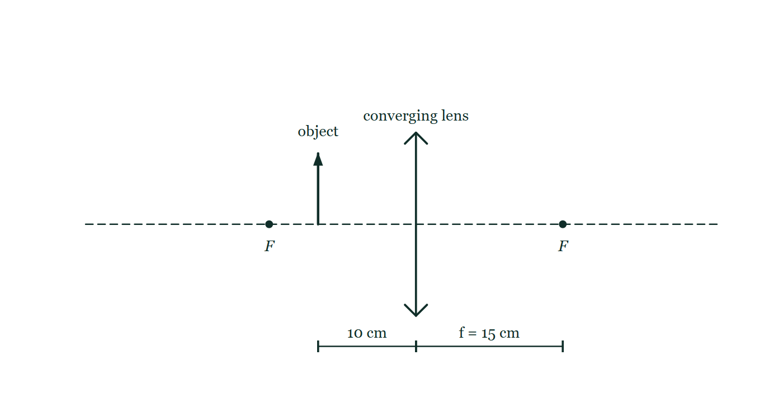
AP PHYSICS 2 · ALGEBRA-BASED
GIOPHYSICS PRACTICE PAPER
Question 5
Multiple choice
Algebra
Demanding
1 mark
Syllabus 13 · SP2
An object is placed 10 cm in front of a converging lens of focal length 15 cm. Which describes the image?
Figure 2 — A converging lens, drawn as a vertical line with outward-pointing arrowheads at each end, stands on a horizontal dashed principal axis. A focal point F is marked by a dot on the axis on each side of the lens, and the distance from the centre of the lens to the focal point on the far side is labelled f = 15 cm. A short upright arrow labelled "object" stands on the axis on the near side, and the distance from it to the centre of the lens is marked 10 cm, so the object lies between the focal point and the lens. No construction rays and no image are drawn.
A
real, inverted, and 30 cm from the lens
B
real, inverted, and 6.0 cm from the lens
C
virtual, upright, and 30 cm from the lens
D
virtual, upright, and 6.0 cm from the lens
AP Physics — AP Physics 2 · Algebra-Based. Written by GioPhysics from College Board AP Physics course and exam descriptions; not an awarding body's document.
10 / 29
Notes:
[Demand] Demanding — Several steps, and you have to choose them. Nothing says which comes first.
[Figure] Figure 2. A converging lens, drawn as a vertical line with outward-pointing arrowheads at each end, stands on a horizontal dashed principal axis. A focal point F is marked by a dot on the axis on each side of the lens, and the distance from the centre of the lens to the focal point on the far side is labelled f = 15 cm. A short upright arrow labelled "object" stands on the axis on the near side, and the distance from it to the centre of the lens is marked 10 cm, so the object lies between the focal point and the lens. No construction rays and no image are drawn.

Slide 11
AP PHYSICS 2 · ALGEBRA-BASED
GIOPHYSICS PRACTICE PAPER
Answer 5
Multiple choice
Algebra
Demanding
1 mark
Mark scheme
C
virtual, upright, and 30 cm from the lens
Why the other three are there
The object is inside the focal length, so the image must be virtual and upright — a candidate who checks that first can discard A and B without calculating. Solving 1/v = 1/15 − 1/10 gives v = −30 cm, and the negative sign is the confirmation, not an error.
AP Physics — AP Physics 2 · Algebra-Based. Written by GioPhysics from College Board AP Physics course and exam descriptions; not an awarding body's document.
11 / 29
Notes:
[Answer] C — virtual, upright, and 30 cm from the lens
[Distractors] The object is inside the focal length, so the image must be virtual and upright — a candidate who checks that first can discard A and B without calculating. Solving 1/v = 1/15 − 1/10 gives v = −30 cm, and the negative sign is the confirmation, not an error.
[Figure] Figure 2. A converging lens, drawn as a vertical line with outward-pointing arrowheads at each end, stands on a horizontal dashed principal axis. A focal point F is marked by a dot on the axis on each side of the lens, and the distance from the centre of the lens to the focal point on the far side is labelled f = 15 cm. A short upright arrow labelled "object" stands on the axis on the near side, and the distance from it to the centre of the lens is marked 10 cm, so the object lies between the focal point and the lens. No construction rays and no image are drawn.

Slide 12
AP PHYSICS 2 · ALGEBRA-BASED
GIOPHYSICS PRACTICE PAPER
Question 6
Multiple choice
Algebra
Routine
1 mark
Syllabus 15 · SP2
A nucleus of ²³⁸₉₂U decays to ²³⁴₉₀Th. What particle is emitted?
A
an alpha particle
B
a beta-minus particle
C
a beta-plus particle
D
a gamma photon
AP Physics — AP Physics 2 · Algebra-Based. Written by GioPhysics from College Board AP Physics course and exam descriptions; not an awarding body's document.
12 / 29
Notes:
[Demand] Routine — The standard application — the named equation, the usual graph read.

Slide 13
AP PHYSICS 2 · ALGEBRA-BASED
GIOPHYSICS PRACTICE PAPER
Answer 6
Multiple choice
Algebra
Routine
1 mark
Mark scheme
A
an alpha particle
Why the other three are there
The mass number falls by 4 and the atomic number by 2, which only an alpha particle can do. D leaves both numbers unchanged.
AP Physics — AP Physics 2 · Algebra-Based. Written by GioPhysics from College Board AP Physics course and exam descriptions; not an awarding body's document.
13 / 29
Notes:
[Answer] A — an alpha particle
[Distractors] The mass number falls by 4 and the atomic number by 2, which only an alpha particle can do. D leaves both numbers unchanged.

Slide 14
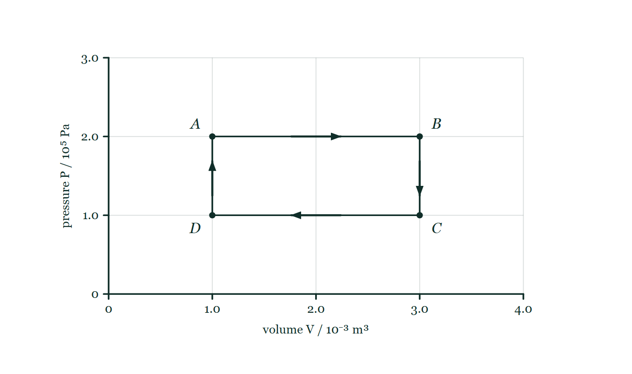
AP PHYSICS 2 · ALGEBRA-BASED
GIOPHYSICS PRACTICE PAPER
Question 7
Free response
Algebra
Demanding
12 marks
Mathematical Routines · Syllabus 9
A fixed quantity of a monatomic ideal gas is taken around the closed cycle A → B → C → D → A. State A is at pressure 2.0 × 10⁵ Pa and volume 1.0 × 10⁻³ m³. The gas expands at constant pressure to state B at 3.0 × 10⁻³ m³. It is then cooled at constant volume to state C at 1.0 × 10⁵ Pa. It is compressed at constant pressure to state D at 1.0 × 10⁻³ m³, and finally warmed at constant volume back to state A.
Figure 3 — A pressure-volume graph with a faint grid. The horizontal axis is volume V in units of 10⁻³ m³, marked from 0 to 4.0; the vertical axis is pressure P in units of 10⁵ Pa, marked from 0 to 3.0. Four states are plotted as dots at the corners of a rectangle and labelled: A at V = 1.0 and P = 2.0, B at V = 3.0 and P = 2.0, C directly below B at P = 1.0, and D directly below A at P = 1.0. Straight lines join A to B to C to D and back to A, and an arrow on each side shows the order in which the gas is taken round the closed cycle.
AP Physics — AP Physics 2 · Algebra-Based. Written by GioPhysics from College Board AP Physics course and exam descriptions; not an awarding body's document.
14 / 29
Notes:
[Demand] Demanding — Several steps, and you have to choose them. Nothing says which comes first.
[Figure] Figure 3. A pressure-volume graph with a faint grid. The horizontal axis is volume V in units of 10⁻³ m³, marked from 0 to 4.0; the vertical axis is pressure P in units of 10⁵ Pa, marked from 0 to 3.0. Four states are plotted as dots at the corners of a rectangle and labelled: A at V = 1.0 and P = 2.0, B at V = 3.0 and P = 2.0, C directly below B at P = 1.0, and D directly below A at P = 1.0. Straight lines join A to B to C to D and back to A, and an arrow on each side shows the order in which the gas is taken round the closed cycle.

Slide 15
AP PHYSICS 2 · ALGEBRA-BASED
GIOPHYSICS PRACTICE PAPER
Question 7 (cont.)
Free response
Algebra
Demanding
12 marks
continued from the previous slide
(a) Calculate
2 marks
Calculate the work done by the gas during the process A → B.
(b) Determine
4 marks
Determine the change in internal energy of the gas during A → B, and hence the thermal energy added to the gas.
(c) Determine
3 marks
Determine the net work done by the gas in one complete cycle.
(d) Explain
3 marks
Explain why the change in internal energy of the gas over one complete cycle is zero, and state what this implies about the net thermal energy exchanged with the surroundings.
AP Physics — AP Physics 2 · Algebra-Based. Written by GioPhysics from College Board AP Physics course and exam descriptions; not an awarding body's document.
15 / 29
Notes:
[Demand] Demanding — Several steps, and you have to choose them. Nothing says which comes first.
[Figure] Figure 3. A pressure-volume graph with a faint grid. The horizontal axis is volume V in units of 10⁻³ m³, marked from 0 to 4.0; the vertical axis is pressure P in units of 10⁵ Pa, marked from 0 to 3.0. Four states are plotted as dots at the corners of a rectangle and labelled: A at V = 1.0 and P = 2.0, B at V = 3.0 and P = 2.0, C directly below B at P = 1.0, and D directly below A at P = 1.0. Straight lines join A to B to C to D and back to A, and an arrow on each side shows the order in which the gas is taken round the closed cycle.
[Reminder] Figure 3 is on the previous slide.

Slide 16
AP PHYSICS 2 · ALGEBRA-BASED
GIOPHYSICS PRACTICE PAPER
Answer 7
Free response
Algebra
Demanding
12 marks
Mark scheme
(a) Calculate — 2 marks
SP2
✓
1 point: W = PΔV for a constant-pressure process
✓
1 point: W = 2.0 × 10⁵ × 2.0 × 10⁻³ = 400 J, done by the gas
(b) Determine — 4 marks
SP2
✓
1 point: for a monatomic ideal gas ΔU = (3/2)nRΔT = (3/2)Δ(PV)
✓
1 point: Δ(PV) = 2.0 × 10⁵ (3.0 × 10⁻³ − 1.0 × 10⁻³) = 400 J, so ΔU = 600 J
✓
1 point: applies the first law, Q = ΔU + W_by
✓
1 point: Q = 600 + 400 = 1000 J added to the gas
(c) Determine — 3 marks
SP2
✓
1 point: net work is the area enclosed by the cycle on the PV diagram
✓
1 point: area = (2.0 × 10⁵ − 1.0 × 10⁵)(3.0 × 10⁻³ − 1.0 × 10⁻³)
✓
1 point: net work = 200 J, done by the gas because the cycle is traversed clockwise
(d) Explain — 3 marks
SP3
✓
1 point: internal energy is a function of state and depends only on the temperature
✓
1 point: the gas returns to state A, so its temperature — and hence its internal energy — is the same as at the start, giving ΔU = 0 for the cycle
✓
1 point: by the first law the net thermal energy added must equal the net work done by the gas, 200 J
AP Physics — AP Physics 2 · Algebra-Based. Written by GioPhysics from College Board AP Physics course and exam descriptions; not an awarding body's document.
16 / 29
Notes:
[Marking] One line per mark, awarded independently unless a point says otherwise.
[Figure] Figure 3. A pressure-volume graph with a faint grid. The horizontal axis is volume V in units of 10⁻³ m³, marked from 0 to 4.0; the vertical axis is pressure P in units of 10⁵ Pa, marked from 0 to 3.0. Four states are plotted as dots at the corners of a rectangle and labelled: A at V = 1.0 and P = 2.0, B at V = 3.0 and P = 2.0, C directly below B at P = 1.0, and D directly below A at P = 1.0. Straight lines join A to B to C to D and back to A, and an arrow on each side shows the order in which the gas is taken round the closed cycle.

Slide 17
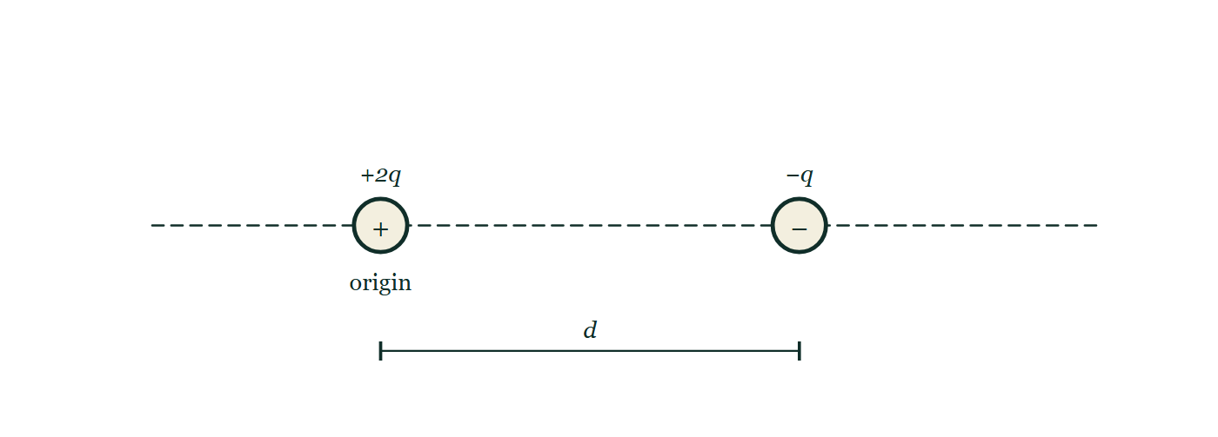
AP PHYSICS 2 · ALGEBRA-BASED
GIOPHYSICS PRACTICE PAPER
Question 8
Free response
Algebra
Demanding
12 marks
Translation Between Representations · Syllabus 10
Two point charges are fixed on a horizontal line: a charge +2q at the origin, and a charge −q at a distance d to the right of it.
Figure 4 — Two point charges rest on a long horizontal dashed line that extends well beyond both of them. On the left, at a point labelled "origin", is a circle containing a plus sign, labelled +2q. A distance to the right of it is a circle containing a minus sign, labelled −q, and that separation is marked d by a dimension line drawn between the two centres below the charges. Nothing else is marked anywhere on the line, in either direction.
(a) Sketch
3 marks
Sketch the electric field lines in the region around the two charges. Indicate the direction of each line with an arrow.
AP Physics — AP Physics 2 · Algebra-Based. Written by GioPhysics from College Board AP Physics course and exam descriptions; not an awarding body's document.
17 / 29
Notes:
[Demand] Demanding — Several steps, and you have to choose them. Nothing says which comes first.
[Figure] Figure 4. Two point charges rest on a long horizontal dashed line that extends well beyond both of them. On the left, at a point labelled "origin", is a circle containing a plus sign, labelled +2q. A distance to the right of it is a circle containing a minus sign, labelled −q, and that separation is marked d by a dimension line drawn between the two centres below the charges. Nothing else is marked anywhere on the line, in either direction.

Slide 18
AP PHYSICS 2 · ALGEBRA-BASED
GIOPHYSICS PRACTICE PAPER
Question 8 (cont.)
Free response
Algebra
Demanding
12 marks
continued from the previous slide
(b) Determine
4 marks
Determine the location on the line through the two charges at which the net electric field is zero. Indicate whether it lies to the left of +2q, between the charges, or to the right of −q, and justify that region before calculating.
(c) Determine
3 marks
Determine whether there is a point on the line between the two charges at which the electric potential is zero, and if so, where.
(d) Explain
2 marks
Explain why the point where the field is zero and the point where the potential is zero are in different places.
AP Physics — AP Physics 2 · Algebra-Based. Written by GioPhysics from College Board AP Physics course and exam descriptions; not an awarding body's document.
18 / 29
Notes:
[Demand] Demanding — Several steps, and you have to choose them. Nothing says which comes first.
[Figure] Figure 4. Two point charges rest on a long horizontal dashed line that extends well beyond both of them. On the left, at a point labelled "origin", is a circle containing a plus sign, labelled +2q. A distance to the right of it is a circle containing a minus sign, labelled −q, and that separation is marked d by a dimension line drawn between the two centres below the charges. Nothing else is marked anywhere on the line, in either direction.
[Reminder] Figure 4 is on the previous slide.

Slide 19
AP PHYSICS 2 · ALGEBRA-BASED
GIOPHYSICS PRACTICE PAPER
Answer 8
Free response
Algebra
Demanding
12 marks
Mark scheme
(a) Sketch — 3 marks
SP1
✓
1 point: lines begin on the positive charge and end on the negative charge, with arrows pointing away from +2q and towards −q
✓
1 point: twice as many lines leave +2q as arrive at −q, with the surplus continuing outward to large distances
✓
1 point: lines meet both charges radially and never cross one another
(b) Determine — 4 marks
SP2
✓
1 point: the null point must lie beyond the smaller charge, to the right of −q, because only there do the two fields oppose and the weaker charge is closer
✓
1 point: sets k(2q)/(d + x)² = kq/x², where x is measured from −q
✓
1 point: 2x² = (d + x)², so x√2 = d + x
✓
1 point: x = d/(√2 − 1) = 2.4d to the right of −q
Choosing the region before calculating is worth a point in its own right. A candidate who sets up the equation between the charges finds no physical solution and loses the whole part.
(c) Determine — 3 marks
SP2
✓
1 point: potentials are scalars, so a zero requires k(2q)/r₁ = kq/r₂ with r₁ + r₂ = d
✓
1 point: 2r₂ = r₁, so r₂ = d/3
✓
1 point: the potential is zero at a distance d/3 to the left of −q (that is, 2d/3 from +2q)
AP Physics — AP Physics 2 · Algebra-Based. Written by GioPhysics from College Board AP Physics course and exam descriptions; not an awarding body's document.
19 / 29
Notes:
[Marking] One line per mark, awarded independently unless a point says otherwise.
[Examiner note (b)] Choosing the region before calculating is worth a point in its own right. A candidate who sets up the equation between the charges finds no physical solution and loses the whole part.
[Figure] Figure 4. Two point charges rest on a long horizontal dashed line that extends well beyond both of them. On the left, at a point labelled "origin", is a circle containing a plus sign, labelled +2q. A distance to the right of it is a circle containing a minus sign, labelled −q, and that separation is marked d by a dimension line drawn between the two centres below the charges. Nothing else is marked anywhere on the line, in either direction.

Slide 20
AP PHYSICS 2 · ALGEBRA-BASED
GIOPHYSICS PRACTICE PAPER
Answer 8 (cont.)
Free response
Algebra
Demanding
12 marks
Mark scheme, continued
(d) Explain — 2 marks
SP3
✓
1 point: the field is a vector sum, so it vanishes where two contributions are equal in magnitude and opposite in direction — which can only happen outside the pair
✓
1 point: the potential is a scalar sum, so it vanishes where two contributions of opposite sign are equal in magnitude, which happens between the charges; the two conditions are different, so the points differ
AP Physics — AP Physics 2 · Algebra-Based. Written by GioPhysics from College Board AP Physics course and exam descriptions; not an awarding body's document.
20 / 29
Notes:
[Marking] One line per mark, awarded independently unless a point says otherwise.
[Examiner note (b)] Choosing the region before calculating is worth a point in its own right. A candidate who sets up the equation between the charges finds no physical solution and loses the whole part.
[Figure] Figure 4. Two point charges rest on a long horizontal dashed line that extends well beyond both of them. On the left, at a point labelled "origin", is a circle containing a plus sign, labelled +2q. A distance to the right of it is a circle containing a minus sign, labelled −q, and that separation is marked d by a dimension line drawn between the two centres below the charges. Nothing else is marked anywhere on the line, in either direction.

Slide 21
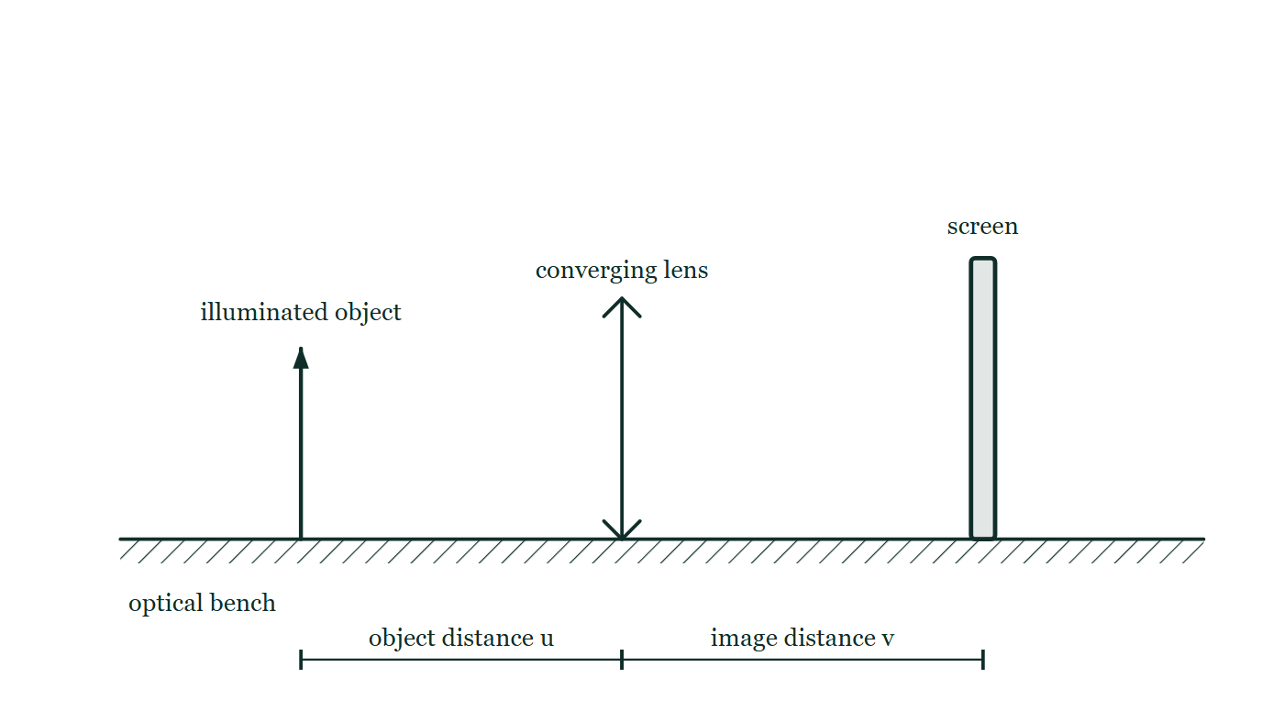
AP PHYSICS 2 · ALGEBRA-BASED
GIOPHYSICS PRACTICE PAPER
Question 9
Free response
Algebra
Discriminating
12 marks
Experimental Design and Analysis · Syllabus 13
A student is given a converging lens of unknown focal length, an illuminated object, a screen, an optical bench and a meter stick. The student measures the object distance u and the corresponding image distance v for several positions of the lens.
The student's measurements
u / cm | 20.0 | 25.0 | 30.0 | 40.0 | 50.0
v / cm | 60.0 | 37.5 | 30.0 | 24.0 | 21.4
1/u / cm⁻¹ | 0.0500 | 0.0400 | 0.0333 | 0.0250 | 0.0200
1/v / cm⁻¹ | 0.0167 | 0.0267 | 0.0333 | 0.0417 | 0.0467
Figure 5 — An elevation view of an optical bench, drawn as a hatched horizontal rail labelled as carrying a metre scale. Standing on the rail, from left to right, are an illuminated object shown as an upright arrow, a converging lens drawn as a vertical line with outward-pointing arrowheads at each end, and a flat screen shown as a narrow upright board. Two dimension lines below the bench measure the object distance u, from the object to the centre of the lens, and the image distance v, from the centre of the lens to the screen.
AP Physics — AP Physics 2 · Algebra-Based. Written by GioPhysics from College Board AP Physics course and exam descriptions; not an awarding body's document.
21 / 29
Notes:
[Demand] Discriminating — The part that separates the top grade: an unfamiliar context, a derivation, or an argument that has to hold together to earn anything.
[Figure] Figure 5. An elevation view of an optical bench, drawn as a hatched horizontal rail labelled as carrying a metre scale. Standing on the rail, from left to right, are an illuminated object shown as an upright arrow, a converging lens drawn as a vertical line with outward-pointing arrowheads at each end, and a flat screen shown as a narrow upright board. Two dimension lines below the bench measure the object distance u, from the object to the centre of the lens, and the image distance v, from the centre of the lens to the screen.

Slide 22
AP PHYSICS 2 · ALGEBRA-BASED
GIOPHYSICS PRACTICE PAPER
Question 9 (cont.)
Free response
Algebra
Discriminating
12 marks
continued from the previous slide
(a) Describe
3 marks
Describe how the student should obtain each value of v so that the measurement is as accurate as possible.
(b) Describe
4 marks
The thin lens equation is 1/u + 1/v = 1/f. Describe how the student should plot the data to obtain a straight line, and state what the slope and the intercepts of that line represent.
(c) Determine
3 marks
Use the data to determine the focal length of the lens.
(d) Explain
2 marks
The student notices that the point at u = 20.0 cm lies slightly further from the best-fit line than the others. Explain why the measurement of v is least precise for small object distances, and describe one change that would improve it.
AP Physics — AP Physics 2 · Algebra-Based. Written by GioPhysics from College Board AP Physics course and exam descriptions; not an awarding body's document.
22 / 29
Notes:
[Demand] Discriminating — The part that separates the top grade: an unfamiliar context, a derivation, or an argument that has to hold together to earn anything.
[Figure] Figure 5. An elevation view of an optical bench, drawn as a hatched horizontal rail labelled as carrying a metre scale. Standing on the rail, from left to right, are an illuminated object shown as an upright arrow, a converging lens drawn as a vertical line with outward-pointing arrowheads at each end, and a flat screen shown as a narrow upright board. Two dimension lines below the bench measure the object distance u, from the object to the centre of the lens, and the image distance v, from the centre of the lens to the screen.
[Reminder] Figure 5 is on the previous slide.

Slide 23
AP PHYSICS 2 · ALGEBRA-BASED
GIOPHYSICS PRACTICE PAPER
Answer 9
Free response
Algebra
Discriminating
12 marks
Mark scheme
(a) Describe — 3 marks
SP4
✓
1 point: move the screen until the image of the object is as sharp as possible, then measure from the centre of the lens to the screen
✓
1 point: approach the sharpest position from both directions and take the midpoint of the range over which the image looks focused
✓
1 point: measure with the meter stick parallel to the bench and the eye directly above the scale, to avoid parallax
The second point is the one that separates a well-designed optics experiment from a rough one. The image looks acceptably sharp over a range of screen positions, and taking the middle of that range is what makes the reading reproducible.
(b) Describe — 4 marks
SP4
✓
1 point: plot 1/v on the vertical axis against 1/u on the horizontal axis
✓
1 point: rearranged, 1/v = −(1/u) + 1/f, which has the form y = mx + c
✓
1 point: the slope is −1
✓
1 point: both intercepts equal 1/f
(c) Determine — 3 marks
SP2
✓
1 point: adds 1/u and 1/v for any row — for example 0.0500 + 0.0167 = 0.0667 cm⁻¹
✓
1 point: confirms the sum is the same for every row, so 1/f = 0.0667 cm⁻¹
✓
1 point: f = 15.0 cm
AP Physics — AP Physics 2 · Algebra-Based. Written by GioPhysics from College Board AP Physics course and exam descriptions; not an awarding body's document.
23 / 29
Notes:
[Marking] One line per mark, awarded independently unless a point says otherwise.
[Examiner note (a)] The second point is the one that separates a well-designed optics experiment from a rough one. The image looks acceptably sharp over a range of screen positions, and taking the middle of that range is what makes the reading reproducible.
[Figure] Figure 5. An elevation view of an optical bench, drawn as a hatched horizontal rail labelled as carrying a metre scale. Standing on the rail, from left to right, are an illuminated object shown as an upright arrow, a converging lens drawn as a vertical line with outward-pointing arrowheads at each end, and a flat screen shown as a narrow upright board. Two dimension lines below the bench measure the object distance u, from the object to the centre of the lens, and the image distance v, from the centre of the lens to the screen.

Slide 24
AP PHYSICS 2 · ALGEBRA-BASED
GIOPHYSICS PRACTICE PAPER
Answer 9 (cont.)
Free response
Algebra
Discriminating
12 marks
Mark scheme, continued
(d) Explain — 2 marks
SP4
✓
1 point: at small u the image distance is large, the image is highly magnified and dim, and the range of screen positions over which it looks sharp is widest — so the uncertainty in v is greatest
✓
1 point: improvement — use a brighter object, work in a darkened room, or take repeated determinations of the sharpest position and average them
AP Physics — AP Physics 2 · Algebra-Based. Written by GioPhysics from College Board AP Physics course and exam descriptions; not an awarding body's document.
24 / 29
Notes:
[Marking] One line per mark, awarded independently unless a point says otherwise.
[Examiner note (a)] The second point is the one that separates a well-designed optics experiment from a rough one. The image looks acceptably sharp over a range of screen positions, and taking the middle of that range is what makes the reading reproducible.
[Figure] Figure 5. An elevation view of an optical bench, drawn as a hatched horizontal rail labelled as carrying a metre scale. Standing on the rail, from left to right, are an illuminated object shown as an upright arrow, a converging lens drawn as a vertical line with outward-pointing arrowheads at each end, and a flat screen shown as a narrow upright board. Two dimension lines below the bench measure the object distance u, from the object to the centre of the lens, and the image distance v, from the centre of the lens to the screen.

Slide 25
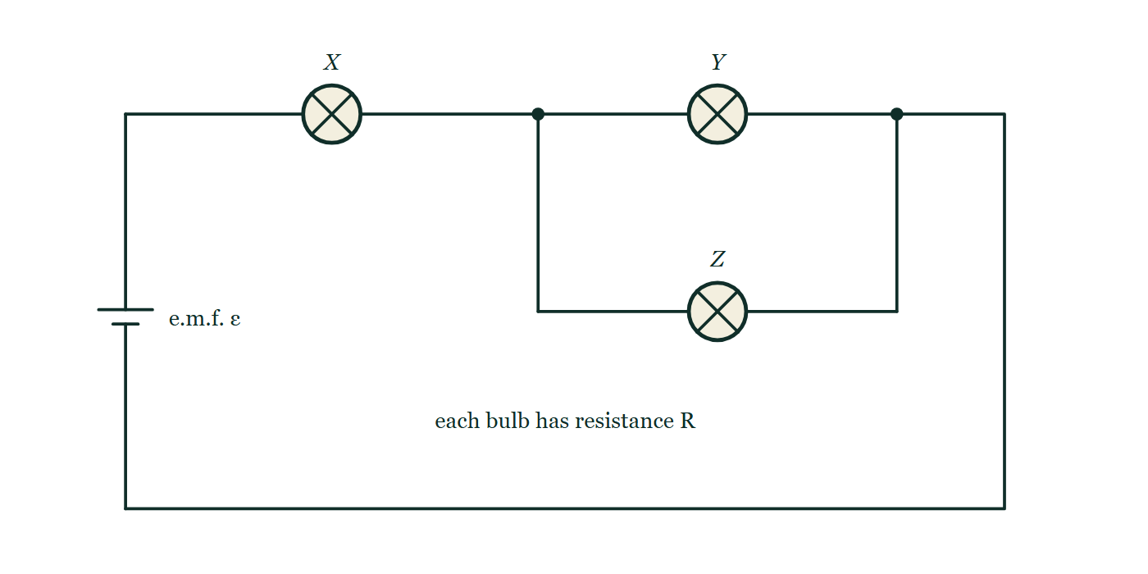
AP PHYSICS 2 · ALGEBRA-BASED
GIOPHYSICS PRACTICE PAPER
Question 10
Free response
Algebra
Discriminating
12 marks
Qualitative/Quantitative Translation · Syllabus 11
Three identical bulbs, each of resistance R, are connected to a battery of e.m.f. ε and negligible internal resistance. Bulb X is connected in series with a parallel combination of bulbs Y and Z. The brightness of a bulb is determined by the power it dissipates.
Figure 6 — A circuit diagram drawn as a rectangular loop. A cell of e.m.f. ε sits in the left-hand side of the loop. Following the wire from the cell along the top of the loop, it passes through bulb X and then reaches a junction dot where the circuit divides into two parallel branches: bulb Y lies on the upper branch, while a wire dropping from the junction carries bulb Z along a lower branch. The two branches rejoin at a second junction dot, after which a single wire runs down the right-hand side and back along the bottom to the cell. A note on the figure states that each bulb has resistance R.
AP Physics — AP Physics 2 · Algebra-Based. Written by GioPhysics from College Board AP Physics course and exam descriptions; not an awarding body's document.
25 / 29
Notes:
[Demand] Discriminating — The part that separates the top grade: an unfamiliar context, a derivation, or an argument that has to hold together to earn anything.
[Figure] Figure 6. A circuit diagram drawn as a rectangular loop. A cell of e.m.f. ε sits in the left-hand side of the loop. Following the wire from the cell along the top of the loop, it passes through bulb X and then reaches a junction dot where the circuit divides into two parallel branches: bulb Y lies on the upper branch, while a wire dropping from the junction carries bulb Z along a lower branch. The two branches rejoin at a second junction dot, after which a single wire runs down the right-hand side and back along the bottom to the cell. A note on the figure states that each bulb has resistance R.

Slide 26
AP PHYSICS 2 · ALGEBRA-BASED
GIOPHYSICS PRACTICE PAPER
Question 10 (cont.)
Free response
Algebra
Discriminating
12 marks
continued from the previous slide
(a) Indicate
1 mark
Indicate which bulb or bulbs are brightest in the original circuit. No justification is required in this part.
(b) Derive
4 marks
Derive expressions for the power dissipated by bulb X and by bulb Y in the original circuit, in terms of ε and R.
(c) Determine
3 marks
Bulb Z now burns out, breaking its branch of the circuit. Determine the new power dissipated by bulb X, and state whether X becomes brighter, dimmer, or stays the same.
(d) Explain
4 marks
Explain, without using equations, why bulb X becomes dimmer while bulb Y becomes brighter when bulb Z burns out.
AP Physics — AP Physics 2 · Algebra-Based. Written by GioPhysics from College Board AP Physics course and exam descriptions; not an awarding body's document.
26 / 29
Notes:
[Demand] Discriminating — The part that separates the top grade: an unfamiliar context, a derivation, or an argument that has to hold together to earn anything.
[Figure] Figure 6. A circuit diagram drawn as a rectangular loop. A cell of e.m.f. ε sits in the left-hand side of the loop. Following the wire from the cell along the top of the loop, it passes through bulb X and then reaches a junction dot where the circuit divides into two parallel branches: bulb Y lies on the upper branch, while a wire dropping from the junction carries bulb Z along a lower branch. The two branches rejoin at a second junction dot, after which a single wire runs down the right-hand side and back along the bottom to the cell. A note on the figure states that each bulb has resistance R.
[Reminder] Figure 6 is on the previous slide.

Slide 27
AP PHYSICS 2 · ALGEBRA-BASED
GIOPHYSICS PRACTICE PAPER
Answer 10
Free response
Algebra
Discriminating
12 marks
Mark scheme
(a) Indicate — 1 mark
SP3
✓
1 point: bulb X
(b) Derive — 4 marks
SP2
✓
1 point: parallel pair has resistance R/2, so the total resistance is 3R/2
✓
1 point: current through X is I = ε/(3R/2) = 2ε/(3R)
✓
1 point: P_X = I²R = 4ε²/(9R)
✓
1 point: current through Y is half of I, so P_Y = (ε/(3R))²R = ε²/(9R)
(c) Determine — 3 marks
SP2
✓
1 point: with Z's branch broken, X and Y are in series and the total resistance is 2R
✓
1 point: I = ε/(2R), so P_X = ε²/(4R)
✓
1 point: ε²/(4R) is less than 4ε²/(9R), so X becomes dimmer
AP Physics — AP Physics 2 · Algebra-Based. Written by GioPhysics from College Board AP Physics course and exam descriptions; not an awarding body's document.
27 / 29
Notes:
[Marking] One line per mark, awarded independently unless a point says otherwise.
[Examiner note (d)] The final point is the one this task type exists to test. Both effects work against each other, and a candidate has to see that the increase from carrying the full current outweighs the decrease in the total current.
[Figure] Figure 6. A circuit diagram drawn as a rectangular loop. A cell of e.m.f. ε sits in the left-hand side of the loop. Following the wire from the cell along the top of the loop, it passes through bulb X and then reaches a junction dot where the circuit divides into two parallel branches: bulb Y lies on the upper branch, while a wire dropping from the junction carries bulb Z along a lower branch. The two branches rejoin at a second junction dot, after which a single wire runs down the right-hand side and back along the bottom to the cell. A note on the figure states that each bulb has resistance R.

Slide 28
AP PHYSICS 2 · ALGEBRA-BASED
GIOPHYSICS PRACTICE PAPER
Answer 10 (cont.)
Free response
Algebra
Discriminating
12 marks
Mark scheme, continued
(d) Explain — 4 marks
SP3
✓
1 point: removing one of two parallel branches raises the resistance of that section, and so raises the total resistance of the circuit
✓
1 point: a higher total resistance means a smaller current from the battery, and bulb X carries the whole of that current, so X dissipates less power and dims
✓
1 point: bulb Y previously carried only half of the current through X, because the current divided between two identical branches
✓
1 point: now Y carries all of the current, and although that total current is smaller than before, it is larger than the half-share Y used to have — so Y brightens
The final point is the one this task type exists to test. Both effects work against each other, and a candidate has to see that the increase from carrying the full current outweighs the decrease in the total current.
AP Physics — AP Physics 2 · Algebra-Based. Written by GioPhysics from College Board AP Physics course and exam descriptions; not an awarding body's document.
28 / 29
Notes:
[Marking] One line per mark, awarded independently unless a point says otherwise.
[Examiner note (d)] The final point is the one this task type exists to test. Both effects work against each other, and a candidate has to see that the increase from carrying the full current outweighs the decrease in the total current.
[Figure] Figure 6. A circuit diagram drawn as a rectangular loop. A cell of e.m.f. ε sits in the left-hand side of the loop. Following the wire from the cell along the top of the loop, it passes through bulb X and then reaches a junction dot where the circuit divides into two parallel branches: bulb Y lies on the upper branch, while a wire dropping from the junction carries bulb Z along a lower branch. The two branches rejoin at a second junction dot, after which a single wire runs down the right-hand side and back along the bottom to the cell. A note on the figure states that each bulb has resistance R.

Slide 29
AP PHYSICS 2 · ALGEBRA-BASED
GIOPHYSICS PRACTICE PAPER
Command words
AP Physics — the board's own definitions
Calculate
Justify
Perform mathematical steps to arrive at a final answer, including an algebraic expression, correctly substituted numbers, and units.
Provide evidence to support or defend a claim, and reasoning to explain how that evidence supports the claim.
Derive
Sketch
Perform a series of mathematical steps from a fundamental law or relationship to arrive at the desired result.
Draw a shape or trend line, without requiring exact plotted values.
Describe
Provide the relevant characteristics of a specified topic.
Determine
Arrive at a conclusion after reasoning, observation, or applying mathematical routines.
Explain
Provide information about how or why a relationship, situation or outcome occurs, using evidence and reasoning.
Indicate
Select the correct option from those provided, before giving any reasoning that is asked for.
AP Physics — AP Physics 2 · Algebra-Based. Written by GioPhysics from College Board AP Physics course and exam descriptions; not an awarding body's document.
29 / 29
Notes:
[Objectives] SP1 Creating representations: Describe, create and use models, diagrams, graphs and free-body diagrams to represent a physical situation. SP2 Mathematical routines: Determine and apply mathematical relationships, working symbolically before substituting, and check the reasonableness of a result. SP3 Scientific questioning and argumentation: Make and justify a claim with evidence and reasoning, and evaluate the claims and reasoning of others. SP4 Experimental method and data analysis: Design an experimental procedure, identify and control variables, analyse data including linearisation, and evaluate sources of error.
[Source] College Board AP Physics course and exam descriptions — https://apcentral.collegeboard.org/courses
[Disclaimer] Written by GioPhysics from the published course frameworks. These are practice exams in the style of AP Physics; they are not College Board materials, contain no released exam questions, and the official course and exam descriptions remain the authority. AP is a trademark of the College Board, which is not affiliated with and does not endorse GioPhysics.

