Slide 1
AP PHYSICS C · ELECTRICITY AND MAGNETISM
GIOPHYSICS PRACTICE PAPER
AP · College Board AP Physics · frameworks first examined in 2025
AP Physics C · Electricity and Magnetism
Calculus-based electromagnetism: charge and Gauss's law, electric potential, conductors and capacitors, circuits including RC transients, magnetic fields and Ampère's law, and electromagnetic induction.
MIRRORS
Section I (single-select multiple choice) and Section II (four free-response task types)
MARKS
62 in total — all Calculus
TIME
70 minutes · 10 questions
DEMAND
Routine 2 · Demanding 6 · Discriminating 2
SYLLABUS
8, 9, 10, 11, 12, 13
Written by GioPhysics from the published course frameworks. These are practice exams in the style of AP Physics; they are not College Board materials, contain no released exam questions, and the official course and exam descriptions remain the authority. AP is a trademark of the College Board, which is not affiliated with and does not endorse GioPhysics.
AP Physics — AP Physics C · Electricity and Magnetism. Written by GioPhysics from College Board AP Physics course and exam descriptions; not an awarding body's document.
1 / 29
Notes:
[Format] Every AP Physics exam has two sections of equal weight. Section I is single-select multiple choice with four options and no penalty for a wrong answer. Section II is free response, scored in points, and every question is built on one of four published task types. A table of equations and a table of constants are supplied for both sections, so nothing on an AP exam tests whether you can recall a formula.
[Demand] Written to the standard the free-response rubrics actually apply. A numerical answer that appears without the symbolic expression behind it earns partial credit at best; a claim without reasoning earns nothing at all, however correct the claim is. The C courses are set at calculus level throughout — moments of inertia by integration, drag and RC problems as differential equations — because that is what separates them from Physics 1 and 2.
[Source] College Board AP Physics course and exam descriptions — https://apcentral.collegeboard.org/courses
[Disclaimer] Written by GioPhysics from the published course frameworks. These are practice exams in the style of AP Physics; they are not College Board materials, contain no released exam questions, and the official course and exam descriptions remain the authority. AP is a trademark of the College Board, which is not affiliated with and does not endorse GioPhysics.

Slide 2
AP PHYSICS C · ELECTRICITY AND MAGNETISM
GIOPHYSICS PRACTICE PAPER
Question 1
Multiple choice
Calculus
Demanding
1 mark
Syllabus 8 · SP2
A solid conducting sphere of radius R carries a total charge Q distributed on its surface. What is the magnitude of the electric field at a distance r from the centre, where r < R?
A
zero
B
Qr/(4πε₀R³)
C
Q/(4πε₀r²)
D
Q/(4πε₀R²)
AP Physics — AP Physics C · Electricity and Magnetism. Written by GioPhysics from College Board AP Physics course and exam descriptions; not an awarding body's document.
2 / 29
Notes:
[Demand] Demanding — Several steps, and you have to choose them. Nothing says which comes first.

Slide 3
AP PHYSICS C · ELECTRICITY AND MAGNETISM
GIOPHYSICS PRACTICE PAPER
Answer 1
Multiple choice
Calculus
Demanding
1 mark
Mark scheme
A
zero
Why the other three are there
B is the field inside a uniformly charged insulating sphere and is the trap: the word conducting is what decides the answer. A Gaussian surface inside a conductor in electrostatic equilibrium encloses no charge, so the field is zero.
AP Physics — AP Physics C · Electricity and Magnetism. Written by GioPhysics from College Board AP Physics course and exam descriptions; not an awarding body's document.
3 / 29
Notes:
[Answer] A — zero
[Distractors] B is the field inside a uniformly charged insulating sphere and is the trap: the word conducting is what decides the answer. A Gaussian surface inside a conductor in electrostatic equilibrium encloses no charge, so the field is zero.

Slide 4
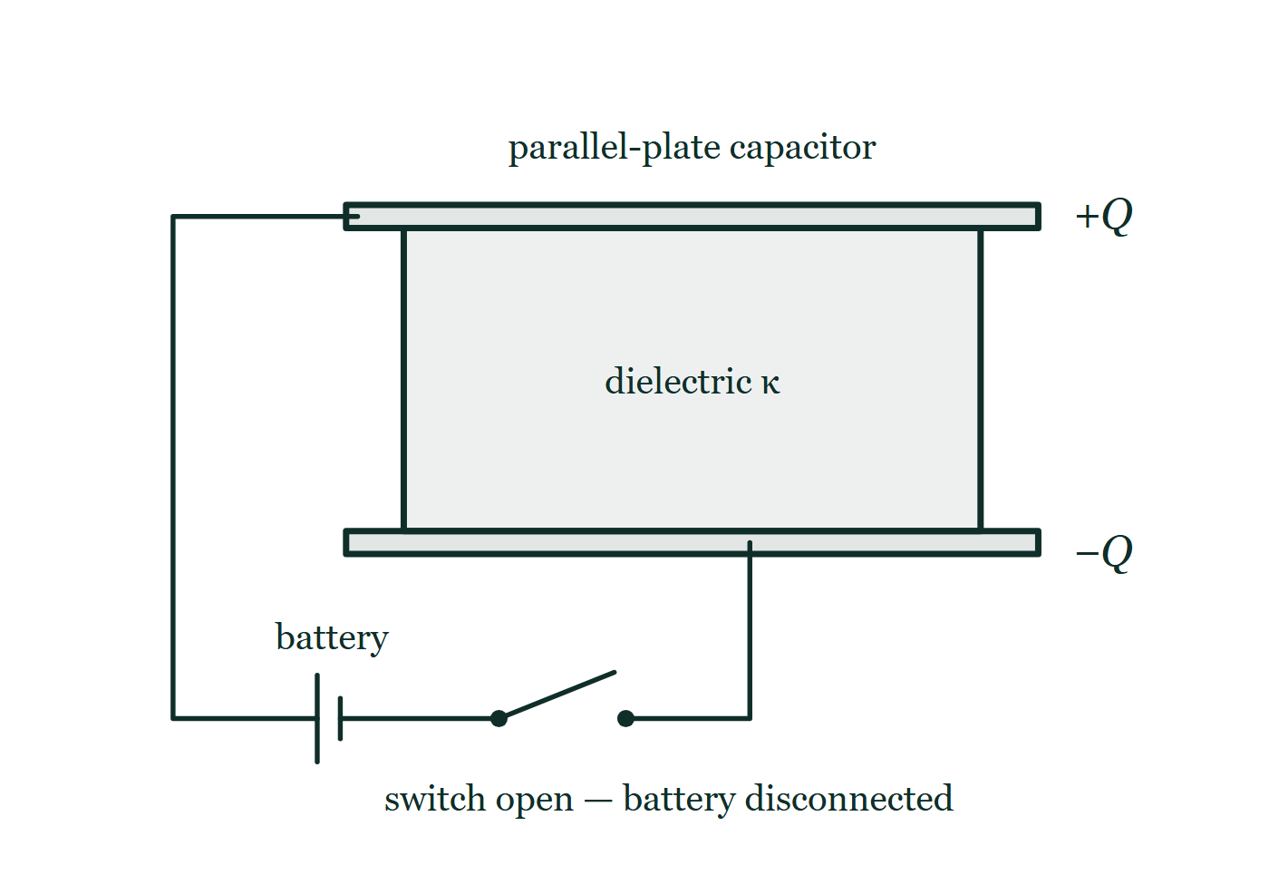
AP PHYSICS C · ELECTRICITY AND MAGNETISM
GIOPHYSICS PRACTICE PAPER
Question 2
Multiple choice
Calculus
Demanding
1 mark
Syllabus 10 · SP3
A parallel-plate capacitor is charged by a battery and the battery is then disconnected. A dielectric slab of dielectric constant κ > 1 is inserted, filling the space between the plates. What happens to the charge on the plates and to the potential difference across them?
Fig. 2.1 — Two long horizontal plates, one directly above the other, form a parallel-plate capacitor; the upper plate is marked +Q at its right-hand end and the lower plate is marked -Q. A lightly shaded slab labelled "dielectric" with the constant k fills the whole space between the plates. A wire leaves the left-hand end of the upper plate, runs left and then down, passes through a battery and then an open switch along the bottom of the figure, and rises again to meet the underside of the lower plate. The switch is drawn open and labelled to show that the battery has been disconnected.
A
charge unchanged, potential difference decreases
B
charge unchanged, potential difference increases
C
charge increases, potential difference unchanged
D
charge decreases, potential difference unchanged
AP Physics — AP Physics C · Electricity and Magnetism. Written by GioPhysics from College Board AP Physics course and exam descriptions; not an awarding body's document.
4 / 29
Notes:
[Demand] Demanding — Several steps, and you have to choose them. Nothing says which comes first.
[Figure] Fig. 2.1. Two long horizontal plates, one directly above the other, form a parallel-plate capacitor; the upper plate is marked +Q at its right-hand end and the lower plate is marked -Q. A lightly shaded slab labelled "dielectric" with the constant k fills the whole space between the plates. A wire leaves the left-hand end of the upper plate, runs left and then down, passes through a battery and then an open switch along the bottom of the figure, and rises again to meet the underside of the lower plate. The switch is drawn open and labelled to show that the battery has been disconnected.

Slide 5
AP PHYSICS C · ELECTRICITY AND MAGNETISM
GIOPHYSICS PRACTICE PAPER
Answer 2
Multiple choice
Calculus
Demanding
1 mark
Mark scheme
A
charge unchanged, potential difference decreases
Why the other three are there
C is the correct answer to the same question with the battery still connected, and telling the two cases apart is the entire item. With the battery removed the charge has nowhere to go, so Q is fixed; C rises by κ, and V = Q/C therefore falls.
AP Physics — AP Physics C · Electricity and Magnetism. Written by GioPhysics from College Board AP Physics course and exam descriptions; not an awarding body's document.
5 / 29
Notes:
[Answer] A — charge unchanged, potential difference decreases
[Distractors] C is the correct answer to the same question with the battery still connected, and telling the two cases apart is the entire item. With the battery removed the charge has nowhere to go, so Q is fixed; C rises by κ, and V = Q/C therefore falls.
[Figure] Fig. 2.1. Two long horizontal plates, one directly above the other, form a parallel-plate capacitor; the upper plate is marked +Q at its right-hand end and the lower plate is marked -Q. A lightly shaded slab labelled "dielectric" with the constant k fills the whole space between the plates. A wire leaves the left-hand end of the upper plate, runs left and then down, passes through a battery and then an open switch along the bottom of the figure, and rises again to meet the underside of the lower plate. The switch is drawn open and labelled to show that the battery has been disconnected.

Slide 6
AP PHYSICS C · ELECTRICITY AND MAGNETISM
GIOPHYSICS PRACTICE PAPER
Question 3
Multiple choice
Calculus
Routine
1 mark
Syllabus 11 · SP2
In a series RC circuit connected to a battery of e.m.f. ε at t = 0 with the capacitor initially uncharged, what are the current immediately after the switch is closed and a long time later?
A
ε/R immediately, and zero a long time later
B
zero immediately, and ε/R a long time later
C
ε/R at both times
D
zero at both times
AP Physics — AP Physics C · Electricity and Magnetism. Written by GioPhysics from College Board AP Physics course and exam descriptions; not an awarding body's document.
6 / 29
Notes:
[Demand] Routine — The standard application — the named equation, the usual graph read.

Slide 7
AP PHYSICS C · ELECTRICITY AND MAGNETISM
GIOPHYSICS PRACTICE PAPER
Answer 3
Multiple choice
Calculus
Routine
1 mark
Mark scheme
A
ε/R immediately, and zero a long time later
Why the other three are there
B is the answer for an inductor rather than a capacitor. An uncharged capacitor has no potential difference across it, so at the first instant it behaves as a wire; once charged to ε it blocks any further current.
AP Physics — AP Physics C · Electricity and Magnetism. Written by GioPhysics from College Board AP Physics course and exam descriptions; not an awarding body's document.
7 / 29
Notes:
[Answer] A — ε/R immediately, and zero a long time later
[Distractors] B is the answer for an inductor rather than a capacitor. An uncharged capacitor has no potential difference across it, so at the first instant it behaves as a wire; once charged to ε it blocks any further current.

Slide 8
AP PHYSICS C · ELECTRICITY AND MAGNETISM
GIOPHYSICS PRACTICE PAPER
Question 4
Multiple choice
Calculus
Routine
1 mark
Syllabus 12 · SP2
A long solenoid has n turns per unit length and carries a current I. Using Ampère's law, what is the magnitude of the magnetic field well inside the solenoid, far from its ends?
A
μ₀I/(2πr)
B
μ₀nI
C
μ₀nI/2
D
μ₀I/(2R)
AP Physics — AP Physics C · Electricity and Magnetism. Written by GioPhysics from College Board AP Physics course and exam descriptions; not an awarding body's document.
8 / 29
Notes:
[Demand] Routine — The standard application — the named equation, the usual graph read.

Slide 9
AP PHYSICS C · ELECTRICITY AND MAGNETISM
GIOPHYSICS PRACTICE PAPER
Answer 4
Multiple choice
Calculus
Routine
1 mark
Mark scheme
B
μ₀nI
Why the other three are there
A is the field of a long straight wire and D that at the centre of a single loop. C is the field at the very end of a solenoid, which is a genuinely different situation from the one described.
AP Physics — AP Physics C · Electricity and Magnetism. Written by GioPhysics from College Board AP Physics course and exam descriptions; not an awarding body's document.
9 / 29
Notes:
[Answer] B — μ₀nI
[Distractors] A is the field of a long straight wire and D that at the centre of a single loop. C is the field at the very end of a solenoid, which is a genuinely different situation from the one described.

Slide 10
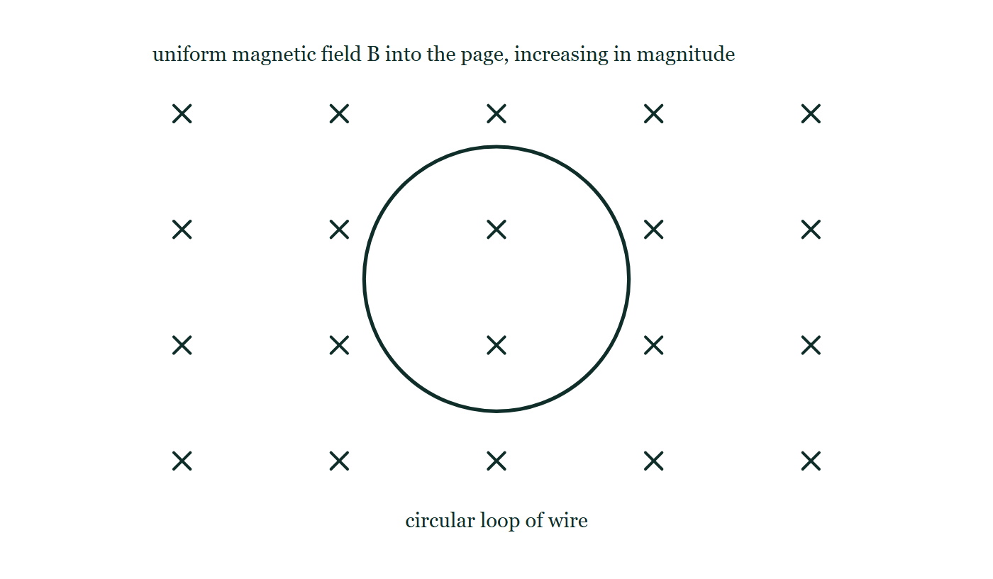
AP PHYSICS C · ELECTRICITY AND MAGNETISM
GIOPHYSICS PRACTICE PAPER
Question 5
Multiple choice
Calculus
Demanding
1 mark
Syllabus 13 · SP3
A circular loop of wire lies in the plane of the page in a uniform magnetic field directed into the page. The magnitude of the field is increasing with time. What is the direction of the induced current in the loop?
Fig. 5.1 — A single circle, labelled as a circular loop of wire, lies in the plane of the page. Small crosses are spaced in an even grid over the whole area of the figure, both inside the loop and all around it, showing a uniform magnetic field directed into the page; the caption to the field states that its magnitude is increasing with time. Nothing is drawn on the loop itself: no arrow, no current direction and no terminals are marked.
A
clockwise, because the induced current opposes the field
B
counterclockwise, because the induced current opposes the increase in flux into the page
C
clockwise, because the induced current reinforces the increase in flux
D
there is no induced current, because the loop is not moving
AP Physics — AP Physics C · Electricity and Magnetism. Written by GioPhysics from College Board AP Physics course and exam descriptions; not an awarding body's document.
10 / 29
Notes:
[Demand] Demanding — Several steps, and you have to choose them. Nothing says which comes first.
[Figure] Fig. 5.1. A single circle, labelled as a circular loop of wire, lies in the plane of the page. Small crosses are spaced in an even grid over the whole area of the figure, both inside the loop and all around it, showing a uniform magnetic field directed into the page; the caption to the field states that its magnitude is increasing with time. Nothing is drawn on the loop itself: no arrow, no current direction and no terminals are marked.

Slide 11
AP PHYSICS C · ELECTRICITY AND MAGNETISM
GIOPHYSICS PRACTICE PAPER
Answer 5
Multiple choice
Calculus
Demanding
1 mark
Mark scheme
B
counterclockwise, because the induced current opposes the increase in flux into the page
Why the other three are there
D confuses motional e.m.f. with Faraday's law in general — a stationary loop in a changing field has an induced e.m.f. A gets the reasoning half right: the induced current opposes the change in flux, not the field itself, and here that requires a counterclockwise current producing flux out of the page.
AP Physics — AP Physics C · Electricity and Magnetism. Written by GioPhysics from College Board AP Physics course and exam descriptions; not an awarding body's document.
11 / 29
Notes:
[Answer] B — counterclockwise, because the induced current opposes the increase in flux into the page
[Distractors] D confuses motional e.m.f. with Faraday's law in general — a stationary loop in a changing field has an induced e.m.f. A gets the reasoning half right: the induced current opposes the change in flux, not the field itself, and here that requires a counterclockwise current producing flux out of the page.
[Figure] Fig. 5.1. A single circle, labelled as a circular loop of wire, lies in the plane of the page. Small crosses are spaced in an even grid over the whole area of the figure, both inside the loop and all around it, showing a uniform magnetic field directed into the page; the caption to the field states that its magnitude is increasing with time. Nothing is drawn on the loop itself: no arrow, no current direction and no terminals are marked.

Slide 12
AP PHYSICS C · ELECTRICITY AND MAGNETISM
GIOPHYSICS PRACTICE PAPER
Question 6
Multiple choice
Calculus
Demanding
1 mark
Syllabus 9 · SP2
In a region of space the electric potential is given by V(x) = 3x² − 2x, where V is in volts and x in metres. What is the x-component of the electric field at x = 2.0 m?
A
−10 V/m
B
−8.0 V/m
C
+8.0 V/m
D
+10 V/m
AP Physics — AP Physics C · Electricity and Magnetism. Written by GioPhysics from College Board AP Physics course and exam descriptions; not an awarding body's document.
12 / 29
Notes:
[Demand] Demanding — Several steps, and you have to choose them. Nothing says which comes first.

Slide 13
AP PHYSICS C · ELECTRICITY AND MAGNETISM
GIOPHYSICS PRACTICE PAPER
Answer 6
Multiple choice
Calculus
Demanding
1 mark
Mark scheme
A
−10 V/m
Why the other three are there
D omits the minus sign in E = −dV/dx, which is the commonest single error on this topic. C evaluates V rather than its derivative.
AP Physics — AP Physics C · Electricity and Magnetism. Written by GioPhysics from College Board AP Physics course and exam descriptions; not an awarding body's document.
13 / 29
Notes:
[Answer] A — −10 V/m
[Distractors] D omits the minus sign in E = −dV/dx, which is the commonest single error on this topic. C evaluates V rather than its derivative.

Slide 14
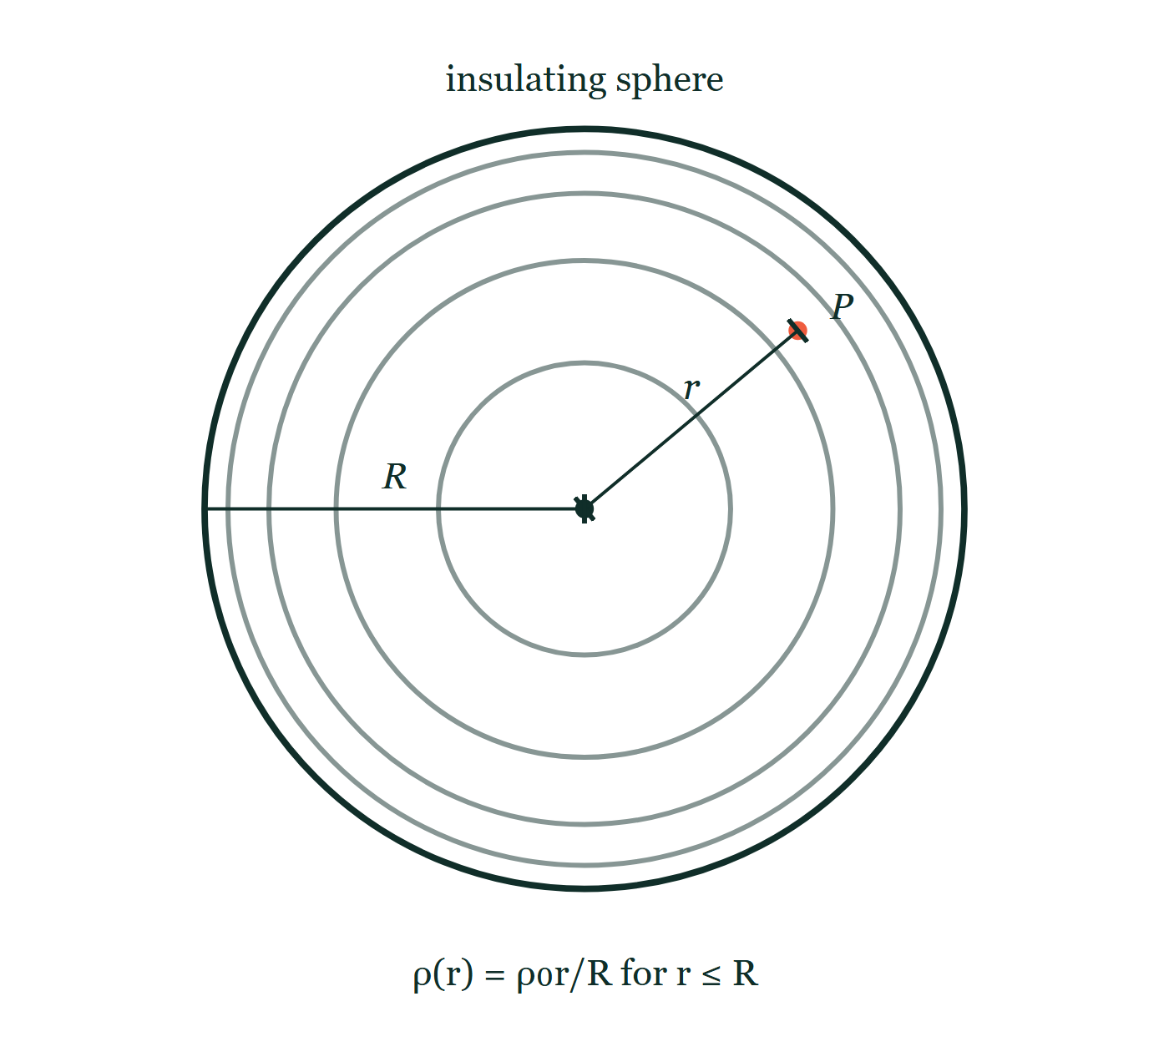
AP PHYSICS C · ELECTRICITY AND MAGNETISM
GIOPHYSICS PRACTICE PAPER
Question 7
Free response
Calculus
Discriminating
14 marks
Mathematical Routines · Syllabus 8, 9
An insulating sphere of radius R carries a volume charge density that varies with distance from the centre as ρ(r) = ρ₀ r/R for r ≤ R, where ρ₀ is a positive constant. There is no charge outside the sphere.
Fig. 7.1 — A large circle represents the insulating sphere. Inside it, faint concentric rings are drawn at intervals that get smaller towards the outside, indicating that the charge density increases with distance from the centre. A dimension line from the centre out to the surface, tick-marked at both ends, is labelled R. A second, shorter dimension line runs from the centre to a small marked point P inside the sphere and is labelled r. Below the sphere the density is written as a function of radius, proportional to r divided by R. No Gaussian surface is drawn.
AP Physics — AP Physics C · Electricity and Magnetism. Written by GioPhysics from College Board AP Physics course and exam descriptions; not an awarding body's document.
14 / 29
Notes:
[Demand] Discriminating — The part that separates the top grade: an unfamiliar context, a derivation, or an argument that has to hold together to earn anything.
[Figure] Fig. 7.1. A large circle represents the insulating sphere. Inside it, faint concentric rings are drawn at intervals that get smaller towards the outside, indicating that the charge density increases with distance from the centre. A dimension line from the centre out to the surface, tick-marked at both ends, is labelled R. A second, shorter dimension line runs from the centre to a small marked point P inside the sphere and is labelled r. Below the sphere the density is written as a function of radius, proportional to r divided by R. No Gaussian surface is drawn.

Slide 15
AP PHYSICS C · ELECTRICITY AND MAGNETISM
GIOPHYSICS PRACTICE PAPER
Question 7 (cont.)
Free response
Calculus
Discriminating
14 marks
continued from the previous slide
(a) Derive
3 marks
Derive an expression for the total charge Q on the sphere.
(b) Derive
4 marks
Using Gauss's law, derive an expression for the magnitude of the electric field at a distance r from the centre, for r < R.
(c) Derive
3 marks
Derive an expression for the magnitude of the electric field at a distance r from the centre, for r > R, and verify that your two expressions agree at r = R.
(d) Derive
4 marks
Derive an expression for the electric potential at the centre of the sphere, taking the potential to be zero at infinity.
AP Physics — AP Physics C · Electricity and Magnetism. Written by GioPhysics from College Board AP Physics course and exam descriptions; not an awarding body's document.
15 / 29
Notes:
[Demand] Discriminating — The part that separates the top grade: an unfamiliar context, a derivation, or an argument that has to hold together to earn anything.
[Figure] Fig. 7.1. A large circle represents the insulating sphere. Inside it, faint concentric rings are drawn at intervals that get smaller towards the outside, indicating that the charge density increases with distance from the centre. A dimension line from the centre out to the surface, tick-marked at both ends, is labelled R. A second, shorter dimension line runs from the centre to a small marked point P inside the sphere and is labelled r. Below the sphere the density is written as a function of radius, proportional to r divided by R. No Gaussian surface is drawn.
[Reminder] Fig. 7.1 is on the previous slide.

Slide 16
AP PHYSICS C · ELECTRICITY AND MAGNETISM
GIOPHYSICS PRACTICE PAPER
Answer 7
Free response
Calculus
Discriminating
14 marks
Mark scheme
(a) Derive — 3 marks
SP2
✓
1 point: uses a spherical shell of volume dV = 4πr²dr as the element of integration
✓
1 point: Q = ∫₀^R ρ₀(r/R)4πr² dr = (4πρ₀/R)∫₀^R r³ dr
✓
1 point: Q = πρ₀R³
(b) Derive — 4 marks
SP2
✓
1 point: chooses a concentric spherical Gaussian surface of radius r and states that E is radial and constant on it, so ∮E·dA = E(4πr²)
✓
1 point: computes the enclosed charge by integrating, q_enc = (4πρ₀/R)(r⁴/4) = πρ₀r⁴/R
✓
1 point: sets E(4πr²) = q_enc/ε₀
✓
1 point: E = ρ₀r²/(4ε₀R)
Treating the enclosed charge as Q(r/R)³ — correct only for a uniform sphere — is the single commonest error here and costs three of the four points.
(c) Derive — 3 marks
SP2
✓
1 point: outside the sphere the whole charge is enclosed, so E = Q/(4πε₀r²) = ρ₀R³/(4ε₀r²)
✓
1 point: substitutes r = R into the inside expression to get ρ₀R/(4ε₀)
✓
1 point: substitutes r = R into the outside expression to get the same value, confirming the field is continuous at the surface
AP Physics — AP Physics C · Electricity and Magnetism. Written by GioPhysics from College Board AP Physics course and exam descriptions; not an awarding body's document.
16 / 29
Notes:
[Marking] One line per mark, awarded independently unless a point says otherwise.
[Examiner note (b)] Treating the enclosed charge as Q(r/R)³ — correct only for a uniform sphere — is the single commonest error here and costs three of the four points.
[Figure] Fig. 7.1. A large circle represents the insulating sphere. Inside it, faint concentric rings are drawn at intervals that get smaller towards the outside, indicating that the charge density increases with distance from the centre. A dimension line from the centre out to the surface, tick-marked at both ends, is labelled R. A second, shorter dimension line runs from the centre to a small marked point P inside the sphere and is labelled r. Below the sphere the density is written as a function of radius, proportional to r divided by R. No Gaussian surface is drawn.

Slide 17
AP PHYSICS C · ELECTRICITY AND MAGNETISM
GIOPHYSICS PRACTICE PAPER
Answer 7 (cont.)
Free response
Calculus
Discriminating
14 marks
Mark scheme, continued
(d) Derive — 4 marks
SP2
✓
1 point: V(0) = ∫₀^∞ E dr, splitting the integral at r = R
✓
1 point: outside contribution ∫_R^∞ ρ₀R³/(4ε₀r²) dr = ρ₀R²/(4ε₀)
✓
1 point: inside contribution ∫₀^R ρ₀r²/(4ε₀R) dr = ρ₀R²/(12ε₀)
✓
1 point: V(0) = ρ₀R²/(4ε₀) + ρ₀R²/(12ε₀) = ρ₀R²/(3ε₀)
AP Physics — AP Physics C · Electricity and Magnetism. Written by GioPhysics from College Board AP Physics course and exam descriptions; not an awarding body's document.
17 / 29
Notes:
[Marking] One line per mark, awarded independently unless a point says otherwise.
[Examiner note (b)] Treating the enclosed charge as Q(r/R)³ — correct only for a uniform sphere — is the single commonest error here and costs three of the four points.
[Figure] Fig. 7.1. A large circle represents the insulating sphere. Inside it, faint concentric rings are drawn at intervals that get smaller towards the outside, indicating that the charge density increases with distance from the centre. A dimension line from the centre out to the surface, tick-marked at both ends, is labelled R. A second, shorter dimension line runs from the centre to a small marked point P inside the sphere and is labelled r. Below the sphere the density is written as a function of radius, proportional to r divided by R. No Gaussian surface is drawn.

Slide 18
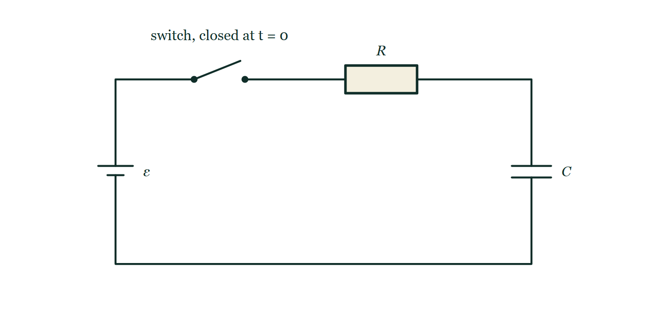
AP PHYSICS C · ELECTRICITY AND MAGNETISM
GIOPHYSICS PRACTICE PAPER
Question 8
Free response
Calculus
Demanding
15 marks
Translation Between Representations · Syllabus 10, 11
A capacitor of capacitance C, initially uncharged, is connected in series with a resistor of resistance R and a battery of e.m.f. ε. The switch is closed at t = 0.
Fig. 8.1 — A single-loop circuit drawn as a rectangle. A cell of e.m.f. epsilon sits in the left-hand side of the loop, with its long positive plate uppermost. Along the top wire, reading from the left, come an open switch labelled S with the note that it is closed at t = 0, and then a rectangular resistor labelled R. A capacitor labelled C, drawn as two equal parallel plates, sits in the right-hand side of the loop. Everything is in series round the one loop: there are no branches and no junction dots anywhere in the circuit.
AP Physics — AP Physics C · Electricity and Magnetism. Written by GioPhysics from College Board AP Physics course and exam descriptions; not an awarding body's document.
18 / 29
Notes:
[Demand] Demanding — Several steps, and you have to choose them. Nothing says which comes first.
[Figure] Fig. 8.1. A single-loop circuit drawn as a rectangle. A cell of e.m.f. epsilon sits in the left-hand side of the loop, with its long positive plate uppermost. Along the top wire, reading from the left, come an open switch labelled S with the note that it is closed at t = 0, and then a rectangular resistor labelled R. A capacitor labelled C, drawn as two equal parallel plates, sits in the right-hand side of the loop. Everything is in series round the one loop: there are no branches and no junction dots anywhere in the circuit.

Slide 19
AP PHYSICS C · ELECTRICITY AND MAGNETISM
GIOPHYSICS PRACTICE PAPER
Question 8 (cont.)
Free response
Calculus
Demanding
15 marks
continued from the previous slide
(a) Derive
4 marks
Write the loop equation for the circuit and derive an expression for the charge on the capacitor as a function of time.
(b) Sketch
4 marks
On separate axes, sketch the charge on the capacitor and the current in the circuit as functions of time. Label the initial value and the asymptotic value on each.
(c) Determine
3 marks
Determine the time, as a multiple of RC, at which the capacitor holds half of its final charge.
(d) Explain
4 marks
The total energy delivered by the battery over the whole charging process is Cε², but only ½Cε² is stored in the capacitor. Explain where the remaining energy goes, and explain why this fraction does not depend on the value of R.
AP Physics — AP Physics C · Electricity and Magnetism. Written by GioPhysics from College Board AP Physics course and exam descriptions; not an awarding body's document.
19 / 29
Notes:
[Demand] Demanding — Several steps, and you have to choose them. Nothing says which comes first.
[Figure] Fig. 8.1. A single-loop circuit drawn as a rectangle. A cell of e.m.f. epsilon sits in the left-hand side of the loop, with its long positive plate uppermost. Along the top wire, reading from the left, come an open switch labelled S with the note that it is closed at t = 0, and then a rectangular resistor labelled R. A capacitor labelled C, drawn as two equal parallel plates, sits in the right-hand side of the loop. Everything is in series round the one loop: there are no branches and no junction dots anywhere in the circuit.
[Reminder] Fig. 8.1 is on the previous slide.

Slide 20
AP PHYSICS C · ELECTRICITY AND MAGNETISM
GIOPHYSICS PRACTICE PAPER
Answer 8
Free response
Calculus
Demanding
15 marks
Mark scheme
(a) Derive — 4 marks
SP2
✓
1 point: ε − IR − q/C = 0 with I = dq/dt
✓
1 point: separates variables, dq/(εC − q) = dt/(RC)
✓
1 point: integrates with q = 0 at t = 0
✓
1 point: q(t) = εC(1 − e^(−t/RC))
(b) Sketch — 4 marks
SP1
✓
1 point: charge rises from zero, concave down, approaching the asymptote q = εC
✓
1 point: εC labelled on the charge graph
✓
1 point: current starts at ε/R and decays, concave up, approaching zero
✓
1 point: ε/R labelled on the current graph
(c) Determine — 3 marks
SP2
✓
1 point: sets εC(1 − e^(−t/RC)) = ½εC
✓
1 point: e^(−t/RC) = ½, so t/RC = ln 2
✓
1 point: t = 0.69RC
AP Physics — AP Physics C · Electricity and Magnetism. Written by GioPhysics from College Board AP Physics course and exam descriptions; not an awarding body's document.
20 / 29
Notes:
[Marking] One line per mark, awarded independently unless a point says otherwise.
[Examiner note (d)] The independence from R is one of the most surprising results in the topic and one of the best-discriminating parts available. Candidates who say only "energy is lost in the resistor" earn one point of four.
[Figure] Fig. 8.1. A single-loop circuit drawn as a rectangle. A cell of e.m.f. epsilon sits in the left-hand side of the loop, with its long positive plate uppermost. Along the top wire, reading from the left, come an open switch labelled S with the note that it is closed at t = 0, and then a rectangular resistor labelled R. A capacitor labelled C, drawn as two equal parallel plates, sits in the right-hand side of the loop. Everything is in series round the one loop: there are no branches and no junction dots anywhere in the circuit.

Slide 21
AP PHYSICS C · ELECTRICITY AND MAGNETISM
GIOPHYSICS PRACTICE PAPER
Answer 8 (cont.)
Free response
Calculus
Demanding
15 marks
Mark scheme, continued
(d) Explain — 4 marks
SP3
✓
1 point: the difference, ½Cε², is dissipated as thermal energy in the resistor
✓
1 point: the battery moves the full charge εC through the full potential difference ε, while the capacitor's stored energy is the integral of q/C dq, which averages to half that
✓
1 point: a larger R makes the current smaller but the process correspondingly longer
✓
1 point: the two effects cancel exactly in ∫I²R dt, so the dissipated energy is ½Cε² whatever the resistance
The independence from R is one of the most surprising results in the topic and one of the best-discriminating parts available. Candidates who say only "energy is lost in the resistor" earn one point of four.
AP Physics — AP Physics C · Electricity and Magnetism. Written by GioPhysics from College Board AP Physics course and exam descriptions; not an awarding body's document.
21 / 29
Notes:
[Marking] One line per mark, awarded independently unless a point says otherwise.
[Examiner note (d)] The independence from R is one of the most surprising results in the topic and one of the best-discriminating parts available. Candidates who say only "energy is lost in the resistor" earn one point of four.
[Figure] Fig. 8.1. A single-loop circuit drawn as a rectangle. A cell of e.m.f. epsilon sits in the left-hand side of the loop, with its long positive plate uppermost. Along the top wire, reading from the left, come an open switch labelled S with the note that it is closed at t = 0, and then a rectangular resistor labelled R. A capacitor labelled C, drawn as two equal parallel plates, sits in the right-hand side of the loop. Everything is in series round the one loop: there are no branches and no junction dots anywhere in the circuit.

Slide 22
AP PHYSICS C · ELECTRICITY AND MAGNETISM
GIOPHYSICS PRACTICE PAPER
Question 9
Free response
Calculus
Demanding
13 marks
Experimental Design and Analysis · Syllabus 10, 11
A student is given a capacitor of unknown capacitance, a resistor of known resistance R = 47 kΩ, a battery, a switch, a voltmeter of very high resistance and a stopwatch. The student wants to determine the capacitance.
(a) Describe
4 marks
Describe a procedure the student could use, and state which quantities should be recorded.
(b) Describe
3 marks
Describe how the student should linearise the data, and state what the slope of the resulting graph represents.
(c) Determine
3 marks
The student's graph of ln(V/V) against t has a slope of −0.43 s⁻¹. Determine the capacitance.
(d) Explain
3 marks
Explain why plotting ln V against t is preferable to determining the time constant by reading off the time at which V has fallen to 37% of its initial value.
AP Physics — AP Physics C · Electricity and Magnetism. Written by GioPhysics from College Board AP Physics course and exam descriptions; not an awarding body's document.
22 / 29
Notes:
[Demand] Demanding — Several steps, and you have to choose them. Nothing says which comes first.

Slide 23
AP PHYSICS C · ELECTRICITY AND MAGNETISM
GIOPHYSICS PRACTICE PAPER
Answer 9
Free response
Calculus
Demanding
13 marks
Mark scheme
(a) Describe — 4 marks
SP4
✓
1 point: charge the capacitor fully through the battery, then disconnect the battery and discharge it through the known resistor
✓
1 point: record the voltmeter reading V at measured time intervals t from the start of the discharge
✓
1 point: repeat the whole discharge several times and average the readings at each time
✓
1 point: states why the voltmeter must have a very high resistance — otherwise it provides a parallel discharge path and shortens the time constant
(b) Describe — 3 marks
SP4
✓
1 point: V = V₀e^(−t/RC), so ln V = ln V₀ − t/(RC)
✓
1 point: plot ln V on the vertical axis against t on the horizontal axis to obtain a straight line
✓
1 point: the slope is −1/(RC), so C = −1/(R × slope)
(c) Determine — 3 marks
SP2
✓
1 point: RC = 1/0.43 = 2.33 s
✓
1 point: C = 2.33 / 47 × 10³
✓
1 point: C = 5.0 × 10⁻⁵ F (50 μF)
AP Physics — AP Physics C · Electricity and Magnetism. Written by GioPhysics from College Board AP Physics course and exam descriptions; not an awarding body's document.
23 / 29
Notes:
[Marking] One line per mark, awarded independently unless a point says otherwise.

Slide 24
AP PHYSICS C · ELECTRICITY AND MAGNETISM
GIOPHYSICS PRACTICE PAPER
Answer 9 (cont.)
Free response
Calculus
Demanding
13 marks
Mark scheme, continued
(d) Explain — 3 marks
SP4
✓
1 point: the single-point method relies on two readings only, V₀ and one other, so an error in either propagates directly into the answer
✓
1 point: the graph uses every data point, so random errors average out and the slope is better determined
✓
1 point: the straightness of the line is itself a test that the discharge really is exponential, which the single-point method assumes without checking
AP Physics — AP Physics C · Electricity and Magnetism. Written by GioPhysics from College Board AP Physics course and exam descriptions; not an awarding body's document.
24 / 29
Notes:
[Marking] One line per mark, awarded independently unless a point says otherwise.

Slide 25
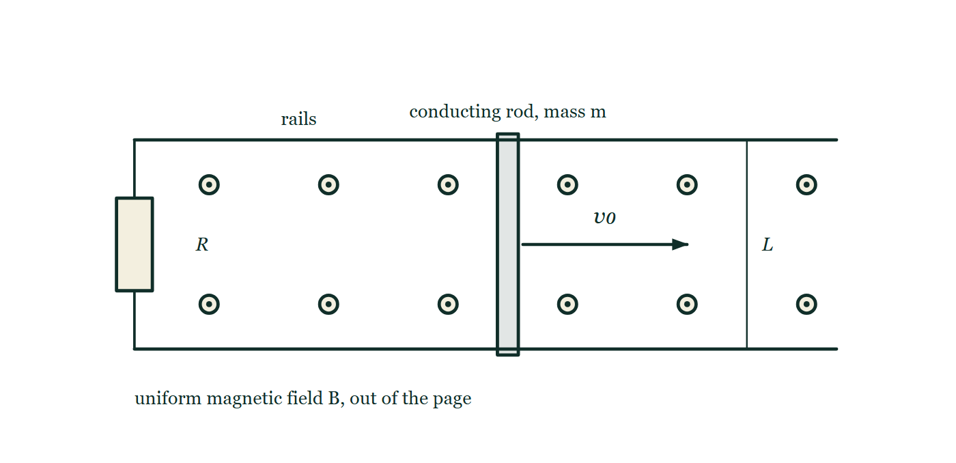
AP PHYSICS C · ELECTRICITY AND MAGNETISM
GIOPHYSICS PRACTICE PAPER
Question 10
Free response
Calculus
Discriminating
14 marks
Qualitative/Quantitative Translation · Syllabus 13
A conducting rod of mass m and length L slides without friction on two long horizontal parallel rails separated by L. The rails are joined at one end by a resistor of resistance R, and the whole apparatus sits in a uniform magnetic field of magnitude B directed vertically, perpendicular to the plane of the rails. The rod is given an initial speed v₀ to the right at t = 0 and then released. The rod and rails have negligible resistance.
Fig. 10.1 — The apparatus is seen from above. Two long parallel horizontal rails run across the figure, joined at their left-hand ends by a resistor labelled R, and open at the right-hand end. A short bar lying across the rails, drawn solid, is the conducting rod of mass m. An arrow starting at the rod points to the right and is labelled v0. A tick-marked dimension line drawn between the rails to the right of the rod is labelled L for their separation. Dots in an even grid cover the whole area, marking a uniform magnetic field pointing out of the page, that is vertically upward from the horizontal plane of the rails. No induced current or force is drawn.
AP Physics — AP Physics C · Electricity and Magnetism. Written by GioPhysics from College Board AP Physics course and exam descriptions; not an awarding body's document.
25 / 29
Notes:
[Demand] Discriminating — The part that separates the top grade: an unfamiliar context, a derivation, or an argument that has to hold together to earn anything.
[Figure] Fig. 10.1. The apparatus is seen from above. Two long parallel horizontal rails run across the figure, joined at their left-hand ends by a resistor labelled R, and open at the right-hand end. A short bar lying across the rails, drawn solid, is the conducting rod of mass m. An arrow starting at the rod points to the right and is labelled v0. A tick-marked dimension line drawn between the rails to the right of the rod is labelled L for their separation. Dots in an even grid cover the whole area, marking a uniform magnetic field pointing out of the page, that is vertically upward from the horizontal plane of the rails. No induced current or force is drawn.

Slide 26
AP PHYSICS C · ELECTRICITY AND MAGNETISM
GIOPHYSICS PRACTICE PAPER
Question 10 (cont.)
Free response
Calculus
Discriminating
14 marks
continued from the previous slide
(a) Derive
3 marks
Derive expressions for the e.m.f. induced in the circuit and the current in the resistor when the rod moves with speed v.
(b) Derive
4 marks
Derive an expression for the speed of the rod as a function of time.
(c) Determine
3 marks
Determine the total energy dissipated in the resistor from t = 0 until the rod has effectively stopped, and determine the total distance the rod travels.
(d) Explain
4 marks
Explain, without deriving anything further, why the rod slows down, and explain what would be observed instead if the resistor were replaced by a superconducting wire of zero resistance.
AP Physics — AP Physics C · Electricity and Magnetism. Written by GioPhysics from College Board AP Physics course and exam descriptions; not an awarding body's document.
26 / 29
Notes:
[Demand] Discriminating — The part that separates the top grade: an unfamiliar context, a derivation, or an argument that has to hold together to earn anything.
[Figure] Fig. 10.1. The apparatus is seen from above. Two long parallel horizontal rails run across the figure, joined at their left-hand ends by a resistor labelled R, and open at the right-hand end. A short bar lying across the rails, drawn solid, is the conducting rod of mass m. An arrow starting at the rod points to the right and is labelled v0. A tick-marked dimension line drawn between the rails to the right of the rod is labelled L for their separation. Dots in an even grid cover the whole area, marking a uniform magnetic field pointing out of the page, that is vertically upward from the horizontal plane of the rails. No induced current or force is drawn.
[Reminder] Fig. 10.1 is on the previous slide.

Slide 27
AP PHYSICS C · ELECTRICITY AND MAGNETISM
GIOPHYSICS PRACTICE PAPER
Answer 10
Free response
Calculus
Discriminating
14 marks
Mark scheme
(a) Derive — 3 marks
SP2
✓
1 point: the flux through the circuit changes as the enclosed area changes, ε = −dΦ/dt = −BL(dx/dt)
✓
1 point: magnitude of the e.m.f. is BLv
✓
1 point: I = BLv/R
(b) Derive — 4 marks
SP2
✓
1 point: the force on the current-carrying rod is F = BIL = B²L²v/R, directed opposite to the motion by Lenz's law
✓
1 point: m dv/dt = −B²L²v/R
✓
1 point: separates and integrates from v₀ at t = 0
✓
1 point: v(t) = v₀e^(−B²L²t/(mR))
(c) Determine — 3 marks
SP2
✓
1 point: the only energy source is the rod's kinetic energy, and it all ends up in the resistor, so the total dissipated energy is ½mv₀²
✓
1 point: distance x = ∫₀^∞ v dt = v₀ mR/(B²L²)
✓
1 point: states both results with correct symbols
AP Physics — AP Physics C · Electricity and Magnetism. Written by GioPhysics from College Board AP Physics course and exam descriptions; not an awarding body's document.
27 / 29
Notes:
[Marking] One line per mark, awarded independently unless a point says otherwise.
[Examiner note (d)] The final point rewards a candidate who recognises that R appearing in a denominator is a signal to ask what happens in the limit, rather than one who simply repeats the derivation with R = 0.
[Figure] Fig. 10.1. The apparatus is seen from above. Two long parallel horizontal rails run across the figure, joined at their left-hand ends by a resistor labelled R, and open at the right-hand end. A short bar lying across the rails, drawn solid, is the conducting rod of mass m. An arrow starting at the rod points to the right and is labelled v0. A tick-marked dimension line drawn between the rails to the right of the rod is labelled L for their separation. Dots in an even grid cover the whole area, marking a uniform magnetic field pointing out of the page, that is vertically upward from the horizontal plane of the rails. No induced current or force is drawn.

Slide 28
AP PHYSICS C · ELECTRICITY AND MAGNETISM
GIOPHYSICS PRACTICE PAPER
Answer 10 (cont.)
Free response
Calculus
Discriminating
14 marks
Mark scheme, continued
(d) Explain — 4 marks
SP3
✓
1 point: the motion changes the flux through the circuit, which drives a current
✓
1 point: by Lenz's law that current is in the direction whose magnetic force opposes the motion, so the rod decelerates — the kinetic energy is transferred to the resistor as thermal energy
✓
1 point: with zero resistance the current, and hence the retarding force, would become arbitrarily large for any non-zero speed
✓
1 point: so the rod would stop almost immediately, and in the idealised limit the flux through the circuit cannot change at all — which is the behaviour that makes a superconducting loop hold its flux fixed
The final point rewards a candidate who recognises that R appearing in a denominator is a signal to ask what happens in the limit, rather than one who simply repeats the derivation with R = 0.
AP Physics — AP Physics C · Electricity and Magnetism. Written by GioPhysics from College Board AP Physics course and exam descriptions; not an awarding body's document.
28 / 29
Notes:
[Marking] One line per mark, awarded independently unless a point says otherwise.
[Examiner note (d)] The final point rewards a candidate who recognises that R appearing in a denominator is a signal to ask what happens in the limit, rather than one who simply repeats the derivation with R = 0.
[Figure] Fig. 10.1. The apparatus is seen from above. Two long parallel horizontal rails run across the figure, joined at their left-hand ends by a resistor labelled R, and open at the right-hand end. A short bar lying across the rails, drawn solid, is the conducting rod of mass m. An arrow starting at the rod points to the right and is labelled v0. A tick-marked dimension line drawn between the rails to the right of the rod is labelled L for their separation. Dots in an even grid cover the whole area, marking a uniform magnetic field pointing out of the page, that is vertically upward from the horizontal plane of the rails. No induced current or force is drawn.

Slide 29
AP PHYSICS C · ELECTRICITY AND MAGNETISM
GIOPHYSICS PRACTICE PAPER
Command words
AP Physics — the board's own definitions
Calculate
Justify
Perform mathematical steps to arrive at a final answer, including an algebraic expression, correctly substituted numbers, and units.
Provide evidence to support or defend a claim, and reasoning to explain how that evidence supports the claim.
Derive
Sketch
Perform a series of mathematical steps from a fundamental law or relationship to arrive at the desired result.
Draw a shape or trend line, without requiring exact plotted values.
Describe
Provide the relevant characteristics of a specified topic.
Determine
Arrive at a conclusion after reasoning, observation, or applying mathematical routines.
Explain
Provide information about how or why a relationship, situation or outcome occurs, using evidence and reasoning.
Indicate
Select the correct option from those provided, before giving any reasoning that is asked for.
AP Physics — AP Physics C · Electricity and Magnetism. Written by GioPhysics from College Board AP Physics course and exam descriptions; not an awarding body's document.
29 / 29
Notes:
[Objectives] SP1 Creating representations: Describe, create and use models, diagrams, graphs and free-body diagrams to represent a physical situation. SP2 Mathematical routines: Determine and apply mathematical relationships, working symbolically before substituting, and check the reasonableness of a result. SP3 Scientific questioning and argumentation: Make and justify a claim with evidence and reasoning, and evaluate the claims and reasoning of others. SP4 Experimental method and data analysis: Design an experimental procedure, identify and control variables, analyse data including linearisation, and evaluate sources of error.
[Source] College Board AP Physics course and exam descriptions — https://apcentral.collegeboard.org/courses
[Disclaimer] Written by GioPhysics from the published course frameworks. These are practice exams in the style of AP Physics; they are not College Board materials, contain no released exam questions, and the official course and exam descriptions remain the authority. AP is a trademark of the College Board, which is not affiliated with and does not endorse GioPhysics.

