Slide 1
AP PHYSICS C · MECHANICS
GIOPHYSICS PRACTICE PAPER
AP · College Board AP Physics · frameworks first examined in 2025
AP Physics C · Mechanics
Calculus-based mechanics: kinematics, translational dynamics including velocity-dependent forces, work and energy, momentum, torque and rotational dynamics, rotational energy and momentum, and oscillations.
MIRRORS
Section I (single-select multiple choice) and Section II (four free-response task types)
MARKS
55 in total — all Calculus
TIME
70 minutes · 10 questions
DEMAND
Routine 2 · Demanding 5 · Discriminating 3
SYLLABUS
1, 2, 3, 4, 5, 6, 7
Written by GioPhysics from the published course frameworks. These are practice exams in the style of AP Physics; they are not College Board materials, contain no released exam questions, and the official course and exam descriptions remain the authority. AP is a trademark of the College Board, which is not affiliated with and does not endorse GioPhysics.
AP Physics — AP Physics C · Mechanics. Written by GioPhysics from College Board AP Physics course and exam descriptions; not an awarding body's document.
1 / 28
Notes:
[Format] Every AP Physics exam has two sections of equal weight. Section I is single-select multiple choice with four options and no penalty for a wrong answer. Section II is free response, scored in points, and every question is built on one of four published task types. A table of equations and a table of constants are supplied for both sections, so nothing on an AP exam tests whether you can recall a formula.
[Demand] Written to the standard the free-response rubrics actually apply. A numerical answer that appears without the symbolic expression behind it earns partial credit at best; a claim without reasoning earns nothing at all, however correct the claim is. The C courses are set at calculus level throughout — moments of inertia by integration, drag and RC problems as differential equations — because that is what separates them from Physics 1 and 2.
[Source] College Board AP Physics course and exam descriptions — https://apcentral.collegeboard.org/courses
[Disclaimer] Written by GioPhysics from the published course frameworks. These are practice exams in the style of AP Physics; they are not College Board materials, contain no released exam questions, and the official course and exam descriptions remain the authority. AP is a trademark of the College Board, which is not affiliated with and does not endorse GioPhysics.

Slide 2
AP PHYSICS C · MECHANICS
GIOPHYSICS PRACTICE PAPER
Question 1
Multiple choice
Calculus
Routine
1 mark
Syllabus 1 · SP2
A particle moves along the x-axis with acceleration a(t) = 6t, where a is in m/s² and t is in seconds. At t = 0 the particle is at rest at the origin. What is its position at t = 2.0 s?
A
4.0 m
B
8.0 m
C
12 m
D
24 m
AP Physics — AP Physics C · Mechanics. Written by GioPhysics from College Board AP Physics course and exam descriptions; not an awarding body's document.
2 / 28
Notes:
[Demand] Routine — The standard application — the named equation, the usual graph read.

Slide 3
AP PHYSICS C · MECHANICS
GIOPHYSICS PRACTICE PAPER
Answer 1
Multiple choice
Calculus
Routine
1 mark
Mark scheme
B
8.0 m
Why the other three are there
Integrating twice gives v = 3t² and x = t³, so x = 8.0 m at t = 2.0 s. D is the answer of a candidate who evaluates a at t = 2.0 s to get 12 m/s² and then applies x = ½at², which is only valid for constant acceleration — the whole point of the item is that this acceleration is not constant.
AP Physics — AP Physics C · Mechanics. Written by GioPhysics from College Board AP Physics course and exam descriptions; not an awarding body's document.
3 / 28
Notes:
[Answer] B — 8.0 m
[Distractors] Integrating twice gives v = 3t² and x = t³, so x = 8.0 m at t = 2.0 s. D is the answer of a candidate who evaluates a at t = 2.0 s to get 12 m/s² and then applies x = ½at², which is only valid for constant acceleration — the whole point of the item is that this acceleration is not constant.

Slide 4
AP PHYSICS C · MECHANICS
GIOPHYSICS PRACTICE PAPER
Question 2
Multiple choice
Calculus
Demanding
1 mark
Syllabus 2 · SP2
An object of mass m falls from rest through a fluid that exerts a resistive force of magnitude bv, where v is the speed. What is the terminal speed?
A
b/(mg)
B
mg/b
C
√(mg/b)
D
mgb
AP Physics — AP Physics C · Mechanics. Written by GioPhysics from College Board AP Physics course and exam descriptions; not an awarding body's document.
4 / 28
Notes:
[Demand] Demanding — Several steps, and you have to choose them. Nothing says which comes first.

Slide 5
AP PHYSICS C · MECHANICS
GIOPHYSICS PRACTICE PAPER
Answer 2
Multiple choice
Calculus
Demanding
1 mark
Mark scheme
B
mg/b
Why the other three are there
C is the terminal speed for a resistive force proportional to v², and is the answer of a candidate who reaches for the more familiar quadratic drag law without reading the exponent given.
AP Physics — AP Physics C · Mechanics. Written by GioPhysics from College Board AP Physics course and exam descriptions; not an awarding body's document.
5 / 28
Notes:
[Answer] B — mg/b
[Distractors] C is the terminal speed for a resistive force proportional to v², and is the answer of a candidate who reaches for the more familiar quadratic drag law without reading the exponent given.

Slide 6
AP PHYSICS C · MECHANICS
GIOPHYSICS PRACTICE PAPER
Question 3
Multiple choice
Calculus
Routine
1 mark
Syllabus 3 · SP2
A single force F(x) = 4x² acts on an object as it moves along the x-axis, where F is in newtons and x in metres. How much work does this force do on the object as it moves from x = 0 to x = 3.0 m?
A
12 J
B
36 J
C
54 J
D
108 J
AP Physics — AP Physics C · Mechanics. Written by GioPhysics from College Board AP Physics course and exam descriptions; not an awarding body's document.
6 / 28
Notes:
[Demand] Routine — The standard application — the named equation, the usual graph read.

Slide 7
AP PHYSICS C · MECHANICS
GIOPHYSICS PRACTICE PAPER
Answer 3
Multiple choice
Calculus
Routine
1 mark
Mark scheme
B
36 J
Why the other three are there
D is F(3.0) × 3.0 = 108 J, the answer of a candidate who multiplies the final force by the distance instead of integrating. Since the force varies, the work is ∫₀³ 4x² dx = (4/3)(27) = 36 J.
AP Physics — AP Physics C · Mechanics. Written by GioPhysics from College Board AP Physics course and exam descriptions; not an awarding body's document.
7 / 28
Notes:
[Answer] B — 36 J
[Distractors] D is F(3.0) × 3.0 = 108 J, the answer of a candidate who multiplies the final force by the distance instead of integrating. Since the force varies, the work is ∫₀³ 4x² dx = (4/3)(27) = 36 J.

Slide 8
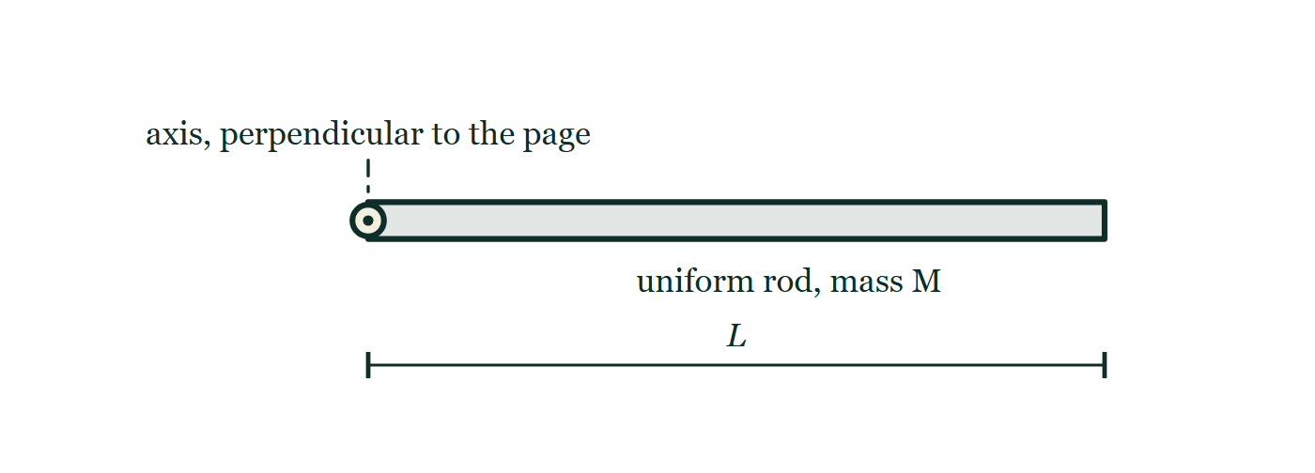
AP PHYSICS C · MECHANICS
GIOPHYSICS PRACTICE PAPER
Question 4
Multiple choice
Calculus
Demanding
1 mark
Syllabus 5 · SP2
A uniform thin rod of mass M and length L rotates about an axis perpendicular to the rod through one end. What is its moment of inertia about that axis?
Fig. 4.1 — A uniform thin rod is drawn horizontally across the figure and labelled as having mass M. At its left-hand end a small circle with a dot at its centre marks the axis of rotation, which is perpendicular both to the rod and to the page; a short dashed leader connects that symbol to the words "axis, perpendicular to the page". A dimension line beneath the rod, with a tick at each end, runs from the axis to the far end of the rod and is labelled L.
A
ML²/12
B
ML²/6
C
ML²/3
D
ML²
AP Physics — AP Physics C · Mechanics. Written by GioPhysics from College Board AP Physics course and exam descriptions; not an awarding body's document.
8 / 28
Notes:
[Demand] Demanding — Several steps, and you have to choose them. Nothing says which comes first.
[Figure] Fig. 4.1. A uniform thin rod is drawn horizontally across the figure and labelled as having mass M. At its left-hand end a small circle with a dot at its centre marks the axis of rotation, which is perpendicular both to the rod and to the page; a short dashed leader connects that symbol to the words "axis, perpendicular to the page". A dimension line beneath the rod, with a tick at each end, runs from the axis to the far end of the rod and is labelled L.

Slide 9
AP PHYSICS C · MECHANICS
GIOPHYSICS PRACTICE PAPER
Answer 4
Multiple choice
Calculus
Demanding
1 mark
Mark scheme
C
ML²/3
Why the other three are there
A is the moment of inertia about the centre. Applying the parallel-axis theorem, I = ML²/12 + M(L/2)² = ML²/3, and a candidate who quotes A has answered a different question.
AP Physics — AP Physics C · Mechanics. Written by GioPhysics from College Board AP Physics course and exam descriptions; not an awarding body's document.
9 / 28
Notes:
[Answer] C — ML²/3
[Distractors] A is the moment of inertia about the centre. Applying the parallel-axis theorem, I = ML²/12 + M(L/2)² = ML²/3, and a candidate who quotes A has answered a different question.
[Figure] Fig. 4.1. A uniform thin rod is drawn horizontally across the figure and labelled as having mass M. At its left-hand end a small circle with a dot at its centre marks the axis of rotation, which is perpendicular both to the rod and to the page; a short dashed leader connects that symbol to the words "axis, perpendicular to the page". A dimension line beneath the rod, with a tick at each end, runs from the axis to the far end of the rod and is labelled L.

Slide 10
AP PHYSICS C · MECHANICS
GIOPHYSICS PRACTICE PAPER
Question 5
Multiple choice
Calculus
Demanding
1 mark
Syllabus 6 · SP3
A figure skater spinning with her arms extended pulls her arms in close to her body. Which of the following is true?
A
Her angular momentum and her kinetic energy both stay the same.
B
Her angular momentum stays the same and her kinetic energy increases.
C
Her angular momentum increases and her kinetic energy stays the same.
D
Her angular momentum and her kinetic energy both increase.
AP Physics — AP Physics C · Mechanics. Written by GioPhysics from College Board AP Physics course and exam descriptions; not an awarding body's document.
10 / 28
Notes:
[Demand] Demanding — Several steps, and you have to choose them. Nothing says which comes first.

Slide 11
AP PHYSICS C · MECHANICS
GIOPHYSICS PRACTICE PAPER
Answer 5
Multiple choice
Calculus
Demanding
1 mark
Mark scheme
B
Her angular momentum stays the same and her kinetic energy increases.
Why the other three are there
A is the intuitive answer and is wrong about the energy. With L = Iω constant and I decreasing, K = L²/(2I) must rise — the skater does work pulling her arms inward against the centripetal requirement, and that work appears as kinetic energy.
AP Physics — AP Physics C · Mechanics. Written by GioPhysics from College Board AP Physics course and exam descriptions; not an awarding body's document.
11 / 28
Notes:
[Answer] B — Her angular momentum stays the same and her kinetic energy increases.
[Distractors] A is the intuitive answer and is wrong about the energy. With L = Iω constant and I decreasing, K = L²/(2I) must rise — the skater does work pulling her arms inward against the centripetal requirement, and that work appears as kinetic energy.

Slide 12
AP PHYSICS C · MECHANICS
GIOPHYSICS PRACTICE PAPER
Question 6
Multiple choice
Calculus
Demanding
1 mark
Syllabus 7 · SP2
A particle of mass m moves in a potential U(x) = ½kx⁴. Which statement about its motion for small oscillations about x = 0 is correct?
A
The motion is simple harmonic with angular frequency √(k/m).
B
The motion is simple harmonic with angular frequency √(2k/m).
C
The motion is periodic but not simple harmonic, and its period depends on the amplitude.
D
The motion is not periodic.
AP Physics — AP Physics C · Mechanics. Written by GioPhysics from College Board AP Physics course and exam descriptions; not an awarding body's document.
12 / 28
Notes:
[Demand] Demanding — Several steps, and you have to choose them. Nothing says which comes first.

Slide 13
AP PHYSICS C · MECHANICS
GIOPHYSICS PRACTICE PAPER
Answer 6
Multiple choice
Calculus
Demanding
1 mark
Mark scheme
C
The motion is periodic but not simple harmonic, and its period depends on the amplitude.
Why the other three are there
The restoring force is −dU/dx = −2kx³, which is not proportional to x, so the motion cannot be simple harmonic however small the amplitude. A and B are offered to candidates who assume any potential minimum gives SHM.
AP Physics — AP Physics C · Mechanics. Written by GioPhysics from College Board AP Physics course and exam descriptions; not an awarding body's document.
13 / 28
Notes:
[Answer] C — The motion is periodic but not simple harmonic, and its period depends on the amplitude.
[Distractors] The restoring force is −dU/dx = −2kx³, which is not proportional to x, so the motion cannot be simple harmonic however small the amplitude. A and B are offered to candidates who assume any potential minimum gives SHM.

Slide 14
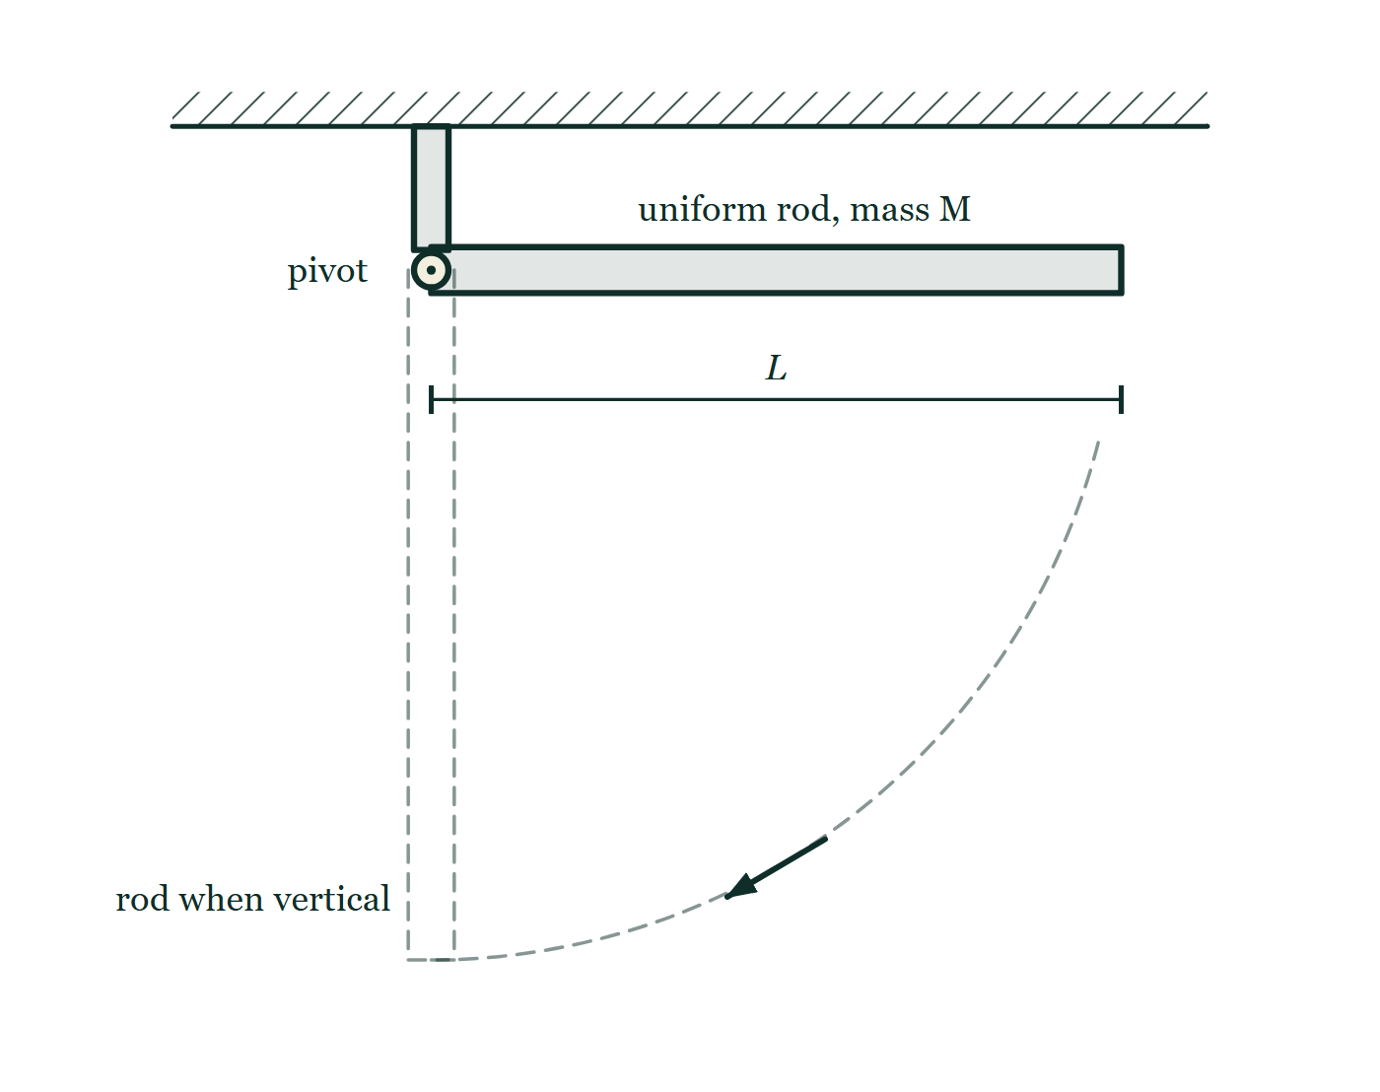
AP PHYSICS C · MECHANICS
GIOPHYSICS PRACTICE PAPER
Question 7
Free response
Calculus
Discriminating
13 marks
Mathematical Routines · Syllabus 5, 6
A uniform thin rod of mass M and length L is free to rotate in a vertical plane about a frictionless horizontal pivot at one end. The rod is held horizontal and released from rest.
Fig. 7.1 — A uniform rod of mass M is held horizontal. Its left-hand end is carried on a hinge at the foot of a short post fixed to a hatched ceiling, and the word "pivot" labels that end. A dimension line below the rod, with a tick at each end, runs from the pivot to the free end and is labelled L. Directly below the pivot a dashed outline of the rod shows the position it will occupy when vertical, and a dashed arc from the free end down to that position, carrying a small arrow, shows the rod swinging down. No forces are marked on the rod.
AP Physics — AP Physics C · Mechanics. Written by GioPhysics from College Board AP Physics course and exam descriptions; not an awarding body's document.
14 / 28
Notes:
[Demand] Discriminating — The part that separates the top grade: an unfamiliar context, a derivation, or an argument that has to hold together to earn anything.
[Figure] Fig. 7.1. A uniform rod of mass M is held horizontal. Its left-hand end is carried on a hinge at the foot of a short post fixed to a hatched ceiling, and the word "pivot" labels that end. A dimension line below the rod, with a tick at each end, runs from the pivot to the free end and is labelled L. Directly below the pivot a dashed outline of the rod shows the position it will occupy when vertical, and a dashed arc from the free end down to that position, carrying a small arrow, shows the rod swinging down. No forces are marked on the rod.

Slide 15
AP PHYSICS C · MECHANICS
GIOPHYSICS PRACTICE PAPER
Question 7 (cont.)
Free response
Calculus
Discriminating
13 marks
continued from the previous slide
(a) Derive
4 marks
Using integration, derive the moment of inertia of the rod about the pivot. Show the mass element you use.
(b) Determine
3 marks
Determine the angular acceleration of the rod at the instant it is released, while it is still horizontal.
(c) Derive
3 marks
Derive an expression for the angular speed of the rod when it reaches the vertical position.
(d) Explain
3 marks
Determine the linear acceleration of the free end of the rod at the instant of release, and explain how a point on the rod can have a downward acceleration greater than g.
AP Physics — AP Physics C · Mechanics. Written by GioPhysics from College Board AP Physics course and exam descriptions; not an awarding body's document.
15 / 28
Notes:
[Demand] Discriminating — The part that separates the top grade: an unfamiliar context, a derivation, or an argument that has to hold together to earn anything.
[Figure] Fig. 7.1. A uniform rod of mass M is held horizontal. Its left-hand end is carried on a hinge at the foot of a short post fixed to a hatched ceiling, and the word "pivot" labels that end. A dimension line below the rod, with a tick at each end, runs from the pivot to the free end and is labelled L. Directly below the pivot a dashed outline of the rod shows the position it will occupy when vertical, and a dashed arc from the free end down to that position, carrying a small arrow, shows the rod swinging down. No forces are marked on the rod.
[Reminder] Fig. 7.1 is on the previous slide.

Slide 16
AP PHYSICS C · MECHANICS
GIOPHYSICS PRACTICE PAPER
Answer 7
Free response
Calculus
Discriminating
13 marks
Mark scheme
(a) Derive — 4 marks
SP2
✓
1 point: takes a mass element dm = (M/L)dx at distance x from the pivot
✓
1 point: writes I = ∫x² dm = ∫₀^L x²(M/L)dx
✓
1 point: evaluates the integral to (M/L)(L³/3)
✓
1 point: I = ML²/3
(b) Determine — 3 marks
SP2
✓
1 point: the weight acts at the centre of mass, a distance L/2 from the pivot, giving τ = MgL/2
✓
1 point: α = τ/I = (MgL/2)/(ML²/3)
✓
1 point: α = 3g/(2L)
(c) Derive — 3 marks
SP2
✓
1 point: the centre of mass falls a distance L/2, so the energy released is MgL/2
✓
1 point: sets MgL/2 = ½Iω² with I = ML²/3
✓
1 point: ω = √(3g/L)
AP Physics — AP Physics C · Mechanics. Written by GioPhysics from College Board AP Physics course and exam descriptions; not an awarding body's document.
16 / 28
Notes:
[Marking] One line per mark, awarded independently unless a point says otherwise.
[Examiner note (d)] A coin balanced on the end of such a rod is left behind when the rod is released — the classic demonstration this part is set on, and the point candidates find hardest to accept.
[Figure] Fig. 7.1. A uniform rod of mass M is held horizontal. Its left-hand end is carried on a hinge at the foot of a short post fixed to a hatched ceiling, and the word "pivot" labels that end. A dimension line below the rod, with a tick at each end, runs from the pivot to the free end and is labelled L. Directly below the pivot a dashed outline of the rod shows the position it will occupy when vertical, and a dashed arc from the free end down to that position, carrying a small arrow, shows the rod swinging down. No forces are marked on the rod.

Slide 17
AP PHYSICS C · MECHANICS
GIOPHYSICS PRACTICE PAPER
Answer 7 (cont.)
Free response
Calculus
Discriminating
13 marks
Mark scheme, continued
(d) Explain — 3 marks
SP3
✓
1 point: a = αL = 3g/2, which is 1.5g
✓
1 point: the rod is a rigid body, not a free particle — the pivot exerts a force on it, so the net force on the rod is not simply its weight
✓
1 point: the pivot pushes down on the rod (or, equivalently, the inner part of the rod is accelerating more slowly than g and the rod's rigidity transmits this as a downward force on the outer part), allowing the far end to accelerate faster than free fall
A coin balanced on the end of such a rod is left behind when the rod is released — the classic demonstration this part is set on, and the point candidates find hardest to accept.
AP Physics — AP Physics C · Mechanics. Written by GioPhysics from College Board AP Physics course and exam descriptions; not an awarding body's document.
17 / 28
Notes:
[Marking] One line per mark, awarded independently unless a point says otherwise.
[Examiner note (d)] A coin balanced on the end of such a rod is left behind when the rod is released — the classic demonstration this part is set on, and the point candidates find hardest to accept.
[Figure] Fig. 7.1. A uniform rod of mass M is held horizontal. Its left-hand end is carried on a hinge at the foot of a short post fixed to a hatched ceiling, and the word "pivot" labels that end. A dimension line below the rod, with a tick at each end, runs from the pivot to the free end and is labelled L. Directly below the pivot a dashed outline of the rod shows the position it will occupy when vertical, and a dashed arc from the free end down to that position, carrying a small arrow, shows the rod swinging down. No forces are marked on the rod.

Slide 18
AP PHYSICS C · MECHANICS
GIOPHYSICS PRACTICE PAPER
Question 8
Free response
Calculus
Discriminating
12 marks
Translation Between Representations · Syllabus 3, 7
A particle of mass m moves along the x-axis in a conservative field described by the potential energy function U(x) = ax⁴ − bx², where a and b are positive constants.
(a) Derive
2 marks
Derive an expression for the force on the particle as a function of x.
(b) Determine
4 marks
Determine the positions of all equilibrium points, and state for each whether it is stable or unstable.
(c) Sketch
3 marks
Sketch a graph of U(x) against x, marking the equilibrium positions, and on the same axes indicate a total energy E for which the particle is confined to a region on one side of the origin only.
(d) Derive
3 marks
Derive an expression for the angular frequency of small oscillations of the particle about one of the stable equilibrium positions.
AP Physics — AP Physics C · Mechanics. Written by GioPhysics from College Board AP Physics course and exam descriptions; not an awarding body's document.
18 / 28
Notes:
[Demand] Discriminating — The part that separates the top grade: an unfamiliar context, a derivation, or an argument that has to hold together to earn anything.

Slide 19
AP PHYSICS C · MECHANICS
GIOPHYSICS PRACTICE PAPER
Answer 8
Free response
Calculus
Discriminating
12 marks
Mark scheme
(a) Derive — 2 marks
SP2
✓
1 point: uses F = −dU/dx
✓
1 point: F = −4ax³ + 2bx
(b) Determine — 4 marks
SP2
✓
1 point: equilibrium requires F = 0, so 2bx = 4ax³
✓
1 point: x = 0 and x = ±√(b/2a)
✓
1 point: x = 0 is unstable — U has a local maximum there, since d²U/dx² = −2b < 0
✓
1 point: x = ±√(b/2a) are stable, since d²U/dx² = 12ax² − 2b = 4b > 0 at those points
(c) Sketch — 3 marks
SP1
✓
1 point: symmetric double-well curve, with U → +∞ as x → ±∞ and a local maximum of U = 0 at x = 0
✓
1 point: minima marked at x = ±√(b/2a), with U negative there
✓
1 point: a horizontal line drawn at a negative energy E, between the minimum value of U and zero, with the two turning points on one side identified
AP Physics — AP Physics C · Mechanics. Written by GioPhysics from College Board AP Physics course and exam descriptions; not an awarding body's document.
19 / 28
Notes:
[Marking] One line per mark, awarded independently unless a point says otherwise.
[Examiner note (d)] The constant a drops out entirely, which is worth remarking on: it sets where the minimum sits but not how stiff the well is at the bottom.

Slide 20
AP PHYSICS C · MECHANICS
GIOPHYSICS PRACTICE PAPER
Answer 8 (cont.)
Free response
Calculus
Discriminating
12 marks
Mark scheme, continued
(d) Derive — 3 marks
SP2
✓
1 point: for small displacements about a minimum, the effective spring constant is k_eff = d²U/dx² evaluated at that point
✓
1 point: k_eff = 12a(b/2a) − 2b = 4b
✓
1 point: ω = √(k_eff/m) = 2√(b/m)
The constant a drops out entirely, which is worth remarking on: it sets where the minimum sits but not how stiff the well is at the bottom.
AP Physics — AP Physics C · Mechanics. Written by GioPhysics from College Board AP Physics course and exam descriptions; not an awarding body's document.
20 / 28
Notes:
[Marking] One line per mark, awarded independently unless a point says otherwise.
[Examiner note (d)] The constant a drops out entirely, which is worth remarking on: it sets where the minimum sits but not how stiff the well is at the bottom.

Slide 21
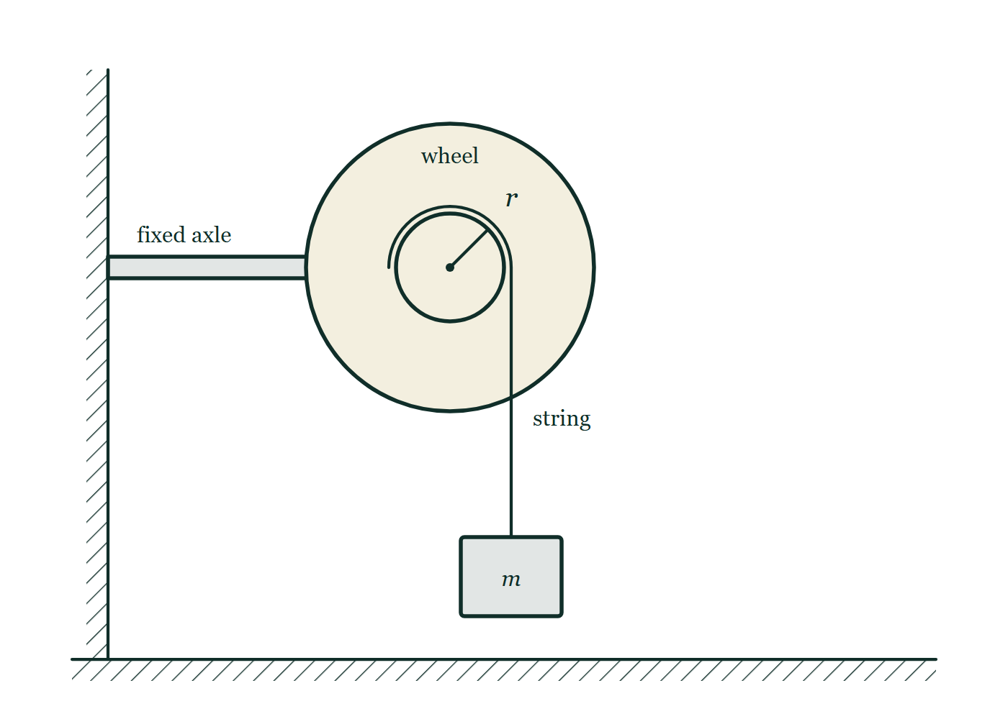
AP PHYSICS C · MECHANICS
GIOPHYSICS PRACTICE PAPER
Question 9
Free response
Calculus
Demanding
11 marks
Experimental Design and Analysis · Syllabus 5, 6
A student wants to determine experimentally the moment of inertia I of a wheel that is free to rotate about a fixed horizontal axle. A light string is wound around a hub of known radius r on the axle, and a hanging mass m is attached to the free end. When released, the mass falls and the wheel rotates. Friction in the axle is not negligible.
Fig. 9.1 — A large wheel is mounted on a fixed horizontal axle, carried on a bracket that runs out from a hatched vertical wall on the left. Concentric with the wheel and in front of it is a much smaller hub; a short line from the centre out to the hub's edge is labelled r. A string is wound over the top of the hub, leaves it tangentially on the right-hand side and hangs straight down to a rectangular block labelled m, which is suspended a short distance above a hatched horizontal floor.
AP Physics — AP Physics C · Mechanics. Written by GioPhysics from College Board AP Physics course and exam descriptions; not an awarding body's document.
21 / 28
Notes:
[Demand] Demanding — Several steps, and you have to choose them. Nothing says which comes first.
[Figure] Fig. 9.1. A large wheel is mounted on a fixed horizontal axle, carried on a bracket that runs out from a hatched vertical wall on the left. Concentric with the wheel and in front of it is a much smaller hub; a short line from the centre out to the hub's edge is labelled r. A string is wound over the top of the hub, leaves it tangentially on the right-hand side and hangs straight down to a rectangular block labelled m, which is suspended a short distance above a hatched horizontal floor.

Slide 22
AP PHYSICS C · MECHANICS
GIOPHYSICS PRACTICE PAPER
Question 9 (cont.)
Free response
Calculus
Demanding
11 marks
continued from the previous slide
(a) Describe
4 marks
Describe a procedure for measuring the linear acceleration of the falling mass, and state the quantity the student should deliberately vary between trials.
(b) Derive
4 marks
Ignoring friction for this part, derive a relationship between the acceleration a of the hanging mass and the moment of inertia I, and describe how the student should plot the data to obtain a straight line.
(c) Explain
3 marks
Explain how the presence of friction in the axle would affect the value of I obtained from the slope, and describe a modification to the analysis that would account for it.
AP Physics — AP Physics C · Mechanics. Written by GioPhysics from College Board AP Physics course and exam descriptions; not an awarding body's document.
22 / 28
Notes:
[Demand] Demanding — Several steps, and you have to choose them. Nothing says which comes first.
[Figure] Fig. 9.1. A large wheel is mounted on a fixed horizontal axle, carried on a bracket that runs out from a hatched vertical wall on the left. Concentric with the wheel and in front of it is a much smaller hub; a short line from the centre out to the hub's edge is labelled r. A string is wound over the top of the hub, leaves it tangentially on the right-hand side and hangs straight down to a rectangular block labelled m, which is suspended a short distance above a hatched horizontal floor.
[Reminder] Fig. 9.1 is on the previous slide.

Slide 23
AP PHYSICS C · MECHANICS
GIOPHYSICS PRACTICE PAPER
Answer 9
Free response
Calculus
Demanding
11 marks
Mark scheme
(a) Describe — 4 marks
SP4
✓
1 point: release the mass from rest from a measured height h and time the fall with a stopwatch or photogate
✓
1 point: obtain the acceleration from h = ½at², repeating each trial and averaging the time
✓
1 point: vary the hanging mass m between trials, keeping the hub radius and the wheel unchanged
✓
1 point: use a photogate or video rather than a hand-operated stopwatch where possible, since the fall times are short and reaction time is a significant fraction of them
(b) Derive — 4 marks
SP4
✓
1 point: for the hanging mass, mg − T = ma; for the wheel, Tr = Iα with α = a/r
✓
1 point: eliminating T gives mg = ma + Ia/r², so a = mg/(m + I/r²)
✓
1 point: rearranges to a linear form — for example 1/a = (I/r²)(1/(mg)) + 1/g
✓
1 point: plot 1/a against 1/m; the slope is I/(gr²) and the vertical intercept is 1/g
Choosing which reciprocal to plot is the substance of the task. Plotting a against m gives a curve and no usable gradient.
(c) Explain — 3 marks
SP4
✓
1 point: a frictional torque opposes the rotation, so every measured acceleration is smaller than the frictionless model predicts
✓
1 point: the analysis attributes that reduction entirely to rotational inertia, so the value of I obtained is too large
✓
1 point: include a constant frictional torque τ_f in the wheel's equation, Tr − τ_f = Iα, which adds a constant term to the linearised relationship and can be found from the intercept — or measure the torque needed to keep the wheel turning at constant speed and subtract it
AP Physics — AP Physics C · Mechanics. Written by GioPhysics from College Board AP Physics course and exam descriptions; not an awarding body's document.
23 / 28
Notes:
[Marking] One line per mark, awarded independently unless a point says otherwise.
[Examiner note (b)] Choosing which reciprocal to plot is the substance of the task. Plotting a against m gives a curve and no usable gradient.
[Figure] Fig. 9.1. A large wheel is mounted on a fixed horizontal axle, carried on a bracket that runs out from a hatched vertical wall on the left. Concentric with the wheel and in front of it is a much smaller hub; a short line from the centre out to the hub's edge is labelled r. A string is wound over the top of the hub, leaves it tangentially on the right-hand side and hangs straight down to a rectangular block labelled m, which is suspended a short distance above a hatched horizontal floor.

Slide 24
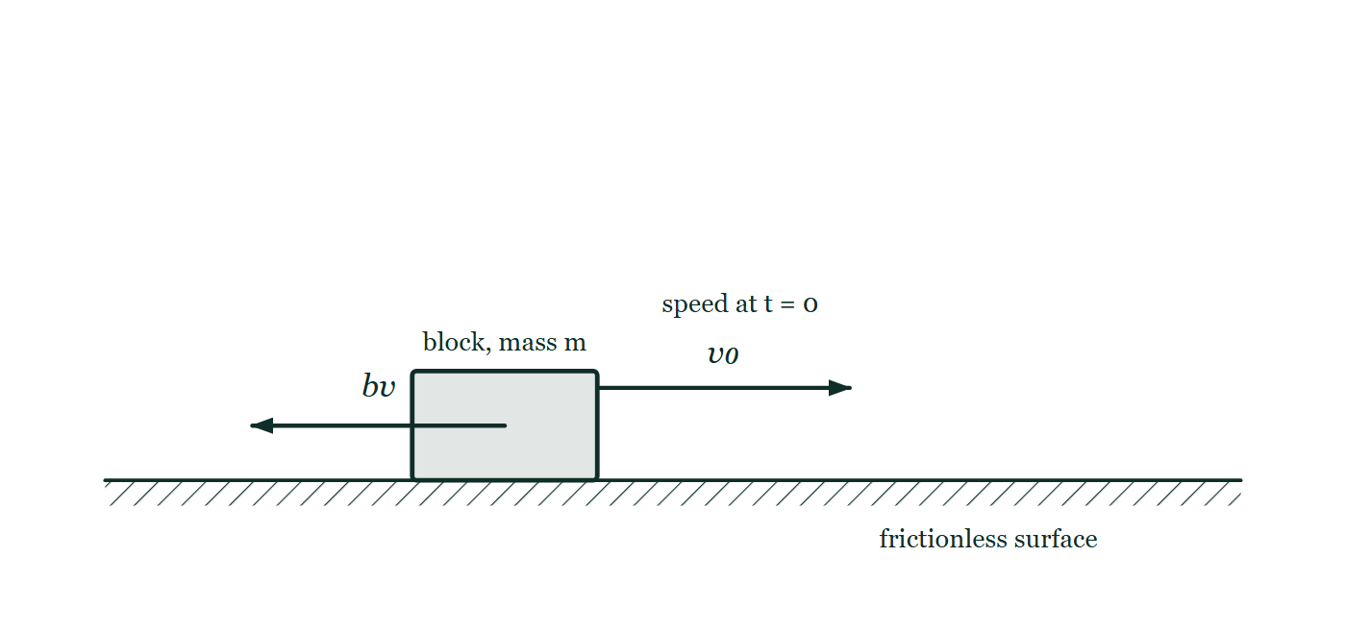
AP PHYSICS C · MECHANICS
GIOPHYSICS PRACTICE PAPER
Question 10
Free response
Calculus
Discriminating
13 marks
Qualitative/Quantitative Translation · Syllabus 2
A block of mass m slides on a frictionless horizontal surface with initial speed v₀ at t = 0. It experiences a resistive force from the surrounding air of magnitude bv, directed opposite to its velocity, where b is a positive constant.
Fig. 10.1 — A rectangular block, labelled as having mass m, sits on a hatched horizontal surface that is marked "frictionless surface". Above the block an arrow points to the right, labelled v0 and annotated as the speed at t = 0. A second arrow begins at the centre of the block and points to the left, in the direction opposite to the motion, and is labelled bv for the resistive force the surrounding air exerts. No vertical forces are drawn, and no graph of the later motion is shown.
AP Physics — AP Physics C · Mechanics. Written by GioPhysics from College Board AP Physics course and exam descriptions; not an awarding body's document.
24 / 28
Notes:
[Demand] Discriminating — The part that separates the top grade: an unfamiliar context, a derivation, or an argument that has to hold together to earn anything.
[Figure] Fig. 10.1. A rectangular block, labelled as having mass m, sits on a hatched horizontal surface that is marked "frictionless surface". Above the block an arrow points to the right, labelled v0 and annotated as the speed at t = 0. A second arrow begins at the centre of the block and points to the left, in the direction opposite to the motion, and is labelled bv for the resistive force the surrounding air exerts. No vertical forces are drawn, and no graph of the later motion is shown.

Slide 25
AP PHYSICS C · MECHANICS
GIOPHYSICS PRACTICE PAPER
Question 10 (cont.)
Free response
Calculus
Discriminating
13 marks
continued from the previous slide
(a) Derive
4 marks
Derive an expression for the speed of the block as a function of time.
(b) Determine
3 marks
Determine the total distance travelled by the block before it comes to rest.
(c) Sketch
3 marks
Sketch graphs of the speed and of the position of the block as functions of time, on separate axes.
(d) Explain
3 marks
Explain how the block can travel a finite total distance even though your expression predicts that its speed never reaches exactly zero.
AP Physics — AP Physics C · Mechanics. Written by GioPhysics from College Board AP Physics course and exam descriptions; not an awarding body's document.
25 / 28
Notes:
[Demand] Discriminating — The part that separates the top grade: an unfamiliar context, a derivation, or an argument that has to hold together to earn anything.
[Figure] Fig. 10.1. A rectangular block, labelled as having mass m, sits on a hatched horizontal surface that is marked "frictionless surface". Above the block an arrow points to the right, labelled v0 and annotated as the speed at t = 0. A second arrow begins at the centre of the block and points to the left, in the direction opposite to the motion, and is labelled bv for the resistive force the surrounding air exerts. No vertical forces are drawn, and no graph of the later motion is shown.
[Reminder] Fig. 10.1 is on the previous slide.

Slide 26
AP PHYSICS C · MECHANICS
GIOPHYSICS PRACTICE PAPER
Answer 10
Free response
Calculus
Discriminating
13 marks
Mark scheme
(a) Derive — 4 marks
SP2
✓
1 point: Newton's second law gives m dv/dt = −bv
✓
1 point: separates variables, dv/v = −(b/m)dt
✓
1 point: integrates from v₀ at t = 0 to v at t, giving ln(v/v₀) = −bt/m
✓
1 point: v(t) = v₀e^(−bt/m)
(b) Determine — 3 marks
SP2
✓
1 point: x = ∫₀^∞ v₀e^(−bt/m) dt
✓
1 point: evaluates to v₀(m/b)[−e^(−bt/m)]₀^∞
✓
1 point: x = mv₀/b, a finite distance
(c) Sketch — 3 marks
SP1
✓
1 point: speed starts at v₀, decreases, is concave up, and approaches zero asymptotically without reaching it
✓
1 point: position starts at zero with initial slope v₀ and increases
✓
1 point: position approaches the horizontal asymptote x = mv₀/b
AP Physics — AP Physics C · Mechanics. Written by GioPhysics from College Board AP Physics course and exam descriptions; not an awarding body's document.
26 / 28
Notes:
[Marking] One line per mark, awarded independently unless a point says otherwise.
[Examiner note (d)] This is the part of the task type that carries no equations at all in the rubric. A candidate who re-derives part (b) instead of explaining it earns nothing here.
[Figure] Fig. 10.1. A rectangular block, labelled as having mass m, sits on a hatched horizontal surface that is marked "frictionless surface". Above the block an arrow points to the right, labelled v0 and annotated as the speed at t = 0. A second arrow begins at the centre of the block and points to the left, in the direction opposite to the motion, and is labelled bv for the resistive force the surrounding air exerts. No vertical forces are drawn, and no graph of the later motion is shown.

Slide 27
AP PHYSICS C · MECHANICS
GIOPHYSICS PRACTICE PAPER
Answer 10 (cont.)
Free response
Calculus
Discriminating
13 marks
Mark scheme, continued
(d) Explain — 3 marks
SP3
✓
1 point: as the block slows, the resistive force also falls in proportion, so the deceleration decreases and the block never quite stops within the model
✓
1 point: the distance covered in each successive interval of time falls off exponentially
✓
1 point: the sum of those ever-smaller contributions converges, so the total distance is finite even though the time taken is unbounded — a physical situation in which "never stops" and "travels a finite distance" are both true
This is the part of the task type that carries no equations at all in the rubric. A candidate who re-derives part (b) instead of explaining it earns nothing here.
AP Physics — AP Physics C · Mechanics. Written by GioPhysics from College Board AP Physics course and exam descriptions; not an awarding body's document.
27 / 28
Notes:
[Marking] One line per mark, awarded independently unless a point says otherwise.
[Examiner note (d)] This is the part of the task type that carries no equations at all in the rubric. A candidate who re-derives part (b) instead of explaining it earns nothing here.
[Figure] Fig. 10.1. A rectangular block, labelled as having mass m, sits on a hatched horizontal surface that is marked "frictionless surface". Above the block an arrow points to the right, labelled v0 and annotated as the speed at t = 0. A second arrow begins at the centre of the block and points to the left, in the direction opposite to the motion, and is labelled bv for the resistive force the surrounding air exerts. No vertical forces are drawn, and no graph of the later motion is shown.

Slide 28
AP PHYSICS C · MECHANICS
GIOPHYSICS PRACTICE PAPER
Command words
AP Physics — the board's own definitions
Calculate
Justify
Perform mathematical steps to arrive at a final answer, including an algebraic expression, correctly substituted numbers, and units.
Provide evidence to support or defend a claim, and reasoning to explain how that evidence supports the claim.
Derive
Sketch
Perform a series of mathematical steps from a fundamental law or relationship to arrive at the desired result.
Draw a shape or trend line, without requiring exact plotted values.
Describe
Provide the relevant characteristics of a specified topic.
Determine
Arrive at a conclusion after reasoning, observation, or applying mathematical routines.
Explain
Provide information about how or why a relationship, situation or outcome occurs, using evidence and reasoning.
Indicate
Select the correct option from those provided, before giving any reasoning that is asked for.
AP Physics — AP Physics C · Mechanics. Written by GioPhysics from College Board AP Physics course and exam descriptions; not an awarding body's document.
28 / 28
Notes:
[Objectives] SP1 Creating representations: Describe, create and use models, diagrams, graphs and free-body diagrams to represent a physical situation. SP2 Mathematical routines: Determine and apply mathematical relationships, working symbolically before substituting, and check the reasonableness of a result. SP3 Scientific questioning and argumentation: Make and justify a claim with evidence and reasoning, and evaluate the claims and reasoning of others. SP4 Experimental method and data analysis: Design an experimental procedure, identify and control variables, analyse data including linearisation, and evaluate sources of error.
[Source] College Board AP Physics course and exam descriptions — https://apcentral.collegeboard.org/courses
[Disclaimer] Written by GioPhysics from the published course frameworks. These are practice exams in the style of AP Physics; they are not College Board materials, contain no released exam questions, and the official course and exam descriptions remain the authority. AP is a trademark of the College Board, which is not affiliated with and does not endorse GioPhysics.

