Slide 1
IB · THEME D · FIELDS
GIOPHYSICS PRACTICE PAPER
IB · IB Diploma Programme Physics · first assessment 2025
Theme D · Fields
Gravitational fields, electric and magnetic fields, motion of charges in electromagnetic fields, and — at HL — electromagnetic induction.
MIRRORS
Paper 1A (multiple choice), Paper 1B (data-based), and Paper 2 (short answer and extended response)
MARKS
52 in total — SL route 37, HL adds 15
TIME
60 minutes · 10 questions
DEMAND
Routine 2 · Demanding 7 · Discriminating 1
SYLLABUS
D.1, D.2, D.3, D.4
Written by GioPhysics from the published course. These are practice papers in the style of IB Diploma Programme Physics; they are not IB papers, contain no past-paper questions, and the official subject guide and data booklet remain the authority. IB is a trademark of the International Baccalaureate Organization, which is not affiliated with and does not endorse GioPhysics.
IB Diploma Physics — Theme D · Fields. Written by GioPhysics from IB Diploma Programme Physics subject page; not an awarding body's document.
1 / 26
Notes:
[Format] Paper 1 has two parts: 1A is multiple choice, and 1B is data-based questions drawn from the experimental work of the course, with no recall in it at all. Paper 2 is short-answer and extended-response across the whole syllabus. HL papers are longer and reach the HL-only sub-topics. The data booklet is provided in every paper, so no question tests whether you can remember an equation.
[Demand] The command term sets the demand, and the papers are written that way. "State" earns one mark for one line; "explain" is not creditworthy without a mechanism; "discuss" and "evaluate" need both sides weighed before a conclusion is reached. The extended-response part that closes each Paper 2 question is where HL candidates separate from one another, and those parts are pitched there rather than at the level of the calculation before them.
[Source] IB Diploma Programme Physics subject page — https://www.ibo.org/programmes/diploma-programme/curriculum/sciences/physics/
[Disclaimer] Written by GioPhysics from the published course. These are practice papers in the style of IB Diploma Programme Physics; they are not IB papers, contain no past-paper questions, and the official subject guide and data booklet remain the authority. IB is a trademark of the International Baccalaureate Organization, which is not affiliated with and does not endorse GioPhysics.

Slide 2
IB · THEME D · FIELDS
GIOPHYSICS PRACTICE PAPER
Question 1
Multiple choice
SL
Routine
1 mark
Syllabus D.1 · AO2
A planet has twice the mass and twice the radius of the Earth. The gravitational field strength at the Earth's surface is g. What is the field strength at the surface of the planet?
A
g/4
B
g/2
C
g
D
2g
IB Diploma Physics — Theme D · Fields. Written by GioPhysics from IB Diploma Programme Physics subject page; not an awarding body's document.
2 / 26
Notes:
[Demand] Routine — The standard application — the named equation, the usual graph read.

Slide 3
IB · THEME D · FIELDS
GIOPHYSICS PRACTICE PAPER
Answer 1
Multiple choice
SL
Routine
1 mark
Mark scheme
B
g/2
Why the other three are there
C is chosen by candidates who assume the two doublings cancel. In g = GM/R², the radius enters squared, so doubling both mass and radius gives 2/4 = ½.
IB Diploma Physics — Theme D · Fields. Written by GioPhysics from IB Diploma Programme Physics subject page; not an awarding body's document.
3 / 26
Notes:
[Answer] B — g/2
[Distractors] C is chosen by candidates who assume the two doublings cancel. In g = GM/R², the radius enters squared, so doubling both mass and radius gives 2/4 = ½.

Slide 4
IB · THEME D · FIELDS
GIOPHYSICS PRACTICE PAPER
Question 2
Multiple choice
SL
Demanding
1 mark
Syllabus D.2 · AO2
Two identical conducting spheres carry charges of +6.0 nC and −2.0 nC. They are touched together and then separated to their original distance apart. How does the magnitude of the force between them change?
A
It becomes zero.
B
It is reduced to one third of its original value.
C
It is reduced to one twelfth of its original value.
D
It increases to twelve times its original value.
IB Diploma Physics — Theme D · Fields. Written by GioPhysics from IB Diploma Programme Physics subject page; not an awarding body's document.
4 / 26
Notes:
[Demand] Demanding — Several steps, and you have to choose them. Nothing says which comes first.

Slide 5
IB · THEME D · FIELDS
GIOPHYSICS PRACTICE PAPER
Answer 2
Multiple choice
SL
Demanding
1 mark
Mark scheme
B
It is reduced to one third of its original value.
Why the other three are there
Touching shares the total charge of +4.0 nC equally, giving +2.0 nC on each, so the product of the charges falls from 12 nC² to 4 nC² and the force to one third. A is chosen by candidates who think the charges neutralise — they only partly do. The force also changes from attraction to repulsion, but the question asks about its magnitude.
IB Diploma Physics — Theme D · Fields. Written by GioPhysics from IB Diploma Programme Physics subject page; not an awarding body's document.
5 / 26
Notes:
[Answer] B — It is reduced to one third of its original value.
[Distractors] Touching shares the total charge of +4.0 nC equally, giving +2.0 nC on each, so the product of the charges falls from 12 nC² to 4 nC² and the force to one third. A is chosen by candidates who think the charges neutralise — they only partly do. The force also changes from attraction to repulsion, but the question asks about its magnitude.

Slide 6
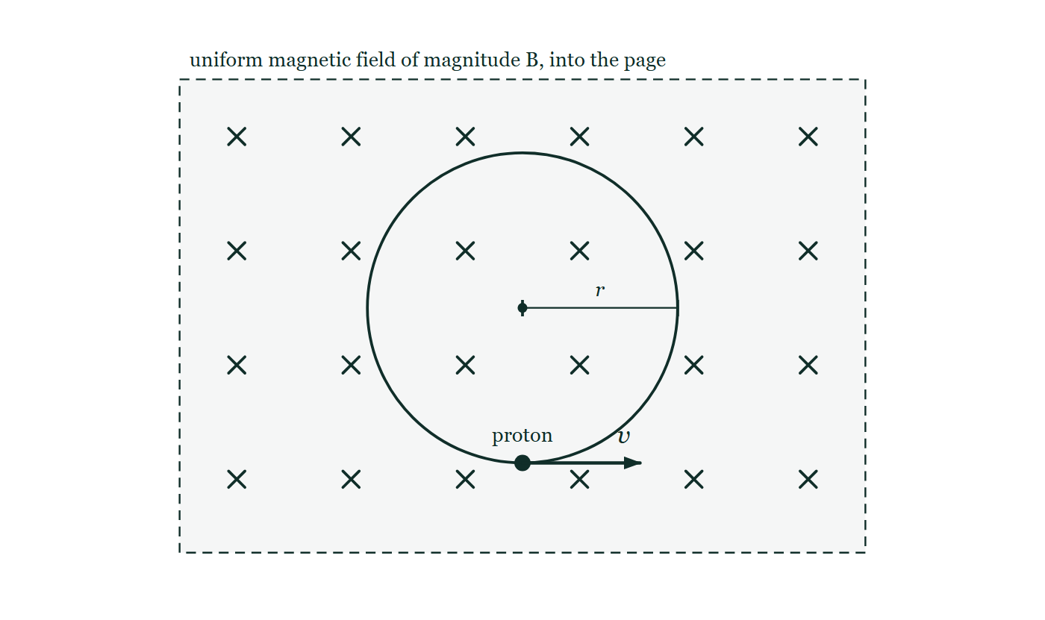
IB · THEME D · FIELDS
GIOPHYSICS PRACTICE PAPER
Question 3
Multiple choice
SL
Routine
1 mark
Syllabus D.3 · AO2
A proton moves in a circular path of radius r in a uniform magnetic field of magnitude B, perpendicular to its velocity. If the speed of the proton is doubled, what is the new radius?
Figure 1 — A rectangular region bounded by a dashed line is filled with an evenly spaced grid of crosses and labelled 'uniform magnetic field of magnitude B, into the page'. Inside the region a complete circle is drawn: the path followed by the proton. A line from the centre of the circle out to the circle is marked with a tick at each end and labelled r. A solid dot on the circle at its lowest point is labelled 'proton', and from that dot an arrow labelled v points horizontally to the right, along the tangent to the circle.
A
r/2
B
r
C
2r
D
4r
IB Diploma Physics — Theme D · Fields. Written by GioPhysics from IB Diploma Programme Physics subject page; not an awarding body's document.
6 / 26
Notes:
[Demand] Routine — The standard application — the named equation, the usual graph read.
[Figure] Figure 1. A rectangular region bounded by a dashed line is filled with an evenly spaced grid of crosses and labelled 'uniform magnetic field of magnitude B, into the page'. Inside the region a complete circle is drawn: the path followed by the proton. A line from the centre of the circle out to the circle is marked with a tick at each end and labelled r. A solid dot on the circle at its lowest point is labelled 'proton', and from that dot an arrow labelled v points horizontally to the right, along the tangent to the circle.

Slide 7
IB · THEME D · FIELDS
GIOPHYSICS PRACTICE PAPER
Answer 3
Multiple choice
SL
Routine
1 mark
Mark scheme
C
2r
Why the other three are there
B is the answer of a candidate who remembers that the period of circular motion in a magnetic field is independent of speed, which is true but is not what was asked. From r = mv/(qB), the radius is proportional to the speed.
IB Diploma Physics — Theme D · Fields. Written by GioPhysics from IB Diploma Programme Physics subject page; not an awarding body's document.
7 / 26
Notes:
[Answer] C — 2r
[Distractors] B is the answer of a candidate who remembers that the period of circular motion in a magnetic field is independent of speed, which is true but is not what was asked. From r = mv/(qB), the radius is proportional to the speed.
[Figure] Figure 1. A rectangular region bounded by a dashed line is filled with an evenly spaced grid of crosses and labelled 'uniform magnetic field of magnitude B, into the page'. Inside the region a complete circle is drawn: the path followed by the proton. A line from the centre of the circle out to the circle is marked with a tick at each end and labelled r. A solid dot on the circle at its lowest point is labelled 'proton', and from that dot an arrow labelled v points horizontally to the right, along the tangent to the circle.

Slide 8
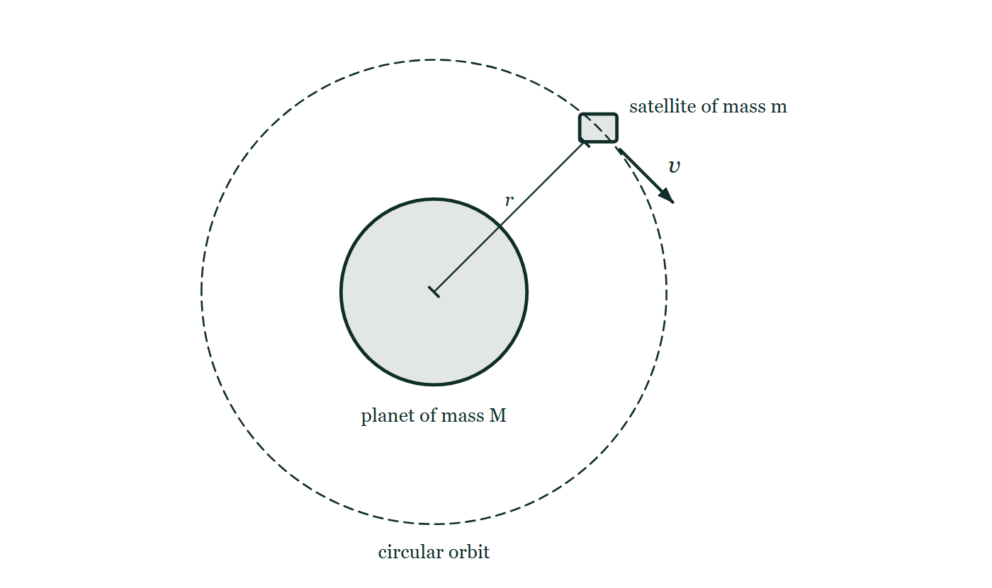
IB · THEME D · FIELDS
GIOPHYSICS PRACTICE PAPER
Question 4
Multiple choice
HL
Demanding
1 mark
Syllabus D.1 · AO2
A satellite of mass m is in a circular orbit of radius r around a planet of mass M. What is its total energy?
Figure 2 — A planet is drawn as a large shaded circle labelled 'planet of mass M'. A dashed circle, concentric with the planet and well outside it, is labelled 'circular orbit'. A small rectangle sitting on the dashed circle, above and to the right of the planet, is labelled 'satellite of mass m'. A short arrow from the satellite, drawn along the tangent to the orbit and labelled v, shows the direction in which it travels. A line runs from the centre of the planet out to the satellite and is labelled r.
A
−GMm/(2r)
B
−GMm/r
C
+GMm/(2r)
D
zero
IB Diploma Physics — Theme D · Fields. Written by GioPhysics from IB Diploma Programme Physics subject page; not an awarding body's document.
8 / 26
Notes:
[Demand] Demanding — Several steps, and you have to choose them. Nothing says which comes first.
[Figure] Figure 2. A planet is drawn as a large shaded circle labelled 'planet of mass M'. A dashed circle, concentric with the planet and well outside it, is labelled 'circular orbit'. A small rectangle sitting on the dashed circle, above and to the right of the planet, is labelled 'satellite of mass m'. A short arrow from the satellite, drawn along the tangent to the orbit and labelled v, shows the direction in which it travels. A line runs from the centre of the planet out to the satellite and is labelled r.

Slide 9
IB · THEME D · FIELDS
GIOPHYSICS PRACTICE PAPER
Answer 4
Multiple choice
HL
Demanding
1 mark
Mark scheme
A
−GMm/(2r)
Why the other three are there
B is the potential energy alone, forgetting that the satellite also has kinetic energy of +GMm/(2r). The total is negative, which is what makes the orbit bound.
IB Diploma Physics — Theme D · Fields. Written by GioPhysics from IB Diploma Programme Physics subject page; not an awarding body's document.
9 / 26
Notes:
[Answer] A — −GMm/(2r)
[Distractors] B is the potential energy alone, forgetting that the satellite also has kinetic energy of +GMm/(2r). The total is negative, which is what makes the orbit bound.
[Figure] Figure 2. A planet is drawn as a large shaded circle labelled 'planet of mass M'. A dashed circle, concentric with the planet and well outside it, is labelled 'circular orbit'. A small rectangle sitting on the dashed circle, above and to the right of the planet, is labelled 'satellite of mass m'. A short arrow from the satellite, drawn along the tangent to the orbit and labelled v, shows the direction in which it travels. A line runs from the centre of the planet out to the satellite and is labelled r.

Slide 10
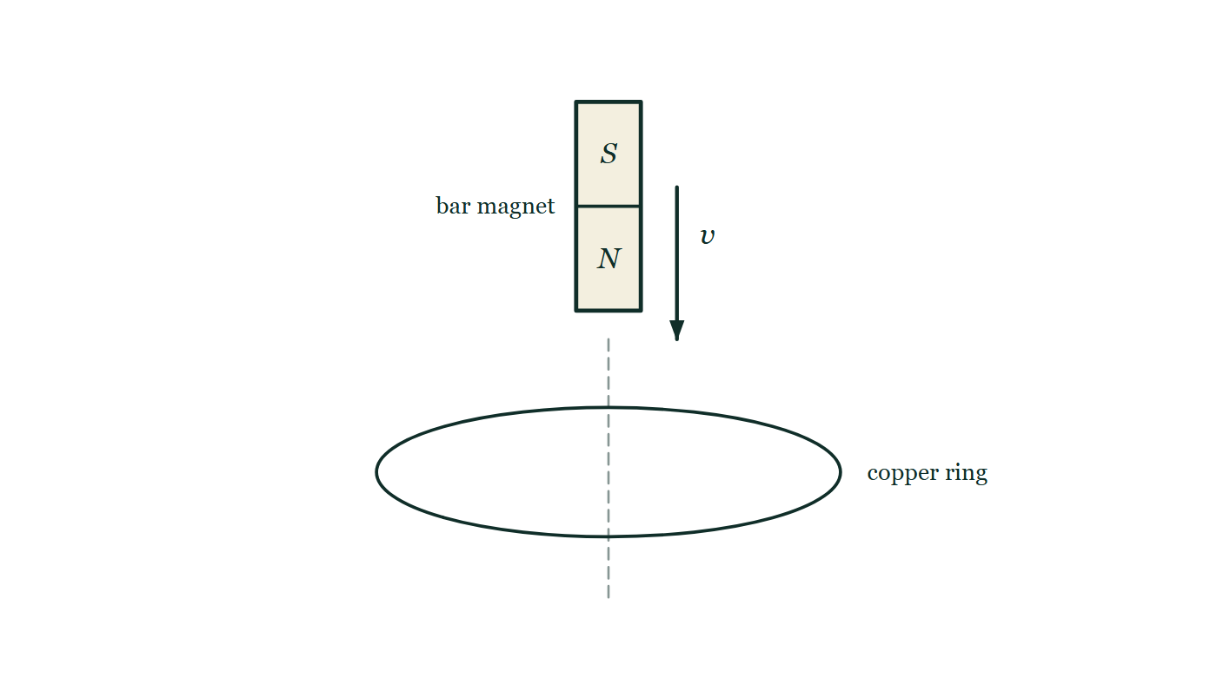
IB · THEME D · FIELDS
GIOPHYSICS PRACTICE PAPER
Question 5
Multiple choice
HL
Demanding
1 mark
Syllabus D.4 · AO2
A bar magnet is dropped, north pole downward, through a horizontal copper ring. Which describes the force on the magnet as it approaches the ring and after it has passed through?
Figure 3 — Side view. A bar magnet is drawn vertically above a horizontal copper ring, with its two halves marked S at the top and N at the bottom, so that the north pole is the end facing the ring. An arrow beside the magnet, labelled v, points vertically downward. A faint dashed line continues from the bottom of the magnet straight down through the centre of the ring, which is drawn as a flattened ellipse to show it lying horizontally, and is labelled 'copper ring'.
A
upward as it approaches, upward after it has passed
B
upward as it approaches, downward after it has passed
C
downward as it approaches, upward after it has passed
D
there is no force, because copper is not magnetic
IB Diploma Physics — Theme D · Fields. Written by GioPhysics from IB Diploma Programme Physics subject page; not an awarding body's document.
10 / 26
Notes:
[Demand] Demanding — Several steps, and you have to choose them. Nothing says which comes first.
[Figure] Figure 3. Side view. A bar magnet is drawn vertically above a horizontal copper ring, with its two halves marked S at the top and N at the bottom, so that the north pole is the end facing the ring. An arrow beside the magnet, labelled v, points vertically downward. A faint dashed line continues from the bottom of the magnet straight down through the centre of the ring, which is drawn as a flattened ellipse to show it lying horizontally, and is labelled 'copper ring'.

Slide 11
IB · THEME D · FIELDS
GIOPHYSICS PRACTICE PAPER
Answer 5
Multiple choice
HL
Demanding
1 mark
Mark scheme
A
upward as it approaches, upward after it has passed
Why the other three are there
B is the intuitive answer — the ring appears to repel then attract — but Lenz's law makes the induced effect oppose the motion in both stages. Approaching, the ring repels; receding, it attracts; and both act upward on a falling magnet. D confuses ferromagnetism with induction.
IB Diploma Physics — Theme D · Fields. Written by GioPhysics from IB Diploma Programme Physics subject page; not an awarding body's document.
11 / 26
Notes:
[Answer] A — upward as it approaches, upward after it has passed
[Distractors] B is the intuitive answer — the ring appears to repel then attract — but Lenz's law makes the induced effect oppose the motion in both stages. Approaching, the ring repels; receding, it attracts; and both act upward on a falling magnet. D confuses ferromagnetism with induction.
[Figure] Figure 3. Side view. A bar magnet is drawn vertically above a horizontal copper ring, with its two halves marked S at the top and N at the bottom, so that the north pole is the end facing the ring. An arrow beside the magnet, labelled v, points vertically downward. A faint dashed line continues from the bottom of the magnet straight down through the centre of the ring, which is drawn as a flattened ellipse to show it lying horizontally, and is labelled 'copper ring'.

Slide 12
IB · THEME D · FIELDS
GIOPHYSICS PRACTICE PAPER
Question 6
Multiple choice
HL
Demanding
1 mark
Syllabus D.2 · AO2
Which statement about equipotential surfaces and field lines is correct for any static field?
A
They are parallel to one another.
B
They are perpendicular to one another.
C
Work is done moving a charge along a field line but not along an equipotential.
D
Both B and C are correct.
IB Diploma Physics — Theme D · Fields. Written by GioPhysics from IB Diploma Programme Physics subject page; not an awarding body's document.
12 / 26
Notes:
[Demand] Demanding — Several steps, and you have to choose them. Nothing says which comes first.

Slide 13
IB · THEME D · FIELDS
GIOPHYSICS PRACTICE PAPER
Answer 6
Multiple choice
HL
Demanding
1 mark
Mark scheme
D
Both B and C are correct.
Why the other three are there
Both statements are true and follow from the same fact: if a field had a component along an equipotential, moving a charge along it would do work and the potential would change. Candidates who stop at the first true statement they meet choose B or C.
IB Diploma Physics — Theme D · Fields. Written by GioPhysics from IB Diploma Programme Physics subject page; not an awarding body's document.
13 / 26
Notes:
[Answer] D — Both B and C are correct.
[Distractors] Both statements are true and follow from the same fact: if a field had a component along an equipotential, moving a charge along it would do work and the potential would change. Candidates who stop at the first true statement they meet choose B or C.

Slide 14
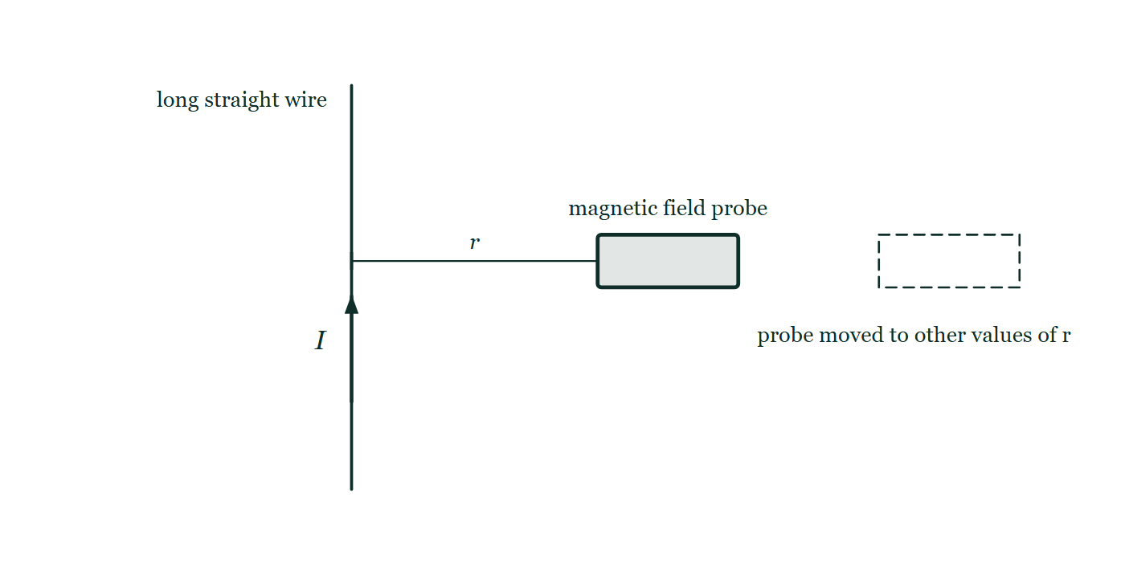
IB · THEME D · FIELDS
GIOPHYSICS PRACTICE PAPER
Question 7
Data analysis
SL
Demanding
10 marks
Syllabus D.2
A student measures the magnetic flux density B at various perpendicular distances r from a long straight wire carrying a steady current I. Theory predicts B = μ₀I/(2πr).
The student's processed data
r / m | 0.020 | 0.025 | 0.040 | 0.050 | 0.100
B / μT | 50.0 | 40.0 | 25.0 | 20.0 | 10.0
1/r / m⁻¹ | 50.0 | 40.0 | 25.0 | 20.0 | 10.0
Figure 4 — A long straight wire is drawn vertically and labelled 'long straight wire'. An arrow drawn along the wire and labelled I gives the direction of the current in it. To the right of the wire, at the same height, a small rectangle labelled 'magnetic field probe' has its near face towards the wire, and a dimension line running perpendicular from the wire to that face is labelled r. A dashed outline of the probe, drawn further to the right at the same height, carries the note 'probe moved to other values of r'.
IB Diploma Physics — Theme D · Fields. Written by GioPhysics from IB Diploma Programme Physics subject page; not an awarding body's document.
14 / 26
Notes:
[Demand] Demanding — Several steps, and you have to choose them. Nothing says which comes first.
[Figure] Figure 4. A long straight wire is drawn vertically and labelled 'long straight wire'. An arrow drawn along the wire and labelled I gives the direction of the current in it. To the right of the wire, at the same height, a small rectangle labelled 'magnetic field probe' has its near face towards the wire, and a dimension line running perpendicular from the wire to that face is labelled r. A dashed outline of the probe, drawn further to the right at the same height, carries the note 'probe moved to other values of r'.

Slide 15
IB · THEME D · FIELDS
GIOPHYSICS PRACTICE PAPER
Question 7 (cont.)
Data analysis
SL
Demanding
10 marks
continued from the previous slide
(a) Explain
2 marks
Explain why a graph of B against 1/r is plotted rather than a graph of B against r.
(b) Determine
4 marks
Determine the gradient of the line, and hence determine the current in the wire.
(c) Suggest
2 marks
The student's measurements at the largest distances scatter more about the line than those close to the wire. Suggest why.
(d) Outline
2 marks
Outline one systematic error that would make every value of B too large, and state how it would show up on the graph.
IB Diploma Physics — Theme D · Fields. Written by GioPhysics from IB Diploma Programme Physics subject page; not an awarding body's document.
15 / 26
Notes:
[Demand] Demanding — Several steps, and you have to choose them. Nothing says which comes first.
[Figure] Figure 4. A long straight wire is drawn vertically and labelled 'long straight wire'. An arrow drawn along the wire and labelled I gives the direction of the current in it. To the right of the wire, at the same height, a small rectangle labelled 'magnetic field probe' has its near face towards the wire, and a dimension line running perpendicular from the wire to that face is labelled r. A dashed outline of the probe, drawn further to the right at the same height, carries the note 'probe moved to other values of r'.
[Reminder] Figure 4 is on the previous slide.

Slide 16
IB · THEME D · FIELDS
GIOPHYSICS PRACTICE PAPER
Answer 7
Data analysis
SL
Demanding
10 marks
Mark scheme
(a) Explain — 2 marks
AO4
✓
B is inversely proportional to r, so a graph of B against r is a curve from which no constant can be read
✓
plotting against 1/r linearises the relationship, so the gradient gives μ₀I/(2π) directly and the straightness of the line tests the inverse proportionality
(b) Determine — 4 marks
AO2
✓
gradient = (50.0 − 10.0) × 10⁻⁶ / (50.0 − 10.0) = 1.0 × 10⁻⁶ T m
✓
gradient = μ₀I/(2π)
✓
I = 2π × 1.0 × 10⁻⁶ / (4π × 10⁻⁷)
✓
I = 5.0 A
(c) Suggest — 2 marks
AO3
✓
the field is weakest at large r, so the reading is a smaller fraction of the probe's full scale and the percentage uncertainty in each reading is larger
✓
the Earth's magnetic field and any stray fields are a larger fraction of the measured value at those distances
(d) Outline — 2 marks
AO3
✓
the probe not being zeroed before the measurements, or the Earth's field component along the probe not being subtracted, would add a constant to every reading
✓
the line would still be straight but would not pass through the origin — it would have a positive intercept on the B axis
The reasoning to reward is the link between the kind of error and its signature on the graph: a constant offset moves the intercept, a scale error changes the gradient.
IB Diploma Physics — Theme D · Fields. Written by GioPhysics from IB Diploma Programme Physics subject page; not an awarding body's document.
16 / 26
Notes:
[Marking] One line per mark, awarded independently unless a point says otherwise.
[Examiner note (d)] The reasoning to reward is the link between the kind of error and its signature on the graph: a constant offset moves the intercept, a scale error changes the gradient.
[Figure] Figure 4. A long straight wire is drawn vertically and labelled 'long straight wire'. An arrow drawn along the wire and labelled I gives the direction of the current in it. To the right of the wire, at the same height, a small rectangle labelled 'magnetic field probe' has its near face towards the wire, and a dimension line running perpendicular from the wire to that face is labelled r. A dashed outline of the probe, drawn further to the right at the same height, carries the note 'probe moved to other values of r'.

Slide 17
IB · THEME D · FIELDS
GIOPHYSICS PRACTICE PAPER
Question 8
Structured
SL
Demanding
12 marks
Syllabus D.1
A planet has mass 6.4 × 10²³ kg and radius 3.4 × 10⁶ m. The gravitational constant is 6.67 × 10⁻¹¹ N m² kg⁻².
(a) Calculate
2 marks
Calculate the gravitational field strength at the surface of the planet.
(b) Determine
3 marks
Determine the escape speed from the surface of the planet.
(c) Explain
3 marks
Explain why gravitational potential is always negative, and state what a gravitational potential of −1.3 × 10⁷ J kg⁻¹ at the planet's surface means.
(d) Discuss
4 marks
The planet has almost no atmosphere, while the Earth retains a substantial one. Discuss how the escape speed helps to explain this difference.
IB Diploma Physics — Theme D · Fields. Written by GioPhysics from IB Diploma Programme Physics subject page; not an awarding body's document.
17 / 26
Notes:
[Demand] Demanding — Several steps, and you have to choose them. Nothing says which comes first.

Slide 18
IB · THEME D · FIELDS
GIOPHYSICS PRACTICE PAPER
Answer 8
Structured
SL
Demanding
12 marks
Mark scheme
(a) Calculate — 2 marks
AO2
✓
g = GM/R² = 6.67 × 10⁻¹¹ × 6.4 × 10²³ / (3.4 × 10⁶)²
✓
g = 3.7 N kg⁻¹
(b) Determine — 3 marks
AO2
✓
escape requires the total energy to be zero: ½mv² = GMm/R
✓
v = √(2GM/R) = √(2 × 6.67 × 10⁻¹¹ × 6.4 × 10²³ / 3.4 × 10⁶)
✓
v = 5.0 × 10³ m s⁻¹
(c) Explain — 3 marks
AO2
✓
gravitational potential is defined as zero at infinity, and gravity is always attractive
✓
so bringing a mass in from infinity releases energy, and its potential energy must be less than zero everywhere else
✓
the value means that 1.3 × 10⁷ J of energy must be supplied to move each kilogram from the surface to infinity
(d) Discuss — 4 marks
AO3
✓
the molecules of a gas have a distribution of speeds, with some far above the mean at any temperature
✓
molecules whose speed exceeds the escape speed at the top of the atmosphere can leave the planet permanently
✓
this planet's escape speed of 5.0 km s⁻¹ is less than half the Earth's 11.2 km s⁻¹, so a much larger fraction of its molecules exceed it
✓
over geological time that fraction is lost, and the lightest gases go first — which is why any remaining atmosphere is thin and dominated by the heavier molecules
IB Diploma Physics — Theme D · Fields. Written by GioPhysics from IB Diploma Programme Physics subject page; not an awarding body's document.
18 / 26
Notes:
[Marking] One line per mark, awarded independently unless a point says otherwise.

Slide 19
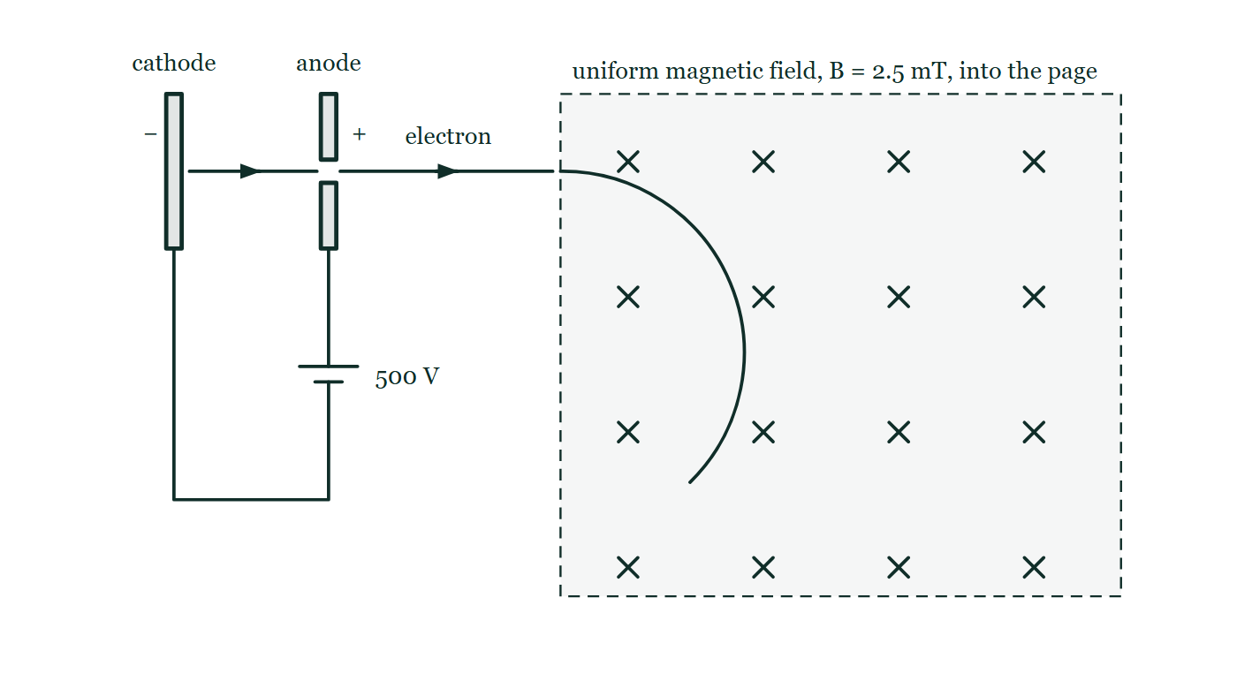
IB · THEME D · FIELDS
GIOPHYSICS PRACTICE PAPER
Question 9
Structured
SL
Demanding
12 marks
Syllabus D.2, D.3
An electron is accelerated from rest through a potential difference of 500 V and then enters a region of uniform magnetic field of magnitude 2.5 mT, travelling perpendicular to the field. The mass of an electron is 9.11 × 10⁻³¹ kg and its charge has magnitude 1.60 × 10⁻¹⁹ C.
Figure 5 — Side view of the arrangement. At the left a cathode plate marked − faces an anode plate marked + which has a small hole in it at the level of the beam; below, the two plates are joined by wires through a cell labelled 500 V, whose positive terminal is connected to the anode. Arrows show an electron leaving the cathode, passing through the hole in the anode and travelling on to the right, where it crosses into a large rectangular region drawn with a dashed boundary and filled with crosses, labelled 'uniform magnetic field, B = 2.5 mT, into the page'. Inside that region the electron's path is drawn as an arc that curves steadily downwards away from its original straight line.
IB Diploma Physics — Theme D · Fields. Written by GioPhysics from IB Diploma Programme Physics subject page; not an awarding body's document.
19 / 26
Notes:
[Demand] Demanding — Several steps, and you have to choose them. Nothing says which comes first.
[Figure] Figure 5. Side view of the arrangement. At the left a cathode plate marked − faces an anode plate marked + which has a small hole in it at the level of the beam; below, the two plates are joined by wires through a cell labelled 500 V, whose positive terminal is connected to the anode. Arrows show an electron leaving the cathode, passing through the hole in the anode and travelling on to the right, where it crosses into a large rectangular region drawn with a dashed boundary and filled with crosses, labelled 'uniform magnetic field, B = 2.5 mT, into the page'. Inside that region the electron's path is drawn as an arc that curves steadily downwards away from its original straight line.

Slide 20
IB · THEME D · FIELDS
GIOPHYSICS PRACTICE PAPER
Question 9 (cont.)
Structured
SL
Demanding
12 marks
continued from the previous slide
(a) Determine
3 marks
Determine the speed of the electron as it enters the magnetic field.
(b) Determine
3 marks
Determine the radius of the circular path followed by the electron in the field.
(c) Explain
3 marks
Explain why the speed of the electron is unchanged while it moves within the magnetic field, even though its velocity is changing continuously.
(d) Compare
3 marks
A uniform electric field is now applied in the same region instead of the magnetic field, perpendicular to the electron's initial velocity. Compare the resulting path and the resulting speed with those in the magnetic field.
IB Diploma Physics — Theme D · Fields. Written by GioPhysics from IB Diploma Programme Physics subject page; not an awarding body's document.
20 / 26
Notes:
[Demand] Demanding — Several steps, and you have to choose them. Nothing says which comes first.
[Figure] Figure 5. Side view of the arrangement. At the left a cathode plate marked − faces an anode plate marked + which has a small hole in it at the level of the beam; below, the two plates are joined by wires through a cell labelled 500 V, whose positive terminal is connected to the anode. Arrows show an electron leaving the cathode, passing through the hole in the anode and travelling on to the right, where it crosses into a large rectangular region drawn with a dashed boundary and filled with crosses, labelled 'uniform magnetic field, B = 2.5 mT, into the page'. Inside that region the electron's path is drawn as an arc that curves steadily downwards away from its original straight line.
[Reminder] Figure 5 is on the previous slide.

Slide 21
IB · THEME D · FIELDS
GIOPHYSICS PRACTICE PAPER
Answer 9
Structured
SL
Demanding
12 marks
Mark scheme
(a) Determine — 3 marks
AO2
✓
eV = ½mv²
✓
v = √(2 × 1.60 × 10⁻¹⁹ × 500 / 9.11 × 10⁻³¹)
✓
v = 1.33 × 10⁷ m s⁻¹
(b) Determine — 3 marks
AO2
✓
the magnetic force provides the centripetal force: evB = mv²/r
✓
r = mv/(eB) = 9.11 × 10⁻³¹ × 1.33 × 10⁷ / (1.60 × 10⁻¹⁹ × 2.5 × 10⁻³)
✓
r = 3.0 × 10⁻² m
(c) Explain — 3 marks
AO2
✓
the magnetic force is always perpendicular to the velocity
✓
so it has no component along the direction of motion and does no work on the electron
✓
the kinetic energy is therefore constant, and only the direction of the velocity changes
(d) Compare — 3 marks
AO3
✓
in the electric field the force is constant in magnitude and direction, so the path is parabolic rather than circular
✓
the force has a component along the velocity once the electron has been deflected, so it does work and the speed increases
✓
in the magnetic field the force turns with the velocity, keeping the path circular and the speed constant
IB Diploma Physics — Theme D · Fields. Written by GioPhysics from IB Diploma Programme Physics subject page; not an awarding body's document.
21 / 26
Notes:
[Marking] One line per mark, awarded independently unless a point says otherwise.
[Figure] Figure 5. Side view of the arrangement. At the left a cathode plate marked − faces an anode plate marked + which has a small hole in it at the level of the beam; below, the two plates are joined by wires through a cell labelled 500 V, whose positive terminal is connected to the anode. Arrows show an electron leaving the cathode, passing through the hole in the anode and travelling on to the right, where it crosses into a large rectangular region drawn with a dashed boundary and filled with crosses, labelled 'uniform magnetic field, B = 2.5 mT, into the page'. Inside that region the electron's path is drawn as an arc that curves steadily downwards away from its original straight line.

Slide 22
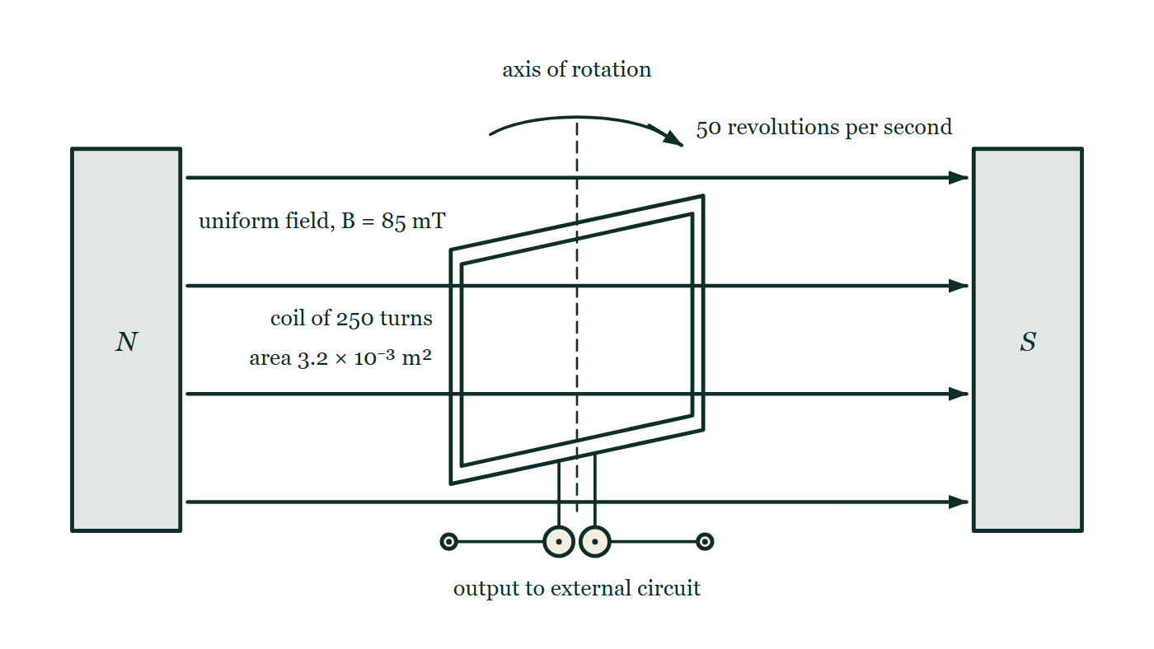
IB · THEME D · FIELDS
GIOPHYSICS PRACTICE PAPER
Question 10
Structured
HL
Discriminating
12 marks
Syllabus D.4
A flat rectangular coil of 250 turns and area 3.2 × 10⁻³ m² is rotated at a constant rate in a uniform magnetic field of magnitude 85 mT. The axis of rotation is perpendicular to the field. The coil completes 50 revolutions per second.
Figure 6 — A rectangular coil hangs between the flat faces of two poles, the north pole a block on the left and the south pole a block on the right. Four evenly spaced horizontal arrows run across the gap from the north pole to the south pole, and a note reads 'uniform field, B = 85 mT'. The coil is drawn obliquely, as a rectangle turned so that its plane lies at an angle to the field, and is labelled 'coil of 250 turns' and 'area 3.2 × 10⁻³ m²'. A vertical dashed line through the middle of the coil is labelled 'axis of rotation', with a curved arrow above it and the note '50 revolutions per second'. Two leads run down from the bottom of the coil to a pair of slip rings with brushes, whose terminals are labelled 'output to external circuit'.
IB Diploma Physics — Theme D · Fields. Written by GioPhysics from IB Diploma Programme Physics subject page; not an awarding body's document.
22 / 26
Notes:
[Demand] Discriminating — The part that separates the top grade: an unfamiliar context, a derivation, or an argument that has to hold together to earn anything.
[Figure] Figure 6. A rectangular coil hangs between the flat faces of two poles, the north pole a block on the left and the south pole a block on the right. Four evenly spaced horizontal arrows run across the gap from the north pole to the south pole, and a note reads 'uniform field, B = 85 mT'. The coil is drawn obliquely, as a rectangle turned so that its plane lies at an angle to the field, and is labelled 'coil of 250 turns' and 'area 3.2 × 10⁻³ m²'. A vertical dashed line through the middle of the coil is labelled 'axis of rotation', with a curved arrow above it and the note '50 revolutions per second'. Two leads run down from the bottom of the coil to a pair of slip rings with brushes, whose terminals are labelled 'output to external circuit'.

Slide 23
IB · THEME D · FIELDS
GIOPHYSICS PRACTICE PAPER
Question 10 (cont.)
Structured
HL
Discriminating
12 marks
continued from the previous slide
(a) State
2 marks
State Faraday's law of electromagnetic induction.
(b) Determine
3 marks
Determine the maximum e.m.f. induced in the coil.
(c) Explain
3 marks
Explain why the induced e.m.f. is zero at the instant when the plane of the coil is perpendicular to the magnetic field, even though the flux through the coil is greatest at that moment.
(d) Discuss
4 marks
The output of the coil is connected to a resistor. Discuss the energy transfers taking place, and explain why more mechanical power must be supplied to keep the coil rotating at 50 revolutions per second once the resistor is connected.
IB Diploma Physics — Theme D · Fields. Written by GioPhysics from IB Diploma Programme Physics subject page; not an awarding body's document.
23 / 26
Notes:
[Demand] Discriminating — The part that separates the top grade: an unfamiliar context, a derivation, or an argument that has to hold together to earn anything.
[Figure] Figure 6. A rectangular coil hangs between the flat faces of two poles, the north pole a block on the left and the south pole a block on the right. Four evenly spaced horizontal arrows run across the gap from the north pole to the south pole, and a note reads 'uniform field, B = 85 mT'. The coil is drawn obliquely, as a rectangle turned so that its plane lies at an angle to the field, and is labelled 'coil of 250 turns' and 'area 3.2 × 10⁻³ m²'. A vertical dashed line through the middle of the coil is labelled 'axis of rotation', with a curved arrow above it and the note '50 revolutions per second'. Two leads run down from the bottom of the coil to a pair of slip rings with brushes, whose terminals are labelled 'output to external circuit'.
[Reminder] Figure 6 is on the previous slide.

Slide 24
IB · THEME D · FIELDS
GIOPHYSICS PRACTICE PAPER
Answer 10
Structured
HL
Discriminating
12 marks
Mark scheme
(a) State — 2 marks
AO1
✓
the magnitude of the induced e.m.f. is equal to the rate of change of magnetic flux linkage
✓
expressed as ε = −N dΦ/dt, the minus sign expressing Lenz's law
(b) Determine — 3 marks
AO2
✓
ω = 2πf = 2π × 50 = 314 rad s⁻¹
✓
ε₀ = NBAω = 250 × 0.085 × 3.2 × 10⁻³ × 314
✓
ε₀ = 21 V
(c) Explain — 3 marks
AO3
✓
the induced e.m.f. depends on the rate of change of flux, not on the flux itself
✓
when the plane of the coil is perpendicular to the field the flux is at a maximum, and at a maximum its rate of change is momentarily zero
✓
so the e.m.f. is zero there and greatest a quarter of a cycle later, when the flux is passing through zero and changing fastest
The relationship between a quantity and its rate of change, tested on a case where intuition points the wrong way. This is one of the most reliably discriminating parts in the whole theme.
IB Diploma Physics — Theme D · Fields. Written by GioPhysics from IB Diploma Programme Physics subject page; not an awarding body's document.
24 / 26
Notes:
[Marking] One line per mark, awarded independently unless a point says otherwise.
[Examiner note (c)] The relationship between a quantity and its rate of change, tested on a case where intuition points the wrong way. This is one of the most reliably discriminating parts in the whole theme.
[Figure] Figure 6. A rectangular coil hangs between the flat faces of two poles, the north pole a block on the left and the south pole a block on the right. Four evenly spaced horizontal arrows run across the gap from the north pole to the south pole, and a note reads 'uniform field, B = 85 mT'. The coil is drawn obliquely, as a rectangle turned so that its plane lies at an angle to the field, and is labelled 'coil of 250 turns' and 'area 3.2 × 10⁻³ m²'. A vertical dashed line through the middle of the coil is labelled 'axis of rotation', with a curved arrow above it and the note '50 revolutions per second'. Two leads run down from the bottom of the coil to a pair of slip rings with brushes, whose terminals are labelled 'output to external circuit'.

Slide 25
IB · THEME D · FIELDS
GIOPHYSICS PRACTICE PAPER
Answer 10 (cont.)
Structured
HL
Discriminating
12 marks
Mark scheme, continued
(d) Discuss — 4 marks
AO3
✓
with the circuit closed, the induced e.m.f. drives a current through the coil and the resistor, and electrical energy is dissipated in the resistor as thermal energy
✓
the current-carrying coil sits in the magnetic field, so it experiences a torque
✓
by Lenz's law that torque opposes the rotation of the coil
✓
so an external agent must do work against it, and the mechanical power supplied equals the electrical power dissipated — energy is conserved, with the coil acting as the converter rather than the source
IB Diploma Physics — Theme D · Fields. Written by GioPhysics from IB Diploma Programme Physics subject page; not an awarding body's document.
25 / 26
Notes:
[Marking] One line per mark, awarded independently unless a point says otherwise.
[Examiner note (c)] The relationship between a quantity and its rate of change, tested on a case where intuition points the wrong way. This is one of the most reliably discriminating parts in the whole theme.
[Figure] Figure 6. A rectangular coil hangs between the flat faces of two poles, the north pole a block on the left and the south pole a block on the right. Four evenly spaced horizontal arrows run across the gap from the north pole to the south pole, and a note reads 'uniform field, B = 85 mT'. The coil is drawn obliquely, as a rectangle turned so that its plane lies at an angle to the field, and is labelled 'coil of 250 turns' and 'area 3.2 × 10⁻³ m²'. A vertical dashed line through the middle of the coil is labelled 'axis of rotation', with a curved arrow above it and the note '50 revolutions per second'. Two leads run down from the bottom of the coil to a pair of slip rings with brushes, whose terminals are labelled 'output to external circuit'.

Slide 26
IB · THEME D · FIELDS
GIOPHYSICS PRACTICE PAPER
Command words
IB Diploma Physics — the board's own definitions
Define
Discuss
Give the precise meaning of a word, phrase, concept or physical quantity.
Offer a considered and balanced review that includes a range of arguments, factors or hypotheses, supported by appropriate evidence.
State
Give a specific name, value or other brief answer without explanation or calculation.
Evaluate
Make an appraisal by weighing up the strengths and limitations.
Calculate
Explain
Obtain a numerical answer, showing the relevant stages in the working.
Give a detailed account including reasons or causes.
Describe
Show (that)
Give a detailed account.
Give the steps in a calculation or derivation.
Determine
Sketch
Obtain the only possible answer, from the data or by reasoning.
Represent by means of a graph showing a line and labelled but unscaled axes, with important features clearly identifiable.
Outline
Give a brief account or summary.
Suggest
Propose a solution, hypothesis or other possible answer.
Compare
Give an account of the similarities between two or more items, referring to both throughout.
IB Diploma Physics — Theme D · Fields. Written by GioPhysics from IB Diploma Programme Physics subject page; not an awarding body's document.
26 / 26
Notes:
[Objectives] AO1 Demonstrate knowledge: Recall facts, concepts and terminology, and state methodologies and techniques used in the course. AO2 Understand and apply knowledge: Apply concepts, terminology and techniques to familiar and unfamiliar situations, including numerical work. AO3 Analyse, evaluate and construct: Analyse and evaluate data, methods, claims and explanations, and construct a reasoned argument or conclusion. AO4 Demonstrate the application of skills: Design and evaluate investigations, handle raw and processed data, treat uncertainties, and communicate results.
[Source] IB Diploma Programme Physics subject page — https://www.ibo.org/programmes/diploma-programme/curriculum/sciences/physics/
[Disclaimer] Written by GioPhysics from the published course. These are practice papers in the style of IB Diploma Programme Physics; they are not IB papers, contain no past-paper questions, and the official subject guide and data booklet remain the authority. IB is a trademark of the International Baccalaureate Organization, which is not affiliated with and does not endorse GioPhysics.

