Slide 1
IB · THEME E · NUCLEAR AND QUANTUM PHYSICS
GIOPHYSICS PRACTICE PAPER
IB · IB Diploma Programme Physics · first assessment 2025
Theme E · Nuclear and quantum physics
Structure of the atom, radioactive decay, fission, fusion and stars, and — at HL — quantum physics.
MIRRORS
Paper 1A (multiple choice), Paper 1B (data-based), and Paper 2 (short answer and extended response)
MARKS
57 in total — SL route 43, HL adds 14
TIME
60 minutes · 10 questions
DEMAND
Routine 2 · Demanding 6 · Discriminating 2
SYLLABUS
E.1, E.2, E.3, E.4, E.5
Written by GioPhysics from the published course. These are practice papers in the style of IB Diploma Programme Physics; they are not IB papers, contain no past-paper questions, and the official subject guide and data booklet remain the authority. IB is a trademark of the International Baccalaureate Organization, which is not affiliated with and does not endorse GioPhysics.
IB Diploma Physics — Theme E · Nuclear and quantum physics. Written by GioPhysics from IB Diploma Programme Physics subject page; not an awarding body's document.
1 / 29
Notes:
[Format] Paper 1 has two parts: 1A is multiple choice, and 1B is data-based questions drawn from the experimental work of the course, with no recall in it at all. Paper 2 is short-answer and extended-response across the whole syllabus. HL papers are longer and reach the HL-only sub-topics. The data booklet is provided in every paper, so no question tests whether you can remember an equation.
[Demand] The command term sets the demand, and the papers are written that way. "State" earns one mark for one line; "explain" is not creditworthy without a mechanism; "discuss" and "evaluate" need both sides weighed before a conclusion is reached. The extended-response part that closes each Paper 2 question is where HL candidates separate from one another, and those parts are pitched there rather than at the level of the calculation before them.
[Source] IB Diploma Programme Physics subject page — https://www.ibo.org/programmes/diploma-programme/curriculum/sciences/physics/
[Disclaimer] Written by GioPhysics from the published course. These are practice papers in the style of IB Diploma Programme Physics; they are not IB papers, contain no past-paper questions, and the official subject guide and data booklet remain the authority. IB is a trademark of the International Baccalaureate Organization, which is not affiliated with and does not endorse GioPhysics.

Slide 2
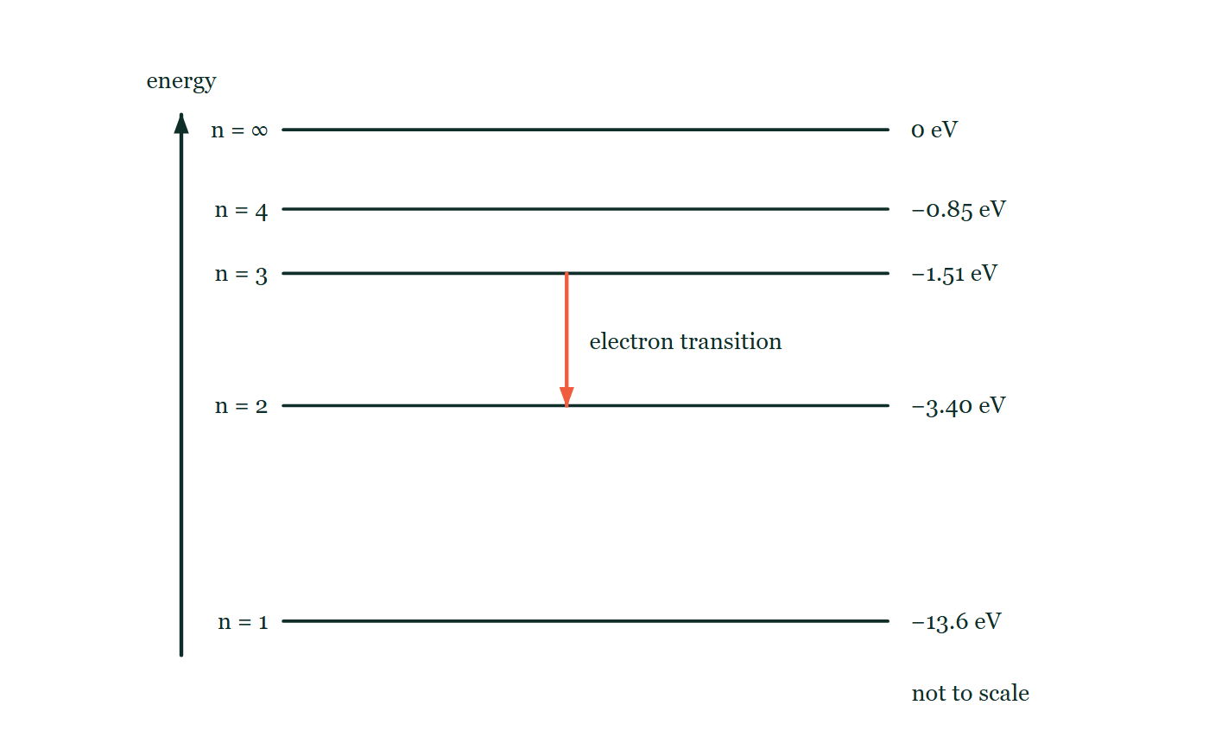
IB · THEME E · NUCLEAR AND QUANTUM PHYSICS
GIOPHYSICS PRACTICE PAPER
Question 1
Multiple choice
SL
Demanding
1 mark
Syllabus E.1 · AO2
An electron in a hydrogen atom moves from an energy level of −1.51 eV to a level of −3.40 eV. What is the wavelength of the emitted photon? (hc = 1240 eV nm)
Fig. 1.1 — An energy level diagram for a hydrogen atom, drawn not to scale, with energy increasing up the page. Five horizontal levels are shown: the ground state n = 1 at −13.6 eV, then n = 2 at −3.40 eV, n = 3 at −1.51 eV, n = 4 at −0.85 eV, and n = ∞ at 0 eV. A vertical arrow drawn between the −1.51 eV level and the −3.40 eV level points downwards, marking the electron transition the question describes.
A
254 nm
B
365 nm
C
656 nm
D
821 nm
IB Diploma Physics — Theme E · Nuclear and quantum physics. Written by GioPhysics from IB Diploma Programme Physics subject page; not an awarding body's document.
2 / 29
Notes:
[Demand] Demanding — Several steps, and you have to choose them. Nothing says which comes first.
[Figure] Fig. 1.1. An energy level diagram for a hydrogen atom, drawn not to scale, with energy increasing up the page. Five horizontal levels are shown: the ground state n = 1 at −13.6 eV, then n = 2 at −3.40 eV, n = 3 at −1.51 eV, n = 4 at −0.85 eV, and n = ∞ at 0 eV. A vertical arrow drawn between the −1.51 eV level and the −3.40 eV level points downwards, marking the electron transition the question describes.

Slide 3
IB · THEME E · NUCLEAR AND QUANTUM PHYSICS
GIOPHYSICS PRACTICE PAPER
Answer 1
Multiple choice
SL
Demanding
1 mark
Mark scheme
C
656 nm
Why the other three are there
The photon energy is the difference between the levels, 1.89 eV, giving 1240/1.89 = 656 nm. B uses 3.40 eV and D uses 1.51 eV — both are the answers of a candidate who uses one level rather than the gap between them.
IB Diploma Physics — Theme E · Nuclear and quantum physics. Written by GioPhysics from IB Diploma Programme Physics subject page; not an awarding body's document.
3 / 29
Notes:
[Answer] C — 656 nm
[Distractors] The photon energy is the difference between the levels, 1.89 eV, giving 1240/1.89 = 656 nm. B uses 3.40 eV and D uses 1.51 eV — both are the answers of a candidate who uses one level rather than the gap between them.
[Figure] Fig. 1.1. An energy level diagram for a hydrogen atom, drawn not to scale, with energy increasing up the page. Five horizontal levels are shown: the ground state n = 1 at −13.6 eV, then n = 2 at −3.40 eV, n = 3 at −1.51 eV, n = 4 at −0.85 eV, and n = ∞ at 0 eV. A vertical arrow drawn between the −1.51 eV level and the −3.40 eV level points downwards, marking the electron transition the question describes.

Slide 4
IB · THEME E · NUCLEAR AND QUANTUM PHYSICS
GIOPHYSICS PRACTICE PAPER
Question 2
Multiple choice
SL
Routine
1 mark
Syllabus E.3 · AO2
A nuclide undergoes beta-minus decay followed by alpha decay. Compared with the original nuclide, the final nuclide has:
A
4 fewer nucleons and 1 fewer proton
B
4 fewer nucleons and 2 fewer protons
C
4 fewer nucleons and 3 fewer protons
D
2 fewer nucleons and 1 fewer proton
IB Diploma Physics — Theme E · Nuclear and quantum physics. Written by GioPhysics from IB Diploma Programme Physics subject page; not an awarding body's document.
4 / 29
Notes:
[Demand] Routine — The standard application — the named equation, the usual graph read.

Slide 5
IB · THEME E · NUCLEAR AND QUANTUM PHYSICS
GIOPHYSICS PRACTICE PAPER
Answer 2
Multiple choice
SL
Routine
1 mark
Mark scheme
A
4 fewer nucleons and 1 fewer proton
Why the other three are there
Beta-minus raises the proton number by one and leaves the nucleon number unchanged; alpha lowers the proton number by two and the nucleon number by four. Net: −4 nucleons, −1 proton. B ignores the beta decay entirely.
IB Diploma Physics — Theme E · Nuclear and quantum physics. Written by GioPhysics from IB Diploma Programme Physics subject page; not an awarding body's document.
5 / 29
Notes:
[Answer] A — 4 fewer nucleons and 1 fewer proton
[Distractors] Beta-minus raises the proton number by one and leaves the nucleon number unchanged; alpha lowers the proton number by two and the nucleon number by four. Net: −4 nucleons, −1 proton. B ignores the beta decay entirely.

Slide 6
IB · THEME E · NUCLEAR AND QUANTUM PHYSICS
GIOPHYSICS PRACTICE PAPER
Question 3
Multiple choice
SL
Demanding
1 mark
Syllabus E.3 · AO2
A sample contains 8.0 × 10²⁰ nuclei of a radioactive isotope with a half-life of 12 days. How many nuclei remain undecayed after 36 days?
A
1.0 × 10²⁰
B
2.0 × 10²⁰
C
2.7 × 10²⁰
D
4.0 × 10²⁰
IB Diploma Physics — Theme E · Nuclear and quantum physics. Written by GioPhysics from IB Diploma Programme Physics subject page; not an awarding body's document.
6 / 29
Notes:
[Demand] Demanding — Several steps, and you have to choose them. Nothing says which comes first.

Slide 7
IB · THEME E · NUCLEAR AND QUANTUM PHYSICS
GIOPHYSICS PRACTICE PAPER
Answer 3
Multiple choice
SL
Demanding
1 mark
Mark scheme
A
1.0 × 10²⁰
Why the other three are there
36 days is three half-lives, so the number is halved three times: 8.0 → 4.0 → 2.0 → 1.0. C divides by three, which is the answer of a candidate treating decay as linear.
IB Diploma Physics — Theme E · Nuclear and quantum physics. Written by GioPhysics from IB Diploma Programme Physics subject page; not an awarding body's document.
7 / 29
Notes:
[Answer] A — 1.0 × 10²⁰
[Distractors] 36 days is three half-lives, so the number is halved three times: 8.0 → 4.0 → 2.0 → 1.0. C divides by three, which is the answer of a candidate treating decay as linear.

Slide 8
IB · THEME E · NUCLEAR AND QUANTUM PHYSICS
GIOPHYSICS PRACTICE PAPER
Question 4
Multiple choice
SL
Demanding
1 mark
Syllabus E.4 · AO2
Which statement about the binding energy per nucleon curve is correct?
A
It rises steadily with nucleon number across the whole range.
B
It peaks near iron, so both fusing lighter nuclei and splitting heavier nuclei release energy.
C
It peaks near uranium, which is why uranium is used as a nuclear fuel.
D
It is the energy released when a nucleus is formed from its nucleons, divided by the nucleon number, and is greatest for hydrogen.
IB Diploma Physics — Theme E · Nuclear and quantum physics. Written by GioPhysics from IB Diploma Programme Physics subject page; not an awarding body's document.
8 / 29
Notes:
[Demand] Demanding — Several steps, and you have to choose them. Nothing says which comes first.

Slide 9
IB · THEME E · NUCLEAR AND QUANTUM PHYSICS
GIOPHYSICS PRACTICE PAPER
Answer 4
Multiple choice
SL
Demanding
1 mark
Mark scheme
B
It peaks near iron, so both fusing lighter nuclei and splitting heavier nuclei release energy.
Why the other three are there
C reverses the position of the peak — uranium is used as a fuel precisely because it lies far to the right of the peak and can move towards it by splitting. D gets the definition right and the maximum wrong.
IB Diploma Physics — Theme E · Nuclear and quantum physics. Written by GioPhysics from IB Diploma Programme Physics subject page; not an awarding body's document.
9 / 29
Notes:
[Answer] B — It peaks near iron, so both fusing lighter nuclei and splitting heavier nuclei release energy.
[Distractors] C reverses the position of the peak — uranium is used as a fuel precisely because it lies far to the right of the peak and can move towards it by splitting. D gets the definition right and the maximum wrong.

Slide 10
IB · THEME E · NUCLEAR AND QUANTUM PHYSICS
GIOPHYSICS PRACTICE PAPER
Question 5
Multiple choice
SL
Routine
1 mark
Syllabus E.5 · AO2
Two stars have the same surface temperature, but star P has four times the radius of star Q. What is the ratio of their luminosities, L_P : L_Q?
A
4 : 1
B
8 : 1
C
16 : 1
D
256 : 1
IB Diploma Physics — Theme E · Nuclear and quantum physics. Written by GioPhysics from IB Diploma Programme Physics subject page; not an awarding body's document.
10 / 29
Notes:
[Demand] Routine — The standard application — the named equation, the usual graph read.

Slide 11
IB · THEME E · NUCLEAR AND QUANTUM PHYSICS
GIOPHYSICS PRACTICE PAPER
Answer 5
Multiple choice
SL
Routine
1 mark
Mark scheme
C
16 : 1
Why the other three are there
D applies the fourth power to the radius instead of to the temperature. Luminosity is 4πR²σT⁴ — the radius enters squared, the temperature to the fourth.
IB Diploma Physics — Theme E · Nuclear and quantum physics. Written by GioPhysics from IB Diploma Programme Physics subject page; not an awarding body's document.
11 / 29
Notes:
[Answer] C — 16 : 1
[Distractors] D applies the fourth power to the radius instead of to the temperature. Luminosity is 4πR²σT⁴ — the radius enters squared, the temperature to the fourth.

Slide 12
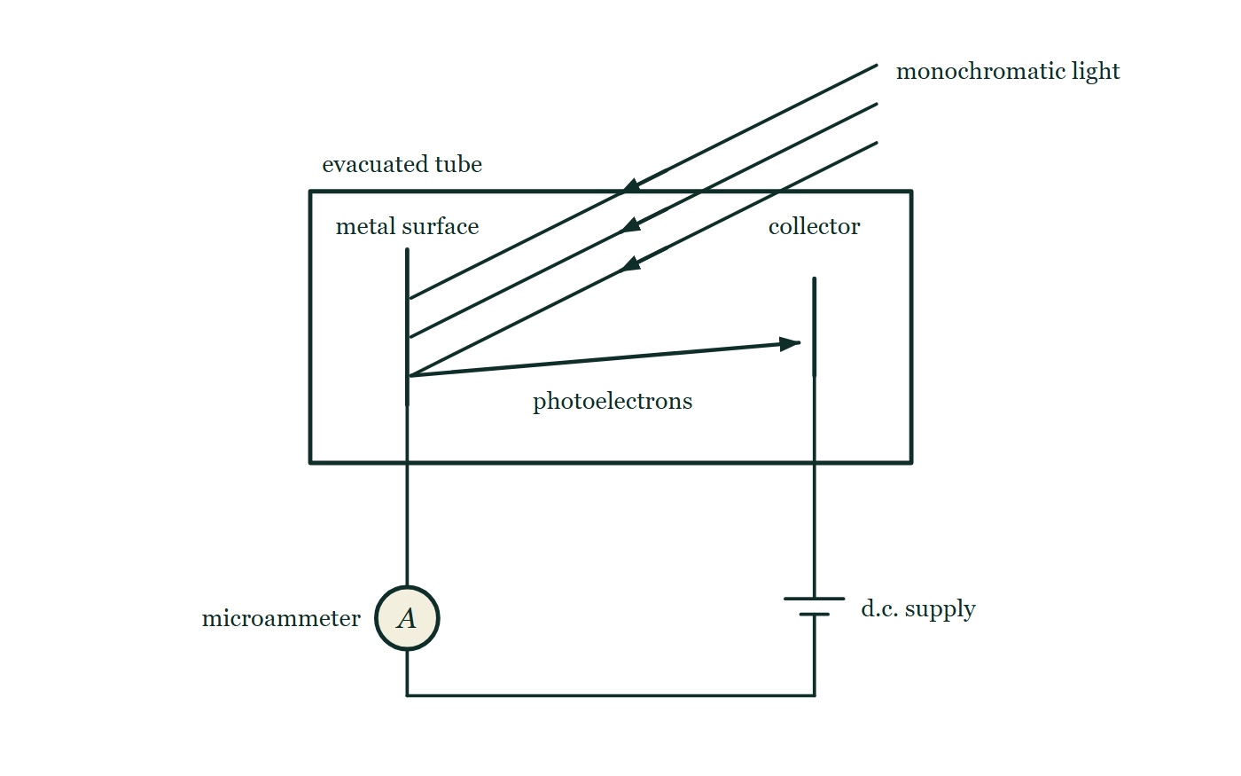
IB · THEME E · NUCLEAR AND QUANTUM PHYSICS
GIOPHYSICS PRACTICE PAPER
Question 6
Multiple choice
HL
Demanding
1 mark
Syllabus E.2 · AO2
In a photoelectric experiment, the intensity of the incident light is increased while its frequency is held constant. What happens to the maximum kinetic energy of the emitted photoelectrons and to the photocurrent?
Fig. 6.1 — A photoelectric cell drawn as an evacuated tube. Inside it a flat metal plate stands on the left and a smaller collecting electrode on the right. A beam of monochromatic light enters through the top of the tube and falls on the face of the plate that faces the collector, and an arrow across the vacuum shows photoelectrons travelling from the plate to the collector. Outside the tube the plate is connected through a microammeter and along a wire to a d.c. supply, the positive terminal of which is the one joined back to the collector.
A
both increase
B
maximum kinetic energy unchanged, photocurrent increases
C
maximum kinetic energy increases, photocurrent unchanged
D
both unchanged
IB Diploma Physics — Theme E · Nuclear and quantum physics. Written by GioPhysics from IB Diploma Programme Physics subject page; not an awarding body's document.
12 / 29
Notes:
[Demand] Demanding — Several steps, and you have to choose them. Nothing says which comes first.
[Figure] Fig. 6.1. A photoelectric cell drawn as an evacuated tube. Inside it a flat metal plate stands on the left and a smaller collecting electrode on the right. A beam of monochromatic light enters through the top of the tube and falls on the face of the plate that faces the collector, and an arrow across the vacuum shows photoelectrons travelling from the plate to the collector. Outside the tube the plate is connected through a microammeter and along a wire to a d.c. supply, the positive terminal of which is the one joined back to the collector.

Slide 13
IB · THEME E · NUCLEAR AND QUANTUM PHYSICS
GIOPHYSICS PRACTICE PAPER
Answer 6
Multiple choice
HL
Demanding
1 mark
Mark scheme
B
maximum kinetic energy unchanged, photocurrent increases
Why the other three are there
A is what the classical wave model predicts and is precisely the prediction the photoelectric effect refutes. Each photon carries hf regardless of intensity, so the maximum kinetic energy depends only on frequency; more intense light means more photons, hence more electrons per second.
IB Diploma Physics — Theme E · Nuclear and quantum physics. Written by GioPhysics from IB Diploma Programme Physics subject page; not an awarding body's document.
13 / 29
Notes:
[Answer] B — maximum kinetic energy unchanged, photocurrent increases
[Distractors] A is what the classical wave model predicts and is precisely the prediction the photoelectric effect refutes. Each photon carries hf regardless of intensity, so the maximum kinetic energy depends only on frequency; more intense light means more photons, hence more electrons per second.
[Figure] Fig. 6.1. A photoelectric cell drawn as an evacuated tube. Inside it a flat metal plate stands on the left and a smaller collecting electrode on the right. A beam of monochromatic light enters through the top of the tube and falls on the face of the plate that faces the collector, and an arrow across the vacuum shows photoelectrons travelling from the plate to the collector. Outside the tube the plate is connected through a microammeter and along a wire to a d.c. supply, the positive terminal of which is the one joined back to the collector.

Slide 14
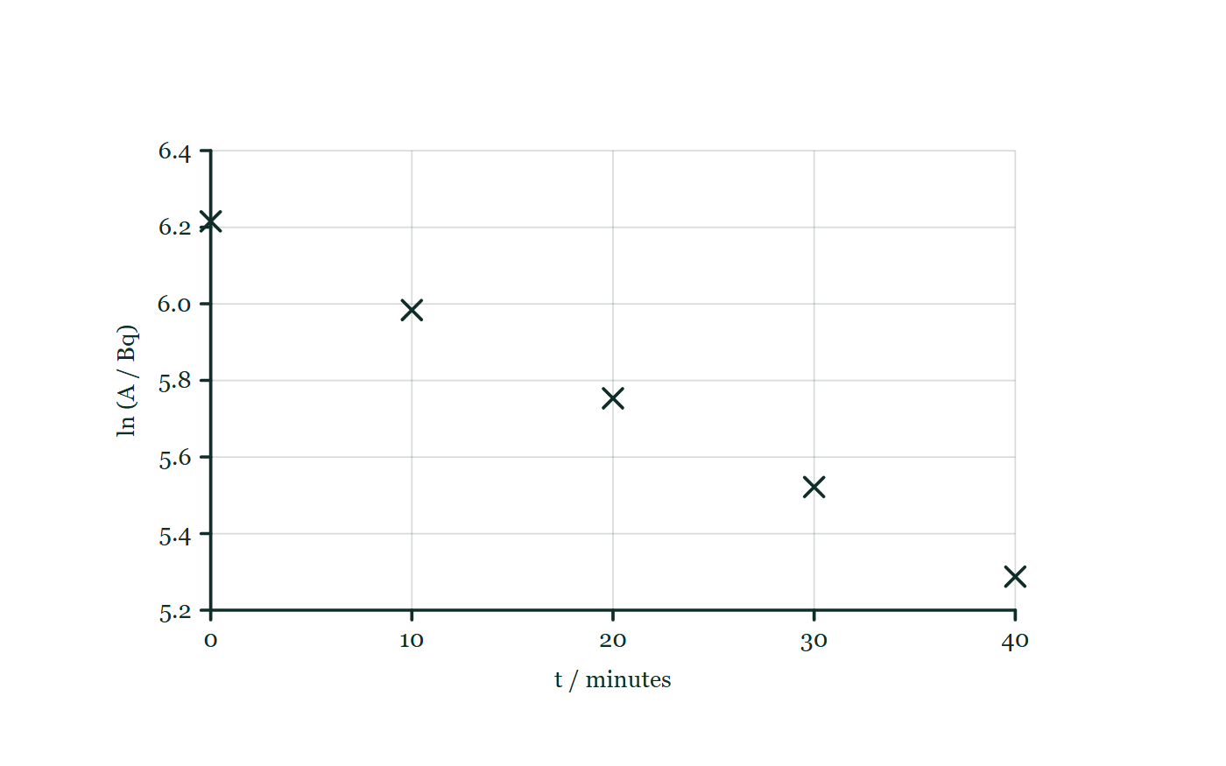
IB · THEME E · NUCLEAR AND QUANTUM PHYSICS
GIOPHYSICS PRACTICE PAPER
Question 7
Data analysis
SL
Demanding
12 marks
Syllabus E.3
A student measures the activity A of a radioactive source at intervals, correcting each reading for background. She expects A = A₀e^(−λt).
The student's processed data
t / minutes | 0 | 10 | 20 | 30 | 40
A / Bq | 500 | 397 | 315 | 250 | 198
ln (A / Bq) | 6.215 | 5.984 | 5.753 | 5.521 | 5.288
Fig. 7.1 — A gridded graph with ln (A / Bq) on the vertical axis, scaled from 5.2 to 6.4 in steps of 0.2, plotted against t / minutes on the horizontal axis, scaled from 0 to 40 in steps of 10. The five processed readings given in the table are plotted as small crosses, one at each ten-minute interval, and they fall steadily from left to right. No line has been drawn through the points.
IB Diploma Physics — Theme E · Nuclear and quantum physics. Written by GioPhysics from IB Diploma Programme Physics subject page; not an awarding body's document.
14 / 29
Notes:
[Demand] Demanding — Several steps, and you have to choose them. Nothing says which comes first.
[Figure] Fig. 7.1. A gridded graph with ln (A / Bq) on the vertical axis, scaled from 5.2 to 6.4 in steps of 0.2, plotted against t / minutes on the horizontal axis, scaled from 0 to 40 in steps of 10. The five processed readings given in the table are plotted as small crosses, one at each ten-minute interval, and they fall steadily from left to right. No line has been drawn through the points.

Slide 15
IB · THEME E · NUCLEAR AND QUANTUM PHYSICS
GIOPHYSICS PRACTICE PAPER
Question 7 (cont.)
Data analysis
SL
Demanding
12 marks
continued from the previous slide
(a) Explain
3 marks
Explain why a graph of ln A against t is plotted, and state what its gradient represents.
(b) Determine
4 marks
Determine the decay constant and hence the half-life of the source.
(c) Outline
2 marks
Outline why the readings had to be corrected for background before being processed.
(d) Explain
3 marks
The student's individual readings scatter about the line even after correction. Explain why this scatter cannot be removed by taking more care with the apparatus.
IB Diploma Physics — Theme E · Nuclear and quantum physics. Written by GioPhysics from IB Diploma Programme Physics subject page; not an awarding body's document.
15 / 29
Notes:
[Demand] Demanding — Several steps, and you have to choose them. Nothing says which comes first.
[Figure] Fig. 7.1. A gridded graph with ln (A / Bq) on the vertical axis, scaled from 5.2 to 6.4 in steps of 0.2, plotted against t / minutes on the horizontal axis, scaled from 0 to 40 in steps of 10. The five processed readings given in the table are plotted as small crosses, one at each ten-minute interval, and they fall steadily from left to right. No line has been drawn through the points.
[Reminder] Fig. 7.1 is on the previous slide.

Slide 16
IB · THEME E · NUCLEAR AND QUANTUM PHYSICS
GIOPHYSICS PRACTICE PAPER
Answer 7
Data analysis
SL
Demanding
12 marks
Mark scheme
(a) Explain — 3 marks
AO4
✓
taking natural logarithms of A = A₀e^(−λt) gives ln A = ln A₀ − λt
✓
this is linear in t, so the points lie on a straight line if the decay is exponential — which the plot therefore also tests
✓
the gradient is −λ, the negative of the decay constant
(b) Determine — 4 marks
AO2
✓
gradient = (5.288 − 6.215)/(40 − 0) = −0.0232 min⁻¹
✓
λ = 0.0232 min⁻¹
✓
t½ = ln 2 / λ = 0.693/0.0232
✓
t½ = 30 minutes
(c) Outline — 2 marks
AO3
✓
the detector registers radiation from cosmic rays, rocks and other natural sources as well as from the sample
✓
background adds a constant to every reading, which is a systematic error — it does not decay away, so an uncorrected plot of ln A against t would curve rather than being straight
IB Diploma Physics — Theme E · Nuclear and quantum physics. Written by GioPhysics from IB Diploma Programme Physics subject page; not an awarding body's document.
16 / 29
Notes:
[Marking] One line per mark, awarded independently unless a point says otherwise.
[Examiner note (d)] The distinction between an uncertainty inherent in the physics and one introduced by the measurement is a Nature of Science point the course returns to repeatedly, and radioactive decay is where it is cleanest.
[Figure] Fig. 7.1. A gridded graph with ln (A / Bq) on the vertical axis, scaled from 5.2 to 6.4 in steps of 0.2, plotted against t / minutes on the horizontal axis, scaled from 0 to 40 in steps of 10. The five processed readings given in the table are plotted as small crosses, one at each ten-minute interval, and they fall steadily from left to right. No line has been drawn through the points.

Slide 17
IB · THEME E · NUCLEAR AND QUANTUM PHYSICS
GIOPHYSICS PRACTICE PAPER
Answer 7 (cont.)
Data analysis
SL
Demanding
12 marks
Mark scheme, continued
(d) Explain — 3 marks
AO3
✓
radioactive decay is a random process — which nucleus decays, and when, cannot be predicted
✓
so the number of decays counted in any fixed interval fluctuates about a mean value, and this fluctuation is a property of the process, not of the instrument
✓
it can only be reduced by counting for longer or over more nuclei, since the fractional fluctuation falls as the total count rises — not by improving the apparatus
The distinction between an uncertainty inherent in the physics and one introduced by the measurement is a Nature of Science point the course returns to repeatedly, and radioactive decay is where it is cleanest.
IB Diploma Physics — Theme E · Nuclear and quantum physics. Written by GioPhysics from IB Diploma Programme Physics subject page; not an awarding body's document.
17 / 29
Notes:
[Marking] One line per mark, awarded independently unless a point says otherwise.
[Examiner note (d)] The distinction between an uncertainty inherent in the physics and one introduced by the measurement is a Nature of Science point the course returns to repeatedly, and radioactive decay is where it is cleanest.
[Figure] Fig. 7.1. A gridded graph with ln (A / Bq) on the vertical axis, scaled from 5.2 to 6.4 in steps of 0.2, plotted against t / minutes on the horizontal axis, scaled from 0 to 40 in steps of 10. The five processed readings given in the table are plotted as small crosses, one at each ten-minute interval, and they fall steadily from left to right. No line has been drawn through the points.

Slide 18
IB · THEME E · NUCLEAR AND QUANTUM PHYSICS
GIOPHYSICS PRACTICE PAPER
Question 8
Structured
SL
Demanding
12 marks
Syllabus E.1, E.3
The nuclide ²²⁶₈₈Ra decays by alpha emission with a half-life of 1600 years. A sealed sample initially contains 3.0 × 10²¹ radium-226 nuclei.
(a) State
2 marks
State the nucleon number and the proton number of the nuclide produced by this decay.
(b) Determine
4 marks
Determine the initial activity of the sample, in becquerel.
(c) Explain
2 marks
Explain what is meant by saying that radioactive decay is both random and spontaneous.
(d) Explain
4 marks
Explain why the emission spectrum of a gas consists of discrete lines rather than a continuous range of wavelengths, and outline what this shows about the atom.
IB Diploma Physics — Theme E · Nuclear and quantum physics. Written by GioPhysics from IB Diploma Programme Physics subject page; not an awarding body's document.
18 / 29
Notes:
[Demand] Demanding — Several steps, and you have to choose them. Nothing says which comes first.

Slide 19
IB · THEME E · NUCLEAR AND QUANTUM PHYSICS
GIOPHYSICS PRACTICE PAPER
Answer 8
Structured
SL
Demanding
12 marks
Mark scheme
(a) State — 2 marks
AO1
✓
nucleon number 222
✓
proton number 86
(b) Determine — 4 marks
AO2
✓
t½ = 1600 years = 1600 × 3.15 × 10⁷ = 5.04 × 10¹⁰ s
✓
λ = ln 2 / t½ = 0.693 / 5.04 × 10¹⁰ = 1.37 × 10⁻¹¹ s⁻¹
✓
A = λN = 1.37 × 10⁻¹¹ × 3.0 × 10²¹
✓
A = 4.1 × 10¹⁰ Bq
Converting the half-life to seconds before finding λ is worth a mark on its own, and is the step that leaves a candidate's activity out by a factor of 3 × 10⁷ when it is missed.
(c) Explain — 2 marks
AO1
✓
random: it cannot be predicted which nucleus will decay next, or when a particular nucleus will decay — only the probability per unit time is known
✓
spontaneous: the decay is unaffected by external conditions such as temperature, pressure or chemical state
IB Diploma Physics — Theme E · Nuclear and quantum physics. Written by GioPhysics from IB Diploma Programme Physics subject page; not an awarding body's document.
19 / 29
Notes:
[Marking] One line per mark, awarded independently unless a point says otherwise.
[Examiner note (b)] Converting the half-life to seconds before finding λ is worth a mark on its own, and is the step that leaves a candidate's activity out by a factor of 3 × 10⁷ when it is missed.

Slide 20
IB · THEME E · NUCLEAR AND QUANTUM PHYSICS
GIOPHYSICS PRACTICE PAPER
Answer 8 (cont.)
Structured
SL
Demanding
12 marks
Mark scheme, continued
(d) Explain — 4 marks
AO3
✓
an atom emits a photon when an electron moves from a higher to a lower energy level
✓
the photon energy equals the difference between the two levels, and its wavelength follows from E = hc/λ
✓
only certain transitions are possible, so only certain photon energies — and hence only certain wavelengths — are emitted
✓
this shows that the energy of an electron in an atom is quantised, taking only discrete values rather than any value in a range
IB Diploma Physics — Theme E · Nuclear and quantum physics. Written by GioPhysics from IB Diploma Programme Physics subject page; not an awarding body's document.
20 / 29
Notes:
[Marking] One line per mark, awarded independently unless a point says otherwise.
[Examiner note (b)] Converting the half-life to seconds before finding λ is worth a mark on its own, and is the step that leaves a candidate's activity out by a factor of 3 × 10⁷ when it is missed.

Slide 21
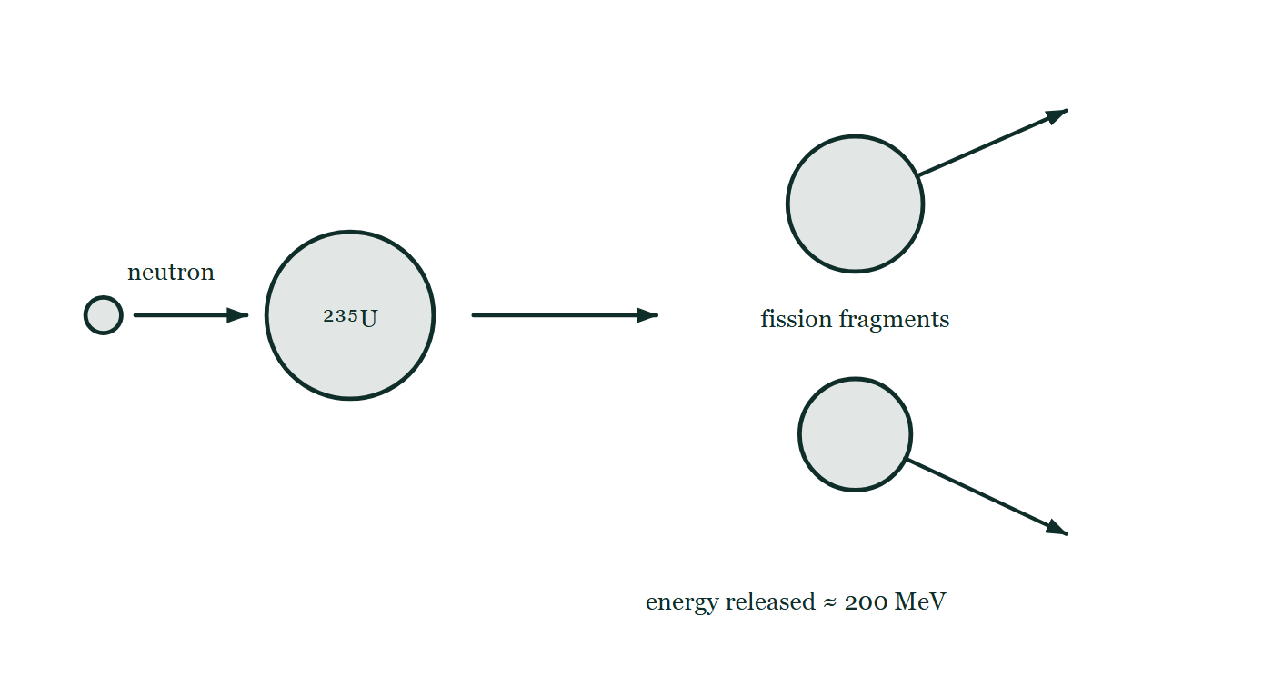
IB · THEME E · NUCLEAR AND QUANTUM PHYSICS
GIOPHYSICS PRACTICE PAPER
Question 9
Structured
SL
Discriminating
14 marks
Syllabus E.4, E.5
In one fission event, a nucleus of ²³⁵U absorbs a neutron and splits, releasing about 200 MeV of energy. In the core of the Sun, four hydrogen nuclei are effectively converted into one helium-4 nucleus, releasing about 26 MeV.
Fig. 9.1 — A schematic of a single induced fission event, read from left to right. A small neutron on the left travels to the right towards a large circle labelled ²³⁵U. An arrow from that nucleus leads to the products: two unequal fission fragments drawn as circles one above the other, each with its own arrow showing it moving away from the other. Printed below the fragments is the energy released in the event, about 200 MeV.
IB Diploma Physics — Theme E · Nuclear and quantum physics. Written by GioPhysics from IB Diploma Programme Physics subject page; not an awarding body's document.
21 / 29
Notes:
[Demand] Discriminating — The part that separates the top grade: an unfamiliar context, a derivation, or an argument that has to hold together to earn anything.
[Figure] Fig. 9.1. A schematic of a single induced fission event, read from left to right. A small neutron on the left travels to the right towards a large circle labelled ²³⁵U. An arrow from that nucleus leads to the products: two unequal fission fragments drawn as circles one above the other, each with its own arrow showing it moving away from the other. Printed below the fragments is the energy released in the event, about 200 MeV.

Slide 22
IB · THEME E · NUCLEAR AND QUANTUM PHYSICS
GIOPHYSICS PRACTICE PAPER
Question 9 (cont.)
Structured
SL
Discriminating
14 marks
continued from the previous slide
(a) Determine
4 marks
Determine the energy released, in joules, per kilogram of uranium-235 undergoing fission. The mass of a ²³⁵U atom may be taken as 3.9 × 10⁻²⁵ kg.
(b) Explain
3 marks
Explain, in terms of binding energy per nucleon, why both fission of uranium and fusion of hydrogen release energy.
(c) Explain
3 marks
Explain why extremely high temperatures are required for fusion but not for fission.
(d) Discuss
4 marks
The Sun's luminosity is 3.8 × 10²⁶ W. Discuss whether the fusion of hydrogen can account for the Sun's output over its estimated remaining lifetime of about 5 × 10⁹ years.
IB Diploma Physics — Theme E · Nuclear and quantum physics. Written by GioPhysics from IB Diploma Programme Physics subject page; not an awarding body's document.
22 / 29
Notes:
[Demand] Discriminating — The part that separates the top grade: an unfamiliar context, a derivation, or an argument that has to hold together to earn anything.
[Figure] Fig. 9.1. A schematic of a single induced fission event, read from left to right. A small neutron on the left travels to the right towards a large circle labelled ²³⁵U. An arrow from that nucleus leads to the products: two unequal fission fragments drawn as circles one above the other, each with its own arrow showing it moving away from the other. Printed below the fragments is the energy released in the event, about 200 MeV.
[Reminder] Fig. 9.1 is on the previous slide.

Slide 23
IB · THEME E · NUCLEAR AND QUANTUM PHYSICS
GIOPHYSICS PRACTICE PAPER
Answer 9
Structured
SL
Discriminating
14 marks
Mark scheme
(a) Determine — 4 marks
AO2
✓
number of nuclei per kg = 1 / 3.9 × 10⁻²⁵ = 2.56 × 10²⁴
✓
energy per fission = 200 × 10⁶ × 1.60 × 10⁻¹⁹ = 3.2 × 10⁻¹¹ J
✓
energy per kg = 2.56 × 10²⁴ × 3.2 × 10⁻¹¹
✓
= 8.2 × 10¹³ J kg⁻¹
(b) Explain — 3 marks
AO2
✓
energy is released whenever the products are more tightly bound — have a greater binding energy per nucleon — than the reactants
✓
uranium lies to the right of the peak of the curve, so its fragments are closer to iron and more tightly bound
✓
hydrogen lies far to the left, so helium formed from it is much more tightly bound
(c) Explain — 3 marks
AO2
✓
fusing nuclei are both positively charged and must be brought within range of the strong nuclear force
✓
this requires them to overcome a large electrostatic repulsion, which needs very high kinetic energies and hence very high temperatures
✓
a neutron has no charge, so it experiences no repulsion and can enter a uranium nucleus at ordinary — even low — energies
IB Diploma Physics — Theme E · Nuclear and quantum physics. Written by GioPhysics from IB Diploma Programme Physics subject page; not an awarding body's document.
23 / 29
Notes:
[Marking] One line per mark, awarded independently unless a point says otherwise.
[Examiner note (d)] An order-of-magnitude argument carried through to a judgement, which is what "discuss" asks for. A candidate whose numbers are within a factor of two and who reaches a supported conclusion earns full marks.
[Figure] Fig. 9.1. A schematic of a single induced fission event, read from left to right. A small neutron on the left travels to the right towards a large circle labelled ²³⁵U. An arrow from that nucleus leads to the products: two unequal fission fragments drawn as circles one above the other, each with its own arrow showing it moving away from the other. Printed below the fragments is the energy released in the event, about 200 MeV.

Slide 24
IB · THEME E · NUCLEAR AND QUANTUM PHYSICS
GIOPHYSICS PRACTICE PAPER
Answer 9 (cont.)
Structured
SL
Discriminating
14 marks
Mark scheme, continued
(d) Discuss — 4 marks
AO3
✓
total energy required = 3.8 × 10²⁶ × 5 × 10⁹ × 3.15 × 10⁷ = 6.0 × 10⁴³ J
✓
each helium nucleus formed releases 26 MeV = 4.2 × 10⁻¹² J, using about 6.7 × 10⁻²⁷ kg of hydrogen
✓
so the mass of hydrogen required is about 6.0 × 10⁴³ × 6.7 × 10⁻²⁷ / 4.2 × 10⁻¹² ≈ 1 × 10²⁹ kg
✓
this is around 5% of the Sun's mass of 2 × 10³⁰ kg, and since fusion occurs only in the hot dense core rather than throughout the Sun, this is consistent with the estimated lifetime
An order-of-magnitude argument carried through to a judgement, which is what "discuss" asks for. A candidate whose numbers are within a factor of two and who reaches a supported conclusion earns full marks.
IB Diploma Physics — Theme E · Nuclear and quantum physics. Written by GioPhysics from IB Diploma Programme Physics subject page; not an awarding body's document.
24 / 29
Notes:
[Marking] One line per mark, awarded independently unless a point says otherwise.
[Examiner note (d)] An order-of-magnitude argument carried through to a judgement, which is what "discuss" asks for. A candidate whose numbers are within a factor of two and who reaches a supported conclusion earns full marks.
[Figure] Fig. 9.1. A schematic of a single induced fission event, read from left to right. A small neutron on the left travels to the right towards a large circle labelled ²³⁵U. An arrow from that nucleus leads to the products: two unequal fission fragments drawn as circles one above the other, each with its own arrow showing it moving away from the other. Printed below the fragments is the energy released in the event, about 200 MeV.

Slide 25
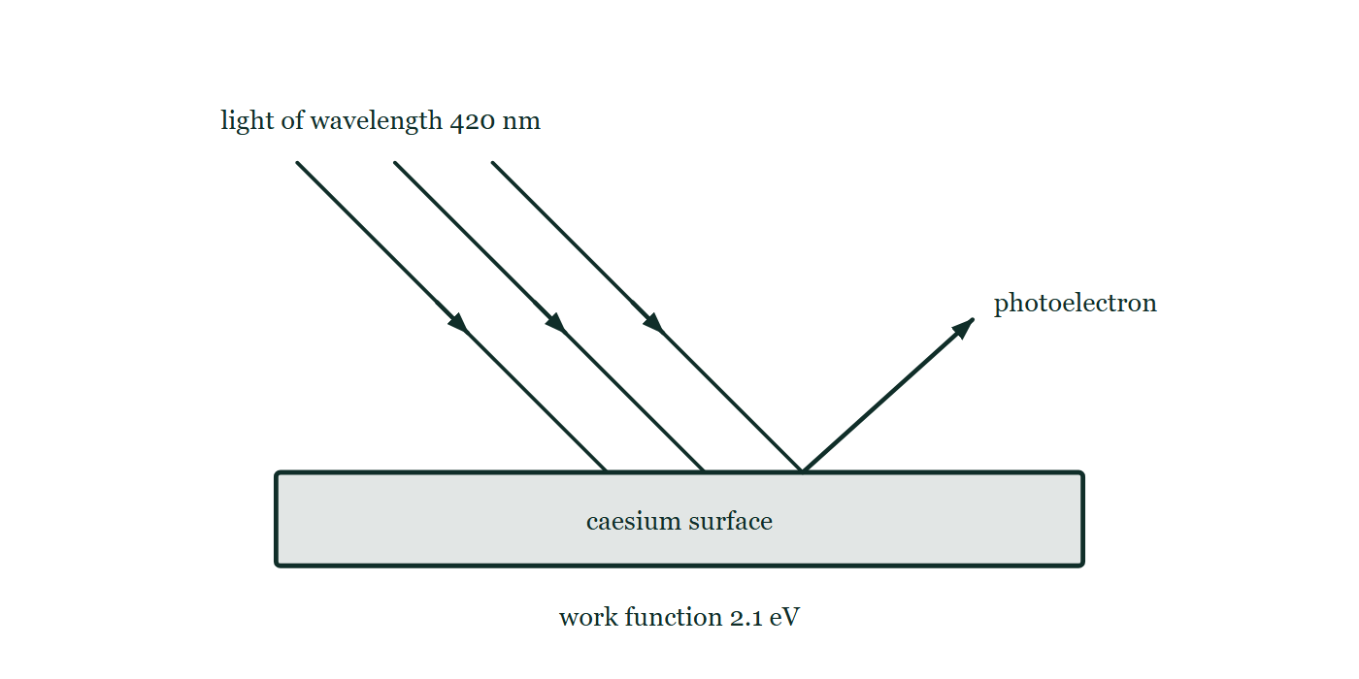
IB · THEME E · NUCLEAR AND QUANTUM PHYSICS
GIOPHYSICS PRACTICE PAPER
Question 10
Structured
HL
Discriminating
13 marks
Syllabus E.2
In a photoelectric experiment, light of wavelength 420 nm is incident on a caesium surface of work function 2.1 eV. Planck's constant is 6.63 × 10⁻³⁴ J s and hc may be taken as 1240 eV nm.
Fig. 10.1 — Three parallel rays of light of wavelength 420 nm slant down to the right and meet the flat upper face of a block labelled as a caesium surface with a work function of 2.1 eV. From a point on that same face, further to the right of where the light lands, a single arrow slants up and to the right, marking one photoelectron leaving the metal.
(a) Determine
3 marks
Determine the maximum kinetic energy of the emitted photoelectrons, in electronvolts.
IB Diploma Physics — Theme E · Nuclear and quantum physics. Written by GioPhysics from IB Diploma Programme Physics subject page; not an awarding body's document.
25 / 29
Notes:
[Demand] Discriminating — The part that separates the top grade: an unfamiliar context, a derivation, or an argument that has to hold together to earn anything.
[Figure] Fig. 10.1. Three parallel rays of light of wavelength 420 nm slant down to the right and meet the flat upper face of a block labelled as a caesium surface with a work function of 2.1 eV. From a point on that same face, further to the right of where the light lands, a single arrow slants up and to the right, marking one photoelectron leaving the metal.

Slide 26
IB · THEME E · NUCLEAR AND QUANTUM PHYSICS
GIOPHYSICS PRACTICE PAPER
Question 10 (cont.)
Structured
HL
Discriminating
13 marks
continued from the previous slide
(b) Determine
2 marks
Determine the threshold wavelength for caesium.
(c) Determine
4 marks
Determine the de Broglie wavelength of an electron emitted with the maximum kinetic energy found in (a).
(d) Explain
4 marks
Explain how the existence of a threshold frequency, and the absence of any measurable time delay before emission begins even in very dim light, together provide evidence against a purely wave model of light.
IB Diploma Physics — Theme E · Nuclear and quantum physics. Written by GioPhysics from IB Diploma Programme Physics subject page; not an awarding body's document.
26 / 29
Notes:
[Demand] Discriminating — The part that separates the top grade: an unfamiliar context, a derivation, or an argument that has to hold together to earn anything.
[Figure] Fig. 10.1. Three parallel rays of light of wavelength 420 nm slant down to the right and meet the flat upper face of a block labelled as a caesium surface with a work function of 2.1 eV. From a point on that same face, further to the right of where the light lands, a single arrow slants up and to the right, marking one photoelectron leaving the metal.
[Reminder] Fig. 10.1 is on the previous slide.

Slide 27
IB · THEME E · NUCLEAR AND QUANTUM PHYSICS
GIOPHYSICS PRACTICE PAPER
Answer 10
Structured
HL
Discriminating
13 marks
Mark scheme
(a) Determine — 3 marks
AO2
✓
photon energy = 1240/420 = 2.95 eV
✓
E_k(max) = hf − φ = 2.95 − 2.1
✓
E_k(max) = 0.85 eV
(b) Determine — 2 marks
AO2
✓
at threshold hf = φ, so λ_max = 1240/2.1
✓
λ_max = 590 nm
(c) Determine — 4 marks
AO2
✓
E_k = 0.85 × 1.60 × 10⁻¹⁹ = 1.36 × 10⁻¹⁹ J
✓
p = √(2mE_k) = √(2 × 9.11 × 10⁻³¹ × 1.36 × 10⁻¹⁹)
✓
p = 4.98 × 10⁻²⁵ kg m s⁻¹
✓
λ = h/p = 6.63 × 10⁻³⁴ / 4.98 × 10⁻²⁵ = 1.3 × 10⁻⁹ m
IB Diploma Physics — Theme E · Nuclear and quantum physics. Written by GioPhysics from IB Diploma Programme Physics subject page; not an awarding body's document.
27 / 29
Notes:
[Marking] One line per mark, awarded independently unless a point says otherwise.
[Examiner note (d)] Two separate observations, each with the wave prediction stated before the contradiction. Candidates who describe the results without saying what the wave model would have predicted earn half the marks at most, because the evidence is precisely the mismatch.
[Figure] Fig. 10.1. Three parallel rays of light of wavelength 420 nm slant down to the right and meet the flat upper face of a block labelled as a caesium surface with a work function of 2.1 eV. From a point on that same face, further to the right of where the light lands, a single arrow slants up and to the right, marking one photoelectron leaving the metal.

Slide 28
IB · THEME E · NUCLEAR AND QUANTUM PHYSICS
GIOPHYSICS PRACTICE PAPER
Answer 10 (cont.)
Structured
HL
Discriminating
13 marks
Mark scheme, continued
(d) Explain — 4 marks
AO3
✓
a wave model predicts that energy arrives continuously and spreads over the whole surface, so any frequency should eventually free an electron if the light shines long enough
✓
instead, no electrons are emitted below the threshold frequency however intense or prolonged the illumination — so the energy must arrive in single indivisible amounts of size hf
✓
a wave model also predicts a measurable delay in very dim light while an electron accumulates enough energy
✓
no such delay is observed, because a single photon delivers all of its energy to a single electron in one interaction
Two separate observations, each with the wave prediction stated before the contradiction. Candidates who describe the results without saying what the wave model would have predicted earn half the marks at most, because the evidence is precisely the mismatch.
IB Diploma Physics — Theme E · Nuclear and quantum physics. Written by GioPhysics from IB Diploma Programme Physics subject page; not an awarding body's document.
28 / 29
Notes:
[Marking] One line per mark, awarded independently unless a point says otherwise.
[Examiner note (d)] Two separate observations, each with the wave prediction stated before the contradiction. Candidates who describe the results without saying what the wave model would have predicted earn half the marks at most, because the evidence is precisely the mismatch.
[Figure] Fig. 10.1. Three parallel rays of light of wavelength 420 nm slant down to the right and meet the flat upper face of a block labelled as a caesium surface with a work function of 2.1 eV. From a point on that same face, further to the right of where the light lands, a single arrow slants up and to the right, marking one photoelectron leaving the metal.

Slide 29
IB · THEME E · NUCLEAR AND QUANTUM PHYSICS
GIOPHYSICS PRACTICE PAPER
Command words
IB Diploma Physics — the board's own definitions
Define
Discuss
Give the precise meaning of a word, phrase, concept or physical quantity.
Offer a considered and balanced review that includes a range of arguments, factors or hypotheses, supported by appropriate evidence.
State
Give a specific name, value or other brief answer without explanation or calculation.
Evaluate
Make an appraisal by weighing up the strengths and limitations.
Calculate
Explain
Obtain a numerical answer, showing the relevant stages in the working.
Give a detailed account including reasons or causes.
Describe
Show (that)
Give a detailed account.
Give the steps in a calculation or derivation.
Determine
Sketch
Obtain the only possible answer, from the data or by reasoning.
Represent by means of a graph showing a line and labelled but unscaled axes, with important features clearly identifiable.
Outline
Give a brief account or summary.
Suggest
Propose a solution, hypothesis or other possible answer.
Compare
Give an account of the similarities between two or more items, referring to both throughout.
IB Diploma Physics — Theme E · Nuclear and quantum physics. Written by GioPhysics from IB Diploma Programme Physics subject page; not an awarding body's document.
29 / 29
Notes:
[Objectives] AO1 Demonstrate knowledge: Recall facts, concepts and terminology, and state methodologies and techniques used in the course. AO2 Understand and apply knowledge: Apply concepts, terminology and techniques to familiar and unfamiliar situations, including numerical work. AO3 Analyse, evaluate and construct: Analyse and evaluate data, methods, claims and explanations, and construct a reasoned argument or conclusion. AO4 Demonstrate the application of skills: Design and evaluate investigations, handle raw and processed data, treat uncertainties, and communicate results.
[Source] IB Diploma Programme Physics subject page — https://www.ibo.org/programmes/diploma-programme/curriculum/sciences/physics/
[Disclaimer] Written by GioPhysics from the published course. These are practice papers in the style of IB Diploma Programme Physics; they are not IB papers, contain no past-paper questions, and the official subject guide and data booklet remain the authority. IB is a trademark of the International Baccalaureate Organization, which is not affiliated with and does not endorse GioPhysics.

