Slide 1
IB · THEME A · SPACE, TIME AND MOTION
GIOPHYSICS PRACTICE PAPER
IB · IB Diploma Programme Physics · first assessment 2025
Theme A · Space, time and motion
Kinematics, forces and momentum, work energy and power, and — at HL — rigid body mechanics and Galilean and special relativity.
MIRRORS
Paper 1A (multiple choice), Paper 1B (data-based), and Paper 2 (short answer and extended response)
MARKS
55 in total — SL route 39, HL adds 16
TIME
60 minutes · 10 questions
DEMAND
Routine 3 · Demanding 6 · Discriminating 1
SYLLABUS
A.1, A.2, A.3, A.4, A.5
Written by GioPhysics from the published course. These are practice papers in the style of IB Diploma Programme Physics; they are not IB papers, contain no past-paper questions, and the official subject guide and data booklet remain the authority. IB is a trademark of the International Baccalaureate Organization, which is not affiliated with and does not endorse GioPhysics.
IB Diploma Physics — Theme A · Space, time and motion. Written by GioPhysics from IB Diploma Programme Physics subject page; not an awarding body's document.
1 / 29
Notes:
[Format] Paper 1 has two parts: 1A is multiple choice, and 1B is data-based questions drawn from the experimental work of the course, with no recall in it at all. Paper 2 is short-answer and extended-response across the whole syllabus. HL papers are longer and reach the HL-only sub-topics. The data booklet is provided in every paper, so no question tests whether you can remember an equation.
[Demand] The command term sets the demand, and the papers are written that way. "State" earns one mark for one line; "explain" is not creditworthy without a mechanism; "discuss" and "evaluate" need both sides weighed before a conclusion is reached. The extended-response part that closes each Paper 2 question is where HL candidates separate from one another, and those parts are pitched there rather than at the level of the calculation before them.
[Source] IB Diploma Programme Physics subject page — https://www.ibo.org/programmes/diploma-programme/curriculum/sciences/physics/
[Disclaimer] Written by GioPhysics from the published course. These are practice papers in the style of IB Diploma Programme Physics; they are not IB papers, contain no past-paper questions, and the official subject guide and data booklet remain the authority. IB is a trademark of the International Baccalaureate Organization, which is not affiliated with and does not endorse GioPhysics.

Slide 2
IB · THEME A · SPACE, TIME AND MOTION
GIOPHYSICS PRACTICE PAPER
Question 1
Multiple choice
SL
Routine
1 mark
Syllabus A.1 · AO2
A ball is launched from level ground at 20 m s⁻¹ at an angle of 30° above the horizontal. Air resistance is negligible. How long does the ball take to reach its maximum height?
A
0.51 s
B
1.0 s
C
1.8 s
D
2.0 s
IB Diploma Physics — Theme A · Space, time and motion. Written by GioPhysics from IB Diploma Programme Physics subject page; not an awarding body's document.
2 / 29
Notes:
[Demand] Routine — The standard application — the named equation, the usual graph read.

Slide 3
IB · THEME A · SPACE, TIME AND MOTION
GIOPHYSICS PRACTICE PAPER
Answer 1
Multiple choice
SL
Routine
1 mark
Mark scheme
B
1.0 s
Why the other three are there
C uses the horizontal component, 20 cos 30°, instead of the vertical one. D is the total time of flight rather than the time to the top.
IB Diploma Physics — Theme A · Space, time and motion. Written by GioPhysics from IB Diploma Programme Physics subject page; not an awarding body's document.
3 / 29
Notes:
[Answer] B — 1.0 s
[Distractors] C uses the horizontal component, 20 cos 30°, instead of the vertical one. D is the total time of flight rather than the time to the top.

Slide 4
IB · THEME A · SPACE, TIME AND MOTION
GIOPHYSICS PRACTICE PAPER
Question 2
Multiple choice
SL
Demanding
1 mark
Syllabus A.2 · AO2
A book rests on a table. Which pair of forces is a Newton's third law pair?
A
the weight of the book and the normal force of the table on the book
B
the weight of the book and the force of the book on the table
C
the normal force of the table on the book and the force of the book on the table
D
the weight of the book and the weight of the table
IB Diploma Physics — Theme A · Space, time and motion. Written by GioPhysics from IB Diploma Programme Physics subject page; not an awarding body's document.
4 / 29
Notes:
[Demand] Demanding — Several steps, and you have to choose them. Nothing says which comes first.

Slide 5
IB · THEME A · SPACE, TIME AND MOTION
GIOPHYSICS PRACTICE PAPER
Answer 2
Multiple choice
SL
Demanding
1 mark
Mark scheme
C
the normal force of the table on the book and the force of the book on the table
Why the other three are there
A is chosen by most candidates because the two forces are equal and opposite — but they act on the same body and are of different types, so they are a balanced pair, not a third law pair. A third law pair acts on two different bodies and is always the same kind of force.
IB Diploma Physics — Theme A · Space, time and motion. Written by GioPhysics from IB Diploma Programme Physics subject page; not an awarding body's document.
5 / 29
Notes:
[Answer] C — the normal force of the table on the book and the force of the book on the table
[Distractors] A is chosen by most candidates because the two forces are equal and opposite — but they act on the same body and are of different types, so they are a balanced pair, not a third law pair. A third law pair acts on two different bodies and is always the same kind of force.

Slide 6
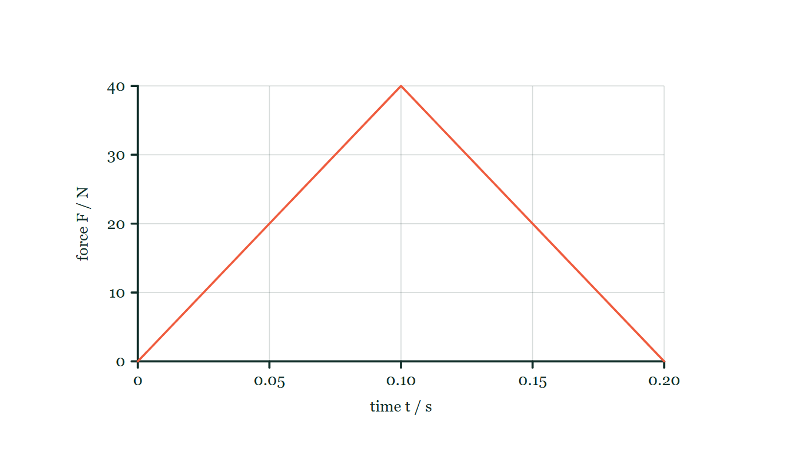
IB · THEME A · SPACE, TIME AND MOTION
GIOPHYSICS PRACTICE PAPER
Question 3
Multiple choice
SL
Routine
1 mark
Syllabus A.2 · AO2
A resultant force acts on a stationary object of mass 0.50 kg. The force–time graph is a triangle rising from zero at t = 0 to a peak of 40 N at t = 0.10 s and falling back to zero at t = 0.20 s. What is the speed of the object at t = 0.20 s?
Figure 1 — A graph of force F / N against time t / s on gridded axes, the force axis marked 0 to 40 N and the time axis 0 to 0.20 s. The plotted line rises straight from the origin to 40 N at t = 0.10 s and falls straight back to zero at t = 0.20 s, so the trace is a triangle standing on the time axis.
A
4.0 m s⁻¹
B
8.0 m s⁻¹
C
16 m s⁻¹
D
20 m s⁻¹
IB Diploma Physics — Theme A · Space, time and motion. Written by GioPhysics from IB Diploma Programme Physics subject page; not an awarding body's document.
6 / 29
Notes:
[Demand] Routine — The standard application — the named equation, the usual graph read.
[Figure] Figure 1. A graph of force F / N against time t / s on gridded axes, the force axis marked 0 to 40 N and the time axis 0 to 0.20 s. The plotted line rises straight from the origin to 40 N at t = 0.10 s and falls straight back to zero at t = 0.20 s, so the trace is a triangle standing on the time axis.

Slide 7
IB · THEME A · SPACE, TIME AND MOTION
GIOPHYSICS PRACTICE PAPER
Answer 3
Multiple choice
SL
Routine
1 mark
Mark scheme
B
8.0 m s⁻¹
Why the other three are there
The impulse is the area under the graph, ½ × 0.20 × 40 = 4.0 N s, and dividing by the mass gives 8.0 m s⁻¹. C treats the graph as a rectangle of height 40 N; A stops at the impulse and forgets to divide by the mass.
IB Diploma Physics — Theme A · Space, time and motion. Written by GioPhysics from IB Diploma Programme Physics subject page; not an awarding body's document.
7 / 29
Notes:
[Answer] B — 8.0 m s⁻¹
[Distractors] The impulse is the area under the graph, ½ × 0.20 × 40 = 4.0 N s, and dividing by the mass gives 8.0 m s⁻¹. C treats the graph as a rectangle of height 40 N; A stops at the impulse and forgets to divide by the mass.
[Figure] Figure 1. A graph of force F / N against time t / s on gridded axes, the force axis marked 0 to 40 N and the time axis 0 to 0.20 s. The plotted line rises straight from the origin to 40 N at t = 0.10 s and falls straight back to zero at t = 0.20 s, so the trace is a triangle standing on the time axis.

Slide 8
IB · THEME A · SPACE, TIME AND MOTION
GIOPHYSICS PRACTICE PAPER
Question 4
Multiple choice
SL
Routine
1 mark
Syllabus A.3 · AO2
A crane lifts a load of mass 250 kg through a vertical height of 12 m in 8.0 s at constant speed. What is the useful output power of the crane?
A
375 W
B
2.5 kW
C
3.7 kW
D
29 kW
IB Diploma Physics — Theme A · Space, time and motion. Written by GioPhysics from IB Diploma Programme Physics subject page; not an awarding body's document.
8 / 29
Notes:
[Demand] Routine — The standard application — the named equation, the usual graph read.

Slide 9
IB · THEME A · SPACE, TIME AND MOTION
GIOPHYSICS PRACTICE PAPER
Answer 4
Multiple choice
SL
Routine
1 mark
Mark scheme
C
3.7 kW
Why the other three are there
D is the work done rather than the power, with the division by time omitted. B omits g.
IB Diploma Physics — Theme A · Space, time and motion. Written by GioPhysics from IB Diploma Programme Physics subject page; not an awarding body's document.
9 / 29
Notes:
[Answer] C — 3.7 kW
[Distractors] D is the work done rather than the power, with the division by time omitted. B omits g.

Slide 10
IB · THEME A · SPACE, TIME AND MOTION
GIOPHYSICS PRACTICE PAPER
Question 5
Multiple choice
HL
Demanding
1 mark
Syllabus A.4 · AO2
A disc of moment of inertia I rotates freely about a vertical axis at angular speed ω. A second, stationary disc of moment of inertia 2I is dropped onto it and the two rotate together. What is the new angular speed?
A
ω/3
B
ω/2
C
2ω/3
D
3ω
IB Diploma Physics — Theme A · Space, time and motion. Written by GioPhysics from IB Diploma Programme Physics subject page; not an awarding body's document.
10 / 29
Notes:
[Demand] Demanding — Several steps, and you have to choose them. Nothing says which comes first.

Slide 11
IB · THEME A · SPACE, TIME AND MOTION
GIOPHYSICS PRACTICE PAPER
Answer 5
Multiple choice
HL
Demanding
1 mark
Mark scheme
A
ω/3
Why the other three are there
No external torque acts about the axis, so Iω = (I + 2I)ω′ and ω′ = ω/3. B is the answer of a candidate who assumes the second disc is identical to the first.
IB Diploma Physics — Theme A · Space, time and motion. Written by GioPhysics from IB Diploma Programme Physics subject page; not an awarding body's document.
11 / 29
Notes:
[Answer] A — ω/3
[Distractors] No external torque acts about the axis, so Iω = (I + 2I)ω′ and ω′ = ω/3. B is the answer of a candidate who assumes the second disc is identical to the first.

Slide 12
IB · THEME A · SPACE, TIME AND MOTION
GIOPHYSICS PRACTICE PAPER
Question 6
Multiple choice
HL
Demanding
1 mark
Syllabus A.5 · AO2
A spacecraft travels past Earth at 0.60c. A clock on board measures a time interval of 2.0 s between two events that occur at the same place on the spacecraft. What is the interval between those events as measured from Earth?
A
1.2 s
B
1.6 s
C
2.5 s
D
3.3 s
IB Diploma Physics — Theme A · Space, time and motion. Written by GioPhysics from IB Diploma Programme Physics subject page; not an awarding body's document.
12 / 29
Notes:
[Demand] Demanding — Several steps, and you have to choose them. Nothing says which comes first.

Slide 13
IB · THEME A · SPACE, TIME AND MOTION
GIOPHYSICS PRACTICE PAPER
Answer 6
Multiple choice
HL
Demanding
1 mark
Mark scheme
C
2.5 s
Why the other three are there
A and B are shorter than the proper time, which no observer can measure — the proper time is always the shortest interval between two events, so the Earth reading must be larger. With γ = 1.25, the answer is 2.5 s.
IB Diploma Physics — Theme A · Space, time and motion. Written by GioPhysics from IB Diploma Programme Physics subject page; not an awarding body's document.
13 / 29
Notes:
[Answer] C — 2.5 s
[Distractors] A and B are shorter than the proper time, which no observer can measure — the proper time is always the shortest interval between two events, so the Earth reading must be larger. With γ = 1.25, the answer is 2.5 s.

Slide 14
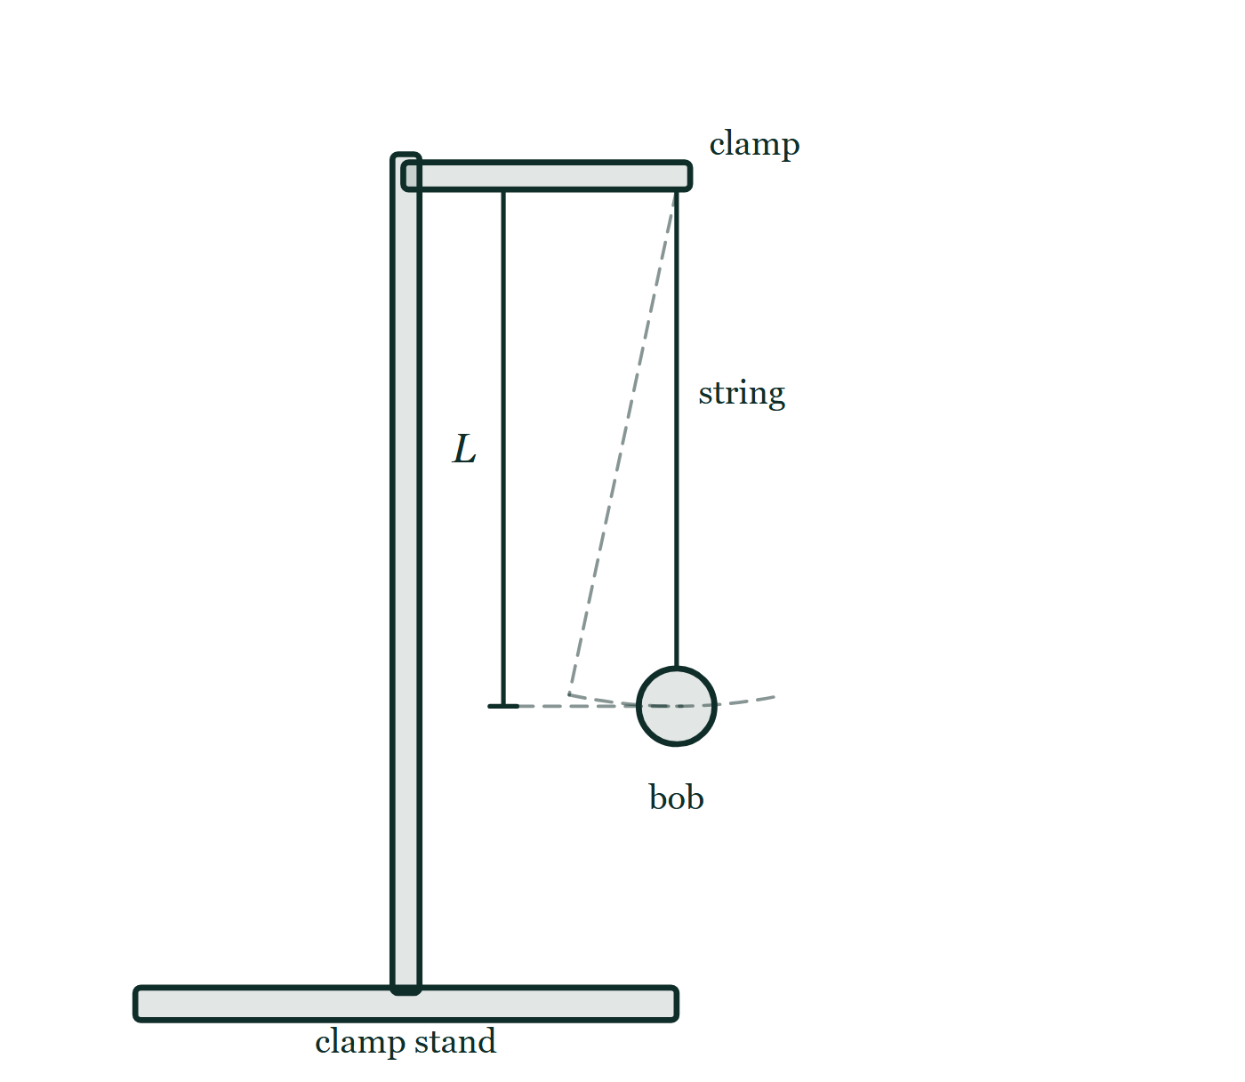
IB · THEME A · SPACE, TIME AND MOTION
GIOPHYSICS PRACTICE PAPER
Question 7
Data analysis
SL
Demanding
12 marks
Syllabus A.1
A student determines the acceleration of free fall using a simple pendulum. She measures the period T for several lengths L and processes the data as shown. Theory predicts T = 2π√(L/g).
The student's processed data
L / m | 0.400 | 0.600 | 0.800 | 1.000 | 1.200
T / s | 1.269 | 1.554 | 1.794 | 2.006 | 2.198
T² / s² | 1.610 | 2.415 | 3.219 | 4.024 | 4.829
Figure 2 — Side view of the apparatus. A vertical rod in a heavy base carries a horizontal clamp arm, and a string hangs from the clamp jaws with a small spherical bob tied to its lower end. A dimension line beside the string marks the length L, running from the point of suspension down to the centre of the bob. A dashed line shows the string displaced to one side and a dashed arc through the bob shows the path it follows as it swings.
IB Diploma Physics — Theme A · Space, time and motion. Written by GioPhysics from IB Diploma Programme Physics subject page; not an awarding body's document.
14 / 29
Notes:
[Demand] Demanding — Several steps, and you have to choose them. Nothing says which comes first.
[Figure] Figure 2. Side view of the apparatus. A vertical rod in a heavy base carries a horizontal clamp arm, and a string hangs from the clamp jaws with a small spherical bob tied to its lower end. A dimension line beside the string marks the length L, running from the point of suspension down to the centre of the bob. A dashed line shows the string displaced to one side and a dashed arc through the bob shows the path it follows as it swings.

Slide 15
IB · THEME A · SPACE, TIME AND MOTION
GIOPHYSICS PRACTICE PAPER
Question 7 (cont.)
Data analysis
SL
Demanding
12 marks
continued from the previous slide
(a) Show (that)
3 marks
Show that a graph of T² against L should be a straight line through the origin, and state an expression for its gradient.
(b) Determine
3 marks
Determine the gradient of the line, and hence determine a value for g.
(c) Outline
3 marks
The uncertainty in each value of L is ±0.005 m and the uncertainty in each value of T is ±0.002 s. Outline why the uncertainty in T² is not ±0.002 s², and determine the uncertainty in T² for the shortest pendulum.
(d) Evaluate
3 marks
The student's line of best fit has a small positive intercept on the T² axis rather than passing through the origin. Evaluate two possible reasons for this.
IB Diploma Physics — Theme A · Space, time and motion. Written by GioPhysics from IB Diploma Programme Physics subject page; not an awarding body's document.
15 / 29
Notes:
[Demand] Demanding — Several steps, and you have to choose them. Nothing says which comes first.
[Figure] Figure 2. Side view of the apparatus. A vertical rod in a heavy base carries a horizontal clamp arm, and a string hangs from the clamp jaws with a small spherical bob tied to its lower end. A dimension line beside the string marks the length L, running from the point of suspension down to the centre of the bob. A dashed line shows the string displaced to one side and a dashed arc through the bob shows the path it follows as it swings.
[Reminder] Figure 2 is on the previous slide.

Slide 16
IB · THEME A · SPACE, TIME AND MOTION
GIOPHYSICS PRACTICE PAPER
Answer 7
Data analysis
SL
Demanding
12 marks
Mark scheme
(a) Show (that) — 3 marks
AO2
✓
squares the relationship: T² = 4π²L/g
✓
this is of the form y = mx with no constant term, so the line passes through the origin
✓
gradient = 4π²/g
(b) Determine — 3 marks
AO2
✓
gradient = (4.829 − 1.610) / (1.200 − 0.400) = 3.219 / 0.800
✓
gradient = 4.02 s² m⁻¹
✓
g = 4π²/4.02 = 9.8 m s⁻²
(c) Outline — 3 marks
AO4
✓
squaring a quantity doubles its fractional (percentage) uncertainty, so the absolute uncertainty is not carried through unchanged
✓
fractional uncertainty in T = 0.002/1.269 = 0.16%, so fractional uncertainty in T² = 0.32%
✓
uncertainty in T² = 0.0032 × 1.610 = ±0.005 s²
IB Diploma Physics — Theme A · Space, time and motion. Written by GioPhysics from IB Diploma Programme Physics subject page; not an awarding body's document.
16 / 29
Notes:
[Marking] One line per mark, awarded independently unless a point says otherwise.
[Examiner note (d)] The third mark is for choosing between the two rather than listing both. "Evaluate" asks for a judgement, and answers that stop at a list earn two marks out of three.
[Figure] Figure 2. Side view of the apparatus. A vertical rod in a heavy base carries a horizontal clamp arm, and a string hangs from the clamp jaws with a small spherical bob tied to its lower end. A dimension line beside the string marks the length L, running from the point of suspension down to the centre of the bob. A dashed line shows the string displaced to one side and a dashed arc through the bob shows the path it follows as it swings.

Slide 17
IB · THEME A · SPACE, TIME AND MOTION
GIOPHYSICS PRACTICE PAPER
Answer 7 (cont.)
Data analysis
SL
Demanding
12 marks
Mark scheme, continued
(d) Evaluate — 3 marks
AO3
✓
a systematic error in the measurement of L — for example measuring to the top of the bob rather than to its centre, so every length is recorded too short
✓
a systematic error in timing — for example consistently starting the stopwatch late, though this would need to affect longer pendulums proportionately less to produce an intercept rather than a change of gradient
✓
evaluates which is more likely, noting that a constant offset in L produces exactly a constant intercept and is therefore the better explanation
The third mark is for choosing between the two rather than listing both. "Evaluate" asks for a judgement, and answers that stop at a list earn two marks out of three.
IB Diploma Physics — Theme A · Space, time and motion. Written by GioPhysics from IB Diploma Programme Physics subject page; not an awarding body's document.
17 / 29
Notes:
[Marking] One line per mark, awarded independently unless a point says otherwise.
[Examiner note (d)] The third mark is for choosing between the two rather than listing both. "Evaluate" asks for a judgement, and answers that stop at a list earn two marks out of three.
[Figure] Figure 2. Side view of the apparatus. A vertical rod in a heavy base carries a horizontal clamp arm, and a string hangs from the clamp jaws with a small spherical bob tied to its lower end. A dimension line beside the string marks the length L, running from the point of suspension down to the centre of the bob. A dashed line shows the string displaced to one side and a dashed arc through the bob shows the path it follows as it swings.

Slide 18
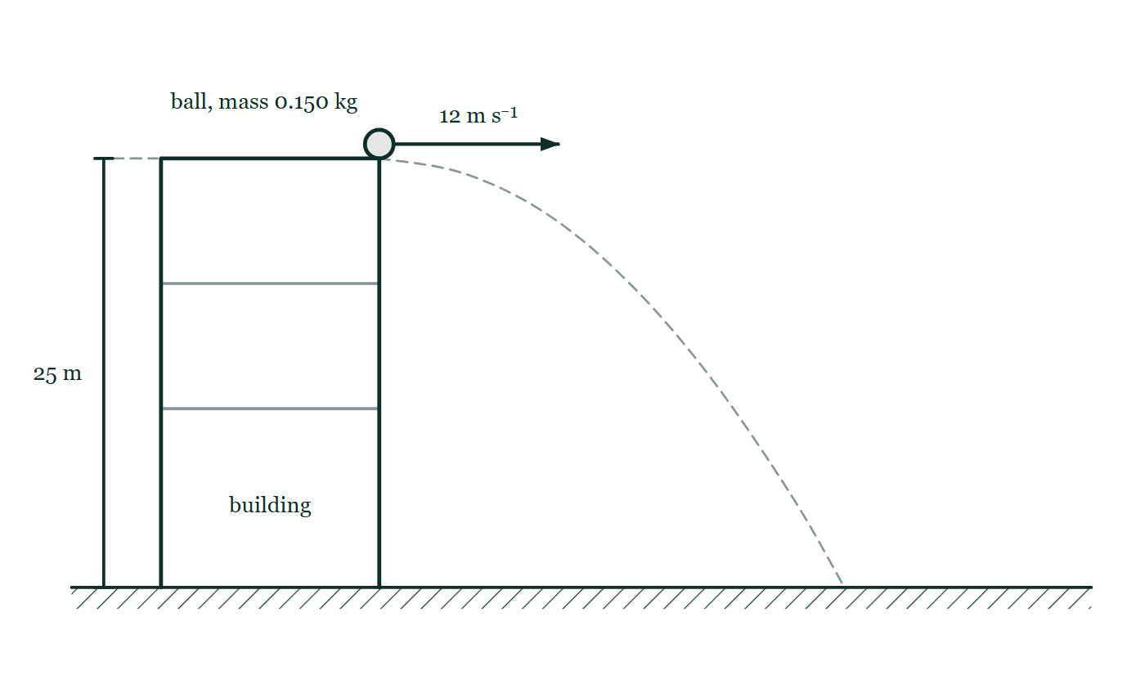
IB · THEME A · SPACE, TIME AND MOTION
GIOPHYSICS PRACTICE PAPER
Question 8
Structured
SL
Demanding
11 marks
Syllabus A.1, A.2
A ball of mass 0.150 kg is thrown horizontally at 12 m s⁻¹ from the top of a building 25 m high. Air resistance is negligible until part (d).
Figure 3 — Side view. A building stands on level hatched ground, its height marked by a dimension line labelled 25 m running from roof level down to the ground. A small ball, labelled as having mass 0.150 kg, sits at the right-hand edge of the roof, and a horizontal arrow from the ball labelled 12 m s⁻¹ points away from the building. A faint dashed curve traces the path the ball follows from the roof edge down to the ground.
IB Diploma Physics — Theme A · Space, time and motion. Written by GioPhysics from IB Diploma Programme Physics subject page; not an awarding body's document.
18 / 29
Notes:
[Demand] Demanding — Several steps, and you have to choose them. Nothing says which comes first.
[Figure] Figure 3. Side view. A building stands on level hatched ground, its height marked by a dimension line labelled 25 m running from roof level down to the ground. A small ball, labelled as having mass 0.150 kg, sits at the right-hand edge of the roof, and a horizontal arrow from the ball labelled 12 m s⁻¹ points away from the building. A faint dashed curve traces the path the ball follows from the roof edge down to the ground.

Slide 19
IB · THEME A · SPACE, TIME AND MOTION
GIOPHYSICS PRACTICE PAPER
Question 8 (cont.)
Structured
SL
Demanding
11 marks
continued from the previous slide
(a) Calculate
2 marks
Calculate the time taken for the ball to reach the ground.
(b) Determine
3 marks
Determine the speed of the ball as it reaches the ground.
(c) Determine
2 marks
Determine the magnitude of the impulse delivered to the ball by gravity during its flight.
(d) Explain
4 marks
In reality air resistance is not negligible. Explain how the horizontal distance travelled and the time of flight each differ from the values calculated above.
IB Diploma Physics — Theme A · Space, time and motion. Written by GioPhysics from IB Diploma Programme Physics subject page; not an awarding body's document.
19 / 29
Notes:
[Demand] Demanding — Several steps, and you have to choose them. Nothing says which comes first.
[Figure] Figure 3. Side view. A building stands on level hatched ground, its height marked by a dimension line labelled 25 m running from roof level down to the ground. A small ball, labelled as having mass 0.150 kg, sits at the right-hand edge of the roof, and a horizontal arrow from the ball labelled 12 m s⁻¹ points away from the building. A faint dashed curve traces the path the ball follows from the roof edge down to the ground.
[Reminder] Figure 3 is on the previous slide.

Slide 20
IB · THEME A · SPACE, TIME AND MOTION
GIOPHYSICS PRACTICE PAPER
Answer 8
Structured
SL
Demanding
11 marks
Mark scheme
(a) Calculate — 2 marks
AO2
✓
25 = ½ × 9.81 × t²
✓
t = 2.26 s
(b) Determine — 3 marks
AO2
✓
vertical component v_y = 9.81 × 2.26 = 22.2 m s⁻¹
✓
horizontal component is unchanged at 12 m s⁻¹
✓
speed = √(12² + 22.2²) = 25 m s⁻¹
(c) Determine — 2 marks
AO2
✓
impulse = change in momentum = m × change in vertical velocity = 0.150 × 22.2
✓
impulse = 3.3 N s, directed vertically downwards
(d) Explain — 4 marks
AO3
✓
air resistance acts opposite to the velocity, so it has both a horizontal and a vertical component throughout the flight
✓
the horizontal component decelerates the ball, so the horizontal velocity is no longer constant and the horizontal distance is smaller
✓
the vertical component acts upward as the ball falls, reducing the downward acceleration below g
✓
so the ball takes longer to fall the same 25 m, and the time of flight increases
The commonest wrong answer says the time of flight is unchanged because "horizontal and vertical motions are independent". That independence is a consequence of the only force being vertical, and it fails as soon as a velocity-dependent force acts.
IB Diploma Physics — Theme A · Space, time and motion. Written by GioPhysics from IB Diploma Programme Physics subject page; not an awarding body's document.
20 / 29
Notes:
[Marking] One line per mark, awarded independently unless a point says otherwise.
[Examiner note (d)] The commonest wrong answer says the time of flight is unchanged because "horizontal and vertical motions are independent". That independence is a consequence of the only force being vertical, and it fails as soon as a velocity-dependent force acts.
[Figure] Figure 3. Side view. A building stands on level hatched ground, its height marked by a dimension line labelled 25 m running from roof level down to the ground. A small ball, labelled as having mass 0.150 kg, sits at the right-hand edge of the roof, and a horizontal arrow from the ball labelled 12 m s⁻¹ points away from the building. A faint dashed curve traces the path the ball follows from the roof edge down to the ground.

Slide 21
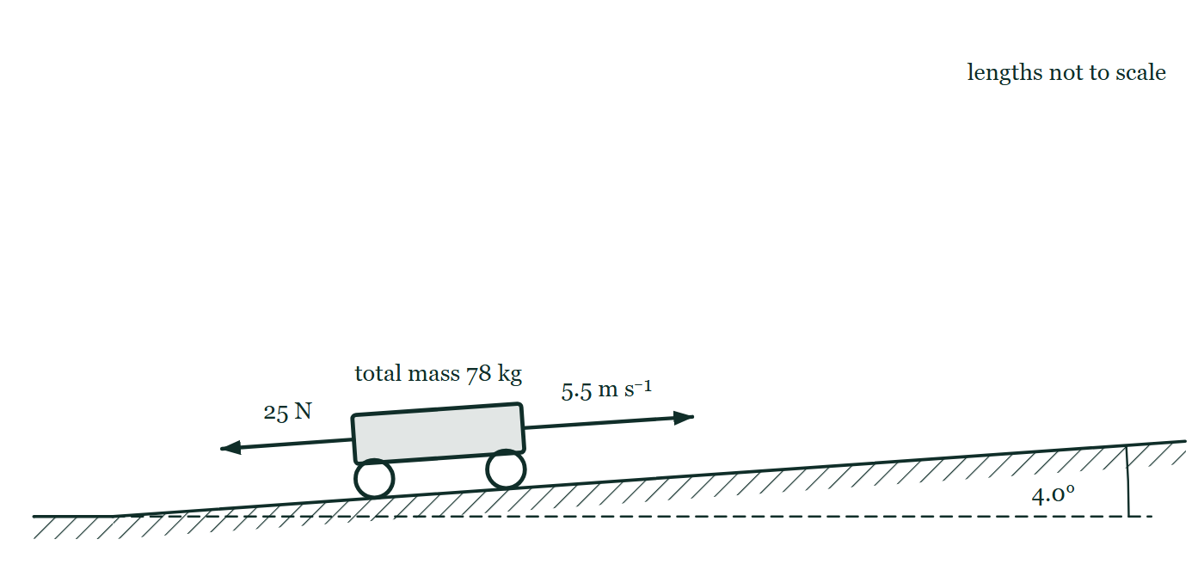
IB · THEME A · SPACE, TIME AND MOTION
GIOPHYSICS PRACTICE PAPER
Question 9
Structured
SL
Demanding
12 marks
Syllabus A.3
A cyclist and her bicycle have a combined mass of 78 kg. She rides up a straight road inclined at 4.0° to the horizontal at a constant speed of 5.5 m s⁻¹. The total resistive force opposing her motion is 25 N.
Figure 4 — Side view, drawn not to scale. A road climbs to the right from level ground, and the angle between the road and a dashed horizontal line drawn from the foot of the slope is marked 4.0°. The cyclist and bicycle are drawn as one wheeled body on the road, labelled total mass 78 kg. An arrow from the front of the body points up the slope and is labelled 5.5 m s⁻¹; a second arrow from the rear points down the slope and is labelled 25 N.
IB Diploma Physics — Theme A · Space, time and motion. Written by GioPhysics from IB Diploma Programme Physics subject page; not an awarding body's document.
21 / 29
Notes:
[Demand] Demanding — Several steps, and you have to choose them. Nothing says which comes first.
[Figure] Figure 4. Side view, drawn not to scale. A road climbs to the right from level ground, and the angle between the road and a dashed horizontal line drawn from the foot of the slope is marked 4.0°. The cyclist and bicycle are drawn as one wheeled body on the road, labelled total mass 78 kg. An arrow from the front of the body points up the slope and is labelled 5.5 m s⁻¹; a second arrow from the rear points down the slope and is labelled 25 N.

Slide 22
IB · THEME A · SPACE, TIME AND MOTION
GIOPHYSICS PRACTICE PAPER
Question 9 (cont.)
Structured
SL
Demanding
12 marks
continued from the previous slide
(a) Define
1 mark
Define power.
(b) Determine
2 marks
Determine the component of the total weight acting down the slope.
(c) Calculate
3 marks
Calculate the useful power output of the cyclist.
(d) Determine
2 marks
The cyclist's body converts chemical energy to mechanical work with an efficiency of 22%. Determine the rate at which she uses chemical energy.
(e) Discuss
4 marks
At the top of the hill the cyclist stops pedalling and freewheels down the other side, which has the same gradient. Discuss whether she reaches a constant speed, and what determines its value.
IB Diploma Physics — Theme A · Space, time and motion. Written by GioPhysics from IB Diploma Programme Physics subject page; not an awarding body's document.
22 / 29
Notes:
[Demand] Demanding — Several steps, and you have to choose them. Nothing says which comes first.
[Figure] Figure 4. Side view, drawn not to scale. A road climbs to the right from level ground, and the angle between the road and a dashed horizontal line drawn from the foot of the slope is marked 4.0°. The cyclist and bicycle are drawn as one wheeled body on the road, labelled total mass 78 kg. An arrow from the front of the body points up the slope and is labelled 5.5 m s⁻¹; a second arrow from the rear points down the slope and is labelled 25 N.
[Reminder] Figure 4 is on the previous slide.

Slide 23
IB · THEME A · SPACE, TIME AND MOTION
GIOPHYSICS PRACTICE PAPER
Answer 9
Structured
SL
Demanding
12 marks
Mark scheme
(a) Define — 1 mark
AO1
✓
the rate at which work is done, or the rate at which energy is transferred
(b) Determine — 2 marks
AO2
✓
component = mg sin θ = 78 × 9.81 × sin 4.0°
✓
= 53 N
(c) Calculate — 3 marks
AO2
✓
at constant speed the driving force balances the weight component and the resistive force: F = 53 + 25 = 78 N
✓
P = Fv = 78 × 5.5
✓
P = 4.3 × 10² W
(d) Determine — 2 marks
AO2
✓
input power = 429 / 0.22
✓
= 1.9 × 10³ W
IB Diploma Physics — Theme A · Space, time and motion. Written by GioPhysics from IB Diploma Programme Physics subject page; not an awarding body's document.
23 / 29
Notes:
[Marking] One line per mark, awarded independently unless a point says otherwise.
[Figure] Figure 4. Side view, drawn not to scale. A road climbs to the right from level ground, and the angle between the road and a dashed horizontal line drawn from the foot of the slope is marked 4.0°. The cyclist and bicycle are drawn as one wheeled body on the road, labelled total mass 78 kg. An arrow from the front of the body points up the slope and is labelled 5.5 m s⁻¹; a second arrow from the rear points down the slope and is labelled 25 N.

Slide 24
IB · THEME A · SPACE, TIME AND MOTION
GIOPHYSICS PRACTICE PAPER
Answer 9 (cont.)
Structured
SL
Demanding
12 marks
Mark scheme, continued
(e) Discuss — 4 marks
AO3
✓
on the way down, the component of weight along the slope now acts in the direction of motion and accelerates her
✓
the resistive force increases with speed, mainly because air resistance rises steeply with speed
✓
she reaches a constant speed when the resistive force has grown to equal the 53 N component of weight down the slope
✓
the value of that speed is set by how quickly the resistive force grows with speed — by her frontal area, her posture and the air density, not by her mass alone
IB Diploma Physics — Theme A · Space, time and motion. Written by GioPhysics from IB Diploma Programme Physics subject page; not an awarding body's document.
24 / 29
Notes:
[Marking] One line per mark, awarded independently unless a point says otherwise.
[Figure] Figure 4. Side view, drawn not to scale. A road climbs to the right from level ground, and the angle between the road and a dashed horizontal line drawn from the foot of the slope is marked 4.0°. The cyclist and bicycle are drawn as one wheeled body on the road, labelled total mass 78 kg. An arrow from the front of the body points up the slope and is labelled 5.5 m s⁻¹; a second arrow from the rear points down the slope and is labelled 25 N.

Slide 25
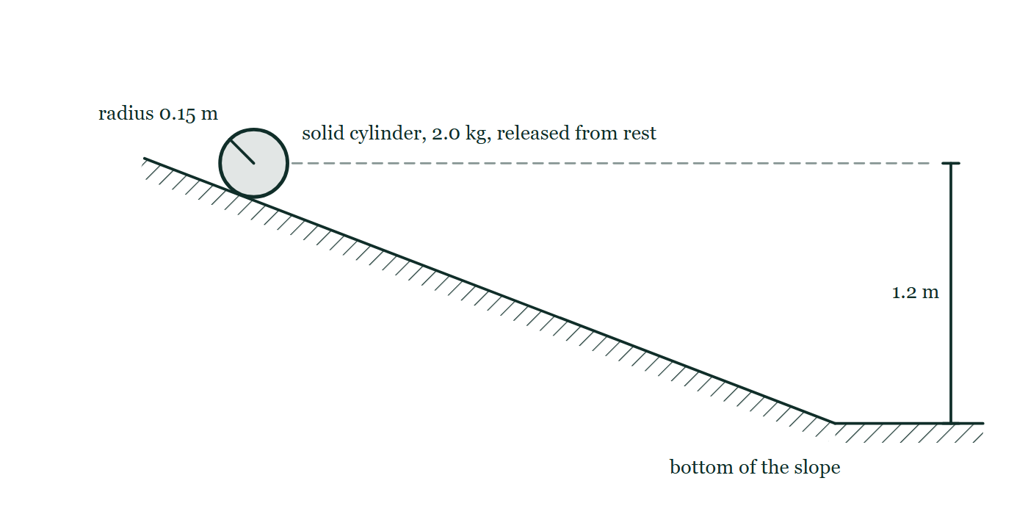
IB · THEME A · SPACE, TIME AND MOTION
GIOPHYSICS PRACTICE PAPER
Question 10
Structured
HL
Discriminating
14 marks
Syllabus A.4, A.5
Part 1. A uniform solid cylinder of mass 2.0 kg and radius 0.15 m rolls without slipping down a slope, starting from rest at a height of 1.2 m above the bottom. The moment of inertia of a uniform solid cylinder about its axis is ½MR². Part 2. A spacecraft passes Earth at a constant speed of 0.80c. The spacecraft has a proper length of 90 m.
Figure 5 — Side view. A straight hatched slope runs down from the upper left to a horizontal surface at the lower right. A cylinder is drawn end-on resting on the slope near the top, labelled solid cylinder, 2.0 kg, released from rest, with a line from its centre to the rim labelled radius 0.15 m. A dashed horizontal line runs to the right from the level of the cylinder's centre, and a dimension line marks 1.2 m between that level and the horizontal surface at the bottom of the slope.
IB Diploma Physics — Theme A · Space, time and motion. Written by GioPhysics from IB Diploma Programme Physics subject page; not an awarding body's document.
25 / 29
Notes:
[Demand] Discriminating — The part that separates the top grade: an unfamiliar context, a derivation, or an argument that has to hold together to earn anything.
[Figure] Figure 5. Side view. A straight hatched slope runs down from the upper left to a horizontal surface at the lower right. A cylinder is drawn end-on resting on the slope near the top, labelled solid cylinder, 2.0 kg, released from rest, with a line from its centre to the rim labelled radius 0.15 m. A dashed horizontal line runs to the right from the level of the cylinder's centre, and a dimension line marks 1.2 m between that level and the horizontal surface at the bottom of the slope.

Slide 26
IB · THEME A · SPACE, TIME AND MOTION
GIOPHYSICS PRACTICE PAPER
Question 10 (cont.)
Structured
HL
Discriminating
14 marks
continued from the previous slide
(a) Show (that)
4 marks
Show that the translational speed of the cylinder at the bottom of the slope is about 4.0 m s⁻¹.
(b) Determine
3 marks
Determine the fraction of the cylinder's total kinetic energy at the bottom that is rotational.
(c) Calculate
3 marks
Calculate the length of the spacecraft as measured by an observer on Earth.
(d) Explain
4 marks
An observer on the spacecraft claims that it is the Earth that is 0.80c and that Earth's distances are contracted, not the spacecraft's. Explain why both observers are correct, and outline what would have to change for one of them to be wrong.
IB Diploma Physics — Theme A · Space, time and motion. Written by GioPhysics from IB Diploma Programme Physics subject page; not an awarding body's document.
26 / 29
Notes:
[Demand] Discriminating — The part that separates the top grade: an unfamiliar context, a derivation, or an argument that has to hold together to earn anything.
[Figure] Figure 5. Side view. A straight hatched slope runs down from the upper left to a horizontal surface at the lower right. A cylinder is drawn end-on resting on the slope near the top, labelled solid cylinder, 2.0 kg, released from rest, with a line from its centre to the rim labelled radius 0.15 m. A dashed horizontal line runs to the right from the level of the cylinder's centre, and a dimension line marks 1.2 m between that level and the horizontal surface at the bottom of the slope.
[Reminder] Figure 5 is on the previous slide.

Slide 27
IB · THEME A · SPACE, TIME AND MOTION
GIOPHYSICS PRACTICE PAPER
Answer 10
Structured
HL
Discriminating
14 marks
Mark scheme
(a) Show (that) — 4 marks
AO2
✓
Mgh = ½Mv² + ½Iω², with I = ½MR²
✓
applies the rolling condition ω = v/R, so ½Iω² = ¼Mv²
✓
Mgh = ¾Mv², so v = √(4gh/3)
✓
v = √(4 × 9.81 × 1.2 / 3) = 3.96 ≈ 4.0 m s⁻¹
(b) Determine — 3 marks
AO2
✓
rotational KE = ¼Mv², translational KE = ½Mv²
✓
total = ¾Mv²
✓
fraction rotational = (¼)/(¾) = 1/3
The fraction is the same for every uniform solid cylinder, whatever its mass, radius or the height of the slope — a point worth making, because it is what the cancellation in part (a) was telling you.
(c) Calculate — 3 marks
AO2
✓
γ = 1/√(1 − 0.80²) = 1/0.60 = 1.67
✓
L = L₀/γ = 90/1.67
✓
L = 54 m
IB Diploma Physics — Theme A · Space, time and motion. Written by GioPhysics from IB Diploma Programme Physics subject page; not an awarding body's document.
27 / 29
Notes:
[Marking] One line per mark, awarded independently unless a point says otherwise.
[Examiner note (b)] The fraction is the same for every uniform solid cylinder, whatever its mass, radius or the height of the slope — a point worth making, because it is what the cancellation in part (a) was telling you.
[Examiner note (d)] The best-discriminating part on the paper. Relativity of simultaneity is the mark that separates a candidate who has understood the argument from one who has memorised the formulae.
[Figure] Figure 5. Side view. A straight hatched slope runs down from the upper left to a horizontal surface at the lower right. A cylinder is drawn end-on resting on the slope near the top, labelled solid cylinder, 2.0 kg, released from rest, with a line from its centre to the rim labelled radius 0.15 m. A dashed horizontal line runs to the right from the level of the cylinder's centre, and a dimension line marks 1.2 m between that level and the horizontal surface at the bottom of the slope.

Slide 28
IB · THEME A · SPACE, TIME AND MOTION
GIOPHYSICS PRACTICE PAPER
Answer 10 (cont.)
Structured
HL
Discriminating
14 marks
Mark scheme, continued
(d) Explain — 4 marks
AO3
✓
both frames are inertial, and the principle of relativity states that the laws of physics are the same in all inertial frames
✓
there is no experiment either observer can do to establish that they are the one "really" moving, so neither frame is privileged
✓
each measures the other's length as contracted because they disagree about which events are simultaneous, and a length measurement requires locating both ends at the same time
✓
the symmetry would be broken only if one observer accelerated — an accelerating frame is not inertial, and that observer would feel the acceleration and know it
The best-discriminating part on the paper. Relativity of simultaneity is the mark that separates a candidate who has understood the argument from one who has memorised the formulae.
IB Diploma Physics — Theme A · Space, time and motion. Written by GioPhysics from IB Diploma Programme Physics subject page; not an awarding body's document.
28 / 29
Notes:
[Marking] One line per mark, awarded independently unless a point says otherwise.
[Examiner note (b)] The fraction is the same for every uniform solid cylinder, whatever its mass, radius or the height of the slope — a point worth making, because it is what the cancellation in part (a) was telling you.
[Examiner note (d)] The best-discriminating part on the paper. Relativity of simultaneity is the mark that separates a candidate who has understood the argument from one who has memorised the formulae.
[Figure] Figure 5. Side view. A straight hatched slope runs down from the upper left to a horizontal surface at the lower right. A cylinder is drawn end-on resting on the slope near the top, labelled solid cylinder, 2.0 kg, released from rest, with a line from its centre to the rim labelled radius 0.15 m. A dashed horizontal line runs to the right from the level of the cylinder's centre, and a dimension line marks 1.2 m between that level and the horizontal surface at the bottom of the slope.

Slide 29
IB · THEME A · SPACE, TIME AND MOTION
GIOPHYSICS PRACTICE PAPER
Command words
IB Diploma Physics — the board's own definitions
Define
Discuss
Give the precise meaning of a word, phrase, concept or physical quantity.
Offer a considered and balanced review that includes a range of arguments, factors or hypotheses, supported by appropriate evidence.
State
Give a specific name, value or other brief answer without explanation or calculation.
Evaluate
Make an appraisal by weighing up the strengths and limitations.
Calculate
Explain
Obtain a numerical answer, showing the relevant stages in the working.
Give a detailed account including reasons or causes.
Describe
Show (that)
Give a detailed account.
Give the steps in a calculation or derivation.
Determine
Sketch
Obtain the only possible answer, from the data or by reasoning.
Represent by means of a graph showing a line and labelled but unscaled axes, with important features clearly identifiable.
Outline
Give a brief account or summary.
Suggest
Propose a solution, hypothesis or other possible answer.
Compare
Give an account of the similarities between two or more items, referring to both throughout.
IB Diploma Physics — Theme A · Space, time and motion. Written by GioPhysics from IB Diploma Programme Physics subject page; not an awarding body's document.
29 / 29
Notes:
[Objectives] AO1 Demonstrate knowledge: Recall facts, concepts and terminology, and state methodologies and techniques used in the course. AO2 Understand and apply knowledge: Apply concepts, terminology and techniques to familiar and unfamiliar situations, including numerical work. AO3 Analyse, evaluate and construct: Analyse and evaluate data, methods, claims and explanations, and construct a reasoned argument or conclusion. AO4 Demonstrate the application of skills: Design and evaluate investigations, handle raw and processed data, treat uncertainties, and communicate results.
[Source] IB Diploma Programme Physics subject page — https://www.ibo.org/programmes/diploma-programme/curriculum/sciences/physics/
[Disclaimer] Written by GioPhysics from the published course. These are practice papers in the style of IB Diploma Programme Physics; they are not IB papers, contain no past-paper questions, and the official subject guide and data booklet remain the authority. IB is a trademark of the International Baccalaureate Organization, which is not affiliated with and does not endorse GioPhysics.

