Slide 1
IB · THEME B · THE PARTICULATE NATURE OF MATTER
GIOPHYSICS PRACTICE PAPER
IB · IB Diploma Programme Physics · first assessment 2025
Theme B · The particulate nature of matter
Thermal energy transfers, the greenhouse effect, gas laws, current and circuits, and — at HL — thermodynamics.
MIRRORS
Paper 1A (multiple choice), Paper 1B (data-based), and Paper 2 (short answer and extended response)
MARKS
53 in total — SL route 39, HL adds 14
TIME
60 minutes · 10 questions
DEMAND
Recall 1 · Routine 3 · Demanding 4 · Discriminating 2
SYLLABUS
B.1, B.2, B.3, B.4, B.5
Written by GioPhysics from the published course. These are practice papers in the style of IB Diploma Programme Physics; they are not IB papers, contain no past-paper questions, and the official subject guide and data booklet remain the authority. IB is a trademark of the International Baccalaureate Organization, which is not affiliated with and does not endorse GioPhysics.
IB Diploma Physics — Theme B · The particulate nature of matter. Written by GioPhysics from IB Diploma Programme Physics subject page; not an awarding body's document.
1 / 28
Notes:
[Format] Paper 1 has two parts: 1A is multiple choice, and 1B is data-based questions drawn from the experimental work of the course, with no recall in it at all. Paper 2 is short-answer and extended-response across the whole syllabus. HL papers are longer and reach the HL-only sub-topics. The data booklet is provided in every paper, so no question tests whether you can remember an equation.
[Demand] The command term sets the demand, and the papers are written that way. "State" earns one mark for one line; "explain" is not creditworthy without a mechanism; "discuss" and "evaluate" need both sides weighed before a conclusion is reached. The extended-response part that closes each Paper 2 question is where HL candidates separate from one another, and those parts are pitched there rather than at the level of the calculation before them.
[Source] IB Diploma Programme Physics subject page — https://www.ibo.org/programmes/diploma-programme/curriculum/sciences/physics/
[Disclaimer] Written by GioPhysics from the published course. These are practice papers in the style of IB Diploma Programme Physics; they are not IB papers, contain no past-paper questions, and the official subject guide and data booklet remain the authority. IB is a trademark of the International Baccalaureate Organization, which is not affiliated with and does not endorse GioPhysics.

Slide 2
IB · THEME B · THE PARTICULATE NATURE OF MATTER
GIOPHYSICS PRACTICE PAPER
Question 1
Multiple choice
SL
Routine
1 mark
Syllabus B.1 · AO2
A 2.0 kW heater supplies energy to 0.30 kg of ice at 0 °C until it has all melted. The specific latent heat of fusion of ice is 3.3 × 10⁵ J kg⁻¹. How long does this take, assuming no losses?
A
5.0 s
B
50 s
C
165 s
D
500 s
IB Diploma Physics — Theme B · The particulate nature of matter. Written by GioPhysics from IB Diploma Programme Physics subject page; not an awarding body's document.
2 / 28
Notes:
[Demand] Routine — The standard application — the named equation, the usual graph read.

Slide 3
IB · THEME B · THE PARTICULATE NATURE OF MATTER
GIOPHYSICS PRACTICE PAPER
Answer 1
Multiple choice
SL
Routine
1 mark
Mark scheme
B
50 s
Why the other three are there
The energy required is mL = 9.9 × 10⁴ J, and dividing by 2000 W gives 50 s. C divides by the mass instead of multiplying by it.
IB Diploma Physics — Theme B · The particulate nature of matter. Written by GioPhysics from IB Diploma Programme Physics subject page; not an awarding body's document.
3 / 28
Notes:
[Answer] B — 50 s
[Distractors] The energy required is mL = 9.9 × 10⁴ J, and dividing by 2000 W gives 50 s. C divides by the mass instead of multiplying by it.

Slide 4
IB · THEME B · THE PARTICULATE NATURE OF MATTER
GIOPHYSICS PRACTICE PAPER
Question 2
Multiple choice
SL
Demanding
1 mark
Syllabus B.2 · AO2
The solar constant is 1360 W m⁻² and the Earth's average albedo is 0.30. What is the average intensity of solar radiation absorbed per square metre of the Earth's surface?
A
238 W m⁻²
B
340 W m⁻²
C
952 W m⁻²
D
1360 W m⁻²
IB Diploma Physics — Theme B · The particulate nature of matter. Written by GioPhysics from IB Diploma Programme Physics subject page; not an awarding body's document.
4 / 28
Notes:
[Demand] Demanding — Several steps, and you have to choose them. Nothing says which comes first.

Slide 5
IB · THEME B · THE PARTICULATE NATURE OF MATTER
GIOPHYSICS PRACTICE PAPER
Answer 2
Multiple choice
SL
Demanding
1 mark
Mark scheme
A
238 W m⁻²
Why the other three are there
Two steps are needed and each is often missed. B applies the factor of 4 — the ratio of the Earth's surface area to the disc that intercepts the beam — but forgets the albedo. C applies the albedo but forgets the factor of 4.
IB Diploma Physics — Theme B · The particulate nature of matter. Written by GioPhysics from IB Diploma Programme Physics subject page; not an awarding body's document.
5 / 28
Notes:
[Answer] A — 238 W m⁻²
[Distractors] Two steps are needed and each is often missed. B applies the factor of 4 — the ratio of the Earth's surface area to the disc that intercepts the beam — but forgets the albedo. C applies the albedo but forgets the factor of 4.

Slide 6
IB · THEME B · THE PARTICULATE NATURE OF MATTER
GIOPHYSICS PRACTICE PAPER
Question 3
Multiple choice
SL
Routine
1 mark
Syllabus B.3 · AO2
A fixed mass of ideal gas is at 27 °C. It is heated at constant volume until its pressure has doubled. What is the new temperature?
A
54 °C
B
327 °C
C
600 °C
D
873 °C
IB Diploma Physics — Theme B · The particulate nature of matter. Written by GioPhysics from IB Diploma Programme Physics subject page; not an awarding body's document.
6 / 28
Notes:
[Demand] Routine — The standard application — the named equation, the usual graph read.

Slide 7
IB · THEME B · THE PARTICULATE NATURE OF MATTER
GIOPHYSICS PRACTICE PAPER
Answer 3
Multiple choice
SL
Routine
1 mark
Mark scheme
B
327 °C
Why the other three are there
A doubles the Celsius temperature, which is the error the question is set to catch. The gas laws work in kelvin: 300 K doubles to 600 K, which is 327 °C.
IB Diploma Physics — Theme B · The particulate nature of matter. Written by GioPhysics from IB Diploma Programme Physics subject page; not an awarding body's document.
7 / 28
Notes:
[Answer] B — 327 °C
[Distractors] A doubles the Celsius temperature, which is the error the question is set to catch. The gas laws work in kelvin: 300 K doubles to 600 K, which is 327 °C.

Slide 8
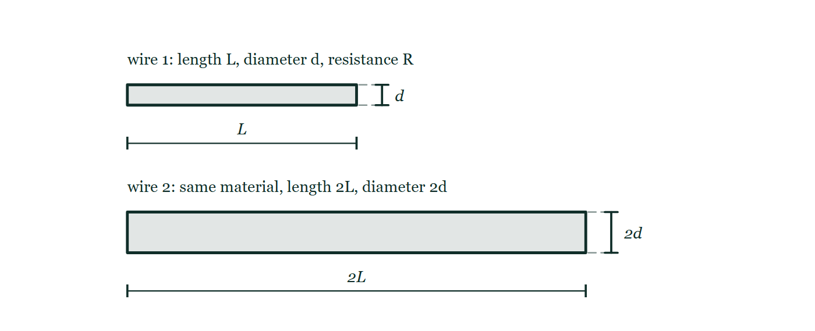
IB · THEME B · THE PARTICULATE NATURE OF MATTER
GIOPHYSICS PRACTICE PAPER
Question 4
Multiple choice
SL
Routine
1 mark
Syllabus B.5 · AO2
A wire of resistivity ρ, length L and cross-sectional area A has resistance R. A second wire of the same material has twice the length and twice the diameter. What is its resistance?
Figure 1 — Two wires of the same material are drawn one above the other, each as a long bar seen from the side. The upper one is labelled wire 1: length L, diameter d, resistance R, with a dimension line under it marking L and a small dimension at its end marking the diameter d. The lower one is drawn twice as long and twice as thick and labelled wire 2: same material, with dimension lines marking 2L along it and 2d across its end.
A
R/2
B
R
C
2R
D
4R
IB Diploma Physics — Theme B · The particulate nature of matter. Written by GioPhysics from IB Diploma Programme Physics subject page; not an awarding body's document.
8 / 28
Notes:
[Demand] Routine — The standard application — the named equation, the usual graph read.
[Figure] Figure 1. Two wires of the same material are drawn one above the other, each as a long bar seen from the side. The upper one is labelled wire 1: length L, diameter d, resistance R, with a dimension line under it marking L and a small dimension at its end marking the diameter d. The lower one is drawn twice as long and twice as thick and labelled wire 2: same material, with dimension lines marking 2L along it and 2d across its end.

Slide 9
IB · THEME B · THE PARTICULATE NATURE OF MATTER
GIOPHYSICS PRACTICE PAPER
Answer 4
Multiple choice
SL
Routine
1 mark
Mark scheme
A
R/2
Why the other three are there
C doubles for the length and forgets that the area depends on the square of the diameter. Doubling the diameter quadruples the area, so the two changes give 2/4 = ½.
IB Diploma Physics — Theme B · The particulate nature of matter. Written by GioPhysics from IB Diploma Programme Physics subject page; not an awarding body's document.
9 / 28
Notes:
[Answer] A — R/2
[Distractors] C doubles for the length and forgets that the area depends on the square of the diameter. Doubling the diameter quadruples the area, so the two changes give 2/4 = ½.
[Figure] Figure 1. Two wires of the same material are drawn one above the other, each as a long bar seen from the side. The upper one is labelled wire 1: length L, diameter d, resistance R, with a dimension line under it marking L and a small dimension at its end marking the diameter d. The lower one is drawn twice as long and twice as thick and labelled wire 2: same material, with dimension lines marking 2L along it and 2d across its end.

Slide 10
IB · THEME B · THE PARTICULATE NATURE OF MATTER
GIOPHYSICS PRACTICE PAPER
Question 5
Multiple choice
HL
Demanding
1 mark
Syllabus B.4 · AO2
An ideal gas is compressed adiabatically. Which statement is correct?
A
No thermal energy enters or leaves the gas, and its temperature falls.
B
No thermal energy enters or leaves the gas, and its temperature rises.
C
Thermal energy leaves the gas, and its temperature stays constant.
D
Thermal energy enters the gas, and its temperature rises.
IB Diploma Physics — Theme B · The particulate nature of matter. Written by GioPhysics from IB Diploma Programme Physics subject page; not an awarding body's document.
10 / 28
Notes:
[Demand] Demanding — Several steps, and you have to choose them. Nothing says which comes first.

Slide 11
IB · THEME B · THE PARTICULATE NATURE OF MATTER
GIOPHYSICS PRACTICE PAPER
Answer 5
Multiple choice
HL
Demanding
1 mark
Mark scheme
B
No thermal energy enters or leaves the gas, and its temperature rises.
Why the other three are there
A gets the definition right and the consequence wrong. In an adiabatic process Q = 0, so ΔU = W: work done on the gas raises its internal energy with nowhere for the energy to escape, and the temperature rises. C describes an isothermal compression.
IB Diploma Physics — Theme B · The particulate nature of matter. Written by GioPhysics from IB Diploma Programme Physics subject page; not an awarding body's document.
11 / 28
Notes:
[Answer] B — No thermal energy enters or leaves the gas, and its temperature rises.
[Distractors] A gets the definition right and the consequence wrong. In an adiabatic process Q = 0, so ΔU = W: work done on the gas raises its internal energy with nowhere for the energy to escape, and the temperature rises. C describes an isothermal compression.

Slide 12
IB · THEME B · THE PARTICULATE NATURE OF MATTER
GIOPHYSICS PRACTICE PAPER
Question 6
Multiple choice
SL
Recall
1 mark
Syllabus B.1 · AO1
Which method of thermal energy transfer can occur through a vacuum?
A
conduction only
B
convection only
C
radiation only
D
all three
IB Diploma Physics — Theme B · The particulate nature of matter. Written by GioPhysics from IB Diploma Programme Physics subject page; not an awarding body's document.
12 / 28
Notes:
[Demand] Recall — One idea, one step. The mark is for knowing it.

Slide 13
IB · THEME B · THE PARTICULATE NATURE OF MATTER
GIOPHYSICS PRACTICE PAPER
Answer 6
Multiple choice
SL
Recall
1 mark
Mark scheme
C
radiation only
Why the other three are there
Conduction and convection both need particles to carry or move the energy. Radiation is an electromagnetic wave and needs no medium at all.
IB Diploma Physics — Theme B · The particulate nature of matter. Written by GioPhysics from IB Diploma Programme Physics subject page; not an awarding body's document.
13 / 28
Notes:
[Answer] C — radiation only
[Distractors] Conduction and convection both need particles to carry or move the energy. Radiation is an electromagnetic wave and needs no medium at all.

Slide 14
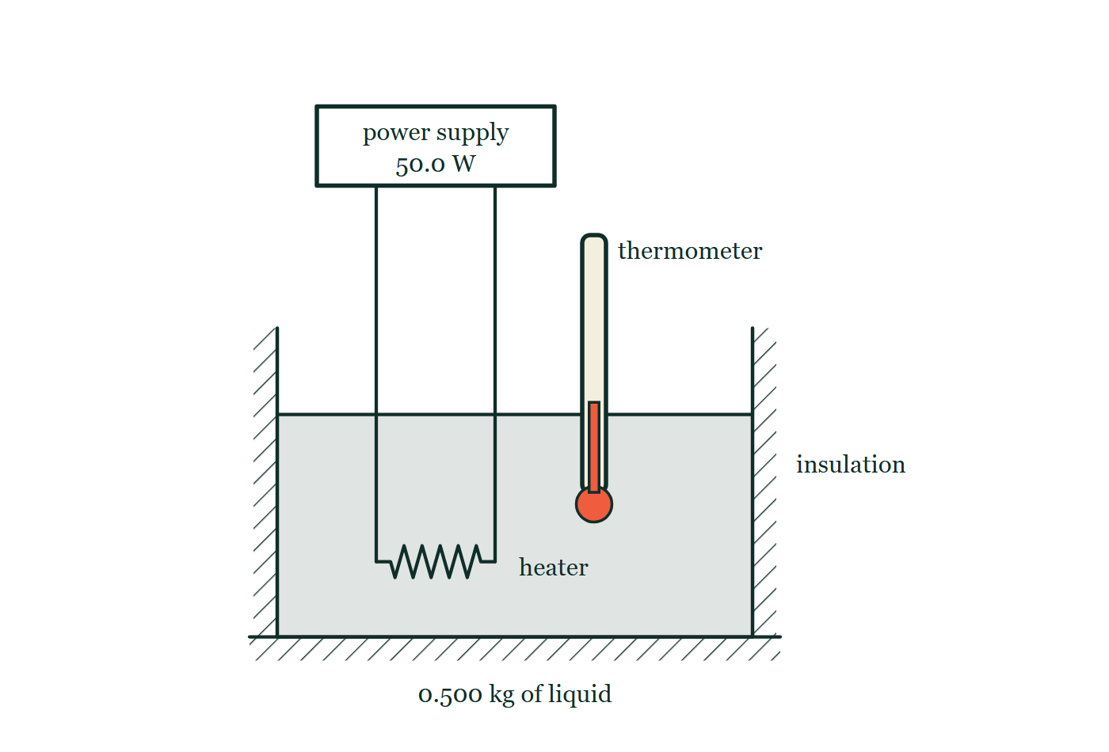
IB · THEME B · THE PARTICULATE NATURE OF MATTER
GIOPHYSICS PRACTICE PAPER
Question 7
Data analysis
SL
Demanding
11 marks
Syllabus B.1
A student determines the specific heat capacity of a liquid. She places 0.500 kg of the liquid in a well-insulated container with an electric heater of constant power 50.0 W and records the temperature at intervals.
The student's readings
t / s | 0 | 120 | 240 | 360 | 480
θ / °C | 20.0 | 22.9 | 25.7 | 28.6 | 31.4
Figure 2 — Section through the apparatus. A container holding the liquid, labelled 0.500 kg of liquid, is surrounded on its sides and base by hatched insulation. A coiled heating element is immersed near the bottom of the liquid, and its two leads run up out of the open top of the container to a box labelled power supply, 50.0 W. A thermometer stands in the liquid with its bulb well below the surface and its stem projecting above the container.
IB Diploma Physics — Theme B · The particulate nature of matter. Written by GioPhysics from IB Diploma Programme Physics subject page; not an awarding body's document.
14 / 28
Notes:
[Demand] Demanding — Several steps, and you have to choose them. Nothing says which comes first.
[Figure] Figure 2. Section through the apparatus. A container holding the liquid, labelled 0.500 kg of liquid, is surrounded on its sides and base by hatched insulation. A coiled heating element is immersed near the bottom of the liquid, and its two leads run up out of the open top of the container to a box labelled power supply, 50.0 W. A thermometer stands in the liquid with its bulb well below the surface and its stem projecting above the container.

Slide 15
IB · THEME B · THE PARTICULATE NATURE OF MATTER
GIOPHYSICS PRACTICE PAPER
Question 7 (cont.)
Data analysis
SL
Demanding
11 marks
continued from the previous slide
(a) Determine
3 marks
Determine the gradient of a graph of temperature against time, and explain why the gradient rather than a single pair of readings should be used.
(b) Determine
3 marks
Determine the specific heat capacity of the liquid.
(c) Outline
2 marks
Outline why the container being well insulated matters more at the end of the experiment than at the beginning.
(d) Suggest
3 marks
The heater and the container itself also absorb energy. Suggest how this affects the value obtained for c, and suggest one way of accounting for it.
IB Diploma Physics — Theme B · The particulate nature of matter. Written by GioPhysics from IB Diploma Programme Physics subject page; not an awarding body's document.
15 / 28
Notes:
[Demand] Demanding — Several steps, and you have to choose them. Nothing says which comes first.
[Figure] Figure 2. Section through the apparatus. A container holding the liquid, labelled 0.500 kg of liquid, is surrounded on its sides and base by hatched insulation. A coiled heating element is immersed near the bottom of the liquid, and its two leads run up out of the open top of the container to a box labelled power supply, 50.0 W. A thermometer stands in the liquid with its bulb well below the surface and its stem projecting above the container.
[Reminder] Figure 2 is on the previous slide.

Slide 16
IB · THEME B · THE PARTICULATE NATURE OF MATTER
GIOPHYSICS PRACTICE PAPER
Answer 7
Data analysis
SL
Demanding
11 marks
Mark scheme
(a) Determine — 3 marks
AO4
✓
gradient = (31.4 − 20.0)/480 = 0.0238 °C s⁻¹
✓
the gradient uses all five readings, so random errors in individual temperature measurements partly cancel
✓
and a straight line confirms that the rate of heating is constant, which the calculation assumes
(b) Determine — 3 marks
AO2
✓
P = mc(dθ/dt)
✓
c = P / (m × gradient) = 50.0 / (0.500 × 0.0238)
✓
c = 4.2 × 10³ J kg⁻¹ K⁻¹
(c) Outline — 2 marks
AO3
✓
the rate of energy transfer to the surroundings depends on the temperature difference between the liquid and the room
✓
at the start the liquid is near room temperature and loses almost nothing; by the end it is 11 °C above the room and the losses are largest
This is why the graph would curve slightly downward at long times in a real experiment, and why a candidate should not simply extend the run to get a bigger temperature rise.
IB Diploma Physics — Theme B · The particulate nature of matter. Written by GioPhysics from IB Diploma Programme Physics subject page; not an awarding body's document.
16 / 28
Notes:
[Marking] One line per mark, awarded independently unless a point says otherwise.
[Examiner note (c)] This is why the graph would curve slightly downward at long times in a real experiment, and why a candidate should not simply extend the run to get a bigger temperature rise.
[Figure] Figure 2. Section through the apparatus. A container holding the liquid, labelled 0.500 kg of liquid, is surrounded on its sides and base by hatched insulation. A coiled heating element is immersed near the bottom of the liquid, and its two leads run up out of the open top of the container to a box labelled power supply, 50.0 W. A thermometer stands in the liquid with its bulb well below the surface and its stem projecting above the container.

Slide 17
IB · THEME B · THE PARTICULATE NATURE OF MATTER
GIOPHYSICS PRACTICE PAPER
Answer 7 (cont.)
Data analysis
SL
Demanding
11 marks
Mark scheme, continued
(d) Suggest — 3 marks
AO3
✓
some of the 50.0 W raises the temperature of the heater and container rather than the liquid
✓
the liquid therefore warms more slowly than the model assumes, the gradient is smaller, and the calculated value of c is too large
✓
account for it by repeating the experiment with a different mass of liquid and using the difference, or by determining the thermal capacity of the container separately and subtracting it
IB Diploma Physics — Theme B · The particulate nature of matter. Written by GioPhysics from IB Diploma Programme Physics subject page; not an awarding body's document.
17 / 28
Notes:
[Marking] One line per mark, awarded independently unless a point says otherwise.
[Examiner note (c)] This is why the graph would curve slightly downward at long times in a real experiment, and why a candidate should not simply extend the run to get a bigger temperature rise.
[Figure] Figure 2. Section through the apparatus. A container holding the liquid, labelled 0.500 kg of liquid, is surrounded on its sides and base by hatched insulation. A coiled heating element is immersed near the bottom of the liquid, and its two leads run up out of the open top of the container to a box labelled power supply, 50.0 W. A thermometer stands in the liquid with its bulb well below the surface and its stem projecting above the container.

Slide 18
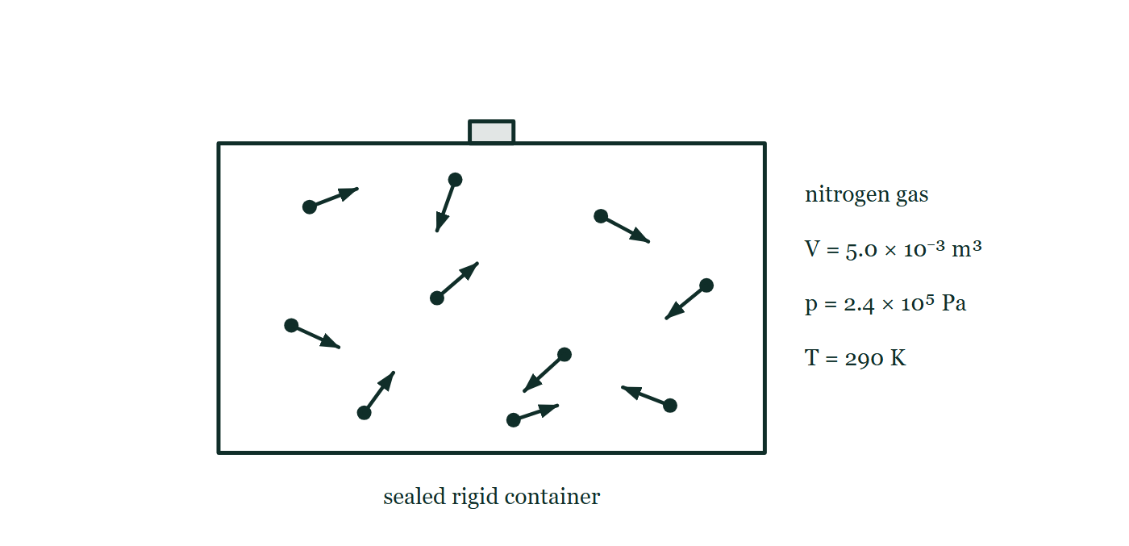
IB · THEME B · THE PARTICULATE NATURE OF MATTER
GIOPHYSICS PRACTICE PAPER
Question 8
Structured
SL
Demanding
11 marks
Syllabus B.1, B.3
A sealed rigid container of volume 5.0 × 10⁻³ m³ holds nitrogen gas at a pressure of 2.4 × 10⁵ Pa and a temperature of 290 K. Nitrogen may be treated as an ideal gas.
Figure 3 — A rectangular container with thick walls and a stopper in its top is labelled sealed rigid container. Inside, ten molecules are drawn as dots, each carrying a short arrow of its own direction and length so that the molecules are moving randomly, several of them towards the walls. To the right of the container stand the labels nitrogen gas, V = 5.0 × 10⁻³ m³, p = 2.4 × 10⁵ Pa and T = 290 K.
IB Diploma Physics — Theme B · The particulate nature of matter. Written by GioPhysics from IB Diploma Programme Physics subject page; not an awarding body's document.
18 / 28
Notes:
[Demand] Demanding — Several steps, and you have to choose them. Nothing says which comes first.
[Figure] Figure 3. A rectangular container with thick walls and a stopper in its top is labelled sealed rigid container. Inside, ten molecules are drawn as dots, each carrying a short arrow of its own direction and length so that the molecules are moving randomly, several of them towards the walls. To the right of the container stand the labels nitrogen gas, V = 5.0 × 10⁻³ m³, p = 2.4 × 10⁵ Pa and T = 290 K.

Slide 19
IB · THEME B · THE PARTICULATE NATURE OF MATTER
GIOPHYSICS PRACTICE PAPER
Question 8 (cont.)
Structured
SL
Demanding
11 marks
continued from the previous slide
(a) Calculate
2 marks
Calculate the amount of gas in the container, in moles.
(b) Determine
2 marks
Determine the average kinetic energy of a nitrogen molecule in the container.
(c) Explain
3 marks
The container is warmed to 350 K. Explain, in terms of the behaviour of the molecules, why the pressure increases.
(d) Explain
4 marks
Outline two assumptions of the ideal gas model, and explain why real nitrogen behaves less like an ideal gas at very high pressure.
IB Diploma Physics — Theme B · The particulate nature of matter. Written by GioPhysics from IB Diploma Programme Physics subject page; not an awarding body's document.
19 / 28
Notes:
[Demand] Demanding — Several steps, and you have to choose them. Nothing says which comes first.
[Figure] Figure 3. A rectangular container with thick walls and a stopper in its top is labelled sealed rigid container. Inside, ten molecules are drawn as dots, each carrying a short arrow of its own direction and length so that the molecules are moving randomly, several of them towards the walls. To the right of the container stand the labels nitrogen gas, V = 5.0 × 10⁻³ m³, p = 2.4 × 10⁵ Pa and T = 290 K.
[Reminder] Figure 3 is on the previous slide.

Slide 20
IB · THEME B · THE PARTICULATE NATURE OF MATTER
GIOPHYSICS PRACTICE PAPER
Answer 8
Structured
SL
Demanding
11 marks
Mark scheme
(a) Calculate — 2 marks
AO2
✓
n = pV/RT = (2.4 × 10⁵ × 5.0 × 10⁻³)/(8.31 × 290)
✓
n = 0.50 mol
(b) Determine — 2 marks
AO2
✓
E_k = (3/2)k_BT = 1.5 × 1.38 × 10⁻²³ × 290
✓
E_k = 6.0 × 10⁻²¹ J
(c) Explain — 3 marks
AO2
✓
the average kinetic energy of the molecules increases, so their mean speed increases
✓
each molecule therefore strikes the walls more frequently
✓
and each collision produces a larger change of momentum, so the average force per unit area on the walls rises
(d) Explain — 4 marks
AO3
✓
the molecules have negligible volume compared with the volume of the container
✓
there are no intermolecular forces except during collisions, and all collisions are elastic
✓
at very high pressure the molecules are pushed close together, so their own volume is no longer negligible compared with the space available
✓
and at those separations the intermolecular attractions are significant, so the molecules exert less force on the walls than the model predicts
IB Diploma Physics — Theme B · The particulate nature of matter. Written by GioPhysics from IB Diploma Programme Physics subject page; not an awarding body's document.
20 / 28
Notes:
[Marking] One line per mark, awarded independently unless a point says otherwise.
[Figure] Figure 3. A rectangular container with thick walls and a stopper in its top is labelled sealed rigid container. Inside, ten molecules are drawn as dots, each carrying a short arrow of its own direction and length so that the molecules are moving randomly, several of them towards the walls. To the right of the container stand the labels nitrogen gas, V = 5.0 × 10⁻³ m³, p = 2.4 × 10⁵ Pa and T = 290 K.

Slide 21
IB · THEME B · THE PARTICULATE NATURE OF MATTER
GIOPHYSICS PRACTICE PAPER
Question 9
Structured
SL
Discriminating
12 marks
Syllabus B.2
The Earth may be modelled as a black body of average surface temperature 288 K. The Stefan–Boltzmann constant is 5.67 × 10⁻⁸ W m⁻² K⁻⁴.
(a) Calculate
2 marks
Calculate the power radiated per square metre by the Earth's surface at this temperature.
(b) Determine
3 marks
The average intensity of solar radiation absorbed by the Earth is 238 W m⁻². Determine the temperature the Earth's surface would have if it radiated only this absorbed power directly to space.
(c) Explain
4 marks
Explain, using your answers to (a) and (b), how the greenhouse effect accounts for the difference between 255 K and the observed 288 K.
(d) Discuss
3 marks
A student says that because the Earth's surface radiates 390 W m⁻² but absorbs only 238 W m⁻² from the Sun, energy is being created. Discuss this claim.
IB Diploma Physics — Theme B · The particulate nature of matter. Written by GioPhysics from IB Diploma Programme Physics subject page; not an awarding body's document.
21 / 28
Notes:
[Demand] Discriminating — The part that separates the top grade: an unfamiliar context, a derivation, or an argument that has to hold together to earn anything.

Slide 22
IB · THEME B · THE PARTICULATE NATURE OF MATTER
GIOPHYSICS PRACTICE PAPER
Answer 9
Structured
SL
Discriminating
12 marks
Mark scheme
(a) Calculate — 2 marks
AO2
✓
I = σT⁴ = 5.67 × 10⁻⁸ × 288⁴
✓
I = 390 W m⁻²
(b) Determine — 3 marks
AO2
✓
sets σT⁴ = 238
✓
T⁴ = 238/5.67 × 10⁻⁸ = 4.20 × 10⁹
✓
T = 255 K
(c) Explain — 4 marks
AO3
✓
the Earth's surface radiates in the infrared, at wavelengths determined by its temperature
✓
greenhouse gases in the atmosphere absorb strongly in the infrared while remaining largely transparent to the incoming shorter-wavelength solar radiation
✓
the absorbed energy is re-emitted in all directions, so a substantial part returns to the surface
✓
the surface therefore receives energy from the Sun and from the atmosphere, and must warm to 288 K before it radiates 390 W m⁻² and reaches equilibrium
The mark most often missed is the second: the effect depends on the atmosphere treating incoming and outgoing radiation differently, and an answer that says only "the gases trap heat" has not said why the trapping is one-way.
IB Diploma Physics — Theme B · The particulate nature of matter. Written by GioPhysics from IB Diploma Programme Physics subject page; not an awarding body's document.
22 / 28
Notes:
[Marking] One line per mark, awarded independently unless a point says otherwise.
[Examiner note (c)] The mark most often missed is the second: the effect depends on the atmosphere treating incoming and outgoing radiation differently, and an answer that says only "the gases trap heat" has not said why the trapping is one-way.
[Examiner note (d)] A genuinely discriminating part. The energy balance holds at every level, but at different levels between different pairs of quantities, and candidates who have learned only the surface figures cannot resolve the apparent paradox.

Slide 23
IB · THEME B · THE PARTICULATE NATURE OF MATTER
GIOPHYSICS PRACTICE PAPER
Answer 9 (cont.)
Structured
SL
Discriminating
12 marks
Mark scheme, continued
(d) Discuss — 3 marks
AO3
✓
the claim is wrong: it counts only one of the two sources of energy arriving at the surface
✓
the surface also receives roughly 150 W m⁻² of infrared radiation emitted downward by the atmosphere, so the total input balances the 390 W m⁻² output
✓
the atmosphere in turn radiates to space, and it is the top of the atmosphere — not the surface — where the 238 W m⁻² balance with space must hold
A genuinely discriminating part. The energy balance holds at every level, but at different levels between different pairs of quantities, and candidates who have learned only the surface figures cannot resolve the apparent paradox.
IB Diploma Physics — Theme B · The particulate nature of matter. Written by GioPhysics from IB Diploma Programme Physics subject page; not an awarding body's document.
23 / 28
Notes:
[Marking] One line per mark, awarded independently unless a point says otherwise.
[Examiner note (c)] The mark most often missed is the second: the effect depends on the atmosphere treating incoming and outgoing radiation differently, and an answer that says only "the gases trap heat" has not said why the trapping is one-way.
[Examiner note (d)] A genuinely discriminating part. The energy balance holds at every level, but at different levels between different pairs of quantities, and candidates who have learned only the surface figures cannot resolve the apparent paradox.

Slide 24
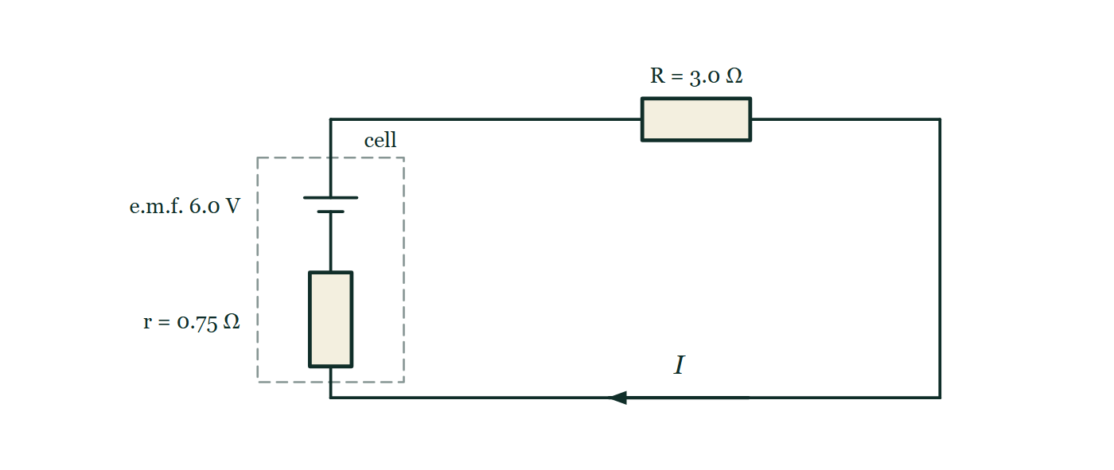
IB · THEME B · THE PARTICULATE NATURE OF MATTER
GIOPHYSICS PRACTICE PAPER
Question 10
Structured
HL
Discriminating
13 marks
Syllabus B.4, B.5
Part 1. A cell of e.m.f. 6.0 V and internal resistance 0.75 Ω is connected to an external resistor of resistance 3.0 Ω. Part 2. A fixed mass of ideal monatomic gas is taken from state X to state Y by two different routes: an isothermal expansion, and an adiabatic expansion to the same final volume.
Figure 4 — Circuit diagram of a single series loop. On the left a dashed boundary encloses the cell itself: a cell symbol with its long positive plate uppermost, labelled e.m.f. 6.0 V, in series with a resistor labelled r = 0.75 Ω. The two terminals cross the dashed boundary and the loop continues round to a resistor in the upper wire labelled R = 3.0 Ω. An arrow on the lower wire, labelled I, marks the direction of the conventional current.
IB Diploma Physics — Theme B · The particulate nature of matter. Written by GioPhysics from IB Diploma Programme Physics subject page; not an awarding body's document.
24 / 28
Notes:
[Demand] Discriminating — The part that separates the top grade: an unfamiliar context, a derivation, or an argument that has to hold together to earn anything.
[Figure] Figure 4. Circuit diagram of a single series loop. On the left a dashed boundary encloses the cell itself: a cell symbol with its long positive plate uppermost, labelled e.m.f. 6.0 V, in series with a resistor labelled r = 0.75 Ω. The two terminals cross the dashed boundary and the loop continues round to a resistor in the upper wire labelled R = 3.0 Ω. An arrow on the lower wire, labelled I, marks the direction of the conventional current.

Slide 25
IB · THEME B · THE PARTICULATE NATURE OF MATTER
GIOPHYSICS PRACTICE PAPER
Question 10 (cont.)
Structured
HL
Discriminating
13 marks
continued from the previous slide
(a) Calculate
3 marks
Calculate the current in the circuit and the terminal potential difference of the cell.
(b) Determine
3 marks
Determine the percentage of the power produced by the cell that is dissipated inside the cell itself.
(c) Compare
4 marks
Compare the final temperature and the work done by the gas for the isothermal and the adiabatic expansions to the same final volume.
(d) Explain
3 marks
Explain why the entropy of the gas increases during the isothermal expansion but is unchanged during a reversible adiabatic expansion.
IB Diploma Physics — Theme B · The particulate nature of matter. Written by GioPhysics from IB Diploma Programme Physics subject page; not an awarding body's document.
25 / 28
Notes:
[Demand] Discriminating — The part that separates the top grade: an unfamiliar context, a derivation, or an argument that has to hold together to earn anything.
[Figure] Figure 4. Circuit diagram of a single series loop. On the left a dashed boundary encloses the cell itself: a cell symbol with its long positive plate uppermost, labelled e.m.f. 6.0 V, in series with a resistor labelled r = 0.75 Ω. The two terminals cross the dashed boundary and the loop continues round to a resistor in the upper wire labelled R = 3.0 Ω. An arrow on the lower wire, labelled I, marks the direction of the conventional current.
[Reminder] Figure 4 is on the previous slide.

Slide 26
IB · THEME B · THE PARTICULATE NATURE OF MATTER
GIOPHYSICS PRACTICE PAPER
Answer 10
Structured
HL
Discriminating
13 marks
Mark scheme
(a) Calculate — 3 marks
AO2
✓
I = ε/(R + r) = 6.0/3.75 = 1.6 A
✓
V = IR = 1.6 × 3.0
✓
V = 4.8 V
(b) Determine — 3 marks
AO2
✓
power in r = I²r = 1.6² × 0.75 = 1.92 W
✓
total power = εI = 6.0 × 1.6 = 9.6 W
✓
percentage = 1.92/9.6 = 20%
(c) Compare — 4 marks
AO3
✓
isothermal: the temperature is unchanged by definition, so ΔU = 0 and the work done by the gas equals the thermal energy absorbed
✓
adiabatic: no thermal energy enters, so the work done by the gas comes entirely from its internal energy
✓
the adiabatic expansion therefore ends at a lower temperature than the isothermal one
✓
and because its pressure falls faster with volume, the area under its curve is smaller — less work is done by the gas
IB Diploma Physics — Theme B · The particulate nature of matter. Written by GioPhysics from IB Diploma Programme Physics subject page; not an awarding body's document.
26 / 28
Notes:
[Marking] One line per mark, awarded independently unless a point says otherwise.
[Examiner note (d)] The last clause is what makes the answer complete. Candidates who argue only from volume conclude that entropy must rise in both cases, which is the misconception this part exists to catch.
[Figure] Figure 4. Circuit diagram of a single series loop. On the left a dashed boundary encloses the cell itself: a cell symbol with its long positive plate uppermost, labelled e.m.f. 6.0 V, in series with a resistor labelled r = 0.75 Ω. The two terminals cross the dashed boundary and the loop continues round to a resistor in the upper wire labelled R = 3.0 Ω. An arrow on the lower wire, labelled I, marks the direction of the conventional current.

Slide 27
IB · THEME B · THE PARTICULATE NATURE OF MATTER
GIOPHYSICS PRACTICE PAPER
Answer 10 (cont.)
Structured
HL
Discriminating
13 marks
Mark scheme, continued
(d) Explain — 3 marks
AO3
✓
entropy change for a reversible process is ΔS = Q/T
✓
in the isothermal expansion the gas absorbs thermal energy at constant temperature, so Q is positive and ΔS is positive — and in molecular terms the same molecules now occupy a larger volume, so there are more available microstates
✓
in a reversible adiabatic expansion Q = 0, so ΔS = 0: the increase in volume is exactly offset by the narrowing of the molecular speed distribution as the gas cools
The last clause is what makes the answer complete. Candidates who argue only from volume conclude that entropy must rise in both cases, which is the misconception this part exists to catch.
IB Diploma Physics — Theme B · The particulate nature of matter. Written by GioPhysics from IB Diploma Programme Physics subject page; not an awarding body's document.
27 / 28
Notes:
[Marking] One line per mark, awarded independently unless a point says otherwise.
[Examiner note (d)] The last clause is what makes the answer complete. Candidates who argue only from volume conclude that entropy must rise in both cases, which is the misconception this part exists to catch.
[Figure] Figure 4. Circuit diagram of a single series loop. On the left a dashed boundary encloses the cell itself: a cell symbol with its long positive plate uppermost, labelled e.m.f. 6.0 V, in series with a resistor labelled r = 0.75 Ω. The two terminals cross the dashed boundary and the loop continues round to a resistor in the upper wire labelled R = 3.0 Ω. An arrow on the lower wire, labelled I, marks the direction of the conventional current.

Slide 28
IB · THEME B · THE PARTICULATE NATURE OF MATTER
GIOPHYSICS PRACTICE PAPER
Command words
IB Diploma Physics — the board's own definitions
Define
Discuss
Give the precise meaning of a word, phrase, concept or physical quantity.
Offer a considered and balanced review that includes a range of arguments, factors or hypotheses, supported by appropriate evidence.
State
Give a specific name, value or other brief answer without explanation or calculation.
Evaluate
Make an appraisal by weighing up the strengths and limitations.
Calculate
Explain
Obtain a numerical answer, showing the relevant stages in the working.
Give a detailed account including reasons or causes.
Describe
Show (that)
Give a detailed account.
Give the steps in a calculation or derivation.
Determine
Sketch
Obtain the only possible answer, from the data or by reasoning.
Represent by means of a graph showing a line and labelled but unscaled axes, with important features clearly identifiable.
Outline
Give a brief account or summary.
Suggest
Propose a solution, hypothesis or other possible answer.
Compare
Give an account of the similarities between two or more items, referring to both throughout.
IB Diploma Physics — Theme B · The particulate nature of matter. Written by GioPhysics from IB Diploma Programme Physics subject page; not an awarding body's document.
28 / 28
Notes:
[Objectives] AO1 Demonstrate knowledge: Recall facts, concepts and terminology, and state methodologies and techniques used in the course. AO2 Understand and apply knowledge: Apply concepts, terminology and techniques to familiar and unfamiliar situations, including numerical work. AO3 Analyse, evaluate and construct: Analyse and evaluate data, methods, claims and explanations, and construct a reasoned argument or conclusion. AO4 Demonstrate the application of skills: Design and evaluate investigations, handle raw and processed data, treat uncertainties, and communicate results.
[Source] IB Diploma Programme Physics subject page — https://www.ibo.org/programmes/diploma-programme/curriculum/sciences/physics/
[Disclaimer] Written by GioPhysics from the published course. These are practice papers in the style of IB Diploma Programme Physics; they are not IB papers, contain no past-paper questions, and the official subject guide and data booklet remain the authority. IB is a trademark of the International Baccalaureate Organization, which is not affiliated with and does not endorse GioPhysics.

