Slide 1
IB · THEME C · WAVE BEHAVIOUR
GIOPHYSICS PRACTICE PAPER
IB · IB Diploma Programme Physics · first assessment 2025
Theme C · Wave behaviour
Simple harmonic motion, the wave model, wave phenomena including interference and diffraction, standing waves and resonance, and the Doppler effect.
MIRRORS
Paper 1A (multiple choice), Paper 1B (data-based), and Paper 2 (short answer and extended response)
MARKS
55 in total — SL route 39, HL adds 16
TIME
60 minutes · 10 questions
DEMAND
Routine 2 · Demanding 6 · Discriminating 2
SYLLABUS
C.1, C.2, C.3, C.4, C.5
Written by GioPhysics from the published course. These are practice papers in the style of IB Diploma Programme Physics; they are not IB papers, contain no past-paper questions, and the official subject guide and data booklet remain the authority. IB is a trademark of the International Baccalaureate Organization, which is not affiliated with and does not endorse GioPhysics.
IB Diploma Physics — Theme C · Wave behaviour. Written by GioPhysics from IB Diploma Programme Physics subject page; not an awarding body's document.
1 / 28
Notes:
[Format] Paper 1 has two parts: 1A is multiple choice, and 1B is data-based questions drawn from the experimental work of the course, with no recall in it at all. Paper 2 is short-answer and extended-response across the whole syllabus. HL papers are longer and reach the HL-only sub-topics. The data booklet is provided in every paper, so no question tests whether you can remember an equation.
[Demand] The command term sets the demand, and the papers are written that way. "State" earns one mark for one line; "explain" is not creditworthy without a mechanism; "discuss" and "evaluate" need both sides weighed before a conclusion is reached. The extended-response part that closes each Paper 2 question is where HL candidates separate from one another, and those parts are pitched there rather than at the level of the calculation before them.
[Source] IB Diploma Programme Physics subject page — https://www.ibo.org/programmes/diploma-programme/curriculum/sciences/physics/
[Disclaimer] Written by GioPhysics from the published course. These are practice papers in the style of IB Diploma Programme Physics; they are not IB papers, contain no past-paper questions, and the official subject guide and data booklet remain the authority. IB is a trademark of the International Baccalaureate Organization, which is not affiliated with and does not endorse GioPhysics.

Slide 2
IB · THEME C · WAVE BEHAVIOUR
GIOPHYSICS PRACTICE PAPER
Question 1
Multiple choice
SL
Demanding
1 mark
Syllabus C.1 · AO2
The amplitude of a mass–spring oscillator is doubled while its mass and spring constant are unchanged. What happens to its period and to its total energy?
A
period unchanged, energy doubled
B
period unchanged, energy quadrupled
C
period doubled, energy doubled
D
period doubled, energy quadrupled
IB Diploma Physics — Theme C · Wave behaviour. Written by GioPhysics from IB Diploma Programme Physics subject page; not an awarding body's document.
2 / 28
Notes:
[Demand] Demanding — Several steps, and you have to choose them. Nothing says which comes first.

Slide 3
IB · THEME C · WAVE BEHAVIOUR
GIOPHYSICS PRACTICE PAPER
Answer 1
Multiple choice
SL
Demanding
1 mark
Mark scheme
B
period unchanged, energy quadrupled
Why the other three are there
The independence of period from amplitude is the defining feature of simple harmonic motion, which rules out C and D. Total energy is ½kx₀², so it goes as the square of the amplitude — A halves that dependence.
IB Diploma Physics — Theme C · Wave behaviour. Written by GioPhysics from IB Diploma Programme Physics subject page; not an awarding body's document.
3 / 28
Notes:
[Answer] B — period unchanged, energy quadrupled
[Distractors] The independence of period from amplitude is the defining feature of simple harmonic motion, which rules out C and D. Total energy is ½kx₀², so it goes as the square of the amplitude — A halves that dependence.

Slide 4
IB · THEME C · WAVE BEHAVIOUR
GIOPHYSICS PRACTICE PAPER
Question 2
Multiple choice
SL
Routine
1 mark
Syllabus C.2 · AO2
A sound wave of frequency 256 Hz travels through air at 340 m s⁻¹ and then passes into water, where its speed is 1500 m s⁻¹. What are its frequency and wavelength in the water?
A
256 Hz and 1.33 m
B
256 Hz and 5.86 m
C
1130 Hz and 1.33 m
D
58 Hz and 5.86 m
IB Diploma Physics — Theme C · Wave behaviour. Written by GioPhysics from IB Diploma Programme Physics subject page; not an awarding body's document.
4 / 28
Notes:
[Demand] Routine — The standard application — the named equation, the usual graph read.

Slide 5
IB · THEME C · WAVE BEHAVIOUR
GIOPHYSICS PRACTICE PAPER
Answer 2
Multiple choice
SL
Routine
1 mark
Mark scheme
B
256 Hz and 5.86 m
Why the other three are there
The frequency is fixed by the source and does not change at a boundary, which eliminates C and D at once. The wavelength changes with the speed: 1500/256 = 5.86 m.
IB Diploma Physics — Theme C · Wave behaviour. Written by GioPhysics from IB Diploma Programme Physics subject page; not an awarding body's document.
5 / 28
Notes:
[Answer] B — 256 Hz and 5.86 m
[Distractors] The frequency is fixed by the source and does not change at a boundary, which eliminates C and D at once. The wavelength changes with the speed: 1500/256 = 5.86 m.

Slide 6
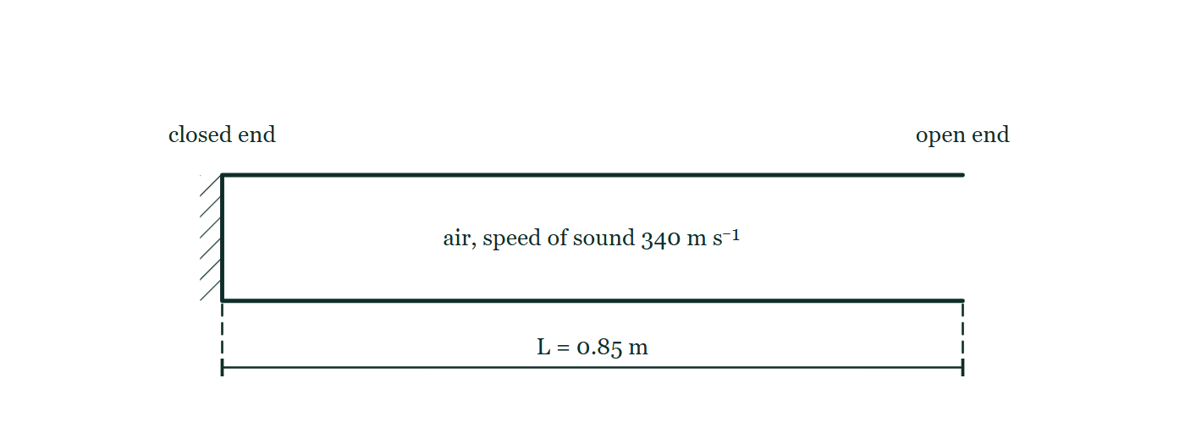
IB · THEME C · WAVE BEHAVIOUR
GIOPHYSICS PRACTICE PAPER
Question 3
Multiple choice
SL
Demanding
1 mark
Syllabus C.4 · AO2
A pipe of length 0.85 m is closed at one end and open at the other. The speed of sound in air is 340 m s⁻¹. What is the frequency of the fundamental note?
Figure 1 — Side view of a horizontal pipe drawn as a long rectangle lying on its side. Its left-hand end is sealed by a wall drawn with hatching behind it and labelled 'closed end'; its right-hand end has no wall drawn across it and is labelled 'open end'. The air column inside carries the note 'air, speed of sound 340 m s⁻¹', and a dimension line beneath the pipe, with a tick at each end, marks its length as L = 0.85 m from the closed end to the open end.
A
100 Hz
B
200 Hz
C
400 Hz
D
800 Hz
IB Diploma Physics — Theme C · Wave behaviour. Written by GioPhysics from IB Diploma Programme Physics subject page; not an awarding body's document.
6 / 28
Notes:
[Demand] Demanding — Several steps, and you have to choose them. Nothing says which comes first.
[Figure] Figure 1. Side view of a horizontal pipe drawn as a long rectangle lying on its side. Its left-hand end is sealed by a wall drawn with hatching behind it and labelled 'closed end'; its right-hand end has no wall drawn across it and is labelled 'open end'. The air column inside carries the note 'air, speed of sound 340 m s⁻¹', and a dimension line beneath the pipe, with a tick at each end, marks its length as L = 0.85 m from the closed end to the open end.

Slide 7
IB · THEME C · WAVE BEHAVIOUR
GIOPHYSICS PRACTICE PAPER
Answer 3
Multiple choice
SL
Demanding
1 mark
Mark scheme
A
100 Hz
Why the other three are there
B is the answer for a pipe open at both ends. A closed pipe has a node at the closed end and an antinode at the open end, so the fundamental fits only a quarter of a wavelength into its length: λ = 4L = 3.4 m.
IB Diploma Physics — Theme C · Wave behaviour. Written by GioPhysics from IB Diploma Programme Physics subject page; not an awarding body's document.
7 / 28
Notes:
[Answer] A — 100 Hz
[Distractors] B is the answer for a pipe open at both ends. A closed pipe has a node at the closed end and an antinode at the open end, so the fundamental fits only a quarter of a wavelength into its length: λ = 4L = 3.4 m.
[Figure] Figure 1. Side view of a horizontal pipe drawn as a long rectangle lying on its side. Its left-hand end is sealed by a wall drawn with hatching behind it and labelled 'closed end'; its right-hand end has no wall drawn across it and is labelled 'open end'. The air column inside carries the note 'air, speed of sound 340 m s⁻¹', and a dimension line beneath the pipe, with a tick at each end, marks its length as L = 0.85 m from the closed end to the open end.

Slide 8
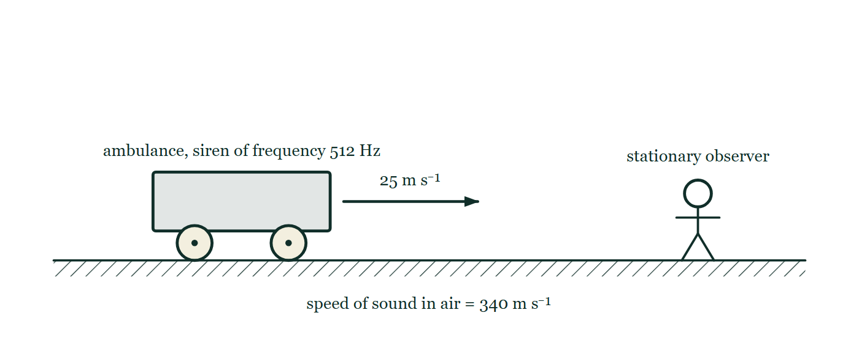
IB · THEME C · WAVE BEHAVIOUR
GIOPHYSICS PRACTICE PAPER
Question 4
Multiple choice
SL
Routine
1 mark
Syllabus C.5 · AO2
An ambulance siren emits a note of frequency 512 Hz. The ambulance travels at 25 m s⁻¹ towards a stationary observer. The speed of sound in air is 340 m s⁻¹. What frequency does the observer hear?
Figure 2 — Side view along a straight road, drawn as a hatched ground line. On the left an ambulance stands on the road, labelled 'ambulance, siren of frequency 512 Hz'. A horizontal arrow leaves the front of the ambulance and points to the right, labelled 25 m s⁻¹. Well ahead of it, on the same road, a person stands still, labelled 'stationary observer'. A note below the road reads 'speed of sound in air = 340 m s⁻¹'.
A
477 Hz
B
512 Hz
C
553 Hz
D
590 Hz
IB Diploma Physics — Theme C · Wave behaviour. Written by GioPhysics from IB Diploma Programme Physics subject page; not an awarding body's document.
8 / 28
Notes:
[Demand] Routine — The standard application — the named equation, the usual graph read.
[Figure] Figure 2. Side view along a straight road, drawn as a hatched ground line. On the left an ambulance stands on the road, labelled 'ambulance, siren of frequency 512 Hz'. A horizontal arrow leaves the front of the ambulance and points to the right, labelled 25 m s⁻¹. Well ahead of it, on the same road, a person stands still, labelled 'stationary observer'. A note below the road reads 'speed of sound in air = 340 m s⁻¹'.

Slide 9
IB · THEME C · WAVE BEHAVIOUR
GIOPHYSICS PRACTICE PAPER
Answer 4
Multiple choice
SL
Routine
1 mark
Mark scheme
C
553 Hz
Why the other three are there
A is the frequency heard after the ambulance has passed, obtained by using the wrong sign. Any answer below 512 Hz can be discarded for an approaching source before the arithmetic begins.
IB Diploma Physics — Theme C · Wave behaviour. Written by GioPhysics from IB Diploma Programme Physics subject page; not an awarding body's document.
9 / 28
Notes:
[Answer] C — 553 Hz
[Distractors] A is the frequency heard after the ambulance has passed, obtained by using the wrong sign. Any answer below 512 Hz can be discarded for an approaching source before the arithmetic begins.
[Figure] Figure 2. Side view along a straight road, drawn as a hatched ground line. On the left an ambulance stands on the road, labelled 'ambulance, siren of frequency 512 Hz'. A horizontal arrow leaves the front of the ambulance and points to the right, labelled 25 m s⁻¹. Well ahead of it, on the same road, a person stands still, labelled 'stationary observer'. A note below the road reads 'speed of sound in air = 340 m s⁻¹'.

Slide 10
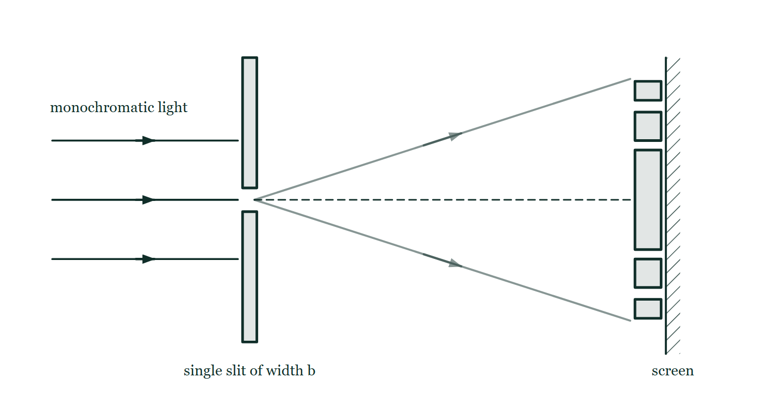
IB · THEME C · WAVE BEHAVIOUR
GIOPHYSICS PRACTICE PAPER
Question 5
Multiple choice
HL
Demanding
1 mark
Syllabus C.3 · AO2
Monochromatic light passes through a single slit and forms a diffraction pattern on a distant screen. The slit is then made narrower. What happens to the width of the central maximum and to its intensity?
Figure 3 — Plan view of the arrangement. Three parallel rays of monochromatic light travel from the left towards an opaque barrier drawn as two vertical bars; only the middle ray meets the narrow gap between them, which is labelled 'single slit of width b'. Beyond the slit, two faint rays spread out above and below a dashed straight line that continues from the slit to a screen at the far right. On the screen a row of bright bands is drawn, centred on the dashed line, with the band on the line noticeably taller than the pairs of bands above and below it.
A
width increases, intensity decreases
B
width increases, intensity increases
C
width decreases, intensity decreases
D
width decreases, intensity increases
IB Diploma Physics — Theme C · Wave behaviour. Written by GioPhysics from IB Diploma Programme Physics subject page; not an awarding body's document.
10 / 28
Notes:
[Demand] Demanding — Several steps, and you have to choose them. Nothing says which comes first.
[Figure] Figure 3. Plan view of the arrangement. Three parallel rays of monochromatic light travel from the left towards an opaque barrier drawn as two vertical bars; only the middle ray meets the narrow gap between them, which is labelled 'single slit of width b'. Beyond the slit, two faint rays spread out above and below a dashed straight line that continues from the slit to a screen at the far right. On the screen a row of bright bands is drawn, centred on the dashed line, with the band on the line noticeably taller than the pairs of bands above and below it.

Slide 11
IB · THEME C · WAVE BEHAVIOUR
GIOPHYSICS PRACTICE PAPER
Answer 5
Multiple choice
HL
Demanding
1 mark
Mark scheme
A
width increases, intensity decreases
Why the other three are there
C is the intuitive answer — a narrower slit ought to give a narrower patch — and it is exactly backwards. The angular width of the central maximum is 2λ/b, so narrowing b spreads the pattern out, while less light passes through and the pattern is dimmer.
IB Diploma Physics — Theme C · Wave behaviour. Written by GioPhysics from IB Diploma Programme Physics subject page; not an awarding body's document.
11 / 28
Notes:
[Answer] A — width increases, intensity decreases
[Distractors] C is the intuitive answer — a narrower slit ought to give a narrower patch — and it is exactly backwards. The angular width of the central maximum is 2λ/b, so narrowing b spreads the pattern out, while less light passes through and the pattern is dimmer.
[Figure] Figure 3. Plan view of the arrangement. Three parallel rays of monochromatic light travel from the left towards an opaque barrier drawn as two vertical bars; only the middle ray meets the narrow gap between them, which is labelled 'single slit of width b'. Beyond the slit, two faint rays spread out above and below a dashed straight line that continues from the slit to a screen at the far right. On the screen a row of bright bands is drawn, centred on the dashed line, with the band on the line noticeably taller than the pairs of bands above and below it.

Slide 12
IB · THEME C · WAVE BEHAVIOUR
GIOPHYSICS PRACTICE PAPER
Question 6
Multiple choice
HL
Demanding
1 mark
Syllabus C.1 · AO2
A particle undergoes simple harmonic motion described by x = x₀ sin(ωt). At what displacement is the kinetic energy equal to the potential energy?
A
x₀/4
B
x₀/2
C
x₀/√2
D
x₀
IB Diploma Physics — Theme C · Wave behaviour. Written by GioPhysics from IB Diploma Programme Physics subject page; not an awarding body's document.
12 / 28
Notes:
[Demand] Demanding — Several steps, and you have to choose them. Nothing says which comes first.

Slide 13
IB · THEME C · WAVE BEHAVIOUR
GIOPHYSICS PRACTICE PAPER
Answer 6
Multiple choice
HL
Demanding
1 mark
Mark scheme
C
x₀/√2
Why the other three are there
B is the answer of a candidate who splits the displacement in half rather than the energy. The potential energy goes as x², so it is half the total when x² = x₀²/2.
IB Diploma Physics — Theme C · Wave behaviour. Written by GioPhysics from IB Diploma Programme Physics subject page; not an awarding body's document.
13 / 28
Notes:
[Answer] C — x₀/√2
[Distractors] B is the answer of a candidate who splits the displacement in half rather than the energy. The potential energy goes as x², so it is half the total when x² = x₀²/2.

Slide 14
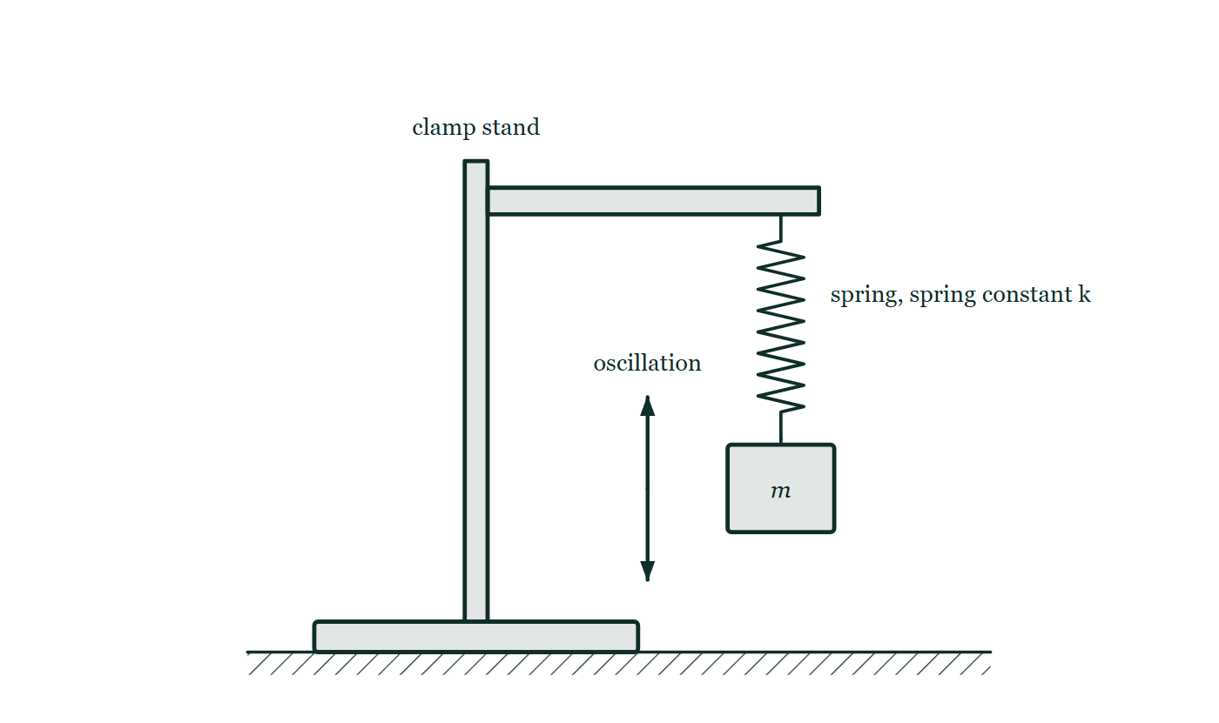
IB · THEME C · WAVE BEHAVIOUR
GIOPHYSICS PRACTICE PAPER
Question 7
Data analysis
SL
Demanding
11 marks
Syllabus C.1
A student investigates the oscillations of a mass hanging from a vertical spring, expecting the period to satisfy T = 2π√(m/k), where k is the spring constant.
The student's processed data
m / kg | 0.100 | 0.200 | 0.300 | 0.400 | 0.500
T / s | 0.444 | 0.628 | 0.770 | 0.889 | 0.993
T² / s² | 0.197 | 0.395 | 0.592 | 0.790 | 0.987
Figure 4 — Side view of the apparatus on a bench. A vertical rod rises from the heavy base of a clamp stand, and a horizontal clamp arm projects from the top of the rod. A helical spring hangs from the end of the arm and is labelled 'spring, spring constant k'. A rectangular block labelled m hangs from the lower end of the spring. Beside the mass a vertical double-headed arrow labelled 'oscillation' shows that it moves up and down about its hanging position.
IB Diploma Physics — Theme C · Wave behaviour. Written by GioPhysics from IB Diploma Programme Physics subject page; not an awarding body's document.
14 / 28
Notes:
[Demand] Demanding — Several steps, and you have to choose them. Nothing says which comes first.
[Figure] Figure 4. Side view of the apparatus on a bench. A vertical rod rises from the heavy base of a clamp stand, and a horizontal clamp arm projects from the top of the rod. A helical spring hangs from the end of the arm and is labelled 'spring, spring constant k'. A rectangular block labelled m hangs from the lower end of the spring. Beside the mass a vertical double-headed arrow labelled 'oscillation' shows that it moves up and down about its hanging position.

Slide 15
IB · THEME C · WAVE BEHAVIOUR
GIOPHYSICS PRACTICE PAPER
Question 7 (cont.)
Data analysis
SL
Demanding
11 marks
continued from the previous slide
(a) Determine
4 marks
Determine the gradient of a graph of T² against m, and hence determine the spring constant k.
(b) Explain
2 marks
Explain why the student plotted T² against m rather than T against m.
(c) Suggest
2 marks
In practice the line of best fit for a real spring has a small positive intercept on the T² axis. Suggest a physical reason for this.
(d) Outline
3 marks
Outline how the student should time the oscillations to keep the uncertainty in T small, and state one reason why timing a single oscillation would be unsatisfactory.
IB Diploma Physics — Theme C · Wave behaviour. Written by GioPhysics from IB Diploma Programme Physics subject page; not an awarding body's document.
15 / 28
Notes:
[Demand] Demanding — Several steps, and you have to choose them. Nothing says which comes first.
[Figure] Figure 4. Side view of the apparatus on a bench. A vertical rod rises from the heavy base of a clamp stand, and a horizontal clamp arm projects from the top of the rod. A helical spring hangs from the end of the arm and is labelled 'spring, spring constant k'. A rectangular block labelled m hangs from the lower end of the spring. Beside the mass a vertical double-headed arrow labelled 'oscillation' shows that it moves up and down about its hanging position.
[Reminder] Figure 4 is on the previous slide.

Slide 16
IB · THEME C · WAVE BEHAVIOUR
GIOPHYSICS PRACTICE PAPER
Answer 7
Data analysis
SL
Demanding
11 marks
Mark scheme
(a) Determine — 4 marks
AO2
✓
T² = (4π²/k)m, so the gradient is 4π²/k
✓
gradient = (0.987 − 0.197)/(0.500 − 0.100) = 0.790/0.400
✓
gradient = 1.98 s² kg⁻¹
✓
k = 4π²/1.98 = 20 N m⁻¹
(b) Explain — 2 marks
AO4
✓
T against m would be a curve, from which no constant can be read directly
✓
squaring produces a linear relationship, so a straight line both tests the model and gives k from a single gradient
(c) Suggest — 2 marks
AO3
✓
the spring itself has mass, and part of it oscillates along with the hanging mass
✓
so the effective oscillating mass exceeds the mass added, giving a non-zero period as the added mass tends to zero — the intercept corresponds to roughly one third of the spring's own mass
The one-third figure is not required for the marks, but a candidate who names the spring's own mass as the cause has given the answer the mark scheme is looking for.
(d) Outline — 3 marks
AO4
✓
time at least 10 or 20 complete oscillations and divide by the number
✓
start and stop the timing as the mass passes through the equilibrium position, where it moves fastest, using a fixed reference marker
✓
the reaction-time uncertainty of about 0.2 s is a large fraction of a single period of about 0.5 s, but only a small fraction of a 10-oscillation total
IB Diploma Physics — Theme C · Wave behaviour. Written by GioPhysics from IB Diploma Programme Physics subject page; not an awarding body's document.
16 / 28
Notes:
[Marking] One line per mark, awarded independently unless a point says otherwise.
[Examiner note (c)] The one-third figure is not required for the marks, but a candidate who names the spring's own mass as the cause has given the answer the mark scheme is looking for.
[Figure] Figure 4. Side view of the apparatus on a bench. A vertical rod rises from the heavy base of a clamp stand, and a horizontal clamp arm projects from the top of the rod. A helical spring hangs from the end of the arm and is labelled 'spring, spring constant k'. A rectangular block labelled m hangs from the lower end of the spring. Beside the mass a vertical double-headed arrow labelled 'oscillation' shows that it moves up and down about its hanging position.

Slide 17
IB · THEME C · WAVE BEHAVIOUR
GIOPHYSICS PRACTICE PAPER
Question 8
Structured
SL
Demanding
12 marks
Syllabus C.2, C.4
A string of length 0.60 m is stretched between two fixed points. When plucked, it vibrates in its fundamental mode at a frequency of 250 Hz.
(a) Determine
3 marks
Determine the speed of the transverse waves on the string.
(b) Describe
4 marks
Describe how a standing wave is formed on the string, and state what distinguishes a standing wave from a progressive wave.
(c) Calculate
2 marks
Calculate the frequency of the third harmonic of this string, and state how many nodes it has, including the two at the ends.
(d) Explain
3 marks
The tension in the string is increased. Explain what happens to the fundamental frequency, and explain why the length of the string does not change the speed of the waves on it.
IB Diploma Physics — Theme C · Wave behaviour. Written by GioPhysics from IB Diploma Programme Physics subject page; not an awarding body's document.
17 / 28
Notes:
[Demand] Demanding — Several steps, and you have to choose them. Nothing says which comes first.

Slide 18
IB · THEME C · WAVE BEHAVIOUR
GIOPHYSICS PRACTICE PAPER
Answer 8
Structured
SL
Demanding
12 marks
Mark scheme
(a) Determine — 3 marks
AO2
✓
in the fundamental mode the string carries half a wavelength, so λ = 2L = 1.2 m
✓
v = fλ = 250 × 1.2
✓
v = 300 m s⁻¹
(b) Describe — 4 marks
AO1
✓
a wave travels along the string and reflects at the fixed end, and the reflected wave travels back along the string
✓
the two waves have the same frequency, speed and amplitude and travel in opposite directions, so they superpose
✓
the superposition produces fixed nodes where the two always cancel and antinodes where they always reinforce
✓
a standing wave transfers no energy along the string, and every point between adjacent nodes oscillates in phase — unlike a progressive wave, in which phase changes steadily along the direction of travel
(c) Calculate — 2 marks
AO2
✓
f₃ = 3 × 250 = 750 Hz
✓
4 nodes
IB Diploma Physics — Theme C · Wave behaviour. Written by GioPhysics from IB Diploma Programme Physics subject page; not an awarding body's document.
18 / 28
Notes:
[Marking] One line per mark, awarded independently unless a point says otherwise.

Slide 19
IB · THEME C · WAVE BEHAVIOUR
GIOPHYSICS PRACTICE PAPER
Answer 8 (cont.)
Structured
SL
Demanding
12 marks
Mark scheme, continued
(d) Explain — 3 marks
AO3
✓
the wave speed on a string increases with tension, so v rises
✓
the wavelength of the fundamental is fixed at 2L by the geometry, so f = v/λ increases
✓
the speed depends only on the tension and the mass per unit length of the string — properties of the medium — and not on how much of that medium is between the supports
IB Diploma Physics — Theme C · Wave behaviour. Written by GioPhysics from IB Diploma Programme Physics subject page; not an awarding body's document.
19 / 28
Notes:
[Marking] One line per mark, awarded independently unless a point says otherwise.

Slide 20
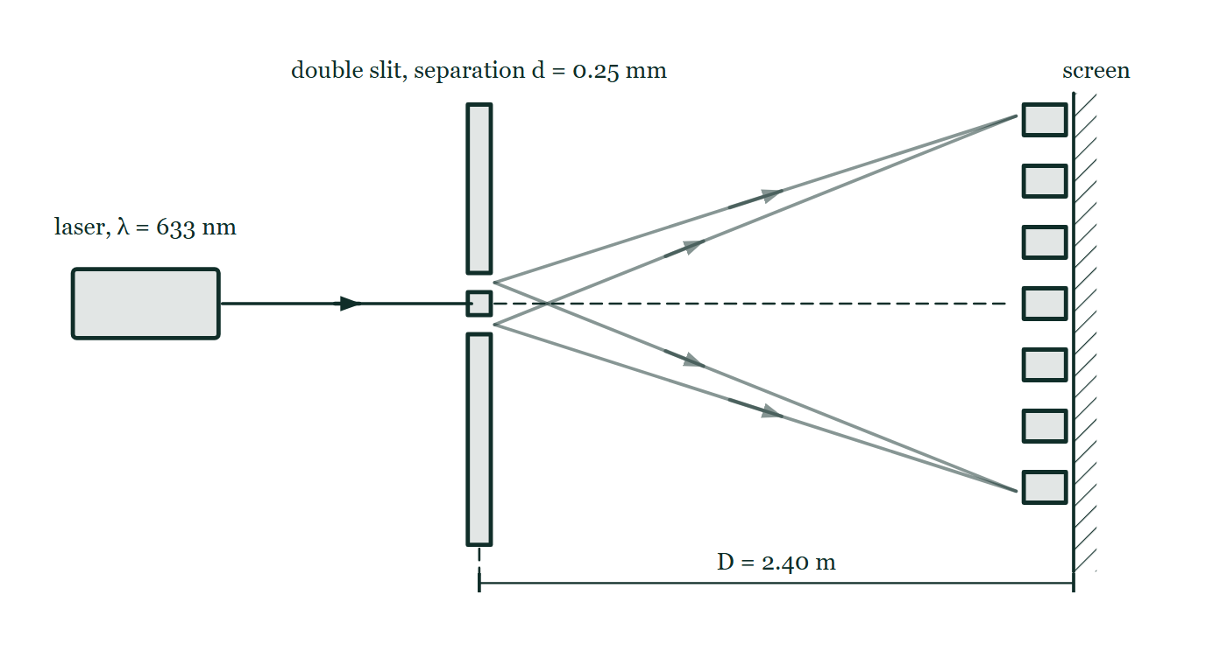
IB · THEME C · WAVE BEHAVIOUR
GIOPHYSICS PRACTICE PAPER
Question 9
Structured
SL
Discriminating
12 marks
Syllabus C.3
Coherent light of wavelength 633 nm from a laser is incident normally on a pair of narrow parallel slits separated by 0.25 mm. An interference pattern is observed on a screen 2.40 m from the slits.
Figure 5 — Plan view. A laser at the left, labelled 'laser, λ = 633 nm', sends a beam horizontally to an opaque barrier, which has two narrow slits, one just above and one just below the beam line, separated by a short bar; the barrier is labelled 'double slit, separation d = 0.25 mm'. Beyond it, faint lines from the two slits spread out towards a screen at the right, where a column of equally spaced bright fringes is drawn, one of them on the dashed line that continues straight on from the slits. A dimension line beneath marks the slit-to-screen distance as D = 2.40 m.
IB Diploma Physics — Theme C · Wave behaviour. Written by GioPhysics from IB Diploma Programme Physics subject page; not an awarding body's document.
20 / 28
Notes:
[Demand] Discriminating — The part that separates the top grade: an unfamiliar context, a derivation, or an argument that has to hold together to earn anything.
[Figure] Figure 5. Plan view. A laser at the left, labelled 'laser, λ = 633 nm', sends a beam horizontally to an opaque barrier, which has two narrow slits, one just above and one just below the beam line, separated by a short bar; the barrier is labelled 'double slit, separation d = 0.25 mm'. Beyond it, faint lines from the two slits spread out towards a screen at the right, where a column of equally spaced bright fringes is drawn, one of them on the dashed line that continues straight on from the slits. A dimension line beneath marks the slit-to-screen distance as D = 2.40 m.

Slide 21
IB · THEME C · WAVE BEHAVIOUR
GIOPHYSICS PRACTICE PAPER
Question 9 (cont.)
Structured
SL
Discriminating
12 marks
continued from the previous slide
(a) Determine
3 marks
Determine the separation of adjacent bright fringes on the screen.
(b) Explain
3 marks
Explain, in terms of path difference, why a bright fringe appears at the centre of the pattern and why dark fringes appear either side of it.
(c) Suggest
3 marks
One of the two slits is now covered with a filter that halves the amplitude of the light passing through it. Suggest how the appearance of the pattern changes.
(d) Compare
3 marks
The double slit is replaced by a diffraction grating of 500 lines per millimetre, illuminated by the same laser. Compare the pattern produced with the double-slit pattern.
IB Diploma Physics — Theme C · Wave behaviour. Written by GioPhysics from IB Diploma Programme Physics subject page; not an awarding body's document.
21 / 28
Notes:
[Demand] Discriminating — The part that separates the top grade: an unfamiliar context, a derivation, or an argument that has to hold together to earn anything.
[Figure] Figure 5. Plan view. A laser at the left, labelled 'laser, λ = 633 nm', sends a beam horizontally to an opaque barrier, which has two narrow slits, one just above and one just below the beam line, separated by a short bar; the barrier is labelled 'double slit, separation d = 0.25 mm'. Beyond it, faint lines from the two slits spread out towards a screen at the right, where a column of equally spaced bright fringes is drawn, one of them on the dashed line that continues straight on from the slits. A dimension line beneath marks the slit-to-screen distance as D = 2.40 m.
[Reminder] Figure 5 is on the previous slide.

Slide 22
IB · THEME C · WAVE BEHAVIOUR
GIOPHYSICS PRACTICE PAPER
Answer 9
Structured
SL
Discriminating
12 marks
Mark scheme
(a) Determine — 3 marks
AO2
✓
s = λD/d
✓
s = (633 × 10⁻⁹ × 2.40)/(0.25 × 10⁻³)
✓
s = 6.1 × 10⁻³ m (6.1 mm)
(b) Explain — 3 marks
AO2
✓
at the centre the two paths are equal, so the path difference is zero and the waves arrive in phase and interfere constructively
✓
moving away from the centre, the path difference grows
✓
where it reaches half a wavelength the waves arrive antiphase and cancel, giving a dark fringe; where it reaches a whole wavelength they reinforce again
(c) Suggest — 3 marks
AO3
✓
the fringe separation is unchanged, because it depends only on λ, D and d
✓
the dark fringes are no longer completely dark, because the two amplitudes no longer cancel exactly
✓
so the contrast between bright and dark fringes is reduced, and the bright fringes are dimmer
The best-discriminating part of the paper. Almost every candidate can find the fringe spacing; far fewer see that the visibility of a two-source pattern depends on the amplitudes being matched.
IB Diploma Physics — Theme C · Wave behaviour. Written by GioPhysics from IB Diploma Programme Physics subject page; not an awarding body's document.
22 / 28
Notes:
[Marking] One line per mark, awarded independently unless a point says otherwise.
[Examiner note (c)] The best-discriminating part of the paper. Almost every candidate can find the fringe spacing; far fewer see that the visibility of a two-source pattern depends on the amplitudes being matched.
[Figure] Figure 5. Plan view. A laser at the left, labelled 'laser, λ = 633 nm', sends a beam horizontally to an opaque barrier, which has two narrow slits, one just above and one just below the beam line, separated by a short bar; the barrier is labelled 'double slit, separation d = 0.25 mm'. Beyond it, faint lines from the two slits spread out towards a screen at the right, where a column of equally spaced bright fringes is drawn, one of them on the dashed line that continues straight on from the slits. A dimension line beneath marks the slit-to-screen distance as D = 2.40 m.

Slide 23
IB · THEME C · WAVE BEHAVIOUR
GIOPHYSICS PRACTICE PAPER
Answer 9 (cont.)
Structured
SL
Discriminating
12 marks
Mark scheme, continued
(d) Compare — 3 marks
AO3
✓
the grating produces maxima that are much sharper and narrower, separated by wide dark regions, rather than broad fringes of gradually varying brightness
✓
the maxima are much further apart, because the slit separation of 2.0 × 10⁻⁶ m is far smaller than 0.25 mm
✓
each maximum is brighter, because light from many thousands of slits contributes to it rather than from only two
IB Diploma Physics — Theme C · Wave behaviour. Written by GioPhysics from IB Diploma Programme Physics subject page; not an awarding body's document.
23 / 28
Notes:
[Marking] One line per mark, awarded independently unless a point says otherwise.
[Examiner note (c)] The best-discriminating part of the paper. Almost every candidate can find the fringe spacing; far fewer see that the visibility of a two-source pattern depends on the amplitudes being matched.
[Figure] Figure 5. Plan view. A laser at the left, labelled 'laser, λ = 633 nm', sends a beam horizontally to an opaque barrier, which has two narrow slits, one just above and one just below the beam line, separated by a short bar; the barrier is labelled 'double slit, separation d = 0.25 mm'. Beyond it, faint lines from the two slits spread out towards a screen at the right, where a column of equally spaced bright fringes is drawn, one of them on the dashed line that continues straight on from the slits. A dimension line beneath marks the slit-to-screen distance as D = 2.40 m.

Slide 24
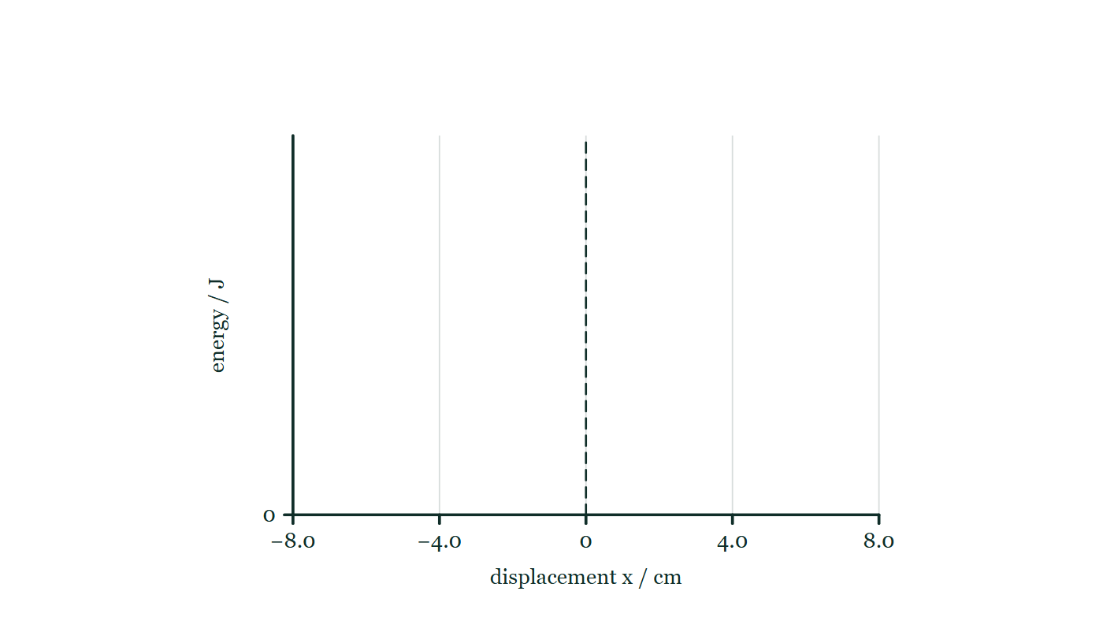
IB · THEME C · WAVE BEHAVIOUR
GIOPHYSICS PRACTICE PAPER
Question 10
Structured
HL
Discriminating
14 marks
Syllabus C.1, C.5
A particle of mass 0.25 kg undergoes simple harmonic motion with amplitude 8.0 cm and period 1.6 s. Separately, a star in a distant galaxy emits a spectral line of laboratory wavelength 486.1 nm, which is observed on Earth at 487.5 nm.
Figure 6 — A pair of empty axes provided for the sketch. The horizontal axis is labelled 'displacement x / cm' and is scaled from −8.0 through 0 to +8.0, with faint gridlines at −8.0, −4.0, 0, +4.0 and +8.0 and a dashed vertical line drawn at x = 0. The vertical axis is labelled 'energy / J' and carries only a zero at its foot, so no numerical scale is imposed. No curve of any kind is drawn on the axes.
IB Diploma Physics — Theme C · Wave behaviour. Written by GioPhysics from IB Diploma Programme Physics subject page; not an awarding body's document.
24 / 28
Notes:
[Demand] Discriminating — The part that separates the top grade: an unfamiliar context, a derivation, or an argument that has to hold together to earn anything.
[Figure] Figure 6. A pair of empty axes provided for the sketch. The horizontal axis is labelled 'displacement x / cm' and is scaled from −8.0 through 0 to +8.0, with faint gridlines at −8.0, −4.0, 0, +4.0 and +8.0 and a dashed vertical line drawn at x = 0. The vertical axis is labelled 'energy / J' and carries only a zero at its foot, so no numerical scale is imposed. No curve of any kind is drawn on the axes.

Slide 25
IB · THEME C · WAVE BEHAVIOUR
GIOPHYSICS PRACTICE PAPER
Question 10 (cont.)
Structured
HL
Discriminating
14 marks
continued from the previous slide
(a) Determine
4 marks
Determine the total energy of the oscillating particle.
(b) Sketch
3 marks
Sketch, on the same axes, graphs of the kinetic energy and of the potential energy of the particle against displacement, from −x₀ to +x₀.
(c) Determine
4 marks
Determine the speed at which the star is moving relative to the Earth, and state whether it is approaching or receding.
(d) Explain
3 marks
Explain why the Doppler shift for light is treated differently from the Doppler shift for sound when the source and the observer are both moving.
IB Diploma Physics — Theme C · Wave behaviour. Written by GioPhysics from IB Diploma Programme Physics subject page; not an awarding body's document.
25 / 28
Notes:
[Demand] Discriminating — The part that separates the top grade: an unfamiliar context, a derivation, or an argument that has to hold together to earn anything.
[Figure] Figure 6. A pair of empty axes provided for the sketch. The horizontal axis is labelled 'displacement x / cm' and is scaled from −8.0 through 0 to +8.0, with faint gridlines at −8.0, −4.0, 0, +4.0 and +8.0 and a dashed vertical line drawn at x = 0. The vertical axis is labelled 'energy / J' and carries only a zero at its foot, so no numerical scale is imposed. No curve of any kind is drawn on the axes.
[Reminder] Figure 6 is on the previous slide.

Slide 26
IB · THEME C · WAVE BEHAVIOUR
GIOPHYSICS PRACTICE PAPER
Answer 10
Structured
HL
Discriminating
14 marks
Mark scheme
(a) Determine — 4 marks
AO2
✓
ω = 2π/T = 2π/1.6 = 3.93 rad s⁻¹
✓
E_total = ½mω²x₀²
✓
E = ½ × 0.25 × 3.93² × 0.080²
✓
E = 1.2 × 10⁻² J
(b) Sketch — 3 marks
AO2
✓
potential energy is a parabola with a minimum of zero at x = 0, rising to the total energy at x = ±x₀
✓
kinetic energy is an inverted parabola, maximum at x = 0 and zero at x = ±x₀
✓
the two curves sum to a constant at every displacement, and cross at x = ±x₀/√2
(c) Determine — 4 marks
AO2
✓
Δλ = 487.5 − 486.1 = 1.4 nm
✓
Δλ/λ₀ = v/c, so v = c(1.4/486.1)
✓
v = 8.6 × 10⁵ m s⁻¹
✓
the observed wavelength is longer, so the light is redshifted and the star is receding
IB Diploma Physics — Theme C · Wave behaviour. Written by GioPhysics from IB Diploma Programme Physics subject page; not an awarding body's document.
26 / 28
Notes:
[Marking] One line per mark, awarded independently unless a point says otherwise.
[Examiner note (d)] This is a Nature of Science point as much as a physics one, and it is the sort of connection the extended-response part of a Paper 2 question is set to reward.
[Figure] Figure 6. A pair of empty axes provided for the sketch. The horizontal axis is labelled 'displacement x / cm' and is scaled from −8.0 through 0 to +8.0, with faint gridlines at −8.0, −4.0, 0, +4.0 and +8.0 and a dashed vertical line drawn at x = 0. The vertical axis is labelled 'energy / J' and carries only a zero at its foot, so no numerical scale is imposed. No curve of any kind is drawn on the axes.

Slide 27
IB · THEME C · WAVE BEHAVIOUR
GIOPHYSICS PRACTICE PAPER
Answer 10 (cont.)
Structured
HL
Discriminating
14 marks
Mark scheme, continued
(d) Explain — 3 marks
AO3
✓
sound travels through a medium, so the equations distinguish a moving source from a moving observer — the two give different shifts for the same relative speed
✓
light needs no medium, and its speed is the same in every inertial frame
✓
so only the relative velocity of source and observer can matter, and a single expression covers every case
This is a Nature of Science point as much as a physics one, and it is the sort of connection the extended-response part of a Paper 2 question is set to reward.
IB Diploma Physics — Theme C · Wave behaviour. Written by GioPhysics from IB Diploma Programme Physics subject page; not an awarding body's document.
27 / 28
Notes:
[Marking] One line per mark, awarded independently unless a point says otherwise.
[Examiner note (d)] This is a Nature of Science point as much as a physics one, and it is the sort of connection the extended-response part of a Paper 2 question is set to reward.
[Figure] Figure 6. A pair of empty axes provided for the sketch. The horizontal axis is labelled 'displacement x / cm' and is scaled from −8.0 through 0 to +8.0, with faint gridlines at −8.0, −4.0, 0, +4.0 and +8.0 and a dashed vertical line drawn at x = 0. The vertical axis is labelled 'energy / J' and carries only a zero at its foot, so no numerical scale is imposed. No curve of any kind is drawn on the axes.

Slide 28
IB · THEME C · WAVE BEHAVIOUR
GIOPHYSICS PRACTICE PAPER
Command words
IB Diploma Physics — the board's own definitions
Define
Discuss
Give the precise meaning of a word, phrase, concept or physical quantity.
Offer a considered and balanced review that includes a range of arguments, factors or hypotheses, supported by appropriate evidence.
State
Give a specific name, value or other brief answer without explanation or calculation.
Evaluate
Make an appraisal by weighing up the strengths and limitations.
Calculate
Explain
Obtain a numerical answer, showing the relevant stages in the working.
Give a detailed account including reasons or causes.
Describe
Show (that)
Give a detailed account.
Give the steps in a calculation or derivation.
Determine
Sketch
Obtain the only possible answer, from the data or by reasoning.
Represent by means of a graph showing a line and labelled but unscaled axes, with important features clearly identifiable.
Outline
Give a brief account or summary.
Suggest
Propose a solution, hypothesis or other possible answer.
Compare
Give an account of the similarities between two or more items, referring to both throughout.
IB Diploma Physics — Theme C · Wave behaviour. Written by GioPhysics from IB Diploma Programme Physics subject page; not an awarding body's document.
28 / 28
Notes:
[Objectives] AO1 Demonstrate knowledge: Recall facts, concepts and terminology, and state methodologies and techniques used in the course. AO2 Understand and apply knowledge: Apply concepts, terminology and techniques to familiar and unfamiliar situations, including numerical work. AO3 Analyse, evaluate and construct: Analyse and evaluate data, methods, claims and explanations, and construct a reasoned argument or conclusion. AO4 Demonstrate the application of skills: Design and evaluate investigations, handle raw and processed data, treat uncertainties, and communicate results.
[Source] IB Diploma Programme Physics subject page — https://www.ibo.org/programmes/diploma-programme/curriculum/sciences/physics/
[Disclaimer] Written by GioPhysics from the published course. These are practice papers in the style of IB Diploma Programme Physics; they are not IB papers, contain no past-paper questions, and the official subject guide and data booklet remain the authority. IB is a trademark of the International Baccalaureate Organization, which is not affiliated with and does not endorse GioPhysics.

