Slide 1
IGCSE · TOPIC 4 · ELECTRICITY AND MAGNETISM
GIOPHYSICS PRACTICE PAPER
IGCSE · Physics 0625 · for examination in 2026, 2027 and 2028
Topic 4 · Electricity and magnetism
Magnetism, charge and current, circuit calculations, electrical safety in the home, the motor effect, induction and transformers.
MIRRORS
Papers 1 and 2 (multiple choice), Papers 3 and 4 (theory), Paper 6 (alternative to practical)
MARKS
41 in total — Core route 19, Supp. adds 22
TIME
50 minutes · 10 questions
DEMAND
Recall 2 · Routine 4 · Demanding 3 · Discriminating 1
SYLLABUS
4.1, 4.2, 4.3, 4.4, 4.5
Written by GioPhysics from the published syllabus. These are practice papers in the style of Cambridge IGCSE Physics 0625; they are not Cambridge papers, contain no past-paper questions, and the official syllabus and specimen materials remain the authority.
Cambridge IGCSE Physics — Topic 4 · Electricity and magnetism. Written by GioPhysics from Cambridge IGCSE Physics 0625 syllabus; not an awarding body's document.
1 / 25
Notes:
[Format] Every candidate sits two theory papers and one practical-skills paper. Core takes Papers 1 and 3 and is capped at grade C; Extended takes Papers 2 and 4 and reaches A*. Both then take either Paper 5 (practical test) or Paper 6 (alternative to practical), which carries 20% either way. Theory papers give you no formula sheet.
[Demand] Pitched at the board's own level, not above it. Multiple choice is mostly one step, with a couple of two-step items and one that rewards the candidate who does not take the obvious route. Structured questions open on a 1-mark recall and close on an explanation or a suggestion worth two marks — the marks real candidates most often drop.
[Source] Cambridge IGCSE Physics 0625 syllabus — https://www.cambridgeinternational.org/Images/697209-2026-2028-syllabus.pdf
[Disclaimer] Written by GioPhysics from the published syllabus. These are practice papers in the style of Cambridge IGCSE Physics 0625; they are not Cambridge papers, contain no past-paper questions, and the official syllabus and specimen materials remain the authority.

Slide 2
IGCSE · TOPIC 4 · ELECTRICITY AND MAGNETISM
GIOPHYSICS PRACTICE PAPER
Question 1
Multiple choice
Core
Recall
1 mark
Syllabus 4.1 · AO1
Which statement about a permanent magnet and a piece of unmagnetised iron is correct?
A
The magnet attracts the iron, and the iron attracts the magnet.
B
The magnet attracts the iron, but the iron has no effect on the magnet.
C
The magnet repels the iron if the south pole is brought close.
D
The iron must first be magnetised before any force acts.
Cambridge IGCSE Physics — Topic 4 · Electricity and magnetism. Written by GioPhysics from Cambridge IGCSE Physics 0625 syllabus; not an awarding body's document.
2 / 25
Notes:
[Demand] Recall — One idea, one step. The mark is for knowing it.

Slide 3
IGCSE · TOPIC 4 · ELECTRICITY AND MAGNETISM
GIOPHYSICS PRACTICE PAPER
Answer 1
Multiple choice
Core
Recall
1 mark
Mark scheme
A
The magnet attracts the iron, and the iron attracts the magnet.
Why the other three are there
C is the item's real target: an unmagnetised magnetic material is always attracted, whichever pole approaches. Repulsion is the only sure test for a magnet.
Cambridge IGCSE Physics — Topic 4 · Electricity and magnetism. Written by GioPhysics from Cambridge IGCSE Physics 0625 syllabus; not an awarding body's document.
3 / 25
Notes:
[Answer] A — The magnet attracts the iron, and the iron attracts the magnet.
[Distractors] C is the item's real target: an unmagnetised magnetic material is always attracted, whichever pole approaches. Repulsion is the only sure test for a magnet.

Slide 4
IGCSE · TOPIC 4 · ELECTRICITY AND MAGNETISM
GIOPHYSICS PRACTICE PAPER
Question 2
Multiple choice
Supp.
Routine
1 mark
Syllabus 4.2 · AO2
A current of 250 mA flows in a lamp for 4.0 minutes. How much charge passes through the lamp?
A
1.0 C
B
60 C
C
1000 C
D
60 000 C
Cambridge IGCSE Physics — Topic 4 · Electricity and magnetism. Written by GioPhysics from Cambridge IGCSE Physics 0625 syllabus; not an awarding body's document.
4 / 25
Notes:
[Demand] Routine — The standard application — the named equation, the usual graph read.

Slide 5
IGCSE · TOPIC 4 · ELECTRICITY AND MAGNETISM
GIOPHYSICS PRACTICE PAPER
Answer 2
Multiple choice
Supp.
Routine
1 mark
Mark scheme
B
60 C
Why the other three are there
A converts the minutes but not the milliamps. C converts the milliamps but not the minutes. Both unit conversions have to be done, which is the point of the item.
Cambridge IGCSE Physics — Topic 4 · Electricity and magnetism. Written by GioPhysics from Cambridge IGCSE Physics 0625 syllabus; not an awarding body's document.
5 / 25
Notes:
[Answer] B — 60 C
[Distractors] A converts the minutes but not the milliamps. C converts the milliamps but not the minutes. Both unit conversions have to be done, which is the point of the item.

Slide 6
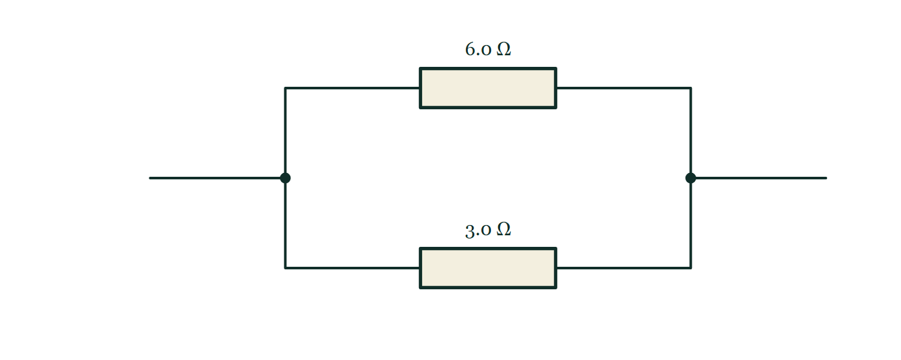
IGCSE · TOPIC 4 · ELECTRICITY AND MAGNETISM
GIOPHYSICS PRACTICE PAPER
Question 3
Multiple choice
Supp.
Routine
1 mark
Syllabus 4.3 · AO2
Two resistors of 6.0 Ω and 3.0 Ω are connected in parallel. What is their combined resistance?
Fig. 3.1 — A circuit diagram of two resistors connected side by side between the same pair of points. A wire arrives from the left and reaches a junction, marked with a dot, where it divides into two branches. The upper branch contains a resistor labelled 6.0 ohm and the lower branch a resistor labelled 3.0 ohm. The two branches rejoin at a second junction dot on the right, from which a single wire continues away to the right.
A
0.50 Ω
B
2.0 Ω
C
4.5 Ω
D
9.0 Ω
Cambridge IGCSE Physics — Topic 4 · Electricity and magnetism. Written by GioPhysics from Cambridge IGCSE Physics 0625 syllabus; not an awarding body's document.
6 / 25
Notes:
[Demand] Routine — The standard application — the named equation, the usual graph read.
[Figure] Fig. 3.1. A circuit diagram of two resistors connected side by side between the same pair of points. A wire arrives from the left and reaches a junction, marked with a dot, where it divides into two branches. The upper branch contains a resistor labelled 6.0 ohm and the lower branch a resistor labelled 3.0 ohm. The two branches rejoin at a second junction dot on the right, from which a single wire continues away to the right.

Slide 7
IGCSE · TOPIC 4 · ELECTRICITY AND MAGNETISM
GIOPHYSICS PRACTICE PAPER
Answer 3
Multiple choice
Supp.
Routine
1 mark
Mark scheme
B
2.0 Ω
Why the other three are there
D is the series total and C is the mean — both offered to candidates who reach for an average. A stops at 1/R without inverting. Any parallel answer must be smaller than the smaller resistor, which rules out C and D at a glance.
Cambridge IGCSE Physics — Topic 4 · Electricity and magnetism. Written by GioPhysics from Cambridge IGCSE Physics 0625 syllabus; not an awarding body's document.
7 / 25
Notes:
[Answer] B — 2.0 Ω
[Distractors] D is the series total and C is the mean — both offered to candidates who reach for an average. A stops at 1/R without inverting. Any parallel answer must be smaller than the smaller resistor, which rules out C and D at a glance.
[Figure] Fig. 3.1. A circuit diagram of two resistors connected side by side between the same pair of points. A wire arrives from the left and reaches a junction, marked with a dot, where it divides into two branches. The upper branch contains a resistor labelled 6.0 ohm and the lower branch a resistor labelled 3.0 ohm. The two branches rejoin at a second junction dot on the right, from which a single wire continues away to the right.

Slide 8
IGCSE · TOPIC 4 · ELECTRICITY AND MAGNETISM
GIOPHYSICS PRACTICE PAPER
Question 4
Multiple choice
Core
Demanding
1 mark
Syllabus 4.4 · AO2
An electric heater is rated at 230 V, 2.0 kW. Fuses of 3 A, 5 A, 10 A and 13 A are available. Which is the most suitable fuse for the heater?
A
3 A
B
5 A
C
10 A
D
13 A
Cambridge IGCSE Physics — Topic 4 · Electricity and magnetism. Written by GioPhysics from Cambridge IGCSE Physics 0625 syllabus; not an awarding body's document.
8 / 25
Notes:
[Demand] Demanding — Several steps, and you have to choose them. Nothing says which comes first.

Slide 9
IGCSE · TOPIC 4 · ELECTRICITY AND MAGNETISM
GIOPHYSICS PRACTICE PAPER
Answer 4
Multiple choice
Core
Demanding
1 mark
Mark scheme
C
10 A
Why the other three are there
The working current is 2000 / 230 = 8.7 A, so the fuse must be the smallest standard rating above it. A and B are below the working current and would melt every time the heater was switched on. D would carry the working current safely but is so far above it that a fault current of 12 A — enough to overheat the flex — would flow without ever blowing the fuse.
Cambridge IGCSE Physics — Topic 4 · Electricity and magnetism. Written by GioPhysics from Cambridge IGCSE Physics 0625 syllabus; not an awarding body's document.
9 / 25
Notes:
[Answer] C — 10 A
[Distractors] The working current is 2000 / 230 = 8.7 A, so the fuse must be the smallest standard rating above it. A and B are below the working current and would melt every time the heater was switched on. D would carry the working current safely but is so far above it that a fault current of 12 A — enough to overheat the flex — would flow without ever blowing the fuse.

Slide 10
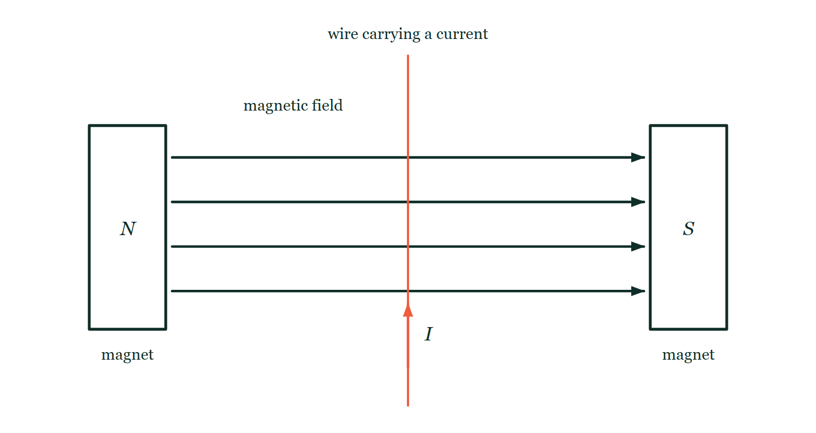
IGCSE · TOPIC 4 · ELECTRICITY AND MAGNETISM
GIOPHYSICS PRACTICE PAPER
Question 5
Multiple choice
Core
Recall
1 mark
Syllabus 4.5 · AO1
A straight wire carrying a current is placed at right angles to a magnetic field. In which direction does the force on the wire act?
Fig. 5.1 — Two magnets face each other across a gap, the left one presenting its north pole and the right one its south pole, with the flat pole faces vertical and parallel. Four horizontal arrows drawn across the gap from the north pole to the south pole represent the magnetic field. A straight wire runs vertically down the page through the middle of the gap, so that it crosses the field lines at right angles, and a short arrow on the wire labelled I shows the current flowing up the page.
A
along the wire, in the direction of the current
B
along the magnetic field lines
C
at right angles to both the current and the field
D
there is no force unless the wire moves
Cambridge IGCSE Physics — Topic 4 · Electricity and magnetism. Written by GioPhysics from Cambridge IGCSE Physics 0625 syllabus; not an awarding body's document.
10 / 25
Notes:
[Demand] Recall — One idea, one step. The mark is for knowing it.
[Figure] Fig. 5.1. Two magnets face each other across a gap, the left one presenting its north pole and the right one its south pole, with the flat pole faces vertical and parallel. Four horizontal arrows drawn across the gap from the north pole to the south pole represent the magnetic field. A straight wire runs vertically down the page through the middle of the gap, so that it crosses the field lines at right angles, and a short arrow on the wire labelled I shows the current flowing up the page.

Slide 11
IGCSE · TOPIC 4 · ELECTRICITY AND MAGNETISM
GIOPHYSICS PRACTICE PAPER
Answer 5
Multiple choice
Core
Recall
1 mark
Mark scheme
C
at right angles to both the current and the field
Why the other three are there
D confuses the motor effect with electromagnetic induction — a current-carrying wire in a field experiences a force whether or not it is moving.
Cambridge IGCSE Physics — Topic 4 · Electricity and magnetism. Written by GioPhysics from Cambridge IGCSE Physics 0625 syllabus; not an awarding body's document.
11 / 25
Notes:
[Answer] C — at right angles to both the current and the field
[Distractors] D confuses the motor effect with electromagnetic induction — a current-carrying wire in a field experiences a force whether or not it is moving.
[Figure] Fig. 5.1. Two magnets face each other across a gap, the left one presenting its north pole and the right one its south pole, with the flat pole faces vertical and parallel. Four horizontal arrows drawn across the gap from the north pole to the south pole represent the magnetic field. A straight wire runs vertically down the page through the middle of the gap, so that it crosses the field lines at right angles, and a short arrow on the wire labelled I shows the current flowing up the page.

Slide 12
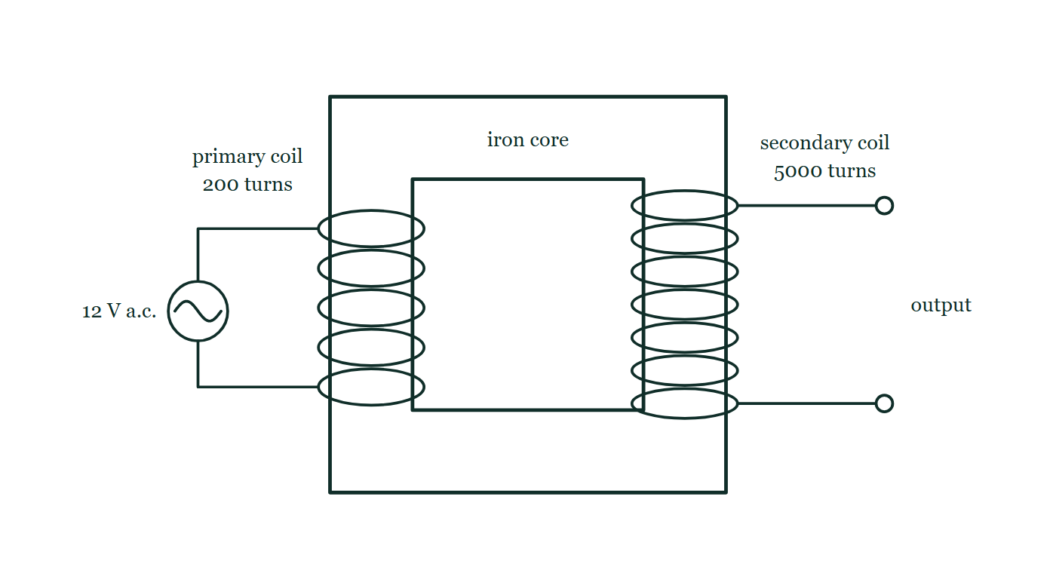
IGCSE · TOPIC 4 · ELECTRICITY AND MAGNETISM
GIOPHYSICS PRACTICE PAPER
Question 6
Multiple choice
Supp.
Routine
1 mark
Syllabus 4.5 · AO2
A transformer has 200 turns on the primary coil and 5000 turns on the secondary coil. The primary is connected to a 12 V a.c. supply. What is the output voltage?
Fig. 6.1 — A transformer drawn as a rectangular iron core with a hollow centre. Wound around the left limb is the primary coil, labelled 200 turns and drawn as five loops encircling the limb; its two ends run out to the left to a 12 V a.c. supply, drawn as a circle containing one cycle of a sine wave. Wound around the right limb is the secondary coil, labelled 5000 turns and drawn as seven closer-spaced loops; its two ends run out to the right to a pair of open output terminals.
A
0.48 V
B
12 V
C
300 V
D
1200 V
Cambridge IGCSE Physics — Topic 4 · Electricity and magnetism. Written by GioPhysics from Cambridge IGCSE Physics 0625 syllabus; not an awarding body's document.
12 / 25
Notes:
[Demand] Routine — The standard application — the named equation, the usual graph read.
[Figure] Fig. 6.1. A transformer drawn as a rectangular iron core with a hollow centre. Wound around the left limb is the primary coil, labelled 200 turns and drawn as five loops encircling the limb; its two ends run out to the left to a 12 V a.c. supply, drawn as a circle containing one cycle of a sine wave. Wound around the right limb is the secondary coil, labelled 5000 turns and drawn as seven closer-spaced loops; its two ends run out to the right to a pair of open output terminals.

Slide 13
IGCSE · TOPIC 4 · ELECTRICITY AND MAGNETISM
GIOPHYSICS PRACTICE PAPER
Answer 6
Multiple choice
Supp.
Routine
1 mark
Mark scheme
C
300 V
Why the other three are there
A inverts the turns ratio. With more turns on the secondary this is a step-up transformer, so any answer at or below 12 V can be discarded before the arithmetic.
Cambridge IGCSE Physics — Topic 4 · Electricity and magnetism. Written by GioPhysics from Cambridge IGCSE Physics 0625 syllabus; not an awarding body's document.
13 / 25
Notes:
[Answer] C — 300 V
[Distractors] A inverts the turns ratio. With more turns on the secondary this is a step-up transformer, so any answer at or below 12 V can be discarded before the arithmetic.
[Figure] Fig. 6.1. A transformer drawn as a rectangular iron core with a hollow centre. Wound around the left limb is the primary coil, labelled 200 turns and drawn as five loops encircling the limb; its two ends run out to the left to a 12 V a.c. supply, drawn as a circle containing one cycle of a sine wave. Wound around the right limb is the secondary coil, labelled 5000 turns and drawn as seven closer-spaced loops; its two ends run out to the right to a pair of open output terminals.

Slide 14
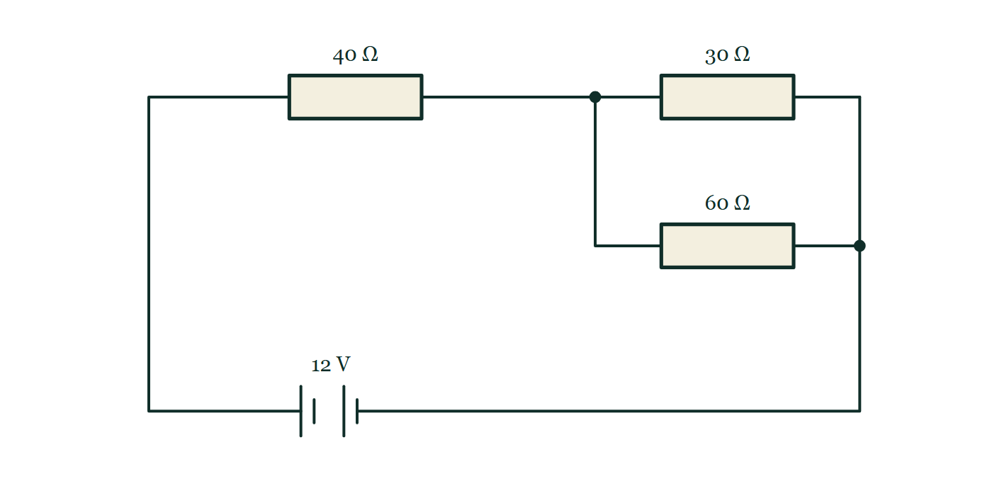
IGCSE · TOPIC 4 · ELECTRICITY AND MAGNETISM
GIOPHYSICS PRACTICE PAPER
Question 7
Structured
Supp.
Demanding
10 marks
Syllabus 4.2, 4.3
A 12 V battery of negligible internal resistance is connected to a 40 Ω resistor in series with a parallel combination of a 30 Ω resistor and a 60 Ω resistor.
Fig. 7.1 — Circuit diagram. From the positive terminal of the 12 V battery, drawn at the foot of the circuit with its long plate on the left, the wire runs round to a resistor labelled 40 ohm. Beyond that resistor the circuit reaches a junction and divides into two parallel branches, the upper one containing a resistor labelled 30 ohm and the lower one a resistor labelled 60 ohm. The branches rejoin at a second junction, and a single wire returns from there to the negative terminal of the battery.
Cambridge IGCSE Physics — Topic 4 · Electricity and magnetism. Written by GioPhysics from Cambridge IGCSE Physics 0625 syllabus; not an awarding body's document.
14 / 25
Notes:
[Demand] Demanding — Several steps, and you have to choose them. Nothing says which comes first.
[Figure] Fig. 7.1. Circuit diagram. From the positive terminal of the 12 V battery, drawn at the foot of the circuit with its long plate on the left, the wire runs round to a resistor labelled 40 ohm. Beyond that resistor the circuit reaches a junction and divides into two parallel branches, the upper one containing a resistor labelled 30 ohm and the lower one a resistor labelled 60 ohm. The branches rejoin at a second junction, and a single wire returns from there to the negative terminal of the battery.

Slide 15
IGCSE · TOPIC 4 · ELECTRICITY AND MAGNETISM
GIOPHYSICS PRACTICE PAPER
Question 7 (cont.)
Structured
Supp.
Demanding
10 marks
continued from the previous slide
(a) Calculate
2 marks
Calculate the combined resistance of the parallel pair.
(b) Calculate
2 marks
Calculate the current drawn from the battery.
(c) Determine
2 marks
Determine the potential difference across the parallel pair.
(d) Determine
2 marks
Determine the current in the 60 Ω resistor.
(e) Explain
2 marks
The 60 Ω resistor is now removed from the circuit, leaving a break in that branch. Explain what happens to the current drawn from the battery.
Cambridge IGCSE Physics — Topic 4 · Electricity and magnetism. Written by GioPhysics from Cambridge IGCSE Physics 0625 syllabus; not an awarding body's document.
15 / 25
Notes:
[Demand] Demanding — Several steps, and you have to choose them. Nothing says which comes first.
[Figure] Fig. 7.1. Circuit diagram. From the positive terminal of the 12 V battery, drawn at the foot of the circuit with its long plate on the left, the wire runs round to a resistor labelled 40 ohm. Beyond that resistor the circuit reaches a junction and divides into two parallel branches, the upper one containing a resistor labelled 30 ohm and the lower one a resistor labelled 60 ohm. The branches rejoin at a second junction, and a single wire returns from there to the negative terminal of the battery.
[Reminder] Fig. 7.1 is on the previous slide.

Slide 16
IGCSE · TOPIC 4 · ELECTRICITY AND MAGNETISM
GIOPHYSICS PRACTICE PAPER
Answer 7
Structured
Supp.
Demanding
10 marks
Mark scheme
(a) Calculate — 2 marks
AO2
✓
1/R = 1/30 + 1/60 = 3/60
✓
R = 20 Ω
(b) Calculate — 2 marks
AO2
✓
total resistance = 40 + 20 = 60 Ω
✓
I = V / R = 12 / 60 = 0.20 A
(c) Determine — 2 marks
AO2
✓
p.d. across the 40 Ω resistor = 0.20 × 40 = 8.0 V
✓
p.d. across the pair = 12 − 8.0 = 4.0 V (or 0.20 × 20 = 4.0 V)
(d) Determine — 2 marks
AO2
✓
I = V / R = 4.0 / 60
✓
I = 0.067 A (67 mA)
(e) Explain — 2 marks
AO2
✓
the total resistance increases, because the parallel pair is replaced by the 30 Ω resistor alone, giving 70 Ω instead of 60 Ω
✓
so the current from the battery decreases (to about 0.17 A)
Candidates routinely say removing a resistor lowers the resistance. Removing one branch of a parallel pair raises it, and this part is set precisely on that.
Cambridge IGCSE Physics — Topic 4 · Electricity and magnetism. Written by GioPhysics from Cambridge IGCSE Physics 0625 syllabus; not an awarding body's document.
16 / 25
Notes:
[Marking] One line per mark, awarded independently unless a point says otherwise.
[Examiner note (e)] Candidates routinely say removing a resistor lowers the resistance. Removing one branch of a parallel pair raises it, and this part is set precisely on that.
[Figure] Fig. 7.1. Circuit diagram. From the positive terminal of the 12 V battery, drawn at the foot of the circuit with its long plate on the left, the wire runs round to a resistor labelled 40 ohm. Beyond that resistor the circuit reaches a junction and divides into two parallel branches, the upper one containing a resistor labelled 30 ohm and the lower one a resistor labelled 60 ohm. The branches rejoin at a second junction, and a single wire returns from there to the negative terminal of the battery.

Slide 17
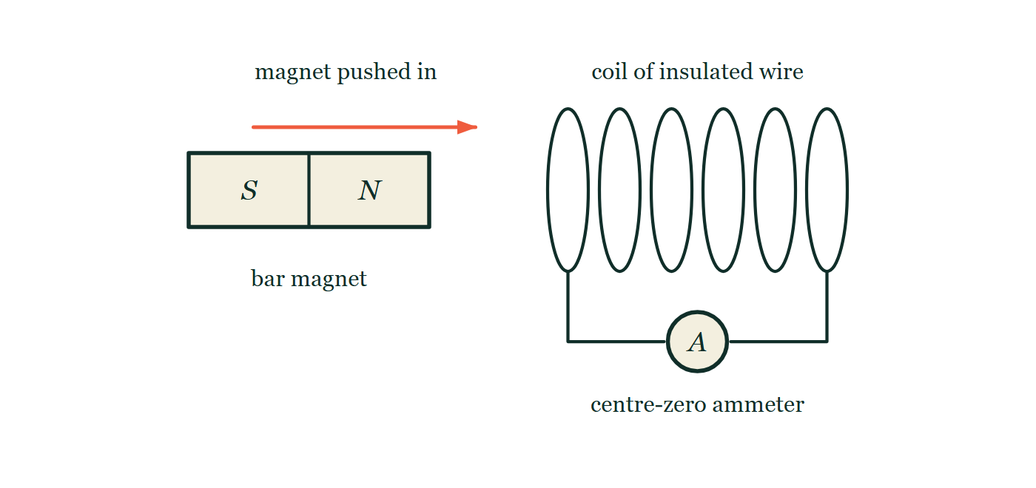
IGCSE · TOPIC 4 · ELECTRICITY AND MAGNETISM
GIOPHYSICS PRACTICE PAPER
Question 8
Structured
Supp.
Discriminating
9 marks
Syllabus 4.5
A bar magnet is pushed, north pole first, into a coil of insulated wire connected to a sensitive centre-zero ammeter. The ammeter needle deflects to the right while the magnet is moving in.
Fig. 8.1 — A bar magnet lies to the left of a coil of insulated wire, on the same horizontal axis as the coil. The magnet's south pole is at its left-hand end and its north pole at the right-hand end, so the north pole faces the coil. An arrow above the magnet points towards the coil, showing the direction in which the magnet is pushed. The coil is drawn as six loops, and wires from its two ends run down and join a centre-zero ammeter, whose face is shown as a circle marked A with no needle drawn on it.
Cambridge IGCSE Physics — Topic 4 · Electricity and magnetism. Written by GioPhysics from Cambridge IGCSE Physics 0625 syllabus; not an awarding body's document.
17 / 25
Notes:
[Demand] Discriminating — The part that separates the top grade: an unfamiliar context, a derivation, or an argument that has to hold together to earn anything.
[Figure] Fig. 8.1. A bar magnet lies to the left of a coil of insulated wire, on the same horizontal axis as the coil. The magnet's south pole is at its left-hand end and its north pole at the right-hand end, so the north pole faces the coil. An arrow above the magnet points towards the coil, showing the direction in which the magnet is pushed. The coil is drawn as six loops, and wires from its two ends run down and join a centre-zero ammeter, whose face is shown as a circle marked A with no needle drawn on it.

Slide 18
IGCSE · TOPIC 4 · ELECTRICITY AND MAGNETISM
GIOPHYSICS PRACTICE PAPER
Question 8 (cont.)
Structured
Supp.
Discriminating
9 marks
continued from the previous slide
(a) State
1 mark
State what happens to the ammeter reading while the magnet is held stationary inside the coil.
(b) Explain
3 marks
Explain, in terms of magnetic field lines, why a current is produced only while the magnet is moving.
(c) State
2 marks
State two changes to the experiment that would each increase the size of the deflection.
(d) Explain
3 marks
The magnet is now pulled out of the coil, south pole first, at the same speed. Explain what is observed on the ammeter, and why.
Cambridge IGCSE Physics — Topic 4 · Electricity and magnetism. Written by GioPhysics from Cambridge IGCSE Physics 0625 syllabus; not an awarding body's document.
18 / 25
Notes:
[Demand] Discriminating — The part that separates the top grade: an unfamiliar context, a derivation, or an argument that has to hold together to earn anything.
[Figure] Fig. 8.1. A bar magnet lies to the left of a coil of insulated wire, on the same horizontal axis as the coil. The magnet's south pole is at its left-hand end and its north pole at the right-hand end, so the north pole faces the coil. An arrow above the magnet points towards the coil, showing the direction in which the magnet is pushed. The coil is drawn as six loops, and wires from its two ends run down and join a centre-zero ammeter, whose face is shown as a circle marked A with no needle drawn on it.
[Reminder] Fig. 8.1 is on the previous slide.

Slide 19
IGCSE · TOPIC 4 · ELECTRICITY AND MAGNETISM
GIOPHYSICS PRACTICE PAPER
Answer 8
Structured
Supp.
Discriminating
9 marks
Mark scheme
(a) State — 1 mark
AO1
✓
the reading returns to (and stays at) zero
(b) Explain — 3 marks
AO1
✓
an e.m.f. is induced when the magnetic field lines linking the coil change
✓
moving the magnet changes the number of field lines through the coil, cutting the turns of wire
✓
a stationary magnet gives an unchanging field through the coil, so no e.m.f. and no current
(c) State — 2 marks
AO1
✓
move the magnet faster
✓
any one of: use a stronger magnet; use a coil with more turns; use a coil of smaller cross-sectional area wound closer to the magnet
(d) Explain — 3 marks
AO2
✓
the needle deflects to the left — the current is in the opposite direction
✓
because the field through the coil is changing in the opposite sense as the magnet is withdrawn
✓
the size of the deflection is the same, because the rate of change of the field is the same
Three marks and three separate ideas: direction, cause and size. Most answers get the reversal and stop, and stop at one mark.
Cambridge IGCSE Physics — Topic 4 · Electricity and magnetism. Written by GioPhysics from Cambridge IGCSE Physics 0625 syllabus; not an awarding body's document.
19 / 25
Notes:
[Marking] One line per mark, awarded independently unless a point says otherwise.
[Examiner note (d)] Three marks and three separate ideas: direction, cause and size. Most answers get the reversal and stop, and stop at one mark.
[Figure] Fig. 8.1. A bar magnet lies to the left of a coil of insulated wire, on the same horizontal axis as the coil. The magnet's south pole is at its left-hand end and its north pole at the right-hand end, so the north pole faces the coil. An arrow above the magnet points towards the coil, showing the direction in which the magnet is pushed. The coil is drawn as six loops, and wires from its two ends run down and join a centre-zero ammeter, whose face is shown as a circle marked A with no needle drawn on it.

Slide 20
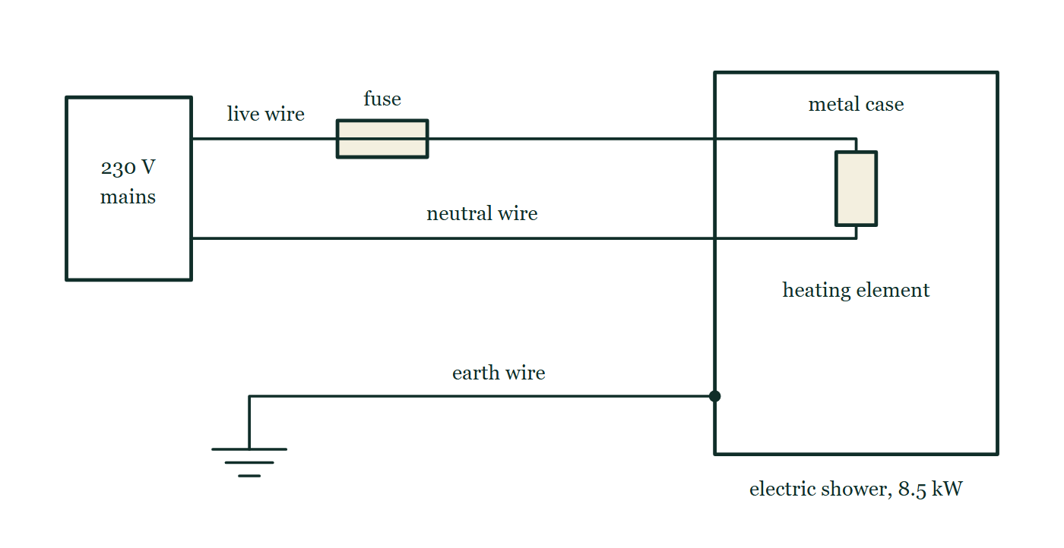
IGCSE · TOPIC 4 · ELECTRICITY AND MAGNETISM
GIOPHYSICS PRACTICE PAPER
Question 9
Structured
Core
Routine
8 marks
Syllabus 4.4
A household electric shower is connected to the 230 V mains supply through a fuse and an earth wire. The shower has a metal case and is marked 8.5 kW.
Fig. 9.1 — A wiring diagram of the electric shower. A box on the left marked 230 V mains has two wires leaving it: the live wire, which passes through a fuse drawn as a small rectangle with a line through it, and the neutral wire, which runs straight across. Both enter the outline of the shower, where they are joined to each other by the heating element. The shower's outline is labelled metal case and the appliance is marked 8.5 kW. A third wire, the earth wire, runs from an earth symbol of three shortening horizontal bars across to the metal case, meeting it at a solid connecting dot.
Cambridge IGCSE Physics — Topic 4 · Electricity and magnetism. Written by GioPhysics from Cambridge IGCSE Physics 0625 syllabus; not an awarding body's document.
20 / 25
Notes:
[Demand] Routine — The standard application — the named equation, the usual graph read.
[Figure] Fig. 9.1. A wiring diagram of the electric shower. A box on the left marked 230 V mains has two wires leaving it: the live wire, which passes through a fuse drawn as a small rectangle with a line through it, and the neutral wire, which runs straight across. Both enter the outline of the shower, where they are joined to each other by the heating element. The shower's outline is labelled metal case and the appliance is marked 8.5 kW. A third wire, the earth wire, runs from an earth symbol of three shortening horizontal bars across to the metal case, meeting it at a solid connecting dot.

Slide 21
IGCSE · TOPIC 4 · ELECTRICITY AND MAGNETISM
GIOPHYSICS PRACTICE PAPER
Question 9 (cont.)
Structured
Core
Routine
8 marks
continued from the previous slide
(a) Calculate
2 marks
Calculate the current in the shower when it is operating normally.
(b) Explain
3 marks
Explain how the earth wire and the fuse together protect a person who touches the metal case if a live wire comes loose inside the shower.
(c) Calculate
3 marks
The shower is used for a total of 30 minutes each day. Electrical energy costs 24 cents per kilowatt-hour. Calculate the cost of using the shower for 30 days.
Cambridge IGCSE Physics — Topic 4 · Electricity and magnetism. Written by GioPhysics from Cambridge IGCSE Physics 0625 syllabus; not an awarding body's document.
21 / 25
Notes:
[Demand] Routine — The standard application — the named equation, the usual graph read.
[Figure] Fig. 9.1. A wiring diagram of the electric shower. A box on the left marked 230 V mains has two wires leaving it: the live wire, which passes through a fuse drawn as a small rectangle with a line through it, and the neutral wire, which runs straight across. Both enter the outline of the shower, where they are joined to each other by the heating element. The shower's outline is labelled metal case and the appliance is marked 8.5 kW. A third wire, the earth wire, runs from an earth symbol of three shortening horizontal bars across to the metal case, meeting it at a solid connecting dot.
[Reminder] Fig. 9.1 is on the previous slide.

Slide 22
IGCSE · TOPIC 4 · ELECTRICITY AND MAGNETISM
GIOPHYSICS PRACTICE PAPER
Answer 9
Structured
Core
Routine
8 marks
Mark scheme
(a) Calculate — 2 marks
AO2
✓
I = P / V = 8500 / 230
✓
I = 37 A
(b) Explain — 3 marks
AO1
✓
the earth wire connects the metal case to earth through a very low resistance path
✓
if the live wire touches the case, a very large current flows to earth rather than through the person
✓
this current melts the fuse, breaking the live wire and isolating the appliance
The fuse must be described as being in the live wire. A fuse in the neutral would blow but leave the case live, and mark schemes withhold the mark for exactly that reason.
(c) Calculate — 3 marks
AO2
✓
energy per day = 8.5 kW × 0.50 h = 4.25 kWh
✓
energy in 30 days = 127.5 kWh
✓
cost = 127.5 × 24 = 3060 cents = $30.60
Cambridge IGCSE Physics — Topic 4 · Electricity and magnetism. Written by GioPhysics from Cambridge IGCSE Physics 0625 syllabus; not an awarding body's document.
22 / 25
Notes:
[Marking] One line per mark, awarded independently unless a point says otherwise.
[Examiner note (b)] The fuse must be described as being in the live wire. A fuse in the neutral would blow but leave the case live, and mark schemes withhold the mark for exactly that reason.
[Figure] Fig. 9.1. A wiring diagram of the electric shower. A box on the left marked 230 V mains has two wires leaving it: the live wire, which passes through a fuse drawn as a small rectangle with a line through it, and the neutral wire, which runs straight across. Both enter the outline of the shower, where they are joined to each other by the heating element. The shower's outline is labelled metal case and the appliance is marked 8.5 kW. A third wire, the earth wire, runs from an earth symbol of three shortening horizontal bars across to the metal case, meeting it at a solid connecting dot.

Slide 23
IGCSE · TOPIC 4 · ELECTRICITY AND MAGNETISM
GIOPHYSICS PRACTICE PAPER
Question 10
Practical skills
Core
Demanding
8 marks
Syllabus 4.3
A student investigates how the current in a filament lamp depends on the potential difference across it. She connects the lamp to a variable power supply, with an ammeter in series and a voltmeter across the lamp.
The student's results
V / V | 0.0 | 1.0 | 2.0 | 3.0 | 4.0 | 5.0 | 6.0
I / A | 0.00 | 0.17 | 0.28 | 0.36 | 0.42 | 0.47 | 0.51
(a) State
2 marks
State how the ammeter and the voltmeter must each be connected in the circuit.
(b) Determine
3 marks
Determine the resistance of the lamp when the potential difference across it is 1.0 V, and again when it is 6.0 V.
(c) Explain
3 marks
Explain, in terms of the filament, why the resistance changes in the way your answers to (b) show.
Cambridge IGCSE Physics — Topic 4 · Electricity and magnetism. Written by GioPhysics from Cambridge IGCSE Physics 0625 syllabus; not an awarding body's document.
23 / 25
Notes:
[Demand] Demanding — Several steps, and you have to choose them. Nothing says which comes first.

Slide 24
IGCSE · TOPIC 4 · ELECTRICITY AND MAGNETISM
GIOPHYSICS PRACTICE PAPER
Answer 10
Practical skills
Core
Demanding
8 marks
Mark scheme
(a) State — 2 marks
AO3
✓
the ammeter is connected in series with the lamp
✓
the voltmeter is connected in parallel with (across) the lamp
(b) Determine — 3 marks
AO2
✓
R = V / I used at both points
✓
at 1.0 V: R = 1.0 / 0.17 = 5.9 Ω
✓
at 6.0 V: R = 6.0 / 0.51 = 11.8 Ω (accept 12 Ω)
(c) Explain — 3 marks
AO2
✓
as the current increases the filament gets hotter
✓
the metal ions in the filament vibrate with greater amplitude
✓
so the electrons collide with them more often and the resistance increases
A graph of I against V for a filament lamp curves towards the V axis. Candidates who say the lamp "does not obey Ohm's law" have named the observation, not explained it, and the marks here are for the mechanism.
Cambridge IGCSE Physics — Topic 4 · Electricity and magnetism. Written by GioPhysics from Cambridge IGCSE Physics 0625 syllabus; not an awarding body's document.
24 / 25
Notes:
[Marking] One line per mark, awarded independently unless a point says otherwise.
[Examiner note (c)] A graph of I against V for a filament lamp curves towards the V axis. Candidates who say the lamp "does not obey Ohm's law" have named the observation, not explained it, and the marks here are for the mechanism.

Slide 25
IGCSE · TOPIC 4 · ELECTRICITY AND MAGNETISM
GIOPHYSICS PRACTICE PAPER
Command words
Cambridge IGCSE Physics — the board's own definitions
Calculate
Show (that)
Work out from given facts, figures or information.
Provide structured evidence that leads to a given result.
Define
State
Give the precise meaning.
Express in clear terms.
Describe
Suggest
State the points of a topic; give characteristics and main features.
Apply knowledge and understanding to situations where there is a range of valid responses in order to make proposals.
Determine
Establish an answer using the information available.
Estimate
Suggest an approximate value.
Explain
Set out purposes or reasons; make relationships evident; give why and/or how.
Give
Produce an answer from a given source or recall.
Identify
Name, select or recognise.
Cambridge IGCSE Physics — Topic 4 · Electricity and magnetism. Written by GioPhysics from Cambridge IGCSE Physics 0625 syllabus; not an awarding body's document.
25 / 25
Notes:
[Objectives] AO1 Knowledge with understanding (50%): Recall, describe, explain and use physics ideas, terminology, instruments and conventions. AO2 Handling information and problem-solving (30%): Locate and interpret information, translate between forms, calculate, reason, and apply physics to unfamiliar situations. AO3 Experimental skills and investigations (20%): Plan, use apparatus, record and present observations, analyse, evaluate, and suggest improvements.
[Source] Cambridge IGCSE Physics 0625 syllabus — https://www.cambridgeinternational.org/Images/697209-2026-2028-syllabus.pdf
[Disclaimer] Written by GioPhysics from the published syllabus. These are practice papers in the style of Cambridge IGCSE Physics 0625; they are not Cambridge papers, contain no past-paper questions, and the official syllabus and specimen materials remain the authority.

