Slide 1
IGCSE · TOPIC 1 · MOTION, FORCES AND ENERGY
GIOPHYSICS PRACTICE PAPER
IGCSE · Physics 0625 · for examination in 2026, 2027 and 2028
Topic 1 · Motion, forces and energy
The largest topic on the syllabus and the one that carries the most marks in the real papers. Measurement, motion graphs, Newton's laws, moments, momentum, energy and pressure.
MIRRORS
Papers 1 and 2 (multiple choice), Papers 3 and 4 (theory), Paper 6 (alternative to practical)
MARKS
41 in total — Core route 13, Supp. adds 28
TIME
50 minutes · 10 questions
DEMAND
Recall 1 · Routine 5 · Demanding 3 · Discriminating 1
SYLLABUS
1.1, 1.2, 1.3, 1.4, 1.5.1, 1.5.2, 1.5.3, 1.6, 1.7.1, 1.7.2, 1.7.3, 1.7.4, 1.8
Written by GioPhysics from the published syllabus. These are practice papers in the style of Cambridge IGCSE Physics 0625; they are not Cambridge papers, contain no past-paper questions, and the official syllabus and specimen materials remain the authority.
Cambridge IGCSE Physics — Topic 1 · Motion, forces and energy. Written by GioPhysics from Cambridge IGCSE Physics 0625 syllabus; not an awarding body's document.
1 / 25
Notes:
[Format] Every candidate sits two theory papers and one practical-skills paper. Core takes Papers 1 and 3 and is capped at grade C; Extended takes Papers 2 and 4 and reaches A*. Both then take either Paper 5 (practical test) or Paper 6 (alternative to practical), which carries 20% either way. Theory papers give you no formula sheet.
[Demand] Pitched at the board's own level, not above it. Multiple choice is mostly one step, with a couple of two-step items and one that rewards the candidate who does not take the obvious route. Structured questions open on a 1-mark recall and close on an explanation or a suggestion worth two marks — the marks real candidates most often drop.
[Source] Cambridge IGCSE Physics 0625 syllabus — https://www.cambridgeinternational.org/Images/697209-2026-2028-syllabus.pdf
[Disclaimer] Written by GioPhysics from the published syllabus. These are practice papers in the style of Cambridge IGCSE Physics 0625; they are not Cambridge papers, contain no past-paper questions, and the official syllabus and specimen materials remain the authority.

Slide 2
IGCSE · TOPIC 1 · MOTION, FORCES AND ENERGY
GIOPHYSICS PRACTICE PAPER
Question 1
Multiple choice
Core
Recall
1 mark
Syllabus 1.1 · AO1
Which pair contains only vector quantities?
A
distance and displacement
B
energy and power
C
mass and weight
D
velocity and weight
Cambridge IGCSE Physics — Topic 1 · Motion, forces and energy. Written by GioPhysics from Cambridge IGCSE Physics 0625 syllabus; not an awarding body's document.
2 / 25
Notes:
[Demand] Recall — One idea, one step. The mark is for knowing it.

Slide 3
IGCSE · TOPIC 1 · MOTION, FORCES AND ENERGY
GIOPHYSICS PRACTICE PAPER
Answer 1
Multiple choice
Core
Recall
1 mark
Mark scheme
D
velocity and weight
Why the other three are there
A and C each pair a scalar with a vector, which is the trap: distance and mass have no direction. B is two scalars. Only D is a vector twice over.
Cambridge IGCSE Physics — Topic 1 · Motion, forces and energy. Written by GioPhysics from Cambridge IGCSE Physics 0625 syllabus; not an awarding body's document.
3 / 25
Notes:
[Answer] D — velocity and weight
[Distractors] A and C each pair a scalar with a vector, which is the trap: distance and mass have no direction. B is two scalars. Only D is a vector twice over.

Slide 4
IGCSE · TOPIC 1 · MOTION, FORCES AND ENERGY
GIOPHYSICS PRACTICE PAPER
Question 2
Multiple choice
Core
Routine
1 mark
Syllabus 1.2 · AO2
A cyclist travels 100 m in a straight line in 20 s, then stops at traffic lights for 10 s. What is the average speed over the whole 30 s?
A
0 m/s
B
3.3 m/s
C
5.0 m/s
D
10 m/s
Cambridge IGCSE Physics — Topic 1 · Motion, forces and energy. Written by GioPhysics from Cambridge IGCSE Physics 0625 syllabus; not an awarding body's document.
4 / 25
Notes:
[Demand] Routine — The standard application — the named equation, the usual graph read.

Slide 5
IGCSE · TOPIC 1 · MOTION, FORCES AND ENERGY
GIOPHYSICS PRACTICE PAPER
Answer 2
Multiple choice
Core
Routine
1 mark
Mark scheme
B
3.3 m/s
Why the other three are there
C is the speed while moving — the commonest wrong answer, because it ignores that average speed is total distance over total time. D halves the time as well as reading only the first stage.
Cambridge IGCSE Physics — Topic 1 · Motion, forces and energy. Written by GioPhysics from Cambridge IGCSE Physics 0625 syllabus; not an awarding body's document.
5 / 25
Notes:
[Answer] B — 3.3 m/s
[Distractors] C is the speed while moving — the commonest wrong answer, because it ignores that average speed is total distance over total time. D halves the time as well as reading only the first stage.

Slide 6
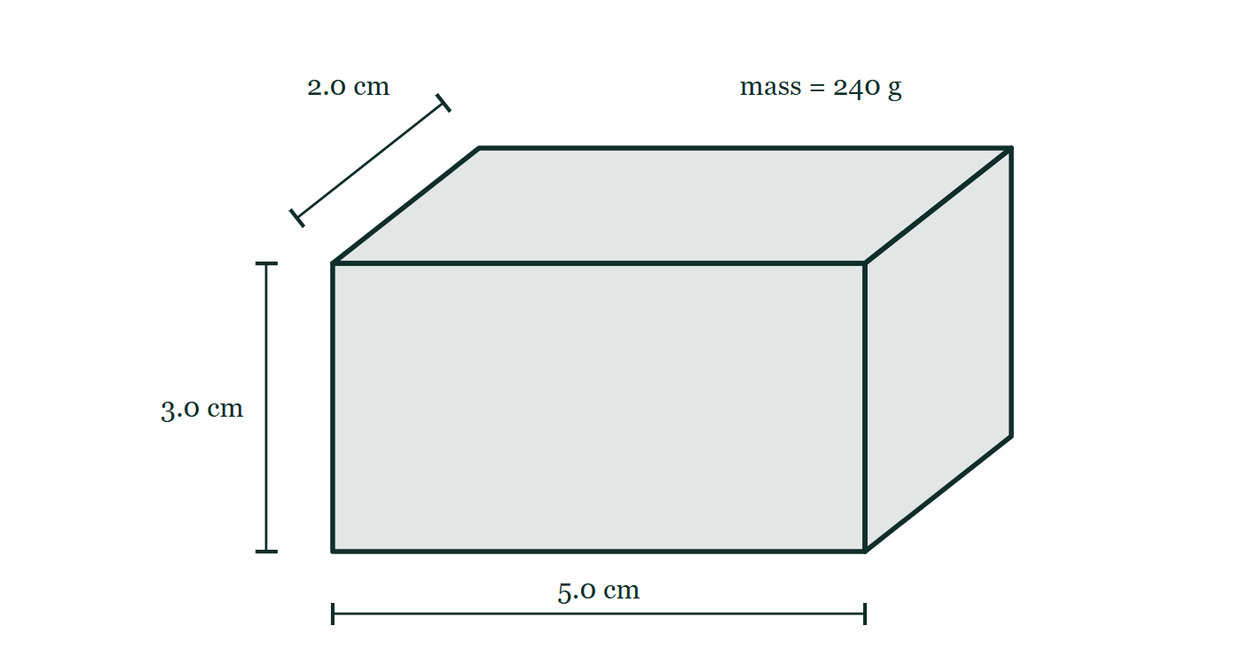
IGCSE · TOPIC 1 · MOTION, FORCES AND ENERGY
GIOPHYSICS PRACTICE PAPER
Question 3
Multiple choice
Core
Routine
1 mark
Syllabus 1.4 · AO2
A rectangular metal block measures 2.0 cm × 3.0 cm × 5.0 cm and has a mass of 240 g. What is its density?
Fig. 3.1 — An oblique drawing of a solid rectangular metal block. The front face is marked 5.0 cm along its lower edge and 3.0 cm up its left-hand edge, and the edge receding into the page is marked 2.0 cm. The block carries the label mass = 240 g.
A
0.13 g/cm³
B
8.0 g/cm³
C
24 g/cm³
D
7200 g/cm³
Cambridge IGCSE Physics — Topic 1 · Motion, forces and energy. Written by GioPhysics from Cambridge IGCSE Physics 0625 syllabus; not an awarding body's document.
6 / 25
Notes:
[Demand] Routine — The standard application — the named equation, the usual graph read.
[Figure] Fig. 3.1. An oblique drawing of a solid rectangular metal block. The front face is marked 5.0 cm along its lower edge and 3.0 cm up its left-hand edge, and the edge receding into the page is marked 2.0 cm. The block carries the label mass = 240 g.

Slide 7
IGCSE · TOPIC 1 · MOTION, FORCES AND ENERGY
GIOPHYSICS PRACTICE PAPER
Answer 3
Multiple choice
Core
Routine
1 mark
Mark scheme
B
8.0 g/cm³
Why the other three are there
A inverts the formula. C divides by only one dimension. D multiplies mass by volume instead of dividing, which is the slip a candidate working too fast makes.
Cambridge IGCSE Physics — Topic 1 · Motion, forces and energy. Written by GioPhysics from Cambridge IGCSE Physics 0625 syllabus; not an awarding body's document.
7 / 25
Notes:
[Answer] B — 8.0 g/cm³
[Distractors] A inverts the formula. C divides by only one dimension. D multiplies mass by volume instead of dividing, which is the slip a candidate working too fast makes.
[Figure] Fig. 3.1. An oblique drawing of a solid rectangular metal block. The front face is marked 5.0 cm along its lower edge and 3.0 cm up its left-hand edge, and the edge receding into the page is marked 2.0 cm. The block carries the label mass = 240 g.

Slide 8
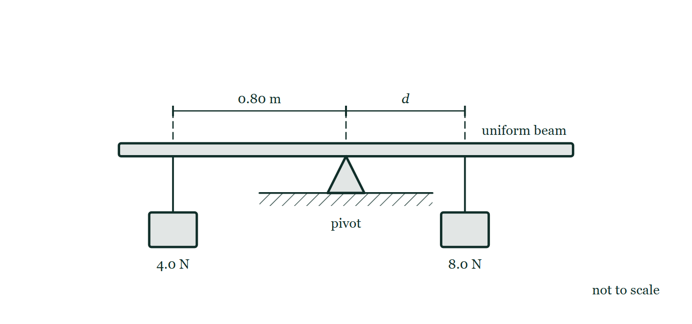
IGCSE · TOPIC 1 · MOTION, FORCES AND ENERGY
GIOPHYSICS PRACTICE PAPER
Question 4
Multiple choice
Core
Routine
1 mark
Syllabus 1.5.2 · AO2
A uniform beam is pivoted at its centre. A weight of 4.0 N hangs 0.80 m from the pivot on the left-hand side. A weight of 8.0 N is hung on the right-hand side so that the beam balances. How far from the pivot is the 8.0 N weight?
Fig. 4.1 — A uniform beam rests on a pivot standing on the ground, the pivot placed at the centre of the beam. A 4.0 N weight hangs from the beam at a point 0.80 m to the left of the pivot, and an 8.0 N weight hangs to the right of the pivot at a distance marked d. Both distances are measured along the beam from the pivot. The drawing is not to scale.
A
0.20 m
B
0.40 m
C
0.80 m
D
1.6 m
Cambridge IGCSE Physics — Topic 1 · Motion, forces and energy. Written by GioPhysics from Cambridge IGCSE Physics 0625 syllabus; not an awarding body's document.
8 / 25
Notes:
[Demand] Routine — The standard application — the named equation, the usual graph read.
[Figure] Fig. 4.1. A uniform beam rests on a pivot standing on the ground, the pivot placed at the centre of the beam. A 4.0 N weight hangs from the beam at a point 0.80 m to the left of the pivot, and an 8.0 N weight hangs to the right of the pivot at a distance marked d. Both distances are measured along the beam from the pivot. The drawing is not to scale.

Slide 9
IGCSE · TOPIC 1 · MOTION, FORCES AND ENERGY
GIOPHYSICS PRACTICE PAPER
Answer 4
Multiple choice
Core
Routine
1 mark
Mark scheme
B
0.40 m
Why the other three are there
D doubles the distance instead of halving it — the error of a candidate who has memorised that the moments are equal but not thought about which way the ratio runs.
Cambridge IGCSE Physics — Topic 1 · Motion, forces and energy. Written by GioPhysics from Cambridge IGCSE Physics 0625 syllabus; not an awarding body's document.
9 / 25
Notes:
[Answer] B — 0.40 m
[Distractors] D doubles the distance instead of halving it — the error of a candidate who has memorised that the moments are equal but not thought about which way the ratio runs.
[Figure] Fig. 4.1. A uniform beam rests on a pivot standing on the ground, the pivot placed at the centre of the beam. A 4.0 N weight hangs from the beam at a point 0.80 m to the left of the pivot, and an 8.0 N weight hangs to the right of the pivot at a distance marked d. Both distances are measured along the beam from the pivot. The drawing is not to scale.

Slide 10
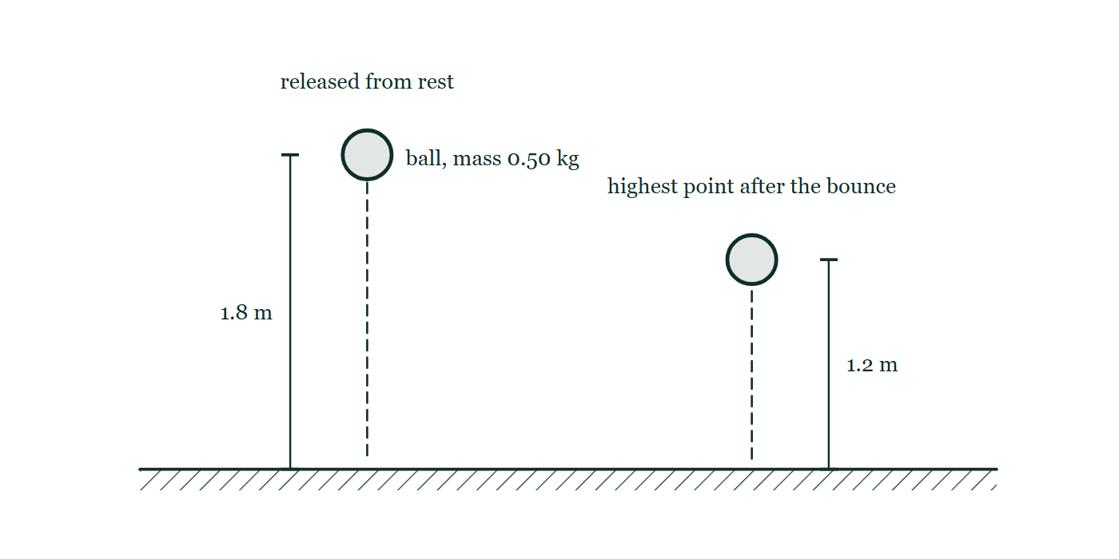
IGCSE · TOPIC 1 · MOTION, FORCES AND ENERGY
GIOPHYSICS PRACTICE PAPER
Question 5
Multiple choice
Supp.
Demanding
1 mark
Syllabus 1.7.1 · AO2
A ball of mass 0.50 kg is dropped from a height of 1.8 m and rebounds to a height of 1.2 m. How much energy is transferred away from the ball during the bounce?
Fig. 5.1 — A ball of mass 0.50 kg is drawn twice above level ground. On the left it is at the point of release, with a dimension line marking 1.8 m from the ground up to the ball. On the right it is at the highest point reached after the bounce, with 1.2 m marked in the same way. Dashed vertical lines show the path down and the path back up.
A
0.60 J
B
2.9 J
C
5.9 J
D
8.8 J
Cambridge IGCSE Physics — Topic 1 · Motion, forces and energy. Written by GioPhysics from Cambridge IGCSE Physics 0625 syllabus; not an awarding body's document.
10 / 25
Notes:
[Demand] Demanding — Several steps, and you have to choose them. Nothing says which comes first.
[Figure] Fig. 5.1. A ball of mass 0.50 kg is drawn twice above level ground. On the left it is at the point of release, with a dimension line marking 1.8 m from the ground up to the ball. On the right it is at the highest point reached after the bounce, with 1.2 m marked in the same way. Dashed vertical lines show the path down and the path back up.

Slide 11
IGCSE · TOPIC 1 · MOTION, FORCES AND ENERGY
GIOPHYSICS PRACTICE PAPER
Answer 5
Multiple choice
Supp.
Demanding
1 mark
Mark scheme
B
2.9 J
Why the other three are there
C and D are mgh for the full drop and for the two heights added together. The question is about the difference in height, 0.60 m, and only B uses it. A is the height itself, not an energy.
Cambridge IGCSE Physics — Topic 1 · Motion, forces and energy. Written by GioPhysics from Cambridge IGCSE Physics 0625 syllabus; not an awarding body's document.
11 / 25
Notes:
[Answer] B — 2.9 J
[Distractors] C and D are mgh for the full drop and for the two heights added together. The question is about the difference in height, 0.60 m, and only B uses it. A is the height itself, not an energy.
[Figure] Fig. 5.1. A ball of mass 0.50 kg is drawn twice above level ground. On the left it is at the point of release, with a dimension line marking 1.8 m from the ground up to the ball. On the right it is at the highest point reached after the bounce, with 1.2 m marked in the same way. Dashed vertical lines show the path down and the path back up.

Slide 12
IGCSE · TOPIC 1 · MOTION, FORCES AND ENERGY
GIOPHYSICS PRACTICE PAPER
Question 6
Multiple choice
Supp.
Routine
1 mark
Syllabus 1.8 · AO2
A diver is 15 m below the surface of a lake. The density of the water is 1000 kg/m³. What is the increase in pressure on the diver caused by the water above her?
A
1.5 × 10³ Pa
B
1.5 × 10⁴ Pa
C
1.5 × 10⁵ Pa
D
1.5 × 10⁶ Pa
Cambridge IGCSE Physics — Topic 1 · Motion, forces and energy. Written by GioPhysics from Cambridge IGCSE Physics 0625 syllabus; not an awarding body's document.
12 / 25
Notes:
[Demand] Routine — The standard application — the named equation, the usual graph read.

Slide 13
IGCSE · TOPIC 1 · MOTION, FORCES AND ENERGY
GIOPHYSICS PRACTICE PAPER
Answer 6
Multiple choice
Supp.
Routine
1 mark
Mark scheme
C
1.5 × 10⁵ Pa
Why the other three are there
All four are the same digits, so the item tests whether the candidate can carry a power of ten through ρgh rather than whether they know the formula. B drops the factor of g.
Cambridge IGCSE Physics — Topic 1 · Motion, forces and energy. Written by GioPhysics from Cambridge IGCSE Physics 0625 syllabus; not an awarding body's document.
13 / 25
Notes:
[Answer] C — 1.5 × 10⁵ Pa
[Distractors] All four are the same digits, so the item tests whether the candidate can carry a power of ten through ρgh rather than whether they know the formula. B drops the factor of g.

Slide 14
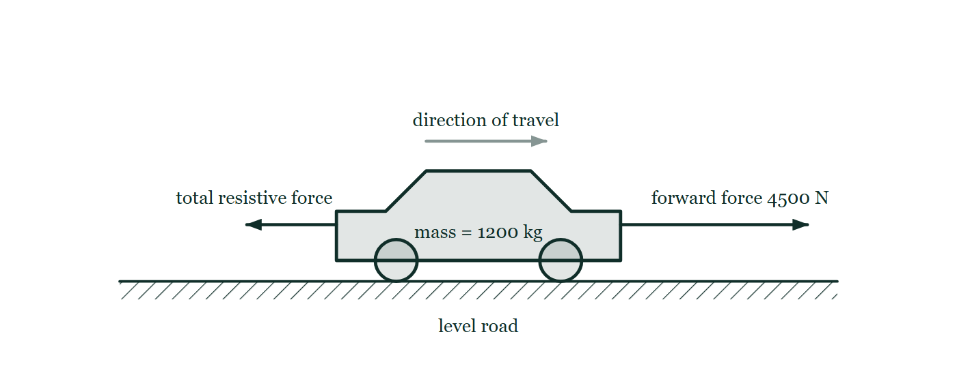
IGCSE · TOPIC 1 · MOTION, FORCES AND ENERGY
GIOPHYSICS PRACTICE PAPER
Question 7
Structured
Supp.
Demanding
9 marks
Syllabus 1.2, 1.5.1
A car of mass 1200 kg starts from rest on a straight, level road. It reaches a speed of 24 m/s in 8.0 s. The forward force produced by the engine during this time is 4500 N.
Fig. 7.1 — A car on a straight, level road, labelled mass = 1200 kg, with a faint arrow above it showing the direction of travel to the right. A long horizontal arrow points forwards from the front of the car and is labelled forward force 4500 N. A shorter horizontal arrow points backwards from the rear of the car and is labelled total resistive force, with no value given.
(a) State
1 mark
State the equation linking acceleration, change in velocity and time taken.
Cambridge IGCSE Physics — Topic 1 · Motion, forces and energy. Written by GioPhysics from Cambridge IGCSE Physics 0625 syllabus; not an awarding body's document.
14 / 25
Notes:
[Demand] Demanding — Several steps, and you have to choose them. Nothing says which comes first.
[Figure] Fig. 7.1. A car on a straight, level road, labelled mass = 1200 kg, with a faint arrow above it showing the direction of travel to the right. A long horizontal arrow points forwards from the front of the car and is labelled forward force 4500 N. A shorter horizontal arrow points backwards from the rear of the car and is labelled total resistive force, with no value given.

Slide 15
IGCSE · TOPIC 1 · MOTION, FORCES AND ENERGY
GIOPHYSICS PRACTICE PAPER
Question 7 (cont.)
Structured
Supp.
Demanding
9 marks
continued from the previous slide
(b) Calculate
2 marks
Calculate the acceleration of the car.
(c) Calculate
2 marks
Calculate the resultant force acting on the car.
(d) Determine
2 marks
Determine the total resistive force acting on the car during this time.
(e) Explain
2 marks
The car later travels along the same road at a constant speed of 30 m/s. Explain, in terms of the forces acting, why the speed is constant.
Cambridge IGCSE Physics — Topic 1 · Motion, forces and energy. Written by GioPhysics from Cambridge IGCSE Physics 0625 syllabus; not an awarding body's document.
15 / 25
Notes:
[Demand] Demanding — Several steps, and you have to choose them. Nothing says which comes first.
[Figure] Fig. 7.1. A car on a straight, level road, labelled mass = 1200 kg, with a faint arrow above it showing the direction of travel to the right. A long horizontal arrow points forwards from the front of the car and is labelled forward force 4500 N. A shorter horizontal arrow points backwards from the rear of the car and is labelled total resistive force, with no value given.
[Reminder] Fig. 7.1 is on the previous slide.

Slide 16
IGCSE · TOPIC 1 · MOTION, FORCES AND ENERGY
GIOPHYSICS PRACTICE PAPER
Answer 7
Structured
Supp.
Demanding
9 marks
Mark scheme
(a) State — 1 mark
AO1
✓
a = Δv / Δt, in words or symbols, with symbols defined or standard
(b) Calculate — 2 marks
AO2
✓
a = 24 / 8.0
✓
a = 3.0 m/s² (unit required)
(c) Calculate — 2 marks
AO2
✓
F = ma = 1200 × 3.0
✓
F = 3600 N (unit required)
(d) Determine — 2 marks
AO2
✓
recognises resistive force = forward force − resultant force
✓
4500 − 3600 = 900 N
The part that separates grades. Candidates who have treated 4500 N as the resultant in (c) cannot recover here, which is exactly what the structure is testing.
(e) Explain — 2 marks
AO1
✓
the resultant force on the car is zero
✓
because the forward force from the engine is equal in size to the total resistive force (and opposite in direction)
"There is no force" earns nothing. The marks are for a resultant of zero produced by two forces that balance.
Cambridge IGCSE Physics — Topic 1 · Motion, forces and energy. Written by GioPhysics from Cambridge IGCSE Physics 0625 syllabus; not an awarding body's document.
16 / 25
Notes:
[Marking] One line per mark, awarded independently unless a point says otherwise.
[Examiner note (d)] The part that separates grades. Candidates who have treated 4500 N as the resultant in (c) cannot recover here, which is exactly what the structure is testing.
[Examiner note (e)] "There is no force" earns nothing. The marks are for a resultant of zero produced by two forces that balance.
[Figure] Fig. 7.1. A car on a straight, level road, labelled mass = 1200 kg, with a faint arrow above it showing the direction of travel to the right. A long horizontal arrow points forwards from the front of the car and is labelled forward force 4500 N. A shorter horizontal arrow points backwards from the rear of the car and is labelled total resistive force, with no value given.

Slide 17
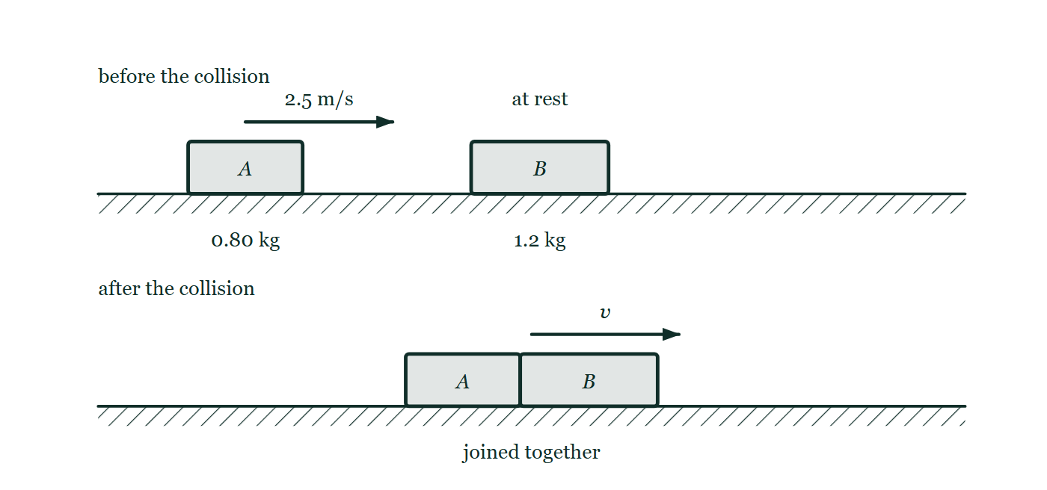
IGCSE · TOPIC 1 · MOTION, FORCES AND ENERGY
GIOPHYSICS PRACTICE PAPER
Question 8
Structured
Supp.
Discriminating
9 marks
Syllabus 1.6, 1.7.1
Trolley A has a mass of 0.80 kg and moves along a straight, level track at 2.5 m/s. It collides with trolley B, of mass 1.2 kg, which is stationary. After the collision the two trolleys move off joined together. Friction is negligible.
Fig. 8.1 — Two panels, one above the other. In the upper panel, labelled before the collision, trolley A of mass 0.80 kg stands on a level track with an arrow showing it moving to the right at 2.5 m/s towards trolley B of mass 1.2 kg, which is at rest. In the lower panel, labelled after the collision, the two trolleys are drawn joined together and moving to the right with a speed marked v.
Cambridge IGCSE Physics — Topic 1 · Motion, forces and energy. Written by GioPhysics from Cambridge IGCSE Physics 0625 syllabus; not an awarding body's document.
17 / 25
Notes:
[Demand] Discriminating — The part that separates the top grade: an unfamiliar context, a derivation, or an argument that has to hold together to earn anything.
[Figure] Fig. 8.1. Two panels, one above the other. In the upper panel, labelled before the collision, trolley A of mass 0.80 kg stands on a level track with an arrow showing it moving to the right at 2.5 m/s towards trolley B of mass 1.2 kg, which is at rest. In the lower panel, labelled after the collision, the two trolleys are drawn joined together and moving to the right with a speed marked v.

Slide 18
IGCSE · TOPIC 1 · MOTION, FORCES AND ENERGY
GIOPHYSICS PRACTICE PAPER
Question 8 (cont.)
Structured
Supp.
Discriminating
9 marks
continued from the previous slide
(a) State
2 marks
State the principle of conservation of momentum.
(b) Calculate
3 marks
Calculate the speed of the joined trolleys immediately after the collision.
(c) Show (that)
3 marks
Show that kinetic energy is not conserved in this collision, and determine how much kinetic energy is transferred to other stores.
(d) Suggest
1 mark
Suggest what happens to the kinetic energy that is not accounted for after the collision.
Cambridge IGCSE Physics — Topic 1 · Motion, forces and energy. Written by GioPhysics from Cambridge IGCSE Physics 0625 syllabus; not an awarding body's document.
18 / 25
Notes:
[Demand] Discriminating — The part that separates the top grade: an unfamiliar context, a derivation, or an argument that has to hold together to earn anything.
[Figure] Fig. 8.1. Two panels, one above the other. In the upper panel, labelled before the collision, trolley A of mass 0.80 kg stands on a level track with an arrow showing it moving to the right at 2.5 m/s towards trolley B of mass 1.2 kg, which is at rest. In the lower panel, labelled after the collision, the two trolleys are drawn joined together and moving to the right with a speed marked v.
[Reminder] Fig. 8.1 is on the previous slide.

Slide 19
IGCSE · TOPIC 1 · MOTION, FORCES AND ENERGY
GIOPHYSICS PRACTICE PAPER
Answer 8
Structured
Supp.
Discriminating
9 marks
Mark scheme
(a) State — 2 marks
AO1
✓
the total momentum of a system (of interacting bodies) before an event equals the total momentum after it
✓
provided no external resultant force acts
(b) Calculate — 3 marks
AO2
✓
momentum before = 0.80 × 2.5 = 2.0 kg m/s
✓
total mass after = 0.80 + 1.2 = 2.0 kg
✓
v = 2.0 / 2.0 = 1.0 m/s
(c) Show (that) — 3 marks
AO2
✓
E_k before = ½ × 0.80 × 2.5² = 2.5 J
✓
E_k after = ½ × 2.0 × 1.0² = 1.0 J
✓
1.5 J transferred away, so kinetic energy is not conserved
Momentum is conserved and kinetic energy is not: the pairing is the whole point of the question, and candidates who assume both are conserved lose all three marks.
(d) Suggest — 1 mark
AO1
✓
transferred to the internal (thermal) energy store of the trolleys and surroundings, and/or emitted as sound
Cambridge IGCSE Physics — Topic 1 · Motion, forces and energy. Written by GioPhysics from Cambridge IGCSE Physics 0625 syllabus; not an awarding body's document.
19 / 25
Notes:
[Marking] One line per mark, awarded independently unless a point says otherwise.
[Examiner note (c)] Momentum is conserved and kinetic energy is not: the pairing is the whole point of the question, and candidates who assume both are conserved lose all three marks.
[Figure] Fig. 8.1. Two panels, one above the other. In the upper panel, labelled before the collision, trolley A of mass 0.80 kg stands on a level track with an arrow showing it moving to the right at 2.5 m/s towards trolley B of mass 1.2 kg, which is at rest. In the lower panel, labelled after the collision, the two trolleys are drawn joined together and moving to the right with a speed marked v.

Slide 20
IGCSE · TOPIC 1 · MOTION, FORCES AND ENERGY
GIOPHYSICS PRACTICE PAPER
Question 9
Structured
Supp.
Routine
8 marks
Syllabus 1.7.3, 1.7.4
A wind turbine generates electricity for a school. Over a period of 60 s, the moving air delivers 900 kJ of energy to the turbine blades. The electrical output of the turbine during this time is 9.0 kW.
(a) State
2 marks
State two renewable energy resources other than wind.
(b) Calculate
2 marks
Calculate the input power delivered to the blades by the moving air.
(c) Calculate
2 marks
Calculate the efficiency of the turbine.
(d) Explain
2 marks
Explain why the efficiency of the turbine can never reach 100%.
Cambridge IGCSE Physics — Topic 1 · Motion, forces and energy. Written by GioPhysics from Cambridge IGCSE Physics 0625 syllabus; not an awarding body's document.
20 / 25
Notes:
[Demand] Routine — The standard application — the named equation, the usual graph read.

Slide 21
IGCSE · TOPIC 1 · MOTION, FORCES AND ENERGY
GIOPHYSICS PRACTICE PAPER
Answer 9
Structured
Supp.
Routine
8 marks
Mark scheme
(a) State — 2 marks
AO1
✓
any one of: solar / hydroelectric / tidal / wave / geothermal / biofuel
✓
a second, different one from the same list
Named fuels such as "gas" or "nuclear" score zero — both are non-renewable.
(b) Calculate — 2 marks
AO2
✓
P = E / t = 900 000 / 60
✓
P = 15 000 W = 15 kW
(c) Calculate — 2 marks
AO2
✓
efficiency = useful output power / total input power = 9.0 / 15
✓
= 0.60 or 60%
(d) Explain — 2 marks
AO1
✓
some energy is always transferred to non-useful stores — friction in the bearings and gearbox heats the surroundings, and sound is emitted
✓
and the air must still be moving after it passes the blades, so it keeps some kinetic energy
The second marking point is the one that separates a good answer. "Energy is lost" alone is not creditworthy: energy is not destroyed, it is transferred to a store that is not useful.
Cambridge IGCSE Physics — Topic 1 · Motion, forces and energy. Written by GioPhysics from Cambridge IGCSE Physics 0625 syllabus; not an awarding body's document.
21 / 25
Notes:
[Marking] One line per mark, awarded independently unless a point says otherwise.
[Examiner note (a)] Named fuels such as "gas" or "nuclear" score zero — both are non-renewable.
[Examiner note (d)] The second marking point is the one that separates a good answer. "Energy is lost" alone is not creditworthy: energy is not destroyed, it is transferred to a store that is not useful.

Slide 22
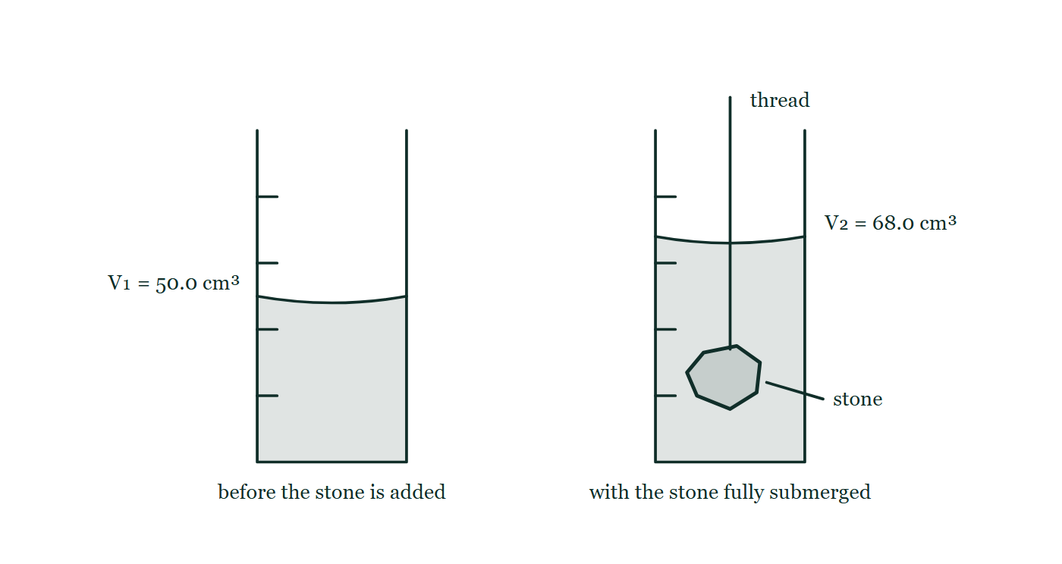
IGCSE · TOPIC 1 · MOTION, FORCES AND ENERGY
GIOPHYSICS PRACTICE PAPER
Question 10
Practical skills
Core
Demanding
9 marks
Syllabus 1.1, 1.4
A student determines the density of a small irregularly shaped stone. She has an electronic balance, a measuring cylinder, water and a length of thread. The stone fits easily inside the measuring cylinder.
The student's readings
Quantity | Reading
mass of stone m | 47.6 g
volume of water alone V₁ | 50.0 cm³
volume of water and stone V₂ | 68.0 cm³
Fig. 10.1 — Two measuring cylinders drawn side by side, each with graduations up the wall and a curved meniscus. The first holds water alone, its surface at the 50.0 cm³ mark. The second holds the same water with the stone lowered in on a thread that runs up and out of the cylinder; the stone lies fully submerged near the base and the surface now stands at the 68.0 cm³ mark.
Cambridge IGCSE Physics — Topic 1 · Motion, forces and energy. Written by GioPhysics from Cambridge IGCSE Physics 0625 syllabus; not an awarding body's document.
22 / 25
Notes:
[Demand] Demanding — Several steps, and you have to choose them. Nothing says which comes first.
[Figure] Fig. 10.1. Two measuring cylinders drawn side by side, each with graduations up the wall and a curved meniscus. The first holds water alone, its surface at the 50.0 cm³ mark. The second holds the same water with the stone lowered in on a thread that runs up and out of the cylinder; the stone lies fully submerged near the base and the surface now stands at the 68.0 cm³ mark.

Slide 23
IGCSE · TOPIC 1 · MOTION, FORCES AND ENERGY
GIOPHYSICS PRACTICE PAPER
Question 10 (cont.)
Practical skills
Core
Demanding
9 marks
continued from the previous slide
(a) Describe
3 marks
Describe how the student should use the measuring cylinder and thread to obtain the readings V₁ and V₂ accurately.
(b) Calculate
3 marks
Calculate the density of the stone. Give your answer to an appropriate number of significant figures.
(c) Suggest
3 marks
The stone is porous and slowly absorbs water. Suggest how this affects the value obtained for the density, and suggest one improvement to the method.
Cambridge IGCSE Physics — Topic 1 · Motion, forces and energy. Written by GioPhysics from Cambridge IGCSE Physics 0625 syllabus; not an awarding body's document.
23 / 25
Notes:
[Demand] Demanding — Several steps, and you have to choose them. Nothing says which comes first.
[Figure] Fig. 10.1. Two measuring cylinders drawn side by side, each with graduations up the wall and a curved meniscus. The first holds water alone, its surface at the 50.0 cm³ mark. The second holds the same water with the stone lowered in on a thread that runs up and out of the cylinder; the stone lies fully submerged near the base and the surface now stands at the 68.0 cm³ mark.
[Reminder] Fig. 10.1 is on the previous slide.

Slide 24
IGCSE · TOPIC 1 · MOTION, FORCES AND ENERGY
GIOPHYSICS PRACTICE PAPER
Answer 10
Practical skills
Core
Demanding
9 marks
Mark scheme
(a) Describe — 3 marks
AO3
✓
part-fill the cylinder with water and record the level V₁, reading the bottom of the meniscus with the eye level with the surface
✓
lower the stone in gently on the thread so that no water splashes out and the stone is fully submerged
✓
record the new level V₂ once the water is still
"Eye level with the meniscus" is the mark examiners report as most often missed, and it is worth as much as the method itself.
(b) Calculate — 3 marks
AO2
✓
V = V₂ − V₁ = 68.0 − 50.0 = 18.0 cm³
✓
ρ = m / V = 47.6 / 18.0
✓
ρ = 2.64 g/cm³ (2.6 g/cm³ also accepted; unit required)
(c) Suggest — 3 marks
AO3
✓
water enters the stone, so the rise in level V₂ − V₁ is smaller than the true volume of the stone
✓
the calculated density is therefore too high
✓
improvement: read V₂ immediately on submerging, or seal the stone first, or use a displacement can
Two marks are for the direction of the error, not just its existence. Answering "it makes it inaccurate" scores one at most.
Cambridge IGCSE Physics — Topic 1 · Motion, forces and energy. Written by GioPhysics from Cambridge IGCSE Physics 0625 syllabus; not an awarding body's document.
24 / 25
Notes:
[Marking] One line per mark, awarded independently unless a point says otherwise.
[Examiner note (a)] "Eye level with the meniscus" is the mark examiners report as most often missed, and it is worth as much as the method itself.
[Examiner note (c)] Two marks are for the direction of the error, not just its existence. Answering "it makes it inaccurate" scores one at most.
[Figure] Fig. 10.1. Two measuring cylinders drawn side by side, each with graduations up the wall and a curved meniscus. The first holds water alone, its surface at the 50.0 cm³ mark. The second holds the same water with the stone lowered in on a thread that runs up and out of the cylinder; the stone lies fully submerged near the base and the surface now stands at the 68.0 cm³ mark.

Slide 25
IGCSE · TOPIC 1 · MOTION, FORCES AND ENERGY
GIOPHYSICS PRACTICE PAPER
Command words
Cambridge IGCSE Physics — the board's own definitions
Calculate
Show (that)
Work out from given facts, figures or information.
Provide structured evidence that leads to a given result.
Define
State
Give the precise meaning.
Express in clear terms.
Describe
Suggest
State the points of a topic; give characteristics and main features.
Apply knowledge and understanding to situations where there is a range of valid responses in order to make proposals.
Determine
Establish an answer using the information available.
Estimate
Suggest an approximate value.
Explain
Set out purposes or reasons; make relationships evident; give why and/or how.
Give
Produce an answer from a given source or recall.
Identify
Name, select or recognise.
Cambridge IGCSE Physics — Topic 1 · Motion, forces and energy. Written by GioPhysics from Cambridge IGCSE Physics 0625 syllabus; not an awarding body's document.
25 / 25
Notes:
[Objectives] AO1 Knowledge with understanding (50%): Recall, describe, explain and use physics ideas, terminology, instruments and conventions. AO2 Handling information and problem-solving (30%): Locate and interpret information, translate between forms, calculate, reason, and apply physics to unfamiliar situations. AO3 Experimental skills and investigations (20%): Plan, use apparatus, record and present observations, analyse, evaluate, and suggest improvements.
[Source] Cambridge IGCSE Physics 0625 syllabus — https://www.cambridgeinternational.org/Images/697209-2026-2028-syllabus.pdf
[Disclaimer] Written by GioPhysics from the published syllabus. These are practice papers in the style of Cambridge IGCSE Physics 0625; they are not Cambridge papers, contain no past-paper questions, and the official syllabus and specimen materials remain the authority.

