Slide 1
IGCSE · TOPIC 5 · NUCLEAR PHYSICS
GIOPHYSICS PRACTICE PAPER
IGCSE · Physics 0625 · for examination in 2026, 2027 and 2028
Topic 5 · Nuclear physics
The nuclear model of the atom, nuclide notation and isotopes, the three radiations and what stops them, decay equations, half-life and safety.
MIRRORS
Papers 1 and 2 (multiple choice), Papers 3 and 4 (theory), Paper 6 (alternative to practical)
MARKS
36 in total — Core route 12, Supp. adds 24
TIME
40 minutes · 10 questions
DEMAND
Recall 3 · Routine 3 · Demanding 2 · Discriminating 2
SYLLABUS
5.1, 5.2
Written by GioPhysics from the published syllabus. These are practice papers in the style of Cambridge IGCSE Physics 0625; they are not Cambridge papers, contain no past-paper questions, and the official syllabus and specimen materials remain the authority.
Cambridge IGCSE Physics — Topic 5 · Nuclear physics. Written by GioPhysics from Cambridge IGCSE Physics 0625 syllabus; not an awarding body's document.
1 / 23
Notes:
[Format] Every candidate sits two theory papers and one practical-skills paper. Core takes Papers 1 and 3 and is capped at grade C; Extended takes Papers 2 and 4 and reaches A*. Both then take either Paper 5 (practical test) or Paper 6 (alternative to practical), which carries 20% either way. Theory papers give you no formula sheet.
[Demand] Pitched at the board's own level, not above it. Multiple choice is mostly one step, with a couple of two-step items and one that rewards the candidate who does not take the obvious route. Structured questions open on a 1-mark recall and close on an explanation or a suggestion worth two marks — the marks real candidates most often drop.
[Source] Cambridge IGCSE Physics 0625 syllabus — https://www.cambridgeinternational.org/Images/697209-2026-2028-syllabus.pdf
[Disclaimer] Written by GioPhysics from the published syllabus. These are practice papers in the style of Cambridge IGCSE Physics 0625; they are not Cambridge papers, contain no past-paper questions, and the official syllabus and specimen materials remain the authority.

Slide 2
IGCSE · TOPIC 5 · NUCLEAR PHYSICS
GIOPHYSICS PRACTICE PAPER
Question 1
Multiple choice
Core
Recall
1 mark
Syllabus 5.1 · AO1
How many neutrons are there in a nucleus of ²³⁵₉₂U?
A
92
B
143
C
235
D
327
Cambridge IGCSE Physics — Topic 5 · Nuclear physics. Written by GioPhysics from Cambridge IGCSE Physics 0625 syllabus; not an awarding body's document.
2 / 23
Notes:
[Demand] Recall — One idea, one step. The mark is for knowing it.

Slide 3
IGCSE · TOPIC 5 · NUCLEAR PHYSICS
GIOPHYSICS PRACTICE PAPER
Answer 1
Multiple choice
Core
Recall
1 mark
Mark scheme
B
143
Why the other three are there
A gives the proton number and C the nucleon number. The neutron number is the difference, 235 − 92 = 143, and D adds them instead.
Cambridge IGCSE Physics — Topic 5 · Nuclear physics. Written by GioPhysics from Cambridge IGCSE Physics 0625 syllabus; not an awarding body's document.
3 / 23
Notes:
[Answer] B — 143
[Distractors] A gives the proton number and C the nucleon number. The neutron number is the difference, 235 − 92 = 143, and D adds them instead.

Slide 4
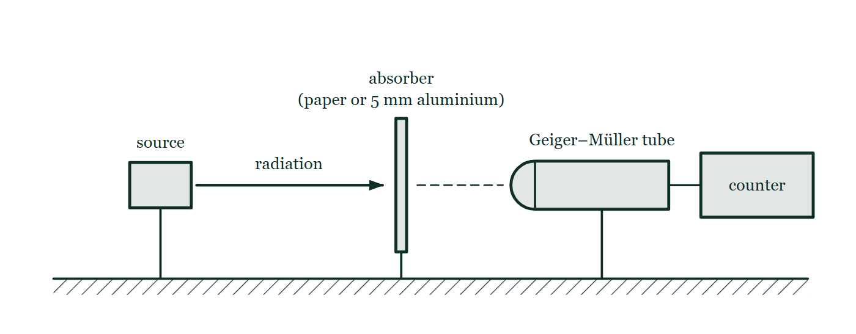
IGCSE · TOPIC 5 · NUCLEAR PHYSICS
GIOPHYSICS PRACTICE PAPER
Question 2
Multiple choice
Core
Recall
1 mark
Syllabus 5.2 · AO1
A radioactive source is placed near a detector. A sheet of paper does not reduce the count rate, but a 5 mm sheet of aluminium reduces it almost to background. What does the source emit?
Fig. 2.1 — A radioactive source in a holder stands on the bench facing a Geiger–Müller tube that is joined by a lead to a counter. Between them an absorber is held upright in the path of the radiation: either a sheet of paper or a 5 mm sheet of aluminium. The source, the absorber and the window of the tube all lie on the same horizontal line, and the distance between the source and the tube is not changed when the absorber is put in place.
A
α-particles only
B
β-particles only
C
γ-rays only
D
α-particles and γ-rays
Cambridge IGCSE Physics — Topic 5 · Nuclear physics. Written by GioPhysics from Cambridge IGCSE Physics 0625 syllabus; not an awarding body's document.
4 / 23
Notes:
[Demand] Recall — One idea, one step. The mark is for knowing it.
[Figure] Fig. 2.1. A radioactive source in a holder stands on the bench facing a Geiger–Müller tube that is joined by a lead to a counter. Between them an absorber is held upright in the path of the radiation: either a sheet of paper or a 5 mm sheet of aluminium. The source, the absorber and the window of the tube all lie on the same horizontal line, and the distance between the source and the tube is not changed when the absorber is put in place.

Slide 5
IGCSE · TOPIC 5 · NUCLEAR PHYSICS
GIOPHYSICS PRACTICE PAPER
Answer 2
Multiple choice
Core
Recall
1 mark
Mark scheme
B
β-particles only
Why the other three are there
The paper result rules out alpha, and the aluminium result rules out gamma. Both pieces of evidence have to be used, which is what makes this a two-step item rather than recall.
Cambridge IGCSE Physics — Topic 5 · Nuclear physics. Written by GioPhysics from Cambridge IGCSE Physics 0625 syllabus; not an awarding body's document.
5 / 23
Notes:
[Answer] B — β-particles only
[Distractors] The paper result rules out alpha, and the aluminium result rules out gamma. Both pieces of evidence have to be used, which is what makes this a two-step item rather than recall.
[Figure] Fig. 2.1. A radioactive source in a holder stands on the bench facing a Geiger–Müller tube that is joined by a lead to a counter. Between them an absorber is held upright in the path of the radiation: either a sheet of paper or a 5 mm sheet of aluminium. The source, the absorber and the window of the tube all lie on the same horizontal line, and the distance between the source and the tube is not changed when the absorber is put in place.

Slide 6
IGCSE · TOPIC 5 · NUCLEAR PHYSICS
GIOPHYSICS PRACTICE PAPER
Question 3
Multiple choice
Core
Routine
1 mark
Syllabus 5.2 · AO2
A sample of a radioactive isotope has an activity of 800 Bq. The half-life of the isotope is 6.0 hours. What is the activity after 24 hours?
A
0 Bq
B
50 Bq
C
200 Bq
D
400 Bq
Cambridge IGCSE Physics — Topic 5 · Nuclear physics. Written by GioPhysics from Cambridge IGCSE Physics 0625 syllabus; not an awarding body's document.
6 / 23
Notes:
[Demand] Routine — The standard application — the named equation, the usual graph read.

Slide 7
IGCSE · TOPIC 5 · NUCLEAR PHYSICS
GIOPHYSICS PRACTICE PAPER
Answer 3
Multiple choice
Core
Routine
1 mark
Mark scheme
B
50 Bq
Why the other three are there
24 hours is four half-lives, so the activity is halved four times: 800 → 400 → 200 → 100 → 50. C and D are the answers of candidates who stop after one or two halvings.
Cambridge IGCSE Physics — Topic 5 · Nuclear physics. Written by GioPhysics from Cambridge IGCSE Physics 0625 syllabus; not an awarding body's document.
7 / 23
Notes:
[Answer] B — 50 Bq
[Distractors] 24 hours is four half-lives, so the activity is halved four times: 800 → 400 → 200 → 100 → 50. C and D are the answers of candidates who stop after one or two halvings.

Slide 8
IGCSE · TOPIC 5 · NUCLEAR PHYSICS
GIOPHYSICS PRACTICE PAPER
Question 4
Multiple choice
Supp.
Routine
1 mark
Syllabus 5.2 · AO2
A nucleus of ²²⁶₈₈Ra decays by emitting an α-particle. What is the nuclide produced?
A
²²²₈₆Rn
B
²²²₈₈Ra
C
²²⁶₈₆Rn
D
²²⁶₈₉Ac
Cambridge IGCSE Physics — Topic 5 · Nuclear physics. Written by GioPhysics from Cambridge IGCSE Physics 0625 syllabus; not an awarding body's document.
8 / 23
Notes:
[Demand] Routine — The standard application — the named equation, the usual graph read.

Slide 9
IGCSE · TOPIC 5 · NUCLEAR PHYSICS
GIOPHYSICS PRACTICE PAPER
Answer 4
Multiple choice
Supp.
Routine
1 mark
Mark scheme
A
²²²₈₆Rn
Why the other three are there
B changes only the nucleon number and C only the proton number. D is a beta decay. An α-particle carries away two protons and two neutrons, so both numbers must fall — by 2 and by 4.
Cambridge IGCSE Physics — Topic 5 · Nuclear physics. Written by GioPhysics from Cambridge IGCSE Physics 0625 syllabus; not an awarding body's document.
9 / 23
Notes:
[Answer] A — ²²²₈₆Rn
[Distractors] B changes only the nucleon number and C only the proton number. D is a beta decay. An α-particle carries away two protons and two neutrons, so both numbers must fall — by 2 and by 4.

Slide 10
IGCSE · TOPIC 5 · NUCLEAR PHYSICS
GIOPHYSICS PRACTICE PAPER
Question 5
Multiple choice
Core
Recall
1 mark
Syllabus 5.2 · AO1
Which is not a source of background radiation?
A
cosmic rays reaching the Earth from space
B
radon gas seeping from rocks and soil
C
the Earth's magnetic field
D
naturally occurring isotopes in food and drink
Cambridge IGCSE Physics — Topic 5 · Nuclear physics. Written by GioPhysics from Cambridge IGCSE Physics 0625 syllabus; not an awarding body's document.
10 / 23
Notes:
[Demand] Recall — One idea, one step. The mark is for knowing it.

Slide 11
IGCSE · TOPIC 5 · NUCLEAR PHYSICS
GIOPHYSICS PRACTICE PAPER
Answer 5
Multiple choice
Core
Recall
1 mark
Mark scheme
C
the Earth's magnetic field
Why the other three are there
A magnetic field is not ionising radiation. The other three are the standard components of background, and candidates who have only learned that background is "from rocks" miss B or D.
Cambridge IGCSE Physics — Topic 5 · Nuclear physics. Written by GioPhysics from Cambridge IGCSE Physics 0625 syllabus; not an awarding body's document.
11 / 23
Notes:
[Answer] C — the Earth's magnetic field
[Distractors] A magnetic field is not ionising radiation. The other three are the standard components of background, and candidates who have only learned that background is "from rocks" miss B or D.

Slide 12
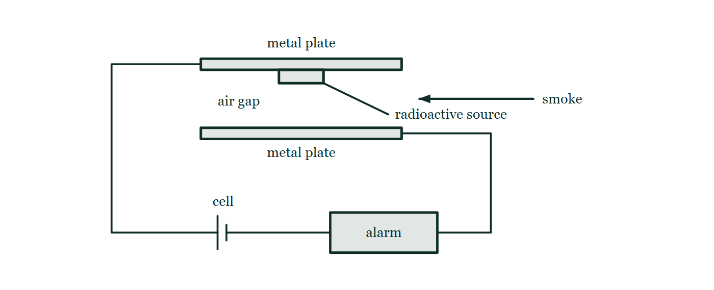
IGCSE · TOPIC 5 · NUCLEAR PHYSICS
GIOPHYSICS PRACTICE PAPER
Question 6
Multiple choice
Core
Demanding
1 mark
Syllabus 5.2 · AO2
A smoke alarm contains a source that ionises the air in a small gap, allowing a tiny current to flow. Smoke entering the gap reduces the current and sets off the alarm. Which source is most suitable?
Fig. 6.1 — A cut-through view of the ionisation chamber of a smoke alarm. Two horizontal metal plates face each other across a small air gap, and a radioactive source is fixed to the underside of the upper plate so that it irradiates the gap. A wire from the upper plate leads to a cell and a wire from the lower plate leads to the alarm, so the two plates and the air gap between them form part of one complete series circuit. An arrow shows smoke drifting sideways into the gap.
A
an α-emitter with a half-life of several hundred years
B
an α-emitter with a half-life of a few hours
C
a γ-emitter with a half-life of several hundred years
D
a β-emitter with a half-life of a few days
Cambridge IGCSE Physics — Topic 5 · Nuclear physics. Written by GioPhysics from Cambridge IGCSE Physics 0625 syllabus; not an awarding body's document.
12 / 23
Notes:
[Demand] Demanding — Several steps, and you have to choose them. Nothing says which comes first.
[Figure] Fig. 6.1. A cut-through view of the ionisation chamber of a smoke alarm. Two horizontal metal plates face each other across a small air gap, and a radioactive source is fixed to the underside of the upper plate so that it irradiates the gap. A wire from the upper plate leads to a cell and a wire from the lower plate leads to the alarm, so the two plates and the air gap between them form part of one complete series circuit. An arrow shows smoke drifting sideways into the gap.

Slide 13
IGCSE · TOPIC 5 · NUCLEAR PHYSICS
GIOPHYSICS PRACTICE PAPER
Answer 6
Multiple choice
Core
Demanding
1 mark
Mark scheme
A
an α-emitter with a half-life of several hundred years
Why the other three are there
Two properties have to be right at once. Alpha is by far the most strongly ionising and is stopped by the alarm's own casing, so it is both effective and safe; and a long half-life means the alarm keeps working for years. B has the right radiation but would stop working almost immediately.
Cambridge IGCSE Physics — Topic 5 · Nuclear physics. Written by GioPhysics from Cambridge IGCSE Physics 0625 syllabus; not an awarding body's document.
13 / 23
Notes:
[Answer] A — an α-emitter with a half-life of several hundred years
[Distractors] Two properties have to be right at once. Alpha is by far the most strongly ionising and is stopped by the alarm's own casing, so it is both effective and safe; and a long half-life means the alarm keeps working for years. B has the right radiation but would stop working almost immediately.
[Figure] Fig. 6.1. A cut-through view of the ionisation chamber of a smoke alarm. Two horizontal metal plates face each other across a small air gap, and a radioactive source is fixed to the underside of the upper plate so that it irradiates the gap. A wire from the upper plate leads to a cell and a wire from the lower plate leads to the alarm, so the two plates and the air gap between them form part of one complete series circuit. An arrow shows smoke drifting sideways into the gap.

Slide 14
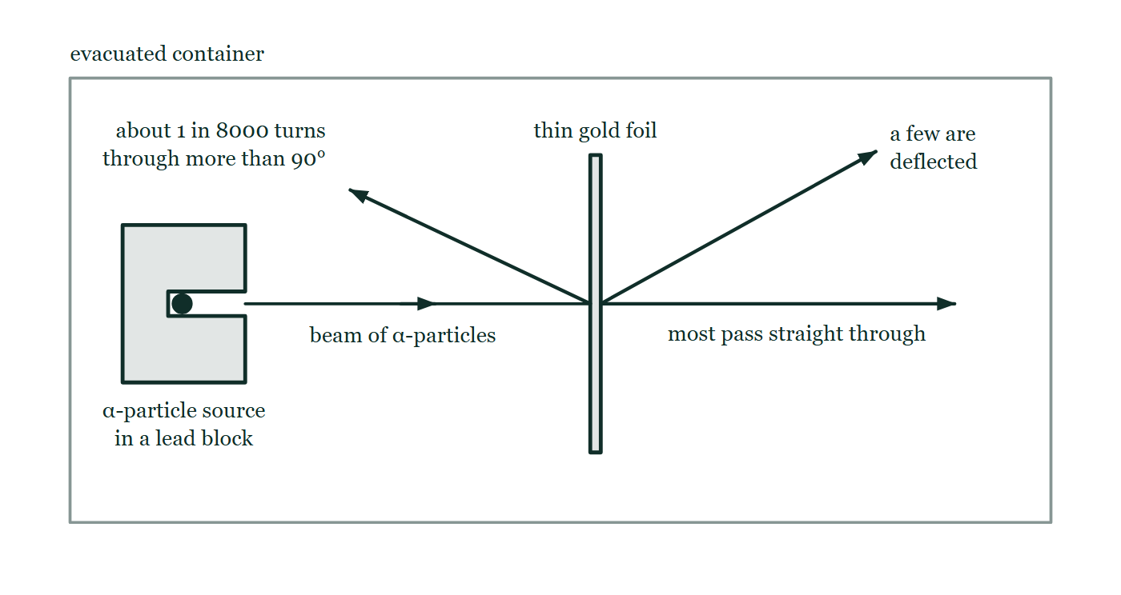
IGCSE · TOPIC 5 · NUCLEAR PHYSICS
GIOPHYSICS PRACTICE PAPER
Question 7
Structured
Supp.
Discriminating
7 marks
Syllabus 5.1
In the α-particle scattering experiment, a beam of α-particles was directed at a very thin sheet of gold foil in an evacuated container. Most α-particles passed straight through with little or no deviation. A small number were deflected through large angles, and about one in 8000 was deflected through more than 90°.
Fig. 7.1 — The scattering apparatus, drawn inside an evacuated container. A source of α-particles sits in a lead block with a narrow channel cut through it, so a fine beam travels horizontally to a very thin vertical sheet of gold foil. Three paths are drawn from the point where the beam meets the foil: one carrying straight on in the original direction and labelled as the path of most of the particles, one deflected upwards through a moderate angle, and one turned back towards the source side of the foil through more than 90°.
(a) Explain
2 marks
Explain what the observation that most α-particles passed straight through tells us about the structure of the atom.
(b) Explain
3 marks
Explain what the small number of α-particles deflected through more than 90° tells us about the nucleus.
(c) Suggest
2 marks
Suggest why the container had to be evacuated and the gold foil had to be very thin.
Cambridge IGCSE Physics — Topic 5 · Nuclear physics. Written by GioPhysics from Cambridge IGCSE Physics 0625 syllabus; not an awarding body's document.
14 / 23
Notes:
[Demand] Discriminating — The part that separates the top grade: an unfamiliar context, a derivation, or an argument that has to hold together to earn anything.
[Figure] Fig. 7.1. The scattering apparatus, drawn inside an evacuated container. A source of α-particles sits in a lead block with a narrow channel cut through it, so a fine beam travels horizontally to a very thin vertical sheet of gold foil. Three paths are drawn from the point where the beam meets the foil: one carrying straight on in the original direction and labelled as the path of most of the particles, one deflected upwards through a moderate angle, and one turned back towards the source side of the foil through more than 90°.

Slide 15
IGCSE · TOPIC 5 · NUCLEAR PHYSICS
GIOPHYSICS PRACTICE PAPER
Answer 7
Structured
Supp.
Discriminating
7 marks
Mark scheme
(a) Explain — 2 marks
AO2
✓
most of the atom is empty space
✓
so most α-particles pass through the foil without coming close to anything that can deflect them
(b) Explain — 3 marks
AO2
✓
the positive charge and almost all the mass of the atom are concentrated in a very small volume — the nucleus
✓
the α-particle is positive, so it is repelled strongly when it passes very close to a nucleus
✓
such a close approach is rare, which is why so few particles are deflected through large angles
All three ideas — concentration, repulsion, rarity — are needed. Candidates who describe only the repulsion have not explained why the effect is so uncommon.
(c) Suggest — 2 marks
AO2
✓
α-particles are absorbed by only a few centimetres of air, so air in the container would stop them before they reached the foil or the detector
✓
a thin foil ensures each α-particle is scattered by at most one nucleus, so the deflections can be interpreted
Cambridge IGCSE Physics — Topic 5 · Nuclear physics. Written by GioPhysics from Cambridge IGCSE Physics 0625 syllabus; not an awarding body's document.
15 / 23
Notes:
[Marking] One line per mark, awarded independently unless a point says otherwise.
[Examiner note (b)] All three ideas — concentration, repulsion, rarity — are needed. Candidates who describe only the repulsion have not explained why the effect is so uncommon.
[Figure] Fig. 7.1. The scattering apparatus, drawn inside an evacuated container. A source of α-particles sits in a lead block with a narrow channel cut through it, so a fine beam travels horizontally to a very thin vertical sheet of gold foil. Three paths are drawn from the point where the beam meets the foil: one carrying straight on in the original direction and labelled as the path of most of the particles, one deflected upwards through a moderate angle, and one turned back towards the source side of the foil through more than 90°.

Slide 16
IGCSE · TOPIC 5 · NUCLEAR PHYSICS
GIOPHYSICS PRACTICE PAPER
Question 8
Structured
Supp.
Demanding
8 marks
Syllabus 5.1, 5.2
Carbon has two naturally occurring stable isotopes, ¹²₆C and ¹³₆C, and one radioactive isotope, ¹⁴₆C, which decays by β-emission to nitrogen.
(a) Define
2 marks
Define the term isotope.
(b) Explain
2 marks
Explain why the three isotopes of carbon all behave identically in chemical reactions.
(c) State
2 marks
Complete the decay equation for carbon-14, giving the nucleon and proton numbers of the nitrogen nucleus produced: ¹⁴₆C → ᴬ_Z N + ⁰₋₁β
(d) Explain
2 marks
A β-particle is an electron, yet there are no electrons in a nucleus. Explain where the emitted β-particle comes from.
Cambridge IGCSE Physics — Topic 5 · Nuclear physics. Written by GioPhysics from Cambridge IGCSE Physics 0625 syllabus; not an awarding body's document.
16 / 23
Notes:
[Demand] Demanding — Several steps, and you have to choose them. Nothing says which comes first.

Slide 17
IGCSE · TOPIC 5 · NUCLEAR PHYSICS
GIOPHYSICS PRACTICE PAPER
Answer 8
Structured
Supp.
Demanding
8 marks
Mark scheme
(a) Define — 2 marks
AO1
✓
atoms of the same element, with the same number of protons (same proton number)
✓
but different numbers of neutrons (different nucleon number)
(b) Explain — 2 marks
AO2
✓
chemical behaviour is determined by the electrons, particularly the outer electrons
✓
all three isotopes have 6 protons and therefore the same number and arrangement of electrons
(c) State — 2 marks
AO2
✓
A = 14
✓
Z = 7
(d) Explain — 2 marks
AO1
✓
a neutron in the nucleus changes into a proton
✓
and an electron is created and emitted at that moment, which is why the proton number rises by one while the nucleon number is unchanged
The part that separates the strongest candidates. It is the only place in the topic where the bookkeeping of the decay equation has to be justified rather than performed.
Cambridge IGCSE Physics — Topic 5 · Nuclear physics. Written by GioPhysics from Cambridge IGCSE Physics 0625 syllabus; not an awarding body's document.
17 / 23
Notes:
[Marking] One line per mark, awarded independently unless a point says otherwise.
[Examiner note (d)] The part that separates the strongest candidates. It is the only place in the topic where the bookkeeping of the decay equation has to be justified rather than performed.

Slide 18
IGCSE · TOPIC 5 · NUCLEAR PHYSICS
GIOPHYSICS PRACTICE PAPER
Question 9
Structured
Core
Routine
7 marks
Syllabus 5.2
A hospital uses a radioactive tracer to study a patient's kidneys. The tracer is a γ-emitter with a half-life of 6 hours and is injected into the bloodstream.
(a) Define
2 marks
Define half-life.
(b) Explain
3 marks
Explain why a γ-emitter is chosen for this use rather than an α-emitter.
(c) Suggest
2 marks
Suggest why an isotope with a half-life of 6 hours is more suitable than one with a half-life of 6 years.
Cambridge IGCSE Physics — Topic 5 · Nuclear physics. Written by GioPhysics from Cambridge IGCSE Physics 0625 syllabus; not an awarding body's document.
18 / 23
Notes:
[Demand] Routine — The standard application — the named equation, the usual graph read.

Slide 19
IGCSE · TOPIC 5 · NUCLEAR PHYSICS
GIOPHYSICS PRACTICE PAPER
Answer 9
Structured
Core
Routine
7 marks
Mark scheme
(a) Define — 2 marks
AO1
✓
the time taken for half the nuclei of the radioactive isotope in a sample to decay
✓
or, equivalently, for the activity (count rate) of the sample to fall to half its original value
(b) Explain — 3 marks
AO2
✓
γ-rays are the most penetrating of the three, so they pass out through the body and can be detected outside it
✓
α-particles would be absorbed within a few centimetres of tissue and never reach the detector
✓
α is the most strongly ionising, so it would do far more damage to the surrounding cells
(c) Suggest — 2 marks
AO2
✓
the activity falls quickly once the measurement is finished, so the patient's total exposure is small
✓
an isotope with a half-life of years would keep irradiating the patient long after the scan, with no benefit
Cambridge IGCSE Physics — Topic 5 · Nuclear physics. Written by GioPhysics from Cambridge IGCSE Physics 0625 syllabus; not an awarding body's document.
19 / 23
Notes:
[Marking] One line per mark, awarded independently unless a point says otherwise.

Slide 20
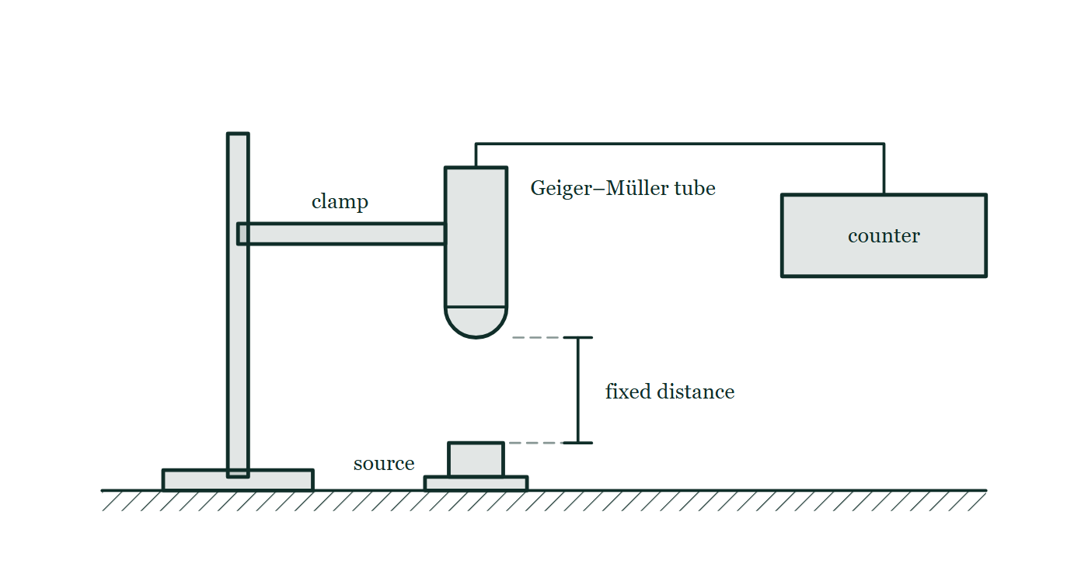
IGCSE · TOPIC 5 · NUCLEAR PHYSICS
GIOPHYSICS PRACTICE PAPER
Question 10
Practical skills
Supp.
Discriminating
8 marks
Syllabus 5.2
A student determines the half-life of a radioactive source using a Geiger–Müller tube and a counter. Before bringing out the source, she records the count over 10 minutes with no source present and obtains 240 counts. She then places the source at a fixed distance from the tube and records the count rate every 20 minutes.
The student's readings, each a measured count rate in counts/minute
time / minutes | 0 | 20 | 40 | 60 | 80
measured count rate / counts per minute | 404 | 214 | 119 | 72 | 48
Fig. 10.1 — The arrangement used for the measurements. A Geiger–Müller tube is held vertically in a clamp on a retort stand with its window facing downwards, and is joined by a lead to a counter standing on the bench. The radioactive source sits on the bench directly beneath the tube, and the vertical gap between the tube window and the source is marked as a fixed distance which is kept the same for every reading.
Cambridge IGCSE Physics — Topic 5 · Nuclear physics. Written by GioPhysics from Cambridge IGCSE Physics 0625 syllabus; not an awarding body's document.
20 / 23
Notes:
[Demand] Discriminating — The part that separates the top grade: an unfamiliar context, a derivation, or an argument that has to hold together to earn anything.
[Figure] Fig. 10.1. The arrangement used for the measurements. A Geiger–Müller tube is held vertically in a clamp on a retort stand with its window facing downwards, and is joined by a lead to a counter standing on the bench. The radioactive source sits on the bench directly beneath the tube, and the vertical gap between the tube window and the source is marked as a fixed distance which is kept the same for every reading.

Slide 21
IGCSE · TOPIC 5 · NUCLEAR PHYSICS
GIOPHYSICS PRACTICE PAPER
Question 10 (cont.)
Practical skills
Supp.
Discriminating
8 marks
continued from the previous slide
(a) Determine
2 marks
Determine the background count rate, and explain why it must be measured.
(b) Determine
4 marks
Correct the readings for background and hence determine the half-life of the source.
(c) Suggest
2 marks
The student's corrected values do not halve over exactly equal intervals. Suggest why, and suggest one improvement to the experiment.
Cambridge IGCSE Physics — Topic 5 · Nuclear physics. Written by GioPhysics from Cambridge IGCSE Physics 0625 syllabus; not an awarding body's document.
21 / 23
Notes:
[Demand] Discriminating — The part that separates the top grade: an unfamiliar context, a derivation, or an argument that has to hold together to earn anything.
[Figure] Fig. 10.1. The arrangement used for the measurements. A Geiger–Müller tube is held vertically in a clamp on a retort stand with its window facing downwards, and is joined by a lead to a counter standing on the bench. The radioactive source sits on the bench directly beneath the tube, and the vertical gap between the tube window and the source is marked as a fixed distance which is kept the same for every reading.
[Reminder] Fig. 10.1 is on the previous slide.

Slide 22
IGCSE · TOPIC 5 · NUCLEAR PHYSICS
GIOPHYSICS PRACTICE PAPER
Answer 10
Practical skills
Supp.
Discriminating
8 marks
Mark scheme
(a) Determine — 2 marks
AO3
✓
background count rate = 240 / 10 = 24 counts per minute
✓
radiation from cosmic rays, rocks, and other natural sources is detected as well as the source, so it must be subtracted from every reading to obtain the count rate due to the source alone
(b) Determine — 4 marks
AO2
✓
subtracts 24 from every reading: corrected rates 380, 190, 95, 48, 24 counts per minute
✓
identifies that the corrected rate halves from 380 to 190 between 0 and 20 minutes
✓
checks a second interval — 190 falls to 95 over the next 20 minutes, and 95 to 48 over the next
✓
half-life = 20 minutes
The whole question turns on the correction. Using the raw readings gives an apparent half-life of about 22 minutes, and the error is systematic rather than random — background does not average away with more readings, it has to be subtracted.
(c) Suggest — 2 marks
AO3
✓
radioactive decay is a random process, so the count in any fixed interval fluctuates
✓
improvement: count over a longer interval at each time, take repeat readings, or plot all the corrected values on a graph and take the half-life from a smooth curve
Cambridge IGCSE Physics — Topic 5 · Nuclear physics. Written by GioPhysics from Cambridge IGCSE Physics 0625 syllabus; not an awarding body's document.
22 / 23
Notes:
[Marking] One line per mark, awarded independently unless a point says otherwise.
[Examiner note (b)] The whole question turns on the correction. Using the raw readings gives an apparent half-life of about 22 minutes, and the error is systematic rather than random — background does not average away with more readings, it has to be subtracted.
[Figure] Fig. 10.1. The arrangement used for the measurements. A Geiger–Müller tube is held vertically in a clamp on a retort stand with its window facing downwards, and is joined by a lead to a counter standing on the bench. The radioactive source sits on the bench directly beneath the tube, and the vertical gap between the tube window and the source is marked as a fixed distance which is kept the same for every reading.

Slide 23
IGCSE · TOPIC 5 · NUCLEAR PHYSICS
GIOPHYSICS PRACTICE PAPER
Command words
Cambridge IGCSE Physics — the board's own definitions
Calculate
Show (that)
Work out from given facts, figures or information.
Provide structured evidence that leads to a given result.
Define
State
Give the precise meaning.
Express in clear terms.
Describe
Suggest
State the points of a topic; give characteristics and main features.
Apply knowledge and understanding to situations where there is a range of valid responses in order to make proposals.
Determine
Establish an answer using the information available.
Estimate
Suggest an approximate value.
Explain
Set out purposes or reasons; make relationships evident; give why and/or how.
Give
Produce an answer from a given source or recall.
Identify
Name, select or recognise.
Cambridge IGCSE Physics — Topic 5 · Nuclear physics. Written by GioPhysics from Cambridge IGCSE Physics 0625 syllabus; not an awarding body's document.
23 / 23
Notes:
[Objectives] AO1 Knowledge with understanding (50%): Recall, describe, explain and use physics ideas, terminology, instruments and conventions. AO2 Handling information and problem-solving (30%): Locate and interpret information, translate between forms, calculate, reason, and apply physics to unfamiliar situations. AO3 Experimental skills and investigations (20%): Plan, use apparatus, record and present observations, analyse, evaluate, and suggest improvements.
[Source] Cambridge IGCSE Physics 0625 syllabus — https://www.cambridgeinternational.org/Images/697209-2026-2028-syllabus.pdf
[Disclaimer] Written by GioPhysics from the published syllabus. These are practice papers in the style of Cambridge IGCSE Physics 0625; they are not Cambridge papers, contain no past-paper questions, and the official syllabus and specimen materials remain the authority.

