Slide 1
IGCSE · TOPIC 6 · SPACE PHYSICS
GIOPHYSICS PRACTICE PAPER
IGCSE · Physics 0625 · for examination in 2026, 2027 and 2028
Topic 6 · Space physics
The Earth and the Solar System, orbits and gravitational field strength, the life cycle of stars, and the evidence for an expanding Universe.
MIRRORS
Papers 1 and 2 (multiple choice), Papers 3 and 4 (theory), with a data-handling question in place of a practical
MARKS
39 in total — Core route 10, Supp. adds 29
TIME
40 minutes · 10 questions
DEMAND
Recall 4 · Routine 2 · Demanding 3 · Discriminating 1
SYLLABUS
6.1, 6.2
Written by GioPhysics from the published syllabus. These are practice papers in the style of Cambridge IGCSE Physics 0625; they are not Cambridge papers, contain no past-paper questions, and the official syllabus and specimen materials remain the authority.
Cambridge IGCSE Physics — Topic 6 · Space physics. Written by GioPhysics from Cambridge IGCSE Physics 0625 syllabus; not an awarding body's document.
1 / 24
Notes:
[Format] Every candidate sits two theory papers and one practical-skills paper. Core takes Papers 1 and 3 and is capped at grade C; Extended takes Papers 2 and 4 and reaches A*. Both then take either Paper 5 (practical test) or Paper 6 (alternative to practical), which carries 20% either way. Theory papers give you no formula sheet.
[Demand] Pitched at the board's own level, not above it. Multiple choice is mostly one step, with a couple of two-step items and one that rewards the candidate who does not take the obvious route. Structured questions open on a 1-mark recall and close on an explanation or a suggestion worth two marks — the marks real candidates most often drop.
[Source] Cambridge IGCSE Physics 0625 syllabus — https://www.cambridgeinternational.org/Images/697209-2026-2028-syllabus.pdf
[Disclaimer] Written by GioPhysics from the published syllabus. These are practice papers in the style of Cambridge IGCSE Physics 0625; they are not Cambridge papers, contain no past-paper questions, and the official syllabus and specimen materials remain the authority.

Slide 2
IGCSE · TOPIC 6 · SPACE PHYSICS
GIOPHYSICS PRACTICE PAPER
Question 1
Multiple choice
Core
Recall
1 mark
Syllabus 6.1 · AO1
What causes the seasons on Earth?
A
The Earth's distance from the Sun changes during the year.
B
The Earth's axis is tilted relative to the plane of its orbit.
C
The Earth spins on its axis once every 24 hours.
D
The Sun's output of energy varies during the year.
Cambridge IGCSE Physics — Topic 6 · Space physics. Written by GioPhysics from Cambridge IGCSE Physics 0625 syllabus; not an awarding body's document.
2 / 24
Notes:
[Demand] Recall — One idea, one step. The mark is for knowing it.

Slide 3
IGCSE · TOPIC 6 · SPACE PHYSICS
GIOPHYSICS PRACTICE PAPER
Answer 1
Multiple choice
Core
Recall
1 mark
Mark scheme
B
The Earth's axis is tilted relative to the plane of its orbit.
Why the other three are there
A is the near-universal misconception, and it is testable against the fact that the northern and southern hemispheres have opposite seasons at the same moment. C gives day and night, not the seasons.
Cambridge IGCSE Physics — Topic 6 · Space physics. Written by GioPhysics from Cambridge IGCSE Physics 0625 syllabus; not an awarding body's document.
3 / 24
Notes:
[Answer] B — The Earth's axis is tilted relative to the plane of its orbit.
[Distractors] A is the near-universal misconception, and it is testable against the fact that the northern and southern hemispheres have opposite seasons at the same moment. C gives day and night, not the seasons.

Slide 4
IGCSE · TOPIC 6 · SPACE PHYSICS
GIOPHYSICS PRACTICE PAPER
Question 2
Multiple choice
Core
Recall
1 mark
Syllabus 6.1 · AO1
Which list gives four planets in order of increasing distance from the Sun?
A
Mercury, Venus, Mars, Earth
B
Venus, Earth, Mars, Jupiter
C
Earth, Venus, Jupiter, Saturn
D
Mars, Earth, Saturn, Jupiter
Cambridge IGCSE Physics — Topic 6 · Space physics. Written by GioPhysics from Cambridge IGCSE Physics 0625 syllabus; not an awarding body's document.
4 / 24
Notes:
[Demand] Recall — One idea, one step. The mark is for knowing it.

Slide 5
IGCSE · TOPIC 6 · SPACE PHYSICS
GIOPHYSICS PRACTICE PAPER
Answer 2
Multiple choice
Core
Recall
1 mark
Mark scheme
B
Venus, Earth, Mars, Jupiter
Why the other three are there
A, C and D each swap one neighbouring pair, so none can be eliminated by a rough sense of the order alone — the candidate has to know the actual sequence. The four rocky planets run Mercury, Venus, Earth, Mars, and Jupiter is the first of the gas giants beyond them.
Cambridge IGCSE Physics — Topic 6 · Space physics. Written by GioPhysics from Cambridge IGCSE Physics 0625 syllabus; not an awarding body's document.
5 / 24
Notes:
[Answer] B — Venus, Earth, Mars, Jupiter
[Distractors] A, C and D each swap one neighbouring pair, so none can be eliminated by a rough sense of the order alone — the candidate has to know the actual sequence. The four rocky planets run Mercury, Venus, Earth, Mars, and Jupiter is the first of the gas giants beyond them.

Slide 6
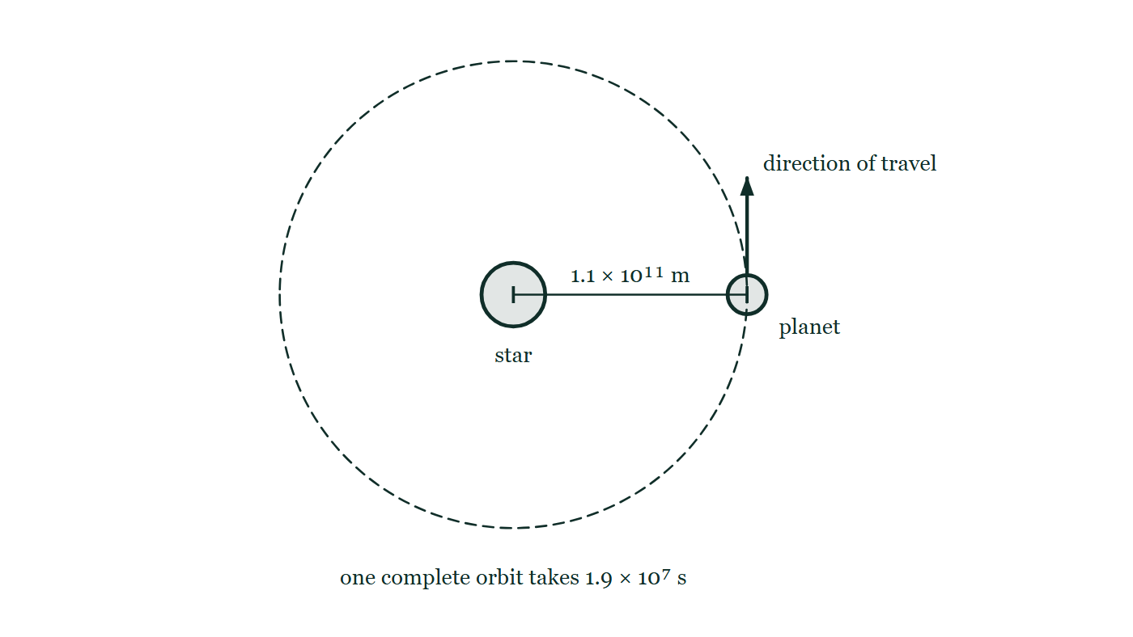
IGCSE · TOPIC 6 · SPACE PHYSICS
GIOPHYSICS PRACTICE PAPER
Question 3
Multiple choice
Supp.
Routine
1 mark
Syllabus 6.1 · AO2
A planet orbits its star in a nearly circular path of radius 1.1 × 10¹¹ m, taking 1.9 × 10⁷ s to complete one orbit. What is its average orbital speed?
Fig. 3.1 — A planet moving on a nearly circular orbit around its star. The star is a disc at the centre of a dashed circle and the planet is a smaller disc on that circle, level with the star and to its right. The distance from the centre of the star out to the planet is marked 1.1 × 10¹¹ m, an arrow at the planet points along the orbit to show the direction in which it travels, and a note beneath states that one complete orbit takes 1.9 × 10⁷ s.
A
5.8 × 10³ m/s
B
1.8 × 10⁴ m/s
C
3.6 × 10⁴ m/s
D
5.8 × 10⁴ m/s
Cambridge IGCSE Physics — Topic 6 · Space physics. Written by GioPhysics from Cambridge IGCSE Physics 0625 syllabus; not an awarding body's document.
6 / 24
Notes:
[Demand] Routine — The standard application — the named equation, the usual graph read.
[Figure] Fig. 3.1. A planet moving on a nearly circular orbit around its star. The star is a disc at the centre of a dashed circle and the planet is a smaller disc on that circle, level with the star and to its right. The distance from the centre of the star out to the planet is marked 1.1 × 10¹¹ m, an arrow at the planet points along the orbit to show the direction in which it travels, and a note beneath states that one complete orbit takes 1.9 × 10⁷ s.

Slide 7
IGCSE · TOPIC 6 · SPACE PHYSICS
GIOPHYSICS PRACTICE PAPER
Answer 3
Multiple choice
Supp.
Routine
1 mark
Mark scheme
C
3.6 × 10⁴ m/s
Why the other three are there
A divides the radius by the time and forgets the circumference entirely. B uses πr rather than 2πr, which is the commonest slip once the candidate has remembered that a circumference is involved.
Cambridge IGCSE Physics — Topic 6 · Space physics. Written by GioPhysics from Cambridge IGCSE Physics 0625 syllabus; not an awarding body's document.
7 / 24
Notes:
[Answer] C — 3.6 × 10⁴ m/s
[Distractors] A divides the radius by the time and forgets the circumference entirely. B uses πr rather than 2πr, which is the commonest slip once the candidate has remembered that a circumference is involved.
[Figure] Fig. 3.1. A planet moving on a nearly circular orbit around its star. The star is a disc at the centre of a dashed circle and the planet is a smaller disc on that circle, level with the star and to its right. The distance from the centre of the star out to the planet is marked 1.1 × 10¹¹ m, an arrow at the planet points along the orbit to show the direction in which it travels, and a note beneath states that one complete orbit takes 1.9 × 10⁷ s.

Slide 8
IGCSE · TOPIC 6 · SPACE PHYSICS
GIOPHYSICS PRACTICE PAPER
Question 4
Multiple choice
Core
Recall
1 mark
Syllabus 6.2 · AO1
What is a light-year?
A
the time taken for light to travel across the Milky Way
B
the distance travelled by light in one year
C
the time taken for light from the Sun to reach the Earth
D
the age of the light emitted by a distant galaxy
Cambridge IGCSE Physics — Topic 6 · Space physics. Written by GioPhysics from Cambridge IGCSE Physics 0625 syllabus; not an awarding body's document.
8 / 24
Notes:
[Demand] Recall — One idea, one step. The mark is for knowing it.

Slide 9
IGCSE · TOPIC 6 · SPACE PHYSICS
GIOPHYSICS PRACTICE PAPER
Answer 4
Multiple choice
Core
Recall
1 mark
Mark scheme
B
the distance travelled by light in one year
Why the other three are there
A, C and D are all times. The name misleads, which is why this item appears on real papers so often: a light-year is a distance.
Cambridge IGCSE Physics — Topic 6 · Space physics. Written by GioPhysics from Cambridge IGCSE Physics 0625 syllabus; not an awarding body's document.
9 / 24
Notes:
[Answer] B — the distance travelled by light in one year
[Distractors] A, C and D are all times. The name misleads, which is why this item appears on real papers so often: a light-year is a distance.

Slide 10
IGCSE · TOPIC 6 · SPACE PHYSICS
GIOPHYSICS PRACTICE PAPER
Question 5
Multiple choice
Core
Recall
1 mark
Syllabus 6.2 · AO1
A star with a mass much greater than that of the Sun reaches the end of its life. Which sequence of stages is correct?
A
red giant → planetary nebula → white dwarf
B
red supergiant → supernova → neutron star or black hole
C
white dwarf → supernova → red supergiant
D
protostar → white dwarf → black hole
Cambridge IGCSE Physics — Topic 6 · Space physics. Written by GioPhysics from Cambridge IGCSE Physics 0625 syllabus; not an awarding body's document.
10 / 24
Notes:
[Demand] Recall — One idea, one step. The mark is for knowing it.

Slide 11
IGCSE · TOPIC 6 · SPACE PHYSICS
GIOPHYSICS PRACTICE PAPER
Answer 5
Multiple choice
Core
Recall
1 mark
Mark scheme
B
red supergiant → supernova → neutron star or black hole
Why the other three are there
A is the route for a star of about the Sun's mass, and is the answer of a candidate who has learned one life cycle rather than two.
Cambridge IGCSE Physics — Topic 6 · Space physics. Written by GioPhysics from Cambridge IGCSE Physics 0625 syllabus; not an awarding body's document.
11 / 24
Notes:
[Answer] B — red supergiant → supernova → neutron star or black hole
[Distractors] A is the route for a star of about the Sun's mass, and is the answer of a candidate who has learned one life cycle rather than two.

Slide 12
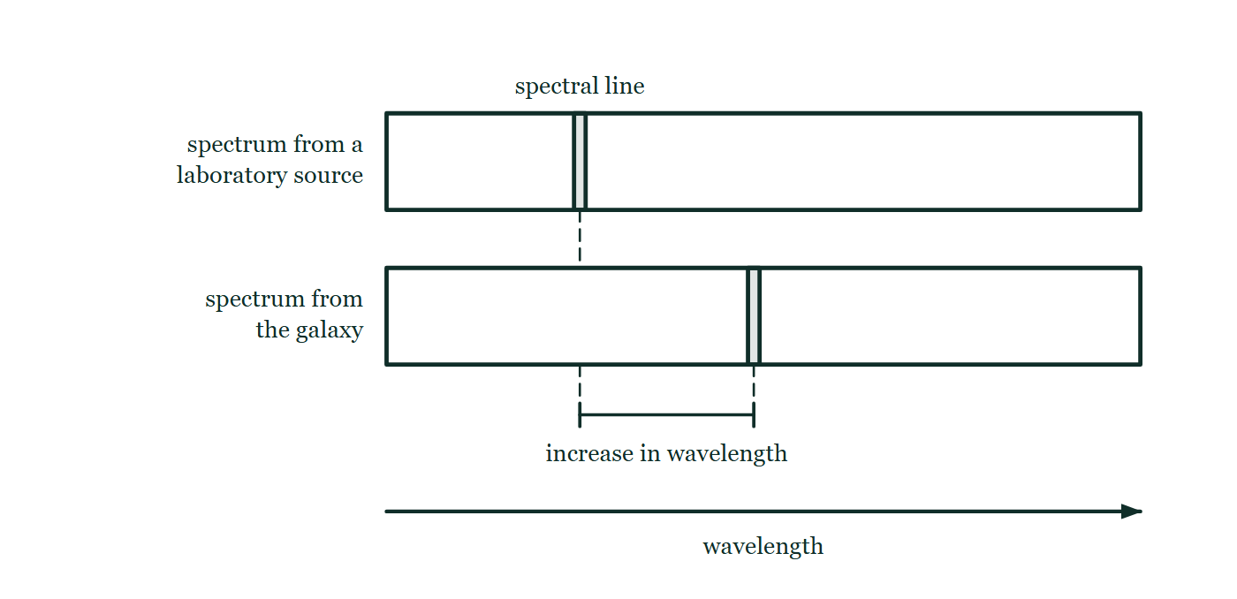
IGCSE · TOPIC 6 · SPACE PHYSICS
GIOPHYSICS PRACTICE PAPER
Question 6
Multiple choice
Supp.
Demanding
1 mark
Syllabus 6.2 · AO2
Light from a distant galaxy shows a spectral line at a wavelength longer than the wavelength of the same line measured in a laboratory on Earth. What does this show?
Fig. 6.1 — Two spectra drawn one above the other against a common horizontal wavelength scale that increases to the right. The upper strip is the spectrum of a source in the laboratory on Earth, with one spectral line marked in it. The lower strip is the spectrum of light received from the distant galaxy, in which the same line appears further to the right. A dashed line dropped from each line marks its position on the scale, and the gap between the two positions is labelled as the increase in wavelength.
A
The galaxy is moving towards the Earth.
B
The galaxy is moving away from the Earth.
C
The galaxy is hotter than the laboratory source.
D
Light slows down as it travels across space.
Cambridge IGCSE Physics — Topic 6 · Space physics. Written by GioPhysics from Cambridge IGCSE Physics 0625 syllabus; not an awarding body's document.
12 / 24
Notes:
[Demand] Demanding — Several steps, and you have to choose them. Nothing says which comes first.
[Figure] Fig. 6.1. Two spectra drawn one above the other against a common horizontal wavelength scale that increases to the right. The upper strip is the spectrum of a source in the laboratory on Earth, with one spectral line marked in it. The lower strip is the spectrum of light received from the distant galaxy, in which the same line appears further to the right. A dashed line dropped from each line marks its position on the scale, and the gap between the two positions is labelled as the increase in wavelength.

Slide 13
IGCSE · TOPIC 6 · SPACE PHYSICS
GIOPHYSICS PRACTICE PAPER
Answer 6
Multiple choice
Supp.
Demanding
1 mark
Mark scheme
B
The galaxy is moving away from the Earth.
Why the other three are there
A is the answer of a candidate who knows the term redshift but not which way it runs. D contradicts the constancy of the speed of light in a vacuum, on which the whole method depends.
Cambridge IGCSE Physics — Topic 6 · Space physics. Written by GioPhysics from Cambridge IGCSE Physics 0625 syllabus; not an awarding body's document.
13 / 24
Notes:
[Answer] B — The galaxy is moving away from the Earth.
[Distractors] A is the answer of a candidate who knows the term redshift but not which way it runs. D contradicts the constancy of the speed of light in a vacuum, on which the whole method depends.
[Figure] Fig. 6.1. Two spectra drawn one above the other against a common horizontal wavelength scale that increases to the right. The upper strip is the spectrum of a source in the laboratory on Earth, with one spectral line marked in it. The lower strip is the spectrum of light received from the distant galaxy, in which the same line appears further to the right. A dashed line dropped from each line marks its position on the scale, and the gap between the two positions is labelled as the increase in wavelength.

Slide 14
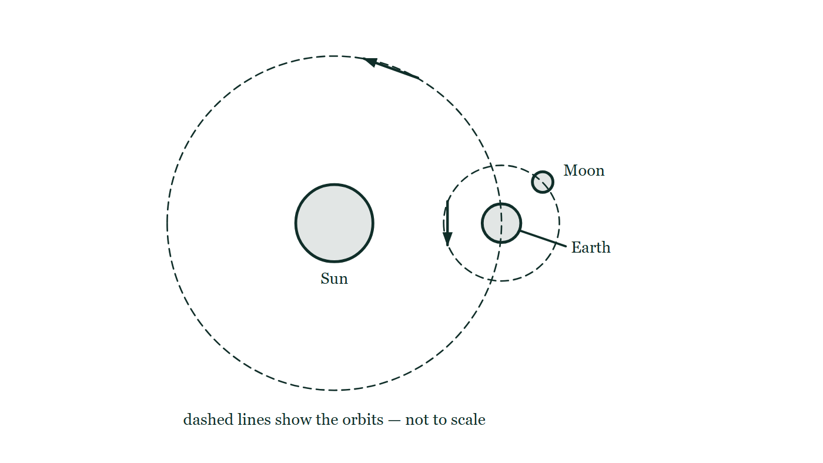
IGCSE · TOPIC 6 · SPACE PHYSICS
GIOPHYSICS PRACTICE PAPER
Question 7
Structured
Core
Routine
6 marks
Syllabus 6.1
The Earth spins on its own axis and also orbits the Sun. The Moon orbits the Earth, taking about one month to complete an orbit.
Fig. 7.1 — A not-to-scale plan view of the Sun, the Earth and the Moon. The Sun is a disc at the centre of a large dashed circle, and the Earth is a smaller disc sitting on that circle to the right of the Sun. A second, much smaller dashed circle is drawn around the Earth with the Moon on it, up and to the right of the Earth. A short arrow on each dashed circle shows the direction in which the Earth travels around the Sun and the Moon around the Earth.
(a) State
2 marks
State the approximate time taken for one rotation of the Earth on its axis, and for one orbit of the Earth around the Sun.
(b) Explain
2 marks
Explain why the Moon can be seen from Earth even though it produces no light of its own.
(c) Explain
2 marks
The Sun is much further from the Earth than the Moon is, yet the Sun and the Moon appear almost the same size in the sky. Explain how this is possible.
Cambridge IGCSE Physics — Topic 6 · Space physics. Written by GioPhysics from Cambridge IGCSE Physics 0625 syllabus; not an awarding body's document.
14 / 24
Notes:
[Demand] Routine — The standard application — the named equation, the usual graph read.
[Figure] Fig. 7.1. A not-to-scale plan view of the Sun, the Earth and the Moon. The Sun is a disc at the centre of a large dashed circle, and the Earth is a smaller disc sitting on that circle to the right of the Sun. A second, much smaller dashed circle is drawn around the Earth with the Moon on it, up and to the right of the Earth. A short arrow on each dashed circle shows the direction in which the Earth travels around the Sun and the Moon around the Earth.

Slide 15
IGCSE · TOPIC 6 · SPACE PHYSICS
GIOPHYSICS PRACTICE PAPER
Answer 7
Structured
Core
Routine
6 marks
Mark scheme
(a) State — 2 marks
AO1
✓
rotation: 24 hours (1 day)
✓
orbit: 365 days (1 year)
(b) Explain — 2 marks
AO1
✓
light from the Sun falls on the Moon
✓
and is reflected from the Moon's surface to the Earth
(c) Explain — 2 marks
AO2
✓
the Sun's diameter is very much larger than the Moon's — about 400 times larger
✓
and the Sun is about 400 times further away, so the two subtend almost the same angle at the Earth
Cambridge IGCSE Physics — Topic 6 · Space physics. Written by GioPhysics from Cambridge IGCSE Physics 0625 syllabus; not an awarding body's document.
15 / 24
Notes:
[Marking] One line per mark, awarded independently unless a point says otherwise.
[Figure] Fig. 7.1. A not-to-scale plan view of the Sun, the Earth and the Moon. The Sun is a disc at the centre of a large dashed circle, and the Earth is a smaller disc sitting on that circle to the right of the Sun. A second, much smaller dashed circle is drawn around the Earth with the Moon on it, up and to the right of the Earth. A short arrow on each dashed circle shows the direction in which the Earth travels around the Sun and the Moon around the Earth.

Slide 16
IGCSE · TOPIC 6 · SPACE PHYSICS
GIOPHYSICS PRACTICE PAPER
Question 8
Structured
Supp.
Demanding
7 marks
Syllabus 6.1
The table gives the orbital radius and the orbital period of four planets in the Solar System.
planet | orbital radius / 10¹¹ m | orbital period / 10⁷ s
Earth | 1.50 | 3.16
Mars | 2.28 | 5.94
Jupiter | 7.78 | 37.4
Saturn | 14.3 | 92.9
(a) Calculate
3 marks
Calculate the average orbital speed of Jupiter.
(b) Determine
2 marks
Without further calculation, determine whether Saturn's orbital speed is greater or smaller than Jupiter's, and justify your answer using the table.
(c) Explain
2 marks
Explain, in terms of gravitational field strength, why planets further from the Sun move more slowly.
Cambridge IGCSE Physics — Topic 6 · Space physics. Written by GioPhysics from Cambridge IGCSE Physics 0625 syllabus; not an awarding body's document.
16 / 24
Notes:
[Demand] Demanding — Several steps, and you have to choose them. Nothing says which comes first.

Slide 17
IGCSE · TOPIC 6 · SPACE PHYSICS
GIOPHYSICS PRACTICE PAPER
Answer 8
Structured
Supp.
Demanding
7 marks
Mark scheme
(a) Calculate — 3 marks
AO2
✓
v = 2πr / T
✓
v = 2π × 7.78 × 10¹¹ / 37.4 × 10⁷
✓
v = 1.31 × 10⁴ m/s
(b) Determine — 2 marks
AO2
✓
Saturn's radius is about 1.8 times Jupiter's, but its period is about 2.5 times Jupiter's
✓
the period grows by the larger factor, so 2πr/T is smaller — Saturn moves more slowly
(c) Explain — 2 marks
AO1
✓
the Sun's gravitational field strength decreases with distance from the Sun
✓
so a more distant planet is held by a weaker force and a smaller speed is enough to maintain its orbit
Cambridge IGCSE Physics — Topic 6 · Space physics. Written by GioPhysics from Cambridge IGCSE Physics 0625 syllabus; not an awarding body's document.
17 / 24
Notes:
[Marking] One line per mark, awarded independently unless a point says otherwise.

Slide 18
IGCSE · TOPIC 6 · SPACE PHYSICS
GIOPHYSICS PRACTICE PAPER
Question 9
Structured
Supp.
Demanding
8 marks
Syllabus 6.2
A star forms from a cloud of dust and gas that is pulled together by gravitational attraction. The Sun is a stable star roughly halfway through its life.
(a) Explain
2 marks
Explain why the Sun is stable at present, in terms of the forces acting within it.
(b) Describe
3 marks
Describe the process by which energy is released in the core of the Sun.
(c) Describe
3 marks
Describe what will happen to the Sun once the hydrogen in its core has been used up.
Cambridge IGCSE Physics — Topic 6 · Space physics. Written by GioPhysics from Cambridge IGCSE Physics 0625 syllabus; not an awarding body's document.
18 / 24
Notes:
[Demand] Demanding — Several steps, and you have to choose them. Nothing says which comes first.

Slide 19
IGCSE · TOPIC 6 · SPACE PHYSICS
GIOPHYSICS PRACTICE PAPER
Answer 9
Structured
Supp.
Demanding
8 marks
Mark scheme
(a) Explain — 2 marks
AO1
✓
the inward gravitational attraction of the Sun's own mass
✓
is balanced by the outward pressure produced by the energy released in the core, so the Sun neither collapses nor expands
(b) Describe — 3 marks
AO1
✓
hydrogen nuclei fuse together at the very high temperature and pressure of the core
✓
forming helium nuclei
✓
the mass of the products is slightly less than that of the reactants, and the difference is released as energy
(c) Describe — 3 marks
AO1
✓
the core contracts and the outer layers expand — the Sun becomes a red giant
✓
helium and heavier nuclei fuse in the core, up to the mass of iron
✓
the outer layers are then thrown off as a planetary nebula, leaving the hot dense core as a white dwarf
Cambridge IGCSE Physics — Topic 6 · Space physics. Written by GioPhysics from Cambridge IGCSE Physics 0625 syllabus; not an awarding body's document.
19 / 24
Notes:
[Marking] One line per mark, awarded independently unless a point says otherwise.

Slide 20
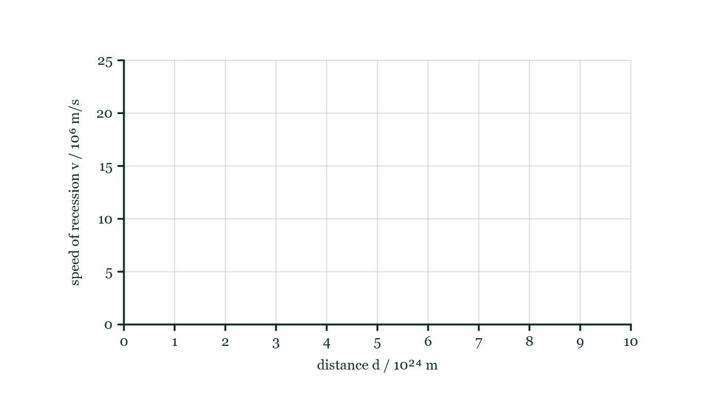
IGCSE · TOPIC 6 · SPACE PHYSICS
GIOPHYSICS PRACTICE PAPER
Question 10
Data analysis
Supp.
Discriminating
12 marks
Syllabus 6.2
Astronomers measure the speed at which distant galaxies are moving away from the Earth and the distance to each galaxy. The table gives values for four galaxies.
galaxy | distance d / 10²⁴ m | speed of recession v / 10⁶ m/s
P | 1.2 | 2.6
Q | 3.5 | 7.7
R | 6.0 | 13.2
S | 9.4 | 20.7
Fig. 10.1 — An empty graph grid on which the readings in the table can be plotted. The horizontal axis is labelled distance d / 10²⁴ m and runs from 0 to 10 with a numbered gridline at every unit; the vertical axis is labelled speed of recession v / 10⁶ m/s and runs from 0 to 25 with a numbered gridline every 5. No points are plotted on the grid.
Cambridge IGCSE Physics — Topic 6 · Space physics. Written by GioPhysics from Cambridge IGCSE Physics 0625 syllabus; not an awarding body's document.
20 / 24
Notes:
[Demand] Discriminating — The part that separates the top grade: an unfamiliar context, a derivation, or an argument that has to hold together to earn anything.
[Figure] Fig. 10.1. An empty graph grid on which the readings in the table can be plotted. The horizontal axis is labelled distance d / 10²⁴ m and runs from 0 to 10 with a numbered gridline at every unit; the vertical axis is labelled speed of recession v / 10⁶ m/s and runs from 0 to 25 with a numbered gridline every 5. No points are plotted on the grid.

Slide 21
IGCSE · TOPIC 6 · SPACE PHYSICS
GIOPHYSICS PRACTICE PAPER
Question 10 (cont.)
Data analysis
Supp.
Discriminating
12 marks
continued from the previous slide
(a) Describe
2 marks
Describe the relationship between the speed of recession and the distance shown by the table.
(b) Determine
3 marks
Determine a value for the Hubble constant H₀ from these data, and give its unit.
(c) Estimate
2 marks
Use your value of H₀ to estimate the age of the Universe. Give your answer in seconds.
(d) Explain
3 marks
Explain how the relationship in (a) supports the idea that the Universe began with the Big Bang.
(e) Suggest
2 marks
The astronomers measured only four galaxies. Suggest two reasons why a value of H₀ obtained this way is less reliable than one obtained from several hundred galaxies.
Cambridge IGCSE Physics — Topic 6 · Space physics. Written by GioPhysics from Cambridge IGCSE Physics 0625 syllabus; not an awarding body's document.
21 / 24
Notes:
[Demand] Discriminating — The part that separates the top grade: an unfamiliar context, a derivation, or an argument that has to hold together to earn anything.
[Figure] Fig. 10.1. An empty graph grid on which the readings in the table can be plotted. The horizontal axis is labelled distance d / 10²⁴ m and runs from 0 to 10 with a numbered gridline at every unit; the vertical axis is labelled speed of recession v / 10⁶ m/s and runs from 0 to 25 with a numbered gridline every 5. No points are plotted on the grid.
[Reminder] Fig. 10.1 is on the previous slide.

Slide 22
IGCSE · TOPIC 6 · SPACE PHYSICS
GIOPHYSICS PRACTICE PAPER
Answer 10
Data analysis
Supp.
Discriminating
12 marks
Mark scheme
(a) Describe — 2 marks
AO2
✓
the speed of recession increases as the distance increases
✓
and the increase is proportional — v/d is the same for all four galaxies
(b) Determine — 3 marks
AO2
✓
H₀ = v / d
✓
using galaxy S: H₀ = 20.7 × 10⁶ / 9.4 × 10²⁴
✓
H₀ = 2.2 × 10⁻¹⁸, unit s⁻¹ (per second)
Working from a single well-separated point, or from the gradient of a v–d graph, both earn full marks. Taking the mean of the four ratios is also accepted.
(c) Estimate — 2 marks
AO2
✓
age ≈ 1 / H₀
✓
age ≈ 1 / 2.2 × 10⁻¹⁸ = 4.5 × 10¹⁷ s
(d) Explain — 3 marks
AO2
✓
every distant galaxy is moving away from us, and the further away it is the faster it recedes, so the Universe is expanding
✓
tracing the motion backwards, all the galaxies were once much closer together
✓
so the expansion began from a single point at a definite time in the past
The last mark is the one that closes the argument. Candidates who describe the expansion but never run it backwards have given evidence for expansion, not for a beginning.
Cambridge IGCSE Physics — Topic 6 · Space physics. Written by GioPhysics from Cambridge IGCSE Physics 0625 syllabus; not an awarding body's document.
22 / 24
Notes:
[Marking] One line per mark, awarded independently unless a point says otherwise.
[Examiner note (b)] Working from a single well-separated point, or from the gradient of a v–d graph, both earn full marks. Taking the mean of the four ratios is also accepted.
[Examiner note (d)] The last mark is the one that closes the argument. Candidates who describe the expansion but never run it backwards have given evidence for expansion, not for a beginning.
[Examiner note (e)] The only place on this paper where the marks are for judging data rather than using it — which is what Topic 6 offers in place of a practical, since space physics is not examined on Paper 5 or Paper 6.
[Figure] Fig. 10.1. An empty graph grid on which the readings in the table can be plotted. The horizontal axis is labelled distance d / 10²⁴ m and runs from 0 to 10 with a numbered gridline at every unit; the vertical axis is labelled speed of recession v / 10⁶ m/s and runs from 0 to 25 with a numbered gridline every 5. No points are plotted on the grid.

Slide 23
IGCSE · TOPIC 6 · SPACE PHYSICS
GIOPHYSICS PRACTICE PAPER
Answer 10 (cont.)
Data analysis
Supp.
Discriminating
12 marks
Mark scheme, continued
(e) Suggest — 2 marks
AO3
✓
the distance to a galaxy is very difficult to measure and carries a large uncertainty, so a value from four galaxies depends heavily on whether those four happen to be well measured
✓
galaxies also have their own motion within their local cluster on top of the expansion, and averaging over many galaxies is what reduces that additional scatter
The only place on this paper where the marks are for judging data rather than using it — which is what Topic 6 offers in place of a practical, since space physics is not examined on Paper 5 or Paper 6.
Cambridge IGCSE Physics — Topic 6 · Space physics. Written by GioPhysics from Cambridge IGCSE Physics 0625 syllabus; not an awarding body's document.
23 / 24
Notes:
[Marking] One line per mark, awarded independently unless a point says otherwise.
[Examiner note (b)] Working from a single well-separated point, or from the gradient of a v–d graph, both earn full marks. Taking the mean of the four ratios is also accepted.
[Examiner note (d)] The last mark is the one that closes the argument. Candidates who describe the expansion but never run it backwards have given evidence for expansion, not for a beginning.
[Examiner note (e)] The only place on this paper where the marks are for judging data rather than using it — which is what Topic 6 offers in place of a practical, since space physics is not examined on Paper 5 or Paper 6.
[Figure] Fig. 10.1. An empty graph grid on which the readings in the table can be plotted. The horizontal axis is labelled distance d / 10²⁴ m and runs from 0 to 10 with a numbered gridline at every unit; the vertical axis is labelled speed of recession v / 10⁶ m/s and runs from 0 to 25 with a numbered gridline every 5. No points are plotted on the grid.

Slide 24
IGCSE · TOPIC 6 · SPACE PHYSICS
GIOPHYSICS PRACTICE PAPER
Command words
Cambridge IGCSE Physics — the board's own definitions
Calculate
Show (that)
Work out from given facts, figures or information.
Provide structured evidence that leads to a given result.
Define
State
Give the precise meaning.
Express in clear terms.
Describe
Suggest
State the points of a topic; give characteristics and main features.
Apply knowledge and understanding to situations where there is a range of valid responses in order to make proposals.
Determine
Establish an answer using the information available.
Estimate
Suggest an approximate value.
Explain
Set out purposes or reasons; make relationships evident; give why and/or how.
Give
Produce an answer from a given source or recall.
Identify
Name, select or recognise.
Cambridge IGCSE Physics — Topic 6 · Space physics. Written by GioPhysics from Cambridge IGCSE Physics 0625 syllabus; not an awarding body's document.
24 / 24
Notes:
[Objectives] AO1 Knowledge with understanding (50%): Recall, describe, explain and use physics ideas, terminology, instruments and conventions. AO2 Handling information and problem-solving (30%): Locate and interpret information, translate between forms, calculate, reason, and apply physics to unfamiliar situations. AO3 Experimental skills and investigations (20%): Plan, use apparatus, record and present observations, analyse, evaluate, and suggest improvements.
[Source] Cambridge IGCSE Physics 0625 syllabus — https://www.cambridgeinternational.org/Images/697209-2026-2028-syllabus.pdf
[Disclaimer] Written by GioPhysics from the published syllabus. These are practice papers in the style of Cambridge IGCSE Physics 0625; they are not Cambridge papers, contain no past-paper questions, and the official syllabus and specimen materials remain the authority.

