Slide 1
IGCSE · TOPIC 2 · THERMAL PHYSICS
GIOPHYSICS PRACTICE PAPER
IGCSE · Physics 0625 · for examination in 2026, 2027 and 2028
Topic 2 · Thermal physics
The kinetic particle model and what it explains: gas pressure, thermal expansion, specific heat capacity, change of state, and the three ways energy moves.
MIRRORS
Papers 1 and 2 (multiple choice), Papers 3 and 4 (theory), Paper 6 (alternative to practical)
MARKS
38 in total — Core route 13, Supp. adds 25
TIME
45 minutes · 10 questions
DEMAND
Recall 1 · Routine 4 · Demanding 4 · Discriminating 1
SYLLABUS
2.1, 2.2, 2.3
Written by GioPhysics from the published syllabus. These are practice papers in the style of Cambridge IGCSE Physics 0625; they are not Cambridge papers, contain no past-paper questions, and the official syllabus and specimen materials remain the authority.
Cambridge IGCSE Physics — Topic 2 · Thermal physics. Written by GioPhysics from Cambridge IGCSE Physics 0625 syllabus; not an awarding body's document.
1 / 24
Notes:
[Format] Every candidate sits two theory papers and one practical-skills paper. Core takes Papers 1 and 3 and is capped at grade C; Extended takes Papers 2 and 4 and reaches A*. Both then take either Paper 5 (practical test) or Paper 6 (alternative to practical), which carries 20% either way. Theory papers give you no formula sheet.
[Demand] Pitched at the board's own level, not above it. Multiple choice is mostly one step, with a couple of two-step items and one that rewards the candidate who does not take the obvious route. Structured questions open on a 1-mark recall and close on an explanation or a suggestion worth two marks — the marks real candidates most often drop.
[Source] Cambridge IGCSE Physics 0625 syllabus — https://www.cambridgeinternational.org/Images/697209-2026-2028-syllabus.pdf
[Disclaimer] Written by GioPhysics from the published syllabus. These are practice papers in the style of Cambridge IGCSE Physics 0625; they are not Cambridge papers, contain no past-paper questions, and the official syllabus and specimen materials remain the authority.

Slide 2
IGCSE · TOPIC 2 · THERMAL PHYSICS
GIOPHYSICS PRACTICE PAPER
Question 1
Multiple choice
Core
Recall
1 mark
Syllabus 2.1 · AO1
Which row describes the molecules of a gas?
 | separation | arrangement | motion
A | close together | regular | vibrating about fixed positions
B | close together | random | moving past one another
C | far apart | random | moving rapidly in all directions
D | far apart | regular | vibrating about fixed positions
A
close together · regular · vibrating about fixed positions
B
close together · random · moving past one another
C
far apart · random · moving rapidly in all directions
D
far apart · regular · vibrating about fixed positions
Cambridge IGCSE Physics — Topic 2 · Thermal physics. Written by GioPhysics from Cambridge IGCSE Physics 0625 syllabus; not an awarding body's document.
2 / 24
Notes:
[Demand] Recall — One idea, one step. The mark is for knowing it.

Slide 3
IGCSE · TOPIC 2 · THERMAL PHYSICS
GIOPHYSICS PRACTICE PAPER
Answer 1
Multiple choice
Core
Recall
1 mark
Mark scheme
C
far apart · random · moving rapidly in all directions
Why the other three are there
A is a solid — close together, regular, vibrating in place. B is a liquid: close together but disordered and able to move past one another. D is the trap, pairing a gas separation with solid motion, and it catches candidates who have learned that gas molecules are far apart without learning what they then do.
Cambridge IGCSE Physics — Topic 2 · Thermal physics. Written by GioPhysics from Cambridge IGCSE Physics 0625 syllabus; not an awarding body's document.
3 / 24
Notes:
[Answer] C — far apart · random · moving rapidly in all directions
[Distractors] A is a solid — close together, regular, vibrating in place. B is a liquid: close together but disordered and able to move past one another. D is the trap, pairing a gas separation with solid motion, and it catches candidates who have learned that gas molecules are far apart without learning what they then do.

Slide 4
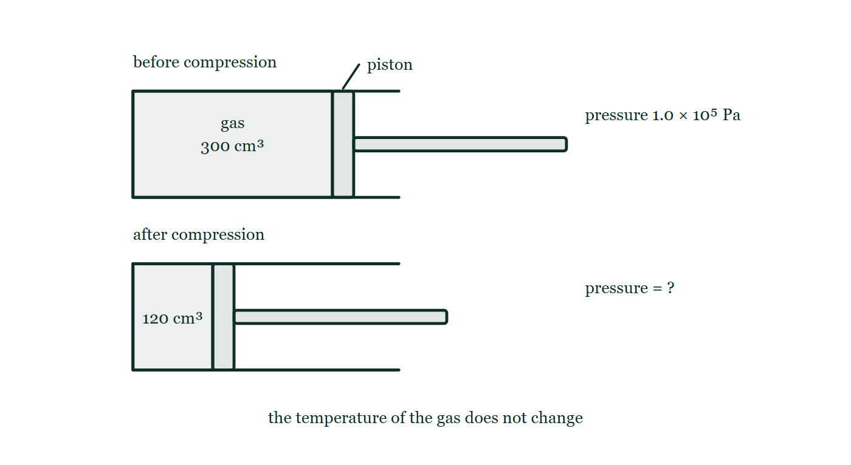
IGCSE · TOPIC 2 · THERMAL PHYSICS
GIOPHYSICS PRACTICE PAPER
Question 2
Multiple choice
Supp.
Routine
1 mark
Syllabus 2.1 · AO2
A fixed mass of gas has a volume of 300 cm³ at a pressure of 1.0 × 10⁵ Pa. The gas is compressed to a volume of 120 cm³ at constant temperature. What is the new pressure?
Fig. 2.1 — Two horizontal cylinders are drawn one above the other, each closed at the left-hand end and fitted with a piston on a rod that comes out through the open right-hand end. In the upper cylinder, labelled before compression, the trapped gas fills a column marked 300 cm³ and the pressure beside it is given as 1.0 × 10⁵ Pa. In the lower cylinder, labelled after compression, the piston has been pushed further in so that the gas column is marked 120 cm³, and the pressure beside it is left as a question mark. A note below states that the temperature of the gas does not change.
A
0.40 × 10⁵ Pa
B
1.2 × 10⁵ Pa
C
2.5 × 10⁵ Pa
D
3.6 × 10⁵ Pa
Cambridge IGCSE Physics — Topic 2 · Thermal physics. Written by GioPhysics from Cambridge IGCSE Physics 0625 syllabus; not an awarding body's document.
4 / 24
Notes:
[Demand] Routine — The standard application — the named equation, the usual graph read.
[Figure] Fig. 2.1. Two horizontal cylinders are drawn one above the other, each closed at the left-hand end and fitted with a piston on a rod that comes out through the open right-hand end. In the upper cylinder, labelled before compression, the trapped gas fills a column marked 300 cm³ and the pressure beside it is given as 1.0 × 10⁵ Pa. In the lower cylinder, labelled after compression, the piston has been pushed further in so that the gas column is marked 120 cm³, and the pressure beside it is left as a question mark. A note below states that the temperature of the gas does not change.

Slide 5
IGCSE · TOPIC 2 · THERMAL PHYSICS
GIOPHYSICS PRACTICE PAPER
Answer 2
Multiple choice
Supp.
Routine
1 mark
Mark scheme
C
2.5 × 10⁵ Pa
Why the other three are there
A applies the ratio the wrong way round — the answer must be larger, because squeezing a gas raises its pressure. D multiplies the volumes instead of taking their ratio.
Cambridge IGCSE Physics — Topic 2 · Thermal physics. Written by GioPhysics from Cambridge IGCSE Physics 0625 syllabus; not an awarding body's document.
5 / 24
Notes:
[Answer] C — 2.5 × 10⁵ Pa
[Distractors] A applies the ratio the wrong way round — the answer must be larger, because squeezing a gas raises its pressure. D multiplies the volumes instead of taking their ratio.
[Figure] Fig. 2.1. Two horizontal cylinders are drawn one above the other, each closed at the left-hand end and fitted with a piston on a rod that comes out through the open right-hand end. In the upper cylinder, labelled before compression, the trapped gas fills a column marked 300 cm³ and the pressure beside it is given as 1.0 × 10⁵ Pa. In the lower cylinder, labelled after compression, the piston has been pushed further in so that the gas column is marked 120 cm³, and the pressure beside it is left as a question mark. A note below states that the temperature of the gas does not change.

Slide 6
IGCSE · TOPIC 2 · THERMAL PHYSICS
GIOPHYSICS PRACTICE PAPER
Question 3
Multiple choice
Core
Routine
1 mark
Syllabus 2.2 · AO2
The specific heat capacity of water is 4200 J/(kg °C). How much energy is needed to raise the temperature of 2.0 kg of water by 15 °C?
A
560 J
B
8400 J
C
63 000 J
D
126 000 J
Cambridge IGCSE Physics — Topic 2 · Thermal physics. Written by GioPhysics from Cambridge IGCSE Physics 0625 syllabus; not an awarding body's document.
6 / 24
Notes:
[Demand] Routine — The standard application — the named equation, the usual graph read.

Slide 7
IGCSE · TOPIC 2 · THERMAL PHYSICS
GIOPHYSICS PRACTICE PAPER
Answer 3
Multiple choice
Core
Routine
1 mark
Mark scheme
D
126 000 J
Why the other three are there
C forgets the mass. B forgets the temperature rise. A divides where the candidate should multiply.
Cambridge IGCSE Physics — Topic 2 · Thermal physics. Written by GioPhysics from Cambridge IGCSE Physics 0625 syllabus; not an awarding body's document.
7 / 24
Notes:
[Answer] D — 126 000 J
[Distractors] C forgets the mass. B forgets the temperature rise. A divides where the candidate should multiply.

Slide 8
IGCSE · TOPIC 2 · THERMAL PHYSICS
GIOPHYSICS PRACTICE PAPER
Question 4
Multiple choice
Core
Demanding
1 mark
Syllabus 2.2 · AO1
Which statement about evaporation is correct?
A
It happens throughout the liquid, at one fixed temperature.
B
It happens only at the surface, at any temperature below the boiling point.
C
It raises the temperature of the liquid that is left behind.
D
It happens faster when the air above the liquid is still and humid.
Cambridge IGCSE Physics — Topic 2 · Thermal physics. Written by GioPhysics from Cambridge IGCSE Physics 0625 syllabus; not an awarding body's document.
8 / 24
Notes:
[Demand] Demanding — Several steps, and you have to choose them. Nothing says which comes first.

Slide 9
IGCSE · TOPIC 2 · THERMAL PHYSICS
GIOPHYSICS PRACTICE PAPER
Answer 4
Multiple choice
Core
Demanding
1 mark
Mark scheme
B
It happens only at the surface, at any temperature below the boiling point.
Why the other three are there
A describes boiling, which is the distinction the item is set on. C reverses the cooling effect — the fastest molecules leave, so the mean energy of those remaining falls. D reverses the effect of a draught.
Cambridge IGCSE Physics — Topic 2 · Thermal physics. Written by GioPhysics from Cambridge IGCSE Physics 0625 syllabus; not an awarding body's document.
9 / 24
Notes:
[Answer] B — It happens only at the surface, at any temperature below the boiling point.
[Distractors] A describes boiling, which is the distinction the item is set on. C reverses the cooling effect — the fastest molecules leave, so the mean energy of those remaining falls. D reverses the effect of a draught.

Slide 10
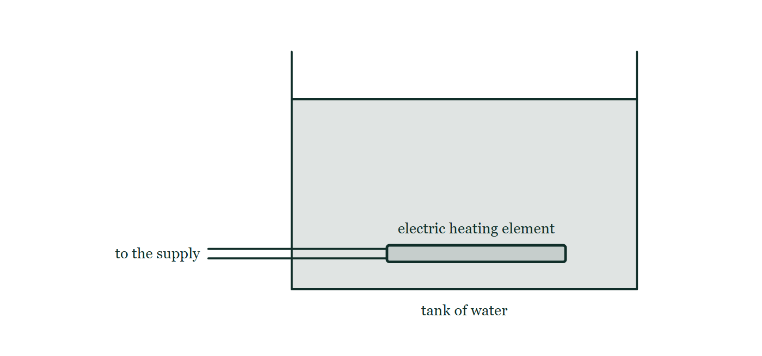
IGCSE · TOPIC 2 · THERMAL PHYSICS
GIOPHYSICS PRACTICE PAPER
Question 5
Multiple choice
Core
Routine
1 mark
Syllabus 2.3 · AO1
An electric heating element is fitted at the bottom of a tank of water. Why is this the best position?
Fig. 5.1 — A rectangular open-topped tank holds water to about four-fifths of its depth. A flat electric heating element lies horizontally inside the tank, well below the water surface and a short distance above the tank floor, spanning about half the width of the tank. Two leads run from the left-hand end of the element out through the side wall of the tank to the electricity supply.
A
Water conducts thermal energy well downwards but not upwards.
B
Warm water is less dense, so it rises and a convection current circulates through the tank.
C
Thermal radiation travels upwards more easily than downwards.
D
The pressure is greatest at the bottom, so energy transfers faster there.
Cambridge IGCSE Physics — Topic 2 · Thermal physics. Written by GioPhysics from Cambridge IGCSE Physics 0625 syllabus; not an awarding body's document.
10 / 24
Notes:
[Demand] Routine — The standard application — the named equation, the usual graph read.
[Figure] Fig. 5.1. A rectangular open-topped tank holds water to about four-fifths of its depth. A flat electric heating element lies horizontally inside the tank, well below the water surface and a short distance above the tank floor, spanning about half the width of the tank. Two leads run from the left-hand end of the element out through the side wall of the tank to the electricity supply.

Slide 11
IGCSE · TOPIC 2 · THERMAL PHYSICS
GIOPHYSICS PRACTICE PAPER
Answer 5
Multiple choice
Core
Routine
1 mark
Mark scheme
B
Warm water is less dense, so it rises and a convection current circulates through the tank.
Why the other three are there
A is wrong twice over — water is a poor conductor and conduction has no preferred direction. D confuses pressure with energy transfer.
Cambridge IGCSE Physics — Topic 2 · Thermal physics. Written by GioPhysics from Cambridge IGCSE Physics 0625 syllabus; not an awarding body's document.
11 / 24
Notes:
[Answer] B — Warm water is less dense, so it rises and a convection current circulates through the tank.
[Distractors] A is wrong twice over — water is a poor conductor and conduction has no preferred direction. D confuses pressure with energy transfer.
[Figure] Fig. 5.1. A rectangular open-topped tank holds water to about four-fifths of its depth. A flat electric heating element lies horizontally inside the tank, well below the water surface and a short distance above the tank floor, spanning about half the width of the tank. Two leads run from the left-hand end of the element out through the side wall of the tank to the electricity supply.

Slide 12
IGCSE · TOPIC 2 · THERMAL PHYSICS
GIOPHYSICS PRACTICE PAPER
Question 6
Multiple choice
Core
Routine
1 mark
Syllabus 2.3 · AO2
Four identical cans are filled with water at 80 °C and left to cool in the same room. Which can cools fastest?
A
a can with a shiny silver surface
B
a can with a shiny white surface
C
a can with a dull black surface
D
all four cool at the same rate
Cambridge IGCSE Physics — Topic 2 · Thermal physics. Written by GioPhysics from Cambridge IGCSE Physics 0625 syllabus; not an awarding body's document.
12 / 24
Notes:
[Demand] Routine — The standard application — the named equation, the usual graph read.

Slide 13
IGCSE · TOPIC 2 · THERMAL PHYSICS
GIOPHYSICS PRACTICE PAPER
Answer 6
Multiple choice
Core
Routine
1 mark
Mark scheme
C
a can with a dull black surface
Why the other three are there
D tempts candidates who remember that the water and temperature are identical but forget that the surface controls the rate of emission. A dull black surface is the best emitter as well as the best absorber.
Cambridge IGCSE Physics — Topic 2 · Thermal physics. Written by GioPhysics from Cambridge IGCSE Physics 0625 syllabus; not an awarding body's document.
13 / 24
Notes:
[Answer] C — a can with a dull black surface
[Distractors] D tempts candidates who remember that the water and temperature are identical but forget that the surface controls the rate of emission. A dull black surface is the best emitter as well as the best absorber.

Slide 14
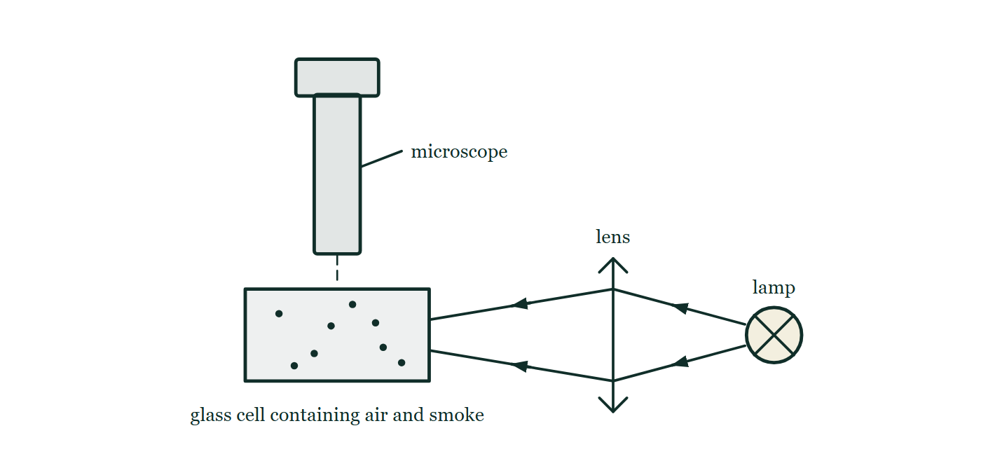
IGCSE · TOPIC 2 · THERMAL PHYSICS
GIOPHYSICS PRACTICE PAPER
Question 7
Structured
Supp.
Discriminating
8 marks
Syllabus 2.1
Smoke particles are placed in a small glass cell containing air and viewed through a microscope with a bright light shining from the side. The smoke particles are seen as tiny bright specks.
Fig. 7.1 — The apparatus is seen from the side. A small glass cell containing air and a scattering of smoke particles stands in the middle of the drawing. To the right, a lamp shines light through a converging lens, which brings the beam together inside the cell. Directly above the cell stands a microscope, its tube vertical and its lower end pointing straight down into the cell, so that the illuminated particles are viewed from above.
(a) Describe
2 marks
Describe what is seen when the smoke particles are observed through the microscope.
(b) Explain
3 marks
Explain this motion in terms of the molecules of the air.
(c) Explain
3 marks
The air in a sealed metal container is heated. The volume of the container does not change. Explain, in terms of molecules, why the pressure of the air increases.
Cambridge IGCSE Physics — Topic 2 · Thermal physics. Written by GioPhysics from Cambridge IGCSE Physics 0625 syllabus; not an awarding body's document.
14 / 24
Notes:
[Demand] Discriminating — The part that separates the top grade: an unfamiliar context, a derivation, or an argument that has to hold together to earn anything.
[Figure] Fig. 7.1. The apparatus is seen from the side. A small glass cell containing air and a scattering of smoke particles stands in the middle of the drawing. To the right, a lamp shines light through a converging lens, which brings the beam together inside the cell. Directly above the cell stands a microscope, its tube vertical and its lower end pointing straight down into the cell, so that the illuminated particles are viewed from above.

Slide 15
IGCSE · TOPIC 2 · THERMAL PHYSICS
GIOPHYSICS PRACTICE PAPER
Answer 7
Structured
Supp.
Discriminating
8 marks
Mark scheme
(a) Describe — 2 marks
AO1
✓
the bright specks move continuously
✓
in random directions / on jerky, unpredictable paths
(b) Explain — 3 marks
AO1
✓
the air molecules are in constant random motion and collide with the smoke particle
✓
the molecules are much smaller than the smoke particle but move much faster, so each collision transfers a noticeable momentum
✓
at any instant the collisions on one side outnumber those on the other, so the resultant force on the particle changes direction randomly
The mark most often lost is the second: candidates say the molecules "hit" the particle without saying why an object too small to see can move something visible.
(c) Explain — 3 marks
AO2
✓
heating increases the average kinetic energy, so the molecules move faster on average
✓
so they strike the walls more often
✓
and each collision produces a greater change of momentum, so the average force on unit area of the wall increases
Both reasons are needed. "They hit the walls harder" on its own is one mark; a candidate who also mentions frequency of collisions earns the second.
Cambridge IGCSE Physics — Topic 2 · Thermal physics. Written by GioPhysics from Cambridge IGCSE Physics 0625 syllabus; not an awarding body's document.
15 / 24
Notes:
[Marking] One line per mark, awarded independently unless a point says otherwise.
[Examiner note (b)] The mark most often lost is the second: candidates say the molecules "hit" the particle without saying why an object too small to see can move something visible.
[Examiner note (c)] Both reasons are needed. "They hit the walls harder" on its own is one mark; a candidate who also mentions frequency of collisions earns the second.
[Figure] Fig. 7.1. The apparatus is seen from the side. A small glass cell containing air and a scattering of smoke particles stands in the middle of the drawing. To the right, a lamp shines light through a converging lens, which brings the beam together inside the cell. Directly above the cell stands a microscope, its tube vertical and its lower end pointing straight down into the cell, so that the illuminated particles are viewed from above.

Slide 16
IGCSE · TOPIC 2 · THERMAL PHYSICS
GIOPHYSICS PRACTICE PAPER
Question 8
Structured
Supp.
Demanding
9 marks
Syllabus 2.2
A 2.0 kW electric kettle contains 0.50 kg of water at 20 °C. The specific heat capacity of water is 4200 J/(kg °C) and the specific latent heat of vaporisation of water is 2.3 × 10⁶ J/kg.
(a) Define
2 marks
Define specific latent heat of vaporisation.
(b) Calculate
2 marks
Calculate the energy needed to raise the water from 20 °C to its boiling point of 100 °C.
(c) Calculate
2 marks
Assuming no energy is transferred to the surroundings, calculate the time taken for the water to reach its boiling point.
(d) Determine
3 marks
The kettle is left switched on after the water boils. Determine the mass of water that boils away in the next 60 s.
Cambridge IGCSE Physics — Topic 2 · Thermal physics. Written by GioPhysics from Cambridge IGCSE Physics 0625 syllabus; not an awarding body's document.
16 / 24
Notes:
[Demand] Demanding — Several steps, and you have to choose them. Nothing says which comes first.

Slide 17
IGCSE · TOPIC 2 · THERMAL PHYSICS
GIOPHYSICS PRACTICE PAPER
Answer 8
Structured
Supp.
Demanding
9 marks
Mark scheme
(a) Define — 2 marks
AO1
✓
the energy required to change unit mass of a substance from liquid to gas
✓
without a change in temperature
The second half is the mark: no temperature change is what distinguishes latent from specific heat capacity.
(b) Calculate — 2 marks
AO2
✓
E = mcΔθ = 0.50 × 4200 × 80
✓
E = 168 000 J = 1.7 × 10⁵ J
(c) Calculate — 2 marks
AO2
✓
t = E / P = 168 000 / 2000
✓
t = 84 s
(d) Determine — 3 marks
AO2
✓
energy supplied = 2000 × 60 = 120 000 J
✓
m = E / L = 120 000 / 2.3 × 10⁶
✓
m = 0.052 kg (52 g)
Candidates who add an mcΔθ term here have not noticed that the water is already at 100 °C and stays there. That is the discrimination the part is built on.
Cambridge IGCSE Physics — Topic 2 · Thermal physics. Written by GioPhysics from Cambridge IGCSE Physics 0625 syllabus; not an awarding body's document.
17 / 24
Notes:
[Marking] One line per mark, awarded independently unless a point says otherwise.
[Examiner note (a)] The second half is the mark: no temperature change is what distinguishes latent from specific heat capacity.
[Examiner note (d)] Candidates who add an mcΔθ term here have not noticed that the water is already at 100 °C and stays there. That is the discrimination the part is built on.

Slide 18
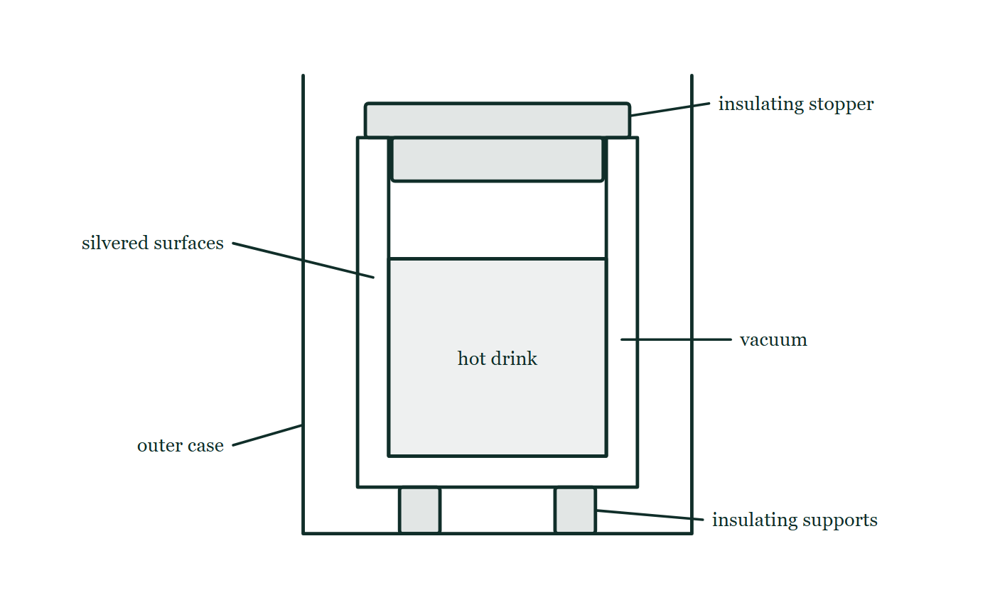
IGCSE · TOPIC 2 · THERMAL PHYSICS
GIOPHYSICS PRACTICE PAPER
Question 9
Structured
Supp.
Demanding
7 marks
Syllabus 2.3
A vacuum flask keeps a hot drink warm. It has a double-walled glass container with a vacuum between the walls, both facing surfaces of the glass are silvered, the flask has an insulating plastic stopper, and the glass container rests on soft insulating supports inside an outer case.
Fig. 9.1 — A cut-away view of a vacuum flask. Inside an outer case stands a double-walled glass container, sealed at the neck, with a narrow gap between the two walls that runs down both sides and under the base; the gap is labelled vacuum and the two facing glass surfaces are labelled silvered. Hot drink fills most of the inner container, an insulating stopper closes the neck at the top, and the glass container rests on small insulating supports standing on the floor of the outer case.
Cambridge IGCSE Physics — Topic 2 · Thermal physics. Written by GioPhysics from Cambridge IGCSE Physics 0625 syllabus; not an awarding body's document.
18 / 24
Notes:
[Demand] Demanding — Several steps, and you have to choose them. Nothing says which comes first.
[Figure] Fig. 9.1. A cut-away view of a vacuum flask. Inside an outer case stands a double-walled glass container, sealed at the neck, with a narrow gap between the two walls that runs down both sides and under the base; the gap is labelled vacuum and the two facing glass surfaces are labelled silvered. Hot drink fills most of the inner container, an insulating stopper closes the neck at the top, and the glass container rests on small insulating supports standing on the floor of the outer case.

Slide 19
IGCSE · TOPIC 2 · THERMAL PHYSICS
GIOPHYSICS PRACTICE PAPER
Question 9 (cont.)
Structured
Supp.
Demanding
7 marks
continued from the previous slide
(a) Explain
2 marks
Explain how the vacuum between the two walls reduces the transfer of thermal energy.
(b) Explain
2 marks
Explain why both facing surfaces of the glass are silvered.
(c) Explain
3 marks
Explain, in terms of the particles in a metal, why a metal spoon left in the drink becomes hot along its whole length far more quickly than a plastic one.
Cambridge IGCSE Physics — Topic 2 · Thermal physics. Written by GioPhysics from Cambridge IGCSE Physics 0625 syllabus; not an awarding body's document.
19 / 24
Notes:
[Demand] Demanding — Several steps, and you have to choose them. Nothing says which comes first.
[Figure] Fig. 9.1. A cut-away view of a vacuum flask. Inside an outer case stands a double-walled glass container, sealed at the neck, with a narrow gap between the two walls that runs down both sides and under the base; the gap is labelled vacuum and the two facing glass surfaces are labelled silvered. Hot drink fills most of the inner container, an insulating stopper closes the neck at the top, and the glass container rests on small insulating supports standing on the floor of the outer case.
[Reminder] Fig. 9.1 is on the previous slide.

Slide 20
IGCSE · TOPIC 2 · THERMAL PHYSICS
GIOPHYSICS PRACTICE PAPER
Answer 9
Structured
Supp.
Demanding
7 marks
Mark scheme
(a) Explain — 2 marks
AO1
✓
there are (almost) no molecules between the walls
✓
so energy cannot be transferred by conduction or convection, both of which need a medium
(b) Explain — 2 marks
AO1
✓
a shiny silvered surface is a poor emitter of infrared radiation, so the inner wall radiates less energy away
✓
and a shiny surface is a good reflector, so radiation crossing the gap is reflected back rather than absorbed
(c) Explain — 3 marks
AO1
✓
in both, particles at the hot end vibrate more and pass energy on by colliding with neighbouring particles
✓
a metal also contains free (delocalised) electrons
✓
these gain kinetic energy at the hot end, move rapidly through the metal, and transfer energy by collision far along the spoon, so conduction is much faster
The Supplement mark is the free-electron mechanism. A candidate who describes only vibrating particles has described the process that happens in plastic too, and has not answered the question asked.
Cambridge IGCSE Physics — Topic 2 · Thermal physics. Written by GioPhysics from Cambridge IGCSE Physics 0625 syllabus; not an awarding body's document.
20 / 24
Notes:
[Marking] One line per mark, awarded independently unless a point says otherwise.
[Examiner note (c)] The Supplement mark is the free-electron mechanism. A candidate who describes only vibrating particles has described the process that happens in plastic too, and has not answered the question asked.
[Figure] Fig. 9.1. A cut-away view of a vacuum flask. Inside an outer case stands a double-walled glass container, sealed at the neck, with a narrow gap between the two walls that runs down both sides and under the base; the gap is labelled vacuum and the two facing glass surfaces are labelled silvered. Hot drink fills most of the inner container, an insulating stopper closes the neck at the top, and the glass container rests on small insulating supports standing on the floor of the outer case.

Slide 21
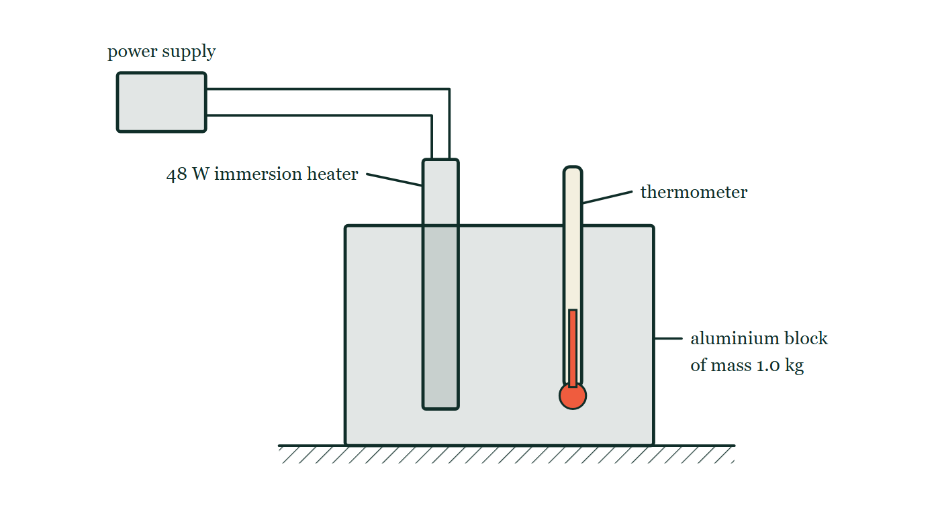
IGCSE · TOPIC 2 · THERMAL PHYSICS
GIOPHYSICS PRACTICE PAPER
Question 10
Practical skills
Core
Demanding
8 marks
Syllabus 2.2
A student determines the specific heat capacity of aluminium. She uses a 1.0 kg aluminium block with two narrow holes drilled in it, one holding a 48 W electric immersion heater and the other a thermometer. She switches on the heater and records the temperature every 2 minutes.
The student's results
time / minutes | 0 | 2 | 4 | 6 | 8
temperature / °C | 19.0 | 24.5 | 30.0 | 35.5 | 41.0
Fig. 10.1 — The apparatus is seen from the side. A rectangular aluminium block of mass 1.0 kg stands on the bench. A 48 W electric immersion heater is pushed down into a narrow hole drilled near one side of the block, and a thermometer is pushed down into a second narrow hole near the other side, its bulb reaching well inside the block. Two leads run from the top of the heater across to a power supply standing beside the apparatus.
Cambridge IGCSE Physics — Topic 2 · Thermal physics. Written by GioPhysics from Cambridge IGCSE Physics 0625 syllabus; not an awarding body's document.
21 / 24
Notes:
[Demand] Demanding — Several steps, and you have to choose them. Nothing says which comes first.
[Figure] Fig. 10.1. The apparatus is seen from the side. A rectangular aluminium block of mass 1.0 kg stands on the bench. A 48 W electric immersion heater is pushed down into a narrow hole drilled near one side of the block, and a thermometer is pushed down into a second narrow hole near the other side, its bulb reaching well inside the block. Two leads run from the top of the heater across to a power supply standing beside the apparatus.

Slide 22
IGCSE · TOPIC 2 · THERMAL PHYSICS
GIOPHYSICS PRACTICE PAPER
Question 10 (cont.)
Practical skills
Core
Demanding
8 marks
continued from the previous slide
(a) Determine
4 marks
Determine the temperature rise over the 8 minutes, and hence determine a value for the specific heat capacity of aluminium.
(b) Suggest
2 marks
The accepted value for the specific heat capacity of aluminium is 900 J/(kg °C). Suggest why the student's value is higher than this.
(c) Suggest
2 marks
Suggest two improvements to the student's method that would give a more accurate value.
Cambridge IGCSE Physics — Topic 2 · Thermal physics. Written by GioPhysics from Cambridge IGCSE Physics 0625 syllabus; not an awarding body's document.
22 / 24
Notes:
[Demand] Demanding — Several steps, and you have to choose them. Nothing says which comes first.
[Figure] Fig. 10.1. The apparatus is seen from the side. A rectangular aluminium block of mass 1.0 kg stands on the bench. A 48 W electric immersion heater is pushed down into a narrow hole drilled near one side of the block, and a thermometer is pushed down into a second narrow hole near the other side, its bulb reaching well inside the block. Two leads run from the top of the heater across to a power supply standing beside the apparatus.
[Reminder] Fig. 10.1 is on the previous slide.

Slide 23
IGCSE · TOPIC 2 · THERMAL PHYSICS
GIOPHYSICS PRACTICE PAPER
Answer 10
Practical skills
Core
Demanding
8 marks
Mark scheme
(a) Determine — 4 marks
AO2
✓
Δθ = 41.0 − 19.0 = 22.0 °C
✓
energy supplied E = Pt = 48 × 480 = 23 040 J
✓
c = E / (mΔθ) = 23 040 / (1.0 × 22.0)
✓
c = 1050 J/(kg °C) (accept 1000–1100)
Converting 8 minutes to 480 s is worth a mark on its own in the real mark scheme, and is the commonest single reason a candidate's answer is out by a factor of 60.
(b) Suggest — 2 marks
AO3
✓
thermal energy is transferred from the block to the surroundings, so not all of the 23 040 J raises the temperature of the block
✓
the measured Δθ is therefore smaller than it should be for that energy, making the calculated c too large
Two marks, and the second is the reasoning. Saying "heat was lost" identifies the cause but does not explain the direction of the error, which is what is being marked.
(c) Suggest — 2 marks
AO3
✓
lag the block with insulation / place it in an insulated container
✓
any one of: put oil in the holes to improve thermal contact; start below and finish above room temperature; take readings more frequently and plot a graph; use a datalogger
Cambridge IGCSE Physics — Topic 2 · Thermal physics. Written by GioPhysics from Cambridge IGCSE Physics 0625 syllabus; not an awarding body's document.
23 / 24
Notes:
[Marking] One line per mark, awarded independently unless a point says otherwise.
[Examiner note (a)] Converting 8 minutes to 480 s is worth a mark on its own in the real mark scheme, and is the commonest single reason a candidate's answer is out by a factor of 60.
[Examiner note (b)] Two marks, and the second is the reasoning. Saying "heat was lost" identifies the cause but does not explain the direction of the error, which is what is being marked.
[Figure] Fig. 10.1. The apparatus is seen from the side. A rectangular aluminium block of mass 1.0 kg stands on the bench. A 48 W electric immersion heater is pushed down into a narrow hole drilled near one side of the block, and a thermometer is pushed down into a second narrow hole near the other side, its bulb reaching well inside the block. Two leads run from the top of the heater across to a power supply standing beside the apparatus.

Slide 24
IGCSE · TOPIC 2 · THERMAL PHYSICS
GIOPHYSICS PRACTICE PAPER
Command words
Cambridge IGCSE Physics — the board's own definitions
Calculate
Show (that)
Work out from given facts, figures or information.
Provide structured evidence that leads to a given result.
Define
State
Give the precise meaning.
Express in clear terms.
Describe
Suggest
State the points of a topic; give characteristics and main features.
Apply knowledge and understanding to situations where there is a range of valid responses in order to make proposals.
Determine
Establish an answer using the information available.
Estimate
Suggest an approximate value.
Explain
Set out purposes or reasons; make relationships evident; give why and/or how.
Give
Produce an answer from a given source or recall.
Identify
Name, select or recognise.
Cambridge IGCSE Physics — Topic 2 · Thermal physics. Written by GioPhysics from Cambridge IGCSE Physics 0625 syllabus; not an awarding body's document.
24 / 24
Notes:
[Objectives] AO1 Knowledge with understanding (50%): Recall, describe, explain and use physics ideas, terminology, instruments and conventions. AO2 Handling information and problem-solving (30%): Locate and interpret information, translate between forms, calculate, reason, and apply physics to unfamiliar situations. AO3 Experimental skills and investigations (20%): Plan, use apparatus, record and present observations, analyse, evaluate, and suggest improvements.
[Source] Cambridge IGCSE Physics 0625 syllabus — https://www.cambridgeinternational.org/Images/697209-2026-2028-syllabus.pdf
[Disclaimer] Written by GioPhysics from the published syllabus. These are practice papers in the style of Cambridge IGCSE Physics 0625; they are not Cambridge papers, contain no past-paper questions, and the official syllabus and specimen materials remain the authority.

