Slide 1
IGCSE · TOPIC 3 · WAVES
GIOPHYSICS PRACTICE PAPER
IGCSE · Physics 0625 · for examination in 2026, 2027 and 2028
Topic 3 · Waves
General wave properties, reflection and refraction, thin lenses, dispersion, the electromagnetic spectrum, and sound.
MIRRORS
Papers 1 and 2 (multiple choice), Papers 3 and 4 (theory), Paper 6 (alternative to practical)
MARKS
38 in total — Core route 13, Supp. adds 25
TIME
45 minutes · 10 questions
DEMAND
Recall 3 · Routine 4 · Demanding 2 · Discriminating 1
SYLLABUS
3.1, 3.2, 3.3, 3.4
Written by GioPhysics from the published syllabus. These are practice papers in the style of Cambridge IGCSE Physics 0625; they are not Cambridge papers, contain no past-paper questions, and the official syllabus and specimen materials remain the authority.
Cambridge IGCSE Physics — Topic 3 · Waves. Written by GioPhysics from Cambridge IGCSE Physics 0625 syllabus; not an awarding body's document.
1 / 25
Notes:
[Format] Every candidate sits two theory papers and one practical-skills paper. Core takes Papers 1 and 3 and is capped at grade C; Extended takes Papers 2 and 4 and reaches A*. Both then take either Paper 5 (practical test) or Paper 6 (alternative to practical), which carries 20% either way. Theory papers give you no formula sheet.
[Demand] Pitched at the board's own level, not above it. Multiple choice is mostly one step, with a couple of two-step items and one that rewards the candidate who does not take the obvious route. Structured questions open on a 1-mark recall and close on an explanation or a suggestion worth two marks — the marks real candidates most often drop.
[Source] Cambridge IGCSE Physics 0625 syllabus — https://www.cambridgeinternational.org/Images/697209-2026-2028-syllabus.pdf
[Disclaimer] Written by GioPhysics from the published syllabus. These are practice papers in the style of Cambridge IGCSE Physics 0625; they are not Cambridge papers, contain no past-paper questions, and the official syllabus and specimen materials remain the authority.

Slide 2
IGCSE · TOPIC 3 · WAVES
GIOPHYSICS PRACTICE PAPER
Question 1
Multiple choice
Core
Recall
1 mark
Syllabus 3.1 · AO1
Which statement describes a longitudinal wave?
A
The particles vibrate at right angles to the direction of energy transfer.
B
The particles vibrate along the direction of energy transfer.
C
The particles travel with the wave from one place to another.
D
The wave cannot travel through a solid.
Cambridge IGCSE Physics — Topic 3 · Waves. Written by GioPhysics from Cambridge IGCSE Physics 0625 syllabus; not an awarding body's document.
2 / 25
Notes:
[Demand] Recall — One idea, one step. The mark is for knowing it.

Slide 3
IGCSE · TOPIC 3 · WAVES
GIOPHYSICS PRACTICE PAPER
Answer 1
Multiple choice
Core
Recall
1 mark
Mark scheme
B
The particles vibrate along the direction of energy transfer.
Why the other three are there
C is the misconception the whole topic is set against: a wave transfers energy without transferring matter. A describes a transverse wave.
Cambridge IGCSE Physics — Topic 3 · Waves. Written by GioPhysics from Cambridge IGCSE Physics 0625 syllabus; not an awarding body's document.
3 / 25
Notes:
[Answer] B — The particles vibrate along the direction of energy transfer.
[Distractors] C is the misconception the whole topic is set against: a wave transfers energy without transferring matter. A describes a transverse wave.

Slide 4
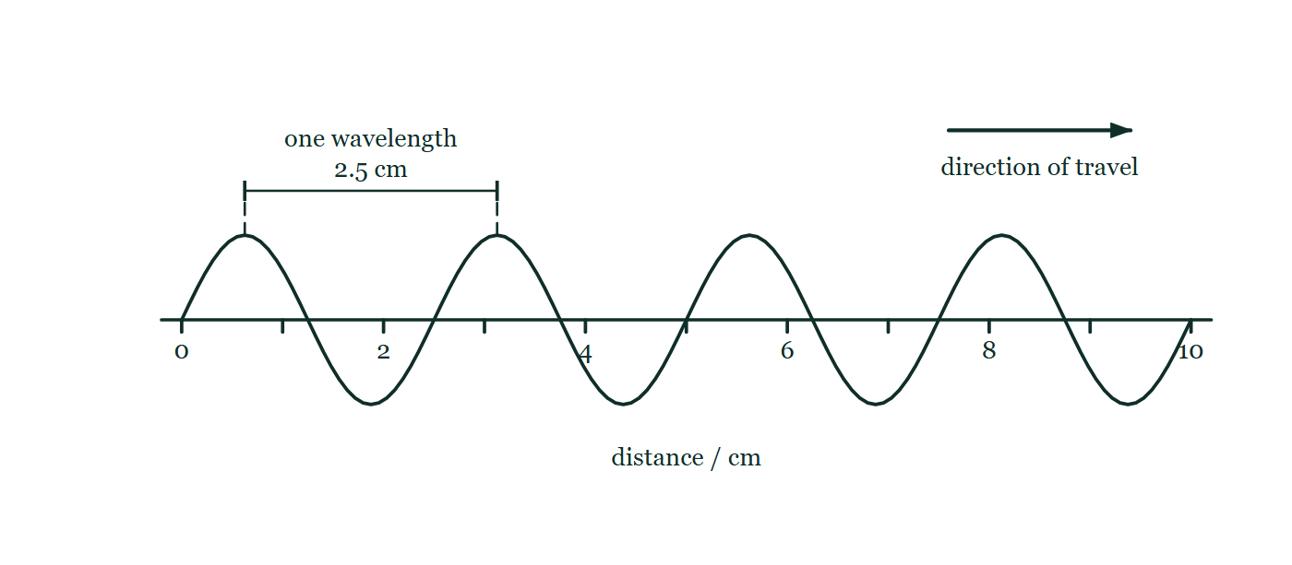
IGCSE · TOPIC 3 · WAVES
GIOPHYSICS PRACTICE PAPER
Question 2
Multiple choice
Core
Routine
1 mark
Syllabus 3.1 · AO2
Water waves in a ripple tank have a wavelength of 2.5 cm. 12 complete waves pass a fixed point in 4.0 s. What is the speed of the waves?
Fig. 2.1 — A snapshot of the water surface in the ripple tank at one instant, drawn as a side view. Four complete waves run left to right above a horizontal distance scale that is marked in centimetres from 0 to 10, the scale line itself being the undisturbed water level. A dimension line drawn between two neighbouring crests is labelled one wavelength, 2.5 cm, and a separate arrow above the wave shows the direction in which the waves are travelling.
A
0.83 cm/s
B
7.5 cm/s
C
30 cm/s
D
120 cm/s
Cambridge IGCSE Physics — Topic 3 · Waves. Written by GioPhysics from Cambridge IGCSE Physics 0625 syllabus; not an awarding body's document.
4 / 25
Notes:
[Demand] Routine — The standard application — the named equation, the usual graph read.
[Figure] Fig. 2.1. A snapshot of the water surface in the ripple tank at one instant, drawn as a side view. Four complete waves run left to right above a horizontal distance scale that is marked in centimetres from 0 to 10, the scale line itself being the undisturbed water level. A dimension line drawn between two neighbouring crests is labelled one wavelength, 2.5 cm, and a separate arrow above the wave shows the direction in which the waves are travelling.

Slide 5
IGCSE · TOPIC 3 · WAVES
GIOPHYSICS PRACTICE PAPER
Answer 2
Multiple choice
Core
Routine
1 mark
Mark scheme
B
7.5 cm/s
Why the other three are there
C multiplies by the number of waves instead of the frequency — the error of a candidate who never works out that f = 12 / 4.0 = 3.0 Hz.
Cambridge IGCSE Physics — Topic 3 · Waves. Written by GioPhysics from Cambridge IGCSE Physics 0625 syllabus; not an awarding body's document.
5 / 25
Notes:
[Answer] B — 7.5 cm/s
[Distractors] C multiplies by the number of waves instead of the frequency — the error of a candidate who never works out that f = 12 / 4.0 = 3.0 Hz.
[Figure] Fig. 2.1. A snapshot of the water surface in the ripple tank at one instant, drawn as a side view. Four complete waves run left to right above a horizontal distance scale that is marked in centimetres from 0 to 10, the scale line itself being the undisturbed water level. A dimension line drawn between two neighbouring crests is labelled one wavelength, 2.5 cm, and a separate arrow above the wave shows the direction in which the waves are travelling.

Slide 6
IGCSE · TOPIC 3 · WAVES
GIOPHYSICS PRACTICE PAPER
Question 3
Multiple choice
Supp.
Routine
1 mark
Syllabus 3.2 · AO2
A ray of light travels from air into a transparent block of refractive index 1.5. The angle of incidence in air is 40°. What is the angle of refraction in the block? (sin 40° = 0.643)
A
17°
B
25°
C
40°
D
74°
Cambridge IGCSE Physics — Topic 3 · Waves. Written by GioPhysics from Cambridge IGCSE Physics 0625 syllabus; not an awarding body's document.
6 / 25
Notes:
[Demand] Routine — The standard application — the named equation, the usual graph read.

Slide 7
IGCSE · TOPIC 3 · WAVES
GIOPHYSICS PRACTICE PAPER
Answer 3
Multiple choice
Supp.
Routine
1 mark
Mark scheme
B
25°
Why the other three are there
D applies the ratio the wrong way round. Light entering a denser medium bends towards the normal, so any answer larger than 40° can be rejected before a calculation is done.
Cambridge IGCSE Physics — Topic 3 · Waves. Written by GioPhysics from Cambridge IGCSE Physics 0625 syllabus; not an awarding body's document.
7 / 25
Notes:
[Answer] B — 25°
[Distractors] D applies the ratio the wrong way round. Light entering a denser medium bends towards the normal, so any answer larger than 40° can be rejected before a calculation is done.

Slide 8
IGCSE · TOPIC 3 · WAVES
GIOPHYSICS PRACTICE PAPER
Question 4
Multiple choice
Core
Recall
1 mark
Syllabus 3.3 · AO1
Which list places these electromagnetic waves in order of increasing frequency?
A
infrared, microwaves, ultraviolet, X-rays
B
microwaves, infrared, ultraviolet, X-rays
C
X-rays, ultraviolet, infrared, microwaves
D
ultraviolet, X-rays, microwaves, infrared
Cambridge IGCSE Physics — Topic 3 · Waves. Written by GioPhysics from Cambridge IGCSE Physics 0625 syllabus; not an awarding body's document.
8 / 25
Notes:
[Demand] Recall — One idea, one step. The mark is for knowing it.

Slide 9
IGCSE · TOPIC 3 · WAVES
GIOPHYSICS PRACTICE PAPER
Answer 4
Multiple choice
Core
Recall
1 mark
Mark scheme
B
microwaves, infrared, ultraviolet, X-rays
Why the other three are there
A swaps the first pair, which is the pair candidates most often reverse. C is the correct order of decreasing frequency, offered for anyone who reads the question too quickly.
Cambridge IGCSE Physics — Topic 3 · Waves. Written by GioPhysics from Cambridge IGCSE Physics 0625 syllabus; not an awarding body's document.
9 / 25
Notes:
[Answer] B — microwaves, infrared, ultraviolet, X-rays
[Distractors] A swaps the first pair, which is the pair candidates most often reverse. C is the correct order of decreasing frequency, offered for anyone who reads the question too quickly.

Slide 10
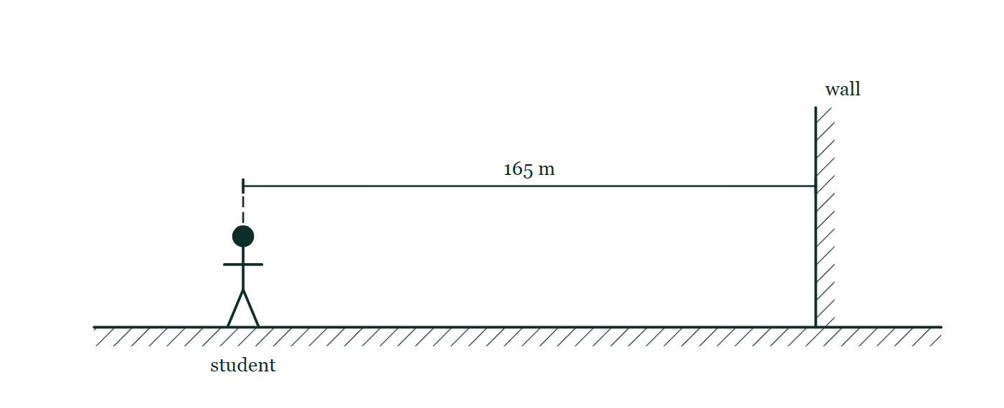
IGCSE · TOPIC 3 · WAVES
GIOPHYSICS PRACTICE PAPER
Question 5
Multiple choice
Core
Routine
1 mark
Syllabus 3.4 · AO2
A student stands 165 m from a large wall and claps once. She hears the echo 1.0 s later. What is the speed of sound in air from her measurement?
Fig. 5.1 — A side view of the arrangement. The student stands on level hatched ground on the left, facing a tall wall drawn as a hatched vertical slab standing on the same ground well to her right. A dimension line above her head runs horizontally from the student across to the face of the wall and is labelled 165 m. No sound path is drawn on the figure.
A
165 m/s
B
247 m/s
C
330 m/s
D
660 m/s
Cambridge IGCSE Physics — Topic 3 · Waves. Written by GioPhysics from Cambridge IGCSE Physics 0625 syllabus; not an awarding body's document.
10 / 25
Notes:
[Demand] Routine — The standard application — the named equation, the usual graph read.
[Figure] Fig. 5.1. A side view of the arrangement. The student stands on level hatched ground on the left, facing a tall wall drawn as a hatched vertical slab standing on the same ground well to her right. A dimension line above her head runs horizontally from the student across to the face of the wall and is labelled 165 m. No sound path is drawn on the figure.

Slide 11
IGCSE · TOPIC 3 · WAVES
GIOPHYSICS PRACTICE PAPER
Answer 5
Multiple choice
Core
Routine
1 mark
Mark scheme
C
330 m/s
Why the other three are there
A is the trap and takes about half of all candidates: the sound travels to the wall and back, so the distance is 330 m, not 165 m.
Cambridge IGCSE Physics — Topic 3 · Waves. Written by GioPhysics from Cambridge IGCSE Physics 0625 syllabus; not an awarding body's document.
11 / 25
Notes:
[Answer] C — 330 m/s
[Distractors] A is the trap and takes about half of all candidates: the sound travels to the wall and back, so the distance is 330 m, not 165 m.
[Figure] Fig. 5.1. A side view of the arrangement. The student stands on level hatched ground on the left, facing a tall wall drawn as a hatched vertical slab standing on the same ground well to her right. A dimension line above her head runs horizontally from the student across to the face of the wall and is labelled 165 m. No sound path is drawn on the figure.

Slide 12
IGCSE · TOPIC 3 · WAVES
GIOPHYSICS PRACTICE PAPER
Question 6
Multiple choice
Core
Recall
1 mark
Syllabus 3.4 · AO1
In which material does sound travel fastest?
A
air
B
a vacuum
C
water
D
steel
Cambridge IGCSE Physics — Topic 3 · Waves. Written by GioPhysics from Cambridge IGCSE Physics 0625 syllabus; not an awarding body's document.
12 / 25
Notes:
[Demand] Recall — One idea, one step. The mark is for knowing it.

Slide 13
IGCSE · TOPIC 3 · WAVES
GIOPHYSICS PRACTICE PAPER
Answer 6
Multiple choice
Core
Recall
1 mark
Mark scheme
D
steel
Why the other three are there
B is set for the candidate who confuses sound with light: sound needs a medium and does not travel through a vacuum at all.
Cambridge IGCSE Physics — Topic 3 · Waves. Written by GioPhysics from Cambridge IGCSE Physics 0625 syllabus; not an awarding body's document.
13 / 25
Notes:
[Answer] D — steel
[Distractors] B is set for the candidate who confuses sound with light: sound needs a medium and does not travel through a vacuum at all.

Slide 14
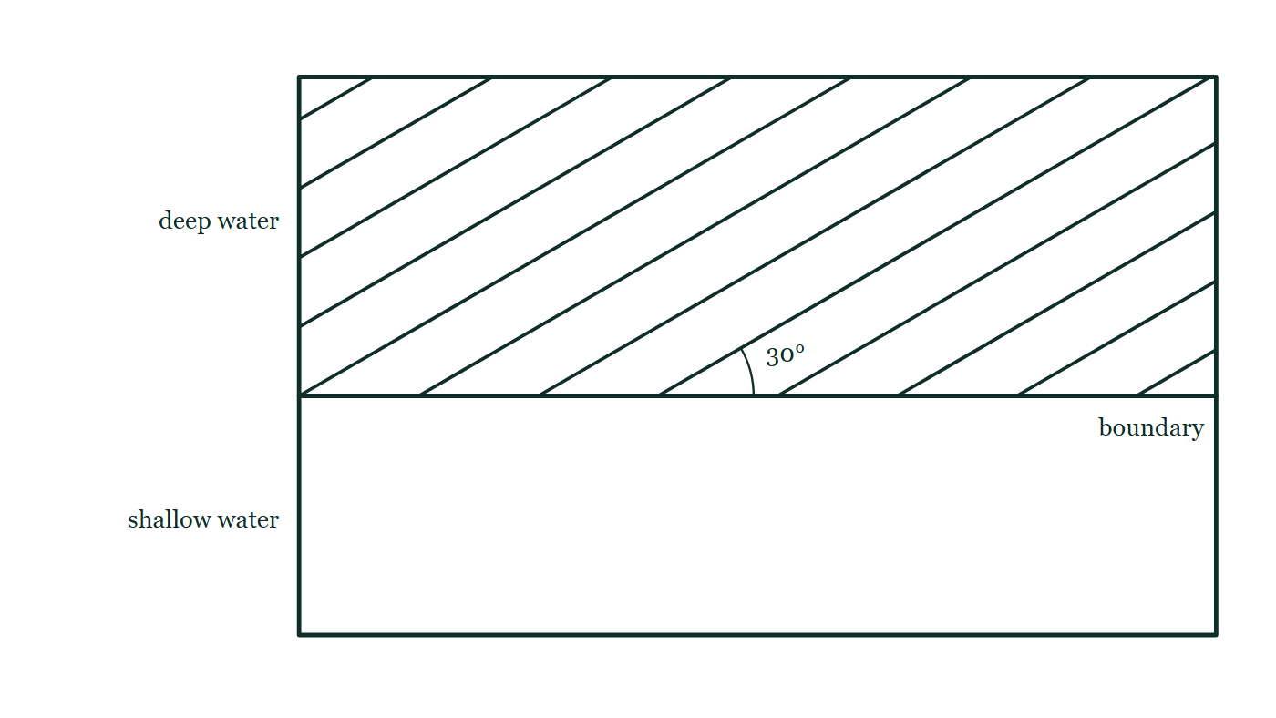
IGCSE · TOPIC 3 · WAVES
GIOPHYSICS PRACTICE PAPER
Question 7
Structured
Supp.
Demanding
7 marks
Syllabus 3.1
Straight water waves in a ripple tank travel from a deep region into a shallow region. The boundary between the regions is a straight line, and the wavefronts meet it at 30° to the boundary. In the deep region the waves have a wavelength of 1.8 cm and a frequency of 8.0 Hz. In the shallow region the wavelength is 1.2 cm.
Fig. 7.1 — Plan view of the ripple tank, seen from above. A straight boundary runs right across the tank, dividing it into deep water in the upper part and shallow water in the lower part, each region labelled. Twelve straight parallel wavefronts, evenly spaced, fill the deep water and slope up to the right so that each one makes an angle of 30° with the boundary; that angle is marked with an arc where one front meets the boundary. The shallow region is drawn empty.
Cambridge IGCSE Physics — Topic 3 · Waves. Written by GioPhysics from Cambridge IGCSE Physics 0625 syllabus; not an awarding body's document.
14 / 25
Notes:
[Demand] Demanding — Several steps, and you have to choose them. Nothing says which comes first.
[Figure] Fig. 7.1. Plan view of the ripple tank, seen from above. A straight boundary runs right across the tank, dividing it into deep water in the upper part and shallow water in the lower part, each region labelled. Twelve straight parallel wavefronts, evenly spaced, fill the deep water and slope up to the right so that each one makes an angle of 30° with the boundary; that angle is marked with an arc where one front meets the boundary. The shallow region is drawn empty.

Slide 15
IGCSE · TOPIC 3 · WAVES
GIOPHYSICS PRACTICE PAPER
Question 7 (cont.)
Structured
Supp.
Demanding
7 marks
continued from the previous slide
(a) Calculate
2 marks
Calculate the speed of the waves in the deep region.
(b) Determine
2 marks
Determine the speed of the waves in the shallow region.
(c) Describe
3 marks
The wavefronts meet the boundary at an angle. Describe and explain what happens to the direction in which the waves travel as they cross into the shallow region.
Cambridge IGCSE Physics — Topic 3 · Waves. Written by GioPhysics from Cambridge IGCSE Physics 0625 syllabus; not an awarding body's document.
15 / 25
Notes:
[Demand] Demanding — Several steps, and you have to choose them. Nothing says which comes first.
[Figure] Fig. 7.1. Plan view of the ripple tank, seen from above. A straight boundary runs right across the tank, dividing it into deep water in the upper part and shallow water in the lower part, each region labelled. Twelve straight parallel wavefronts, evenly spaced, fill the deep water and slope up to the right so that each one makes an angle of 30° with the boundary; that angle is marked with an arc where one front meets the boundary. The shallow region is drawn empty.
[Reminder] Fig. 7.1 is on the previous slide.

Slide 16
IGCSE · TOPIC 3 · WAVES
GIOPHYSICS PRACTICE PAPER
Answer 7
Structured
Supp.
Demanding
7 marks
Mark scheme
(a) Calculate — 2 marks
AO2
✓
v = fλ = 8.0 × 1.8
✓
v = 14.4 cm/s
(b) Determine — 2 marks
AO2
✓
the frequency is unchanged at 8.0 Hz as the waves cross the boundary
✓
v = 8.0 × 1.2 = 9.6 cm/s
The first marking point is the physics. Frequency is set by the source and does not change at a boundary; wavelength and speed do.
(c) Describe — 3 marks
AO2
✓
the direction of travel changes — the waves bend towards the normal to the boundary
✓
because the part of each wavefront that reaches the shallow water first slows down before the rest of it does
✓
so the wavefront pivots, and refraction has occurred
Cambridge IGCSE Physics — Topic 3 · Waves. Written by GioPhysics from Cambridge IGCSE Physics 0625 syllabus; not an awarding body's document.
16 / 25
Notes:
[Marking] One line per mark, awarded independently unless a point says otherwise.
[Examiner note (b)] The first marking point is the physics. Frequency is set by the source and does not change at a boundary; wavelength and speed do.
[Figure] Fig. 7.1. Plan view of the ripple tank, seen from above. A straight boundary runs right across the tank, dividing it into deep water in the upper part and shallow water in the lower part, each region labelled. Twelve straight parallel wavefronts, evenly spaced, fill the deep water and slope up to the right so that each one makes an angle of 30° with the boundary; that angle is marked with an arc where one front meets the boundary. The shallow region is drawn empty.

Slide 17
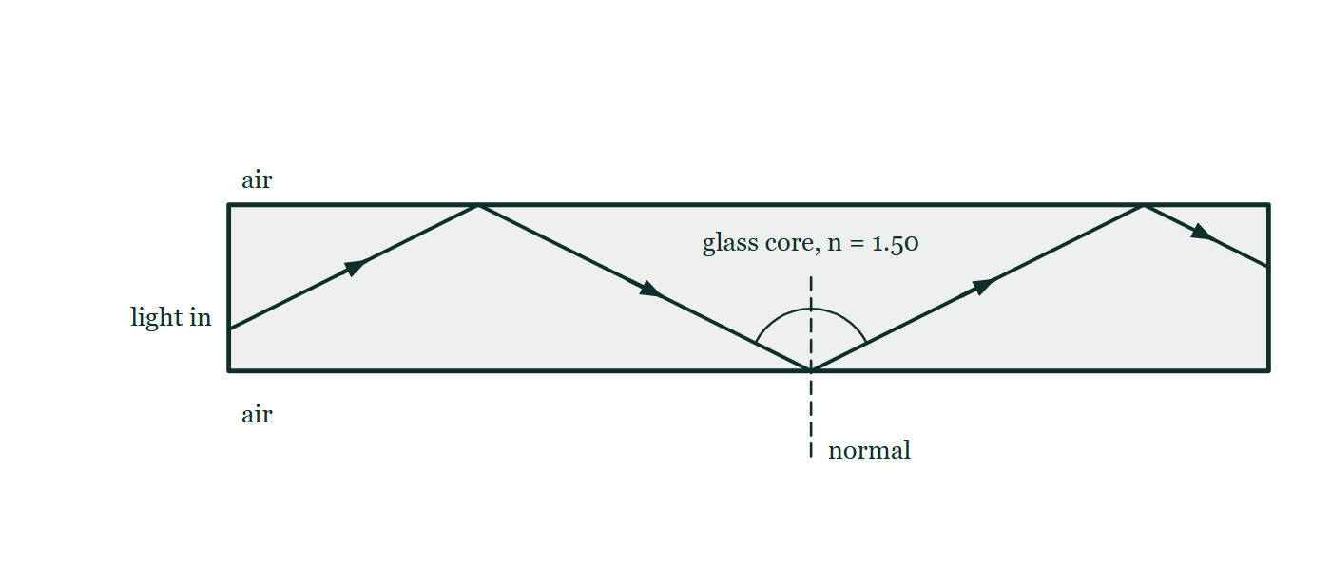
IGCSE · TOPIC 3 · WAVES
GIOPHYSICS PRACTICE PAPER
Question 8
Structured
Supp.
Discriminating
9 marks
Syllabus 3.2
An optical fibre has a glass core of refractive index 1.50. Light entering one end of the fibre travels along it by repeated total internal reflection at the core boundary, even where the fibre is gently curved.
Fig. 8.1 — A straight length of optical fibre drawn in section as a long horizontal band with parallel walls, shaded to show glass and labelled glass core, n = 1.50, with air labelled outside it. Light entering the flat left-hand end travels up to the upper wall, reflects down to the lower wall, reflects again up to the upper wall and reaches the far end, giving a zig-zag path along the fibre. At one reflection a dashed normal is drawn perpendicular to the wall, and the angle on each side of it is marked with an arc; no angle is given a numerical value.
Cambridge IGCSE Physics — Topic 3 · Waves. Written by GioPhysics from Cambridge IGCSE Physics 0625 syllabus; not an awarding body's document.
17 / 25
Notes:
[Demand] Discriminating — The part that separates the top grade: an unfamiliar context, a derivation, or an argument that has to hold together to earn anything.
[Figure] Fig. 8.1. A straight length of optical fibre drawn in section as a long horizontal band with parallel walls, shaded to show glass and labelled glass core, n = 1.50, with air labelled outside it. Light entering the flat left-hand end travels up to the upper wall, reflects down to the lower wall, reflects again up to the upper wall and reaches the far end, giving a zig-zag path along the fibre. At one reflection a dashed normal is drawn perpendicular to the wall, and the angle on each side of it is marked with an arc; no angle is given a numerical value.

Slide 18
IGCSE · TOPIC 3 · WAVES
GIOPHYSICS PRACTICE PAPER
Question 8 (cont.)
Structured
Supp.
Discriminating
9 marks
continued from the previous slide
(a) State
2 marks
State the two conditions necessary for total internal reflection to occur.
(b) Calculate
3 marks
Calculate the critical angle for the glass core.
(c) Explain
3 marks
A student suggests that bending the fibre very sharply would make no difference, because total internal reflection always happens. Explain why the student is wrong.
(d) Give
1 mark
Give one use of optical fibres other than in medicine.
Cambridge IGCSE Physics — Topic 3 · Waves. Written by GioPhysics from Cambridge IGCSE Physics 0625 syllabus; not an awarding body's document.
18 / 25
Notes:
[Demand] Discriminating — The part that separates the top grade: an unfamiliar context, a derivation, or an argument that has to hold together to earn anything.
[Figure] Fig. 8.1. A straight length of optical fibre drawn in section as a long horizontal band with parallel walls, shaded to show glass and labelled glass core, n = 1.50, with air labelled outside it. Light entering the flat left-hand end travels up to the upper wall, reflects down to the lower wall, reflects again up to the upper wall and reaches the far end, giving a zig-zag path along the fibre. At one reflection a dashed normal is drawn perpendicular to the wall, and the angle on each side of it is marked with an arc; no angle is given a numerical value.
[Reminder] Fig. 8.1 is on the previous slide.

Slide 19
IGCSE · TOPIC 3 · WAVES
GIOPHYSICS PRACTICE PAPER
Answer 8
Structured
Supp.
Discriminating
9 marks
Mark scheme
(a) State — 2 marks
AO1
✓
the light must be travelling in the optically denser medium, towards a boundary with a less dense medium
✓
the angle of incidence at the boundary must be greater than the critical angle
(b) Calculate — 3 marks
AO2
✓
sin c = 1 / n
✓
sin c = 1 / 1.50 = 0.667
✓
c = 41.8° (accept 42°)
(c) Explain — 3 marks
AO2
✓
bending the fibre sharply reduces the angle of incidence at the outer wall of the bend
✓
if that angle falls below the critical angle of 41.8°, the light is no longer totally internally reflected
✓
some light refracts out through the boundary and the signal is weakened or lost
The discriminating part of the paper. It requires the candidate to see that the angle of incidence is a property of the geometry, not a fixed feature of the fibre.
(d) Give — 1 mark
AO1
✓
telephone / cable television / internet communication — any high-speed data transmission
Cambridge IGCSE Physics — Topic 3 · Waves. Written by GioPhysics from Cambridge IGCSE Physics 0625 syllabus; not an awarding body's document.
19 / 25
Notes:
[Marking] One line per mark, awarded independently unless a point says otherwise.
[Examiner note (c)] The discriminating part of the paper. It requires the candidate to see that the angle of incidence is a property of the geometry, not a fixed feature of the fibre.
[Figure] Fig. 8.1. A straight length of optical fibre drawn in section as a long horizontal band with parallel walls, shaded to show glass and labelled glass core, n = 1.50, with air labelled outside it. Light entering the flat left-hand end travels up to the upper wall, reflects down to the lower wall, reflects again up to the upper wall and reaches the far end, giving a zig-zag path along the fibre. At one reflection a dashed normal is drawn perpendicular to the wall, and the angle on each side of it is marked with an arc; no angle is given a numerical value.

Slide 20
IGCSE · TOPIC 3 · WAVES
GIOPHYSICS PRACTICE PAPER
Question 9
Structured
Core
Routine
8 marks
Syllabus 3.3
The electromagnetic spectrum is a family of transverse waves that all travel at the same speed in a vacuum, 3.0 × 10⁸ m/s.
(a) State
1 mark
State one property, other than their speed in a vacuum, that all electromagnetic waves share.
(b) Identify
2 marks
Identify the region of the electromagnetic spectrum used for each of the following, and give one different region for each: (i) cooking food in an oven that heats from the outside; (ii) sterilising medical equipment.
(c) Calculate
3 marks
A radio station broadcasts at a frequency of 95.8 MHz. Calculate the wavelength of the waves it emits.
(d) Describe
2 marks
Describe one harmful effect of excessive exposure to ultraviolet radiation, and state one way of reducing the risk.
Cambridge IGCSE Physics — Topic 3 · Waves. Written by GioPhysics from Cambridge IGCSE Physics 0625 syllabus; not an awarding body's document.
20 / 25
Notes:
[Demand] Routine — The standard application — the named equation, the usual graph read.

Slide 21
IGCSE · TOPIC 3 · WAVES
GIOPHYSICS PRACTICE PAPER
Answer 9
Structured
Core
Routine
8 marks
Mark scheme
(a) State — 1 mark
AO1
✓
any one of: they are transverse; they transfer energy; they can travel through a vacuum; they can be reflected and refracted
(b) Identify — 2 marks
AO1
✓
(i) infrared
✓
(ii) gamma rays (accept ultraviolet for surface sterilisation)
(c) Calculate — 3 marks
AO2
✓
λ = v / f
✓
λ = 3.0 × 10⁸ / 95.8 × 10⁶
✓
λ = 3.1 m
(d) Describe — 2 marks
AO1
✓
damage to surface cells / skin ageing / skin cancer / eye damage such as cataracts
✓
wear sunscreen, sunglasses or protective clothing; limit exposure at midday
Cambridge IGCSE Physics — Topic 3 · Waves. Written by GioPhysics from Cambridge IGCSE Physics 0625 syllabus; not an awarding body's document.
21 / 25
Notes:
[Marking] One line per mark, awarded independently unless a point says otherwise.

Slide 22
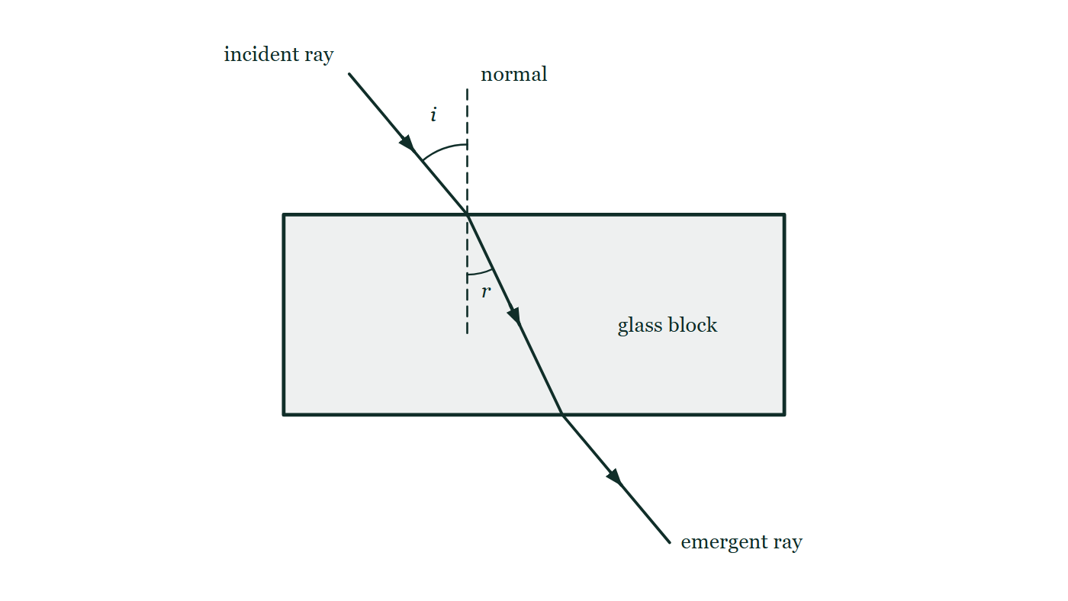
IGCSE · TOPIC 3 · WAVES
GIOPHYSICS PRACTICE PAPER
Question 10
Practical skills
Supp.
Demanding
8 marks
Syllabus 3.2
A student determines the refractive index of a glass block using optical pins. She places the block on a sheet of paper, draws round it, and shines a ray at the top face at an angle of incidence i, marking the ray in and the ray out with pins. She repeats this for several values of i and measures the angle of refraction r inside the block.
The student's results
i / degrees | 20 | 30 | 40 | 50 | 60
r / degrees | 13.2 | 19.5 | 25.4 | 30.7 | 35.3
sin i | 0.342 | 0.500 | 0.643 | 0.766 | 0.866
sin r | 0.228 | 0.334 | 0.429 | 0.511 | 0.578
Fig. 10.1 — The rectangular glass block drawn on the paper, seen from above. A ray labelled incident ray comes down from the upper left and meets the top face of the block; a dashed normal is drawn perpendicular to that face at the point where the ray strikes it. The angle between the incident ray and the normal is labelled i, and the angle between the normal and the ray travelling inside the glass is labelled r. The ray crosses the block, leaves through the bottom face and continues as the emergent ray. The optical pins are not shown.
Cambridge IGCSE Physics — Topic 3 · Waves. Written by GioPhysics from Cambridge IGCSE Physics 0625 syllabus; not an awarding body's document.
22 / 25
Notes:
[Demand] Demanding — Several steps, and you have to choose them. Nothing says which comes first.
[Figure] Fig. 10.1. The rectangular glass block drawn on the paper, seen from above. A ray labelled incident ray comes down from the upper left and meets the top face of the block; a dashed normal is drawn perpendicular to that face at the point where the ray strikes it. The angle between the incident ray and the normal is labelled i, and the angle between the normal and the ray travelling inside the glass is labelled r. The ray crosses the block, leaves through the bottom face and continues as the emergent ray. The optical pins are not shown.

Slide 23
IGCSE · TOPIC 3 · WAVES
GIOPHYSICS PRACTICE PAPER
Question 10 (cont.)
Practical skills
Supp.
Demanding
8 marks
continued from the previous slide
(a) Describe
3 marks
Describe how the student should place and use the optical pins so that the path of the ray is marked accurately.
(b) Explain
3 marks
Explain why plotting a graph of sin i against sin r gives a more reliable value for the refractive index than calculating sin i / sin r for a single pair of readings.
(c) Determine
2 marks
Use the first and last results to determine a value for the refractive index of the glass.
Cambridge IGCSE Physics — Topic 3 · Waves. Written by GioPhysics from Cambridge IGCSE Physics 0625 syllabus; not an awarding body's document.
23 / 25
Notes:
[Demand] Demanding — Several steps, and you have to choose them. Nothing says which comes first.
[Figure] Fig. 10.1. The rectangular glass block drawn on the paper, seen from above. A ray labelled incident ray comes down from the upper left and meets the top face of the block; a dashed normal is drawn perpendicular to that face at the point where the ray strikes it. The angle between the incident ray and the normal is labelled i, and the angle between the normal and the ray travelling inside the glass is labelled r. The ray crosses the block, leaves through the bottom face and continues as the emergent ray. The optical pins are not shown.
[Reminder] Fig. 10.1 is on the previous slide.

Slide 24
IGCSE · TOPIC 3 · WAVES
GIOPHYSICS PRACTICE PAPER
Answer 10
Practical skills
Supp.
Demanding
8 marks
Mark scheme
(a) Describe — 3 marks
AO3
✓
place two pins in the incident ray, as far apart as possible
✓
view from the far side of the block and place two more pins so that all four appear in line, one behind another
✓
remove the block and draw a straight line through each pair to find the ray in and the ray out
"As far apart as possible" is a marking point in its own right: it reduces the effect of the uncertainty in each pin's position on the direction of the line.
(b) Explain — 3 marks
AO3
✓
n = sin i / sin r, so a graph of sin i against sin r should be a straight line through the origin of gradient n
✓
the gradient uses all of the readings rather than one, so random errors in individual measurements average out
✓
an anomalous result is visible as a point off the line and can be identified rather than silently included
(c) Determine — 2 marks
AO2
✓
gradient = (0.866 − 0.342) / (0.578 − 0.228) = 0.524 / 0.350
✓
n = 1.50 (accept 1.5)
Cambridge IGCSE Physics — Topic 3 · Waves. Written by GioPhysics from Cambridge IGCSE Physics 0625 syllabus; not an awarding body's document.
24 / 25
Notes:
[Marking] One line per mark, awarded independently unless a point says otherwise.
[Examiner note (a)] "As far apart as possible" is a marking point in its own right: it reduces the effect of the uncertainty in each pin's position on the direction of the line.
[Figure] Fig. 10.1. The rectangular glass block drawn on the paper, seen from above. A ray labelled incident ray comes down from the upper left and meets the top face of the block; a dashed normal is drawn perpendicular to that face at the point where the ray strikes it. The angle between the incident ray and the normal is labelled i, and the angle between the normal and the ray travelling inside the glass is labelled r. The ray crosses the block, leaves through the bottom face and continues as the emergent ray. The optical pins are not shown.

Slide 25
IGCSE · TOPIC 3 · WAVES
GIOPHYSICS PRACTICE PAPER
Command words
Cambridge IGCSE Physics — the board's own definitions
Calculate
Show (that)
Work out from given facts, figures or information.
Provide structured evidence that leads to a given result.
Define
State
Give the precise meaning.
Express in clear terms.
Describe
Suggest
State the points of a topic; give characteristics and main features.
Apply knowledge and understanding to situations where there is a range of valid responses in order to make proposals.
Determine
Establish an answer using the information available.
Estimate
Suggest an approximate value.
Explain
Set out purposes or reasons; make relationships evident; give why and/or how.
Give
Produce an answer from a given source or recall.
Identify
Name, select or recognise.
Cambridge IGCSE Physics — Topic 3 · Waves. Written by GioPhysics from Cambridge IGCSE Physics 0625 syllabus; not an awarding body's document.
25 / 25
Notes:
[Objectives] AO1 Knowledge with understanding (50%): Recall, describe, explain and use physics ideas, terminology, instruments and conventions. AO2 Handling information and problem-solving (30%): Locate and interpret information, translate between forms, calculate, reason, and apply physics to unfamiliar situations. AO3 Experimental skills and investigations (20%): Plan, use apparatus, record and present observations, analyse, evaluate, and suggest improvements.
[Source] Cambridge IGCSE Physics 0625 syllabus — https://www.cambridgeinternational.org/Images/697209-2026-2028-syllabus.pdf
[Disclaimer] Written by GioPhysics from the published syllabus. These are practice papers in the style of Cambridge IGCSE Physics 0625; they are not Cambridge papers, contain no past-paper questions, and the official syllabus and specimen materials remain the authority.

