Slide 1
MOTION · KINEMATICS CALCULUS INTEGRATION
GIOPHYSICS LESSON
01 · Motion
Calculus is the bridge between a motion graph and its physical meaning.
Kinematics Calculus Integration
A graph shows where an object has been. Calculus lets us zoom into one instant, measure how motion changes, and rebuild a journey from its rates.
POSITION
Lesson 7 of 7 in Motion
PLAN
17 slides in the 45-minute core run, about 45 minutes of it
LESSON PAGE
https://giophysics.com/chapter-1/kinematics-calculus/
Built by GioPhysics from the lesson's own page. Every word on these slides is the lesson's; nothing here is re-authored. Teaching material, not an awarding body's document.
Motion — Kinematics Calculus Integration. Built by GioPhysics from the lesson's own copy; nothing on these slides is re-authored.
1 / 31
Notes:
[Lesson] Motion — Kinematics Calculus Integration. Lesson 7 of 7.
[Intro] A graph shows where an object has been. Calculus lets us zoom into one instant, measure how motion changes, and rebuild a journey from its rates.
[Source] https://giophysics.com/chapter-1/kinematics-calculus/
[Disclaimer] Built by GioPhysics from the lesson's own page. Every word on these slides is the lesson's; nothing here is re-authored. Teaching material, not an awarding body's document.

Slide 2
MOTION · KINEMATICS CALCULUS INTEGRATION
GIOPHYSICS LESSON
THINK FIRST
Your speedometer reads 30 m/s. Over what stretch of time was that speed measured?
Take answers before you click — the point is the commitment
Average speed needs two moments and the gap between them. The needle, though, is telling you a speed right now — this instant, not the last minute.
THE ANSWER
Over no stretch at all. It is the limit that average speed approaches as the gap between the two moments shrinks towards zero — which is exactly what a derivative is, and why calculus had to be invented before instantaneous speed could be defined at all.
Motion — Kinematics Calculus Integration. Built by GioPhysics from the lesson's own copy; nothing on these slides is re-authored.
2 / 31
Notes:
[Phase] Starter: Recall what this lesson stands on (minutes 0–5 of 45)
[Hook] Your speedometer reads 30 m/s. Over what stretch of time was that speed measured? Average speed needs two moments and the gap between them. The needle, though, is telling you a speed right now — this instant, not the last minute.
[Answer] Over no stretch at all. It is the limit that average speed approaches as the gap between the two moments shrinks towards zero — which is exactly what a derivative is, and why calculus had to be invented before instantaneous speed could be defined at all.

Slide 3
MOTION · KINEMATICS CALCULUS INTEGRATION
GIOPHYSICS LESSON
EXPLAINED SIMPLY
In one sentence
Introduce the idea — The big idea and the definition
Kinematics calculus uses derivatives to find velocity and acceleration, and integrals to recover changes in motion.
Motion — Kinematics Calculus Integration. Built by GioPhysics from the lesson's own copy; nothing on these slides is re-authored.
3 / 31
Notes:
[Phase] Introduce the idea: The big idea and the definition (minutes 5–13 of 45)
[Definition] Kinematics calculus uses derivatives to find velocity and acceleration, and integrals to recover changes in motion.

Slide 4
MOTION · KINEMATICS CALCULUS INTEGRATION
GIOPHYSICS LESSON
EXPLAINED SIMPLY
What that looks like
Introduce the idea — The big idea and the definition
FOR EXAMPLE
If x = (1.0 m/s²)t², then v = (2.0 m/s²)t and a = 2.0 m/s².
Motion — Kinematics Calculus Integration. Built by GioPhysics from the lesson's own copy; nothing on these slides is re-authored.
4 / 31
Notes:
[Phase] Introduce the idea: The big idea and the definition (minutes 5–13 of 45)
[Worked illustration] If x = (1.0 m/s²)t², then v = (2.0 m/s²)t and a = 2.0 m/s².

Slide 5
MOTION · KINEMATICS CALCULUS INTEGRATION
GIOPHYSICS LESSON
THE BIG IDEA
Calculus is the bridge between a motion graph and its physical meaning.
Introduce the idea — The big idea and the definition
Limits make “at this instant” precise. Derivatives turn graphs into rates. Integrals run the process backward and accumulate change over time.
Limit: zooms into one instant. Derivative: reveals the rate of change. Integral: accumulates change over time.
Motion — Kinematics Calculus Integration. Built by GioPhysics from the lesson's own copy; nothing on these slides is re-authored.
5 / 31
Notes:
[Phase] Introduce the idea: The big idea and the definition (minutes 5–13 of 45)
[Big idea] Limits make “at this instant” precise. Derivatives turn graphs into rates. Integrals run the process backward and accumulate change over time. Limit: zooms into one instant. Derivative: reveals the rate of change. Integral: accumulates change over time.

Slide 6
MOTION · KINEMATICS CALCULUS INTEGRATION
GIOPHYSICS LESSON
THE PHYSICS · 1 OF 9
Bring two moments closer together.
Build the model — The formulae, one at a time, in plain English
Average velocity uses two points. Instantaneous velocity is the limit of that average as the time gap shrinks toward zero.
Motion — Kinematics Calculus Integration. Built by GioPhysics from the lesson's own copy; nothing on these slides is re-authored.
6 / 31
Notes:
[Phase] Build the model: The formulae, one at a time, in plain English (minutes 13–22 of 45)
[Section] Average velocity uses two points. Instantaneous velocity is the limit of that average as the time gap shrinks toward zero.

Slide 7
MOTION · KINEMATICS CALCULUS INTEGRATION
GIOPHYSICS LESSON
THE PHYSICS · 2 OF 9
Differentiate one graph to reveal the next.
Build the model — The formulae, one at a time, in plain English
The power rule is a fast slope machine: multiply by the power, then reduce that power by one.
Motion — Kinematics Calculus Integration. Built by GioPhysics from the lesson's own copy; nothing on these slides is re-authored.
7 / 31
Notes:
[Phase] Build the model: The formulae, one at a time, in plain English (minutes 13–22 of 45)
[Section] The power rule is a fast slope machine: multiply by the power, then reduce that power by one.

Slide 8
MOTION · KINEMATICS CALCULUS INTEGRATION
GIOPHYSICS LESSON
THE PHYSICS · 3 OF 9
The sign of the slope tells the direction.
Build the model — The formulae, one at a time, in plain English
Positive velocity means position is increasing; negative velocity means it is decreasing. At v = 0, inspect either side to decide whether the object turns around.
Motion — Kinematics Calculus Integration. Built by GioPhysics from the lesson's own copy; nothing on these slides is re-authored.
8 / 31
Notes:
[Phase] Build the model: The formulae, one at a time, in plain English (minutes 13–22 of 45)
[Section] Positive velocity means position is increasing; negative velocity means it is decreasing. At v = 0, inspect either side to decide whether the object turns around.

Slide 9
MOTION · KINEMATICS CALCULUS INTEGRATION
GIOPHYSICS LESSON
THE PHYSICS · 4 OF 9
Tangent
Build the model — The formulae, one at a time, in plain English
Same slope as the curve. On an x–t graph, its gradient is instantaneous velocity.
Motion — Kinematics Calculus Integration. Built by GioPhysics from the lesson's own copy; nothing on these slides is re-authored.
9 / 31
Notes:
[Phase] Build the model: The formulae, one at a time, in plain English (minutes 13–22 of 45)
[Section] Same slope as the curve. On an x–t graph, its gradient is instantaneous velocity.

Slide 10
MOTION · KINEMATICS CALCULUS INTEGRATION
GIOPHYSICS LESSON
THE PHYSICS · 5 OF 9
Normal
Build the model — The formulae, one at a time, in plain English
Perpendicular to the tangent. For non-zero slope m, the normal gradient is −1/m.
Motion — Kinematics Calculus Integration. Built by GioPhysics from the lesson's own copy; nothing on these slides is re-authored.
10 / 31
Notes:
[Phase] Build the model: The formulae, one at a time, in plain English (minutes 13–22 of 45)
[Section] Perpendicular to the tangent. For non-zero slope m, the normal gradient is −1/m.

Slide 11
MOTION · KINEMATICS CALCULUS INTEGRATION
GIOPHYSICS LESSON
THE PHYSICS · 6 OF 9
Stationary point
Build the model — The formulae, one at a time, in plain English
Derivative equals zero. It may be a local maximum, local minimum, or stationary inflection.
Motion — Kinematics Calculus Integration. Built by GioPhysics from the lesson's own copy; nothing on these slides is re-authored.
11 / 31
Notes:
[Phase] Build the model: The formulae, one at a time, in plain English (minutes 13–22 of 45)
[Section] Derivative equals zero. It may be a local maximum, local minimum, or stationary inflection.

Slide 12
MOTION · KINEMATICS CALCULUS INTEGRATION
GIOPHYSICS LESSON
THE PHYSICS · 7 OF 9
Find the instant when a quantity is largest or smallest.
Build the model — The formulae, one at a time, in plain English
Define the quantity, differentiate it, set the derivative to zero, then classify the stationary point and check the physical domain.
Motion — Kinematics Calculus Integration. Built by GioPhysics from the lesson's own copy; nothing on these slides is re-authored.
12 / 31
Notes:
[Phase] Build the model: The formulae, one at a time, in plain English (minutes 13–22 of 45)
[Section] Define the quantity, differentiate it, set the derivative to zero, then classify the stationary point and check the physical domain.

Slide 13
MOTION · KINEMATICS CALCULUS INTEGRATION
GIOPHYSICS LESSON
THE PHYSICS · 8 OF 9
Add every tiny change to rebuild the motion.
Build the model — The formulae, one at a time, in plain English
The signed area under a velocity–time graph is displacement. The total area, with every piece made positive, is distance.
Motion — Kinematics Calculus Integration. Built by GioPhysics from the lesson's own copy; nothing on these slides is re-authored.
13 / 31
Notes:
[Phase] Build the model: The formulae, one at a time, in plain English (minutes 13–22 of 45)
[Section] The signed area under a velocity–time graph is displacement. The total area, with every piece made positive, is distance.

Slide 14
MOTION · KINEMATICS CALCULUS INTEGRATION
GIOPHYSICS LESSON
THE PHYSICS · 9 OF 9
Model → operate → interpret → check.
Build the model — The formulae, one at a time, in plain English
Define the function. Write what depends on time and include units. Choose the operation. Derivative for a rate; integral for accumulated change.
Use the conditions. Initial position or velocity determines the integration constant. Interpret the sign. Connect the algebra back to direction and the graph.
Check the physics. Test units, endpoints, domain, and whether the answer is realistic.
Motion — Kinematics Calculus Integration. Built by GioPhysics from the lesson's own copy; nothing on these slides is re-authored.
14 / 31
Notes:
[Phase] Build the model: The formulae, one at a time, in plain English (minutes 13–22 of 45)
[Section] Define the function. Write what depends on time and include units. Choose the operation. Derivative for a rate; integral for accumulated change. Use the conditions. Initial position or velocity determines the integration constant. Interpret the sign. Connect the algebra back to direction and the graph. Check the physics. Test units, endpoints, domain, and whether the answer is realistic.

Slide 15
MOTION · KINEMATICS CALCULUS INTEGRATION
GIOPHYSICS LESSON
FORMULA 1 OF 7
Instantaneous velocity
Build the model — The formulae, one at a time, in plain English
v(t) = lim Δt→0 [x(t + Δt) − x(t)] / Δt
Average velocity Δx / Δt
IN PLAIN ENGLISH
The function does not need to be evaluated at every nearby point for a limit to describe the value it approaches.
Motion — Kinematics Calculus Integration. Built by GioPhysics from the lesson's own copy; nothing on these slides is re-authored.
15 / 31
Notes:
[Phase] Build the model: The formulae, one at a time, in plain English (minutes 13–22 of 45)
[Formula] Instantaneous velocity: v(t) = lim Δt→0 [x(t + Δt) − x(t)] / Δt
[In plain English] The function does not need to be evaluated at every nearby point for a limit to describe the value it approaches.
[Note] Average velocity Δx / Δt

Slide 16
MOTION · KINEMATICS CALCULUS INTEGRATION
GIOPHYSICS LESSON
FORMULA 2 OF 7
The derivative chain
Build the model — The formulae, one at a time, in plain English
v = dx/dt · a = dv/dt = d²x/dt²
x(t) ⇄ v(t) ⇄ a(t)
IN PLAIN ENGLISH
Differentiate → rate now. Integrate → accumulated change.
Motion — Kinematics Calculus Integration. Built by GioPhysics from the lesson's own copy; nothing on these slides is re-authored.
16 / 31
Notes:
[Phase] Build the model: The formulae, one at a time, in plain English (minutes 13–22 of 45)
[Formula] The derivative chain: v = dx/dt · a = dv/dt = d²x/dt²
[In plain English] Differentiate → rate now. Integrate → accumulated change.
[Note] x(t) ⇄ v(t) ⇄ a(t)

Slide 17
MOTION · KINEMATICS CALCULUS INTEGRATION
GIOPHYSICS LESSON
FORMULA 3 OF 7
Power rule
Build the model — The formulae, one at a time, in plain English
d/dt (tⁿ) = ntⁿ⁻¹
d/dt (constant) = 0 · units change m → m/s → m/s²
Motion — Kinematics Calculus Integration. Built by GioPhysics from the lesson's own copy; nothing on these slides is re-authored.
17 / 31
Notes:
[Phase] Build the model: The formulae, one at a time, in plain English (minutes 13–22 of 45)
[Formula] Power rule: d/dt (tⁿ) = ntⁿ⁻¹
[Note] d/dt (constant) = 0 · units change m → m/s → m/s²

Slide 18
MOTION · KINEMATICS CALCULUS INTEGRATION
GIOPHYSICS LESSON
FORMULA 4 OF 7
Motion models
Build the model — The formulae, one at a time, in plain English
x = 2 + 4t · x = 1 + 2t + t² · x = t³ − 6t² + 9t
cruise · speed up · turn around
IN PLAIN ENGLISH
A straight position graph gives constant velocity and zero acceleration. A curved position graph gives changing velocity and non-zero acceleration. A zero velocity marks a stationary instant; its sign shows the direction of motion.
Motion — Kinematics Calculus Integration. Built by GioPhysics from the lesson's own copy; nothing on these slides is re-authored.
18 / 31
Notes:
[Phase] Build the model: The formulae, one at a time, in plain English (minutes 13–22 of 45)
[Formula] Motion models: x = 2 + 4t · x = 1 + 2t + t² · x = t³ − 6t² + 9t
[In plain English] A straight position graph gives constant velocity and zero acceleration. A curved position graph gives changing velocity and non-zero acceleration. A zero velocity marks a stationary instant; its sign shows the direction of motion.
[Note] cruise · speed up · turn around

Slide 19
MOTION · KINEMATICS CALCULUS INTEGRATION
GIOPHYSICS LESSON
FORMULA 5 OF 7
Height model
Build the model — The formulae, one at a time, in plain English
y(t) = h + ut − ½gt²
Define the quantity: y(t) · Differentiate: vᵧ = u − gt · Set vᵧ = 0, then check the maximum
Motion — Kinematics Calculus Integration. Built by GioPhysics from the lesson's own copy; nothing on these slides is re-authored.
19 / 31
Notes:
[Phase] Build the model: The formulae, one at a time, in plain English (minutes 13–22 of 45)
[Formula] Height model: y(t) = h + ut − ½gt²
[Note] Define the quantity: y(t) · Differentiate: vᵧ = u − gt · Set vᵧ = 0, then check the maximum

Slide 20
MOTION · KINEMATICS CALCULUS INTEGRATION
GIOPHYSICS LESSON
FORMULA 6 OF 7
Accumulated change
Build the model — The formulae, one at a time, in plain English
Δx = ∫ v(t) dt
from acceleration Δv = ∫ a(t) dt · boundary condition x = x₀ + Δx
Motion — Kinematics Calculus Integration. Built by GioPhysics from the lesson's own copy; nothing on these slides is re-authored.
20 / 31
Notes:
[Phase] Build the model: The formulae, one at a time, in plain English (minutes 13–22 of 45)
[Formula] Accumulated change: Δx = ∫ v(t) dt
[Note] from acceleration Δv = ∫ a(t) dt · boundary condition x = x₀ + Δx

Slide 21
MOTION · KINEMATICS CALCULUS INTEGRATION
GIOPHYSICS LESSON
FORMULA 7 OF 7
Velocity models
Build the model — The formulae, one at a time, in plain English
v(t) = 6 − 2t · v(t) = 2 + 1.5t · v(t) = 4 − 2t
brake and reverse · steady acceleration · out and back
IN PLAIN ENGLISH
Positive area builds displacement; negative area subtracts from it. The velocity stays positive, so distance and displacement are equal. The object returns to its starting position even though it travelled a non-zero distance.
Motion — Kinematics Calculus Integration. Built by GioPhysics from the lesson's own copy; nothing on these slides is re-authored.
21 / 31
Notes:
[Phase] Build the model: The formulae, one at a time, in plain English (minutes 13–22 of 45)
[Formula] Velocity models: v(t) = 6 − 2t · v(t) = 2 + 1.5t · v(t) = 4 − 2t
[In plain English] Positive area builds displacement; negative area subtracts from it. The velocity stays positive, so distance and displacement are equal. The object returns to its starting position even though it travelled a non-zero distance.
[Note] brake and reverse · steady acceleration · out and back

Slide 22
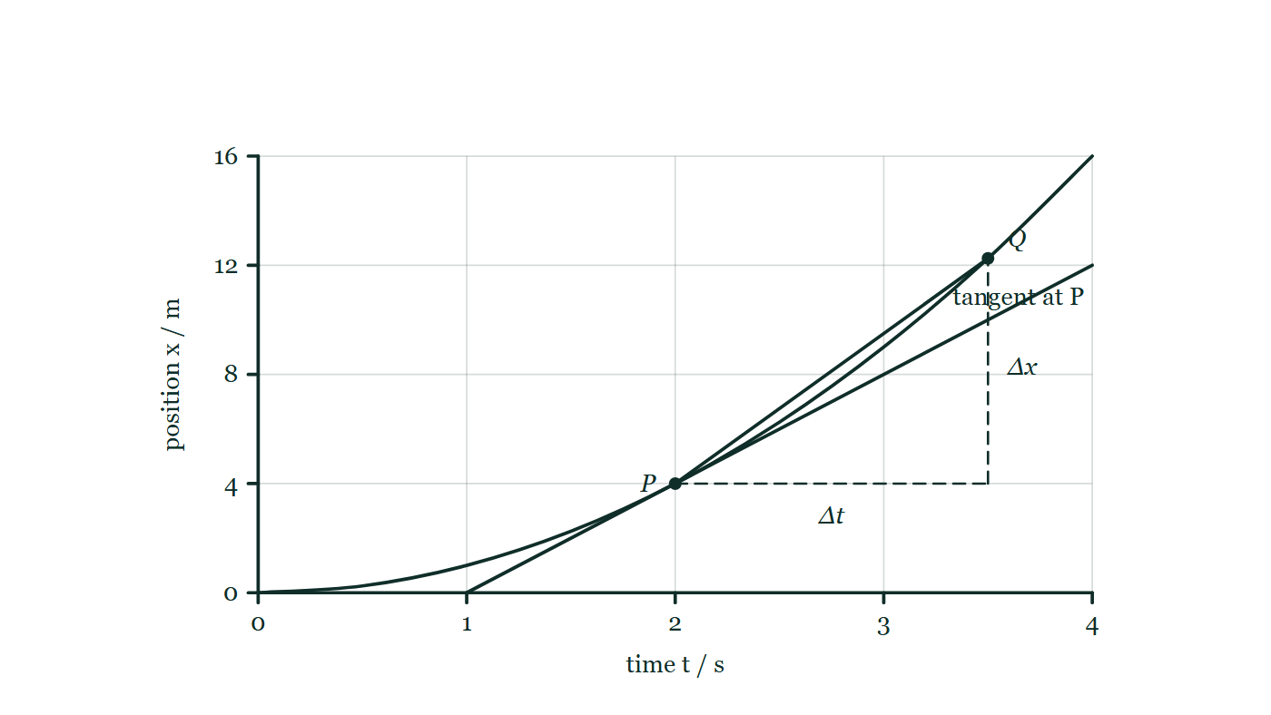
MOTION · KINEMATICS CALCULUS INTEGRATION
GIOPHYSICS LESSON
THE PICTURE
Chord, tangent, limit
Drawn for this lesson
A curved position–time graph with P marked at 2.0 s and Q further along it; the chord PQ is drawn with its Δt and Δx sides dashed, and the tangent at P passes through the same point.
The live version of this figure — click here
Motion — Kinematics Calculus Integration. Built by GioPhysics from the lesson's own copy; nothing on these slides is re-authored.
22 / 31
Notes:
[Phase] Build the model: The formulae, one at a time, in plain English (minutes 13–22 of 45)
[Figure] A curved position–time graph with P marked at 2.0 s and Q further along it; the chord PQ is drawn with its Δt and Δx sides dashed, and the tangent at P passes through the same point.

Slide 23
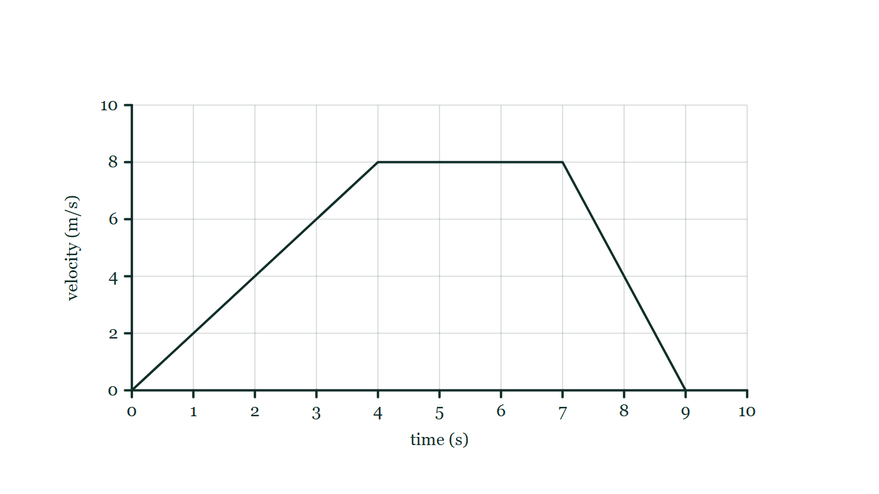
MOTION · KINEMATICS CALCULUS INTEGRATION
GIOPHYSICS LESSON
FIGURE 1 OF 2
Fig. 1.1 — AP Physics 1 · Algebra-Based
Drawn for question 1 of that paper · syllabus 1
A velocity–time graph on a gridded pair of axes. The horizontal axis is time in seconds, marked at every second from 0 to 10; the vertical axis is velocity in metres per second, marked 0, 2, 4, 6, 8 and 10. The plotted line is a straight rise from the origin to 8.0 m/s at 4.0 s, then a horizontal segment held at 8.0 m/s until 7.0 s, then a straight fall back to zero at 9.0 s.
See the question this was drawn for — click here
Motion — Kinematics Calculus Integration. Built by GioPhysics from the lesson's own copy; nothing on these slides is re-authored.
23 / 31
Notes:
[Phase] Build the model: The formulae, one at a time, in plain English (minutes 13–22 of 45)
[Figure] Fig. 1.1. A velocity–time graph on a gridded pair of axes. The horizontal axis is time in seconds, marked at every second from 0 to 10; the vertical axis is velocity in metres per second, marked 0, 2, 4, 6, 8 and 10. The plotted line is a straight rise from the origin to 8.0 m/s at 4.0 s, then a horizontal segment held at 8.0 m/s until 7.0 s, then a straight fall back to zero at 9.0 s.
[Where it came from] AP Physics 1 · Algebra-Based, question 1; syllabus 1.

Slide 24
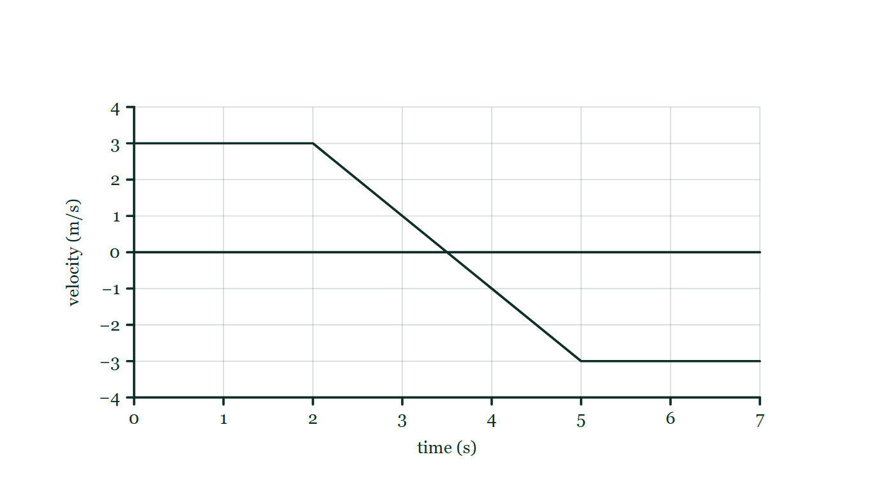
MOTION · KINEMATICS CALCULUS INTEGRATION
GIOPHYSICS LESSON
FIGURE 2 OF 2
Fig. 8.1 — AP Physics 1 · Algebra-Based
Drawn for question 8 of that paper · syllabus 1
The cart's velocity–time graph. The time axis is drawn horizontally through velocity zero and is marked in seconds from 1 to 7; the vertical velocity axis is marked in metres per second from −4 to +4. The plotted line runs horizontally at +3.0 m/s from t = 0 to t = 2.0 s, then falls as a single straight sloping segment, passing through zero, to −3.0 m/s at t = 5.0 s, and then runs horizontally at −3.0 m/s until t = 7.0 s.
See the question this was drawn for — click here
Motion — Kinematics Calculus Integration. Built by GioPhysics from the lesson's own copy; nothing on these slides is re-authored.
24 / 31
Notes:
[Phase] Build the model: The formulae, one at a time, in plain English (minutes 13–22 of 45)
[Figure] Fig. 8.1. The cart's velocity–time graph. The time axis is drawn horizontally through velocity zero and is marked in seconds from 1 to 7; the vertical velocity axis is marked in metres per second from −4 to +4. The plotted line runs horizontally at +3.0 m/s from t = 0 to t = 2.0 s, then falls as a single straight sloping segment, passing through zero, to −3.0 m/s at t = 5.0 s, and then runs horizontally at −3.0 m/s until t = 7.0 s.
[Where it came from] AP Physics 1 · Algebra-Based, question 8; syllabus 1.

Slide 25
MOTION · KINEMATICS CALCULUS INTEGRATION
GIOPHYSICS LESSON
SPOT THE MISTAKE
One line here is wrong
The whole working is up — find the bad line before you click
1.
A particle moves with v(t) = 3t² − 12 m/s. Find its displacement between t = 0 and t = 3.0 s.
2.
Δx = ∫₀³ (3t² − 12) dt
3.
Δx = [t³ − 12t]₀³
4.
Δx = (27 − 36) − 0 = −9 m
5.
So the particle travelled a distance of 9 m in those 3.0 s.
LINE 5 IS WRONG
The integral is right; the last sentence quietly turns a displacement into a distance by dropping the sign. The velocity is negative until t = 2.0 s and positive afterwards, so the particle goes back before it comes forward, and the two parts partly cancel. Distance needs the journey split at t = 2.0 s and each part taken as positive — which gives 16 + 7 = 23 m, not 9.
IT SHOULD SAY
So the particle finished 9 m behind where it started; the distance it covered is larger than that.
Motion — Kinematics Calculus Integration. Built by GioPhysics from the lesson's own copy; nothing on these slides is re-authored.
25 / 31
Notes:
[Phase] Worked examples: I do, we do — one step revealed at a time (minutes 22–35 of 45)
[Spot the mistake] The working is complete and one line of it is wrong. Let the room hunt: one click names the line, a second shows it done correctly.
[Line 5 is wrong] The integral is right; the last sentence quietly turns a displacement into a distance by dropping the sign. The velocity is negative until t = 2.0 s and positive afterwards, so the particle goes back before it comes forward, and the two parts partly cancel. Distance needs the journey split at t = 2.0 s and each part taken as positive — which gives 16 + 7 = 23 m, not 9.
[It should say] So the particle finished 9 m behind where it started; the distance it covered is larger than that.

Slide 26
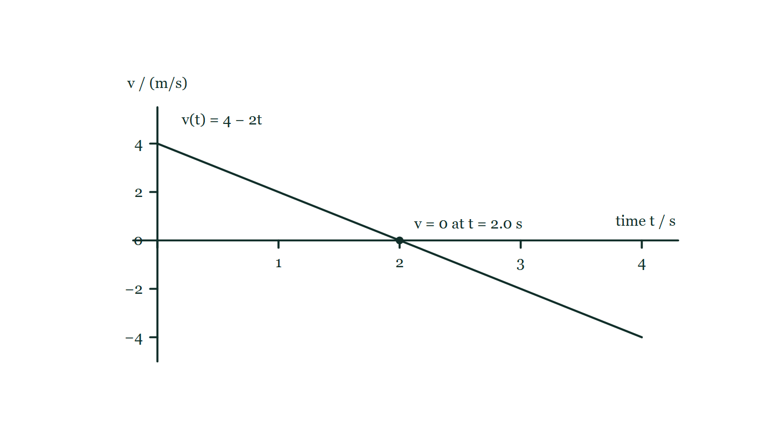
MOTION · KINEMATICS CALCULUS INTEGRATION
GIOPHYSICS LESSON
PREDICT · TAKE THE VOTE
Commit before you are told
Hands up for each option, then click
The object moves with v(t) = 4 − 2t. What is its displacement over the whole 4.0 s?
A 16 m
B 8 m
C 0 m
A straight velocity–time line falls from +4 m/s at t = 0 to −4 m/s at t = 4.0 s; it crosses the time axis at 2.0 s, so part of the plot lies above the axis and part of it below.
The live version of this figure — click here
Motion — Kinematics Calculus Integration. Built by GioPhysics from the lesson's own copy; nothing on these slides is re-authored.
26 / 31
Notes:
[Phase] Build the model: The formulae, one at a time, in plain English (minutes 13–22 of 45)
[Predict] The object moves with v(t) = 4 − 2t. What is its displacement over the whole 4.0 s?
[Options] A 16 m B 8 m C 0 m
[Figure] A straight velocity–time line falls from +4 m/s at t = 0 to −4 m/s at t = 4.0 s; it crosses the time axis at 2.0 s, so part of the plot lies above the axis and part of it below.

Slide 27
MOTION · KINEMATICS CALCULUS INTEGRATION
GIOPHYSICS LESSON
PREDICT · THE OUTCOME
What actually happens
Ask the room who changed their mind, and why
C 0 m
WHY
Displacement is the signed area under the line. The triangle above the axis, from 0 to 2.0 s, is ½ × 2 × 4 = +4 m; the triangle below it, from 2.0 to 4.0 s, is the same size but counts as −4 m because the velocity has reversed. They cancel: the object travelled 8 m of distance and finished exactly where it started.
Motion — Kinematics Calculus Integration. Built by GioPhysics from the lesson's own copy; nothing on these slides is re-authored.
27 / 31
Notes:
[Phase] Build the model: The formulae, one at a time, in plain English (minutes 13–22 of 45)
[Answer] C — 0 m. Displacement is the signed area under the line. The triangle above the axis, from 0 to 2.0 s, is ½ × 2 × 4 = +4 m; the triangle below it, from 2.0 to 4.0 s, is the same size but counts as −4 m because the velocity has reversed. They cancel: the object travelled 8 m of distance and finished exactly where it started.

Slide 28
MOTION · KINEMATICS CALCULUS INTEGRATION
GIOPHYSICS LESSON
QUICK CHECK
Decide before the answer goes up
Check and misconception — The quick check and the trap
What does the slope of a position–time graph represent?
A
Velocity
B
Acceleration
C
Displacement
Motion — Kinematics Calculus Integration. Built by GioPhysics from the lesson's own copy; nothing on these slides is re-authored.
28 / 31
Notes:
[Phase] Check and misconception: The quick check and the trap (minutes 35–41 of 45)
[Question] What does the slope of a position–time graph represent?
[Options] A Velocity B Acceleration C Displacement

Slide 29
MOTION · KINEMATICS CALCULUS INTEGRATION
GIOPHYSICS LESSON
QUICK CHECK · THE ANSWER
The answer, and why
Check and misconception — The quick check and the trap
A Velocity
HOW TO GET THERE
The derivative dx/dt is velocity. At one instant, it is the slope of the tangent to the position graph.
WHY THE OTHERS TEMPT
A Correct. The slope of the position–time graph is dx/dt, which is velocity — and at a single instant it is the slope of the tangent there.
B Acceleration is one derivative further along: it is the slope of the velocity–time graph, or how this graph's slope is changing. A perfectly straight position graph has a slope but no acceleration whatever.
C Displacement is read off the vertical axis of this graph — it is the quantity plotted, not the quantity the slope gives. Areas under graphs do give accumulated quantities, but that is the velocity–time graph, not this one.
Motion — Kinematics Calculus Integration. Built by GioPhysics from the lesson's own copy; nothing on these slides is re-authored.
29 / 31
Notes:
[Phase] Check and misconception: The quick check and the trap (minutes 35–41 of 45)
[Question] What does the slope of a position–time graph represent?
[Option by option] A: Correct. The slope of the position–time graph is dx/dt, which is velocity — and at a single instant it is the slope of the tangent there. B: Acceleration is one derivative further along: it is the slope of the velocity–time graph, or how this graph's slope is changing. A perfectly straight position graph has a slope but no acceleration whatever. C: Displacement is read off the vertical axis of this graph — it is the quantity plotted, not the quantity the slope gives. Areas under graphs do give accumulated quantities, but that is the velocity–time graph, not this one.
[Answer] A — Velocity
[Why] The derivative dx/dt is velocity. At one instant, it is the slope of the tangent to the position graph.
[Reveal] One click for the answer, then one for the reason.

Slide 30
MOTION · KINEMATICS CALCULUS INTEGRATION
GIOPHYSICS LESSON
EXTENSION
No harder example in this lesson
Worked examples — I do, we do — one step revealed at a time
This lesson sets no Hard or Challenging example. The extension for a class that has finished early is the next lesson, or the practice paper questions the figures came from.
Motion — Kinematics Calculus Integration. Built by GioPhysics from the lesson's own copy; nothing on these slides is re-authored.
30 / 31
Notes:
[Phase] Worked examples: I do, we do — one step revealed at a time (minutes 22–35 of 45)
[Extension] The lesson record carries no Hard or Challenging example.

Slide 31
MOTION · KINEMATICS CALCULUS INTEGRATION
GIOPHYSICS LESSON
MOTION
Where to go next
Plenary — What to take away, what to practise next
Next
Kinematics Model for Gaming
https://giophysics.com/chapter-1/kinematics-model-for-gaming/
Lesson
This lesson on giophysics.com
https://giophysics.com/chapter-1/kinematics-calculus/
Live
The live, interactive version of these slides
https://giophysics.com/chapter-1/presentation/?lesson=calculus
Chapter
All Motion lessons
https://giophysics.com/chapter-1/
PDF
Download the lesson PDF
https://giophysics.com/downloads/1-7-kinematics-calculus-integration.pdf
Motion — Kinematics Calculus Integration. Built by GioPhysics from the lesson's own copy; nothing on these slides is re-authored.
31 / 31
Notes:
[Phase] Plenary: What to take away, what to practise next (minutes 41–45 of 45)
[Interactive] The graphs and the circuit topology on these slides are frozen. The live version at https://giophysics.com/chapter-1/presentation/?lesson=calculus moves them.

