Slide 1
MOTION · KINEMATICS 1D · PART 1
GIOPHYSICS LESSON
01 · Motion
Four ideas tell the whole first story.
Kinematics 1D · Part 1
Describe motion along one straight line—without asking what caused it yet.
POSITION
Lesson 3 of 7 in Motion
PLAN
19 slides in the 45-minute core run, about 43 minutes of it
LESSON PAGE
https://giophysics.com/chapter-1/kinematics-1d-part-1/
Built by GioPhysics from the lesson's own page. Every word on these slides is the lesson's; nothing here is re-authored. Teaching material, not an awarding body's document.
Motion — Kinematics 1D · Part 1. Built by GioPhysics from the lesson's own copy; nothing on these slides is re-authored.
1 / 29
Notes:
[Lesson] Motion — Kinematics 1D · Part 1. Lesson 3 of 7.
[Intro] Describe motion along one straight line—without asking what caused it yet.
[Source] https://giophysics.com/chapter-1/kinematics-1d-part-1/
[Disclaimer] Built by GioPhysics from the lesson's own page. Every word on these slides is the lesson's; nothing here is re-authored. Teaching material, not an awarding body's document.

Slide 2
MOTION · KINEMATICS 1D · PART 1
GIOPHYSICS LESSON
THINK FIRST
A runner finishes exactly where she started. Her average speed was 3 m/s — what was her average velocity?
Take answers before you click — the point is the commitment
She ran four laps of a 400 m track, hard, and stopped on the line she set off from.
THE ANSWER
Zero. Velocity is displacement divided by time, and her displacement is zero: she is standing where she began. Speed followed all 1600 m of the path, which is why the two answers are so far apart.
Motion — Kinematics 1D · Part 1. Built by GioPhysics from the lesson's own copy; nothing on these slides is re-authored.
2 / 29
Notes:
[Phase] Starter: Recall what this lesson stands on (minutes 0–5 of 45)
[Hook] A runner finishes exactly where she started. Her average speed was 3 m/s — what was her average velocity? She ran four laps of a 400 m track, hard, and stopped on the line she set off from.
[Answer] Zero. Velocity is displacement divided by time, and her displacement is zero: she is standing where she began. Speed followed all 1600 m of the path, which is why the two answers are so far apart.

Slide 3
MOTION · KINEMATICS 1D · PART 1
GIOPHYSICS LESSON
EXPLAINED SIMPLY
In one sentence
Introduce the idea — The big idea and the definition
One-dimensional kinematics describes position and motion along one straight axis.
Motion — Kinematics 1D · Part 1. Built by GioPhysics from the lesson's own copy; nothing on these slides is re-authored.
3 / 29
Notes:
[Phase] Introduce the idea: The big idea and the definition (minutes 5–13 of 45)
[Definition] One-dimensional kinematics describes position and motion along one straight axis.

Slide 4
MOTION · KINEMATICS 1D · PART 1
GIOPHYSICS LESSON
EXPLAINED SIMPLY
What that looks like
Introduce the idea — The big idea and the definition
FOR EXAMPLE
A lift moving from 2 m to 8 m has a displacement of +6 m along the vertical axis.
Motion — Kinematics 1D · Part 1. Built by GioPhysics from the lesson's own copy; nothing on these slides is re-authored.
4 / 29
Notes:
[Phase] Introduce the idea: The big idea and the definition (minutes 5–13 of 45)
[Worked illustration] A lift moving from 2 m to 8 m has a displacement of +6 m along the vertical axis.

Slide 5
MOTION · KINEMATICS 1D · PART 1
GIOPHYSICS LESSON
THE BIG IDEA
Four ideas tell the whole first story.
Introduce the idea — The big idea and the definition
Position: where the object is. Displacement: how position changes.
Velocity: how quickly position changes. Acceleration: how quickly velocity changes.
Motion — Kinematics 1D · Part 1. Built by GioPhysics from the lesson's own copy; nothing on these slides is re-authored.
5 / 29
Notes:
[Phase] Introduce the idea: The big idea and the definition (minutes 5–13 of 45)
[Big idea] Position: where the object is. Displacement: how position changes. Velocity: how quickly position changes. Acceleration: how quickly velocity changes.

Slide 6
MOTION · KINEMATICS 1D · PART 1
GIOPHYSICS LESSON
THE PHYSICS · 1 OF 5
Motion needs a reference point
Build the model — The formulae, one at a time, in plain English
Position tells where an object is compared with an origin. In one dimension, choose one direction as positive; the other becomes negative.
Motion — Kinematics 1D · Part 1. Built by GioPhysics from the lesson's own copy; nothing on these slides is re-authored.
6 / 29
Notes:
[Phase] Build the model: The formulae, one at a time, in plain English (minutes 13–22 of 45)
[Section] Position tells where an object is compared with an origin. In one dimension, choose one direction as positive; the other becomes negative.

Slide 7
MOTION · KINEMATICS 1D · PART 1
GIOPHYSICS LESSON
THE PHYSICS · 2 OF 5
Speed and velocity are rates
Build the model — The formulae, one at a time, in plain English
Both use metres per second. Speed follows the whole path, while velocity follows the signed displacement.
Motion — Kinematics 1D · Part 1. Built by GioPhysics from the lesson's own copy; nothing on these slides is re-authored.
7 / 29
Notes:
[Phase] Build the model: The formulae, one at a time, in plain English (minutes 13–22 of 45)
[Section] Both use metres per second. Speed follows the whole path, while velocity follows the signed displacement.

Slide 8
MOTION · KINEMATICS 1D · PART 1
GIOPHYSICS LESSON
THE PHYSICS · 3 OF 5
Acceleration tracks velocity
Build the model — The formulae, one at a time, in plain English
Acceleration is the change in velocity divided by time. Because velocity includes direction, turning around also requires acceleration.
Motion — Kinematics 1D · Part 1. Built by GioPhysics from the lesson's own copy; nothing on these slides is re-authored.
8 / 29
Notes:
[Phase] Build the model: The formulae, one at a time, in plain English (minutes 13–22 of 45)
[Section] Acceleration is the change in velocity divided by time. Because velocity includes direction, turning around also requires acceleration.

Slide 9
MOTION · KINEMATICS 1D · PART 1
GIOPHYSICS LESSON
THE PHYSICS · 4 OF 5
A position–time graph is a motion story
Build the model — The formulae, one at a time, in plain English
Time runs horizontally. Position runs vertically. The slope tells velocity: steeper means a larger speed, and the slope’s sign gives direction.
Flat: stationary. Upward: positive velocity. Downward: negative velocity.
Curving: changing velocity.
Motion — Kinematics 1D · Part 1. Built by GioPhysics from the lesson's own copy; nothing on these slides is re-authored.
9 / 29
Notes:
[Phase] Build the model: The formulae, one at a time, in plain English (minutes 13–22 of 45)
[Section] Time runs horizontally. Position runs vertically. The slope tells velocity: steeper means a larger speed, and the slope’s sign gives direction. Flat: stationary. Upward: positive velocity. Downward: negative velocity. Curving: changing velocity.

Slide 10
MOTION · KINEMATICS 1D · PART 1
GIOPHYSICS LESSON
THE PHYSICS · 5 OF 5
Instantaneous speed
Build the model — The formulae, one at a time, in plain English
A speedometer shows the speed at one moment. An average uses an entire time interval.
Motion — Kinematics 1D · Part 1. Built by GioPhysics from the lesson's own copy; nothing on these slides is re-authored.
10 / 29
Notes:
[Phase] Build the model: The formulae, one at a time, in plain English (minutes 13–22 of 45)
[Section] A speedometer shows the speed at one moment. An average uses an entire time interval.

Slide 11
MOTION · KINEMATICS 1D · PART 1
GIOPHYSICS LESSON
FORMULA 1 OF 6
Change in position
Build the model — The formulae, one at a time, in plain English
Δx
Final position minus initial position
IN PLAIN ENGLISH
Reference point, 0 m: the fixed origin used for comparison. Position, x: a signed location measured from the origin.
Motion — Kinematics 1D · Part 1. Built by GioPhysics from the lesson's own copy; nothing on these slides is re-authored.
11 / 29
Notes:
[Phase] Build the model: The formulae, one at a time, in plain English (minutes 13–22 of 45)
[Formula] Change in position: Δx
[In plain English] Reference point, 0 m: the fixed origin used for comparison. Position, x: a signed location measured from the origin.
[Note] Final position minus initial position

Slide 12
MOTION · KINEMATICS 1D · PART 1
GIOPHYSICS LESSON
FORMULA 2 OF 6
Distance · total path
Build the model — The formulae, one at a time, in plain English
|B − A| + |C − B|
scalar · total ground covered · never negative
Motion — Kinematics 1D · Part 1. Built by GioPhysics from the lesson's own copy; nothing on these slides is re-authored.
12 / 29
Notes:
[Phase] Build the model: The formulae, one at a time, in plain English (minutes 13–22 of 45)
[Formula] Distance · total path: |B − A| + |C − B|
[Note] scalar · total ground covered · never negative

Slide 13
MOTION · KINEMATICS 1D · PART 1
GIOPHYSICS LESSON
FORMULA 3 OF 6
Displacement · final change
Build the model — The formulae, one at a time, in plain English
C − A
vector · straight change from start to finish · can be +, −, or 0
Motion — Kinematics 1D · Part 1. Built by GioPhysics from the lesson's own copy; nothing on these slides is re-authored.
13 / 29
Notes:
[Phase] Build the model: The formulae, one at a time, in plain English (minutes 13–22 of 45)
[Formula] Displacement · final change: C − A
[Note] vector · straight change from start to finish · can be +, −, or 0

Slide 14
MOTION · KINEMATICS 1D · PART 1
GIOPHYSICS LESSON
FORMULA 4 OF 6
Average speed
Build the model — The formulae, one at a time, in plain English
total distance ÷ total time
Speed follows the whole path
Motion — Kinematics 1D · Part 1. Built by GioPhysics from the lesson's own copy; nothing on these slides is re-authored.
14 / 29
Notes:
[Phase] Build the model: The formulae, one at a time, in plain English (minutes 13–22 of 45)
[Formula] Average speed: total distance ÷ total time
[Note] Speed follows the whole path

Slide 15
MOTION · KINEMATICS 1D · PART 1
GIOPHYSICS LESSON
FORMULA 5 OF 6
Average velocity
Build the model — The formulae, one at a time, in plain English
displacement ÷ total time
velocity follows the signed displacement
Motion — Kinematics 1D · Part 1. Built by GioPhysics from the lesson's own copy; nothing on these slides is re-authored.
15 / 29
Notes:
[Phase] Build the model: The formulae, one at a time, in plain English (minutes 13–22 of 45)
[Formula] Average velocity: displacement ÷ total time
[Note] velocity follows the signed displacement

Slide 16
MOTION · KINEMATICS 1D · PART 1
GIOPHYSICS LESSON
FORMULA 6 OF 6
Calculated acceleration
Build the model — The formulae, one at a time, in plain English
(v − u) ÷ t
m/s²
IN PLAIN ENGLISH
Same direction → speeding up. Opposite directions → slowing down.
Motion — Kinematics 1D · Part 1. Built by GioPhysics from the lesson's own copy; nothing on these slides is re-authored.
16 / 29
Notes:
[Phase] Build the model: The formulae, one at a time, in plain English (minutes 13–22 of 45)
[Formula] Calculated acceleration: (v − u) ÷ t
[In plain English] Same direction → speeding up. Opposite directions → slowing down.
[Note] m/s²

Slide 17
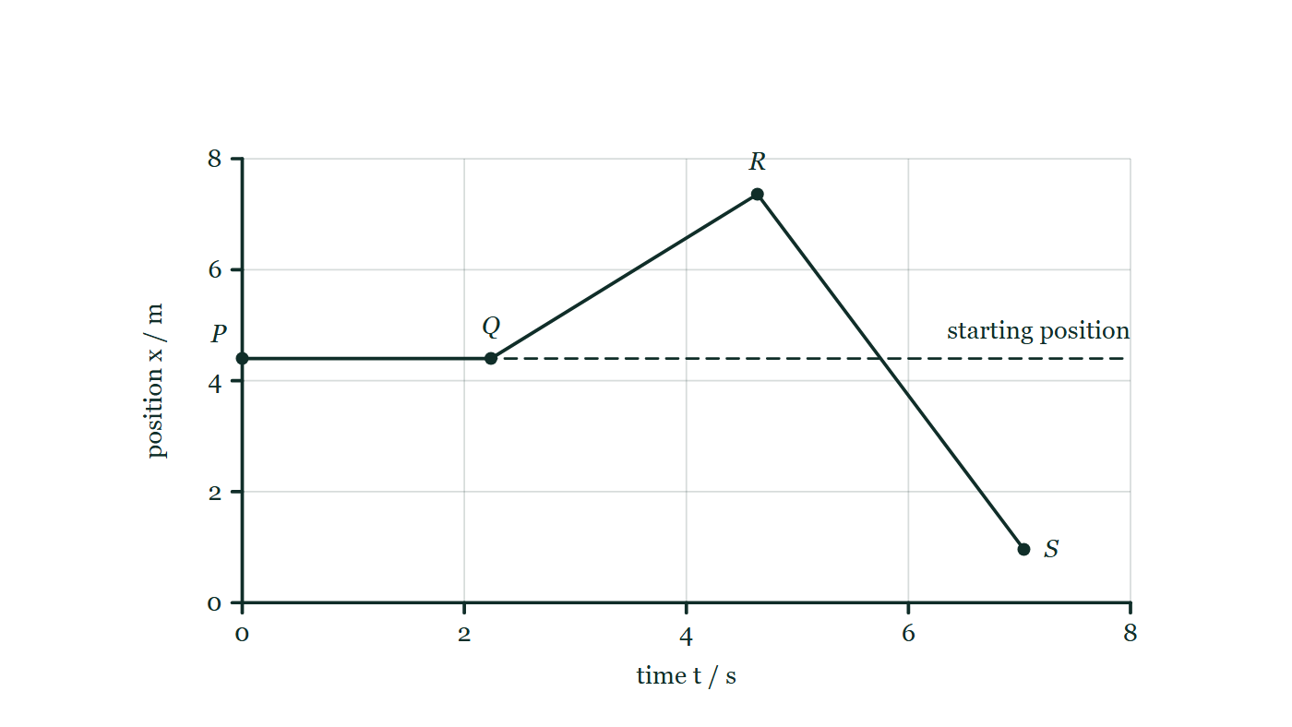
MOTION · KINEMATICS 1D · PART 1
GIOPHYSICS LESSON
THE PICTURE
Reading a position–time graph
Drawn for this lesson
A position–time graph through four marked instants: flat from P to Q, rising steeply to R, then falling steadily to S, which finishes below the dashed line drawn at the starting position.
The live version of this figure — click here
Motion — Kinematics 1D · Part 1. Built by GioPhysics from the lesson's own copy; nothing on these slides is re-authored.
17 / 29
Notes:
[Phase] Build the model: The formulae, one at a time, in plain English (minutes 13–22 of 45)
[Figure] A position–time graph through four marked instants: flat from P to Q, rising steeply to R, then falling steadily to S, which finishes below the dashed line drawn at the starting position.

Slide 18
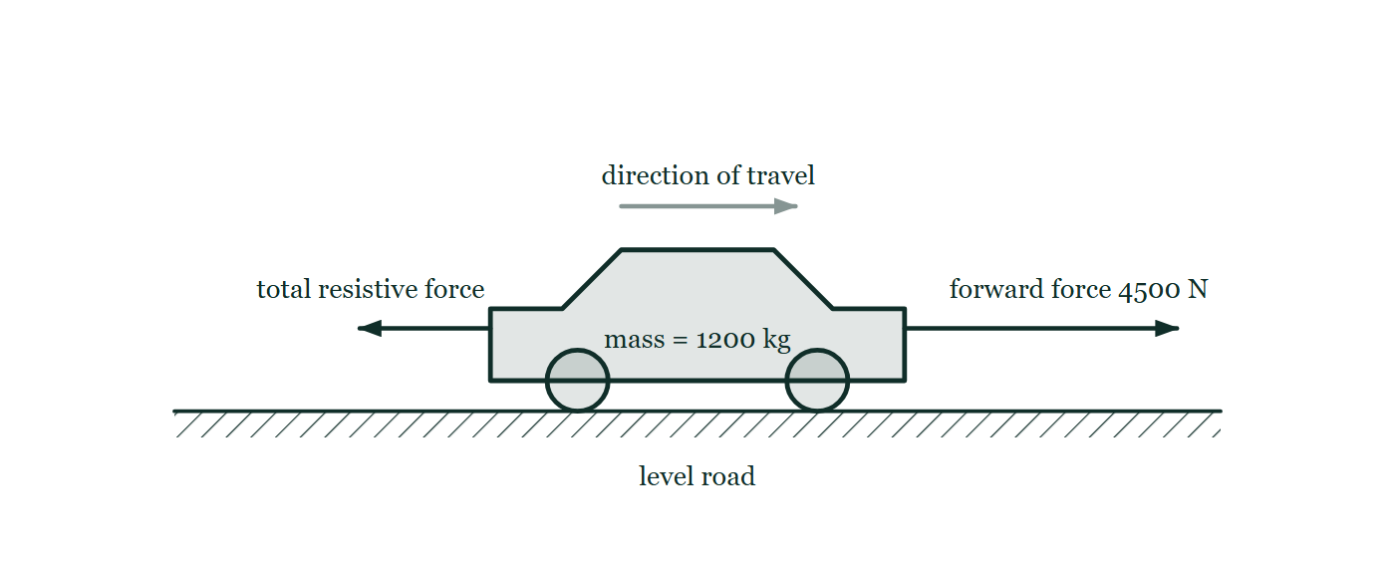
MOTION · KINEMATICS 1D · PART 1
GIOPHYSICS LESSON
FIGURE 1 OF 5
Fig. 7.1 — IGCSE Topic 1 · Motion, forces and energy
Drawn for question 7 of that paper · syllabus 1.2, 1.5.1
A car on a straight, level road, labelled mass = 1200 kg, with a faint arrow above it showing the direction of travel to the right. A long horizontal arrow points forwards from the front of the car and is labelled forward force 4500 N. A shorter horizontal arrow points backwards from the rear of the car and is labelled total resistive force, with no value given.
See the question this was drawn for — click here
Motion — Kinematics 1D · Part 1. Built by GioPhysics from the lesson's own copy; nothing on these slides is re-authored.
18 / 29
Notes:
[Phase] Build the model: The formulae, one at a time, in plain English (minutes 13–22 of 45)
[Figure] Fig. 7.1. A car on a straight, level road, labelled mass = 1200 kg, with a faint arrow above it showing the direction of travel to the right. A long horizontal arrow points forwards from the front of the car and is labelled forward force 4500 N. A shorter horizontal arrow points backwards from the rear of the car and is labelled total resistive force, with no value given.
[Where it came from] IGCSE Topic 1 · Motion, forces and energy, question 7; syllabus 1.2, 1.5.1.

Slide 19
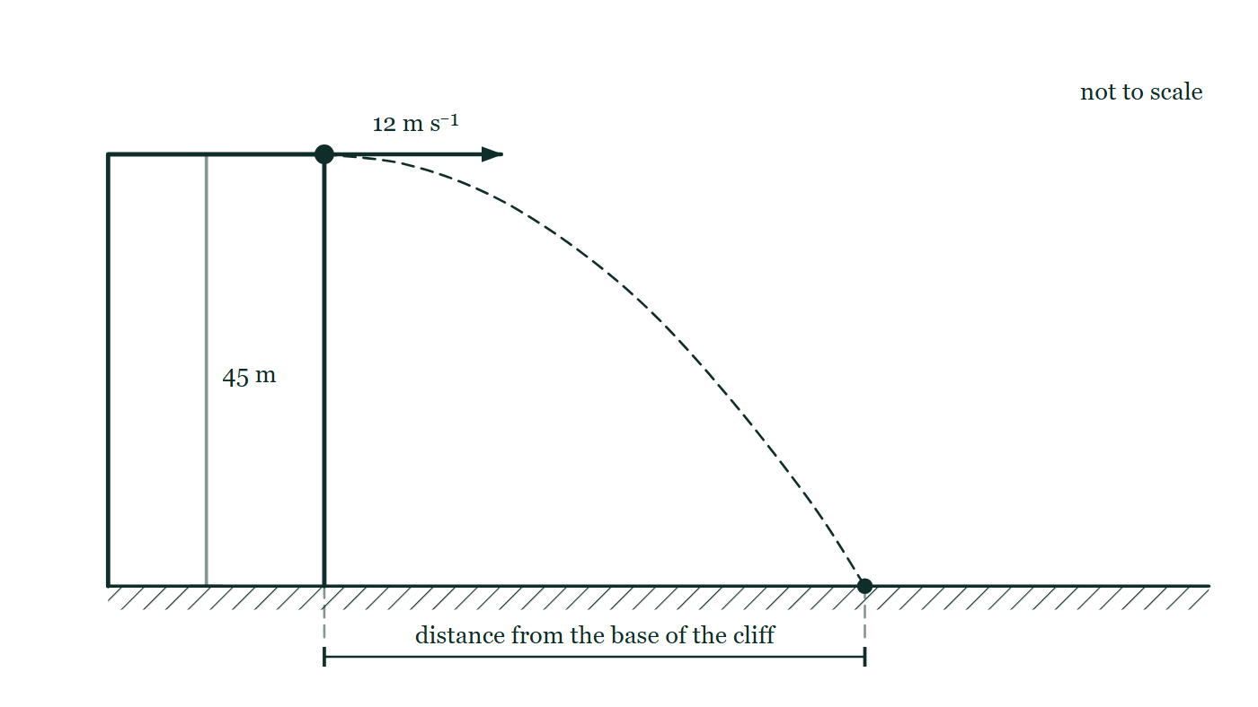
MOTION · KINEMATICS 1D · PART 1
GIOPHYSICS LESSON
FIGURE 2 OF 5
Fig. 2.1 — A Level AS · Topics 1–11
Drawn for question 2 of that paper · syllabus 2
A cliff of height 45 m rises vertically from level ground. A stone leaves the very edge of the cliff top moving horizontally, its initial velocity shown by an arrow labelled 12 m s⁻¹ pointing away from the cliff, and a dashed curve traces its path down to the ground. The height of the cliff is marked 45 m; the horizontal distance from the base of the cliff to the point where the stone lands is marked by a dimension line but is given no value. The figure is not to scale.
See the question this was drawn for — click here
Motion — Kinematics 1D · Part 1. Built by GioPhysics from the lesson's own copy; nothing on these slides is re-authored.
19 / 29
Notes:
[Phase] Build the model: The formulae, one at a time, in plain English (minutes 13–22 of 45)
[Figure] Fig. 2.1. A cliff of height 45 m rises vertically from level ground. A stone leaves the very edge of the cliff top moving horizontally, its initial velocity shown by an arrow labelled 12 m s⁻¹ pointing away from the cliff, and a dashed curve traces its path down to the ground. The height of the cliff is marked 45 m; the horizontal distance from the base of the cliff to the point where the stone lands is marked by a dimension line but is given no value. The figure is not to scale.
[Where it came from] A Level AS · Topics 1–11, question 2; syllabus 2.

Slide 20
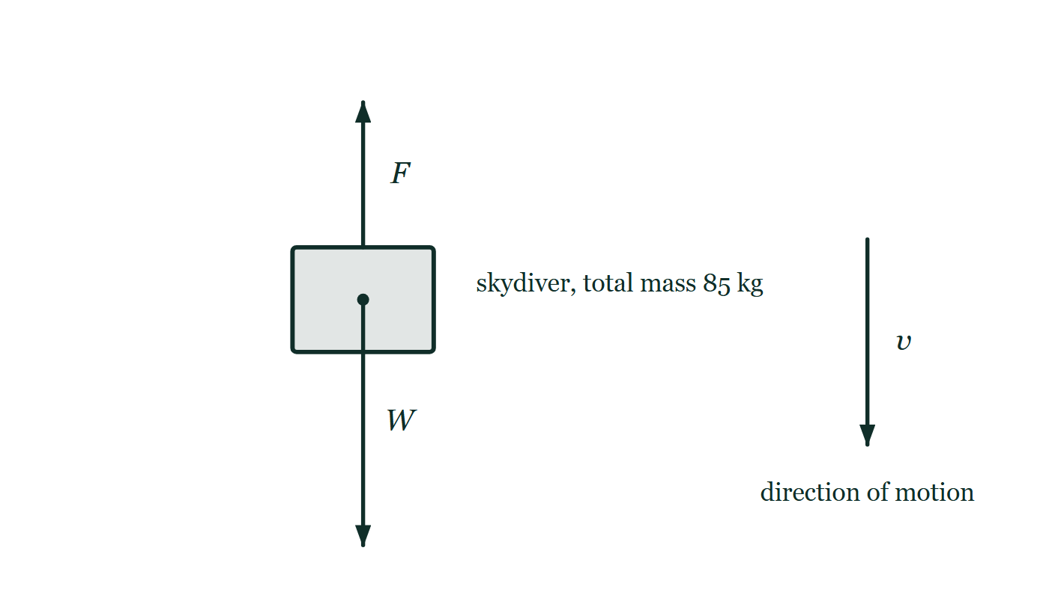
MOTION · KINEMATICS 1D · PART 1
GIOPHYSICS LESSON
FIGURE 3 OF 5
Fig. 7.1 — A Level AS · Topics 1–11
Drawn for question 7 of that paper · syllabus 2, 3, 4
The falling skydiver is drawn as a block with a dot at her centre of mass, labelled as having a total mass of 85 kg. A long arrow labelled W starts at that dot and points vertically downwards. A shorter arrow labelled F starts at her upper surface and points vertically upwards. To one side, a separate arrow labelled v points downwards to show her direction of motion.
See the question this was drawn for — click here
Motion — Kinematics 1D · Part 1. Built by GioPhysics from the lesson's own copy; nothing on these slides is re-authored.
20 / 29
Notes:
[Phase] Build the model: The formulae, one at a time, in plain English (minutes 13–22 of 45)
[Figure] Fig. 7.1. The falling skydiver is drawn as a block with a dot at her centre of mass, labelled as having a total mass of 85 kg. A long arrow labelled W starts at that dot and points vertically downwards. A shorter arrow labelled F starts at her upper surface and points vertically upwards. To one side, a separate arrow labelled v points downwards to show her direction of motion.
[Where it came from] A Level AS · Topics 1–11, question 7; syllabus 2, 3, 4.

Slide 21
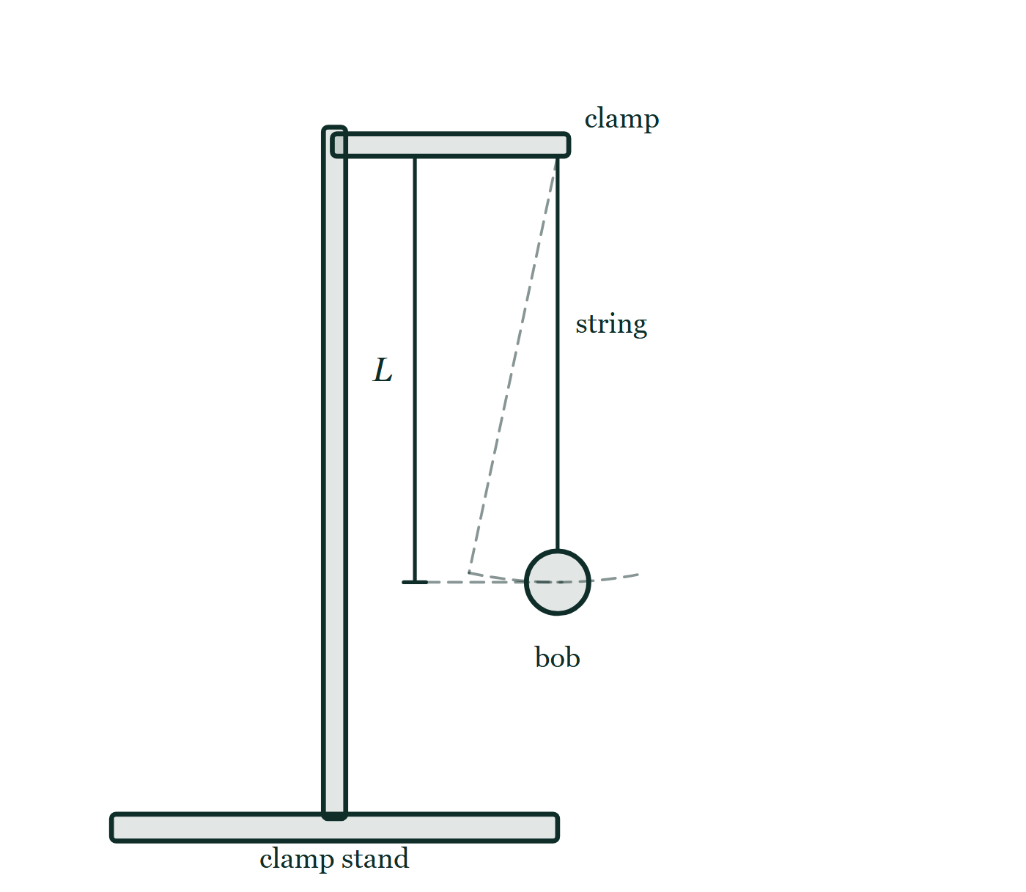
MOTION · KINEMATICS 1D · PART 1
GIOPHYSICS LESSON
FIGURE 4 OF 5
Figure 2 — IB Theme A · Space, time and motion
Drawn for question 7 of that paper · syllabus A.1
Side view of the apparatus. A vertical rod in a heavy base carries a horizontal clamp arm, and a string hangs from the clamp jaws with a small spherical bob tied to its lower end. A dimension line beside the string marks the length L, running from the point of suspension down to the centre of the bob. A dashed line shows the string displaced to one side and a dashed arc through the bob shows the path it follows as it swings.
See the question this was drawn for — click here
Motion — Kinematics 1D · Part 1. Built by GioPhysics from the lesson's own copy; nothing on these slides is re-authored.
21 / 29
Notes:
[Phase] Build the model: The formulae, one at a time, in plain English (minutes 13–22 of 45)
[Figure] Figure 2. Side view of the apparatus. A vertical rod in a heavy base carries a horizontal clamp arm, and a string hangs from the clamp jaws with a small spherical bob tied to its lower end. A dimension line beside the string marks the length L, running from the point of suspension down to the centre of the bob. A dashed line shows the string displaced to one side and a dashed arc through the bob shows the path it follows as it swings.
[Where it came from] IB Theme A · Space, time and motion, question 7; syllabus A.1.

Slide 22
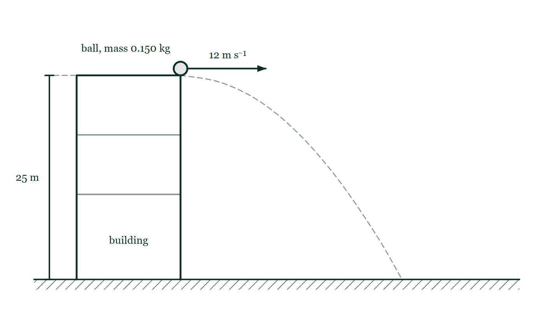
MOTION · KINEMATICS 1D · PART 1
GIOPHYSICS LESSON
FIGURE 5 OF 5
Figure 3 — IB Theme A · Space, time and motion
Drawn for question 8 of that paper · syllabus A.1, A.2
Side view. A building stands on level hatched ground, its height marked by a dimension line labelled 25 m running from roof level down to the ground. A small ball, labelled as having mass 0.150 kg, sits at the right-hand edge of the roof, and a horizontal arrow from the ball labelled 12 m s⁻¹ points away from the building. A faint dashed curve traces the path the ball follows from the roof edge down to the ground.
See the question this was drawn for — click here
Motion — Kinematics 1D · Part 1. Built by GioPhysics from the lesson's own copy; nothing on these slides is re-authored.
22 / 29
Notes:
[Phase] Build the model: The formulae, one at a time, in plain English (minutes 13–22 of 45)
[Figure] Figure 3. Side view. A building stands on level hatched ground, its height marked by a dimension line labelled 25 m running from roof level down to the ground. A small ball, labelled as having mass 0.150 kg, sits at the right-hand edge of the roof, and a horizontal arrow from the ball labelled 12 m s⁻¹ points away from the building. A faint dashed curve traces the path the ball follows from the roof edge down to the ground.
[Where it came from] IB Theme A · Space, time and motion, question 8; syllabus A.1, A.2.

Slide 23
MOTION · KINEMATICS 1D · PART 1
GIOPHYSICS LESSON
WATCH OUT
The common trap
Check and misconception — The quick check and the trap
Sign is direction—not a verdict. Positive acceleration points in the chosen positive direction.
Negative acceleration points the other way. Compare the directions of velocity and acceleration to decide whether speed is increasing or decreasing.
Motion — Kinematics 1D · Part 1. Built by GioPhysics from the lesson's own copy; nothing on these slides is re-authored.
23 / 29
Notes:
[Phase] Check and misconception: The quick check and the trap (minutes 35–41 of 45)
[Misconception] Sign is direction—not a verdict. Positive acceleration points in the chosen positive direction. Negative acceleration points the other way. Compare the directions of velocity and acceleration to decide whether speed is increasing or decreasing.

Slide 24
MOTION · KINEMATICS 1D · PART 1
GIOPHYSICS LESSON
PREDICT · TAKE THE VOTE
Commit before you are told
Hands up for each option, then click
Between R and S the graph slopes downwards. What is the object doing?
A Slowing down, but still moving forwards
B Moving backwards, past where it started
C Standing still at a lower position
A position–time graph through four marked instants: flat from P to Q, rising steeply to R, then falling steadily to S, which finishes below the dashed line drawn at the starting position.
The live version of this figure — click here
Motion — Kinematics 1D · Part 1. Built by GioPhysics from the lesson's own copy; nothing on these slides is re-authored.
24 / 29
Notes:
[Phase] Build the model: The formulae, one at a time, in plain English (minutes 13–22 of 45)
[Predict] Between R and S the graph slopes downwards. What is the object doing?
[Options] A Slowing down, but still moving forwards B Moving backwards, past where it started C Standing still at a lower position
[Figure] A position–time graph through four marked instants: flat from P to Q, rising steeply to R, then falling steadily to S, which finishes below the dashed line drawn at the starting position.

Slide 25
MOTION · KINEMATICS 1D · PART 1
GIOPHYSICS LESSON
PREDICT · THE OUTCOME
What actually happens
Ask the room who changed their mind, and why
B Moving backwards, past where it started
WHY
On a position–time graph the height is where the object is, not how fast it is going. From R to S the height falls steadily, so the object is moving back the way it came at a steady speed — and since S sits below the dashed starting line, it has gone past its starting point.
Motion — Kinematics 1D · Part 1. Built by GioPhysics from the lesson's own copy; nothing on these slides is re-authored.
25 / 29
Notes:
[Phase] Build the model: The formulae, one at a time, in plain English (minutes 13–22 of 45)
[Answer] B — Moving backwards, past where it started. On a position–time graph the height is where the object is, not how fast it is going. From R to S the height falls steadily, so the object is moving back the way it came at a steady speed — and since S sits below the dashed starting line, it has gone past its starting point.

Slide 26
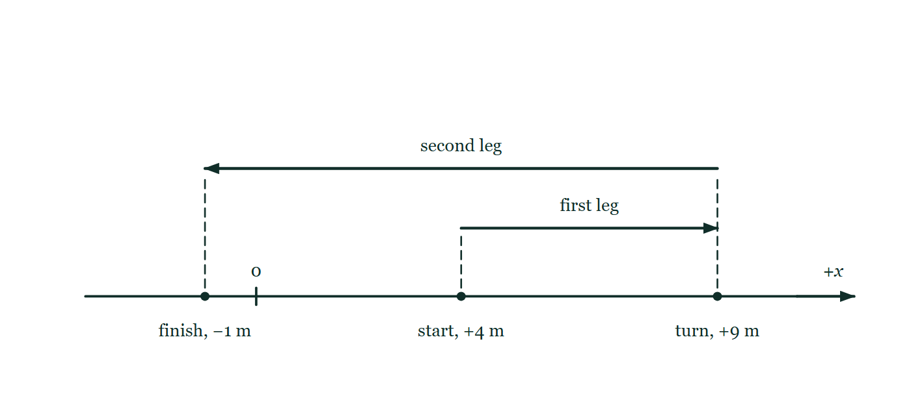
MOTION · KINEMATICS 1D · PART 1
GIOPHYSICS LESSON
QUICK CHECK
Decide before the answer goes up
Check and misconception — The quick check and the trap
A runner goes from +4 m to +9 m, then finishes at −1 m. What are distance and displacement?
A
10 m and −5 m
B
15 m and −5 m
C
15 m and +5 m
A signed position axis with zero marked; the runner's three positions sit on it at +4 m, +9 m and −1 m, and two arrows above the axis show the outward leg and the longer return leg.
The live version of this figure — click here
Motion — Kinematics 1D · Part 1. Built by GioPhysics from the lesson's own copy; nothing on these slides is re-authored.
26 / 29
Notes:
[Phase] Check and misconception: The quick check and the trap (minutes 35–41 of 45)
[Question] A runner goes from +4 m to +9 m, then finishes at −1 m. What are distance and displacement?
[Figure] A signed position axis with zero marked; the runner's three positions sit on it at +4 m, +9 m and −1 m, and two arrows above the axis show the outward leg and the longer return leg.
[Options] A 10 m and −5 m B 15 m and −5 m C 15 m and +5 m

Slide 27
MOTION · KINEMATICS 1D · PART 1
GIOPHYSICS LESSON
QUICK CHECK · THE ANSWER
The answer, and why
Check and misconception — The quick check and the trap
B 15 m and −5 m
HOW TO GET THERE
Distance = 5 m + 10 m = 15 m. Displacement = −1 m − 4 m = −5 m.
WHY THE OTHERS TEMPT
A 10 m is the second leg on its own, from +9 m back to −1 m. Distance counts every metre actually covered, so the 5 m out to the turn has to be added to it. The −5 m displacement beside it is right.
B Correct. Distance is 5 m + 10 m = 15 m along the path; displacement is −1 − (+4) = −5 m, straight from start to finish.
C The distance is right, but the displacement subtraction has been done the wrong way round. Final minus initial gives −1 − (+4) = −5 m. A positive answer would place the finish to the right of the start, and the drawing puts it to the left.
Motion — Kinematics 1D · Part 1. Built by GioPhysics from the lesson's own copy; nothing on these slides is re-authored.
27 / 29
Notes:
[Phase] Check and misconception: The quick check and the trap (minutes 35–41 of 45)
[Question] A runner goes from +4 m to +9 m, then finishes at −1 m. What are distance and displacement?
[Option by option] A: 10 m is the second leg on its own, from +9 m back to −1 m. Distance counts every metre actually covered, so the 5 m out to the turn has to be added to it. The −5 m displacement beside it is right. B: Correct. Distance is 5 m + 10 m = 15 m along the path; displacement is −1 − (+4) = −5 m, straight from start to finish. C: The distance is right, but the displacement subtraction has been done the wrong way round. Final minus initial gives −1 − (+4) = −5 m. A positive answer would place the finish to the right of the start, and the drawing puts it to the left.
[Answer] B — 15 m and −5 m
[Why] Distance = 5 m + 10 m = 15 m. Displacement = −1 m − 4 m = −5 m.
[Reveal] One click for the answer, then one for the reason.

Slide 28
MOTION · KINEMATICS 1D · PART 1
GIOPHYSICS LESSON
EXTENSION
No harder example in this lesson
Worked examples — I do, we do — one step revealed at a time
This lesson sets no Hard or Challenging example. The extension for a class that has finished early is the next lesson, or the practice paper questions the figures came from.
Motion — Kinematics 1D · Part 1. Built by GioPhysics from the lesson's own copy; nothing on these slides is re-authored.
28 / 29
Notes:
[Phase] Worked examples: I do, we do — one step revealed at a time (minutes 22–35 of 45)
[Extension] The lesson record carries no Hard or Challenging example.

Slide 29
MOTION · KINEMATICS 1D · PART 1
GIOPHYSICS LESSON
MOTION
Where to go next
Plenary — What to take away, what to practise next
Next
Kinematics 1D · Part 2
https://giophysics.com/chapter-1/kinematics-1d-part-2/
Lesson
This lesson on giophysics.com
https://giophysics.com/chapter-1/kinematics-1d-part-1/
Live
The live, interactive version of these slides
https://giophysics.com/chapter-1/presentation/?lesson=oneDimensionPartOne
Chapter
All Motion lessons
https://giophysics.com/chapter-1/
PDF
Download the lesson PDF
https://giophysics.com/downloads/1-3-kinematics-1d-part-1.pdf
Motion — Kinematics 1D · Part 1. Built by GioPhysics from the lesson's own copy; nothing on these slides is re-authored.
29 / 29
Notes:
[Phase] Plenary: What to take away, what to practise next (minutes 41–45 of 45)
[Interactive] The graphs and the circuit topology on these slides are frozen. The live version at https://giophysics.com/chapter-1/presentation/?lesson=oneDimensionPartOne moves them.

