Slide 1
MOTION · KINEMATICS 1D · PART 2
GIOPHYSICS LESSON
01 · Motion
Three connections unlock accelerated motion.
Kinematics 1D · Part 2
Turn acceleration into predictions—then see how the same straight-line maths powers free fall.
POSITION
Lesson 4 of 7 in Motion
PLAN
18 slides in the 45-minute core run, about 45 minutes of it
LESSON PAGE
https://giophysics.com/chapter-1/kinematics-1d-part-2/
Built by GioPhysics from the lesson's own page. Every word on these slides is the lesson's; nothing here is re-authored. Teaching material, not an awarding body's document.
Motion — Kinematics 1D · Part 2. Built by GioPhysics from the lesson's own copy; nothing on these slides is re-authored.
1 / 28
Notes:
[Lesson] Motion — Kinematics 1D · Part 2. Lesson 4 of 7.
[Intro] Turn acceleration into predictions—then see how the same straight-line maths powers free fall.
[Source] https://giophysics.com/chapter-1/kinematics-1d-part-2/
[Disclaimer] Built by GioPhysics from the lesson's own page. Every word on these slides is the lesson's; nothing here is re-authored. Teaching material, not an awarding body's document.

Slide 2
MOTION · KINEMATICS 1D · PART 2
GIOPHYSICS LESSON
THINK FIRST
Two cars set off together. One holds 10 m/s for 10 s; the other starts from rest and reaches 20 m/s in the same 10 s. Which is in front at the end?
Take answers before you click — the point is the commitment
Both start on the same line at the same instant. The second car accelerates steadily the whole way and is clearly travelling faster by the end of it.
THE ANSWER
Neither — they are level. The second car's average velocity over those 10 s is (0 + 20)/2 = 10 m/s, exactly the first car's steady speed, so both have covered 100 m. Finishing faster is not the same as having gone further.
Motion — Kinematics 1D · Part 2. Built by GioPhysics from the lesson's own copy; nothing on these slides is re-authored.
2 / 28
Notes:
[Phase] Starter: Recall what this lesson stands on (minutes 0–5 of 45)
[Hook] Two cars set off together. One holds 10 m/s for 10 s; the other starts from rest and reaches 20 m/s in the same 10 s. Which is in front at the end? Both start on the same line at the same instant. The second car accelerates steadily the whole way and is clearly travelling faster by the end of it.
[Answer] Neither — they are level. The second car's average velocity over those 10 s is (0 + 20)/2 = 10 m/s, exactly the first car's steady speed, so both have covered 100 m. Finishing faster is not the same as having gone further.

Slide 3
MOTION · KINEMATICS 1D · PART 2
GIOPHYSICS LESSON
EXPLAINED SIMPLY
In one sentence
Introduce the idea — The big idea and the definition
Constant-acceleration kinematics links displacement, velocity, acceleration, and time when acceleration stays unchanged.
Motion — Kinematics 1D · Part 2. Built by GioPhysics from the lesson's own copy; nothing on these slides is re-authored.
3 / 28
Notes:
[Phase] Introduce the idea: The big idea and the definition (minutes 5–13 of 45)
[Definition] Constant-acceleration kinematics links displacement, velocity, acceleration, and time when acceleration stays unchanged.

Slide 4
MOTION · KINEMATICS 1D · PART 2
GIOPHYSICS LESSON
EXPLAINED SIMPLY
What that looks like
Introduce the idea — The big idea and the definition
FOR EXAMPLE
A bicycle starting at 2 m/s and accelerating at 3 m/s² reaches 8 m/s after 2 s.
Motion — Kinematics 1D · Part 2. Built by GioPhysics from the lesson's own copy; nothing on these slides is re-authored.
4 / 28
Notes:
[Phase] Introduce the idea: The big idea and the definition (minutes 5–13 of 45)
[Worked illustration] A bicycle starting at 2 m/s and accelerating at 3 m/s² reaches 8 m/s after 2 s.

Slide 5
MOTION · KINEMATICS 1D · PART 2
GIOPHYSICS LESSON
THE BIG IDEA
Three connections unlock accelerated motion.
Introduce the idea — The big idea and the definition
Gradient: velocity–time slope gives acceleration. Area: velocity × time gives displacement. Gravity: free fall is constant acceleration in one dimension.
Motion — Kinematics 1D · Part 2. Built by GioPhysics from the lesson's own copy; nothing on these slides is re-authored.
5 / 28
Notes:
[Phase] Introduce the idea: The big idea and the definition (minutes 5–13 of 45)
[Big idea] Gradient: velocity–time slope gives acceleration. Area: velocity × time gives displacement. Gravity: free fall is constant acceleration in one dimension.

Slide 6
MOTION · KINEMATICS 1D · PART 2
GIOPHYSICS LESSON
THE PHYSICS · 1 OF 6
Acceleration is a rate of change
Build the model — The formulae, one at a time, in plain English
Average acceleration tells how much velocity changes each second. When acceleration is constant, every equal time interval adds the same amount of velocity.
Motion — Kinematics 1D · Part 2. Built by GioPhysics from the lesson's own copy; nothing on these slides is re-authored.
6 / 28
Notes:
[Phase] Build the model: The formulae, one at a time, in plain English (minutes 13–22 of 45)
[Section] Average acceleration tells how much velocity changes each second. When acceleration is constant, every equal time interval adds the same amount of velocity.

Slide 7
MOTION · KINEMATICS 1D · PART 2
GIOPHYSICS LESSON
THE PHYSICS · 2 OF 6
One graph gives acceleration and displacement
Build the model — The formulae, one at a time, in plain English
On a velocity–time graph, the gradient is acceleration. The signed area between the line and the time axis is displacement.
The straight line means the acceleration stays constant. A horizontal line would mean zero acceleration.
Motion — Kinematics 1D · Part 2. Built by GioPhysics from the lesson's own copy; nothing on these slides is re-authored.
7 / 28
Notes:
[Phase] Build the model: The formulae, one at a time, in plain English (minutes 13–22 of 45)
[Section] On a velocity–time graph, the gradient is acceleration. The signed area between the line and the time axis is displacement. The straight line means the acceleration stays constant. A horizontal line would mean zero acceleration.

Slide 8
MOTION · KINEMATICS 1D · PART 2
GIOPHYSICS LESSON
THE PHYSICS · 3 OF 6
Four equations connect five quantities
Build the model — The formulae, one at a time, in plain English
The symbols are s, u, v, a, and t. List what you know, identify what you need, then choose the equation that leaves out the unused quantity.
Motion — Kinematics 1D · Part 2. Built by GioPhysics from the lesson's own copy; nothing on these slides is re-authored.
8 / 28
Notes:
[Phase] Build the model: The formulae, one at a time, in plain English (minutes 13–22 of 45)
[Section] The symbols are s, u, v, a, and t. List what you know, identify what you need, then choose the equation that leaves out the unused quantity.

Slide 9
MOTION · KINEMATICS 1D · PART 2
GIOPHYSICS LESSON
THE PHYSICS · 4 OF 6
Reliable method
Build the model — The formulae, one at a time, in plain English
Choose a positive direction. Write each known value with its sign and unit.
Select the equation containing the quantity you need. Substitute, solve, and check whether the sign makes sense.
Motion — Kinematics 1D · Part 2. Built by GioPhysics from the lesson's own copy; nothing on these slides is re-authored.
9 / 28
Notes:
[Phase] Build the model: The formulae, one at a time, in plain English (minutes 13–22 of 45)
[Section] Choose a positive direction. Write each known value with its sign and unit. Select the equation containing the quantity you need. Substitute, solve, and check whether the sign makes sense.

Slide 10
MOTION · KINEMATICS 1D · PART 2
GIOPHYSICS LESSON
THE PHYSICS · 5 OF 6
Free fall has one constant acceleration
Build the model — The formulae, one at a time, in plain English
Ignore air resistance and gravity gives every object the same downward acceleration: g = 9.81 m/s². Here, upward is positive, so a = −9.81 m/s².
Motion — Kinematics 1D · Part 2. Built by GioPhysics from the lesson's own copy; nothing on these slides is re-authored.
10 / 28
Notes:
[Phase] Build the model: The formulae, one at a time, in plain English (minutes 13–22 of 45)
[Section] Ignore air resistance and gravity gives every object the same downward acceleration: g = 9.81 m/s². Here, upward is positive, so a = −9.81 m/s².

Slide 11
MOTION · KINEMATICS 1D · PART 2
GIOPHYSICS LESSON
THE PHYSICS · 6 OF 6
A projectile is two 1D stories sharing time
Build the model — The formulae, one at a time, in plain English
Split the launch velocity into horizontal and vertical components. The horizontal component stays constant; the vertical component follows the free-fall mathematics above.
Motion — Kinematics 1D · Part 2. Built by GioPhysics from the lesson's own copy; nothing on these slides is re-authored.
11 / 28
Notes:
[Phase] Build the model: The formulae, one at a time, in plain English (minutes 13–22 of 45)
[Section] Split the launch velocity into horizontal and vertical components. The horizontal component stays constant; the vertical component follows the free-fall mathematics above.

Slide 12
MOTION · KINEMATICS 1D · PART 2
GIOPHYSICS LESSON
FORMULA 1 OF 8
Acceleration
Build the model — The formulae, one at a time, in plain English
(v − u) ÷ t
change in velocity ÷ time taken · the gradient of a velocity–time graph
Motion — Kinematics 1D · Part 2. Built by GioPhysics from the lesson's own copy; nothing on these slides is re-authored.
12 / 28
Notes:
[Phase] Build the model: The formulae, one at a time, in plain English (minutes 13–22 of 45)
[Formula] Acceleration: (v − u) ÷ t
[Note] change in velocity ÷ time taken · the gradient of a velocity–time graph

Slide 13
MOTION · KINEMATICS 1D · PART 2
GIOPHYSICS LESSON
FORMULA 2 OF 8
Five quantities
Build the model — The formulae, one at a time, in plain English
s · u · v · a · t
displacement m · initial velocity m/s · final velocity m/s · acceleration m/s² · time s
Motion — Kinematics 1D · Part 2. Built by GioPhysics from the lesson's own copy; nothing on these slides is re-authored.
13 / 28
Notes:
[Phase] Build the model: The formulae, one at a time, in plain English (minutes 13–22 of 45)
[Formula] Five quantities: s · u · v · a · t
[Note] displacement m · initial velocity m/s · final velocity m/s · acceleration m/s² · time s

Slide 14
MOTION · KINEMATICS 1D · PART 2
GIOPHYSICS LESSON
FORMULA 3 OF 8
Equation 01
Build the model — The formulae, one at a time, in plain English
v = u + at
No displacement, s
IN PLAIN ENGLISH
Use it when velocity changes steadily for a known time.
Motion — Kinematics 1D · Part 2. Built by GioPhysics from the lesson's own copy; nothing on these slides is re-authored.
14 / 28
Notes:
[Phase] Build the model: The formulae, one at a time, in plain English (minutes 13–22 of 45)
[Formula] Equation 01: v = u + at
[In plain English] Use it when velocity changes steadily for a known time.
[Note] No displacement, s

Slide 15
MOTION · KINEMATICS 1D · PART 2
GIOPHYSICS LESSON
FORMULA 4 OF 8
Equation 02
Build the model — The formulae, one at a time, in plain English
s = ½(u + v)t
No acceleration, a
IN PLAIN ENGLISH
Average the initial and final velocities, then multiply by time.
Motion — Kinematics 1D · Part 2. Built by GioPhysics from the lesson's own copy; nothing on these slides is re-authored.
15 / 28
Notes:
[Phase] Build the model: The formulae, one at a time, in plain English (minutes 13–22 of 45)
[Formula] Equation 02: s = ½(u + v)t
[In plain English] Average the initial and final velocities, then multiply by time.
[Note] No acceleration, a

Slide 16
MOTION · KINEMATICS 1D · PART 2
GIOPHYSICS LESSON
FORMULA 5 OF 8
Equation 03
Build the model — The formulae, one at a time, in plain English
s = ut + ½at²
No final velocity, v
IN PLAIN ENGLISH
Build displacement from the initial motion and the extra due to acceleration.
Motion — Kinematics 1D · Part 2. Built by GioPhysics from the lesson's own copy; nothing on these slides is re-authored.
16 / 28
Notes:
[Phase] Build the model: The formulae, one at a time, in plain English (minutes 13–22 of 45)
[Formula] Equation 03: s = ut + ½at²
[In plain English] Build displacement from the initial motion and the extra due to acceleration.
[Note] No final velocity, v

Slide 17
MOTION · KINEMATICS 1D · PART 2
GIOPHYSICS LESSON
FORMULA 6 OF 8
Equation 04
Build the model — The formulae, one at a time, in plain English
v² = u² + 2as
No time, t
IN PLAIN ENGLISH
Connect speed and displacement when the time is not given.
Motion — Kinematics 1D · Part 2. Built by GioPhysics from the lesson's own copy; nothing on these slides is re-authored.
17 / 28
Notes:
[Phase] Build the model: The formulae, one at a time, in plain English (minutes 13–22 of 45)
[Formula] Equation 04: v² = u² + 2as
[In plain English] Connect speed and displacement when the time is not given.
[Note] No time, t

Slide 18
MOTION · KINEMATICS 1D · PART 2
GIOPHYSICS LESSON
FORMULA 7 OF 8
Free fall
Build the model — The formulae, one at a time, in plain English
g = 9.81 m/s²
upward is positive, so a = −9.81 m/s²
IN PLAIN ENGLISH
At the highest point: v = 0 for one instant; a is still −9.81 m/s².
Motion — Kinematics 1D · Part 2. Built by GioPhysics from the lesson's own copy; nothing on these slides is re-authored.
18 / 28
Notes:
[Phase] Build the model: The formulae, one at a time, in plain English (minutes 13–22 of 45)
[Formula] Free fall: g = 9.81 m/s²
[In plain English] At the highest point: v = 0 for one instant; a is still −9.81 m/s².
[Note] upward is positive, so a = −9.81 m/s²

Slide 19
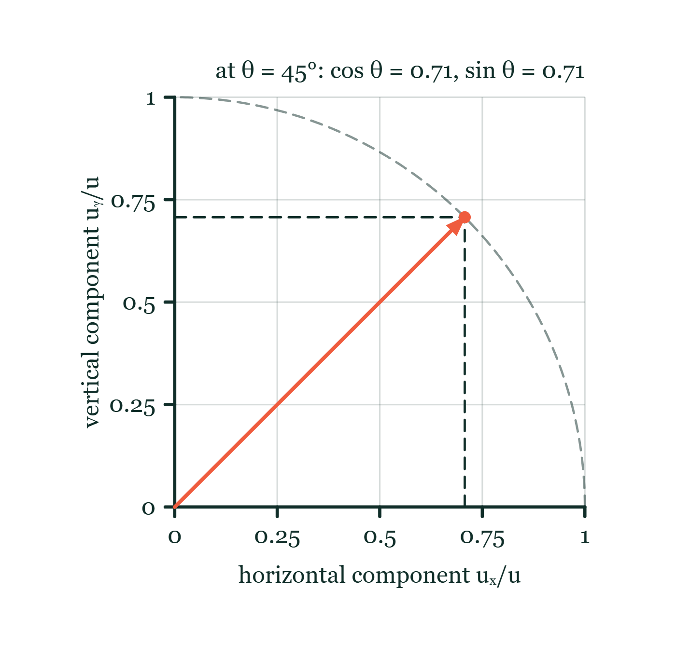
MOTION · KINEMATICS 1D · PART 2
GIOPHYSICS LESSON
FORMULA 8 OF 8
Projectile components
Build the model — The formulae, one at a time, in plain English
uₓ = u cos θ · uᵧ = u sin θ
horizontal story aₓ = 0 · vertical story aᵧ = −g · combined path: parabola
Launch components explorer
Move this graph on the live version — click here
Motion — Kinematics 1D · Part 2. Built by GioPhysics from the lesson's own copy; nothing on these slides is re-authored.
19 / 28
Notes:
[Phase] Build the model: The formulae, one at a time, in plain English (minutes 13–22 of 45)
[Formula] Projectile components: uₓ = u cos θ · uᵧ = u sin θ
[Note] horizontal story aₓ = 0 · vertical story aᵧ = −g · combined path: parabola
[Graph] Launch components explorer. A fixed launch velocity is resolved into perpendicular cosine and sine components.
[Axes] Horizontal: horizontal component uₓ/u. Vertical: vertical component uᵧ/u. Values are normalised — the graph teaches the shape, not a measurement.

Slide 20
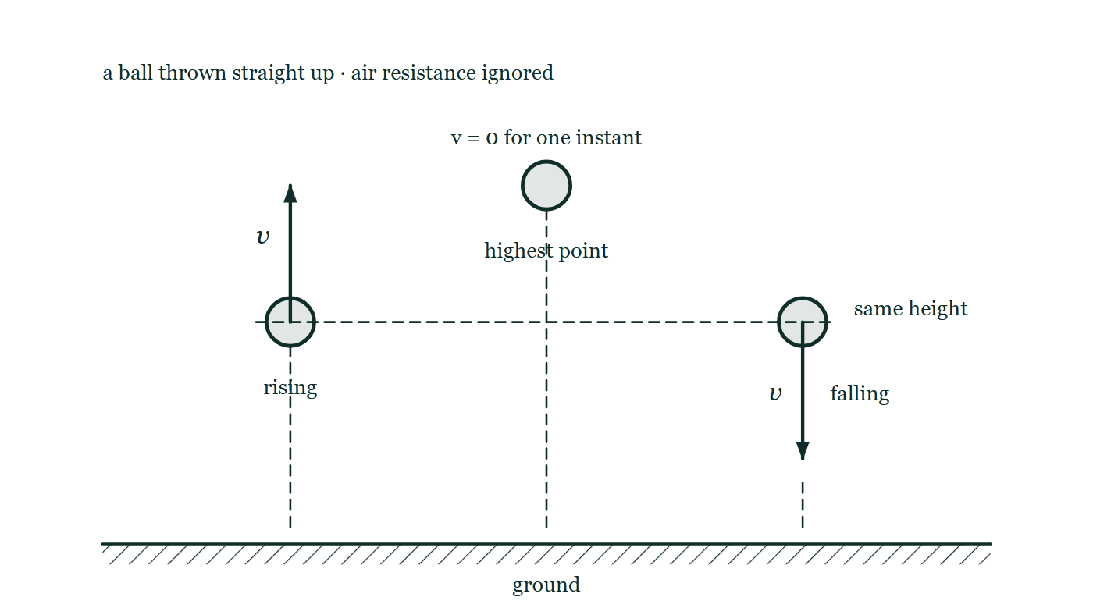
MOTION · KINEMATICS 1D · PART 2
GIOPHYSICS LESSON
THE PICTURE
A ball thrown straight up
Drawn for this lesson
The same ball drawn at three instants side by side: rising with an upward velocity arrow, at its highest point with no velocity arrow at all, and falling back through the same dashed height line.
The live version of this figure — click here
Motion — Kinematics 1D · Part 2. Built by GioPhysics from the lesson's own copy; nothing on these slides is re-authored.
20 / 28
Notes:
[Phase] Build the model: The formulae, one at a time, in plain English (minutes 13–22 of 45)
[Figure] The same ball drawn at three instants side by side: rising with an upward velocity arrow, at its highest point with no velocity arrow at all, and falling back through the same dashed height line.

Slide 21
MOTION · KINEMATICS 1D · PART 2
GIOPHYSICS LESSON
WATCH OUT
The common trap
Check and misconception — The quick check and the trap
A negative acceleration does not always mean slowing down. Compare directions: velocity and acceleration in the same direction make speed increase; opposite directions make speed decrease. Zero velocity does not mean zero acceleration.
Motion — Kinematics 1D · Part 2. Built by GioPhysics from the lesson's own copy; nothing on these slides is re-authored.
21 / 28
Notes:
[Phase] Check and misconception: The quick check and the trap (minutes 35–41 of 45)
[Misconception] A negative acceleration does not always mean slowing down. Compare directions: velocity and acceleration in the same direction make speed increase; opposite directions make speed decrease. Zero velocity does not mean zero acceleration.

Slide 22
MOTION · KINEMATICS 1D · PART 2
GIOPHYSICS LESSON
SPOT THE MISTAKE
One line here is wrong
The whole working is up — find the bad line before you click
1.
A stone is dropped from rest and falls for 3.0 s. Find the distance fallen.
2.
Taking downwards as positive: u = 0, a = 9.81 m/s², t = 3.0 s
3.
s = ut + ½at²
4.
s = 0 + ½ × 9.81 × 3.0
5.
s = 14.7 m
LINE 4 IS WRONG
The time has not been squared. It is an easy line to lose because ½at² is usually written and read as one block, and 9.81 × 3 gives a number that looks perfectly plausible for a three-second fall. The units are the giveaway: m/s² × s is m/s, a velocity, not a distance.
IT SHOULD SAY
s = 0 + ½ × 9.81 × 3.0² = ½ × 9.81 × 9.0 = 44 m
Motion — Kinematics 1D · Part 2. Built by GioPhysics from the lesson's own copy; nothing on these slides is re-authored.
22 / 28
Notes:
[Phase] Worked examples: I do, we do — one step revealed at a time (minutes 22–35 of 45)
[Spot the mistake] The working is complete and one line of it is wrong. Let the room hunt: one click names the line, a second shows it done correctly.
[Line 4 is wrong] The time has not been squared. It is an easy line to lose because ½at² is usually written and read as one block, and 9.81 × 3 gives a number that looks perfectly plausible for a three-second fall. The units are the giveaway: m/s² × s is m/s, a velocity, not a distance.
[It should say] s = 0 + ½ × 9.81 × 3.0² = ½ × 9.81 × 9.0 = 44 m

Slide 23
MOTION · KINEMATICS 1D · PART 2
GIOPHYSICS LESSON
PREDICT · TAKE THE VOTE
Commit before you are told
Hands up for each option, then click
At the highest point of the throw, what is the ball's acceleration?
A Zero — the ball is momentarily at rest
B 9.81 m/s², directed downwards
C 9.81 m/s², directed upwards, since it is about to come back down
The same ball drawn at three instants side by side: rising with an upward velocity arrow, at its highest point with no velocity arrow at all, and falling back through the same dashed height line.
The live version of this figure — click here
Motion — Kinematics 1D · Part 2. Built by GioPhysics from the lesson's own copy; nothing on these slides is re-authored.
23 / 28
Notes:
[Phase] Build the model: The formulae, one at a time, in plain English (minutes 13–22 of 45)
[Predict] At the highest point of the throw, what is the ball's acceleration?
[Options] A Zero — the ball is momentarily at rest B 9.81 m/s², directed downwards C 9.81 m/s², directed upwards, since it is about to come back down
[Figure] The same ball drawn at three instants side by side: rising with an upward velocity arrow, at its highest point with no velocity arrow at all, and falling back through the same dashed height line.

Slide 24
MOTION · KINEMATICS 1D · PART 2
GIOPHYSICS LESSON
PREDICT · THE OUTCOME
What actually happens
Ask the room who changed their mind, and why
B 9.81 m/s², directed downwards
WHY
Nothing has changed about the forces on the ball: gravity is pulling it down at every instant of the flight, including this one. Its velocity is zero for one instant, but its velocity is still changing — a moment earlier it was moving up, a moment later it is moving down. Zero velocity and zero acceleration are different statements.
Motion — Kinematics 1D · Part 2. Built by GioPhysics from the lesson's own copy; nothing on these slides is re-authored.
24 / 28
Notes:
[Phase] Build the model: The formulae, one at a time, in plain English (minutes 13–22 of 45)
[Answer] B — 9.81 m/s², directed downwards. Nothing has changed about the forces on the ball: gravity is pulling it down at every instant of the flight, including this one. Its velocity is zero for one instant, but its velocity is still changing — a moment earlier it was moving up, a moment later it is moving down. Zero velocity and zero acceleration are different statements.

Slide 25
MOTION · KINEMATICS 1D · PART 2
GIOPHYSICS LESSON
QUICK CHECK
Decide before the answer goes up
Check and misconception — The quick check and the trap
A car starts at 10 m/s and accelerates at 2 m/s² for 4 s. How far does it travel?
A
48 m
B
56 m
C
72 m
Motion — Kinematics 1D · Part 2. Built by GioPhysics from the lesson's own copy; nothing on these slides is re-authored.
25 / 28
Notes:
[Phase] Check and misconception: The quick check and the trap (minutes 35–41 of 45)
[Question] A car starts at 10 m/s and accelerates at 2 m/s² for 4 s. How far does it travel?
[Options] A 48 m B 56 m C 72 m

Slide 26
MOTION · KINEMATICS 1D · PART 2
GIOPHYSICS LESSON
QUICK CHECK · THE ANSWER
The answer, and why
Check and misconception — The quick check and the trap
B 56 m
HOW TO GET THERE
s = ut + ½at² = (10 × 4) + ½(2)(4²) = 40 + 16 = 56 m.
WHY THE OTHERS TEMPT
A 48 m is 40 + 8, which is what you get if the last term is worked as ½ × 2 × 4 instead of ½ × 2 × 4². It is the time that gets squared, and that squaring is why the extra distance builds so quickly.
B Correct. s = ut + ½at² = (10 × 4) + ½ × 2 × 4² = 40 + 16 = 56 m.
C 72 m is 18 × 4 — the final velocity multiplied by the whole four seconds. That treats the car as if it had been doing 18 m/s from the very start. It was averaging 14 m/s, and 14 × 4 = 56 m.
Motion — Kinematics 1D · Part 2. Built by GioPhysics from the lesson's own copy; nothing on these slides is re-authored.
26 / 28
Notes:
[Phase] Check and misconception: The quick check and the trap (minutes 35–41 of 45)
[Question] A car starts at 10 m/s and accelerates at 2 m/s² for 4 s. How far does it travel?
[Option by option] A: 48 m is 40 + 8, which is what you get if the last term is worked as ½ × 2 × 4 instead of ½ × 2 × 4². It is the time that gets squared, and that squaring is why the extra distance builds so quickly. B: Correct. s = ut + ½at² = (10 × 4) + ½ × 2 × 4² = 40 + 16 = 56 m. C: 72 m is 18 × 4 — the final velocity multiplied by the whole four seconds. That treats the car as if it had been doing 18 m/s from the very start. It was averaging 14 m/s, and 14 × 4 = 56 m.
[Answer] B — 56 m
[Why] s = ut + ½at² = (10 × 4) + ½(2)(4²) = 40 + 16 = 56 m.
[Reveal] One click for the answer, then one for the reason.

Slide 27
MOTION · KINEMATICS 1D · PART 2
GIOPHYSICS LESSON
EXTENSION
No harder example in this lesson
Worked examples — I do, we do — one step revealed at a time
This lesson sets no Hard or Challenging example. The extension for a class that has finished early is the next lesson, or the practice paper questions the figures came from.
Motion — Kinematics 1D · Part 2. Built by GioPhysics from the lesson's own copy; nothing on these slides is re-authored.
27 / 28
Notes:
[Phase] Worked examples: I do, we do — one step revealed at a time (minutes 22–35 of 45)
[Extension] The lesson record carries no Hard or Challenging example.

Slide 28
MOTION · KINEMATICS 1D · PART 2
GIOPHYSICS LESSON
MOTION
Where to go next
Plenary — What to take away, what to practise next
Next
Kinematics 2D
https://giophysics.com/chapter-1/kinematics-2d/
Lesson
This lesson on giophysics.com
https://giophysics.com/chapter-1/kinematics-1d-part-2/
Live
The live, interactive version of these slides
https://giophysics.com/chapter-1/presentation/?lesson=oneDimensionPartTwo
Chapter
All Motion lessons
https://giophysics.com/chapter-1/
PDF
Download the lesson PDF
https://giophysics.com/downloads/1-4-kinematics-1d-part-2.pdf
Motion — Kinematics 1D · Part 2. Built by GioPhysics from the lesson's own copy; nothing on these slides is re-authored.
28 / 28
Notes:
[Phase] Plenary: What to take away, what to practise next (minutes 41–45 of 45)
[Interactive] The graphs and the circuit topology on these slides are frozen. The live version at https://giophysics.com/chapter-1/presentation/?lesson=oneDimensionPartTwo moves them.

