Slide 1
MOTION · KINEMATICS 2D ADVANCED
GIOPHYSICS LESSON
01 · Motion
A path is the visible result of changing vectors.
Kinematics 2D Advanced
A curve is two motions sharing one clock. Now we go further: describe the whole path with vectors, change reference frames, and connect a turning velocity to acceleration.
POSITION
Lesson 6 of 7 in Motion
PLAN
18 slides in the 45-minute core run, about 44.5 minutes of it
LESSON PAGE
https://giophysics.com/chapter-1/kinematics-2d-advanced/
Built by GioPhysics from the lesson's own page. Every word on these slides is the lesson's; nothing here is re-authored. Teaching material, not an awarding body's document.
Motion — Kinematics 2D Advanced. Built by GioPhysics from the lesson's own copy; nothing on these slides is re-authored.
1 / 31
Notes:
[Lesson] Motion — Kinematics 2D Advanced. Lesson 6 of 7.
[Intro] A curve is two motions sharing one clock. Now we go further: describe the whole path with vectors, change reference frames, and connect a turning velocity to acceleration.
[Source] https://giophysics.com/chapter-1/kinematics-2d-advanced/
[Disclaimer] Built by GioPhysics from the lesson's own page. Every word on these slides is the lesson's; nothing here is re-authored. Teaching material, not an awarding body's document.

Slide 2
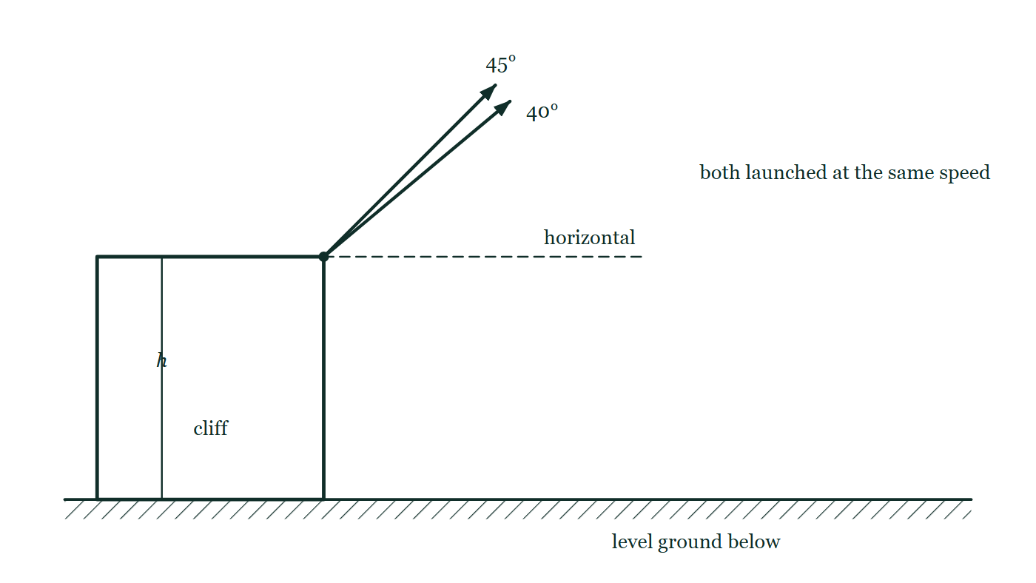
MOTION · KINEMATICS 2D ADVANCED
GIOPHYSICS LESSON
THINK FIRST
To throw a stone as far as possible from a clifftop, do you still throw it at 45°?
Take answers before you click — the point is the commitment
Everyone knows 45° gives the greatest range. But this stone does not land where it was launched — it lands on the beach, thirty metres lower down.
THE ANSWER
No, a little flatter than 45° goes further. Launching from a height already buys extra flight time, so it pays to spend more of the fixed launch speed on horizontal velocity and less on climbing.
A cliff of height h with two arrows leaving the same point at the same speed, one at 45° and one at 40° above the dashed horizontal, both aimed out over the level ground far below.
The live version of this figure — click here
Motion — Kinematics 2D Advanced. Built by GioPhysics from the lesson's own copy; nothing on these slides is re-authored.
2 / 31
Notes:
[Phase] Starter: Recall what this lesson stands on (minutes 0–5 of 45)
[Hook] To throw a stone as far as possible from a clifftop, do you still throw it at 45°? Everyone knows 45° gives the greatest range. But this stone does not land where it was launched — it lands on the beach, thirty metres lower down.
[Answer] No, a little flatter than 45° goes further. Launching from a height already buys extra flight time, so it pays to spend more of the fixed launch speed on horizontal velocity and less on climbing.
[Figure] A cliff of height h with two arrows leaving the same point at the same speed, one at 45° and one at 40° above the dashed horizontal, both aimed out over the level ground far below.

Slide 3
MOTION · KINEMATICS 2D ADVANCED
GIOPHYSICS LESSON
EXPLAINED SIMPLY
In one sentence
Introduce the idea — The big idea and the definition
Advanced two-dimensional kinematics uses changing vectors and reference frames to model complex paths.
Motion — Kinematics 2D Advanced. Built by GioPhysics from the lesson's own copy; nothing on these slides is re-authored.
3 / 31
Notes:
[Phase] Introduce the idea: The big idea and the definition (minutes 5–13 of 45)
[Definition] Advanced two-dimensional kinematics uses changing vectors and reference frames to model complex paths.

Slide 4
MOTION · KINEMATICS 2D ADVANCED
GIOPHYSICS LESSON
EXPLAINED SIMPLY
What that looks like
Introduce the idea — The big idea and the definition
FOR EXAMPLE
A boat’s velocity relative to the bank equals its velocity through the water plus the river current.
Motion — Kinematics 2D Advanced. Built by GioPhysics from the lesson's own copy; nothing on these slides is re-authored.
4 / 31
Notes:
[Phase] Introduce the idea: The big idea and the definition (minutes 5–13 of 45)
[Worked illustration] A boat’s velocity relative to the bank equals its velocity through the water plus the river current.

Slide 5
MOTION · KINEMATICS 2D ADVANCED
GIOPHYSICS LESSON
THE BIG IDEA
A path is the visible result of changing vectors.
Introduce the idea — The big idea and the definition
In two dimensions, one equation can hold both components. Differentiate position to get the tangent velocity; differentiate velocity to get acceleration. The vectors tell the story at one instant. r(t) locates the object. v = dr/dt runs tangent to the path. a = dv/dt reveals how velocity changes.
Motion — Kinematics 2D Advanced. Built by GioPhysics from the lesson's own copy; nothing on these slides is re-authored.
5 / 31
Notes:
[Phase] Introduce the idea: The big idea and the definition (minutes 5–13 of 45)
[Big idea] In two dimensions, one equation can hold both components. Differentiate position to get the tangent velocity; differentiate velocity to get acceleration. The vectors tell the story at one instant. r(t) locates the object. v = dr/dt runs tangent to the path. a = dv/dt reveals how velocity changes.

Slide 6
MOTION · KINEMATICS 2D ADVANCED
GIOPHYSICS LESSON
THE PHYSICS · 1 OF 11
Watch the vectors change along the path.
Build the model — The formulae, one at a time, in plain English
Move time forward, then compare straight, projectile, and circular motion. The velocity vector does not change, so acceleration is zero.
Velocity is tangent to the curve; acceleration remains downward. Speed can stay constant while velocity turns continuously.
Motion — Kinematics 2D Advanced. Built by GioPhysics from the lesson's own copy; nothing on these slides is re-authored.
6 / 31
Notes:
[Phase] Build the model: The formulae, one at a time, in plain English (minutes 13–22 of 45)
[Section] Move time forward, then compare straight, projectile, and circular motion. The velocity vector does not change, so acceleration is zero. Velocity is tangent to the curve; acceleration remains downward. Speed can stay constant while velocity turns continuously.

Slide 7
MOTION · KINEMATICS 2D ADVANCED
GIOPHYSICS LESSON
THE PHYSICS · 2 OF 11
Launch and landing heights do not have to match.
Build the model — The formulae, one at a time, in plain English
Resolve the initial velocity, solve the vertical quadratic for the shared flight time, then use that time horizontally.
Motion — Kinematics 2D Advanced. Built by GioPhysics from the lesson's own copy; nothing on these slides is re-authored.
7 / 31
Notes:
[Phase] Build the model: The formulae, one at a time, in plain English (minutes 13–22 of 45)
[Section] Resolve the initial velocity, solve the vertical quadratic for the shared flight time, then use that time horizontally.

Slide 8
MOTION · KINEMATICS 2D ADVANCED
GIOPHYSICS LESSON
THE PHYSICS · 3 OF 11
Velocity depends on the frame of reference.
Build the model — The formulae, one at a time, in plain English
“The boat moves at 5 m/s” is incomplete. Relative to the water or the bank? Label both frames before adding the velocity vectors.
Motion — Kinematics 2D Advanced. Built by GioPhysics from the lesson's own copy; nothing on these slides is re-authored.
8 / 31
Notes:
[Phase] Build the model: The formulae, one at a time, in plain English (minutes 13–22 of 45)
[Section] “The boat moves at 5 m/s” is incomplete. Relative to the water or the bank? Label both frames before adding the velocity vectors.

Slide 9
MOTION · KINEMATICS 2D ADVANCED
GIOPHYSICS LESSON
THE PHYSICS · 4 OF 11
Inertial-frame shortcut
Build the model — The formulae, one at a time, in plain English
Frames moving at constant velocity relative to one another measure the same acceleration. An accelerating or rotating frame needs extra care.
Motion — Kinematics 2D Advanced. Built by GioPhysics from the lesson's own copy; nothing on these slides is re-authored.
9 / 31
Notes:
[Phase] Build the model: The formulae, one at a time, in plain English (minutes 13–22 of 45)
[Section] Frames moving at constant velocity relative to one another measure the same acceleration. An accelerating or rotating frame needs extra care.

Slide 10
MOTION · KINEMATICS 2D ADVANCED
GIOPHYSICS LESSON
THE PHYSICS · 5 OF 11
Constant speed does not mean constant velocity.
Build the model — The formulae, one at a time, in plain English
On a circle, the velocity is tangent to the path. Its direction changes at every instant, so acceleration points inward.
Motion — Kinematics 2D Advanced. Built by GioPhysics from the lesson's own copy; nothing on these slides is re-authored.
10 / 31
Notes:
[Phase] Build the model: The formulae, one at a time, in plain English (minutes 13–22 of 45)
[Section] On a circle, the velocity is tangent to the path. Its direction changes at every instant, so acceleration points inward.

Slide 11
MOTION · KINEMATICS 2D ADVANCED
GIOPHYSICS LESSON
THE PHYSICS · 6 OF 11
Every motion equation begins with assumptions.
Build the model — The formulae, one at a time, in plain English
Kinematics describes the motion. Newton’s second law explains why the acceleration takes that form.
Motion — Kinematics 2D Advanced. Built by GioPhysics from the lesson's own copy; nothing on these slides is re-authored.
11 / 31
Notes:
[Phase] Build the model: The formulae, one at a time, in plain English (minutes 13–22 of 45)
[Section] Kinematics describes the motion. Newton’s second law explains why the acceleration takes that form.

Slide 12
MOTION · KINEMATICS 2D ADVANCED
GIOPHYSICS LESSON
THE PHYSICS · 7 OF 11
Ideal projectile
Build the model — The formulae, one at a time, in plain English
After release, gravity is the only force. Horizontal velocity stays constant and the path is parabolic.
Motion — Kinematics 2D Advanced. Built by GioPhysics from the lesson's own copy; nothing on these slides is re-authored.
12 / 31
Notes:
[Phase] Build the model: The formulae, one at a time, in plain English (minutes 13–22 of 45)
[Section] After release, gravity is the only force. Horizontal velocity stays constant and the path is parabolic.

Slide 13
MOTION · KINEMATICS 2D ADVANCED
GIOPHYSICS LESSON
THE PHYSICS · 8 OF 11
With air resistance
Build the model — The formulae, one at a time, in plain English
Drag points opposite the instantaneous velocity. Acceleration now changes in both magnitude and direction, so the simple parabola is only an approximation.
Motion — Kinematics 2D Advanced. Built by GioPhysics from the lesson's own copy; nothing on these slides is re-authored.
13 / 31
Notes:
[Phase] Build the model: The formulae, one at a time, in plain English (minutes 13–22 of 45)
[Section] Drag points opposite the instantaneous velocity. Acceleration now changes in both magnitude and direction, so the simple parabola is only an approximation.

Slide 14
MOTION · KINEMATICS 2D ADVANCED
GIOPHYSICS LESSON
THE PHYSICS · 9 OF 11
Powered motion
Build the model — The formulae, one at a time, in plain English
A rocket or powered drone has another force. Its acceleration follows the total force, not necessarily its velocity or the path.
Motion — Kinematics 2D Advanced. Built by GioPhysics from the lesson's own copy; nothing on these slides is re-authored.
14 / 31
Notes:
[Phase] Build the model: The formulae, one at a time, in plain English (minutes 13–22 of 45)
[Section] A rocket or powered drone has another force. Its acceleration follows the total force, not necessarily its velocity or the path.

Slide 15
MOTION · KINEMATICS 2D ADVANCED
GIOPHYSICS LESSON
THE PHYSICS · 10 OF 11
Before using a formula, ask:
Build the model — The formulae, one at a time, in plain English
Which frame and axes am I using? Which forces act after release?
Is acceleration constant? Are air resistance and Earth’s curvature negligible?
Motion — Kinematics 2D Advanced. Built by GioPhysics from the lesson's own copy; nothing on these slides is re-authored.
15 / 31
Notes:
[Phase] Build the model: The formulae, one at a time, in plain English (minutes 13–22 of 45)
[Section] Which frame and axes am I using? Which forces act after release? Is acceleration constant? Are air resistance and Earth’s curvature negligible?

Slide 16
MOTION · KINEMATICS 2D ADVANCED
GIOPHYSICS LESSON
THE PHYSICS · 11 OF 11
Frame → components → time → recombine → check.
Build the model — The formulae, one at a time, in plain English
Name the frame. State what each velocity is relative to. Draw axes and vectors. Resolve only after directions are clear.
Write component equations. Keep signs consistent with the chosen axes. Use the shared clock. Or eliminate time to get the trajectory y(x).
Recombine and test. Check units, direction, limits, and assumptions.
Motion — Kinematics 2D Advanced. Built by GioPhysics from the lesson's own copy; nothing on these slides is re-authored.
16 / 31
Notes:
[Phase] Build the model: The formulae, one at a time, in plain English (minutes 13–22 of 45)
[Section] Name the frame. State what each velocity is relative to. Draw axes and vectors. Resolve only after directions are clear. Write component equations. Keep signs consistent with the chosen axes. Use the shared clock. Or eliminate time to get the trajectory y(x). Recombine and test. Check units, direction, limits, and assumptions.

Slide 17
MOTION · KINEMATICS 2D ADVANCED
GIOPHYSICS LESSON
FORMULA 1 OF 8
The vector picture
Build the model — The formulae, one at a time, in plain English
r(t) = r₀ + v₀t + ½at²
Velocity v = dr/dt · Acceleration a = dv/dt
Motion — Kinematics 2D Advanced. Built by GioPhysics from the lesson's own copy; nothing on these slides is re-authored.
17 / 31
Notes:
[Phase] Build the model: The formulae, one at a time, in plain English (minutes 13–22 of 45)
[Formula] The vector picture: r(t) = r₀ + v₀t + ½at²
[Note] Velocity v = dr/dt · Acceleration a = dv/dt

Slide 18
MOTION · KINEMATICS 2D ADVANCED
GIOPHYSICS LESSON
FORMULA 2 OF 8
Constant velocity
Build the model — The formulae, one at a time, in plain English
r(t) = r₀ + vt
The velocity vector does not change, so acceleration is zero.
Motion — Kinematics 2D Advanced. Built by GioPhysics from the lesson's own copy; nothing on these slides is re-authored.
18 / 31
Notes:
[Phase] Build the model: The formulae, one at a time, in plain English (minutes 13–22 of 45)
[Formula] Constant velocity: r(t) = r₀ + vt
[Note] The velocity vector does not change, so acceleration is zero.

Slide 19
MOTION · KINEMATICS 2D ADVANCED
GIOPHYSICS LESSON
FORMULA 3 OF 8
Projectile
Build the model — The formulae, one at a time, in plain English
r(t) = v₀t + ½gt²
Velocity is tangent to the curve; acceleration remains downward.
Motion — Kinematics 2D Advanced. Built by GioPhysics from the lesson's own copy; nothing on these slides is re-authored.
19 / 31
Notes:
[Phase] Build the model: The formulae, one at a time, in plain English (minutes 13–22 of 45)
[Formula] Projectile: r(t) = v₀t + ½gt²
[Note] Velocity is tangent to the curve; acceleration remains downward.

Slide 20
MOTION · KINEMATICS 2D ADVANCED
GIOPHYSICS LESSON
FORMULA 4 OF 8
Circular motion
Build the model — The formulae, one at a time, in plain English
r(t) = R cos(ωt) i + R sin(ωt) j
Speed can stay constant while velocity turns continuously.
Motion — Kinematics 2D Advanced. Built by GioPhysics from the lesson's own copy; nothing on these slides is re-authored.
20 / 31
Notes:
[Phase] Build the model: The formulae, one at a time, in plain English (minutes 13–22 of 45)
[Formula] Circular motion: r(t) = R cos(ωt) i + R sin(ωt) j
[Note] Speed can stay constant while velocity turns continuously.

Slide 21
MOTION · KINEMATICS 2D ADVANCED
GIOPHYSICS LESSON
FORMULA 5 OF 8
Parametric form
Build the model — The formulae, one at a time, in plain English
x = (u cos θ)t
y = h + (u sin θ)t − ½gt²
Motion — Kinematics 2D Advanced. Built by GioPhysics from the lesson's own copy; nothing on these slides is re-authored.
21 / 31
Notes:
[Phase] Build the model: The formulae, one at a time, in plain English (minutes 13–22 of 45)
[Formula] Parametric form: x = (u cos θ)t
[Note] y = h + (u sin θ)t − ½gt²

Slide 22
MOTION · KINEMATICS 2D ADVANCED
GIOPHYSICS LESSON
FORMULA 6 OF 8
Eliminate time
Build the model — The formulae, one at a time, in plain English
y = h + x tan θ − gx² / (2u²cos²θ)
the trajectory y(x)
Motion — Kinematics 2D Advanced. Built by GioPhysics from the lesson's own copy; nothing on these slides is re-authored.
22 / 31
Notes:
[Phase] Build the model: The formulae, one at a time, in plain English (minutes 13–22 of 45)
[Formula] Eliminate time: y = h + x tan θ − gx² / (2u²cos²θ)
[Note] the trajectory y(x)

Slide 23
MOTION · KINEMATICS 2D ADVANCED
GIOPHYSICS LESSON
FORMULA 7 OF 8
Frame equation
Build the model — The formulae, one at a time, in plain English
v(boat/bank) = v(boat/water) + v(water/bank)
Name the frames, then add vectors
Motion — Kinematics 2D Advanced. Built by GioPhysics from the lesson's own copy; nothing on these slides is re-authored.
23 / 31
Notes:
[Phase] Build the model: The formulae, one at a time, in plain English (minutes 13–22 of 45)
[Formula] Frame equation: v(boat/bank) = v(boat/water) + v(water/bank)
[Note] Name the frames, then add vectors

Slide 24
MOTION · KINEMATICS 2D ADVANCED
GIOPHYSICS LESSON
FORMULA 8 OF 8
Inward acceleration
Build the model — The formulae, one at a time, in plain English
aᶜ = v² / r
x(t) = R cos(ωt) · y(t) = R sin(ωt)
IN PLAIN ENGLISH
The acceleration vector is perpendicular to velocity and always points toward the centre.
Motion — Kinematics 2D Advanced. Built by GioPhysics from the lesson's own copy; nothing on these slides is re-authored.
24 / 31
Notes:
[Phase] Build the model: The formulae, one at a time, in plain English (minutes 13–22 of 45)
[Formula] Inward acceleration: aᶜ = v² / r
[In plain English] The acceleration vector is perpendicular to velocity and always points toward the centre.
[Note] x(t) = R cos(ωt) · y(t) = R sin(ωt)

Slide 25
MOTION · KINEMATICS 2D ADVANCED
GIOPHYSICS LESSON
WATCH OUT
The common trap
Check and misconception — The quick check and the trap
The 45° rule has conditions. It is exact for equal launch and landing heights in the ideal no-drag model.
With extra launch height, the projectile already has more flight time. A slightly flatter launch uses more of the speed horizontally.
Motion — Kinematics 2D Advanced. Built by GioPhysics from the lesson's own copy; nothing on these slides is re-authored.
25 / 31
Notes:
[Phase] Check and misconception: The quick check and the trap (minutes 35–41 of 45)
[Misconception] The 45° rule has conditions. It is exact for equal launch and landing heights in the ideal no-drag model. With extra launch height, the projectile already has more flight time. A slightly flatter launch uses more of the speed horizontally.

Slide 26
MOTION · KINEMATICS 2D ADVANCED
GIOPHYSICS LESSON
PREDICT · TAKE THE VOTE
Commit before you are told
Hands up for each option, then click
Both stones leave the clifftop at the same speed. Which lands further out?
A The 45° stone — 45° always gives the maximum range
B The 40° stone
C They land the same distance out — 5° is far too small to matter
A cliff of height h with two arrows leaving the same point at the same speed, one at 45° and one at 40° above the dashed horizontal, both aimed out over the level ground far below.
The live version of this figure — click here
Motion — Kinematics 2D Advanced. Built by GioPhysics from the lesson's own copy; nothing on these slides is re-authored.
26 / 31
Notes:
[Phase] Build the model: The formulae, one at a time, in plain English (minutes 13–22 of 45)
[Predict] Both stones leave the clifftop at the same speed. Which lands further out?
[Options] A The 45° stone — 45° always gives the maximum range B The 40° stone C They land the same distance out — 5° is far too small to matter
[Figure] A cliff of height h with two arrows leaving the same point at the same speed, one at 45° and one at 40° above the dashed horizontal, both aimed out over the level ground far below.

Slide 27
MOTION · KINEMATICS 2D ADVANCED
GIOPHYSICS LESSON
PREDICT · THE OUTCOME
What actually happens
Ask the room who changed their mind, and why
B The 40° stone
WHY
The 45° rule is proved for a launch and a landing at the same height, and this launch is above its landing. The drop off the cliff adds flight time whatever the angle, so the extra climb that 45° buys is worth less than the extra horizontal speed the flatter launch keeps. Below the clifftop, the best angle slides under 45° — and the higher the cliff, the flatter it gets.
Motion — Kinematics 2D Advanced. Built by GioPhysics from the lesson's own copy; nothing on these slides is re-authored.
27 / 31
Notes:
[Phase] Build the model: The formulae, one at a time, in plain English (minutes 13–22 of 45)
[Answer] B — The 40° stone. The 45° rule is proved for a launch and a landing at the same height, and this launch is above its landing. The drop off the cliff adds flight time whatever the angle, so the extra climb that 45° buys is worth less than the extra horizontal speed the flatter launch keeps. Below the clifftop, the best angle slides under 45° — and the higher the cliff, the flatter it gets.

Slide 28
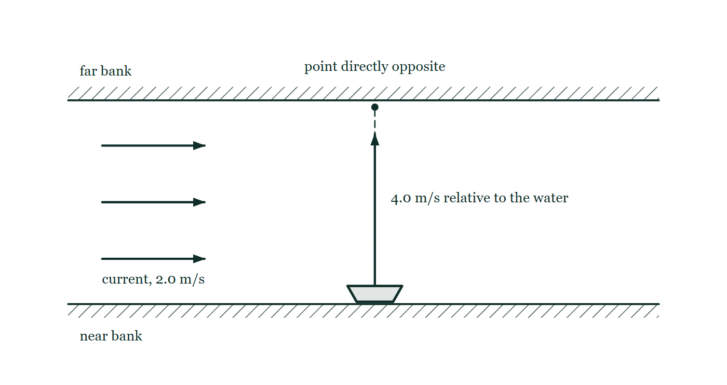
MOTION · KINEMATICS 2D ADVANCED
GIOPHYSICS LESSON
QUICK CHECK
Decide before the answer goes up
Check and misconception — The quick check and the trap
A boat moves relative to the water while the water moves relative to the bank. How do you find the boat’s velocity relative to the bank?
A
Add the two velocity vectors
B
Add only their magnitudes
C
Ignore the water velocity
A river between two hatched banks carries three downstream current arrows; a boat on the near bank has one arrow pointing straight across, and the point directly opposite is dotted on the far bank.
The live version of this figure — click here
Motion — Kinematics 2D Advanced. Built by GioPhysics from the lesson's own copy; nothing on these slides is re-authored.
28 / 31
Notes:
[Phase] Check and misconception: The quick check and the trap (minutes 35–41 of 45)
[Question] A boat moves relative to the water while the water moves relative to the bank. How do you find the boat’s velocity relative to the bank?
[Figure] A river between two hatched banks carries three downstream current arrows; a boat on the near bank has one arrow pointing straight across, and the point directly opposite is dotted on the far bank.
[Options] A Add the two velocity vectors B Add only their magnitudes C Ignore the water velocity

Slide 29
MOTION · KINEMATICS 2D ADVANCED
GIOPHYSICS LESSON
QUICK CHECK · THE ANSWER
The answer, and why
Check and misconception — The quick check and the trap
A Add the two velocity vectors
HOW TO GET THERE
Name the frames, then add vectors: v(boat/bank) = v(boat/water) + v(water/bank).
WHY THE OTHERS TEMPT
A Correct. Name the two frames, then add: v(boat/bank) = v(boat/water) + v(water/bank), head to tail like any other vectors.
B Adding magnitudes only works when the two velocities point the same way. Here they are at right angles, so 4 + 2 overstates the speed — and a single number cannot say where on the far bank the boat arrives.
C This is what the boat's own instruments encourage, since its log reads speed through the water and the crew feel nothing of the current. But the bank is a different frame, and the water is carrying the whole boat downstream the entire time it is crossing.
Motion — Kinematics 2D Advanced. Built by GioPhysics from the lesson's own copy; nothing on these slides is re-authored.
29 / 31
Notes:
[Phase] Check and misconception: The quick check and the trap (minutes 35–41 of 45)
[Question] A boat moves relative to the water while the water moves relative to the bank. How do you find the boat’s velocity relative to the bank?
[Option by option] A: Correct. Name the two frames, then add: v(boat/bank) = v(boat/water) + v(water/bank), head to tail like any other vectors. B: Adding magnitudes only works when the two velocities point the same way. Here they are at right angles, so 4 + 2 overstates the speed — and a single number cannot say where on the far bank the boat arrives. C: This is what the boat's own instruments encourage, since its log reads speed through the water and the crew feel nothing of the current. But the bank is a different frame, and the water is carrying the whole boat downstream the entire time it is crossing.
[Answer] A — Add the two velocity vectors
[Why] Name the frames, then add vectors: v(boat/bank) = v(boat/water) + v(water/bank).
[Reveal] One click for the answer, then one for the reason.

Slide 30
MOTION · KINEMATICS 2D ADVANCED
GIOPHYSICS LESSON
EXTENSION
No harder example in this lesson
Worked examples — I do, we do — one step revealed at a time
This lesson sets no Hard or Challenging example. The extension for a class that has finished early is the next lesson, or the practice paper questions the figures came from.
Motion — Kinematics 2D Advanced. Built by GioPhysics from the lesson's own copy; nothing on these slides is re-authored.
30 / 31
Notes:
[Phase] Worked examples: I do, we do — one step revealed at a time (minutes 22–35 of 45)
[Extension] The lesson record carries no Hard or Challenging example.

Slide 31
MOTION · KINEMATICS 2D ADVANCED
GIOPHYSICS LESSON
MOTION
Where to go next
Plenary — What to take away, what to practise next
Next
Kinematics Calculus Integration
https://giophysics.com/chapter-1/kinematics-calculus/
Lesson
This lesson on giophysics.com
https://giophysics.com/chapter-1/kinematics-2d-advanced/
Live
The live, interactive version of these slides
https://giophysics.com/chapter-1/presentation/?lesson=twoDimensionAdvanced
Chapter
All Motion lessons
https://giophysics.com/chapter-1/
PDF
Download the lesson PDF
https://giophysics.com/downloads/1-6-kinematics-2d-advanced.pdf
Motion — Kinematics 2D Advanced. Built by GioPhysics from the lesson's own copy; nothing on these slides is re-authored.
31 / 31
Notes:
[Phase] Plenary: What to take away, what to practise next (minutes 41–45 of 45)
[Interactive] The graphs and the circuit topology on these slides are frozen. The live version at https://giophysics.com/chapter-1/presentation/?lesson=twoDimensionAdvanced moves them.

