Slide 1
MOTION · KINEMATICS 2D
GIOPHYSICS LESSON
01 · Motion
Separate the components. Keep the same clock.
Kinematics 2D
One curved path becomes simple when you split it into two straight-line motions.
POSITION
Lesson 5 of 7 in Motion
PLAN
18 slides in the 45-minute core run, about 44.5 minutes of it
LESSON PAGE
https://giophysics.com/chapter-1/kinematics-2d/
Built by GioPhysics from the lesson's own page. Every word on these slides is the lesson's; nothing here is re-authored. Teaching material, not an awarding body's document.
Motion — Kinematics 2D. Built by GioPhysics from the lesson's own copy; nothing on these slides is re-authored.
1 / 29
Notes:
[Lesson] Motion — Kinematics 2D. Lesson 5 of 7.
[Intro] One curved path becomes simple when you split it into two straight-line motions.
[Source] https://giophysics.com/chapter-1/kinematics-2d/
[Disclaimer] Built by GioPhysics from the lesson's own page. Every word on these slides is the lesson's; nothing here is re-authored. Teaching material, not an awarding body's document.

Slide 2
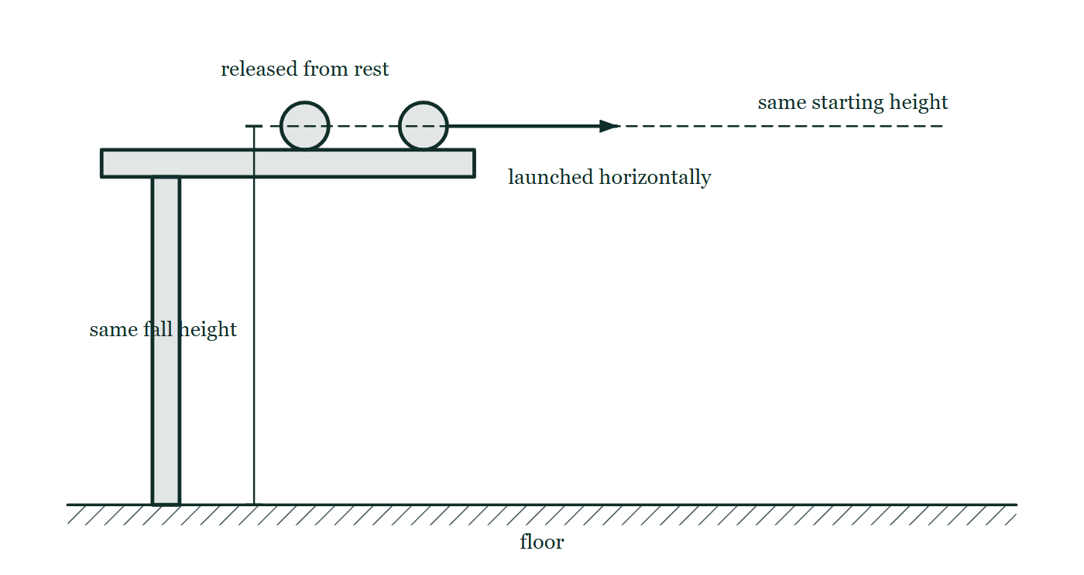
MOTION · KINEMATICS 2D
GIOPHYSICS LESSON
THINK FIRST
A bullet is fired horizontally at the same instant an identical bullet is dropped from the same height. Which hits the ground first?
Take answers before you click — the point is the commitment
The fired bullet leaves the barrel at 300 m/s and lands hundreds of metres away. The dropped one falls straight down at your feet.
THE ANSWER
They land together. Firing sideways gives the bullet horizontal velocity, and nothing horizontal can change how quickly gravity pulls it down. The vertical story of both bullets is identical, so the two clocks agree.
Two identical balls rest at the same height on a bench top; the left one is about to be released from rest and the right one carries a horizontal arrow showing it is about to be launched sideways.
The live version of this figure — click here
Motion — Kinematics 2D. Built by GioPhysics from the lesson's own copy; nothing on these slides is re-authored.
2 / 29
Notes:
[Phase] Starter: Recall what this lesson stands on (minutes 0–5 of 45)
[Hook] A bullet is fired horizontally at the same instant an identical bullet is dropped from the same height. Which hits the ground first? The fired bullet leaves the barrel at 300 m/s and lands hundreds of metres away. The dropped one falls straight down at your feet.
[Answer] They land together. Firing sideways gives the bullet horizontal velocity, and nothing horizontal can change how quickly gravity pulls it down. The vertical story of both bullets is identical, so the two clocks agree.
[Figure] Two identical balls rest at the same height on a bench top; the left one is about to be released from rest and the right one carries a horizontal arrow showing it is about to be launched sideways.

Slide 3
MOTION · KINEMATICS 2D
GIOPHYSICS LESSON
EXPLAINED SIMPLY
In one sentence
Introduce the idea — The big idea and the definition
Two-dimensional kinematics describes motion by treating horizontal and vertical components separately.
Motion — Kinematics 2D. Built by GioPhysics from the lesson's own copy; nothing on these slides is re-authored.
3 / 29
Notes:
[Phase] Introduce the idea: The big idea and the definition (minutes 5–13 of 45)
[Definition] Two-dimensional kinematics describes motion by treating horizontal and vertical components separately.

Slide 4
MOTION · KINEMATICS 2D
GIOPHYSICS LESSON
EXPLAINED SIMPLY
What that looks like
Introduce the idea — The big idea and the definition
FOR EXAMPLE
A kicked ball moves forward horizontally while gravity changes its vertical velocity.
Motion — Kinematics 2D. Built by GioPhysics from the lesson's own copy; nothing on these slides is re-authored.
4 / 29
Notes:
[Phase] Introduce the idea: The big idea and the definition (minutes 5–13 of 45)
[Worked illustration] A kicked ball moves forward horizontally while gravity changes its vertical velocity.

Slide 5
MOTION · KINEMATICS 2D
GIOPHYSICS LESSON
THE BIG IDEA
Separate the components. Keep the same clock.
Introduce the idea — The big idea and the definition
Resolve: uₓ = u cos θ and uᵧ = u sin θ. Predict: aₓ = 0 while aᵧ = −g. Recombine: the two 1D answers describe the full motion.
Motion — Kinematics 2D. Built by GioPhysics from the lesson's own copy; nothing on these slides is re-authored.
5 / 29
Notes:
[Phase] Introduce the idea: The big idea and the definition (minutes 5–13 of 45)
[Big idea] Resolve: uₓ = u cos θ and uᵧ = u sin θ. Predict: aₓ = 0 while aᵧ = −g. Recombine: the two 1D answers describe the full motion.

Slide 6
MOTION · KINEMATICS 2D
GIOPHYSICS LESSON
THE PHYSICS · 1 OF 9
One vector becomes two simpler motions
Build the model — The formulae, one at a time, in plain English
Resolve the launch velocity into perpendicular components. The horizontal and vertical motions can then be calculated separately, but they always use the same time.
Motion — Kinematics 2D. Built by GioPhysics from the lesson's own copy; nothing on these slides is re-authored.
6 / 29
Notes:
[Phase] Build the model: The formulae, one at a time, in plain English (minutes 13–22 of 45)
[Section] Resolve the launch velocity into perpendicular components. The horizontal and vertical motions can then be calculated separately, but they always use the same time.

Slide 7
MOTION · KINEMATICS 2D
GIOPHYSICS LESSON
THE PHYSICS · 2 OF 9
The velocity changes along the path
Build the model — The formulae, one at a time, in plain English
In the ideal model, horizontal velocity stays constant while vertical velocity decreases by 9.81 m/s each second. The velocity arrow is always tangent to the path.
Motion — Kinematics 2D. Built by GioPhysics from the lesson's own copy; nothing on these slides is re-authored.
7 / 29
Notes:
[Phase] Build the model: The formulae, one at a time, in plain English (minutes 13–22 of 45)
[Section] In the ideal model, horizontal velocity stays constant while vertical velocity decreases by 9.81 m/s each second. The velocity arrow is always tangent to the path.

Slide 8
MOTION · KINEMATICS 2D
GIOPHYSICS LESSON
THE PHYSICS · 3 OF 9
Graphs reveal the two separate stories
Build the model — The formulae, one at a time, in plain English
Horizontal position — A straight line: equal horizontal distances in equal times. Vertical position — A curve: the height rises, reaches a maximum, then falls.
Horizontal velocity — A horizontal line: vₓ stays constant in the ideal model. Vertical velocity — A falling straight line with gradient −g.
Motion — Kinematics 2D. Built by GioPhysics from the lesson's own copy; nothing on these slides is re-authored.
8 / 29
Notes:
[Phase] Build the model: The formulae, one at a time, in plain English (minutes 13–22 of 45)
[Section] Horizontal position — A straight line: equal horizontal distances in equal times. Vertical position — A curve: the height rises, reaches a maximum, then falls. Horizontal velocity — A horizontal line: vₓ stays constant in the ideal model. Vertical velocity — A falling straight line with gradient −g.

Slide 9
MOTION · KINEMATICS 2D
GIOPHYSICS LESSON
THE PHYSICS · 4 OF 9
Horizontal speed does not delay the fall
Build the model — The formulae, one at a time, in plain English
Drop one ball and launch another horizontally from the same height. With air resistance ignored, their vertical motions are identical, so they touch the ground together.
Motion — Kinematics 2D. Built by GioPhysics from the lesson's own copy; nothing on these slides is re-authored.
9 / 29
Notes:
[Phase] Build the model: The formulae, one at a time, in plain English (minutes 13–22 of 45)
[Section] Drop one ball and launch another horizontally from the same height. With air resistance ignored, their vertical motions are identical, so they touch the ground together.

Slide 10
MOTION · KINEMATICS 2D
GIOPHYSICS LESSON
THE PHYSICS · 5 OF 9
Kinematics describes; dynamics explains
Build the model — The formulae, one at a time, in plain English
Kinematics tells how position and velocity change. Newton’s laws connect those changes to resultant force. For an ideal projectile, weight is the only force after release.
Motion — Kinematics 2D. Built by GioPhysics from the lesson's own copy; nothing on these slides is re-authored.
10 / 29
Notes:
[Phase] Build the model: The formulae, one at a time, in plain English (minutes 13–22 of 45)
[Section] Kinematics tells how position and velocity change. Newton’s laws connect those changes to resultant force. For an ideal projectile, weight is the only force after release.

Slide 11
MOTION · KINEMATICS 2D
GIOPHYSICS LESSON
THE PHYSICS · 6 OF 9
The ideal model ignores air resistance.
Build the model — The formulae, one at a time, in plain English
In real flight, drag opposes velocity and changes both components. Start with the ideal model because it isolates gravity and makes the two-dimensional structure clear.
Motion — Kinematics 2D. Built by GioPhysics from the lesson's own copy; nothing on these slides is re-authored.
11 / 29
Notes:
[Phase] Build the model: The formulae, one at a time, in plain English (minutes 13–22 of 45)
[Section] In real flight, drag opposes velocity and changes both components. Start with the ideal model because it isolates gravity and makes the two-dimensional structure clear.

Slide 12
MOTION · KINEMATICS 2D
GIOPHYSICS LESSON
THE PHYSICS · 7 OF 9
Keep x and y in separate columns
Build the model — The formulae, one at a time, in plain English
Treat every projectile problem as two linked one-dimensional problems. Time is usually the bridge between the columns.
Motion — Kinematics 2D. Built by GioPhysics from the lesson's own copy; nothing on these slides is re-authored.
12 / 29
Notes:
[Phase] Build the model: The formulae, one at a time, in plain English (minutes 13–22 of 45)
[Section] Treat every projectile problem as two linked one-dimensional problems. Time is usually the bridge between the columns.

Slide 13
MOTION · KINEMATICS 2D
GIOPHYSICS LESSON
THE PHYSICS · 8 OF 9
A reliable solution route
Build the model — The formulae, one at a time, in plain English
Sketch and choose axes. Usually right is +x and up is +y. Resolve the launch velocity. Find uₓ = u cos θ and uᵧ = u sin θ.
Write the accelerations. Use aₓ = 0 and aᵧ = −9.81 m/s². Solve one direction first. Use it to find the shared time.
Use the same time in the other direction. Then combine components if a speed or direction is needed.
Motion — Kinematics 2D. Built by GioPhysics from the lesson's own copy; nothing on these slides is re-authored.
13 / 29
Notes:
[Phase] Build the model: The formulae, one at a time, in plain English (minutes 13–22 of 45)
[Section] Sketch and choose axes. Usually right is +x and up is +y. Resolve the launch velocity. Find uₓ = u cos θ and uᵧ = u sin θ. Write the accelerations. Use aₓ = 0 and aᵧ = −9.81 m/s². Solve one direction first. Use it to find the shared time. Use the same time in the other direction. Then combine components if a speed or direction is needed.

Slide 14
MOTION · KINEMATICS 2D
GIOPHYSICS LESSON
THE PHYSICS · 9 OF 9
Same-height symmetry
Build the model — The formulae, one at a time, in plain English
Without drag, the time up equals the time down. At the same height, the speed is the same but the vertical direction is reversed. For a fixed speed on level ground, 45° gives maximum range.
Motion — Kinematics 2D. Built by GioPhysics from the lesson's own copy; nothing on these slides is re-authored.
14 / 29
Notes:
[Phase] Build the model: The formulae, one at a time, in plain English (minutes 13–22 of 45)
[Section] Without drag, the time up equals the time down. At the same height, the speed is the same but the vertical direction is reversed. For a fixed speed on level ground, 45° gives maximum range.

Slide 15
MOTION · KINEMATICS 2D
GIOPHYSICS LESSON
FORMULA 1 OF 6
Horizontal component
Build the model — The formulae, one at a time, in plain English
uₓ = u cos θ
x = uₓt · vₓ = uₓ
IN PLAIN ENGLISH
The horizontal component is adjacent to θ, so uₓ = u cos θ. The vertical component is uᵧ = u sin θ.
Motion — Kinematics 2D. Built by GioPhysics from the lesson's own copy; nothing on these slides is re-authored.
15 / 29
Notes:
[Phase] Build the model: The formulae, one at a time, in plain English (minutes 13–22 of 45)
[Formula] Horizontal component: uₓ = u cos θ
[In plain English] The horizontal component is adjacent to θ, so uₓ = u cos θ. The vertical component is uᵧ = u sin θ.
[Note] x = uₓt · vₓ = uₓ

Slide 16
MOTION · KINEMATICS 2D
GIOPHYSICS LESSON
FORMULA 2 OF 6
Vertical component
Build the model — The formulae, one at a time, in plain English
uᵧ = u sin θ
y = uᵧt − ½gt² · vᵧ = uᵧ − gt
Motion — Kinematics 2D. Built by GioPhysics from the lesson's own copy; nothing on these slides is re-authored.
16 / 29
Notes:
[Phase] Build the model: The formulae, one at a time, in plain English (minutes 13–22 of 45)
[Formula] Vertical component: uᵧ = u sin θ
[Note] y = uᵧt − ½gt² · vᵧ = uᵧ − gt

Slide 17
MOTION · KINEMATICS 2D
GIOPHYSICS LESSON
FORMULA 3 OF 6
Horizontal story
Build the model — The formulae, one at a time, in plain English
aₓ = 0
ΣFₓ = 0, therefore aₓ = 0 · vₓ stays constant
IN PLAIN ENGLISH
Newton’s laws explain the model: with drag ignored, weight is the only force. It points downward, so the horizontal acceleration is zero.
Motion — Kinematics 2D. Built by GioPhysics from the lesson's own copy; nothing on these slides is re-authored.
17 / 29
Notes:
[Phase] Build the model: The formulae, one at a time, in plain English (minutes 13–22 of 45)
[Formula] Horizontal story: aₓ = 0
[In plain English] Newton’s laws explain the model: with drag ignored, weight is the only force. It points downward, so the horizontal acceleration is zero.
[Note] ΣFₓ = 0, therefore aₓ = 0 · vₓ stays constant

Slide 18
MOTION · KINEMATICS 2D
GIOPHYSICS LESSON
FORMULA 4 OF 6
Vertical story
Build the model — The formulae, one at a time, in plain English
aᵧ = −g
ΣFᵧ = −mg, therefore aᵧ = −g · vᵧ changes steadily
Motion — Kinematics 2D. Built by GioPhysics from the lesson's own copy; nothing on these slides is re-authored.
18 / 29
Notes:
[Phase] Build the model: The formulae, one at a time, in plain English (minutes 13–22 of 45)
[Formula] Vertical story: aᵧ = −g
[Note] ΣFᵧ = −mg, therefore aᵧ = −g · vᵧ changes steadily

Slide 19
MOTION · KINEMATICS 2D
GIOPHYSICS LESSON
FORMULA 5 OF 6
Projectile predictions
Build the model — The formulae, one at a time, in plain English
flight time = 2uᵧ ÷ g
maximum height = uᵧ² ÷ 2g · horizontal range = uₓ × flight time
Motion — Kinematics 2D. Built by GioPhysics from the lesson's own copy; nothing on these slides is re-authored.
19 / 29
Notes:
[Phase] Build the model: The formulae, one at a time, in plain English (minutes 13–22 of 45)
[Formula] Projectile predictions: flight time = 2uᵧ ÷ g
[Note] maximum height = uᵧ² ÷ 2g · horizontal range = uₓ × flight time

Slide 20
MOTION · KINEMATICS 2D
GIOPHYSICS LESSON
FORMULA 6 OF 6
Recombine
Build the model — The formulae, one at a time, in plain English
v = √(vₓ² + vᵧ²)
tan φ = vᵧ ÷ vₓ
Motion — Kinematics 2D. Built by GioPhysics from the lesson's own copy; nothing on these slides is re-authored.
20 / 29
Notes:
[Phase] Build the model: The formulae, one at a time, in plain English (minutes 13–22 of 45)
[Formula] Recombine: v = √(vₓ² + vᵧ²)
[Note] tan φ = vᵧ ÷ vₓ

Slide 21
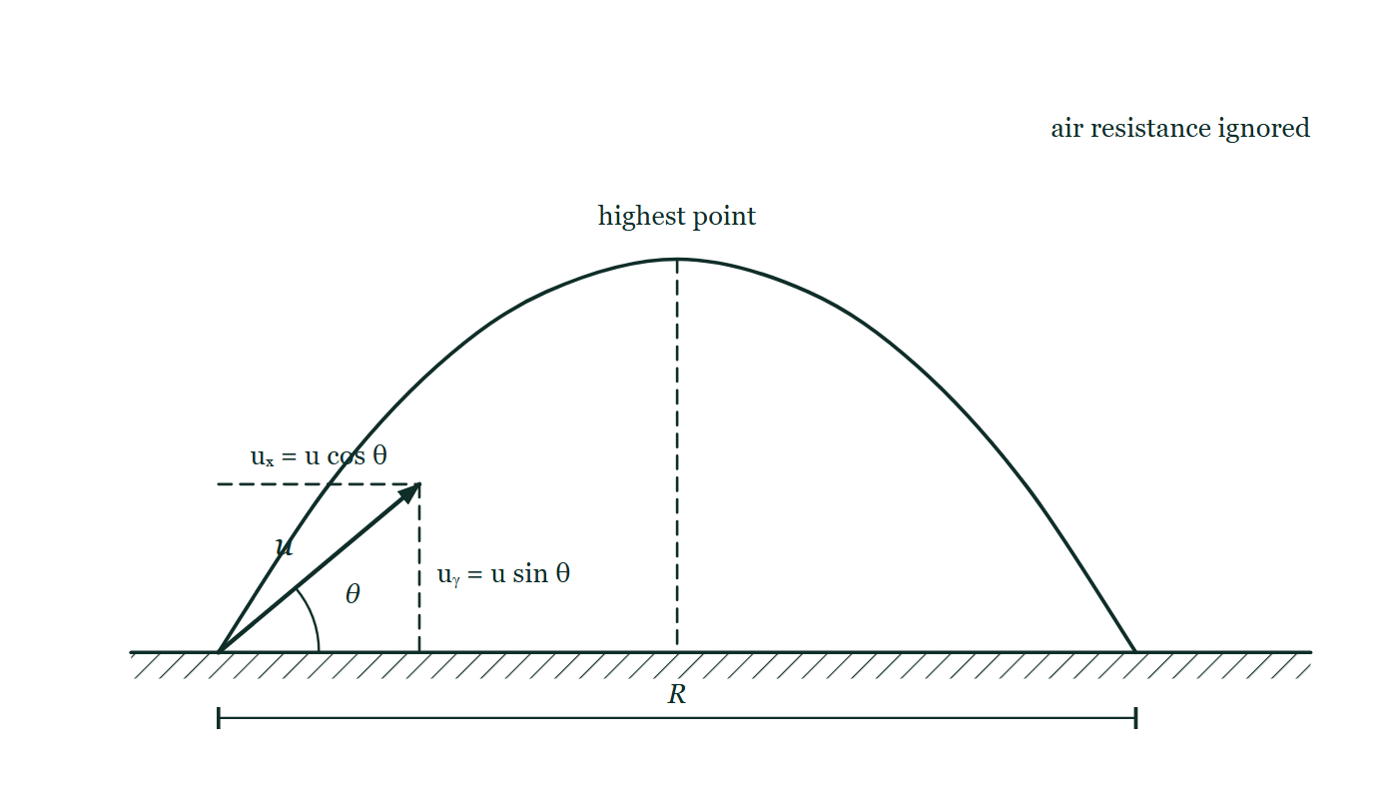
MOTION · KINEMATICS 2D
GIOPHYSICS LESSON
THE PICTURE
Resolving the launch
Drawn for this lesson
A parabola rises from level ground and returns to it; the launch velocity u is drawn at angle θ, and a dashed rectangle at its tip marks u cos θ along the horizontal and u sin θ up the vertical.
The live version of this figure — click here
Motion — Kinematics 2D. Built by GioPhysics from the lesson's own copy; nothing on these slides is re-authored.
21 / 29
Notes:
[Phase] Build the model: The formulae, one at a time, in plain English (minutes 13–22 of 45)
[Figure] A parabola rises from level ground and returns to it; the launch velocity u is drawn at angle θ, and a dashed rectangle at its tip marks u cos θ along the horizontal and u sin θ up the vertical.

Slide 22
MOTION · KINEMATICS 2D
GIOPHYSICS LESSON
WATCH OUT
The common trap
Check and misconception — The quick check and the trap
At the top, vᵧ = 0. The projectile is not stopped: vₓ is still present, and acceleration is still 9.81 m/s² downward.
Motion — Kinematics 2D. Built by GioPhysics from the lesson's own copy; nothing on these slides is re-authored.
22 / 29
Notes:
[Phase] Check and misconception: The quick check and the trap (minutes 35–41 of 45)
[Misconception] At the top, vᵧ = 0. The projectile is not stopped: vₓ is still present, and acceleration is still 9.81 m/s² downward.

Slide 23
MOTION · KINEMATICS 2D
GIOPHYSICS LESSON
SPOT THE MISTAKE
One line here is wrong
The whole working is up — find the bad line before you click
1.
A ball is launched at 20 m/s at 30° above the horizontal on level ground. Find its time of flight.
2.
uₓ = 20 cos 30° = 17.3 m/s, uᵧ = 20 sin 30° = 10.0 m/s
3.
Going up: 0 = uᵧ − gt, so t = 10.0 / 9.81 = 1.02 s
4.
Time of flight = 2 × 1.02 = 2.04 s
5.
Check: using the horizontal component, 0 = uₓ − gt gives t = 17.3 / 9.81 = 1.76 s
LINE 5 IS WRONG
Gravity has been applied to the horizontal component. It is a tempting check because the algebra looks like the line above it, but aₓ = 0 — nothing slows the horizontal motion in this model, so vₓ never reaches zero and there is no time to find from it. Any working that puts g in an x-equation has crossed the two columns.
IT SHOULD SAY
Check: horizontal range = uₓ × time of flight = 17.3 × 2.04 = 35 m
Motion — Kinematics 2D. Built by GioPhysics from the lesson's own copy; nothing on these slides is re-authored.
23 / 29
Notes:
[Phase] Worked examples: I do, we do — one step revealed at a time (minutes 22–35 of 45)
[Spot the mistake] The working is complete and one line of it is wrong. Let the room hunt: one click names the line, a second shows it done correctly.
[Line 5 is wrong] Gravity has been applied to the horizontal component. It is a tempting check because the algebra looks like the line above it, but aₓ = 0 — nothing slows the horizontal motion in this model, so vₓ never reaches zero and there is no time to find from it. Any working that puts g in an x-equation has crossed the two columns.
[It should say] Check: horizontal range = uₓ × time of flight = 17.3 × 2.04 = 35 m

Slide 24
MOTION · KINEMATICS 2D
GIOPHYSICS LESSON
PREDICT · TAKE THE VOTE
Commit before you are told
Hands up for each option, then click
Both balls leave the bench at the same instant. Which reaches the floor first?
A The dropped ball — it takes the shorter route
B The launched ball — it is moving faster
C They land at the same instant
Two identical balls rest at the same height on a bench top; the left one is about to be released from rest and the right one carries a horizontal arrow showing it is about to be launched sideways.
The live version of this figure — click here
Motion — Kinematics 2D. Built by GioPhysics from the lesson's own copy; nothing on these slides is re-authored.
24 / 29
Notes:
[Phase] Build the model: The formulae, one at a time, in plain English (minutes 13–22 of 45)
[Predict] Both balls leave the bench at the same instant. Which reaches the floor first?
[Options] A The dropped ball — it takes the shorter route B The launched ball — it is moving faster C They land at the same instant
[Figure] Two identical balls rest at the same height on a bench top; the left one is about to be released from rest and the right one carries a horizontal arrow showing it is about to be launched sideways.

Slide 25
MOTION · KINEMATICS 2D
GIOPHYSICS LESSON
PREDICT · THE OUTCOME
What actually happens
Ask the room who changed their mind, and why
C They land at the same instant
WHY
Split each ball into two stories that share one clock. Horizontally, one has velocity and the other has none — but gravity acts vertically, so it changes the vertical story only, and the two vertical stories are identical: same starting height, same starting vertical velocity of zero, same 9.81 m/s². Same fall, same time.
Motion — Kinematics 2D. Built by GioPhysics from the lesson's own copy; nothing on these slides is re-authored.
25 / 29
Notes:
[Phase] Build the model: The formulae, one at a time, in plain English (minutes 13–22 of 45)
[Answer] C — They land at the same instant. Split each ball into two stories that share one clock. Horizontally, one has velocity and the other has none — but gravity acts vertically, so it changes the vertical story only, and the two vertical stories are identical: same starting height, same starting vertical velocity of zero, same 9.81 m/s². Same fall, same time.

Slide 26
MOTION · KINEMATICS 2D
GIOPHYSICS LESSON
QUICK CHECK
Decide before the answer goes up
Check and misconception — The quick check and the trap
At the highest point of an ideal projectile, which statement is correct?
A
vₓ = 0, vᵧ = 0, and a = 0
B
vₓ is constant, vᵧ = 0, and aᵧ = −g
C
vₓ increases while vᵧ stays constant
Motion — Kinematics 2D. Built by GioPhysics from the lesson's own copy; nothing on these slides is re-authored.
26 / 29
Notes:
[Phase] Check and misconception: The quick check and the trap (minutes 35–41 of 45)
[Question] At the highest point of an ideal projectile, which statement is correct?
[Options] A vₓ = 0, vᵧ = 0, and a = 0 B vₓ is constant, vᵧ = 0, and aᵧ = −g C vₓ increases while vᵧ stays constant

Slide 27
MOTION · KINEMATICS 2D
GIOPHYSICS LESSON
QUICK CHECK · THE ANSWER
The answer, and why
Check and misconception — The quick check and the trap
B vₓ is constant, vᵧ = 0, and aᵧ = −g
HOW TO GET THERE
The vertical velocity is zero for one instant. Horizontal velocity remains constant, and gravity still accelerates the projectile downward.
WHY THE OTHERS TEMPT
A This is the picture of a ball thrown straight up, where everything really does stop for an instant. An angled launch is different: nothing has acted horizontally to remove vₓ, and gravity has not switched off just because the ball has stopped climbing.
B Correct. The vertical velocity passes through zero at the top, the horizontal velocity is untouched, and the acceleration is still g downwards throughout.
C This has the two components the wrong way round. With no horizontal force there is nothing to make vₓ increase — and vᵧ is precisely the component gravity is changing every second, so it is the one that cannot stay constant.
Motion — Kinematics 2D. Built by GioPhysics from the lesson's own copy; nothing on these slides is re-authored.
27 / 29
Notes:
[Phase] Check and misconception: The quick check and the trap (minutes 35–41 of 45)
[Question] At the highest point of an ideal projectile, which statement is correct?
[Option by option] A: This is the picture of a ball thrown straight up, where everything really does stop for an instant. An angled launch is different: nothing has acted horizontally to remove vₓ, and gravity has not switched off just because the ball has stopped climbing. B: Correct. The vertical velocity passes through zero at the top, the horizontal velocity is untouched, and the acceleration is still g downwards throughout. C: This has the two components the wrong way round. With no horizontal force there is nothing to make vₓ increase — and vᵧ is precisely the component gravity is changing every second, so it is the one that cannot stay constant.
[Answer] B — vₓ is constant, vᵧ = 0, and aᵧ = −g
[Why] The vertical velocity is zero for one instant. Horizontal velocity remains constant, and gravity still accelerates the projectile downward.
[Reveal] One click for the answer, then one for the reason.

Slide 28
MOTION · KINEMATICS 2D
GIOPHYSICS LESSON
EXTENSION
No harder example in this lesson
Worked examples — I do, we do — one step revealed at a time
This lesson sets no Hard or Challenging example. The extension for a class that has finished early is the next lesson, or the practice paper questions the figures came from.
Motion — Kinematics 2D. Built by GioPhysics from the lesson's own copy; nothing on these slides is re-authored.
28 / 29
Notes:
[Phase] Worked examples: I do, we do — one step revealed at a time (minutes 22–35 of 45)
[Extension] The lesson record carries no Hard or Challenging example.

Slide 29
MOTION · KINEMATICS 2D
GIOPHYSICS LESSON
MOTION
Where to go next
Plenary — What to take away, what to practise next
Next
Kinematics 2D · Advanced
https://giophysics.com/chapter-1/kinematics-2d-advanced/
Lesson
This lesson on giophysics.com
https://giophysics.com/chapter-1/kinematics-2d/
Live
The live, interactive version of these slides
https://giophysics.com/chapter-1/presentation/?lesson=twoDimension
Chapter
All Motion lessons
https://giophysics.com/chapter-1/
PDF
Download the lesson PDF
https://giophysics.com/downloads/1-5-kinematics-2d.pdf
Motion — Kinematics 2D. Built by GioPhysics from the lesson's own copy; nothing on these slides is re-authored.
29 / 29
Notes:
[Phase] Plenary: What to take away, what to practise next (minutes 41–45 of 45)
[Interactive] The graphs and the circuit topology on these slides are frozen. The live version at https://giophysics.com/chapter-1/presentation/?lesson=twoDimension moves them.

