Slide 1
MOTION · UNITS
GIOPHYSICS LESSON
01 · Motion
Every complete measurement needs a number and a unit.
Units
Numbers become useful when we give them meaning. A unit tells us exactly what was measured.
POSITION
Lesson 1 of 7 in Motion
PLAN
18 slides in the 45-minute core run, about 39.5 minutes of it
LESSON PAGE
https://giophysics.com/chapter-1/units/
Built by GioPhysics from the lesson's own page. Every word on these slides is the lesson's; nothing here is re-authored. Teaching material, not an awarding body's document.
Motion — Units. Built by GioPhysics from the lesson's own copy; nothing on these slides is re-authored.
1 / 22
Notes:
[Lesson] Motion — Units. Lesson 1 of 7.
[Intro] Numbers become useful when we give them meaning. A unit tells us exactly what was measured.
[Source] https://giophysics.com/chapter-1/units/
[Disclaimer] Built by GioPhysics from the lesson's own page. Every word on these slides is the lesson's; nothing here is re-authored. Teaching material, not an awarding body's document.

Slide 2
MOTION · UNITS
GIOPHYSICS LESSON
THINK FIRST
Two people measure the same bench and write down 1.42 and 142. Who is wrong?
Take answers before you click — the point is the commitment
One used a rule marked in metres, the other a rule marked in centimetres. Both wrote the number in a notebook and neither wrote a unit beside it.
THE ANSWER
Neither. Both readings describe the same bench — but until a unit is written down, neither number can be checked, compared or used, because a number on its own does not say what it counts.
Motion — Units. Built by GioPhysics from the lesson's own copy; nothing on these slides is re-authored.
2 / 22
Notes:
[Phase] Starter: Recall what this lesson stands on (minutes 0–5 of 45)
[Hook] Two people measure the same bench and write down 1.42 and 142. Who is wrong? One used a rule marked in metres, the other a rule marked in centimetres. Both wrote the number in a notebook and neither wrote a unit beside it.
[Answer] Neither. Both readings describe the same bench — but until a unit is written down, neither number can be checked, compared or used, because a number on its own does not say what it counts.

Slide 3
MOTION · UNITS
GIOPHYSICS LESSON
EXPLAINED SIMPLY
In one sentence
Introduce the idea — The big idea and the definition
A unit is an agreed standard that tells us what a measured number represents.
Motion — Units. Built by GioPhysics from the lesson's own copy; nothing on these slides is re-authored.
3 / 22
Notes:
[Phase] Introduce the idea: The big idea and the definition (minutes 5–13 of 45)
[Definition] A unit is an agreed standard that tells us what a measured number represents.

Slide 4
MOTION · UNITS
GIOPHYSICS LESSON
EXPLAINED SIMPLY
What that looks like
Introduce the idea — The big idea and the definition
FOR EXAMPLE
A desk length of 1.2 m means the desk is 1.2 times the agreed metre standard.
Motion — Units. Built by GioPhysics from the lesson's own copy; nothing on these slides is re-authored.
4 / 22
Notes:
[Phase] Introduce the idea: The big idea and the definition (minutes 5–13 of 45)
[Worked illustration] A desk length of 1.2 m means the desk is 1.2 times the agreed metre standard.

Slide 5
MOTION · UNITS
GIOPHYSICS LESSON
THE BIG IDEA
Every complete measurement needs a number and a unit.
Introduce the idea — The big idea and the definition
Describe qualities with words. Measure quantities with numbers and units.
Use SI so everyone understands. Use prefixes and conversions to resize the number.
Motion — Units. Built by GioPhysics from the lesson's own copy; nothing on these slides is re-authored.
5 / 22
Notes:
[Phase] Introduce the idea: The big idea and the definition (minutes 5–13 of 45)
[Big idea] Describe qualities with words. Measure quantities with numbers and units. Use SI so everyone understands. Use prefixes and conversions to resize the number.

Slide 6
MOTION · UNITS
GIOPHYSICS LESSON
THE PHYSICS · 1 OF 4
Words or numbers?
Build the model — The formulae, one at a time, in plain English
Physics starts by noticing. Some observations describe a quality; others measure a quantity. Qualitative: uses words, qualities, or the senses.
A number is not required. Quantitative: uses a measuring tool and gives a number with a unit.
Motion — Units. Built by GioPhysics from the lesson's own copy; nothing on these slides is re-authored.
6 / 22
Notes:
[Phase] Build the model: The formulae, one at a time, in plain English (minutes 13–22 of 45)
[Section] Physics starts by noticing. Some observations describe a quality; others measure a quantity. Qualitative: uses words, qualities, or the senses. A number is not required. Quantitative: uses a measuring tool and gives a number with a unit.

Slide 7
MOTION · UNITS
GIOPHYSICS LESSON
THE PHYSICS · 2 OF 4
Meet the SI system
Build the model — The formulae, one at a time, in plain English
Scientists use one agreed system so a measurement means the same thing in every classroom, laboratory, and country.
Motion — Units. Built by GioPhysics from the lesson's own copy; nothing on these slides is re-authored.
7 / 22
Notes:
[Phase] Build the model: The formulae, one at a time, in plain English (minutes 13–22 of 45)
[Section] Scientists use one agreed system so a measurement means the same thing in every classroom, laboratory, and country.

Slide 8
MOTION · UNITS
GIOPHYSICS LESSON
THE PHYSICS · 3 OF 4
A ladder of prefixes
Build the model — The formulae, one at a time, in plain English
Prefixes keep very large and very small measurements easy to read. Slide along the ladder to see how each step changes the base unit.
Motion — Units. Built by GioPhysics from the lesson's own copy; nothing on these slides is re-authored.
8 / 22
Notes:
[Phase] Build the model: The formulae, one at a time, in plain English (minutes 13–22 of 45)
[Section] Prefixes keep very large and very small measurements easy to read. Slide along the ladder to see how each step changes the base unit.

Slide 9
MOTION · UNITS
GIOPHYSICS LESSON
THE PHYSICS · 4 OF 4
Same amount, new unit
Build the model — The formulae, one at a time, in plain English
Moving to a smaller unit makes the number larger. Moving to a larger unit makes the number smaller.
Motion — Units. Built by GioPhysics from the lesson's own copy; nothing on these slides is re-authored.
9 / 22
Notes:
[Phase] Build the model: The formulae, one at a time, in plain English (minutes 13–22 of 45)
[Section] Moving to a smaller unit makes the number larger. Moving to a larger unit makes the number smaller.

Slide 10
MOTION · UNITS
GIOPHYSICS LESSON
FORMULA 1 OF 5
A complete measurement
Build the model — The formulae, one at a time, in plain English
measurement = number + unit
complete measurement · 14.2 cm
Motion — Units. Built by GioPhysics from the lesson's own copy; nothing on these slides is re-authored.
10 / 22
Notes:
[Phase] Build the model: The formulae, one at a time, in plain English (minutes 13–22 of 45)
[Formula] A complete measurement: measurement = number + unit
[Note] complete measurement · 14.2 cm

Slide 11
MOTION · UNITS
GIOPHYSICS LESSON
FORMULA 2 OF 5
The SI base units
Build the model — The formulae, one at a time, in plain English
metre m · kilogram kg · second s · kelvin K
ampere A · mole mol · candela cd
IN PLAIN ENGLISH
How far? How much matter? How long? How hot?
Motion — Units. Built by GioPhysics from the lesson's own copy; nothing on these slides is re-authored.
11 / 22
Notes:
[Phase] Build the model: The formulae, one at a time, in plain English (minutes 13–22 of 45)
[Formula] The SI base units: metre m · kilogram kg · second s · kelvin K
[In plain English] How far? How much matter? How long? How hot?
[Note] ampere A · mole mol · candela cd

Slide 12
MOTION · UNITS
GIOPHYSICS LESSON
FORMULA 3 OF 5
Derived units
Build the model — The formulae, one at a time, in plain English
speed m/s · volume m³ · force N
Combine base units to describe more
Motion — Units. Built by GioPhysics from the lesson's own copy; nothing on these slides is re-authored.
12 / 22
Notes:
[Phase] Build the model: The formulae, one at a time, in plain English (minutes 13–22 of 45)
[Formula] Derived units: speed m/s · volume m³ · force N
[Note] Combine base units to describe more

Slide 13
MOTION · UNITS
GIOPHYSICS LESSON
FORMULA 4 OF 5
A ladder of prefixes
Build the model — The formulae, one at a time, in plain English
1 mm = 0.001 m · 1 cm = 0.01 m · 1 km = 1,000 m
milli 10⁻³ · centi 10⁻² · kilo 10³
Motion — Units. Built by GioPhysics from the lesson's own copy; nothing on these slides is re-authored.
13 / 22
Notes:
[Phase] Build the model: The formulae, one at a time, in plain English (minutes 13–22 of 45)
[Formula] A ladder of prefixes: 1 mm = 0.001 m · 1 cm = 0.01 m · 1 km = 1,000 m
[Note] milli 10⁻³ · centi 10⁻² · kilo 10³

Slide 14
MOTION · UNITS
GIOPHYSICS LESSON
FORMULA 5 OF 5
Same amount, new unit
Build the model — The formulae, one at a time, in plain English
to a smaller unit → multiply · to a larger unit → divide
→ bigger number · → smaller number
Motion — Units. Built by GioPhysics from the lesson's own copy; nothing on these slides is re-authored.
14 / 22
Notes:
[Phase] Build the model: The formulae, one at a time, in plain English (minutes 13–22 of 45)
[Formula] Same amount, new unit: to a smaller unit → multiply · to a larger unit → divide
[Note] → bigger number · → smaller number

Slide 15
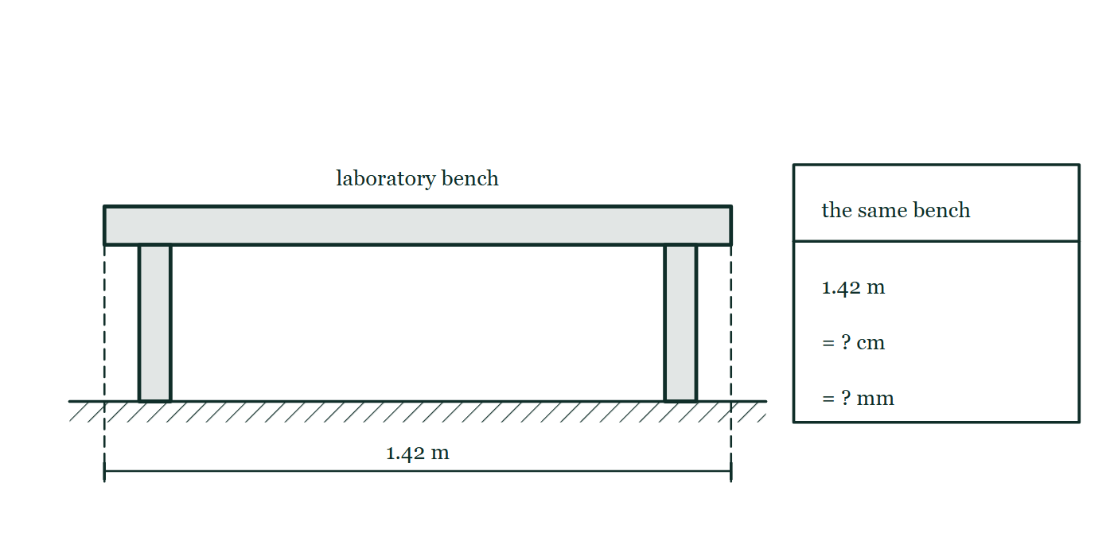
MOTION · UNITS
GIOPHYSICS LESSON
THE PICTURE
One length, three units
Drawn for this lesson
The bench is spanned by a dimension line reading 1.42 m; beside it a panel repeats the same length three times, as metres, then as a centimetre row and a millimetre row left blank.
The live version of this figure — click here
Motion — Units. Built by GioPhysics from the lesson's own copy; nothing on these slides is re-authored.
15 / 22
Notes:
[Phase] Build the model: The formulae, one at a time, in plain English (minutes 13–22 of 45)
[Figure] The bench is spanned by a dimension line reading 1.42 m; beside it a panel repeats the same length three times, as metres, then as a centimetre row and a millimetre row left blank.

Slide 16
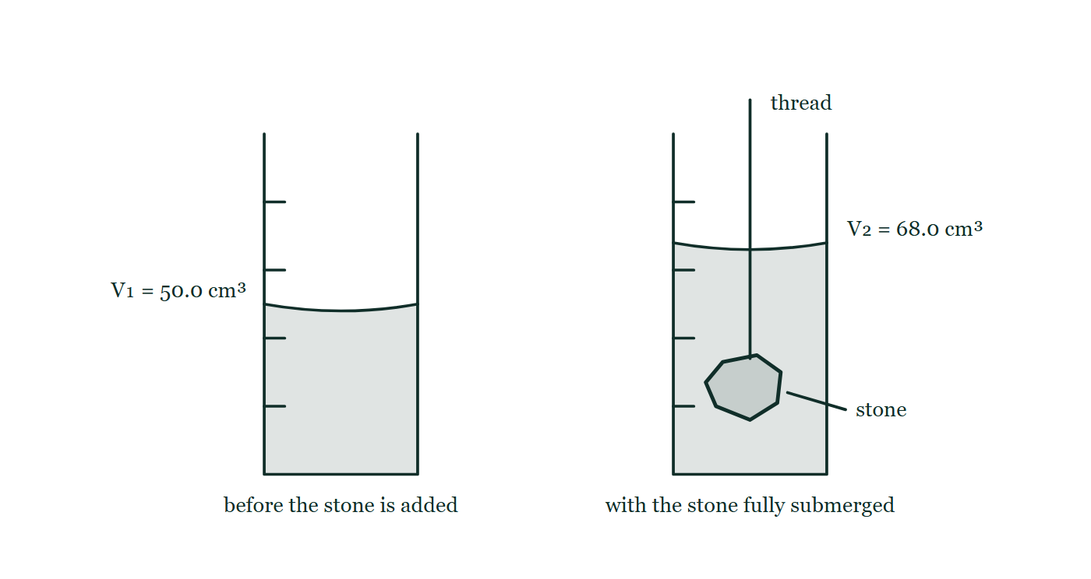
MOTION · UNITS
GIOPHYSICS LESSON
FIGURE
Fig. 10.1 — IGCSE Topic 1 · Motion, forces and energy
Drawn for question 10 of that paper · syllabus 1.1, 1.4
Two measuring cylinders drawn side by side, each with graduations up the wall and a curved meniscus. The first holds water alone, its surface at the 50.0 cm³ mark. The second holds the same water with the stone lowered in on a thread that runs up and out of the cylinder; the stone lies fully submerged near the base and the surface now stands at the 68.0 cm³ mark.
See the question this was drawn for — click here
Motion — Units. Built by GioPhysics from the lesson's own copy; nothing on these slides is re-authored.
16 / 22
Notes:
[Phase] Build the model: The formulae, one at a time, in plain English (minutes 13–22 of 45)
[Figure] Fig. 10.1. Two measuring cylinders drawn side by side, each with graduations up the wall and a curved meniscus. The first holds water alone, its surface at the 50.0 cm³ mark. The second holds the same water with the stone lowered in on a thread that runs up and out of the cylinder; the stone lies fully submerged near the base and the surface now stands at the 68.0 cm³ mark.
[Where it came from] IGCSE Topic 1 · Motion, forces and energy, question 10; syllabus 1.1, 1.4.

Slide 17
MOTION · UNITS
GIOPHYSICS LESSON
PREDICT · TAKE THE VOTE
Commit before you are told
Hands up for each option, then click
The bench is 1.42 m long. What is that same length in centimetres?
A 0.0142 cm
B 14.2 cm
C 142 cm
The bench is spanned by a dimension line reading 1.42 m; beside it a panel repeats the same length three times, as metres, then as a centimetre row and a millimetre row left blank.
The live version of this figure — click here
Motion — Units. Built by GioPhysics from the lesson's own copy; nothing on these slides is re-authored.
17 / 22
Notes:
[Phase] Build the model: The formulae, one at a time, in plain English (minutes 13–22 of 45)
[Predict] The bench is 1.42 m long. What is that same length in centimetres?
[Options] A 0.0142 cm B 14.2 cm C 142 cm
[Figure] The bench is spanned by a dimension line reading 1.42 m; beside it a panel repeats the same length three times, as metres, then as a centimetre row and a millimetre row left blank.

Slide 18
MOTION · UNITS
GIOPHYSICS LESSON
PREDICT · THE OUTCOME
What actually happens
Ask the room who changed their mind, and why
C 142 cm
WHY
A centimetre is smaller than a metre, so it takes more of them to span the same bench: the number must get bigger. There are 100 cm in 1 m, so 1.42 × 100 = 142 cm — the bench has not changed length, only the unit counting it.
Motion — Units. Built by GioPhysics from the lesson's own copy; nothing on these slides is re-authored.
18 / 22
Notes:
[Phase] Build the model: The formulae, one at a time, in plain English (minutes 13–22 of 45)
[Answer] C — 142 cm. A centimetre is smaller than a metre, so it takes more of them to span the same bench: the number must get bigger. There are 100 cm in 1 m, so 1.42 × 100 = 142 cm — the bench has not changed length, only the unit counting it.

Slide 19
MOTION · UNITS
GIOPHYSICS LESSON
QUICK CHECK
Decide before the answer goes up
Check and misconception — The quick check and the trap
“The pencil is 14 cm long.” What kind of observation is this?
A
qualitative
B
quantitative
Motion — Units. Built by GioPhysics from the lesson's own copy; nothing on these slides is re-authored.
19 / 22
Notes:
[Phase] Check and misconception: The quick check and the trap (minutes 35–41 of 45)
[Question] “The pencil is 14 cm long.” What kind of observation is this?
[Options] A qualitative B quantitative

Slide 20
MOTION · UNITS
GIOPHYSICS LESSON
QUICK CHECK · THE ANSWER
The answer, and why
Check and misconception — The quick check and the trap
B quantitative
HOW TO GET THERE
It includes both a number and a unit, so it is a measurement.
WHY THE OTHERS TEMPT
A Qualitative describes with words and the senses — "the pencil is short", "the pencil is blue". The sentence does read like a plain description, which is what makes this tempting, but it carries something a description does not: a measured number with a unit attached to it.
B Correct. 14 is the number and cm is the unit that says what the number counts, so this came from a measuring instrument rather than from an impression.
Motion — Units. Built by GioPhysics from the lesson's own copy; nothing on these slides is re-authored.
20 / 22
Notes:
[Phase] Check and misconception: The quick check and the trap (minutes 35–41 of 45)
[Question] “The pencil is 14 cm long.” What kind of observation is this?
[Option by option] A: Qualitative describes with words and the senses — "the pencil is short", "the pencil is blue". The sentence does read like a plain description, which is what makes this tempting, but it carries something a description does not: a measured number with a unit attached to it. B: Correct. 14 is the number and cm is the unit that says what the number counts, so this came from a measuring instrument rather than from an impression.
[Answer] B — quantitative
[Why] It includes both a number and a unit, so it is a measurement.
[Reveal] One click for the answer, then one for the reason.

Slide 21
MOTION · UNITS
GIOPHYSICS LESSON
EXTENSION
No harder example in this lesson
Worked examples — I do, we do — one step revealed at a time
This lesson sets no Hard or Challenging example. The extension for a class that has finished early is the next lesson, or the practice paper questions the figures came from.
Motion — Units. Built by GioPhysics from the lesson's own copy; nothing on these slides is re-authored.
21 / 22
Notes:
[Phase] Worked examples: I do, we do — one step revealed at a time (minutes 22–35 of 45)
[Extension] The lesson record carries no Hard or Challenging example.

Slide 22
MOTION · UNITS
GIOPHYSICS LESSON
MOTION
Where to go next
Plenary — What to take away, what to practise next
Next
Scalar and Vector Quantities
https://giophysics.com/chapter-1/scalar-vector/
Lesson
This lesson on giophysics.com
https://giophysics.com/chapter-1/units/
Live
The live, interactive version of these slides
https://giophysics.com/chapter-1/presentation/?lesson=units
Chapter
All Motion lessons
https://giophysics.com/chapter-1/
PDF
Download the lesson PDF
https://giophysics.com/downloads/1-1-units.pdf
Motion — Units. Built by GioPhysics from the lesson's own copy; nothing on these slides is re-authored.
22 / 22
Notes:
[Phase] Plenary: What to take away, what to practise next (minutes 41–45 of 45)
[Interactive] The graphs and the circuit topology on these slides are frozen. The live version at https://giophysics.com/chapter-1/presentation/?lesson=units moves them.

