Slide 1
MOTION · SCALARS & VECTORS
GIOPHYSICS LESSON
01 · Motion
Vector thinking, simplified
Scalars & Vectors
A scalar tells us how much. A vector also tells us which way.
POSITION
Lesson 2 of 7 in Motion
PLAN
19 slides in the 45-minute core run, about 42 minutes of it
LESSON PAGE
https://giophysics.com/chapter-1/scalar-vector/
Built by GioPhysics from the lesson's own page. Every word on these slides is the lesson's; nothing here is re-authored. Teaching material, not an awarding body's document.
Motion — Scalars & Vectors. Built by GioPhysics from the lesson's own copy; nothing on these slides is re-authored.
1 / 22
Notes:
[Lesson] Motion — Scalars & Vectors. Lesson 2 of 7.
[Intro] A scalar tells us how much. A vector also tells us which way.
[Source] https://giophysics.com/chapter-1/scalar-vector/
[Disclaimer] Built by GioPhysics from the lesson's own page. Every word on these slides is the lesson's; nothing here is re-authored. Teaching material, not an awarding body's document.

Slide 2
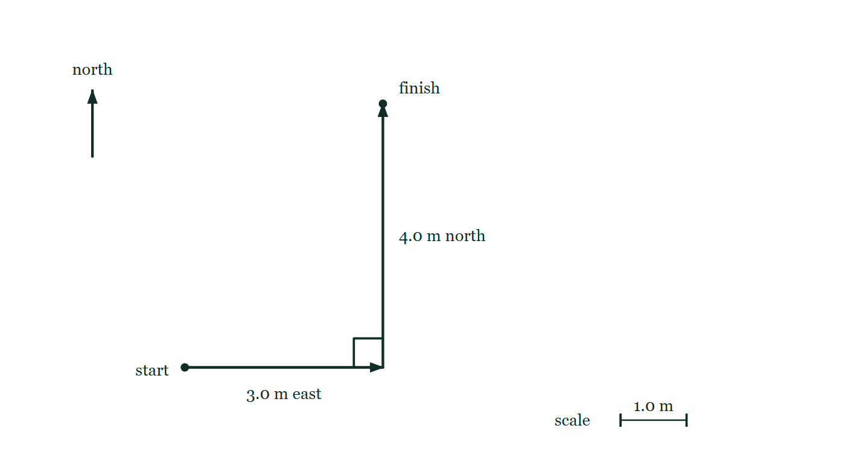
MOTION · SCALARS & VECTORS
GIOPHYSICS LESSON
THINK FIRST
You walk 3 m east, then 4 m north. How far are you from where you started?
Take answers before you click — the point is the commitment
Your pedometer counted every step and says you covered 7 m. Someone standing where you began looks straight at you and disagrees.
THE ANSWER
5 m. The pedometer measured distance, which follows the path; the person measured displacement, which is the straight line from start to finish. Both are correct answers to different questions.
Two displacement arrows are drawn tip to tail: 3.0 m east from the start, then 4.0 m north from the tip of the first, with a right-angle mark at the corner and a 1.0 m scale bar below.
The live version of this figure — click here
Motion — Scalars & Vectors. Built by GioPhysics from the lesson's own copy; nothing on these slides is re-authored.
2 / 22
Notes:
[Phase] Starter: Recall what this lesson stands on (minutes 0–5 of 45)
[Hook] You walk 3 m east, then 4 m north. How far are you from where you started? Your pedometer counted every step and says you covered 7 m. Someone standing where you began looks straight at you and disagrees.
[Answer] 5 m. The pedometer measured distance, which follows the path; the person measured displacement, which is the straight line from start to finish. Both are correct answers to different questions.
[Figure] Two displacement arrows are drawn tip to tail: 3.0 m east from the start, then 4.0 m north from the tip of the first, with a right-angle mark at the corner and a 1.0 m scale bar below.

Slide 3
MOTION · SCALARS & VECTORS
GIOPHYSICS LESSON
EXPLAINED SIMPLY
In one sentence
Introduce the idea — The big idea and the definition
A scalar has size only, while a vector has both size and direction.
Motion — Scalars & Vectors. Built by GioPhysics from the lesson's own copy; nothing on these slides is re-authored.
3 / 22
Notes:
[Phase] Introduce the idea: The big idea and the definition (minutes 5–13 of 45)
[Definition] A scalar has size only, while a vector has both size and direction.

Slide 4
MOTION · SCALARS & VECTORS
GIOPHYSICS LESSON
EXPLAINED SIMPLY
What that looks like
Introduce the idea — The big idea and the definition
FOR EXAMPLE
A speed of 12 m/s is a scalar; a velocity of 12 m/s east is a vector.
Motion — Scalars & Vectors. Built by GioPhysics from the lesson's own copy; nothing on these slides is re-authored.
4 / 22
Notes:
[Phase] Introduce the idea: The big idea and the definition (minutes 5–13 of 45)
[Worked illustration] A speed of 12 m/s is a scalar; a velocity of 12 m/s east is a vector.

Slide 5
MOTION · SCALARS & VECTORS
GIOPHYSICS LESSON
THE BIG IDEA
Vector thinking, simplified
Introduce the idea — The big idea and the definition
Scalar: magnitude only. Vector: magnitude and direction. Arrow: length shows size; tip shows direction.
Resultant: the combined effect of the vectors. Components: horizontal and vertical parts.
Motion — Scalars & Vectors. Built by GioPhysics from the lesson's own copy; nothing on these slides is re-authored.
5 / 22
Notes:
[Phase] Introduce the idea: The big idea and the definition (minutes 5–13 of 45)
[Big idea] Scalar: magnitude only. Vector: magnitude and direction. Arrow: length shows size; tip shows direction. Resultant: the combined effect of the vectors. Components: horizontal and vertical parts.

Slide 6
MOTION · SCALARS & VECTORS
GIOPHYSICS LESSON
THE PHYSICS · 1 OF 5
Magnitude—or magnitude and direction?
Build the model — The formulae, one at a time, in plain English
Magnitude means size. Scalars stop there. Vectors add a direction, which is why speed and velocity are not the same idea.
Motion — Scalars & Vectors. Built by GioPhysics from the lesson's own copy; nothing on these slides is re-authored.
6 / 22
Notes:
[Phase] Build the model: The formulae, one at a time, in plain English (minutes 13–22 of 45)
[Section] Magnitude means size. Scalars stop there. Vectors add a direction, which is why speed and velocity are not the same idea.

Slide 7
MOTION · SCALARS & VECTORS
GIOPHYSICS LESSON
THE PHYSICS · 2 OF 5
A vector is drawn to scale
Build the model — The formulae, one at a time, in plain English
The arrow’s length represents magnitude. Its tip shows the direction. Tail: where the vector begins.
Tip: the direction it points. Scale: turns arrow length into magnitude.
Motion — Scalars & Vectors. Built by GioPhysics from the lesson's own copy; nothing on these slides is re-authored.
7 / 22
Notes:
[Phase] Build the model: The formulae, one at a time, in plain English (minutes 13–22 of 45)
[Section] The arrow’s length represents magnitude. Its tip shows the direction. Tail: where the vector begins. Tip: the direction it points. Scale: turns arrow length into magnitude.

Slide 8
MOTION · SCALARS & VECTORS
GIOPHYSICS LESSON
THE PHYSICS · 3 OF 5
The resultant is the final effect
Build the model — The formulae, one at a time, in plain English
Add vectors tip to tail, or add their horizontal and vertical components. The resultant joins the first tail to the final tip.
Motion — Scalars & Vectors. Built by GioPhysics from the lesson's own copy; nothing on these slides is re-authored.
8 / 22
Notes:
[Phase] Build the model: The formulae, one at a time, in plain English (minutes 13–22 of 45)
[Section] Add vectors tip to tail, or add their horizontal and vertical components. The resultant joins the first tail to the final tip.

Slide 9
MOTION · SCALARS & VECTORS
GIOPHYSICS LESSON
THE PHYSICS · 4 OF 5
One vector, two perpendicular parts
Build the model — The formulae, one at a time, in plain English
If the angle is measured from the positive horizontal axis, the horizontal part uses cosine and the vertical part uses sine.
Motion — Scalars & Vectors. Built by GioPhysics from the lesson's own copy; nothing on these slides is re-authored.
9 / 22
Notes:
[Phase] Build the model: The formulae, one at a time, in plain English (minutes 13–22 of 45)
[Section] If the angle is measured from the positive horizontal axis, the horizontal part uses cosine and the vertical part uses sine.

Slide 10
MOTION · SCALARS & VECTORS
GIOPHYSICS LESSON
THE PHYSICS · 5 OF 5
When do sine and cosine rules help?
Build the model — The formulae, one at a time, in plain English
When vectors form a triangle but are not at right angles, the cosine rule can find a missing magnitude and the sine rule can find a missing angle. A scale drawing is useful for checking the result.
Motion — Scalars & Vectors. Built by GioPhysics from the lesson's own copy; nothing on these slides is re-authored.
10 / 22
Notes:
[Phase] Build the model: The formulae, one at a time, in plain English (minutes 13–22 of 45)
[Section] When vectors form a triangle but are not at right angles, the cosine rule can find a missing magnitude and the sine rule can find a missing angle. A scale drawing is useful for checking the result.

Slide 11
MOTION · SCALARS & VECTORS
GIOPHYSICS LESSON
FORMULA 1 OF 5
A vector
Build the model — The formulae, one at a time, in plain English
vector = magnitude + direction
scalars: mass, time, speed, energy, pressure · vectors: displacement, velocity, acceleration, force, momentum
IN PLAIN ENGLISH
One number and a unit completely describe the quantity. A direction is needed to complete the description.
Motion — Scalars & Vectors. Built by GioPhysics from the lesson's own copy; nothing on these slides is re-authored.
11 / 22
Notes:
[Phase] Build the model: The formulae, one at a time, in plain English (minutes 13–22 of 45)
[Formula] A vector: vector = magnitude + direction
[In plain English] One number and a unit completely describe the quantity. A direction is needed to complete the description.
[Note] scalars: mass, time, speed, energy, pressure · vectors: displacement, velocity, acceleration, force, momentum

Slide 12
MOTION · SCALARS & VECTORS
GIOPHYSICS LESSON
FORMULA 2 OF 5
The resultant range
Build the model — The formulae, one at a time, in plain English
|A − B| ≤ R ≤ A + B
The magnitude must always stay inside this range
IN PLAIN ENGLISH
Same direction: add magnitudes. Opposite directions: subtract magnitudes. Any angle: add components.
Motion — Scalars & Vectors. Built by GioPhysics from the lesson's own copy; nothing on these slides is re-authored.
12 / 22
Notes:
[Phase] Build the model: The formulae, one at a time, in plain English (minutes 13–22 of 45)
[Formula] The resultant range: |A − B| ≤ R ≤ A + B
[In plain English] Same direction: add magnitudes. Opposite directions: subtract magnitudes. Any angle: add components.
[Note] The magnitude must always stay inside this range

Slide 13
MOTION · SCALARS & VECTORS
GIOPHYSICS LESSON
FORMULA 3 OF 5
Subtracting vectors
Build the model — The formulae, one at a time, in plain English
A − B = A + (−B)
Reverse B’s direction, then add as usual
Motion — Scalars & Vectors. Built by GioPhysics from the lesson's own copy; nothing on these slides is re-authored.
13 / 22
Notes:
[Phase] Build the model: The formulae, one at a time, in plain English (minutes 13–22 of 45)
[Formula] Subtracting vectors: A − B = A + (−B)
[Note] Reverse B’s direction, then add as usual

Slide 14
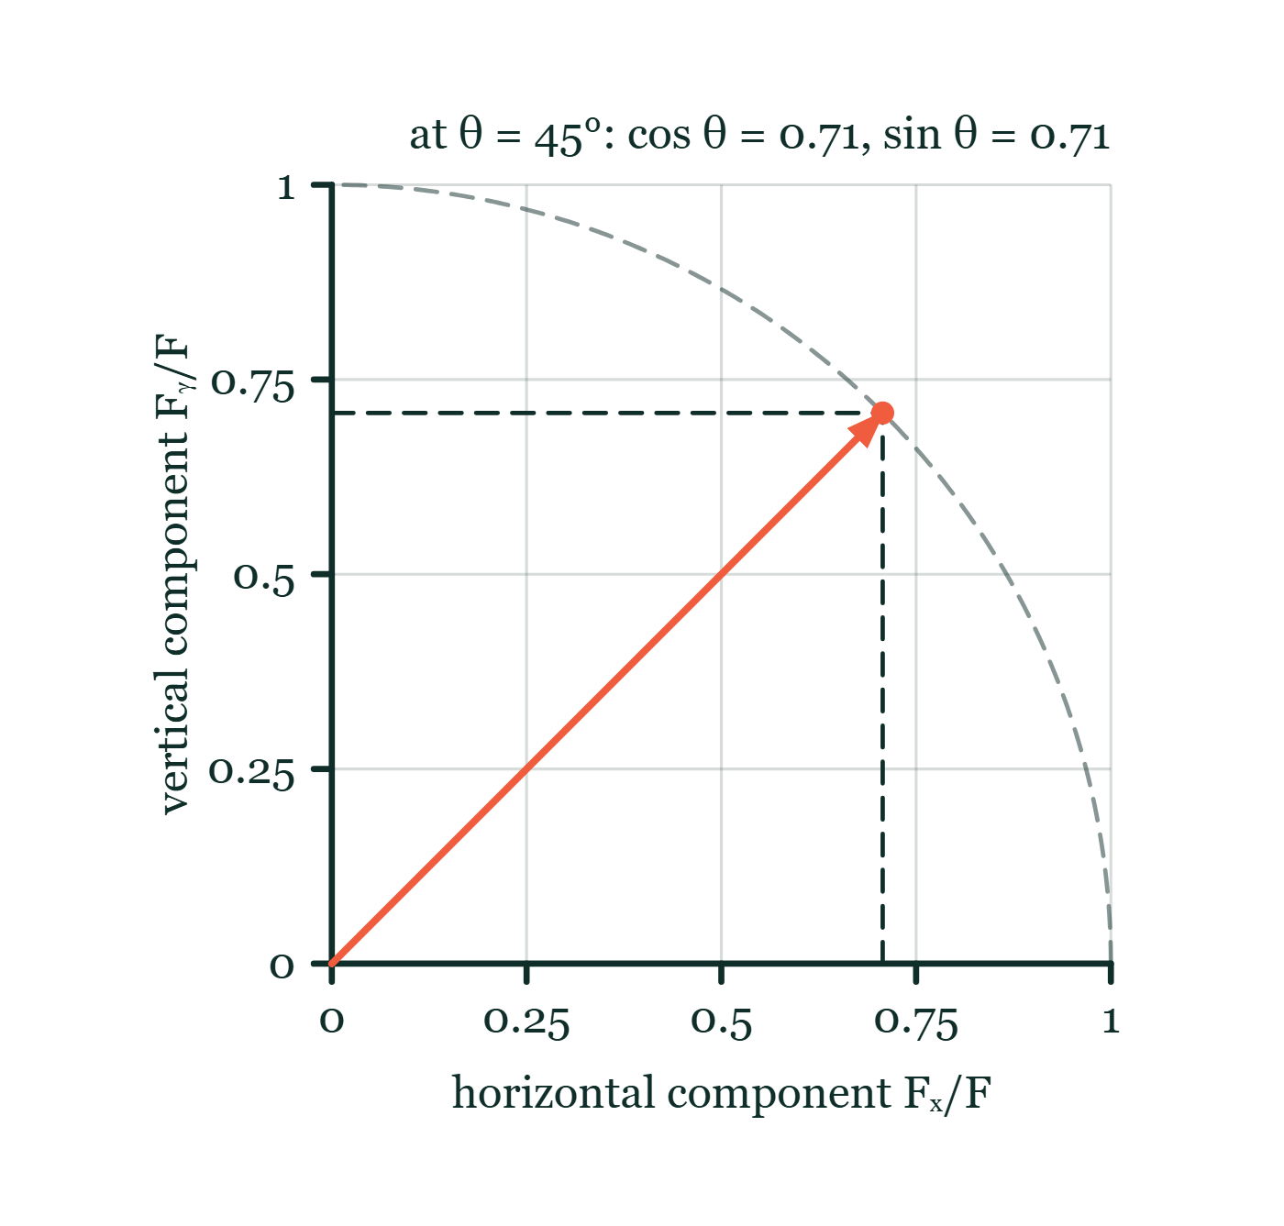
MOTION · SCALARS & VECTORS
GIOPHYSICS LESSON
FORMULA 4 OF 5
Horizontal component
Build the model — The formulae, one at a time, in plain English
Fₓ = F cos θ
the horizontal part uses cosine
Vector components explorer
Move this graph on the live version — click here
Motion — Scalars & Vectors. Built by GioPhysics from the lesson's own copy; nothing on these slides is re-authored.
14 / 22
Notes:
[Phase] Build the model: The formulae, one at a time, in plain English (minutes 13–22 of 45)
[Formula] Horizontal component: Fₓ = F cos θ
[Note] the horizontal part uses cosine
[Graph] Vector components explorer. Changing the angle redistributes one fixed vector between perpendicular components.
[Axes] Horizontal: horizontal component Fₓ/F. Vertical: vertical component Fᵧ/F. Values are normalised — the graph teaches the shape, not a measurement.

Slide 15
MOTION · SCALARS & VECTORS
GIOPHYSICS LESSON
FORMULA 5 OF 5
Vertical component
Build the model — The formulae, one at a time, in plain English
Fᵧ = F sin θ
the vertical part uses sine
Vector components explorer
Move this graph on the live version — click here
Motion — Scalars & Vectors. Built by GioPhysics from the lesson's own copy; nothing on these slides is re-authored.
15 / 22
Notes:
[Phase] Build the model: The formulae, one at a time, in plain English (minutes 13–22 of 45)
[Formula] Vertical component: Fᵧ = F sin θ
[Note] the vertical part uses sine
[Graph] Vector components explorer. Changing the angle redistributes one fixed vector between perpendicular components.
[Axes] Horizontal: horizontal component Fₓ/F. Vertical: vertical component Fᵧ/F. Values are normalised — the graph teaches the shape, not a measurement.

Slide 16
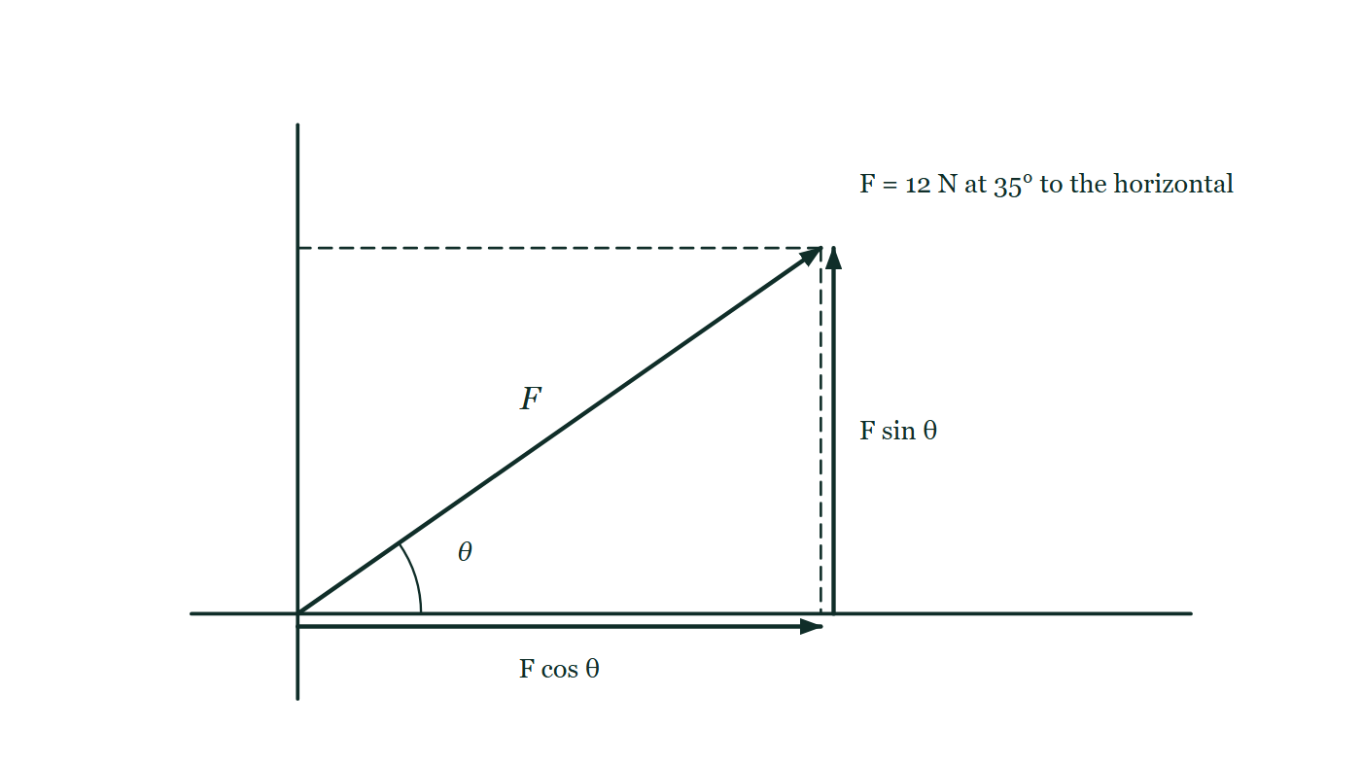
MOTION · SCALARS & VECTORS
GIOPHYSICS LESSON
THE PICTURE
One vector, two perpendicular parts
Drawn for this lesson
A 12 N force arrow leaves the origin at 35° above the horizontal axis, with dashed lines dropped from its tip to each axis and the two sides of that rectangle marked F cos θ and F sin θ.
The live version of this figure — click here
Motion — Scalars & Vectors. Built by GioPhysics from the lesson's own copy; nothing on these slides is re-authored.
16 / 22
Notes:
[Phase] Build the model: The formulae, one at a time, in plain English (minutes 13–22 of 45)
[Figure] A 12 N force arrow leaves the origin at 35° above the horizontal axis, with dashed lines dropped from its tip to each axis and the two sides of that rectangle marked F cos θ and F sin θ.

Slide 17
MOTION · SCALARS & VECTORS
GIOPHYSICS LESSON
PREDICT · TAKE THE VOTE
Commit before you are told
Hands up for each option, then click
How far is the finish from the start on this drawing?
A 7.0 m
B 5.0 m
C 1.0 m
Two displacement arrows are drawn tip to tail: 3.0 m east from the start, then 4.0 m north from the tip of the first, with a right-angle mark at the corner and a 1.0 m scale bar below.
The live version of this figure — click here
Motion — Scalars & Vectors. Built by GioPhysics from the lesson's own copy; nothing on these slides is re-authored.
17 / 22
Notes:
[Phase] Build the model: The formulae, one at a time, in plain English (minutes 13–22 of 45)
[Predict] How far is the finish from the start on this drawing?
[Options] A 7.0 m B 5.0 m C 1.0 m
[Figure] Two displacement arrows are drawn tip to tail: 3.0 m east from the start, then 4.0 m north from the tip of the first, with a right-angle mark at the corner and a 1.0 m scale bar below.

Slide 18
MOTION · SCALARS & VECTORS
GIOPHYSICS LESSON
PREDICT · THE OUTCOME
What actually happens
Ask the room who changed their mind, and why
B 5.0 m
WHY
The two arrows are at right angles, so the straight line from the first tail to the last tip closes a 3–4–5 triangle: 5.0 m. Measure it against the scale bar and it comes out at five squares. 7.0 m would only be right if the second arrow carried straight on east.
Motion — Scalars & Vectors. Built by GioPhysics from the lesson's own copy; nothing on these slides is re-authored.
18 / 22
Notes:
[Phase] Build the model: The formulae, one at a time, in plain English (minutes 13–22 of 45)
[Answer] B — 5.0 m. The two arrows are at right angles, so the straight line from the first tail to the last tip closes a 3–4–5 triangle: 5.0 m. Measure it against the scale bar and it comes out at five squares. 7.0 m would only be right if the second arrow carried straight on east.

Slide 19
MOTION · SCALARS & VECTORS
GIOPHYSICS LESSON
QUICK CHECK
Decide before the answer goes up
Check and misconception — The quick check and the trap
Velocity: 12 m/s east. Both a size and a direction are given.
A
scalar
B
vector
Motion — Scalars & Vectors. Built by GioPhysics from the lesson's own copy; nothing on these slides is re-authored.
19 / 22
Notes:
[Phase] Check and misconception: The quick check and the trap (minutes 35–41 of 45)
[Question] Velocity: 12 m/s east. Both a size and a direction are given.
[Options] A scalar B vector

Slide 20
MOTION · SCALARS & VECTORS
GIOPHYSICS LESSON
QUICK CHECK · THE ANSWER
The answer, and why
Check and misconception — The quick check and the trap
B vector
HOW TO GET THERE
Velocity needs magnitude and direction, so it is a vector.
WHY THE OTHERS TEMPT
A A speed of 12 m/s really is a scalar, and that is exactly why this is tempting — the number and unit are the same in both cases. What changes the quantity is the word "east": with a direction attached, the description is no longer complete without it.
B Correct. Magnitude and direction together, so it is a vector. Reverse the direction and it is a different velocity, even though the 12 m/s has not changed.
Motion — Scalars & Vectors. Built by GioPhysics from the lesson's own copy; nothing on these slides is re-authored.
20 / 22
Notes:
[Phase] Check and misconception: The quick check and the trap (minutes 35–41 of 45)
[Question] Velocity: 12 m/s east. Both a size and a direction are given.
[Option by option] A: A speed of 12 m/s really is a scalar, and that is exactly why this is tempting — the number and unit are the same in both cases. What changes the quantity is the word "east": with a direction attached, the description is no longer complete without it. B: Correct. Magnitude and direction together, so it is a vector. Reverse the direction and it is a different velocity, even though the 12 m/s has not changed.
[Answer] B — vector
[Why] Velocity needs magnitude and direction, so it is a vector.
[Reveal] One click for the answer, then one for the reason.

Slide 21
MOTION · SCALARS & VECTORS
GIOPHYSICS LESSON
EXTENSION
No harder example in this lesson
Worked examples — I do, we do — one step revealed at a time
This lesson sets no Hard or Challenging example. The extension for a class that has finished early is the next lesson, or the practice paper questions the figures came from.
Motion — Scalars & Vectors. Built by GioPhysics from the lesson's own copy; nothing on these slides is re-authored.
21 / 22
Notes:
[Phase] Worked examples: I do, we do — one step revealed at a time (minutes 22–35 of 45)
[Extension] The lesson record carries no Hard or Challenging example.

Slide 22
MOTION · SCALARS & VECTORS
GIOPHYSICS LESSON
MOTION
Where to go next
Plenary — What to take away, what to practise next
Next
Kinematics 1D · Part 1
https://giophysics.com/chapter-1/kinematics-1d-part-1/
Lesson
This lesson on giophysics.com
https://giophysics.com/chapter-1/scalar-vector/
Live
The live, interactive version of these slides
https://giophysics.com/chapter-1/presentation/?lesson=vectors
Chapter
All Motion lessons
https://giophysics.com/chapter-1/
PDF
Download the lesson PDF
https://giophysics.com/downloads/1-2-scalar-vector-quantities.pdf
Motion — Scalars & Vectors. Built by GioPhysics from the lesson's own copy; nothing on these slides is re-authored.
22 / 22
Notes:
[Phase] Plenary: What to take away, what to practise next (minutes 41–45 of 45)
[Interactive] The graphs and the circuit topology on these slides are frozen. The live version at https://giophysics.com/chapter-1/presentation/?lesson=vectors moves them.

