Slide 1
CIRCULAR MOTION · ANGULAR MOMENTUM
GIOPHYSICS LESSON
06 · Circular Motion
Directed rotational motion
Angular Momentum
Angular momentum depends on position, momentum, and the chosen origin. Torque is its rate of change.
POSITION
Lesson 8 of 11 in Circular Motion
PLAN
16 slides in the 45-minute core run, about 44 minutes of it
LESSON PAGE
https://giophysics.com/chapter-10/angular-momentum/
Built by GioPhysics from the lesson's own page. Every word on these slides is the lesson's; nothing here is re-authored. Teaching material, not an awarding body's document.
Circular Motion — Angular Momentum. Built by GioPhysics from the lesson's own copy; nothing on these slides is re-authored.
1 / 31
Notes:
[Lesson] Circular Motion — Angular Momentum. Lesson 8 of 11.
[Intro] Angular momentum depends on position, momentum, and the chosen origin. Torque is its rate of change.
[Source] https://giophysics.com/chapter-10/angular-momentum/
[Disclaimer] Built by GioPhysics from the lesson's own page. Every word on these slides is the lesson's; nothing here is re-authored. Teaching material, not an awarding body's document.

Slide 2
CIRCULAR MOTION · ANGULAR MOMENTUM
GIOPHYSICS LESSON
THINK FIRST
A car drives past you along a straight road at a steady speed. Does it have angular momentum about you?
Take answers before you click — the point is the commitment
It is going in a perfectly straight line and nothing about it is going round anything.
THE ANSWER
Yes — and a constant amount of it. Angular momentum needs no circle, only a chosen point and a perpendicular distance from it. mv times your perpendicular distance from the road is constant the whole way past, which is exactly what zero torque about you means.
Circular Motion — Angular Momentum. Built by GioPhysics from the lesson's own copy; nothing on these slides is re-authored.
2 / 31
Notes:
[Phase] Starter: Recall what this lesson stands on (minutes 0–5 of 45)
[Hook] A car drives past you along a straight road at a steady speed. Does it have angular momentum about you? It is going in a perfectly straight line and nothing about it is going round anything.
[Answer] Yes — and a constant amount of it. Angular momentum needs no circle, only a chosen point and a perpendicular distance from it. mv times your perpendicular distance from the road is constant the whole way past, which is exactly what zero torque about you means.

Slide 3
CIRCULAR MOTION · ANGULAR MOMENTUM
GIOPHYSICS LESSON
EXPLAINED SIMPLY
In one sentence
Introduce the idea — The big idea and the definition
Angular momentum measures an object's rotational motion about a chosen point or axis.
Circular Motion — Angular Momentum. Built by GioPhysics from the lesson's own copy; nothing on these slides is re-authored.
3 / 31
Notes:
[Phase] Introduce the idea: The big idea and the definition (minutes 5–13 of 45)
[Definition] Angular momentum measures an object's rotational motion about a chosen point or axis.

Slide 4
CIRCULAR MOTION · ANGULAR MOMENTUM
GIOPHYSICS LESSON
EXPLAINED SIMPLY
What that looks like
Introduce the idea — The big idea and the definition
FOR EXAMPLE
A spinning flywheel has angular momentum along its axis, with its direction set by the right-hand rule.
Circular Motion — Angular Momentum. Built by GioPhysics from the lesson's own copy; nothing on these slides is re-authored.
4 / 31
Notes:
[Phase] Introduce the idea: The big idea and the definition (minutes 5–13 of 45)
[Worked illustration] A spinning flywheel has angular momentum along its axis, with its direction set by the right-hand rule.

Slide 5
CIRCULAR MOTION · ANGULAR MOMENTUM
GIOPHYSICS LESSON
THE BIG IDEA
Directed rotational motion
Introduce the idea — The big idea and the definition
For a particle, angular momentum is the cross product of position and linear momentum. Its magnitude depends on the perpendicular momentum component. For a rigid body rotating about a suitable symmetry axis, L = Iω.
Circular Motion — Angular Momentum. Built by GioPhysics from the lesson's own copy; nothing on these slides is re-authored.
5 / 31
Notes:
[Phase] Introduce the idea: The big idea and the definition (minutes 5–13 of 45)
[Big idea] For a particle, angular momentum is the cross product of position and linear momentum. Its magnitude depends on the perpendicular momentum component. For a rigid body rotating about a suitable symmetry axis, L = Iω.

Slide 6
CIRCULAR MOTION · ANGULAR MOMENTUM
GIOPHYSICS LESSON
THE PHYSICS · 1 OF 3
Choose the origin
Build the model — The formulae, one at a time, in plain English
Angular momentum changes when the reference origin changes, so name it.
Circular Motion — Angular Momentum. Built by GioPhysics from the lesson's own copy; nothing on these slides is re-authored.
6 / 31
Notes:
[Phase] Build the model: The formulae, one at a time, in plain English (minutes 13–22 of 45)
[Section] Angular momentum changes when the reference origin changes, so name it.

Slide 7
CIRCULAR MOTION · ANGULAR MOMENTUM
GIOPHYSICS LESSON
THE PHYSICS · 2 OF 3
Use the right-hand rule
Build the model — The formulae, one at a time, in plain English
Curl from r⃗ toward p⃗; the thumb gives the L⃗ direction.
Circular Motion — Angular Momentum. Built by GioPhysics from the lesson's own copy; nothing on these slides is re-authored.
7 / 31
Notes:
[Phase] Build the model: The formulae, one at a time, in plain English (minutes 13–22 of 45)
[Section] Curl from r⃗ toward p⃗; the thumb gives the L⃗ direction.

Slide 8
CIRCULAR MOTION · ANGULAR MOMENTUM
GIOPHYSICS LESSON
THE PHYSICS · 3 OF 3
Perpendicular matters
Build the model — The formulae, one at a time, in plain English
Radial momentum gives zero angular momentum about the origin because sin 0° = 0.
Circular Motion — Angular Momentum. Built by GioPhysics from the lesson's own copy; nothing on these slides is re-authored.
8 / 31
Notes:
[Phase] Build the model: The formulae, one at a time, in plain English (minutes 13–22 of 45)
[Section] Radial momentum gives zero angular momentum about the origin because sin 0° = 0.

Slide 9
CIRCULAR MOTION · ANGULAR MOMENTUM
GIOPHYSICS LESSON
FORMULA 1 OF 3
Particle
Build the model — The formulae, one at a time, in plain English
L⃗ = r⃗ × p⃗
L = r p sin φ
IN PLAIN ENGLISH
Angular momentum: how much 'circling motion' a moving object has about a chosen point.
Circular Motion — Angular Momentum. Built by GioPhysics from the lesson's own copy; nothing on these slides is re-authored.
9 / 31
Notes:
[Phase] Build the model: The formulae, one at a time, in plain English (minutes 13–22 of 45)
[Formula] Particle: L⃗ = r⃗ × p⃗
[In plain English] Angular momentum: how much 'circling motion' a moving object has about a chosen point.
[Note] L = r p sin φ

Slide 10
CIRCULAR MOTION · ANGULAR MOMENTUM
GIOPHYSICS LESSON
FORMULA 2 OF 3
Rigid body
Build the model — The formulae, one at a time, in plain English
L = Iω
Suitable symmetry/principal axis
IN PLAIN ENGLISH
A spinning body's angular momentum: rotational inertia times spin rate.
Circular Motion — Angular Momentum. Built by GioPhysics from the lesson's own copy; nothing on these slides is re-authored.
10 / 31
Notes:
[Phase] Build the model: The formulae, one at a time, in plain English (minutes 13–22 of 45)
[Formula] Rigid body: L = Iω
[In plain English] A spinning body's angular momentum: rotational inertia times spin rate.
[Note] Suitable symmetry/principal axis

Slide 11
CIRCULAR MOTION · ANGULAR MOMENTUM
GIOPHYSICS LESSON
FORMULA 3 OF 3
Torque link
Build the model — The formulae, one at a time, in plain English
Στ⃗ext = dL⃗/dt
External torque changes system L⃗
IN PLAIN ENGLISH
Only an outside twist can change a system's angular momentum — no outside twist, no change.
Circular Motion — Angular Momentum. Built by GioPhysics from the lesson's own copy; nothing on these slides is re-authored.
11 / 31
Notes:
[Phase] Build the model: The formulae, one at a time, in plain English (minutes 13–22 of 45)
[Formula] Torque link: Στ⃗ext = dL⃗/dt
[In plain English] Only an outside twist can change a system's angular momentum — no outside twist, no change.
[Note] External torque changes system L⃗

Slide 12
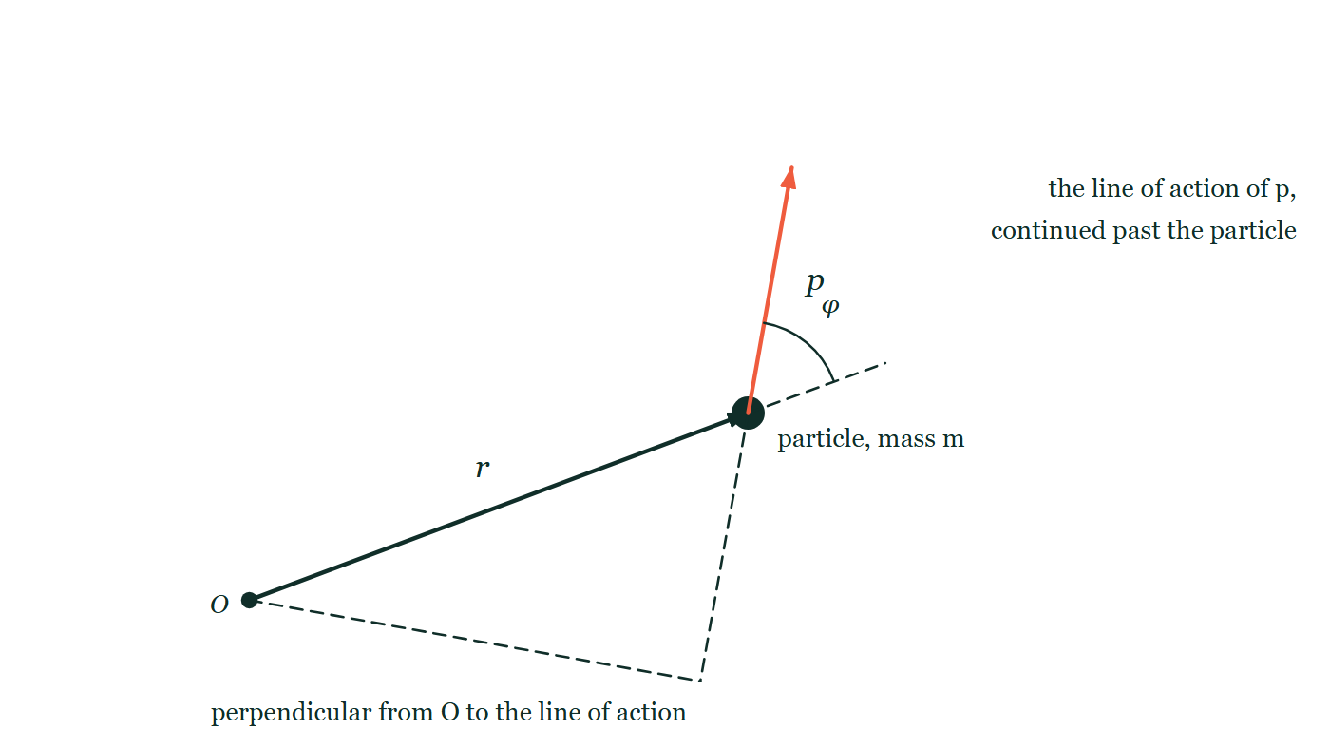
CIRCULAR MOTION · ANGULAR MOMENTUM
GIOPHYSICS LESSON
THE PICTURE
Angular momentum needs a point
Drawn for this lesson
An origin O marked at the lower left, with a position vector r drawn from it out to a moving particle. At the particle, a momentum arrow p leaves at an angle φ to the continuation of r, which is shown dashed. The line of action of p is carried back past the particle as a second dashed line, and a third dashed line drops from O perpendicular onto it.
The live version of this figure — click here
Circular Motion — Angular Momentum. Built by GioPhysics from the lesson's own copy; nothing on these slides is re-authored.
12 / 31
Notes:
[Phase] Build the model: The formulae, one at a time, in plain English (minutes 13–22 of 45)
[Figure] An origin O marked at the lower left, with a position vector r drawn from it out to a moving particle. At the particle, a momentum arrow p leaves at an angle φ to the continuation of r, which is shown dashed. The line of action of p is carried back past the particle as a second dashed line, and a third dashed line drops from O perpendicular onto it.

Slide 13
CIRCULAR MOTION · ANGULAR MOMENTUM
GIOPHYSICS LESSON
WATCH OUT
The common trap
Check and misconception — The quick check and the trap
L⃗ = Iω⃗ is not universally valid for every axis of an asymmetric body. Use it for an appropriate fixed symmetry or principal axis.
Circular Motion — Angular Momentum. Built by GioPhysics from the lesson's own copy; nothing on these slides is re-authored.
13 / 31
Notes:
[Phase] Check and misconception: The quick check and the trap (minutes 35–41 of 45)
[Misconception] L⃗ = Iω⃗ is not universally valid for every axis of an asymmetric body. Use it for an appropriate fixed symmetry or principal axis.

Slide 14
CIRCULAR MOTION · ANGULAR MOMENTUM
GIOPHYSICS LESSON
WORKED EXAMPLE 1 OF 2 · EASY
The question
Easy
Worked examples — I do, we do — one step revealed at a time
A wheel with I = 1.5 kg·m² spins at 8.0 rad/s. Find its angular momentum.
Circular Motion — Angular Momentum. Built by GioPhysics from the lesson's own copy; nothing on these slides is re-authored.
14 / 31
Notes:
[Phase] Worked examples: I do, we do — one step revealed at a time (minutes 22–35 of 45)
[Question] A wheel with I = 1.5 kg·m² spins at 8.0 rad/s. Find its angular momentum.
[Answer] L = 12 kg·m²/s

Slide 15
CIRCULAR MOTION · ANGULAR MOMENTUM
GIOPHYSICS LESSON
WORKED EXAMPLE 1 OF 2 · EASY · THE WORKING
How to solve it
Easy
Worked examples — I do, we do — one step revealed at a time
A wheel with I = 1.5 kg·m² spins at 8.0 rad/s. Find its angular momentum.
1.
L = Iω = 1.5 × 8.0.
2.
L = 12 kg·m²/s.
Circular Motion — Angular Momentum. Built by GioPhysics from the lesson's own copy; nothing on these slides is re-authored.
15 / 31
Notes:
[Phase] Worked examples: I do, we do — one step revealed at a time (minutes 22–35 of 45)
[Reveal] One click per step. The class works each line before the next appears.
[Step 1] L = Iω = 1.5 × 8.0.
[Step 2] L = 12 kg·m²/s.

Slide 16
CIRCULAR MOTION · ANGULAR MOMENTUM
GIOPHYSICS LESSON
WORKED EXAMPLE 1 OF 2 · EASY
Answer
Easy
Worked examples — I do, we do — one step revealed at a time
L = 12 kg·m²/s
Circular Motion — Angular Momentum. Built by GioPhysics from the lesson's own copy; nothing on these slides is re-authored.
16 / 31
Notes:
[Phase] Worked examples: I do, we do — one step revealed at a time (minutes 22–35 of 45)
[Answer] L = 12 kg·m²/s

Slide 17
CIRCULAR MOTION · ANGULAR MOMENTUM
GIOPHYSICS LESSON
WORKED EXAMPLE 2 OF 2 · MEDIUM
The question
Medium
Worked examples — I do, we do — one step revealed at a time
A 0.20 kg ball moves at 15 m/s perpendicular to a 0.80 m radius from an origin. Find |L⃗|.
Circular Motion — Angular Momentum. Built by GioPhysics from the lesson's own copy; nothing on these slides is re-authored.
17 / 31
Notes:
[Phase] Worked examples: I do, we do — one step revealed at a time (minutes 22–35 of 45)
[Question] A 0.20 kg ball moves at 15 m/s perpendicular to a 0.80 m radius from an origin. Find |L⃗|.
[Answer] L = 2.40 kg·m²/s

Slide 18
CIRCULAR MOTION · ANGULAR MOMENTUM
GIOPHYSICS LESSON
WORKED EXAMPLE 2 OF 2 · MEDIUM · THE WORKING
How to solve it
Medium
Worked examples — I do, we do — one step revealed at a time
A 0.20 kg ball moves at 15 m/s perpendicular to a 0.80 m radius from an origin. Find |L⃗|.
1.
Use L = rmv sinφ.
2.
φ = 90°, so sinφ = 1.
3.
L = (0.80)(0.20)(15).
Circular Motion — Angular Momentum. Built by GioPhysics from the lesson's own copy; nothing on these slides is re-authored.
18 / 31
Notes:
[Phase] Worked examples: I do, we do — one step revealed at a time (minutes 22–35 of 45)
[Reveal] One click per step. The class works each line before the next appears.
[Step 1] Use L = rmv sinφ.
[Step 2] φ = 90°, so sinφ = 1.
[Step 3] L = (0.80)(0.20)(15).

Slide 19
CIRCULAR MOTION · ANGULAR MOMENTUM
GIOPHYSICS LESSON
WORKED EXAMPLE 2 OF 2 · MEDIUM
Answer
Medium
Worked examples — I do, we do — one step revealed at a time
L = 2.40 kg·m²/s
Circular Motion — Angular Momentum. Built by GioPhysics from the lesson's own copy; nothing on these slides is re-authored.
19 / 31
Notes:
[Phase] Worked examples: I do, we do — one step revealed at a time (minutes 22–35 of 45)
[Answer] L = 2.40 kg·m²/s

Slide 20
CIRCULAR MOTION · ANGULAR MOMENTUM
GIOPHYSICS LESSON
SPOT THE MISTAKE
One line here is wrong
The whole working is up — find the bad line before you click
1.
The string is pulled in through the centre, so the pull is central and angular momentum about the centre is conserved.
2.
Before: L = mvr = 0.15 × 4.0 × 0.80 = 0.48 kg·m²/s.
3.
The pull acts at right angles to the motion, so it cannot change the speed: v stays at 4.0 m/s.
4.
The ball therefore circles the smaller 0.40 m radius at 4.0 m/s.
LINE 3 IS WRONG
The pull is only at right angles to the motion while the radius is fixed. The moment the string is drawn in, the ball moves inward as well as around, so the tension does have a component along the motion and does do work. The statement is a true one about steady circular motion, quoted in a situation where the radius is changing — which is exactly what makes it tempting.
IT SHOULD SAY
L is conserved, so 0.48 = 0.15 × v × 0.40, giving v = 8.0 m/s — halving the radius doubles the speed.
Circular Motion — Angular Momentum. Built by GioPhysics from the lesson's own copy; nothing on these slides is re-authored.
20 / 31
Notes:
[Phase] Worked examples: I do, we do — one step revealed at a time (minutes 22–35 of 45)
[Spot the mistake] The working is complete and one line of it is wrong. Let the room hunt: one click names the line, a second shows it done correctly.
[Line 3 is wrong] The pull is only at right angles to the motion while the radius is fixed. The moment the string is drawn in, the ball moves inward as well as around, so the tension does have a component along the motion and does do work. The statement is a true one about steady circular motion, quoted in a situation where the radius is changing — which is exactly what makes it tempting.
[It should say] L is conserved, so 0.48 = 0.15 × v × 0.40, giving v = 8.0 m/s — halving the radius doubles the speed.

Slide 21
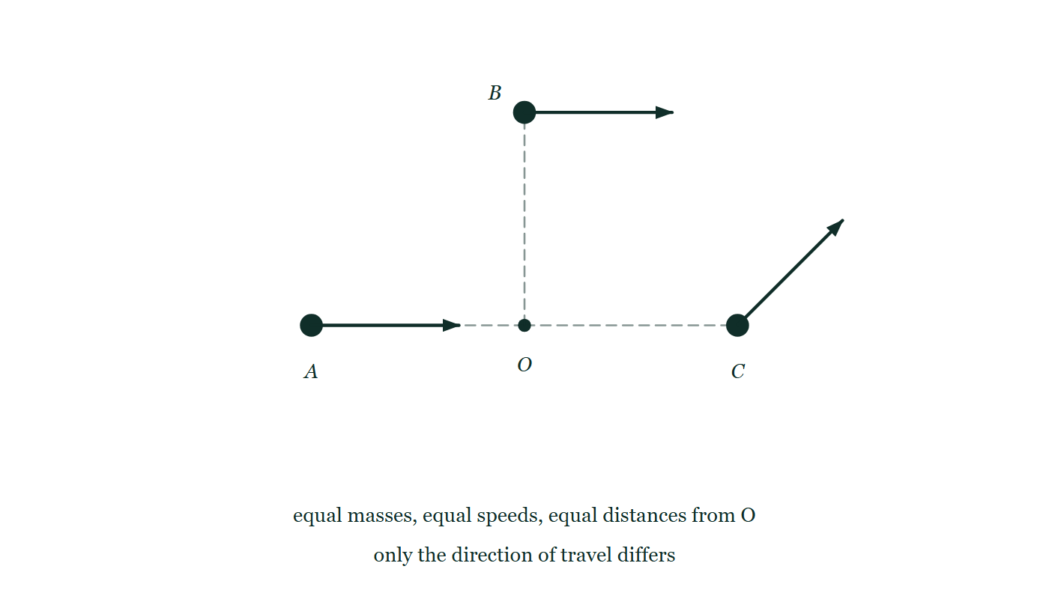
CIRCULAR MOTION · ANGULAR MOMENTUM
GIOPHYSICS LESSON
PREDICT · TAKE THE VOTE
Commit before you are told
Hands up for each option, then click
Same mass, same speed, same distance from O. Which particle has the largest angular momentum about O — and which the smallest?
A All three are equal, since r, m and v are all the same
B B is largest and A is zero
C A is largest, because it is closing on O fastest
Three identical particles, A, B and C, each the same distance from a central point O and each carrying a velocity arrow of the same length. A is heading straight at O, B is moving square across its own radius, and C is moving at forty-five degrees to its. Nothing differs between them but direction.
The live version of this figure — click here
Circular Motion — Angular Momentum. Built by GioPhysics from the lesson's own copy; nothing on these slides is re-authored.
21 / 31
Notes:
[Phase] Build the model: The formulae, one at a time, in plain English (minutes 13–22 of 45)
[Predict] Same mass, same speed, same distance from O. Which particle has the largest angular momentum about O — and which the smallest?
[Options] A All three are equal, since r, m and v are all the same B B is largest and A is zero C A is largest, because it is closing on O fastest
[Figure] Three identical particles, A, B and C, each the same distance from a central point O and each carrying a velocity arrow of the same length. A is heading straight at O, B is moving square across its own radius, and C is moving at forty-five degrees to its. Nothing differs between them but direction.

Slide 22
CIRCULAR MOTION · ANGULAR MOMENTUM
GIOPHYSICS LESSON
PREDICT · THE OUTCOME
What actually happens
Ask the room who changed their mind, and why
B B is largest and A is zero
WHY
L = r p sin φ, and φ is the angle between the position vector and the momentum. For B those are at right angles, sin φ = 1 and L is at its maximum. For A they are along the same line, sin φ = 0 and L vanishes — an object heading straight at a point is not circling it at all. C sits in between.
Circular Motion — Angular Momentum. Built by GioPhysics from the lesson's own copy; nothing on these slides is re-authored.
22 / 31
Notes:
[Phase] Build the model: The formulae, one at a time, in plain English (minutes 13–22 of 45)
[Answer] B — B is largest and A is zero. L = r p sin φ, and φ is the angle between the position vector and the momentum. For B those are at right angles, sin φ = 1 and L is at its maximum. For A they are along the same line, sin φ = 0 and L vanishes — an object heading straight at a point is not circling it at all. C sits in between.

Slide 23
CIRCULAR MOTION · ANGULAR MOMENTUM
GIOPHYSICS LESSON
QUICK CHECK
Decide before the answer goes up
Check and misconception — The quick check and the trap
A particle moves directly toward the chosen origin. What is its angular momentum about that origin?
A
Maximum
B
Zero
C
Equal to its linear momentum
Three identical particles, A, B and C, each the same distance from a central point O and each carrying a velocity arrow of the same length. A is heading straight at O, B is moving square across its own radius, and C is moving at forty-five degrees to its. Nothing differs between them but direction.
The live version of this figure — click here
Circular Motion — Angular Momentum. Built by GioPhysics from the lesson's own copy; nothing on these slides is re-authored.
23 / 31
Notes:
[Phase] Check and misconception: The quick check and the trap (minutes 35–41 of 45)
[Question] A particle moves directly toward the chosen origin. What is its angular momentum about that origin?
[Figure] Three identical particles, A, B and C, each the same distance from a central point O and each carrying a velocity arrow of the same length. A is heading straight at O, B is moving square across its own radius, and C is moving at forty-five degrees to its. Nothing differs between them but direction.
[Options] A Maximum B Zero C Equal to its linear momentum

Slide 24
CIRCULAR MOTION · ANGULAR MOMENTUM
GIOPHYSICS LESSON
QUICK CHECK · THE ANSWER
The answer, and why
Check and misconception — The quick check and the trap
B Zero
HOW TO GET THERE
r⃗ and p⃗ are parallel or antiparallel, so their cross product is zero.
WHY THE OTHERS TEMPT
A 'Maximum' is the answer if the perpendicular distance is confused with the distance. The particle is a long way from the origin, which feels as though it should count for a great deal — but the line along which it travels passes straight through the origin, so its perpendicular distance from that origin is zero.
B Correct. r and p lie along the same line, the angle between them is 0 or 180°, sin φ = 0, and the cross product vanishes. Nothing about that motion circulates around the origin.
C Angular momentum and linear momentum are different quantities with different units — kg·m²/s against kg·m/s — so they can never be equal. The temptation comes from the fact that L is built out of p, but it is built with the position vector as well.
Circular Motion — Angular Momentum. Built by GioPhysics from the lesson's own copy; nothing on these slides is re-authored.
24 / 31
Notes:
[Phase] Check and misconception: The quick check and the trap (minutes 35–41 of 45)
[Question] A particle moves directly toward the chosen origin. What is its angular momentum about that origin?
[Option by option] A: 'Maximum' is the answer if the perpendicular distance is confused with the distance. The particle is a long way from the origin, which feels as though it should count for a great deal — but the line along which it travels passes straight through the origin, so its perpendicular distance from that origin is zero. B: Correct. r and p lie along the same line, the angle between them is 0 or 180°, sin φ = 0, and the cross product vanishes. Nothing about that motion circulates around the origin. C: Angular momentum and linear momentum are different quantities with different units — kg·m²/s against kg·m/s — so they can never be equal. The temptation comes from the fact that L is built out of p, but it is built with the position vector as well.
[Answer] B — Zero
[Why] r⃗ and p⃗ are parallel or antiparallel, so their cross product is zero.
[Reveal] One click for the answer, then one for the reason.

Slide 25
CIRCULAR MOTION · ANGULAR MOMENTUM
GIOPHYSICS LESSON
EXTENSION 1 OF 2 · HARD
The question
Hard
Worked examples — I do, we do — one step revealed at a time
A 0.15 kg ball on a string circles at 4.0 m/s at radius 0.80 m. The string is pulled in to 0.40 m. Find the new speed.
Circular Motion — Angular Momentum. Built by GioPhysics from the lesson's own copy; nothing on these slides is re-authored.
25 / 31
Notes:
[Phase] Worked examples: I do, we do — one step revealed at a time (minutes 22–35 of 45)
[Question] A 0.15 kg ball on a string circles at 4.0 m/s at radius 0.80 m. The string is pulled in to 0.40 m. Find the new speed.
[Answer] v = 8.0 m/s

Slide 26
CIRCULAR MOTION · ANGULAR MOMENTUM
GIOPHYSICS LESSON
EXTENSION 1 OF 2 · HARD · THE WORKING
How to solve it
Hard
Worked examples — I do, we do — one step revealed at a time
A 0.15 kg ball on a string circles at 4.0 m/s at radius 0.80 m. The string is pulled in to 0.40 m. Find the new speed.
1.
The pull is central — L = mvr is conserved.
2.
0.15 × 4.0 × 0.80 = 0.15 × v × 0.40.
3.
v = 8.0 m/s — halving r doubles v.
Circular Motion — Angular Momentum. Built by GioPhysics from the lesson's own copy; nothing on these slides is re-authored.
26 / 31
Notes:
[Phase] Worked examples: I do, we do — one step revealed at a time (minutes 22–35 of 45)
[Reveal] One click per step. The class works each line before the next appears.
[Step 1] The pull is central — L = mvr is conserved.
[Step 2] 0.15 × 4.0 × 0.80 = 0.15 × v × 0.40.
[Step 3] v = 8.0 m/s — halving r doubles v.

Slide 27
CIRCULAR MOTION · ANGULAR MOMENTUM
GIOPHYSICS LESSON
EXTENSION 1 OF 2 · HARD
Answer
Hard
Worked examples — I do, we do — one step revealed at a time
v = 8.0 m/s
Circular Motion — Angular Momentum. Built by GioPhysics from the lesson's own copy; nothing on these slides is re-authored.
27 / 31
Notes:
[Phase] Worked examples: I do, we do — one step revealed at a time (minutes 22–35 of 45)
[Answer] v = 8.0 m/s

Slide 28
CIRCULAR MOTION · ANGULAR MOMENTUM
GIOPHYSICS LESSON
EXTENSION 2 OF 2 · CHALLENGING
The question
Challenging
Worked examples — I do, we do — one step revealed at a time
A comet's speed at perihelion (8.0 × 10¹⁰ m) is 5.4 × 10⁴ m/s. Find its speed at aphelion (5.4 × 10¹² m), and state the law you used.
Circular Motion — Angular Momentum. Built by GioPhysics from the lesson's own copy; nothing on these slides is re-authored.
28 / 31
Notes:
[Phase] Worked examples: I do, we do — one step revealed at a time (minutes 22–35 of 45)
[Question] A comet's speed at perihelion (8.0 × 10¹⁰ m) is 5.4 × 10⁴ m/s. Find its speed at aphelion (5.4 × 10¹² m), and state the law you used.
[Answer] v ≈ 8.0 × 10² m/s

Slide 29
CIRCULAR MOTION · ANGULAR MOMENTUM
GIOPHYSICS LESSON
EXTENSION 2 OF 2 · CHALLENGING · THE WORKING
How to solve it
Challenging
Worked examples — I do, we do — one step revealed at a time
A comet's speed at perihelion (8.0 × 10¹⁰ m) is 5.4 × 10⁴ m/s. Find its speed at aphelion (5.4 × 10¹² m), and state the law you used.
1.
Gravity is central, so angular momentum about the Sun is conserved: v₁r₁ = v₂r₂ (velocity ⟂ radius at both extremes).
2.
v₂ = 5.4 × 10⁴ × (8.0 × 10¹⁰ ÷ 5.4 × 10¹²).
3.
v₂ = 5.4 × 10⁴ × 0.0148 ≈ 800 m/s — Kepler's second law in action.
Circular Motion — Angular Momentum. Built by GioPhysics from the lesson's own copy; nothing on these slides is re-authored.
29 / 31
Notes:
[Phase] Worked examples: I do, we do — one step revealed at a time (minutes 22–35 of 45)
[Reveal] One click per step. The class works each line before the next appears.
[Step 1] Gravity is central, so angular momentum about the Sun is conserved: v₁r₁ = v₂r₂ (velocity ⟂ radius at both extremes).
[Step 2] v₂ = 5.4 × 10⁴ × (8.0 × 10¹⁰ ÷ 5.4 × 10¹²).
[Step 3] v₂ = 5.4 × 10⁴ × 0.0148 ≈ 800 m/s — Kepler's second law in action.

Slide 30
CIRCULAR MOTION · ANGULAR MOMENTUM
GIOPHYSICS LESSON
EXTENSION 2 OF 2 · CHALLENGING
Answer
Challenging
Worked examples — I do, we do — one step revealed at a time
v ≈ 8.0 × 10² m/s
Circular Motion — Angular Momentum. Built by GioPhysics from the lesson's own copy; nothing on these slides is re-authored.
30 / 31
Notes:
[Phase] Worked examples: I do, we do — one step revealed at a time (minutes 22–35 of 45)
[Answer] v ≈ 8.0 × 10² m/s

Slide 31
CIRCULAR MOTION · ANGULAR MOMENTUM
GIOPHYSICS LESSON
CIRCULAR MOTION
Where to go next
Plenary — What to take away, what to practise next
Next
6.9 Conservation & Orbits
https://giophysics.com/chapter-10/angular-momentum-conservation-orbits/
Lesson
This lesson on giophysics.com
https://giophysics.com/chapter-10/angular-momentum/
Live
The live, interactive version of these slides
https://giophysics.com/chapter-10/presentation/?lesson=angularMomentum
Chapter
All Circular Motion lessons
https://giophysics.com/chapter-10/
PDF
Download the lesson PDF
https://giophysics.com/downloads/10-8-angular-momentum.pdf
Circular Motion — Angular Momentum. Built by GioPhysics from the lesson's own copy; nothing on these slides is re-authored.
31 / 31
Notes:
[Phase] Plenary: What to take away, what to practise next (minutes 41–45 of 45)
[Interactive] The graphs and the circuit topology on these slides are frozen. The live version at https://giophysics.com/chapter-10/presentation/?lesson=angularMomentum moves them.

