Slide 1
CIRCULAR MOTION · ANGULAR MOMENTUM CONSERVATION & ORBITS
GIOPHYSICS LESSON
06 · Circular Motion
No external torque
Angular Momentum Conservation & Orbits
When net external torque is zero, total angular momentum stays fixed even while shape, angular speed, or orbital distance changes.
POSITION
Lesson 9 of 11 in Circular Motion
PLAN
16 slides in the 45-minute core run, about 44 minutes of it
LESSON PAGE
https://giophysics.com/chapter-10/angular-momentum-conservation-orbits/
Built by GioPhysics from the lesson's own page. Every word on these slides is the lesson's; nothing here is re-authored. Teaching material, not an awarding body's document.
Circular Motion — Angular Momentum Conservation & Orbits. Built by GioPhysics from the lesson's own copy; nothing on these slides is re-authored.
1 / 31
Notes:
[Lesson] Circular Motion — Angular Momentum Conservation & Orbits. Lesson 9 of 11.
[Intro] When net external torque is zero, total angular momentum stays fixed even while shape, angular speed, or orbital distance changes.
[Source] https://giophysics.com/chapter-10/angular-momentum-conservation-orbits/
[Disclaimer] Built by GioPhysics from the lesson's own page. Every word on these slides is the lesson's; nothing here is re-authored. Teaching material, not an awarding body's document.

Slide 2
CIRCULAR MOTION · ANGULAR MOMENTUM CONSERVATION & ORBITS
GIOPHYSICS LESSON
THINK FIRST
A skater pulls her arms in and spins visibly faster. Where did the extra energy come from?
Take answers before you click — the point is the commitment
The ice is nearly frictionless and nobody pushed her, yet she is unmistakably spinning harder than before.
THE ANSWER
From her own muscles. Angular momentum was conserved because nothing outside exerted a torque — but her arms had to be dragged inward against a real outward tendency, and that work went straight into the spin. Conserving L does not conserve energy.
Circular Motion — Angular Momentum Conservation & Orbits. Built by GioPhysics from the lesson's own copy; nothing on these slides is re-authored.
2 / 31
Notes:
[Phase] Starter: Recall what this lesson stands on (minutes 0–5 of 45)
[Hook] A skater pulls her arms in and spins visibly faster. Where did the extra energy come from? The ice is nearly frictionless and nobody pushed her, yet she is unmistakably spinning harder than before.
[Answer] From her own muscles. Angular momentum was conserved because nothing outside exerted a torque — but her arms had to be dragged inward against a real outward tendency, and that work went straight into the spin. Conserving L does not conserve energy.

Slide 3
CIRCULAR MOTION · ANGULAR MOMENTUM CONSERVATION & ORBITS
GIOPHYSICS LESSON
EXPLAINED SIMPLY
In one sentence
Introduce the idea — The big idea and the definition
Conservation of angular momentum means total angular momentum stays constant when no net external torque acts.
Circular Motion — Angular Momentum Conservation & Orbits. Built by GioPhysics from the lesson's own copy; nothing on these slides is re-authored.
3 / 31
Notes:
[Phase] Introduce the idea: The big idea and the definition (minutes 5–13 of 45)
[Definition] Conservation of angular momentum means total angular momentum stays constant when no net external torque acts.

Slide 4
CIRCULAR MOTION · ANGULAR MOMENTUM CONSERVATION & ORBITS
GIOPHYSICS LESSON
EXPLAINED SIMPLY
What that looks like
Introduce the idea — The big idea and the definition
FOR EXAMPLE
A spinning skater pulls in their arms and rotates faster while keeping the same total angular momentum.
Circular Motion — Angular Momentum Conservation & Orbits. Built by GioPhysics from the lesson's own copy; nothing on these slides is re-authored.
4 / 31
Notes:
[Phase] Introduce the idea: The big idea and the definition (minutes 5–13 of 45)
[Worked illustration] A spinning skater pulls in their arms and rotates faster while keeping the same total angular momentum.

Slide 5
CIRCULAR MOTION · ANGULAR MOMENTUM CONSERVATION & ORBITS
GIOPHYSICS LESSON
THE BIG IDEA
No external torque
Introduce the idea — The big idea and the definition
A rotating system speeds up when its moment of inertia falls because Iω remains constant. Central forces such as gravity create no torque about the force centre, which leads directly to equal orbital areas in equal times.
Circular Motion — Angular Momentum Conservation & Orbits. Built by GioPhysics from the lesson's own copy; nothing on these slides is re-authored.
5 / 31
Notes:
[Phase] Introduce the idea: The big idea and the definition (minutes 5–13 of 45)
[Big idea] A rotating system speeds up when its moment of inertia falls because Iω remains constant. Central forces such as gravity create no torque about the force centre, which leads directly to equal orbital areas in equal times.

Slide 6
CIRCULAR MOTION · ANGULAR MOMENTUM CONSERVATION & ORBITS
GIOPHYSICS LESSON
THE PHYSICS · 1 OF 3
Pull inward, spin faster
Build the model — The formulae, one at a time, in plain English
Reducing I requires ω to rise so that L stays constant.
Circular Motion — Angular Momentum Conservation & Orbits. Built by GioPhysics from the lesson's own copy; nothing on these slides is re-authored.
6 / 31
Notes:
[Phase] Build the model: The formulae, one at a time, in plain English (minutes 13–22 of 45)
[Section] Reducing I requires ω to rise so that L stays constant.

Slide 7
CIRCULAR MOTION · ANGULAR MOMENTUM CONSERVATION & ORBITS
GIOPHYSICS LESSON
THE PHYSICS · 2 OF 3
Energy may change
Build the model — The formulae, one at a time, in plain English
A skater's muscles can do internal work while external torque remains negligible.
Circular Motion — Angular Momentum Conservation & Orbits. Built by GioPhysics from the lesson's own copy; nothing on these slides is re-authored.
7 / 31
Notes:
[Phase] Build the model: The formulae, one at a time, in plain English (minutes 13–22 of 45)
[Section] A skater's muscles can do internal work while external torque remains negligible.

Slide 8
CIRCULAR MOTION · ANGULAR MOMENTUM CONSERVATION & ORBITS
GIOPHYSICS LESSON
THE PHYSICS · 3 OF 3
Gravity is central
Build the model — The formulae, one at a time, in plain English
Because r⃗ and F⃗ point along one line, gravity produces zero torque about the attracting centre.
Circular Motion — Angular Momentum Conservation & Orbits. Built by GioPhysics from the lesson's own copy; nothing on these slides is re-authored.
8 / 31
Notes:
[Phase] Build the model: The formulae, one at a time, in plain English (minutes 13–22 of 45)
[Section] Because r⃗ and F⃗ point along one line, gravity produces zero torque about the attracting centre.

Slide 9
CIRCULAR MOTION · ANGULAR MOMENTUM CONSERVATION & ORBITS
GIOPHYSICS LESSON
FORMULA 1 OF 3
Conservation
Build the model — The formulae, one at a time, in plain English
Iiωi = Ifωf
Zero external torque
IN PLAIN ENGLISH
Pull mass inward and the spin speeds up; spread it out and the spin slows — skaters use exactly this.
Circular Motion — Angular Momentum Conservation & Orbits. Built by GioPhysics from the lesson's own copy; nothing on these slides is re-authored.
9 / 31
Notes:
[Phase] Build the model: The formulae, one at a time, in plain English (minutes 13–22 of 45)
[Formula] Conservation: Iiωi = Ifωf
[In plain English] Pull mass inward and the spin speeds up; spread it out and the spin slows — skaters use exactly this.
[Note] Zero external torque

Slide 10
CIRCULAR MOTION · ANGULAR MOMENTUM CONSERVATION & ORBITS
GIOPHYSICS LESSON
FORMULA 2 OF 3
Energy at fixed L
Build the model — The formulae, one at a time, in plain English
Kᵣₒₜ = L²/(2I)
Internal work can change K
IN PLAIN ENGLISH
At fixed angular momentum, shrinking the rotational inertia raises the spin energy — the skater's arms do that work.
Circular Motion — Angular Momentum Conservation & Orbits. Built by GioPhysics from the lesson's own copy; nothing on these slides is re-authored.
10 / 31
Notes:
[Phase] Build the model: The formulae, one at a time, in plain English (minutes 13–22 of 45)
[Formula] Energy at fixed L: Kᵣₒₜ = L²/(2I)
[In plain English] At fixed angular momentum, shrinking the rotational inertia raises the spin energy — the skater's arms do that work.
[Note] Internal work can change K

Slide 11
CIRCULAR MOTION · ANGULAR MOMENTUM CONSERVATION & ORBITS
GIOPHYSICS LESSON
FORMULA 3 OF 3
Areal speed
Build the model — The formulae, one at a time, in plain English
dA/dt = L/(2m)
Constant for a central force
IN PLAIN ENGLISH
An orbiting body sweeps out area at a steady rate — Kepler's equal-areas law, coming straight from angular momentum.
Circular Motion — Angular Momentum Conservation & Orbits. Built by GioPhysics from the lesson's own copy; nothing on these slides is re-authored.
11 / 31
Notes:
[Phase] Build the model: The formulae, one at a time, in plain English (minutes 13–22 of 45)
[Formula] Areal speed: dA/dt = L/(2m)
[In plain English] An orbiting body sweeps out area at a steady rate — Kepler's equal-areas law, coming straight from angular momentum.
[Note] Constant for a central force

Slide 12
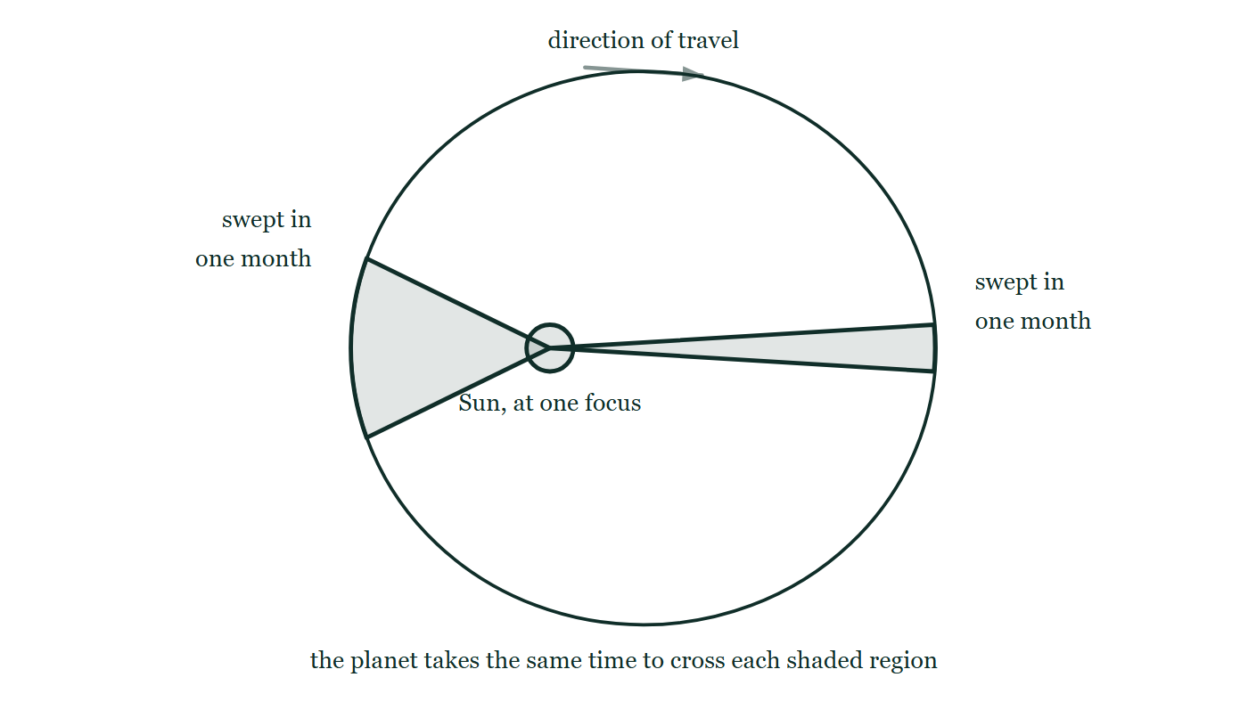
CIRCULAR MOTION · ANGULAR MOMENTUM CONSERVATION & ORBITS
GIOPHYSICS LESSON
THE PICTURE
Equal areas in equal times
Drawn for this lesson
An elliptical orbit with the Sun drawn at one focus rather than at the centre. Two regions are shaded: a short fat wedge close to the Sun and a long thin sliver out at the far end of the orbit. The planet is stated to take the same time to cross each of them.
The live version of this figure — click here
Circular Motion — Angular Momentum Conservation & Orbits. Built by GioPhysics from the lesson's own copy; nothing on these slides is re-authored.
12 / 31
Notes:
[Phase] Build the model: The formulae, one at a time, in plain English (minutes 13–22 of 45)
[Figure] An elliptical orbit with the Sun drawn at one focus rather than at the centre. Two regions are shaded: a short fat wedge close to the Sun and a long thin sliver out at the far end of the orbit. The planet is stated to take the same time to cross each of them.

Slide 13
CIRCULAR MOTION · ANGULAR MOMENTUM CONSERVATION & ORBITS
GIOPHYSICS LESSON
WATCH OUT
The common trap
Check and misconception — The quick check and the trap
Conserving angular momentum does not automatically conserve rotational kinetic energy. Internal work can change energy while leaving total L fixed.
Circular Motion — Angular Momentum Conservation & Orbits. Built by GioPhysics from the lesson's own copy; nothing on these slides is re-authored.
13 / 31
Notes:
[Phase] Check and misconception: The quick check and the trap (minutes 35–41 of 45)
[Misconception] Conserving angular momentum does not automatically conserve rotational kinetic energy. Internal work can change energy while leaving total L fixed.

Slide 14
CIRCULAR MOTION · ANGULAR MOMENTUM CONSERVATION & ORBITS
GIOPHYSICS LESSON
WORKED EXAMPLE 1 OF 2 · EASY
The question
Easy
Worked examples — I do, we do — one step revealed at a time
A skater spinning at 3.0 rad/s pulls her arms in, halving her moment of inertia. Find her new spin rate.
Circular Motion — Angular Momentum Conservation & Orbits. Built by GioPhysics from the lesson's own copy; nothing on these slides is re-authored.
14 / 31
Notes:
[Phase] Worked examples: I do, we do — one step revealed at a time (minutes 22–35 of 45)
[Question] A skater spinning at 3.0 rad/s pulls her arms in, halving her moment of inertia. Find her new spin rate.
[Answer] ω = 6.0 rad/s

Slide 15
CIRCULAR MOTION · ANGULAR MOMENTUM CONSERVATION & ORBITS
GIOPHYSICS LESSON
WORKED EXAMPLE 1 OF 2 · EASY · THE WORKING
How to solve it
Easy
Worked examples — I do, we do — one step revealed at a time
A skater spinning at 3.0 rad/s pulls her arms in, halving her moment of inertia. Find her new spin rate.
1.
Iω conserved: I × 3.0 = (I/2) × ω.
2.
ω = 6.0 rad/s.
Circular Motion — Angular Momentum Conservation & Orbits. Built by GioPhysics from the lesson's own copy; nothing on these slides is re-authored.
15 / 31
Notes:
[Phase] Worked examples: I do, we do — one step revealed at a time (minutes 22–35 of 45)
[Reveal] One click per step. The class works each line before the next appears.
[Step 1] Iω conserved: I × 3.0 = (I/2) × ω.
[Step 2] ω = 6.0 rad/s.

Slide 16
CIRCULAR MOTION · ANGULAR MOMENTUM CONSERVATION & ORBITS
GIOPHYSICS LESSON
WORKED EXAMPLE 1 OF 2 · EASY
Answer
Easy
Worked examples — I do, we do — one step revealed at a time
ω = 6.0 rad/s
Circular Motion — Angular Momentum Conservation & Orbits. Built by GioPhysics from the lesson's own copy; nothing on these slides is re-authored.
16 / 31
Notes:
[Phase] Worked examples: I do, we do — one step revealed at a time (minutes 22–35 of 45)
[Answer] ω = 6.0 rad/s

Slide 17
CIRCULAR MOTION · ANGULAR MOMENTUM CONSERVATION & ORBITS
GIOPHYSICS LESSON
WORKED EXAMPLE 2 OF 2 · MEDIUM
The question
Medium
Worked examples — I do, we do — one step revealed at a time
A student spins at 2.0 rad/s with I = 4.0 kg·m², then pulls inward to I = 1.6 kg·m². Find the new angular speed.
Circular Motion — Angular Momentum Conservation & Orbits. Built by GioPhysics from the lesson's own copy; nothing on these slides is re-authored.
17 / 31
Notes:
[Phase] Worked examples: I do, we do — one step revealed at a time (minutes 22–35 of 45)
[Question] A student spins at 2.0 rad/s with I = 4.0 kg·m², then pulls inward to I = 1.6 kg·m². Find the new angular speed.
[Answer] ωf = 5.0 rad/s

Slide 18
CIRCULAR MOTION · ANGULAR MOMENTUM CONSERVATION & ORBITS
GIOPHYSICS LESSON
WORKED EXAMPLE 2 OF 2 · MEDIUM · THE WORKING
How to solve it
Medium
Worked examples — I do, we do — one step revealed at a time
A student spins at 2.0 rad/s with I = 4.0 kg·m², then pulls inward to I = 1.6 kg·m². Find the new angular speed.
1.
External torque is negligible, so Iiωi = Ifωf.
2.
(4.0)(2.0) = (1.6)ωf.
3.
Solve for ωf.
Circular Motion — Angular Momentum Conservation & Orbits. Built by GioPhysics from the lesson's own copy; nothing on these slides is re-authored.
18 / 31
Notes:
[Phase] Worked examples: I do, we do — one step revealed at a time (minutes 22–35 of 45)
[Reveal] One click per step. The class works each line before the next appears.
[Step 1] External torque is negligible, so Iiωi = Ifωf.
[Step 2] (4.0)(2.0) = (1.6)ωf.
[Step 3] Solve for ωf.

Slide 19
CIRCULAR MOTION · ANGULAR MOMENTUM CONSERVATION & ORBITS
GIOPHYSICS LESSON
WORKED EXAMPLE 2 OF 2 · MEDIUM
Answer
Medium
Worked examples — I do, we do — one step revealed at a time
ωf = 5.0 rad/s
Circular Motion — Angular Momentum Conservation & Orbits. Built by GioPhysics from the lesson's own copy; nothing on these slides is re-authored.
19 / 31
Notes:
[Phase] Worked examples: I do, we do — one step revealed at a time (minutes 22–35 of 45)
[Answer] ωf = 5.0 rad/s

Slide 20
CIRCULAR MOTION · ANGULAR MOMENTUM CONSERVATION & ORBITS
GIOPHYSICS LESSON
SPOT THE MISTAKE
One line here is wrong
The whole working is up — find the bad line before you click
1.
No external torque, so Iω is conserved: 4.0 × 2.0 = 1.6 × ω_f, giving ω_f = 5.0 rad/s.
2.
Nothing outside did any work on her either, so kinetic energy is conserved as well.
3.
So the rotational kinetic energy stays at ½ × 4.0 × 2.0² = 8.0 J throughout.
LINE 2 IS WRONG
'No external torque' and 'no work done' are not the same statement, and this is the one place in the syllabus where the difference bites. Her muscles are inside the system, so they add no external torque — but they certainly do work, hauling the masses inward. Assuming both conservation laws at once is the standard trap.
IT SHOULD SAY
Kinetic energy is not conserved: it rises from ½ × 4.0 × 2.0² = 8.0 J to ½ × 1.6 × 5.0² = 20 J, the extra 12 J being the work her muscles did.
Circular Motion — Angular Momentum Conservation & Orbits. Built by GioPhysics from the lesson's own copy; nothing on these slides is re-authored.
20 / 31
Notes:
[Phase] Worked examples: I do, we do — one step revealed at a time (minutes 22–35 of 45)
[Spot the mistake] The working is complete and one line of it is wrong. Let the room hunt: one click names the line, a second shows it done correctly.
[Line 2 is wrong] 'No external torque' and 'no work done' are not the same statement, and this is the one place in the syllabus where the difference bites. Her muscles are inside the system, so they add no external torque — but they certainly do work, hauling the masses inward. Assuming both conservation laws at once is the standard trap.
[It should say] Kinetic energy is not conserved: it rises from ½ × 4.0 × 2.0² = 8.0 J to ½ × 1.6 × 5.0² = 20 J, the extra 12 J being the work her muscles did.

Slide 21
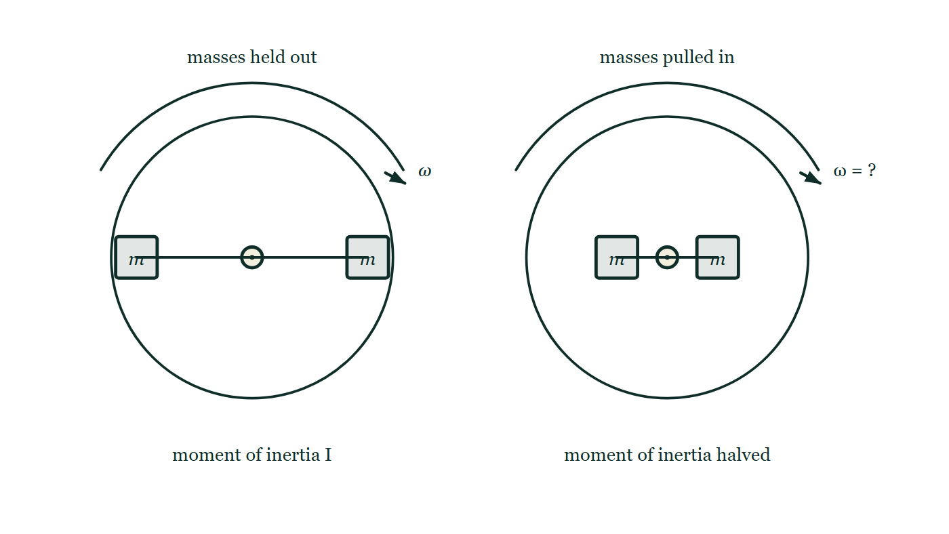
CIRCULAR MOTION · ANGULAR MOMENTUM CONSERVATION & ORBITS
GIOPHYSICS LESSON
PREDICT · TAKE THE VOTE
Commit before you are told
Hands up for each option, then click
The masses are pulled in until the moment of inertia is halved, with nothing outside exerting a torque. What happens to ω?
A It halves
B It doubles
C It is unchanged — she never pushed against anything outside herself
A turntable seen face on with two equal masses held out near the rim on a bar through the centre, turning at ω. Beside it is the same turntable with the same two masses drawn much closer to the axle, so its moment of inertia is halved, and its new spin rate is left written as a question.
The live version of this figure — click here
Circular Motion — Angular Momentum Conservation & Orbits. Built by GioPhysics from the lesson's own copy; nothing on these slides is re-authored.
21 / 31
Notes:
[Phase] Build the model: The formulae, one at a time, in plain English (minutes 13–22 of 45)
[Predict] The masses are pulled in until the moment of inertia is halved, with nothing outside exerting a torque. What happens to ω?
[Options] A It halves B It doubles C It is unchanged — she never pushed against anything outside herself
[Figure] A turntable seen face on with two equal masses held out near the rim on a bar through the centre, turning at ω. Beside it is the same turntable with the same two masses drawn much closer to the axle, so its moment of inertia is halved, and its new spin rate is left written as a question.

Slide 22
CIRCULAR MOTION · ANGULAR MOMENTUM CONSERVATION & ORBITS
GIOPHYSICS LESSON
PREDICT · THE OUTCOME
What actually happens
Ask the room who changed their mind, and why
B It doubles
WHY
Iω has to keep the same value, so halving I forces ω to double. The picture is the reason it works: the masses have moved in, nothing has left the system, and the only way the product can stay put is for the turning rate to rise.
Circular Motion — Angular Momentum Conservation & Orbits. Built by GioPhysics from the lesson's own copy; nothing on these slides is re-authored.
22 / 31
Notes:
[Phase] Build the model: The formulae, one at a time, in plain English (minutes 13–22 of 45)
[Answer] B — It doubles. Iω has to keep the same value, so halving I forces ω to double. The picture is the reason it works: the masses have moved in, nothing has left the system, and the only way the product can stay put is for the turning rate to rise.

Slide 23
CIRCULAR MOTION · ANGULAR MOMENTUM CONSERVATION & ORBITS
GIOPHYSICS LESSON
QUICK CHECK
Decide before the answer goes up
Check and misconception — The quick check and the trap
A skater halves their moment of inertia with negligible external torque. What happens to ω?
A
It halves
B
It doubles
C
It stays fixed
A turntable seen face on with two equal masses held out near the rim on a bar through the centre, turning at ω. Beside it is the same turntable with the same two masses drawn much closer to the axle, so its moment of inertia is halved, and its new spin rate is left written as a question.
The live version of this figure — click here
Circular Motion — Angular Momentum Conservation & Orbits. Built by GioPhysics from the lesson's own copy; nothing on these slides is re-authored.
23 / 31
Notes:
[Phase] Check and misconception: The quick check and the trap (minutes 35–41 of 45)
[Question] A skater halves their moment of inertia with negligible external torque. What happens to ω?
[Figure] A turntable seen face on with two equal masses held out near the rim on a bar through the centre, turning at ω. Beside it is the same turntable with the same two masses drawn much closer to the axle, so its moment of inertia is halved, and its new spin rate is left written as a question.
[Options] A It halves B It doubles C It stays fixed

Slide 24
CIRCULAR MOTION · ANGULAR MOMENTUM CONSERVATION & ORBITS
GIOPHYSICS LESSON
QUICK CHECK · THE ANSWER
The answer, and why
Check and misconception — The quick check and the trap
B It doubles
HOW TO GET THERE
Iiωi = Ifωf, so halving I doubles ω.
WHY THE OTHERS TEMPT
A Halving is what you get by making ω follow I rather than compensate for it. It is a natural reading — 'less inertia, less of everything' — but the conserved quantity is the product Iω, so when one factor falls the other must rise.
B Correct. With no external torque, Iᵢωᵢ = I_fω_f, so halving the moment of inertia doubles the angular speed. It is the whole skater effect in one line.
C The premise is right and the conclusion is not. It is true that nothing outside exerted a torque — that is exactly why L is conserved. But an internal change can still redistribute mass, and moving mass inward changes I, which forces ω to change with it.
Circular Motion — Angular Momentum Conservation & Orbits. Built by GioPhysics from the lesson's own copy; nothing on these slides is re-authored.
24 / 31
Notes:
[Phase] Check and misconception: The quick check and the trap (minutes 35–41 of 45)
[Question] A skater halves their moment of inertia with negligible external torque. What happens to ω?
[Option by option] A: Halving is what you get by making ω follow I rather than compensate for it. It is a natural reading — 'less inertia, less of everything' — but the conserved quantity is the product Iω, so when one factor falls the other must rise. B: Correct. With no external torque, Iᵢωᵢ = I_fω_f, so halving the moment of inertia doubles the angular speed. It is the whole skater effect in one line. C: The premise is right and the conclusion is not. It is true that nothing outside exerted a torque — that is exactly why L is conserved. But an internal change can still redistribute mass, and moving mass inward changes I, which forces ω to change with it.
[Answer] B — It doubles
[Why] Iiωi = Ifωf, so halving I doubles ω.
[Reveal] One click for the answer, then one for the reason.

Slide 25
CIRCULAR MOTION · ANGULAR MOMENTUM CONSERVATION & ORBITS
GIOPHYSICS LESSON
EXTENSION 1 OF 2 · HARD
The question
Hard
Worked examples — I do, we do — one step revealed at a time
A 60 kg student stands at the rim of a stationary 200 kg merry-go-round (solid disc, R = 2.0 m) and starts walking at 1.0 m/s (relative to the ground) along the rim. Find the platform's angular speed.
Circular Motion — Angular Momentum Conservation & Orbits. Built by GioPhysics from the lesson's own copy; nothing on these slides is re-authored.
25 / 31
Notes:
[Phase] Worked examples: I do, we do — one step revealed at a time (minutes 22–35 of 45)
[Question] A 60 kg student stands at the rim of a stationary 200 kg merry-go-round (solid disc, R = 2.0 m) and starts walking at 1.0 m/s (relative to the ground) along the rim. Find the platform's angular speed.
[Answer] ω = 0.30 rad/s backwards

Slide 26
CIRCULAR MOTION · ANGULAR MOMENTUM CONSERVATION & ORBITS
GIOPHYSICS LESSON
EXTENSION 1 OF 2 · HARD · THE WORKING
How to solve it
Hard
Worked examples — I do, we do — one step revealed at a time
A 60 kg student stands at the rim of a stationary 200 kg merry-go-round (solid disc, R = 2.0 m) and starts walking at 1.0 m/s (relative to the ground) along the rim. Find the platform's angular speed.
1.
Total L stays zero: L(student) + L(platform) = 0.
2.
mvR = I(platform)ω → 60 × 1.0 × 2.0 = (½ × 200 × 4.0)ω.
3.
ω = 120 ÷ 400 = 0.30 rad/s opposite to the walk.
Circular Motion — Angular Momentum Conservation & Orbits. Built by GioPhysics from the lesson's own copy; nothing on these slides is re-authored.
26 / 31
Notes:
[Phase] Worked examples: I do, we do — one step revealed at a time (minutes 22–35 of 45)
[Reveal] One click per step. The class works each line before the next appears.
[Step 1] Total L stays zero: L(student) + L(platform) = 0.
[Step 2] mvR = I(platform)ω → 60 × 1.0 × 2.0 = (½ × 200 × 4.0)ω.
[Step 3] ω = 120 ÷ 400 = 0.30 rad/s opposite to the walk.

Slide 27
CIRCULAR MOTION · ANGULAR MOMENTUM CONSERVATION & ORBITS
GIOPHYSICS LESSON
EXTENSION 1 OF 2 · HARD
Answer
Hard
Worked examples — I do, we do — one step revealed at a time
ω = 0.30 rad/s backwards
Circular Motion — Angular Momentum Conservation & Orbits. Built by GioPhysics from the lesson's own copy; nothing on these slides is re-authored.
27 / 31
Notes:
[Phase] Worked examples: I do, we do — one step revealed at a time (minutes 22–35 of 45)
[Answer] ω = 0.30 rad/s backwards

Slide 28
CIRCULAR MOTION · ANGULAR MOMENTUM CONSERVATION & ORBITS
GIOPHYSICS LESSON
EXTENSION 2 OF 2 · CHALLENGING
The question
Challenging
Worked examples — I do, we do — one step revealed at a time
The spinning skater (I from 4.0 to 1.6 kg·m² at 2.0 rad/s) speeds up to 5.0 rad/s. Show kinetic energy is NOT conserved and account for the difference.
Circular Motion — Angular Momentum Conservation & Orbits. Built by GioPhysics from the lesson's own copy; nothing on these slides is re-authored.
28 / 31
Notes:
[Phase] Worked examples: I do, we do — one step revealed at a time (minutes 22–35 of 45)
[Question] The spinning skater (I from 4.0 to 1.6 kg·m² at 2.0 rad/s) speeds up to 5.0 rad/s. Show kinetic energy is NOT conserved and account for the difference.
[Answer] K rises 8 J → 20 J; her muscles supplied the 12 J

Slide 29
CIRCULAR MOTION · ANGULAR MOMENTUM CONSERVATION & ORBITS
GIOPHYSICS LESSON
EXTENSION 2 OF 2 · CHALLENGING · THE WORKING
How to solve it
Challenging
Worked examples — I do, we do — one step revealed at a time
The spinning skater (I from 4.0 to 1.6 kg·m² at 2.0 rad/s) speeds up to 5.0 rad/s. Show kinetic energy is NOT conserved and account for the difference.
1.
K(before) = ½ × 4.0 × 4.0 = 8.0 J.
2.
K(after) = ½ × 1.6 × 25 = 20 J.
3.
The extra 12 J is the work her muscles did pulling mass inward against the centrifugal tendency — L conserved, K increased.
Circular Motion — Angular Momentum Conservation & Orbits. Built by GioPhysics from the lesson's own copy; nothing on these slides is re-authored.
29 / 31
Notes:
[Phase] Worked examples: I do, we do — one step revealed at a time (minutes 22–35 of 45)
[Reveal] One click per step. The class works each line before the next appears.
[Step 1] K(before) = ½ × 4.0 × 4.0 = 8.0 J.
[Step 2] K(after) = ½ × 1.6 × 25 = 20 J.
[Step 3] The extra 12 J is the work her muscles did pulling mass inward against the centrifugal tendency — L conserved, K increased.

Slide 30
CIRCULAR MOTION · ANGULAR MOMENTUM CONSERVATION & ORBITS
GIOPHYSICS LESSON
EXTENSION 2 OF 2 · CHALLENGING
Answer
Challenging
Worked examples — I do, we do — one step revealed at a time
K rises 8 J → 20 J; her muscles supplied the 12 J
Circular Motion — Angular Momentum Conservation & Orbits. Built by GioPhysics from the lesson's own copy; nothing on these slides is re-authored.
30 / 31
Notes:
[Phase] Worked examples: I do, we do — one step revealed at a time (minutes 22–35 of 45)
[Answer] K rises 8 J → 20 J; her muscles supplied the 12 J

Slide 31
CIRCULAR MOTION · ANGULAR MOMENTUM CONSERVATION & ORBITS
GIOPHYSICS LESSON
CIRCULAR MOTION
Where to go next
Plenary — What to take away, what to practise next
Next
6.10 Circular Motion Model for Gaming
https://giophysics.com/chapter-10/circular-motion-model-for-gaming/
Lesson
This lesson on giophysics.com
https://giophysics.com/chapter-10/angular-momentum-conservation-orbits/
Live
The live, interactive version of these slides
https://giophysics.com/chapter-10/presentation/?lesson=conservation
Chapter
All Circular Motion lessons
https://giophysics.com/chapter-10/
PDF
Download the lesson PDF
https://giophysics.com/downloads/10-9-angular-momentum-conservation-orbits.pdf
Circular Motion — Angular Momentum Conservation & Orbits. Built by GioPhysics from the lesson's own copy; nothing on these slides is re-authored.
31 / 31
Notes:
[Phase] Plenary: What to take away, what to practise next (minutes 41–45 of 45)
[Interactive] The graphs and the circuit topology on these slides are frozen. The live version at https://giophysics.com/chapter-10/presentation/?lesson=conservation moves them.

