Slide 1
CIRCULAR MOTION · ROTATIONAL WORK, ENERGY & POWER
GIOPHYSICS LESSON
06 · Circular Motion
Transfer energy through a turn
Rotational Work, Energy & Power
Torque acting through an angle transfers energy, while angular speed determines the rate of that transfer.
POSITION
Lesson 6 of 11 in Circular Motion
PLAN
16 slides in the 45-minute core run, about 44 minutes of it
LESSON PAGE
https://giophysics.com/chapter-10/rotational-work-energy-power/
Built by GioPhysics from the lesson's own page. Every word on these slides is the lesson's; nothing here is re-authored. Teaching material, not an awarding body's document.
Circular Motion — Rotational Work, Energy & Power. Built by GioPhysics from the lesson's own copy; nothing on these slides is re-authored.
1 / 31
Notes:
[Lesson] Circular Motion — Rotational Work, Energy & Power. Lesson 6 of 11.
[Intro] Torque acting through an angle transfers energy, while angular speed determines the rate of that transfer.
[Source] https://giophysics.com/chapter-10/rotational-work-energy-power/
[Disclaimer] Built by GioPhysics from the lesson's own page. Every word on these slides is the lesson's; nothing here is re-authored. Teaching material, not an awarding body's document.

Slide 2
CIRCULAR MOTION · ROTATIONAL WORK, ENERGY & POWER
GIOPHYSICS LESSON
THINK FIRST
A potter's wheel and a bicycle wheel are each given the same steady push through the same quarter turn. Do they end up with the same energy, or the same speed?
Take answers before you click — the point is the commitment
One is a heavy stone disc; the other is a light rim on thin spokes.
THE ANSWER
The same energy. Work done is torque times the angle turned, and both of those were identical, so both wheels receive the same joules. They end up at very different speeds, because the same energy in a bigger I buys a smaller ω.
Circular Motion — Rotational Work, Energy & Power. Built by GioPhysics from the lesson's own copy; nothing on these slides is re-authored.
2 / 31
Notes:
[Phase] Starter: Recall what this lesson stands on (minutes 0–5 of 45)
[Hook] A potter's wheel and a bicycle wheel are each given the same steady push through the same quarter turn. Do they end up with the same energy, or the same speed? One is a heavy stone disc; the other is a light rim on thin spokes.
[Answer] The same energy. Work done is torque times the angle turned, and both of those were identical, so both wheels receive the same joules. They end up at very different speeds, because the same energy in a bigger I buys a smaller ω.

Slide 3
CIRCULAR MOTION · ROTATIONAL WORK, ENERGY & POWER
GIOPHYSICS LESSON
EXPLAINED SIMPLY
In one sentence
Introduce the idea — The big idea and the definition
Rotational kinetic energy is energy due to spinning; rotational power is how quickly torque transfers that energy.
Circular Motion — Rotational Work, Energy & Power. Built by GioPhysics from the lesson's own copy; nothing on these slides is re-authored.
3 / 31
Notes:
[Phase] Introduce the idea: The big idea and the definition (minutes 5–13 of 45)
[Definition] Rotational kinetic energy is energy due to spinning; rotational power is how quickly torque transfers that energy.

Slide 4
CIRCULAR MOTION · ROTATIONAL WORK, ENERGY & POWER
GIOPHYSICS LESSON
EXPLAINED SIMPLY
What that looks like
Introduce the idea — The big idea and the definition
FOR EXAMPLE
An electric motor does work on a wheel as it turns it, and a faster energy transfer means greater power.
Circular Motion — Rotational Work, Energy & Power. Built by GioPhysics from the lesson's own copy; nothing on these slides is re-authored.
4 / 31
Notes:
[Phase] Introduce the idea: The big idea and the definition (minutes 5–13 of 45)
[Worked illustration] An electric motor does work on a wheel as it turns it, and a faster energy transfer means greater power.

Slide 5
CIRCULAR MOTION · ROTATIONAL WORK, ENERGY & POWER
GIOPHYSICS LESSON
THE BIG IDEA
Transfer energy through a turn
Introduce the idea — The big idea and the definition
Rotational kinetic energy depends on moment of inertia and angular speed squared. Work is the signed area under a torque–angle graph, and instantaneous rotational power is torque times angular speed when the vectors align.
Circular Motion — Rotational Work, Energy & Power. Built by GioPhysics from the lesson's own copy; nothing on these slides is re-authored.
5 / 31
Notes:
[Phase] Introduce the idea: The big idea and the definition (minutes 5–13 of 45)
[Big idea] Rotational kinetic energy depends on moment of inertia and angular speed squared. Work is the signed area under a torque–angle graph, and instantaneous rotational power is torque times angular speed when the vectors align.

Slide 6
CIRCULAR MOTION · ROTATIONAL WORK, ENERGY & POWER
GIOPHYSICS LESSON
THE PHYSICS · 1 OF 3
Speed is squared
Build the model — The formulae, one at a time, in plain English
Doubling ω makes rotational kinetic energy four times larger for fixed I.
Circular Motion — Rotational Work, Energy & Power. Built by GioPhysics from the lesson's own copy; nothing on these slides is re-authored.
6 / 31
Notes:
[Phase] Build the model: The formulae, one at a time, in plain English (minutes 13–22 of 45)
[Section] Doubling ω makes rotational kinetic energy four times larger for fixed I.

Slide 7
CIRCULAR MOTION · ROTATIONAL WORK, ENERGY & POWER
GIOPHYSICS LESSON
THE PHYSICS · 2 OF 3
Graph area is work
Build the model — The formulae, one at a time, in plain English
A torque–angle graph plays the same role as a force–displacement graph.
Circular Motion — Rotational Work, Energy & Power. Built by GioPhysics from the lesson's own copy; nothing on these slides is re-authored.
7 / 31
Notes:
[Phase] Build the model: The formulae, one at a time, in plain English (minutes 13–22 of 45)
[Section] A torque–angle graph plays the same role as a force–displacement graph.

Slide 8
CIRCULAR MOTION · ROTATIONAL WORK, ENERGY & POWER
GIOPHYSICS LESSON
THE PHYSICS · 3 OF 3
Power is a rate
Build the model — The formulae, one at a time, in plain English
The same torque transfers energy faster when the shaft turns faster.
Circular Motion — Rotational Work, Energy & Power. Built by GioPhysics from the lesson's own copy; nothing on these slides is re-authored.
8 / 31
Notes:
[Phase] Build the model: The formulae, one at a time, in plain English (minutes 13–22 of 45)
[Section] The same torque transfers energy faster when the shaft turns faster.

Slide 9
CIRCULAR MOTION · ROTATIONAL WORK, ENERGY & POWER
GIOPHYSICS LESSON
FORMULA 1 OF 3
Rotational kinetic energy
Build the model — The formulae, one at a time, in plain English
Kᵣₒₜ = ½Iω²
Joules
IN PLAIN ENGLISH
Energy of spinning — the rotating twin of ½mv², with rotational inertia in place of mass and spin rate in place of speed.
Circular Motion — Rotational Work, Energy & Power. Built by GioPhysics from the lesson's own copy; nothing on these slides is re-authored.
9 / 31
Notes:
[Phase] Build the model: The formulae, one at a time, in plain English (minutes 13–22 of 45)
[Formula] Rotational kinetic energy: Kᵣₒₜ = ½Iω²
[In plain English] Energy of spinning — the rotating twin of ½mv², with rotational inertia in place of mass and spin rate in place of speed.
[Note] Joules

Slide 10
CIRCULAR MOTION · ROTATIONAL WORK, ENERGY & POWER
GIOPHYSICS LESSON
FORMULA 2 OF 3
Variable torque work
Build the model — The formulae, one at a time, in plain English
W = ∫τ dθ
Signed τ–θ area
IN PLAIN ENGLISH
Work done by a twist: turning effect times angle turned, added up over the whole turn.
Circular Motion — Rotational Work, Energy & Power. Built by GioPhysics from the lesson's own copy; nothing on these slides is re-authored.
10 / 31
Notes:
[Phase] Build the model: The formulae, one at a time, in plain English (minutes 13–22 of 45)
[Formula] Variable torque work: W = ∫τ dθ
[In plain English] Work done by a twist: turning effect times angle turned, added up over the whole turn.
[Note] Signed τ–θ area

Slide 11
CIRCULAR MOTION · ROTATIONAL WORK, ENERGY & POWER
GIOPHYSICS LESSON
FORMULA 3 OF 3
Rotational power
Build the model — The formulae, one at a time, in plain English
P = τω
For aligned scalar directions
IN PLAIN ENGLISH
Power delivered by a twist: turning effect times spin rate — how engines are rated.
Circular Motion — Rotational Work, Energy & Power. Built by GioPhysics from the lesson's own copy; nothing on these slides is re-authored.
11 / 31
Notes:
[Phase] Build the model: The formulae, one at a time, in plain English (minutes 13–22 of 45)
[Formula] Rotational power: P = τω
[In plain English] Power delivered by a twist: turning effect times spin rate — how engines are rated.
[Note] For aligned scalar directions

Slide 12
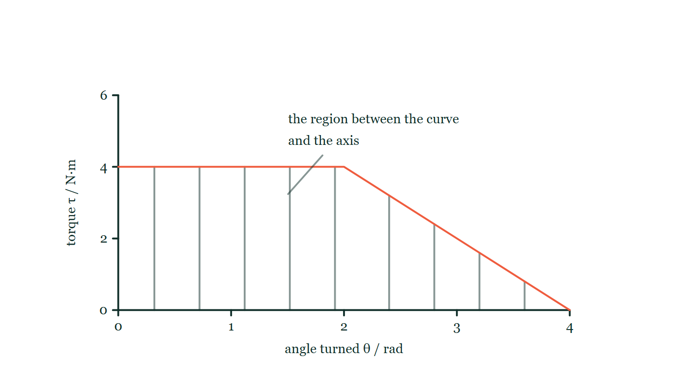
CIRCULAR MOTION · ROTATIONAL WORK, ENERGY & POWER
GIOPHYSICS LESSON
THE PICTURE
Work as an area
Drawn for this lesson
A graph of torque against the angle turned. The torque holds steady at four newton metres for the first two radians and then falls away linearly to zero at four radians. Faint vertical rules run from the angle axis up to the curve, so the region between the two reads as a quantity rather than as blank space.
The live version of this figure — click here
Circular Motion — Rotational Work, Energy & Power. Built by GioPhysics from the lesson's own copy; nothing on these slides is re-authored.
12 / 31
Notes:
[Phase] Build the model: The formulae, one at a time, in plain English (minutes 13–22 of 45)
[Figure] A graph of torque against the angle turned. The torque holds steady at four newton metres for the first two radians and then falls away linearly to zero at four radians. Faint vertical rules run from the angle axis up to the curve, so the region between the two reads as a quantity rather than as blank space.

Slide 13
CIRCULAR MOTION · ROTATIONAL WORK, ENERGY & POWER
GIOPHYSICS LESSON
WATCH OUT
The common trap
Check and misconception — The quick check and the trap
Use W = τΔθ only for constant torque. A changing torque requires graph area or integration.
Circular Motion — Rotational Work, Energy & Power. Built by GioPhysics from the lesson's own copy; nothing on these slides is re-authored.
13 / 31
Notes:
[Phase] Check and misconception: The quick check and the trap (minutes 35–41 of 45)
[Misconception] Use W = τΔθ only for constant torque. A changing torque requires graph area or integration.

Slide 14
CIRCULAR MOTION · ROTATIONAL WORK, ENERGY & POWER
GIOPHYSICS LESSON
WORKED EXAMPLE 1 OF 2 · EASY
The question
Easy
Worked examples — I do, we do — one step revealed at a time
A flywheel with I = 4.0 kg·m² spins at 10 rad/s. Find its rotational kinetic energy.
Circular Motion — Rotational Work, Energy & Power. Built by GioPhysics from the lesson's own copy; nothing on these slides is re-authored.
14 / 31
Notes:
[Phase] Worked examples: I do, we do — one step revealed at a time (minutes 22–35 of 45)
[Question] A flywheel with I = 4.0 kg·m² spins at 10 rad/s. Find its rotational kinetic energy.
[Answer] K = 200 J

Slide 15
CIRCULAR MOTION · ROTATIONAL WORK, ENERGY & POWER
GIOPHYSICS LESSON
WORKED EXAMPLE 1 OF 2 · EASY · THE WORKING
How to solve it
Easy
Worked examples — I do, we do — one step revealed at a time
A flywheel with I = 4.0 kg·m² spins at 10 rad/s. Find its rotational kinetic energy.
1.
K = ½Iω² = ½ × 4.0 × 100.
2.
K = 200 J.
Circular Motion — Rotational Work, Energy & Power. Built by GioPhysics from the lesson's own copy; nothing on these slides is re-authored.
15 / 31
Notes:
[Phase] Worked examples: I do, we do — one step revealed at a time (minutes 22–35 of 45)
[Reveal] One click per step. The class works each line before the next appears.
[Step 1] K = ½Iω² = ½ × 4.0 × 100.
[Step 2] K = 200 J.

Slide 16
CIRCULAR MOTION · ROTATIONAL WORK, ENERGY & POWER
GIOPHYSICS LESSON
WORKED EXAMPLE 1 OF 2 · EASY
Answer
Easy
Worked examples — I do, we do — one step revealed at a time
K = 200 J
Circular Motion — Rotational Work, Energy & Power. Built by GioPhysics from the lesson's own copy; nothing on these slides is re-authored.
16 / 31
Notes:
[Phase] Worked examples: I do, we do — one step revealed at a time (minutes 22–35 of 45)
[Answer] K = 200 J

Slide 17
CIRCULAR MOTION · ROTATIONAL WORK, ENERGY & POWER
GIOPHYSICS LESSON
WORKED EXAMPLE 2 OF 2 · MEDIUM
The question
Medium
Worked examples — I do, we do — one step revealed at a time
A flywheel has I = 2.0 kg·m² and spins at 6.0 rad/s. Find its rotational kinetic energy.
Circular Motion — Rotational Work, Energy & Power. Built by GioPhysics from the lesson's own copy; nothing on these slides is re-authored.
17 / 31
Notes:
[Phase] Worked examples: I do, we do — one step revealed at a time (minutes 22–35 of 45)
[Question] A flywheel has I = 2.0 kg·m² and spins at 6.0 rad/s. Find its rotational kinetic energy.
[Answer] Kᵣₒₜ = 36 J

Slide 18
CIRCULAR MOTION · ROTATIONAL WORK, ENERGY & POWER
GIOPHYSICS LESSON
WORKED EXAMPLE 2 OF 2 · MEDIUM · THE WORKING
How to solve it
Medium
Worked examples — I do, we do — one step revealed at a time
A flywheel has I = 2.0 kg·m² and spins at 6.0 rad/s. Find its rotational kinetic energy.
1.
Use Kᵣₒₜ = ½Iω².
2.
Kᵣₒₜ = ½(2.0)(6.0²).
3.
The result is an energy in joules.
Circular Motion — Rotational Work, Energy & Power. Built by GioPhysics from the lesson's own copy; nothing on these slides is re-authored.
18 / 31
Notes:
[Phase] Worked examples: I do, we do — one step revealed at a time (minutes 22–35 of 45)
[Reveal] One click per step. The class works each line before the next appears.
[Step 1] Use Kᵣₒₜ = ½Iω².
[Step 2] Kᵣₒₜ = ½(2.0)(6.0²).
[Step 3] The result is an energy in joules.

Slide 19
CIRCULAR MOTION · ROTATIONAL WORK, ENERGY & POWER
GIOPHYSICS LESSON
WORKED EXAMPLE 2 OF 2 · MEDIUM
Answer
Medium
Worked examples — I do, we do — one step revealed at a time
Kᵣₒₜ = 36 J
Circular Motion — Rotational Work, Energy & Power. Built by GioPhysics from the lesson's own copy; nothing on these slides is re-authored.
19 / 31
Notes:
[Phase] Worked examples: I do, we do — one step revealed at a time (minutes 22–35 of 45)
[Answer] Kᵣₒₜ = 36 J

Slide 20
CIRCULAR MOTION · ROTATIONAL WORK, ENERGY & POWER
GIOPHYSICS LESSON
SPOT THE MISTAKE
One line here is wrong
The whole working is up — find the bad line before you click
1.
The torque is constant, so the work done is W = τθ.
2.
The wheel turns through 20 revolutions, so θ = 20 rad.
3.
W = 5.0 × 20 = 100 J.
4.
All of it becomes rotational kinetic energy: ω = √(2W/I) = √(2 × 100 ÷ 2.5) ≈ 8.9 rad/s.
LINE 2 IS WRONG
Revolutions were used where radians were required. Every rotational formula in this chapter takes its angle in radians, and one revolution is 2π of them — so the angle here is about 126 rad, more than six times the number used. The slip hides well because '20' appears in the question and looks ready to substitute.
IT SHOULD SAY
θ = 20 × 2π ≈ 126 rad, so W = 5.0 × 126 ≈ 630 J and ω ≈ 22 rad/s.
Circular Motion — Rotational Work, Energy & Power. Built by GioPhysics from the lesson's own copy; nothing on these slides is re-authored.
20 / 31
Notes:
[Phase] Worked examples: I do, we do — one step revealed at a time (minutes 22–35 of 45)
[Spot the mistake] The working is complete and one line of it is wrong. Let the room hunt: one click names the line, a second shows it done correctly.
[Line 2 is wrong] Revolutions were used where radians were required. Every rotational formula in this chapter takes its angle in radians, and one revolution is 2π of them — so the angle here is about 126 rad, more than six times the number used. The slip hides well because '20' appears in the question and looks ready to substitute.
[It should say] θ = 20 × 2π ≈ 126 rad, so W = 5.0 × 126 ≈ 630 J and ω ≈ 22 rad/s.

Slide 21
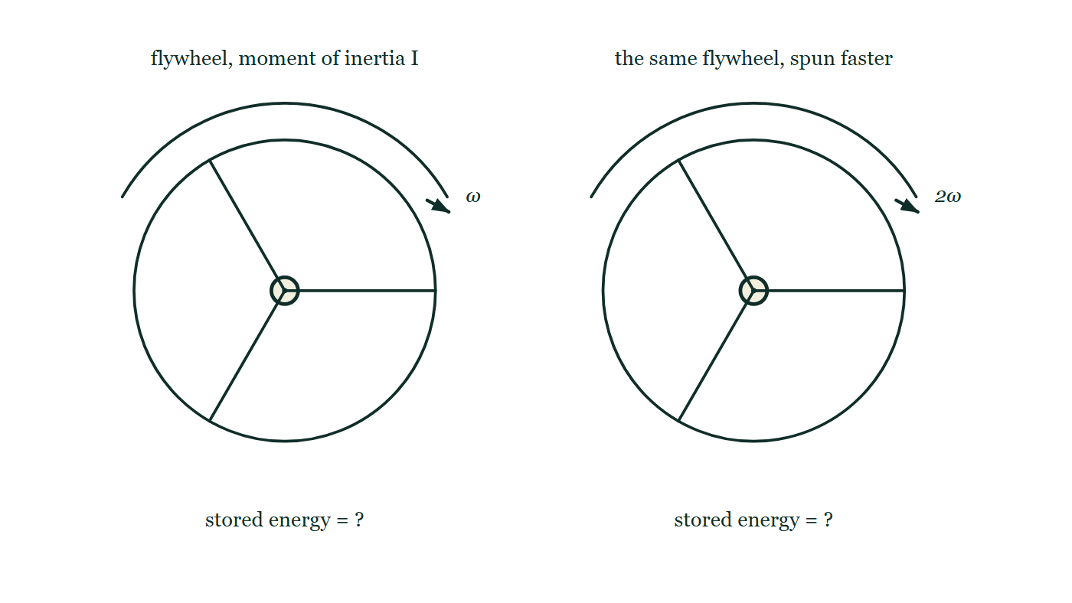
CIRCULAR MOTION · ROTATIONAL WORK, ENERGY & POWER
GIOPHYSICS LESSON
PREDICT · TAKE THE VOTE
Commit before you are told
Hands up for each option, then click
The right-hand flywheel is the same wheel spun at twice the rate. What happens to the energy stored in it?
A It doubles
B It becomes four times as large
C It stays the same — the wheel has not changed, so its inertia has not changed
The same spoked flywheel drawn twice, so its moment of inertia is identical in both. A curved arrow above the left one is labelled ω and above the right one 2ω, and beneath each the stored energy is left written as a question.
The live version of this figure — click here
Circular Motion — Rotational Work, Energy & Power. Built by GioPhysics from the lesson's own copy; nothing on these slides is re-authored.
21 / 31
Notes:
[Phase] Build the model: The formulae, one at a time, in plain English (minutes 13–22 of 45)
[Predict] The right-hand flywheel is the same wheel spun at twice the rate. What happens to the energy stored in it?
[Options] A It doubles B It becomes four times as large C It stays the same — the wheel has not changed, so its inertia has not changed
[Figure] The same spoked flywheel drawn twice, so its moment of inertia is identical in both. A curved arrow above the left one is labelled ω and above the right one 2ω, and beneath each the stored energy is left written as a question.

Slide 22
CIRCULAR MOTION · ROTATIONAL WORK, ENERGY & POWER
GIOPHYSICS LESSON
PREDICT · THE OUTCOME
What actually happens
Ask the room who changed their mind, and why
B It becomes four times as large
WHY
The two wheels are drawn identical, so I is the same and only ω differs. In K = ½Iω² the angular speed is squared, so twice the spin stores four times the energy. It is the same square that makes a flywheel such a good energy store, and the same square that makes one so dangerous to burst.
Circular Motion — Rotational Work, Energy & Power. Built by GioPhysics from the lesson's own copy; nothing on these slides is re-authored.
22 / 31
Notes:
[Phase] Build the model: The formulae, one at a time, in plain English (minutes 13–22 of 45)
[Answer] B — It becomes four times as large. The two wheels are drawn identical, so I is the same and only ω differs. In K = ½Iω² the angular speed is squared, so twice the spin stores four times the energy. It is the same square that makes a flywheel such a good energy store, and the same square that makes one so dangerous to burst.

Slide 23
CIRCULAR MOTION · ROTATIONAL WORK, ENERGY & POWER
GIOPHYSICS LESSON
QUICK CHECK
Decide before the answer goes up
Check and misconception — The quick check and the trap
At fixed I, what happens to rotational kinetic energy when ω doubles?
A
It doubles
B
It quadruples
C
It stays constant
The same spoked flywheel drawn twice, so its moment of inertia is identical in both. A curved arrow above the left one is labelled ω and above the right one 2ω, and beneath each the stored energy is left written as a question.
The live version of this figure — click here
Circular Motion — Rotational Work, Energy & Power. Built by GioPhysics from the lesson's own copy; nothing on these slides is re-authored.
23 / 31
Notes:
[Phase] Check and misconception: The quick check and the trap (minutes 35–41 of 45)
[Question] At fixed I, what happens to rotational kinetic energy when ω doubles?
[Figure] The same spoked flywheel drawn twice, so its moment of inertia is identical in both. A curved arrow above the left one is labelled ω and above the right one 2ω, and beneath each the stored energy is left written as a question.
[Options] A It doubles B It quadruples C It stays constant

Slide 24
CIRCULAR MOTION · ROTATIONAL WORK, ENERGY & POWER
GIOPHYSICS LESSON
QUICK CHECK · THE ANSWER
The answer, and why
Check and misconception — The quick check and the trap
B It quadruples
HOW TO GET THERE
Kᵣₒₜ = ½Iω² contains the square of angular speed.
WHY THE OTHERS TEMPT
A Doubling would be right if K were proportional to ω, which is what L = Iω looks like — and the two formulae are easy to confuse because they sit on the same page. Angular momentum is linear in ω; kinetic energy is not.
B Correct. K = ½Iω² carries the square of the angular speed, so a factor of two on ω is a factor of four on the energy — exactly as ½mv² behaves for straight-line motion.
C It is quite true that I is unchanged: it is the same wheel about the same axis. But I is only half of the story. The energy also depends on how fast the wheel is turning, and that is what has changed.
Circular Motion — Rotational Work, Energy & Power. Built by GioPhysics from the lesson's own copy; nothing on these slides is re-authored.
24 / 31
Notes:
[Phase] Check and misconception: The quick check and the trap (minutes 35–41 of 45)
[Question] At fixed I, what happens to rotational kinetic energy when ω doubles?
[Option by option] A: Doubling would be right if K were proportional to ω, which is what L = Iω looks like — and the two formulae are easy to confuse because they sit on the same page. Angular momentum is linear in ω; kinetic energy is not. B: Correct. K = ½Iω² carries the square of the angular speed, so a factor of two on ω is a factor of four on the energy — exactly as ½mv² behaves for straight-line motion. C: It is quite true that I is unchanged: it is the same wheel about the same axis. But I is only half of the story. The energy also depends on how fast the wheel is turning, and that is what has changed.
[Answer] B — It quadruples
[Why] Kᵣₒₜ = ½Iω² contains the square of angular speed.
[Reveal] One click for the answer, then one for the reason.

Slide 25
CIRCULAR MOTION · ROTATIONAL WORK, ENERGY & POWER
GIOPHYSICS LESSON
EXTENSION 1 OF 2 · HARD
The question
Hard
Worked examples — I do, we do — one step revealed at a time
A motor applies a constant 5.0 N·m torque to a wheel (I = 2.5 kg·m²) starting from rest. Find the work done and angular speed after 20 revolutions.
Circular Motion — Rotational Work, Energy & Power. Built by GioPhysics from the lesson's own copy; nothing on these slides is re-authored.
25 / 31
Notes:
[Phase] Worked examples: I do, we do — one step revealed at a time (minutes 22–35 of 45)
[Question] A motor applies a constant 5.0 N·m torque to a wheel (I = 2.5 kg·m²) starting from rest. Find the work done and angular speed after 20 revolutions.
[Answer] W ≈ 630 J; ω ≈ 22 rad/s

Slide 26
CIRCULAR MOTION · ROTATIONAL WORK, ENERGY & POWER
GIOPHYSICS LESSON
EXTENSION 1 OF 2 · HARD · THE WORKING
How to solve it
Hard
Worked examples — I do, we do — one step revealed at a time
A motor applies a constant 5.0 N·m torque to a wheel (I = 2.5 kg·m²) starting from rest. Find the work done and angular speed after 20 revolutions.
1.
θ = 20 × 2π ≈ 125.7 rad; W = τθ = 5.0 × 125.7 ≈ 628 J.
2.
W = ½Iω² → ω = √(2 × 628 ÷ 2.5).
3.
ω ≈ 22 rad/s.
Circular Motion — Rotational Work, Energy & Power. Built by GioPhysics from the lesson's own copy; nothing on these slides is re-authored.
26 / 31
Notes:
[Phase] Worked examples: I do, we do — one step revealed at a time (minutes 22–35 of 45)
[Reveal] One click per step. The class works each line before the next appears.
[Step 1] θ = 20 × 2π ≈ 125.7 rad; W = τθ = 5.0 × 125.7 ≈ 628 J.
[Step 2] W = ½Iω² → ω = √(2 × 628 ÷ 2.5).
[Step 3] ω ≈ 22 rad/s.

Slide 27
CIRCULAR MOTION · ROTATIONAL WORK, ENERGY & POWER
GIOPHYSICS LESSON
EXTENSION 1 OF 2 · HARD
Answer
Hard
Worked examples — I do, we do — one step revealed at a time
W ≈ 630 J; ω ≈ 22 rad/s
Circular Motion — Rotational Work, Energy & Power. Built by GioPhysics from the lesson's own copy; nothing on these slides is re-authored.
27 / 31
Notes:
[Phase] Worked examples: I do, we do — one step revealed at a time (minutes 22–35 of 45)
[Answer] W ≈ 630 J; ω ≈ 22 rad/s

Slide 28
CIRCULAR MOTION · ROTATIONAL WORK, ENERGY & POWER
GIOPHYSICS LESSON
EXTENSION 2 OF 2 · CHALLENGING
The question
Challenging
Worked examples — I do, we do — one step revealed at a time
A bus stores braking energy in a 180 kg flywheel (solid disc, R = 0.60 m) spun to 3000 rpm. How many stops' worth of energy is that if each stop dissipates 250 kJ?
Circular Motion — Rotational Work, Energy & Power. Built by GioPhysics from the lesson's own copy; nothing on these slides is re-authored.
28 / 31
Notes:
[Phase] Worked examples: I do, we do — one step revealed at a time (minutes 22–35 of 45)
[Question] A bus stores braking energy in a 180 kg flywheel (solid disc, R = 0.60 m) spun to 3000 rpm. How many stops' worth of energy is that if each stop dissipates 250 kJ?
[Answer] ≈ 1.6 MJ stored — roughly six stops

Slide 29
CIRCULAR MOTION · ROTATIONAL WORK, ENERGY & POWER
GIOPHYSICS LESSON
EXTENSION 2 OF 2 · CHALLENGING · THE WORKING
How to solve it
Challenging
Worked examples — I do, we do — one step revealed at a time
A bus stores braking energy in a 180 kg flywheel (solid disc, R = 0.60 m) spun to 3000 rpm. How many stops' worth of energy is that if each stop dissipates 250 kJ?
1.
I = ½MR² = ½ × 180 × 0.36 = 32.4 kg·m²; ω = 3000 × 2π/60 = 314 rad/s.
2.
K = ½ × 32.4 × 314² ≈ 1.60 × 10⁶ J.
3.
1.6 MJ ÷ 250 kJ ≈ 6.4 — about six full stops of energy.
Circular Motion — Rotational Work, Energy & Power. Built by GioPhysics from the lesson's own copy; nothing on these slides is re-authored.
29 / 31
Notes:
[Phase] Worked examples: I do, we do — one step revealed at a time (minutes 22–35 of 45)
[Reveal] One click per step. The class works each line before the next appears.
[Step 1] I = ½MR² = ½ × 180 × 0.36 = 32.4 kg·m²; ω = 3000 × 2π/60 = 314 rad/s.
[Step 2] K = ½ × 32.4 × 314² ≈ 1.60 × 10⁶ J.
[Step 3] 1.6 MJ ÷ 250 kJ ≈ 6.4 — about six full stops of energy.

Slide 30
CIRCULAR MOTION · ROTATIONAL WORK, ENERGY & POWER
GIOPHYSICS LESSON
EXTENSION 2 OF 2 · CHALLENGING
Answer
Challenging
Worked examples — I do, we do — one step revealed at a time
≈ 1.6 MJ stored — roughly six stops
Circular Motion — Rotational Work, Energy & Power. Built by GioPhysics from the lesson's own copy; nothing on these slides is re-authored.
30 / 31
Notes:
[Phase] Worked examples: I do, we do — one step revealed at a time (minutes 22–35 of 45)
[Answer] ≈ 1.6 MJ stored — roughly six stops

Slide 31
CIRCULAR MOTION · ROTATIONAL WORK, ENERGY & POWER
GIOPHYSICS LESSON
CIRCULAR MOTION
Where to go next
Plenary — What to take away, what to practise next
Next
6.7 Rolling Without Slipping
https://giophysics.com/chapter-10/rolling-without-slipping/
Lesson
This lesson on giophysics.com
https://giophysics.com/chapter-10/rotational-work-energy-power/
Live
The live, interactive version of these slides
https://giophysics.com/chapter-10/presentation/?lesson=energy
Chapter
All Circular Motion lessons
https://giophysics.com/chapter-10/
PDF
Download the lesson PDF
https://giophysics.com/downloads/10-6-rotational-work-energy-power.pdf
Circular Motion — Rotational Work, Energy & Power. Built by GioPhysics from the lesson's own copy; nothing on these slides is re-authored.
31 / 31
Notes:
[Phase] Plenary: What to take away, what to practise next (minutes 41–45 of 45)
[Interactive] The graphs and the circuit topology on these slides are frozen. The live version at https://giophysics.com/chapter-10/presentation/?lesson=energy moves them.

