Slide 1
CIRCULAR MOTION · CENTRIPETAL FORCES & APPLICATIONS
GIOPHYSICS LESSON
06 · Circular Motion
Name the real inward forces
Centripetal Forces & Applications
Centripetal force is the net inward resultant supplied by familiar forces such as friction, tension, gravity, or the normal force.
POSITION
Lesson 3 of 11 in Circular Motion
PLAN
16 slides in the 45-minute core run, about 43 minutes of it
LESSON PAGE
https://giophysics.com/chapter-10/centripetal-forces-applications/
Built by GioPhysics from the lesson's own page. Every word on these slides is the lesson's; nothing here is re-authored. Teaching material, not an awarding body's document.
Circular Motion — Centripetal Forces & Applications. Built by GioPhysics from the lesson's own copy; nothing on these slides is re-authored.
1 / 32
Notes:
[Lesson] Circular Motion — Centripetal Forces & Applications. Lesson 3 of 11.
[Intro] Centripetal force is the net inward resultant supplied by familiar forces such as friction, tension, gravity, or the normal force.
[Source] https://giophysics.com/chapter-10/centripetal-forces-applications/
[Disclaimer] Built by GioPhysics from the lesson's own page. Every word on these slides is the lesson's; nothing here is re-authored. Teaching material, not an awarding body's document.

Slide 2
CIRCULAR MOTION · CENTRIPETAL FORCES & APPLICATIONS
GIOPHYSICS LESSON
THINK FIRST
The car swings round a bend and you are thrown against the door. What is pushing you outward?
Take answers before you click — the point is the commitment
It is one of the most convincing sensations in everyday physics — the whole left side of your body can feel it.
THE ANSWER
Nothing is. You were travelling in a straight line and the car turned out from under you; the door then arrived and pushed you inward, which is the only horizontal force on you. What you feel as 'thrown outward' is the door pressing you into the turn.
Circular Motion — Centripetal Forces & Applications. Built by GioPhysics from the lesson's own copy; nothing on these slides is re-authored.
2 / 32
Notes:
[Phase] Starter: Recall what this lesson stands on (minutes 0–5 of 45)
[Hook] The car swings round a bend and you are thrown against the door. What is pushing you outward? It is one of the most convincing sensations in everyday physics — the whole left side of your body can feel it.
[Answer] Nothing is. You were travelling in a straight line and the car turned out from under you; the door then arrived and pushed you inward, which is the only horizontal force on you. What you feel as 'thrown outward' is the door pressing you into the turn.

Slide 3
CIRCULAR MOTION · CENTRIPETAL FORCES & APPLICATIONS
GIOPHYSICS LESSON
EXPLAINED SIMPLY
In one sentence
Introduce the idea — The big idea and the definition
Centripetal force is the name for the net force directed toward the centre of a circular path.
Circular Motion — Centripetal Forces & Applications. Built by GioPhysics from the lesson's own copy; nothing on these slides is re-authored.
3 / 32
Notes:
[Phase] Introduce the idea: The big idea and the definition (minutes 5–13 of 45)
[Definition] Centripetal force is the name for the net force directed toward the centre of a circular path.

Slide 4
CIRCULAR MOTION · CENTRIPETAL FORCES & APPLICATIONS
GIOPHYSICS LESSON
EXPLAINED SIMPLY
What that looks like
Introduce the idea — The big idea and the definition
FOR EXAMPLE
When a car turns on a flat road, tyre–road friction supplies the centripetal force that points into the bend.
Circular Motion — Centripetal Forces & Applications. Built by GioPhysics from the lesson's own copy; nothing on these slides is re-authored.
4 / 32
Notes:
[Phase] Introduce the idea: The big idea and the definition (minutes 5–13 of 45)
[Worked illustration] When a car turns on a flat road, tyre–road friction supplies the centripetal force that points into the bend.

Slide 5
CIRCULAR MOTION · CENTRIPETAL FORCES & APPLICATIONS
GIOPHYSICS LESSON
THE BIG IDEA
Name the real inward forces
Introduce the idea — The big idea and the definition
Start with a free-body diagram, choose inward as the radial direction, and add the radial components of real forces. The required resultant grows with mass and with speed squared, but falls when the path radius grows.
Circular Motion — Centripetal Forces & Applications. Built by GioPhysics from the lesson's own copy; nothing on these slides is re-authored.
5 / 32
Notes:
[Phase] Introduce the idea: The big idea and the definition (minutes 5–13 of 45)
[Big idea] Start with a free-body diagram, choose inward as the radial direction, and add the radial components of real forces. The required resultant grows with mass and with speed squared, but falls when the path radius grows.

Slide 6
CIRCULAR MOTION · CENTRIPETAL FORCES & APPLICATIONS
GIOPHYSICS LESSON
THE PHYSICS · 1 OF 3
Not an extra force
Build the model — The formulae, one at a time, in plain English
Centripetal describes the role of the net radial force; never draw a separate centripetal-force arrow.
Circular Motion — Centripetal Forces & Applications. Built by GioPhysics from the lesson's own copy; nothing on these slides is re-authored.
6 / 32
Notes:
[Phase] Build the model: The formulae, one at a time, in plain English (minutes 13–22 of 45)
[Section] Centripetal describes the role of the net radial force; never draw a separate centripetal-force arrow.

Slide 7
CIRCULAR MOTION · CENTRIPETAL FORCES & APPLICATIONS
GIOPHYSICS LESSON
THE PHYSICS · 2 OF 3
Use components
Build the model — The formulae, one at a time, in plain English
On a banked curve, the normal force has both vertical and inward components.
Circular Motion — Centripetal Forces & Applications. Built by GioPhysics from the lesson's own copy; nothing on these slides is re-authored.
7 / 32
Notes:
[Phase] Build the model: The formulae, one at a time, in plain English (minutes 13–22 of 45)
[Section] On a banked curve, the normal force has both vertical and inward components.

Slide 8
CIRCULAR MOTION · CENTRIPETAL FORCES & APPLICATIONS
GIOPHYSICS LESSON
THE PHYSICS · 3 OF 3
Check the top and bottom
Build the model — The formulae, one at a time, in plain English
In a vertical circle, gravity can assist or oppose the other inward forces depending on position.
Circular Motion — Centripetal Forces & Applications. Built by GioPhysics from the lesson's own copy; nothing on these slides is re-authored.
8 / 32
Notes:
[Phase] Build the model: The formulae, one at a time, in plain English (minutes 13–22 of 45)
[Section] In a vertical circle, gravity can assist or oppose the other inward forces depending on position.

Slide 9
CIRCULAR MOTION · CENTRIPETAL FORCES & APPLICATIONS
GIOPHYSICS LESSON
FORMULA 1 OF 3
Radial force account
Build the model — The formulae, one at a time, in plain English
ΣFᵣ = mv²/r
Inward is usually positive
IN PLAIN ENGLISH
Something must supply the inward pull — tension, friction, gravity — and together those forces must equal mass times the inward acceleration.
Circular Motion — Centripetal Forces & Applications. Built by GioPhysics from the lesson's own copy; nothing on these slides is re-authored.
9 / 32
Notes:
[Phase] Build the model: The formulae, one at a time, in plain English (minutes 13–22 of 45)
[Formula] Radial force account: ΣFᵣ = mv²/r
[In plain English] Something must supply the inward pull — tension, friction, gravity — and together those forces must equal mass times the inward acceleration.
[Note] Inward is usually positive

Slide 10
CIRCULAR MOTION · CENTRIPETAL FORCES & APPLICATIONS
GIOPHYSICS LESSON
FORMULA 2 OF 3
Flat road limit
Build the model — The formulae, one at a time, in plain English
vₘₐₓ = √(μgr)
Static friction supplies the inward force
IN PLAIN ENGLISH
The fastest a car can round a flat corner: beyond this speed, tyre grip can no longer supply the inward force.
Circular Motion — Centripetal Forces & Applications. Built by GioPhysics from the lesson's own copy; nothing on these slides is re-authored.
10 / 32
Notes:
[Phase] Build the model: The formulae, one at a time, in plain English (minutes 13–22 of 45)
[Formula] Flat road limit: vₘₐₓ = √(μgr)
[In plain English] The fastest a car can round a flat corner: beyond this speed, tyre grip can no longer supply the inward force.
[Note] Static friction supplies the inward force

Slide 11
CIRCULAR MOTION · CENTRIPETAL FORCES & APPLICATIONS
GIOPHYSICS LESSON
FORMULA 3 OF 3
Ideal bank
Build the model — The formulae, one at a time, in plain English
tan β = v²/(rg)
No sideways friction needed at design speed
IN PLAIN ENGLISH
A banked road tilted at just this angle turns the car using only the road's push — no sideways grip needed at the design speed.
Circular Motion — Centripetal Forces & Applications. Built by GioPhysics from the lesson's own copy; nothing on these slides is re-authored.
11 / 32
Notes:
[Phase] Build the model: The formulae, one at a time, in plain English (minutes 13–22 of 45)
[Formula] Ideal bank: tan β = v²/(rg)
[In plain English] A banked road tilted at just this angle turns the car using only the road's push — no sideways grip needed at the design speed.
[Note] No sideways friction needed at design speed

Slide 12
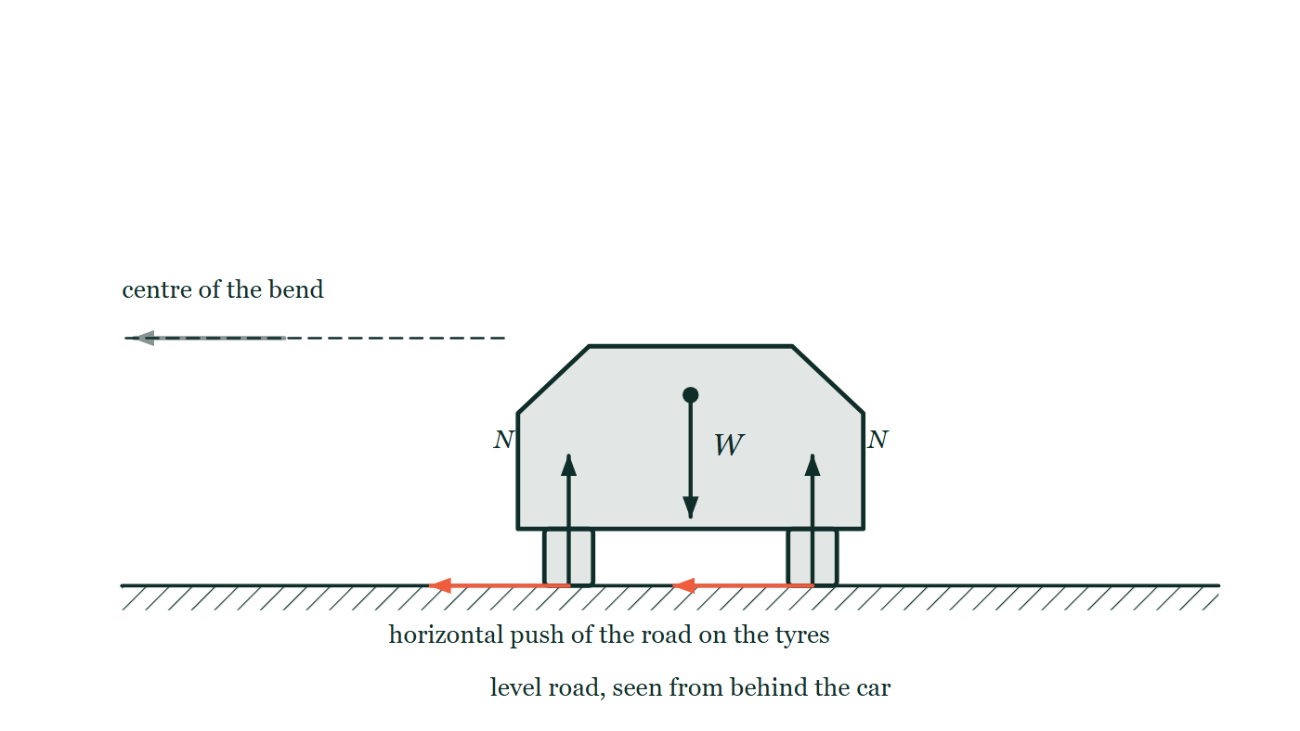
CIRCULAR MOTION · CENTRIPETAL FORCES & APPLICATIONS
GIOPHYSICS LESSON
PICTURE 1 OF 2
The forces on a car in a bend
Drawn for this lesson
A car seen from behind on a level road, cornering toward a centre marked off to the left. Its weight arrow starts at the centre of mass and points straight down; a normal force arrow rises from each tyre's contact patch; and a horizontal arrow also starts at each contact patch and points toward the centre of the bend, labelled only as the road's push on the tyres.
The live version of this figure — click here
Circular Motion — Centripetal Forces & Applications. Built by GioPhysics from the lesson's own copy; nothing on these slides is re-authored.
12 / 32
Notes:
[Phase] Build the model: The formulae, one at a time, in plain English (minutes 13–22 of 45)
[Figure] A car seen from behind on a level road, cornering toward a centre marked off to the left. Its weight arrow starts at the centre of mass and points straight down; a normal force arrow rises from each tyre's contact patch; and a horizontal arrow also starts at each contact patch and points toward the centre of the bend, labelled only as the road's push on the tyres.

Slide 13
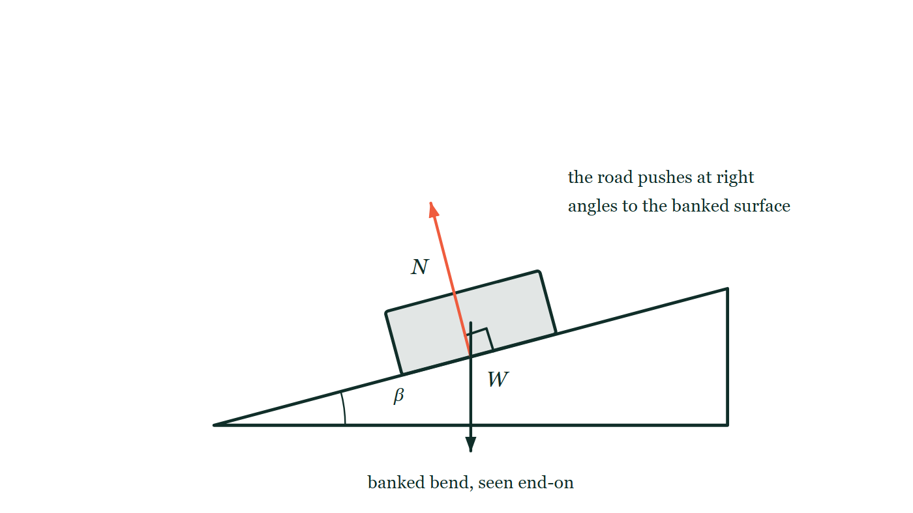
CIRCULAR MOTION · CENTRIPETAL FORCES & APPLICATIONS
GIOPHYSICS LESSON
PICTURE 2 OF 2
Why banking works
Drawn for this lesson
A banked bend seen end-on: a wedge of road tilted at an angle β to the horizontal with a car sitting on the slope. The weight arrow drops vertically from the car's centre of mass, while the road's push starts at the contact point and runs perpendicular to the banked surface, marked with a right angle — so it leans inward as well as upward.
The live version of this figure — click here
Circular Motion — Centripetal Forces & Applications. Built by GioPhysics from the lesson's own copy; nothing on these slides is re-authored.
13 / 32
Notes:
[Phase] Build the model: The formulae, one at a time, in plain English (minutes 13–22 of 45)
[Figure] A banked bend seen end-on: a wedge of road tilted at an angle β to the horizontal with a car sitting on the slope. The weight arrow drops vertically from the car's centre of mass, while the road's push starts at the contact point and runs perpendicular to the banked surface, marked with a right angle — so it leans inward as well as upward.

Slide 14
CIRCULAR MOTION · CENTRIPETAL FORCES & APPLICATIONS
GIOPHYSICS LESSON
WATCH OUT
The common trap
Check and misconception — The quick check and the trap
An outward 'centrifugal force' is not part of an inertial-frame free-body diagram. The object's inertia is not a real outward interaction.
Circular Motion — Centripetal Forces & Applications. Built by GioPhysics from the lesson's own copy; nothing on these slides is re-authored.
14 / 32
Notes:
[Phase] Check and misconception: The quick check and the trap (minutes 35–41 of 45)
[Misconception] An outward 'centrifugal force' is not part of an inertial-frame free-body diagram. The object's inertia is not a real outward interaction.

Slide 15
CIRCULAR MOTION · CENTRIPETAL FORCES & APPLICATIONS
GIOPHYSICS LESSON
WORKED EXAMPLE 1 OF 2 · EASY
The question
Easy
Worked examples — I do, we do — one step revealed at a time
What inward force keeps a 0.50 kg model plane flying in a 5.0 m radius circle at 10 m/s?
Circular Motion — Centripetal Forces & Applications. Built by GioPhysics from the lesson's own copy; nothing on these slides is re-authored.
15 / 32
Notes:
[Phase] Worked examples: I do, we do — one step revealed at a time (minutes 22–35 of 45)
[Question] What inward force keeps a 0.50 kg model plane flying in a 5.0 m radius circle at 10 m/s?
[Answer] F = 10 N

Slide 16
CIRCULAR MOTION · CENTRIPETAL FORCES & APPLICATIONS
GIOPHYSICS LESSON
WORKED EXAMPLE 1 OF 2 · EASY · THE WORKING
How to solve it
Easy
Worked examples — I do, we do — one step revealed at a time
What inward force keeps a 0.50 kg model plane flying in a 5.0 m radius circle at 10 m/s?
1.
F = mv²/r = 0.50 × 100 ÷ 5.0.
2.
F = 10 N toward the centre.
Circular Motion — Centripetal Forces & Applications. Built by GioPhysics from the lesson's own copy; nothing on these slides is re-authored.
16 / 32
Notes:
[Phase] Worked examples: I do, we do — one step revealed at a time (minutes 22–35 of 45)
[Reveal] One click per step. The class works each line before the next appears.
[Step 1] F = mv²/r = 0.50 × 100 ÷ 5.0.
[Step 2] F = 10 N toward the centre.

Slide 17
CIRCULAR MOTION · CENTRIPETAL FORCES & APPLICATIONS
GIOPHYSICS LESSON
WORKED EXAMPLE 1 OF 2 · EASY
Answer
Easy
Worked examples — I do, we do — one step revealed at a time
F = 10 N
Circular Motion — Centripetal Forces & Applications. Built by GioPhysics from the lesson's own copy; nothing on these slides is re-authored.
17 / 32
Notes:
[Phase] Worked examples: I do, we do — one step revealed at a time (minutes 22–35 of 45)
[Answer] F = 10 N

Slide 18
CIRCULAR MOTION · CENTRIPETAL FORCES & APPLICATIONS
GIOPHYSICS LESSON
WORKED EXAMPLE 2 OF 2 · MEDIUM
The question
Medium
Worked examples — I do, we do — one step revealed at a time
A 900 kg car travels at 15 m/s around a level bend of radius 45 m. Find the inward resultant.
Circular Motion — Centripetal Forces & Applications. Built by GioPhysics from the lesson's own copy; nothing on these slides is re-authored.
18 / 32
Notes:
[Phase] Worked examples: I do, we do — one step revealed at a time (minutes 22–35 of 45)
[Question] A 900 kg car travels at 15 m/s around a level bend of radius 45 m. Find the inward resultant.
[Answer] ΣFᵣ = 4.50 kN inward

Slide 19
CIRCULAR MOTION · CENTRIPETAL FORCES & APPLICATIONS
GIOPHYSICS LESSON
WORKED EXAMPLE 2 OF 2 · MEDIUM · THE WORKING
How to solve it
Medium
Worked examples — I do, we do — one step revealed at a time
A 900 kg car travels at 15 m/s around a level bend of radius 45 m. Find the inward resultant.
1.
Use ΣFᵣ = mv²/r.
2.
ΣFᵣ = (900)(15²)/45.
3.
On a level bend, static friction supplies this resultant.
Circular Motion — Centripetal Forces & Applications. Built by GioPhysics from the lesson's own copy; nothing on these slides is re-authored.
19 / 32
Notes:
[Phase] Worked examples: I do, we do — one step revealed at a time (minutes 22–35 of 45)
[Reveal] One click per step. The class works each line before the next appears.
[Step 1] Use ΣFᵣ = mv²/r.
[Step 2] ΣFᵣ = (900)(15²)/45.
[Step 3] On a level bend, static friction supplies this resultant.

Slide 20
CIRCULAR MOTION · CENTRIPETAL FORCES & APPLICATIONS
GIOPHYSICS LESSON
WORKED EXAMPLE 2 OF 2 · MEDIUM
Answer
Medium
Worked examples — I do, we do — one step revealed at a time
ΣFᵣ = 4.50 kN inward
Circular Motion — Centripetal Forces & Applications. Built by GioPhysics from the lesson's own copy; nothing on these slides is re-authored.
20 / 32
Notes:
[Phase] Worked examples: I do, we do — one step revealed at a time (minutes 22–35 of 45)
[Answer] ΣFᵣ = 4.50 kN inward

Slide 21
CIRCULAR MOTION · CENTRIPETAL FORCES & APPLICATIONS
GIOPHYSICS LESSON
SPOT THE MISTAKE
One line here is wrong
The whole working is up — find the bad line before you click
1.
At the crest the rider feels weightless when the road pushes with no force at all: N = 0.
2.
Gravity alone then supplies the centripetal force: mg = mv²/r.
3.
Cancel m from both sides: g = v²/r, so v² = g/r = 9.81 ÷ 12.
4.
v = √0.818 ≈ 0.90 m/s.
LINE 3 IS WRONG
The rearrangement went the wrong way. From g = v²/r the r multiplies across, giving v² = gr, not v² = g/r. Dividing rather than multiplying is the commonest slip in the whole topic because r appears underneath in the original formula and the eye keeps it there. The answer is a warning in itself: 0.90 m/s is walking pace, and nobody has ever gone weightless walking over a bridge.
IT SHOULD SAY
g = v²/r gives v² = gr = 9.81 × 12 = 118, so v ≈ 10.8 m/s.
Circular Motion — Centripetal Forces & Applications. Built by GioPhysics from the lesson's own copy; nothing on these slides is re-authored.
21 / 32
Notes:
[Phase] Worked examples: I do, we do — one step revealed at a time (minutes 22–35 of 45)
[Spot the mistake] The working is complete and one line of it is wrong. Let the room hunt: one click names the line, a second shows it done correctly.
[Line 3 is wrong] The rearrangement went the wrong way. From g = v²/r the r multiplies across, giving v² = gr, not v² = g/r. Dividing rather than multiplying is the commonest slip in the whole topic because r appears underneath in the original formula and the eye keeps it there. The answer is a warning in itself: 0.90 m/s is walking pace, and nobody has ever gone weightless walking over a bridge.
[It should say] g = v²/r gives v² = gr = 9.81 × 12 = 118, so v ≈ 10.8 m/s.

Slide 22
CIRCULAR MOTION · CENTRIPETAL FORCES & APPLICATIONS
GIOPHYSICS LESSON
PREDICT · TAKE THE VOTE
Commit before you are told
Hands up for each option, then click
A student wants to add a fourth arrow to this diagram: an outward one, away from the centre, labelled centrifugal force. Should it go on?
A Yes — passengers are pushed outward on a bend, so something must be pushing them
B No — nothing pushes the car outward; the inward push from the road is the whole horizontal story
C Yes, but only once the car is going fast enough to feel it
A car seen from behind on a level road, cornering toward a centre marked off to the left. Its weight arrow starts at the centre of mass and points straight down; a normal force arrow rises from each tyre's contact patch; and a horizontal arrow also starts at each contact patch and points toward the centre of the bend, labelled only as the road's push on the tyres.
The live version of this figure — click here
Circular Motion — Centripetal Forces & Applications. Built by GioPhysics from the lesson's own copy; nothing on these slides is re-authored.
22 / 32
Notes:
[Phase] Build the model: The formulae, one at a time, in plain English (minutes 13–22 of 45)
[Predict] A student wants to add a fourth arrow to this diagram: an outward one, away from the centre, labelled centrifugal force. Should it go on?
[Options] A Yes — passengers are pushed outward on a bend, so something must be pushing them B No — nothing pushes the car outward; the inward push from the road is the whole horizontal story C Yes, but only once the car is going fast enough to feel it
[Figure] A car seen from behind on a level road, cornering toward a centre marked off to the left. Its weight arrow starts at the centre of mass and points straight down; a normal force arrow rises from each tyre's contact patch; and a horizontal arrow also starts at each contact patch and points toward the centre of the bend, labelled only as the road's push on the tyres.

Slide 23
CIRCULAR MOTION · CENTRIPETAL FORCES & APPLICATIONS
GIOPHYSICS LESSON
PREDICT · THE OUTCOME
What actually happens
Ask the room who changed their mind, and why
B No — nothing pushes the car outward; the inward push from the road is the whole horizontal story
WHY
Every arrow on a free-body diagram must name something that touches or pulls on the car — the road, the Earth, the air. Nothing at all is on the far side pushing outward. If an outward arrow were added it would cancel the inward one, and a car with no net inward force would go straight on instead of round the bend.
Circular Motion — Centripetal Forces & Applications. Built by GioPhysics from the lesson's own copy; nothing on these slides is re-authored.
23 / 32
Notes:
[Phase] Build the model: The formulae, one at a time, in plain English (minutes 13–22 of 45)
[Answer] B — No — nothing pushes the car outward; the inward push from the road is the whole horizontal story. Every arrow on a free-body diagram must name something that touches or pulls on the car — the road, the Earth, the air. Nothing at all is on the far side pushing outward. If an outward arrow were added it would cancel the inward one, and a car with no net inward force would go straight on instead of round the bend.

Slide 24
CIRCULAR MOTION · CENTRIPETAL FORCES & APPLICATIONS
GIOPHYSICS LESSON
QUICK CHECK
Decide before the answer goes up
Check and misconception — The quick check and the trap
A car turns on a flat road without slipping. Which real force points toward the centre?
A
Static friction
B
Weight
C
A separate centripetal force
Circular Motion — Centripetal Forces & Applications. Built by GioPhysics from the lesson's own copy; nothing on these slides is re-authored.
24 / 32
Notes:
[Phase] Check and misconception: The quick check and the trap (minutes 35–41 of 45)
[Question] A car turns on a flat road without slipping. Which real force points toward the centre?
[Options] A Static friction B Weight C A separate centripetal force

Slide 25
CIRCULAR MOTION · CENTRIPETAL FORCES & APPLICATIONS
GIOPHYSICS LESSON
QUICK CHECK · THE ANSWER
The answer, and why
Check and misconception — The quick check and the trap
A Static friction
HOW TO GET THERE
Static friction supplies the horizontal inward resultant on a flat road.
WHY THE OTHERS TEMPT
A Correct. On a level road it is friction between tyre and road that acts horizontally, and it points into the bend. Take that friction away — black ice — and the car goes straight on, which is exactly what a missing centripetal force looks like.
B Weight is real, and it is what presses the tyres onto the road hard enough for friction to act. But weight points straight down, not sideways, so it has no component toward the centre of a level bend and cannot be the inward resultant.
C This is the tempting one, because 'centripetal force' does appear in every equation in the lesson. But it is a job title, not an interaction: it names whatever real force happens to be doing the turning. On a level road that is friction; on a string it is tension; for a satellite it is gravity. It never appears as an extra arrow of its own.
Circular Motion — Centripetal Forces & Applications. Built by GioPhysics from the lesson's own copy; nothing on these slides is re-authored.
25 / 32
Notes:
[Phase] Check and misconception: The quick check and the trap (minutes 35–41 of 45)
[Question] A car turns on a flat road without slipping. Which real force points toward the centre?
[Option by option] A: Correct. On a level road it is friction between tyre and road that acts horizontally, and it points into the bend. Take that friction away — black ice — and the car goes straight on, which is exactly what a missing centripetal force looks like. B: Weight is real, and it is what presses the tyres onto the road hard enough for friction to act. But weight points straight down, not sideways, so it has no component toward the centre of a level bend and cannot be the inward resultant. C: This is the tempting one, because 'centripetal force' does appear in every equation in the lesson. But it is a job title, not an interaction: it names whatever real force happens to be doing the turning. On a level road that is friction; on a string it is tension; for a satellite it is gravity. It never appears as an extra arrow of its own.
[Answer] A — Static friction
[Why] Static friction supplies the horizontal inward resultant on a flat road.
[Reveal] One click for the answer, then one for the reason.

Slide 26
CIRCULAR MOTION · CENTRIPETAL FORCES & APPLICATIONS
GIOPHYSICS LESSON
EXTENSION 1 OF 2 · HARD
The question
Hard
Worked examples — I do, we do — one step revealed at a time
A 65 kg rider crests a hump-backed bridge of radius 12 m. At what speed does the rider feel weightless?
Circular Motion — Centripetal Forces & Applications. Built by GioPhysics from the lesson's own copy; nothing on these slides is re-authored.
26 / 32
Notes:
[Phase] Worked examples: I do, we do — one step revealed at a time (minutes 22–35 of 45)
[Question] A 65 kg rider crests a hump-backed bridge of radius 12 m. At what speed does the rider feel weightless?
[Answer] v ≈ 11 m/s

Slide 27
CIRCULAR MOTION · CENTRIPETAL FORCES & APPLICATIONS
GIOPHYSICS LESSON
EXTENSION 1 OF 2 · HARD · THE WORKING
How to solve it
Hard
Worked examples — I do, we do — one step revealed at a time
A 65 kg rider crests a hump-backed bridge of radius 12 m. At what speed does the rider feel weightless?
1.
Weightless when gravity alone supplies the centripetal force: mg = mv²/r.
2.
v = √(gr) = √(9.81 × 12).
3.
v ≈ 10.8 m/s (~39 km/h).
Circular Motion — Centripetal Forces & Applications. Built by GioPhysics from the lesson's own copy; nothing on these slides is re-authored.
27 / 32
Notes:
[Phase] Worked examples: I do, we do — one step revealed at a time (minutes 22–35 of 45)
[Reveal] One click per step. The class works each line before the next appears.
[Step 1] Weightless when gravity alone supplies the centripetal force: mg = mv²/r.
[Step 2] v = √(gr) = √(9.81 × 12).
[Step 3] v ≈ 10.8 m/s (~39 km/h).

Slide 28
CIRCULAR MOTION · CENTRIPETAL FORCES & APPLICATIONS
GIOPHYSICS LESSON
EXTENSION 1 OF 2 · HARD
Answer
Hard
Worked examples — I do, we do — one step revealed at a time
v ≈ 11 m/s
Circular Motion — Centripetal Forces & Applications. Built by GioPhysics from the lesson's own copy; nothing on these slides is re-authored.
28 / 32
Notes:
[Phase] Worked examples: I do, we do — one step revealed at a time (minutes 22–35 of 45)
[Answer] v ≈ 11 m/s

Slide 29
CIRCULAR MOTION · CENTRIPETAL FORCES & APPLICATIONS
GIOPHYSICS LESSON
EXTENSION 2 OF 2 · CHALLENGING
The question
Challenging
Worked examples — I do, we do — one step revealed at a time
A 1200 kg car rounds a 60 m bend banked at 15° with μs = 0.40. Find the maximum safe speed.
Circular Motion — Centripetal Forces & Applications. Built by GioPhysics from the lesson's own copy; nothing on these slides is re-authored.
29 / 32
Notes:
[Phase] Worked examples: I do, we do — one step revealed at a time (minutes 22–35 of 45)
[Question] A 1200 kg car rounds a 60 m bend banked at 15° with μs = 0.40. Find the maximum safe speed.
[Answer] v(max) ≈ 21 m/s

Slide 30
CIRCULAR MOTION · CENTRIPETAL FORCES & APPLICATIONS
GIOPHYSICS LESSON
EXTENSION 2 OF 2 · CHALLENGING · THE WORKING
How to solve it
Challenging
Worked examples — I do, we do — one step revealed at a time
A 1200 kg car rounds a 60 m bend banked at 15° with μs = 0.40. Find the maximum safe speed.
1.
With friction assisting the bank: v² = gr(tanθ + μ)/(1 − μ tanθ).
2.
v² = 9.81 × 60 × (0.268 + 0.40)/(1 − 0.107) = 588.6 × 0.668/0.893 ≈ 440.3.
3.
v ≈ 21 m/s (~76 km/h).
Circular Motion — Centripetal Forces & Applications. Built by GioPhysics from the lesson's own copy; nothing on these slides is re-authored.
30 / 32
Notes:
[Phase] Worked examples: I do, we do — one step revealed at a time (minutes 22–35 of 45)
[Reveal] One click per step. The class works each line before the next appears.
[Step 1] With friction assisting the bank: v² = gr(tanθ + μ)/(1 − μ tanθ).
[Step 2] v² = 9.81 × 60 × (0.268 + 0.40)/(1 − 0.107) = 588.6 × 0.668/0.893 ≈ 440.3.
[Step 3] v ≈ 21 m/s (~76 km/h).

Slide 31
CIRCULAR MOTION · CENTRIPETAL FORCES & APPLICATIONS
GIOPHYSICS LESSON
EXTENSION 2 OF 2 · CHALLENGING
Answer
Challenging
Worked examples — I do, we do — one step revealed at a time
v(max) ≈ 21 m/s
Circular Motion — Centripetal Forces & Applications. Built by GioPhysics from the lesson's own copy; nothing on these slides is re-authored.
31 / 32
Notes:
[Phase] Worked examples: I do, we do — one step revealed at a time (minutes 22–35 of 45)
[Answer] v(max) ≈ 21 m/s

Slide 32
CIRCULAR MOTION · CENTRIPETAL FORCES & APPLICATIONS
GIOPHYSICS LESSON
CIRCULAR MOTION
Where to go next
Plenary — What to take away, what to practise next
Next
6.4 Torque & Rotational Dynamics
https://giophysics.com/chapter-10/torque-rotational-dynamics/
Lesson
This lesson on giophysics.com
https://giophysics.com/chapter-10/centripetal-forces-applications/
Live
The live, interactive version of these slides
https://giophysics.com/chapter-10/presentation/?lesson=forces
Chapter
All Circular Motion lessons
https://giophysics.com/chapter-10/
PDF
Download the lesson PDF
https://giophysics.com/downloads/10-3-centripetal-forces-applications.pdf
Circular Motion — Centripetal Forces & Applications. Built by GioPhysics from the lesson's own copy; nothing on these slides is re-authored.
32 / 32
Notes:
[Phase] Plenary: What to take away, what to practise next (minutes 41–45 of 45)
[Interactive] The graphs and the circuit topology on these slides are frozen. The live version at https://giophysics.com/chapter-10/presentation/?lesson=forces moves them.

