Slide 1
CIRCULAR MOTION · CIRCULAR MOTION FOUNDATIONS
GIOPHYSICS LESSON
06 · Circular Motion
Describe a turn
Circular Motion Foundations
Radians connect distance around a circle to angle, while period and frequency connect one turn to time.
POSITION
Lesson 1 of 11 in Circular Motion
PLAN
16 slides in the 45-minute core run, about 44 minutes of it
LESSON PAGE
https://giophysics.com/chapter-10/circular-motion-foundations/
Built by GioPhysics from the lesson's own page. Every word on these slides is the lesson's; nothing here is re-authored. Teaching material, not an awarding body's document.
Circular Motion — Circular Motion Foundations. Built by GioPhysics from the lesson's own copy; nothing on these slides is re-authored.
1 / 31
Notes:
[Lesson] Circular Motion — Circular Motion Foundations. Lesson 1 of 11.
[Intro] Radians connect distance around a circle to angle, while period and frequency connect one turn to time.
[Source] https://giophysics.com/chapter-10/circular-motion-foundations/
[Disclaimer] Built by GioPhysics from the lesson's own page. Every word on these slides is the lesson's; nothing here is re-authored. Teaching material, not an awarding body's document.

Slide 2
CIRCULAR MOTION · CIRCULAR MOTION FOUNDATIONS
GIOPHYSICS LESSON
THINK FIRST
Two children sit on a playground roundabout, one at the edge and one near the middle. Who is going faster?
Take answers before you click — the point is the commitment
They set off together and they finish every turn together, so neither one is ever left behind.
THE ANSWER
The one at the edge, easily. They go round together, so they share the angle turned per second — but the child at the edge has a much longer circle to get round in that same time. Shared ω, different v.
Circular Motion — Circular Motion Foundations. Built by GioPhysics from the lesson's own copy; nothing on these slides is re-authored.
2 / 31
Notes:
[Phase] Starter: Recall what this lesson stands on (minutes 0–5 of 45)
[Hook] Two children sit on a playground roundabout, one at the edge and one near the middle. Who is going faster? They set off together and they finish every turn together, so neither one is ever left behind.
[Answer] The one at the edge, easily. They go round together, so they share the angle turned per second — but the child at the edge has a much longer circle to get round in that same time. Shared ω, different v.

Slide 3
CIRCULAR MOTION · CIRCULAR MOTION FOUNDATIONS
GIOPHYSICS LESSON
EXPLAINED SIMPLY
In one sentence
Introduce the idea — The big idea and the definition
Circular motion is movement along a circular path while staying the same distance from a centre.
Circular Motion — Circular Motion Foundations. Built by GioPhysics from the lesson's own copy; nothing on these slides is re-authored.
3 / 31
Notes:
[Phase] Introduce the idea: The big idea and the definition (minutes 5–13 of 45)
[Definition] Circular motion is movement along a circular path while staying the same distance from a centre.

Slide 4
CIRCULAR MOTION · CIRCULAR MOTION FOUNDATIONS
GIOPHYSICS LESSON
EXPLAINED SIMPLY
What that looks like
Introduce the idea — The big idea and the definition
FOR EXAMPLE
A point on a bicycle wheel travels around the axle, completing one full turn through 2π radians.
Circular Motion — Circular Motion Foundations. Built by GioPhysics from the lesson's own copy; nothing on these slides is re-authored.
4 / 31
Notes:
[Phase] Introduce the idea: The big idea and the definition (minutes 5–13 of 45)
[Worked illustration] A point on a bicycle wheel travels around the axle, completing one full turn through 2π radians.

Slide 5
CIRCULAR MOTION · CIRCULAR MOTION FOUNDATIONS
GIOPHYSICS LESSON
THE BIG IDEA
Describe a turn
Introduce the idea — The big idea and the definition
A rotating point can be described by its radius and angular position. One revolution is 2π radians. Angular speed tells how rapidly the angle changes; multiplying by radius converts that angular rate into tangential speed.
Circular Motion — Circular Motion Foundations. Built by GioPhysics from the lesson's own copy; nothing on these slides is re-authored.
5 / 31
Notes:
[Phase] Introduce the idea: The big idea and the definition (minutes 5–13 of 45)
[Big idea] A rotating point can be described by its radius and angular position. One revolution is 2π radians. Angular speed tells how rapidly the angle changes; multiplying by radius converts that angular rate into tangential speed.

Slide 6
CIRCULAR MOTION · CIRCULAR MOTION FOUNDATIONS
GIOPHYSICS LESSON
THE PHYSICS · 1 OF 3
Radians are natural
Build the model — The formulae, one at a time, in plain English
An angle of 1 radian cuts off an arc whose length equals the radius.
Circular Motion — Circular Motion Foundations. Built by GioPhysics from the lesson's own copy; nothing on these slides is re-authored.
6 / 31
Notes:
[Phase] Build the model: The formulae, one at a time, in plain English (minutes 13–22 of 45)
[Section] An angle of 1 radian cuts off an arc whose length equals the radius.

Slide 7
CIRCULAR MOTION · CIRCULAR MOTION FOUNDATIONS
GIOPHYSICS LESSON
THE PHYSICS · 2 OF 3
Period and frequency
Build the model — The formulae, one at a time, in plain English
Period T is time per revolution; frequency f is revolutions per second, so f = 1/T.
Circular Motion — Circular Motion Foundations. Built by GioPhysics from the lesson's own copy; nothing on these slides is re-authored.
7 / 31
Notes:
[Phase] Build the model: The formulae, one at a time, in plain English (minutes 13–22 of 45)
[Section] Period T is time per revolution; frequency f is revolutions per second, so f = 1/T.

Slide 8
CIRCULAR MOTION · CIRCULAR MOTION FOUNDATIONS
GIOPHYSICS LESSON
THE PHYSICS · 3 OF 3
Same ω, different v
Build the model — The formulae, one at a time, in plain English
Points on one rigid object share angular speed, but points farther from the axis move faster.
Circular Motion — Circular Motion Foundations. Built by GioPhysics from the lesson's own copy; nothing on these slides is re-authored.
8 / 31
Notes:
[Phase] Build the model: The formulae, one at a time, in plain English (minutes 13–22 of 45)
[Section] Points on one rigid object share angular speed, but points farther from the axis move faster.

Slide 9
CIRCULAR MOTION · CIRCULAR MOTION FOUNDATIONS
GIOPHYSICS LESSON
FORMULA 1 OF 3
Arc length
Build the model — The formulae, one at a time, in plain English
s = rθ
θ must be in radians
IN PLAIN ENGLISH
Distance travelled along a circle: radius times the angle turned (measured in radians).
Circular Motion — Circular Motion Foundations. Built by GioPhysics from the lesson's own copy; nothing on these slides is re-authored.
9 / 31
Notes:
[Phase] Build the model: The formulae, one at a time, in plain English (minutes 13–22 of 45)
[Formula] Arc length: s = rθ
[In plain English] Distance travelled along a circle: radius times the angle turned (measured in radians).
[Note] θ must be in radians

Slide 10
CIRCULAR MOTION · CIRCULAR MOTION FOUNDATIONS
GIOPHYSICS LESSON
FORMULA 2 OF 3
Angular speed
Build the model — The formulae, one at a time, in plain English
ω = Δθ/Δt = 2π/T
rad/s
IN PLAIN ENGLISH
How fast something spins: angle turned per second, or one full circle (2π) divided by the time for one lap.
Circular Motion — Circular Motion Foundations. Built by GioPhysics from the lesson's own copy; nothing on these slides is re-authored.
10 / 31
Notes:
[Phase] Build the model: The formulae, one at a time, in plain English (minutes 13–22 of 45)
[Formula] Angular speed: ω = Δθ/Δt = 2π/T
[In plain English] How fast something spins: angle turned per second, or one full circle (2π) divided by the time for one lap.
[Note] rad/s

Slide 11
CIRCULAR MOTION · CIRCULAR MOTION FOUNDATIONS
GIOPHYSICS LESSON
FORMULA 3 OF 3
Tangential speed
Build the model — The formulae, one at a time, in plain English
v = ωr
Tangent to the path
IN PLAIN ENGLISH
The actual speed along the circle: spin rate times radius — the outer edge of a wheel moves faster than points near the axle.
Circular Motion — Circular Motion Foundations. Built by GioPhysics from the lesson's own copy; nothing on these slides is re-authored.
11 / 31
Notes:
[Phase] Build the model: The formulae, one at a time, in plain English (minutes 13–22 of 45)
[Formula] Tangential speed: v = ωr
[In plain English] The actual speed along the circle: spin rate times radius — the outer edge of a wheel moves faster than points near the axle.
[Note] Tangent to the path

Slide 12
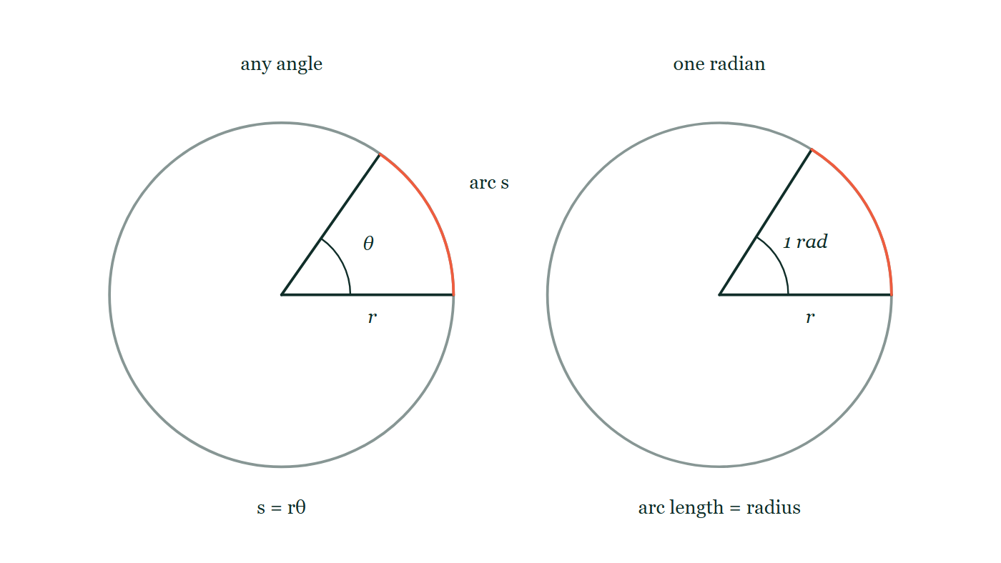
CIRCULAR MOTION · CIRCULAR MOTION FOUNDATIONS
GIOPHYSICS LESSON
THE PICTURE
What a radian actually measures
Drawn for this lesson
Two circles of equal radius side by side. On the left, two radii open out to a general angle θ with the arc between them picked out; on the right the same circle is opened until that arc is exactly as long as the radius, and the angle that does it is labelled one radian.
The live version of this figure — click here
Circular Motion — Circular Motion Foundations. Built by GioPhysics from the lesson's own copy; nothing on these slides is re-authored.
12 / 31
Notes:
[Phase] Build the model: The formulae, one at a time, in plain English (minutes 13–22 of 45)
[Figure] Two circles of equal radius side by side. On the left, two radii open out to a general angle θ with the arc between them picked out; on the right the same circle is opened until that arc is exactly as long as the radius, and the angle that does it is labelled one radian.

Slide 13
CIRCULAR MOTION · CIRCULAR MOTION FOUNDATIONS
GIOPHYSICS LESSON
WATCH OUT
The common trap
Check and misconception — The quick check and the trap
Radians are dimensionless, but writing rad/s is still helpful because it identifies an angular rate rather than a linear speed.
Circular Motion — Circular Motion Foundations. Built by GioPhysics from the lesson's own copy; nothing on these slides is re-authored.
13 / 31
Notes:
[Phase] Check and misconception: The quick check and the trap (minutes 35–41 of 45)
[Misconception] Radians are dimensionless, but writing rad/s is still helpful because it identifies an angular rate rather than a linear speed.

Slide 14
CIRCULAR MOTION · CIRCULAR MOTION FOUNDATIONS
GIOPHYSICS LESSON
WORKED EXAMPLE 1 OF 2 · EASY
The question
Easy
Worked examples — I do, we do — one step revealed at a time
Convert 90° to radians, and state the arc length it subtends on a circle of radius 2.0 m.
Circular Motion — Circular Motion Foundations. Built by GioPhysics from the lesson's own copy; nothing on these slides is re-authored.
14 / 31
Notes:
[Phase] Worked examples: I do, we do — one step revealed at a time (minutes 22–35 of 45)
[Question] Convert 90° to radians, and state the arc length it subtends on a circle of radius 2.0 m.
[Answer] θ ≈ 1.57 rad; s ≈ 3.1 m

Slide 15
CIRCULAR MOTION · CIRCULAR MOTION FOUNDATIONS
GIOPHYSICS LESSON
WORKED EXAMPLE 1 OF 2 · EASY · THE WORKING
How to solve it
Easy
Worked examples — I do, we do — one step revealed at a time
Convert 90° to radians, and state the arc length it subtends on a circle of radius 2.0 m.
1.
90° = π/2 ≈ 1.57 rad.
2.
s = rθ = 2.0 × 1.57 ≈ 3.1 m.
Circular Motion — Circular Motion Foundations. Built by GioPhysics from the lesson's own copy; nothing on these slides is re-authored.
15 / 31
Notes:
[Phase] Worked examples: I do, we do — one step revealed at a time (minutes 22–35 of 45)
[Reveal] One click per step. The class works each line before the next appears.
[Step 1] 90° = π/2 ≈ 1.57 rad.
[Step 2] s = rθ = 2.0 × 1.57 ≈ 3.1 m.

Slide 16
CIRCULAR MOTION · CIRCULAR MOTION FOUNDATIONS
GIOPHYSICS LESSON
WORKED EXAMPLE 1 OF 2 · EASY
Answer
Easy
Worked examples — I do, we do — one step revealed at a time
θ ≈ 1.57 rad; s ≈ 3.1 m
Circular Motion — Circular Motion Foundations. Built by GioPhysics from the lesson's own copy; nothing on these slides is re-authored.
16 / 31
Notes:
[Phase] Worked examples: I do, we do — one step revealed at a time (minutes 22–35 of 45)
[Answer] θ ≈ 1.57 rad; s ≈ 3.1 m

Slide 17
CIRCULAR MOTION · CIRCULAR MOTION FOUNDATIONS
GIOPHYSICS LESSON
WORKED EXAMPLE 2 OF 2 · MEDIUM
The question
Medium
Worked examples — I do, we do — one step revealed at a time
A wheel of radius 0.40 m makes 3.0 revolutions each second. Find ω and the rim speed.
Circular Motion — Circular Motion Foundations. Built by GioPhysics from the lesson's own copy; nothing on these slides is re-authored.
17 / 31
Notes:
[Phase] Worked examples: I do, we do — one step revealed at a time (minutes 22–35 of 45)
[Question] A wheel of radius 0.40 m makes 3.0 revolutions each second. Find ω and the rim speed.
[Answer] ω = 18.8 rad/s and v = 7.54 m/s

Slide 18
CIRCULAR MOTION · CIRCULAR MOTION FOUNDATIONS
GIOPHYSICS LESSON
WORKED EXAMPLE 2 OF 2 · MEDIUM · THE WORKING
How to solve it
Medium
Worked examples — I do, we do — one step revealed at a time
A wheel of radius 0.40 m makes 3.0 revolutions each second. Find ω and the rim speed.
1.
f = 3.0 Hz.
2.
ω = 2πf = 6π rad/s.
3.
v = ωr = (6π)(0.40).
Circular Motion — Circular Motion Foundations. Built by GioPhysics from the lesson's own copy; nothing on these slides is re-authored.
18 / 31
Notes:
[Phase] Worked examples: I do, we do — one step revealed at a time (minutes 22–35 of 45)
[Reveal] One click per step. The class works each line before the next appears.
[Step 1] f = 3.0 Hz.
[Step 2] ω = 2πf = 6π rad/s.
[Step 3] v = ωr = (6π)(0.40).

Slide 19
CIRCULAR MOTION · CIRCULAR MOTION FOUNDATIONS
GIOPHYSICS LESSON
WORKED EXAMPLE 2 OF 2 · MEDIUM
Answer
Medium
Worked examples — I do, we do — one step revealed at a time
ω = 18.8 rad/s and v = 7.54 m/s
Circular Motion — Circular Motion Foundations. Built by GioPhysics from the lesson's own copy; nothing on these slides is re-authored.
19 / 31
Notes:
[Phase] Worked examples: I do, we do — one step revealed at a time (minutes 22–35 of 45)
[Answer] ω = 18.8 rad/s and v = 7.54 m/s

Slide 20
CIRCULAR MOTION · CIRCULAR MOTION FOUNDATIONS
GIOPHYSICS LESSON
SPOT THE MISTAKE
One line here is wrong
The whole working is up — find the bad line before you click
1.
The platter turns at 7200 rpm, so ω = 7200 × 2π = 45 200 rad/s.
2.
A point sits 4.0 cm from the axis.
3.
v = ωr = 45 200 × 4.0 = 1.8 × 10⁵ m/s.
LINE 1 IS WRONG
Revolutions per MINUTE were treated as revolutions per second. It is an easy slip because 'rpm' is read aloud as one word and the minute in it goes unnoticed — and the answer that comes out is sixty times too large without looking obviously absurd. (Line 3 then compounds it by leaving the radius in centimetres.)
IT SHOULD SAY
7200 rpm = 7200 ÷ 60 = 120 rev/s, so ω = 120 × 2π ≈ 754 rad/s, and with r = 0.040 m, v ≈ 30 m/s.
Circular Motion — Circular Motion Foundations. Built by GioPhysics from the lesson's own copy; nothing on these slides is re-authored.
20 / 31
Notes:
[Phase] Worked examples: I do, we do — one step revealed at a time (minutes 22–35 of 45)
[Spot the mistake] The working is complete and one line of it is wrong. Let the room hunt: one click names the line, a second shows it done correctly.
[Line 1 is wrong] Revolutions per MINUTE were treated as revolutions per second. It is an easy slip because 'rpm' is read aloud as one word and the minute in it goes unnoticed — and the answer that comes out is sixty times too large without looking obviously absurd. (Line 3 then compounds it by leaving the radius in centimetres.)
[It should say] 7200 rpm = 7200 ÷ 60 = 120 rev/s, so ω = 120 × 2π ≈ 754 rad/s, and with r = 0.040 m, v ≈ 30 m/s.

Slide 21
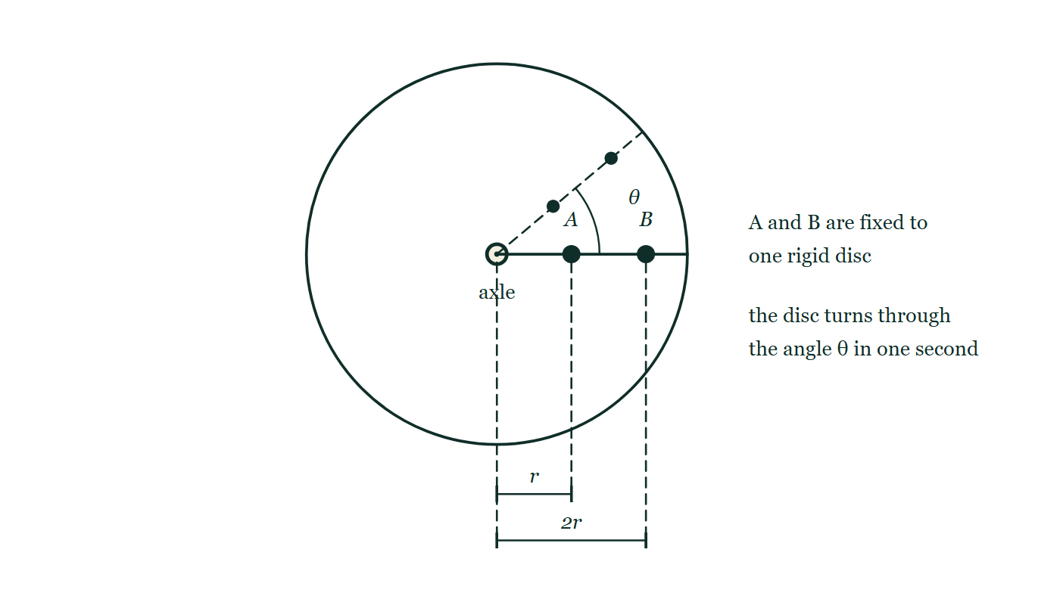
CIRCULAR MOTION · CIRCULAR MOTION FOUNDATIONS
GIOPHYSICS LESSON
PREDICT · TAKE THE VOTE
Commit before you are told
Hands up for each option, then click
The turntable sweeps through the angle θ in one second. Which dot travels the greater distance in that second?
A A, the inner one — it is closer to the axle, so it whips round
B B, the outer one
C Neither — they sweep the same angle, so they cover the same distance
A turntable seen face on, with an axle at its centre and a radius drawn out to the rim. Two dots, A and B, are fixed on that radius, A at a distance r from the axle and B at 2r. A faint dashed radius shows where both dots have moved to one second later, having swept the same angle θ.
The live version of this figure — click here
Circular Motion — Circular Motion Foundations. Built by GioPhysics from the lesson's own copy; nothing on these slides is re-authored.
21 / 31
Notes:
[Phase] Build the model: The formulae, one at a time, in plain English (minutes 13–22 of 45)
[Predict] The turntable sweeps through the angle θ in one second. Which dot travels the greater distance in that second?
[Options] A A, the inner one — it is closer to the axle, so it whips round B B, the outer one C Neither — they sweep the same angle, so they cover the same distance
[Figure] A turntable seen face on, with an axle at its centre and a radius drawn out to the rim. Two dots, A and B, are fixed on that radius, A at a distance r from the axle and B at 2r. A faint dashed radius shows where both dots have moved to one second later, having swept the same angle θ.

Slide 22
CIRCULAR MOTION · CIRCULAR MOTION FOUNDATIONS
GIOPHYSICS LESSON
PREDICT · THE OUTCOME
What actually happens
Ask the room who changed their mind, and why
B B, the outer one
WHY
Both dots stay on the same radius, so both sweep the angle θ. But the distance each travels is its own arc, s = rθ, and B sits at twice A's radius — so B's arc is twice as long and B is moving twice as fast.
Circular Motion — Circular Motion Foundations. Built by GioPhysics from the lesson's own copy; nothing on these slides is re-authored.
22 / 31
Notes:
[Phase] Build the model: The formulae, one at a time, in plain English (minutes 13–22 of 45)
[Answer] B — B, the outer one. Both dots stay on the same radius, so both sweep the angle θ. But the distance each travels is its own arc, s = rθ, and B sits at twice A's radius — so B's arc is twice as long and B is moving twice as fast.

Slide 23
CIRCULAR MOTION · CIRCULAR MOTION FOUNDATIONS
GIOPHYSICS LESSON
QUICK CHECK
Decide before the answer goes up
Check and misconception — The quick check and the trap
Two points share one rigid turntable. Which point has the larger tangential speed?
A
The point nearer the axis
B
The point farther from the axis
C
They have equal tangential speeds
A turntable seen face on, with an axle at its centre and a radius drawn out to the rim. Two dots, A and B, are fixed on that radius, A at a distance r from the axle and B at 2r. A faint dashed radius shows where both dots have moved to one second later, having swept the same angle θ.
The live version of this figure — click here
Circular Motion — Circular Motion Foundations. Built by GioPhysics from the lesson's own copy; nothing on these slides is re-authored.
23 / 31
Notes:
[Phase] Check and misconception: The quick check and the trap (minutes 35–41 of 45)
[Question] Two points share one rigid turntable. Which point has the larger tangential speed?
[Figure] A turntable seen face on, with an axle at its centre and a radius drawn out to the rim. Two dots, A and B, are fixed on that radius, A at a distance r from the axle and B at 2r. A faint dashed radius shows where both dots have moved to one second later, having swept the same angle θ.
[Options] A The point nearer the axis B The point farther from the axis C They have equal tangential speeds

Slide 24
CIRCULAR MOTION · CIRCULAR MOTION FOUNDATIONS
GIOPHYSICS LESSON
QUICK CHECK · THE ANSWER
The answer, and why
Check and misconception — The quick check and the trap
B The point farther from the axis
HOW TO GET THERE
Both points share ω, and v = ωr increases with radius.
WHY THE OTHERS TEMPT
A Nearness to the axle feels like an advantage because the inner point looks busier — it completes its small circle without ever seeming to hurry. But a small circle is exactly the problem: less distance covered in the same second means a smaller tangential speed, not a larger one.
B Correct. Both points are locked to the same rigid disc, so they share ω. With v = ωr, the point at the larger radius has the longer arc to cover in each second and therefore the greater tangential speed.
C This is the right instinct pushed one step too far. What the two points genuinely share is angular speed — the same angle every second. Tangential speed is a distance per second, and s = rθ means the same angle buys a bigger distance at a bigger radius.
Circular Motion — Circular Motion Foundations. Built by GioPhysics from the lesson's own copy; nothing on these slides is re-authored.
24 / 31
Notes:
[Phase] Check and misconception: The quick check and the trap (minutes 35–41 of 45)
[Question] Two points share one rigid turntable. Which point has the larger tangential speed?
[Option by option] A: Nearness to the axle feels like an advantage because the inner point looks busier — it completes its small circle without ever seeming to hurry. But a small circle is exactly the problem: less distance covered in the same second means a smaller tangential speed, not a larger one. B: Correct. Both points are locked to the same rigid disc, so they share ω. With v = ωr, the point at the larger radius has the longer arc to cover in each second and therefore the greater tangential speed. C: This is the right instinct pushed one step too far. What the two points genuinely share is angular speed — the same angle every second. Tangential speed is a distance per second, and s = rθ means the same angle buys a bigger distance at a bigger radius.
[Answer] B — The point farther from the axis
[Why] Both points share ω, and v = ωr increases with radius.
[Reveal] One click for the answer, then one for the reason.

Slide 25
CIRCULAR MOTION · CIRCULAR MOTION FOUNDATIONS
GIOPHYSICS LESSON
EXTENSION 1 OF 2 · HARD
The question
Hard
Worked examples — I do, we do — one step revealed at a time
A hard drive platter spins at 7200 rpm. Find ω in rad/s and the speed of a point 4.0 cm from the axis.
Circular Motion — Circular Motion Foundations. Built by GioPhysics from the lesson's own copy; nothing on these slides is re-authored.
25 / 31
Notes:
[Phase] Worked examples: I do, we do — one step revealed at a time (minutes 22–35 of 45)
[Question] A hard drive platter spins at 7200 rpm. Find ω in rad/s and the speed of a point 4.0 cm from the axis.
[Answer] ω ≈ 754 rad/s; v ≈ 30 m/s

Slide 26
CIRCULAR MOTION · CIRCULAR MOTION FOUNDATIONS
GIOPHYSICS LESSON
EXTENSION 1 OF 2 · HARD · THE WORKING
How to solve it
Hard
Worked examples — I do, we do — one step revealed at a time
A hard drive platter spins at 7200 rpm. Find ω in rad/s and the speed of a point 4.0 cm from the axis.
1.
7200 rpm = 120 rev/s.
2.
ω = 120 × 2π ≈ 754 rad/s.
3.
v = ωr = 754 × 0.040 ≈ 30 m/s.
Circular Motion — Circular Motion Foundations. Built by GioPhysics from the lesson's own copy; nothing on these slides is re-authored.
26 / 31
Notes:
[Phase] Worked examples: I do, we do — one step revealed at a time (minutes 22–35 of 45)
[Reveal] One click per step. The class works each line before the next appears.
[Step 1] 7200 rpm = 120 rev/s.
[Step 2] ω = 120 × 2π ≈ 754 rad/s.
[Step 3] v = ωr = 754 × 0.040 ≈ 30 m/s.

Slide 27
CIRCULAR MOTION · CIRCULAR MOTION FOUNDATIONS
GIOPHYSICS LESSON
EXTENSION 1 OF 2 · HARD
Answer
Hard
Worked examples — I do, we do — one step revealed at a time
ω ≈ 754 rad/s; v ≈ 30 m/s
Circular Motion — Circular Motion Foundations. Built by GioPhysics from the lesson's own copy; nothing on these slides is re-authored.
27 / 31
Notes:
[Phase] Worked examples: I do, we do — one step revealed at a time (minutes 22–35 of 45)
[Answer] ω ≈ 754 rad/s; v ≈ 30 m/s

Slide 28
CIRCULAR MOTION · CIRCULAR MOTION FOUNDATIONS
GIOPHYSICS LESSON
EXTENSION 2 OF 2 · CHALLENGING
The question
Challenging
Worked examples — I do, we do — one step revealed at a time
Two gears mesh: gear A (radius 3.0 cm) drives gear B (radius 9.0 cm). If A turns at 1200 rpm, find B's angular speed and explain which quantity the meshing point shares.
Circular Motion — Circular Motion Foundations. Built by GioPhysics from the lesson's own copy; nothing on these slides is re-authored.
28 / 31
Notes:
[Phase] Worked examples: I do, we do — one step revealed at a time (minutes 22–35 of 45)
[Question] Two gears mesh: gear A (radius 3.0 cm) drives gear B (radius 9.0 cm). If A turns at 1200 rpm, find B's angular speed and explain which quantity the meshing point shares.
[Answer] ω_B = 400 rpm — the contact point's linear speed is shared, not ω

Slide 29
CIRCULAR MOTION · CIRCULAR MOTION FOUNDATIONS
GIOPHYSICS LESSON
EXTENSION 2 OF 2 · CHALLENGING · THE WORKING
How to solve it
Challenging
Worked examples — I do, we do — one step revealed at a time
Two gears mesh: gear A (radius 3.0 cm) drives gear B (radius 9.0 cm). If A turns at 1200 rpm, find B's angular speed and explain which quantity the meshing point shares.
1.
Meshed teeth share the same rim (tangential) speed: v = ω_A r_A = ω_B r_B.
2.
ω_B = ω_A (r_A/r_B) = 1200 × (3/9) = 400 rpm.
3.
Angular speed divides by the radius ratio; the linear speed at contact is common.
Circular Motion — Circular Motion Foundations. Built by GioPhysics from the lesson's own copy; nothing on these slides is re-authored.
29 / 31
Notes:
[Phase] Worked examples: I do, we do — one step revealed at a time (minutes 22–35 of 45)
[Reveal] One click per step. The class works each line before the next appears.
[Step 1] Meshed teeth share the same rim (tangential) speed: v = ω_A r_A = ω_B r_B.
[Step 2] ω_B = ω_A (r_A/r_B) = 1200 × (3/9) = 400 rpm.
[Step 3] Angular speed divides by the radius ratio; the linear speed at contact is common.

Slide 30
CIRCULAR MOTION · CIRCULAR MOTION FOUNDATIONS
GIOPHYSICS LESSON
EXTENSION 2 OF 2 · CHALLENGING
Answer
Challenging
Worked examples — I do, we do — one step revealed at a time
ω_B = 400 rpm — the contact point's linear speed is shared, not ω
Circular Motion — Circular Motion Foundations. Built by GioPhysics from the lesson's own copy; nothing on these slides is re-authored.
30 / 31
Notes:
[Phase] Worked examples: I do, we do — one step revealed at a time (minutes 22–35 of 45)
[Answer] ω_B = 400 rpm — the contact point's linear speed is shared, not ω

Slide 31
CIRCULAR MOTION · CIRCULAR MOTION FOUNDATIONS
GIOPHYSICS LESSON
CIRCULAR MOTION
Where to go next
Plenary — What to take away, what to practise next
Next
6.2 Uniform Circular Motion
https://giophysics.com/chapter-10/uniform-circular-motion/
Lesson
This lesson on giophysics.com
https://giophysics.com/chapter-10/circular-motion-foundations/
Live
The live, interactive version of these slides
https://giophysics.com/chapter-10/presentation/?lesson=foundations
Chapter
All Circular Motion lessons
https://giophysics.com/chapter-10/
PDF
Download the lesson PDF
https://giophysics.com/downloads/10-1-circular-motion-foundations.pdf
Circular Motion — Circular Motion Foundations. Built by GioPhysics from the lesson's own copy; nothing on these slides is re-authored.
31 / 31
Notes:
[Phase] Plenary: What to take away, what to practise next (minutes 41–45 of 45)
[Interactive] The graphs and the circuit topology on these slides are frozen. The live version at https://giophysics.com/chapter-10/presentation/?lesson=foundations moves them.

