Slide 1
CIRCULAR MOTION · CIRCULAR MOTION MODEL FOR GAMING
GIOPHYSICS LESSON
06 · Circular Motion
Design a stable orbit gate
Circular Motion Model for Gaming
Turn the equations into a game rule: the craft must curve fast enough to reach the gate without exceeding its inward-force limit.
POSITION
Lesson 10 of 11 in Circular Motion
PLAN
16 slides in the 45-minute core run, about 43 minutes of it
LESSON PAGE
https://giophysics.com/chapter-10/circular-motion-model-for-gaming/
Built by GioPhysics from the lesson's own page. Every word on these slides is the lesson's; nothing here is re-authored. Teaching material, not an awarding body's document.
Circular Motion — Circular Motion Model for Gaming. Built by GioPhysics from the lesson's own copy; nothing on these slides is re-authored.
1 / 32
Notes:
[Lesson] Circular Motion — Circular Motion Model for Gaming. Lesson 10 of 11.
[Intro] Turn the equations into a game rule: the craft must curve fast enough to reach the gate without exceeding its inward-force limit.
[Source] https://giophysics.com/chapter-10/circular-motion-model-for-gaming/
[Disclaimer] Built by GioPhysics from the lesson's own page. Every word on these slides is the lesson's; nothing here is re-authored. Teaching material, not an awarding body's document.

Slide 2
CIRCULAR MOTION · CIRCULAR MOTION MODEL FOR GAMING
GIOPHYSICS LESSON
THINK FIRST
Your ship makes the turn at 20 m/s but flies straight through the gate at 25 m/s. Only a quarter more speed — why did it fail so badly?
Take answers before you click — the point is the commitment
The thruster is the same, the radius is the same, and the only thing the player changed was the throttle.
THE ANSWER
Because the demand grows with the square of the speed. Going from 20 to 25 m/s raises the required inward force by a factor of (25/20)² = 1.56 — more than half again — and the thruster had nothing like that in reserve.
Circular Motion — Circular Motion Model for Gaming. Built by GioPhysics from the lesson's own copy; nothing on these slides is re-authored.
2 / 32
Notes:
[Phase] Starter: Recall what this lesson stands on (minutes 0–5 of 45)
[Hook] Your ship makes the turn at 20 m/s but flies straight through the gate at 25 m/s. Only a quarter more speed — why did it fail so badly? The thruster is the same, the radius is the same, and the only thing the player changed was the throttle.
[Answer] Because the demand grows with the square of the speed. Going from 20 to 25 m/s raises the required inward force by a factor of (25/20)² = 1.56 — more than half again — and the thruster had nothing like that in reserve.

Slide 3
CIRCULAR MOTION · CIRCULAR MOTION MODEL FOR GAMING
GIOPHYSICS LESSON
EXPLAINED SIMPLY
In one sentence
Introduce the idea — The big idea and the definition
A circular-motion game model updates a moving object's velocity with an inward acceleration at each time step.
Circular Motion — Circular Motion Model for Gaming. Built by GioPhysics from the lesson's own copy; nothing on these slides is re-authored.
3 / 32
Notes:
[Phase] Introduce the idea: The big idea and the definition (minutes 5–13 of 45)
[Definition] A circular-motion game model updates a moving object's velocity with an inward acceleration at each time step.

Slide 4
CIRCULAR MOTION · CIRCULAR MOTION MODEL FOR GAMING
GIOPHYSICS LESSON
EXPLAINED SIMPLY
What that looks like
Introduce the idea — The big idea and the definition
FOR EXAMPLE
A spacecraft game curves the craft toward an orbit gate only when the available inward force is large enough for its speed and radius.
Circular Motion — Circular Motion Model for Gaming. Built by GioPhysics from the lesson's own copy; nothing on these slides is re-authored.
4 / 32
Notes:
[Phase] Introduce the idea: The big idea and the definition (minutes 5–13 of 45)
[Worked illustration] A spacecraft game curves the craft toward an orbit gate only when the available inward force is large enough for its speed and radius.

Slide 5
CIRCULAR MOTION · CIRCULAR MOTION MODEL FOR GAMING
GIOPHYSICS LESSON
THE BIG IDEA
Design a stable orbit gate
Introduce the idea — The big idea and the definition
A useful game model separates state, rule, and feedback. Radius and speed define the current state; Fneeded = mv²/r is the rule; a force gauge and orbit preview explain why a run is safe or unstable.
Circular Motion — Circular Motion Model for Gaming. Built by GioPhysics from the lesson's own copy; nothing on these slides is re-authored.
5 / 32
Notes:
[Phase] Introduce the idea: The big idea and the definition (minutes 5–13 of 45)
[Big idea] A useful game model separates state, rule, and feedback. Radius and speed define the current state; Fneeded = mv²/r is the rule; a force gauge and orbit preview explain why a run is safe or unstable.

Slide 6
CIRCULAR MOTION · CIRCULAR MOTION MODEL FOR GAMING
GIOPHYSICS LESSON
THE PHYSICS · 1 OF 3
Expose the constraint
Build the model — The formulae, one at a time, in plain English
The gauge should show required and available force, not only a pass/fail result.
Circular Motion — Circular Motion Model for Gaming. Built by GioPhysics from the lesson's own copy; nothing on these slides is re-authored.
6 / 32
Notes:
[Phase] Build the model: The formulae, one at a time, in plain English (minutes 13–22 of 45)
[Section] The gauge should show required and available force, not only a pass/fail result.

Slide 7
CIRCULAR MOTION · CIRCULAR MOTION MODEL FOR GAMING
GIOPHYSICS LESSON
THE PHYSICS · 2 OF 3
Predict the path
Build the model — The formulae, one at a time, in plain English
A short dotted preview helps players connect stronger inward acceleration with tighter curvature.
Circular Motion — Circular Motion Model for Gaming. Built by GioPhysics from the lesson's own copy; nothing on these slides is re-authored.
7 / 32
Notes:
[Phase] Build the model: The formulae, one at a time, in plain English (minutes 13–22 of 45)
[Section] A short dotted preview helps players connect stronger inward acceleration with tighter curvature.

Slide 8
CIRCULAR MOTION · CIRCULAR MOTION MODEL FOR GAMING
GIOPHYSICS LESSON
THE PHYSICS · 3 OF 3
Keep one model
Build the model — The formulae, one at a time, in plain English
The preview and live craft must use the same update rule to avoid misleading feedback.
Circular Motion — Circular Motion Model for Gaming. Built by GioPhysics from the lesson's own copy; nothing on these slides is re-authored.
8 / 32
Notes:
[Phase] Build the model: The formulae, one at a time, in plain English (minutes 13–22 of 45)
[Section] The preview and live craft must use the same update rule to avoid misleading feedback.

Slide 9
CIRCULAR MOTION · CIRCULAR MOTION MODEL FOR GAMING
GIOPHYSICS LESSON
FORMULA 1 OF 3
Required inward force
Build the model — The formulae, one at a time, in plain English
Fneeded = mv²/r
Game physics rule
IN PLAIN ENGLISH
The game engine's rule: to keep a ship on a circular path, supply this much inward force every frame.
Circular Motion — Circular Motion Model for Gaming. Built by GioPhysics from the lesson's own copy; nothing on these slides is re-authored.
9 / 32
Notes:
[Phase] Build the model: The formulae, one at a time, in plain English (minutes 13–22 of 45)
[Formula] Required inward force: Fneeded = mv²/r
[In plain English] The game engine's rule: to keep a ship on a circular path, supply this much inward force every frame.
[Note] Game physics rule

Slide 10
CIRCULAR MOTION · CIRCULAR MOTION MODEL FOR GAMING
GIOPHYSICS LESSON
FORMULA 2 OF 3
Force-limited speed
Build the model — The formulae, one at a time, in plain English
vmax = √(Fmax r/m)
Safe-orbit ceiling
IN PLAIN ENGLISH
If your thruster can only pull so hard, this is the fastest orbit it can hold at that radius.
Circular Motion — Circular Motion Model for Gaming. Built by GioPhysics from the lesson's own copy; nothing on these slides is re-authored.
10 / 32
Notes:
[Phase] Build the model: The formulae, one at a time, in plain English (minutes 13–22 of 45)
[Formula] Force-limited speed: vmax = √(Fmax r/m)
[In plain English] If your thruster can only pull so hard, this is the fastest orbit it can hold at that radius.
[Note] Safe-orbit ceiling

Slide 11
CIRCULAR MOTION · CIRCULAR MOTION MODEL FOR GAMING
GIOPHYSICS LESSON
FORMULA 3 OF 3
Frame update
Build the model — The formulae, one at a time, in plain English
v⃗n+1 = v⃗n + a⃗Δt
Use small fixed time steps
IN PLAIN ENGLISH
Each frame, nudge the velocity by acceleration times the tiny time step — how games simulate motion.
Circular Motion — Circular Motion Model for Gaming. Built by GioPhysics from the lesson's own copy; nothing on these slides is re-authored.
11 / 32
Notes:
[Phase] Build the model: The formulae, one at a time, in plain English (minutes 13–22 of 45)
[Formula] Frame update: v⃗n+1 = v⃗n + a⃗Δt
[In plain English] Each frame, nudge the velocity by acceleration times the tiny time step — how games simulate motion.
[Note] Use small fixed time steps

Slide 12
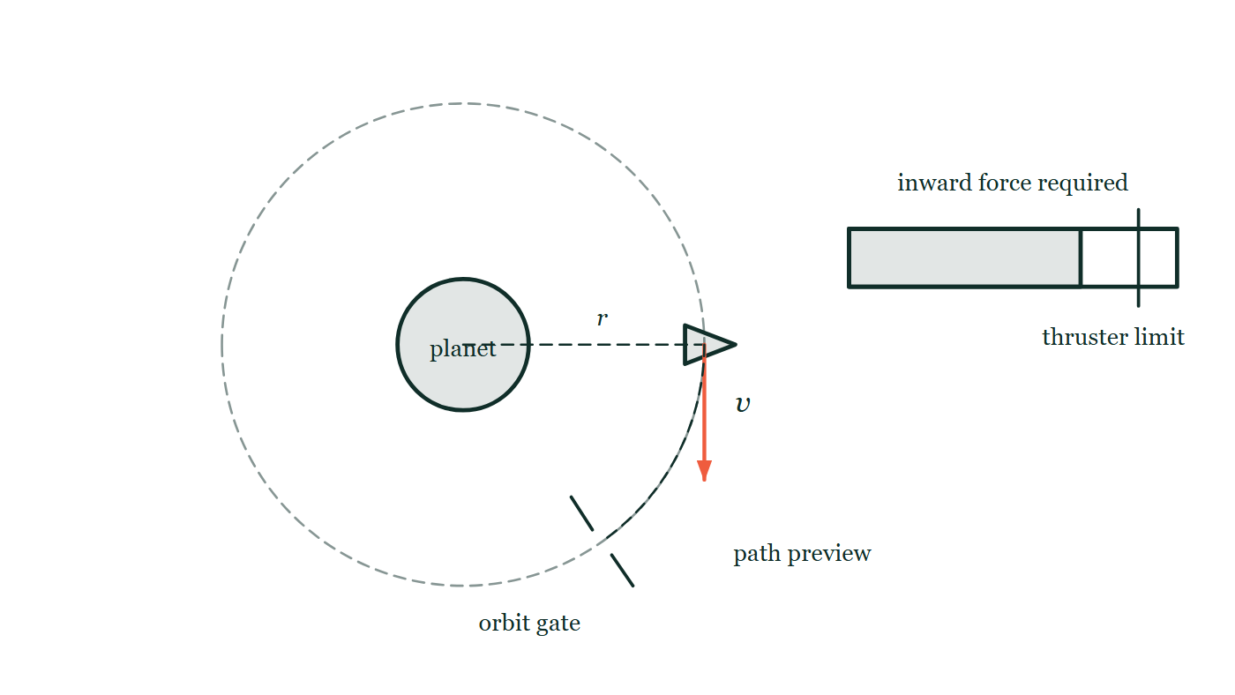
CIRCULAR MOTION · CIRCULAR MOTION MODEL FOR GAMING
GIOPHYSICS LESSON
PICTURE 1 OF 2
The screen the model has to show
Drawn for this lesson
A game screen: a planet at the centre, a dashed circle marking the target orbit at radius r, and the craft out on that circle with a velocity arrow along the tangent. A dotted preview arc runs ahead of the craft to an orbit gate drawn as two short posts across the path. To the right a horizontal bar gauge shows the inward force the path is demanding, with a heavy line further along it marking the thruster's limit.
The live version of this figure — click here
Circular Motion — Circular Motion Model for Gaming. Built by GioPhysics from the lesson's own copy; nothing on these slides is re-authored.
12 / 32
Notes:
[Phase] Build the model: The formulae, one at a time, in plain English (minutes 13–22 of 45)
[Figure] A game screen: a planet at the centre, a dashed circle marking the target orbit at radius r, and the craft out on that circle with a velocity arrow along the tangent. A dotted preview arc runs ahead of the craft to an orbit gate drawn as two short posts across the path. To the right a horizontal bar gauge shows the inward force the path is demanding, with a heavy line further along it marking the thruster's limit.

Slide 13
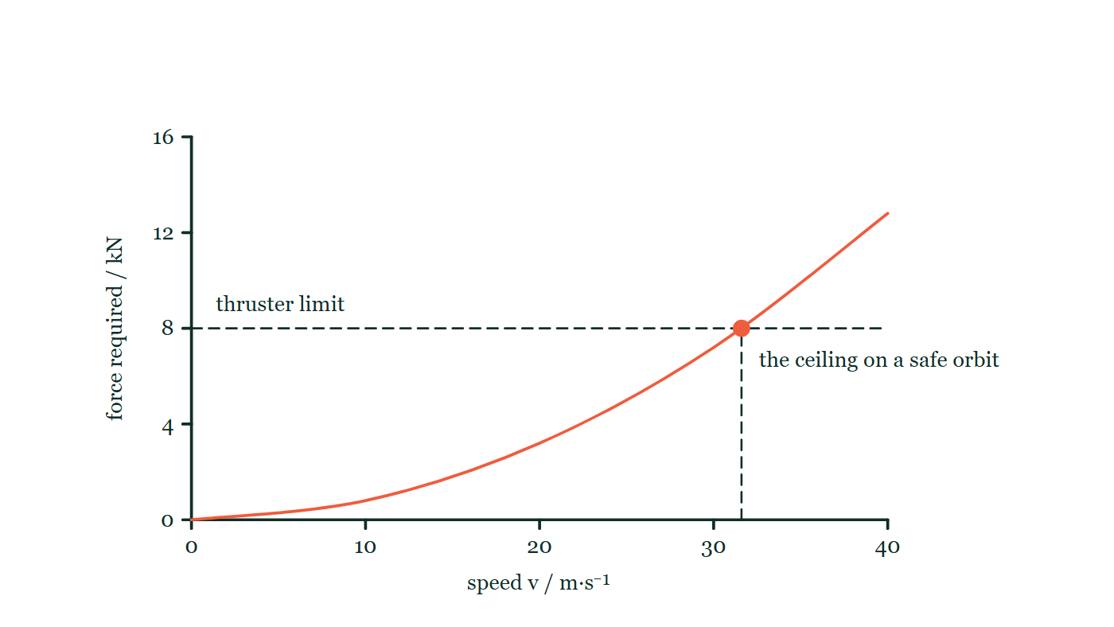
CIRCULAR MOTION · CIRCULAR MOTION MODEL FOR GAMING
GIOPHYSICS LESSON
PICTURE 2 OF 2
Where the ceiling comes from
Drawn for this lesson
A graph of the inward force a circular path demands against the craft's speed. The curve rises with increasing steepness from the origin, and a dashed horizontal line across it marks the thruster's fixed limit. The two meet at a single marked point, with a dashed vertical dropping from it to the speed axis.
The live version of this figure — click here
Circular Motion — Circular Motion Model for Gaming. Built by GioPhysics from the lesson's own copy; nothing on these slides is re-authored.
13 / 32
Notes:
[Phase] Build the model: The formulae, one at a time, in plain English (minutes 13–22 of 45)
[Figure] A graph of the inward force a circular path demands against the craft's speed. The curve rises with increasing steepness from the origin, and a dashed horizontal line across it marks the thruster's fixed limit. The two meet at a single marked point, with a dashed vertical dropping from it to the speed axis.

Slide 14
CIRCULAR MOTION · CIRCULAR MOTION MODEL FOR GAMING
GIOPHYSICS LESSON
WATCH OUT
The common trap
Check and misconception — The quick check and the trap
A higher speed is not always better. Required inward force grows with v², so a small speed increase can push the mission beyond its force limit.
Circular Motion — Circular Motion Model for Gaming. Built by GioPhysics from the lesson's own copy; nothing on these slides is re-authored.
14 / 32
Notes:
[Phase] Check and misconception: The quick check and the trap (minutes 35–41 of 45)
[Misconception] A higher speed is not always better. Required inward force grows with v², so a small speed increase can push the mission beyond its force limit.

Slide 15
CIRCULAR MOTION · CIRCULAR MOTION MODEL FOR GAMING
GIOPHYSICS LESSON
WORKED EXAMPLE 1 OF 2 · EASY
The question
Easy
Worked examples — I do, we do — one step revealed at a time
A game ship of mass 400 kg circles at radius 50 m. Its thruster can pull 8.0 kN inward. What is the top safe speed?
Circular Motion — Circular Motion Model for Gaming. Built by GioPhysics from the lesson's own copy; nothing on these slides is re-authored.
15 / 32
Notes:
[Phase] Worked examples: I do, we do — one step revealed at a time (minutes 22–35 of 45)
[Question] A game ship of mass 400 kg circles at radius 50 m. Its thruster can pull 8.0 kN inward. What is the top safe speed?
[Answer] v ≈ 32 m/s

Slide 16
CIRCULAR MOTION · CIRCULAR MOTION MODEL FOR GAMING
GIOPHYSICS LESSON
WORKED EXAMPLE 1 OF 2 · EASY · THE WORKING
How to solve it
Easy
Worked examples — I do, we do — one step revealed at a time
A game ship of mass 400 kg circles at radius 50 m. Its thruster can pull 8.0 kN inward. What is the top safe speed?
1.
F = mv²/r → v = √(Fr/m) = √(8000 × 50 ÷ 400).
2.
v = √1000 ≈ 32 m/s.
Circular Motion — Circular Motion Model for Gaming. Built by GioPhysics from the lesson's own copy; nothing on these slides is re-authored.
16 / 32
Notes:
[Phase] Worked examples: I do, we do — one step revealed at a time (minutes 22–35 of 45)
[Reveal] One click per step. The class works each line before the next appears.
[Step 1] F = mv²/r → v = √(Fr/m) = √(8000 × 50 ÷ 400).
[Step 2] v = √1000 ≈ 32 m/s.

Slide 17
CIRCULAR MOTION · CIRCULAR MOTION MODEL FOR GAMING
GIOPHYSICS LESSON
WORKED EXAMPLE 1 OF 2 · EASY
Answer
Easy
Worked examples — I do, we do — one step revealed at a time
v ≈ 32 m/s
Circular Motion — Circular Motion Model for Gaming. Built by GioPhysics from the lesson's own copy; nothing on these slides is re-authored.
17 / 32
Notes:
[Phase] Worked examples: I do, we do — one step revealed at a time (minutes 22–35 of 45)
[Answer] v ≈ 32 m/s

Slide 18
CIRCULAR MOTION · CIRCULAR MOTION MODEL FOR GAMING
GIOPHYSICS LESSON
WORKED EXAMPLE 2 OF 2 · MEDIUM
The question
Medium
Worked examples — I do, we do — one step revealed at a time
A 500 kg craft follows a 40 m curve with a 5.0 kN inward-force limit. Find its safe speed ceiling.
Circular Motion — Circular Motion Model for Gaming. Built by GioPhysics from the lesson's own copy; nothing on these slides is re-authored.
18 / 32
Notes:
[Phase] Worked examples: I do, we do — one step revealed at a time (minutes 22–35 of 45)
[Question] A 500 kg craft follows a 40 m curve with a 5.0 kN inward-force limit. Find its safe speed ceiling.
[Answer] vmax = 20.0 m/s

Slide 19
CIRCULAR MOTION · CIRCULAR MOTION MODEL FOR GAMING
GIOPHYSICS LESSON
WORKED EXAMPLE 2 OF 2 · MEDIUM · THE WORKING
How to solve it
Medium
Worked examples — I do, we do — one step revealed at a time
A 500 kg craft follows a 40 m curve with a 5.0 kN inward-force limit. Find its safe speed ceiling.
1.
Use vmax = √(Fmax r/m).
2.
vmax = √[(5000)(40)/500].
3.
Compare the planned speed with this ceiling.
Circular Motion — Circular Motion Model for Gaming. Built by GioPhysics from the lesson's own copy; nothing on these slides is re-authored.
19 / 32
Notes:
[Phase] Worked examples: I do, we do — one step revealed at a time (minutes 22–35 of 45)
[Reveal] One click per step. The class works each line before the next appears.
[Step 1] Use vmax = √(Fmax r/m).
[Step 2] vmax = √[(5000)(40)/500].
[Step 3] Compare the planned speed with this ceiling.

Slide 20
CIRCULAR MOTION · CIRCULAR MOTION MODEL FOR GAMING
GIOPHYSICS LESSON
WORKED EXAMPLE 2 OF 2 · MEDIUM
Answer
Medium
Worked examples — I do, we do — one step revealed at a time
vmax = 20.0 m/s
Circular Motion — Circular Motion Model for Gaming. Built by GioPhysics from the lesson's own copy; nothing on these slides is re-authored.
20 / 32
Notes:
[Phase] Worked examples: I do, we do — one step revealed at a time (minutes 22–35 of 45)
[Answer] vmax = 20.0 m/s

Slide 21
CIRCULAR MOTION · CIRCULAR MOTION MODEL FOR GAMING
GIOPHYSICS LESSON
SPOT THE MISTAKE
One line here is wrong
The whole working is up — find the bad line before you click
1.
The thruster limit sets the requirement: F(max) = mv²/r.
2.
Rearranged, v² = F(max) r / m = 8000 × 50 ÷ 400 = 1000.
3.
So the top safe speed is v = 1000 m/s.
LINE 3 IS WRONG
The square root was never taken. Line 2 correctly finds v², and line 3 reports that number as if it were v. It is the single most common slip in this whole family of problems, and the units are the tell — 1000 here is in m²/s², not m/s.
IT SHOULD SAY
v = √1000 ≈ 32 m/s.
Circular Motion — Circular Motion Model for Gaming. Built by GioPhysics from the lesson's own copy; nothing on these slides is re-authored.
21 / 32
Notes:
[Phase] Worked examples: I do, we do — one step revealed at a time (minutes 22–35 of 45)
[Spot the mistake] The working is complete and one line of it is wrong. Let the room hunt: one click names the line, a second shows it done correctly.
[Line 3 is wrong] The square root was never taken. Line 2 correctly finds v², and line 3 reports that number as if it were v. It is the single most common slip in this whole family of problems, and the units are the tell — 1000 here is in m²/s², not m/s.
[It should say] v = √1000 ≈ 32 m/s.

Slide 22
CIRCULAR MOTION · CIRCULAR MOTION MODEL FOR GAMING
GIOPHYSICS LESSON
PREDICT · TAKE THE VOTE
Commit before you are told
Hands up for each option, then click
The pilot doubles the speed and keeps the same orbit radius. How far along the gauge does the required-force needle move?
A To twice as far along
B To four times as far along
C It does not move — the radius has not changed, and the gauge reads the radius
A game screen: a planet at the centre, a dashed circle marking the target orbit at radius r, and the craft out on that circle with a velocity arrow along the tangent. A dotted preview arc runs ahead of the craft to an orbit gate drawn as two short posts across the path. To the right a horizontal bar gauge shows the inward force the path is demanding, with a heavy line further along it marking the thruster's limit.
The live version of this figure — click here
Circular Motion — Circular Motion Model for Gaming. Built by GioPhysics from the lesson's own copy; nothing on these slides is re-authored.
22 / 32
Notes:
[Phase] Build the model: The formulae, one at a time, in plain English (minutes 13–22 of 45)
[Predict] The pilot doubles the speed and keeps the same orbit radius. How far along the gauge does the required-force needle move?
[Options] A To twice as far along B To four times as far along C It does not move — the radius has not changed, and the gauge reads the radius
[Figure] A game screen: a planet at the centre, a dashed circle marking the target orbit at radius r, and the craft out on that circle with a velocity arrow along the tangent. A dotted preview arc runs ahead of the craft to an orbit gate drawn as two short posts across the path. To the right a horizontal bar gauge shows the inward force the path is demanding, with a heavy line further along it marking the thruster's limit.

Slide 23
CIRCULAR MOTION · CIRCULAR MOTION MODEL FOR GAMING
GIOPHYSICS LESSON
PREDICT · THE OUTCOME
What actually happens
Ask the room who changed their mind, and why
B To four times as far along
WHY
The gauge is reading mv²/r straight out of the game rule. The mass and the radius on the screen are both unchanged, so only v² moves, and doubling v multiplies the reading by four. A gauge that was comfortably inside the limit can be well past it after one nudge of the throttle.
Circular Motion — Circular Motion Model for Gaming. Built by GioPhysics from the lesson's own copy; nothing on these slides is re-authored.
23 / 32
Notes:
[Phase] Build the model: The formulae, one at a time, in plain English (minutes 13–22 of 45)
[Answer] B — To four times as far along. The gauge is reading mv²/r straight out of the game rule. The mass and the radius on the screen are both unchanged, so only v² moves, and doubling v multiplies the reading by four. A gauge that was comfortably inside the limit can be well past it after one nudge of the throttle.

Slide 24
CIRCULAR MOTION · CIRCULAR MOTION MODEL FOR GAMING
GIOPHYSICS LESSON
QUICK CHECK
Decide before the answer goes up
Check and misconception — The quick check and the trap
At fixed mass and radius, which change most quickly raises the required inward force?
A
Increasing speed
B
Increasing the time step label
C
Changing the craft colour
Circular Motion — Circular Motion Model for Gaming. Built by GioPhysics from the lesson's own copy; nothing on these slides is re-authored.
24 / 32
Notes:
[Phase] Check and misconception: The quick check and the trap (minutes 35–41 of 45)
[Question] At fixed mass and radius, which change most quickly raises the required inward force?
[Options] A Increasing speed B Increasing the time step label C Changing the craft colour

Slide 25
CIRCULAR MOTION · CIRCULAR MOTION MODEL FOR GAMING
GIOPHYSICS LESSON
QUICK CHECK · THE ANSWER
The answer, and why
Check and misconception — The quick check and the trap
A Increasing speed
HOW TO GET THERE
The requirement grows with speed squared.
WHY THE OTHERS TEMPT
A Correct. The rule the engine applies is F = mv²/r, and of the three quantities in it only the speed is squared — so raising the speed raises the demand faster than raising anything else.
B The time step is a number the simulation uses to advance the state, not a physical quantity in the force rule. Relabelling it changes nothing about how hard the craft must be pulled; it only changes how finely the path is computed.
C This one is in the list to make the point that a model has a state and a rule, and only the state variables in the rule can change the outcome. Colour is neither — it is feedback, and feedback never feeds back into the physics.
Circular Motion — Circular Motion Model for Gaming. Built by GioPhysics from the lesson's own copy; nothing on these slides is re-authored.
25 / 32
Notes:
[Phase] Check and misconception: The quick check and the trap (minutes 35–41 of 45)
[Question] At fixed mass and radius, which change most quickly raises the required inward force?
[Option by option] A: Correct. The rule the engine applies is F = mv²/r, and of the three quantities in it only the speed is squared — so raising the speed raises the demand faster than raising anything else. B: The time step is a number the simulation uses to advance the state, not a physical quantity in the force rule. Relabelling it changes nothing about how hard the craft must be pulled; it only changes how finely the path is computed. C: This one is in the list to make the point that a model has a state and a rule, and only the state variables in the rule can change the outcome. Colour is neither — it is feedback, and feedback never feeds back into the physics.
[Answer] A — Increasing speed
[Why] The requirement grows with speed squared.
[Reveal] One click for the answer, then one for the reason.

Slide 26
CIRCULAR MOTION · CIRCULAR MOTION MODEL FOR GAMING
GIOPHYSICS LESSON
EXTENSION 1 OF 2 · HARD
The question
Hard
Worked examples — I do, we do — one step revealed at a time
A frame update runs at 60 fps. A ship at speed 40 m/s on a 100 m circular path: how many degrees does it advance per frame, and what velocity rotation must the engine apply each frame?
Circular Motion — Circular Motion Model for Gaming. Built by GioPhysics from the lesson's own copy; nothing on these slides is re-authored.
26 / 32
Notes:
[Phase] Worked examples: I do, we do — one step revealed at a time (minutes 22–35 of 45)
[Question] A frame update runs at 60 fps. A ship at speed 40 m/s on a 100 m circular path: how many degrees does it advance per frame, and what velocity rotation must the engine apply each frame?
[Answer] ≈ 0.38° of arc — and the same rotation of the velocity vector — per frame

Slide 27
CIRCULAR MOTION · CIRCULAR MOTION MODEL FOR GAMING
GIOPHYSICS LESSON
EXTENSION 1 OF 2 · HARD · THE WORKING
How to solve it
Hard
Worked examples — I do, we do — one step revealed at a time
A frame update runs at 60 fps. A ship at speed 40 m/s on a 100 m circular path: how many degrees does it advance per frame, and what velocity rotation must the engine apply each frame?
1.
ω = v/r = 0.40 rad/s; per frame Δθ = 0.40 ÷ 60 ≈ 0.00667 rad.
2.
≈ 0.38° per frame.
3.
The velocity vector must rotate by the same 0.38° each frame to stay tangent.
Circular Motion — Circular Motion Model for Gaming. Built by GioPhysics from the lesson's own copy; nothing on these slides is re-authored.
27 / 32
Notes:
[Phase] Worked examples: I do, we do — one step revealed at a time (minutes 22–35 of 45)
[Reveal] One click per step. The class works each line before the next appears.
[Step 1] ω = v/r = 0.40 rad/s; per frame Δθ = 0.40 ÷ 60 ≈ 0.00667 rad.
[Step 2] ≈ 0.38° per frame.
[Step 3] The velocity vector must rotate by the same 0.38° each frame to stay tangent.

Slide 28
CIRCULAR MOTION · CIRCULAR MOTION MODEL FOR GAMING
GIOPHYSICS LESSON
EXTENSION 1 OF 2 · HARD
Answer
Hard
Worked examples — I do, we do — one step revealed at a time
≈ 0.38° of arc — and the same rotation of the velocity vector — per frame
Circular Motion — Circular Motion Model for Gaming. Built by GioPhysics from the lesson's own copy; nothing on these slides is re-authored.
28 / 32
Notes:
[Phase] Worked examples: I do, we do — one step revealed at a time (minutes 22–35 of 45)
[Answer] ≈ 0.38° of arc — and the same rotation of the velocity vector — per frame

Slide 29
CIRCULAR MOTION · CIRCULAR MOTION MODEL FOR GAMING
GIOPHYSICS LESSON
EXTENSION 2 OF 2 · CHALLENGING
The question
Challenging
Worked examples — I do, we do — one step revealed at a time
Your game integrates circular motion with v ← v + aΔt using the inward acceleration. Explain why the orbit slowly spirals outward, and compute the radius error after one revolution for v = 30 m/s, r = 60 m, Δt = 1/60 s.
Circular Motion — Circular Motion Model for Gaming. Built by GioPhysics from the lesson's own copy; nothing on these slides is re-authored.
29 / 32
Notes:
[Phase] Worked examples: I do, we do — one step revealed at a time (minutes 22–35 of 45)
[Question] Your game integrates circular motion with v ← v + aΔt using the inward acceleration. Explain why the orbit slowly spirals outward, and compute the radius error after one revolution for v = 30 m/s, r = 60 m, Δt = 1/60 s.
[Answer] Euler steps add energy; ~1.3 cm drift per orbit here — fix by rotating the velocity vector exactly

Slide 30
CIRCULAR MOTION · CIRCULAR MOTION MODEL FOR GAMING
GIOPHYSICS LESSON
EXTENSION 2 OF 2 · CHALLENGING · THE WORKING
How to solve it
Challenging
Worked examples — I do, we do — one step revealed at a time
Your game integrates circular motion with v ← v + aΔt using the inward acceleration. Explain why the orbit slowly spirals outward, and compute the radius error after one revolution for v = 30 m/s, r = 60 m, Δt = 1/60 s.
1.
Euler integration applies acceleration along the OLD inward direction, so each step's velocity slightly overshoots the tangent — energy creeps in.
2.
Per step the speed gains ≈ ½(aΔt)²/v; over one period (T = 2πr/v ≈ 12.6 s, 754 steps) the error compounds to roughly (ωΔt)²π/1 × r ≈ r(ωΔt)²·π.
3.
ωΔt = 0.5/60 ≈ 0.00833 → Δr ≈ 60 × 6.9 × 10⁻⁵ × π ≈ 0.013 m — small per orbit but grows; use semi-implicit or rotate-the-velocity updates instead.
Circular Motion — Circular Motion Model for Gaming. Built by GioPhysics from the lesson's own copy; nothing on these slides is re-authored.
30 / 32
Notes:
[Phase] Worked examples: I do, we do — one step revealed at a time (minutes 22–35 of 45)
[Reveal] One click per step. The class works each line before the next appears.
[Step 1] Euler integration applies acceleration along the OLD inward direction, so each step's velocity slightly overshoots the tangent — energy creeps in.
[Step 2] Per step the speed gains ≈ ½(aΔt)²/v; over one period (T = 2πr/v ≈ 12.6 s, 754 steps) the error compounds to roughly (ωΔt)²π/1 × r ≈ r(ωΔt)²·π.
[Step 3] ωΔt = 0.5/60 ≈ 0.00833 → Δr ≈ 60 × 6.9 × 10⁻⁵ × π ≈ 0.013 m — small per orbit but grows; use semi-implicit or rotate-the-velocity updates instead.

Slide 31
CIRCULAR MOTION · CIRCULAR MOTION MODEL FOR GAMING
GIOPHYSICS LESSON
EXTENSION 2 OF 2 · CHALLENGING
Answer
Challenging
Worked examples — I do, we do — one step revealed at a time
Euler steps add energy; ~1.3 cm drift per orbit here — fix by rotating the velocity vector exactly
Circular Motion — Circular Motion Model for Gaming. Built by GioPhysics from the lesson's own copy; nothing on these slides is re-authored.
31 / 32
Notes:
[Phase] Worked examples: I do, we do — one step revealed at a time (minutes 22–35 of 45)
[Answer] Euler steps add energy; ~1.3 cm drift per orbit here — fix by rotating the velocity vector exactly

Slide 32
CIRCULAR MOTION · CIRCULAR MOTION MODEL FOR GAMING
GIOPHYSICS LESSON
CIRCULAR MOTION
Where to go next
Plenary — What to take away, what to practise next
Next
6.11 Rotation Calculus
https://giophysics.com/chapter-10/rotation-calculus/
Lesson
This lesson on giophysics.com
https://giophysics.com/chapter-10/circular-motion-model-for-gaming/
Live
The live, interactive version of these slides
https://giophysics.com/chapter-10/presentation/?lesson=gaming
Chapter
All Circular Motion lessons
https://giophysics.com/chapter-10/
PDF
Download the lesson PDF
https://giophysics.com/downloads/10-10-circular-motion-model-for-gaming.pdf
Circular Motion — Circular Motion Model for Gaming. Built by GioPhysics from the lesson's own copy; nothing on these slides is re-authored.
32 / 32
Notes:
[Phase] Plenary: What to take away, what to practise next (minutes 41–45 of 45)
[Interactive] The graphs and the circuit topology on these slides are frozen. The live version at https://giophysics.com/chapter-10/presentation/?lesson=gaming moves them.

