Slide 1
CIRCULAR MOTION · MOMENT OF INERTIA
GIOPHYSICS LESSON
06 · Circular Motion
Mass distribution matters
Moment of Inertia
Moment of inertia is rotational resistance to angular acceleration, set by both mass and its distance from the axis.
POSITION
Lesson 5 of 11 in Circular Motion
PLAN
16 slides in the 45-minute core run, about 44 minutes of it
LESSON PAGE
https://giophysics.com/chapter-10/moment-of-inertia/
Built by GioPhysics from the lesson's own page. Every word on these slides is the lesson's; nothing here is re-authored. Teaching material, not an awarding body's document.
Circular Motion — Moment of Inertia. Built by GioPhysics from the lesson's own copy; nothing on these slides is re-authored.
1 / 31
Notes:
[Lesson] Circular Motion — Moment of Inertia. Lesson 5 of 11.
[Intro] Moment of inertia is rotational resistance to angular acceleration, set by both mass and its distance from the axis.
[Source] https://giophysics.com/chapter-10/moment-of-inertia/
[Disclaimer] Built by GioPhysics from the lesson's own page. Every word on these slides is the lesson's; nothing here is re-authored. Teaching material, not an awarding body's document.

Slide 2
CIRCULAR MOTION · MOMENT OF INERTIA
GIOPHYSICS LESSON
THINK FIRST
Two rods weigh exactly the same and are the same length. Why is one of them so much harder to twirl?
Take answers before you click — the point is the commitment
One has its lead packed into the middle, the other has the same lead split between the two ends.
THE ANSWER
Because rotational resistance is not about how much mass there is but where it is. Every gram counts as mass × distance², so moving lead to the ends multiplies its effect enormously — the end-loaded rod can be several times harder to start and stop.
Circular Motion — Moment of Inertia. Built by GioPhysics from the lesson's own copy; nothing on these slides is re-authored.
2 / 31
Notes:
[Phase] Starter: Recall what this lesson stands on (minutes 0–5 of 45)
[Hook] Two rods weigh exactly the same and are the same length. Why is one of them so much harder to twirl? One has its lead packed into the middle, the other has the same lead split between the two ends.
[Answer] Because rotational resistance is not about how much mass there is but where it is. Every gram counts as mass × distance², so moving lead to the ends multiplies its effect enormously — the end-loaded rod can be several times harder to start and stop.

Slide 3
CIRCULAR MOTION · MOMENT OF INERTIA
GIOPHYSICS LESSON
EXPLAINED SIMPLY
In one sentence
Introduce the idea — The big idea and the definition
Moment of inertia measures how strongly an object's mass resists a change in rotation about a chosen axis.
Circular Motion — Moment of Inertia. Built by GioPhysics from the lesson's own copy; nothing on these slides is re-authored.
3 / 31
Notes:
[Phase] Introduce the idea: The big idea and the definition (minutes 5–13 of 45)
[Definition] Moment of inertia measures how strongly an object's mass resists a change in rotation about a chosen axis.

Slide 4
CIRCULAR MOTION · MOMENT OF INERTIA
GIOPHYSICS LESSON
EXPLAINED SIMPLY
What that looks like
Introduce the idea — The big idea and the definition
FOR EXAMPLE
A skater with arms extended has a larger moment of inertia than the same skater with arms pulled inward.
Circular Motion — Moment of Inertia. Built by GioPhysics from the lesson's own copy; nothing on these slides is re-authored.
4 / 31
Notes:
[Phase] Introduce the idea: The big idea and the definition (minutes 5–13 of 45)
[Worked illustration] A skater with arms extended has a larger moment of inertia than the same skater with arms pulled inward.

Slide 5
CIRCULAR MOTION · MOMENT OF INERTIA
GIOPHYSICS LESSON
THE BIG IDEA
Mass distribution matters
Introduce the idea — The big idea and the definition
Moving the same mass outward makes rotation harder to change because every contribution is weighted by radius squared. Always name the axis when quoting or calculating a moment of inertia.
Circular Motion — Moment of Inertia. Built by GioPhysics from the lesson's own copy; nothing on these slides is re-authored.
5 / 31
Notes:
[Phase] Introduce the idea: The big idea and the definition (minutes 5–13 of 45)
[Big idea] Moving the same mass outward makes rotation harder to change because every contribution is weighted by radius squared. Always name the axis when quoting or calculating a moment of inertia.

Slide 6
CIRCULAR MOTION · MOMENT OF INERTIA
GIOPHYSICS LESSON
THE PHYSICS · 1 OF 3
Hoop versus disk
Build the model — The formulae, one at a time, in plain English
For equal M and R, a hoop has I = MR² while a solid disk has I = ½MR².
Circular Motion — Moment of Inertia. Built by GioPhysics from the lesson's own copy; nothing on these slides is re-authored.
6 / 31
Notes:
[Phase] Build the model: The formulae, one at a time, in plain English (minutes 13–22 of 45)
[Section] For equal M and R, a hoop has I = MR² while a solid disk has I = ½MR².

Slide 7
CIRCULAR MOTION · MOMENT OF INERTIA
GIOPHYSICS LESSON
THE PHYSICS · 2 OF 3
Radius is squared
Build the model — The formulae, one at a time, in plain English
Doubling every mass distance multiplies moment of inertia by four.
Circular Motion — Moment of Inertia. Built by GioPhysics from the lesson's own copy; nothing on these slides is re-authored.
7 / 31
Notes:
[Phase] Build the model: The formulae, one at a time, in plain English (minutes 13–22 of 45)
[Section] Doubling every mass distance multiplies moment of inertia by four.

Slide 8
CIRCULAR MOTION · MOMENT OF INERTIA
GIOPHYSICS LESSON
THE PHYSICS · 3 OF 3
Axis is part of the answer
Build the model — The formulae, one at a time, in plain English
A rod about its centre and the same rod about one end have different I values.
Circular Motion — Moment of Inertia. Built by GioPhysics from the lesson's own copy; nothing on these slides is re-authored.
8 / 31
Notes:
[Phase] Build the model: The formulae, one at a time, in plain English (minutes 13–22 of 45)
[Section] A rod about its centre and the same rod about one end have different I values.

Slide 9
CIRCULAR MOTION · MOMENT OF INERTIA
GIOPHYSICS LESSON
FORMULA 1 OF 3
Discrete masses
Build the model — The formulae, one at a time, in plain English
I = Σmᵢrᵢ²
Distance is perpendicular to the axis
IN PLAIN ENGLISH
Rotational inertia: add mass × distance² for every piece — mass far from the axis resists spinning much more than mass near it.
Circular Motion — Moment of Inertia. Built by GioPhysics from the lesson's own copy; nothing on these slides is re-authored.
9 / 31
Notes:
[Phase] Build the model: The formulae, one at a time, in plain English (minutes 13–22 of 45)
[Formula] Discrete masses: I = Σmᵢrᵢ²
[In plain English] Rotational inertia: add mass × distance² for every piece — mass far from the axis resists spinning much more than mass near it.
[Note] Distance is perpendicular to the axis

Slide 10
CIRCULAR MOTION · MOMENT OF INERTIA
GIOPHYSICS LESSON
FORMULA 2 OF 3
Continuous body
Build the model — The formulae, one at a time, in plain English
I = ∫r² dm
Add every mass element
IN PLAIN ENGLISH
The same idea for a solid object: sum mass × distance² over every tiny piece of the body.
Circular Motion — Moment of Inertia. Built by GioPhysics from the lesson's own copy; nothing on these slides is re-authored.
10 / 31
Notes:
[Phase] Build the model: The formulae, one at a time, in plain English (minutes 13–22 of 45)
[Formula] Continuous body: I = ∫r² dm
[In plain English] The same idea for a solid object: sum mass × distance² over every tiny piece of the body.
[Note] Add every mass element

Slide 11
CIRCULAR MOTION · MOMENT OF INERTIA
GIOPHYSICS LESSON
FORMULA 3 OF 3
Parallel axis
Build the model — The formulae, one at a time, in plain English
I = ICM + Md²
Axis displaced by d
IN PLAIN ENGLISH
Spinning about an off-centre axis is always harder: add total mass times the (shift distance)² to the centre value.
Circular Motion — Moment of Inertia. Built by GioPhysics from the lesson's own copy; nothing on these slides is re-authored.
11 / 31
Notes:
[Phase] Build the model: The formulae, one at a time, in plain English (minutes 13–22 of 45)
[Formula] Parallel axis: I = ICM + Md²
[In plain English] Spinning about an off-centre axis is always harder: add total mass times the (shift distance)² to the centre value.
[Note] Axis displaced by d

Slide 12
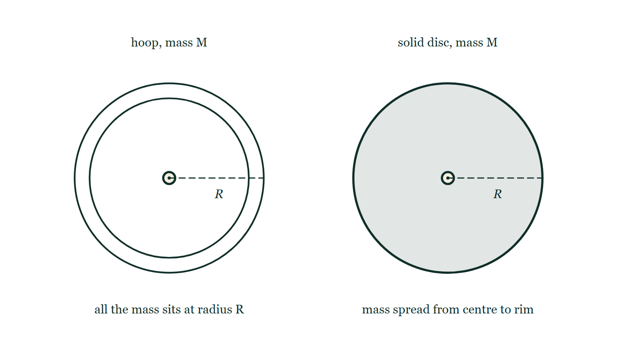
CIRCULAR MOTION · MOMENT OF INERTIA
GIOPHYSICS LESSON
THE PICTURE
Hoop against solid disc
Drawn for this lesson
A hoop and a solid disc drawn side by side to the same radius R and stated to have the same mass M. The hoop is an open ring with all its material at the rim; the disc is filled solid from its axle out to the edge. Both are shown face on with the axle at the centre.
The live version of this figure — click here
Circular Motion — Moment of Inertia. Built by GioPhysics from the lesson's own copy; nothing on these slides is re-authored.
12 / 31
Notes:
[Phase] Build the model: The formulae, one at a time, in plain English (minutes 13–22 of 45)
[Figure] A hoop and a solid disc drawn side by side to the same radius R and stated to have the same mass M. The hoop is an open ring with all its material at the rim; the disc is filled solid from its axle out to the edge. Both are shown face on with the axle at the centre.

Slide 13
CIRCULAR MOTION · MOMENT OF INERTIA
GIOPHYSICS LESSON
WATCH OUT
The common trap
Check and misconception — The quick check and the trap
Moment of inertia is not a property of mass alone. It changes when the chosen axis or the mass distribution changes.
Circular Motion — Moment of Inertia. Built by GioPhysics from the lesson's own copy; nothing on these slides is re-authored.
13 / 31
Notes:
[Phase] Check and misconception: The quick check and the trap (minutes 35–41 of 45)
[Misconception] Moment of inertia is not a property of mass alone. It changes when the chosen axis or the mass distribution changes.

Slide 14
CIRCULAR MOTION · MOMENT OF INERTIA
GIOPHYSICS LESSON
WORKED EXAMPLE 1 OF 2 · EASY
The question
Easy
Worked examples — I do, we do — one step revealed at a time
A 0.80 kg point mass sits 0.50 m from an axis. What is its moment of inertia?
Circular Motion — Moment of Inertia. Built by GioPhysics from the lesson's own copy; nothing on these slides is re-authored.
14 / 31
Notes:
[Phase] Worked examples: I do, we do — one step revealed at a time (minutes 22–35 of 45)
[Question] A 0.80 kg point mass sits 0.50 m from an axis. What is its moment of inertia?
[Answer] I = 0.20 kg·m²

Slide 15
CIRCULAR MOTION · MOMENT OF INERTIA
GIOPHYSICS LESSON
WORKED EXAMPLE 1 OF 2 · EASY · THE WORKING
How to solve it
Easy
Worked examples — I do, we do — one step revealed at a time
A 0.80 kg point mass sits 0.50 m from an axis. What is its moment of inertia?
1.
I = mr² = 0.80 × 0.25.
2.
I = 0.20 kg·m².
Circular Motion — Moment of Inertia. Built by GioPhysics from the lesson's own copy; nothing on these slides is re-authored.
15 / 31
Notes:
[Phase] Worked examples: I do, we do — one step revealed at a time (minutes 22–35 of 45)
[Reveal] One click per step. The class works each line before the next appears.
[Step 1] I = mr² = 0.80 × 0.25.
[Step 2] I = 0.20 kg·m².

Slide 16
CIRCULAR MOTION · MOMENT OF INERTIA
GIOPHYSICS LESSON
WORKED EXAMPLE 1 OF 2 · EASY
Answer
Easy
Worked examples — I do, we do — one step revealed at a time
I = 0.20 kg·m²
Circular Motion — Moment of Inertia. Built by GioPhysics from the lesson's own copy; nothing on these slides is re-authored.
16 / 31
Notes:
[Phase] Worked examples: I do, we do — one step revealed at a time (minutes 22–35 of 45)
[Answer] I = 0.20 kg·m²

Slide 17
CIRCULAR MOTION · MOMENT OF INERTIA
GIOPHYSICS LESSON
WORKED EXAMPLE 2 OF 2 · MEDIUM
The question
Medium
Worked examples — I do, we do — one step revealed at a time
Two 0.50 kg point masses sit 0.40 m from a light axle. Find the total moment of inertia.
Circular Motion — Moment of Inertia. Built by GioPhysics from the lesson's own copy; nothing on these slides is re-authored.
17 / 31
Notes:
[Phase] Worked examples: I do, we do — one step revealed at a time (minutes 22–35 of 45)
[Question] Two 0.50 kg point masses sit 0.40 m from a light axle. Find the total moment of inertia.
[Answer] I = 0.160 kg·m²

Slide 18
CIRCULAR MOTION · MOMENT OF INERTIA
GIOPHYSICS LESSON
WORKED EXAMPLE 2 OF 2 · MEDIUM · THE WORKING
How to solve it
Medium
Worked examples — I do, we do — one step revealed at a time
Two 0.50 kg point masses sit 0.40 m from a light axle. Find the total moment of inertia.
1.
Each mass contributes mr².
2.
I = 2(0.50)(0.40²).
3.
Use kg·m² for the unit.
Circular Motion — Moment of Inertia. Built by GioPhysics from the lesson's own copy; nothing on these slides is re-authored.
18 / 31
Notes:
[Phase] Worked examples: I do, we do — one step revealed at a time (minutes 22–35 of 45)
[Reveal] One click per step. The class works each line before the next appears.
[Step 1] Each mass contributes mr².
[Step 2] I = 2(0.50)(0.40²).
[Step 3] Use kg·m² for the unit.

Slide 19
CIRCULAR MOTION · MOMENT OF INERTIA
GIOPHYSICS LESSON
WORKED EXAMPLE 2 OF 2 · MEDIUM
Answer
Medium
Worked examples — I do, we do — one step revealed at a time
I = 0.160 kg·m²
Circular Motion — Moment of Inertia. Built by GioPhysics from the lesson's own copy; nothing on these slides is re-authored.
19 / 31
Notes:
[Phase] Worked examples: I do, we do — one step revealed at a time (minutes 22–35 of 45)
[Answer] I = 0.160 kg·m²

Slide 20
CIRCULAR MOTION · MOMENT OF INERTIA
GIOPHYSICS LESSON
SPOT THE MISTAKE
One line here is wrong
The whole working is up — find the bad line before you click
1.
For a uniform rod about its centre, I(CM) = mL²/12 = 1.2 × 0.90² ÷ 12 = 0.081 kg·m².
2.
The pivot is at one end, so the axis has been shifted by d = L = 0.90 m.
3.
Parallel axis: I = I(CM) + md² = 0.081 + 1.2 × 0.81 = 1.05 kg·m².
LINE 2 IS WRONG
The shift d is the distance the AXIS moved, not the length of the rod. Moving the axis from the centre of a rod to its end is a shift of only half the length. Reaching for L is natural because L is the number the question gave you, and because d is squared the mistake is magnified — the answer comes out more than three times too big.
IT SHOULD SAY
The axis moves from the centre to the end, so d = L/2 = 0.45 m, giving I = 0.081 + 1.2 × 0.2025 = 0.324 kg·m² (which is mL²/3, as it should be).
Circular Motion — Moment of Inertia. Built by GioPhysics from the lesson's own copy; nothing on these slides is re-authored.
20 / 31
Notes:
[Phase] Worked examples: I do, we do — one step revealed at a time (minutes 22–35 of 45)
[Spot the mistake] The working is complete and one line of it is wrong. Let the room hunt: one click names the line, a second shows it done correctly.
[Line 2 is wrong] The shift d is the distance the AXIS moved, not the length of the rod. Moving the axis from the centre of a rod to its end is a shift of only half the length. Reaching for L is natural because L is the number the question gave you, and because d is squared the mistake is magnified — the answer comes out more than three times too big.
[It should say] The axis moves from the centre to the end, so d = L/2 = 0.45 m, giving I = 0.081 + 1.2 × 0.2025 = 0.324 kg·m² (which is mL²/3, as it should be).

Slide 21
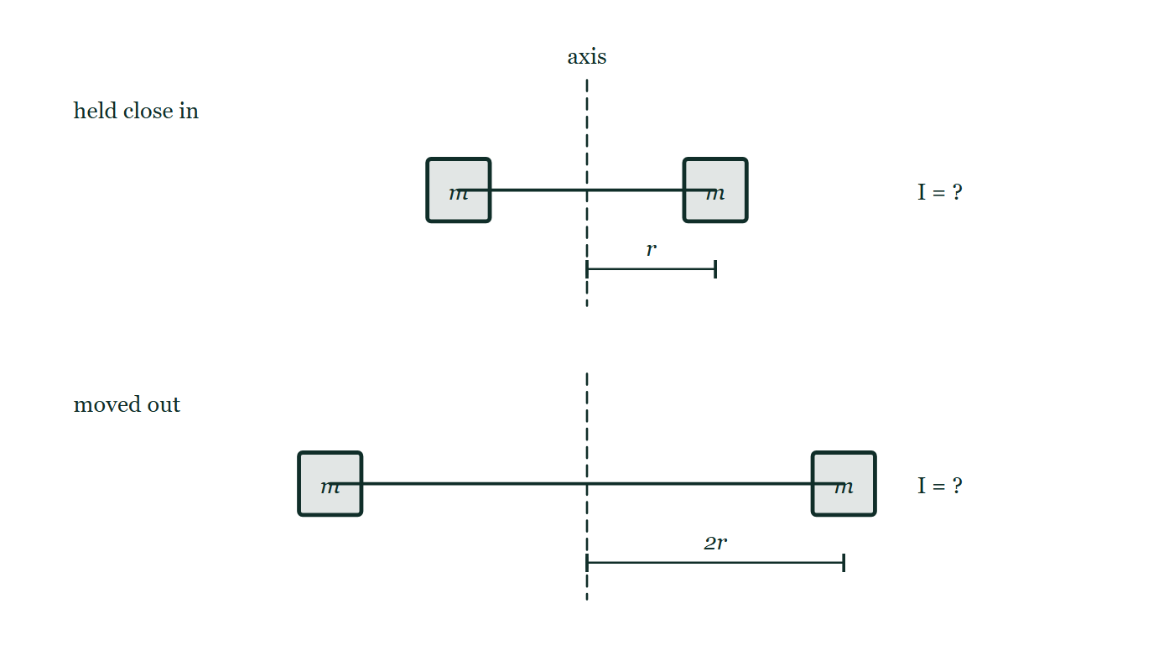
CIRCULAR MOTION · MOMENT OF INERTIA
GIOPHYSICS LESSON
PREDICT · TAKE THE VOTE
Commit before you are told
Hands up for each option, then click
The two masses are moved from r out to 2r. What happens to the moment of inertia of the arrangement?
A It doubles — the distance doubled
B It becomes four times as large
C It is unchanged — it is the same two masses
Two identical masses on a light rod through a vertical axis, drawn twice. In the upper arrangement each mass sits a distance r from the axis; in the lower one the same two masses sit at 2r. Nothing else differs, and the moment of inertia of each arrangement is left written as a question.
The live version of this figure — click here
Circular Motion — Moment of Inertia. Built by GioPhysics from the lesson's own copy; nothing on these slides is re-authored.
21 / 31
Notes:
[Phase] Build the model: The formulae, one at a time, in plain English (minutes 13–22 of 45)
[Predict] The two masses are moved from r out to 2r. What happens to the moment of inertia of the arrangement?
[Options] A It doubles — the distance doubled B It becomes four times as large C It is unchanged — it is the same two masses
[Figure] Two identical masses on a light rod through a vertical axis, drawn twice. In the upper arrangement each mass sits a distance r from the axis; in the lower one the same two masses sit at 2r. Nothing else differs, and the moment of inertia of each arrangement is left written as a question.

Slide 22
CIRCULAR MOTION · MOMENT OF INERTIA
GIOPHYSICS LESSON
PREDICT · THE OUTCOME
What actually happens
Ask the room who changed their mind, and why
B It becomes four times as large
WHY
Each mass contributes mr², so its contribution depends on the square of its distance from the axis. Doubling that distance multiplies each contribution by 2² = 4. The masses in the picture have not changed at all; only their distance has, and that is the term the squaring acts on.
Circular Motion — Moment of Inertia. Built by GioPhysics from the lesson's own copy; nothing on these slides is re-authored.
22 / 31
Notes:
[Phase] Build the model: The formulae, one at a time, in plain English (minutes 13–22 of 45)
[Answer] B — It becomes four times as large. Each mass contributes mr², so its contribution depends on the square of its distance from the axis. Doubling that distance multiplies each contribution by 2² = 4. The masses in the picture have not changed at all; only their distance has, and that is the term the squaring acts on.

Slide 23
CIRCULAR MOTION · MOMENT OF INERTIA
GIOPHYSICS LESSON
QUICK CHECK
Decide before the answer goes up
Check and misconception — The quick check and the trap
Equal masses are moved from radius r to radius 2r. What happens to their contribution to I?
A
It doubles
B
It quadruples
C
It is unchanged
Two identical masses on a light rod through a vertical axis, drawn twice. In the upper arrangement each mass sits a distance r from the axis; in the lower one the same two masses sit at 2r. Nothing else differs, and the moment of inertia of each arrangement is left written as a question.
The live version of this figure — click here
Circular Motion — Moment of Inertia. Built by GioPhysics from the lesson's own copy; nothing on these slides is re-authored.
23 / 31
Notes:
[Phase] Check and misconception: The quick check and the trap (minutes 35–41 of 45)
[Question] Equal masses are moved from radius r to radius 2r. What happens to their contribution to I?
[Figure] Two identical masses on a light rod through a vertical axis, drawn twice. In the upper arrangement each mass sits a distance r from the axis; in the lower one the same two masses sit at 2r. Nothing else differs, and the moment of inertia of each arrangement is left written as a question.
[Options] A It doubles B It quadruples C It is unchanged

Slide 24
CIRCULAR MOTION · MOMENT OF INERTIA
GIOPHYSICS LESSON
QUICK CHECK · THE ANSWER
The answer, and why
Check and misconception — The quick check and the trap
B It quadruples
HOW TO GET THERE
Each contribution is mr², so replacing r by 2r gives 4mr².
WHY THE OTHERS TEMPT
A Doubling is what you get by reading the contribution as mr rather than mr². It is a fair guess — most quantities so far have been linear in distance — but here the radius is squared, which is why a small move outward makes such a large difference.
B Correct. Each contribution is mr², so replacing r by 2r gives m(2r)² = 4mr². The whole point of the lesson is in that square.
C This is the answer if moment of inertia is thought of as a property of the mass, like weight. It is not: it is a property of the mass AND the axis AND where the mass sits relative to it. Move the same mass and I changes.
Circular Motion — Moment of Inertia. Built by GioPhysics from the lesson's own copy; nothing on these slides is re-authored.
24 / 31
Notes:
[Phase] Check and misconception: The quick check and the trap (minutes 35–41 of 45)
[Question] Equal masses are moved from radius r to radius 2r. What happens to their contribution to I?
[Option by option] A: Doubling is what you get by reading the contribution as mr rather than mr². It is a fair guess — most quantities so far have been linear in distance — but here the radius is squared, which is why a small move outward makes such a large difference. B: Correct. Each contribution is mr², so replacing r by 2r gives m(2r)² = 4mr². The whole point of the lesson is in that square. C: This is the answer if moment of inertia is thought of as a property of the mass, like weight. It is not: it is a property of the mass AND the axis AND where the mass sits relative to it. Move the same mass and I changes.
[Answer] B — It quadruples
[Why] Each contribution is mr², so replacing r by 2r gives 4mr².
[Reveal] One click for the answer, then one for the reason.

Slide 25
CIRCULAR MOTION · MOMENT OF INERTIA
GIOPHYSICS LESSON
EXTENSION 1 OF 2 · HARD
The question
Hard
Worked examples — I do, we do — one step revealed at a time
Compare the moments of inertia of a 2.0 kg solid disc and a 2.0 kg hoop, both of radius 0.30 m, about their central axes.
Circular Motion — Moment of Inertia. Built by GioPhysics from the lesson's own copy; nothing on these slides is re-authored.
25 / 31
Notes:
[Phase] Worked examples: I do, we do — one step revealed at a time (minutes 22–35 of 45)
[Question] Compare the moments of inertia of a 2.0 kg solid disc and a 2.0 kg hoop, both of radius 0.30 m, about their central axes.
[Answer] Disc 0.090, hoop 0.180 kg·m² — the hoop resists twice as much

Slide 26
CIRCULAR MOTION · MOMENT OF INERTIA
GIOPHYSICS LESSON
EXTENSION 1 OF 2 · HARD · THE WORKING
How to solve it
Hard
Worked examples — I do, we do — one step revealed at a time
Compare the moments of inertia of a 2.0 kg solid disc and a 2.0 kg hoop, both of radius 0.30 m, about their central axes.
1.
Disc: I = ½MR² = ½ × 2.0 × 0.09 = 0.090 kg·m².
2.
Hoop: I = MR² = 0.180 kg·m².
3.
The hoop's mass all sits at full radius — twice the inertia, so it spins up half as fast for the same torque.
Circular Motion — Moment of Inertia. Built by GioPhysics from the lesson's own copy; nothing on these slides is re-authored.
26 / 31
Notes:
[Phase] Worked examples: I do, we do — one step revealed at a time (minutes 22–35 of 45)
[Reveal] One click per step. The class works each line before the next appears.
[Step 1] Disc: I = ½MR² = ½ × 2.0 × 0.09 = 0.090 kg·m².
[Step 2] Hoop: I = MR² = 0.180 kg·m².
[Step 3] The hoop's mass all sits at full radius — twice the inertia, so it spins up half as fast for the same torque.

Slide 27
CIRCULAR MOTION · MOMENT OF INERTIA
GIOPHYSICS LESSON
EXTENSION 1 OF 2 · HARD
Answer
Hard
Worked examples — I do, we do — one step revealed at a time
Disc 0.090, hoop 0.180 kg·m² — the hoop resists twice as much
Circular Motion — Moment of Inertia. Built by GioPhysics from the lesson's own copy; nothing on these slides is re-authored.
27 / 31
Notes:
[Phase] Worked examples: I do, we do — one step revealed at a time (minutes 22–35 of 45)
[Answer] Disc 0.090, hoop 0.180 kg·m² — the hoop resists twice as much

Slide 28
CIRCULAR MOTION · MOMENT OF INERTIA
GIOPHYSICS LESSON
EXTENSION 2 OF 2 · CHALLENGING
The question
Challenging
Worked examples — I do, we do — one step revealed at a time
A uniform 1.2 kg rod of length 0.90 m pivots about one end. Use the parallel-axis theorem to find its moment of inertia there, starting from I(CM) = mL²/12.
Circular Motion — Moment of Inertia. Built by GioPhysics from the lesson's own copy; nothing on these slides is re-authored.
28 / 31
Notes:
[Phase] Worked examples: I do, we do — one step revealed at a time (minutes 22–35 of 45)
[Question] A uniform 1.2 kg rod of length 0.90 m pivots about one end. Use the parallel-axis theorem to find its moment of inertia there, starting from I(CM) = mL²/12.
[Answer] I = 0.32 kg·m², matching the mL²/3 end-pivot formula

Slide 29
CIRCULAR MOTION · MOMENT OF INERTIA
GIOPHYSICS LESSON
EXTENSION 2 OF 2 · CHALLENGING · THE WORKING
How to solve it
Challenging
Worked examples — I do, we do — one step revealed at a time
A uniform 1.2 kg rod of length 0.90 m pivots about one end. Use the parallel-axis theorem to find its moment of inertia there, starting from I(CM) = mL²/12.
1.
I(CM) = 1.2 × 0.81 ÷ 12 = 0.081 kg·m².
2.
Shift d = L/2 = 0.45 m: I = I(CM) + md² = 0.081 + 1.2 × 0.2025.
3.
I = 0.081 + 0.243 = 0.324 kg·m² (= mL²/3 ✓).
Circular Motion — Moment of Inertia. Built by GioPhysics from the lesson's own copy; nothing on these slides is re-authored.
29 / 31
Notes:
[Phase] Worked examples: I do, we do — one step revealed at a time (minutes 22–35 of 45)
[Reveal] One click per step. The class works each line before the next appears.
[Step 1] I(CM) = 1.2 × 0.81 ÷ 12 = 0.081 kg·m².
[Step 2] Shift d = L/2 = 0.45 m: I = I(CM) + md² = 0.081 + 1.2 × 0.2025.
[Step 3] I = 0.081 + 0.243 = 0.324 kg·m² (= mL²/3 ✓).

Slide 30
CIRCULAR MOTION · MOMENT OF INERTIA
GIOPHYSICS LESSON
EXTENSION 2 OF 2 · CHALLENGING
Answer
Challenging
Worked examples — I do, we do — one step revealed at a time
I = 0.32 kg·m², matching the mL²/3 end-pivot formula
Circular Motion — Moment of Inertia. Built by GioPhysics from the lesson's own copy; nothing on these slides is re-authored.
30 / 31
Notes:
[Phase] Worked examples: I do, we do — one step revealed at a time (minutes 22–35 of 45)
[Answer] I = 0.32 kg·m², matching the mL²/3 end-pivot formula

Slide 31
CIRCULAR MOTION · MOMENT OF INERTIA
GIOPHYSICS LESSON
CIRCULAR MOTION
Where to go next
Plenary — What to take away, what to practise next
Next
6.6 Rotational Work, Energy & Power
https://giophysics.com/chapter-10/rotational-work-energy-power/
Lesson
This lesson on giophysics.com
https://giophysics.com/chapter-10/moment-of-inertia/
Live
The live, interactive version of these slides
https://giophysics.com/chapter-10/presentation/?lesson=inertia
Chapter
All Circular Motion lessons
https://giophysics.com/chapter-10/
PDF
Download the lesson PDF
https://giophysics.com/downloads/10-5-moment-of-inertia.pdf
Circular Motion — Moment of Inertia. Built by GioPhysics from the lesson's own copy; nothing on these slides is re-authored.
31 / 31
Notes:
[Phase] Plenary: What to take away, what to practise next (minutes 41–45 of 45)
[Interactive] The graphs and the circuit topology on these slides are frozen. The live version at https://giophysics.com/chapter-10/presentation/?lesson=inertia moves them.

