Slide 1
CIRCULAR MOTION · ROLLING WITHOUT SLIPPING
GIOPHYSICS LESSON
06 · Circular Motion
Translate and rotate together
Rolling Without Slipping
A rolling body's centre moves while the body rotates. The no-slip condition locks those motions together.
POSITION
Lesson 7 of 11 in Circular Motion
PLAN
16 slides in the 45-minute core run, about 44 minutes of it
LESSON PAGE
https://giophysics.com/chapter-10/rolling-without-slipping/
Built by GioPhysics from the lesson's own page. Every word on these slides is the lesson's; nothing here is re-authored. Teaching material, not an awarding body's document.
Circular Motion — Rolling Without Slipping. Built by GioPhysics from the lesson's own copy; nothing on these slides is re-authored.
1 / 31
Notes:
[Lesson] Circular Motion — Rolling Without Slipping. Lesson 7 of 11.
[Intro] A rolling body's centre moves while the body rotates. The no-slip condition locks those motions together.
[Source] https://giophysics.com/chapter-10/rolling-without-slipping/
[Disclaimer] Built by GioPhysics from the lesson's own page. Every word on these slides is the lesson's; nothing here is re-authored. Teaching material, not an awarding body's document.

Slide 2
CIRCULAR MOTION · ROLLING WITHOUT SLIPPING
GIOPHYSICS LESSON
THINK FIRST
A wheel is rolling along the road at ten metres a second. Is any part of it standing still?
Take answers before you click — the point is the commitment
Nothing on the wheel is bolted down and the whole thing is clearly moving along the road.
THE ANSWER
Yes — the point actually touching the road. For one instant it has no speed relative to the ground at all, which is precisely what 'not slipping' means. That is also why a tyre grips instead of skidding.
Circular Motion — Rolling Without Slipping. Built by GioPhysics from the lesson's own copy; nothing on these slides is re-authored.
2 / 31
Notes:
[Phase] Starter: Recall what this lesson stands on (minutes 0–5 of 45)
[Hook] A wheel is rolling along the road at ten metres a second. Is any part of it standing still? Nothing on the wheel is bolted down and the whole thing is clearly moving along the road.
[Answer] Yes — the point actually touching the road. For one instant it has no speed relative to the ground at all, which is precisely what 'not slipping' means. That is also why a tyre grips instead of skidding.

Slide 3
CIRCULAR MOTION · ROLLING WITHOUT SLIPPING
GIOPHYSICS LESSON
EXPLAINED SIMPLY
In one sentence
Introduce the idea — The big idea and the definition
Rolling without slipping combines forward motion and rotation so the contact point is instantaneously at rest on the surface.
Circular Motion — Rolling Without Slipping. Built by GioPhysics from the lesson's own copy; nothing on these slides is re-authored.
3 / 31
Notes:
[Phase] Introduce the idea: The big idea and the definition (minutes 5–13 of 45)
[Definition] Rolling without slipping combines forward motion and rotation so the contact point is instantaneously at rest on the surface.

Slide 4
CIRCULAR MOTION · ROLLING WITHOUT SLIPPING
GIOPHYSICS LESSON
EXPLAINED SIMPLY
What that looks like
Introduce the idea — The big idea and the definition
FOR EXAMPLE
A bicycle tyre gripping the road rolls without sliding, with its centre moving at v while the wheel spins at ω = v/R.
Circular Motion — Rolling Without Slipping. Built by GioPhysics from the lesson's own copy; nothing on these slides is re-authored.
4 / 31
Notes:
[Phase] Introduce the idea: The big idea and the definition (minutes 5–13 of 45)
[Worked illustration] A bicycle tyre gripping the road rolls without sliding, with its centre moving at v while the wheel spins at ω = v/R.

Slide 5
CIRCULAR MOTION · ROLLING WITHOUT SLIPPING
GIOPHYSICS LESSON
THE BIG IDEA
Translate and rotate together
Introduce the idea — The big idea and the definition
For pure rolling, the contact point is instantaneously at rest relative to the ground. Total kinetic energy contains translational and rotational parts, so mass distribution affects acceleration down a slope.
Circular Motion — Rolling Without Slipping. Built by GioPhysics from the lesson's own copy; nothing on these slides is re-authored.
5 / 31
Notes:
[Phase] Introduce the idea: The big idea and the definition (minutes 5–13 of 45)
[Big idea] For pure rolling, the contact point is instantaneously at rest relative to the ground. Total kinetic energy contains translational and rotational parts, so mass distribution affects acceleration down a slope.

Slide 6
CIRCULAR MOTION · ROLLING WITHOUT SLIPPING
GIOPHYSICS LESSON
THE PHYSICS · 1 OF 3
Instantaneous rest
Build the model — The formulae, one at a time, in plain English
The contact point has zero ground speed only at that instant; it is not a permanently fixed pivot.
Circular Motion — Rolling Without Slipping. Built by GioPhysics from the lesson's own copy; nothing on these slides is re-authored.
6 / 31
Notes:
[Phase] Build the model: The formulae, one at a time, in plain English (minutes 13–22 of 45)
[Section] The contact point has zero ground speed only at that instant; it is not a permanently fixed pivot.

Slide 7
CIRCULAR MOTION · ROLLING WITHOUT SLIPPING
GIOPHYSICS LESSON
THE PHYSICS · 2 OF 3
Top point is fastest
Build the model — The formulae, one at a time, in plain English
Relative to the ground, the top point moves at 2vCM while the centre moves at vCM.
Circular Motion — Rolling Without Slipping. Built by GioPhysics from the lesson's own copy; nothing on these slides is re-authored.
7 / 31
Notes:
[Phase] Build the model: The formulae, one at a time, in plain English (minutes 13–22 of 45)
[Section] Relative to the ground, the top point moves at 2vCM while the centre moves at vCM.

Slide 8
CIRCULAR MOTION · ROLLING WITHOUT SLIPPING
GIOPHYSICS LESSON
THE PHYSICS · 3 OF 3
Shape changes the race
Build the model — The formulae, one at a time, in plain English
Less rotational inertia leaves more gravitational energy for translation, producing greater acceleration.
Circular Motion — Rolling Without Slipping. Built by GioPhysics from the lesson's own copy; nothing on these slides is re-authored.
8 / 31
Notes:
[Phase] Build the model: The formulae, one at a time, in plain English (minutes 13–22 of 45)
[Section] Less rotational inertia leaves more gravitational energy for translation, producing greater acceleration.

Slide 9
CIRCULAR MOTION · ROLLING WITHOUT SLIPPING
GIOPHYSICS LESSON
FORMULA 1 OF 3
No-slip condition
Build the model — The formulae, one at a time, in plain English
vCM = Rω
Also aCM = Rα
IN PLAIN ENGLISH
Rolling without skidding locks the two motions together: the wheel's forward speed equals its spin rate times its radius.
Circular Motion — Rolling Without Slipping. Built by GioPhysics from the lesson's own copy; nothing on these slides is re-authored.
9 / 31
Notes:
[Phase] Build the model: The formulae, one at a time, in plain English (minutes 13–22 of 45)
[Formula] No-slip condition: vCM = Rω
[In plain English] Rolling without skidding locks the two motions together: the wheel's forward speed equals its spin rate times its radius.
[Note] Also aCM = Rα

Slide 10
CIRCULAR MOTION · ROLLING WITHOUT SLIPPING
GIOPHYSICS LESSON
FORMULA 2 OF 3
Total kinetic energy
Build the model — The formulae, one at a time, in plain English
K = ½Mv² + ½ICMω²
Translation plus rotation
IN PLAIN ENGLISH
A rolling object carries two kinds of motion energy: moving forward and spinning — add them.
Circular Motion — Rolling Without Slipping. Built by GioPhysics from the lesson's own copy; nothing on these slides is re-authored.
10 / 31
Notes:
[Phase] Build the model: The formulae, one at a time, in plain English (minutes 13–22 of 45)
[Formula] Total kinetic energy: K = ½Mv² + ½ICMω²
[In plain English] A rolling object carries two kinds of motion energy: moving forward and spinning — add them.
[Note] Translation plus rotation

Slide 11
CIRCULAR MOTION · ROLLING WITHOUT SLIPPING
GIOPHYSICS LESSON
FORMULA 3 OF 3
Slope acceleration
Build the model — The formulae, one at a time, in plain English
a = g sin β / [1 + I/(MR²)]
Pure rolling model
IN PLAIN ENGLISH
Rolling objects accelerate downhill more slowly than sliding ones, because some gravity income is spent on spinning them up.
Circular Motion — Rolling Without Slipping. Built by GioPhysics from the lesson's own copy; nothing on these slides is re-authored.
11 / 31
Notes:
[Phase] Build the model: The formulae, one at a time, in plain English (minutes 13–22 of 45)
[Formula] Slope acceleration: a = g sin β / [1 + I/(MR²)]
[In plain English] Rolling objects accelerate downhill more slowly than sliding ones, because some gravity income is spent on spinning them up.
[Note] Pure rolling model

Slide 12
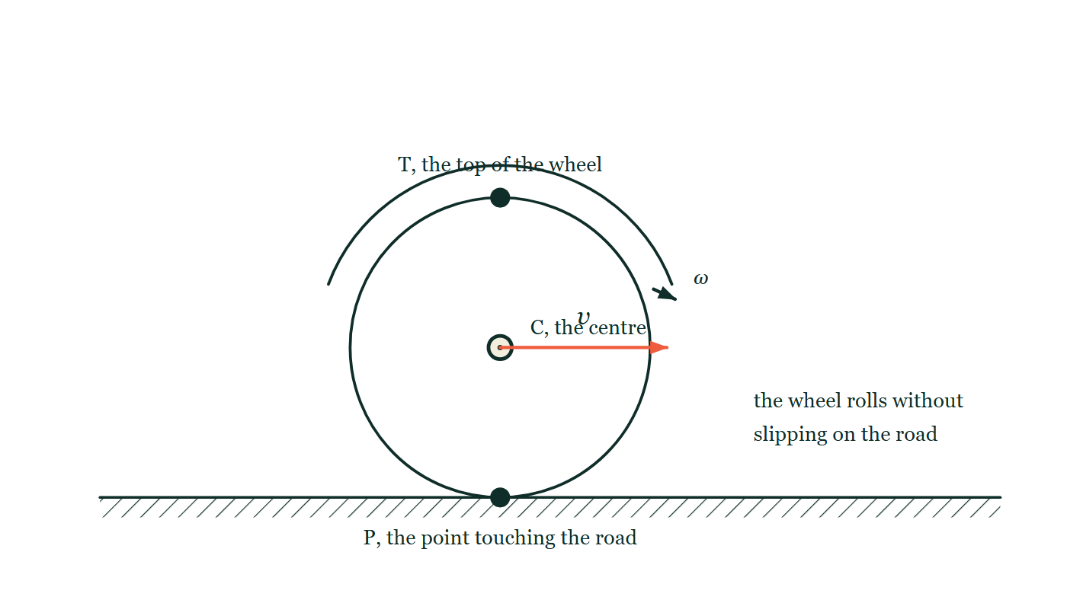
CIRCULAR MOTION · ROLLING WITHOUT SLIPPING
GIOPHYSICS LESSON
THE PICTURE
Three points on a rolling wheel
Drawn for this lesson
A wheel rolling along a road, with three points named: T at the very top, C at the centre and P at the point touching the road. Only the centre carries a velocity arrow, labelled v, and a curved arrow round the rim marks the spin ω. Nothing is said about how fast T or P is moving.
The live version of this figure — click here
Circular Motion — Rolling Without Slipping. Built by GioPhysics from the lesson's own copy; nothing on these slides is re-authored.
12 / 31
Notes:
[Phase] Build the model: The formulae, one at a time, in plain English (minutes 13–22 of 45)
[Figure] A wheel rolling along a road, with three points named: T at the very top, C at the centre and P at the point touching the road. Only the centre carries a velocity arrow, labelled v, and a curved arrow round the rim marks the spin ω. Nothing is said about how fast T or P is moving.

Slide 13
CIRCULAR MOTION · ROLLING WITHOUT SLIPPING
GIOPHYSICS LESSON
WATCH OUT
The common trap
Check and misconception — The quick check and the trap
Static friction is not automatically μN. Its actual value and direction are whatever the no-slip constraint requires, up to its limiting value.
Circular Motion — Rolling Without Slipping. Built by GioPhysics from the lesson's own copy; nothing on these slides is re-authored.
13 / 31
Notes:
[Phase] Check and misconception: The quick check and the trap (minutes 35–41 of 45)
[Misconception] Static friction is not automatically μN. Its actual value and direction are whatever the no-slip constraint requires, up to its limiting value.

Slide 14
CIRCULAR MOTION · ROLLING WITHOUT SLIPPING
GIOPHYSICS LESSON
WORKED EXAMPLE 1 OF 2 · EASY
The question
Easy
Worked examples — I do, we do — one step revealed at a time
A wheel of radius 0.35 m rolls without slipping at 14 m/s. What is its angular speed?
Circular Motion — Rolling Without Slipping. Built by GioPhysics from the lesson's own copy; nothing on these slides is re-authored.
14 / 31
Notes:
[Phase] Worked examples: I do, we do — one step revealed at a time (minutes 22–35 of 45)
[Question] A wheel of radius 0.35 m rolls without slipping at 14 m/s. What is its angular speed?
[Answer] ω = 40 rad/s

Slide 15
CIRCULAR MOTION · ROLLING WITHOUT SLIPPING
GIOPHYSICS LESSON
WORKED EXAMPLE 1 OF 2 · EASY · THE WORKING
How to solve it
Easy
Worked examples — I do, we do — one step revealed at a time
A wheel of radius 0.35 m rolls without slipping at 14 m/s. What is its angular speed?
1.
v = Rω → ω = v/R = 14 ÷ 0.35.
2.
ω = 40 rad/s.
Circular Motion — Rolling Without Slipping. Built by GioPhysics from the lesson's own copy; nothing on these slides is re-authored.
15 / 31
Notes:
[Phase] Worked examples: I do, we do — one step revealed at a time (minutes 22–35 of 45)
[Reveal] One click per step. The class works each line before the next appears.
[Step 1] v = Rω → ω = v/R = 14 ÷ 0.35.
[Step 2] ω = 40 rad/s.

Slide 16
CIRCULAR MOTION · ROLLING WITHOUT SLIPPING
GIOPHYSICS LESSON
WORKED EXAMPLE 1 OF 2 · EASY
Answer
Easy
Worked examples — I do, we do — one step revealed at a time
ω = 40 rad/s
Circular Motion — Rolling Without Slipping. Built by GioPhysics from the lesson's own copy; nothing on these slides is re-authored.
16 / 31
Notes:
[Phase] Worked examples: I do, we do — one step revealed at a time (minutes 22–35 of 45)
[Answer] ω = 40 rad/s

Slide 17
CIRCULAR MOTION · ROLLING WITHOUT SLIPPING
GIOPHYSICS LESSON
WORKED EXAMPLE 2 OF 2 · MEDIUM
The question
Medium
Worked examples — I do, we do — one step revealed at a time
A solid cylinder rolls from rest down a 30° slope. Find its acceleration.
Circular Motion — Rolling Without Slipping. Built by GioPhysics from the lesson's own copy; nothing on these slides is re-authored.
17 / 31
Notes:
[Phase] Worked examples: I do, we do — one step revealed at a time (minutes 22–35 of 45)
[Question] A solid cylinder rolls from rest down a 30° slope. Find its acceleration.
[Answer] a = 3.27 m/s² down the slope

Slide 18
CIRCULAR MOTION · ROLLING WITHOUT SLIPPING
GIOPHYSICS LESSON
WORKED EXAMPLE 2 OF 2 · MEDIUM · THE WORKING
How to solve it
Medium
Worked examples — I do, we do — one step revealed at a time
A solid cylinder rolls from rest down a 30° slope. Find its acceleration.
1.
For a solid cylinder, I/(MR²) = 1/2.
2.
a = g sin30°/(1 + 1/2).
3.
Use g = 9.81 m/s².
Circular Motion — Rolling Without Slipping. Built by GioPhysics from the lesson's own copy; nothing on these slides is re-authored.
18 / 31
Notes:
[Phase] Worked examples: I do, we do — one step revealed at a time (minutes 22–35 of 45)
[Reveal] One click per step. The class works each line before the next appears.
[Step 1] For a solid cylinder, I/(MR²) = 1/2.
[Step 2] a = g sin30°/(1 + 1/2).
[Step 3] Use g = 9.81 m/s².

Slide 19
CIRCULAR MOTION · ROLLING WITHOUT SLIPPING
GIOPHYSICS LESSON
WORKED EXAMPLE 2 OF 2 · MEDIUM
Answer
Medium
Worked examples — I do, we do — one step revealed at a time
a = 3.27 m/s² down the slope
Circular Motion — Rolling Without Slipping. Built by GioPhysics from the lesson's own copy; nothing on these slides is re-authored.
19 / 31
Notes:
[Phase] Worked examples: I do, we do — one step revealed at a time (minutes 22–35 of 45)
[Answer] a = 3.27 m/s² down the slope

Slide 20
CIRCULAR MOTION · ROLLING WITHOUT SLIPPING
GIOPHYSICS LESSON
SPOT THE MISTAKE
One line here is wrong
The whole working is up — find the bad line before you click
1.
The slope is 30°, so the component of gravity down the slope gives a = g sin30°.
2.
a = 9.81 × 0.500 = 4.91 m/s².
3.
So the solid cylinder accelerates down the slope at 4.9 m/s².
LINE 1 IS WRONG
This is the acceleration of something SLIDING down a frictionless slope. A rolling body has to spin up as well as speed up, and the friction that spins it up also holds it back — so part of the gravitational energy goes into rotation and the acceleration is smaller. Line 1 is the answer to a question about a block, applied to a cylinder.
IT SHOULD SAY
For rolling, a = g sin θ / (1 + I/MR²), and a solid cylinder has I/MR² = ½, so a = 9.81 × 0.500 ÷ 1.5 = 3.27 m/s².
Circular Motion — Rolling Without Slipping. Built by GioPhysics from the lesson's own copy; nothing on these slides is re-authored.
20 / 31
Notes:
[Phase] Worked examples: I do, we do — one step revealed at a time (minutes 22–35 of 45)
[Spot the mistake] The working is complete and one line of it is wrong. Let the room hunt: one click names the line, a second shows it done correctly.
[Line 1 is wrong] This is the acceleration of something SLIDING down a frictionless slope. A rolling body has to spin up as well as speed up, and the friction that spins it up also holds it back — so part of the gravitational energy goes into rotation and the acceleration is smaller. Line 1 is the answer to a question about a block, applied to a cylinder.
[It should say] For rolling, a = g sin θ / (1 + I/MR²), and a solid cylinder has I/MR² = ½, so a = 9.81 × 0.500 ÷ 1.5 = 3.27 m/s².

Slide 21
CIRCULAR MOTION · ROLLING WITHOUT SLIPPING
GIOPHYSICS LESSON
PREDICT · TAKE THE VOTE
Commit before you are told
Hands up for each option, then click
The centre C moves at v. How fast is the top point T moving relative to the road?
A At v, the same as the centre — it is all one rigid wheel
B At 2v
C At zero — the top of the wheel is where the motion cancels
A wheel rolling along a road, with three points named: T at the very top, C at the centre and P at the point touching the road. Only the centre carries a velocity arrow, labelled v, and a curved arrow round the rim marks the spin ω. Nothing is said about how fast T or P is moving.
The live version of this figure — click here
Circular Motion — Rolling Without Slipping. Built by GioPhysics from the lesson's own copy; nothing on these slides is re-authored.
21 / 31
Notes:
[Phase] Build the model: The formulae, one at a time, in plain English (minutes 13–22 of 45)
[Predict] The centre C moves at v. How fast is the top point T moving relative to the road?
[Options] A At v, the same as the centre — it is all one rigid wheel B At 2v C At zero — the top of the wheel is where the motion cancels
[Figure] A wheel rolling along a road, with three points named: T at the very top, C at the centre and P at the point touching the road. Only the centre carries a velocity arrow, labelled v, and a curved arrow round the rim marks the spin ω. Nothing is said about how fast T or P is moving.

Slide 22
CIRCULAR MOTION · ROLLING WITHOUT SLIPPING
GIOPHYSICS LESSON
PREDICT · THE OUTCOME
What actually happens
Ask the room who changed their mind, and why
B At 2v
WHY
Every point carries the centre's forward motion v plus its own motion around the centre, which is ωR = v. At the top those two point the same way and add, giving 2v; at the contact point they oppose and cancel, giving zero. That is why the spokes of a moving wheel blur at the top and look sharp at the bottom.
Circular Motion — Rolling Without Slipping. Built by GioPhysics from the lesson's own copy; nothing on these slides is re-authored.
22 / 31
Notes:
[Phase] Build the model: The formulae, one at a time, in plain English (minutes 13–22 of 45)
[Answer] B — At 2v. Every point carries the centre's forward motion v plus its own motion around the centre, which is ωR = v. At the top those two point the same way and add, giving 2v; at the contact point they oppose and cancel, giving zero. That is why the spokes of a moving wheel blur at the top and look sharp at the bottom.

Slide 23
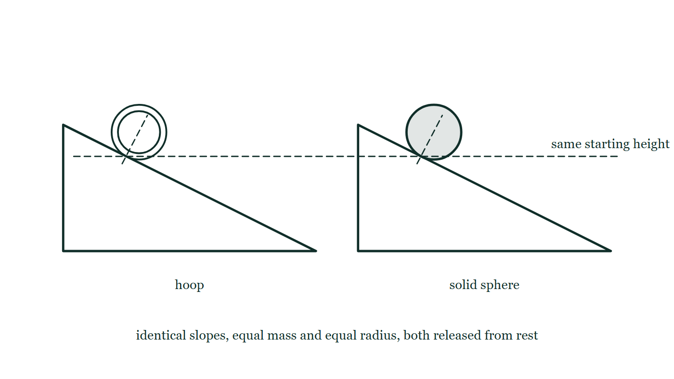
CIRCULAR MOTION · ROLLING WITHOUT SLIPPING
GIOPHYSICS LESSON
QUICK CHECK
Decide before the answer goes up
Check and misconception — The quick check and the trap
Which ideal body reaches the bottom first on the same no-slip slope?
A
A hoop
B
A solid sphere
C
They always tie
Two identical slopes side by side. A hoop is held near the top of one and a solid sphere near the top of the other, each behind a dashed start line drawn across its slope, and a single dashed horizontal line runs across both to show they begin at the same height. Both are still at rest.
The live version of this figure — click here
Circular Motion — Rolling Without Slipping. Built by GioPhysics from the lesson's own copy; nothing on these slides is re-authored.
23 / 31
Notes:
[Phase] Check and misconception: The quick check and the trap (minutes 35–41 of 45)
[Question] Which ideal body reaches the bottom first on the same no-slip slope?
[Figure] Two identical slopes side by side. A hoop is held near the top of one and a solid sphere near the top of the other, each behind a dashed start line drawn across its slope, and a single dashed horizontal line runs across both to show they begin at the same height. Both are still at rest.
[Options] A A hoop B A solid sphere C They always tie

Slide 24
CIRCULAR MOTION · ROLLING WITHOUT SLIPPING
GIOPHYSICS LESSON
QUICK CHECK · THE ANSWER
The answer, and why
Check and misconception — The quick check and the trap
B A solid sphere
HOW TO GET THERE
A solid sphere has the smaller I/(MR²), so it accelerates more quickly.
WHY THE OTHERS TEMPT
A A hoop feels like the strong contender because all its mass sits at the rim, and heavier-at-the-rim sounds like more momentum. It is more rotational inertia, which is the opposite of what you want here — the hoop has to put a much larger share of the gravitational energy into spinning rather than into going forward.
B Correct. A solid sphere has I/(MR²) = 2/5 against the hoop's 1, so a = g sin θ / (1 + I/MR²) is larger for the sphere. Less of the energy is spent on spin, more is left for translation, and it wins every time — regardless of mass or radius.
C It is a fair guess, because mass and radius genuinely do cancel out of the slope acceleration, so a heavy sphere and a light one really do tie. What does not cancel is the SHAPE factor I/(MR²), and hoop and sphere differ there.
Circular Motion — Rolling Without Slipping. Built by GioPhysics from the lesson's own copy; nothing on these slides is re-authored.
24 / 31
Notes:
[Phase] Check and misconception: The quick check and the trap (minutes 35–41 of 45)
[Question] Which ideal body reaches the bottom first on the same no-slip slope?
[Option by option] A: A hoop feels like the strong contender because all its mass sits at the rim, and heavier-at-the-rim sounds like more momentum. It is more rotational inertia, which is the opposite of what you want here — the hoop has to put a much larger share of the gravitational energy into spinning rather than into going forward. B: Correct. A solid sphere has I/(MR²) = 2/5 against the hoop's 1, so a = g sin θ / (1 + I/MR²) is larger for the sphere. Less of the energy is spent on spin, more is left for translation, and it wins every time — regardless of mass or radius. C: It is a fair guess, because mass and radius genuinely do cancel out of the slope acceleration, so a heavy sphere and a light one really do tie. What does not cancel is the SHAPE factor I/(MR²), and hoop and sphere differ there.
[Answer] B — A solid sphere
[Why] A solid sphere has the smaller I/(MR²), so it accelerates more quickly.
[Reveal] One click for the answer, then one for the reason.

Slide 25
CIRCULAR MOTION · ROLLING WITHOUT SLIPPING
GIOPHYSICS LESSON
EXTENSION 1 OF 2 · HARD
The question
Hard
Worked examples — I do, we do — one step revealed at a time
A solid sphere and a hoop are released together down the same slope. Using a = g sinθ/(1 + I/MR²), find their acceleration ratio.
Circular Motion — Rolling Without Slipping. Built by GioPhysics from the lesson's own copy; nothing on these slides is re-authored.
25 / 31
Notes:
[Phase] Worked examples: I do, we do — one step revealed at a time (minutes 22–35 of 45)
[Question] A solid sphere and a hoop are released together down the same slope. Using a = g sinθ/(1 + I/MR²), find their acceleration ratio.
[Answer] a(sphere)/a(hoop) = 10/7 ≈ 1.43

Slide 26
CIRCULAR MOTION · ROLLING WITHOUT SLIPPING
GIOPHYSICS LESSON
EXTENSION 1 OF 2 · HARD · THE WORKING
How to solve it
Hard
Worked examples — I do, we do — one step revealed at a time
A solid sphere and a hoop are released together down the same slope. Using a = g sinθ/(1 + I/MR²), find their acceleration ratio.
1.
Sphere: I/MR² = 2/5 → a = g sinθ/1.4.
2.
Hoop: I/MR² = 1 → a = g sinθ/2.
3.
Ratio sphere:hoop = 2 ÷ 1.4 ≈ 1.43 — the sphere wins every race.
Circular Motion — Rolling Without Slipping. Built by GioPhysics from the lesson's own copy; nothing on these slides is re-authored.
26 / 31
Notes:
[Phase] Worked examples: I do, we do — one step revealed at a time (minutes 22–35 of 45)
[Reveal] One click per step. The class works each line before the next appears.
[Step 1] Sphere: I/MR² = 2/5 → a = g sinθ/1.4.
[Step 2] Hoop: I/MR² = 1 → a = g sinθ/2.
[Step 3] Ratio sphere:hoop = 2 ÷ 1.4 ≈ 1.43 — the sphere wins every race.

Slide 27
CIRCULAR MOTION · ROLLING WITHOUT SLIPPING
GIOPHYSICS LESSON
EXTENSION 1 OF 2 · HARD
Answer
Hard
Worked examples — I do, we do — one step revealed at a time
a(sphere)/a(hoop) = 10/7 ≈ 1.43
Circular Motion — Rolling Without Slipping. Built by GioPhysics from the lesson's own copy; nothing on these slides is re-authored.
27 / 31
Notes:
[Phase] Worked examples: I do, we do — one step revealed at a time (minutes 22–35 of 45)
[Answer] a(sphere)/a(hoop) = 10/7 ≈ 1.43

Slide 28
CIRCULAR MOTION · ROLLING WITHOUT SLIPPING
GIOPHYSICS LESSON
EXTENSION 2 OF 2 · CHALLENGING
The question
Challenging
Worked examples — I do, we do — one step revealed at a time
A solid cylinder rolls without slipping down a 25° slope. Find the minimum coefficient of static friction required.
Circular Motion — Rolling Without Slipping. Built by GioPhysics from the lesson's own copy; nothing on these slides is re-authored.
28 / 31
Notes:
[Phase] Worked examples: I do, we do — one step revealed at a time (minutes 22–35 of 45)
[Question] A solid cylinder rolls without slipping down a 25° slope. Find the minimum coefficient of static friction required.
[Answer] μs ≥ tan25°/3 ≈ 0.16

Slide 29
CIRCULAR MOTION · ROLLING WITHOUT SLIPPING
GIOPHYSICS LESSON
EXTENSION 2 OF 2 · CHALLENGING · THE WORKING
How to solve it
Challenging
Worked examples — I do, we do — one step revealed at a time
A solid cylinder rolls without slipping down a 25° slope. Find the minimum coefficient of static friction required.
1.
Rolling analysis gives friction f = (Mg sinθ)/3 for a solid cylinder.
2.
Normal force N = Mg cosθ, so μ(min) = tanθ/3.
3.
μ(min) = tan25° ÷ 3 ≈ 0.155.
Circular Motion — Rolling Without Slipping. Built by GioPhysics from the lesson's own copy; nothing on these slides is re-authored.
29 / 31
Notes:
[Phase] Worked examples: I do, we do — one step revealed at a time (minutes 22–35 of 45)
[Reveal] One click per step. The class works each line before the next appears.
[Step 1] Rolling analysis gives friction f = (Mg sinθ)/3 for a solid cylinder.
[Step 2] Normal force N = Mg cosθ, so μ(min) = tanθ/3.
[Step 3] μ(min) = tan25° ÷ 3 ≈ 0.155.

Slide 30
CIRCULAR MOTION · ROLLING WITHOUT SLIPPING
GIOPHYSICS LESSON
EXTENSION 2 OF 2 · CHALLENGING
Answer
Challenging
Worked examples — I do, we do — one step revealed at a time
μs ≥ tan25°/3 ≈ 0.16
Circular Motion — Rolling Without Slipping. Built by GioPhysics from the lesson's own copy; nothing on these slides is re-authored.
30 / 31
Notes:
[Phase] Worked examples: I do, we do — one step revealed at a time (minutes 22–35 of 45)
[Answer] μs ≥ tan25°/3 ≈ 0.16

Slide 31
CIRCULAR MOTION · ROLLING WITHOUT SLIPPING
GIOPHYSICS LESSON
CIRCULAR MOTION
Where to go next
Plenary — What to take away, what to practise next
Next
6.8 Angular Momentum
https://giophysics.com/chapter-10/angular-momentum/
Lesson
This lesson on giophysics.com
https://giophysics.com/chapter-10/rolling-without-slipping/
Live
The live, interactive version of these slides
https://giophysics.com/chapter-10/presentation/?lesson=rolling
Chapter
All Circular Motion lessons
https://giophysics.com/chapter-10/
PDF
Download the lesson PDF
https://giophysics.com/downloads/10-7-rolling-without-slipping.pdf
Circular Motion — Rolling Without Slipping. Built by GioPhysics from the lesson's own copy; nothing on these slides is re-authored.
31 / 31
Notes:
[Phase] Plenary: What to take away, what to practise next (minutes 41–45 of 45)
[Interactive] The graphs and the circuit topology on these slides are frozen. The live version at https://giophysics.com/chapter-10/presentation/?lesson=rolling moves them.

