Slide 1
CIRCULAR MOTION · TORQUE & ROTATIONAL DYNAMICS
GIOPHYSICS LESSON
06 · Circular Motion
Change angular motion
Torque & Rotational Dynamics
Torque measures how effectively a force changes rotation. The perpendicular force component and lever arm both matter.
POSITION
Lesson 4 of 11 in Circular Motion
PLAN
16 slides in the 45-minute core run, about 44.5 minutes of it
LESSON PAGE
https://giophysics.com/chapter-10/torque-rotational-dynamics/
Built by GioPhysics from the lesson's own page. Every word on these slides is the lesson's; nothing here is re-authored. Teaching material, not an awarding body's document.
Circular Motion — Torque & Rotational Dynamics. Built by GioPhysics from the lesson's own copy; nothing on these slides is re-authored.
1 / 36
Notes:
[Lesson] Circular Motion — Torque & Rotational Dynamics. Lesson 4 of 11.
[Intro] Torque measures how effectively a force changes rotation. The perpendicular force component and lever arm both matter.
[Source] https://giophysics.com/chapter-10/torque-rotational-dynamics/
[Disclaimer] Built by GioPhysics from the lesson's own page. Every word on these slides is the lesson's; nothing here is re-authored. Teaching material, not an awarding body's document.

Slide 2
CIRCULAR MOTION · TORQUE & ROTATIONAL DYNAMICS
GIOPHYSICS LESSON
THINK FIRST
Same door, same push, same distance from the hinge — how can one push swing it open and another do nothing at all?
Take answers before you click — the point is the commitment
Push the edge of a door straight toward its hinge as hard as you like and it will not budge.
THE ANSWER
Only the part of the force at right angles to the line from the hinge turns anything. Push straight along that line and there is no perpendicular part at all, so there is no turning effect — however hard you shove.
Circular Motion — Torque & Rotational Dynamics. Built by GioPhysics from the lesson's own copy; nothing on these slides is re-authored.
2 / 36
Notes:
[Phase] Starter: Recall what this lesson stands on (minutes 0–5 of 45)
[Hook] Same door, same push, same distance from the hinge — how can one push swing it open and another do nothing at all? Push the edge of a door straight toward its hinge as hard as you like and it will not budge.
[Answer] Only the part of the force at right angles to the line from the hinge turns anything. Push straight along that line and there is no perpendicular part at all, so there is no turning effect — however hard you shove.

Slide 3
CIRCULAR MOTION · TORQUE & ROTATIONAL DYNAMICS
GIOPHYSICS LESSON
EXPLAINED SIMPLY
In one sentence
Introduce the idea — The big idea and the definition
Torque is the turning effect of a force about an axis, and net torque produces angular acceleration.
Circular Motion — Torque & Rotational Dynamics. Built by GioPhysics from the lesson's own copy; nothing on these slides is re-authored.
3 / 36
Notes:
[Phase] Introduce the idea: The big idea and the definition (minutes 5–13 of 45)
[Definition] Torque is the turning effect of a force about an axis, and net torque produces angular acceleration.

Slide 4
CIRCULAR MOTION · TORQUE & ROTATIONAL DYNAMICS
GIOPHYSICS LESSON
EXPLAINED SIMPLY
What that looks like
Introduce the idea — The big idea and the definition
FOR EXAMPLE
Pushing a door far from its hinges creates more torque than applying the same force close to the hinges.
Circular Motion — Torque & Rotational Dynamics. Built by GioPhysics from the lesson's own copy; nothing on these slides is re-authored.
4 / 36
Notes:
[Phase] Introduce the idea: The big idea and the definition (minutes 5–13 of 45)
[Worked illustration] Pushing a door far from its hinges creates more torque than applying the same force close to the hinges.

Slide 5
CIRCULAR MOTION · TORQUE & ROTATIONAL DYNAMICS
GIOPHYSICS LESSON
THE BIG IDEA
Change angular motion
Introduce the idea — The big idea and the definition
Choose an axis first. A tangential force creates maximum torque, while a force directed through the axis creates zero torque about that axis. Net external torque produces angular acceleration for a fixed-axis rigid body.
Circular Motion — Torque & Rotational Dynamics. Built by GioPhysics from the lesson's own copy; nothing on these slides is re-authored.
5 / 36
Notes:
[Phase] Introduce the idea: The big idea and the definition (minutes 5–13 of 45)
[Big idea] Choose an axis first. A tangential force creates maximum torque, while a force directed through the axis creates zero torque about that axis. Net external torque produces angular acceleration for a fixed-axis rigid body.

Slide 6
CIRCULAR MOTION · TORQUE & ROTATIONAL DYNAMICS
GIOPHYSICS LESSON
THE PHYSICS · 1 OF 4
State the axis
Build the model — The formulae, one at a time, in plain English
The same force can produce different torques about different axes.
Circular Motion — Torque & Rotational Dynamics. Built by GioPhysics from the lesson's own copy; nothing on these slides is re-authored.
6 / 36
Notes:
[Phase] Build the model: The formulae, one at a time, in plain English (minutes 13–22 of 45)
[Section] The same force can produce different torques about different axes.

Slide 7
CIRCULAR MOTION · TORQUE & ROTATIONAL DYNAMICS
GIOPHYSICS LESSON
THE PHYSICS · 2 OF 4
Radial versus tangential
Build the model — The formulae, one at a time, in plain English
Radial force can turn motion yet gives zero torque about the centre; tangential force changes angular speed.
Circular Motion — Torque & Rotational Dynamics. Built by GioPhysics from the lesson's own copy; nothing on these slides is re-authored.
7 / 36
Notes:
[Phase] Build the model: The formulae, one at a time, in plain English (minutes 13–22 of 45)
[Section] Radial force can turn motion yet gives zero torque about the centre; tangential force changes angular speed.

Slide 8
CIRCULAR MOTION · TORQUE & ROTATIONAL DYNAMICS
GIOPHYSICS LESSON
THE PHYSICS · 3 OF 4
Signs encode sense
Build the model — The formulae, one at a time, in plain English
Choose clockwise or counter-clockwise as positive before adding torques.
Circular Motion — Torque & Rotational Dynamics. Built by GioPhysics from the lesson's own copy; nothing on these slides is re-authored.
8 / 36
Notes:
[Phase] Build the model: The formulae, one at a time, in plain English (minutes 13–22 of 45)
[Section] Choose clockwise or counter-clockwise as positive before adding torques.

Slide 9
CIRCULAR MOTION · TORQUE & ROTATIONAL DYNAMICS
GIOPHYSICS LESSON
THE PHYSICS · 4 OF 4
Every straight-line equation has an angular twin
Build the model — The formulae, one at a time, in plain English
Swap s → θ, v → ω and a → α and the constant-acceleration equations carry straight over, because θ = s/r, ω = v/r and α = aₜ/r all share the same radius. So ω = ω₀ + αt is v = u + at, θ = ω₀t + ½αt² is s = ut + ½at², and ω² = ω₀² + 2αθ is v² = u² + 2as. They hold under exactly the same condition as their linear originals — a constant angular acceleration — and every angle in them must be in radians, not degrees.
Circular Motion — Torque & Rotational Dynamics. Built by GioPhysics from the lesson's own copy; nothing on these slides is re-authored.
9 / 36
Notes:
[Phase] Build the model: The formulae, one at a time, in plain English (minutes 13–22 of 45)
[Section] Swap s → θ, v → ω and a → α and the constant-acceleration equations carry straight over, because θ = s/r, ω = v/r and α = aₜ/r all share the same radius. So ω = ω₀ + αt is v = u + at, θ = ω₀t + ½αt² is s = ut + ½at², and ω² = ω₀² + 2αθ is v² = u² + 2as. They hold under exactly the same condition as their linear originals — a constant angular acceleration — and every angle in them must be in radians, not degrees.

Slide 10
CIRCULAR MOTION · TORQUE & ROTATIONAL DYNAMICS
GIOPHYSICS LESSON
FORMULA 1 OF 6
Torque magnitude
Build the model — The formulae, one at a time, in plain English
τ = rF sin φ
φ is between r⃗ and F⃗
IN PLAIN ENGLISH
Turning effect: force times distance from the pivot, counting only the part of the force that pushes at right angles to the arm.
Circular Motion — Torque & Rotational Dynamics. Built by GioPhysics from the lesson's own copy; nothing on these slides is re-authored.
10 / 36
Notes:
[Phase] Build the model: The formulae, one at a time, in plain English (minutes 13–22 of 45)
[Formula] Torque magnitude: τ = rF sin φ
[In plain English] Turning effect: force times distance from the pivot, counting only the part of the force that pushes at right angles to the arm.
[Note] φ is between r⃗ and F⃗

Slide 11
CIRCULAR MOTION · TORQUE & ROTATIONAL DYNAMICS
GIOPHYSICS LESSON
FORMULA 2 OF 6
Rotational dynamics
Build the model — The formulae, one at a time, in plain English
Στ = Iα
Fixed axis model
IN PLAIN ENGLISH
The spinning version of F = ma: total turning effect equals rotational inertia times how fast the spin rate changes.
Circular Motion — Torque & Rotational Dynamics. Built by GioPhysics from the lesson's own copy; nothing on these slides is re-authored.
11 / 36
Notes:
[Phase] Build the model: The formulae, one at a time, in plain English (minutes 13–22 of 45)
[Formula] Rotational dynamics: Στ = Iα
[In plain English] The spinning version of F = ma: total turning effect equals rotational inertia times how fast the spin rate changes.
[Note] Fixed axis model

Slide 12
CIRCULAR MOTION · TORQUE & ROTATIONAL DYNAMICS
GIOPHYSICS LESSON
FORMULA 3 OF 6
Tangential acceleration
Build the model — The formulae, one at a time, in plain English
aₜ = αr
Changes the speed
IN PLAIN ENGLISH
When the spin speeds up, points farther from the axis speed up faster.
Circular Motion — Torque & Rotational Dynamics. Built by GioPhysics from the lesson's own copy; nothing on these slides is re-authored.
12 / 36
Notes:
[Phase] Build the model: The formulae, one at a time, in plain English (minutes 13–22 of 45)
[Formula] Tangential acceleration: aₜ = αr
[In plain English] When the spin speeds up, points farther from the axis speed up faster.
[Note] Changes the speed

Slide 13
CIRCULAR MOTION · TORQUE & ROTATIONAL DYNAMICS
GIOPHYSICS LESSON
FORMULA 4 OF 6
Angular velocity
Build the model — The formulae, one at a time, in plain English
ω = ω₀ + αt
Constant α only
IN PLAIN ENGLISH
Spin rate now: the rate you started with, plus the change a steady angular acceleration adds each second.
Circular Motion — Torque & Rotational Dynamics. Built by GioPhysics from the lesson's own copy; nothing on these slides is re-authored.
13 / 36
Notes:
[Phase] Build the model: The formulae, one at a time, in plain English (minutes 13–22 of 45)
[Formula] Angular velocity: ω = ω₀ + αt
[In plain English] Spin rate now: the rate you started with, plus the change a steady angular acceleration adds each second.
[Note] Constant α only

Slide 14
CIRCULAR MOTION · TORQUE & ROTATIONAL DYNAMICS
GIOPHYSICS LESSON
FORMULA 5 OF 6
Angle turned
Build the model — The formulae, one at a time, in plain English
θ = ω₀t + ½αt²
θ in radians; constant α only
IN PLAIN ENGLISH
What the starting spin alone would have swept, plus the extra the angular acceleration piles on.
Circular Motion — Torque & Rotational Dynamics. Built by GioPhysics from the lesson's own copy; nothing on these slides is re-authored.
14 / 36
Notes:
[Phase] Build the model: The formulae, one at a time, in plain English (minutes 13–22 of 45)
[Formula] Angle turned: θ = ω₀t + ½αt²
[In plain English] What the starting spin alone would have swept, plus the extra the angular acceleration piles on.
[Note] θ in radians; constant α only

Slide 15
CIRCULAR MOTION · TORQUE & ROTATIONAL DYNAMICS
GIOPHYSICS LESSON
FORMULA 6 OF 6
Angle without time
Build the model — The formulae, one at a time, in plain English
ω² = ω₀² + 2αθ
Use when the time is not given
IN PLAIN ENGLISH
The no-clock version: links spin rate to the angle turned when you were never told how long it took.
Circular Motion — Torque & Rotational Dynamics. Built by GioPhysics from the lesson's own copy; nothing on these slides is re-authored.
15 / 36
Notes:
[Phase] Build the model: The formulae, one at a time, in plain English (minutes 13–22 of 45)
[Formula] Angle without time: ω² = ω₀² + 2αθ
[In plain English] The no-clock version: links spin rate to the angle turned when you were never told how long it took.
[Note] Use when the time is not given

Slide 16
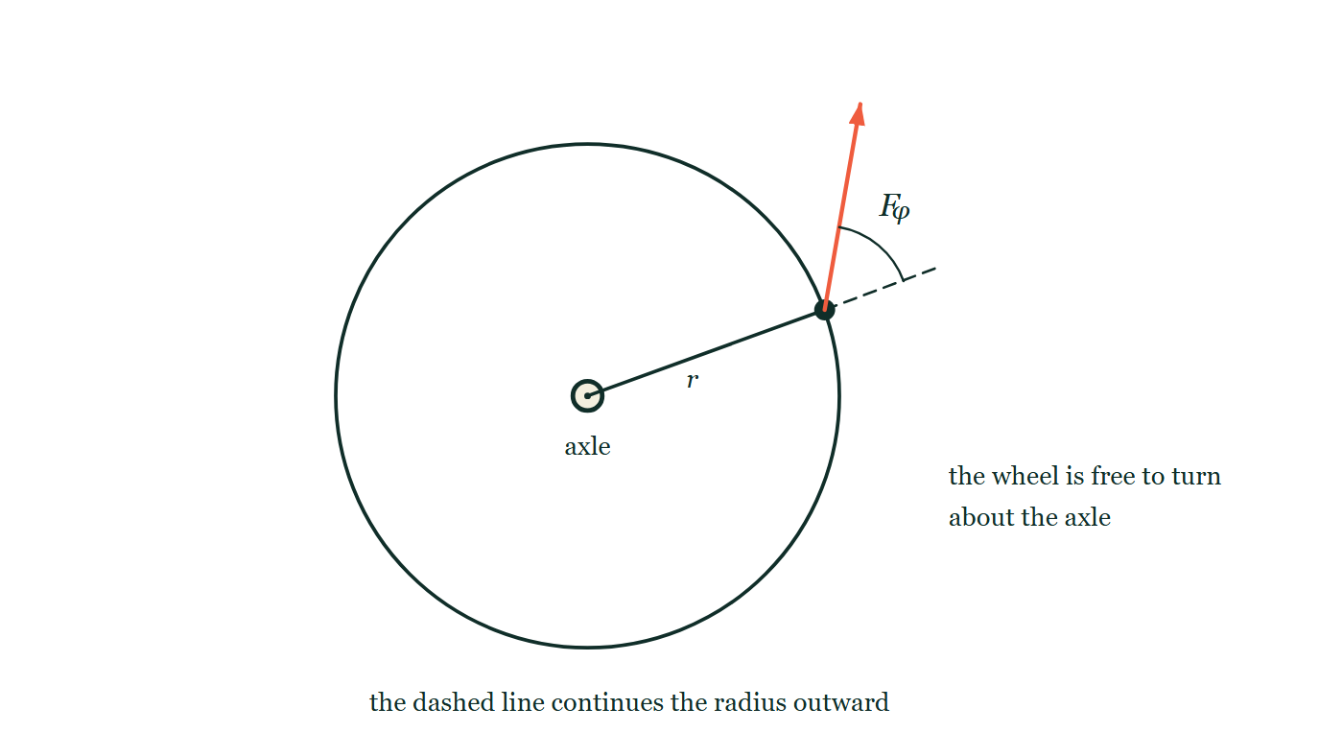
CIRCULAR MOTION · TORQUE & ROTATIONAL DYNAMICS
GIOPHYSICS LESSON
THE PICTURE
Where the angle in τ = rF sin φ is measured
Drawn for this lesson
A wheel free to turn about a central axle. A radius is drawn from the axle out to a point on the rim, and a force arrow starts at that point. The radius is continued outward past the rim as a dashed line, and the angle φ is marked between that dashed continuation and the force.
The live version of this figure — click here
Circular Motion — Torque & Rotational Dynamics. Built by GioPhysics from the lesson's own copy; nothing on these slides is re-authored.
16 / 36
Notes:
[Phase] Build the model: The formulae, one at a time, in plain English (minutes 13–22 of 45)
[Figure] A wheel free to turn about a central axle. A radius is drawn from the axle out to a point on the rim, and a force arrow starts at that point. The radius is continued outward past the rim as a dashed line, and the angle φ is marked between that dashed continuation and the force.

Slide 17
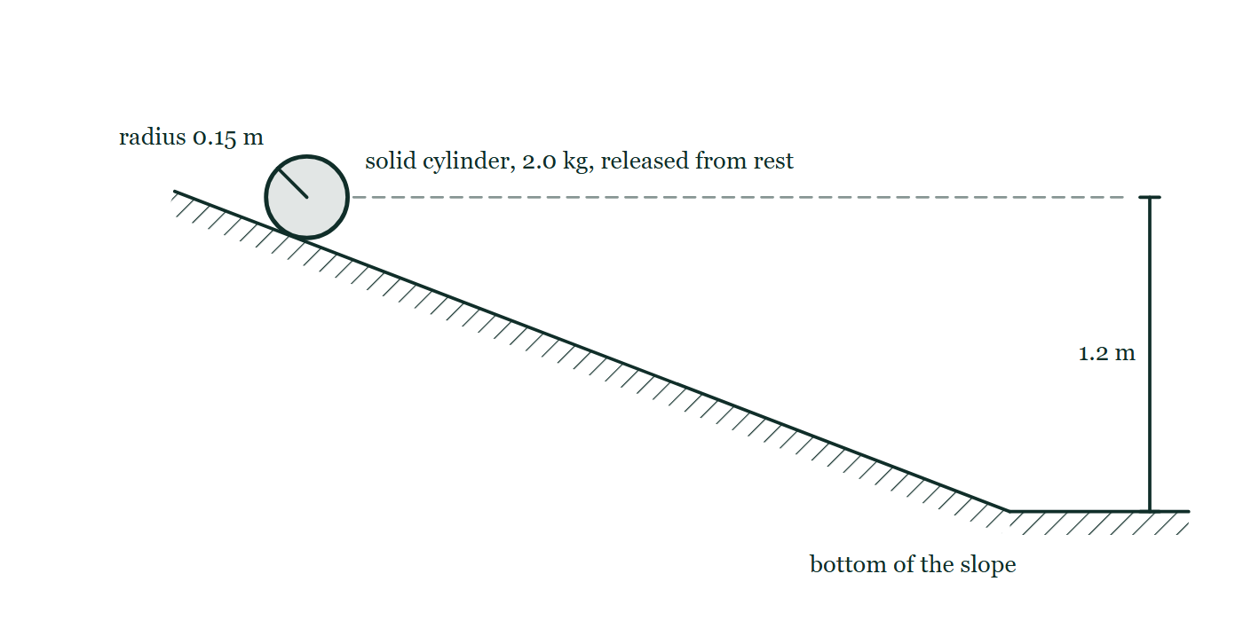
CIRCULAR MOTION · TORQUE & ROTATIONAL DYNAMICS
GIOPHYSICS LESSON
FIGURE
Figure 5 — IB Theme A · Space, time and motion
Drawn for question 10 of that paper · syllabus A.4, A.5
Side view. A straight hatched slope runs down from the upper left to a horizontal surface at the lower right. A cylinder is drawn end-on resting on the slope near the top, labelled solid cylinder, 2.0 kg, released from rest, with a line from its centre to the rim labelled radius 0.15 m. A dashed horizontal line runs to the right from the level of the cylinder's centre, and a dimension line marks 1.2 m between that level and the horizontal surface at the bottom of the slope.
See the question this was drawn for — click here
Circular Motion — Torque & Rotational Dynamics. Built by GioPhysics from the lesson's own copy; nothing on these slides is re-authored.
17 / 36
Notes:
[Phase] Build the model: The formulae, one at a time, in plain English (minutes 13–22 of 45)
[Figure] Figure 5. Side view. A straight hatched slope runs down from the upper left to a horizontal surface at the lower right. A cylinder is drawn end-on resting on the slope near the top, labelled solid cylinder, 2.0 kg, released from rest, with a line from its centre to the rim labelled radius 0.15 m. A dashed horizontal line runs to the right from the level of the cylinder's centre, and a dimension line marks 1.2 m between that level and the horizontal surface at the bottom of the slope.
[Where it came from] IB Theme A · Space, time and motion, question 10; syllabus A.4, A.5.

Slide 18
CIRCULAR MOTION · TORQUE & ROTATIONAL DYNAMICS
GIOPHYSICS LESSON
WATCH OUT
The common trap
Check and misconception — The quick check and the trap
A radial force does not 'do nothing'. It produces no torque about the centre, but it can still produce centripetal acceleration.
Circular Motion — Torque & Rotational Dynamics. Built by GioPhysics from the lesson's own copy; nothing on these slides is re-authored.
18 / 36
Notes:
[Phase] Check and misconception: The quick check and the trap (minutes 35–41 of 45)
[Misconception] A radial force does not 'do nothing'. It produces no torque about the centre, but it can still produce centripetal acceleration.

Slide 19
CIRCULAR MOTION · TORQUE & ROTATIONAL DYNAMICS
GIOPHYSICS LESSON
WORKED EXAMPLE 1 OF 2 · EASY
The question
Easy
Worked examples — I do, we do — one step revealed at a time
A 40 N force is applied at the end of a 0.25 m wrench, perpendicular to the handle. Find the torque.
Circular Motion — Torque & Rotational Dynamics. Built by GioPhysics from the lesson's own copy; nothing on these slides is re-authored.
19 / 36
Notes:
[Phase] Worked examples: I do, we do — one step revealed at a time (minutes 22–35 of 45)
[Question] A 40 N force is applied at the end of a 0.25 m wrench, perpendicular to the handle. Find the torque.
[Answer] τ = 10 N·m

Slide 20
CIRCULAR MOTION · TORQUE & ROTATIONAL DYNAMICS
GIOPHYSICS LESSON
WORKED EXAMPLE 1 OF 2 · EASY · THE WORKING
How to solve it
Easy
Worked examples — I do, we do — one step revealed at a time
A 40 N force is applied at the end of a 0.25 m wrench, perpendicular to the handle. Find the torque.
1.
τ = rF sinφ with φ = 90°.
2.
τ = 0.25 × 40 = 10 N·m.
Circular Motion — Torque & Rotational Dynamics. Built by GioPhysics from the lesson's own copy; nothing on these slides is re-authored.
20 / 36
Notes:
[Phase] Worked examples: I do, we do — one step revealed at a time (minutes 22–35 of 45)
[Reveal] One click per step. The class works each line before the next appears.
[Step 1] τ = rF sinφ with φ = 90°.
[Step 2] τ = 0.25 × 40 = 10 N·m.

Slide 21
CIRCULAR MOTION · TORQUE & ROTATIONAL DYNAMICS
GIOPHYSICS LESSON
WORKED EXAMPLE 1 OF 2 · EASY
Answer
Easy
Worked examples — I do, we do — one step revealed at a time
τ = 10 N·m
Circular Motion — Torque & Rotational Dynamics. Built by GioPhysics from the lesson's own copy; nothing on these slides is re-authored.
21 / 36
Notes:
[Phase] Worked examples: I do, we do — one step revealed at a time (minutes 22–35 of 45)
[Answer] τ = 10 N·m

Slide 22
CIRCULAR MOTION · TORQUE & ROTATIONAL DYNAMICS
GIOPHYSICS LESSON
WORKED EXAMPLE 2 OF 2 · MEDIUM
The question
Medium
Worked examples — I do, we do — one step revealed at a time
A 20 N tangential force acts at the rim of a 0.30 m wheel with I = 1.5 kg·m². Find α.
Circular Motion — Torque & Rotational Dynamics. Built by GioPhysics from the lesson's own copy; nothing on these slides is re-authored.
22 / 36
Notes:
[Phase] Worked examples: I do, we do — one step revealed at a time (minutes 22–35 of 45)
[Question] A 20 N tangential force acts at the rim of a 0.30 m wheel with I = 1.5 kg·m². Find α.
[Answer] α = 4.0 rad/s²

Slide 23
CIRCULAR MOTION · TORQUE & ROTATIONAL DYNAMICS
GIOPHYSICS LESSON
WORKED EXAMPLE 2 OF 2 · MEDIUM · THE WORKING
How to solve it
Medium
Worked examples — I do, we do — one step revealed at a time
A 20 N tangential force acts at the rim of a 0.30 m wheel with I = 1.5 kg·m². Find α.
1.
τ = rF = (0.30)(20) = 6.0 N·m.
2.
Use α = τ/I.
3.
α = 6.0/1.5.
Circular Motion — Torque & Rotational Dynamics. Built by GioPhysics from the lesson's own copy; nothing on these slides is re-authored.
23 / 36
Notes:
[Phase] Worked examples: I do, we do — one step revealed at a time (minutes 22–35 of 45)
[Reveal] One click per step. The class works each line before the next appears.
[Step 1] τ = rF = (0.30)(20) = 6.0 N·m.
[Step 2] Use α = τ/I.
[Step 3] α = 6.0/1.5.

Slide 24
CIRCULAR MOTION · TORQUE & ROTATIONAL DYNAMICS
GIOPHYSICS LESSON
WORKED EXAMPLE 2 OF 2 · MEDIUM
Answer
Medium
Worked examples — I do, we do — one step revealed at a time
α = 4.0 rad/s²
Circular Motion — Torque & Rotational Dynamics. Built by GioPhysics from the lesson's own copy; nothing on these slides is re-authored.
24 / 36
Notes:
[Phase] Worked examples: I do, we do — one step revealed at a time (minutes 22–35 of 45)
[Answer] α = 4.0 rad/s²

Slide 25
CIRCULAR MOTION · TORQUE & ROTATIONAL DYNAMICS
GIOPHYSICS LESSON
SPOT THE MISTAKE
One line here is wrong
The whole working is up — find the bad line before you click
1.
The grindstone must gain 30 rad/s in 5.0 s, so α = Δω/Δt = 30 ÷ 5.0 = 6.0 rad/s².
2.
The torque needed is τ = Iα = 0.60 × 6.0 = 3.6 N·m.
3.
The force is applied at the 0.20 m rim, so F = τr = 3.6 × 0.20 = 0.72 N.
LINE 3 IS WRONG
τ = rF was rearranged by multiplying instead of dividing. It is a tempting slip precisely because r is small: multiplying by 0.20 makes the answer smaller and 'smaller force at a bigger wheel' feels like the right shape of result. It is backwards — a bigger wheel needs LESS force for the same torque, so dividing by r is what gives that.
IT SHOULD SAY
F = τ/r = 3.6 ÷ 0.20 = 18 N.
Circular Motion — Torque & Rotational Dynamics. Built by GioPhysics from the lesson's own copy; nothing on these slides is re-authored.
25 / 36
Notes:
[Phase] Worked examples: I do, we do — one step revealed at a time (minutes 22–35 of 45)
[Spot the mistake] The working is complete and one line of it is wrong. Let the room hunt: one click names the line, a second shows it done correctly.
[Line 3 is wrong] τ = rF was rearranged by multiplying instead of dividing. It is a tempting slip precisely because r is small: multiplying by 0.20 makes the answer smaller and 'smaller force at a bigger wheel' feels like the right shape of result. It is backwards — a bigger wheel needs LESS force for the same torque, so dividing by r is what gives that.
[It should say] F = τ/r = 3.6 ÷ 0.20 = 18 N.

Slide 26
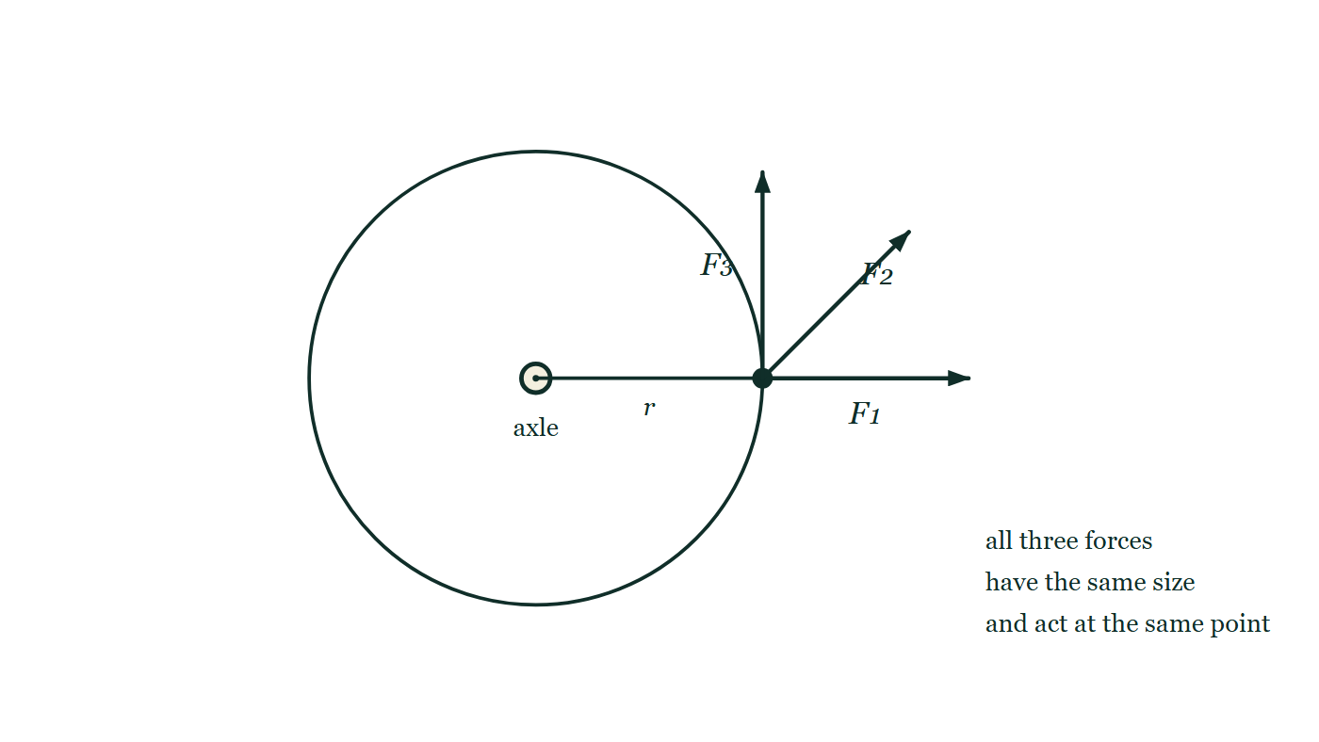
CIRCULAR MOTION · TORQUE & ROTATIONAL DYNAMICS
GIOPHYSICS LESSON
PREDICT · TAKE THE VOTE
Commit before you are told
Hands up for each option, then click
All three forces are the same size and act at the same point. Which produces the largest turning effect about the axle?
A The radial one — it drives straight at the axle, so it presses hardest on it
B The tangential one
C All three are the same, because r and F are the same for all of them
A wheel on an axle with three arrows of identical length all starting at the same point on the rim: one pointing straight outward along the radius, one at forty-five degrees to it, and one tangential, at right angles to the radius. Nothing distinguishes them but direction.
The live version of this figure — click here
Circular Motion — Torque & Rotational Dynamics. Built by GioPhysics from the lesson's own copy; nothing on these slides is re-authored.
26 / 36
Notes:
[Phase] Build the model: The formulae, one at a time, in plain English (minutes 13–22 of 45)
[Predict] All three forces are the same size and act at the same point. Which produces the largest turning effect about the axle?
[Options] A The radial one — it drives straight at the axle, so it presses hardest on it B The tangential one C All three are the same, because r and F are the same for all of them
[Figure] A wheel on an axle with three arrows of identical length all starting at the same point on the rim: one pointing straight outward along the radius, one at forty-five degrees to it, and one tangential, at right angles to the radius. Nothing distinguishes them but direction.

Slide 27
CIRCULAR MOTION · TORQUE & ROTATIONAL DYNAMICS
GIOPHYSICS LESSON
PREDICT · THE OUTCOME
What actually happens
Ask the room who changed their mind, and why
B The tangential one
WHY
τ = rF sin φ, and sin φ is largest when φ = 90° — which is the tangential arrow, the one lying square across the radius. The radial arrow has φ = 0, so sin φ = 0 and it turns the wheel not at all; it only pushes on the axle. The forty-five-degree one lands in between.
Circular Motion — Torque & Rotational Dynamics. Built by GioPhysics from the lesson's own copy; nothing on these slides is re-authored.
27 / 36
Notes:
[Phase] Build the model: The formulae, one at a time, in plain English (minutes 13–22 of 45)
[Answer] B — The tangential one. τ = rF sin φ, and sin φ is largest when φ = 90° — which is the tangential arrow, the one lying square across the radius. The radial arrow has φ = 0, so sin φ = 0 and it turns the wheel not at all; it only pushes on the axle. The forty-five-degree one lands in between.

Slide 28
CIRCULAR MOTION · TORQUE & ROTATIONAL DYNAMICS
GIOPHYSICS LESSON
QUICK CHECK
Decide before the answer goes up
Check and misconception — The quick check and the trap
When does a force create the largest torque for fixed r and F?
A
When it is radial
B
When it is tangential
C
The angle never matters
A wheel on an axle with three arrows of identical length all starting at the same point on the rim: one pointing straight outward along the radius, one at forty-five degrees to it, and one tangential, at right angles to the radius. Nothing distinguishes them but direction.
The live version of this figure — click here
Circular Motion — Torque & Rotational Dynamics. Built by GioPhysics from the lesson's own copy; nothing on these slides is re-authored.
28 / 36
Notes:
[Phase] Check and misconception: The quick check and the trap (minutes 35–41 of 45)
[Question] When does a force create the largest torque for fixed r and F?
[Figure] A wheel on an axle with three arrows of identical length all starting at the same point on the rim: one pointing straight outward along the radius, one at forty-five degrees to it, and one tangential, at right angles to the radius. Nothing distinguishes them but direction.
[Options] A When it is radial B When it is tangential C The angle never matters

Slide 29
CIRCULAR MOTION · TORQUE & ROTATIONAL DYNAMICS
GIOPHYSICS LESSON
QUICK CHECK · THE ANSWER
The answer, and why
Check and misconception — The quick check and the trap
B When it is tangential
HOW TO GET THERE
sin φ is largest at 90°, when the force is perpendicular to the radius.
WHY THE OTHERS TEMPT
A A radial force is doing something — it loads the axle, and in circular motion it can supply the centripetal force. What it cannot do is turn the wheel about that axle: its line of action passes straight through the pivot, so its lever arm is zero and its torque is zero.
B Correct. At 90° the whole force is doing turning work, sin φ = 1, and τ = rF. Any other direction wastes part of the force pushing along the radius, where it has no turning effect at all.
C This is the answer if τ is read as 'r times F' with the sin φ treated as decoration. The angle is not decoration — it is the entire difference between a force that spins a wheel and one that merely leans on its axle.
Circular Motion — Torque & Rotational Dynamics. Built by GioPhysics from the lesson's own copy; nothing on these slides is re-authored.
29 / 36
Notes:
[Phase] Check and misconception: The quick check and the trap (minutes 35–41 of 45)
[Question] When does a force create the largest torque for fixed r and F?
[Option by option] A: A radial force is doing something — it loads the axle, and in circular motion it can supply the centripetal force. What it cannot do is turn the wheel about that axle: its line of action passes straight through the pivot, so its lever arm is zero and its torque is zero. B: Correct. At 90° the whole force is doing turning work, sin φ = 1, and τ = rF. Any other direction wastes part of the force pushing along the radius, where it has no turning effect at all. C: This is the answer if τ is read as 'r times F' with the sin φ treated as decoration. The angle is not decoration — it is the entire difference between a force that spins a wheel and one that merely leans on its axle.
[Answer] B — When it is tangential
[Why] sin φ is largest at 90°, when the force is perpendicular to the radius.
[Reveal] One click for the answer, then one for the reason.

Slide 30
CIRCULAR MOTION · TORQUE & ROTATIONAL DYNAMICS
GIOPHYSICS LESSON
EXTENSION 1 OF 2 · HARD
The question
Hard
Worked examples — I do, we do — one step revealed at a time
A grindstone (I = 0.60 kg·m²) must reach 30 rad/s from rest in 5.0 s. What tangential force is needed at its 0.20 m rim?
Circular Motion — Torque & Rotational Dynamics. Built by GioPhysics from the lesson's own copy; nothing on these slides is re-authored.
30 / 36
Notes:
[Phase] Worked examples: I do, we do — one step revealed at a time (minutes 22–35 of 45)
[Question] A grindstone (I = 0.60 kg·m²) must reach 30 rad/s from rest in 5.0 s. What tangential force is needed at its 0.20 m rim?
[Answer] F = 18 N

Slide 31
CIRCULAR MOTION · TORQUE & ROTATIONAL DYNAMICS
GIOPHYSICS LESSON
EXTENSION 1 OF 2 · HARD · THE WORKING
How to solve it
Hard
Worked examples — I do, we do — one step revealed at a time
A grindstone (I = 0.60 kg·m²) must reach 30 rad/s from rest in 5.0 s. What tangential force is needed at its 0.20 m rim?
1.
α = Δω/Δt = 30 ÷ 5.0 = 6.0 rad/s².
2.
τ = Iα = 0.60 × 6.0 = 3.6 N·m.
3.
F = τ/r = 3.6 ÷ 0.20 = 18 N.
Circular Motion — Torque & Rotational Dynamics. Built by GioPhysics from the lesson's own copy; nothing on these slides is re-authored.
31 / 36
Notes:
[Phase] Worked examples: I do, we do — one step revealed at a time (minutes 22–35 of 45)
[Reveal] One click per step. The class works each line before the next appears.
[Step 1] α = Δω/Δt = 30 ÷ 5.0 = 6.0 rad/s².
[Step 2] τ = Iα = 0.60 × 6.0 = 3.6 N·m.
[Step 3] F = τ/r = 3.6 ÷ 0.20 = 18 N.

Slide 32
CIRCULAR MOTION · TORQUE & ROTATIONAL DYNAMICS
GIOPHYSICS LESSON
EXTENSION 1 OF 2 · HARD
Answer
Hard
Worked examples — I do, we do — one step revealed at a time
F = 18 N
Circular Motion — Torque & Rotational Dynamics. Built by GioPhysics from the lesson's own copy; nothing on these slides is re-authored.
32 / 36
Notes:
[Phase] Worked examples: I do, we do — one step revealed at a time (minutes 22–35 of 45)
[Answer] F = 18 N

Slide 33
CIRCULAR MOTION · TORQUE & ROTATIONAL DYNAMICS
GIOPHYSICS LESSON
EXTENSION 2 OF 2 · CHALLENGING
The question
Challenging
Worked examples — I do, we do — one step revealed at a time
A 2.0 kg mass hangs from a cord wrapped round a 0.50 kg solid cylindrical pulley of radius 0.10 m. Find the mass's downward acceleration.
Circular Motion — Torque & Rotational Dynamics. Built by GioPhysics from the lesson's own copy; nothing on these slides is re-authored.
33 / 36
Notes:
[Phase] Worked examples: I do, we do — one step revealed at a time (minutes 22–35 of 45)
[Question] A 2.0 kg mass hangs from a cord wrapped round a 0.50 kg solid cylindrical pulley of radius 0.10 m. Find the mass's downward acceleration.
[Answer] a ≈ 8.7 m/s²

Slide 34
CIRCULAR MOTION · TORQUE & ROTATIONAL DYNAMICS
GIOPHYSICS LESSON
EXTENSION 2 OF 2 · CHALLENGING · THE WORKING
How to solve it
Challenging
Worked examples — I do, we do — one step revealed at a time
A 2.0 kg mass hangs from a cord wrapped round a 0.50 kg solid cylindrical pulley of radius 0.10 m. Find the mass's downward acceleration.
1.
Mass: mg − T = ma. Pulley: TR = Iα with I = ½MR² and a = αR.
2.
T = ½Ma, so mg = a(m + M/2).
3.
a = 2.0 × 9.81 ÷ (2.0 + 0.25) ≈ 8.7 m/s².
Circular Motion — Torque & Rotational Dynamics. Built by GioPhysics from the lesson's own copy; nothing on these slides is re-authored.
34 / 36
Notes:
[Phase] Worked examples: I do, we do — one step revealed at a time (minutes 22–35 of 45)
[Reveal] One click per step. The class works each line before the next appears.
[Step 1] Mass: mg − T = ma. Pulley: TR = Iα with I = ½MR² and a = αR.
[Step 2] T = ½Ma, so mg = a(m + M/2).
[Step 3] a = 2.0 × 9.81 ÷ (2.0 + 0.25) ≈ 8.7 m/s².

Slide 35
CIRCULAR MOTION · TORQUE & ROTATIONAL DYNAMICS
GIOPHYSICS LESSON
EXTENSION 2 OF 2 · CHALLENGING
Answer
Challenging
Worked examples — I do, we do — one step revealed at a time
a ≈ 8.7 m/s²
Circular Motion — Torque & Rotational Dynamics. Built by GioPhysics from the lesson's own copy; nothing on these slides is re-authored.
35 / 36
Notes:
[Phase] Worked examples: I do, we do — one step revealed at a time (minutes 22–35 of 45)
[Answer] a ≈ 8.7 m/s²

Slide 36
CIRCULAR MOTION · TORQUE & ROTATIONAL DYNAMICS
GIOPHYSICS LESSON
CIRCULAR MOTION
Where to go next
Plenary — What to take away, what to practise next
Next
6.5 Moment of Inertia
https://giophysics.com/chapter-10/moment-of-inertia/
Lesson
This lesson on giophysics.com
https://giophysics.com/chapter-10/torque-rotational-dynamics/
Live
The live, interactive version of these slides
https://giophysics.com/chapter-10/presentation/?lesson=torque
Chapter
All Circular Motion lessons
https://giophysics.com/chapter-10/
PDF
Download the lesson PDF
https://giophysics.com/downloads/10-4-torque-rotational-dynamics.pdf
Circular Motion — Torque & Rotational Dynamics. Built by GioPhysics from the lesson's own copy; nothing on these slides is re-authored.
36 / 36
Notes:
[Phase] Plenary: What to take away, what to practise next (minutes 41–45 of 45)
[Interactive] The graphs and the circuit topology on these slides are frozen. The live version at https://giophysics.com/chapter-10/presentation/?lesson=torque moves them.

