Slide 1
CIRCULAR MOTION · UNIFORM CIRCULAR MOTION
GIOPHYSICS LESSON
06 · Circular Motion
Constant speed, changing velocity
Uniform Circular Motion
An object can keep the same speed while accelerating because its velocity direction changes continuously.
POSITION
Lesson 2 of 11 in Circular Motion
PLAN
16 slides in the 45-minute core run, about 44 minutes of it
LESSON PAGE
https://giophysics.com/chapter-10/uniform-circular-motion/
Built by GioPhysics from the lesson's own page. Every word on these slides is the lesson's; nothing here is re-authored. Teaching material, not an awarding body's document.
Circular Motion — Uniform Circular Motion. Built by GioPhysics from the lesson's own copy; nothing on these slides is re-authored.
1 / 32
Notes:
[Lesson] Circular Motion — Uniform Circular Motion. Lesson 2 of 11.
[Intro] An object can keep the same speed while accelerating because its velocity direction changes continuously.
[Source] https://giophysics.com/chapter-10/uniform-circular-motion/
[Disclaimer] Built by GioPhysics from the lesson's own page. Every word on these slides is the lesson's; nothing here is re-authored. Teaching material, not an awarding body's document.

Slide 2
CIRCULAR MOTION · UNIFORM CIRCULAR MOTION
GIOPHYSICS LESSON
THINK FIRST
A car goes round a roundabout at a steady 30 km/h, needle never moving. Is it accelerating?
Take answers before you click — the point is the commitment
The speedometer reads the same number the whole way round, and the driver never touches the accelerator or the brake.
THE ANSWER
Yes, strongly. Acceleration is the rate of change of velocity, and velocity carries a direction. The car's direction is changing every instant, so it is accelerating toward the centre of the roundabout the entire time — which is exactly why the passengers can feel it.
Circular Motion — Uniform Circular Motion. Built by GioPhysics from the lesson's own copy; nothing on these slides is re-authored.
2 / 32
Notes:
[Phase] Starter: Recall what this lesson stands on (minutes 0–5 of 45)
[Hook] A car goes round a roundabout at a steady 30 km/h, needle never moving. Is it accelerating? The speedometer reads the same number the whole way round, and the driver never touches the accelerator or the brake.
[Answer] Yes, strongly. Acceleration is the rate of change of velocity, and velocity carries a direction. The car's direction is changing every instant, so it is accelerating toward the centre of the roundabout the entire time — which is exactly why the passengers can feel it.

Slide 3
CIRCULAR MOTION · UNIFORM CIRCULAR MOTION
GIOPHYSICS LESSON
EXPLAINED SIMPLY
In one sentence
Introduce the idea — The big idea and the definition
Uniform circular motion is movement around a circle at constant speed while the velocity direction continually changes.
Circular Motion — Uniform Circular Motion. Built by GioPhysics from the lesson's own copy; nothing on these slides is re-authored.
3 / 32
Notes:
[Phase] Introduce the idea: The big idea and the definition (minutes 5–13 of 45)
[Definition] Uniform circular motion is movement around a circle at constant speed while the velocity direction continually changes.

Slide 4
CIRCULAR MOTION · UNIFORM CIRCULAR MOTION
GIOPHYSICS LESSON
EXPLAINED SIMPLY
What that looks like
Introduce the idea — The big idea and the definition
FOR EXAMPLE
The tip of a fan blade turning steadily keeps the same speed but accelerates inward as its direction changes.
Circular Motion — Uniform Circular Motion. Built by GioPhysics from the lesson's own copy; nothing on these slides is re-authored.
4 / 32
Notes:
[Phase] Introduce the idea: The big idea and the definition (minutes 5–13 of 45)
[Worked illustration] The tip of a fan blade turning steadily keeps the same speed but accelerates inward as its direction changes.

Slide 5
CIRCULAR MOTION · UNIFORM CIRCULAR MOTION
GIOPHYSICS LESSON
THE BIG IDEA
Constant speed, changing velocity
Introduce the idea — The big idea and the definition
In uniform circular motion, velocity is tangent to the path and centripetal acceleration points toward the centre. The two vectors are perpendicular, so the acceleration changes direction without changing speed.
Circular Motion — Uniform Circular Motion. Built by GioPhysics from the lesson's own copy; nothing on these slides is re-authored.
5 / 32
Notes:
[Phase] Introduce the idea: The big idea and the definition (minutes 5–13 of 45)
[Big idea] In uniform circular motion, velocity is tangent to the path and centripetal acceleration points toward the centre. The two vectors are perpendicular, so the acceleration changes direction without changing speed.

Slide 6
CIRCULAR MOTION · UNIFORM CIRCULAR MOTION
GIOPHYSICS LESSON
THE PHYSICS · 1 OF 3
Velocity is tangent
Build the model — The formulae, one at a time, in plain English
At every instant, velocity points along the direction the object would continue if the inward interaction vanished.
Circular Motion — Uniform Circular Motion. Built by GioPhysics from the lesson's own copy; nothing on these slides is re-authored.
6 / 32
Notes:
[Phase] Build the model: The formulae, one at a time, in plain English (minutes 13–22 of 45)
[Section] At every instant, velocity points along the direction the object would continue if the inward interaction vanished.

Slide 7
CIRCULAR MOTION · UNIFORM CIRCULAR MOTION
GIOPHYSICS LESSON
THE PHYSICS · 2 OF 3
Acceleration is inward
Build the model — The formulae, one at a time, in plain English
The centre-seeking acceleration turns the velocity vector toward the next tangent.
Circular Motion — Uniform Circular Motion. Built by GioPhysics from the lesson's own copy; nothing on these slides is re-authored.
7 / 32
Notes:
[Phase] Build the model: The formulae, one at a time, in plain English (minutes 13–22 of 45)
[Section] The centre-seeking acceleration turns the velocity vector toward the next tangent.

Slide 8
CIRCULAR MOTION · UNIFORM CIRCULAR MOTION
GIOPHYSICS LESSON
THE PHYSICS · 3 OF 3
Speed matters twice
Build the model — The formulae, one at a time, in plain English
Doubling speed makes centripetal acceleration four times larger at the same radius.
Circular Motion — Uniform Circular Motion. Built by GioPhysics from the lesson's own copy; nothing on these slides is re-authored.
8 / 32
Notes:
[Phase] Build the model: The formulae, one at a time, in plain English (minutes 13–22 of 45)
[Section] Doubling speed makes centripetal acceleration four times larger at the same radius.

Slide 9
CIRCULAR MOTION · UNIFORM CIRCULAR MOTION
GIOPHYSICS LESSON
FORMULA 1 OF 3
Centripetal acceleration
Build the model — The formulae, one at a time, in plain English
aᶜ = v²/r
Always inward
IN PLAIN ENGLISH
Moving in a circle means constantly turning inward; the needed inward acceleration grows with speed squared and shrinks with a wider circle.
Circular Motion — Uniform Circular Motion. Built by GioPhysics from the lesson's own copy; nothing on these slides is re-authored.
9 / 32
Notes:
[Phase] Build the model: The formulae, one at a time, in plain English (minutes 13–22 of 45)
[Formula] Centripetal acceleration: aᶜ = v²/r
[In plain English] Moving in a circle means constantly turning inward; the needed inward acceleration grows with speed squared and shrinks with a wider circle.
[Note] Always inward

Slide 10
CIRCULAR MOTION · UNIFORM CIRCULAR MOTION
GIOPHYSICS LESSON
FORMULA 2 OF 3
Angular form
Build the model — The formulae, one at a time, in plain English
aᶜ = ω²r
Use v = ωr
IN PLAIN ENGLISH
The same inward acceleration, written with spin rate instead of speed.
Circular Motion — Uniform Circular Motion. Built by GioPhysics from the lesson's own copy; nothing on these slides is re-authored.
10 / 32
Notes:
[Phase] Build the model: The formulae, one at a time, in plain English (minutes 13–22 of 45)
[Formula] Angular form: aᶜ = ω²r
[In plain English] The same inward acceleration, written with spin rate instead of speed.
[Note] Use v = ωr

Slide 11
CIRCULAR MOTION · UNIFORM CIRCULAR MOTION
GIOPHYSICS LESSON
FORMULA 3 OF 3
Vector direction
Build the model — The formulae, one at a time, in plain English
a⃗ = −ω²r⃗
Opposite the outward position vector
IN PLAIN ENGLISH
The minus sign says the acceleration points inward — opposite to the line drawn outward from the centre.
Circular Motion — Uniform Circular Motion. Built by GioPhysics from the lesson's own copy; nothing on these slides is re-authored.
11 / 32
Notes:
[Phase] Build the model: The formulae, one at a time, in plain English (minutes 13–22 of 45)
[Formula] Vector direction: a⃗ = −ω²r⃗
[In plain English] The minus sign says the acceleration points inward — opposite to the line drawn outward from the centre.
[Note] Opposite the outward position vector

Slide 12
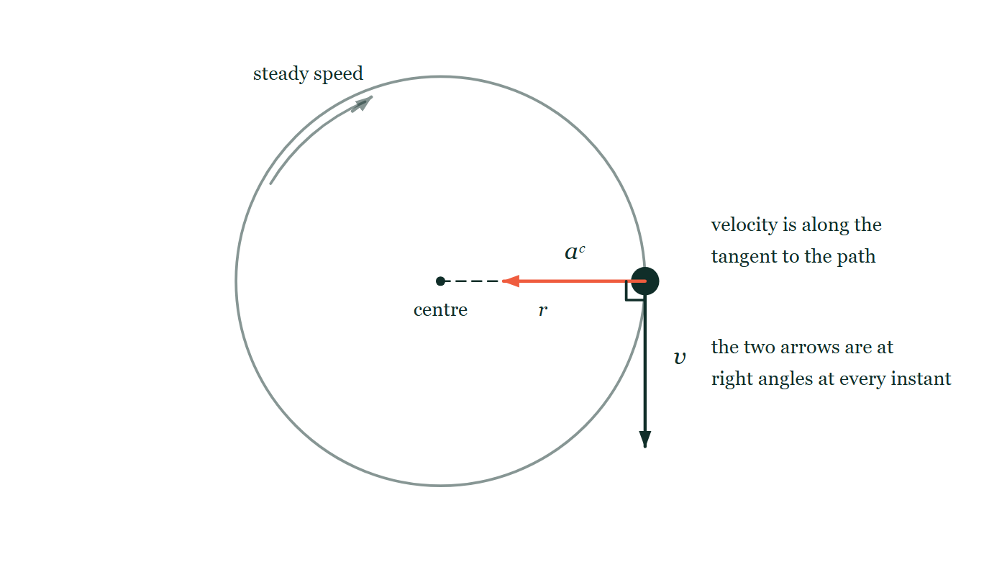
CIRCULAR MOTION · UNIFORM CIRCULAR MOTION
GIOPHYSICS LESSON
THE PICTURE
Two vectors at right angles
Drawn for this lesson
An object drawn at the far right of a circular path. From it, one arrow points straight down the page along the tangent and is labelled v; a second arrow points straight left, back along the radius toward the centre, and is labelled a. A small square marks the right angle between them, and a faint curved arrow shows the object going round at a steady speed.
The live version of this figure — click here
Circular Motion — Uniform Circular Motion. Built by GioPhysics from the lesson's own copy; nothing on these slides is re-authored.
12 / 32
Notes:
[Phase] Build the model: The formulae, one at a time, in plain English (minutes 13–22 of 45)
[Figure] An object drawn at the far right of a circular path. From it, one arrow points straight down the page along the tangent and is labelled v; a second arrow points straight left, back along the radius toward the centre, and is labelled a. A small square marks the right angle between them, and a faint curved arrow shows the object going round at a steady speed.

Slide 13
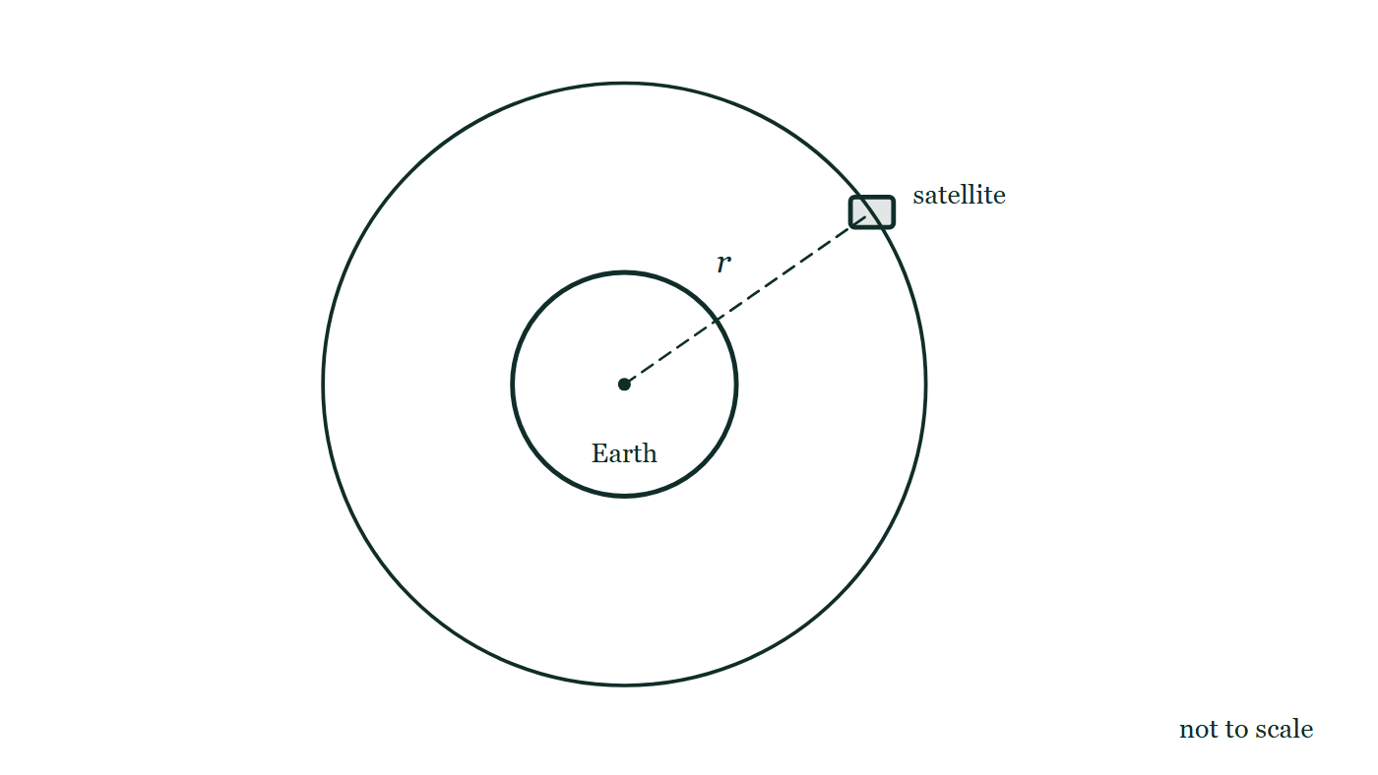
CIRCULAR MOTION · UNIFORM CIRCULAR MOTION
GIOPHYSICS LESSON
FIGURE
Fig. 7.1 — A Level · Topics 12–25
Drawn for question 7 of that paper · syllabus 12, 13
The Earth is drawn as a circle, labelled, with a dot marking its centre. A second, larger circle drawn concentric with it is the satellite's circular orbit. The satellite itself is a small block sitting on that larger circle, above and to the right of the Earth, and a dashed straight line runs from the dot at the centre of the Earth out to the satellite, labelled r. The figure is marked not to scale.
See the question this was drawn for — click here
Circular Motion — Uniform Circular Motion. Built by GioPhysics from the lesson's own copy; nothing on these slides is re-authored.
13 / 32
Notes:
[Phase] Build the model: The formulae, one at a time, in plain English (minutes 13–22 of 45)
[Figure] Fig. 7.1. The Earth is drawn as a circle, labelled, with a dot marking its centre. A second, larger circle drawn concentric with it is the satellite's circular orbit. The satellite itself is a small block sitting on that larger circle, above and to the right of the Earth, and a dashed straight line runs from the dot at the centre of the Earth out to the satellite, labelled r. The figure is marked not to scale.
[Where it came from] A Level · Topics 12–25, question 7; syllabus 12, 13.

Slide 14
CIRCULAR MOTION · UNIFORM CIRCULAR MOTION
GIOPHYSICS LESSON
WATCH OUT
The common trap
Check and misconception — The quick check and the trap
Uniform circular motion does not mean zero acceleration. Uniform refers to speed; velocity still changes because its direction changes.
Circular Motion — Uniform Circular Motion. Built by GioPhysics from the lesson's own copy; nothing on these slides is re-authored.
14 / 32
Notes:
[Phase] Check and misconception: The quick check and the trap (minutes 35–41 of 45)
[Misconception] Uniform circular motion does not mean zero acceleration. Uniform refers to speed; velocity still changes because its direction changes.

Slide 15
CIRCULAR MOTION · UNIFORM CIRCULAR MOTION
GIOPHYSICS LESSON
WORKED EXAMPLE 1 OF 2 · EASY
The question
Easy
Worked examples — I do, we do — one step revealed at a time
A ball moves in a circle of radius 2.0 m at 4.0 m/s. Find its centripetal acceleration.
Circular Motion — Uniform Circular Motion. Built by GioPhysics from the lesson's own copy; nothing on these slides is re-authored.
15 / 32
Notes:
[Phase] Worked examples: I do, we do — one step revealed at a time (minutes 22–35 of 45)
[Question] A ball moves in a circle of radius 2.0 m at 4.0 m/s. Find its centripetal acceleration.
[Answer] a = 8.0 m/s² inward

Slide 16
CIRCULAR MOTION · UNIFORM CIRCULAR MOTION
GIOPHYSICS LESSON
WORKED EXAMPLE 1 OF 2 · EASY · THE WORKING
How to solve it
Easy
Worked examples — I do, we do — one step revealed at a time
A ball moves in a circle of radius 2.0 m at 4.0 m/s. Find its centripetal acceleration.
1.
a = v²/r = 16 ÷ 2.0.
2.
a = 8.0 m/s² toward the centre.
Circular Motion — Uniform Circular Motion. Built by GioPhysics from the lesson's own copy; nothing on these slides is re-authored.
16 / 32
Notes:
[Phase] Worked examples: I do, we do — one step revealed at a time (minutes 22–35 of 45)
[Reveal] One click per step. The class works each line before the next appears.
[Step 1] a = v²/r = 16 ÷ 2.0.
[Step 2] a = 8.0 m/s² toward the centre.

Slide 17
CIRCULAR MOTION · UNIFORM CIRCULAR MOTION
GIOPHYSICS LESSON
WORKED EXAMPLE 1 OF 2 · EASY
Answer
Easy
Worked examples — I do, we do — one step revealed at a time
a = 8.0 m/s² inward
Circular Motion — Uniform Circular Motion. Built by GioPhysics from the lesson's own copy; nothing on these slides is re-authored.
17 / 32
Notes:
[Phase] Worked examples: I do, we do — one step revealed at a time (minutes 22–35 of 45)
[Answer] a = 8.0 m/s² inward

Slide 18
CIRCULAR MOTION · UNIFORM CIRCULAR MOTION
GIOPHYSICS LESSON
WORKED EXAMPLE 2 OF 2 · MEDIUM
The question
Medium
Worked examples — I do, we do — one step revealed at a time
A cyclist travels at 12 m/s around a bend of radius 30 m. Find the centripetal acceleration.
Circular Motion — Uniform Circular Motion. Built by GioPhysics from the lesson's own copy; nothing on these slides is re-authored.
18 / 32
Notes:
[Phase] Worked examples: I do, we do — one step revealed at a time (minutes 22–35 of 45)
[Question] A cyclist travels at 12 m/s around a bend of radius 30 m. Find the centripetal acceleration.
[Answer] aᶜ = 4.8 m/s² inward

Slide 19
CIRCULAR MOTION · UNIFORM CIRCULAR MOTION
GIOPHYSICS LESSON
WORKED EXAMPLE 2 OF 2 · MEDIUM · THE WORKING
How to solve it
Medium
Worked examples — I do, we do — one step revealed at a time
A cyclist travels at 12 m/s around a bend of radius 30 m. Find the centripetal acceleration.
1.
Use aᶜ = v²/r.
2.
aᶜ = 12²/30.
3.
The direction is toward the centre of the bend.
Circular Motion — Uniform Circular Motion. Built by GioPhysics from the lesson's own copy; nothing on these slides is re-authored.
19 / 32
Notes:
[Phase] Worked examples: I do, we do — one step revealed at a time (minutes 22–35 of 45)
[Reveal] One click per step. The class works each line before the next appears.
[Step 1] Use aᶜ = v²/r.
[Step 2] aᶜ = 12²/30.
[Step 3] The direction is toward the centre of the bend.

Slide 20
CIRCULAR MOTION · UNIFORM CIRCULAR MOTION
GIOPHYSICS LESSON
WORKED EXAMPLE 2 OF 2 · MEDIUM
Answer
Medium
Worked examples — I do, we do — one step revealed at a time
aᶜ = 4.8 m/s² inward
Circular Motion — Uniform Circular Motion. Built by GioPhysics from the lesson's own copy; nothing on these slides is re-authored.
20 / 32
Notes:
[Phase] Worked examples: I do, we do — one step revealed at a time (minutes 22–35 of 45)
[Answer] aᶜ = 4.8 m/s² inward

Slide 21
CIRCULAR MOTION · UNIFORM CIRCULAR MOTION
GIOPHYSICS LESSON
SPOT THE MISTAKE
One line here is wrong
The whole working is up — find the bad line before you click
1.
Gravity supplies the centripetal acceleration, so v = √(gr) = √(8.2 × 7.0 × 10⁶) ≈ 7.6 × 10³ m/s.
2.
One orbit is a circumference: T = 2πr/v = 2π × 7.0 × 10⁶ ÷ 7.6 × 10³.
3.
T ≈ 5.8 × 10³ s, so the satellite orbits once every 97 seconds.
LINE 3 IS WRONG
The arithmetic is right and the units are not. 5.8 × 10³ seconds was divided by sixty in the head to get 97 — and then the answer was reported in seconds anyway. A number that looks like a sensible orbital figure hides the slip: 97 minutes is a real low orbit, 97 seconds is faster than anything can travel.
IT SHOULD SAY
T ≈ 5.8 × 10³ s = 5.8 × 10³ ÷ 60 ≈ 97 minutes.
Circular Motion — Uniform Circular Motion. Built by GioPhysics from the lesson's own copy; nothing on these slides is re-authored.
21 / 32
Notes:
[Phase] Worked examples: I do, we do — one step revealed at a time (minutes 22–35 of 45)
[Spot the mistake] The working is complete and one line of it is wrong. Let the room hunt: one click names the line, a second shows it done correctly.
[Line 3 is wrong] The arithmetic is right and the units are not. 5.8 × 10³ seconds was divided by sixty in the head to get 97 — and then the answer was reported in seconds anyway. A number that looks like a sensible orbital figure hides the slip: 97 minutes is a real low orbit, 97 seconds is faster than anything can travel.
[It should say] T ≈ 5.8 × 10³ s = 5.8 × 10³ ÷ 60 ≈ 97 minutes.

Slide 22
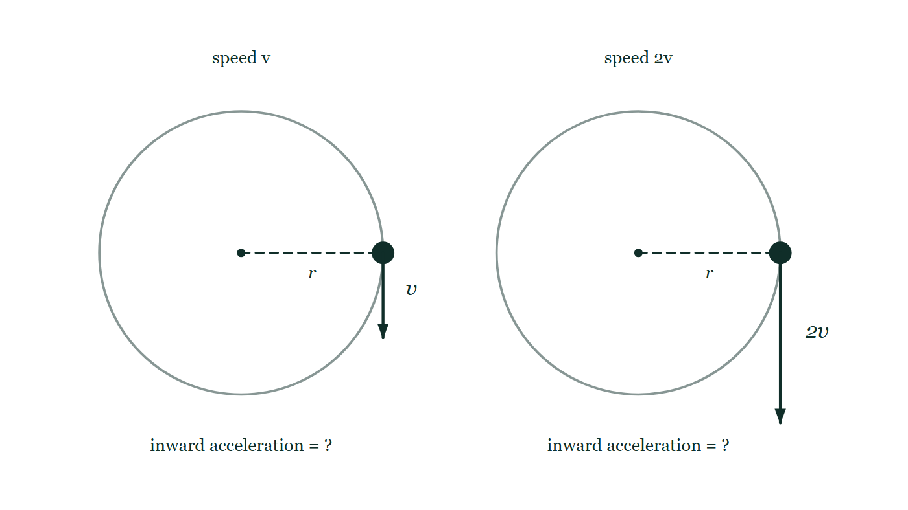
CIRCULAR MOTION · UNIFORM CIRCULAR MOTION
GIOPHYSICS LESSON
PREDICT · TAKE THE VOTE
Commit before you are told
Hands up for each option, then click
The right-hand object goes round the same circle at twice the speed. What happens to the inward acceleration?
A It doubles — twice the speed, twice the acceleration
B It becomes four times as large
C It stays the same — the speed is steady in both cases, so there is no acceleration to change
The same circle drawn twice at the same radius r. On the left the object carries a short tangential velocity arrow labelled v; on the right the identical object carries an arrow twice as long, labelled 2v. Under each circle the inward acceleration is left written as a question.
The live version of this figure — click here
Circular Motion — Uniform Circular Motion. Built by GioPhysics from the lesson's own copy; nothing on these slides is re-authored.
22 / 32
Notes:
[Phase] Build the model: The formulae, one at a time, in plain English (minutes 13–22 of 45)
[Predict] The right-hand object goes round the same circle at twice the speed. What happens to the inward acceleration?
[Options] A It doubles — twice the speed, twice the acceleration B It becomes four times as large C It stays the same — the speed is steady in both cases, so there is no acceleration to change
[Figure] The same circle drawn twice at the same radius r. On the left the object carries a short tangential velocity arrow labelled v; on the right the identical object carries an arrow twice as long, labelled 2v. Under each circle the inward acceleration is left written as a question.

Slide 23
CIRCULAR MOTION · UNIFORM CIRCULAR MOTION
GIOPHYSICS LESSON
PREDICT · THE OUTCOME
What actually happens
Ask the room who changed their mind, and why
B It becomes four times as large
WHY
The radius is drawn the same on both circles, so only v changes. In a = v²/r the speed appears squared: doubling v multiplies the inward acceleration by four. The faster object must turn through the same corner in half the time, and turning twice as sharply per second at twice the speed costs four times as much.
Circular Motion — Uniform Circular Motion. Built by GioPhysics from the lesson's own copy; nothing on these slides is re-authored.
23 / 32
Notes:
[Phase] Build the model: The formulae, one at a time, in plain English (minutes 13–22 of 45)
[Answer] B — It becomes four times as large. The radius is drawn the same on both circles, so only v changes. In a = v²/r the speed appears squared: doubling v multiplies the inward acceleration by four. The faster object must turn through the same corner in half the time, and turning twice as sharply per second at twice the speed costs four times as much.

Slide 24
CIRCULAR MOTION · UNIFORM CIRCULAR MOTION
GIOPHYSICS LESSON
QUICK CHECK
Decide before the answer goes up
Check and misconception — The quick check and the trap
If speed doubles while radius stays fixed, what happens to centripetal acceleration?
A
It doubles
B
It quadruples
C
It is unchanged
The same circle drawn twice at the same radius r. On the left the object carries a short tangential velocity arrow labelled v; on the right the identical object carries an arrow twice as long, labelled 2v. Under each circle the inward acceleration is left written as a question.
The live version of this figure — click here
Circular Motion — Uniform Circular Motion. Built by GioPhysics from the lesson's own copy; nothing on these slides is re-authored.
24 / 32
Notes:
[Phase] Check and misconception: The quick check and the trap (minutes 35–41 of 45)
[Question] If speed doubles while radius stays fixed, what happens to centripetal acceleration?
[Figure] The same circle drawn twice at the same radius r. On the left the object carries a short tangential velocity arrow labelled v; on the right the identical object carries an arrow twice as long, labelled 2v. Under each circle the inward acceleration is left written as a question.
[Options] A It doubles B It quadruples C It is unchanged

Slide 25
CIRCULAR MOTION · UNIFORM CIRCULAR MOTION
GIOPHYSICS LESSON
QUICK CHECK · THE ANSWER
The answer, and why
Check and misconception — The quick check and the trap
B It quadruples
HOW TO GET THERE
aᶜ = v²/r, so the speed factor is squared.
WHY THE OTHERS TEMPT
A This is the answer that comes from reading v²/r as though it were v/r. Every other formula in mechanics so far has been linear in speed, so proportionality is a well-trained habit — but here the speed enters twice, once for how sharply the direction must turn and once for how quickly it must be turned.
B Correct. With r fixed, aᶜ = v²/r depends on the square of the speed, so a factor of two on v becomes a factor of four on the acceleration. This is why cornering speed limits are so much more punishing than they look.
C 'Unchanged' is the answer if you believe uniform circular motion has no acceleration at all — the word 'uniform' does a lot of damage here. It refers only to the speed. The velocity is changing direction continuously, and that change is the acceleration.
Circular Motion — Uniform Circular Motion. Built by GioPhysics from the lesson's own copy; nothing on these slides is re-authored.
25 / 32
Notes:
[Phase] Check and misconception: The quick check and the trap (minutes 35–41 of 45)
[Question] If speed doubles while radius stays fixed, what happens to centripetal acceleration?
[Option by option] A: This is the answer that comes from reading v²/r as though it were v/r. Every other formula in mechanics so far has been linear in speed, so proportionality is a well-trained habit — but here the speed enters twice, once for how sharply the direction must turn and once for how quickly it must be turned. B: Correct. With r fixed, aᶜ = v²/r depends on the square of the speed, so a factor of two on v becomes a factor of four on the acceleration. This is why cornering speed limits are so much more punishing than they look. C: 'Unchanged' is the answer if you believe uniform circular motion has no acceleration at all — the word 'uniform' does a lot of damage here. It refers only to the speed. The velocity is changing direction continuously, and that change is the acceleration.
[Answer] B — It quadruples
[Why] aᶜ = v²/r, so the speed factor is squared.
[Reveal] One click for the answer, then one for the reason.

Slide 26
CIRCULAR MOTION · UNIFORM CIRCULAR MOTION
GIOPHYSICS LESSON
EXTENSION 1 OF 2 · HARD
The question
Hard
Worked examples — I do, we do — one step revealed at a time
A satellite orbits at radius 7.0 × 10⁶ m where g = 8.2 m/s². Find its orbital speed and period.
Circular Motion — Uniform Circular Motion. Built by GioPhysics from the lesson's own copy; nothing on these slides is re-authored.
26 / 32
Notes:
[Phase] Worked examples: I do, we do — one step revealed at a time (minutes 22–35 of 45)
[Question] A satellite orbits at radius 7.0 × 10⁶ m where g = 8.2 m/s². Find its orbital speed and period.
[Answer] v ≈ 7.6 km/s; T ≈ 97 min

Slide 27
CIRCULAR MOTION · UNIFORM CIRCULAR MOTION
GIOPHYSICS LESSON
EXTENSION 1 OF 2 · HARD · THE WORKING
How to solve it
Hard
Worked examples — I do, we do — one step revealed at a time
A satellite orbits at radius 7.0 × 10⁶ m where g = 8.2 m/s². Find its orbital speed and period.
1.
Gravity is the centripetal acceleration: v = √(gr) = √(8.2 × 7.0 × 10⁶) ≈ 7.6 × 10³ m/s.
2.
T = 2πr/v = 2π × 7.0 × 10⁶ ÷ 7.6 × 10³.
3.
T ≈ 5.8 × 10³ s ≈ 97 minutes.
Circular Motion — Uniform Circular Motion. Built by GioPhysics from the lesson's own copy; nothing on these slides is re-authored.
27 / 32
Notes:
[Phase] Worked examples: I do, we do — one step revealed at a time (minutes 22–35 of 45)
[Reveal] One click per step. The class works each line before the next appears.
[Step 1] Gravity is the centripetal acceleration: v = √(gr) = √(8.2 × 7.0 × 10⁶) ≈ 7.6 × 10³ m/s.
[Step 2] T = 2πr/v = 2π × 7.0 × 10⁶ ÷ 7.6 × 10³.
[Step 3] T ≈ 5.8 × 10³ s ≈ 97 minutes.

Slide 28
CIRCULAR MOTION · UNIFORM CIRCULAR MOTION
GIOPHYSICS LESSON
EXTENSION 1 OF 2 · HARD
Answer
Hard
Worked examples — I do, we do — one step revealed at a time
v ≈ 7.6 km/s; T ≈ 97 min
Circular Motion — Uniform Circular Motion. Built by GioPhysics from the lesson's own copy; nothing on these slides is re-authored.
28 / 32
Notes:
[Phase] Worked examples: I do, we do — one step revealed at a time (minutes 22–35 of 45)
[Answer] v ≈ 7.6 km/s; T ≈ 97 min

Slide 29
CIRCULAR MOTION · UNIFORM CIRCULAR MOTION
GIOPHYSICS LESSON
EXTENSION 2 OF 2 · CHALLENGING
The question
Challenging
Worked examples — I do, we do — one step revealed at a time
A conical-pendulum bob circles on a 1.5 m string at 20° from vertical. Find its speed.
Circular Motion — Uniform Circular Motion. Built by GioPhysics from the lesson's own copy; nothing on these slides is re-authored.
29 / 32
Notes:
[Phase] Worked examples: I do, we do — one step revealed at a time (minutes 22–35 of 45)
[Question] A conical-pendulum bob circles on a 1.5 m string at 20° from vertical. Find its speed.
[Answer] v ≈ 1.4 m/s

Slide 30
CIRCULAR MOTION · UNIFORM CIRCULAR MOTION
GIOPHYSICS LESSON
EXTENSION 2 OF 2 · CHALLENGING · THE WORKING
How to solve it
Challenging
Worked examples — I do, we do — one step revealed at a time
A conical-pendulum bob circles on a 1.5 m string at 20° from vertical. Find its speed.
1.
Vertical: T cos20° = mg. Horizontal: T sin20° = mv²/r with r = 1.5 sin20° ≈ 0.513 m.
2.
Divide: tan20° = v²/(rg) → v² = 0.513 × 9.81 × 0.364.
3.
v ≈ √1.83 ≈ 1.4 m/s.
Circular Motion — Uniform Circular Motion. Built by GioPhysics from the lesson's own copy; nothing on these slides is re-authored.
30 / 32
Notes:
[Phase] Worked examples: I do, we do — one step revealed at a time (minutes 22–35 of 45)
[Reveal] One click per step. The class works each line before the next appears.
[Step 1] Vertical: T cos20° = mg. Horizontal: T sin20° = mv²/r with r = 1.5 sin20° ≈ 0.513 m.
[Step 2] Divide: tan20° = v²/(rg) → v² = 0.513 × 9.81 × 0.364.
[Step 3] v ≈ √1.83 ≈ 1.4 m/s.

Slide 31
CIRCULAR MOTION · UNIFORM CIRCULAR MOTION
GIOPHYSICS LESSON
EXTENSION 2 OF 2 · CHALLENGING
Answer
Challenging
Worked examples — I do, we do — one step revealed at a time
v ≈ 1.4 m/s
Circular Motion — Uniform Circular Motion. Built by GioPhysics from the lesson's own copy; nothing on these slides is re-authored.
31 / 32
Notes:
[Phase] Worked examples: I do, we do — one step revealed at a time (minutes 22–35 of 45)
[Answer] v ≈ 1.4 m/s

Slide 32
CIRCULAR MOTION · UNIFORM CIRCULAR MOTION
GIOPHYSICS LESSON
CIRCULAR MOTION
Where to go next
Plenary — What to take away, what to practise next
Next
6.3 Centripetal Forces & Applications
https://giophysics.com/chapter-10/centripetal-forces-applications/
Lesson
This lesson on giophysics.com
https://giophysics.com/chapter-10/uniform-circular-motion/
Live
The live, interactive version of these slides
https://giophysics.com/chapter-10/presentation/?lesson=uniform
Chapter
All Circular Motion lessons
https://giophysics.com/chapter-10/
PDF
Download the lesson PDF
https://giophysics.com/downloads/10-2-uniform-circular-motion.pdf
Circular Motion — Uniform Circular Motion. Built by GioPhysics from the lesson's own copy; nothing on these slides is re-authored.
32 / 32
Notes:
[Phase] Plenary: What to take away, what to practise next (minutes 41–45 of 45)
[Interactive] The graphs and the circuit topology on these slides are frozen. The live version at https://giophysics.com/chapter-10/presentation/?lesson=uniform moves them.

