Slide 1
MATTER · ATMOSPHERIC PRESSURE & MANOMETERS
GIOPHYSICS LESSON
07 · Matter
Compare pressures with liquid levels
Atmospheric Pressure & Manometers
The atmosphere presses on every exposed surface. Barometers measure that pressure; manometers compare an unknown pressure with a reference.
POSITION
Lesson 5 of 7 in Matter
PLAN
16 slides in the 45-minute core run, about 44.5 minutes of it
LESSON PAGE
https://giophysics.com/chapter-13/atmospheric-pressure-manometers/
Built by GioPhysics from the lesson's own page. Every word on these slides is the lesson's; nothing here is re-authored. Teaching material, not an awarding body's document.
Matter — Atmospheric Pressure & Manometers. Built by GioPhysics from the lesson's own copy; nothing on these slides is re-authored.
1 / 31
Notes:
[Lesson] Matter — Atmospheric Pressure & Manometers. Lesson 5 of 7.
[Intro] The atmosphere presses on every exposed surface. Barometers measure that pressure; manometers compare an unknown pressure with a reference.
[Source] https://giophysics.com/chapter-13/atmospheric-pressure-manometers/
[Disclaimer] Built by GioPhysics from the lesson's own page. Every word on these slides is the lesson's; nothing here is re-authored. Teaching material, not an awarding body's document.

Slide 2
MATTER · ATMOSPHERIC PRESSURE & MANOMETERS
GIOPHYSICS LESSON
WHAT THIS NEEDS
What you already know
Starter — Recall what this lesson stands on
Recall
Pressure units & prefixes
https://giophysics.com/chapter-1/units/
Recall
Hydrostatic pressure
https://giophysics.com/chapter-13/pressure-fluids/
Matter — Atmospheric Pressure & Manometers. Built by GioPhysics from the lesson's own copy; nothing on these slides is re-authored.
2 / 31
Notes:
[Phase] Starter: Recall what this lesson stands on (minutes 0–5 of 45)
[Starter] Recall: Pressure units & prefixes; Hydrostatic pressure

Slide 3
MATTER · ATMOSPHERIC PRESSURE & MANOMETERS
GIOPHYSICS LESSON
THINK FIRST
Could you drink a milkshake through a straw twelve metres long?
Take answers before you click — the point is the commitment
A straw is only a tube, and a longer straw is only more of the same tube. Suck hard enough and surely the drink comes up.
THE ANSWER
No, and sucking harder cannot help. Sucking does not pull the drink up; it lowers the pressure at the top so the atmosphere, pressing on the surface in the glass, pushes the drink up instead. The atmosphere is worth about 101 kPa, which supports 101 000/(1000 × 9.81) ≈ 10.3 m of water. Beyond that even a perfect vacuum leaves the drink short of your mouth.
Matter — Atmospheric Pressure & Manometers. Built by GioPhysics from the lesson's own copy; nothing on these slides is re-authored.
3 / 31
Notes:
[Phase] Starter: Recall what this lesson stands on (minutes 0–5 of 45)
[Hook] Could you drink a milkshake through a straw twelve metres long? A straw is only a tube, and a longer straw is only more of the same tube. Suck hard enough and surely the drink comes up.
[Answer] No, and sucking harder cannot help. Sucking does not pull the drink up; it lowers the pressure at the top so the atmosphere, pressing on the surface in the glass, pushes the drink up instead. The atmosphere is worth about 101 kPa, which supports 101 000/(1000 × 9.81) ≈ 10.3 m of water. Beyond that even a perfect vacuum leaves the drink short of your mouth.

Slide 4
MATTER · ATMOSPHERIC PRESSURE & MANOMETERS
GIOPHYSICS LESSON
EXPLAINED SIMPLY
In one sentence
Introduce the idea — The big idea and the definition
Atmospheric pressure is the pressure caused by the air above us; a manometer compares one pressure with a reference using liquid levels.
Matter — Atmospheric Pressure & Manometers. Built by GioPhysics from the lesson's own copy; nothing on these slides is re-authored.
4 / 31
Notes:
[Phase] Introduce the idea: The big idea and the definition (minutes 5–13 of 45)
[Definition] Atmospheric pressure is the pressure caused by the air above us; a manometer compares one pressure with a reference using liquid levels.

Slide 5
MATTER · ATMOSPHERIC PRESSURE & MANOMETERS
GIOPHYSICS LESSON
EXPLAINED SIMPLY
What that looks like
Introduce the idea — The big idea and the definition
FOR EXAMPLE
If gas pushes the liquid lower on its side of an open U-tube, the gas pressure is greater than atmospheric pressure.
Matter — Atmospheric Pressure & Manometers. Built by GioPhysics from the lesson's own copy; nothing on these slides is re-authored.
5 / 31
Notes:
[Phase] Introduce the idea: The big idea and the definition (minutes 5–13 of 45)
[Worked illustration] If gas pushes the liquid lower on its side of an open U-tube, the gas pressure is greater than atmospheric pressure.

Slide 6
MATTER · ATMOSPHERIC PRESSURE & MANOMETERS
GIOPHYSICS LESSON
THE BIG IDEA
Compare pressures with liquid levels
Introduce the idea — The big idea and the definition
Gauge pressure is measured relative to the surrounding atmosphere, while absolute pressure is measured relative to vacuum. In an open U-tube, the lower liquid level lies on the higher-pressure side.
Matter — Atmospheric Pressure & Manometers. Built by GioPhysics from the lesson's own copy; nothing on these slides is re-authored.
6 / 31
Notes:
[Phase] Introduce the idea: The big idea and the definition (minutes 5–13 of 45)
[Big idea] Gauge pressure is measured relative to the surrounding atmosphere, while absolute pressure is measured relative to vacuum. In an open U-tube, the lower liquid level lies on the higher-pressure side.

Slide 7
MATTER · ATMOSPHERIC PRESSURE & MANOMETERS
GIOPHYSICS LESSON
THE PHYSICS · 1 OF 3
Follow equal levels
Build the model — The formulae, one at a time, in plain English
Pressure is equal at equal height within the same connected manometer liquid. Move vertically and add or subtract ρgh.
Matter — Atmospheric Pressure & Manometers. Built by GioPhysics from the lesson's own copy; nothing on these slides is re-authored.
7 / 31
Notes:
[Phase] Build the model: The formulae, one at a time, in plain English (minutes 13–22 of 45)
[Section] Pressure is equal at equal height within the same connected manometer liquid. Move vertically and add or subtract ρgh.

Slide 8
MATTER · ATMOSPHERIC PRESSURE & MANOMETERS
GIOPHYSICS LESSON
THE PHYSICS · 2 OF 3
Decide the sign
Build the model — The formulae, one at a time, in plain English
If the gas-side liquid is lower, gas pressure is above atmospheric. If it is higher, gas pressure is below atmospheric.
Matter — Atmospheric Pressure & Manometers. Built by GioPhysics from the lesson's own copy; nothing on these slides is re-authored.
8 / 31
Notes:
[Phase] Build the model: The formulae, one at a time, in plain English (minutes 13–22 of 45)
[Section] If the gas-side liquid is lower, gas pressure is above atmospheric. If it is higher, gas pressure is below atmospheric.

Slide 9
MATTER · ATMOSPHERIC PRESSURE & MANOMETERS
GIOPHYSICS LESSON
THE PHYSICS · 3 OF 3
Barometer
Build the model — The formulae, one at a time, in plain English
A barometer balances atmospheric pressure against a liquid column: Patm = ρgh when the space above is effectively a vacuum.
Matter — Atmospheric Pressure & Manometers. Built by GioPhysics from the lesson's own copy; nothing on these slides is re-authored.
9 / 31
Notes:
[Phase] Build the model: The formulae, one at a time, in plain English (minutes 13–22 of 45)
[Section] A barometer balances atmospheric pressure against a liquid column: Patm = ρgh when the space above is effectively a vacuum.

Slide 10
MATTER · ATMOSPHERIC PRESSURE & MANOMETERS
GIOPHYSICS LESSON
FORMULA 1 OF 3
Absolute and gauge
Build the model — The formulae, one at a time, in plain English
Pabs = Patm + Pgauge
Gauge pressure may be positive or negative
IN PLAIN ENGLISH
Gauges read pressure relative to the atmosphere; add atmospheric pressure to get the true total.
Matter — Atmospheric Pressure & Manometers. Built by GioPhysics from the lesson's own copy; nothing on these slides is re-authored.
10 / 31
Notes:
[Phase] Build the model: The formulae, one at a time, in plain English (minutes 13–22 of 45)
[Formula] Absolute and gauge: Pabs = Patm + Pgauge
[In plain English] Gauges read pressure relative to the atmosphere; add atmospheric pressure to get the true total.
[Note] Gauge pressure may be positive or negative

Slide 11
MATTER · ATMOSPHERIC PRESSURE & MANOMETERS
GIOPHYSICS LESSON
FORMULA 2 OF 3
Manometer difference
Build the model — The formulae, one at a time, in plain English
|ΔP| = ρgh
Use the vertical level difference, not tube length
IN PLAIN ENGLISH
In a U-tube, the height difference between the two liquid levels measures the pressure difference — vertical height, not tube length.
Matter — Atmospheric Pressure & Manometers. Built by GioPhysics from the lesson's own copy; nothing on these slides is re-authored.
11 / 31
Notes:
[Phase] Build the model: The formulae, one at a time, in plain English (minutes 13–22 of 45)
[Formula] Manometer difference: |ΔP| = ρgh
[In plain English] In a U-tube, the height difference between the two liquid levels measures the pressure difference — vertical height, not tube length.
[Note] Use the vertical level difference, not tube length

Slide 12
MATTER · ATMOSPHERIC PRESSURE & MANOMETERS
GIOPHYSICS LESSON
FORMULA 3 OF 3
Standard atmosphere
Build the model — The formulae, one at a time, in plain English
1 atm ≈ 1.013 × 10⁵ Pa
Often rounded to 100 kPa in estimates
IN PLAIN ENGLISH
The weight of the whole atmosphere pressing on each square metre — about 100,000 pascals at sea level.
Matter — Atmospheric Pressure & Manometers. Built by GioPhysics from the lesson's own copy; nothing on these slides is re-authored.
12 / 31
Notes:
[Phase] Build the model: The formulae, one at a time, in plain English (minutes 13–22 of 45)
[Formula] Standard atmosphere: 1 atm ≈ 1.013 × 10⁵ Pa
[In plain English] The weight of the whole atmosphere pressing on each square metre — about 100,000 pascals at sea level.
[Note] Often rounded to 100 kPa in estimates

Slide 13
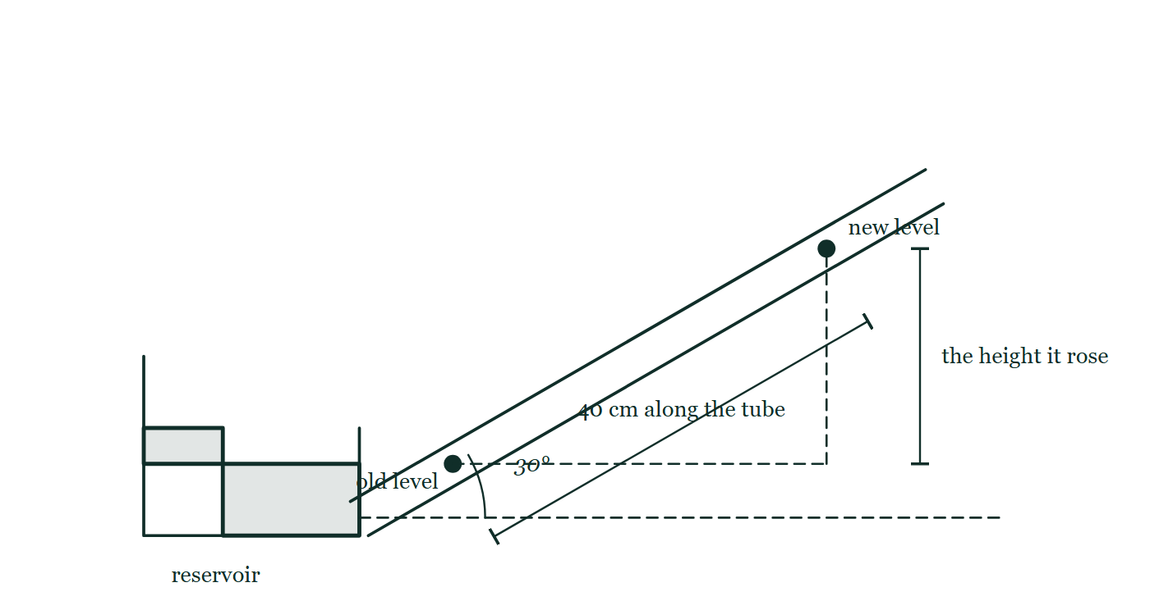
MATTER · ATMOSPHERIC PRESSURE & MANOMETERS
GIOPHYSICS LESSON
THE PICTURE
Along the tube, or straight up?
Drawn for this lesson
A manometer with its right arm tilted at 30° to the horizontal: the liquid has run 40 cm along that sloping tube, and the vertical rise from the old level to the new one is drawn as a separate dashed height.
The live version of this figure — click here
Matter — Atmospheric Pressure & Manometers. Built by GioPhysics from the lesson's own copy; nothing on these slides is re-authored.
13 / 31
Notes:
[Phase] Build the model: The formulae, one at a time, in plain English (minutes 13–22 of 45)
[Figure] A manometer with its right arm tilted at 30° to the horizontal: the liquid has run 40 cm along that sloping tube, and the vertical rise from the old level to the new one is drawn as a separate dashed height.

Slide 14
MATTER · ATMOSPHERIC PRESSURE & MANOMETERS
GIOPHYSICS LESSON
WATCH OUT
The common trap
Check and misconception — The quick check and the trap
The length of liquid along a tilted tube is not h. Hydrostatic pressure depends only on the vertical height difference between levels.
Matter — Atmospheric Pressure & Manometers. Built by GioPhysics from the lesson's own copy; nothing on these slides is re-authored.
14 / 31
Notes:
[Phase] Check and misconception: The quick check and the trap (minutes 35–41 of 45)
[Misconception] The length of liquid along a tilted tube is not h. Hydrostatic pressure depends only on the vertical height difference between levels.

Slide 15
MATTER · ATMOSPHERIC PRESSURE & MANOMETERS
GIOPHYSICS LESSON
WORKED EXAMPLE 1 OF 2 · EASY
The question
Easy
Worked examples — I do, we do — one step revealed at a time
A mercury barometer stands at 760 mm (ρ = 13 600 kg/m³). Confirm atmospheric pressure in Pa.
Matter — Atmospheric Pressure & Manometers. Built by GioPhysics from the lesson's own copy; nothing on these slides is re-authored.
15 / 31
Notes:
[Phase] Worked examples: I do, we do — one step revealed at a time (minutes 22–35 of 45)
[Question] A mercury barometer stands at 760 mm (ρ = 13 600 kg/m³). Confirm atmospheric pressure in Pa.
[Answer] ≈ 101 kPa

Slide 16
MATTER · ATMOSPHERIC PRESSURE & MANOMETERS
GIOPHYSICS LESSON
WORKED EXAMPLE 1 OF 2 · EASY · THE WORKING
How to solve it
Easy
Worked examples — I do, we do — one step revealed at a time
A mercury barometer stands at 760 mm (ρ = 13 600 kg/m³). Confirm atmospheric pressure in Pa.
1.
P = ρgh = 13600 × 9.81 × 0.760.
2.
P ≈ 1.01 × 10⁵ Pa.
Matter — Atmospheric Pressure & Manometers. Built by GioPhysics from the lesson's own copy; nothing on these slides is re-authored.
16 / 31
Notes:
[Phase] Worked examples: I do, we do — one step revealed at a time (minutes 22–35 of 45)
[Reveal] One click per step. The class works each line before the next appears.
[Step 1] P = ρgh = 13600 × 9.81 × 0.760.
[Step 2] P ≈ 1.01 × 10⁵ Pa.

Slide 17
MATTER · ATMOSPHERIC PRESSURE & MANOMETERS
GIOPHYSICS LESSON
WORKED EXAMPLE 1 OF 2 · EASY
Answer
Easy
Worked examples — I do, we do — one step revealed at a time
≈ 101 kPa
Matter — Atmospheric Pressure & Manometers. Built by GioPhysics from the lesson's own copy; nothing on these slides is re-authored.
17 / 31
Notes:
[Phase] Worked examples: I do, we do — one step revealed at a time (minutes 22–35 of 45)
[Answer] ≈ 101 kPa

Slide 18
MATTER · ATMOSPHERIC PRESSURE & MANOMETERS
GIOPHYSICS LESSON
WORKED EXAMPLE 2 OF 2 · MEDIUM
The question
Medium
Worked examples — I do, we do — one step revealed at a time
An open water manometer shows the gas-side level 0.18 m lower than the open side. Patm = 101 kPa. Find the gas pressure.
Matter — Atmospheric Pressure & Manometers. Built by GioPhysics from the lesson's own copy; nothing on these slides is re-authored.
18 / 31
Notes:
[Phase] Worked examples: I do, we do — one step revealed at a time (minutes 22–35 of 45)
[Question] An open water manometer shows the gas-side level 0.18 m lower than the open side. Patm = 101 kPa. Find the gas pressure.
[Answer] Pgas ≈ 102.8 kPa absolute

Slide 19
MATTER · ATMOSPHERIC PRESSURE & MANOMETERS
GIOPHYSICS LESSON
WORKED EXAMPLE 2 OF 2 · MEDIUM · THE WORKING
How to solve it
Medium
Worked examples — I do, we do — one step revealed at a time
An open water manometer shows the gas-side level 0.18 m lower than the open side. Patm = 101 kPa. Find the gas pressure.
1.
The gas-side level is lower, so Pgas is greater than Patm.
2.
ΔP = ρgh = (1000)(9.81)(0.18) = 1766 Pa = 1.77 kPa.
3.
Pgas = Patm + ΔP = 101 + 1.77 kPa.
Matter — Atmospheric Pressure & Manometers. Built by GioPhysics from the lesson's own copy; nothing on these slides is re-authored.
19 / 31
Notes:
[Phase] Worked examples: I do, we do — one step revealed at a time (minutes 22–35 of 45)
[Reveal] One click per step. The class works each line before the next appears.
[Step 1] The gas-side level is lower, so Pgas is greater than Patm.
[Step 2] ΔP = ρgh = (1000)(9.81)(0.18) = 1766 Pa = 1.77 kPa.
[Step 3] Pgas = Patm + ΔP = 101 + 1.77 kPa.

Slide 20
MATTER · ATMOSPHERIC PRESSURE & MANOMETERS
GIOPHYSICS LESSON
WORKED EXAMPLE 2 OF 2 · MEDIUM
Answer
Medium
Worked examples — I do, we do — one step revealed at a time
Pgas ≈ 102.8 kPa absolute
Matter — Atmospheric Pressure & Manometers. Built by GioPhysics from the lesson's own copy; nothing on these slides is re-authored.
20 / 31
Notes:
[Phase] Worked examples: I do, we do — one step revealed at a time (minutes 22–35 of 45)
[Answer] Pgas ≈ 102.8 kPa absolute

Slide 21
MATTER · ATMOSPHERIC PRESSURE & MANOMETERS
GIOPHYSICS LESSON
PREDICT · TAKE THE VOTE
Commit before you are told
Hands up for each option, then click
The liquid has run 40 cm along the tilted arm, which sits at 30° to the horizontal. Which length belongs in ΔP = ρgh?
A 40 cm, the length of liquid that actually moved
B 20 cm, the vertical height it rose
C 30 cm, somewhere between the two
A manometer with its right arm tilted at 30° to the horizontal: the liquid has run 40 cm along that sloping tube, and the vertical rise from the old level to the new one is drawn as a separate dashed height.
The live version of this figure — click here
Matter — Atmospheric Pressure & Manometers. Built by GioPhysics from the lesson's own copy; nothing on these slides is re-authored.
21 / 31
Notes:
[Phase] Build the model: The formulae, one at a time, in plain English (minutes 13–22 of 45)
[Predict] The liquid has run 40 cm along the tilted arm, which sits at 30° to the horizontal. Which length belongs in ΔP = ρgh?
[Options] A 40 cm, the length of liquid that actually moved B 20 cm, the vertical height it rose C 30 cm, somewhere between the two
[Figure] A manometer with its right arm tilted at 30° to the horizontal: the liquid has run 40 cm along that sloping tube, and the vertical rise from the old level to the new one is drawn as a separate dashed height.

Slide 22
MATTER · ATMOSPHERIC PRESSURE & MANOMETERS
GIOPHYSICS LESSON
PREDICT · THE OUTCOME
What actually happens
Ask the room who changed their mind, and why
B 20 cm, the vertical height it rose
WHY
Hydrostatic pressure counts the weight of liquid stacked above a point, and only vertical stacking counts — a metre of tube laid flat adds nothing at all. Running 40 cm along a 30° tube lifts the liquid 40 sin 30° = 20 cm, and it is that 20 cm that goes into ρgh. Tilting the arm turns a small height into a long, easily read movement, which is exactly why inclined manometers are built that way.
Matter — Atmospheric Pressure & Manometers. Built by GioPhysics from the lesson's own copy; nothing on these slides is re-authored.
22 / 31
Notes:
[Phase] Build the model: The formulae, one at a time, in plain English (minutes 13–22 of 45)
[Answer] B — 20 cm, the vertical height it rose. Hydrostatic pressure counts the weight of liquid stacked above a point, and only vertical stacking counts — a metre of tube laid flat adds nothing at all. Running 40 cm along a 30° tube lifts the liquid 40 sin 30° = 20 cm, and it is that 20 cm that goes into ρgh. Tilting the arm turns a small height into a long, easily read movement, which is exactly why inclined manometers are built that way.

Slide 23
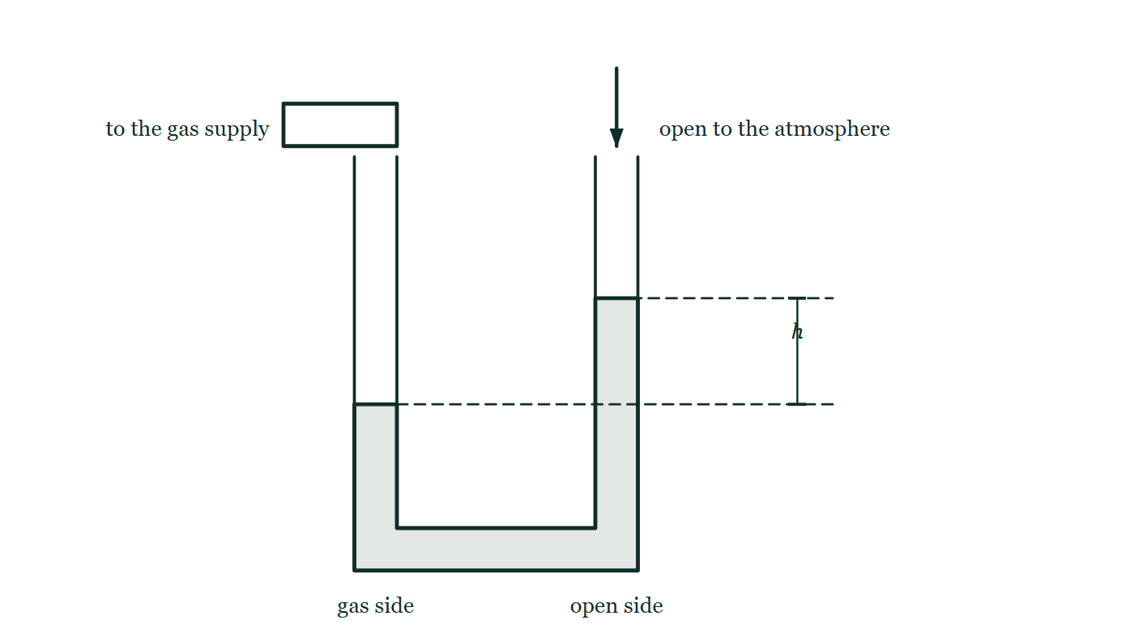
MATTER · ATMOSPHERIC PRESSURE & MANOMETERS
GIOPHYSICS LESSON
QUICK CHECK
Decide before the answer goes up
Check and misconception — The quick check and the trap
In an open U-tube, the liquid level is lower on the gas side. What does that show?
A
Pgas > Patm
B
Pgas = Patm
C
Pgas < Patm
An open U-tube manometer has a gas supply sealed onto its left arm and its right arm open to the air; the liquid stands lower in the gas arm than the open arm, and the height difference between the two levels is marked h.
The live version of this figure — click here
Matter — Atmospheric Pressure & Manometers. Built by GioPhysics from the lesson's own copy; nothing on these slides is re-authored.
23 / 31
Notes:
[Phase] Check and misconception: The quick check and the trap (minutes 35–41 of 45)
[Question] In an open U-tube, the liquid level is lower on the gas side. What does that show?
[Figure] An open U-tube manometer has a gas supply sealed onto its left arm and its right arm open to the air; the liquid stands lower in the gas arm than the open arm, and the height difference between the two levels is marked h.
[Options] A Pgas > Patm B Pgas = Patm C Pgas < Patm

Slide 24
MATTER · ATMOSPHERIC PRESSURE & MANOMETERS
GIOPHYSICS LESSON
QUICK CHECK · THE ANSWER
The answer, and why
Check and misconception — The quick check and the trap
A Pgas > Patm
HOW TO GET THERE
The higher gas pressure pushes its side down and the open side up.
WHY THE OTHERS TEMPT
A Correct. Something has pushed that side down and the other side up, and there are only two candidates — the gas and the atmosphere. The gas is winning.
B Equal pressures give equal levels; that is a manometer reading zero. Any height difference at all says the two sides are not in balance.
C This is the natural reading of "lower", and it is inverted. The side pushed DOWN is the side being pressed hardest. A gas weaker than the atmosphere gets driven back up its own arm, and it is the open side that falls.
Matter — Atmospheric Pressure & Manometers. Built by GioPhysics from the lesson's own copy; nothing on these slides is re-authored.
24 / 31
Notes:
[Phase] Check and misconception: The quick check and the trap (minutes 35–41 of 45)
[Question] In an open U-tube, the liquid level is lower on the gas side. What does that show?
[Option by option] A: Correct. Something has pushed that side down and the other side up, and there are only two candidates — the gas and the atmosphere. The gas is winning. B: Equal pressures give equal levels; that is a manometer reading zero. Any height difference at all says the two sides are not in balance. C: This is the natural reading of "lower", and it is inverted. The side pushed DOWN is the side being pressed hardest. A gas weaker than the atmosphere gets driven back up its own arm, and it is the open side that falls.
[Answer] A — Pgas > Patm
[Why] The higher gas pressure pushes its side down and the open side up.
[Reveal] One click for the answer, then one for the reason.

Slide 25
MATTER · ATMOSPHERIC PRESSURE & MANOMETERS
GIOPHYSICS LESSON
EXTENSION 1 OF 2 · HARD
The question
Hard
Worked examples — I do, we do — one step revealed at a time
An open-tube water manometer connects to a gas supply; the open side stands 24 cm higher than the gas side. Find the gas's gauge and absolute pressure (Patm = 101 kPa).
Matter — Atmospheric Pressure & Manometers. Built by GioPhysics from the lesson's own copy; nothing on these slides is re-authored.
25 / 31
Notes:
[Phase] Worked examples: I do, we do — one step revealed at a time (minutes 22–35 of 45)
[Question] An open-tube water manometer connects to a gas supply; the open side stands 24 cm higher than the gas side. Find the gas's gauge and absolute pressure (Patm = 101 kPa).
[Answer] Gauge ≈ +2.4 kPa; absolute ≈ 103 kPa

Slide 26
MATTER · ATMOSPHERIC PRESSURE & MANOMETERS
GIOPHYSICS LESSON
EXTENSION 1 OF 2 · HARD · THE WORKING
How to solve it
Hard
Worked examples — I do, we do — one step revealed at a time
An open-tube water manometer connects to a gas supply; the open side stands 24 cm higher than the gas side. Find the gas's gauge and absolute pressure (Patm = 101 kPa).
1.
Higher open side means the gas pushes the liquid down: gas is ABOVE atmospheric.
2.
Gauge = ρgh = 1000 × 9.81 × 0.24 ≈ 2.4 kPa.
3.
Absolute = 101 + 2.4 ≈ 103 kPa.
Matter — Atmospheric Pressure & Manometers. Built by GioPhysics from the lesson's own copy; nothing on these slides is re-authored.
26 / 31
Notes:
[Phase] Worked examples: I do, we do — one step revealed at a time (minutes 22–35 of 45)
[Reveal] One click per step. The class works each line before the next appears.
[Step 1] Higher open side means the gas pushes the liquid down: gas is ABOVE atmospheric.
[Step 2] Gauge = ρgh = 1000 × 9.81 × 0.24 ≈ 2.4 kPa.
[Step 3] Absolute = 101 + 2.4 ≈ 103 kPa.

Slide 27
MATTER · ATMOSPHERIC PRESSURE & MANOMETERS
GIOPHYSICS LESSON
EXTENSION 1 OF 2 · HARD
Answer
Hard
Worked examples — I do, we do — one step revealed at a time
Gauge ≈ +2.4 kPa; absolute ≈ 103 kPa
Matter — Atmospheric Pressure & Manometers. Built by GioPhysics from the lesson's own copy; nothing on these slides is re-authored.
27 / 31
Notes:
[Phase] Worked examples: I do, we do — one step revealed at a time (minutes 22–35 of 45)
[Answer] Gauge ≈ +2.4 kPa; absolute ≈ 103 kPa

Slide 28
MATTER · ATMOSPHERIC PRESSURE & MANOMETERS
GIOPHYSICS LESSON
EXTENSION 2 OF 2 · CHALLENGING
The question
Challenging
Worked examples — I do, we do — one step revealed at a time
Could you drink through a 12 m straw at sea level? Justify with the physics of suction.
Matter — Atmospheric Pressure & Manometers. Built by GioPhysics from the lesson's own copy; nothing on these slides is re-authored.
28 / 31
Notes:
[Phase] Worked examples: I do, we do — one step revealed at a time (minutes 22–35 of 45)
[Question] Could you drink through a 12 m straw at sea level? Justify with the physics of suction.
[Answer] No — the atmosphere maxes out at ≈ 10.3 m of water lift

Slide 29
MATTER · ATMOSPHERIC PRESSURE & MANOMETERS
GIOPHYSICS LESSON
EXTENSION 2 OF 2 · CHALLENGING · THE WORKING
How to solve it
Challenging
Worked examples — I do, we do — one step revealed at a time
Could you drink through a 12 m straw at sea level? Justify with the physics of suction.
1.
Suction only removes pressure above the liquid; the atmosphere does the lifting.
2.
The atmosphere can support at most h = Patm/ρg = 101 000 ÷ (1000 × 9.81) ≈ 10.3 m of water.
3.
Even a perfect vacuum in the straw lifts water only ~10.3 m — a 12 m straw can never deliver.
Matter — Atmospheric Pressure & Manometers. Built by GioPhysics from the lesson's own copy; nothing on these slides is re-authored.
29 / 31
Notes:
[Phase] Worked examples: I do, we do — one step revealed at a time (minutes 22–35 of 45)
[Reveal] One click per step. The class works each line before the next appears.
[Step 1] Suction only removes pressure above the liquid; the atmosphere does the lifting.
[Step 2] The atmosphere can support at most h = Patm/ρg = 101 000 ÷ (1000 × 9.81) ≈ 10.3 m of water.
[Step 3] Even a perfect vacuum in the straw lifts water only ~10.3 m — a 12 m straw can never deliver.

Slide 30
MATTER · ATMOSPHERIC PRESSURE & MANOMETERS
GIOPHYSICS LESSON
EXTENSION 2 OF 2 · CHALLENGING
Answer
Challenging
Worked examples — I do, we do — one step revealed at a time
No — the atmosphere maxes out at ≈ 10.3 m of water lift
Matter — Atmospheric Pressure & Manometers. Built by GioPhysics from the lesson's own copy; nothing on these slides is re-authored.
30 / 31
Notes:
[Phase] Worked examples: I do, we do — one step revealed at a time (minutes 22–35 of 45)
[Answer] No — the atmosphere maxes out at ≈ 10.3 m of water lift

Slide 31
MATTER · ATMOSPHERIC PRESSURE & MANOMETERS
GIOPHYSICS LESSON
MATTER
Where to go next
Plenary — What to take away, what to practise next
Next
7.6 Buoyancy & Archimedes’ Principle
https://giophysics.com/chapter-13/buoyancy-archimedes-principle/
Lesson
This lesson on giophysics.com
https://giophysics.com/chapter-13/atmospheric-pressure-manometers/
Live
The live, interactive version of these slides
https://giophysics.com/chapter-13/presentation/?lesson=atmosphere
Chapter
All Matter lessons
https://giophysics.com/chapter-13/
PDF
Download the lesson PDF
https://giophysics.com/downloads/13-5-atmospheric-pressure-manometers.pdf
Matter — Atmospheric Pressure & Manometers. Built by GioPhysics from the lesson's own copy; nothing on these slides is re-authored.
31 / 31
Notes:
[Phase] Plenary: What to take away, what to practise next (minutes 41–45 of 45)
[Interactive] The graphs and the circuit topology on these slides are frozen. The live version at https://giophysics.com/chapter-13/presentation/?lesson=atmosphere moves them.

