Slide 1
MATTER · BUOYANCY & ARCHIMEDES’ PRINCIPLE
GIOPHYSICS LESSON
07 · Matter
A pressure difference creates lift
Buoyancy & Archimedes’ Principle
Pressure is greater on the lower parts of an immersed object than on its upper parts. The resulting upward force equals the weight of displaced fluid.
POSITION
Lesson 6 of 7 in Matter
PLAN
16 slides in the 45-minute core run, about 44.5 minutes of it
LESSON PAGE
https://giophysics.com/chapter-13/buoyancy-archimedes-principle/
Built by GioPhysics from the lesson's own page. Every word on these slides is the lesson's; nothing here is re-authored. Teaching material, not an awarding body's document.
Matter — Buoyancy & Archimedes’ Principle. Built by GioPhysics from the lesson's own copy; nothing on these slides is re-authored.
1 / 31
Notes:
[Lesson] Matter — Buoyancy & Archimedes’ Principle. Lesson 6 of 7.
[Intro] Pressure is greater on the lower parts of an immersed object than on its upper parts. The resulting upward force equals the weight of displaced fluid.
[Source] https://giophysics.com/chapter-13/buoyancy-archimedes-principle/
[Disclaimer] Built by GioPhysics from the lesson's own page. Every word on these slides is the lesson's; nothing here is re-authored. Teaching material, not an awarding body's document.

Slide 2
MATTER · BUOYANCY & ARCHIMEDES’ PRINCIPLE
GIOPHYSICS LESSON
WHAT THIS NEEDS
What you already know
Starter — Recall what this lesson stands on
Recall
Weight forces
https://giophysics.com/chapter-3/applied-weight-normal-forces/
Recall
Free-body diagrams
https://giophysics.com/chapter-3/free-body-diagrams-net-forces/
Matter — Buoyancy & Archimedes’ Principle. Built by GioPhysics from the lesson's own copy; nothing on these slides is re-authored.
2 / 31
Notes:
[Phase] Starter: Recall what this lesson stands on (minutes 0–5 of 45)
[Starter] Recall: Weight forces; Free-body diagrams

Slide 3
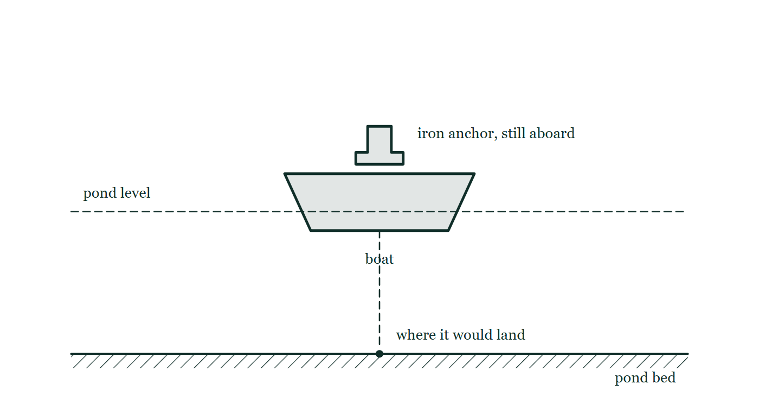
MATTER · BUOYANCY & ARCHIMEDES’ PRINCIPLE
GIOPHYSICS LESSON
THINK FIRST
You are in a boat on a small pond, holding a heavy iron anchor. You drop it over the side. Does the pond's level rise, fall, or stay the same?
Take answers before you click — the point is the commitment
The anchor was in the pond's boat and is now on the pond's bottom. Nothing has left the pond and nothing has been added to it.
THE ANSWER
It falls. Carried in the boat, the anchor made the boat displace its own WEIGHT of water. Lying on the bottom it displaces only its own VOLUME — and iron is about eight times denser than water, so that volume is about eight times smaller than the water it was displacing before. Buoyancy is always about the fluid pushed aside, never about the object's mass.
A small boat floats on a pond with a heavy anchor sitting in it; the water level is drawn as a dashed line across the whole pond, and the pond bed below is hatched with the anchor's landing place dotted on it.
The live version of this figure — click here
Matter — Buoyancy & Archimedes’ Principle. Built by GioPhysics from the lesson's own copy; nothing on these slides is re-authored.
3 / 31
Notes:
[Phase] Starter: Recall what this lesson stands on (minutes 0–5 of 45)
[Hook] You are in a boat on a small pond, holding a heavy iron anchor. You drop it over the side. Does the pond's level rise, fall, or stay the same? The anchor was in the pond's boat and is now on the pond's bottom. Nothing has left the pond and nothing has been added to it.
[Answer] It falls. Carried in the boat, the anchor made the boat displace its own WEIGHT of water. Lying on the bottom it displaces only its own VOLUME — and iron is about eight times denser than water, so that volume is about eight times smaller than the water it was displacing before. Buoyancy is always about the fluid pushed aside, never about the object's mass.
[Figure] A small boat floats on a pond with a heavy anchor sitting in it; the water level is drawn as a dashed line across the whole pond, and the pond bed below is hatched with the anchor's landing place dotted on it.

Slide 4
MATTER · BUOYANCY & ARCHIMEDES’ PRINCIPLE
GIOPHYSICS LESSON
EXPLAINED SIMPLY
In one sentence
Introduce the idea — The big idea and the definition
Buoyant force is the upward force a fluid exerts on an immersed object, equal to the weight of the displaced fluid.
Matter — Buoyancy & Archimedes’ Principle. Built by GioPhysics from the lesson's own copy; nothing on these slides is re-authored.
4 / 31
Notes:
[Phase] Introduce the idea: The big idea and the definition (minutes 5–13 of 45)
[Definition] Buoyant force is the upward force a fluid exerts on an immersed object, equal to the weight of the displaced fluid.

Slide 5
MATTER · BUOYANCY & ARCHIMEDES’ PRINCIPLE
GIOPHYSICS LESSON
EXPLAINED SIMPLY
What that looks like
Introduce the idea — The big idea and the definition
FOR EXAMPLE
A boat floats when it displaces enough water for the upward buoyant force to balance its weight.
Matter — Buoyancy & Archimedes’ Principle. Built by GioPhysics from the lesson's own copy; nothing on these slides is re-authored.
5 / 31
Notes:
[Phase] Introduce the idea: The big idea and the definition (minutes 5–13 of 45)
[Worked illustration] A boat floats when it displaces enough water for the upward buoyant force to balance its weight.

Slide 6
MATTER · BUOYANCY & ARCHIMEDES’ PRINCIPLE
GIOPHYSICS LESSON
THE BIG IDEA
A pressure difference creates lift
Introduce the idea — The big idea and the definition
Archimedes’ principle determines buoyant force from the displaced fluid—not directly from the object's mass. Compare buoyant force with weight on a free-body diagram to predict the initial acceleration.
Matter — Buoyancy & Archimedes’ Principle. Built by GioPhysics from the lesson's own copy; nothing on these slides is re-authored.
6 / 31
Notes:
[Phase] Introduce the idea: The big idea and the definition (minutes 5–13 of 45)
[Big idea] Archimedes’ principle determines buoyant force from the displaced fluid—not directly from the object's mass. Compare buoyant force with weight on a free-body diagram to predict the initial acceleration.

Slide 7
MATTER · BUOYANCY & ARCHIMEDES’ PRINCIPLE
GIOPHYSICS LESSON
THE PHYSICS · 1 OF 3
Fully submerged
Build the model — The formulae, one at a time, in plain English
For an incompressible fluid and fixed object volume, buoyant force is independent of depth; the pressure difference remains ρg times the object's height.
Matter — Buoyancy & Archimedes’ Principle. Built by GioPhysics from the lesson's own copy; nothing on these slides is re-authored.
7 / 31
Notes:
[Phase] Build the model: The formulae, one at a time, in plain English (minutes 13–22 of 45)
[Section] For an incompressible fluid and fixed object volume, buoyant force is independent of depth; the pressure difference remains ρg times the object's height.

Slide 8
MATTER · BUOYANCY & ARCHIMEDES’ PRINCIPLE
GIOPHYSICS LESSON
THE PHYSICS · 2 OF 3
Floating equilibrium
Build the model — The formulae, one at a time, in plain English
A floating object displaces just enough fluid for FB = W. Less-dense objects need a smaller submerged fraction.
Matter — Buoyancy & Archimedes’ Principle. Built by GioPhysics from the lesson's own copy; nothing on these slides is re-authored.
8 / 31
Notes:
[Phase] Build the model: The formulae, one at a time, in plain English (minutes 13–22 of 45)
[Section] A floating object displaces just enough fluid for FB = W. Less-dense objects need a smaller submerged fraction.

Slide 9
MATTER · BUOYANCY & ARCHIMEDES’ PRINCIPLE
GIOPHYSICS LESSON
THE PHYSICS · 3 OF 3
Free-body check
Build the model — The formulae, one at a time, in plain English
FB > W gives initial upward acceleration; FB < W gives downward acceleration. Equality means zero net vertical force.
Matter — Buoyancy & Archimedes’ Principle. Built by GioPhysics from the lesson's own copy; nothing on these slides is re-authored.
9 / 31
Notes:
[Phase] Build the model: The formulae, one at a time, in plain English (minutes 13–22 of 45)
[Section] FB > W gives initial upward acceleration; FB < W gives downward acceleration. Equality means zero net vertical force.

Slide 10
MATTER · BUOYANCY & ARCHIMEDES’ PRINCIPLE
GIOPHYSICS LESSON
FORMULA 1 OF 3
Buoyant force
Build the model — The formulae, one at a time, in plain English
FB = ρfluid gVdisplaced
Equal to the weight of displaced fluid
IN PLAIN ENGLISH
The upward push on a submerged object equals the weight of the fluid it shoved aside — Archimedes' principle.
Matter — Buoyancy & Archimedes’ Principle. Built by GioPhysics from the lesson's own copy; nothing on these slides is re-authored.
10 / 31
Notes:
[Phase] Build the model: The formulae, one at a time, in plain English (minutes 13–22 of 45)
[Formula] Buoyant force: FB = ρfluid gVdisplaced
[In plain English] The upward push on a submerged object equals the weight of the fluid it shoved aside — Archimedes' principle.
[Note] Equal to the weight of displaced fluid

Slide 11
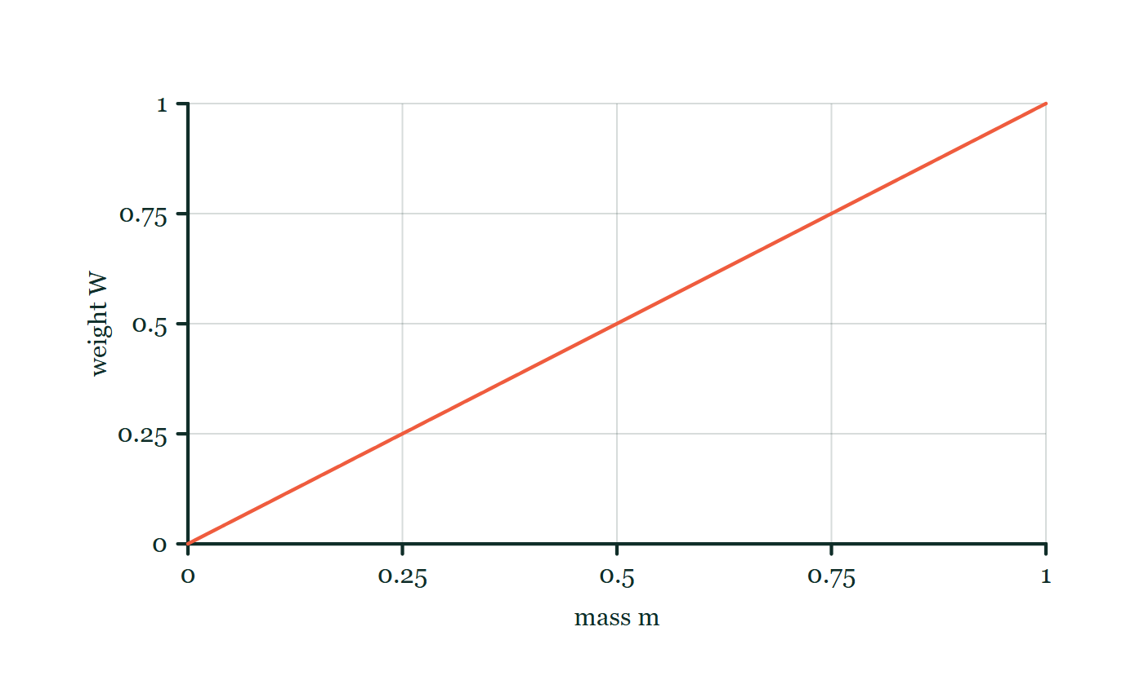
MATTER · BUOYANCY & ARCHIMEDES’ PRINCIPLE
GIOPHYSICS LESSON
FORMULA 2 OF 3
Object weight
Build the model — The formulae, one at a time, in plain English
W = mg
Compare FB and W for vertical motion
IN PLAIN ENGLISH
The downward pull of gravity on the object; compare it with the buoyant push to see if it sinks or floats.
Weight–mass explorer
Move this graph on the live version — click here
Matter — Buoyancy & Archimedes’ Principle. Built by GioPhysics from the lesson's own copy; nothing on these slides is re-authored.
11 / 31
Notes:
[Phase] Build the model: The formulae, one at a time, in plain English (minutes 13–22 of 45)
[Formula] Object weight: W = mg
[In plain English] The downward pull of gravity on the object; compare it with the buoyant push to see if it sinks or floats.
[Note] Compare FB and W for vertical motion
[Graph] Weight–mass explorer. At one location, gravitational field strength g is fixed, so weight is directly proportional to mass.
[Axes] Horizontal: mass m. Vertical: weight W. Values are normalised — the graph teaches the shape, not a measurement.

Slide 12
MATTER · BUOYANCY & ARCHIMEDES’ PRINCIPLE
GIOPHYSICS LESSON
FORMULA 3 OF 3
Floating fraction
Build the model — The formulae, one at a time, in plain English
Vsub/Vobject = ρobject/ρfluid
For a uniform object floating at rest
IN PLAIN ENGLISH
How much of a floating object sits underwater: an iceberg at 90% of water's density floats 90% submerged.
Matter — Buoyancy & Archimedes’ Principle. Built by GioPhysics from the lesson's own copy; nothing on these slides is re-authored.
12 / 31
Notes:
[Phase] Build the model: The formulae, one at a time, in plain English (minutes 13–22 of 45)
[Formula] Floating fraction: Vsub/Vobject = ρobject/ρfluid
[In plain English] How much of a floating object sits underwater: an iceberg at 90% of water's density floats 90% submerged.
[Note] For a uniform object floating at rest

Slide 13
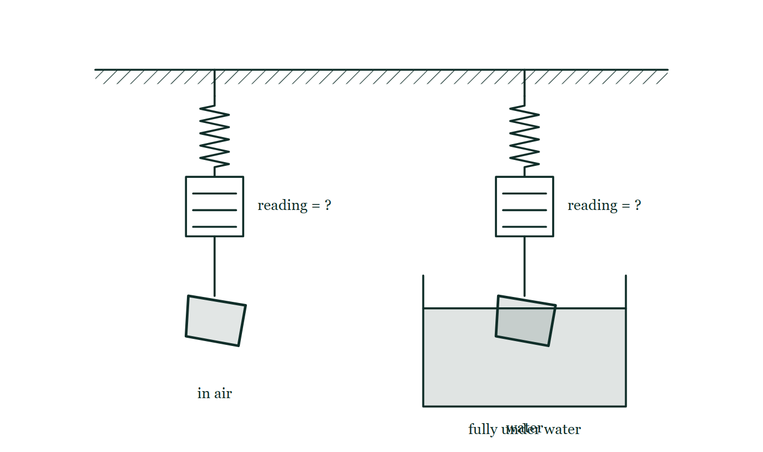
MATTER · BUOYANCY & ARCHIMEDES’ PRINCIPLE
GIOPHYSICS LESSON
THE PICTURE
The same stone, weighed twice
Drawn for this lesson
A stone hangs from a spring balance in air on the left and from the same balance fully under the water of a beaker on the right, with both balance scales drawn and neither reading printed.
The live version of this figure — click here
Matter — Buoyancy & Archimedes’ Principle. Built by GioPhysics from the lesson's own copy; nothing on these slides is re-authored.
13 / 31
Notes:
[Phase] Build the model: The formulae, one at a time, in plain English (minutes 13–22 of 45)
[Figure] A stone hangs from a spring balance in air on the left and from the same balance fully under the water of a beaker on the right, with both balance scales drawn and neither reading printed.

Slide 14
MATTER · BUOYANCY & ARCHIMEDES’ PRINCIPLE
GIOPHYSICS LESSON
WATCH OUT
The common trap
Check and misconception — The quick check and the trap
Buoyant force does not always equal object weight. They are equal only when the vertical acceleration is zero and no other vertical force matters.
Matter — Buoyancy & Archimedes’ Principle. Built by GioPhysics from the lesson's own copy; nothing on these slides is re-authored.
14 / 31
Notes:
[Phase] Check and misconception: The quick check and the trap (minutes 35–41 of 45)
[Misconception] Buoyant force does not always equal object weight. They are equal only when the vertical acceleration is zero and no other vertical force matters.

Slide 15
MATTER · BUOYANCY & ARCHIMEDES’ PRINCIPLE
GIOPHYSICS LESSON
WORKED EXAMPLE 1 OF 2 · EASY
The question
Easy
Worked examples — I do, we do — one step revealed at a time
A 0.002 m³ toy is fully submerged in water. Find the buoyant force on it.
Matter — Buoyancy & Archimedes’ Principle. Built by GioPhysics from the lesson's own copy; nothing on these slides is re-authored.
15 / 31
Notes:
[Phase] Worked examples: I do, we do — one step revealed at a time (minutes 22–35 of 45)
[Question] A 0.002 m³ toy is fully submerged in water. Find the buoyant force on it.
[Answer] FB ≈ 20 N

Slide 16
MATTER · BUOYANCY & ARCHIMEDES’ PRINCIPLE
GIOPHYSICS LESSON
WORKED EXAMPLE 1 OF 2 · EASY · THE WORKING
How to solve it
Easy
Worked examples — I do, we do — one step revealed at a time
A 0.002 m³ toy is fully submerged in water. Find the buoyant force on it.
1.
FB = ρgV = 1000 × 9.81 × 0.002.
2.
FB ≈ 20 N upward.
Matter — Buoyancy & Archimedes’ Principle. Built by GioPhysics from the lesson's own copy; nothing on these slides is re-authored.
16 / 31
Notes:
[Phase] Worked examples: I do, we do — one step revealed at a time (minutes 22–35 of 45)
[Reveal] One click per step. The class works each line before the next appears.
[Step 1] FB = ρgV = 1000 × 9.81 × 0.002.
[Step 2] FB ≈ 20 N upward.

Slide 17
MATTER · BUOYANCY & ARCHIMEDES’ PRINCIPLE
GIOPHYSICS LESSON
WORKED EXAMPLE 1 OF 2 · EASY
Answer
Easy
Worked examples — I do, we do — one step revealed at a time
FB ≈ 20 N
Matter — Buoyancy & Archimedes’ Principle. Built by GioPhysics from the lesson's own copy; nothing on these slides is re-authored.
17 / 31
Notes:
[Phase] Worked examples: I do, we do — one step revealed at a time (minutes 22–35 of 45)
[Answer] FB ≈ 20 N

Slide 18
MATTER · BUOYANCY & ARCHIMEDES’ PRINCIPLE
GIOPHYSICS LESSON
WORKED EXAMPLE 2 OF 2 · MEDIUM
The question
Medium
Worked examples — I do, we do — one step revealed at a time
A fully submerged object displaces 0.015 m³ of water. Find the buoyant force. If its mass is 12 kg, predict its initial motion.
Matter — Buoyancy & Archimedes’ Principle. Built by GioPhysics from the lesson's own copy; nothing on these slides is re-authored.
18 / 31
Notes:
[Phase] Worked examples: I do, we do — one step revealed at a time (minutes 22–35 of 45)
[Question] A fully submerged object displaces 0.015 m³ of water. Find the buoyant force. If its mass is 12 kg, predict its initial motion.
[Answer] FB ≈ 147 N; the object initially accelerates upward

Slide 19
MATTER · BUOYANCY & ARCHIMEDES’ PRINCIPLE
GIOPHYSICS LESSON
WORKED EXAMPLE 2 OF 2 · MEDIUM · THE WORKING
How to solve it
Medium
Worked examples — I do, we do — one step revealed at a time
A fully submerged object displaces 0.015 m³ of water. Find the buoyant force. If its mass is 12 kg, predict its initial motion.
1.
FB = ρwater gV = (1000)(9.81)(0.015) = 147 N.
2.
W = mg = (12)(9.81) = 118 N.
3.
The initial net force is 147 − 118 = 29 N upward.
Matter — Buoyancy & Archimedes’ Principle. Built by GioPhysics from the lesson's own copy; nothing on these slides is re-authored.
19 / 31
Notes:
[Phase] Worked examples: I do, we do — one step revealed at a time (minutes 22–35 of 45)
[Reveal] One click per step. The class works each line before the next appears.
[Step 1] FB = ρwater gV = (1000)(9.81)(0.015) = 147 N.
[Step 2] W = mg = (12)(9.81) = 118 N.
[Step 3] The initial net force is 147 − 118 = 29 N upward.

Slide 20
MATTER · BUOYANCY & ARCHIMEDES’ PRINCIPLE
GIOPHYSICS LESSON
WORKED EXAMPLE 2 OF 2 · MEDIUM
Answer
Medium
Worked examples — I do, we do — one step revealed at a time
FB ≈ 147 N; the object initially accelerates upward
Matter — Buoyancy & Archimedes’ Principle. Built by GioPhysics from the lesson's own copy; nothing on these slides is re-authored.
20 / 31
Notes:
[Phase] Worked examples: I do, we do — one step revealed at a time (minutes 22–35 of 45)
[Answer] FB ≈ 147 N; the object initially accelerates upward

Slide 21
MATTER · BUOYANCY & ARCHIMEDES’ PRINCIPLE
GIOPHYSICS LESSON
PREDICT · TAKE THE VOTE
Commit before you are told
Hands up for each option, then click
A stone hangs from a spring balance reading 8.0 N, then is lowered until it is completely under water. What does the balance read now?
A 8.0 N — the stone's weight has not changed
B Less than 8.0 N, by exactly the weight of the water pushed aside
C Zero — the water is holding the stone up now
A stone hangs from a spring balance in air on the left and from the same balance fully under the water of a beaker on the right, with both balance scales drawn and neither reading printed.
The live version of this figure — click here
Matter — Buoyancy & Archimedes’ Principle. Built by GioPhysics from the lesson's own copy; nothing on these slides is re-authored.
21 / 31
Notes:
[Phase] Build the model: The formulae, one at a time, in plain English (minutes 13–22 of 45)
[Predict] A stone hangs from a spring balance reading 8.0 N, then is lowered until it is completely under water. What does the balance read now?
[Options] A 8.0 N — the stone's weight has not changed B Less than 8.0 N, by exactly the weight of the water pushed aside C Zero — the water is holding the stone up now
[Figure] A stone hangs from a spring balance in air on the left and from the same balance fully under the water of a beaker on the right, with both balance scales drawn and neither reading printed.

Slide 22
MATTER · BUOYANCY & ARCHIMEDES’ PRINCIPLE
GIOPHYSICS LESSON
PREDICT · THE OUTCOME
What actually happens
Ask the room who changed their mind, and why
B Less than 8.0 N, by exactly the weight of the water pushed aside
WHY
Three forces act on the stone: its weight down, the string up, and the buoyant force up. The weight genuinely has not changed, so the string simply does not have to pull as hard — it is relieved of exactly the buoyant force, which is the weight of the displaced water. Note what this case shows: the buoyant force here is nothing like the object's weight. Those two are equal only when buoyancy is the one thing holding the object up.
Matter — Buoyancy & Archimedes’ Principle. Built by GioPhysics from the lesson's own copy; nothing on these slides is re-authored.
22 / 31
Notes:
[Phase] Build the model: The formulae, one at a time, in plain English (minutes 13–22 of 45)
[Answer] B — Less than 8.0 N, by exactly the weight of the water pushed aside. Three forces act on the stone: its weight down, the string up, and the buoyant force up. The weight genuinely has not changed, so the string simply does not have to pull as hard — it is relieved of exactly the buoyant force, which is the weight of the displaced water. Note what this case shows: the buoyant force here is nothing like the object's weight. Those two are equal only when buoyancy is the one thing holding the object up.

Slide 23
MATTER · BUOYANCY & ARCHIMEDES’ PRINCIPLE
GIOPHYSICS LESSON
QUICK CHECK
Decide before the answer goes up
Check and misconception — The quick check and the trap
A floating object is at rest. Which statement is correct?
A
Buoyant force equals its weight
B
Buoyant force is always larger
C
Its weight is zero
Matter — Buoyancy & Archimedes’ Principle. Built by GioPhysics from the lesson's own copy; nothing on these slides is re-authored.
23 / 31
Notes:
[Phase] Check and misconception: The quick check and the trap (minutes 35–41 of 45)
[Question] A floating object is at rest. Which statement is correct?
[Options] A Buoyant force equals its weight B Buoyant force is always larger C Its weight is zero

Slide 24
MATTER · BUOYANCY & ARCHIMEDES’ PRINCIPLE
GIOPHYSICS LESSON
QUICK CHECK · THE ANSWER
The answer, and why
Check and misconception — The quick check and the trap
A Buoyant force equals its weight
HOW TO GET THERE
At rest, the vertical net force is zero, so the upward buoyant force balances weight.
WHY THE OTHERS TEMPT
A Correct. At rest the vertical forces sum to zero and buoyancy is the only upward one, so it matches the weight exactly — which is how a ship's displacement tells you what the ship weighs.
B "Always larger" describes an object that is still rising, not one at rest. Hold a beach ball under water and let go: buoyancy does exceed the weight, which is why it accelerates upward — and it stops accelerating the moment the two are equal.
C Floating feels weightless, but the weight has not changed at all; gravity does not switch off over water. What has changed is that something else is now carrying it.
Matter — Buoyancy & Archimedes’ Principle. Built by GioPhysics from the lesson's own copy; nothing on these slides is re-authored.
24 / 31
Notes:
[Phase] Check and misconception: The quick check and the trap (minutes 35–41 of 45)
[Question] A floating object is at rest. Which statement is correct?
[Option by option] A: Correct. At rest the vertical forces sum to zero and buoyancy is the only upward one, so it matches the weight exactly — which is how a ship's displacement tells you what the ship weighs. B: "Always larger" describes an object that is still rising, not one at rest. Hold a beach ball under water and let go: buoyancy does exceed the weight, which is why it accelerates upward — and it stops accelerating the moment the two are equal. C: Floating feels weightless, but the weight has not changed at all; gravity does not switch off over water. What has changed is that something else is now carrying it.
[Answer] A — Buoyant force equals its weight
[Why] At rest, the vertical net force is zero, so the upward buoyant force balances weight.
[Reveal] One click for the answer, then one for the reason.

Slide 25
MATTER · BUOYANCY & ARCHIMEDES’ PRINCIPLE
GIOPHYSICS LESSON
EXTENSION 1 OF 2 · HARD
The question
Hard
Worked examples — I do, we do — one step revealed at a time
A 920 kg/m³ iceberg floats in 1025 kg/m³ seawater. What fraction shows above the surface?
Matter — Buoyancy & Archimedes’ Principle. Built by GioPhysics from the lesson's own copy; nothing on these slides is re-authored.
25 / 31
Notes:
[Phase] Worked examples: I do, we do — one step revealed at a time (minutes 22–35 of 45)
[Question] A 920 kg/m³ iceberg floats in 1025 kg/m³ seawater. What fraction shows above the surface?
[Answer] ≈ 10% above water

Slide 26
MATTER · BUOYANCY & ARCHIMEDES’ PRINCIPLE
GIOPHYSICS LESSON
EXTENSION 1 OF 2 · HARD · THE WORKING
How to solve it
Hard
Worked examples — I do, we do — one step revealed at a time
A 920 kg/m³ iceberg floats in 1025 kg/m³ seawater. What fraction shows above the surface?
1.
Floating: submerged fraction = ρ(object)/ρ(fluid) = 920 ÷ 1025 ≈ 0.898.
2.
Above water: 1 − 0.898.
3.
≈ 10% — the classic tip of the iceberg.
Matter — Buoyancy & Archimedes’ Principle. Built by GioPhysics from the lesson's own copy; nothing on these slides is re-authored.
26 / 31
Notes:
[Phase] Worked examples: I do, we do — one step revealed at a time (minutes 22–35 of 45)
[Reveal] One click per step. The class works each line before the next appears.
[Step 1] Floating: submerged fraction = ρ(object)/ρ(fluid) = 920 ÷ 1025 ≈ 0.898.
[Step 2] Above water: 1 − 0.898.
[Step 3] ≈ 10% — the classic tip of the iceberg.

Slide 27
MATTER · BUOYANCY & ARCHIMEDES’ PRINCIPLE
GIOPHYSICS LESSON
EXTENSION 1 OF 2 · HARD
Answer
Hard
Worked examples — I do, we do — one step revealed at a time
≈ 10% above water
Matter — Buoyancy & Archimedes’ Principle. Built by GioPhysics from the lesson's own copy; nothing on these slides is re-authored.
27 / 31
Notes:
[Phase] Worked examples: I do, we do — one step revealed at a time (minutes 22–35 of 45)
[Answer] ≈ 10% above water

Slide 28
MATTER · BUOYANCY & ARCHIMEDES’ PRINCIPLE
GIOPHYSICS LESSON
EXTENSION 2 OF 2 · CHALLENGING
The question
Challenging
Worked examples — I do, we do — one step revealed at a time
A 5.0 kg metal block (ρ = 8000 kg/m³) hangs from a spring balance while fully submerged in oil (ρ = 850 kg/m³). What does the balance read?
Matter — Buoyancy & Archimedes’ Principle. Built by GioPhysics from the lesson's own copy; nothing on these slides is re-authored.
28 / 31
Notes:
[Phase] Worked examples: I do, we do — one step revealed at a time (minutes 22–35 of 45)
[Question] A 5.0 kg metal block (ρ = 8000 kg/m³) hangs from a spring balance while fully submerged in oil (ρ = 850 kg/m³). What does the balance read?
[Answer] ≈ 44 N — about 0.5 kg of apparent mass 'lost' to buoyancy

Slide 29
MATTER · BUOYANCY & ARCHIMEDES’ PRINCIPLE
GIOPHYSICS LESSON
EXTENSION 2 OF 2 · CHALLENGING · THE WORKING
How to solve it
Challenging
Worked examples — I do, we do — one step revealed at a time
A 5.0 kg metal block (ρ = 8000 kg/m³) hangs from a spring balance while fully submerged in oil (ρ = 850 kg/m³). What does the balance read?
1.
V = m/ρ = 5.0 ÷ 8000 = 6.25 × 10⁻⁴ m³.
2.
FB = 850 × 9.81 × 6.25 × 10⁻⁴ ≈ 5.2 N.
3.
Reading = mg − FB = 49.05 − 5.2 ≈ 43.8 N (an apparent mass of ≈ 4.5 kg).
Matter — Buoyancy & Archimedes’ Principle. Built by GioPhysics from the lesson's own copy; nothing on these slides is re-authored.
29 / 31
Notes:
[Phase] Worked examples: I do, we do — one step revealed at a time (minutes 22–35 of 45)
[Reveal] One click per step. The class works each line before the next appears.
[Step 1] V = m/ρ = 5.0 ÷ 8000 = 6.25 × 10⁻⁴ m³.
[Step 2] FB = 850 × 9.81 × 6.25 × 10⁻⁴ ≈ 5.2 N.
[Step 3] Reading = mg − FB = 49.05 − 5.2 ≈ 43.8 N (an apparent mass of ≈ 4.5 kg).

Slide 30
MATTER · BUOYANCY & ARCHIMEDES’ PRINCIPLE
GIOPHYSICS LESSON
EXTENSION 2 OF 2 · CHALLENGING
Answer
Challenging
Worked examples — I do, we do — one step revealed at a time
≈ 44 N — about 0.5 kg of apparent mass 'lost' to buoyancy
Matter — Buoyancy & Archimedes’ Principle. Built by GioPhysics from the lesson's own copy; nothing on these slides is re-authored.
30 / 31
Notes:
[Phase] Worked examples: I do, we do — one step revealed at a time (minutes 22–35 of 45)
[Answer] ≈ 44 N — about 0.5 kg of apparent mass 'lost' to buoyancy

Slide 31
MATTER · BUOYANCY & ARCHIMEDES’ PRINCIPLE
GIOPHYSICS LESSON
MATTER
Where to go next
Plenary — What to take away, what to practise next
Next
7.7 Fluids Calculus
https://giophysics.com/chapter-13/fluids-calculus/
Lesson
This lesson on giophysics.com
https://giophysics.com/chapter-13/buoyancy-archimedes-principle/
Live
The live, interactive version of these slides
https://giophysics.com/chapter-13/presentation/?lesson=buoyancy
Chapter
All Matter lessons
https://giophysics.com/chapter-13/
PDF
Download the lesson PDF
https://giophysics.com/downloads/13-6-buoyancy-archimedes-principle.pdf
Matter — Buoyancy & Archimedes’ Principle. Built by GioPhysics from the lesson's own copy; nothing on these slides is re-authored.
31 / 31
Notes:
[Phase] Plenary: What to take away, what to practise next (minutes 41–45 of 45)
[Interactive] The graphs and the circuit topology on these slides are frozen. The live version at https://giophysics.com/chapter-13/presentation/?lesson=buoyancy moves them.

