Slide 1
MATTER · DENSITY & RELATIVE DENSITY
GIOPHYSICS LESSON
07 · Matter
Mass packed into volume
Density & Relative Density
Density identifies how much mass occupies each unit of volume. For a uniform material under fixed conditions, it does not depend on the size of the sample.
POSITION
Lesson 2 of 7 in Matter
PLAN
16 slides in the 45-minute core run, about 44.5 minutes of it
LESSON PAGE
https://giophysics.com/chapter-13/density-relative-density/
Built by GioPhysics from the lesson's own page. Every word on these slides is the lesson's; nothing here is re-authored. Teaching material, not an awarding body's document.
Matter — Density & Relative Density. Built by GioPhysics from the lesson's own copy; nothing on these slides is re-authored.
1 / 33
Notes:
[Lesson] Matter — Density & Relative Density. Lesson 2 of 7.
[Intro] Density identifies how much mass occupies each unit of volume. For a uniform material under fixed conditions, it does not depend on the size of the sample.
[Source] https://giophysics.com/chapter-13/density-relative-density/
[Disclaimer] Built by GioPhysics from the lesson's own page. Every word on these slides is the lesson's; nothing here is re-authored. Teaching material, not an awarding body's document.

Slide 2
MATTER · DENSITY & RELATIVE DENSITY
GIOPHYSICS LESSON
WHAT THIS NEEDS
What you already know
Starter — Recall what this lesson stands on
Recall
SI units & prefixes
https://giophysics.com/chapter-1/units/
Matter — Density & Relative Density. Built by GioPhysics from the lesson's own copy; nothing on these slides is re-authored.
2 / 33
Notes:
[Phase] Starter: Recall what this lesson stands on (minutes 0–5 of 45)
[Starter] Recall: SI units & prefixes

Slide 3
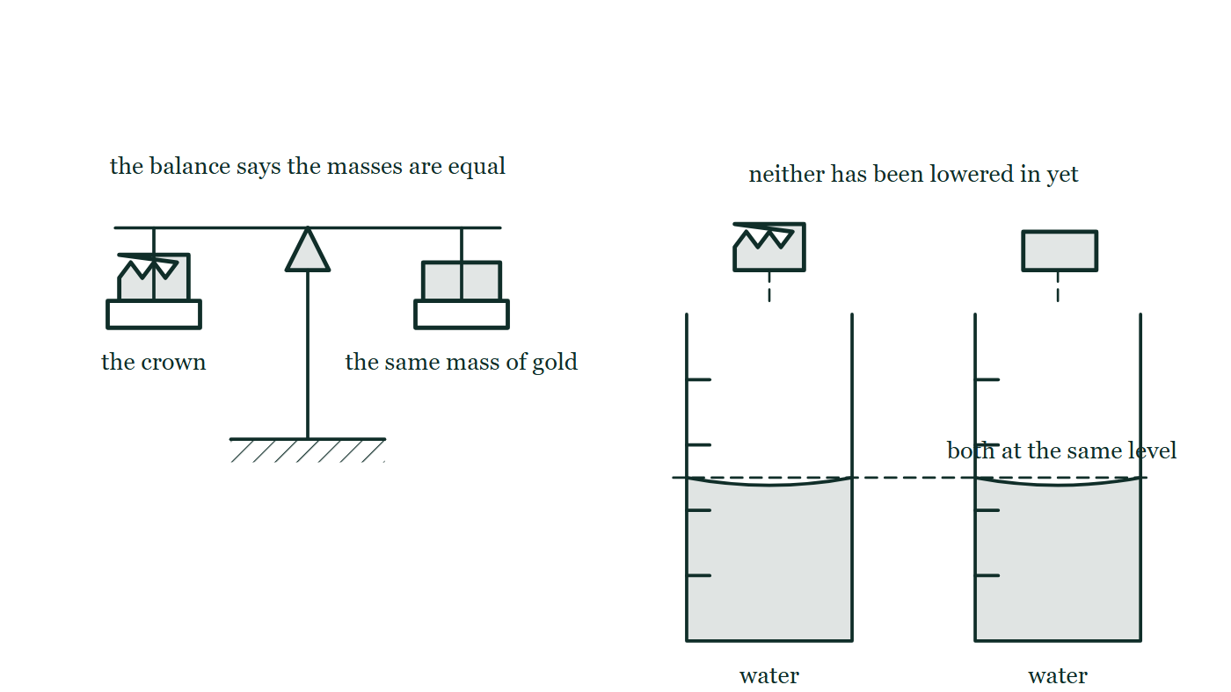
MATTER · DENSITY & RELATIVE DENSITY
GIOPHYSICS LESSON
THINK FIRST
The crown weighed exactly the gold the king had handed the goldsmith. So how did Archimedes prove it was not pure gold?
Take answers before you click — the point is the commitment
The crown was a temple offering: it could not be scratched, melted or cut open. On a balance it matched the issued gold, gram for gram.
THE ANSWER
By measuring its volume. Mass alone identifies nothing — you can have a kilogram of anything. Density identifies a material, and density needs the volume as well: the crown pushed aside more water than the same mass of pure gold does, so its mass was spread through too much space, and something lighter had been mixed in.
A beam balance shows the crown resting level against an equal mass of gold; beside it two identical measuring cylinders stand filled to the same marked level, with the crown hanging over one and the gold over the other, neither yet lowered in.
The live version of this figure — click here
Matter — Density & Relative Density. Built by GioPhysics from the lesson's own copy; nothing on these slides is re-authored.
3 / 33
Notes:
[Phase] Starter: Recall what this lesson stands on (minutes 0–5 of 45)
[Hook] The crown weighed exactly the gold the king had handed the goldsmith. So how did Archimedes prove it was not pure gold? The crown was a temple offering: it could not be scratched, melted or cut open. On a balance it matched the issued gold, gram for gram.
[Answer] By measuring its volume. Mass alone identifies nothing — you can have a kilogram of anything. Density identifies a material, and density needs the volume as well: the crown pushed aside more water than the same mass of pure gold does, so its mass was spread through too much space, and something lighter had been mixed in.
[Figure] A beam balance shows the crown resting level against an equal mass of gold; beside it two identical measuring cylinders stand filled to the same marked level, with the crown hanging over one and the gold over the other, neither yet lowered in.

Slide 4
MATTER · DENSITY & RELATIVE DENSITY
GIOPHYSICS LESSON
EXPLAINED SIMPLY
In one sentence
Introduce the idea — The big idea and the definition
Density is the mass contained in each unit of volume; relative density compares a material's density with the density of water.
Matter — Density & Relative Density. Built by GioPhysics from the lesson's own copy; nothing on these slides is re-authored.
4 / 33
Notes:
[Phase] Introduce the idea: The big idea and the definition (minutes 5–13 of 45)
[Definition] Density is the mass contained in each unit of volume; relative density compares a material's density with the density of water.

Slide 5
MATTER · DENSITY & RELATIVE DENSITY
GIOPHYSICS LESSON
EXPLAINED SIMPLY
What that looks like
Introduce the idea — The big idea and the definition
FOR EXAMPLE
A 200 g block with volume 100 cm³ has density 2.0 g/cm³, so its relative density is about 2.0.
Matter — Density & Relative Density. Built by GioPhysics from the lesson's own copy; nothing on these slides is re-authored.
5 / 33
Notes:
[Phase] Introduce the idea: The big idea and the definition (minutes 5–13 of 45)
[Worked illustration] A 200 g block with volume 100 cm³ has density 2.0 g/cm³, so its relative density is about 2.0.

Slide 6
MATTER · DENSITY & RELATIVE DENSITY
GIOPHYSICS LESSON
THE BIG IDEA
Mass packed into volume
Introduce the idea — The big idea and the definition
Density is the gradient of a mass–volume graph for a uniform material. Relative density compares that value with a reference density—usually water at about 1000 kg/m³—so it has no unit.
Matter — Density & Relative Density. Built by GioPhysics from the lesson's own copy; nothing on these slides is re-authored.
6 / 33
Notes:
[Phase] Introduce the idea: The big idea and the definition (minutes 5–13 of 45)
[Big idea] Density is the gradient of a mass–volume graph for a uniform material. Relative density compares that value with a reference density—usually water at about 1000 kg/m³—so it has no unit.

Slide 7
MATTER · DENSITY & RELATIVE DENSITY
GIOPHYSICS LESSON
THE PHYSICS · 1 OF 3
Measure mass
Build the model — The formulae, one at a time, in plain English
Use a balance and subtract the empty container if the sample cannot sit directly on it.
Matter — Density & Relative Density. Built by GioPhysics from the lesson's own copy; nothing on these slides is re-authored.
7 / 33
Notes:
[Phase] Build the model: The formulae, one at a time, in plain English (minutes 13–22 of 45)
[Section] Use a balance and subtract the empty container if the sample cannot sit directly on it.

Slide 8
MATTER · DENSITY & RELATIVE DENSITY
GIOPHYSICS LESSON
THE PHYSICS · 2 OF 3
Measure volume
Build the model — The formulae, one at a time, in plain English
Use geometry for regular solids or displaced liquid for an irregular object that does not dissolve.
Matter — Density & Relative Density. Built by GioPhysics from the lesson's own copy; nothing on these slides is re-authored.
8 / 33
Notes:
[Phase] Build the model: The formulae, one at a time, in plain English (minutes 13–22 of 45)
[Section] Use geometry for regular solids or displaced liquid for an irregular object that does not dissolve.

Slide 9
MATTER · DENSITY & RELATIVE DENSITY
GIOPHYSICS LESSON
THE PHYSICS · 3 OF 3
Read the graph
Build the model — The formulae, one at a time, in plain English
For one uniform material, m = ρV is a straight line through the origin and its slope is density.
Matter — Density & Relative Density. Built by GioPhysics from the lesson's own copy; nothing on these slides is re-authored.
9 / 33
Notes:
[Phase] Build the model: The formulae, one at a time, in plain English (minutes 13–22 of 45)
[Section] For one uniform material, m = ρV is a straight line through the origin and its slope is density.

Slide 10
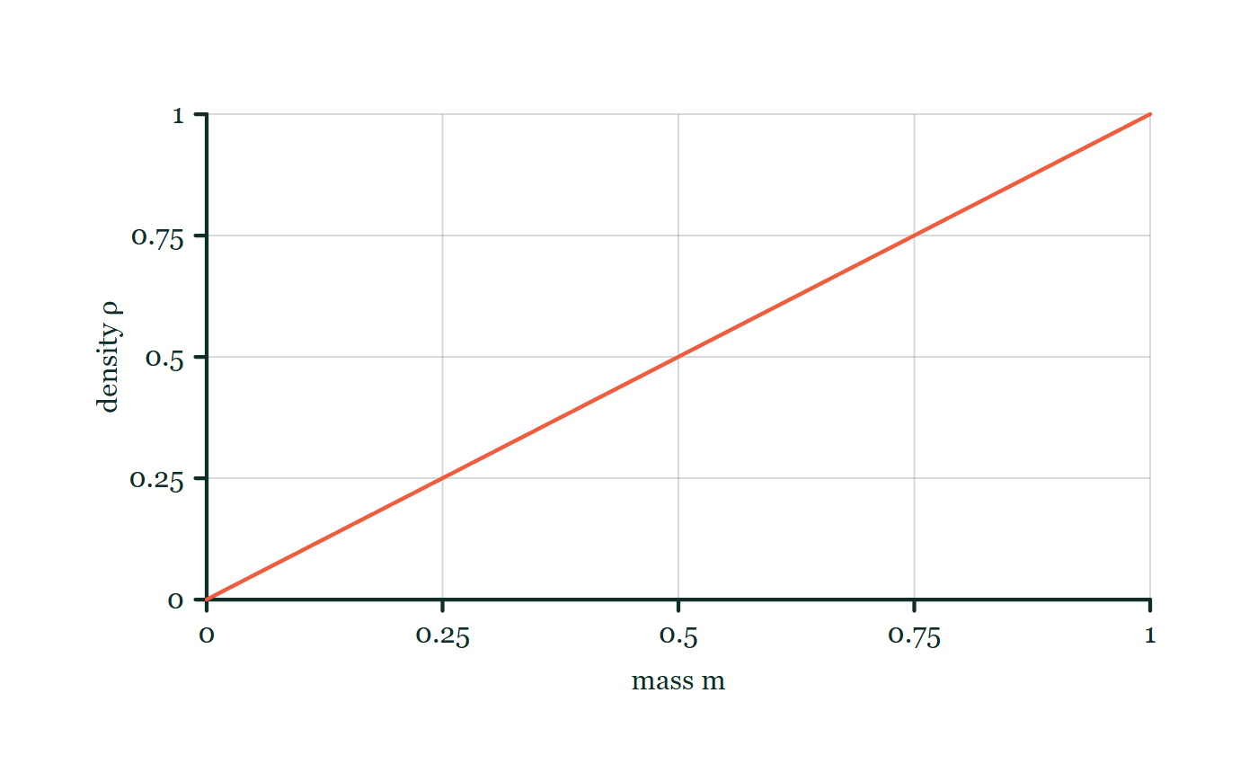
MATTER · DENSITY & RELATIVE DENSITY
GIOPHYSICS LESSON
FORMULA 1 OF 3
Density
Build the model — The formulae, one at a time, in plain English
ρ = m/V
SI unit: kg/m³
IN PLAIN ENGLISH
Density is how much mass is packed into each unit of space — mass divided by volume.
Density–mass explorer
Move this graph on the live version — click here
Matter — Density & Relative Density. Built by GioPhysics from the lesson's own copy; nothing on these slides is re-authored.
10 / 33
Notes:
[Phase] Build the model: The formulae, one at a time, in plain English (minutes 13–22 of 45)
[Formula] Density: ρ = m/V
[In plain English] Density is how much mass is packed into each unit of space — mass divided by volume.
[Note] SI unit: kg/m³
[Graph] Density–mass explorer. For a fixed volume, density rises in direct proportion to mass.
[Axes] Horizontal: mass m. Vertical: density ρ. Values are normalised — the graph teaches the shape, not a measurement.

Slide 11
MATTER · DENSITY & RELATIVE DENSITY
GIOPHYSICS LESSON
FORMULA 2 OF 3
Relative density
Build the model — The formulae, one at a time, in plain English
RD = ρsubstance/ρwater
A ratio of like units, so it is dimensionless
IN PLAIN ENGLISH
How a material's density compares with water's: above 1 it sinks in water, below 1 it floats.
Matter — Density & Relative Density. Built by GioPhysics from the lesson's own copy; nothing on these slides is re-authored.
11 / 33
Notes:
[Phase] Build the model: The formulae, one at a time, in plain English (minutes 13–22 of 45)
[Formula] Relative density: RD = ρsubstance/ρwater
[In plain English] How a material's density compares with water's: above 1 it sinks in water, below 1 it floats.
[Note] A ratio of like units, so it is dimensionless

Slide 12
MATTER · DENSITY & RELATIVE DENSITY
GIOPHYSICS LESSON
FORMULA 3 OF 3
Useful conversion
Build the model — The formulae, one at a time, in plain English
1 g/cm³ = 1000 kg/m³
Convert mass and volume together
IN PLAIN ENGLISH
The two everyday density units differ by a factor of 1000 — water is 1 g/cm³, which is 1000 kg/m³.
Matter — Density & Relative Density. Built by GioPhysics from the lesson's own copy; nothing on these slides is re-authored.
12 / 33
Notes:
[Phase] Build the model: The formulae, one at a time, in plain English (minutes 13–22 of 45)
[Formula] Useful conversion: 1 g/cm³ = 1000 kg/m³
[In plain English] The two everyday density units differ by a factor of 1000 — water is 1 g/cm³, which is 1000 kg/m³.
[Note] Convert mass and volume together

Slide 13
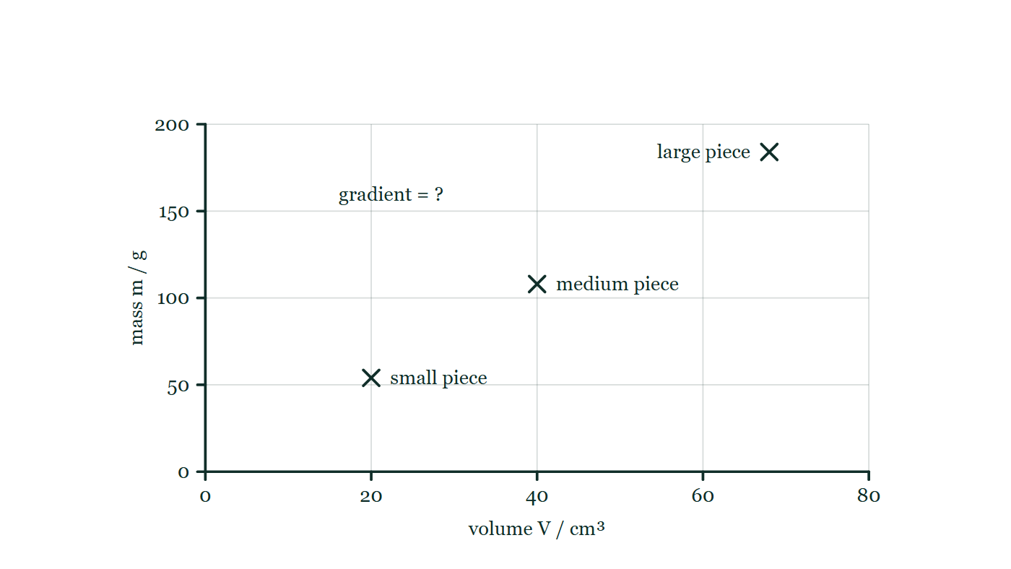
MATTER · DENSITY & RELATIVE DENSITY
GIOPHYSICS LESSON
THE PICTURE
Three samples, one material
Drawn for this lesson
Mass-against-volume axes carry three plotted crosses for a small, a medium and a large piece of the same alloy, with no line drawn through them and the gradient of the graph labelled only with a question mark.
The live version of this figure — click here
Matter — Density & Relative Density. Built by GioPhysics from the lesson's own copy; nothing on these slides is re-authored.
13 / 33
Notes:
[Phase] Build the model: The formulae, one at a time, in plain English (minutes 13–22 of 45)
[Figure] Mass-against-volume axes carry three plotted crosses for a small, a medium and a large piece of the same alloy, with no line drawn through them and the gradient of the graph labelled only with a question mark.

Slide 14
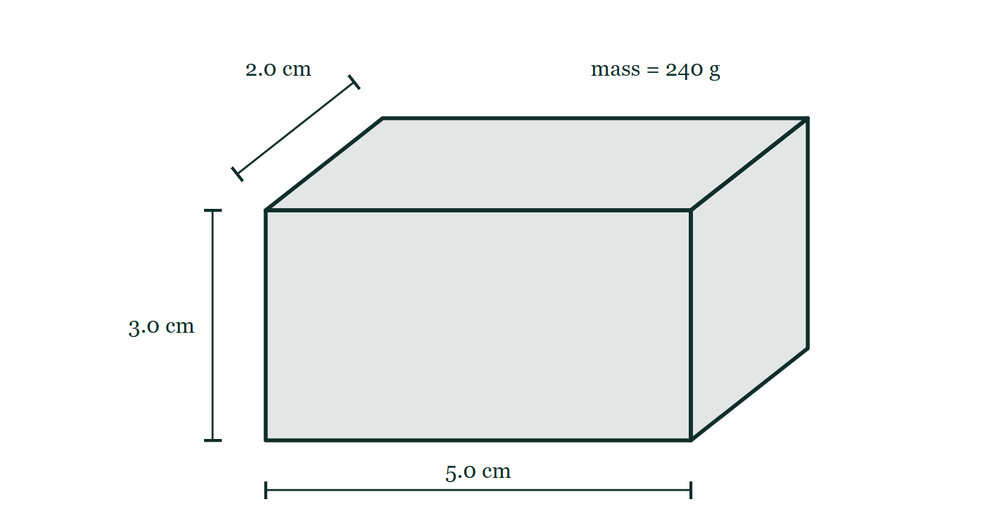
MATTER · DENSITY & RELATIVE DENSITY
GIOPHYSICS LESSON
FIGURE 1 OF 2
Fig. 3.1 — IGCSE Topic 1 · Motion, forces and energy
Drawn for question 3 of that paper · syllabus 1.4
An oblique drawing of a solid rectangular metal block. The front face is marked 5.0 cm along its lower edge and 3.0 cm up its left-hand edge, and the edge receding into the page is marked 2.0 cm. The block carries the label mass = 240 g.
See the question this was drawn for — click here
Matter — Density & Relative Density. Built by GioPhysics from the lesson's own copy; nothing on these slides is re-authored.
14 / 33
Notes:
[Phase] Build the model: The formulae, one at a time, in plain English (minutes 13–22 of 45)
[Figure] Fig. 3.1. An oblique drawing of a solid rectangular metal block. The front face is marked 5.0 cm along its lower edge and 3.0 cm up its left-hand edge, and the edge receding into the page is marked 2.0 cm. The block carries the label mass = 240 g.
[Where it came from] IGCSE Topic 1 · Motion, forces and energy, question 3; syllabus 1.4.

Slide 15
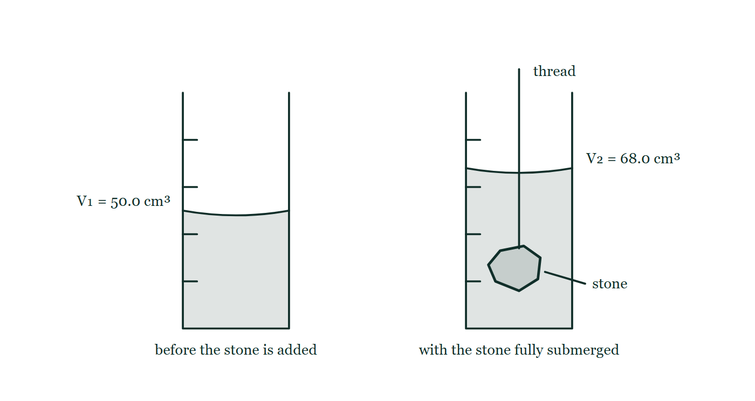
MATTER · DENSITY & RELATIVE DENSITY
GIOPHYSICS LESSON
FIGURE 2 OF 2
Fig. 10.1 — IGCSE Topic 1 · Motion, forces and energy
Drawn for question 10 of that paper · syllabus 1.1, 1.4
Two measuring cylinders drawn side by side, each with graduations up the wall and a curved meniscus. The first holds water alone, its surface at the 50.0 cm³ mark. The second holds the same water with the stone lowered in on a thread that runs up and out of the cylinder; the stone lies fully submerged near the base and the surface now stands at the 68.0 cm³ mark.
See the question this was drawn for — click here
Matter — Density & Relative Density. Built by GioPhysics from the lesson's own copy; nothing on these slides is re-authored.
15 / 33
Notes:
[Phase] Build the model: The formulae, one at a time, in plain English (minutes 13–22 of 45)
[Figure] Fig. 10.1. Two measuring cylinders drawn side by side, each with graduations up the wall and a curved meniscus. The first holds water alone, its surface at the 50.0 cm³ mark. The second holds the same water with the stone lowered in on a thread that runs up and out of the cylinder; the stone lies fully submerged near the base and the surface now stands at the 68.0 cm³ mark.
[Where it came from] IGCSE Topic 1 · Motion, forces and energy, question 10; syllabus 1.1, 1.4.

Slide 16
MATTER · DENSITY & RELATIVE DENSITY
GIOPHYSICS LESSON
WATCH OUT
The common trap
Check and misconception — The quick check and the trap
At the same temperature and pressure, a larger uniform sample has more mass, but not a different density. Cutting it changes m and V by the same factor, leaving m/V unchanged.
Matter — Density & Relative Density. Built by GioPhysics from the lesson's own copy; nothing on these slides is re-authored.
16 / 33
Notes:
[Phase] Check and misconception: The quick check and the trap (minutes 35–41 of 45)
[Misconception] At the same temperature and pressure, a larger uniform sample has more mass, but not a different density. Cutting it changes m and V by the same factor, leaving m/V unchanged.

Slide 17
MATTER · DENSITY & RELATIVE DENSITY
GIOPHYSICS LESSON
WORKED EXAMPLE 1 OF 2 · EASY
The question
Easy
Worked examples — I do, we do — one step revealed at a time
A 2.0 L bottle of water has mass 2.0 kg (ignoring the bottle). Confirm water's density in kg/m³.
Matter — Density & Relative Density. Built by GioPhysics from the lesson's own copy; nothing on these slides is re-authored.
17 / 33
Notes:
[Phase] Worked examples: I do, we do — one step revealed at a time (minutes 22–35 of 45)
[Question] A 2.0 L bottle of water has mass 2.0 kg (ignoring the bottle). Confirm water's density in kg/m³.
[Answer] ρ = 1000 kg/m³

Slide 18
MATTER · DENSITY & RELATIVE DENSITY
GIOPHYSICS LESSON
WORKED EXAMPLE 1 OF 2 · EASY · THE WORKING
How to solve it
Easy
Worked examples — I do, we do — one step revealed at a time
A 2.0 L bottle of water has mass 2.0 kg (ignoring the bottle). Confirm water's density in kg/m³.
1.
V = 2.0 L = 2.0 × 10⁻³ m³.
2.
ρ = 2.0 ÷ 2.0 × 10⁻³ = 1000 kg/m³.
Matter — Density & Relative Density. Built by GioPhysics from the lesson's own copy; nothing on these slides is re-authored.
18 / 33
Notes:
[Phase] Worked examples: I do, we do — one step revealed at a time (minutes 22–35 of 45)
[Reveal] One click per step. The class works each line before the next appears.
[Step 1] V = 2.0 L = 2.0 × 10⁻³ m³.
[Step 2] ρ = 2.0 ÷ 2.0 × 10⁻³ = 1000 kg/m³.

Slide 19
MATTER · DENSITY & RELATIVE DENSITY
GIOPHYSICS LESSON
WORKED EXAMPLE 1 OF 2 · EASY
Answer
Easy
Worked examples — I do, we do — one step revealed at a time
ρ = 1000 kg/m³
Matter — Density & Relative Density. Built by GioPhysics from the lesson's own copy; nothing on these slides is re-authored.
19 / 33
Notes:
[Phase] Worked examples: I do, we do — one step revealed at a time (minutes 22–35 of 45)
[Answer] ρ = 1000 kg/m³

Slide 20
MATTER · DENSITY & RELATIVE DENSITY
GIOPHYSICS LESSON
WORKED EXAMPLE 2 OF 2 · MEDIUM
The question
Medium
Worked examples — I do, we do — one step revealed at a time
A 540 g sample occupies 200 cm³. Find its density in g/cm³ and kg/m³.
Matter — Density & Relative Density. Built by GioPhysics from the lesson's own copy; nothing on these slides is re-authored.
20 / 33
Notes:
[Phase] Worked examples: I do, we do — one step revealed at a time (minutes 22–35 of 45)
[Question] A 540 g sample occupies 200 cm³. Find its density in g/cm³ and kg/m³.
[Answer] ρ = 2.70 g/cm³ = 2700 kg/m³; relative density ≈ 2.70

Slide 21
MATTER · DENSITY & RELATIVE DENSITY
GIOPHYSICS LESSON
WORKED EXAMPLE 2 OF 2 · MEDIUM · THE WORKING
How to solve it
Medium
Worked examples — I do, we do — one step revealed at a time
A 540 g sample occupies 200 cm³. Find its density in g/cm³ and kg/m³.
1.
ρ = m/V = 540 g ÷ 200 cm³.
2.
ρ = 2.70 g/cm³.
3.
Multiply by 1000 to convert g/cm³ to kg/m³.
Matter — Density & Relative Density. Built by GioPhysics from the lesson's own copy; nothing on these slides is re-authored.
21 / 33
Notes:
[Phase] Worked examples: I do, we do — one step revealed at a time (minutes 22–35 of 45)
[Reveal] One click per step. The class works each line before the next appears.
[Step 1] ρ = m/V = 540 g ÷ 200 cm³.
[Step 2] ρ = 2.70 g/cm³.
[Step 3] Multiply by 1000 to convert g/cm³ to kg/m³.

Slide 22
MATTER · DENSITY & RELATIVE DENSITY
GIOPHYSICS LESSON
WORKED EXAMPLE 2 OF 2 · MEDIUM
Answer
Medium
Worked examples — I do, we do — one step revealed at a time
ρ = 2.70 g/cm³ = 2700 kg/m³; relative density ≈ 2.70
Matter — Density & Relative Density. Built by GioPhysics from the lesson's own copy; nothing on these slides is re-authored.
22 / 33
Notes:
[Phase] Worked examples: I do, we do — one step revealed at a time (minutes 22–35 of 45)
[Answer] ρ = 2.70 g/cm³ = 2700 kg/m³; relative density ≈ 2.70

Slide 23
MATTER · DENSITY & RELATIVE DENSITY
GIOPHYSICS LESSON
PREDICT · TAKE THE VOTE
Commit before you are told
Hands up for each option, then click
Three pieces of the same alloy — small, medium and large — are each weighed and their volumes measured. Where do the three points fall on these axes?
A Scattered above the line, since a bigger piece is denser
B On one straight line through the origin
C On a curve that bends upward, since mass grows faster than volume
Mass-against-volume axes carry three plotted crosses for a small, a medium and a large piece of the same alloy, with no line drawn through them and the gradient of the graph labelled only with a question mark.
The live version of this figure — click here
Matter — Density & Relative Density. Built by GioPhysics from the lesson's own copy; nothing on these slides is re-authored.
23 / 33
Notes:
[Phase] Build the model: The formulae, one at a time, in plain English (minutes 13–22 of 45)
[Predict] Three pieces of the same alloy — small, medium and large — are each weighed and their volumes measured. Where do the three points fall on these axes?
[Options] A Scattered above the line, since a bigger piece is denser B On one straight line through the origin C On a curve that bends upward, since mass grows faster than volume
[Figure] Mass-against-volume axes carry three plotted crosses for a small, a medium and a large piece of the same alloy, with no line drawn through them and the gradient of the graph labelled only with a question mark.

Slide 24
MATTER · DENSITY & RELATIVE DENSITY
GIOPHYSICS LESSON
PREDICT · THE OUTCOME
What actually happens
Ask the room who changed their mind, and why
B On one straight line through the origin
WHY
m = ρV with one fixed ρ is the equation of a straight line through the origin, and its gradient is that density. All three points sit on it however different their sizes, because zero volume must mean zero mass. This is the same statement as "cutting a block does not change its density", drawn instead of said.
Matter — Density & Relative Density. Built by GioPhysics from the lesson's own copy; nothing on these slides is re-authored.
24 / 33
Notes:
[Phase] Build the model: The formulae, one at a time, in plain English (minutes 13–22 of 45)
[Answer] B — On one straight line through the origin. m = ρV with one fixed ρ is the equation of a straight line through the origin, and its gradient is that density. All three points sit on it however different their sizes, because zero volume must mean zero mass. This is the same statement as "cutting a block does not change its density", drawn instead of said.

Slide 25
MATTER · DENSITY & RELATIVE DENSITY
GIOPHYSICS LESSON
QUICK CHECK
Decide before the answer goes up
Check and misconception — The quick check and the trap
A uniform metal block is cut exactly in half. What happens to its density?
A
It halves
B
It doubles
C
It stays the same
Matter — Density & Relative Density. Built by GioPhysics from the lesson's own copy; nothing on these slides is re-authored.
25 / 33
Notes:
[Phase] Check and misconception: The quick check and the trap (minutes 35–41 of 45)
[Question] A uniform metal block is cut exactly in half. What happens to its density?
[Options] A It halves B It doubles C It stays the same

Slide 26
MATTER · DENSITY & RELATIVE DENSITY
GIOPHYSICS LESSON
QUICK CHECK · THE ANSWER
The answer, and why
Check and misconception — The quick check and the trap
C It stays the same
HOW TO GET THERE
Both mass and volume halve, so their ratio remains constant.
WHY THE OTHERS TEMPT
A The mass really does halve, and that is the half of the ratio most people look at. The volume halves in the very same stroke of the saw, so m/V comes out exactly where it started.
B Doubling would need the same mass packed into half the space. Cutting the block takes the mass away along with the space — you would have to crush it, not cut it.
C Correct. Density is a property of the material, not of how much of it you happen to be holding.
Matter — Density & Relative Density. Built by GioPhysics from the lesson's own copy; nothing on these slides is re-authored.
26 / 33
Notes:
[Phase] Check and misconception: The quick check and the trap (minutes 35–41 of 45)
[Question] A uniform metal block is cut exactly in half. What happens to its density?
[Option by option] A: The mass really does halve, and that is the half of the ratio most people look at. The volume halves in the very same stroke of the saw, so m/V comes out exactly where it started. B: Doubling would need the same mass packed into half the space. Cutting the block takes the mass away along with the space — you would have to crush it, not cut it. C: Correct. Density is a property of the material, not of how much of it you happen to be holding.
[Answer] C — It stays the same
[Why] Both mass and volume halve, so their ratio remains constant.
[Reveal] One click for the answer, then one for the reason.

Slide 27
MATTER · DENSITY & RELATIVE DENSITY
GIOPHYSICS LESSON
EXTENSION 1 OF 2 · HARD
The question
Hard
Worked examples — I do, we do — one step revealed at a time
A crown of mass 1.20 kg displaces 75 cm³ of water. Is it pure gold (ρ = 19 300 kg/m³)?
Matter — Density & Relative Density. Built by GioPhysics from the lesson's own copy; nothing on these slides is re-authored.
27 / 33
Notes:
[Phase] Worked examples: I do, we do — one step revealed at a time (minutes 22–35 of 45)
[Question] A crown of mass 1.20 kg displaces 75 cm³ of water. Is it pure gold (ρ = 19 300 kg/m³)?
[Answer] No — its density is ~16 000 kg/m³, not 19 300

Slide 28
MATTER · DENSITY & RELATIVE DENSITY
GIOPHYSICS LESSON
EXTENSION 1 OF 2 · HARD · THE WORKING
How to solve it
Hard
Worked examples — I do, we do — one step revealed at a time
A crown of mass 1.20 kg displaces 75 cm³ of water. Is it pure gold (ρ = 19 300 kg/m³)?
1.
ρ = m/V = 1.20 ÷ 75 × 10⁻⁶.
2.
ρ = 16 000 kg/m³.
3.
Well below gold's 19 300 — the crown is alloyed or hollow. Archimedes would object.
Matter — Density & Relative Density. Built by GioPhysics from the lesson's own copy; nothing on these slides is re-authored.
28 / 33
Notes:
[Phase] Worked examples: I do, we do — one step revealed at a time (minutes 22–35 of 45)
[Reveal] One click per step. The class works each line before the next appears.
[Step 1] ρ = m/V = 1.20 ÷ 75 × 10⁻⁶.
[Step 2] ρ = 16 000 kg/m³.
[Step 3] Well below gold's 19 300 — the crown is alloyed or hollow. Archimedes would object.

Slide 29
MATTER · DENSITY & RELATIVE DENSITY
GIOPHYSICS LESSON
EXTENSION 1 OF 2 · HARD
Answer
Hard
Worked examples — I do, we do — one step revealed at a time
No — its density is ~16 000 kg/m³, not 19 300
Matter — Density & Relative Density. Built by GioPhysics from the lesson's own copy; nothing on these slides is re-authored.
29 / 33
Notes:
[Phase] Worked examples: I do, we do — one step revealed at a time (minutes 22–35 of 45)
[Answer] No — its density is ~16 000 kg/m³, not 19 300

Slide 30
MATTER · DENSITY & RELATIVE DENSITY
GIOPHYSICS LESSON
EXTENSION 2 OF 2 · CHALLENGING
The question
Challenging
Worked examples — I do, we do — one step revealed at a time
Equal masses of two liquids (ρ₁ = 800, ρ₂ = 1200 kg/m³) are mixed without volume change. Find the mixture's density, and explain why it is NOT 1000 kg/m³.
Matter — Density & Relative Density. Built by GioPhysics from the lesson's own copy; nothing on these slides is re-authored.
30 / 33
Notes:
[Phase] Worked examples: I do, we do — one step revealed at a time (minutes 22–35 of 45)
[Question] Equal masses of two liquids (ρ₁ = 800, ρ₂ = 1200 kg/m³) are mixed without volume change. Find the mixture's density, and explain why it is NOT 1000 kg/m³.
[Answer] ρ = 960 kg/m³

Slide 31
MATTER · DENSITY & RELATIVE DENSITY
GIOPHYSICS LESSON
EXTENSION 2 OF 2 · CHALLENGING · THE WORKING
How to solve it
Challenging
Worked examples — I do, we do — one step revealed at a time
Equal masses of two liquids (ρ₁ = 800, ρ₂ = 1200 kg/m³) are mixed without volume change. Find the mixture's density, and explain why it is NOT 1000 kg/m³.
1.
Take mass m of each: volumes m/800 and m/1200; total V = m(1/800 + 1/1200) = m × 25/12000.
2.
ρ = 2m ÷ (25m/12000) = 960 kg/m³.
3.
Equal masses mean MORE volume of the lighter liquid, dragging the average below the midpoint — the harmonic, not arithmetic, mean applies.
Matter — Density & Relative Density. Built by GioPhysics from the lesson's own copy; nothing on these slides is re-authored.
31 / 33
Notes:
[Phase] Worked examples: I do, we do — one step revealed at a time (minutes 22–35 of 45)
[Reveal] One click per step. The class works each line before the next appears.
[Step 1] Take mass m of each: volumes m/800 and m/1200; total V = m(1/800 + 1/1200) = m × 25/12000.
[Step 2] ρ = 2m ÷ (25m/12000) = 960 kg/m³.
[Step 3] Equal masses mean MORE volume of the lighter liquid, dragging the average below the midpoint — the harmonic, not arithmetic, mean applies.

Slide 32
MATTER · DENSITY & RELATIVE DENSITY
GIOPHYSICS LESSON
EXTENSION 2 OF 2 · CHALLENGING
Answer
Challenging
Worked examples — I do, we do — one step revealed at a time
ρ = 960 kg/m³
Matter — Density & Relative Density. Built by GioPhysics from the lesson's own copy; nothing on these slides is re-authored.
32 / 33
Notes:
[Phase] Worked examples: I do, we do — one step revealed at a time (minutes 22–35 of 45)
[Answer] ρ = 960 kg/m³

Slide 33
MATTER · DENSITY & RELATIVE DENSITY
GIOPHYSICS LESSON
MATTER
Where to go next
Plenary — What to take away, what to practise next
Next
7.3 Pressure in Solids
https://giophysics.com/chapter-13/pressure-solids/
Lesson
This lesson on giophysics.com
https://giophysics.com/chapter-13/density-relative-density/
Live
The live, interactive version of these slides
https://giophysics.com/chapter-13/presentation/?lesson=density
Chapter
All Matter lessons
https://giophysics.com/chapter-13/
PDF
Download the lesson PDF
https://giophysics.com/downloads/13-2-density-relative-density.pdf
Matter — Density & Relative Density. Built by GioPhysics from the lesson's own copy; nothing on these slides is re-authored.
33 / 33
Notes:
[Phase] Plenary: What to take away, what to practise next (minutes 41–45 of 45)
[Interactive] The graphs and the circuit topology on these slides are frozen. The live version at https://giophysics.com/chapter-13/presentation/?lesson=density moves them.

