Slide 1
SOLID DEFORMATION · ELASTIC, PLASTIC, BRITTLE & DUCTILE BEHAVIOUR
GIOPHYSICS LESSON
08 · Solid Deformation
Classify the response
Elastic, Plastic, Brittle & Ductile Behaviour
Compare recovery, permanent deformation, sudden fracture, large plastic strain, and rubber hysteresis without confusing stiffness with strength.
POSITION
Lesson 5 of 7 in Solid Deformation
PLAN
16 slides in the 45-minute core run, about 44 minutes of it
LESSON PAGE
https://giophysics.com/chapter-14/elastic-plastic-brittle-ductile-behaviour/
Built by GioPhysics from the lesson's own page. Every word on these slides is the lesson's; nothing here is re-authored. Teaching material, not an awarding body's document.
Solid Deformation — Elastic, Plastic, Brittle & Ductile Behaviour. Built by GioPhysics from the lesson's own copy; nothing on these slides is re-authored.
1 / 31
Notes:
[Lesson] Solid Deformation — Elastic, Plastic, Brittle & Ductile Behaviour. Lesson 5 of 7.
[Intro] Compare recovery, permanent deformation, sudden fracture, large plastic strain, and rubber hysteresis without confusing stiffness with strength.
[Source] https://giophysics.com/chapter-14/elastic-plastic-brittle-ductile-behaviour/
[Disclaimer] Built by GioPhysics from the lesson's own page. Every word on these slides is the lesson's; nothing here is re-authored. Teaching material, not an awarding body's document.

Slide 2
SOLID DEFORMATION · ELASTIC, PLASTIC, BRITTLE & DUCTILE BEHAVIOUR
GIOPHYSICS LESSON
THINK FIRST
A rubber band springs straight back to its original length. Does it obey Hooke's law?
Take answers before you click — the point is the commitment
Stretch one between your fingers and let go — nothing about it looks permanent.
THE ANSWER
It does not. It is elastic, because elastic only means that it recovers. Hooke's law is a much stronger claim — that force is proportional to extension — and rubber's force–extension graph is a pronounced curve. Elastic and linear are two different properties, and rubber has only one of them.
Solid Deformation — Elastic, Plastic, Brittle & Ductile Behaviour. Built by GioPhysics from the lesson's own copy; nothing on these slides is re-authored.
2 / 31
Notes:
[Phase] Starter: Recall what this lesson stands on (minutes 0–5 of 45)
[Hook] A rubber band springs straight back to its original length. Does it obey Hooke's law? Stretch one between your fingers and let go — nothing about it looks permanent.
[Answer] It does not. It is elastic, because elastic only means that it recovers. Hooke's law is a much stronger claim — that force is proportional to extension — and rubber's force–extension graph is a pronounced curve. Elastic and linear are two different properties, and rubber has only one of them.

Slide 3
SOLID DEFORMATION · ELASTIC, PLASTIC, BRITTLE & DUCTILE BEHAVIOUR
GIOPHYSICS LESSON
EXPLAINED SIMPLY
In one sentence
Introduce the idea — The big idea and the definition
Elastic deformation reverses when a load is removed; plastic deformation remains. Brittle materials break with little plastic change, while ductile materials deform substantially first.
Solid Deformation — Elastic, Plastic, Brittle & Ductile Behaviour. Built by GioPhysics from the lesson's own copy; nothing on these slides is re-authored.
3 / 31
Notes:
[Phase] Introduce the idea: The big idea and the definition (minutes 5–13 of 45)
[Definition] Elastic deformation reverses when a load is removed; plastic deformation remains. Brittle materials break with little plastic change, while ductile materials deform substantially first.

Slide 4
SOLID DEFORMATION · ELASTIC, PLASTIC, BRITTLE & DUCTILE BEHAVIOUR
GIOPHYSICS LESSON
EXPLAINED SIMPLY
What that looks like
Introduce the idea — The big idea and the definition
FOR EXAMPLE
A lightly stretched elastic band returns to its length, a bent paperclip stays bent, glass fractures with little bending, and copper wire stretches noticeably before breaking.
Solid Deformation — Elastic, Plastic, Brittle & Ductile Behaviour. Built by GioPhysics from the lesson's own copy; nothing on these slides is re-authored.
4 / 31
Notes:
[Phase] Introduce the idea: The big idea and the definition (minutes 5–13 of 45)
[Worked illustration] A lightly stretched elastic band returns to its length, a bent paperclip stays bent, glass fractures with little bending, and copper wire stretches noticeably before breaking.

Slide 5
SOLID DEFORMATION · ELASTIC, PLASTIC, BRITTLE & DUCTILE BEHAVIOUR
GIOPHYSICS LESSON
THE BIG IDEA
Classify the response
Introduce the idea — The big idea and the definition
Elastic describes recovery after unloading; plastic describes permanent deformation. Brittle materials fracture with little plastic strain, whereas ductile materials deform substantially first. Rubber is elastic over large strains but follows different loading and unloading paths, dissipating the hysteresis-loop area as internal energy.
Solid Deformation — Elastic, Plastic, Brittle & Ductile Behaviour. Built by GioPhysics from the lesson's own copy; nothing on these slides is re-authored.
5 / 31
Notes:
[Phase] Introduce the idea: The big idea and the definition (minutes 5–13 of 45)
[Big idea] Elastic describes recovery after unloading; plastic describes permanent deformation. Brittle materials fracture with little plastic strain, whereas ductile materials deform substantially first. Rubber is elastic over large strains but follows different loading and unloading paths, dissipating the hysteresis-loop area as internal energy.

Slide 6
SOLID DEFORMATION · ELASTIC, PLASTIC, BRITTLE & DUCTILE BEHAVIOUR
GIOPHYSICS LESSON
THE PHYSICS · 1 OF 3
Brittle
Build the model — The formulae, one at a time, in plain English
Glass and cast iron can stay nearly elastic until sudden fracture, absorbing relatively little energy.
Solid Deformation — Elastic, Plastic, Brittle & Ductile Behaviour. Built by GioPhysics from the lesson's own copy; nothing on these slides is re-authored.
6 / 31
Notes:
[Phase] Build the model: The formulae, one at a time, in plain English (minutes 13–22 of 45)
[Section] Glass and cast iron can stay nearly elastic until sudden fracture, absorbing relatively little energy.

Slide 7
SOLID DEFORMATION · ELASTIC, PLASTIC, BRITTLE & DUCTILE BEHAVIOUR
GIOPHYSICS LESSON
THE PHYSICS · 2 OF 3
Ductile
Build the model — The formulae, one at a time, in plain English
Many metals yield and stretch plastically, providing warning and absorbing energy before fracture.
Solid Deformation — Elastic, Plastic, Brittle & Ductile Behaviour. Built by GioPhysics from the lesson's own copy; nothing on these slides is re-authored.
7 / 31
Notes:
[Phase] Build the model: The formulae, one at a time, in plain English (minutes 13–22 of 45)
[Section] Many metals yield and stretch plastically, providing warning and absorbing energy before fracture.

Slide 8
SOLID DEFORMATION · ELASTIC, PLASTIC, BRITTLE & DUCTILE BEHAVIOUR
GIOPHYSICS LESSON
THE PHYSICS · 3 OF 3
Polymeric
Build the model — The formulae, one at a time, in plain English
Rubber can recover after large nonlinear strain, but the unloading path returns less mechanical energy than loading supplied.
Solid Deformation — Elastic, Plastic, Brittle & Ductile Behaviour. Built by GioPhysics from the lesson's own copy; nothing on these slides is re-authored.
8 / 31
Notes:
[Phase] Build the model: The formulae, one at a time, in plain English (minutes 13–22 of 45)
[Section] Rubber can recover after large nonlinear strain, but the unloading path returns less mechanical energy than loading supplied.

Slide 9
SOLID DEFORMATION · ELASTIC, PLASTIC, BRITTLE & DUCTILE BEHAVIOUR
GIOPHYSICS LESSON
FORMULA 1 OF 3
Elastic recovery
Build the model — The formulae, one at a time, in plain English
final strain → 0
When unloaded within the elastic range
IN PLAIN ENGLISH
Elastic means it springs back completely once the load is removed.
Solid Deformation — Elastic, Plastic, Brittle & Ductile Behaviour. Built by GioPhysics from the lesson's own copy; nothing on these slides is re-authored.
9 / 31
Notes:
[Phase] Build the model: The formulae, one at a time, in plain English (minutes 13–22 of 45)
[Formula] Elastic recovery: final strain → 0
[In plain English] Elastic means it springs back completely once the load is removed.
[Note] When unloaded within the elastic range

Slide 10
SOLID DEFORMATION · ELASTIC, PLASTIC, BRITTLE & DUCTILE BEHAVIOUR
GIOPHYSICS LESSON
FORMULA 2 OF 3
Plastic strain
Build the model — The formulae, one at a time, in plain English
εₚ > 0 after unload
Permanent change of shape
IN PLAIN ENGLISH
Plastic means it keeps a permanent stretch after the load is removed — the shape change stays.
Solid Deformation — Elastic, Plastic, Brittle & Ductile Behaviour. Built by GioPhysics from the lesson's own copy; nothing on these slides is re-authored.
10 / 31
Notes:
[Phase] Build the model: The formulae, one at a time, in plain English (minutes 13–22 of 45)
[Formula] Plastic strain: εₚ > 0 after unload
[In plain English] Plastic means it keeps a permanent stretch after the load is removed — the shape change stays.
[Note] Permanent change of shape

Slide 11
SOLID DEFORMATION · ELASTIC, PLASTIC, BRITTLE & DUCTILE BEHAVIOUR
GIOPHYSICS LESSON
FORMULA 3 OF 3
Hysteresis loss
Build the model — The formulae, one at a time, in plain English
Δu = ∮ σ dε
Loop area becomes internal energy
IN PLAIN ENGLISH
Load a material and unload it: if the two graph paths differ, the loop between them is energy lost as heat each cycle — how rubber warms up.
Solid Deformation — Elastic, Plastic, Brittle & Ductile Behaviour. Built by GioPhysics from the lesson's own copy; nothing on these slides is re-authored.
11 / 31
Notes:
[Phase] Build the model: The formulae, one at a time, in plain English (minutes 13–22 of 45)
[Formula] Hysteresis loss: Δu = ∮ σ dε
[In plain English] Load a material and unload it: if the two graph paths differ, the loop between them is energy lost as heat each cycle — how rubber warms up.
[Note] Loop area becomes internal energy

Slide 12
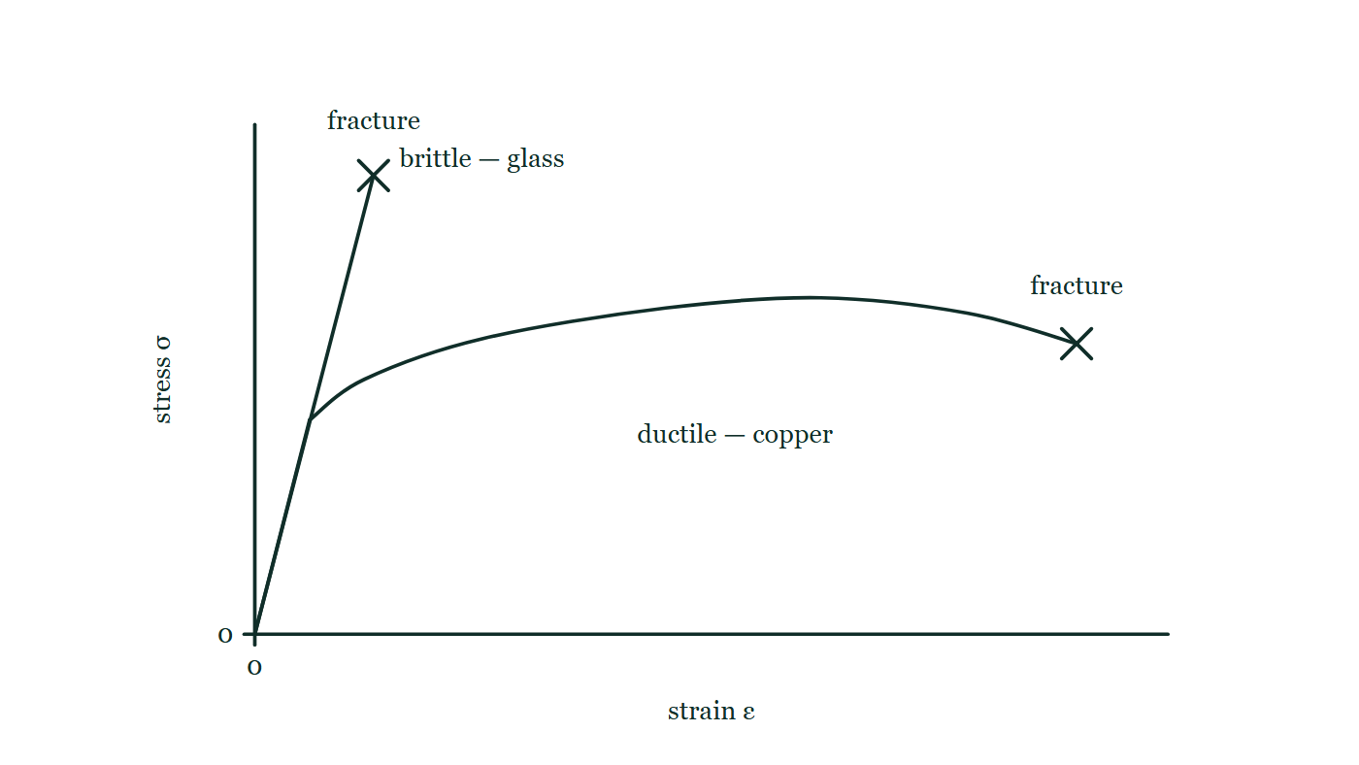
SOLID DEFORMATION · ELASTIC, PLASTIC, BRITTLE & DUCTILE BEHAVIOUR
GIOPHYSICS LESSON
THE PICTURE
Brittle beside ductile
Drawn for this lesson
Two stress–strain curves on one pair of axes. The brittle one is steep and stops abruptly at a fracture cross, high up the stress axis and very early along the strain axis. The ductile one rises less steeply, bends over into a long plateau and ends at a fracture cross far to the right at a lower stress.
The live version of this figure — click here
Solid Deformation — Elastic, Plastic, Brittle & Ductile Behaviour. Built by GioPhysics from the lesson's own copy; nothing on these slides is re-authored.
12 / 31
Notes:
[Phase] Build the model: The formulae, one at a time, in plain English (minutes 13–22 of 45)
[Figure] Two stress–strain curves on one pair of axes. The brittle one is steep and stops abruptly at a fracture cross, high up the stress axis and very early along the strain axis. The ductile one rises less steeply, bends over into a long plateau and ends at a fracture cross far to the right at a lower stress.

Slide 13
SOLID DEFORMATION · ELASTIC, PLASTIC, BRITTLE & DUCTILE BEHAVIOUR
GIOPHYSICS LESSON
WATCH OUT
The common trap
Check and misconception — The quick check and the trap
Elastic does not mean linear. Rubber can be elastic—returning close to its original shape—while its force–extension graph is strongly curved.
Solid Deformation — Elastic, Plastic, Brittle & Ductile Behaviour. Built by GioPhysics from the lesson's own copy; nothing on these slides is re-authored.
13 / 31
Notes:
[Phase] Check and misconception: The quick check and the trap (minutes 35–41 of 45)
[Misconception] Elastic does not mean linear. Rubber can be elastic—returning close to its original shape—while its force–extension graph is strongly curved.

Slide 14
SOLID DEFORMATION · ELASTIC, PLASTIC, BRITTLE & DUCTILE BEHAVIOUR
GIOPHYSICS LESSON
WORKED EXAMPLE 1 OF 2 · EASY
The question
Easy
Worked examples — I do, we do — one step revealed at a time
A wire is stretched within its elastic limit and released. What happens to its length and the energy stored?
Solid Deformation — Elastic, Plastic, Brittle & Ductile Behaviour. Built by GioPhysics from the lesson's own copy; nothing on these slides is re-authored.
14 / 31
Notes:
[Phase] Worked examples: I do, we do — one step revealed at a time (minutes 22–35 of 45)
[Question] A wire is stretched within its elastic limit and released. What happens to its length and the energy stored?
[Answer] Returns to original length; energy fully recovered

Slide 15
SOLID DEFORMATION · ELASTIC, PLASTIC, BRITTLE & DUCTILE BEHAVIOUR
GIOPHYSICS LESSON
WORKED EXAMPLE 1 OF 2 · EASY · THE WORKING
How to solve it
Easy
Worked examples — I do, we do — one step revealed at a time
A wire is stretched within its elastic limit and released. What happens to its length and the energy stored?
1.
Elastic behaviour: it returns exactly to its natural length.
2.
The stored elastic energy is fully recovered.
Solid Deformation — Elastic, Plastic, Brittle & Ductile Behaviour. Built by GioPhysics from the lesson's own copy; nothing on these slides is re-authored.
15 / 31
Notes:
[Phase] Worked examples: I do, we do — one step revealed at a time (minutes 22–35 of 45)
[Reveal] One click per step. The class works each line before the next appears.
[Step 1] Elastic behaviour: it returns exactly to its natural length.
[Step 2] The stored elastic energy is fully recovered.

Slide 16
SOLID DEFORMATION · ELASTIC, PLASTIC, BRITTLE & DUCTILE BEHAVIOUR
GIOPHYSICS LESSON
WORKED EXAMPLE 1 OF 2 · EASY
Answer
Easy
Worked examples — I do, we do — one step revealed at a time
Returns to original length; energy fully recovered
Solid Deformation — Elastic, Plastic, Brittle & Ductile Behaviour. Built by GioPhysics from the lesson's own copy; nothing on these slides is re-authored.
16 / 31
Notes:
[Phase] Worked examples: I do, we do — one step revealed at a time (minutes 22–35 of 45)
[Answer] Returns to original length; energy fully recovered

Slide 17
SOLID DEFORMATION · ELASTIC, PLASTIC, BRITTLE & DUCTILE BEHAVIOUR
GIOPHYSICS LESSON
WORKED EXAMPLE 2 OF 2 · MEDIUM
The question
Medium
Worked examples — I do, we do — one step revealed at a time
A rubber sample receives 12 J during loading and returns 8 J during unloading. Find the dissipated energy.
Solid Deformation — Elastic, Plastic, Brittle & Ductile Behaviour. Built by GioPhysics from the lesson's own copy; nothing on these slides is re-authored.
17 / 31
Notes:
[Phase] Worked examples: I do, we do — one step revealed at a time (minutes 22–35 of 45)
[Question] A rubber sample receives 12 J during loading and returns 8 J during unloading. Find the dissipated energy.
[Answer] 4 J becomes internal energy

Slide 18
SOLID DEFORMATION · ELASTIC, PLASTIC, BRITTLE & DUCTILE BEHAVIOUR
GIOPHYSICS LESSON
WORKED EXAMPLE 2 OF 2 · MEDIUM · THE WORKING
How to solve it
Medium
Worked examples — I do, we do — one step revealed at a time
A rubber sample receives 12 J during loading and returns 8 J during unloading. Find the dissipated energy.
1.
Energy supplied on loading = 12 J.
2.
Mechanical energy returned = 8 J.
3.
Dissipated energy = 12 − 8.
Solid Deformation — Elastic, Plastic, Brittle & Ductile Behaviour. Built by GioPhysics from the lesson's own copy; nothing on these slides is re-authored.
18 / 31
Notes:
[Phase] Worked examples: I do, we do — one step revealed at a time (minutes 22–35 of 45)
[Reveal] One click per step. The class works each line before the next appears.
[Step 1] Energy supplied on loading = 12 J.
[Step 2] Mechanical energy returned = 8 J.
[Step 3] Dissipated energy = 12 − 8.

Slide 19
SOLID DEFORMATION · ELASTIC, PLASTIC, BRITTLE & DUCTILE BEHAVIOUR
GIOPHYSICS LESSON
WORKED EXAMPLE 2 OF 2 · MEDIUM
Answer
Medium
Worked examples — I do, we do — one step revealed at a time
4 J becomes internal energy
Solid Deformation — Elastic, Plastic, Brittle & Ductile Behaviour. Built by GioPhysics from the lesson's own copy; nothing on these slides is re-authored.
19 / 31
Notes:
[Phase] Worked examples: I do, we do — one step revealed at a time (minutes 22–35 of 45)
[Answer] 4 J becomes internal energy

Slide 20
SOLID DEFORMATION · ELASTIC, PLASTIC, BRITTLE & DUCTILE BEHAVIOUR
GIOPHYSICS LESSON
SPOT THE MISTAKE
One line here is wrong
The whole working is up — find the bad line before you click
1.
A metal specimen is loaded to a strain of 0.008 and then unloaded.
2.
The unloading line runs parallel to the elastic line and reaches zero stress at a strain of 0.005.
3.
The permanent strain is therefore 0.008 − 0.005 = 0.003.
4.
The elastic recovery is whatever is left of the 0.008.
LINE 3 IS WRONG
The permanent strain is not a difference at all — it is simply where the specimen ends up once the stress is back to zero, read straight off the axis as 0.005. Subtracting feels like the more sophisticated move, which is exactly why it gets done.
IT SHOULD SAY
The permanent strain is 0.005 — the strain the sample is left holding at zero stress.
Solid Deformation — Elastic, Plastic, Brittle & Ductile Behaviour. Built by GioPhysics from the lesson's own copy; nothing on these slides is re-authored.
20 / 31
Notes:
[Phase] Worked examples: I do, we do — one step revealed at a time (minutes 22–35 of 45)
[Spot the mistake] The working is complete and one line of it is wrong. Let the room hunt: one click names the line, a second shows it done correctly.
[Line 3 is wrong] The permanent strain is not a difference at all — it is simply where the specimen ends up once the stress is back to zero, read straight off the axis as 0.005. Subtracting feels like the more sophisticated move, which is exactly why it gets done.
[It should say] The permanent strain is 0.005 — the strain the sample is left holding at zero stress.

Slide 21
SOLID DEFORMATION · ELASTIC, PLASTIC, BRITTLE & DUCTILE BEHAVIOUR
GIOPHYSICS LESSON
PREDICT · TAKE THE VOTE
Commit before you are told
Hands up for each option, then click
Equal volumes of these two materials are pulled to destruction. Which absorbs more energy on the way?
A The brittle one — its curve reaches a far higher stress
B The ductile one
C The same: both were broken by the same testing machine
Two stress–strain curves on one pair of axes. The brittle one is steep and stops abruptly at a fracture cross, high up the stress axis and very early along the strain axis. The ductile one rises less steeply, bends over into a long plateau and ends at a fracture cross far to the right at a lower stress.
The live version of this figure — click here
Solid Deformation — Elastic, Plastic, Brittle & Ductile Behaviour. Built by GioPhysics from the lesson's own copy; nothing on these slides is re-authored.
21 / 31
Notes:
[Phase] Build the model: The formulae, one at a time, in plain English (minutes 13–22 of 45)
[Predict] Equal volumes of these two materials are pulled to destruction. Which absorbs more energy on the way?
[Options] A The brittle one — its curve reaches a far higher stress B The ductile one C The same: both were broken by the same testing machine
[Figure] Two stress–strain curves on one pair of axes. The brittle one is steep and stops abruptly at a fracture cross, high up the stress axis and very early along the strain axis. The ductile one rises less steeply, bends over into a long plateau and ends at a fracture cross far to the right at a lower stress.

Slide 22
SOLID DEFORMATION · ELASTIC, PLASTIC, BRITTLE & DUCTILE BEHAVIOUR
GIOPHYSICS LESSON
PREDICT · THE OUTCOME
What actually happens
Ask the room who changed their mind, and why
B The ductile one
WHY
Energy per unit volume is the area under the curve, not the height of it. The brittle curve is tall and almost without width; the ductile one is lower but runs right across the strain axis, and its area is much the larger. That is the whole difference between strong and tough.
Solid Deformation — Elastic, Plastic, Brittle & Ductile Behaviour. Built by GioPhysics from the lesson's own copy; nothing on these slides is re-authored.
22 / 31
Notes:
[Phase] Build the model: The formulae, one at a time, in plain English (minutes 13–22 of 45)
[Answer] B — The ductile one. Energy per unit volume is the area under the curve, not the height of it. The brittle curve is tall and almost without width; the ductile one is lower but runs right across the strain axis, and its area is much the larger. That is the whole difference between strong and tough.

Slide 23
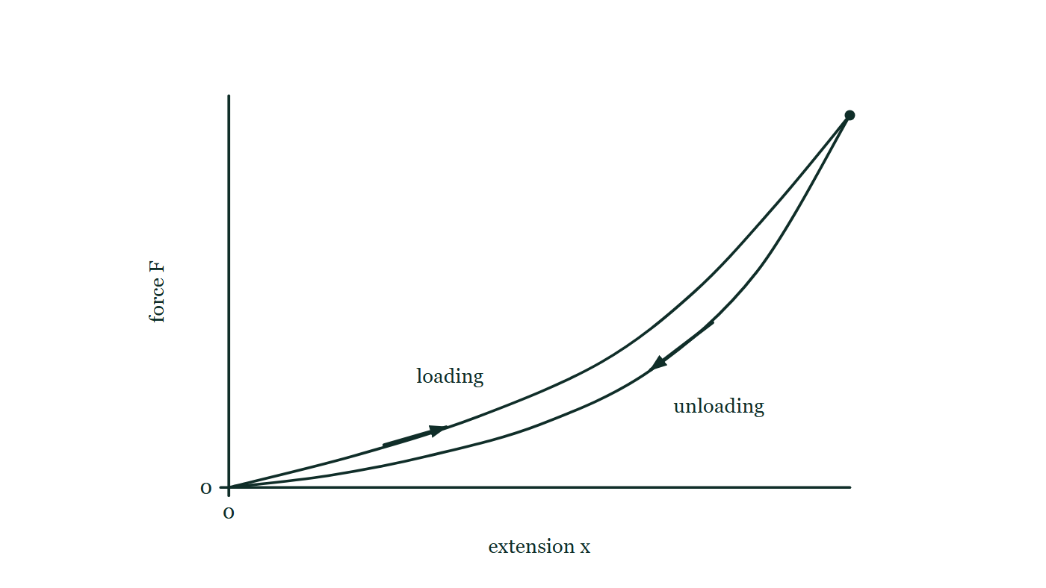
SOLID DEFORMATION · ELASTIC, PLASTIC, BRITTLE & DUCTILE BEHAVIOUR
GIOPHYSICS LESSON
QUICK CHECK
Decide before the answer goes up
Check and misconception — The quick check and the trap
What does the area inside a rubber loading–unloading loop represent?
A
Energy dissipated as internal energy
B
Young modulus
C
Permanent extension only
Force against extension for a rubber sample. The loading path curves up gently and then steeply to the top point; the unloading path comes back to the origin along a separate, lower curve, and each path carries an arrow showing the direction it is travelled in.
The live version of this figure — click here
Solid Deformation — Elastic, Plastic, Brittle & Ductile Behaviour. Built by GioPhysics from the lesson's own copy; nothing on these slides is re-authored.
23 / 31
Notes:
[Phase] Check and misconception: The quick check and the trap (minutes 35–41 of 45)
[Question] What does the area inside a rubber loading–unloading loop represent?
[Figure] Force against extension for a rubber sample. The loading path curves up gently and then steeply to the top point; the unloading path comes back to the origin along a separate, lower curve, and each path carries an arrow showing the direction it is travelled in.
[Options] A Energy dissipated as internal energy B Young modulus C Permanent extension only

Slide 24
SOLID DEFORMATION · ELASTIC, PLASTIC, BRITTLE & DUCTILE BEHAVIOUR
GIOPHYSICS LESSON
QUICK CHECK · THE ANSWER
The answer, and why
Check and misconception — The quick check and the trap
A Energy dissipated as internal energy
HOW TO GET THERE
Loading work exceeds unloading work; their difference is the hysteresis-loop area and becomes internal energy, often warming the rubber.
WHY THE OTHERS TEMPT
A Right. Loading put more work in than unloading gave back, and the difference is the area enclosed by the loop. It ends up as internal energy, which is why worked rubber warms up.
B Young modulus is a gradient, not an area — and rubber's curved graph has no single gradient to read anyway. Reach for E only where the line is straight.
C Permanent extension is a distance along the extension axis, and a rubber band that comes back to its original length has none of it. Its loop still encloses an area, so the two ideas must be separate.
Solid Deformation — Elastic, Plastic, Brittle & Ductile Behaviour. Built by GioPhysics from the lesson's own copy; nothing on these slides is re-authored.
24 / 31
Notes:
[Phase] Check and misconception: The quick check and the trap (minutes 35–41 of 45)
[Question] What does the area inside a rubber loading–unloading loop represent?
[Option by option] A: Right. Loading put more work in than unloading gave back, and the difference is the area enclosed by the loop. It ends up as internal energy, which is why worked rubber warms up. B: Young modulus is a gradient, not an area — and rubber's curved graph has no single gradient to read anyway. Reach for E only where the line is straight. C: Permanent extension is a distance along the extension axis, and a rubber band that comes back to its original length has none of it. Its loop still encloses an area, so the two ideas must be separate.
[Answer] A — Energy dissipated as internal energy
[Why] Loading work exceeds unloading work; their difference is the hysteresis-loop area and becomes internal energy, often warming the rubber.
[Reveal] One click for the answer, then one for the reason.

Slide 25
SOLID DEFORMATION · ELASTIC, PLASTIC, BRITTLE & DUCTILE BEHAVIOUR
GIOPHYSICS LESSON
EXTENSION 1 OF 2 · HARD
The question
Hard
Worked examples — I do, we do — one step revealed at a time
A metal specimen is loaded to a strain of 0.008 and unloaded; the unload line, parallel to the elastic line, reaches zero stress at strain 0.005. Identify the permanent strain and the elastic recovery.
Solid Deformation — Elastic, Plastic, Brittle & Ductile Behaviour. Built by GioPhysics from the lesson's own copy; nothing on these slides is re-authored.
25 / 31
Notes:
[Phase] Worked examples: I do, we do — one step revealed at a time (minutes 22–35 of 45)
[Question] A metal specimen is loaded to a strain of 0.008 and unloaded; the unload line, parallel to the elastic line, reaches zero stress at strain 0.005. Identify the permanent strain and the elastic recovery.
[Answer] Plastic strain 0.005; elastic recovery 0.003

Slide 26
SOLID DEFORMATION · ELASTIC, PLASTIC, BRITTLE & DUCTILE BEHAVIOUR
GIOPHYSICS LESSON
EXTENSION 1 OF 2 · HARD · THE WORKING
How to solve it
Hard
Worked examples — I do, we do — one step revealed at a time
A metal specimen is loaded to a strain of 0.008 and unloaded; the unload line, parallel to the elastic line, reaches zero stress at strain 0.005. Identify the permanent strain and the elastic recovery.
1.
Permanent (plastic) strain = where unloading ends: 0.005.
2.
Elastic recovery = 0.008 − 0.005 = 0.003.
3.
The unload line's parallel slope confirms E is unchanged by yielding.
Solid Deformation — Elastic, Plastic, Brittle & Ductile Behaviour. Built by GioPhysics from the lesson's own copy; nothing on these slides is re-authored.
26 / 31
Notes:
[Phase] Worked examples: I do, we do — one step revealed at a time (minutes 22–35 of 45)
[Reveal] One click per step. The class works each line before the next appears.
[Step 1] Permanent (plastic) strain = where unloading ends: 0.005.
[Step 2] Elastic recovery = 0.008 − 0.005 = 0.003.
[Step 3] The unload line's parallel slope confirms E is unchanged by yielding.

Slide 27
SOLID DEFORMATION · ELASTIC, PLASTIC, BRITTLE & DUCTILE BEHAVIOUR
GIOPHYSICS LESSON
EXTENSION 1 OF 2 · HARD
Answer
Hard
Worked examples — I do, we do — one step revealed at a time
Plastic strain 0.005; elastic recovery 0.003
Solid Deformation — Elastic, Plastic, Brittle & Ductile Behaviour. Built by GioPhysics from the lesson's own copy; nothing on these slides is re-authored.
27 / 31
Notes:
[Phase] Worked examples: I do, we do — one step revealed at a time (minutes 22–35 of 45)
[Answer] Plastic strain 0.005; elastic recovery 0.003

Slide 28
SOLID DEFORMATION · ELASTIC, PLASTIC, BRITTLE & DUCTILE BEHAVIOUR
GIOPHYSICS LESSON
EXTENSION 2 OF 2 · CHALLENGING
The question
Challenging
Worked examples — I do, we do — one step revealed at a time
A rubber band's loading curve stores 15 J; its unloading curve returns 11 J. Where did 4 J go, what is the loop called, and why do car tyres get hot?
Solid Deformation — Elastic, Plastic, Brittle & Ductile Behaviour. Built by GioPhysics from the lesson's own copy; nothing on these slides is re-authored.
28 / 31
Notes:
[Phase] Worked examples: I do, we do — one step revealed at a time (minutes 22–35 of 45)
[Question] A rubber band's loading curve stores 15 J; its unloading curve returns 11 J. Where did 4 J go, what is the loop called, and why do car tyres get hot?
[Answer] 4 J lost as heat per cycle (hysteresis) — the same physics warms flexing tyres

Slide 29
SOLID DEFORMATION · ELASTIC, PLASTIC, BRITTLE & DUCTILE BEHAVIOUR
GIOPHYSICS LESSON
EXTENSION 2 OF 2 · CHALLENGING · THE WORKING
How to solve it
Challenging
Worked examples — I do, we do — one step revealed at a time
A rubber band's loading curve stores 15 J; its unloading curve returns 11 J. Where did 4 J go, what is the loop called, and why do car tyres get hot?
1.
The 4 J between the curves — the hysteresis loop — became internal heating of the rubber.
2.
Every load–unload cycle dissipates the loop's area.
3.
A rolling tyre flexes cyclically many times per second, so hysteresis continuously pumps heat into it.
Solid Deformation — Elastic, Plastic, Brittle & Ductile Behaviour. Built by GioPhysics from the lesson's own copy; nothing on these slides is re-authored.
29 / 31
Notes:
[Phase] Worked examples: I do, we do — one step revealed at a time (minutes 22–35 of 45)
[Reveal] One click per step. The class works each line before the next appears.
[Step 1] The 4 J between the curves — the hysteresis loop — became internal heating of the rubber.
[Step 2] Every load–unload cycle dissipates the loop's area.
[Step 3] A rolling tyre flexes cyclically many times per second, so hysteresis continuously pumps heat into it.

Slide 30
SOLID DEFORMATION · ELASTIC, PLASTIC, BRITTLE & DUCTILE BEHAVIOUR
GIOPHYSICS LESSON
EXTENSION 2 OF 2 · CHALLENGING
Answer
Challenging
Worked examples — I do, we do — one step revealed at a time
4 J lost as heat per cycle (hysteresis) — the same physics warms flexing tyres
Solid Deformation — Elastic, Plastic, Brittle & Ductile Behaviour. Built by GioPhysics from the lesson's own copy; nothing on these slides is re-authored.
30 / 31
Notes:
[Phase] Worked examples: I do, we do — one step revealed at a time (minutes 22–35 of 45)
[Answer] 4 J lost as heat per cycle (hysteresis) — the same physics warms flexing tyres

Slide 31
SOLID DEFORMATION · ELASTIC, PLASTIC, BRITTLE & DUCTILE BEHAVIOUR
GIOPHYSICS LESSON
SOLID DEFORMATION
Where to go next
Plenary — What to take away, what to practise next
Next
8.6 Material Selection & Deformation Modelling
https://giophysics.com/chapter-14/material-selection-deformation-modelling/
Lesson
This lesson on giophysics.com
https://giophysics.com/chapter-14/elastic-plastic-brittle-ductile-behaviour/
Live
The live, interactive version of these slides
https://giophysics.com/chapter-14/presentation/?lesson=behaviour
Chapter
All Solid Deformation lessons
https://giophysics.com/chapter-14/
PDF
Download the lesson PDF
https://giophysics.com/downloads/14-5-elastic-plastic-brittle-ductile-behaviour.pdf
Solid Deformation — Elastic, Plastic, Brittle & Ductile Behaviour. Built by GioPhysics from the lesson's own copy; nothing on these slides is re-authored.
31 / 31
Notes:
[Phase] Plenary: What to take away, what to practise next (minutes 41–45 of 45)
[Interactive] The graphs and the circuit topology on these slides are frozen. The live version at https://giophysics.com/chapter-14/presentation/?lesson=behaviour moves them.

