Slide 1
SOLID DEFORMATION · ELASTIC ENERGY & FORCE-EXTENSION GRAPHS
GIOPHYSICS LESSON
08 · Solid Deformation
Graph area stores energy
Elastic Energy & Force-Extension Graphs
Use the area under a force–extension graph to track work transferred into a deformed spring or sample.
POSITION
Lesson 2 of 7 in Solid Deformation
PLAN
16 slides in the 45-minute core run, about 43 minutes of it
LESSON PAGE
https://giophysics.com/chapter-14/elastic-energy-force-extension-graphs/
Built by GioPhysics from the lesson's own page. Every word on these slides is the lesson's; nothing here is re-authored. Teaching material, not an awarding body's document.
Solid Deformation — Elastic Energy & Force-Extension Graphs. Built by GioPhysics from the lesson's own copy; nothing on these slides is re-authored.
1 / 32
Notes:
[Lesson] Solid Deformation — Elastic Energy & Force-Extension Graphs. Lesson 2 of 7.
[Intro] Use the area under a force–extension graph to track work transferred into a deformed spring or sample.
[Source] https://giophysics.com/chapter-14/elastic-energy-force-extension-graphs/
[Disclaimer] Built by GioPhysics from the lesson's own page. Every word on these slides is the lesson's; nothing here is re-authored. Teaching material, not an awarding body's document.

Slide 2
SOLID DEFORMATION · ELASTIC ENERGY & FORCE-EXTENSION GRAPHS
GIOPHYSICS LESSON
THINK FIRST
It takes 16 N to hold a spring at 8 cm. Has 16 × 0.08 = 1.28 J gone into it?
Take answers before you click — the point is the commitment
You stretch the spring slowly with a force meter and watch the reading climb steadily from zero to 16 N.
THE ANSWER
No — 0.64 J, exactly half of it. The 16 N is only reached at the very last instant; for the whole of the stretch the force was smaller, averaging 8 N. Work is the area under the force–extension graph, and that area is a triangle, not a rectangle.
Solid Deformation — Elastic Energy & Force-Extension Graphs. Built by GioPhysics from the lesson's own copy; nothing on these slides is re-authored.
2 / 32
Notes:
[Phase] Starter: Recall what this lesson stands on (minutes 0–5 of 45)
[Hook] It takes 16 N to hold a spring at 8 cm. Has 16 × 0.08 = 1.28 J gone into it? You stretch the spring slowly with a force meter and watch the reading climb steadily from zero to 16 N.
[Answer] No — 0.64 J, exactly half of it. The 16 N is only reached at the very last instant; for the whole of the stretch the force was smaller, averaging 8 N. Work is the area under the force–extension graph, and that area is a triangle, not a rectangle.

Slide 3
SOLID DEFORMATION · ELASTIC ENERGY & FORCE-EXTENSION GRAPHS
GIOPHYSICS LESSON
EXPLAINED SIMPLY
In one sentence
Introduce the idea — The big idea and the definition
Elastic potential energy is recoverable energy stored when an object is deformed; it equals the area under the force-extension graph.
Solid Deformation — Elastic Energy & Force-Extension Graphs. Built by GioPhysics from the lesson's own copy; nothing on these slides is re-authored.
3 / 32
Notes:
[Phase] Introduce the idea: The big idea and the definition (minutes 5–13 of 45)
[Definition] Elastic potential energy is recoverable energy stored when an object is deformed; it equals the area under the force-extension graph.

Slide 4
SOLID DEFORMATION · ELASTIC ENERGY & FORCE-EXTENSION GRAPHS
GIOPHYSICS LESSON
EXPLAINED SIMPLY
What that looks like
Introduce the idea — The big idea and the definition
FOR EXAMPLE
A compressed toy spring stores energy and releases it when the spring pushes the toy forward.
Solid Deformation — Elastic Energy & Force-Extension Graphs. Built by GioPhysics from the lesson's own copy; nothing on these slides is re-authored.
4 / 32
Notes:
[Phase] Introduce the idea: The big idea and the definition (minutes 5–13 of 45)
[Worked illustration] A compressed toy spring stores energy and releases it when the spring pushes the toy forward.

Slide 5
SOLID DEFORMATION · ELASTIC ENERGY & FORCE-EXTENSION GRAPHS
GIOPHYSICS LESSON
THE BIG IDEA
Graph area stores energy
Introduce the idea — The big idea and the definition
Work transferred into a solid while it deforms equals the area under its force–extension graph. That work is stored as elastic potential energy only when the deformation is recoverable without dissipation. A Hookean spring produces a triangle; for a curved graph, split the area into shapes or integrate F with respect to x.
Solid Deformation — Elastic Energy & Force-Extension Graphs. Built by GioPhysics from the lesson's own copy; nothing on these slides is re-authored.
5 / 32
Notes:
[Phase] Introduce the idea: The big idea and the definition (minutes 5–13 of 45)
[Big idea] Work transferred into a solid while it deforms equals the area under its force–extension graph. That work is stored as elastic potential energy only when the deformation is recoverable without dissipation. A Hookean spring produces a triangle; for a curved graph, split the area into shapes or integrate F with respect to x.

Slide 6
SOLID DEFORMATION · ELASTIC ENERGY & FORCE-EXTENSION GRAPHS
GIOPHYSICS LESSON
THE PHYSICS · 1 OF 3
Area, not final force
Build the model — The formulae, one at a time, in plain English
Multiplying Fx gives a rectangle. A linearly rising force uses half that area.
Solid Deformation — Elastic Energy & Force-Extension Graphs. Built by GioPhysics from the lesson's own copy; nothing on these slides is re-authored.
6 / 32
Notes:
[Phase] Build the model: The formulae, one at a time, in plain English (minutes 13–22 of 45)
[Section] Multiplying Fx gives a rectangle. A linearly rising force uses half that area.

Slide 7
SOLID DEFORMATION · ELASTIC ENERGY & FORCE-EXTENSION GRAPHS
GIOPHYSICS LESSON
THE PHYSICS · 2 OF 3
Series is softer
Build the model — The formulae, one at a time, in plain English
Two identical springs in series share the total extension, reducing the effective spring constant.
Solid Deformation — Elastic Energy & Force-Extension Graphs. Built by GioPhysics from the lesson's own copy; nothing on these slides is re-authored.
7 / 32
Notes:
[Phase] Build the model: The formulae, one at a time, in plain English (minutes 13–22 of 45)
[Section] Two identical springs in series share the total extension, reducing the effective spring constant.

Slide 8
SOLID DEFORMATION · ELASTIC ENERGY & FORCE-EXTENSION GRAPHS
GIOPHYSICS LESSON
THE PHYSICS · 3 OF 3
Parallel is stiffer
Build the model — The formulae, one at a time, in plain English
Identical parallel springs share the load, so their spring constants add.
Solid Deformation — Elastic Energy & Force-Extension Graphs. Built by GioPhysics from the lesson's own copy; nothing on these slides is re-authored.
8 / 32
Notes:
[Phase] Build the model: The formulae, one at a time, in plain English (minutes 13–22 of 45)
[Section] Identical parallel springs share the load, so their spring constants add.

Slide 9
SOLID DEFORMATION · ELASTIC ENERGY & FORCE-EXTENSION GRAPHS
GIOPHYSICS LESSON
FORMULA 1 OF 3
Loading work
Build the model — The formulae, one at a time, in plain English
W = ∫ F dx
Stored as U only for a lossless elastic path
IN PLAIN ENGLISH
The work done stretching is the area under the force–extension graph.
Solid Deformation — Elastic Energy & Force-Extension Graphs. Built by GioPhysics from the lesson's own copy; nothing on these slides is re-authored.
9 / 32
Notes:
[Phase] Build the model: The formulae, one at a time, in plain English (minutes 13–22 of 45)
[Formula] Loading work: W = ∫ F dx
[In plain English] The work done stretching is the area under the force–extension graph.
[Note] Stored as U only for a lossless elastic path

Slide 10
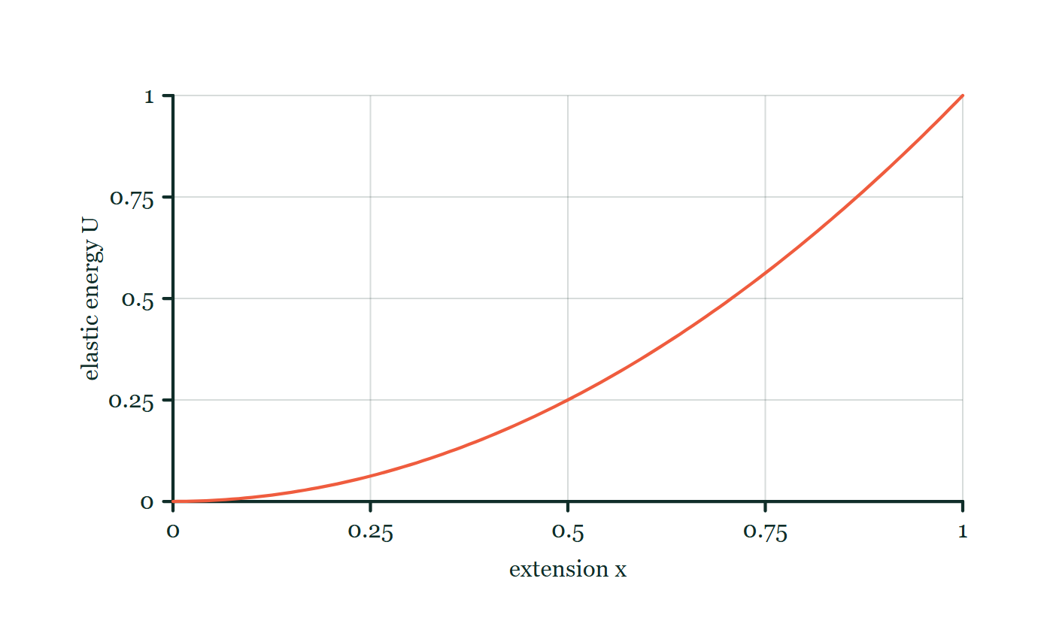
SOLID DEFORMATION · ELASTIC ENERGY & FORCE-EXTENSION GRAPHS
GIOPHYSICS LESSON
FORMULA 2 OF 3
Hookean spring
Build the model — The formulae, one at a time, in plain English
U = ½Fx = ½kx²
Only when F = kx
IN PLAIN ENGLISH
Energy stored in a stretched spring — the ½ appears because the force grows from zero as you stretch.
Elastic energy explorer
Move this graph on the live version — click here
Solid Deformation — Elastic Energy & Force-Extension Graphs. Built by GioPhysics from the lesson's own copy; nothing on these slides is re-authored.
10 / 32
Notes:
[Phase] Build the model: The formulae, one at a time, in plain English (minutes 13–22 of 45)
[Formula] Hookean spring: U = ½Fx = ½kx²
[In plain English] Energy stored in a stretched spring — the ½ appears because the force grows from zero as you stretch.
[Note] Only when F = kx
[Graph] Elastic energy explorer. Inside the Hooke-law region, doubling extension makes four times the stored elastic energy.
[Axes] Horizontal: extension x. Vertical: elastic energy U. Values are normalised — the graph teaches the shape, not a measurement.

Slide 11
SOLID DEFORMATION · ELASTIC ENERGY & FORCE-EXTENSION GRAPHS
GIOPHYSICS LESSON
FORMULA 3 OF 3
Spring combinations
Build the model — The formulae, one at a time, in plain English
kₛ = k/n; kₚ = nk
n identical springs in series or parallel
IN PLAIN ENGLISH
Chaining springs end-to-end makes the set n times softer; placing them side-by-side makes it n times stiffer.
Solid Deformation — Elastic Energy & Force-Extension Graphs. Built by GioPhysics from the lesson's own copy; nothing on these slides is re-authored.
11 / 32
Notes:
[Phase] Build the model: The formulae, one at a time, in plain English (minutes 13–22 of 45)
[Formula] Spring combinations: kₛ = k/n; kₚ = nk
[In plain English] Chaining springs end-to-end makes the set n times softer; placing them side-by-side makes it n times stiffer.
[Note] n identical springs in series or parallel

Slide 12
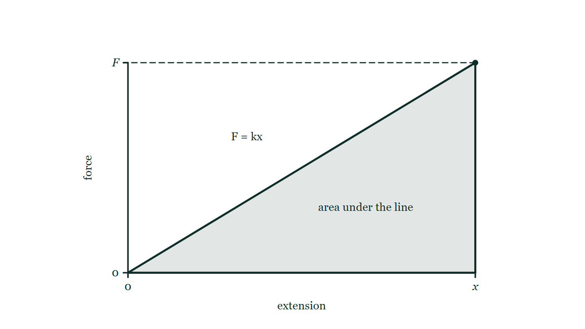
SOLID DEFORMATION · ELASTIC ENERGY & FORCE-EXTENSION GRAPHS
GIOPHYSICS LESSON
PICTURE 1 OF 2
Why the area and not the rectangle
Drawn for this lesson
Force–extension axes carrying a straight line from the origin out to a point at extension x and force F. The region between that line and the extension axis is shaded, and a dashed line runs from the end point across to the force axis, so the shaded region reads as a triangle of base x and height F.
The live version of this figure — click here
Solid Deformation — Elastic Energy & Force-Extension Graphs. Built by GioPhysics from the lesson's own copy; nothing on these slides is re-authored.
12 / 32
Notes:
[Phase] Build the model: The formulae, one at a time, in plain English (minutes 13–22 of 45)
[Figure] Force–extension axes carrying a straight line from the origin out to a point at extension x and force F. The region between that line and the extension axis is shaded, and a dashed line runs from the end point across to the force axis, so the shaded region reads as a triangle of base x and height F.

Slide 13
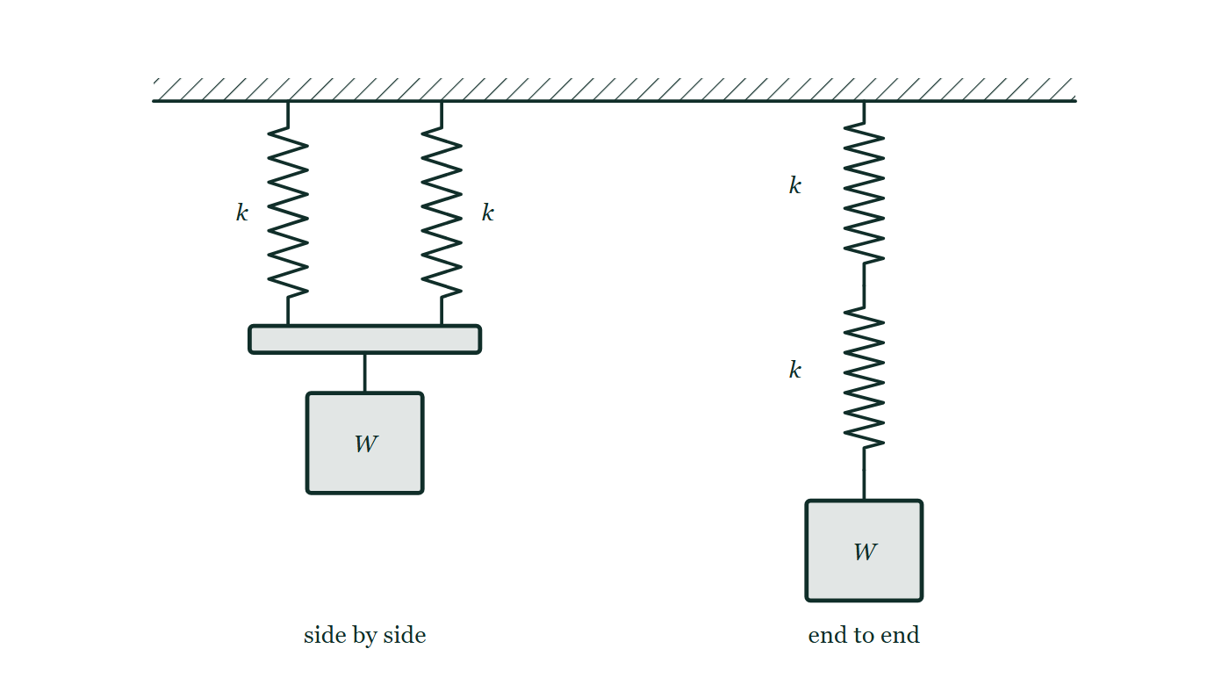
SOLID DEFORMATION · ELASTIC ENERGY & FORCE-EXTENSION GRAPHS
GIOPHYSICS LESSON
PICTURE 2 OF 2
Two springs, two ways of joining them
Drawn for this lesson
Two identical springs of stiffness k hung side by side from a ceiling onto a rigid bar, with a load W hanging from the middle of the bar; beside them, the same two springs joined one below the other with the identical load W on the bottom of the pair.
The live version of this figure — click here
Solid Deformation — Elastic Energy & Force-Extension Graphs. Built by GioPhysics from the lesson's own copy; nothing on these slides is re-authored.
13 / 32
Notes:
[Phase] Build the model: The formulae, one at a time, in plain English (minutes 13–22 of 45)
[Figure] Two identical springs of stiffness k hung side by side from a ceiling onto a rigid bar, with a load W hanging from the middle of the bar; beside them, the same two springs joined one below the other with the identical load W on the bottom of the pair.

Slide 14
SOLID DEFORMATION · ELASTIC ENERGY & FORCE-EXTENSION GRAPHS
GIOPHYSICS LESSON
WATCH OUT
The common trap
Check and misconception — The quick check and the trap
U = ½kx² is not the general deformation-energy formula. It follows from the triangular area only when force is proportional to extension.
Solid Deformation — Elastic Energy & Force-Extension Graphs. Built by GioPhysics from the lesson's own copy; nothing on these slides is re-authored.
14 / 32
Notes:
[Phase] Check and misconception: The quick check and the trap (minutes 35–41 of 45)
[Misconception] U = ½kx² is not the general deformation-energy formula. It follows from the triangular area only when force is proportional to extension.

Slide 15
SOLID DEFORMATION · ELASTIC ENERGY & FORCE-EXTENSION GRAPHS
GIOPHYSICS LESSON
WORKED EXAMPLE 1 OF 2 · EASY
The question
Easy
Worked examples — I do, we do — one step revealed at a time
How much energy is stored in a spring of k = 500 N/m compressed by 0.10 m?
Solid Deformation — Elastic Energy & Force-Extension Graphs. Built by GioPhysics from the lesson's own copy; nothing on these slides is re-authored.
15 / 32
Notes:
[Phase] Worked examples: I do, we do — one step revealed at a time (minutes 22–35 of 45)
[Question] How much energy is stored in a spring of k = 500 N/m compressed by 0.10 m?
[Answer] U = 2.5 J

Slide 16
SOLID DEFORMATION · ELASTIC ENERGY & FORCE-EXTENSION GRAPHS
GIOPHYSICS LESSON
WORKED EXAMPLE 1 OF 2 · EASY · THE WORKING
How to solve it
Easy
Worked examples — I do, we do — one step revealed at a time
How much energy is stored in a spring of k = 500 N/m compressed by 0.10 m?
1.
U = ½kx² = ½ × 500 × 0.01.
2.
U = 2.5 J.
Solid Deformation — Elastic Energy & Force-Extension Graphs. Built by GioPhysics from the lesson's own copy; nothing on these slides is re-authored.
16 / 32
Notes:
[Phase] Worked examples: I do, we do — one step revealed at a time (minutes 22–35 of 45)
[Reveal] One click per step. The class works each line before the next appears.
[Step 1] U = ½kx² = ½ × 500 × 0.01.
[Step 2] U = 2.5 J.

Slide 17
SOLID DEFORMATION · ELASTIC ENERGY & FORCE-EXTENSION GRAPHS
GIOPHYSICS LESSON
WORKED EXAMPLE 1 OF 2 · EASY
Answer
Easy
Worked examples — I do, we do — one step revealed at a time
U = 2.5 J
Solid Deformation — Elastic Energy & Force-Extension Graphs. Built by GioPhysics from the lesson's own copy; nothing on these slides is re-authored.
17 / 32
Notes:
[Phase] Worked examples: I do, we do — one step revealed at a time (minutes 22–35 of 45)
[Answer] U = 2.5 J

Slide 18
SOLID DEFORMATION · ELASTIC ENERGY & FORCE-EXTENSION GRAPHS
GIOPHYSICS LESSON
WORKED EXAMPLE 2 OF 2 · MEDIUM
The question
Medium
Worked examples — I do, we do — one step revealed at a time
A 200 N m⁻¹ spring is extended by 8.0 cm. Find its final force and stored energy.
Solid Deformation — Elastic Energy & Force-Extension Graphs. Built by GioPhysics from the lesson's own copy; nothing on these slides is re-authored.
18 / 32
Notes:
[Phase] Worked examples: I do, we do — one step revealed at a time (minutes 22–35 of 45)
[Question] A 200 N m⁻¹ spring is extended by 8.0 cm. Find its final force and stored energy.
[Answer] F = 16 N and U = 0.64 J

Slide 19
SOLID DEFORMATION · ELASTIC ENERGY & FORCE-EXTENSION GRAPHS
GIOPHYSICS LESSON
WORKED EXAMPLE 2 OF 2 · MEDIUM · THE WORKING
How to solve it
Medium
Worked examples — I do, we do — one step revealed at a time
A 200 N m⁻¹ spring is extended by 8.0 cm. Find its final force and stored energy.
1.
Convert x = 8.0 cm = 0.080 m.
2.
F = kx = (200)(0.080) = 16 N.
3.
U = ½kx² = ½(200)(0.080)².
Solid Deformation — Elastic Energy & Force-Extension Graphs. Built by GioPhysics from the lesson's own copy; nothing on these slides is re-authored.
19 / 32
Notes:
[Phase] Worked examples: I do, we do — one step revealed at a time (minutes 22–35 of 45)
[Reveal] One click per step. The class works each line before the next appears.
[Step 1] Convert x = 8.0 cm = 0.080 m.
[Step 2] F = kx = (200)(0.080) = 16 N.
[Step 3] U = ½kx² = ½(200)(0.080)².

Slide 20
SOLID DEFORMATION · ELASTIC ENERGY & FORCE-EXTENSION GRAPHS
GIOPHYSICS LESSON
WORKED EXAMPLE 2 OF 2 · MEDIUM
Answer
Medium
Worked examples — I do, we do — one step revealed at a time
F = 16 N and U = 0.64 J
Solid Deformation — Elastic Energy & Force-Extension Graphs. Built by GioPhysics from the lesson's own copy; nothing on these slides is re-authored.
20 / 32
Notes:
[Phase] Worked examples: I do, we do — one step revealed at a time (minutes 22–35 of 45)
[Answer] F = 16 N and U = 0.64 J

Slide 21
SOLID DEFORMATION · ELASTIC ENERGY & FORCE-EXTENSION GRAPHS
GIOPHYSICS LESSON
SPOT THE MISTAKE
One line here is wrong
The whole working is up — find the bad line before you click
1.
Convert the extension first: x = 8.0 cm = 0.080 m.
2.
Force at that extension: F = kx = 200 × 0.080 = 16 N.
3.
Energy stored: U = ½kx² = ½ × 200 × 0.080 = 8.0 J.
4.
So the spring holds 8.0 J.
LINE 3 IS WRONG
x was squared in the formula but not on the calculator — the line uses 0.080 where it needs 0.0064. Squaring a number smaller than one makes it smaller, so this slip does not produce an absurd answer, just one that is more than ten times too big.
IT SHOULD SAY
U = ½kx² = ½ × 200 × 0.0064 = 0.64 J.
Solid Deformation — Elastic Energy & Force-Extension Graphs. Built by GioPhysics from the lesson's own copy; nothing on these slides is re-authored.
21 / 32
Notes:
[Phase] Worked examples: I do, we do — one step revealed at a time (minutes 22–35 of 45)
[Spot the mistake] The working is complete and one line of it is wrong. Let the room hunt: one click names the line, a second shows it done correctly.
[Line 3 is wrong] x was squared in the formula but not on the calculator — the line uses 0.080 where it needs 0.0064. Squaring a number smaller than one makes it smaller, so this slip does not produce an absurd answer, just one that is more than ten times too big.
[It should say] U = ½kx² = ½ × 200 × 0.0064 = 0.64 J.

Slide 22
SOLID DEFORMATION · ELASTIC ENERGY & FORCE-EXTENSION GRAPHS
GIOPHYSICS LESSON
PREDICT · TAKE THE VOTE
Commit before you are told
Hands up for each option, then click
Both arrangements hang the same load W from the same two springs. Which one drops further?
A The pair side by side — twice as many coils are sharing the pull
B The pair joined end to end
C Neither: identical springs and an identical load must give an identical stretch
Two identical springs of stiffness k hung side by side from a ceiling onto a rigid bar, with a load W hanging from the middle of the bar; beside them, the same two springs joined one below the other with the identical load W on the bottom of the pair.
The live version of this figure — click here
Solid Deformation — Elastic Energy & Force-Extension Graphs. Built by GioPhysics from the lesson's own copy; nothing on these slides is re-authored.
22 / 32
Notes:
[Phase] Build the model: The formulae, one at a time, in plain English (minutes 13–22 of 45)
[Predict] Both arrangements hang the same load W from the same two springs. Which one drops further?
[Options] A The pair side by side — twice as many coils are sharing the pull B The pair joined end to end C Neither: identical springs and an identical load must give an identical stretch
[Figure] Two identical springs of stiffness k hung side by side from a ceiling onto a rigid bar, with a load W hanging from the middle of the bar; beside them, the same two springs joined one below the other with the identical load W on the bottom of the pair.

Slide 23
SOLID DEFORMATION · ELASTIC ENERGY & FORCE-EXTENSION GRAPHS
GIOPHYSICS LESSON
PREDICT · THE OUTCOME
What actually happens
Ask the room who changed their mind, and why
B The pair joined end to end
WHY
End to end, each spring feels the whole of W and each stretches by W/k, so the load falls 2W/k. Side by side they share the load, W/2 each, and the bar drops only W/2k — four times less. Springs in parallel stiffen the set; springs in series soften it.
Solid Deformation — Elastic Energy & Force-Extension Graphs. Built by GioPhysics from the lesson's own copy; nothing on these slides is re-authored.
23 / 32
Notes:
[Phase] Build the model: The formulae, one at a time, in plain English (minutes 13–22 of 45)
[Answer] B — The pair joined end to end. End to end, each spring feels the whole of W and each stretches by W/k, so the load falls 2W/k. Side by side they share the load, W/2 each, and the bar drops only W/2k — four times less. Springs in parallel stiffen the set; springs in series soften it.

Slide 24
SOLID DEFORMATION · ELASTIC ENERGY & FORCE-EXTENSION GRAPHS
GIOPHYSICS LESSON
QUICK CHECK
Decide before the answer goes up
Check and misconception — The quick check and the trap
A Hookean spring reaches force F at extension x. What is the stored energy?
A
Fx
B
½Fx
C
F/x
Solid Deformation — Elastic Energy & Force-Extension Graphs. Built by GioPhysics from the lesson's own copy; nothing on these slides is re-authored.
24 / 32
Notes:
[Phase] Check and misconception: The quick check and the trap (minutes 35–41 of 45)
[Question] A Hookean spring reaches force F at extension x. What is the stored energy?
[Options] A Fx B ½Fx C F/x

Slide 25
SOLID DEFORMATION · ELASTIC ENERGY & FORCE-EXTENSION GRAPHS
GIOPHYSICS LESSON
QUICK CHECK · THE ANSWER
The answer, and why
Check and misconception — The quick check and the trap
B ½Fx
HOW TO GET THERE
The F–x graph is a triangle with base x and height F, so its area is ½Fx.
WHY THE OTHERS TEMPT
A Fx is the rectangle F tall and x wide — the work you would do if the full force F acted over the whole of the stretch. It does not: the force starts at zero and builds, so the rectangle is exactly twice the truth.
B Right. The graph is a triangle of base x and height F, so the work stored is ½Fx — which for a Hookean spring is the same thing as ½kx².
C F/x is the gradient of the line, which is the spring constant k in N/m. It is a stiffness, not an energy: check the units and it cannot possibly come out in joules.
Solid Deformation — Elastic Energy & Force-Extension Graphs. Built by GioPhysics from the lesson's own copy; nothing on these slides is re-authored.
25 / 32
Notes:
[Phase] Check and misconception: The quick check and the trap (minutes 35–41 of 45)
[Question] A Hookean spring reaches force F at extension x. What is the stored energy?
[Option by option] A: Fx is the rectangle F tall and x wide — the work you would do if the full force F acted over the whole of the stretch. It does not: the force starts at zero and builds, so the rectangle is exactly twice the truth. B: Right. The graph is a triangle of base x and height F, so the work stored is ½Fx — which for a Hookean spring is the same thing as ½kx². C: F/x is the gradient of the line, which is the spring constant k in N/m. It is a stiffness, not an energy: check the units and it cannot possibly come out in joules.
[Answer] B — ½Fx
[Why] The F–x graph is a triangle with base x and height F, so its area is ½Fx.
[Reveal] One click for the answer, then one for the reason.

Slide 26
SOLID DEFORMATION · ELASTIC ENERGY & FORCE-EXTENSION GRAPHS
GIOPHYSICS LESSON
EXTENSION 1 OF 2 · HARD
The question
Hard
Worked examples — I do, we do — one step revealed at a time
A force–extension graph is linear up to (0.060 m, 30 N) then curves. Find the energy stored in the linear region, and explain what the area under the curved part represents.
Solid Deformation — Elastic Energy & Force-Extension Graphs. Built by GioPhysics from the lesson's own copy; nothing on these slides is re-authored.
26 / 32
Notes:
[Phase] Worked examples: I do, we do — one step revealed at a time (minutes 22–35 of 45)
[Question] A force–extension graph is linear up to (0.060 m, 30 N) then curves. Find the energy stored in the linear region, and explain what the area under the curved part represents.
[Answer] 0.90 J; beyond the limit the area includes energy lost to plastic deformation

Slide 27
SOLID DEFORMATION · ELASTIC ENERGY & FORCE-EXTENSION GRAPHS
GIOPHYSICS LESSON
EXTENSION 1 OF 2 · HARD · THE WORKING
How to solve it
Hard
Worked examples — I do, we do — one step revealed at a time
A force–extension graph is linear up to (0.060 m, 30 N) then curves. Find the energy stored in the linear region, and explain what the area under the curved part represents.
1.
Linear region: U = ½Fx = ½ × 30 × 0.060 = 0.90 J.
2.
Beyond the limit of proportionality the area under the curve is still work done on the material.
3.
But part of it is no longer recoverable — permanent (plastic) deformation and heat.
Solid Deformation — Elastic Energy & Force-Extension Graphs. Built by GioPhysics from the lesson's own copy; nothing on these slides is re-authored.
27 / 32
Notes:
[Phase] Worked examples: I do, we do — one step revealed at a time (minutes 22–35 of 45)
[Reveal] One click per step. The class works each line before the next appears.
[Step 1] Linear region: U = ½Fx = ½ × 30 × 0.060 = 0.90 J.
[Step 2] Beyond the limit of proportionality the area under the curve is still work done on the material.
[Step 3] But part of it is no longer recoverable — permanent (plastic) deformation and heat.

Slide 28
SOLID DEFORMATION · ELASTIC ENERGY & FORCE-EXTENSION GRAPHS
GIOPHYSICS LESSON
EXTENSION 1 OF 2 · HARD
Answer
Hard
Worked examples — I do, we do — one step revealed at a time
0.90 J; beyond the limit the area includes energy lost to plastic deformation
Solid Deformation — Elastic Energy & Force-Extension Graphs. Built by GioPhysics from the lesson's own copy; nothing on these slides is re-authored.
28 / 32
Notes:
[Phase] Worked examples: I do, we do — one step revealed at a time (minutes 22–35 of 45)
[Answer] 0.90 J; beyond the limit the area includes energy lost to plastic deformation

Slide 29
SOLID DEFORMATION · ELASTIC ENERGY & FORCE-EXTENSION GRAPHS
GIOPHYSICS LESSON
EXTENSION 2 OF 2 · CHALLENGING
The question
Challenging
Worked examples — I do, we do — one step revealed at a time
A catapult's two elastic cords (each k = 150 N/m) are both stretched 0.25 m and released against a 0.060 kg projectile. Estimate the launch speed if 20% of the stored energy is lost.
Solid Deformation — Elastic Energy & Force-Extension Graphs. Built by GioPhysics from the lesson's own copy; nothing on these slides is re-authored.
29 / 32
Notes:
[Phase] Worked examples: I do, we do — one step revealed at a time (minutes 22–35 of 45)
[Question] A catapult's two elastic cords (each k = 150 N/m) are both stretched 0.25 m and released against a 0.060 kg projectile. Estimate the launch speed if 20% of the stored energy is lost.
[Answer] v ≈ 16 m/s

Slide 30
SOLID DEFORMATION · ELASTIC ENERGY & FORCE-EXTENSION GRAPHS
GIOPHYSICS LESSON
EXTENSION 2 OF 2 · CHALLENGING · THE WORKING
How to solve it
Challenging
Worked examples — I do, we do — one step revealed at a time
A catapult's two elastic cords (each k = 150 N/m) are both stretched 0.25 m and released against a 0.060 kg projectile. Estimate the launch speed if 20% of the stored energy is lost.
1.
Stored: 2 × ½ × 150 × 0.0625 = 9.375 J; usable = 0.80 × 9.375 = 7.5 J.
2.
½mv² = 7.5 → v² = 250.
3.
v ≈ 15.8 m/s.
Solid Deformation — Elastic Energy & Force-Extension Graphs. Built by GioPhysics from the lesson's own copy; nothing on these slides is re-authored.
30 / 32
Notes:
[Phase] Worked examples: I do, we do — one step revealed at a time (minutes 22–35 of 45)
[Reveal] One click per step. The class works each line before the next appears.
[Step 1] Stored: 2 × ½ × 150 × 0.0625 = 9.375 J; usable = 0.80 × 9.375 = 7.5 J.
[Step 2] ½mv² = 7.5 → v² = 250.
[Step 3] v ≈ 15.8 m/s.

Slide 31
SOLID DEFORMATION · ELASTIC ENERGY & FORCE-EXTENSION GRAPHS
GIOPHYSICS LESSON
EXTENSION 2 OF 2 · CHALLENGING
Answer
Challenging
Worked examples — I do, we do — one step revealed at a time
v ≈ 16 m/s
Solid Deformation — Elastic Energy & Force-Extension Graphs. Built by GioPhysics from the lesson's own copy; nothing on these slides is re-authored.
31 / 32
Notes:
[Phase] Worked examples: I do, we do — one step revealed at a time (minutes 22–35 of 45)
[Answer] v ≈ 16 m/s

Slide 32
SOLID DEFORMATION · ELASTIC ENERGY & FORCE-EXTENSION GRAPHS
GIOPHYSICS LESSON
SOLID DEFORMATION
Where to go next
Plenary — What to take away, what to practise next
Next
8.3 Stress, Strain & Young Modulus
https://giophysics.com/chapter-14/stress-strain-young-modulus/
Lesson
This lesson on giophysics.com
https://giophysics.com/chapter-14/elastic-energy-force-extension-graphs/
Live
The live, interactive version of these slides
https://giophysics.com/chapter-14/presentation/?lesson=energy
Chapter
All Solid Deformation lessons
https://giophysics.com/chapter-14/
PDF
Download the lesson PDF
https://giophysics.com/downloads/14-2-elastic-energy-force-extension-graphs.pdf
Solid Deformation — Elastic Energy & Force-Extension Graphs. Built by GioPhysics from the lesson's own copy; nothing on these slides is re-authored.
32 / 32
Notes:
[Phase] Plenary: What to take away, what to practise next (minutes 41–45 of 45)
[Interactive] The graphs and the circuit topology on these slides are frozen. The live version at https://giophysics.com/chapter-14/presentation/?lesson=energy moves them.

