Slide 1
SOLID DEFORMATION · HOOKE'S LAW & EXTENSION
GIOPHYSICS LESSON
08 · Solid Deformation
Force changes length
Hooke's Law & Extension
Separate compression from tension, measure extension from the natural length, and use Hooke's law only inside its linear range.
POSITION
Lesson 1 of 7 in Solid Deformation
PLAN
16 slides in the 45-minute core run, about 44 minutes of it
LESSON PAGE
https://giophysics.com/chapter-14/hookes-law-extension/
Built by GioPhysics from the lesson's own page. Every word on these slides is the lesson's; nothing here is re-authored. Teaching material, not an awarding body's document.
Solid Deformation — Hooke's Law & Extension. Built by GioPhysics from the lesson's own copy; nothing on these slides is re-authored.
1 / 32
Notes:
[Lesson] Solid Deformation — Hooke's Law & Extension. Lesson 1 of 7.
[Intro] Separate compression from tension, measure extension from the natural length, and use Hooke's law only inside its linear range.
[Source] https://giophysics.com/chapter-14/hookes-law-extension/
[Disclaimer] Built by GioPhysics from the lesson's own page. Every word on these slides is the lesson's; nothing here is re-authored. Teaching material, not an awarding body's document.

Slide 2
SOLID DEFORMATION · HOOKE'S LAW & EXTENSION
GIOPHYSICS LESSON
THINK FIRST
A spring stretches 2 cm when you hang 4 N on it. What will 40 N do?
Take answers before you click — the point is the commitment
Every spring in the lab drawer has a stiffness you can measure in a minute — and a length it never comes back from.
THE ANSWER
Nothing like 20 cm. Hooke's law only holds while the spring is inside its proportional range, and ten times the test load is usually well outside it: the extension runs ahead of what F = kx predicts, and the spring may never return to 18 cm once the load comes off.
Solid Deformation — Hooke's Law & Extension. Built by GioPhysics from the lesson's own copy; nothing on these slides is re-authored.
2 / 32
Notes:
[Phase] Starter: Recall what this lesson stands on (minutes 0–5 of 45)
[Hook] A spring stretches 2 cm when you hang 4 N on it. What will 40 N do? Every spring in the lab drawer has a stiffness you can measure in a minute — and a length it never comes back from.
[Answer] Nothing like 20 cm. Hooke's law only holds while the spring is inside its proportional range, and ten times the test load is usually well outside it: the extension runs ahead of what F = kx predicts, and the spring may never return to 18 cm once the load comes off.

Slide 3
SOLID DEFORMATION · HOOKE'S LAW & EXTENSION
GIOPHYSICS LESSON
EXPLAINED SIMPLY
In one sentence
Introduce the idea — The big idea and the definition
Hooke's law says a spring's force is directly proportional to its extension while the spring remains in its proportional range.
Solid Deformation — Hooke's Law & Extension. Built by GioPhysics from the lesson's own copy; nothing on these slides is re-authored.
3 / 32
Notes:
[Phase] Introduce the idea: The big idea and the definition (minutes 5–13 of 45)
[Definition] Hooke's law says a spring's force is directly proportional to its extension while the spring remains in its proportional range.

Slide 4
SOLID DEFORMATION · HOOKE'S LAW & EXTENSION
GIOPHYSICS LESSON
EXPLAINED SIMPLY
What that looks like
Introduce the idea — The big idea and the definition
FOR EXAMPLE
If a spring needs 4 N to extend 2 cm, the same spring needs 8 N to extend 4 cm while Hooke's law still applies.
Solid Deformation — Hooke's Law & Extension. Built by GioPhysics from the lesson's own copy; nothing on these slides is re-authored.
4 / 32
Notes:
[Phase] Introduce the idea: The big idea and the definition (minutes 5–13 of 45)
[Worked illustration] If a spring needs 4 N to extend 2 cm, the same spring needs 8 N to extend 4 cm while Hooke's law still applies.

Slide 5
SOLID DEFORMATION · HOOKE'S LAW & EXTENSION
GIOPHYSICS LESSON
THE BIG IDEA
Force changes length
Introduce the idea — The big idea and the definition
A tensile force stretches a sample; a compressive force shortens it. Extension x is the signed change from the original length. For a spring in its proportional region, force and extension form a straight line through the origin, whose gradient is the spring constant k.
Solid Deformation — Hooke's Law & Extension. Built by GioPhysics from the lesson's own copy; nothing on these slides is re-authored.
5 / 32
Notes:
[Phase] Introduce the idea: The big idea and the definition (minutes 5–13 of 45)
[Big idea] A tensile force stretches a sample; a compressive force shortens it. Extension x is the signed change from the original length. For a spring in its proportional region, force and extension form a straight line through the origin, whose gradient is the spring constant k.

Slide 6
SOLID DEFORMATION · HOOKE'S LAW & EXTENSION
GIOPHYSICS LESSON
THE PHYSICS · 1 OF 3
Measure the change
Build the model — The formulae, one at a time, in plain English
Do not substitute the final length for x. Subtract the natural length first.
Solid Deformation — Hooke's Law & Extension. Built by GioPhysics from the lesson's own copy; nothing on these slides is re-authored.
6 / 32
Notes:
[Phase] Build the model: The formulae, one at a time, in plain English (minutes 13–22 of 45)
[Section] Do not substitute the final length for x. Subtract the natural length first.

Slide 7
SOLID DEFORMATION · HOOKE'S LAW & EXTENSION
GIOPHYSICS LESSON
THE PHYSICS · 2 OF 3
Read the gradient
Build the model — The formulae, one at a time, in plain English
A steeper F–x line means a larger k and therefore a stiffer spring.
Solid Deformation — Hooke's Law & Extension. Built by GioPhysics from the lesson's own copy; nothing on these slides is re-authored.
7 / 32
Notes:
[Phase] Build the model: The formulae, one at a time, in plain English (minutes 13–22 of 45)
[Section] A steeper F–x line means a larger k and therefore a stiffer spring.

Slide 8
SOLID DEFORMATION · HOOKE'S LAW & EXTENSION
GIOPHYSICS LESSON
THE PHYSICS · 3 OF 3
Know the boundary
Build the model — The formulae, one at a time, in plain English
Beyond the proportional limit, a curved graph means one constant k no longer describes the sample.
Solid Deformation — Hooke's Law & Extension. Built by GioPhysics from the lesson's own copy; nothing on these slides is re-authored.
8 / 32
Notes:
[Phase] Build the model: The formulae, one at a time, in plain English (minutes 13–22 of 45)
[Section] Beyond the proportional limit, a curved graph means one constant k no longer describes the sample.

Slide 9
SOLID DEFORMATION · HOOKE'S LAW & EXTENSION
GIOPHYSICS LESSON
FORMULA 1 OF 3
Extension
Build the model — The formulae, one at a time, in plain English
x = L − L₀
Metres; x may be negative in compression
IN PLAIN ENGLISH
How much longer the object got: stretched length minus natural length (negative when squashed).
Solid Deformation — Hooke's Law & Extension. Built by GioPhysics from the lesson's own copy; nothing on these slides is re-authored.
9 / 32
Notes:
[Phase] Build the model: The formulae, one at a time, in plain English (minutes 13–22 of 45)
[Formula] Extension: x = L − L₀
[In plain English] How much longer the object got: stretched length minus natural length (negative when squashed).
[Note] Metres; x may be negative in compression

Slide 10
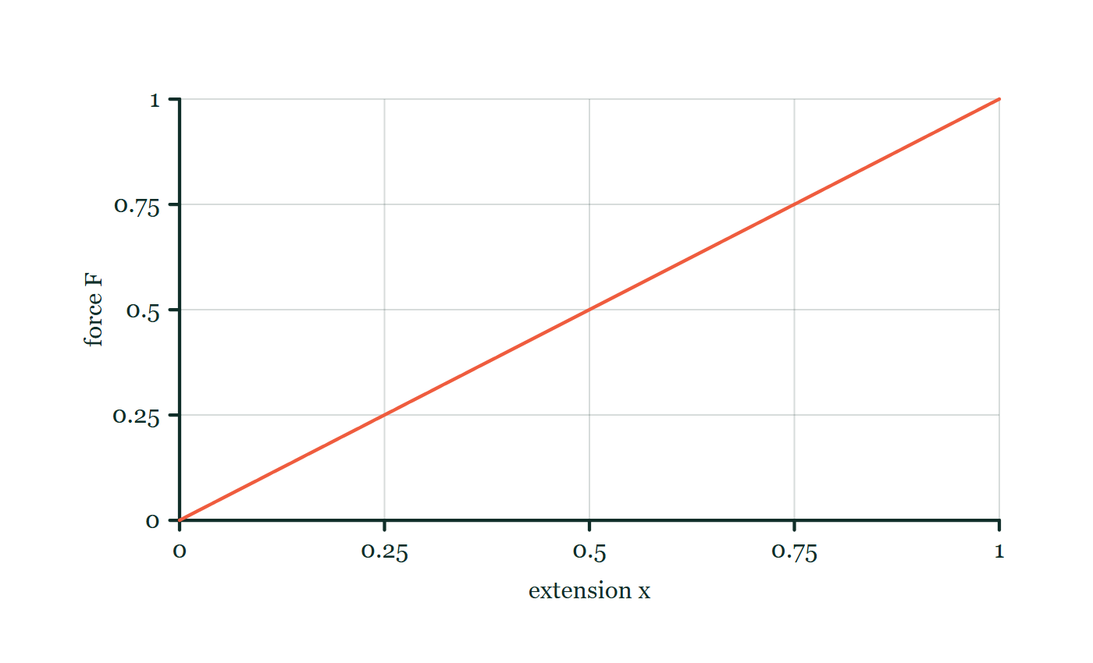
SOLID DEFORMATION · HOOKE'S LAW & EXTENSION
GIOPHYSICS LESSON
FORMULA 2 OF 3
Hooke's law
Build the model — The formulae, one at a time, in plain English
F = kx
Valid only in the proportional region
IN PLAIN ENGLISH
Within limits, a spring's pull is proportional to its stretch — double the stretch, double the force; k measures its stiffness.
Force–extension explorer
Move this graph on the live version — click here
Solid Deformation — Hooke's Law & Extension. Built by GioPhysics from the lesson's own copy; nothing on these slides is re-authored.
10 / 32
Notes:
[Phase] Build the model: The formulae, one at a time, in plain English (minutes 13–22 of 45)
[Formula] Hooke's law: F = kx
[In plain English] Within limits, a spring's pull is proportional to its stretch — double the stretch, double the force; k measures its stiffness.
[Note] Valid only in the proportional region
[Graph] Force–extension explorer. Inside the Hooke-law region, doubling extension doubles force when stiffness k is fixed.
[Axes] Horizontal: extension x. Vertical: force F. Values are normalised — the graph teaches the shape, not a measurement.

Slide 11
SOLID DEFORMATION · HOOKE'S LAW & EXTENSION
GIOPHYSICS LESSON
FORMULA 3 OF 3
Graph gradient
Build the model — The formulae, one at a time, in plain English
k = ΔF/Δx
On a force–extension graph
IN PLAIN ENGLISH
The slope of the force–extension graph is the stiffness: a steeper line means a stiffer spring.
Solid Deformation — Hooke's Law & Extension. Built by GioPhysics from the lesson's own copy; nothing on these slides is re-authored.
11 / 32
Notes:
[Phase] Build the model: The formulae, one at a time, in plain English (minutes 13–22 of 45)
[Formula] Graph gradient: k = ΔF/Δx
[In plain English] The slope of the force–extension graph is the stiffness: a steeper line means a stiffer spring.
[Note] On a force–extension graph

Slide 12
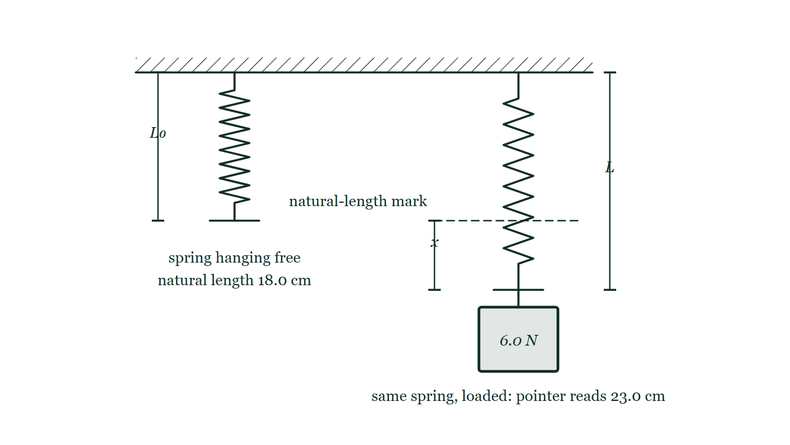
SOLID DEFORMATION · HOOKE'S LAW & EXTENSION
GIOPHYSICS LESSON
THE PICTURE
Measuring an extension
Drawn for this lesson
The same spring twice: hanging free from a clamp with its pointer at the 18.0 cm mark, and again with a 6.0 N load on the hanger so the pointer has dropped to 23.0 cm. The natural-length mark is carried across to the loaded spring, and the gap between that mark and the pointer is dimensioned as x.
The live version of this figure — click here
Solid Deformation — Hooke's Law & Extension. Built by GioPhysics from the lesson's own copy; nothing on these slides is re-authored.
12 / 32
Notes:
[Phase] Build the model: The formulae, one at a time, in plain English (minutes 13–22 of 45)
[Figure] The same spring twice: hanging free from a clamp with its pointer at the 18.0 cm mark, and again with a 6.0 N load on the hanger so the pointer has dropped to 23.0 cm. The natural-length mark is carried across to the loaded spring, and the gap between that mark and the pointer is dimensioned as x.

Slide 13
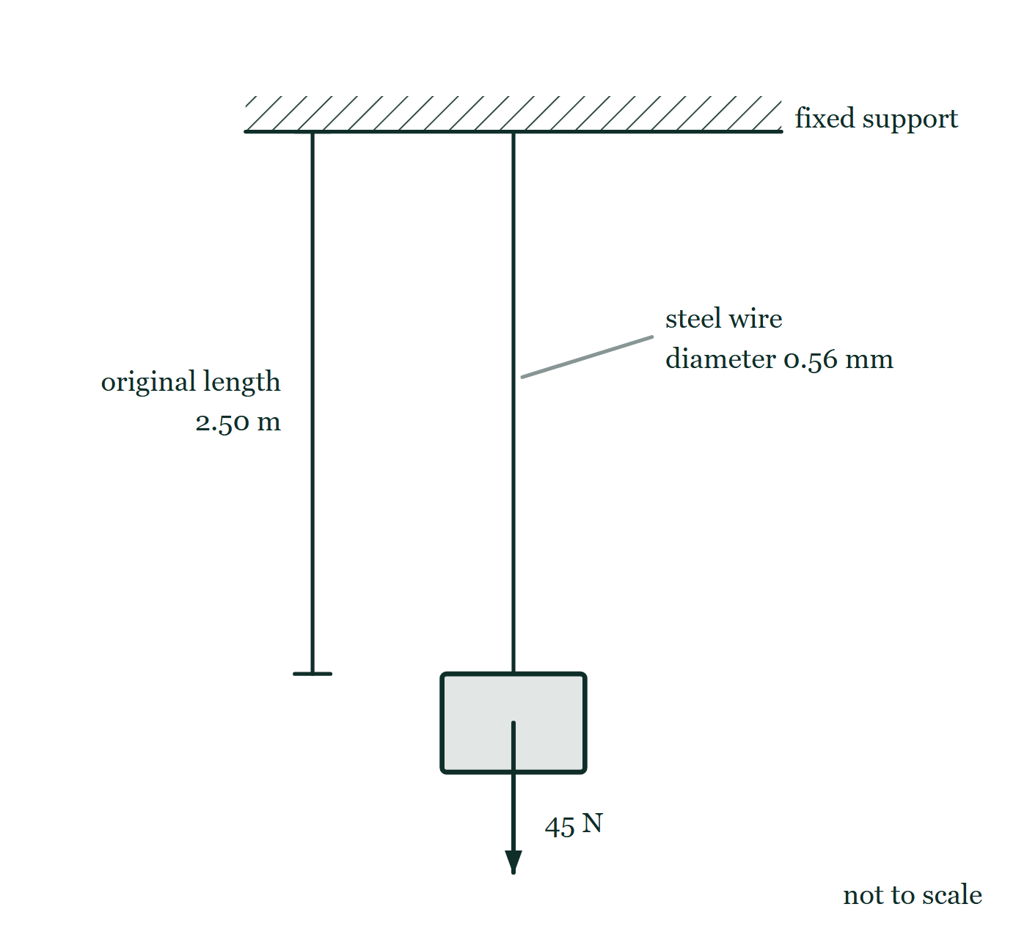
SOLID DEFORMATION · HOOKE'S LAW & EXTENSION
GIOPHYSICS LESSON
FIGURE
Fig. 8.1 — A Level AS · Topics 1–11
Drawn for question 8 of that paper · syllabus 5, 6
A steel wire hangs vertically from a rigid support drawn as a hatched ceiling, and a block is attached to its lower end. An arrow starting at the centre of that block points vertically downwards and is labelled 45 N. A dimension line to the left of the wire marks its original length as 2.50 m, and a leader line to the wire labels it as a steel wire of diameter 0.56 mm. The figure is not to scale.
See the question this was drawn for — click here
Solid Deformation — Hooke's Law & Extension. Built by GioPhysics from the lesson's own copy; nothing on these slides is re-authored.
13 / 32
Notes:
[Phase] Build the model: The formulae, one at a time, in plain English (minutes 13–22 of 45)
[Figure] Fig. 8.1. A steel wire hangs vertically from a rigid support drawn as a hatched ceiling, and a block is attached to its lower end. An arrow starting at the centre of that block points vertically downwards and is labelled 45 N. A dimension line to the left of the wire marks its original length as 2.50 m, and a leader line to the wire labels it as a steel wire of diameter 0.56 mm. The figure is not to scale.
[Where it came from] A Level AS · Topics 1–11, question 8; syllabus 5, 6.

Slide 14
SOLID DEFORMATION · HOOKE'S LAW & EXTENSION
GIOPHYSICS LESSON
WATCH OUT
The common trap
Check and misconception — The quick check and the trap
The elastic limit and proportional limit are related but not identical ideas. A material can stop being proportional before it stops returning fully to its original shape.
Solid Deformation — Hooke's Law & Extension. Built by GioPhysics from the lesson's own copy; nothing on these slides is re-authored.
14 / 32
Notes:
[Phase] Check and misconception: The quick check and the trap (minutes 35–41 of 45)
[Misconception] The elastic limit and proportional limit are related but not identical ideas. A material can stop being proportional before it stops returning fully to its original shape.

Slide 15
SOLID DEFORMATION · HOOKE'S LAW & EXTENSION
GIOPHYSICS LESSON
WORKED EXAMPLE 1 OF 2 · EASY
The question
Easy
Worked examples — I do, we do — one step revealed at a time
A spring with k = 25 N/m is stretched 0.12 m. What force does it exert?
Solid Deformation — Hooke's Law & Extension. Built by GioPhysics from the lesson's own copy; nothing on these slides is re-authored.
15 / 32
Notes:
[Phase] Worked examples: I do, we do — one step revealed at a time (minutes 22–35 of 45)
[Question] A spring with k = 25 N/m is stretched 0.12 m. What force does it exert?
[Answer] F = 3.0 N

Slide 16
SOLID DEFORMATION · HOOKE'S LAW & EXTENSION
GIOPHYSICS LESSON
WORKED EXAMPLE 1 OF 2 · EASY · THE WORKING
How to solve it
Easy
Worked examples — I do, we do — one step revealed at a time
A spring with k = 25 N/m is stretched 0.12 m. What force does it exert?
1.
F = kx = 25 × 0.12.
2.
F = 3.0 N pulling back toward natural length.
Solid Deformation — Hooke's Law & Extension. Built by GioPhysics from the lesson's own copy; nothing on these slides is re-authored.
16 / 32
Notes:
[Phase] Worked examples: I do, we do — one step revealed at a time (minutes 22–35 of 45)
[Reveal] One click per step. The class works each line before the next appears.
[Step 1] F = kx = 25 × 0.12.
[Step 2] F = 3.0 N pulling back toward natural length.

Slide 17
SOLID DEFORMATION · HOOKE'S LAW & EXTENSION
GIOPHYSICS LESSON
WORKED EXAMPLE 1 OF 2 · EASY
Answer
Easy
Worked examples — I do, we do — one step revealed at a time
F = 3.0 N
Solid Deformation — Hooke's Law & Extension. Built by GioPhysics from the lesson's own copy; nothing on these slides is re-authored.
17 / 32
Notes:
[Phase] Worked examples: I do, we do — one step revealed at a time (minutes 22–35 of 45)
[Answer] F = 3.0 N

Slide 18
SOLID DEFORMATION · HOOKE'S LAW & EXTENSION
GIOPHYSICS LESSON
WORKED EXAMPLE 2 OF 2 · MEDIUM
The question
Medium
Worked examples — I do, we do — one step revealed at a time
A spring lengthens from 18.0 cm to 23.0 cm under a 6.0 N load. Find its extension and spring constant while Hooke's law applies.
Solid Deformation — Hooke's Law & Extension. Built by GioPhysics from the lesson's own copy; nothing on these slides is re-authored.
18 / 32
Notes:
[Phase] Worked examples: I do, we do — one step revealed at a time (minutes 22–35 of 45)
[Question] A spring lengthens from 18.0 cm to 23.0 cm under a 6.0 N load. Find its extension and spring constant while Hooke's law applies.
[Answer] x = 0.050 m and k = 120 N m⁻¹

Slide 19
SOLID DEFORMATION · HOOKE'S LAW & EXTENSION
GIOPHYSICS LESSON
WORKED EXAMPLE 2 OF 2 · MEDIUM · THE WORKING
How to solve it
Medium
Worked examples — I do, we do — one step revealed at a time
A spring lengthens from 18.0 cm to 23.0 cm under a 6.0 N load. Find its extension and spring constant while Hooke's law applies.
1.
x = 23.0 cm − 18.0 cm = 5.0 cm.
2.
Convert before calculating: x = 0.050 m.
3.
Use k = F/x = 6.0/0.050.
Solid Deformation — Hooke's Law & Extension. Built by GioPhysics from the lesson's own copy; nothing on these slides is re-authored.
19 / 32
Notes:
[Phase] Worked examples: I do, we do — one step revealed at a time (minutes 22–35 of 45)
[Reveal] One click per step. The class works each line before the next appears.
[Step 1] x = 23.0 cm − 18.0 cm = 5.0 cm.
[Step 2] Convert before calculating: x = 0.050 m.
[Step 3] Use k = F/x = 6.0/0.050.

Slide 20
SOLID DEFORMATION · HOOKE'S LAW & EXTENSION
GIOPHYSICS LESSON
WORKED EXAMPLE 2 OF 2 · MEDIUM
Answer
Medium
Worked examples — I do, we do — one step revealed at a time
x = 0.050 m and k = 120 N m⁻¹
Solid Deformation — Hooke's Law & Extension. Built by GioPhysics from the lesson's own copy; nothing on these slides is re-authored.
20 / 32
Notes:
[Phase] Worked examples: I do, we do — one step revealed at a time (minutes 22–35 of 45)
[Answer] x = 0.050 m and k = 120 N m⁻¹

Slide 21
SOLID DEFORMATION · HOOKE'S LAW & EXTENSION
GIOPHYSICS LESSON
SPOT THE MISTAKE
One line here is wrong
The whole working is up — find the bad line before you click
1.
Extension: x = 23.0 cm − 18.0 cm = 5.0 cm.
2.
Hooke's law rearranged: k = F/x.
3.
k = 6.0 ÷ 5.0 = 1.2 N/m.
4.
So the spring constant is 1.2 N/m.
LINE 3 IS WRONG
The extension was found in centimetres and then fed straight into a formula that wants metres. It is the single commonest mark lost in this topic, and the answer is no help at all: 1.2 N/m looks like a perfectly believable spring constant, so nobody goes back and checks it.
IT SHOULD SAY
k = 6.0 ÷ 0.050 = 120 N/m.
Solid Deformation — Hooke's Law & Extension. Built by GioPhysics from the lesson's own copy; nothing on these slides is re-authored.
21 / 32
Notes:
[Phase] Worked examples: I do, we do — one step revealed at a time (minutes 22–35 of 45)
[Spot the mistake] The working is complete and one line of it is wrong. Let the room hunt: one click names the line, a second shows it done correctly.
[Line 3 is wrong] The extension was found in centimetres and then fed straight into a formula that wants metres. It is the single commonest mark lost in this topic, and the answer is no help at all: 1.2 N/m looks like a perfectly believable spring constant, so nobody goes back and checks it.
[It should say] k = 6.0 ÷ 0.050 = 120 N/m.

Slide 22
SOLID DEFORMATION · HOOKE'S LAW & EXTENSION
GIOPHYSICS LESSON
PREDICT · TAKE THE VOTE
Commit before you are told
Hands up for each option, then click
The pointer reads 18.0 cm with the spring hanging free and 23.0 cm with the 6.0 N load on. Which number goes into F = kx as x?
A 23.0 cm — the length of the spring while it is loaded
B 5.0 cm — the increase in length
C 41.0 cm — the two readings taken together
The same spring twice: hanging free from a clamp with its pointer at the 18.0 cm mark, and again with a 6.0 N load on the hanger so the pointer has dropped to 23.0 cm. The natural-length mark is carried across to the loaded spring, and the gap between that mark and the pointer is dimensioned as x.
The live version of this figure — click here
Solid Deformation — Hooke's Law & Extension. Built by GioPhysics from the lesson's own copy; nothing on these slides is re-authored.
22 / 32
Notes:
[Phase] Build the model: The formulae, one at a time, in plain English (minutes 13–22 of 45)
[Predict] The pointer reads 18.0 cm with the spring hanging free and 23.0 cm with the 6.0 N load on. Which number goes into F = kx as x?
[Options] A 23.0 cm — the length of the spring while it is loaded B 5.0 cm — the increase in length C 41.0 cm — the two readings taken together
[Figure] The same spring twice: hanging free from a clamp with its pointer at the 18.0 cm mark, and again with a 6.0 N load on the hanger so the pointer has dropped to 23.0 cm. The natural-length mark is carried across to the loaded spring, and the gap between that mark and the pointer is dimensioned as x.

Slide 23
SOLID DEFORMATION · HOOKE'S LAW & EXTENSION
GIOPHYSICS LESSON
PREDICT · THE OUTCOME
What actually happens
Ask the room who changed their mind, and why
B 5.0 cm — the increase in length
WHY
On the drawing, x is the gap between the dashed natural-length mark and the loaded pointer, not the distance from the clamp down to the pointer. That gap is 5.0 cm — and it has to become 0.050 m before it goes anywhere near k = F/x.
Solid Deformation — Hooke's Law & Extension. Built by GioPhysics from the lesson's own copy; nothing on these slides is re-authored.
23 / 32
Notes:
[Phase] Build the model: The formulae, one at a time, in plain English (minutes 13–22 of 45)
[Answer] B — 5.0 cm — the increase in length. On the drawing, x is the gap between the dashed natural-length mark and the loaded pointer, not the distance from the clamp down to the pointer. That gap is 5.0 cm — and it has to become 0.050 m before it goes anywhere near k = F/x.

Slide 24
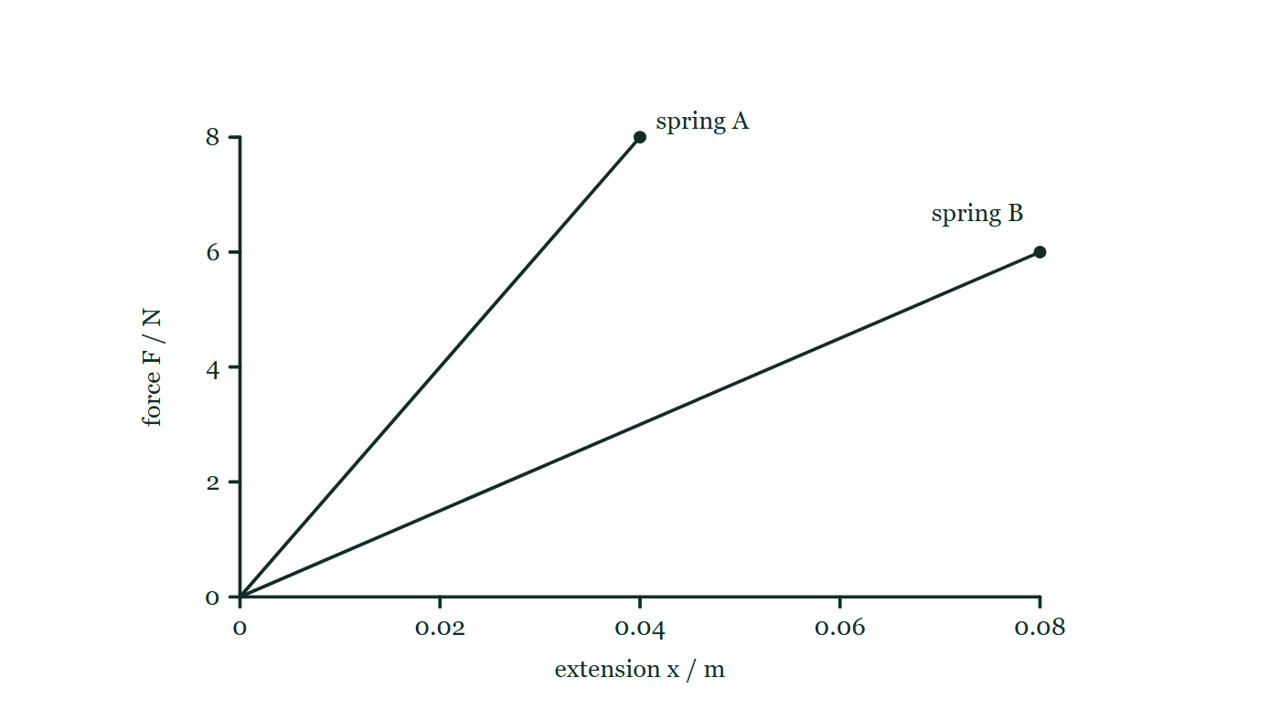
SOLID DEFORMATION · HOOKE'S LAW & EXTENSION
GIOPHYSICS LESSON
QUICK CHECK
Decide before the answer goes up
Check and misconception — The quick check and the trap
Two springs are shown on the same force–extension axes. Which spring is stiffer?
A
The line with the steeper gradient
B
The line with the shallower gradient
C
They are equally stiff at every gradient
Force plotted against extension for two springs, both lines straight and through the origin. Spring A's line ends at 8 N and 0.04 m; spring B's line runs on twice as far in extension, to 0.08 m, but only reaches 6 N.
The live version of this figure — click here
Solid Deformation — Hooke's Law & Extension. Built by GioPhysics from the lesson's own copy; nothing on these slides is re-authored.
24 / 32
Notes:
[Phase] Check and misconception: The quick check and the trap (minutes 35–41 of 45)
[Question] Two springs are shown on the same force–extension axes. Which spring is stiffer?
[Figure] Force plotted against extension for two springs, both lines straight and through the origin. Spring A's line ends at 8 N and 0.04 m; spring B's line runs on twice as far in extension, to 0.08 m, but only reaches 6 N.
[Options] A The line with the steeper gradient B The line with the shallower gradient C They are equally stiff at every gradient

Slide 25
SOLID DEFORMATION · HOOKE'S LAW & EXTENSION
GIOPHYSICS LESSON
QUICK CHECK · THE ANSWER
The answer, and why
Check and misconception — The quick check and the trap
A The line with the steeper gradient
HOW TO GET THERE
On an F–x graph the gradient is k, so a steeper line represents the larger spring constant.
WHY THE OTHERS TEMPT
A Right. On force–extension axes the gradient is k, so the steeper line needs more newtons for every millimetre of stretch — which is exactly what being stiffer means.
B This is the answer you get from thinking 'stretchier'. A shallow line means a lot of extension for very little force, which describes a floppy spring: a small k.
C Two lines through the origin with different gradients cannot describe equally stiff springs — pick any force and they sit at different extensions. Equal stiffness would put one line on top of the other.
Solid Deformation — Hooke's Law & Extension. Built by GioPhysics from the lesson's own copy; nothing on these slides is re-authored.
25 / 32
Notes:
[Phase] Check and misconception: The quick check and the trap (minutes 35–41 of 45)
[Question] Two springs are shown on the same force–extension axes. Which spring is stiffer?
[Option by option] A: Right. On force–extension axes the gradient is k, so the steeper line needs more newtons for every millimetre of stretch — which is exactly what being stiffer means. B: This is the answer you get from thinking 'stretchier'. A shallow line means a lot of extension for very little force, which describes a floppy spring: a small k. C: Two lines through the origin with different gradients cannot describe equally stiff springs — pick any force and they sit at different extensions. Equal stiffness would put one line on top of the other.
[Answer] A — The line with the steeper gradient
[Why] On an F–x graph the gradient is k, so a steeper line represents the larger spring constant.
[Reveal] One click for the answer, then one for the reason.

Slide 26
SOLID DEFORMATION · HOOKE'S LAW & EXTENSION
GIOPHYSICS LESSON
EXTENSION 1 OF 2 · HARD
The question
Hard
Worked examples — I do, we do — one step revealed at a time
A spring is 30.0 cm long under a 4.0 N load and 34.0 cm under a 9.0 N load. Find k and the natural length.
Solid Deformation — Hooke's Law & Extension. Built by GioPhysics from the lesson's own copy; nothing on these slides is re-authored.
26 / 32
Notes:
[Phase] Worked examples: I do, we do — one step revealed at a time (minutes 22–35 of 45)
[Question] A spring is 30.0 cm long under a 4.0 N load and 34.0 cm under a 9.0 N load. Find k and the natural length.
[Answer] k = 125 N/m; L₀ = 26.8 cm

Slide 27
SOLID DEFORMATION · HOOKE'S LAW & EXTENSION
GIOPHYSICS LESSON
EXTENSION 1 OF 2 · HARD · THE WORKING
How to solve it
Hard
Worked examples — I do, we do — one step revealed at a time
A spring is 30.0 cm long under a 4.0 N load and 34.0 cm under a 9.0 N load. Find k and the natural length.
1.
Extra 5.0 N produced extra 4.0 cm: k = 5.0 ÷ 0.040 = 125 N/m.
2.
At 4.0 N the extension is x = F/k = 4.0 ÷ 125 = 3.2 cm.
3.
Natural length = 30.0 − 3.2 = 26.8 cm.
Solid Deformation — Hooke's Law & Extension. Built by GioPhysics from the lesson's own copy; nothing on these slides is re-authored.
27 / 32
Notes:
[Phase] Worked examples: I do, we do — one step revealed at a time (minutes 22–35 of 45)
[Reveal] One click per step. The class works each line before the next appears.
[Step 1] Extra 5.0 N produced extra 4.0 cm: k = 5.0 ÷ 0.040 = 125 N/m.
[Step 2] At 4.0 N the extension is x = F/k = 4.0 ÷ 125 = 3.2 cm.
[Step 3] Natural length = 30.0 − 3.2 = 26.8 cm.

Slide 28
SOLID DEFORMATION · HOOKE'S LAW & EXTENSION
GIOPHYSICS LESSON
EXTENSION 1 OF 2 · HARD
Answer
Hard
Worked examples — I do, we do — one step revealed at a time
k = 125 N/m; L₀ = 26.8 cm
Solid Deformation — Hooke's Law & Extension. Built by GioPhysics from the lesson's own copy; nothing on these slides is re-authored.
28 / 32
Notes:
[Phase] Worked examples: I do, we do — one step revealed at a time (minutes 22–35 of 45)
[Answer] k = 125 N/m; L₀ = 26.8 cm

Slide 29
SOLID DEFORMATION · HOOKE'S LAW & EXTENSION
GIOPHYSICS LESSON
EXTENSION 2 OF 2 · CHALLENGING
The question
Challenging
Worked examples — I do, we do — one step revealed at a time
Three identical springs (k = 300 N/m) support a 6.0 kg mass: two in parallel, joined in series to the third. Find the total extension.
Solid Deformation — Hooke's Law & Extension. Built by GioPhysics from the lesson's own copy; nothing on these slides is re-authored.
29 / 32
Notes:
[Phase] Worked examples: I do, we do — one step revealed at a time (minutes 22–35 of 45)
[Question] Three identical springs (k = 300 N/m) support a 6.0 kg mass: two in parallel, joined in series to the third. Find the total extension.
[Answer] x ≈ 0.29 m

Slide 30
SOLID DEFORMATION · HOOKE'S LAW & EXTENSION
GIOPHYSICS LESSON
EXTENSION 2 OF 2 · CHALLENGING · THE WORKING
How to solve it
Challenging
Worked examples — I do, we do — one step revealed at a time
Three identical springs (k = 300 N/m) support a 6.0 kg mass: two in parallel, joined in series to the third. Find the total extension.
1.
Parallel pair: 2k = 600 N/m. In series with k: 1/k(total) = 1/600 + 1/300 → k(total) = 200 N/m.
2.
Load F = 6.0 × 9.81 ≈ 58.9 N.
3.
x = F/k = 58.9 ÷ 200 ≈ 0.29 m.
Solid Deformation — Hooke's Law & Extension. Built by GioPhysics from the lesson's own copy; nothing on these slides is re-authored.
30 / 32
Notes:
[Phase] Worked examples: I do, we do — one step revealed at a time (minutes 22–35 of 45)
[Reveal] One click per step. The class works each line before the next appears.
[Step 1] Parallel pair: 2k = 600 N/m. In series with k: 1/k(total) = 1/600 + 1/300 → k(total) = 200 N/m.
[Step 2] Load F = 6.0 × 9.81 ≈ 58.9 N.
[Step 3] x = F/k = 58.9 ÷ 200 ≈ 0.29 m.

Slide 31
SOLID DEFORMATION · HOOKE'S LAW & EXTENSION
GIOPHYSICS LESSON
EXTENSION 2 OF 2 · CHALLENGING
Answer
Challenging
Worked examples — I do, we do — one step revealed at a time
x ≈ 0.29 m
Solid Deformation — Hooke's Law & Extension. Built by GioPhysics from the lesson's own copy; nothing on these slides is re-authored.
31 / 32
Notes:
[Phase] Worked examples: I do, we do — one step revealed at a time (minutes 22–35 of 45)
[Answer] x ≈ 0.29 m

Slide 32
SOLID DEFORMATION · HOOKE'S LAW & EXTENSION
GIOPHYSICS LESSON
SOLID DEFORMATION
Where to go next
Plenary — What to take away, what to practise next
Next
8.2 Elastic Energy & Force-Extension Graphs
https://giophysics.com/chapter-14/elastic-energy-force-extension-graphs/
Lesson
This lesson on giophysics.com
https://giophysics.com/chapter-14/hookes-law-extension/
Live
The live, interactive version of these slides
https://giophysics.com/chapter-14/presentation/?lesson=hooke
Chapter
All Solid Deformation lessons
https://giophysics.com/chapter-14/
PDF
Download the lesson PDF
https://giophysics.com/downloads/14-1-hookes-law-extension.pdf
Solid Deformation — Hooke's Law & Extension. Built by GioPhysics from the lesson's own copy; nothing on these slides is re-authored.
32 / 32
Notes:
[Phase] Plenary: What to take away, what to practise next (minutes 41–45 of 45)
[Interactive] The graphs and the circuit topology on these slides are frozen. The live version at https://giophysics.com/chapter-14/presentation/?lesson=hooke moves them.

