Slide 1
SOLID DEFORMATION · STRESS, STRAIN & YOUNG MODULUS
GIOPHYSICS LESSON
08 · Solid Deformation
Compare materials fairly
Stress, Strain & Young Modulus
Remove the effects of sample length and cross-sectional area so the stiffness of different materials can be compared.
POSITION
Lesson 3 of 7 in Solid Deformation
PLAN
16 slides in the 45-minute core run, about 44.5 minutes of it
LESSON PAGE
https://giophysics.com/chapter-14/stress-strain-young-modulus/
Built by GioPhysics from the lesson's own page. Every word on these slides is the lesson's; nothing here is re-authored. Teaching material, not an awarding body's document.
Solid Deformation — Stress, Strain & Young Modulus. Built by GioPhysics from the lesson's own copy; nothing on these slides is re-authored.
1 / 32
Notes:
[Lesson] Solid Deformation — Stress, Strain & Young Modulus. Lesson 3 of 7.
[Intro] Remove the effects of sample length and cross-sectional area so the stiffness of different materials can be compared.
[Source] https://giophysics.com/chapter-14/stress-strain-young-modulus/
[Disclaimer] Built by GioPhysics from the lesson's own page. Every word on these slides is the lesson's; nothing here is re-authored. Teaching material, not an awarding body's document.

Slide 2
SOLID DEFORMATION · STRESS, STRAIN & YOUNG MODULUS
GIOPHYSICS LESSON
THINK FIRST
A steel wire and a steel cable have the same Young modulus. Do they stretch by the same amount?
Take answers before you click — the point is the commitment
Both are steel, both two metres long, and you hang the same 100 N from each of them.
THE ANSWER
No — and Young modulus is precisely why that is not obvious. E belongs to steel, not to any particular piece of it: it fixes the strain for a given stress. The cable has far more cross-sectional area, so the same 100 N makes a far smaller stress in it, and therefore a far smaller strain.
Solid Deformation — Stress, Strain & Young Modulus. Built by GioPhysics from the lesson's own copy; nothing on these slides is re-authored.
2 / 32
Notes:
[Phase] Starter: Recall what this lesson stands on (minutes 0–5 of 45)
[Hook] A steel wire and a steel cable have the same Young modulus. Do they stretch by the same amount? Both are steel, both two metres long, and you hang the same 100 N from each of them.
[Answer] No — and Young modulus is precisely why that is not obvious. E belongs to steel, not to any particular piece of it: it fixes the strain for a given stress. The cable has far more cross-sectional area, so the same 100 N makes a far smaller stress in it, and therefore a far smaller strain.

Slide 3
SOLID DEFORMATION · STRESS, STRAIN & YOUNG MODULUS
GIOPHYSICS LESSON
EXPLAINED SIMPLY
In one sentence
Introduce the idea — The big idea and the definition
Stress is force per cross-sectional area, strain is fractional change in length, and Young modulus is stress divided by strain in the linear elastic region.
Solid Deformation — Stress, Strain & Young Modulus. Built by GioPhysics from the lesson's own copy; nothing on these slides is re-authored.
3 / 32
Notes:
[Phase] Introduce the idea: The big idea and the definition (minutes 5–13 of 45)
[Definition] Stress is force per cross-sectional area, strain is fractional change in length, and Young modulus is stress divided by strain in the linear elastic region.

Slide 4
SOLID DEFORMATION · STRESS, STRAIN & YOUNG MODULUS
GIOPHYSICS LESSON
EXPLAINED SIMPLY
What that looks like
Introduce the idea — The big idea and the definition
FOR EXAMPLE
Two wires of the same material have the same Young modulus, but the thicker wire stretches less under the same force because its stress is smaller.
Solid Deformation — Stress, Strain & Young Modulus. Built by GioPhysics from the lesson's own copy; nothing on these slides is re-authored.
4 / 32
Notes:
[Phase] Introduce the idea: The big idea and the definition (minutes 5–13 of 45)
[Worked illustration] Two wires of the same material have the same Young modulus, but the thicker wire stretches less under the same force because its stress is smaller.

Slide 5
SOLID DEFORMATION · STRESS, STRAIN & YOUNG MODULUS
GIOPHYSICS LESSON
THE BIG IDEA
Compare materials fairly
Introduce the idea — The big idea and the definition
Force and extension describe one sample. Stress divides force by cross-sectional area; strain divides extension by original length. Their ratio in the linear elastic region is Young modulus E, a material stiffness rather than a breaking-strength measurement.
Solid Deformation — Stress, Strain & Young Modulus. Built by GioPhysics from the lesson's own copy; nothing on these slides is re-authored.
5 / 32
Notes:
[Phase] Introduce the idea: The big idea and the definition (minutes 5–13 of 45)
[Big idea] Force and extension describe one sample. Stress divides force by cross-sectional area; strain divides extension by original length. Their ratio in the linear elastic region is Young modulus E, a material stiffness rather than a breaking-strength measurement.

Slide 6
SOLID DEFORMATION · STRESS, STRAIN & YOUNG MODULUS
GIOPHYSICS LESSON
THE PHYSICS · 1 OF 3
Area matters
Build the model — The formulae, one at a time, in plain English
For the same force, a thicker wire has lower stress because its cross-sectional area is larger.
Solid Deformation — Stress, Strain & Young Modulus. Built by GioPhysics from the lesson's own copy; nothing on these slides is re-authored.
6 / 32
Notes:
[Phase] Build the model: The formulae, one at a time, in plain English (minutes 13–22 of 45)
[Section] For the same force, a thicker wire has lower stress because its cross-sectional area is larger.

Slide 7
SOLID DEFORMATION · STRESS, STRAIN & YOUNG MODULUS
GIOPHYSICS LESSON
THE PHYSICS · 2 OF 3
Length matters
Build the model — The formulae, one at a time, in plain English
For the same strain, a longer wire changes length more because x = εL₀.
Solid Deformation — Stress, Strain & Young Modulus. Built by GioPhysics from the lesson's own copy; nothing on these slides is re-authored.
7 / 32
Notes:
[Phase] Build the model: The formulae, one at a time, in plain English (minutes 13–22 of 45)
[Section] For the same strain, a longer wire changes length more because x = εL₀.

Slide 8
SOLID DEFORMATION · STRESS, STRAIN & YOUNG MODULUS
GIOPHYSICS LESSON
THE PHYSICS · 3 OF 3
Stiff is not strong
Build the model — The formulae, one at a time, in plain English
A large E means little elastic strain for a given stress; it does not by itself state the fracture stress.
Solid Deformation — Stress, Strain & Young Modulus. Built by GioPhysics from the lesson's own copy; nothing on these slides is re-authored.
8 / 32
Notes:
[Phase] Build the model: The formulae, one at a time, in plain English (minutes 13–22 of 45)
[Section] A large E means little elastic strain for a given stress; it does not by itself state the fracture stress.

Slide 9
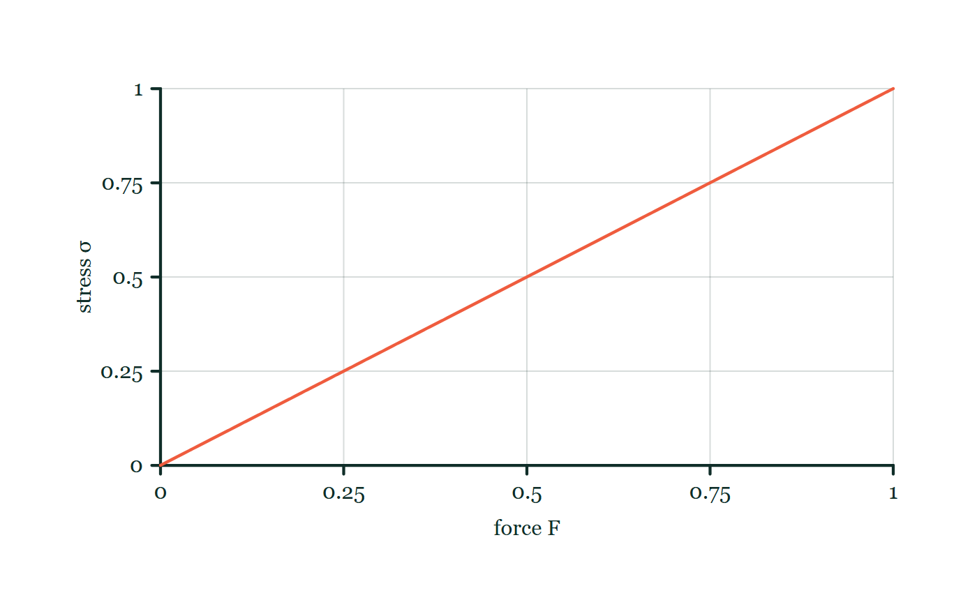
SOLID DEFORMATION · STRESS, STRAIN & YOUNG MODULUS
GIOPHYSICS LESSON
FORMULA 1 OF 4
Tensile stress
Build the model — The formulae, one at a time, in plain English
σ = F/A
Pa = N m⁻²
IN PLAIN ENGLISH
Stress is force spread over the cross-section — a thin wire feels the same pull far more intensely than a thick one.
Stress–force explorer
Move this graph on the live version — click here
Solid Deformation — Stress, Strain & Young Modulus. Built by GioPhysics from the lesson's own copy; nothing on these slides is re-authored.
9 / 32
Notes:
[Phase] Build the model: The formulae, one at a time, in plain English (minutes 13–22 of 45)
[Formula] Tensile stress: σ = F/A
[In plain English] Stress is force spread over the cross-section — a thin wire feels the same pull far more intensely than a thick one.
[Note] Pa = N m⁻²
[Graph] Stress–force explorer. For a fixed cross-sectional area, stress is directly proportional to force.
[Axes] Horizontal: force F. Vertical: stress σ. Values are normalised — the graph teaches the shape, not a measurement.

Slide 10
SOLID DEFORMATION · STRESS, STRAIN & YOUNG MODULUS
GIOPHYSICS LESSON
FORMULA 2 OF 4
Tensile strain
Build the model — The formulae, one at a time, in plain English
ε = x/L₀
A dimensionless ratio
IN PLAIN ENGLISH
Strain is the stretch as a fraction of original length — 1% strain means it got 1% longer, whatever its size.
Solid Deformation — Stress, Strain & Young Modulus. Built by GioPhysics from the lesson's own copy; nothing on these slides is re-authored.
10 / 32
Notes:
[Phase] Build the model: The formulae, one at a time, in plain English (minutes 13–22 of 45)
[Formula] Tensile strain: ε = x/L₀
[In plain English] Strain is the stretch as a fraction of original length — 1% strain means it got 1% longer, whatever its size.
[Note] A dimensionless ratio

Slide 11
SOLID DEFORMATION · STRESS, STRAIN & YOUNG MODULUS
GIOPHYSICS LESSON
FORMULA 3 OF 4
Young modulus
Build the model — The formulae, one at a time, in plain English
E = σ/ε = FL₀/(Ax)
Gradient of the linear σ–ε graph
IN PLAIN ENGLISH
A material's intrinsic stiffness: stress divided by strain — the same for a short thick bar or a long thin wire of that material.
Solid Deformation — Stress, Strain & Young Modulus. Built by GioPhysics from the lesson's own copy; nothing on these slides is re-authored.
11 / 32
Notes:
[Phase] Build the model: The formulae, one at a time, in plain English (minutes 13–22 of 45)
[Formula] Young modulus: E = σ/ε = FL₀/(Ax)
[In plain English] A material's intrinsic stiffness: stress divided by strain — the same for a short thick bar or a long thin wire of that material.
[Note] Gradient of the linear σ–ε graph

Slide 12
SOLID DEFORMATION · STRESS, STRAIN & YOUNG MODULUS
GIOPHYSICS LESSON
FORMULA 4 OF 4
Wire stiffness
Build the model — The formulae, one at a time, in plain English
k = EA/L₀
Same material, different geometry
IN PLAIN ENGLISH
A specific wire's stiffness: stiffer material, fatter cross-section, or shorter length all make it harder to stretch.
Solid Deformation — Stress, Strain & Young Modulus. Built by GioPhysics from the lesson's own copy; nothing on these slides is re-authored.
12 / 32
Notes:
[Phase] Build the model: The formulae, one at a time, in plain English (minutes 13–22 of 45)
[Formula] Wire stiffness: k = EA/L₀
[In plain English] A specific wire's stiffness: stiffer material, fatter cross-section, or shorter length all make it harder to stretch.
[Note] Same material, different geometry

Slide 13
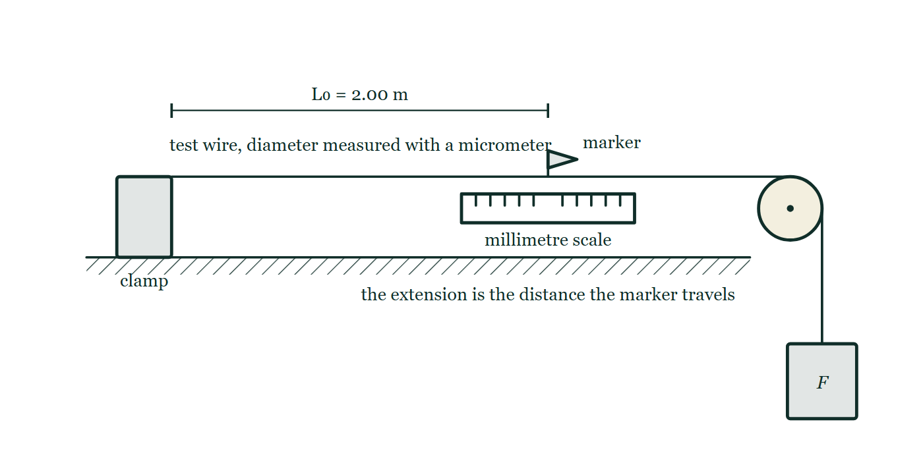
SOLID DEFORMATION · STRESS, STRAIN & YOUNG MODULUS
GIOPHYSICS LESSON
THE PICTURE
Where Young modulus is actually measured
Drawn for this lesson
A long test wire clamped to the bench at one end, running horizontally to a pulley at the bench edge and turning down to a hanging load. A small marker sits on the wire above a millimetre scale, and the original length L₀ of 2.00 m is dimensioned from the clamp to that marker.
The live version of this figure — click here
Solid Deformation — Stress, Strain & Young Modulus. Built by GioPhysics from the lesson's own copy; nothing on these slides is re-authored.
13 / 32
Notes:
[Phase] Build the model: The formulae, one at a time, in plain English (minutes 13–22 of 45)
[Figure] A long test wire clamped to the bench at one end, running horizontally to a pulley at the bench edge and turning down to a hanging load. A small marker sits on the wire above a millimetre scale, and the original length L₀ of 2.00 m is dimensioned from the clamp to that marker.

Slide 14
SOLID DEFORMATION · STRESS, STRAIN & YOUNG MODULUS
GIOPHYSICS LESSON
WATCH OUT
The common trap
Check and misconception — The quick check and the trap
Strain is not measured in metres. It is extension divided by original length, so the length units cancel.
Solid Deformation — Stress, Strain & Young Modulus. Built by GioPhysics from the lesson's own copy; nothing on these slides is re-authored.
14 / 32
Notes:
[Phase] Check and misconception: The quick check and the trap (minutes 35–41 of 45)
[Misconception] Strain is not measured in metres. It is extension divided by original length, so the length units cancel.

Slide 15
SOLID DEFORMATION · STRESS, STRAIN & YOUNG MODULUS
GIOPHYSICS LESSON
WORKED EXAMPLE 1 OF 2 · EASY
The question
Easy
Worked examples — I do, we do — one step revealed at a time
A wire of cross-section 2.0 mm² carries a 100 N load. Find the tensile stress in MPa.
Solid Deformation — Stress, Strain & Young Modulus. Built by GioPhysics from the lesson's own copy; nothing on these slides is re-authored.
15 / 32
Notes:
[Phase] Worked examples: I do, we do — one step revealed at a time (minutes 22–35 of 45)
[Question] A wire of cross-section 2.0 mm² carries a 100 N load. Find the tensile stress in MPa.
[Answer] σ = 50 MPa

Slide 16
SOLID DEFORMATION · STRESS, STRAIN & YOUNG MODULUS
GIOPHYSICS LESSON
WORKED EXAMPLE 1 OF 2 · EASY · THE WORKING
How to solve it
Easy
Worked examples — I do, we do — one step revealed at a time
A wire of cross-section 2.0 mm² carries a 100 N load. Find the tensile stress in MPa.
1.
σ = F/A = 100 ÷ 2.0 × 10⁻⁶.
2.
σ = 5.0 × 10⁷ Pa = 50 MPa.
Solid Deformation — Stress, Strain & Young Modulus. Built by GioPhysics from the lesson's own copy; nothing on these slides is re-authored.
16 / 32
Notes:
[Phase] Worked examples: I do, we do — one step revealed at a time (minutes 22–35 of 45)
[Reveal] One click per step. The class works each line before the next appears.
[Step 1] σ = F/A = 100 ÷ 2.0 × 10⁻⁶.
[Step 2] σ = 5.0 × 10⁷ Pa = 50 MPa.

Slide 17
SOLID DEFORMATION · STRESS, STRAIN & YOUNG MODULUS
GIOPHYSICS LESSON
WORKED EXAMPLE 1 OF 2 · EASY
Answer
Easy
Worked examples — I do, we do — one step revealed at a time
σ = 50 MPa
Solid Deformation — Stress, Strain & Young Modulus. Built by GioPhysics from the lesson's own copy; nothing on these slides is re-authored.
17 / 32
Notes:
[Phase] Worked examples: I do, we do — one step revealed at a time (minutes 22–35 of 45)
[Answer] σ = 50 MPa

Slide 18
SOLID DEFORMATION · STRESS, STRAIN & YOUNG MODULUS
GIOPHYSICS LESSON
WORKED EXAMPLE 2 OF 2 · MEDIUM
The question
Medium
Worked examples — I do, we do — one step revealed at a time
A 2.0 m wire of area 1.5 mm² extends 1.0 mm under 150 N. Find stress, strain, and Young modulus.
Solid Deformation — Stress, Strain & Young Modulus. Built by GioPhysics from the lesson's own copy; nothing on these slides is re-authored.
18 / 32
Notes:
[Phase] Worked examples: I do, we do — one step revealed at a time (minutes 22–35 of 45)
[Question] A 2.0 m wire of area 1.5 mm² extends 1.0 mm under 150 N. Find stress, strain, and Young modulus.
[Answer] σ = 100 MPa, ε = 5.0 × 10⁻⁴, and E = 200 GPa

Slide 19
SOLID DEFORMATION · STRESS, STRAIN & YOUNG MODULUS
GIOPHYSICS LESSON
WORKED EXAMPLE 2 OF 2 · MEDIUM · THE WORKING
How to solve it
Medium
Worked examples — I do, we do — one step revealed at a time
A 2.0 m wire of area 1.5 mm² extends 1.0 mm under 150 N. Find stress, strain, and Young modulus.
1.
A = 1.5 × 10⁻⁶ m² and x = 1.0 × 10⁻³ m.
2.
σ = F/A = 150/(1.5 × 10⁻⁶) = 1.0 × 10⁸ Pa.
3.
ε = x/L₀ = (1.0 × 10⁻³)/2.0 = 5.0 × 10⁻⁴.
4.
E = σ/ε.
Solid Deformation — Stress, Strain & Young Modulus. Built by GioPhysics from the lesson's own copy; nothing on these slides is re-authored.
19 / 32
Notes:
[Phase] Worked examples: I do, we do — one step revealed at a time (minutes 22–35 of 45)
[Reveal] One click per step. The class works each line before the next appears.
[Step 1] A = 1.5 × 10⁻⁶ m² and x = 1.0 × 10⁻³ m.
[Step 2] σ = F/A = 150/(1.5 × 10⁻⁶) = 1.0 × 10⁸ Pa.
[Step 3] ε = x/L₀ = (1.0 × 10⁻³)/2.0 = 5.0 × 10⁻⁴.
[Step 4] E = σ/ε.

Slide 20
SOLID DEFORMATION · STRESS, STRAIN & YOUNG MODULUS
GIOPHYSICS LESSON
WORKED EXAMPLE 2 OF 2 · MEDIUM
Answer
Medium
Worked examples — I do, we do — one step revealed at a time
σ = 100 MPa, ε = 5.0 × 10⁻⁴, and E = 200 GPa
Solid Deformation — Stress, Strain & Young Modulus. Built by GioPhysics from the lesson's own copy; nothing on these slides is re-authored.
20 / 32
Notes:
[Phase] Worked examples: I do, we do — one step revealed at a time (minutes 22–35 of 45)
[Answer] σ = 100 MPa, ε = 5.0 × 10⁻⁴, and E = 200 GPa

Slide 21
SOLID DEFORMATION · STRESS, STRAIN & YOUNG MODULUS
GIOPHYSICS LESSON
SPOT THE MISTAKE
One line here is wrong
The whole working is up — find the bad line before you click
1.
The wire's cross-section is A = 1.5 mm².
2.
Stress: σ = F/A = 150 ÷ 1.5 = 100 Pa.
3.
Strain: ε = x/L₀ = 0.0010 ÷ 2.0 = 5.0 × 10⁻⁴.
4.
Young modulus: E = σ/ε.
LINE 2 IS WRONG
The area was left in mm². A pascal is a newton per square METRE, and 1 mm² is 10⁻⁶ m², so this is out by a factor of a million — and 100 Pa is such a mild-looking number that nothing about it draws attention to itself.
IT SHOULD SAY
σ = F/A = 150 ÷ (1.5 × 10⁻⁶) = 1.0 × 10⁸ Pa = 100 MPa.
Solid Deformation — Stress, Strain & Young Modulus. Built by GioPhysics from the lesson's own copy; nothing on these slides is re-authored.
21 / 32
Notes:
[Phase] Worked examples: I do, we do — one step revealed at a time (minutes 22–35 of 45)
[Spot the mistake] The working is complete and one line of it is wrong. Let the room hunt: one click names the line, a second shows it done correctly.
[Line 2 is wrong] The area was left in mm². A pascal is a newton per square METRE, and 1 mm² is 10⁻⁶ m², so this is out by a factor of a million — and 100 Pa is such a mild-looking number that nothing about it draws attention to itself.
[It should say] σ = F/A = 150 ÷ (1.5 × 10⁻⁶) = 1.0 × 10⁸ Pa = 100 MPa.

Slide 22
SOLID DEFORMATION · STRESS, STRAIN & YOUNG MODULUS
GIOPHYSICS LESSON
PREDICT · TAKE THE VOTE
Commit before you are told
Hands up for each option, then click
The marker on the 2.00 m wire travels 1.0 mm when the load goes on. What is the strain?
A 1.0 mm
B 5.0 × 10⁻⁴, with no unit at all
C 2000 — the length divided by the extension
A long test wire clamped to the bench at one end, running horizontally to a pulley at the bench edge and turning down to a hanging load. A small marker sits on the wire above a millimetre scale, and the original length L₀ of 2.00 m is dimensioned from the clamp to that marker.
The live version of this figure — click here
Solid Deformation — Stress, Strain & Young Modulus. Built by GioPhysics from the lesson's own copy; nothing on these slides is re-authored.
22 / 32
Notes:
[Phase] Build the model: The formulae, one at a time, in plain English (minutes 13–22 of 45)
[Predict] The marker on the 2.00 m wire travels 1.0 mm when the load goes on. What is the strain?
[Options] A 1.0 mm B 5.0 × 10⁻⁴, with no unit at all C 2000 — the length divided by the extension
[Figure] A long test wire clamped to the bench at one end, running horizontally to a pulley at the bench edge and turning down to a hanging load. A small marker sits on the wire above a millimetre scale, and the original length L₀ of 2.00 m is dimensioned from the clamp to that marker.

Slide 23
SOLID DEFORMATION · STRESS, STRAIN & YOUNG MODULUS
GIOPHYSICS LESSON
PREDICT · THE OUTCOME
What actually happens
Ask the room who changed their mind, and why
B 5.0 × 10⁻⁴, with no unit at all
WHY
Strain is the extension as a fraction of the length it started from: 1.0 × 10⁻³ m ÷ 2.00 m. The metres cancel, which is why a strain never carries a unit — and why the number is always small, and always worth reading back off the calculator.
Solid Deformation — Stress, Strain & Young Modulus. Built by GioPhysics from the lesson's own copy; nothing on these slides is re-authored.
23 / 32
Notes:
[Phase] Build the model: The formulae, one at a time, in plain English (minutes 13–22 of 45)
[Answer] B — 5.0 × 10⁻⁴, with no unit at all. Strain is the extension as a fraction of the length it started from: 1.0 × 10⁻³ m ÷ 2.00 m. The metres cancel, which is why a strain never carries a unit — and why the number is always small, and always worth reading back off the calculator.

Slide 24
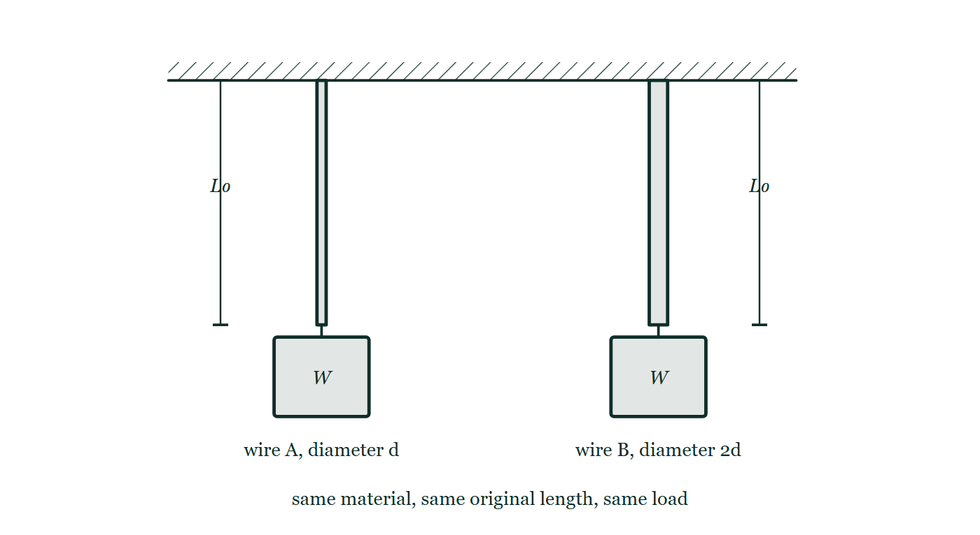
SOLID DEFORMATION · STRESS, STRAIN & YOUNG MODULUS
GIOPHYSICS LESSON
QUICK CHECK
Decide before the answer goes up
Check and misconception — The quick check and the trap
A wire's diameter doubles while force and material stay the same. What happens to its elastic extension?
A
It halves
B
It becomes one quarter
C
It doubles
Two wires hanging from one ceiling, drawn at their unloaded length: wire A of diameter d and wire B drawn twice as thick, each carrying an identical load W and each marked with the same original length L₀.
The live version of this figure — click here
Solid Deformation — Stress, Strain & Young Modulus. Built by GioPhysics from the lesson's own copy; nothing on these slides is re-authored.
24 / 32
Notes:
[Phase] Check and misconception: The quick check and the trap (minutes 35–41 of 45)
[Question] A wire's diameter doubles while force and material stay the same. What happens to its elastic extension?
[Figure] Two wires hanging from one ceiling, drawn at their unloaded length: wire A of diameter d and wire B drawn twice as thick, each carrying an identical load W and each marked with the same original length L₀.
[Options] A It halves B It becomes one quarter C It doubles

Slide 25
SOLID DEFORMATION · STRESS, STRAIN & YOUNG MODULUS
GIOPHYSICS LESSON
QUICK CHECK · THE ANSWER
The answer, and why
Check and misconception — The quick check and the trap
B It becomes one quarter
HOW TO GET THERE
Area is proportional to diameter squared. Doubling diameter makes A four times larger, so x = FL/(EA) becomes one quarter.
WHY THE OTHERS TEMPT
A The tempting one: double the diameter, halve the extension. But it is the cross-sectional area that carries the load, and area goes as d², so doubling the diameter divides the extension by four rather than two.
B Right. A = πd²/4, so twice the diameter is four times the area, and x = FL₀/(EA) is quartered.
C This has the fraction upside down. A fatter wire has more area, so less stress and less strain for the same pull — it stretches less than the thin one, never more.
Solid Deformation — Stress, Strain & Young Modulus. Built by GioPhysics from the lesson's own copy; nothing on these slides is re-authored.
25 / 32
Notes:
[Phase] Check and misconception: The quick check and the trap (minutes 35–41 of 45)
[Question] A wire's diameter doubles while force and material stay the same. What happens to its elastic extension?
[Option by option] A: The tempting one: double the diameter, halve the extension. But it is the cross-sectional area that carries the load, and area goes as d², so doubling the diameter divides the extension by four rather than two. B: Right. A = πd²/4, so twice the diameter is four times the area, and x = FL₀/(EA) is quartered. C: This has the fraction upside down. A fatter wire has more area, so less stress and less strain for the same pull — it stretches less than the thin one, never more.
[Answer] B — It becomes one quarter
[Why] Area is proportional to diameter squared. Doubling diameter makes A four times larger, so x = FL/(EA) becomes one quarter.
[Reveal] One click for the answer, then one for the reason.

Slide 26
SOLID DEFORMATION · STRESS, STRAIN & YOUNG MODULUS
GIOPHYSICS LESSON
EXTENSION 1 OF 2 · HARD
The question
Hard
Worked examples — I do, we do — one step revealed at a time
A 3.0 m steel wire (E = 200 GPa) of diameter 1.2 mm supports 45 kg. Find its extension.
Solid Deformation — Stress, Strain & Young Modulus. Built by GioPhysics from the lesson's own copy; nothing on these slides is re-authored.
26 / 32
Notes:
[Phase] Worked examples: I do, we do — one step revealed at a time (minutes 22–35 of 45)
[Question] A 3.0 m steel wire (E = 200 GPa) of diameter 1.2 mm supports 45 kg. Find its extension.
[Answer] x ≈ 5.9 mm

Slide 27
SOLID DEFORMATION · STRESS, STRAIN & YOUNG MODULUS
GIOPHYSICS LESSON
EXTENSION 1 OF 2 · HARD · THE WORKING
How to solve it
Hard
Worked examples — I do, we do — one step revealed at a time
A 3.0 m steel wire (E = 200 GPa) of diameter 1.2 mm supports 45 kg. Find its extension.
1.
A = πd²/4 = π × 1.44 × 10⁻⁶ ÷ 4 ≈ 1.13 × 10⁻⁶ m²; F = 45 × 9.81 ≈ 441 N.
2.
x = FL/(EA) = 441 × 3.0 ÷ (2.0 × 10¹¹ × 1.13 × 10⁻⁶).
3.
x ≈ 5.9 × 10⁻³ m ≈ 5.9 mm.
Solid Deformation — Stress, Strain & Young Modulus. Built by GioPhysics from the lesson's own copy; nothing on these slides is re-authored.
27 / 32
Notes:
[Phase] Worked examples: I do, we do — one step revealed at a time (minutes 22–35 of 45)
[Reveal] One click per step. The class works each line before the next appears.
[Step 1] A = πd²/4 = π × 1.44 × 10⁻⁶ ÷ 4 ≈ 1.13 × 10⁻⁶ m²; F = 45 × 9.81 ≈ 441 N.
[Step 2] x = FL/(EA) = 441 × 3.0 ÷ (2.0 × 10¹¹ × 1.13 × 10⁻⁶).
[Step 3] x ≈ 5.9 × 10⁻³ m ≈ 5.9 mm.

Slide 28
SOLID DEFORMATION · STRESS, STRAIN & YOUNG MODULUS
GIOPHYSICS LESSON
EXTENSION 1 OF 2 · HARD
Answer
Hard
Worked examples — I do, we do — one step revealed at a time
x ≈ 5.9 mm
Solid Deformation — Stress, Strain & Young Modulus. Built by GioPhysics from the lesson's own copy; nothing on these slides is re-authored.
28 / 32
Notes:
[Phase] Worked examples: I do, we do — one step revealed at a time (minutes 22–35 of 45)
[Answer] x ≈ 5.9 mm

Slide 29
SOLID DEFORMATION · STRESS, STRAIN & YOUNG MODULUS
GIOPHYSICS LESSON
EXTENSION 2 OF 2 · CHALLENGING
The question
Challenging
Worked examples — I do, we do — one step revealed at a time
Two wires of the same material and length share a 600 N load equally by hanging side by side; wire B has twice the diameter of wire A. Show the load does NOT split equally, and find each wire's share.
Solid Deformation — Stress, Strain & Young Modulus. Built by GioPhysics from the lesson's own copy; nothing on these slides is re-authored.
29 / 32
Notes:
[Phase] Worked examples: I do, we do — one step revealed at a time (minutes 22–35 of 45)
[Question] Two wires of the same material and length share a 600 N load equally by hanging side by side; wire B has twice the diameter of wire A. Show the load does NOT split equally, and find each wire's share.
[Answer] Wire A carries 120 N, wire B 480 N — stiffness, not fairness, divides the load

Slide 30
SOLID DEFORMATION · STRESS, STRAIN & YOUNG MODULUS
GIOPHYSICS LESSON
EXTENSION 2 OF 2 · CHALLENGING · THE WORKING
How to solve it
Challenging
Worked examples — I do, we do — one step revealed at a time
Two wires of the same material and length share a 600 N load equally by hanging side by side; wire B has twice the diameter of wire A. Show the load does NOT split equally, and find each wire's share.
1.
Equal extensions (same length, joined ends): F ∝ A for the same x, since F = (EA/L)x.
2.
A(B) = 4 × A(A), so F(B) = 4F(A).
3.
F(A) + 4F(A) = 600 → F(A) = 120 N, F(B) = 480 N.
Solid Deformation — Stress, Strain & Young Modulus. Built by GioPhysics from the lesson's own copy; nothing on these slides is re-authored.
30 / 32
Notes:
[Phase] Worked examples: I do, we do — one step revealed at a time (minutes 22–35 of 45)
[Reveal] One click per step. The class works each line before the next appears.
[Step 1] Equal extensions (same length, joined ends): F ∝ A for the same x, since F = (EA/L)x.
[Step 2] A(B) = 4 × A(A), so F(B) = 4F(A).
[Step 3] F(A) + 4F(A) = 600 → F(A) = 120 N, F(B) = 480 N.

Slide 31
SOLID DEFORMATION · STRESS, STRAIN & YOUNG MODULUS
GIOPHYSICS LESSON
EXTENSION 2 OF 2 · CHALLENGING
Answer
Challenging
Worked examples — I do, we do — one step revealed at a time
Wire A carries 120 N, wire B 480 N — stiffness, not fairness, divides the load
Solid Deformation — Stress, Strain & Young Modulus. Built by GioPhysics from the lesson's own copy; nothing on these slides is re-authored.
31 / 32
Notes:
[Phase] Worked examples: I do, we do — one step revealed at a time (minutes 22–35 of 45)
[Answer] Wire A carries 120 N, wire B 480 N — stiffness, not fairness, divides the load

Slide 32
SOLID DEFORMATION · STRESS, STRAIN & YOUNG MODULUS
GIOPHYSICS LESSON
SOLID DEFORMATION
Where to go next
Plenary — What to take away, what to practise next
Next
8.4 Stress-Strain Curves
https://giophysics.com/chapter-14/stress-strain-curves/
Lesson
This lesson on giophysics.com
https://giophysics.com/chapter-14/stress-strain-young-modulus/
Live
The live, interactive version of these slides
https://giophysics.com/chapter-14/presentation/?lesson=modulus
Chapter
All Solid Deformation lessons
https://giophysics.com/chapter-14/
PDF
Download the lesson PDF
https://giophysics.com/downloads/14-3-stress-strain-young-modulus.pdf
Solid Deformation — Stress, Strain & Young Modulus. Built by GioPhysics from the lesson's own copy; nothing on these slides is re-authored.
32 / 32
Notes:
[Phase] Plenary: What to take away, what to practise next (minutes 41–45 of 45)
[Interactive] The graphs and the circuit topology on these slides are frozen. The live version at https://giophysics.com/chapter-14/presentation/?lesson=modulus moves them.

