Slide 1
STATICS · CENTRE OF MASS & STABILITY
GIOPHYSICS LESSON
09 · Statics
Find the balance point
Centre of Mass & Stability
The centre of mass is the weighted average position of a body's mass. Stability depends on where the weight's line of action meets the support base.
POSITION
Lesson 1 of 7 in Statics
PLAN
16 slides in the 45-minute core run, about 45 minutes of it
LESSON PAGE
https://giophysics.com/chapter-15/centre-of-mass-stability/
Built by GioPhysics from the lesson's own page. Every word on these slides is the lesson's; nothing here is re-authored. Teaching material, not an awarding body's document.
Statics — Centre of Mass & Stability. Built by GioPhysics from the lesson's own copy; nothing on these slides is re-authored.
1 / 33
Notes:
[Lesson] Statics — Centre of Mass & Stability. Lesson 1 of 7.
[Intro] The centre of mass is the weighted average position of a body's mass. Stability depends on where the weight's line of action meets the support base.
[Source] https://giophysics.com/chapter-15/centre-of-mass-stability/
[Disclaimer] Built by GioPhysics from the lesson's own page. Every word on these slides is the lesson's; nothing here is re-authored. Teaching material, not an awarding body's document.

Slide 2
STATICS · CENTRE OF MASS & STABILITY
GIOPHYSICS LESSON
THINK FIRST
Why does a lorry that takes a bend easily when empty tip over on the same bend when it is loaded?
Take answers before you click — the point is the commitment
The load is well inside what the axles are rated for, and the driver takes the corner at the same speed.
THE ANSWER
Because the load did not only add weight, it added HEIGHT: the centre of mass of the loaded lorry sits far above the empty one's. The tilt needed to swing the weight line outside the wheels shrinks as the centre of mass rises, so a corner that was comfortable is now past the threshold.
Statics — Centre of Mass & Stability. Built by GioPhysics from the lesson's own copy; nothing on these slides is re-authored.
2 / 33
Notes:
[Phase] Starter: Recall what this lesson stands on (minutes 0–5 of 45)
[Hook] Why does a lorry that takes a bend easily when empty tip over on the same bend when it is loaded? The load is well inside what the axles are rated for, and the driver takes the corner at the same speed.
[Answer] Because the load did not only add weight, it added HEIGHT: the centre of mass of the loaded lorry sits far above the empty one's. The tilt needed to swing the weight line outside the wheels shrinks as the centre of mass rises, so a corner that was comfortable is now past the threshold.

Slide 3
STATICS · CENTRE OF MASS & STABILITY
GIOPHYSICS LESSON
EXPLAINED SIMPLY
In one sentence
Introduce the idea — The big idea and the definition
The centre of mass is the single point that represents the average position of an object's mass; stability depends on whether its weight line stays inside the support base.
Statics — Centre of Mass & Stability. Built by GioPhysics from the lesson's own copy; nothing on these slides is re-authored.
3 / 33
Notes:
[Phase] Introduce the idea: The big idea and the definition (minutes 5–13 of 45)
[Definition] The centre of mass is the single point that represents the average position of an object's mass; stability depends on whether its weight line stays inside the support base.

Slide 4
STATICS · CENTRE OF MASS & STABILITY
GIOPHYSICS LESSON
EXPLAINED SIMPLY
What that looks like
Introduce the idea — The big idea and the definition
FOR EXAMPLE
A hammer's centre of mass lies closer to its heavy head, and it tips when the vertical line through that point moves beyond its support edge.
Statics — Centre of Mass & Stability. Built by GioPhysics from the lesson's own copy; nothing on these slides is re-authored.
4 / 33
Notes:
[Phase] Introduce the idea: The big idea and the definition (minutes 5–13 of 45)
[Worked illustration] A hammer's centre of mass lies closer to its heavy head, and it tips when the vertical line through that point moves beyond its support edge.

Slide 5
STATICS · CENTRE OF MASS & STABILITY
GIOPHYSICS LESSON
THE BIG IDEA
Find the balance point
Introduce the idea — The big idea and the definition
Treat each small mass as a contribution mᵢrᵢ. The centre of mass is the point whose position gives the same total first moment. In a nearly uniform gravitational field, the whole weight can be represented as acting through that point.
Statics — Centre of Mass & Stability. Built by GioPhysics from the lesson's own copy; nothing on these slides is re-authored.
5 / 33
Notes:
[Phase] Introduce the idea: The big idea and the definition (minutes 5–13 of 45)
[Big idea] Treat each small mass as a contribution mᵢrᵢ. The centre of mass is the point whose position gives the same total first moment. In a nearly uniform gravitational field, the whole weight can be represented as acting through that point.

Slide 6
STATICS · CENTRE OF MASS & STABILITY
GIOPHYSICS LESSON
THE PHYSICS · 1 OF 5
Use symmetry first
Build the model — The formulae, one at a time, in plain English
A uniform object's centre of mass lies on every symmetry line or plane, often removing most of the calculation.
Statics — Centre of Mass & Stability. Built by GioPhysics from the lesson's own copy; nothing on these slides is re-authored.
6 / 33
Notes:
[Phase] Build the model: The formulae, one at a time, in plain English (minutes 13–22 of 45)
[Section] A uniform object's centre of mass lies on every symmetry line or plane, often removing most of the calculation.

Slide 7
STATICS · CENTRE OF MASS & STABILITY
GIOPHYSICS LESSON
THE PHYSICS · 2 OF 5
It need not lie in material
Build the model — The formulae, one at a time, in plain English
The centre of mass of a ring or curved object can lie in empty space.
Statics — Centre of Mass & Stability. Built by GioPhysics from the lesson's own copy; nothing on these slides is re-authored.
7 / 33
Notes:
[Phase] Build the model: The formulae, one at a time, in plain English (minutes 13–22 of 45)
[Section] The centre of mass of a ring or curved object can lie in empty space.

Slide 8
STATICS · CENTRE OF MASS & STABILITY
GIOPHYSICS LESSON
THE PHYSICS · 3 OF 5
Lower and wider is safer
Build the model — The formulae, one at a time, in plain English
A lower centre of mass and wider base require a larger tilt before the weight line reaches an edge.
Statics — Centre of Mass & Stability. Built by GioPhysics from the lesson's own copy; nothing on these slides is re-authored.
8 / 33
Notes:
[Phase] Build the model: The formulae, one at a time, in plain English (minutes 13–22 of 45)
[Section] A lower centre of mass and wider base require a larger tilt before the weight line reaches an edge.

Slide 9
STATICS · CENTRE OF MASS & STABILITY
GIOPHYSICS LESSON
THE PHYSICS · 4 OF 5
Centre of gravity, and finding it
Build the model — The formulae, one at a time, in plain English
The centre of gravity is the single point through which the whole weight of a body can be taken to act. In the almost uniform field at the Earth's surface it sits where the centre of mass does, and exam questions use the term centre of gravity, so treat the two names as the same point unless a question says otherwise.
Statics — Centre of Mass & Stability. Built by GioPhysics from the lesson's own copy; nothing on these slides is re-authored.
9 / 33
Notes:
[Phase] Build the model: The formulae, one at a time, in plain English (minutes 13–22 of 45)
[Section] The centre of gravity is the single point through which the whole weight of a body can be taken to act. In the almost uniform field at the Earth's surface it sits where the centre of mass does, and exam questions use the term centre of gravity, so treat the two names as the same point unless a question says otherwise.

Slide 10
STATICS · CENTRE OF MASS & STABILITY
GIOPHYSICS LESSON
THE PHYSICS · 5 OF 5
The plumb-line method
Build the model — The formulae, one at a time, in plain English
To find it for an irregular lamina: make a small hole near the edge of the card and hang it on a pin held horizontally, loose enough to swing freely. Hang a plumb line from the same pin and, once both have stopped moving, draw the line the string marks across the card. The centre of gravity lies somewhere on that line, because the card only rests when its weight acts straight down through the point of support.
Repeat from a second hole well away from the first: the centre of gravity is where the two lines cross. A third hole gives a check — all three should meet at one point, and a small triangle between them means a line was drawn carelessly.
Statics — Centre of Mass & Stability. Built by GioPhysics from the lesson's own copy; nothing on these slides is re-authored.
10 / 33
Notes:
[Phase] Build the model: The formulae, one at a time, in plain English (minutes 13–22 of 45)
[Section] To find it for an irregular lamina: make a small hole near the edge of the card and hang it on a pin held horizontally, loose enough to swing freely. Hang a plumb line from the same pin and, once both have stopped moving, draw the line the string marks across the card. The centre of gravity lies somewhere on that line, because the card only rests when its weight acts straight down through the point of support. Repeat from a second hole well away from the first: the centre of gravity is where the two lines cross. A third hole gives a check — all three should meet at one point, and a small triangle between them means a line was drawn carelessly.

Slide 11
STATICS · CENTRE OF MASS & STABILITY
GIOPHYSICS LESSON
FORMULA 1 OF 3
Discrete masses
Build the model — The formulae, one at a time, in plain English
xCM = Σmᵢxᵢ / Σmᵢ
Repeat independently for y and z
IN PLAIN ENGLISH
The centre of mass is the weighted average position — each mass counts in proportion to how heavy it is.
Statics — Centre of Mass & Stability. Built by GioPhysics from the lesson's own copy; nothing on these slides is re-authored.
11 / 33
Notes:
[Phase] Build the model: The formulae, one at a time, in plain English (minutes 13–22 of 45)
[Formula] Discrete masses: xCM = Σmᵢxᵢ / Σmᵢ
[In plain English] The centre of mass is the weighted average position — each mass counts in proportion to how heavy it is.
[Note] Repeat independently for y and z

Slide 12
STATICS · CENTRE OF MASS & STABILITY
GIOPHYSICS LESSON
FORMULA 2 OF 3
Continuous body
Build the model — The formulae, one at a time, in plain English
rCM = (1/M)∫r dm
M = ∫dm
IN PLAIN ENGLISH
The same average for a solid object: add position × tiny mass over the whole body, then divide by total mass.
Statics — Centre of Mass & Stability. Built by GioPhysics from the lesson's own copy; nothing on these slides is re-authored.
12 / 33
Notes:
[Phase] Build the model: The formulae, one at a time, in plain English (minutes 13–22 of 45)
[Formula] Continuous body: rCM = (1/M)∫r dm
[In plain English] The same average for a solid object: add position × tiny mass over the whole body, then divide by total mass.
[Note] M = ∫dm

Slide 13
STATICS · CENTRE OF MASS & STABILITY
GIOPHYSICS LESSON
FORMULA 3 OF 3
Stability test
Build the model — The formulae, one at a time, in plain English
weight line lies inside base
At the edge: tipping threshold
IN PLAIN ENGLISH
An object stays upright while the vertical line from its centre of mass falls inside its footprint; past the edge, it tips.
Statics — Centre of Mass & Stability. Built by GioPhysics from the lesson's own copy; nothing on these slides is re-authored.
13 / 33
Notes:
[Phase] Build the model: The formulae, one at a time, in plain English (minutes 13–22 of 45)
[Formula] Stability test: weight line lies inside base
[In plain English] An object stays upright while the vertical line from its centre of mass falls inside its footprint; past the edge, it tips.
[Note] At the edge: tipping threshold

Slide 14
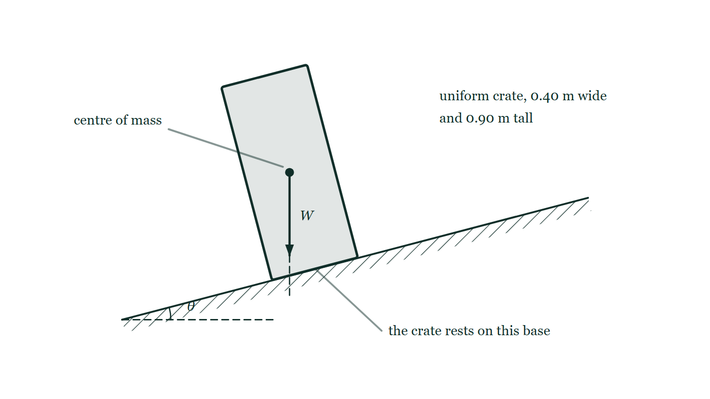
STATICS · CENTRE OF MASS & STABILITY
GIOPHYSICS LESSON
THE PICTURE
The line that decides it
Drawn for this lesson
A uniform crate 0.40 m wide and 0.90 m tall standing on a surface tilted about fifteen degrees from horizontal, with the tilt angle marked. Its centre of mass is marked at the middle of the crate, its weight is drawn as an arrow from that point straight down the page, and the line of action is continued as a dashed line to the tilted surface.
The live version of this figure — click here
Statics — Centre of Mass & Stability. Built by GioPhysics from the lesson's own copy; nothing on these slides is re-authored.
14 / 33
Notes:
[Phase] Build the model: The formulae, one at a time, in plain English (minutes 13–22 of 45)
[Figure] A uniform crate 0.40 m wide and 0.90 m tall standing on a surface tilted about fifteen degrees from horizontal, with the tilt angle marked. Its centre of mass is marked at the middle of the crate, its weight is drawn as an arrow from that point straight down the page, and the line of action is continued as a dashed line to the tilted surface.

Slide 15
STATICS · CENTRE OF MASS & STABILITY
GIOPHYSICS LESSON
WATCH OUT
The common trap
Check and misconception — The quick check and the trap
The centre of mass does not have to sit directly on a pivot. For balance, its vertical weight line must pass through the support point or support region.
Statics — Centre of Mass & Stability. Built by GioPhysics from the lesson's own copy; nothing on these slides is re-authored.
15 / 33
Notes:
[Phase] Check and misconception: The quick check and the trap (minutes 35–41 of 45)
[Misconception] The centre of mass does not have to sit directly on a pivot. For balance, its vertical weight line must pass through the support point or support region.

Slide 16
STATICS · CENTRE OF MASS & STABILITY
GIOPHYSICS LESSON
WORKED EXAMPLE 1 OF 2 · EASY
The question
Easy
Worked examples — I do, we do — one step revealed at a time
Masses of 3.0 kg and 1.0 kg sit at the ends of a light 2.0 m rod. How far from the 3.0 kg mass is the centre of mass?
Statics — Centre of Mass & Stability. Built by GioPhysics from the lesson's own copy; nothing on these slides is re-authored.
16 / 33
Notes:
[Phase] Worked examples: I do, we do — one step revealed at a time (minutes 22–35 of 45)
[Question] Masses of 3.0 kg and 1.0 kg sit at the ends of a light 2.0 m rod. How far from the 3.0 kg mass is the centre of mass?
[Answer] 0.50 m from the 3.0 kg mass

Slide 17
STATICS · CENTRE OF MASS & STABILITY
GIOPHYSICS LESSON
WORKED EXAMPLE 1 OF 2 · EASY · THE WORKING
How to solve it
Easy
Worked examples — I do, we do — one step revealed at a time
Masses of 3.0 kg and 1.0 kg sit at the ends of a light 2.0 m rod. How far from the 3.0 kg mass is the centre of mass?
1.
x(CM) = (3.0 × 0 + 1.0 × 2.0) ÷ 4.0.
2.
x = 0.50 m from the heavier end.
Statics — Centre of Mass & Stability. Built by GioPhysics from the lesson's own copy; nothing on these slides is re-authored.
17 / 33
Notes:
[Phase] Worked examples: I do, we do — one step revealed at a time (minutes 22–35 of 45)
[Reveal] One click per step. The class works each line before the next appears.
[Step 1] x(CM) = (3.0 × 0 + 1.0 × 2.0) ÷ 4.0.
[Step 2] x = 0.50 m from the heavier end.

Slide 18
STATICS · CENTRE OF MASS & STABILITY
GIOPHYSICS LESSON
WORKED EXAMPLE 1 OF 2 · EASY
Answer
Easy
Worked examples — I do, we do — one step revealed at a time
0.50 m from the 3.0 kg mass
Statics — Centre of Mass & Stability. Built by GioPhysics from the lesson's own copy; nothing on these slides is re-authored.
18 / 33
Notes:
[Phase] Worked examples: I do, we do — one step revealed at a time (minutes 22–35 of 45)
[Answer] 0.50 m from the 3.0 kg mass

Slide 19
STATICS · CENTRE OF MASS & STABILITY
GIOPHYSICS LESSON
WORKED EXAMPLE 2 OF 2 · MEDIUM
The question
Medium
Worked examples — I do, we do — one step revealed at a time
Masses of 2.0 kg and 6.0 kg are at x = 0 m and x = 4.0 m. Locate their centre of mass.
Statics — Centre of Mass & Stability. Built by GioPhysics from the lesson's own copy; nothing on these slides is re-authored.
19 / 33
Notes:
[Phase] Worked examples: I do, we do — one step revealed at a time (minutes 22–35 of 45)
[Question] Masses of 2.0 kg and 6.0 kg are at x = 0 m and x = 4.0 m. Locate their centre of mass.
[Answer] xCM = 3.0 m

Slide 20
STATICS · CENTRE OF MASS & STABILITY
GIOPHYSICS LESSON
WORKED EXAMPLE 2 OF 2 · MEDIUM · THE WORKING
How to solve it
Medium
Worked examples — I do, we do — one step revealed at a time
Masses of 2.0 kg and 6.0 kg are at x = 0 m and x = 4.0 m. Locate their centre of mass.
1.
Choose the stated origin and keep both coordinates signed.
2.
xCM = (2.0×0 + 6.0×4.0)/(2.0 + 6.0).
3.
The larger mass pulls the weighted average closer to x = 4.0 m.
Statics — Centre of Mass & Stability. Built by GioPhysics from the lesson's own copy; nothing on these slides is re-authored.
20 / 33
Notes:
[Phase] Worked examples: I do, we do — one step revealed at a time (minutes 22–35 of 45)
[Reveal] One click per step. The class works each line before the next appears.
[Step 1] Choose the stated origin and keep both coordinates signed.
[Step 2] xCM = (2.0×0 + 6.0×4.0)/(2.0 + 6.0).
[Step 3] The larger mass pulls the weighted average closer to x = 4.0 m.

Slide 21
STATICS · CENTRE OF MASS & STABILITY
GIOPHYSICS LESSON
WORKED EXAMPLE 2 OF 2 · MEDIUM
Answer
Medium
Worked examples — I do, we do — one step revealed at a time
xCM = 3.0 m
Statics — Centre of Mass & Stability. Built by GioPhysics from the lesson's own copy; nothing on these slides is re-authored.
21 / 33
Notes:
[Phase] Worked examples: I do, we do — one step revealed at a time (minutes 22–35 of 45)
[Answer] xCM = 3.0 m

Slide 22
STATICS · CENTRE OF MASS & STABILITY
GIOPHYSICS LESSON
SPOT THE MISTAKE
One line here is wrong
The whole working is up — find the bad line before you click
1.
The crate is uniform, 0.40 m wide and 0.90 m tall, so its centre of mass is 0.45 m above the base.
2.
It is on the point of toppling when the weight line reaches the base edge.
3.
That happens when tan θ = 0.40 ÷ 0.45 = 0.889.
4.
θ is then the inverse tangent of that.
LINE 3 IS WRONG
The horizontal distance from the centre of mass to the edge it tips about is HALF the width — the centre of mass sits above the middle of the base, not above the edge. Using the full width doubles that arm and flatters the crate's stability badly.
IT SHOULD SAY
That happens when tan θ = 0.20 ÷ 0.45 = 0.444, using half the width.
Statics — Centre of Mass & Stability. Built by GioPhysics from the lesson's own copy; nothing on these slides is re-authored.
22 / 33
Notes:
[Phase] Worked examples: I do, we do — one step revealed at a time (minutes 22–35 of 45)
[Spot the mistake] The working is complete and one line of it is wrong. Let the room hunt: one click names the line, a second shows it done correctly.
[Line 3 is wrong] The horizontal distance from the centre of mass to the edge it tips about is HALF the width — the centre of mass sits above the middle of the base, not above the edge. Using the full width doubles that arm and flatters the crate's stability badly.
[It should say] That happens when tan θ = 0.20 ÷ 0.45 = 0.444, using half the width.

Slide 23
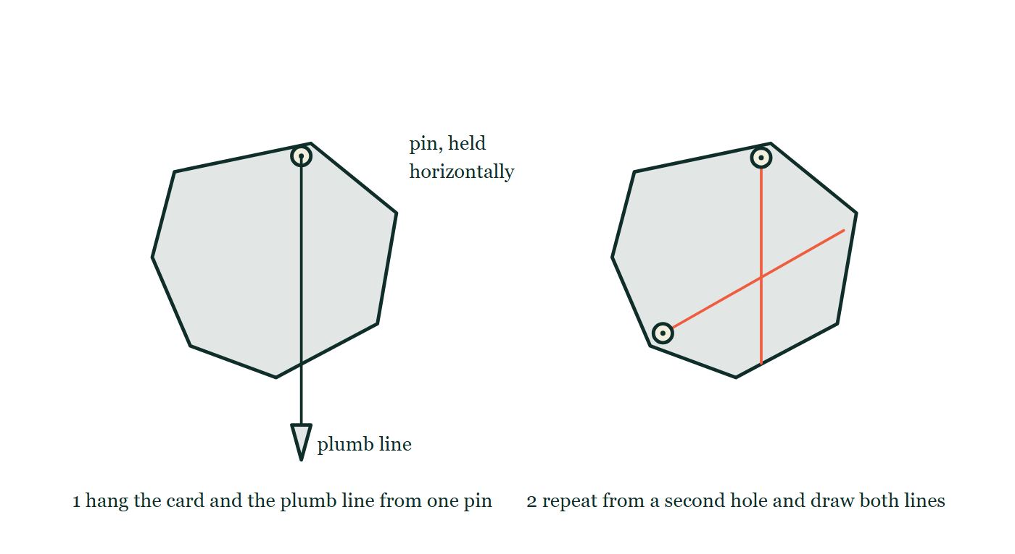
STATICS · CENTRE OF MASS & STABILITY
GIOPHYSICS LESSON
PREDICT · TAKE THE VOTE
Commit before you are told
Hands up for each option, then click
Two lines have been drawn on the card, one from each hole. Where is its centre of gravity?
A Half way along each of the lines
B At the point where the two lines cross
C At the geometric centre of the card
On the left, an irregular card hanging from a pin near its edge with a plumb line and bob hanging from the same pin across the face of the card. On the right, the same card laid flat with two straight lines drawn on it, one from each of two pin holes, crossing each other away from the middle of the card.
The live version of this figure — click here
Statics — Centre of Mass & Stability. Built by GioPhysics from the lesson's own copy; nothing on these slides is re-authored.
23 / 33
Notes:
[Phase] Build the model: The formulae, one at a time, in plain English (minutes 13–22 of 45)
[Predict] Two lines have been drawn on the card, one from each hole. Where is its centre of gravity?
[Options] A Half way along each of the lines B At the point where the two lines cross C At the geometric centre of the card
[Figure] On the left, an irregular card hanging from a pin near its edge with a plumb line and bob hanging from the same pin across the face of the card. On the right, the same card laid flat with two straight lines drawn on it, one from each of two pin holes, crossing each other away from the middle of the card.

Slide 24
STATICS · CENTRE OF MASS & STABILITY
GIOPHYSICS LESSON
PREDICT · THE OUTCOME
What actually happens
Ask the room who changed their mind, and why
B At the point where the two lines cross
WHY
Each hanging tells you one thing only: the centre of gravity lies somewhere on the line the string marked, because the card comes to rest only when its weight acts straight down through the point of support. One line narrows it to a line; two lines that are not parallel narrow it to a single crossing point. A third hole is worth doing as a check.
Statics — Centre of Mass & Stability. Built by GioPhysics from the lesson's own copy; nothing on these slides is re-authored.
24 / 33
Notes:
[Phase] Build the model: The formulae, one at a time, in plain English (minutes 13–22 of 45)
[Answer] B — At the point where the two lines cross. Each hanging tells you one thing only: the centre of gravity lies somewhere on the line the string marked, because the card comes to rest only when its weight acts straight down through the point of support. One line narrows it to a line; two lines that are not parallel narrow it to a single crossing point. A third hole is worth doing as a check.

Slide 25
STATICS · CENTRE OF MASS & STABILITY
GIOPHYSICS LESSON
QUICK CHECK
Decide before the answer goes up
Check and misconception — The quick check and the trap
A rigid object is slowly tilted. When does it reach the ideal tipping threshold?
A
When its centre of mass reaches the floor
B
When the weight line passes through a base edge
C
When its normal force becomes larger than its weight
Statics — Centre of Mass & Stability. Built by GioPhysics from the lesson's own copy; nothing on these slides is re-authored.
25 / 33
Notes:
[Phase] Check and misconception: The quick check and the trap (minutes 35–41 of 45)
[Question] A rigid object is slowly tilted. When does it reach the ideal tipping threshold?
[Options] A When its centre of mass reaches the floor B When the weight line passes through a base edge C When its normal force becomes larger than its weight

Slide 26
STATICS · CENTRE OF MASS & STABILITY
GIOPHYSICS LESSON
QUICK CHECK · THE ANSWER
The answer, and why
Check and misconception — The quick check and the trap
B When the weight line passes through a base edge
HOW TO GET THERE
At the threshold, the weight's line of action passes through the final contact edge; beyond it, gravity produces a tipping moment.
WHY THE OTHERS TEMPT
A The centre of mass of a toppling wardrobe never gets anywhere near the floor before it goes over. What matters is not how low the centre of mass is, but where the vertical line through it falls.
B Right. At that instant the weight has no moment arm about the edge at all; tilt a degree further and it acts outside the base, and its moment turns the object over.
C While an object rests on a level floor the normal force equals its weight and never exceeds it, so this can never be a threshold for anything.
Statics — Centre of Mass & Stability. Built by GioPhysics from the lesson's own copy; nothing on these slides is re-authored.
26 / 33
Notes:
[Phase] Check and misconception: The quick check and the trap (minutes 35–41 of 45)
[Question] A rigid object is slowly tilted. When does it reach the ideal tipping threshold?
[Option by option] A: The centre of mass of a toppling wardrobe never gets anywhere near the floor before it goes over. What matters is not how low the centre of mass is, but where the vertical line through it falls. B: Right. At that instant the weight has no moment arm about the edge at all; tilt a degree further and it acts outside the base, and its moment turns the object over. C: While an object rests on a level floor the normal force equals its weight and never exceeds it, so this can never be a threshold for anything.
[Answer] B — When the weight line passes through a base edge
[Why] At the threshold, the weight's line of action passes through the final contact edge; beyond it, gravity produces a tipping moment.
[Reveal] One click for the answer, then one for the reason.

Slide 27
STATICS · CENTRE OF MASS & STABILITY
GIOPHYSICS LESSON
EXTENSION 1 OF 2 · HARD
The question
Hard
Worked examples — I do, we do — one step revealed at a time
A uniform L-shaped plate is made of two 1.0 m × 0.20 m strips of the same sheet joined at right angles. Locate its centre of mass relative to the corner.
Statics — Centre of Mass & Stability. Built by GioPhysics from the lesson's own copy; nothing on these slides is re-authored.
27 / 33
Notes:
[Phase] Worked examples: I do, we do — one step revealed at a time (minutes 22–35 of 45)
[Question] A uniform L-shaped plate is made of two 1.0 m × 0.20 m strips of the same sheet joined at right angles. Locate its centre of mass relative to the corner.
[Answer] (0.30 m, 0.30 m) from the corner — off the plate itself

Slide 28
STATICS · CENTRE OF MASS & STABILITY
GIOPHYSICS LESSON
EXTENSION 1 OF 2 · HARD · THE WORKING
How to solve it
Hard
Worked examples — I do, we do — one step revealed at a time
A uniform L-shaped plate is made of two 1.0 m × 0.20 m strips of the same sheet joined at right angles. Locate its centre of mass relative to the corner.
1.
Each strip's CM sits at its centre: (0.50, 0.10) and (0.10, 0.50) m; equal masses.
2.
x(CM) = (0.50 + 0.10)/2 = 0.30 m; y(CM) = (0.10 + 0.50)/2 = 0.30 m.
3.
The CM at (0.30, 0.30) lies outside the material of the L — perfectly allowed.
Statics — Centre of Mass & Stability. Built by GioPhysics from the lesson's own copy; nothing on these slides is re-authored.
28 / 33
Notes:
[Phase] Worked examples: I do, we do — one step revealed at a time (minutes 22–35 of 45)
[Reveal] One click per step. The class works each line before the next appears.
[Step 1] Each strip's CM sits at its centre: (0.50, 0.10) and (0.10, 0.50) m; equal masses.
[Step 2] x(CM) = (0.50 + 0.10)/2 = 0.30 m; y(CM) = (0.10 + 0.50)/2 = 0.30 m.
[Step 3] The CM at (0.30, 0.30) lies outside the material of the L — perfectly allowed.

Slide 29
STATICS · CENTRE OF MASS & STABILITY
GIOPHYSICS LESSON
EXTENSION 1 OF 2 · HARD
Answer
Hard
Worked examples — I do, we do — one step revealed at a time
(0.30 m, 0.30 m) from the corner — off the plate itself
Statics — Centre of Mass & Stability. Built by GioPhysics from the lesson's own copy; nothing on these slides is re-authored.
29 / 33
Notes:
[Phase] Worked examples: I do, we do — one step revealed at a time (minutes 22–35 of 45)
[Answer] (0.30 m, 0.30 m) from the corner — off the plate itself

Slide 30
STATICS · CENTRE OF MASS & STABILITY
GIOPHYSICS LESSON
EXTENSION 2 OF 2 · CHALLENGING
The question
Challenging
Worked examples — I do, we do — one step revealed at a time
A uniform box 0.40 m wide and 0.90 m tall stands on a lorry bed. At what sideways tilt angle does it topple, and how does loading the bottom half with extra mass change the answer?
Statics — Centre of Mass & Stability. Built by GioPhysics from the lesson's own copy; nothing on these slides is re-authored.
30 / 33
Notes:
[Phase] Worked examples: I do, we do — one step revealed at a time (minutes 22–35 of 45)
[Question] A uniform box 0.40 m wide and 0.90 m tall stands on a lorry bed. At what sideways tilt angle does it topple, and how does loading the bottom half with extra mass change the answer?
[Answer] ≈ 24° unladen; lowering the CM to 0.30 m raises it to ≈ 34°

Slide 31
STATICS · CENTRE OF MASS & STABILITY
GIOPHYSICS LESSON
EXTENSION 2 OF 2 · CHALLENGING · THE WORKING
How to solve it
Challenging
Worked examples — I do, we do — one step revealed at a time
A uniform box 0.40 m wide and 0.90 m tall stands on a lorry bed. At what sideways tilt angle does it topple, and how does loading the bottom half with extra mass change the answer?
1.
Topple when the weight line leaves the base edge: tanθ = (width/2)/(height of CM) = 0.20 ÷ 0.45.
2.
θ = tan⁻¹(0.444) ≈ 24°.
3.
Bottom-loading lowers the CM (say to 0.30 m): tanθ = 0.20/0.30 → θ ≈ 34° — lower CM, wider safety margin.
Statics — Centre of Mass & Stability. Built by GioPhysics from the lesson's own copy; nothing on these slides is re-authored.
31 / 33
Notes:
[Phase] Worked examples: I do, we do — one step revealed at a time (minutes 22–35 of 45)
[Reveal] One click per step. The class works each line before the next appears.
[Step 1] Topple when the weight line leaves the base edge: tanθ = (width/2)/(height of CM) = 0.20 ÷ 0.45.
[Step 2] θ = tan⁻¹(0.444) ≈ 24°.
[Step 3] Bottom-loading lowers the CM (say to 0.30 m): tanθ = 0.20/0.30 → θ ≈ 34° — lower CM, wider safety margin.

Slide 32
STATICS · CENTRE OF MASS & STABILITY
GIOPHYSICS LESSON
EXTENSION 2 OF 2 · CHALLENGING
Answer
Challenging
Worked examples — I do, we do — one step revealed at a time
≈ 24° unladen; lowering the CM to 0.30 m raises it to ≈ 34°
Statics — Centre of Mass & Stability. Built by GioPhysics from the lesson's own copy; nothing on these slides is re-authored.
32 / 33
Notes:
[Phase] Worked examples: I do, we do — one step revealed at a time (minutes 22–35 of 45)
[Answer] ≈ 24° unladen; lowering the CM to 0.30 m raises it to ≈ 34°

Slide 33
STATICS · CENTRE OF MASS & STABILITY
GIOPHYSICS LESSON
STATICS
Where to go next
Plenary — What to take away, what to practise next
Next
9.2 Static Equilibrium & Free-Body Diagrams
https://giophysics.com/chapter-15/static-equilibrium-free-body-diagrams/
Lesson
This lesson on giophysics.com
https://giophysics.com/chapter-15/centre-of-mass-stability/
Live
The live, interactive version of these slides
https://giophysics.com/chapter-15/presentation/?lesson=centreMass
Chapter
All Statics lessons
https://giophysics.com/chapter-15/
PDF
Download the lesson PDF
https://giophysics.com/downloads/15-1-centre-of-mass-stability.pdf
Statics — Centre of Mass & Stability. Built by GioPhysics from the lesson's own copy; nothing on these slides is re-authored.
33 / 33
Notes:
[Phase] Plenary: What to take away, what to practise next (minutes 41–45 of 45)
[Interactive] The graphs and the circuit topology on these slides are frozen. The live version at https://giophysics.com/chapter-15/presentation/?lesson=centreMass moves them.

