Slide 1
STATICS · STATIC EQUILIBRIUM & FREE-BODY DIAGRAMS
GIOPHYSICS LESSON
09 · Statics
Balance translation and rotation
Static Equilibrium & Free-Body Diagrams
A body is in static equilibrium only when the resultant force and resultant moment are both zero.
POSITION
Lesson 2 of 7 in Statics
PLAN
16 slides in the 45-minute core run, about 44 minutes of it
LESSON PAGE
https://giophysics.com/chapter-15/static-equilibrium-free-body-diagrams/
Built by GioPhysics from the lesson's own page. Every word on these slides is the lesson's; nothing here is re-authored. Teaching material, not an awarding body's document.
Statics — Static Equilibrium & Free-Body Diagrams. Built by GioPhysics from the lesson's own copy; nothing on these slides is re-authored.
1 / 31
Notes:
[Lesson] Statics — Static Equilibrium & Free-Body Diagrams. Lesson 2 of 7.
[Intro] A body is in static equilibrium only when the resultant force and resultant moment are both zero.
[Source] https://giophysics.com/chapter-15/static-equilibrium-free-body-diagrams/
[Disclaimer] Built by GioPhysics from the lesson's own page. Every word on these slides is the lesson's; nothing here is re-authored. Teaching material, not an awarding body's document.

Slide 2
STATICS · STATIC EQUILIBRIUM & FREE-BODY DIAGRAMS
GIOPHYSICS LESSON
THINK FIRST
A book lies on a table. Is the table's upward push the Newton's-third-law partner of the book's weight?
Take answers before you click — the point is the commitment
The two forces are equal in size, opposite in direction, and both act on the book.
THE ANSWER
No. A third-law pair acts on two DIFFERENT bodies: the partner of the Earth pulling the book down is the book pulling the Earth up. The table's push and the book's weight both act on the book, and they are equal here only because the book happens to be in equilibrium — press down on it and they stop being equal at once.
Statics — Static Equilibrium & Free-Body Diagrams. Built by GioPhysics from the lesson's own copy; nothing on these slides is re-authored.
2 / 31
Notes:
[Phase] Starter: Recall what this lesson stands on (minutes 0–5 of 45)
[Hook] A book lies on a table. Is the table's upward push the Newton's-third-law partner of the book's weight? The two forces are equal in size, opposite in direction, and both act on the book.
[Answer] No. A third-law pair acts on two DIFFERENT bodies: the partner of the Earth pulling the book down is the book pulling the Earth up. The table's push and the book's weight both act on the book, and they are equal here only because the book happens to be in equilibrium — press down on it and they stop being equal at once.

Slide 3
STATICS · STATIC EQUILIBRIUM & FREE-BODY DIAGRAMS
GIOPHYSICS LESSON
EXPLAINED SIMPLY
In one sentence
Introduce the idea — The big idea and the definition
Static equilibrium means an object remains at rest because both its resultant force and its resultant moment are zero.
Statics — Static Equilibrium & Free-Body Diagrams. Built by GioPhysics from the lesson's own copy; nothing on these slides is re-authored.
3 / 31
Notes:
[Phase] Introduce the idea: The big idea and the definition (minutes 5–13 of 45)
[Definition] Static equilibrium means an object remains at rest because both its resultant force and its resultant moment are zero.

Slide 4
STATICS · STATIC EQUILIBRIUM & FREE-BODY DIAGRAMS
GIOPHYSICS LESSON
EXPLAINED SIMPLY
What that looks like
Introduce the idea — The big idea and the definition
FOR EXAMPLE
A book resting on a table is in static equilibrium when the table's upward normal force balances the book's weight and no unbalanced moment acts.
Statics — Static Equilibrium & Free-Body Diagrams. Built by GioPhysics from the lesson's own copy; nothing on these slides is re-authored.
4 / 31
Notes:
[Phase] Introduce the idea: The big idea and the definition (minutes 5–13 of 45)
[Worked illustration] A book resting on a table is in static equilibrium when the table's upward normal force balances the book's weight and no unbalanced moment acts.

Slide 5
STATICS · STATIC EQUILIBRIUM & FREE-BODY DIAGRAMS
GIOPHYSICS LESSON
THE BIG IDEA
Balance translation and rotation
Introduce the idea — The big idea and the definition
Isolate one body, replace each contact by the force it exerts, choose axes, and then write component equations. Force balance prevents centre-of-mass acceleration; moment balance prevents angular acceleration.
Statics — Static Equilibrium & Free-Body Diagrams. Built by GioPhysics from the lesson's own copy; nothing on these slides is re-authored.
5 / 31
Notes:
[Phase] Introduce the idea: The big idea and the definition (minutes 5–13 of 45)
[Big idea] Isolate one body, replace each contact by the force it exerts, choose axes, and then write component equations. Force balance prevents centre-of-mass acceleration; moment balance prevents angular acceleration.

Slide 6
STATICS · STATIC EQUILIBRIUM & FREE-BODY DIAGRAMS
GIOPHYSICS LESSON
THE PHYSICS · 1 OF 3
Define the body
Build the model — The formulae, one at a time, in plain English
Draw only external forces acting on the isolated body. A third-law partner acts on another object and belongs on another diagram.
Statics — Static Equilibrium & Free-Body Diagrams. Built by GioPhysics from the lesson's own copy; nothing on these slides is re-authored.
6 / 31
Notes:
[Phase] Build the model: The formulae, one at a time, in plain English (minutes 13–22 of 45)
[Section] Draw only external forces acting on the isolated body. A third-law partner acts on another object and belongs on another diagram.

Slide 7
STATICS · STATIC EQUILIBRIUM & FREE-BODY DIAGRAMS
GIOPHYSICS LESSON
THE PHYSICS · 2 OF 3
Model contacts
Build the model — The formulae, one at a time, in plain English
A smooth contact supplies a normal force; a rough contact can also supply tangential friction; a cable pulls along itself.
Statics — Static Equilibrium & Free-Body Diagrams. Built by GioPhysics from the lesson's own copy; nothing on these slides is re-authored.
7 / 31
Notes:
[Phase] Build the model: The formulae, one at a time, in plain English (minutes 13–22 of 45)
[Section] A smooth contact supplies a normal force; a rough contact can also supply tangential friction; a cable pulls along itself.

Slide 8
STATICS · STATIC EQUILIBRIUM & FREE-BODY DIAGRAMS
GIOPHYSICS LESSON
THE PHYSICS · 3 OF 3
Choose the moment point
Build the model — The formulae, one at a time, in plain English
Taking moments through unknown reaction lines removes those forces from that equation without removing them physically.
Statics — Static Equilibrium & Free-Body Diagrams. Built by GioPhysics from the lesson's own copy; nothing on these slides is re-authored.
8 / 31
Notes:
[Phase] Build the model: The formulae, one at a time, in plain English (minutes 13–22 of 45)
[Section] Taking moments through unknown reaction lines removes those forces from that equation without removing them physically.

Slide 9
STATICS · STATIC EQUILIBRIUM & FREE-BODY DIAGRAMS
GIOPHYSICS LESSON
FORMULA 1 OF 3
Force balance
Build the model — The formulae, one at a time, in plain English
ΣFₓ = 0 and ΣFᵧ = 0
No translational acceleration
IN PLAIN ENGLISH
For something at rest, all pushes and pulls must cancel — horizontally and vertically, separately.
Statics — Static Equilibrium & Free-Body Diagrams. Built by GioPhysics from the lesson's own copy; nothing on these slides is re-authored.
9 / 31
Notes:
[Phase] Build the model: The formulae, one at a time, in plain English (minutes 13–22 of 45)
[Formula] Force balance: ΣFₓ = 0 and ΣFᵧ = 0
[In plain English] For something at rest, all pushes and pulls must cancel — horizontally and vertically, separately.
[Note] No translational acceleration

Slide 10
STATICS · STATIC EQUILIBRIUM & FREE-BODY DIAGRAMS
GIOPHYSICS LESSON
FORMULA 2 OF 3
Moment balance
Build the model — The formulae, one at a time, in plain English
ΣMₒ = 0
Choose any convenient point O
IN PLAIN ENGLISH
The turning effects must cancel too, about any point you choose — clockwise must match anticlockwise.
Statics — Static Equilibrium & Free-Body Diagrams. Built by GioPhysics from the lesson's own copy; nothing on these slides is re-authored.
10 / 31
Notes:
[Phase] Build the model: The formulae, one at a time, in plain English (minutes 13–22 of 45)
[Formula] Moment balance: ΣMₒ = 0
[In plain English] The turning effects must cancel too, about any point you choose — clockwise must match anticlockwise.
[Note] Choose any convenient point O

Slide 11
STATICS · STATIC EQUILIBRIUM & FREE-BODY DIAGRAMS
GIOPHYSICS LESSON
FORMULA 3 OF 3
Static friction
Build the model — The formulae, one at a time, in plain English
|fₛ| ≤ μₛN
Equality only at impending slip
IN PLAIN ENGLISH
Friction supplies only as much grip as the situation demands, up to a maximum set by the surfaces and the pressing force.
Statics — Static Equilibrium & Free-Body Diagrams. Built by GioPhysics from the lesson's own copy; nothing on these slides is re-authored.
11 / 31
Notes:
[Phase] Build the model: The formulae, one at a time, in plain English (minutes 13–22 of 45)
[Formula] Static friction: |fₛ| ≤ μₛN
[In plain English] Friction supplies only as much grip as the situation demands, up to a maximum set by the surfaces and the pressing force.
[Note] Equality only at impending slip

Slide 12
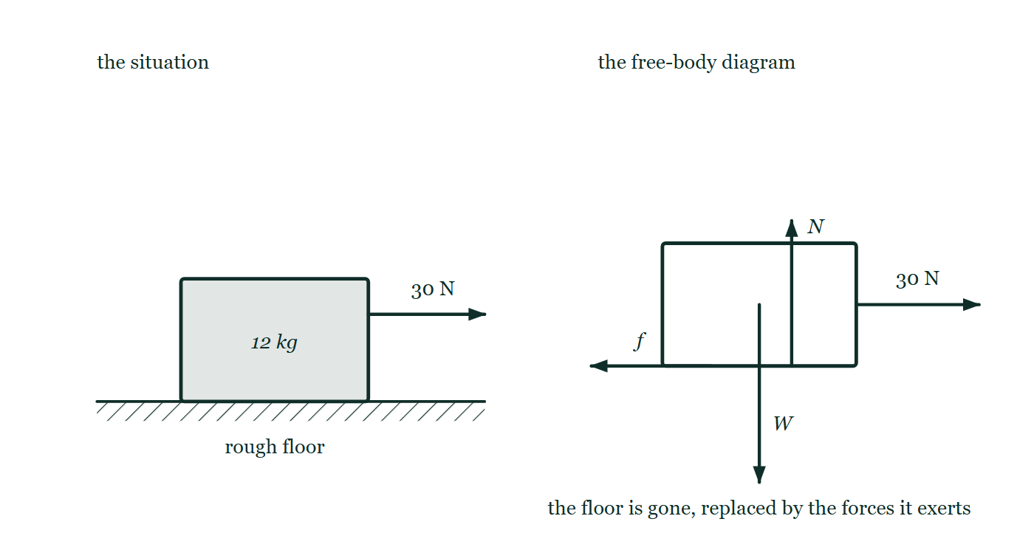
STATICS · STATIC EQUILIBRIUM & FREE-BODY DIAGRAMS
GIOPHYSICS LESSON
THE PICTURE
Taking the floor away
Drawn for this lesson
On the left a 12 kg crate resting on a rough floor with a horizontal 30 N pull applied to its side. On the right the same crate drawn on its own as an outline, carrying four arrows: the weight from its centre downwards, the floor's normal force upwards from the base, a friction force along the base, and the 30 N pull from the face the rope is tied to.
The live version of this figure — click here
Statics — Static Equilibrium & Free-Body Diagrams. Built by GioPhysics from the lesson's own copy; nothing on these slides is re-authored.
12 / 31
Notes:
[Phase] Build the model: The formulae, one at a time, in plain English (minutes 13–22 of 45)
[Figure] On the left a 12 kg crate resting on a rough floor with a horizontal 30 N pull applied to its side. On the right the same crate drawn on its own as an outline, carrying four arrows: the weight from its centre downwards, the floor's normal force upwards from the base, a friction force along the base, and the 30 N pull from the face the rope is tied to.

Slide 13
STATICS · STATIC EQUILIBRIUM & FREE-BODY DIAGRAMS
GIOPHYSICS LESSON
WATCH OUT
The common trap
Check and misconception — The quick check and the trap
Zero resultant force is not sufficient for a rigid body. Equal and opposite forces can form a couple and still create angular acceleration.
Statics — Static Equilibrium & Free-Body Diagrams. Built by GioPhysics from the lesson's own copy; nothing on these slides is re-authored.
13 / 31
Notes:
[Phase] Check and misconception: The quick check and the trap (minutes 35–41 of 45)
[Misconception] Zero resultant force is not sufficient for a rigid body. Equal and opposite forces can form a couple and still create angular acceleration.

Slide 14
STATICS · STATIC EQUILIBRIUM & FREE-BODY DIAGRAMS
GIOPHYSICS LESSON
WORKED EXAMPLE 1 OF 2 · EASY
The question
Easy
Worked examples — I do, we do — one step revealed at a time
A lamp of weight 40 N hangs at rest from two vertical cords sharing the load equally. Find the tension in each.
Statics — Static Equilibrium & Free-Body Diagrams. Built by GioPhysics from the lesson's own copy; nothing on these slides is re-authored.
14 / 31
Notes:
[Phase] Worked examples: I do, we do — one step revealed at a time (minutes 22–35 of 45)
[Question] A lamp of weight 40 N hangs at rest from two vertical cords sharing the load equally. Find the tension in each.
[Answer] T = 20 N per cord

Slide 15
STATICS · STATIC EQUILIBRIUM & FREE-BODY DIAGRAMS
GIOPHYSICS LESSON
WORKED EXAMPLE 1 OF 2 · EASY · THE WORKING
How to solve it
Easy
Worked examples — I do, we do — one step revealed at a time
A lamp of weight 40 N hangs at rest from two vertical cords sharing the load equally. Find the tension in each.
1.
ΣFᵧ = 0: 2T = 40.
2.
T = 20 N each.
Statics — Static Equilibrium & Free-Body Diagrams. Built by GioPhysics from the lesson's own copy; nothing on these slides is re-authored.
15 / 31
Notes:
[Phase] Worked examples: I do, we do — one step revealed at a time (minutes 22–35 of 45)
[Reveal] One click per step. The class works each line before the next appears.
[Step 1] ΣFᵧ = 0: 2T = 40.
[Step 2] T = 20 N each.

Slide 16
STATICS · STATIC EQUILIBRIUM & FREE-BODY DIAGRAMS
GIOPHYSICS LESSON
WORKED EXAMPLE 1 OF 2 · EASY
Answer
Easy
Worked examples — I do, we do — one step revealed at a time
T = 20 N per cord
Statics — Static Equilibrium & Free-Body Diagrams. Built by GioPhysics from the lesson's own copy; nothing on these slides is re-authored.
16 / 31
Notes:
[Phase] Worked examples: I do, we do — one step revealed at a time (minutes 22–35 of 45)
[Answer] T = 20 N per cord

Slide 17
STATICS · STATIC EQUILIBRIUM & FREE-BODY DIAGRAMS
GIOPHYSICS LESSON
WORKED EXAMPLE 2 OF 2 · MEDIUM
The question
Medium
Worked examples — I do, we do — one step revealed at a time
A 12 kg crate is pulled horizontally with 30 N and remains at rest on a level floor. Find the friction and normal forces.
Statics — Static Equilibrium & Free-Body Diagrams. Built by GioPhysics from the lesson's own copy; nothing on these slides is re-authored.
17 / 31
Notes:
[Phase] Worked examples: I do, we do — one step revealed at a time (minutes 22–35 of 45)
[Question] A 12 kg crate is pulled horizontally with 30 N and remains at rest on a level floor. Find the friction and normal forces.
[Answer] fₛ = 30 N opposite the pull; N = 118 N

Slide 18
STATICS · STATIC EQUILIBRIUM & FREE-BODY DIAGRAMS
GIOPHYSICS LESSON
WORKED EXAMPLE 2 OF 2 · MEDIUM · THE WORKING
How to solve it
Medium
Worked examples — I do, we do — one step revealed at a time
A 12 kg crate is pulled horizontally with 30 N and remains at rest on a level floor. Find the friction and normal forces.
1.
Horizontal balance requires fₛ − 30 = 0 in magnitude.
2.
Vertical balance requires N − mg = 0.
3.
Use g = 9.81 m/s² and check that the required friction is below its limit.
Statics — Static Equilibrium & Free-Body Diagrams. Built by GioPhysics from the lesson's own copy; nothing on these slides is re-authored.
18 / 31
Notes:
[Phase] Worked examples: I do, we do — one step revealed at a time (minutes 22–35 of 45)
[Reveal] One click per step. The class works each line before the next appears.
[Step 1] Horizontal balance requires fₛ − 30 = 0 in magnitude.
[Step 2] Vertical balance requires N − mg = 0.
[Step 3] Use g = 9.81 m/s² and check that the required friction is below its limit.

Slide 19
STATICS · STATIC EQUILIBRIUM & FREE-BODY DIAGRAMS
GIOPHYSICS LESSON
WORKED EXAMPLE 2 OF 2 · MEDIUM
Answer
Medium
Worked examples — I do, we do — one step revealed at a time
fₛ = 30 N opposite the pull; N = 118 N
Statics — Static Equilibrium & Free-Body Diagrams. Built by GioPhysics from the lesson's own copy; nothing on these slides is re-authored.
19 / 31
Notes:
[Phase] Worked examples: I do, we do — one step revealed at a time (minutes 22–35 of 45)
[Answer] fₛ = 30 N opposite the pull; N = 118 N

Slide 20
STATICS · STATIC EQUILIBRIUM & FREE-BODY DIAGRAMS
GIOPHYSICS LESSON
SPOT THE MISTAKE
One line here is wrong
The whole working is up — find the bad line before you click
1.
Horizontal: T₁cos30° = T₂cos60°, so T₂ = 1.73T₁.
2.
Vertical: T₁sin30° + T₂sin60° = 100.
3.
0.500T₁ + 0.866T₁ = 100, so T₁ = 73 N.
4.
T₂ = 1.73 × 73 = 126 N.
LINE 3 IS WRONG
The sin 60° went in but the T₂ it multiplies was left as T₁ — the substitution T₂ = 1.73T₁ was worked out on the line above and then quietly forgotten. The check that catches it is the vertical one: 73 N and 126 N at those angles hold up far more than 100 N.
IT SHOULD SAY
0.500T₁ + 0.866(1.73T₁) = 2.00T₁ = 100, so T₁ = 50 N.
Statics — Static Equilibrium & Free-Body Diagrams. Built by GioPhysics from the lesson's own copy; nothing on these slides is re-authored.
20 / 31
Notes:
[Phase] Worked examples: I do, we do — one step revealed at a time (minutes 22–35 of 45)
[Spot the mistake] The working is complete and one line of it is wrong. Let the room hunt: one click names the line, a second shows it done correctly.
[Line 3 is wrong] The sin 60° went in but the T₂ it multiplies was left as T₁ — the substitution T₂ = 1.73T₁ was worked out on the line above and then quietly forgotten. The check that catches it is the vertical one: 73 N and 126 N at those angles hold up far more than 100 N.
[It should say] 0.500T₁ + 0.866(1.73T₁) = 2.00T₁ = 100, so T₁ = 50 N.

Slide 21
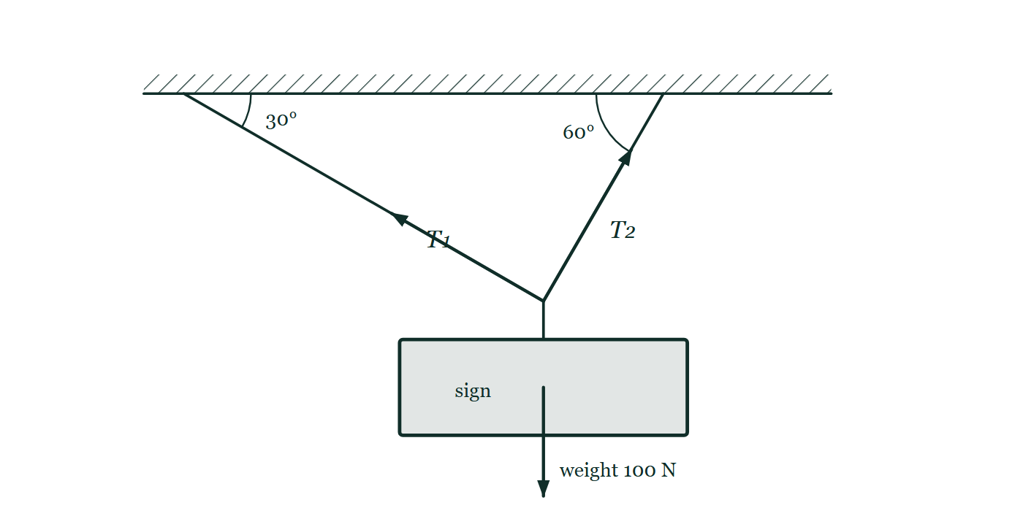
STATICS · STATIC EQUILIBRIUM & FREE-BODY DIAGRAMS
GIOPHYSICS LESSON
PREDICT · TAKE THE VOTE
Commit before you are told
Hands up for each option, then click
One cord meets the ceiling at 30°, the other at 60°. Which cord is under the greater tension?
A The 30° cord, the shallower of the two
B The 60° cord, the steeper of the two
C Equal — they are holding the same sign between them
A 100 N sign hanging from a junction held by two cords, one meeting the ceiling at 30° and the other at 60°, with both angles marked at the ceiling. The two tensions are drawn as arrows from the junction along their own cords, deliberately the same length as each other, and the sign's weight is drawn from its centre.
The live version of this figure — click here
Statics — Static Equilibrium & Free-Body Diagrams. Built by GioPhysics from the lesson's own copy; nothing on these slides is re-authored.
21 / 31
Notes:
[Phase] Build the model: The formulae, one at a time, in plain English (minutes 13–22 of 45)
[Predict] One cord meets the ceiling at 30°, the other at 60°. Which cord is under the greater tension?
[Options] A The 30° cord, the shallower of the two B The 60° cord, the steeper of the two C Equal — they are holding the same sign between them
[Figure] A 100 N sign hanging from a junction held by two cords, one meeting the ceiling at 30° and the other at 60°, with both angles marked at the ceiling. The two tensions are drawn as arrows from the junction along their own cords, deliberately the same length as each other, and the sign's weight is drawn from its centre.

Slide 22
STATICS · STATIC EQUILIBRIUM & FREE-BODY DIAGRAMS
GIOPHYSICS LESSON
PREDICT · THE OUTCOME
What actually happens
Ask the room who changed their mind, and why
B The 60° cord, the steeper of the two
WHY
Only the vertical components hold the sign up, and the steeper cord has much the larger share of itself pointing upwards. Balancing the horizontal components as well forces T₂ = √3 T₁, so the 60° cord carries about 87 N against the other's 50 N. Equal tensions need equal angles.
Statics — Static Equilibrium & Free-Body Diagrams. Built by GioPhysics from the lesson's own copy; nothing on these slides is re-authored.
22 / 31
Notes:
[Phase] Build the model: The formulae, one at a time, in plain English (minutes 13–22 of 45)
[Answer] B — The 60° cord, the steeper of the two. Only the vertical components hold the sign up, and the steeper cord has much the larger share of itself pointing upwards. Balancing the horizontal components as well forces T₂ = √3 T₁, so the 60° cord carries about 87 N against the other's 50 N. Equal tensions need equal angles.

Slide 23
STATICS · STATIC EQUILIBRIUM & FREE-BODY DIAGRAMS
GIOPHYSICS LESSON
QUICK CHECK
Decide before the answer goes up
Check and misconception — The quick check and the trap
A stationary body has three non-parallel forces and no couple. What must be true in planar equilibrium?
A
Their lines of action are concurrent
B
Their magnitudes are all equal
C
They all act at the centre of mass
Statics — Static Equilibrium & Free-Body Diagrams. Built by GioPhysics from the lesson's own copy; nothing on these slides is re-authored.
23 / 31
Notes:
[Phase] Check and misconception: The quick check and the trap (minutes 35–41 of 45)
[Question] A stationary body has three non-parallel forces and no couple. What must be true in planar equilibrium?
[Options] A Their lines of action are concurrent B Their magnitudes are all equal C They all act at the centre of mass

Slide 24
STATICS · STATIC EQUILIBRIUM & FREE-BODY DIAGRAMS
GIOPHYSICS LESSON
QUICK CHECK · THE ANSWER
The answer, and why
Check and misconception — The quick check and the trap
A Their lines of action are concurrent
HOW TO GET THERE
If two lines meet at a point but the third misses it, the third force creates an unbalanced moment about that point.
WHY THE OTHERS TEMPT
A Right. Take moments about the point where two of them cross: both of those give zero, so the third must give zero as well — which it can only do by passing through that same point.
B Equal magnitudes would only balance if the three forces were arranged symmetrically at 120°. Three unequal forces balance perfectly well; a sign on two cords at different angles is the standard example.
C Only the weight is obliged to act at the centre of mass. Contact forces act where the contact is and a hinge reaction acts at the hinge, and a body with all three forces concurrent somewhere else is still in equilibrium.
Statics — Static Equilibrium & Free-Body Diagrams. Built by GioPhysics from the lesson's own copy; nothing on these slides is re-authored.
24 / 31
Notes:
[Phase] Check and misconception: The quick check and the trap (minutes 35–41 of 45)
[Question] A stationary body has three non-parallel forces and no couple. What must be true in planar equilibrium?
[Option by option] A: Right. Take moments about the point where two of them cross: both of those give zero, so the third must give zero as well — which it can only do by passing through that same point. B: Equal magnitudes would only balance if the three forces were arranged symmetrically at 120°. Three unequal forces balance perfectly well; a sign on two cords at different angles is the standard example. C: Only the weight is obliged to act at the centre of mass. Contact forces act where the contact is and a hinge reaction acts at the hinge, and a body with all three forces concurrent somewhere else is still in equilibrium.
[Answer] A — Their lines of action are concurrent
[Why] If two lines meet at a point but the third misses it, the third force creates an unbalanced moment about that point.
[Reveal] One click for the answer, then one for the reason.

Slide 25
STATICS · STATIC EQUILIBRIUM & FREE-BODY DIAGRAMS
GIOPHYSICS LESSON
EXTENSION 1 OF 2 · HARD
The question
Hard
Worked examples — I do, we do — one step revealed at a time
A 100 N sign hangs from two cords making 30° and 60° with the ceiling. Find both tensions.
Statics — Static Equilibrium & Free-Body Diagrams. Built by GioPhysics from the lesson's own copy; nothing on these slides is re-authored.
25 / 31
Notes:
[Phase] Worked examples: I do, we do — one step revealed at a time (minutes 22–35 of 45)
[Question] A 100 N sign hangs from two cords making 30° and 60° with the ceiling. Find both tensions.
[Answer] T₁ = 50 N, T₂ ≈ 87 N

Slide 26
STATICS · STATIC EQUILIBRIUM & FREE-BODY DIAGRAMS
GIOPHYSICS LESSON
EXTENSION 1 OF 2 · HARD · THE WORKING
How to solve it
Hard
Worked examples — I do, we do — one step revealed at a time
A 100 N sign hangs from two cords making 30° and 60° with the ceiling. Find both tensions.
1.
Horizontal: T₁cos30° = T₂cos60° → T₂ = T₁√3.
2.
Vertical: T₁sin30° + T₂sin60° = 100 → 0.5T₁ + 1.5T₁ = 100.
3.
T₁ = 50 N; T₂ ≈ 87 N.
Statics — Static Equilibrium & Free-Body Diagrams. Built by GioPhysics from the lesson's own copy; nothing on these slides is re-authored.
26 / 31
Notes:
[Phase] Worked examples: I do, we do — one step revealed at a time (minutes 22–35 of 45)
[Reveal] One click per step. The class works each line before the next appears.
[Step 1] Horizontal: T₁cos30° = T₂cos60° → T₂ = T₁√3.
[Step 2] Vertical: T₁sin30° + T₂sin60° = 100 → 0.5T₁ + 1.5T₁ = 100.
[Step 3] T₁ = 50 N; T₂ ≈ 87 N.

Slide 27
STATICS · STATIC EQUILIBRIUM & FREE-BODY DIAGRAMS
GIOPHYSICS LESSON
EXTENSION 1 OF 2 · HARD
Answer
Hard
Worked examples — I do, we do — one step revealed at a time
T₁ = 50 N, T₂ ≈ 87 N
Statics — Static Equilibrium & Free-Body Diagrams. Built by GioPhysics from the lesson's own copy; nothing on these slides is re-authored.
27 / 31
Notes:
[Phase] Worked examples: I do, we do — one step revealed at a time (minutes 22–35 of 45)
[Answer] T₁ = 50 N, T₂ ≈ 87 N

Slide 28
STATICS · STATIC EQUILIBRIUM & FREE-BODY DIAGRAMS
GIOPHYSICS LESSON
EXTENSION 2 OF 2 · CHALLENGING
The question
Challenging
Worked examples — I do, we do — one step revealed at a time
A 20 kg traffic light hangs from the midpoint of a cable stretched between poles 30 m apart, sagging 0.50 m. Estimate the cable tension and explain why a perfectly horizontal cable is impossible.
Statics — Static Equilibrium & Free-Body Diagrams. Built by GioPhysics from the lesson's own copy; nothing on these slides is re-authored.
28 / 31
Notes:
[Phase] Worked examples: I do, we do — one step revealed at a time (minutes 22–35 of 45)
[Question] A 20 kg traffic light hangs from the midpoint of a cable stretched between poles 30 m apart, sagging 0.50 m. Estimate the cable tension and explain why a perfectly horizontal cable is impossible.
[Answer] T ≈ 2.9 kN; zero sag would require infinite tension

Slide 29
STATICS · STATIC EQUILIBRIUM & FREE-BODY DIAGRAMS
GIOPHYSICS LESSON
EXTENSION 2 OF 2 · CHALLENGING · THE WORKING
How to solve it
Challenging
Worked examples — I do, we do — one step revealed at a time
A 20 kg traffic light hangs from the midpoint of a cable stretched between poles 30 m apart, sagging 0.50 m. Estimate the cable tension and explain why a perfectly horizontal cable is impossible.
1.
Each side's angle: tanθ = 0.50 ÷ 15 → θ ≈ 1.91°; sinθ ≈ 0.0333.
2.
2T sinθ = mg → T = 196 ÷ (2 × 0.0333) ≈ 2.9 kN.
3.
As sag → 0, sinθ → 0 and T → ∞ — some sag is mandatory for any real cable.
Statics — Static Equilibrium & Free-Body Diagrams. Built by GioPhysics from the lesson's own copy; nothing on these slides is re-authored.
29 / 31
Notes:
[Phase] Worked examples: I do, we do — one step revealed at a time (minutes 22–35 of 45)
[Reveal] One click per step. The class works each line before the next appears.
[Step 1] Each side's angle: tanθ = 0.50 ÷ 15 → θ ≈ 1.91°; sinθ ≈ 0.0333.
[Step 2] 2T sinθ = mg → T = 196 ÷ (2 × 0.0333) ≈ 2.9 kN.
[Step 3] As sag → 0, sinθ → 0 and T → ∞ — some sag is mandatory for any real cable.

Slide 30
STATICS · STATIC EQUILIBRIUM & FREE-BODY DIAGRAMS
GIOPHYSICS LESSON
EXTENSION 2 OF 2 · CHALLENGING
Answer
Challenging
Worked examples — I do, we do — one step revealed at a time
T ≈ 2.9 kN; zero sag would require infinite tension
Statics — Static Equilibrium & Free-Body Diagrams. Built by GioPhysics from the lesson's own copy; nothing on these slides is re-authored.
30 / 31
Notes:
[Phase] Worked examples: I do, we do — one step revealed at a time (minutes 22–35 of 45)
[Answer] T ≈ 2.9 kN; zero sag would require infinite tension

Slide 31
STATICS · STATIC EQUILIBRIUM & FREE-BODY DIAGRAMS
GIOPHYSICS LESSON
STATICS
Where to go next
Plenary — What to take away, what to practise next
Next
9.3 Moments, Couples & Torque
https://giophysics.com/chapter-15/moments-couples-torque/
Lesson
This lesson on giophysics.com
https://giophysics.com/chapter-15/static-equilibrium-free-body-diagrams/
Live
The live, interactive version of these slides
https://giophysics.com/chapter-15/presentation/?lesson=equilibrium
Chapter
All Statics lessons
https://giophysics.com/chapter-15/
PDF
Download the lesson PDF
https://giophysics.com/downloads/15-2-static-equilibrium-free-body-diagrams.pdf
Statics — Static Equilibrium & Free-Body Diagrams. Built by GioPhysics from the lesson's own copy; nothing on these slides is re-authored.
31 / 31
Notes:
[Phase] Plenary: What to take away, what to practise next (minutes 41–45 of 45)
[Interactive] The graphs and the circuit topology on these slides are frozen. The live version at https://giophysics.com/chapter-15/presentation/?lesson=equilibrium moves them.

