Slide 1
STATICS · MOMENTS, COUPLES & TORQUE
GIOPHYSICS LESSON
09 · Statics
Measure turning effect
Moments, Couples & Torque
A force's turning effect depends on its magnitude, its line of action, and the chosen moment point.
POSITION
Lesson 3 of 7 in Statics
PLAN
16 slides in the 45-minute core run, about 44 minutes of it
LESSON PAGE
https://giophysics.com/chapter-15/moments-couples-torque/
Built by GioPhysics from the lesson's own page. Every word on these slides is the lesson's; nothing here is re-authored. Teaching material, not an awarding body's document.
Statics — Moments, Couples & Torque. Built by GioPhysics from the lesson's own copy; nothing on these slides is re-authored.
1 / 32
Notes:
[Lesson] Statics — Moments, Couples & Torque. Lesson 3 of 7.
[Intro] A force's turning effect depends on its magnitude, its line of action, and the chosen moment point.
[Source] https://giophysics.com/chapter-15/moments-couples-torque/
[Disclaimer] Built by GioPhysics from the lesson's own page. Every word on these slides is the lesson's; nothing here is re-authored. Teaching material, not an awarding body's document.

Slide 2
STATICS · MOMENTS, COUPLES & TORQUE
GIOPHYSICS LESSON
THINK FIRST
A moment is measured in newton metres, and so is a joule. Is a moment a kind of energy?
Take answers before you click — the point is the commitment
Multiply a force by a distance and you get work. Multiply a force by a distance and you get a moment.
THE ANSWER
No, and the units are a trap. Work uses the distance moved ALONG the force; a moment uses the perpendicular distance from the pivot to the force's line of action, which nothing moves through at all. They are two different products of the same pair of quantities, which is why a torque is never written in joules.
Statics — Moments, Couples & Torque. Built by GioPhysics from the lesson's own copy; nothing on these slides is re-authored.
2 / 32
Notes:
[Phase] Starter: Recall what this lesson stands on (minutes 0–5 of 45)
[Hook] A moment is measured in newton metres, and so is a joule. Is a moment a kind of energy? Multiply a force by a distance and you get work. Multiply a force by a distance and you get a moment.
[Answer] No, and the units are a trap. Work uses the distance moved ALONG the force; a moment uses the perpendicular distance from the pivot to the force's line of action, which nothing moves through at all. They are two different products of the same pair of quantities, which is why a torque is never written in joules.

Slide 3
STATICS · MOMENTS, COUPLES & TORQUE
GIOPHYSICS LESSON
EXPLAINED SIMPLY
In one sentence
Introduce the idea — The big idea and the definition
A moment is the turning effect of a force about a point, equal to the force multiplied by its perpendicular distance from that point.
Statics — Moments, Couples & Torque. Built by GioPhysics from the lesson's own copy; nothing on these slides is re-authored.
3 / 32
Notes:
[Phase] Introduce the idea: The big idea and the definition (minutes 5–13 of 45)
[Definition] A moment is the turning effect of a force about a point, equal to the force multiplied by its perpendicular distance from that point.

Slide 4
STATICS · MOMENTS, COUPLES & TORQUE
GIOPHYSICS LESSON
EXPLAINED SIMPLY
What that looks like
Introduce the idea — The big idea and the definition
FOR EXAMPLE
Pushing a door at its handle produces a larger moment than pushing with the same force close to the hinge.
Statics — Moments, Couples & Torque. Built by GioPhysics from the lesson's own copy; nothing on these slides is re-authored.
4 / 32
Notes:
[Phase] Introduce the idea: The big idea and the definition (minutes 5–13 of 45)
[Worked illustration] Pushing a door at its handle produces a larger moment than pushing with the same force close to the hinge.

Slide 5
STATICS · MOMENTS, COUPLES & TORQUE
GIOPHYSICS LESSON
THE BIG IDEA
Measure turning effect
Introduce the idea — The big idea and the definition
Moment is force multiplied by perpendicular distance. The cross product supplies its sign and direction. A couple is two equal, opposite, parallel forces separated by a distance; its resultant force is zero but its moment is not.
Statics — Moments, Couples & Torque. Built by GioPhysics from the lesson's own copy; nothing on these slides is re-authored.
5 / 32
Notes:
[Phase] Introduce the idea: The big idea and the definition (minutes 5–13 of 45)
[Big idea] Moment is force multiplied by perpendicular distance. The cross product supplies its sign and direction. A couple is two equal, opposite, parallel forces separated by a distance; its resultant force is zero but its moment is not.

Slide 6
STATICS · MOMENTS, COUPLES & TORQUE
GIOPHYSICS LESSON
THE PHYSICS · 1 OF 3
Line of action matters
Build the model — The formulae, one at a time, in plain English
Sliding a force along its own line of action does not change its moment about a fixed point.
Statics — Moments, Couples & Torque. Built by GioPhysics from the lesson's own copy; nothing on these slides is re-authored.
6 / 32
Notes:
[Phase] Build the model: The formulae, one at a time, in plain English (minutes 13–22 of 45)
[Section] Sliding a force along its own line of action does not change its moment about a fixed point.

Slide 7
STATICS · MOMENTS, COUPLES & TORQUE
GIOPHYSICS LESSON
THE PHYSICS · 2 OF 3
Use one sign convention
Build the model — The formulae, one at a time, in plain English
For planar problems, state clockwise or counterclockwise as positive before adding signed moments.
Statics — Moments, Couples & Torque. Built by GioPhysics from the lesson's own copy; nothing on these slides is re-authored.
7 / 32
Notes:
[Phase] Build the model: The formulae, one at a time, in plain English (minutes 13–22 of 45)
[Section] For planar problems, state clockwise or counterclockwise as positive before adding signed moments.

Slide 8
STATICS · MOMENTS, COUPLES & TORQUE
GIOPHYSICS LESSON
THE PHYSICS · 3 OF 3
Couples rotate without translating
Build the model — The formulae, one at a time, in plain English
The forces cancel as vectors while their moments reinforce, leaving a pure turning effect.
Statics — Moments, Couples & Torque. Built by GioPhysics from the lesson's own copy; nothing on these slides is re-authored.
8 / 32
Notes:
[Phase] Build the model: The formulae, one at a time, in plain English (minutes 13–22 of 45)
[Section] The forces cancel as vectors while their moments reinforce, leaving a pure turning effect.

Slide 9
STATICS · MOMENTS, COUPLES & TORQUE
GIOPHYSICS LESSON
FORMULA 1 OF 3
Force moment
Build the model — The formulae, one at a time, in plain English
M = rF sin θ = Fd⊥
Unit: N·m
IN PLAIN ENGLISH
Turning effect: force times the perpendicular distance from the pivot to its line of action — that's why long levers help.
Statics — Moments, Couples & Torque. Built by GioPhysics from the lesson's own copy; nothing on these slides is re-authored.
9 / 32
Notes:
[Phase] Build the model: The formulae, one at a time, in plain English (minutes 13–22 of 45)
[Formula] Force moment: M = rF sin θ = Fd⊥
[In plain English] Turning effect: force times the perpendicular distance from the pivot to its line of action — that's why long levers help.
[Note] Unit: N·m

Slide 10
STATICS · MOMENTS, COUPLES & TORQUE
GIOPHYSICS LESSON
FORMULA 2 OF 3
Vector form
Build the model — The formulae, one at a time, in plain English
M⃗ₒ = r⃗ × F⃗
Right-hand rule
IN PLAIN ENGLISH
The full 3D version of a moment; the right-hand rule gives its axis of turn.
Statics — Moments, Couples & Torque. Built by GioPhysics from the lesson's own copy; nothing on these slides is re-authored.
10 / 32
Notes:
[Phase] Build the model: The formulae, one at a time, in plain English (minutes 13–22 of 45)
[Formula] Vector form: M⃗ₒ = r⃗ × F⃗
[In plain English] The full 3D version of a moment; the right-hand rule gives its axis of turn.
[Note] Right-hand rule

Slide 11
STATICS · MOMENTS, COUPLES & TORQUE
GIOPHYSICS LESSON
FORMULA 3 OF 3
Couple
Build the model — The formulae, one at a time, in plain English
Mcouple = Fs
Independent of moment point
IN PLAIN ENGLISH
Two equal, opposite, offset forces produce a pure twist — the same turning effect about every point.
Statics — Moments, Couples & Torque. Built by GioPhysics from the lesson's own copy; nothing on these slides is re-authored.
11 / 32
Notes:
[Phase] Build the model: The formulae, one at a time, in plain English (minutes 13–22 of 45)
[Formula] Couple: Mcouple = Fs
[In plain English] Two equal, opposite, offset forces produce a pure twist — the same turning effect about every point.
[Note] Independent of moment point

Slide 12
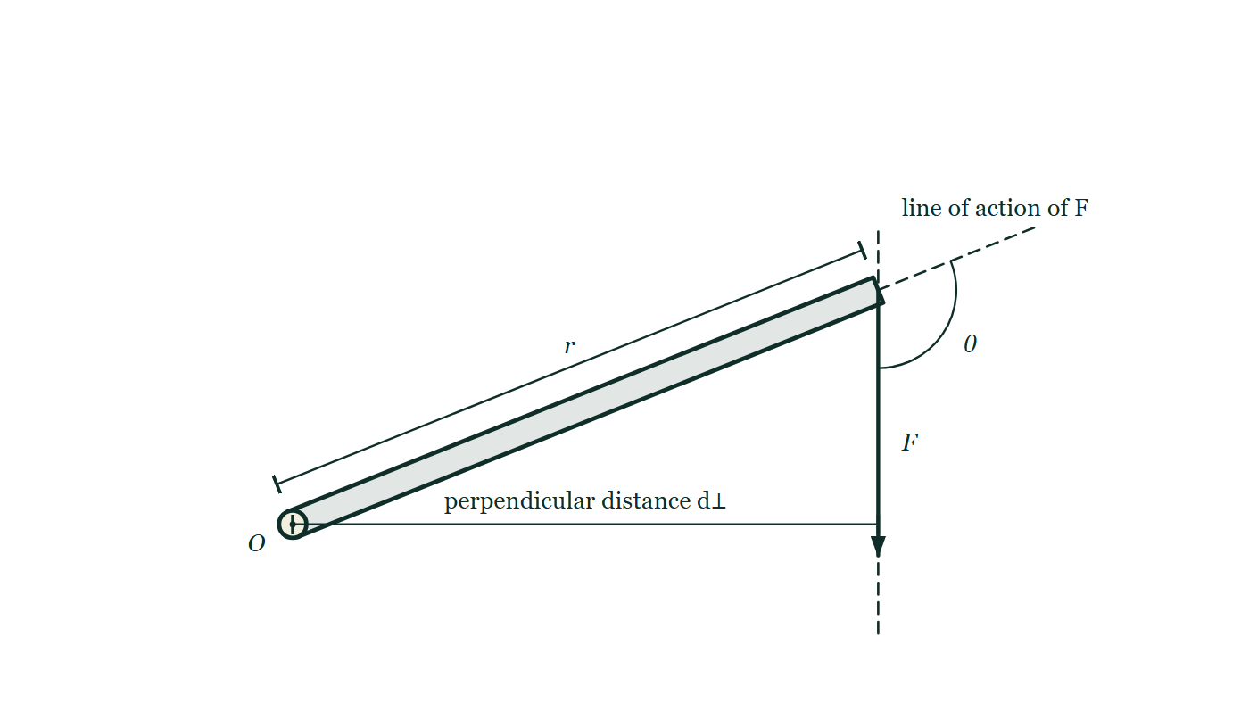
STATICS · MOMENTS, COUPLES & TORQUE
GIOPHYSICS LESSON
THE PICTURE
The distance that counts
Drawn for this lesson
A rigid arm pivoted at a point O with a force F applied at its far end and pointing down the page. The force's line of action is continued as a dashed line, the angle θ between the arm and the force is marked at the far end, and the perpendicular distance from O across to that dashed line is dimensioned.
The live version of this figure — click here
Statics — Moments, Couples & Torque. Built by GioPhysics from the lesson's own copy; nothing on these slides is re-authored.
12 / 32
Notes:
[Phase] Build the model: The formulae, one at a time, in plain English (minutes 13–22 of 45)
[Figure] A rigid arm pivoted at a point O with a force F applied at its far end and pointing down the page. The force's line of action is continued as a dashed line, the angle θ between the arm and the force is marked at the far end, and the perpendicular distance from O across to that dashed line is dimensioned.

Slide 13
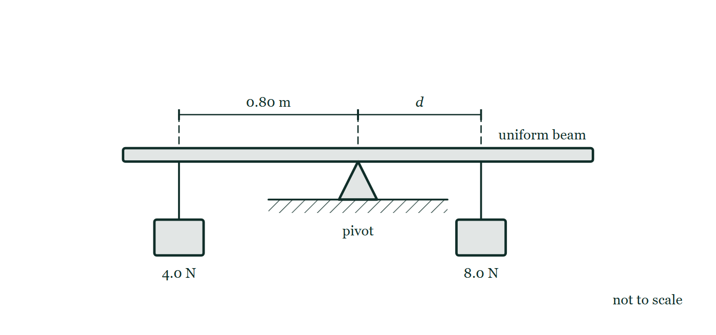
STATICS · MOMENTS, COUPLES & TORQUE
GIOPHYSICS LESSON
FIGURE
Fig. 4.1 — IGCSE Topic 1 · Motion, forces and energy
Drawn for question 4 of that paper · syllabus 1.5.2
A uniform beam rests on a pivot standing on the ground, the pivot placed at the centre of the beam. A 4.0 N weight hangs from the beam at a point 0.80 m to the left of the pivot, and an 8.0 N weight hangs to the right of the pivot at a distance marked d. Both distances are measured along the beam from the pivot. The drawing is not to scale.
See the question this was drawn for — click here
Statics — Moments, Couples & Torque. Built by GioPhysics from the lesson's own copy; nothing on these slides is re-authored.
13 / 32
Notes:
[Phase] Build the model: The formulae, one at a time, in plain English (minutes 13–22 of 45)
[Figure] Fig. 4.1. A uniform beam rests on a pivot standing on the ground, the pivot placed at the centre of the beam. A 4.0 N weight hangs from the beam at a point 0.80 m to the left of the pivot, and an 8.0 N weight hangs to the right of the pivot at a distance marked d. Both distances are measured along the beam from the pivot. The drawing is not to scale.
[Where it came from] IGCSE Topic 1 · Motion, forces and energy, question 4; syllabus 1.5.2.

Slide 14
STATICS · MOMENTS, COUPLES & TORQUE
GIOPHYSICS LESSON
WATCH OUT
The common trap
Check and misconception — The quick check and the trap
N·m is also the dimensional form of a joule, but moment is not energy. Do not relabel torque or moment as J.
Statics — Moments, Couples & Torque. Built by GioPhysics from the lesson's own copy; nothing on these slides is re-authored.
14 / 32
Notes:
[Phase] Check and misconception: The quick check and the trap (minutes 35–41 of 45)
[Misconception] N·m is also the dimensional form of a joule, but moment is not energy. Do not relabel torque or moment as J.

Slide 15
STATICS · MOMENTS, COUPLES & TORQUE
GIOPHYSICS LESSON
WORKED EXAMPLE 1 OF 2 · EASY
The question
Easy
Worked examples — I do, we do — one step revealed at a time
A 200 N child sits 1.5 m from a see-saw pivot. What moment do they produce?
Statics — Moments, Couples & Torque. Built by GioPhysics from the lesson's own copy; nothing on these slides is re-authored.
15 / 32
Notes:
[Phase] Worked examples: I do, we do — one step revealed at a time (minutes 22–35 of 45)
[Question] A 200 N child sits 1.5 m from a see-saw pivot. What moment do they produce?
[Answer] M = 300 N·m

Slide 16
STATICS · MOMENTS, COUPLES & TORQUE
GIOPHYSICS LESSON
WORKED EXAMPLE 1 OF 2 · EASY · THE WORKING
How to solve it
Easy
Worked examples — I do, we do — one step revealed at a time
A 200 N child sits 1.5 m from a see-saw pivot. What moment do they produce?
1.
M = Fd = 200 × 1.5.
2.
M = 300 N·m.
Statics — Moments, Couples & Torque. Built by GioPhysics from the lesson's own copy; nothing on these slides is re-authored.
16 / 32
Notes:
[Phase] Worked examples: I do, we do — one step revealed at a time (minutes 22–35 of 45)
[Reveal] One click per step. The class works each line before the next appears.
[Step 1] M = Fd = 200 × 1.5.
[Step 2] M = 300 N·m.

Slide 17
STATICS · MOMENTS, COUPLES & TORQUE
GIOPHYSICS LESSON
WORKED EXAMPLE 1 OF 2 · EASY
Answer
Easy
Worked examples — I do, we do — one step revealed at a time
M = 300 N·m
Statics — Moments, Couples & Torque. Built by GioPhysics from the lesson's own copy; nothing on these slides is re-authored.
17 / 32
Notes:
[Phase] Worked examples: I do, we do — one step revealed at a time (minutes 22–35 of 45)
[Answer] M = 300 N·m

Slide 18
STATICS · MOMENTS, COUPLES & TORQUE
GIOPHYSICS LESSON
WORKED EXAMPLE 2 OF 2 · MEDIUM
The question
Medium
Worked examples — I do, we do — one step revealed at a time
A 75 N force acts 0.40 m from a pivot at 30° to the lever arm. Find its moment magnitude.
Statics — Moments, Couples & Torque. Built by GioPhysics from the lesson's own copy; nothing on these slides is re-authored.
18 / 32
Notes:
[Phase] Worked examples: I do, we do — one step revealed at a time (minutes 22–35 of 45)
[Question] A 75 N force acts 0.40 m from a pivot at 30° to the lever arm. Find its moment magnitude.
[Answer] M = 15 N·m

Slide 19
STATICS · MOMENTS, COUPLES & TORQUE
GIOPHYSICS LESSON
WORKED EXAMPLE 2 OF 2 · MEDIUM · THE WORKING
How to solve it
Medium
Worked examples — I do, we do — one step revealed at a time
A 75 N force acts 0.40 m from a pivot at 30° to the lever arm. Find its moment magnitude.
1.
Use the angle between the lever arm and the force.
2.
M = rF sin θ = 0.40×75×sin 30°.
3.
State clockwise or counterclockwise from the diagram if a direction is shown.
Statics — Moments, Couples & Torque. Built by GioPhysics from the lesson's own copy; nothing on these slides is re-authored.
19 / 32
Notes:
[Phase] Worked examples: I do, we do — one step revealed at a time (minutes 22–35 of 45)
[Reveal] One click per step. The class works each line before the next appears.
[Step 1] Use the angle between the lever arm and the force.
[Step 2] M = rF sin θ = 0.40×75×sin 30°.
[Step 3] State clockwise or counterclockwise from the diagram if a direction is shown.

Slide 20
STATICS · MOMENTS, COUPLES & TORQUE
GIOPHYSICS LESSON
WORKED EXAMPLE 2 OF 2 · MEDIUM
Answer
Medium
Worked examples — I do, we do — one step revealed at a time
M = 15 N·m
Statics — Moments, Couples & Torque. Built by GioPhysics from the lesson's own copy; nothing on these slides is re-authored.
20 / 32
Notes:
[Phase] Worked examples: I do, we do — one step revealed at a time (minutes 22–35 of 45)
[Answer] M = 15 N·m

Slide 21
STATICS · MOMENTS, COUPLES & TORQUE
GIOPHYSICS LESSON
SPOT THE MISTAKE
One line here is wrong
The whole working is up — find the bad line before you click
1.
A 75 N force acts 0.40 m from the pivot, at 30° to the lever arm.
2.
Moment = force × perpendicular distance from the pivot to its line of action.
3.
M = 0.40 × 75 × cos30° = 26 N·m.
4.
So the moment is 26 N·m.
LINE 3 IS WRONG
The perpendicular distance is r sin θ, not r cos θ. The quickest way to catch it is the extreme case: with the force pointing straight along the arm, θ = 0 and there is plainly no turning effect — yet cos 0° = 1, which would claim the maximum.
IT SHOULD SAY
M = rF sin θ = 0.40 × 75 × sin30° = 15 N·m.
Statics — Moments, Couples & Torque. Built by GioPhysics from the lesson's own copy; nothing on these slides is re-authored.
21 / 32
Notes:
[Phase] Worked examples: I do, we do — one step revealed at a time (minutes 22–35 of 45)
[Spot the mistake] The working is complete and one line of it is wrong. Let the room hunt: one click names the line, a second shows it done correctly.
[Line 3 is wrong] The perpendicular distance is r sin θ, not r cos θ. The quickest way to catch it is the extreme case: with the force pointing straight along the arm, θ = 0 and there is plainly no turning effect — yet cos 0° = 1, which would claim the maximum.
[It should say] M = rF sin θ = 0.40 × 75 × sin30° = 15 N·m.

Slide 22
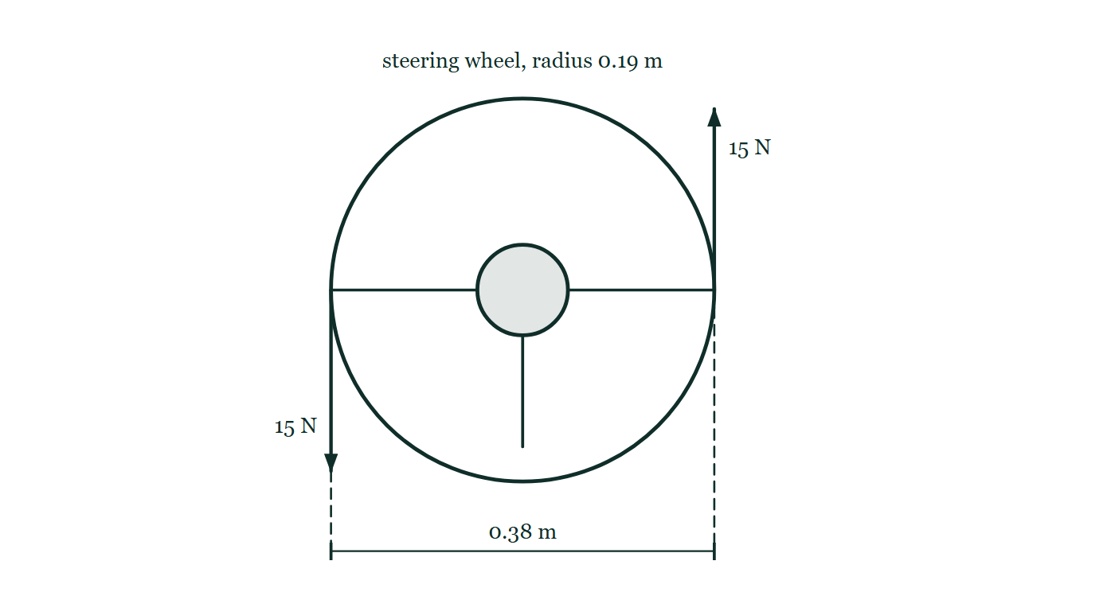
STATICS · MOMENTS, COUPLES & TORQUE
GIOPHYSICS LESSON
PREDICT · TAKE THE VOTE
Commit before you are told
Hands up for each option, then click
Compare the turning effect of the two hands about the centre of the wheel with their turning effect about a point on the rim.
A Twice as large about the centre — the centre is where the wheel actually turns
B The same about both points
C Zero about the rim point, because one of the forces passes through it
A steering wheel of radius 0.19 m seen face on, with a 15 N force pushing down at the left-hand rim point and an equal 15 N force pushing up at the right-hand rim point. The perpendicular distance between the two lines of action, 0.38 m, is dimensioned below the wheel.
The live version of this figure — click here
Statics — Moments, Couples & Torque. Built by GioPhysics from the lesson's own copy; nothing on these slides is re-authored.
22 / 32
Notes:
[Phase] Build the model: The formulae, one at a time, in plain English (minutes 13–22 of 45)
[Predict] Compare the turning effect of the two hands about the centre of the wheel with their turning effect about a point on the rim.
[Options] A Twice as large about the centre — the centre is where the wheel actually turns B The same about both points C Zero about the rim point, because one of the forces passes through it
[Figure] A steering wheel of radius 0.19 m seen face on, with a 15 N force pushing down at the left-hand rim point and an equal 15 N force pushing up at the right-hand rim point. The perpendicular distance between the two lines of action, 0.38 m, is dimensioned below the wheel.

Slide 23
STATICS · MOMENTS, COUPLES & TORQUE
GIOPHYSICS LESSON
PREDICT · THE OUTCOME
What actually happens
Ask the room who changed their mind, and why
B The same about both points
WHY
Two equal and opposite forces make a couple, and a couple's moment is the same about every point in the plane. Move your chosen point and one force's arm grows by exactly as much as the other's shrinks, so the sum never changes: 15 N × 0.38 m about the centre, about the rim, or about the far side of the room.
Statics — Moments, Couples & Torque. Built by GioPhysics from the lesson's own copy; nothing on these slides is re-authored.
23 / 32
Notes:
[Phase] Build the model: The formulae, one at a time, in plain English (minutes 13–22 of 45)
[Answer] B — The same about both points. Two equal and opposite forces make a couple, and a couple's moment is the same about every point in the plane. Move your chosen point and one force's arm grows by exactly as much as the other's shrinks, so the sum never changes: 15 N × 0.38 m about the centre, about the rim, or about the far side of the room.

Slide 24
STATICS · MOMENTS, COUPLES & TORQUE
GIOPHYSICS LESSON
QUICK CHECK
Decide before the answer goes up
Check and misconception — The quick check and the trap
For fixed r and F, at which angle between r⃗ and F⃗ is the moment magnitude largest?
A
0°
B
45°
C
90°
Statics — Moments, Couples & Torque. Built by GioPhysics from the lesson's own copy; nothing on these slides is re-authored.
24 / 32
Notes:
[Phase] Check and misconception: The quick check and the trap (minutes 35–41 of 45)
[Question] For fixed r and F, at which angle between r⃗ and F⃗ is the moment magnitude largest?
[Options] A 0° B 45° C 90°

Slide 25
STATICS · MOMENTS, COUPLES & TORQUE
GIOPHYSICS LESSON
QUICK CHECK · THE ANSWER
The answer, and why
Check and misconception — The quick check and the trap
C 90°
HOW TO GET THERE
M = rF sin θ is largest when sin θ = 1, so the force is perpendicular to the position vector.
WHY THE OTHERS TEMPT
A At 0° the force points straight along the arm. It tries to pull the lever out of its socket and turns it not at all, because sin 0° = 0.
B 45° gives sin 45° = 0.71, so about seven tenths of the maximum. Better than nothing, but a push at right angles does better.
C Right. M = rF sin θ peaks where sin θ = 1, and there the whole of r is the perpendicular distance.
Statics — Moments, Couples & Torque. Built by GioPhysics from the lesson's own copy; nothing on these slides is re-authored.
25 / 32
Notes:
[Phase] Check and misconception: The quick check and the trap (minutes 35–41 of 45)
[Question] For fixed r and F, at which angle between r⃗ and F⃗ is the moment magnitude largest?
[Option by option] A: At 0° the force points straight along the arm. It tries to pull the lever out of its socket and turns it not at all, because sin 0° = 0. B: 45° gives sin 45° = 0.71, so about seven tenths of the maximum. Better than nothing, but a push at right angles does better. C: Right. M = rF sin θ peaks where sin θ = 1, and there the whole of r is the perpendicular distance.
[Answer] C — 90°
[Why] M = rF sin θ is largest when sin θ = 1, so the force is perpendicular to the position vector.
[Reveal] One click for the answer, then one for the reason.

Slide 26
STATICS · MOMENTS, COUPLES & TORQUE
GIOPHYSICS LESSON
EXTENSION 1 OF 2 · HARD
The question
Hard
Worked examples — I do, we do — one step revealed at a time
A 60 N uniform trapdoor 1.0 m long is lifted at its edge, held at 30° above horizontal. Find the lifting force applied perpendicular to the door.
Statics — Moments, Couples & Torque. Built by GioPhysics from the lesson's own copy; nothing on these slides is re-authored.
26 / 32
Notes:
[Phase] Worked examples: I do, we do — one step revealed at a time (minutes 22–35 of 45)
[Question] A 60 N uniform trapdoor 1.0 m long is lifted at its edge, held at 30° above horizontal. Find the lifting force applied perpendicular to the door.
[Answer] F ≈ 26 N

Slide 27
STATICS · MOMENTS, COUPLES & TORQUE
GIOPHYSICS LESSON
EXTENSION 1 OF 2 · HARD · THE WORKING
How to solve it
Hard
Worked examples — I do, we do — one step revealed at a time
A 60 N uniform trapdoor 1.0 m long is lifted at its edge, held at 30° above horizontal. Find the lifting force applied perpendicular to the door.
1.
Weight acts at the centre, moment arm = 0.50 cos30° ≈ 0.433 m about the hinge.
2.
Perpendicular lift at the far edge has arm 1.0 m: F × 1.0 = 60 × 0.433.
3.
F ≈ 26 N.
Statics — Moments, Couples & Torque. Built by GioPhysics from the lesson's own copy; nothing on these slides is re-authored.
27 / 32
Notes:
[Phase] Worked examples: I do, we do — one step revealed at a time (minutes 22–35 of 45)
[Reveal] One click per step. The class works each line before the next appears.
[Step 1] Weight acts at the centre, moment arm = 0.50 cos30° ≈ 0.433 m about the hinge.
[Step 2] Perpendicular lift at the far edge has arm 1.0 m: F × 1.0 = 60 × 0.433.
[Step 3] F ≈ 26 N.

Slide 28
STATICS · MOMENTS, COUPLES & TORQUE
GIOPHYSICS LESSON
EXTENSION 1 OF 2 · HARD
Answer
Hard
Worked examples — I do, we do — one step revealed at a time
F ≈ 26 N
Statics — Moments, Couples & Torque. Built by GioPhysics from the lesson's own copy; nothing on these slides is re-authored.
28 / 32
Notes:
[Phase] Worked examples: I do, we do — one step revealed at a time (minutes 22–35 of 45)
[Answer] F ≈ 26 N

Slide 29
STATICS · MOMENTS, COUPLES & TORQUE
GIOPHYSICS LESSON
EXTENSION 2 OF 2 · CHALLENGING
The question
Challenging
Worked examples — I do, we do — one step revealed at a time
A steering wheel of radius 0.19 m is turned by two hands pushing oppositely with 15 N each on opposite rim points. Show the effect is the same about ANY point in the plane, and compute it.
Statics — Moments, Couples & Torque. Built by GioPhysics from the lesson's own copy; nothing on these slides is re-authored.
29 / 32
Notes:
[Phase] Worked examples: I do, we do — one step revealed at a time (minutes 22–35 of 45)
[Question] A steering wheel of radius 0.19 m is turned by two hands pushing oppositely with 15 N each on opposite rim points. Show the effect is the same about ANY point in the plane, and compute it.
[Answer] A 5.7 N·m couple — identical about every point

Slide 30
STATICS · MOMENTS, COUPLES & TORQUE
GIOPHYSICS LESSON
EXTENSION 2 OF 2 · CHALLENGING · THE WORKING
How to solve it
Challenging
Worked examples — I do, we do — one step revealed at a time
A steering wheel of radius 0.19 m is turned by two hands pushing oppositely with 15 N each on opposite rim points. Show the effect is the same about ANY point in the plane, and compute it.
1.
The pair forms a couple: net force zero, moment = F × separation = 15 × 0.38 = 5.7 N·m.
2.
About any point, the two moments always sum to F·d regardless of where the point is — shift the point and one arm grows exactly as the other shrinks.
3.
That location-independence is the defining property of a couple.
Statics — Moments, Couples & Torque. Built by GioPhysics from the lesson's own copy; nothing on these slides is re-authored.
30 / 32
Notes:
[Phase] Worked examples: I do, we do — one step revealed at a time (minutes 22–35 of 45)
[Reveal] One click per step. The class works each line before the next appears.
[Step 1] The pair forms a couple: net force zero, moment = F × separation = 15 × 0.38 = 5.7 N·m.
[Step 2] About any point, the two moments always sum to F·d regardless of where the point is — shift the point and one arm grows exactly as the other shrinks.
[Step 3] That location-independence is the defining property of a couple.

Slide 31
STATICS · MOMENTS, COUPLES & TORQUE
GIOPHYSICS LESSON
EXTENSION 2 OF 2 · CHALLENGING
Answer
Challenging
Worked examples — I do, we do — one step revealed at a time
A 5.7 N·m couple — identical about every point
Statics — Moments, Couples & Torque. Built by GioPhysics from the lesson's own copy; nothing on these slides is re-authored.
31 / 32
Notes:
[Phase] Worked examples: I do, we do — one step revealed at a time (minutes 22–35 of 45)
[Answer] A 5.7 N·m couple — identical about every point

Slide 32
STATICS · MOMENTS, COUPLES & TORQUE
GIOPHYSICS LESSON
STATICS
Where to go next
Plenary — What to take away, what to practise next
Next
9.4 Distributed Loads & Resultants
https://giophysics.com/chapter-15/distributed-loads-resultants/
Lesson
This lesson on giophysics.com
https://giophysics.com/chapter-15/moments-couples-torque/
Live
The live, interactive version of these slides
https://giophysics.com/chapter-15/presentation/?lesson=moments
Chapter
All Statics lessons
https://giophysics.com/chapter-15/
PDF
Download the lesson PDF
https://giophysics.com/downloads/15-3-moments-couples-torque.pdf
Statics — Moments, Couples & Torque. Built by GioPhysics from the lesson's own copy; nothing on these slides is re-authored.
32 / 32
Notes:
[Phase] Plenary: What to take away, what to practise next (minutes 41–45 of 45)
[Interactive] The graphs and the circuit topology on these slides are frozen. The live version at https://giophysics.com/chapter-15/presentation/?lesson=moments moves them.

