Slide 1
ELECTRIC CHARGES · ELECTROSTATICS APPLICATIONS & SAFETY
GIOPHYSICS LESSON
10 · Electric Charges
Give charge a controlled path
Electrostatics Applications & Safety
Electrostatics is useful when charge is guided deliberately and hazardous when an unexpected discharge creates heat, a spark, or a large current pulse.
POSITION
Lesson 6 of 7 in Electric Charges
PLAN
15 slides in the 45-minute core run, about 43 minutes of it
LESSON PAGE
https://giophysics.com/chapter-19/electrostatics-applications-safety/
Built by GioPhysics from the lesson's own page. Every word on these slides is the lesson's; nothing here is re-authored. Teaching material, not an awarding body's document.
Electric Charges — Electrostatics Applications & Safety. Built by GioPhysics from the lesson's own copy; nothing on these slides is re-authored.
1 / 30
Notes:
[Lesson] Electric Charges — Electrostatics Applications & Safety. Lesson 6 of 7.
[Intro] Electrostatics is useful when charge is guided deliberately and hazardous when an unexpected discharge creates heat, a spark, or a large current pulse.
[Source] https://giophysics.com/chapter-19/electrostatics-applications-safety/
[Disclaimer] Built by GioPhysics from the lesson's own page. Every word on these slides is the lesson's; nothing here is re-authored. Teaching material, not an awarding body's document.

Slide 2
ELECTRIC CHARGES · ELECTROSTATICS APPLICATIONS & SAFETY
GIOPHYSICS LESSON
WHAT THIS NEEDS
What you already know
Starter — Recall what this lesson stands on
Recall
Charging & grounding
https://giophysics.com/chapter-19/charging-friction-contact-induction/
Recall
Electric force
https://giophysics.com/chapter-19/coulombs-law/
Electric Charges — Electrostatics Applications & Safety. Built by GioPhysics from the lesson's own copy; nothing on these slides is re-authored.
2 / 30
Notes:
[Phase] Starter: Recall what this lesson stands on (minutes 0–5 of 45)
[Starter] Recall: Charging & grounding; Electric force

Slide 3
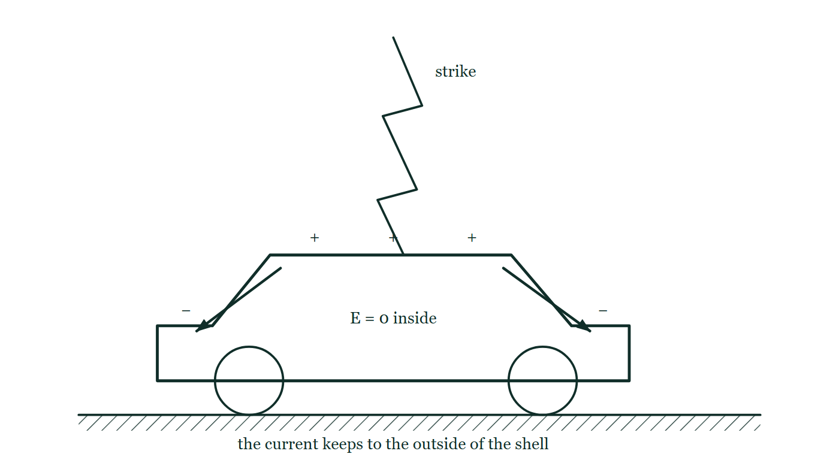
ELECTRIC CHARGES · ELECTROSTATICS APPLICATIONS & SAFETY
GIOPHYSICS LESSON
THINK FIRST
A car is one of the safest places to be in a thunderstorm. Is it the rubber tyres?
Take answers before you click — the point is the commitment
It is the answer almost everyone gives, and rubber really is an excellent insulator.
THE ANSWER
No. A strike that has just jumped a kilometre of air is not going to be stopped by a centimetre of rubber. What protects you is the metal shell: charge rearranges over the outside of the bodywork until the field inside is very nearly zero, and the current runs around you rather than through you. A convertible with a fabric roof gives you none of that.
A car stands on the road with a lightning stroke striking its roof; induced charge is marked all round the outside of the bodywork, arrows carry the current down the outer shell towards the ground, and the passenger space inside is labelled E = 0.
The live version of this figure — click here
Electric Charges — Electrostatics Applications & Safety. Built by GioPhysics from the lesson's own copy; nothing on these slides is re-authored.
3 / 30
Notes:
[Phase] Starter: Recall what this lesson stands on (minutes 0–5 of 45)
[Hook] A car is one of the safest places to be in a thunderstorm. Is it the rubber tyres? It is the answer almost everyone gives, and rubber really is an excellent insulator.
[Answer] No. A strike that has just jumped a kilometre of air is not going to be stopped by a centimetre of rubber. What protects you is the metal shell: charge rearranges over the outside of the bodywork until the field inside is very nearly zero, and the current runs around you rather than through you. A convertible with a fabric roof gives you none of that.
[Figure] A car stands on the road with a lightning stroke striking its roof; induced charge is marked all round the outside of the bodywork, arrows carry the current down the outer shell towards the ground, and the passenger space inside is labelled E = 0.

Slide 4
ELECTRIC CHARGES · ELECTROSTATICS APPLICATIONS & SAFETY
GIOPHYSICS LESSON
EXPLAINED SIMPLY
In one sentence
Introduce the idea — The big idea and the definition
Electrostatic safety controls charge by grounding it to Earth, bonding conductors together, or shielding regions from strong fields.
Electric Charges — Electrostatics Applications & Safety. Built by GioPhysics from the lesson's own copy; nothing on these slides is re-authored.
4 / 30
Notes:
[Phase] Introduce the idea: The big idea and the definition (minutes 5–13 of 45)
[Definition] Electrostatic safety controls charge by grounding it to Earth, bonding conductors together, or shielding regions from strong fields.

Slide 5
ELECTRIC CHARGES · ELECTROSTATICS APPLICATIONS & SAFETY
GIOPHYSICS LESSON
EXPLAINED SIMPLY
What that looks like
Introduce the idea — The big idea and the definition
FOR EXAMPLE
Bonding two fuel containers during transfer keeps their potentials close and reduces the chance of a spark between them.
Electric Charges — Electrostatics Applications & Safety. Built by GioPhysics from the lesson's own copy; nothing on these slides is re-authored.
5 / 30
Notes:
[Phase] Introduce the idea: The big idea and the definition (minutes 5–13 of 45)
[Worked illustration] Bonding two fuel containers during transfer keeps their potentials close and reduces the chance of a spark between them.

Slide 6
ELECTRIC CHARGES · ELECTROSTATICS APPLICATIONS & SAFETY
GIOPHYSICS LESSON
THE BIG IDEA
Give charge a controlled path
Introduce the idea — The big idea and the definition
Grounding connects an object to Earth so charge can flow away or arrive. Bonding connects conductors so a dangerous potential difference is less likely to develop. Shielding and lightning-protection systems redirect fields and current through engineered paths.
Electric Charges — Electrostatics Applications & Safety. Built by GioPhysics from the lesson's own copy; nothing on these slides is re-authored.
6 / 30
Notes:
[Phase] Introduce the idea: The big idea and the definition (minutes 5–13 of 45)
[Big idea] Grounding connects an object to Earth so charge can flow away or arrive. Bonding connects conductors so a dangerous potential difference is less likely to develop. Shielding and lightning-protection systems redirect fields and current through engineered paths.

Slide 7
ELECTRIC CHARGES · ELECTROSTATICS APPLICATIONS & SAFETY
GIOPHYSICS LESSON
THE PHYSICS · 1 OF 3
Use charge
Build the model — The formulae, one at a time, in plain English
Photocopiers, electrostatic precipitators, inkjet control, and powder or paint spraying use attraction to place particles selectively.
Electric Charges — Electrostatics Applications & Safety. Built by GioPhysics from the lesson's own copy; nothing on these slides is re-authored.
7 / 30
Notes:
[Phase] Build the model: The formulae, one at a time, in plain English (minutes 13–22 of 45)
[Section] Photocopiers, electrostatic precipitators, inkjet control, and powder or paint spraying use attraction to place particles selectively.

Slide 8
ELECTRIC CHARGES · ELECTROSTATICS APPLICATIONS & SAFETY
GIOPHYSICS LESSON
THE PHYSICS · 2 OF 3
Control charge
Build the model — The formulae, one at a time, in plain English
Grounding, bonding, conductive flooring, humidity control, and approved equipment reduce unwanted potential differences in the right context.
Electric Charges — Electrostatics Applications & Safety. Built by GioPhysics from the lesson's own copy; nothing on these slides is re-authored.
8 / 30
Notes:
[Phase] Build the model: The formulae, one at a time, in plain English (minutes 13–22 of 45)
[Section] Grounding, bonding, conductive flooring, humidity control, and approved equipment reduce unwanted potential differences in the right context.

Slide 9
ELECTRIC CHARGES · ELECTROSTATICS APPLICATIONS & SAFETY
GIOPHYSICS LESSON
THE PHYSICS · 3 OF 3
Respect high voltage
Build the model — The formulae, one at a time, in plain English
Lightning systems require professional design. During thunder, seek substantial indoor shelter or a hard-topped vehicle—never reproduce historical kite experiments.
Electric Charges — Electrostatics Applications & Safety. Built by GioPhysics from the lesson's own copy; nothing on these slides is re-authored.
9 / 30
Notes:
[Phase] Build the model: The formulae, one at a time, in plain English (minutes 13–22 of 45)
[Section] Lightning systems require professional design. During thunder, seek substantial indoor shelter or a hard-topped vehicle—never reproduce historical kite experiments.

Slide 10
ELECTRIC CHARGES · ELECTROSTATICS APPLICATIONS & SAFETY
GIOPHYSICS LESSON
FORMULA 1 OF 3
Potential difference
Build the model — The formulae, one at a time, in plain English
ΔV = ΔU/q
A large potential difference can drive a discharge
IN PLAIN ENGLISH
Voltage is energy per unit of charge — how much work each coulomb would gain or need moving between two points.
Electric Charges — Electrostatics Applications & Safety. Built by GioPhysics from the lesson's own copy; nothing on these slides is re-authored.
10 / 30
Notes:
[Phase] Build the model: The formulae, one at a time, in plain English (minutes 13–22 of 45)
[Formula] Potential difference: ΔV = ΔU/q
[In plain English] Voltage is energy per unit of charge — how much work each coulomb would gain or need moving between two points.
[Note] A large potential difference can drive a discharge

Slide 11
ELECTRIC CHARGES · ELECTROSTATICS APPLICATIONS & SAFETY
GIOPHYSICS LESSON
FORMULA 2 OF 3
Capacitor energy
Build the model — The formulae, one at a time, in plain English
U = ½CV²
Stored energy rises with the square of voltage
IN PLAIN ENGLISH
The energy a charged capacitor holds grows with the square of its voltage — double the voltage, four times the energy.
Electric Charges — Electrostatics Applications & Safety. Built by GioPhysics from the lesson's own copy; nothing on these slides is re-authored.
11 / 30
Notes:
[Phase] Build the model: The formulae, one at a time, in plain English (minutes 13–22 of 45)
[Formula] Capacitor energy: U = ½CV²
[In plain English] The energy a charged capacitor holds grows with the square of its voltage — double the voltage, four times the energy.
[Note] Stored energy rises with the square of voltage

Slide 12
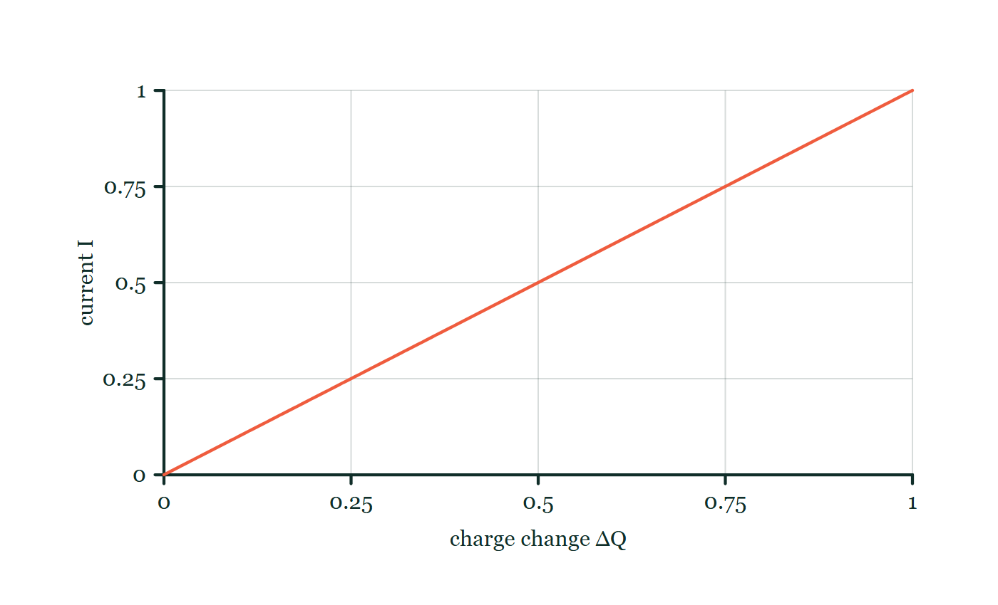
ELECTRIC CHARGES · ELECTROSTATICS APPLICATIONS & SAFETY
GIOPHYSICS LESSON
FORMULA 3 OF 3
Discharge current
Build the model — The formulae, one at a time, in plain English
I = ΔQ/Δt
A short discharge time can produce a large pulse
IN PLAIN ENGLISH
Current is charge flowing per second; dumping charge quickly means a large, possibly dangerous, current.
Current–charge explorer
Move this graph on the live version — click here
Electric Charges — Electrostatics Applications & Safety. Built by GioPhysics from the lesson's own copy; nothing on these slides is re-authored.
12 / 30
Notes:
[Phase] Build the model: The formulae, one at a time, in plain English (minutes 13–22 of 45)
[Formula] Discharge current: I = ΔQ/Δt
[In plain English] Current is charge flowing per second; dumping charge quickly means a large, possibly dangerous, current.
[Note] A short discharge time can produce a large pulse
[Graph] Current–charge explorer. Over a fixed time interval Δt, current is directly proportional to the charge transferred.
[Axes] Horizontal: charge change ΔQ. Vertical: current I. Values are normalised — the graph teaches the shape, not a measurement.

Slide 13
ELECTRIC CHARGES · ELECTROSTATICS APPLICATIONS & SAFETY
GIOPHYSICS LESSON
WATCH OUT
The common trap
Check and misconception — The quick check and the trap
A lightning rod does not make outdoor exposure safe or simply ‘attract lightning.’ A complete engineered system provides a preferred conducting route to Earth and manages dangerous fields and currents.
Electric Charges — Electrostatics Applications & Safety. Built by GioPhysics from the lesson's own copy; nothing on these slides is re-authored.
13 / 30
Notes:
[Phase] Check and misconception: The quick check and the trap (minutes 35–41 of 45)
[Misconception] A lightning rod does not make outdoor exposure safe or simply ‘attract lightning.’ A complete engineered system provides a preferred conducting route to Earth and manages dangerous fields and currents.

Slide 14
ELECTRIC CHARGES · ELECTROSTATICS APPLICATIONS & SAFETY
GIOPHYSICS LESSON
WORKED EXAMPLE 1 OF 2 · EASY
The question
Easy
Worked examples — I do, we do — one step revealed at a time
Why are fuel tankers fitted with an earthing strap or bonding wire during filling?
Electric Charges — Electrostatics Applications & Safety. Built by GioPhysics from the lesson's own copy; nothing on these slides is re-authored.
14 / 30
Notes:
[Phase] Worked examples: I do, we do — one step revealed at a time (minutes 22–35 of 45)
[Question] Why are fuel tankers fitted with an earthing strap or bonding wire during filling?
[Answer] To bleed off friction charge and prevent ignition sparks

Slide 15
ELECTRIC CHARGES · ELECTROSTATICS APPLICATIONS & SAFETY
GIOPHYSICS LESSON
WORKED EXAMPLE 1 OF 2 · EASY · THE WORKING
How to solve it
Easy
Worked examples — I do, we do — one step revealed at a time
Why are fuel tankers fitted with an earthing strap or bonding wire during filling?
1.
Flowing fuel charges surfaces by friction.
2.
The strap conducts the charge safely to Earth before a spark can ignite vapour.
Electric Charges — Electrostatics Applications & Safety. Built by GioPhysics from the lesson's own copy; nothing on these slides is re-authored.
15 / 30
Notes:
[Phase] Worked examples: I do, we do — one step revealed at a time (minutes 22–35 of 45)
[Reveal] One click per step. The class works each line before the next appears.
[Step 1] Flowing fuel charges surfaces by friction.
[Step 2] The strap conducts the charge safely to Earth before a spark can ignite vapour.

Slide 16
ELECTRIC CHARGES · ELECTROSTATICS APPLICATIONS & SAFETY
GIOPHYSICS LESSON
WORKED EXAMPLE 1 OF 2 · EASY
Answer
Easy
Worked examples — I do, we do — one step revealed at a time
To bleed off friction charge and prevent ignition sparks
Electric Charges — Electrostatics Applications & Safety. Built by GioPhysics from the lesson's own copy; nothing on these slides is re-authored.
16 / 30
Notes:
[Phase] Worked examples: I do, we do — one step revealed at a time (minutes 22–35 of 45)
[Answer] To bleed off friction charge and prevent ignition sparks

Slide 17
ELECTRIC CHARGES · ELECTROSTATICS APPLICATIONS & SAFETY
GIOPHYSICS LESSON
WORKED EXAMPLE 2 OF 2 · MEDIUM
The question
Medium
Worked examples — I do, we do — one step revealed at a time
A capacitor of 220 pF reaches 12 kV. Estimate the stored electrostatic energy.
Electric Charges — Electrostatics Applications & Safety. Built by GioPhysics from the lesson's own copy; nothing on these slides is re-authored.
17 / 30
Notes:
[Phase] Worked examples: I do, we do — one step revealed at a time (minutes 22–35 of 45)
[Question] A capacitor of 220 pF reaches 12 kV. Estimate the stored electrostatic energy.
[Answer] U ≈ 1.58 × 10⁻² J = 15.8 mJ

Slide 18
ELECTRIC CHARGES · ELECTROSTATICS APPLICATIONS & SAFETY
GIOPHYSICS LESSON
WORKED EXAMPLE 2 OF 2 · MEDIUM · THE WORKING
How to solve it
Medium
Worked examples — I do, we do — one step revealed at a time
A capacitor of 220 pF reaches 12 kV. Estimate the stored electrostatic energy.
1.
Convert: C = 220 × 10⁻¹² F and V = 12 × 10³ V.
2.
Use U = ½CV².
3.
U = 0.5(220 × 10⁻¹²)(12 × 10³)².
Electric Charges — Electrostatics Applications & Safety. Built by GioPhysics from the lesson's own copy; nothing on these slides is re-authored.
18 / 30
Notes:
[Phase] Worked examples: I do, we do — one step revealed at a time (minutes 22–35 of 45)
[Reveal] One click per step. The class works each line before the next appears.
[Step 1] Convert: C = 220 × 10⁻¹² F and V = 12 × 10³ V.
[Step 2] Use U = ½CV².
[Step 3] U = 0.5(220 × 10⁻¹²)(12 × 10³)².

Slide 19
ELECTRIC CHARGES · ELECTROSTATICS APPLICATIONS & SAFETY
GIOPHYSICS LESSON
WORKED EXAMPLE 2 OF 2 · MEDIUM
Answer
Medium
Worked examples — I do, we do — one step revealed at a time
U ≈ 1.58 × 10⁻² J = 15.8 mJ
Electric Charges — Electrostatics Applications & Safety. Built by GioPhysics from the lesson's own copy; nothing on these slides is re-authored.
19 / 30
Notes:
[Phase] Worked examples: I do, we do — one step revealed at a time (minutes 22–35 of 45)
[Answer] U ≈ 1.58 × 10⁻² J = 15.8 mJ

Slide 20
ELECTRIC CHARGES · ELECTROSTATICS APPLICATIONS & SAFETY
GIOPHYSICS LESSON
PREDICT · TAKE THE VOTE
Commit before you are told
Hands up for each option, then click
What does a lightning rod on a building actually do?
A It attracts strikes that would otherwise have missed the building
B It repels lightning, keeping the building clear
C It gives a strike that was going to happen anyway a chosen path to earth
A car stands on the road with a lightning stroke striking its roof; induced charge is marked all round the outside of the bodywork, arrows carry the current down the outer shell towards the ground, and the passenger space inside is labelled E = 0.
The live version of this figure — click here
Electric Charges — Electrostatics Applications & Safety. Built by GioPhysics from the lesson's own copy; nothing on these slides is re-authored.
20 / 30
Notes:
[Phase] Build the model: The formulae, one at a time, in plain English (minutes 13–22 of 45)
[Predict] What does a lightning rod on a building actually do?
[Options] A It attracts strikes that would otherwise have missed the building B It repels lightning, keeping the building clear C It gives a strike that was going to happen anyway a chosen path to earth
[Figure] A car stands on the road with a lightning stroke striking its roof; induced charge is marked all round the outside of the bodywork, arrows carry the current down the outer shell towards the ground, and the passenger space inside is labelled E = 0.

Slide 21
ELECTRIC CHARGES · ELECTROSTATICS APPLICATIONS & SAFETY
GIOPHYSICS LESSON
PREDICT · THE OUTCOME
What actually happens
Ask the room who changed their mind, and why
C It gives a strike that was going to happen anyway a chosen path to earth
WHY
The point does matter — charge crowds where the curvature is sharp, so the field there is large and the air ionises early, making attachment at the rod likelier than at the chimney. But what the system is worth lies in the thick conductor and the earth electrode behind that point. A rod with no route to earth is worse than no rod at all, and no rod on any building makes the ground around it a safe place to stand.
Electric Charges — Electrostatics Applications & Safety. Built by GioPhysics from the lesson's own copy; nothing on these slides is re-authored.
21 / 30
Notes:
[Phase] Build the model: The formulae, one at a time, in plain English (minutes 13–22 of 45)
[Answer] C — It gives a strike that was going to happen anyway a chosen path to earth. The point does matter — charge crowds where the curvature is sharp, so the field there is large and the air ionises early, making attachment at the rod likelier than at the chimney. But what the system is worth lies in the thick conductor and the earth electrode behind that point. A rod with no route to earth is worse than no rod at all, and no rod on any building makes the ground around it a safe place to stand.

Slide 22
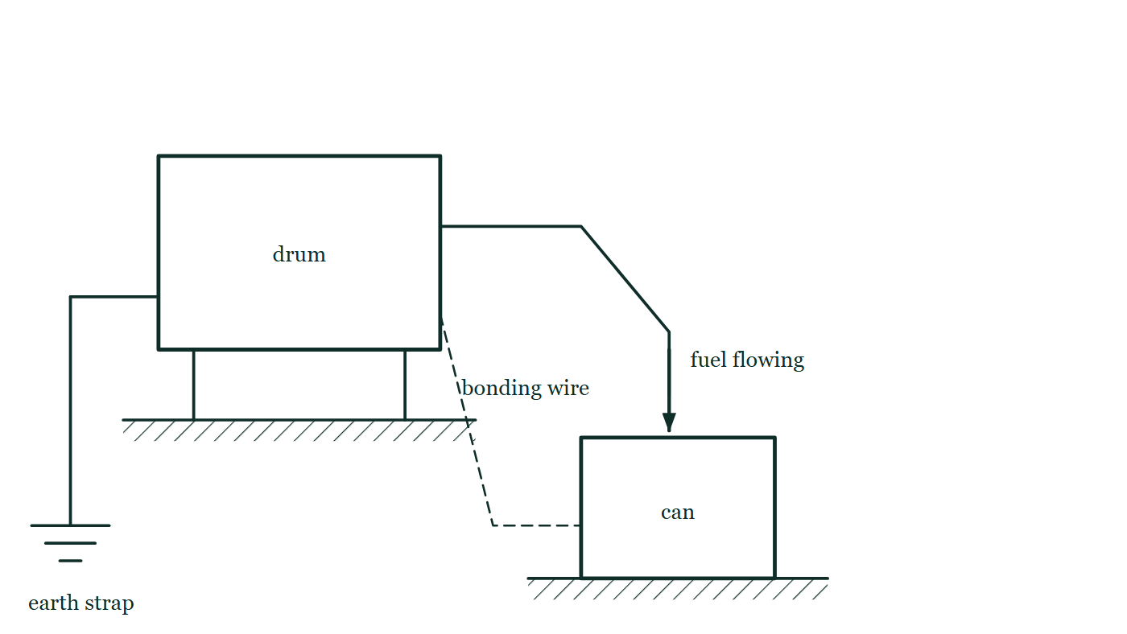
ELECTRIC CHARGES · ELECTROSTATICS APPLICATIONS & SAFETY
GIOPHYSICS LESSON
QUICK CHECK
Decide before the answer goes up
Check and misconception — The quick check and the trap
Why are two conductive containers bonded during flammable-liquid transfer?
A
To make both positively charged
B
To reduce potential difference between them
C
To increase friction
Fuel runs from a raised drum into a metal can below it, with a bonding wire clipped between the two containers and a separate earth strap running from the drum down to a ground spike.
The live version of this figure — click here
Electric Charges — Electrostatics Applications & Safety. Built by GioPhysics from the lesson's own copy; nothing on these slides is re-authored.
22 / 30
Notes:
[Phase] Check and misconception: The quick check and the trap (minutes 35–41 of 45)
[Question] Why are two conductive containers bonded during flammable-liquid transfer?
[Figure] Fuel runs from a raised drum into a metal can below it, with a bonding wire clipped between the two containers and a separate earth strap running from the drum down to a ground spike.
[Options] A To make both positively charged B To reduce potential difference between them C To increase friction

Slide 23
ELECTRIC CHARGES · ELECTROSTATICS APPLICATIONS & SAFETY
GIOPHYSICS LESSON
QUICK CHECK · THE ANSWER
The answer, and why
Check and misconception — The quick check and the trap
B To reduce potential difference between them
HOW TO GET THERE
Bonding lets charge redistribute so a spark-producing potential difference is less likely to grow between the containers.
WHY THE OTHERS TEMPT
A Charging both containers up is the opposite of what a bond is for. It is a tempting reading, because bonding does move charge — but it moves it so as to level the two, not to raise either.
B Correct. Joined together, the two bodies redistribute charge until their potentials are close, and a spark needs a potential difference to jump.
C Friction is the problem here, not the cure: fuel rushing past a hose wall is what separates the charge in the first place. A bond does nothing to the flow — it removes the voltage the flow builds up.
Electric Charges — Electrostatics Applications & Safety. Built by GioPhysics from the lesson's own copy; nothing on these slides is re-authored.
23 / 30
Notes:
[Phase] Check and misconception: The quick check and the trap (minutes 35–41 of 45)
[Question] Why are two conductive containers bonded during flammable-liquid transfer?
[Option by option] A: Charging both containers up is the opposite of what a bond is for. It is a tempting reading, because bonding does move charge — but it moves it so as to level the two, not to raise either. B: Correct. Joined together, the two bodies redistribute charge until their potentials are close, and a spark needs a potential difference to jump. C: Friction is the problem here, not the cure: fuel rushing past a hose wall is what separates the charge in the first place. A bond does nothing to the flow — it removes the voltage the flow builds up.
[Answer] B — To reduce potential difference between them
[Why] Bonding lets charge redistribute so a spark-producing potential difference is less likely to grow between the containers.
[Reveal] One click for the answer, then one for the reason.

Slide 24
ELECTRIC CHARGES · ELECTROSTATICS APPLICATIONS & SAFETY
GIOPHYSICS LESSON
EXTENSION 1 OF 2 · HARD
The question
Hard
Worked examples — I do, we do — one step revealed at a time
A photocopier drum region carries σ = 2.0 × 10⁻⁵ C/m² over 0.030 m². Find the charge and the number of elementary charges deposited.
Electric Charges — Electrostatics Applications & Safety. Built by GioPhysics from the lesson's own copy; nothing on these slides is re-authored.
24 / 30
Notes:
[Phase] Worked examples: I do, we do — one step revealed at a time (minutes 22–35 of 45)
[Question] A photocopier drum region carries σ = 2.0 × 10⁻⁵ C/m² over 0.030 m². Find the charge and the number of elementary charges deposited.
[Answer] 0.60 μC ≈ 3.8 × 10¹² charges

Slide 25
ELECTRIC CHARGES · ELECTROSTATICS APPLICATIONS & SAFETY
GIOPHYSICS LESSON
EXTENSION 1 OF 2 · HARD · THE WORKING
How to solve it
Hard
Worked examples — I do, we do — one step revealed at a time
A photocopier drum region carries σ = 2.0 × 10⁻⁵ C/m² over 0.030 m². Find the charge and the number of elementary charges deposited.
1.
Q = σA = 2.0 × 10⁻⁵ × 0.030 = 6.0 × 10⁻⁷ C.
2.
n = Q/e = 6.0 × 10⁻⁷ ÷ 1.6 × 10⁻¹⁹.
3.
n ≈ 3.8 × 10¹².
Electric Charges — Electrostatics Applications & Safety. Built by GioPhysics from the lesson's own copy; nothing on these slides is re-authored.
25 / 30
Notes:
[Phase] Worked examples: I do, we do — one step revealed at a time (minutes 22–35 of 45)
[Reveal] One click per step. The class works each line before the next appears.
[Step 1] Q = σA = 2.0 × 10⁻⁵ × 0.030 = 6.0 × 10⁻⁷ C.
[Step 2] n = Q/e = 6.0 × 10⁻⁷ ÷ 1.6 × 10⁻¹⁹.
[Step 3] n ≈ 3.8 × 10¹².

Slide 26
ELECTRIC CHARGES · ELECTROSTATICS APPLICATIONS & SAFETY
GIOPHYSICS LESSON
EXTENSION 1 OF 2 · HARD
Answer
Hard
Worked examples — I do, we do — one step revealed at a time
0.60 μC ≈ 3.8 × 10¹² charges
Electric Charges — Electrostatics Applications & Safety. Built by GioPhysics from the lesson's own copy; nothing on these slides is re-authored.
26 / 30
Notes:
[Phase] Worked examples: I do, we do — one step revealed at a time (minutes 22–35 of 45)
[Answer] 0.60 μC ≈ 3.8 × 10¹² charges

Slide 27
ELECTRIC CHARGES · ELECTROSTATICS APPLICATIONS & SAFETY
GIOPHYSICS LESSON
EXTENSION 2 OF 2 · CHALLENGING
The question
Challenging
Worked examples — I do, we do — one step revealed at a time
A defibrillator capacitor (C = 32 μF) charges to 5.0 kV. Find the stored energy, and the average power if it discharges in 4.0 ms.
Electric Charges — Electrostatics Applications & Safety. Built by GioPhysics from the lesson's own copy; nothing on these slides is re-authored.
27 / 30
Notes:
[Phase] Worked examples: I do, we do — one step revealed at a time (minutes 22–35 of 45)
[Question] A defibrillator capacitor (C = 32 μF) charges to 5.0 kV. Find the stored energy, and the average power if it discharges in 4.0 ms.
[Answer] 400 J at ≈ 100 kW

Slide 28
ELECTRIC CHARGES · ELECTROSTATICS APPLICATIONS & SAFETY
GIOPHYSICS LESSON
EXTENSION 2 OF 2 · CHALLENGING · THE WORKING
How to solve it
Challenging
Worked examples — I do, we do — one step revealed at a time
A defibrillator capacitor (C = 32 μF) charges to 5.0 kV. Find the stored energy, and the average power if it discharges in 4.0 ms.
1.
U = ½CV² = ½ × 32 × 10⁻⁶ × 25 × 10⁶ = 400 J.
2.
P(avg) = U/t = 400 ÷ 0.004.
3.
P ≈ 100 kW — briefly the power of a small car engine.
Electric Charges — Electrostatics Applications & Safety. Built by GioPhysics from the lesson's own copy; nothing on these slides is re-authored.
28 / 30
Notes:
[Phase] Worked examples: I do, we do — one step revealed at a time (minutes 22–35 of 45)
[Reveal] One click per step. The class works each line before the next appears.
[Step 1] U = ½CV² = ½ × 32 × 10⁻⁶ × 25 × 10⁶ = 400 J.
[Step 2] P(avg) = U/t = 400 ÷ 0.004.
[Step 3] P ≈ 100 kW — briefly the power of a small car engine.

Slide 29
ELECTRIC CHARGES · ELECTROSTATICS APPLICATIONS & SAFETY
GIOPHYSICS LESSON
EXTENSION 2 OF 2 · CHALLENGING
Answer
Challenging
Worked examples — I do, we do — one step revealed at a time
400 J at ≈ 100 kW
Electric Charges — Electrostatics Applications & Safety. Built by GioPhysics from the lesson's own copy; nothing on these slides is re-authored.
29 / 30
Notes:
[Phase] Worked examples: I do, we do — one step revealed at a time (minutes 22–35 of 45)
[Answer] 400 J at ≈ 100 kW

Slide 30
ELECTRIC CHARGES · ELECTROSTATICS APPLICATIONS & SAFETY
GIOPHYSICS LESSON
ELECTRIC CHARGES
Where to go next
Plenary — What to take away, what to practise next
Next
10.7 Electrostatics Calculus
https://giophysics.com/chapter-19/electrostatics-calculus/
Lesson
This lesson on giophysics.com
https://giophysics.com/chapter-19/electrostatics-applications-safety/
Live
The live, interactive version of these slides
https://giophysics.com/chapter-19/presentation/?lesson=applications
Chapter
All Electric Charges lessons
https://giophysics.com/chapter-19/
PDF
Download the lesson PDF
https://giophysics.com/downloads/19-6-electrostatics-applications-safety.pdf
Electric Charges — Electrostatics Applications & Safety. Built by GioPhysics from the lesson's own copy; nothing on these slides is re-authored.
30 / 30
Notes:
[Phase] Plenary: What to take away, what to practise next (minutes 41–45 of 45)
[Interactive] The graphs and the circuit topology on these slides are frozen. The live version at https://giophysics.com/chapter-19/presentation/?lesson=applications moves them.

