Slide 1
ELECTRIC CHARGES · CHARGE, CONSERVATION & QUANTISATION
GIOPHYSICS LESSON
10 · Electric Charges
Count charge carriers before calculating coulombs
Charge, Conservation & Quantisation
Electric charge comes in positive and negative forms. Ordinary charging moves electrons; it does not manufacture charge or move protons between solid objects.
POSITION
Lesson 1 of 7 in Electric Charges
PLAN
15 slides in the 45-minute core run, about 43 minutes of it
LESSON PAGE
https://giophysics.com/chapter-19/charge-conservation-quantisation/
Built by GioPhysics from the lesson's own page. Every word on these slides is the lesson's; nothing here is re-authored. Teaching material, not an awarding body's document.
Electric Charges — Charge, Conservation & Quantisation. Built by GioPhysics from the lesson's own copy; nothing on these slides is re-authored.
1 / 30
Notes:
[Lesson] Electric Charges — Charge, Conservation & Quantisation. Lesson 1 of 7.
[Intro] Electric charge comes in positive and negative forms. Ordinary charging moves electrons; it does not manufacture charge or move protons between solid objects.
[Source] https://giophysics.com/chapter-19/charge-conservation-quantisation/
[Disclaimer] Built by GioPhysics from the lesson's own page. Every word on these slides is the lesson's; nothing here is re-authored. Teaching material, not an awarding body's document.

Slide 2
ELECTRIC CHARGES · CHARGE, CONSERVATION & QUANTISATION
GIOPHYSICS LESSON
WHAT THIS NEEDS
What you already know
Starter — Recall what this lesson stands on
Recall
SI units & prefixes
https://giophysics.com/chapter-1/units/
Recall
Scalars & vectors
https://giophysics.com/chapter-1/scalar-vector/
Electric Charges — Charge, Conservation & Quantisation. Built by GioPhysics from the lesson's own copy; nothing on these slides is re-authored.
2 / 30
Notes:
[Phase] Starter: Recall what this lesson stands on (minutes 0–5 of 45)
[Starter] Recall: SI units & prefixes; Scalars & vectors

Slide 3
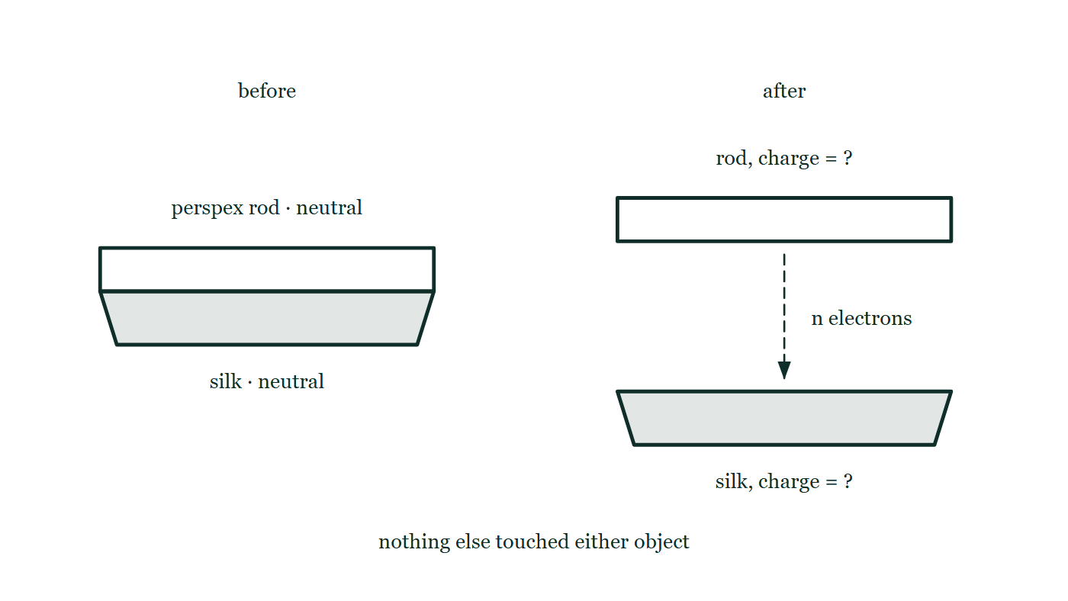
ELECTRIC CHARGES · CHARGE, CONSERVATION & QUANTISATION
GIOPHYSICS LESSON
THINK FIRST
A perspex rod rubbed with silk comes away positively charged. Where did the positive charge come from?
Take answers before you click — the point is the commitment
Neither the rod nor the silk was charged before they touched, and nothing was added to either of them.
THE ANSWER
Nowhere — nothing positive moved at all. Electrons left the rod for the silk, and the protons in the rod's nuclei never budged; they are bound into the solid and no amount of rubbing shifts one. In a solid, "positively charged" always means the same thing: short of electrons. The silk, which now has them, is equally negative.
A perspex rod and a silk cloth are drawn twice: pressed together and both marked neutral, then separated with a dashed arrow of electrons running from the rod to the cloth and the net charge on each left as a question mark.
The live version of this figure — click here
Electric Charges — Charge, Conservation & Quantisation. Built by GioPhysics from the lesson's own copy; nothing on these slides is re-authored.
3 / 30
Notes:
[Phase] Starter: Recall what this lesson stands on (minutes 0–5 of 45)
[Hook] A perspex rod rubbed with silk comes away positively charged. Where did the positive charge come from? Neither the rod nor the silk was charged before they touched, and nothing was added to either of them.
[Answer] Nowhere — nothing positive moved at all. Electrons left the rod for the silk, and the protons in the rod's nuclei never budged; they are bound into the solid and no amount of rubbing shifts one. In a solid, "positively charged" always means the same thing: short of electrons. The silk, which now has them, is equally negative.
[Figure] A perspex rod and a silk cloth are drawn twice: pressed together and both marked neutral, then separated with a dashed arrow of electrons running from the rod to the cloth and the net charge on each left as a question mark.

Slide 4
ELECTRIC CHARGES · CHARGE, CONSERVATION & QUANTISATION
GIOPHYSICS LESSON
EXPLAINED SIMPLY
In one sentence
Introduce the idea — The big idea and the definition
Electric charge is a conserved property of matter that can be positive or negative and occurs in whole-number multiples of the elementary charge.
Electric Charges — Charge, Conservation & Quantisation. Built by GioPhysics from the lesson's own copy; nothing on these slides is re-authored.
4 / 30
Notes:
[Phase] Introduce the idea: The big idea and the definition (minutes 5–13 of 45)
[Definition] Electric charge is a conserved property of matter that can be positive or negative and occurs in whole-number multiples of the elementary charge.

Slide 5
ELECTRIC CHARGES · CHARGE, CONSERVATION & QUANTISATION
GIOPHYSICS LESSON
EXPLAINED SIMPLY
What that looks like
Introduce the idea — The big idea and the definition
FOR EXAMPLE
When a balloon gains electrons from hair, the balloon becomes negative and the hair becomes equally positive overall.
Electric Charges — Charge, Conservation & Quantisation. Built by GioPhysics from the lesson's own copy; nothing on these slides is re-authored.
5 / 30
Notes:
[Phase] Introduce the idea: The big idea and the definition (minutes 5–13 of 45)
[Worked illustration] When a balloon gains electrons from hair, the balloon becomes negative and the hair becomes equally positive overall.

Slide 6
ELECTRIC CHARGES · CHARGE, CONSERVATION & QUANTISATION
GIOPHYSICS LESSON
THE BIG IDEA
Count charge carriers before calculating coulombs
Introduce the idea — The big idea and the definition
An object is neutral when its total positive and negative charges balance—not when it contains no charge. Losing electrons leaves a positive net charge; gaining electrons leaves a negative net charge. In an isolated system, every transferred electron changes two objects by equal and opposite amounts.
Electric Charges — Charge, Conservation & Quantisation. Built by GioPhysics from the lesson's own copy; nothing on these slides is re-authored.
6 / 30
Notes:
[Phase] Introduce the idea: The big idea and the definition (minutes 5–13 of 45)
[Big idea] An object is neutral when its total positive and negative charges balance—not when it contains no charge. Losing electrons leaves a positive net charge; gaining electrons leaves a negative net charge. In an isolated system, every transferred electron changes two objects by equal and opposite amounts.

Slide 7
ELECTRIC CHARGES · CHARGE, CONSERVATION & QUANTISATION
GIOPHYSICS LESSON
THE PHYSICS · 1 OF 3
Name the imbalance
Build the model — The formulae, one at a time, in plain English
Count missing or excess electrons relative to the neutral state. Missing electrons give +ne; excess electrons give −ne.
Electric Charges — Charge, Conservation & Quantisation. Built by GioPhysics from the lesson's own copy; nothing on these slides is re-authored.
7 / 30
Notes:
[Phase] Build the model: The formulae, one at a time, in plain English (minutes 13–22 of 45)
[Section] Count missing or excess electrons relative to the neutral state. Missing electrons give +ne; excess electrons give −ne.

Slide 8
ELECTRIC CHARGES · CHARGE, CONSERVATION & QUANTISATION
GIOPHYSICS LESSON
THE PHYSICS · 2 OF 3
Keep a charge ledger
Build the model — The formulae, one at a time, in plain English
If n electrons leave object A and arrive at object B, ΔQA = +ne and ΔQB = −ne, so the combined change is zero.
Electric Charges — Charge, Conservation & Quantisation. Built by GioPhysics from the lesson's own copy; nothing on these slides is re-authored.
8 / 30
Notes:
[Phase] Build the model: The formulae, one at a time, in plain English (minutes 13–22 of 45)
[Section] If n electrons leave object A and arrive at object B, ΔQA = +ne and ΔQB = −ne, so the combined change is zero.

Slide 9
ELECTRIC CHARGES · CHARGE, CONSERVATION & QUANTISATION
GIOPHYSICS LESSON
THE PHYSICS · 3 OF 3
Use a modern atom model
Build the model — The formulae, one at a time, in plain English
Electrons occupy quantum states described by probability clouds. They are not tiny planets following fixed circular paths around a nucleus.
Electric Charges — Charge, Conservation & Quantisation. Built by GioPhysics from the lesson's own copy; nothing on these slides is re-authored.
9 / 30
Notes:
[Phase] Build the model: The formulae, one at a time, in plain English (minutes 13–22 of 45)
[Section] Electrons occupy quantum states described by probability clouds. They are not tiny planets following fixed circular paths around a nucleus.

Slide 10
ELECTRIC CHARGES · CHARGE, CONSERVATION & QUANTISATION
GIOPHYSICS LESSON
FORMULA 1 OF 3
Quantised charge
Build the model — The formulae, one at a time, in plain English
Q = ne
n is an integer and e = 1.602 × 10⁻¹⁹ C is a positive magnitude
IN PLAIN ENGLISH
Charge comes in fixed packets: any charge is a whole number of elementary charges e — never a fraction.
Electric Charges — Charge, Conservation & Quantisation. Built by GioPhysics from the lesson's own copy; nothing on these slides is re-authored.
10 / 30
Notes:
[Phase] Build the model: The formulae, one at a time, in plain English (minutes 13–22 of 45)
[Formula] Quantised charge: Q = ne
[In plain English] Charge comes in fixed packets: any charge is a whole number of elementary charges e — never a fraction.
[Note] n is an integer and e = 1.602 × 10⁻¹⁹ C is a positive magnitude

Slide 11
ELECTRIC CHARGES · CHARGE, CONSERVATION & QUANTISATION
GIOPHYSICS LESSON
FORMULA 2 OF 3
Electron charge
Build the model — The formulae, one at a time, in plain English
qₑ = −e
An electron contributes one negative elementary charge
IN PLAIN ENGLISH
Each electron carries exactly one negative packet of charge.
Electric Charges — Charge, Conservation & Quantisation. Built by GioPhysics from the lesson's own copy; nothing on these slides is re-authored.
11 / 30
Notes:
[Phase] Build the model: The formulae, one at a time, in plain English (minutes 13–22 of 45)
[Formula] Electron charge: qₑ = −e
[In plain English] Each electron carries exactly one negative packet of charge.
[Note] An electron contributes one negative elementary charge

Slide 12
ELECTRIC CHARGES · CHARGE, CONSERVATION & QUANTISATION
GIOPHYSICS LESSON
FORMULA 3 OF 3
Conservation
Build the model — The formulae, one at a time, in plain English
ΣQbefore = ΣQafter
For an isolated system, net charge stays constant
IN PLAIN ENGLISH
Charge is never created or destroyed, only moved — the totals before and after any process match.
Electric Charges — Charge, Conservation & Quantisation. Built by GioPhysics from the lesson's own copy; nothing on these slides is re-authored.
12 / 30
Notes:
[Phase] Build the model: The formulae, one at a time, in plain English (minutes 13–22 of 45)
[Formula] Conservation: ΣQbefore = ΣQafter
[In plain English] Charge is never created or destroyed, only moved — the totals before and after any process match.
[Note] For an isolated system, net charge stays constant

Slide 13
ELECTRIC CHARGES · CHARGE, CONSERVATION & QUANTISATION
GIOPHYSICS LESSON
WATCH OUT
The common trap
Check and misconception — The quick check and the trap
A positively charged object has not usually gained protons. In solid charging experiments its nuclei remain bound; the object has lost some electrons.
Electric Charges — Charge, Conservation & Quantisation. Built by GioPhysics from the lesson's own copy; nothing on these slides is re-authored.
13 / 30
Notes:
[Phase] Check and misconception: The quick check and the trap (minutes 35–41 of 45)
[Misconception] A positively charged object has not usually gained protons. In solid charging experiments its nuclei remain bound; the object has lost some electrons.

Slide 14
ELECTRIC CHARGES · CHARGE, CONSERVATION & QUANTISATION
GIOPHYSICS LESSON
WORKED EXAMPLE 1 OF 2 · EASY
The question
Easy
Worked examples — I do, we do — one step revealed at a time
How many elementary charges make up −4.8 × 10⁻¹⁹ C?
Electric Charges — Charge, Conservation & Quantisation. Built by GioPhysics from the lesson's own copy; nothing on these slides is re-authored.
14 / 30
Notes:
[Phase] Worked examples: I do, we do — one step revealed at a time (minutes 22–35 of 45)
[Question] How many elementary charges make up −4.8 × 10⁻¹⁹ C?
[Answer] 3 electrons

Slide 15
ELECTRIC CHARGES · CHARGE, CONSERVATION & QUANTISATION
GIOPHYSICS LESSON
WORKED EXAMPLE 1 OF 2 · EASY · THE WORKING
How to solve it
Easy
Worked examples — I do, we do — one step revealed at a time
How many elementary charges make up −4.8 × 10⁻¹⁹ C?
1.
n = Q/e = 4.8 × 10⁻¹⁹ ÷ 1.6 × 10⁻¹⁹.
2.
n = 3 — three excess electrons.
Electric Charges — Charge, Conservation & Quantisation. Built by GioPhysics from the lesson's own copy; nothing on these slides is re-authored.
15 / 30
Notes:
[Phase] Worked examples: I do, we do — one step revealed at a time (minutes 22–35 of 45)
[Reveal] One click per step. The class works each line before the next appears.
[Step 1] n = Q/e = 4.8 × 10⁻¹⁹ ÷ 1.6 × 10⁻¹⁹.
[Step 2] n = 3 — three excess electrons.

Slide 16
ELECTRIC CHARGES · CHARGE, CONSERVATION & QUANTISATION
GIOPHYSICS LESSON
WORKED EXAMPLE 1 OF 2 · EASY
Answer
Easy
Worked examples — I do, we do — one step revealed at a time
3 electrons
Electric Charges — Charge, Conservation & Quantisation. Built by GioPhysics from the lesson's own copy; nothing on these slides is re-authored.
16 / 30
Notes:
[Phase] Worked examples: I do, we do — one step revealed at a time (minutes 22–35 of 45)
[Answer] 3 electrons

Slide 17
ELECTRIC CHARGES · CHARGE, CONSERVATION & QUANTISATION
GIOPHYSICS LESSON
WORKED EXAMPLE 2 OF 2 · MEDIUM
The question
Medium
Worked examples — I do, we do — one step revealed at a time
A small sphere loses 2.5 × 10¹³ electrons. Find its final charge if it was initially neutral.
Electric Charges — Charge, Conservation & Quantisation. Built by GioPhysics from the lesson's own copy; nothing on these slides is re-authored.
17 / 30
Notes:
[Phase] Worked examples: I do, we do — one step revealed at a time (minutes 22–35 of 45)
[Question] A small sphere loses 2.5 × 10¹³ electrons. Find its final charge if it was initially neutral.
[Answer] Q = +4.0 × 10⁻⁶ C = +4.0 μC

Slide 18
ELECTRIC CHARGES · CHARGE, CONSERVATION & QUANTISATION
GIOPHYSICS LESSON
WORKED EXAMPLE 2 OF 2 · MEDIUM · THE WORKING
How to solve it
Medium
Worked examples — I do, we do — one step revealed at a time
A small sphere loses 2.5 × 10¹³ electrons. Find its final charge if it was initially neutral.
1.
Losing electrons leaves a positive charge, so decide the sign before multiplying.
2.
Q = ne = (2.5 × 10¹³)(1.602 × 10⁻¹⁹ C).
3.
Round to the precision of the electron count and keep the positive sign.
Electric Charges — Charge, Conservation & Quantisation. Built by GioPhysics from the lesson's own copy; nothing on these slides is re-authored.
18 / 30
Notes:
[Phase] Worked examples: I do, we do — one step revealed at a time (minutes 22–35 of 45)
[Reveal] One click per step. The class works each line before the next appears.
[Step 1] Losing electrons leaves a positive charge, so decide the sign before multiplying.
[Step 2] Q = ne = (2.5 × 10¹³)(1.602 × 10⁻¹⁹ C).
[Step 3] Round to the precision of the electron count and keep the positive sign.

Slide 19
ELECTRIC CHARGES · CHARGE, CONSERVATION & QUANTISATION
GIOPHYSICS LESSON
WORKED EXAMPLE 2 OF 2 · MEDIUM
Answer
Medium
Worked examples — I do, we do — one step revealed at a time
Q = +4.0 × 10⁻⁶ C = +4.0 μC
Electric Charges — Charge, Conservation & Quantisation. Built by GioPhysics from the lesson's own copy; nothing on these slides is re-authored.
19 / 30
Notes:
[Phase] Worked examples: I do, we do — one step revealed at a time (minutes 22–35 of 45)
[Answer] Q = +4.0 × 10⁻⁶ C = +4.0 μC

Slide 20
ELECTRIC CHARGES · CHARGE, CONSERVATION & QUANTISATION
GIOPHYSICS LESSON
PREDICT · TAKE THE VOTE
Commit before you are told
Hands up for each option, then click
After the rubbing, the rod is left carrying +2.0 nC. What is on the cloth?
A −2.0 nC
B 0 — the friction created the charge on the rod
C +2.0 nC — both were rubbed, so both charge the same way
A perspex rod and a silk cloth are drawn twice: pressed together and both marked neutral, then separated with a dashed arrow of electrons running from the rod to the cloth and the net charge on each left as a question mark.
The live version of this figure — click here
Electric Charges — Charge, Conservation & Quantisation. Built by GioPhysics from the lesson's own copy; nothing on these slides is re-authored.
20 / 30
Notes:
[Phase] Build the model: The formulae, one at a time, in plain English (minutes 13–22 of 45)
[Predict] After the rubbing, the rod is left carrying +2.0 nC. What is on the cloth?
[Options] A −2.0 nC B 0 — the friction created the charge on the rod C +2.0 nC — both were rubbed, so both charge the same way
[Figure] A perspex rod and a silk cloth are drawn twice: pressed together and both marked neutral, then separated with a dashed arrow of electrons running from the rod to the cloth and the net charge on each left as a question mark.

Slide 21
ELECTRIC CHARGES · CHARGE, CONSERVATION & QUANTISATION
GIOPHYSICS LESSON
PREDICT · THE OUTCOME
What actually happens
Ask the room who changed their mind, and why
A −2.0 nC
WHY
Rubbing does not make charge, it moves charge, and this pair was isolated from everything else. Every electron the rod lost is now sitting on the cloth, so the cloth's surplus matches the rod's shortfall exactly: ΣQ before = ΣQ after = 0, which puts the cloth at −2.0 nC. A transfer always has two ends, and this is what makes charging a thing you can check rather than a thing you assert.
Electric Charges — Charge, Conservation & Quantisation. Built by GioPhysics from the lesson's own copy; nothing on these slides is re-authored.
21 / 30
Notes:
[Phase] Build the model: The formulae, one at a time, in plain English (minutes 13–22 of 45)
[Answer] A — −2.0 nC. Rubbing does not make charge, it moves charge, and this pair was isolated from everything else. Every electron the rod lost is now sitting on the cloth, so the cloth's surplus matches the rod's shortfall exactly: ΣQ before = ΣQ after = 0, which puts the cloth at −2.0 nC. A transfer always has two ends, and this is what makes charging a thing you can check rather than a thing you assert.

Slide 22
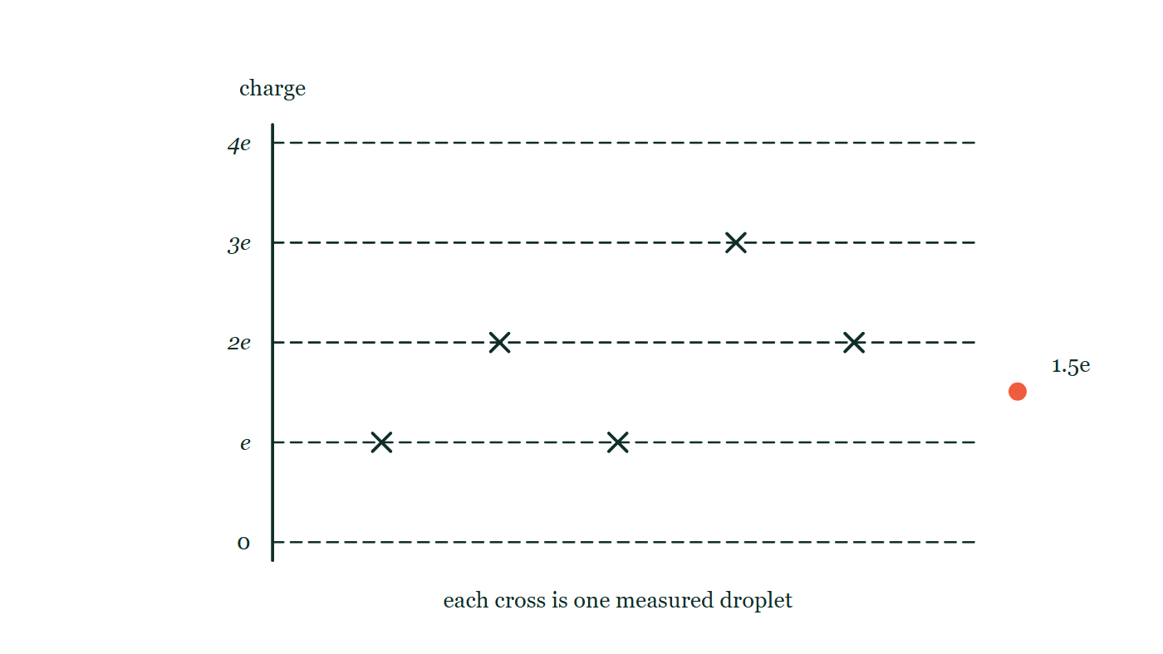
ELECTRIC CHARGES · CHARGE, CONSERVATION & QUANTISATION
GIOPHYSICS LESSON
QUICK CHECK
Decide before the answer goes up
Check and misconception — The quick check and the trap
A neutral object gains 5 electrons. What is its final charge?
A
+5e
B
−5e
C
0
A vertical charge scale ruled at 0, e, 2e, 3e and 4e carries five measured droplet readings drawn as crosses sitting exactly on the rungs, with one further candidate value marked halfway between the 1e and 2e rungs.
The live version of this figure — click here
Electric Charges — Charge, Conservation & Quantisation. Built by GioPhysics from the lesson's own copy; nothing on these slides is re-authored.
22 / 30
Notes:
[Phase] Check and misconception: The quick check and the trap (minutes 35–41 of 45)
[Question] A neutral object gains 5 electrons. What is its final charge?
[Figure] A vertical charge scale ruled at 0, e, 2e, 3e and 4e carries five measured droplet readings drawn as crosses sitting exactly on the rungs, with one further candidate value marked halfway between the 1e and 2e rungs.
[Options] A +5e B −5e C 0

Slide 23
ELECTRIC CHARGES · CHARGE, CONSERVATION & QUANTISATION
GIOPHYSICS LESSON
QUICK CHECK · THE ANSWER
The answer, and why
Check and misconception — The quick check and the trap
B −5e
HOW TO GET THERE
Each gained electron contributes −e, so the net charge is −5e.
WHY THE OTHERS TEMPT
A +5e is the charge of an object that has LOST five electrons. The sign is easy to invert, because "gaining" sounds as though it ought to push the total up — but what is gained here is negative, so the total goes down.
B Correct. Each arriving electron contributes −e, and five of them make −5e.
C Zero would be right if five protons had arrived alongside the five electrons. Nothing brought any: the object now holds five more negative charges than positive ones, and that imbalance is exactly what "charged" means.
Electric Charges — Charge, Conservation & Quantisation. Built by GioPhysics from the lesson's own copy; nothing on these slides is re-authored.
23 / 30
Notes:
[Phase] Check and misconception: The quick check and the trap (minutes 35–41 of 45)
[Question] A neutral object gains 5 electrons. What is its final charge?
[Option by option] A: +5e is the charge of an object that has LOST five electrons. The sign is easy to invert, because "gaining" sounds as though it ought to push the total up — but what is gained here is negative, so the total goes down. B: Correct. Each arriving electron contributes −e, and five of them make −5e. C: Zero would be right if five protons had arrived alongside the five electrons. Nothing brought any: the object now holds five more negative charges than positive ones, and that imbalance is exactly what "charged" means.
[Answer] B — −5e
[Why] Each gained electron contributes −e, so the net charge is −5e.
[Reveal] One click for the answer, then one for the reason.

Slide 24
ELECTRIC CHARGES · CHARGE, CONSERVATION & QUANTISATION
GIOPHYSICS LESSON
EXTENSION 1 OF 2 · HARD
The question
Hard
Worked examples — I do, we do — one step revealed at a time
A charged rod transfers 5.0 × 10¹⁰ electrons to a neutral sphere each second for 4.0 s. Find the sphere's final charge and the average transfer current.
Electric Charges — Charge, Conservation & Quantisation. Built by GioPhysics from the lesson's own copy; nothing on these slides is re-authored.
24 / 30
Notes:
[Phase] Worked examples: I do, we do — one step revealed at a time (minutes 22–35 of 45)
[Question] A charged rod transfers 5.0 × 10¹⁰ electrons to a neutral sphere each second for 4.0 s. Find the sphere's final charge and the average transfer current.
[Answer] Q = −32 nC; I = 8.0 nA

Slide 25
ELECTRIC CHARGES · CHARGE, CONSERVATION & QUANTISATION
GIOPHYSICS LESSON
EXTENSION 1 OF 2 · HARD · THE WORKING
How to solve it
Hard
Worked examples — I do, we do — one step revealed at a time
A charged rod transfers 5.0 × 10¹⁰ electrons to a neutral sphere each second for 4.0 s. Find the sphere's final charge and the average transfer current.
1.
Total electrons = 2.0 × 10¹¹; Q = ne = 2.0 × 10¹¹ × 1.6 × 10⁻¹⁹ = 3.2 × 10⁻⁸ C (negative).
2.
I = Q/t = 3.2 × 10⁻⁸ ÷ 4.0.
3.
I = 8.0 nA.
Electric Charges — Charge, Conservation & Quantisation. Built by GioPhysics from the lesson's own copy; nothing on these slides is re-authored.
25 / 30
Notes:
[Phase] Worked examples: I do, we do — one step revealed at a time (minutes 22–35 of 45)
[Reveal] One click per step. The class works each line before the next appears.
[Step 1] Total electrons = 2.0 × 10¹¹; Q = ne = 2.0 × 10¹¹ × 1.6 × 10⁻¹⁹ = 3.2 × 10⁻⁸ C (negative).
[Step 2] I = Q/t = 3.2 × 10⁻⁸ ÷ 4.0.
[Step 3] I = 8.0 nA.

Slide 26
ELECTRIC CHARGES · CHARGE, CONSERVATION & QUANTISATION
GIOPHYSICS LESSON
EXTENSION 1 OF 2 · HARD
Answer
Hard
Worked examples — I do, we do — one step revealed at a time
Q = −32 nC; I = 8.0 nA
Electric Charges — Charge, Conservation & Quantisation. Built by GioPhysics from the lesson's own copy; nothing on these slides is re-authored.
26 / 30
Notes:
[Phase] Worked examples: I do, we do — one step revealed at a time (minutes 22–35 of 45)
[Answer] Q = −32 nC; I = 8.0 nA

Slide 27
ELECTRIC CHARGES · CHARGE, CONSERVATION & QUANTISATION
GIOPHYSICS LESSON
EXTENSION 2 OF 2 · CHALLENGING
The question
Challenging
Worked examples — I do, we do — one step revealed at a time
Could an isolated droplet carry a charge of 2.4 × 10⁻¹⁹ C? Use quantisation to decide, and describe Millikan's logic.
Electric Charges — Charge, Conservation & Quantisation. Built by GioPhysics from the lesson's own copy; nothing on these slides is re-authored.
27 / 30
Notes:
[Phase] Worked examples: I do, we do — one step revealed at a time (minutes 22–35 of 45)
[Question] Could an isolated droplet carry a charge of 2.4 × 10⁻¹⁹ C? Use quantisation to decide, and describe Millikan's logic.
[Answer] No — 1.5e is forbidden; charge is quantised in whole e steps

Slide 28
ELECTRIC CHARGES · CHARGE, CONSERVATION & QUANTISATION
GIOPHYSICS LESSON
EXTENSION 2 OF 2 · CHALLENGING · THE WORKING
How to solve it
Challenging
Worked examples — I do, we do — one step revealed at a time
Could an isolated droplet carry a charge of 2.4 × 10⁻¹⁹ C? Use quantisation to decide, and describe Millikan's logic.
1.
Q/e = 2.4 ÷ 1.6 = 1.5 — not a whole number.
2.
Charge only comes in integer multiples of e, so this value is impossible for a real droplet.
3.
Millikan measured many droplet charges and found every one a multiple of the same basic step — that step is e.
Electric Charges — Charge, Conservation & Quantisation. Built by GioPhysics from the lesson's own copy; nothing on these slides is re-authored.
28 / 30
Notes:
[Phase] Worked examples: I do, we do — one step revealed at a time (minutes 22–35 of 45)
[Reveal] One click per step. The class works each line before the next appears.
[Step 1] Q/e = 2.4 ÷ 1.6 = 1.5 — not a whole number.
[Step 2] Charge only comes in integer multiples of e, so this value is impossible for a real droplet.
[Step 3] Millikan measured many droplet charges and found every one a multiple of the same basic step — that step is e.

Slide 29
ELECTRIC CHARGES · CHARGE, CONSERVATION & QUANTISATION
GIOPHYSICS LESSON
EXTENSION 2 OF 2 · CHALLENGING
Answer
Challenging
Worked examples — I do, we do — one step revealed at a time
No — 1.5e is forbidden; charge is quantised in whole e steps
Electric Charges — Charge, Conservation & Quantisation. Built by GioPhysics from the lesson's own copy; nothing on these slides is re-authored.
29 / 30
Notes:
[Phase] Worked examples: I do, we do — one step revealed at a time (minutes 22–35 of 45)
[Answer] No — 1.5e is forbidden; charge is quantised in whole e steps

Slide 30
ELECTRIC CHARGES · CHARGE, CONSERVATION & QUANTISATION
GIOPHYSICS LESSON
ELECTRIC CHARGES
Where to go next
Plenary — What to take away, what to practise next
Next
10.2 Conductors, Insulators & Polarisation
https://giophysics.com/chapter-19/conductors-insulators-polarisation/
Lesson
This lesson on giophysics.com
https://giophysics.com/chapter-19/charge-conservation-quantisation/
Live
The live, interactive version of these slides
https://giophysics.com/chapter-19/presentation/?lesson=charge
Chapter
All Electric Charges lessons
https://giophysics.com/chapter-19/
PDF
Download the lesson PDF
https://giophysics.com/downloads/19-1-charge-conservation-quantisation.pdf
Electric Charges — Charge, Conservation & Quantisation. Built by GioPhysics from the lesson's own copy; nothing on these slides is re-authored.
30 / 30
Notes:
[Phase] Plenary: What to take away, what to practise next (minutes 41–45 of 45)
[Interactive] The graphs and the circuit topology on these slides are frozen. The live version at https://giophysics.com/chapter-19/presentation/?lesson=charge moves them.

