Slide 1
ELECTRIC CHARGES · COULOMB’S LAW
GIOPHYSICS LESSON
10 · Electric Charges
Separate magnitude from direction
Coulomb’s Law
The force between two point charges grows with both charge magnitudes and falls with the square of their separation.
POSITION
Lesson 4 of 7 in Electric Charges
PLAN
16 slides in the 45-minute core run, about 44.5 minutes of it
LESSON PAGE
https://giophysics.com/chapter-19/coulombs-law/
Built by GioPhysics from the lesson's own page. Every word on these slides is the lesson's; nothing here is re-authored. Teaching material, not an awarding body's document.
Electric Charges — Coulomb’s Law. Built by GioPhysics from the lesson's own copy; nothing on these slides is re-authored.
1 / 31
Notes:
[Lesson] Electric Charges — Coulomb’s Law. Lesson 4 of 7.
[Intro] The force between two point charges grows with both charge magnitudes and falls with the square of their separation.
[Source] https://giophysics.com/chapter-19/coulombs-law/
[Disclaimer] Built by GioPhysics from the lesson's own page. Every word on these slides is the lesson's; nothing here is re-authored. Teaching material, not an awarding body's document.

Slide 2
ELECTRIC CHARGES · COULOMB’S LAW
GIOPHYSICS LESSON
WHAT THIS NEEDS
What you already know
Starter — Recall what this lesson stands on
Recall
SI prefixes
https://giophysics.com/chapter-1/units/
Recall
Newton’s third law
https://giophysics.com/chapter-3/newtons-laws-of-motion/
Electric Charges — Coulomb’s Law. Built by GioPhysics from the lesson's own copy; nothing on these slides is re-authored.
2 / 31
Notes:
[Phase] Starter: Recall what this lesson stands on (minutes 0–5 of 45)
[Starter] Recall: SI prefixes; Newton’s third law

Slide 3
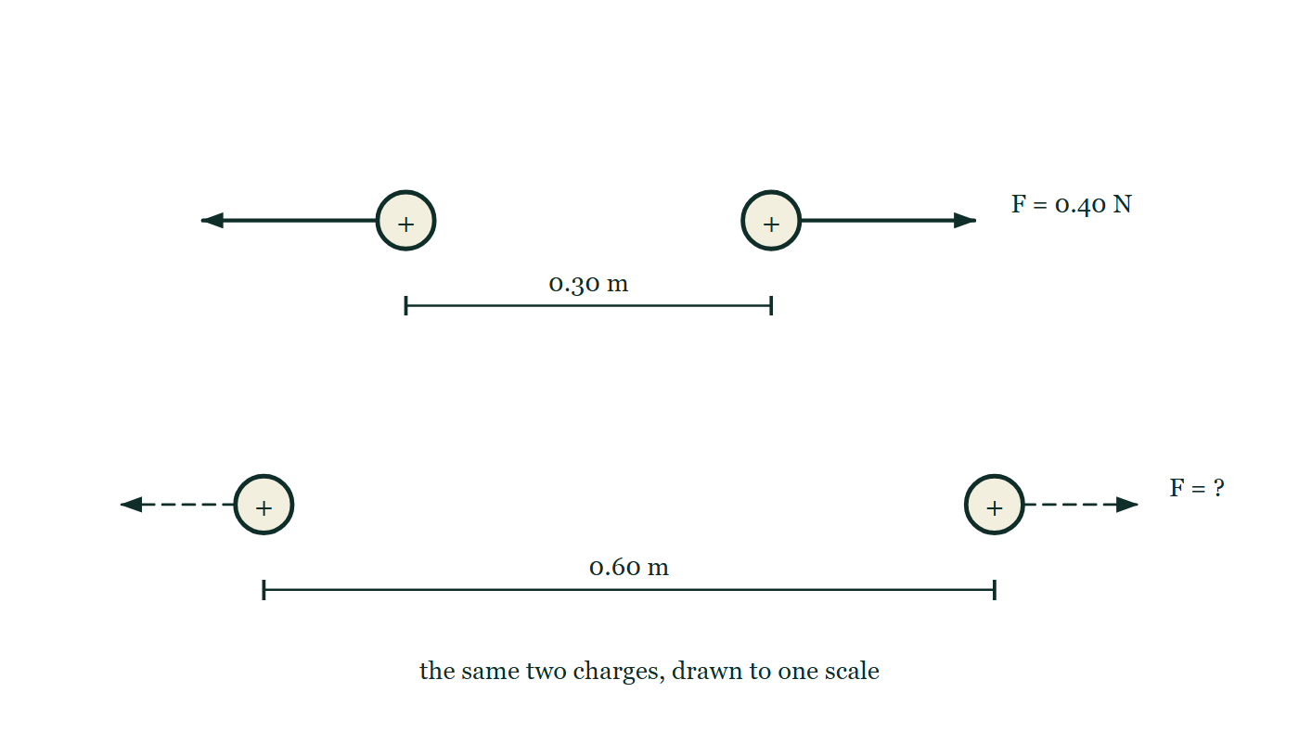
ELECTRIC CHARGES · COULOMB’S LAW
GIOPHYSICS LESSON
THINK FIRST
The electric force between a proton and an electron is about 10³⁹ times their gravitational pull. So why is the solar system run by gravity and not by electricity?
Take answers before you click — the point is the commitment
Both forces fall off as 1/r², so their ratio is the same at every distance — inside an atom and across the galaxy alike.
THE ANSWER
Because matter is very nearly neutral. Charge comes in two signs that cancel, and bulk matter cancels to an extraordinary precision, so almost none of that enormous force survives at large scales. Mass only ever adds. Gravity runs the universe not by being strong but by never cancelling.
The same two charges are drawn twice against one scale line: 0.30 m apart with a long repulsion arrow on each, and beneath that 0.60 m apart with the two force arrows left as bare outlines labelled with a question mark.
The live version of this figure — click here
Electric Charges — Coulomb’s Law. Built by GioPhysics from the lesson's own copy; nothing on these slides is re-authored.
3 / 31
Notes:
[Phase] Starter: Recall what this lesson stands on (minutes 0–5 of 45)
[Hook] The electric force between a proton and an electron is about 10³⁹ times their gravitational pull. So why is the solar system run by gravity and not by electricity? Both forces fall off as 1/r², so their ratio is the same at every distance — inside an atom and across the galaxy alike.
[Answer] Because matter is very nearly neutral. Charge comes in two signs that cancel, and bulk matter cancels to an extraordinary precision, so almost none of that enormous force survives at large scales. Mass only ever adds. Gravity runs the universe not by being strong but by never cancelling.
[Figure] The same two charges are drawn twice against one scale line: 0.30 m apart with a long repulsion arrow on each, and beneath that 0.60 m apart with the two force arrows left as bare outlines labelled with a question mark.

Slide 4
ELECTRIC CHARGES · COULOMB’S LAW
GIOPHYSICS LESSON
EXPLAINED SIMPLY
In one sentence
Introduce the idea — The big idea and the definition
Coulomb's law gives the electric-force magnitude between two point charges: it grows with both charge magnitudes and decreases with separation squared.
Electric Charges — Coulomb’s Law. Built by GioPhysics from the lesson's own copy; nothing on these slides is re-authored.
4 / 31
Notes:
[Phase] Introduce the idea: The big idea and the definition (minutes 5–13 of 45)
[Definition] Coulomb's law gives the electric-force magnitude between two point charges: it grows with both charge magnitudes and decreases with separation squared.

Slide 5
ELECTRIC CHARGES · COULOMB’S LAW
GIOPHYSICS LESSON
EXPLAINED SIMPLY
What that looks like
Introduce the idea — The big idea and the definition
FOR EXAMPLE
If two fixed charges move from 1 m apart to 2 m apart, their electric-force magnitude becomes one quarter as large.
Electric Charges — Coulomb’s Law. Built by GioPhysics from the lesson's own copy; nothing on these slides is re-authored.
5 / 31
Notes:
[Phase] Introduce the idea: The big idea and the definition (minutes 5–13 of 45)
[Worked illustration] If two fixed charges move from 1 m apart to 2 m apart, their electric-force magnitude becomes one quarter as large.

Slide 6
ELECTRIC CHARGES · COULOMB’S LAW
GIOPHYSICS LESSON
THE BIG IDEA
Separate magnitude from direction
Introduce the idea — The big idea and the definition
Use charge magnitudes in Coulomb’s formula, then decide direction from the signs: like charges repel and unlike charges attract. The forces on the two charges have equal magnitude and opposite direction, as required by Newton’s third law.
Electric Charges — Coulomb’s Law. Built by GioPhysics from the lesson's own copy; nothing on these slides is re-authored.
6 / 31
Notes:
[Phase] Introduce the idea: The big idea and the definition (minutes 5–13 of 45)
[Big idea] Use charge magnitudes in Coulomb’s formula, then decide direction from the signs: like charges repel and unlike charges attract. The forces on the two charges have equal magnitude and opposite direction, as required by Newton’s third law.

Slide 7
ELECTRIC CHARGES · COULOMB’S LAW
GIOPHYSICS LESSON
THE PHYSICS · 1 OF 3
Convert first
Build the model — The formulae, one at a time, in plain English
Convert μC or nC to coulombs and centimetres to metres before substitution. Keep units visible until the final line.
Electric Charges — Coulomb’s Law. Built by GioPhysics from the lesson's own copy; nothing on these slides is re-authored.
7 / 31
Notes:
[Phase] Build the model: The formulae, one at a time, in plain English (minutes 13–22 of 45)
[Section] Convert μC or nC to coulombs and centimetres to metres before substitution. Keep units visible until the final line.

Slide 8
ELECTRIC CHARGES · COULOMB’S LAW
GIOPHYSICS LESSON
THE PHYSICS · 2 OF 3
Use the line of centres
Build the model — The formulae, one at a time, in plain English
For two point charges the force lies along the line joining them. Signs determine whether each arrow points toward or away from the other charge.
Electric Charges — Coulomb’s Law. Built by GioPhysics from the lesson's own copy; nothing on these slides is re-authored.
8 / 31
Notes:
[Phase] Build the model: The formulae, one at a time, in plain English (minutes 13–22 of 45)
[Section] For two point charges the force lies along the line joining them. Signs determine whether each arrow points toward or away from the other charge.

Slide 9
ELECTRIC CHARGES · COULOMB’S LAW
GIOPHYSICS LESSON
THE PHYSICS · 3 OF 3
Check inverse square
Build the model — The formulae, one at a time, in plain English
Doubling r makes the force one quarter as large; tripling r makes it one ninth. This is a fast reasonableness check.
Electric Charges — Coulomb’s Law. Built by GioPhysics from the lesson's own copy; nothing on these slides is re-authored.
9 / 31
Notes:
[Phase] Build the model: The formulae, one at a time, in plain English (minutes 13–22 of 45)
[Section] Doubling r makes the force one quarter as large; tripling r makes it one ninth. This is a fast reasonableness check.

Slide 10
ELECTRIC CHARGES · COULOMB’S LAW
GIOPHYSICS LESSON
FORMULA 1 OF 3
Coulomb’s law
Build the model — The formulae, one at a time, in plain English
F = k|q₁q₂|/r²
r is the centre-to-centre separation
IN PLAIN ENGLISH
The force between two charges: bigger charges pull or push harder, and doubling the distance cuts the force to a quarter.
Electric Charges — Coulomb’s Law. Built by GioPhysics from the lesson's own copy; nothing on these slides is re-authored.
10 / 31
Notes:
[Phase] Build the model: The formulae, one at a time, in plain English (minutes 13–22 of 45)
[Formula] Coulomb’s law: F = k|q₁q₂|/r²
[In plain English] The force between two charges: bigger charges pull or push harder, and doubling the distance cuts the force to a quarter.
[Note] r is the centre-to-centre separation

Slide 11
ELECTRIC CHARGES · COULOMB’S LAW
GIOPHYSICS LESSON
FORMULA 2 OF 3
Coulomb constant
Build the model — The formulae, one at a time, in plain English
k = 8.99 × 10⁹ N·m²/C²
In vacuum; air is usually close enough for school problems
IN PLAIN ENGLISH
The huge number in Coulomb's law — even tiny charges exert real forces.
Electric Charges — Coulomb’s Law. Built by GioPhysics from the lesson's own copy; nothing on these slides is re-authored.
11 / 31
Notes:
[Phase] Build the model: The formulae, one at a time, in plain English (minutes 13–22 of 45)
[Formula] Coulomb constant: k = 8.99 × 10⁹ N·m²/C²
[In plain English] The huge number in Coulomb's law — even tiny charges exert real forces.
[Note] In vacuum; air is usually close enough for school problems

Slide 12
ELECTRIC CHARGES · COULOMB’S LAW
GIOPHYSICS LESSON
FORMULA 3 OF 3
Permittivity form
Build the model — The formulae, one at a time, in plain English
k = 1/(4πε₀)
ε₀ = 8.854 × 10⁻¹² C²/(N·m²)
IN PLAIN ENGLISH
The same constant written with ε₀, the constant describing how vacuum transmits electric effects.
Electric Charges — Coulomb’s Law. Built by GioPhysics from the lesson's own copy; nothing on these slides is re-authored.
12 / 31
Notes:
[Phase] Build the model: The formulae, one at a time, in plain English (minutes 13–22 of 45)
[Formula] Permittivity form: k = 1/(4πε₀)
[In plain English] The same constant written with ε₀, the constant describing how vacuum transmits electric effects.
[Note] ε₀ = 8.854 × 10⁻¹² C²/(N·m²)

Slide 13
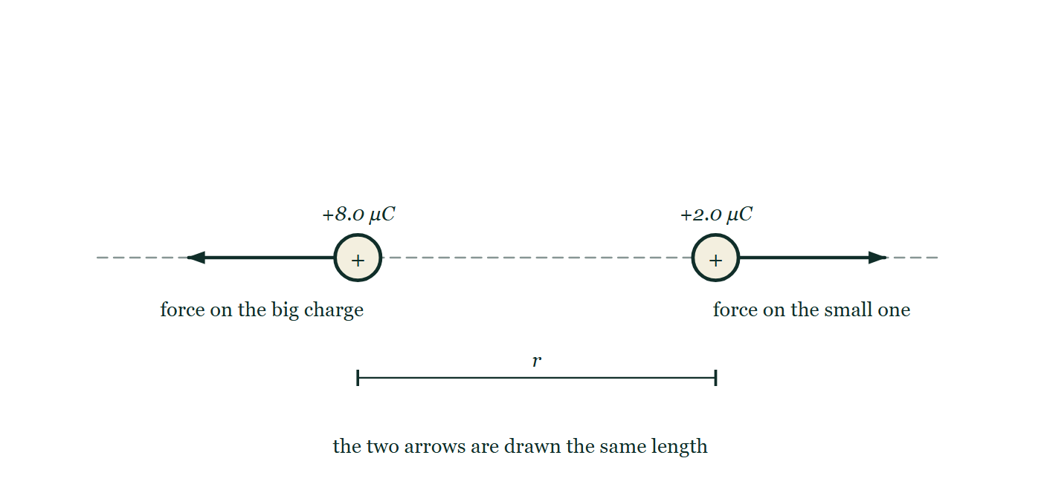
ELECTRIC CHARGES · COULOMB’S LAW
GIOPHYSICS LESSON
THE PICTURE
The big charge does not push harder
Drawn for this lesson
A +8.0 μC charge and a +2.0 μC charge sit on a line of centres with a repulsion arrow drawn on each, the two arrows exactly equal in length and pointing directly away from one another.
The live version of this figure — click here
Electric Charges — Coulomb’s Law. Built by GioPhysics from the lesson's own copy; nothing on these slides is re-authored.
13 / 31
Notes:
[Phase] Build the model: The formulae, one at a time, in plain English (minutes 13–22 of 45)
[Figure] A +8.0 μC charge and a +2.0 μC charge sit on a line of centres with a repulsion arrow drawn on each, the two arrows exactly equal in length and pointing directly away from one another.

Slide 14
ELECTRIC CHARGES · COULOMB’S LAW
GIOPHYSICS LESSON
WATCH OUT
The common trap
Check and misconception — The quick check and the trap
Doubling separation does not halve the force. The r² in the denominator makes the new force F/4.
Electric Charges — Coulomb’s Law. Built by GioPhysics from the lesson's own copy; nothing on these slides is re-authored.
14 / 31
Notes:
[Phase] Check and misconception: The quick check and the trap (minutes 35–41 of 45)
[Misconception] Doubling separation does not halve the force. The r² in the denominator makes the new force F/4.

Slide 15
ELECTRIC CHARGES · COULOMB’S LAW
GIOPHYSICS LESSON
WORKED EXAMPLE 1 OF 2 · EASY
The question
Easy
Worked examples — I do, we do — one step revealed at a time
Two +2.0 μC charges sit 0.30 m apart. Find the force between them.
Electric Charges — Coulomb’s Law. Built by GioPhysics from the lesson's own copy; nothing on these slides is re-authored.
15 / 31
Notes:
[Phase] Worked examples: I do, we do — one step revealed at a time (minutes 22–35 of 45)
[Question] Two +2.0 μC charges sit 0.30 m apart. Find the force between them.
[Answer] F ≈ 0.40 N repulsion

Slide 16
ELECTRIC CHARGES · COULOMB’S LAW
GIOPHYSICS LESSON
WORKED EXAMPLE 1 OF 2 · EASY · THE WORKING
How to solve it
Easy
Worked examples — I do, we do — one step revealed at a time
Two +2.0 μC charges sit 0.30 m apart. Find the force between them.
1.
F = kq₁q₂/r² = 8.99 × 10⁹ × 4.0 × 10⁻¹² ÷ 0.09.
2.
F ≈ 0.40 N, repulsive.
Electric Charges — Coulomb’s Law. Built by GioPhysics from the lesson's own copy; nothing on these slides is re-authored.
16 / 31
Notes:
[Phase] Worked examples: I do, we do — one step revealed at a time (minutes 22–35 of 45)
[Reveal] One click per step. The class works each line before the next appears.
[Step 1] F = kq₁q₂/r² = 8.99 × 10⁹ × 4.0 × 10⁻¹² ÷ 0.09.
[Step 2] F ≈ 0.40 N, repulsive.

Slide 17
ELECTRIC CHARGES · COULOMB’S LAW
GIOPHYSICS LESSON
WORKED EXAMPLE 1 OF 2 · EASY
Answer
Easy
Worked examples — I do, we do — one step revealed at a time
F ≈ 0.40 N repulsion
Electric Charges — Coulomb’s Law. Built by GioPhysics from the lesson's own copy; nothing on these slides is re-authored.
17 / 31
Notes:
[Phase] Worked examples: I do, we do — one step revealed at a time (minutes 22–35 of 45)
[Answer] F ≈ 0.40 N repulsion

Slide 18
ELECTRIC CHARGES · COULOMB’S LAW
GIOPHYSICS LESSON
WORKED EXAMPLE 2 OF 2 · MEDIUM
The question
Medium
Worked examples — I do, we do — one step revealed at a time
An electron and proton are 0.53 × 10⁻¹⁰ m apart. Find the electric-force magnitude and direction.
Electric Charges — Coulomb’s Law. Built by GioPhysics from the lesson's own copy; nothing on these slides is re-authored.
18 / 31
Notes:
[Phase] Worked examples: I do, we do — one step revealed at a time (minutes 22–35 of 45)
[Question] An electron and proton are 0.53 × 10⁻¹⁰ m apart. Find the electric-force magnitude and direction.
[Answer] F ≈ 8.2 × 10⁻⁸ N, attractive

Slide 19
ELECTRIC CHARGES · COULOMB’S LAW
GIOPHYSICS LESSON
WORKED EXAMPLE 2 OF 2 · MEDIUM · THE WORKING
How to solve it
Medium
Worked examples — I do, we do — one step revealed at a time
An electron and proton are 0.53 × 10⁻¹⁰ m apart. Find the electric-force magnitude and direction.
1.
Use |q₁| = |q₂| = e = 1.602 × 10⁻¹⁹ C.
2.
F = (8.99 × 10⁹)(1.602 × 10⁻¹⁹)²/(0.53 × 10⁻¹⁰)².
3.
The charges have opposite signs, so the force is attractive.
Electric Charges — Coulomb’s Law. Built by GioPhysics from the lesson's own copy; nothing on these slides is re-authored.
19 / 31
Notes:
[Phase] Worked examples: I do, we do — one step revealed at a time (minutes 22–35 of 45)
[Reveal] One click per step. The class works each line before the next appears.
[Step 1] Use |q₁| = |q₂| = e = 1.602 × 10⁻¹⁹ C.
[Step 2] F = (8.99 × 10⁹)(1.602 × 10⁻¹⁹)²/(0.53 × 10⁻¹⁰)².
[Step 3] The charges have opposite signs, so the force is attractive.

Slide 20
ELECTRIC CHARGES · COULOMB’S LAW
GIOPHYSICS LESSON
WORKED EXAMPLE 2 OF 2 · MEDIUM
Answer
Medium
Worked examples — I do, we do — one step revealed at a time
F ≈ 8.2 × 10⁻⁸ N, attractive
Electric Charges — Coulomb’s Law. Built by GioPhysics from the lesson's own copy; nothing on these slides is re-authored.
20 / 31
Notes:
[Phase] Worked examples: I do, we do — one step revealed at a time (minutes 22–35 of 45)
[Answer] F ≈ 8.2 × 10⁻⁸ N, attractive

Slide 21
ELECTRIC CHARGES · COULOMB’S LAW
GIOPHYSICS LESSON
PREDICT · TAKE THE VOTE
Commit before you are told
Hands up for each option, then click
At 0.30 m apart these two charges repel with 0.40 N. Moved to 0.60 m apart, the force becomes…
A 0.20 N
B 0.10 N
C 0.13 N
The same two charges are drawn twice against one scale line: 0.30 m apart with a long repulsion arrow on each, and beneath that 0.60 m apart with the two force arrows left as bare outlines labelled with a question mark.
The live version of this figure — click here
Electric Charges — Coulomb’s Law. Built by GioPhysics from the lesson's own copy; nothing on these slides is re-authored.
21 / 31
Notes:
[Phase] Build the model: The formulae, one at a time, in plain English (minutes 13–22 of 45)
[Predict] At 0.30 m apart these two charges repel with 0.40 N. Moved to 0.60 m apart, the force becomes…
[Options] A 0.20 N B 0.10 N C 0.13 N
[Figure] The same two charges are drawn twice against one scale line: 0.30 m apart with a long repulsion arrow on each, and beneath that 0.60 m apart with the two force arrows left as bare outlines labelled with a question mark.

Slide 22
ELECTRIC CHARGES · COULOMB’S LAW
GIOPHYSICS LESSON
PREDICT · THE OUTCOME
What actually happens
Ask the room who changed their mind, and why
B 0.10 N
WHY
The separation has doubled and r² sits underneath, so the force falls by 2² = 4: 0.40/4 = 0.10 N. 0.20 N is 0.40 ÷ 2 — the distance factor applied once instead of squared, which is the commonest single slip in this topic. 0.13 N is 0.40 ÷ 3, the answer to a question about tripling that nobody asked.
Electric Charges — Coulomb’s Law. Built by GioPhysics from the lesson's own copy; nothing on these slides is re-authored.
22 / 31
Notes:
[Phase] Build the model: The formulae, one at a time, in plain English (minutes 13–22 of 45)
[Answer] B — 0.10 N. The separation has doubled and r² sits underneath, so the force falls by 2² = 4: 0.40/4 = 0.10 N. 0.20 N is 0.40 ÷ 2 — the distance factor applied once instead of squared, which is the commonest single slip in this topic. 0.13 N is 0.40 ÷ 3, the answer to a question about tripling that nobody asked.

Slide 23
ELECTRIC CHARGES · COULOMB’S LAW
GIOPHYSICS LESSON
QUICK CHECK
Decide before the answer goes up
Check and misconception — The quick check and the trap
Two charge magnitudes stay fixed while their separation triples. What is the new force magnitude?
A
F/3
B
F/6
C
F/9
Electric Charges — Coulomb’s Law. Built by GioPhysics from the lesson's own copy; nothing on these slides is re-authored.
23 / 31
Notes:
[Phase] Check and misconception: The quick check and the trap (minutes 35–41 of 45)
[Question] Two charge magnitudes stay fixed while their separation triples. What is the new force magnitude?
[Options] A F/3 B F/6 C F/9

Slide 24
ELECTRIC CHARGES · COULOMB’S LAW
GIOPHYSICS LESSON
QUICK CHECK · THE ANSWER
The answer, and why
Check and misconception — The quick check and the trap
C F/9
HOW TO GET THERE
Coulomb force follows 1/r², so Fnew/Fold = 1/3² = 1/9.
WHY THE OTHERS TEMPT
A F/3 is what an inverse-FIRST-power law would give, and it is what intuition offers every time. Coulomb's law has r² underneath, not r.
B F/6 is 3 × 2 — the factor of three found correctly and then doubled, as though squaring meant multiplying by two. Three squared is nine.
C Correct. Fnew/Fold = 1/3² = 1/9.
Electric Charges — Coulomb’s Law. Built by GioPhysics from the lesson's own copy; nothing on these slides is re-authored.
24 / 31
Notes:
[Phase] Check and misconception: The quick check and the trap (minutes 35–41 of 45)
[Question] Two charge magnitudes stay fixed while their separation triples. What is the new force magnitude?
[Option by option] A: F/3 is what an inverse-FIRST-power law would give, and it is what intuition offers every time. Coulomb's law has r² underneath, not r. B: F/6 is 3 × 2 — the factor of three found correctly and then doubled, as though squaring meant multiplying by two. Three squared is nine. C: Correct. Fnew/Fold = 1/3² = 1/9.
[Answer] C — F/9
[Why] Coulomb force follows 1/r², so Fnew/Fold = 1/3² = 1/9.
[Reveal] One click for the answer, then one for the reason.

Slide 25
ELECTRIC CHARGES · COULOMB’S LAW
GIOPHYSICS LESSON
EXTENSION 1 OF 2 · HARD
The question
Hard
Worked examples — I do, we do — one step revealed at a time
At what separation would two 1.0 C charges exert 1.0 N on each other? Comment on the practicality of the coulomb.
Electric Charges — Coulomb’s Law. Built by GioPhysics from the lesson's own copy; nothing on these slides is re-authored.
25 / 31
Notes:
[Phase] Worked examples: I do, we do — one step revealed at a time (minutes 22–35 of 45)
[Question] At what separation would two 1.0 C charges exert 1.0 N on each other? Comment on the practicality of the coulomb.
[Answer] r ≈ 95 km — showing 1 C is a huge charge

Slide 26
ELECTRIC CHARGES · COULOMB’S LAW
GIOPHYSICS LESSON
EXTENSION 1 OF 2 · HARD · THE WORKING
How to solve it
Hard
Worked examples — I do, we do — one step revealed at a time
At what separation would two 1.0 C charges exert 1.0 N on each other? Comment on the practicality of the coulomb.
1.
r = √(kq₁q₂/F) = √(8.99 × 10⁹).
2.
r ≈ 9.5 × 10⁴ m — about 95 km!
3.
The coulomb is an enormously large charge; real electrostatics deals in μC and nC.
Electric Charges — Coulomb’s Law. Built by GioPhysics from the lesson's own copy; nothing on these slides is re-authored.
26 / 31
Notes:
[Phase] Worked examples: I do, we do — one step revealed at a time (minutes 22–35 of 45)
[Reveal] One click per step. The class works each line before the next appears.
[Step 1] r = √(kq₁q₂/F) = √(8.99 × 10⁹).
[Step 2] r ≈ 9.5 × 10⁴ m — about 95 km!
[Step 3] The coulomb is an enormously large charge; real electrostatics deals in μC and nC.

Slide 27
ELECTRIC CHARGES · COULOMB’S LAW
GIOPHYSICS LESSON
EXTENSION 1 OF 2 · HARD
Answer
Hard
Worked examples — I do, we do — one step revealed at a time
r ≈ 95 km — showing 1 C is a huge charge
Electric Charges — Coulomb’s Law. Built by GioPhysics from the lesson's own copy; nothing on these slides is re-authored.
27 / 31
Notes:
[Phase] Worked examples: I do, we do — one step revealed at a time (minutes 22–35 of 45)
[Answer] r ≈ 95 km — showing 1 C is a huge charge

Slide 28
ELECTRIC CHARGES · COULOMB’S LAW
GIOPHYSICS LESSON
EXTENSION 2 OF 2 · CHALLENGING
The question
Challenging
Worked examples — I do, we do — one step revealed at a time
Compare the electric and gravitational forces between a proton and an electron. (mₚ = 1.67 × 10⁻²⁷ kg, mₑ = 9.11 × 10⁻³¹ kg, G = 6.67 × 10⁻¹¹)
Electric Charges — Coulomb’s Law. Built by GioPhysics from the lesson's own copy; nothing on these slides is re-authored.
28 / 31
Notes:
[Phase] Worked examples: I do, we do — one step revealed at a time (minutes 22–35 of 45)
[Question] Compare the electric and gravitational forces between a proton and an electron. (mₚ = 1.67 × 10⁻²⁷ kg, mₑ = 9.11 × 10⁻³¹ kg, G = 6.67 × 10⁻¹¹)
[Answer] Electric force ≈ 10³⁹ times stronger, at any distance

Slide 29
ELECTRIC CHARGES · COULOMB’S LAW
GIOPHYSICS LESSON
EXTENSION 2 OF 2 · CHALLENGING · THE WORKING
How to solve it
Challenging
Worked examples — I do, we do — one step revealed at a time
Compare the electric and gravitational forces between a proton and an electron. (mₚ = 1.67 × 10⁻²⁷ kg, mₑ = 9.11 × 10⁻³¹ kg, G = 6.67 × 10⁻¹¹)
1.
Both forces scale as 1/r², so their ratio is distance-independent.
2.
Fe/Fg = ke²/(G mₚ mₑ) = (8.99 × 10⁹ × 2.56 × 10⁻³⁸) ÷ (6.67 × 10⁻¹¹ × 1.52 × 10⁻⁵⁷).
3.
≈ 2.3 × 10³⁹ — electricity dwarfs gravity at the atomic scale.
Electric Charges — Coulomb’s Law. Built by GioPhysics from the lesson's own copy; nothing on these slides is re-authored.
29 / 31
Notes:
[Phase] Worked examples: I do, we do — one step revealed at a time (minutes 22–35 of 45)
[Reveal] One click per step. The class works each line before the next appears.
[Step 1] Both forces scale as 1/r², so their ratio is distance-independent.
[Step 2] Fe/Fg = ke²/(G mₚ mₑ) = (8.99 × 10⁹ × 2.56 × 10⁻³⁸) ÷ (6.67 × 10⁻¹¹ × 1.52 × 10⁻⁵⁷).
[Step 3] ≈ 2.3 × 10³⁹ — electricity dwarfs gravity at the atomic scale.

Slide 30
ELECTRIC CHARGES · COULOMB’S LAW
GIOPHYSICS LESSON
EXTENSION 2 OF 2 · CHALLENGING
Answer
Challenging
Worked examples — I do, we do — one step revealed at a time
Electric force ≈ 10³⁹ times stronger, at any distance
Electric Charges — Coulomb’s Law. Built by GioPhysics from the lesson's own copy; nothing on these slides is re-authored.
30 / 31
Notes:
[Phase] Worked examples: I do, we do — one step revealed at a time (minutes 22–35 of 45)
[Answer] Electric force ≈ 10³⁹ times stronger, at any distance

Slide 31
ELECTRIC CHARGES · COULOMB’S LAW
GIOPHYSICS LESSON
ELECTRIC CHARGES
Where to go next
Plenary — What to take away, what to practise next
Next
10.5 Superposition & Charge Equilibrium
https://giophysics.com/chapter-19/superposition-charge-equilibrium/
Lesson
This lesson on giophysics.com
https://giophysics.com/chapter-19/coulombs-law/
Live
The live, interactive version of these slides
https://giophysics.com/chapter-19/presentation/?lesson=coulomb
Chapter
All Electric Charges lessons
https://giophysics.com/chapter-19/
PDF
Download the lesson PDF
https://giophysics.com/downloads/19-4-coulombs-law.pdf
Electric Charges — Coulomb’s Law. Built by GioPhysics from the lesson's own copy; nothing on these slides is re-authored.
31 / 31
Notes:
[Phase] Plenary: What to take away, what to practise next (minutes 41–45 of 45)
[Interactive] The graphs and the circuit topology on these slides are frozen. The live version at https://giophysics.com/chapter-19/presentation/?lesson=coulomb moves them.

