Slide 1
ELECTRIC CHARGES · CONDUCTORS, INSULATORS & POLARISATION
GIOPHYSICS LESSON
10 · Electric Charges
Separate net charge from charge redistribution
Conductors, Insulators & Polarisation
Conductors contain mobile charge carriers. In insulators, charges are largely bound, but their positions can shift slightly and form induced dipoles.
POSITION
Lesson 2 of 7 in Electric Charges
PLAN
16 slides in the 45-minute core run, about 44.5 minutes of it
LESSON PAGE
https://giophysics.com/chapter-19/conductors-insulators-polarisation/
Built by GioPhysics from the lesson's own page. Every word on these slides is the lesson's; nothing here is re-authored. Teaching material, not an awarding body's document.
Electric Charges — Conductors, Insulators & Polarisation. Built by GioPhysics from the lesson's own copy; nothing on these slides is re-authored.
1 / 31
Notes:
[Lesson] Electric Charges — Conductors, Insulators & Polarisation. Lesson 2 of 7.
[Intro] Conductors contain mobile charge carriers. In insulators, charges are largely bound, but their positions can shift slightly and form induced dipoles.
[Source] https://giophysics.com/chapter-19/conductors-insulators-polarisation/
[Disclaimer] Built by GioPhysics from the lesson's own page. Every word on these slides is the lesson's; nothing here is re-authored. Teaching material, not an awarding body's document.

Slide 2
ELECTRIC CHARGES · CONDUCTORS, INSULATORS & POLARISATION
GIOPHYSICS LESSON
WHAT THIS NEEDS
What you already know
Starter — Recall what this lesson stands on
Recall
Charge, conservation & quantisation
https://giophysics.com/chapter-19/charge-conservation-quantisation/
Electric Charges — Conductors, Insulators & Polarisation. Built by GioPhysics from the lesson's own copy; nothing on these slides is re-authored.
2 / 31
Notes:
[Phase] Starter: Recall what this lesson stands on (minutes 0–5 of 45)
[Starter] Recall: Charge, conservation & quantisation

Slide 3
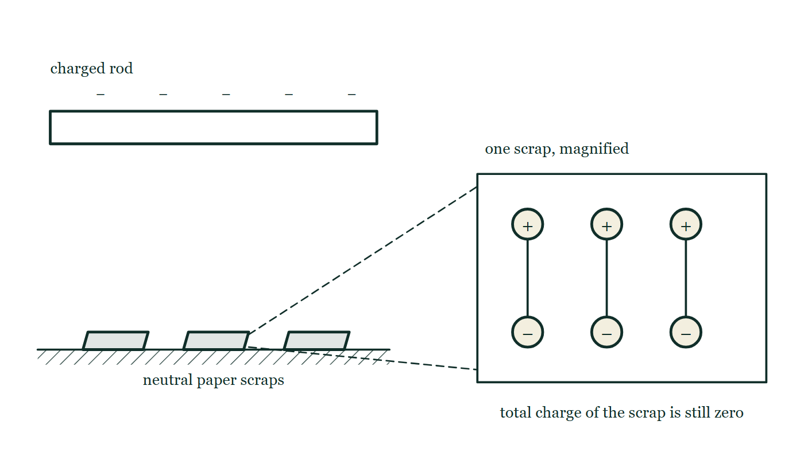
ELECTRIC CHARGES · CONDUCTORS, INSULATORS & POLARISATION
GIOPHYSICS LESSON
THINK FIRST
A charged rod attracts a scrap of paper. The scrap touches the rod — and instantly jumps away. Why?
Take answers before you click — the point is the commitment
The paper was neutral the whole time it was being pulled in, and nothing was done to the rod between the two moments.
THE ANSWER
Two different mechanisms, one after the other. While neutral, the scrap was polarised: its molecular charges shifted a fraction of a nanometre, putting opposite charge slightly nearer than like charge, and 1/r² lets the nearer attraction win. On contact it picked up some of the rod's own charge — so it now carries the same sign as the rod, and like signs repel.
A negatively charged rod is held above three small paper scraps on a bench, and one scrap is drawn enlarged beside them as a row of molecules each turned so its positive end faces up towards the rod and its negative end down.
The live version of this figure — click here
Electric Charges — Conductors, Insulators & Polarisation. Built by GioPhysics from the lesson's own copy; nothing on these slides is re-authored.
3 / 31
Notes:
[Phase] Starter: Recall what this lesson stands on (minutes 0–5 of 45)
[Hook] A charged rod attracts a scrap of paper. The scrap touches the rod — and instantly jumps away. Why? The paper was neutral the whole time it was being pulled in, and nothing was done to the rod between the two moments.
[Answer] Two different mechanisms, one after the other. While neutral, the scrap was polarised: its molecular charges shifted a fraction of a nanometre, putting opposite charge slightly nearer than like charge, and 1/r² lets the nearer attraction win. On contact it picked up some of the rod's own charge — so it now carries the same sign as the rod, and like signs repel.
[Figure] A negatively charged rod is held above three small paper scraps on a bench, and one scrap is drawn enlarged beside them as a row of molecules each turned so its positive end faces up towards the rod and its negative end down.

Slide 4
ELECTRIC CHARGES · CONDUCTORS, INSULATORS & POLARISATION
GIOPHYSICS LESSON
EXPLAINED SIMPLY
In one sentence
Introduce the idea — The big idea and the definition
A conductor lets charge move through it, an insulator keeps charge mostly bound, and polarisation is a small separation of positive and negative charge within neutral matter.
Electric Charges — Conductors, Insulators & Polarisation. Built by GioPhysics from the lesson's own copy; nothing on these slides is re-authored.
4 / 31
Notes:
[Phase] Introduce the idea: The big idea and the definition (minutes 5–13 of 45)
[Definition] A conductor lets charge move through it, an insulator keeps charge mostly bound, and polarisation is a small separation of positive and negative charge within neutral matter.

Slide 5
ELECTRIC CHARGES · CONDUCTORS, INSULATORS & POLARISATION
GIOPHYSICS LESSON
EXPLAINED SIMPLY
What that looks like
Introduce the idea — The big idea and the definition
FOR EXAMPLE
A charged balloon polarises a neutral wall, bringing opposite charge slightly closer so the balloon is attracted.
Electric Charges — Conductors, Insulators & Polarisation. Built by GioPhysics from the lesson's own copy; nothing on these slides is re-authored.
5 / 31
Notes:
[Phase] Introduce the idea: The big idea and the definition (minutes 5–13 of 45)
[Worked illustration] A charged balloon polarises a neutral wall, bringing opposite charge slightly closer so the balloon is attracted.

Slide 6
ELECTRIC CHARGES · CONDUCTORS, INSULATORS & POLARISATION
GIOPHYSICS LESSON
THE BIG IDEA
Separate net charge from charge redistribution
Introduce the idea — The big idea and the definition
A nearby charged body can attract a neutral object. Its electric field redistributes charge in a conductor or polarises molecules in an insulator, placing opposite charge slightly closer than like charge. The nearer attraction is then stronger than the farther repulsion.
Electric Charges — Conductors, Insulators & Polarisation. Built by GioPhysics from the lesson's own copy; nothing on these slides is re-authored.
6 / 31
Notes:
[Phase] Introduce the idea: The big idea and the definition (minutes 5–13 of 45)
[Big idea] A nearby charged body can attract a neutral object. Its electric field redistributes charge in a conductor or polarises molecules in an insulator, placing opposite charge slightly closer than like charge. The nearer attraction is then stronger than the farther repulsion.

Slide 7
ELECTRIC CHARGES · CONDUCTORS, INSULATORS & POLARISATION
GIOPHYSICS LESSON
THE PHYSICS · 1 OF 3
Conductor
Build the model — The formulae, one at a time, in plain English
Mobile electrons move through the material until electrostatic equilibrium is reached. Excess charge resides on the surface, but is uniform only in special symmetric situations.
Electric Charges — Conductors, Insulators & Polarisation. Built by GioPhysics from the lesson's own copy; nothing on these slides is re-authored.
7 / 31
Notes:
[Phase] Build the model: The formulae, one at a time, in plain English (minutes 13–22 of 45)
[Section] Mobile electrons move through the material until electrostatic equilibrium is reached. Excess charge resides on the surface, but is uniform only in special symmetric situations.

Slide 8
ELECTRIC CHARGES · CONDUCTORS, INSULATORS & POLARISATION
GIOPHYSICS LESSON
THE PHYSICS · 2 OF 3
Insulator
Build the model — The formulae, one at a time, in plain English
Charges are bound to atoms or molecules. Local displacement or molecular alignment produces polarisation without free charge crossing the whole object.
Electric Charges — Conductors, Insulators & Polarisation. Built by GioPhysics from the lesson's own copy; nothing on these slides is re-authored.
8 / 31
Notes:
[Phase] Build the model: The formulae, one at a time, in plain English (minutes 13–22 of 45)
[Section] Charges are bound to atoms or molecules. Local displacement or molecular alignment produces polarisation without free charge crossing the whole object.

Slide 9
ELECTRIC CHARGES · CONDUCTORS, INSULATORS & POLARISATION
GIOPHYSICS LESSON
THE PHYSICS · 3 OF 3
Neutral attraction
Build the model — The formulae, one at a time, in plain English
The opposite induced charge lies nearer the external charge. Because electric force decreases with distance squared, the near attraction can win.
Electric Charges — Conductors, Insulators & Polarisation. Built by GioPhysics from the lesson's own copy; nothing on these slides is re-authored.
9 / 31
Notes:
[Phase] Build the model: The formulae, one at a time, in plain English (minutes 13–22 of 45)
[Section] The opposite induced charge lies nearer the external charge. Because electric force decreases with distance squared, the near attraction can win.

Slide 10
ELECTRIC CHARGES · CONDUCTORS, INSULATORS & POLARISATION
GIOPHYSICS LESSON
FORMULA 1 OF 3
Neutral condition
Build the model — The formulae, one at a time, in plain English
Qnet = 0
Neutral matter can still contain separated positive and negative regions
IN PLAIN ENGLISH
Neutral doesn't mean empty: equal amounts of positive and negative charge are present, cancelling out.
Electric Charges — Conductors, Insulators & Polarisation. Built by GioPhysics from the lesson's own copy; nothing on these slides is re-authored.
10 / 31
Notes:
[Phase] Build the model: The formulae, one at a time, in plain English (minutes 13–22 of 45)
[Formula] Neutral condition: Qnet = 0
[In plain English] Neutral doesn't mean empty: equal amounts of positive and negative charge are present, cancelling out.
[Note] Neutral matter can still contain separated positive and negative regions

Slide 11
ELECTRIC CHARGES · CONDUCTORS, INSULATORS & POLARISATION
GIOPHYSICS LESSON
FORMULA 2 OF 3
Electric dipole moment
Build the model — The formulae, one at a time, in plain English
p = qd
q is the separated charge magnitude and d is the separation
IN PLAIN ENGLISH
A measure of charge separation: how much charge moved apart, times how far apart it sits.
Electric Charges — Conductors, Insulators & Polarisation. Built by GioPhysics from the lesson's own copy; nothing on these slides is re-authored.
11 / 31
Notes:
[Phase] Build the model: The formulae, one at a time, in plain English (minutes 13–22 of 45)
[Formula] Electric dipole moment: p = qd
[In plain English] A measure of charge separation: how much charge moved apart, times how far apart it sits.
[Note] q is the separated charge magnitude and d is the separation

Slide 12
ELECTRIC CHARGES · CONDUCTORS, INSULATORS & POLARISATION
GIOPHYSICS LESSON
FORMULA 3 OF 3
Average surface charge
Build the model — The formulae, one at a time, in plain English
σavg = Q/A
Local σ can vary, especially near sharp curvature
IN PLAIN ENGLISH
How thickly charge is spread over a surface: total charge divided by area.
Electric Charges — Conductors, Insulators & Polarisation. Built by GioPhysics from the lesson's own copy; nothing on these slides is re-authored.
12 / 31
Notes:
[Phase] Build the model: The formulae, one at a time, in plain English (minutes 13–22 of 45)
[Formula] Average surface charge: σavg = Q/A
[In plain English] How thickly charge is spread over a surface: total charge divided by area.
[Note] Local σ can vary, especially near sharp curvature

Slide 13
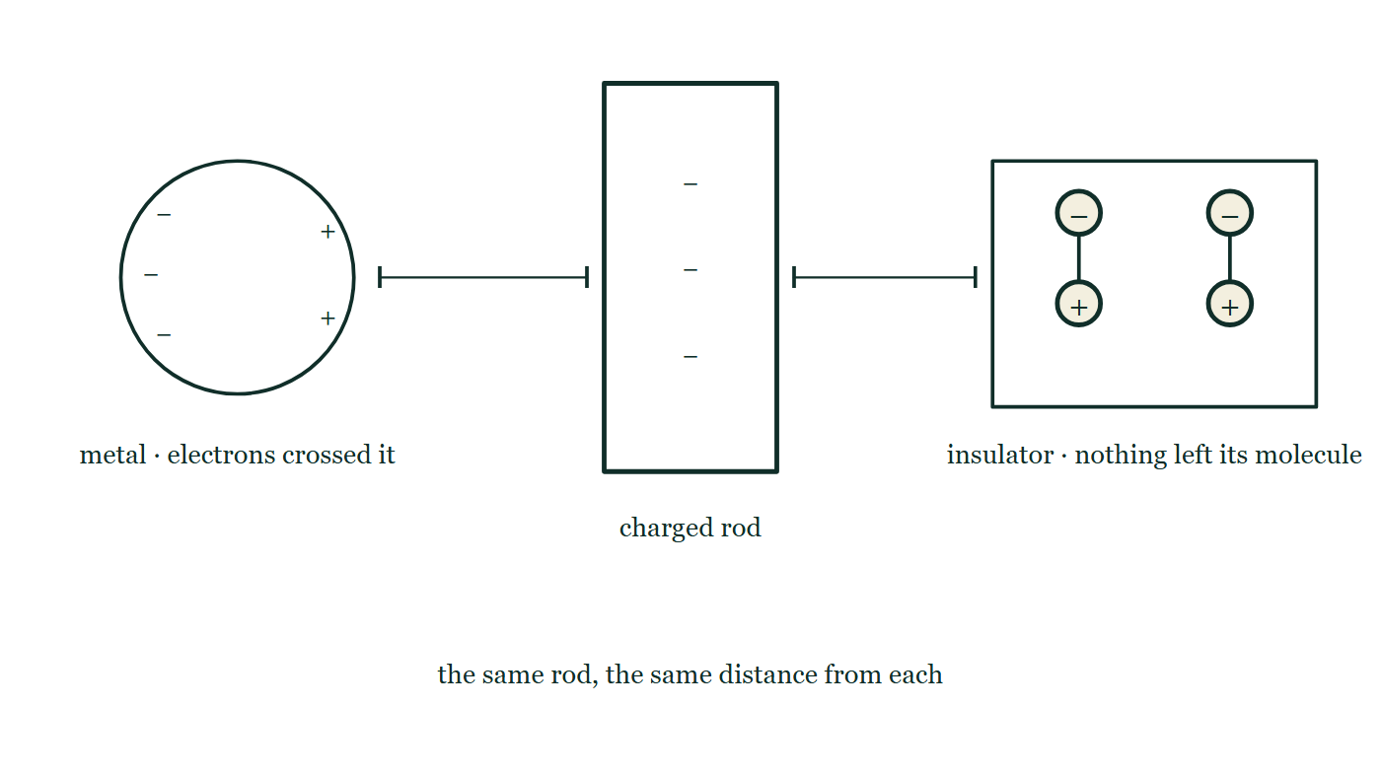
ELECTRIC CHARGES · CONDUCTORS, INSULATORS & POLARISATION
GIOPHYSICS LESSON
THE PICTURE
Two ways to answer a field
Drawn for this lesson
A negative rod is held the same distance from two objects side by side: a metal sphere whose free electrons have crowded onto its far side, and an insulating block whose molecules have each turned very slightly without going anywhere.
The live version of this figure — click here
Electric Charges — Conductors, Insulators & Polarisation. Built by GioPhysics from the lesson's own copy; nothing on these slides is re-authored.
13 / 31
Notes:
[Phase] Build the model: The formulae, one at a time, in plain English (minutes 13–22 of 45)
[Figure] A negative rod is held the same distance from two objects side by side: a metal sphere whose free electrons have crowded onto its far side, and an insulating block whose molecules have each turned very slightly without going anywhere.

Slide 14
ELECTRIC CHARGES · CONDUCTORS, INSULATORS & POLARISATION
GIOPHYSICS LESSON
WATCH OUT
The common trap
Check and misconception — The quick check and the trap
Neutral does not mean electrically inactive. A neutral conductor or insulator can be attracted after its charges redistribute or polarise.
Electric Charges — Conductors, Insulators & Polarisation. Built by GioPhysics from the lesson's own copy; nothing on these slides is re-authored.
14 / 31
Notes:
[Phase] Check and misconception: The quick check and the trap (minutes 35–41 of 45)
[Misconception] Neutral does not mean electrically inactive. A neutral conductor or insulator can be attracted after its charges redistribute or polarise.

Slide 15
ELECTRIC CHARGES · CONDUCTORS, INSULATORS & POLARISATION
GIOPHYSICS LESSON
WORKED EXAMPLE 1 OF 2 · EASY
The question
Easy
Worked examples — I do, we do — one step revealed at a time
Why can charge flow easily through copper but not through rubber?
Electric Charges — Conductors, Insulators & Polarisation. Built by GioPhysics from the lesson's own copy; nothing on these slides is re-authored.
15 / 31
Notes:
[Phase] Worked examples: I do, we do — one step revealed at a time (minutes 22–35 of 45)
[Question] Why can charge flow easily through copper but not through rubber?
[Answer] Copper has mobile free electrons; rubber's are fixed

Slide 16
ELECTRIC CHARGES · CONDUCTORS, INSULATORS & POLARISATION
GIOPHYSICS LESSON
WORKED EXAMPLE 1 OF 2 · EASY · THE WORKING
How to solve it
Easy
Worked examples — I do, we do — one step revealed at a time
Why can charge flow easily through copper but not through rubber?
1.
Copper's outer electrons are delocalised and free to drift.
2.
Rubber's electrons are bound to their molecules — almost none are free.
Electric Charges — Conductors, Insulators & Polarisation. Built by GioPhysics from the lesson's own copy; nothing on these slides is re-authored.
16 / 31
Notes:
[Phase] Worked examples: I do, we do — one step revealed at a time (minutes 22–35 of 45)
[Reveal] One click per step. The class works each line before the next appears.
[Step 1] Copper's outer electrons are delocalised and free to drift.
[Step 2] Rubber's electrons are bound to their molecules — almost none are free.

Slide 17
ELECTRIC CHARGES · CONDUCTORS, INSULATORS & POLARISATION
GIOPHYSICS LESSON
WORKED EXAMPLE 1 OF 2 · EASY
Answer
Easy
Worked examples — I do, we do — one step revealed at a time
Copper has mobile free electrons; rubber's are fixed
Electric Charges — Conductors, Insulators & Polarisation. Built by GioPhysics from the lesson's own copy; nothing on these slides is re-authored.
17 / 31
Notes:
[Phase] Worked examples: I do, we do — one step revealed at a time (minutes 22–35 of 45)
[Answer] Copper has mobile free electrons; rubber's are fixed

Slide 18
ELECTRIC CHARGES · CONDUCTORS, INSULATORS & POLARISATION
GIOPHYSICS LESSON
WORKED EXAMPLE 2 OF 2 · MEDIUM
The question
Medium
Worked examples — I do, we do — one step revealed at a time
Explain why a charged balloon can attract a neutral wall.
Electric Charges — Conductors, Insulators & Polarisation. Built by GioPhysics from the lesson's own copy; nothing on these slides is re-authored.
18 / 31
Notes:
[Phase] Worked examples: I do, we do — one step revealed at a time (minutes 22–35 of 45)
[Question] Explain why a charged balloon can attract a neutral wall.
[Answer] Polarisation creates a closer opposite-charge region, producing net attraction without changing the wall’s total charge.

Slide 19
ELECTRIC CHARGES · CONDUCTORS, INSULATORS & POLARISATION
GIOPHYSICS LESSON
WORKED EXAMPLE 2 OF 2 · MEDIUM · THE WORKING
How to solve it
Medium
Worked examples — I do, we do — one step revealed at a time
Explain why a charged balloon can attract a neutral wall.
1.
The balloon's field slightly shifts bound charges in the wall's molecules.
2.
Opposite charge is displaced a little nearer the balloon and like charge a little farther away.
3.
The nearer attractive force is stronger, so the wall experiences a net attraction while remaining neutral overall.
Electric Charges — Conductors, Insulators & Polarisation. Built by GioPhysics from the lesson's own copy; nothing on these slides is re-authored.
19 / 31
Notes:
[Phase] Worked examples: I do, we do — one step revealed at a time (minutes 22–35 of 45)
[Reveal] One click per step. The class works each line before the next appears.
[Step 1] The balloon's field slightly shifts bound charges in the wall's molecules.
[Step 2] Opposite charge is displaced a little nearer the balloon and like charge a little farther away.
[Step 3] The nearer attractive force is stronger, so the wall experiences a net attraction while remaining neutral overall.

Slide 20
ELECTRIC CHARGES · CONDUCTORS, INSULATORS & POLARISATION
GIOPHYSICS LESSON
WORKED EXAMPLE 2 OF 2 · MEDIUM
Answer
Medium
Worked examples — I do, we do — one step revealed at a time
Polarisation creates a closer opposite-charge region, producing net attraction without changing the wall’s total charge.
Electric Charges — Conductors, Insulators & Polarisation. Built by GioPhysics from the lesson's own copy; nothing on these slides is re-authored.
20 / 31
Notes:
[Phase] Worked examples: I do, we do — one step revealed at a time (minutes 22–35 of 45)
[Answer] Polarisation creates a closer opposite-charge region, producing net attraction without changing the wall’s total charge.

Slide 21
ELECTRIC CHARGES · CONDUCTORS, INSULATORS & POLARISATION
GIOPHYSICS LESSON
PREDICT · TAKE THE VOTE
Commit before you are told
Hands up for each option, then click
Every one of these paper scraps is completely neutral. The charged rod is lowered towards them. What happens?
A Nothing — no net charge means no force
B They are attracted up to the rod
C They are repelled away from the rod
A negatively charged rod is held above three small paper scraps on a bench, and one scrap is drawn enlarged beside them as a row of molecules each turned so its positive end faces up towards the rod and its negative end down.
The live version of this figure — click here
Electric Charges — Conductors, Insulators & Polarisation. Built by GioPhysics from the lesson's own copy; nothing on these slides is re-authored.
21 / 31
Notes:
[Phase] Build the model: The formulae, one at a time, in plain English (minutes 13–22 of 45)
[Predict] Every one of these paper scraps is completely neutral. The charged rod is lowered towards them. What happens?
[Options] A Nothing — no net charge means no force B They are attracted up to the rod C They are repelled away from the rod
[Figure] A negatively charged rod is held above three small paper scraps on a bench, and one scrap is drawn enlarged beside them as a row of molecules each turned so its positive end faces up towards the rod and its negative end down.

Slide 22
ELECTRIC CHARGES · CONDUCTORS, INSULATORS & POLARISATION
GIOPHYSICS LESSON
PREDICT · THE OUTCOME
What actually happens
Ask the room who changed their mind, and why
B They are attracted up to the rod
WHY
Neutral means the positive and the negative add to zero, not that there is nothing there to push on. The rod's field pulls one kind of charge in each molecule a little nearer and pushes the other a little further off — a tiny separation, but the near charge is the opposite sign and the force goes as 1/r², so the near attraction beats the far repulsion. The scrap is dragged in while its total charge stays exactly zero.
Electric Charges — Conductors, Insulators & Polarisation. Built by GioPhysics from the lesson's own copy; nothing on these slides is re-authored.
22 / 31
Notes:
[Phase] Build the model: The formulae, one at a time, in plain English (minutes 13–22 of 45)
[Answer] B — They are attracted up to the rod. Neutral means the positive and the negative add to zero, not that there is nothing there to push on. The rod's field pulls one kind of charge in each molecule a little nearer and pushes the other a little further off — a tiny separation, but the near charge is the opposite sign and the force goes as 1/r², so the near attraction beats the far repulsion. The scrap is dragged in while its total charge stays exactly zero.

Slide 23
ELECTRIC CHARGES · CONDUCTORS, INSULATORS & POLARISATION
GIOPHYSICS LESSON
QUICK CHECK
Decide before the answer goes up
Check and misconception — The quick check and the trap
A negative rod approaches a neutral metal sphere without touching it. What happens first?
A
Protons move toward the rod
B
Electrons shift away from the rod
C
The sphere becomes permanently positive
Electric Charges — Conductors, Insulators & Polarisation. Built by GioPhysics from the lesson's own copy; nothing on these slides is re-authored.
23 / 31
Notes:
[Phase] Check and misconception: The quick check and the trap (minutes 35–41 of 45)
[Question] A negative rod approaches a neutral metal sphere without touching it. What happens first?
[Options] A Protons move toward the rod B Electrons shift away from the rod C The sphere becomes permanently positive

Slide 24
ELECTRIC CHARGES · CONDUCTORS, INSULATORS & POLARISATION
GIOPHYSICS LESSON
QUICK CHECK · THE ANSWER
The answer, and why
Check and misconception — The quick check and the trap
B Electrons shift away from the rod
HOW TO GET THERE
Mobile electrons are repelled to the far side. The sphere remains net neutral unless a charge-transfer path such as grounding is added.
WHY THE OTHERS TEMPT
A Protons sit inside nuclei bonded into the metal lattice; nothing a rod does at arm's length moves one. The near side does finish positive, which is what makes this sound right — but it is positive because electrons left it, not because protons arrived.
B Correct. The sphere's free electrons are repelled to the far side, leaving the near side short of them and therefore positive.
C "Permanently" is the word that fails. Take the rod away and the electrons flow straight back to a uniform spread: nothing has entered the sphere and nothing has left it. Making the change permanent needs a grounding step, which is the next lesson.
Electric Charges — Conductors, Insulators & Polarisation. Built by GioPhysics from the lesson's own copy; nothing on these slides is re-authored.
24 / 31
Notes:
[Phase] Check and misconception: The quick check and the trap (minutes 35–41 of 45)
[Question] A negative rod approaches a neutral metal sphere without touching it. What happens first?
[Option by option] A: Protons sit inside nuclei bonded into the metal lattice; nothing a rod does at arm's length moves one. The near side does finish positive, which is what makes this sound right — but it is positive because electrons left it, not because protons arrived. B: Correct. The sphere's free electrons are repelled to the far side, leaving the near side short of them and therefore positive. C: "Permanently" is the word that fails. Take the rod away and the electrons flow straight back to a uniform spread: nothing has entered the sphere and nothing has left it. Making the change permanent needs a grounding step, which is the next lesson.
[Answer] B — Electrons shift away from the rod
[Why] Mobile electrons are repelled to the far side. The sphere remains net neutral unless a charge-transfer path such as grounding is added.
[Reveal] One click for the answer, then one for the reason.

Slide 25
ELECTRIC CHARGES · CONDUCTORS, INSULATORS & POLARISATION
GIOPHYSICS LESSON
EXTENSION 1 OF 2 · HARD
The question
Hard
Worked examples — I do, we do — one step revealed at a time
A charged rod is brought near (not touching) small pieces of paper, which jump to it. Explain the attraction of NEUTRAL paper.
Electric Charges — Conductors, Insulators & Polarisation. Built by GioPhysics from the lesson's own copy; nothing on these slides is re-authored.
25 / 31
Notes:
[Phase] Worked examples: I do, we do — one step revealed at a time (minutes 22–35 of 45)
[Question] A charged rod is brought near (not touching) small pieces of paper, which jump to it. Explain the attraction of NEUTRAL paper.
[Answer] Polarisation puts opposite charge closer, so attraction wins

Slide 26
ELECTRIC CHARGES · CONDUCTORS, INSULATORS & POLARISATION
GIOPHYSICS LESSON
EXTENSION 1 OF 2 · HARD · THE WORKING
How to solve it
Hard
Worked examples — I do, we do — one step revealed at a time
A charged rod is brought near (not touching) small pieces of paper, which jump to it. Explain the attraction of NEUTRAL paper.
1.
The rod's field polarises each scrap — molecular charges shift slightly, near side opposite to the rod.
2.
The opposite charges sit closer than the like charges.
3.
The 1/r² law makes the nearer attraction beat the farther repulsion — net pull.
Electric Charges — Conductors, Insulators & Polarisation. Built by GioPhysics from the lesson's own copy; nothing on these slides is re-authored.
26 / 31
Notes:
[Phase] Worked examples: I do, we do — one step revealed at a time (minutes 22–35 of 45)
[Reveal] One click per step. The class works each line before the next appears.
[Step 1] The rod's field polarises each scrap — molecular charges shift slightly, near side opposite to the rod.
[Step 2] The opposite charges sit closer than the like charges.
[Step 3] The 1/r² law makes the nearer attraction beat the farther repulsion — net pull.

Slide 27
ELECTRIC CHARGES · CONDUCTORS, INSULATORS & POLARISATION
GIOPHYSICS LESSON
EXTENSION 1 OF 2 · HARD
Answer
Hard
Worked examples — I do, we do — one step revealed at a time
Polarisation puts opposite charge closer, so attraction wins
Electric Charges — Conductors, Insulators & Polarisation. Built by GioPhysics from the lesson's own copy; nothing on these slides is re-authored.
27 / 31
Notes:
[Phase] Worked examples: I do, we do — one step revealed at a time (minutes 22–35 of 45)
[Answer] Polarisation puts opposite charge closer, so attraction wins

Slide 28
ELECTRIC CHARGES · CONDUCTORS, INSULATORS & POLARISATION
GIOPHYSICS LESSON
EXTENSION 2 OF 2 · CHALLENGING
The question
Challenging
Worked examples — I do, we do — one step revealed at a time
A metal sphere on an insulating stand is touched briefly by a person standing on the ground while a negative rod is held near. What charge is the sphere left with after the rod is removed, and why?
Electric Charges — Conductors, Insulators & Polarisation. Built by GioPhysics from the lesson's own copy; nothing on these slides is re-authored.
28 / 31
Notes:
[Phase] Worked examples: I do, we do — one step revealed at a time (minutes 22–35 of 45)
[Question] A metal sphere on an insulating stand is touched briefly by a person standing on the ground while a negative rod is held near. What charge is the sphere left with after the rod is removed, and why?
[Answer] Positive — induction leaves the opposite sign to the inducing rod

Slide 29
ELECTRIC CHARGES · CONDUCTORS, INSULATORS & POLARISATION
GIOPHYSICS LESSON
EXTENSION 2 OF 2 · CHALLENGING · THE WORKING
How to solve it
Challenging
Worked examples — I do, we do — one step revealed at a time
A metal sphere on an insulating stand is touched briefly by a person standing on the ground while a negative rod is held near. What charge is the sphere left with after the rod is removed, and why?
1.
The rod repels the sphere's electrons; touching lets them escape through the person to Earth.
2.
Breaking the touch first traps the deficit; then removing the rod leaves it.
3.
The sphere ends positively charged — charging by induction, opposite in sign to the rod.
Electric Charges — Conductors, Insulators & Polarisation. Built by GioPhysics from the lesson's own copy; nothing on these slides is re-authored.
29 / 31
Notes:
[Phase] Worked examples: I do, we do — one step revealed at a time (minutes 22–35 of 45)
[Reveal] One click per step. The class works each line before the next appears.
[Step 1] The rod repels the sphere's electrons; touching lets them escape through the person to Earth.
[Step 2] Breaking the touch first traps the deficit; then removing the rod leaves it.
[Step 3] The sphere ends positively charged — charging by induction, opposite in sign to the rod.

Slide 30
ELECTRIC CHARGES · CONDUCTORS, INSULATORS & POLARISATION
GIOPHYSICS LESSON
EXTENSION 2 OF 2 · CHALLENGING
Answer
Challenging
Worked examples — I do, we do — one step revealed at a time
Positive — induction leaves the opposite sign to the inducing rod
Electric Charges — Conductors, Insulators & Polarisation. Built by GioPhysics from the lesson's own copy; nothing on these slides is re-authored.
30 / 31
Notes:
[Phase] Worked examples: I do, we do — one step revealed at a time (minutes 22–35 of 45)
[Answer] Positive — induction leaves the opposite sign to the inducing rod

Slide 31
ELECTRIC CHARGES · CONDUCTORS, INSULATORS & POLARISATION
GIOPHYSICS LESSON
ELECTRIC CHARGES
Where to go next
Plenary — What to take away, what to practise next
Next
10.3 Charging: Friction, Contact & Induction
https://giophysics.com/chapter-19/charging-friction-contact-induction/
Lesson
This lesson on giophysics.com
https://giophysics.com/chapter-19/conductors-insulators-polarisation/
Live
The live, interactive version of these slides
https://giophysics.com/chapter-19/presentation/?lesson=materials
Chapter
All Electric Charges lessons
https://giophysics.com/chapter-19/
PDF
Download the lesson PDF
https://giophysics.com/downloads/19-2-conductors-insulators-polarisation.pdf
Electric Charges — Conductors, Insulators & Polarisation. Built by GioPhysics from the lesson's own copy; nothing on these slides is re-authored.
31 / 31
Notes:
[Phase] Plenary: What to take away, what to practise next (minutes 41–45 of 45)
[Interactive] The graphs and the circuit topology on these slides are frozen. The live version at https://giophysics.com/chapter-19/presentation/?lesson=materials moves them.

