Slide 1
ELECTRIC FIELDS · ELECTRIC FIELD LINES & DIRECTION
GIOPHYSICS LESSON
11 · Electric Fields
Read a map without mistaking it for an object
Electric Field Lines & Direction
Field lines are a visual language. Their tangent gives direction, their relative spacing suggests strength, and their pattern exposes symmetry.
POSITION
Lesson 2 of 8 in Electric Fields
PLAN
16 slides in the 45-minute core run, about 44.5 minutes of it
LESSON PAGE
https://giophysics.com/chapter-20/electric-field-lines-direction/
Built by GioPhysics from the lesson's own page. Every word on these slides is the lesson's; nothing here is re-authored. Teaching material, not an awarding body's document.
Electric Fields — Electric Field Lines & Direction. Built by GioPhysics from the lesson's own copy; nothing on these slides is re-authored.
1 / 31
Notes:
[Lesson] Electric Fields — Electric Field Lines & Direction. Lesson 2 of 8.
[Intro] Field lines are a visual language. Their tangent gives direction, their relative spacing suggests strength, and their pattern exposes symmetry.
[Source] https://giophysics.com/chapter-20/electric-field-lines-direction/
[Disclaimer] Built by GioPhysics from the lesson's own page. Every word on these slides is the lesson's; nothing here is re-authored. Teaching material, not an awarding body's document.

Slide 2
ELECTRIC FIELDS · ELECTRIC FIELD LINES & DIRECTION
GIOPHYSICS LESSON
WHAT THIS NEEDS
What you already know
Starter — Recall what this lesson stands on
Recall
Field strength & force
https://giophysics.com/chapter-20/electric-field-strength-force/
Recall
Vector direction
https://giophysics.com/chapter-1/scalar-vector/
Electric Fields — Electric Field Lines & Direction. Built by GioPhysics from the lesson's own copy; nothing on these slides is re-authored.
2 / 31
Notes:
[Phase] Starter: Recall what this lesson stands on (minutes 0–5 of 45)
[Starter] Recall: Field strength & force; Vector direction

Slide 3
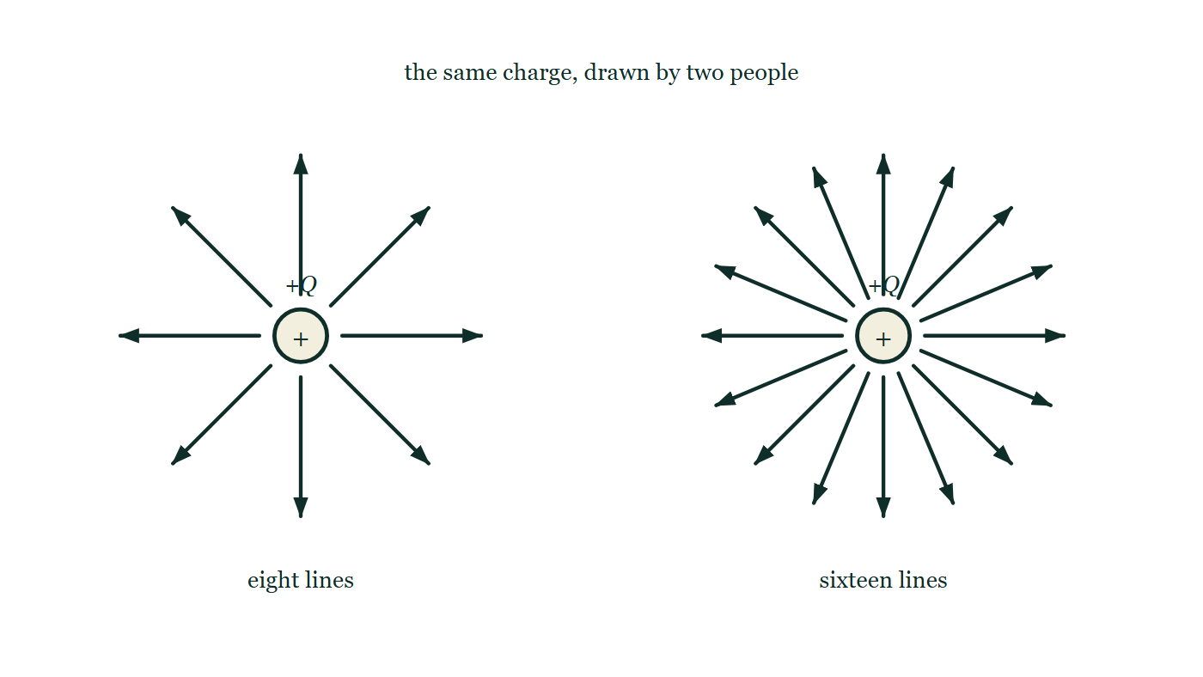
ELECTRIC FIELDS · ELECTRIC FIELD LINES & DIRECTION
GIOPHYSICS LESSON
THINK FIRST
You draw the field of a point charge with eight lines. Your neighbour draws the same charge with sixteen. Whose field is stronger?
Take answers before you click — the point is the commitment
Both diagrams are neatly and correctly drawn, and both are of exactly the same charge in exactly the same place.
THE ANSWER
Neither — it is the same field twice. How many lines to draw is a decision made by whoever is holding the pen; it is not a measurement of anything. What does carry meaning is how the spacing changes WITHIN one diagram: where that map's lines crowd together, that map's field is strong. Compare line counts across two diagrams and you are comparing draughtsmen.
The same positive point charge is drawn twice: on the left eight field lines leave it radially, on the right sixteen leave an identical charge, and both are labelled with the same value of Q.
The live version of this figure — click here
Electric Fields — Electric Field Lines & Direction. Built by GioPhysics from the lesson's own copy; nothing on these slides is re-authored.
3 / 31
Notes:
[Phase] Starter: Recall what this lesson stands on (minutes 0–5 of 45)
[Hook] You draw the field of a point charge with eight lines. Your neighbour draws the same charge with sixteen. Whose field is stronger? Both diagrams are neatly and correctly drawn, and both are of exactly the same charge in exactly the same place.
[Answer] Neither — it is the same field twice. How many lines to draw is a decision made by whoever is holding the pen; it is not a measurement of anything. What does carry meaning is how the spacing changes WITHIN one diagram: where that map's lines crowd together, that map's field is strong. Compare line counts across two diagrams and you are comparing draughtsmen.
[Figure] The same positive point charge is drawn twice: on the left eight field lines leave it radially, on the right sixteen leave an identical charge, and both are labelled with the same value of Q.

Slide 4
ELECTRIC FIELDS · ELECTRIC FIELD LINES & DIRECTION
GIOPHYSICS LESSON
EXPLAINED SIMPLY
In one sentence
Introduce the idea — The big idea and the definition
An electric field line is a drawing whose tangent shows field direction and whose relative spacing shows field strength within one map.
Electric Fields — Electric Field Lines & Direction. Built by GioPhysics from the lesson's own copy; nothing on these slides is re-authored.
4 / 31
Notes:
[Phase] Introduce the idea: The big idea and the definition (minutes 5–13 of 45)
[Definition] An electric field line is a drawing whose tangent shows field direction and whose relative spacing shows field strength within one map.

Slide 5
ELECTRIC FIELDS · ELECTRIC FIELD LINES & DIRECTION
GIOPHYSICS LESSON
EXPLAINED SIMPLY
What that looks like
Introduce the idea — The big idea and the definition
FOR EXAMPLE
Around one positive point charge, field lines point radially outward; a positive test charge would initially accelerate along them.
Electric Fields — Electric Field Lines & Direction. Built by GioPhysics from the lesson's own copy; nothing on these slides is re-authored.
5 / 31
Notes:
[Phase] Introduce the idea: The big idea and the definition (minutes 5–13 of 45)
[Worked illustration] Around one positive point charge, field lines point radially outward; a positive test charge would initially accelerate along them.

Slide 6
ELECTRIC FIELDS · ELECTRIC FIELD LINES & DIRECTION
GIOPHYSICS LESSON
THE BIG IDEA
Read a map without mistaking it for an object
Introduce the idea — The big idea and the definition
Field lines leave positive charges and enter negative charges—or continue to or from infinity. They never cross because the field has one direction at a point. A denser set of lines within one consistently drawn map represents a stronger field, but the chosen number of lines is not itself a measurement.
Electric Fields — Electric Field Lines & Direction. Built by GioPhysics from the lesson's own copy; nothing on these slides is re-authored.
6 / 31
Notes:
[Phase] Introduce the idea: The big idea and the definition (minutes 5–13 of 45)
[Big idea] Field lines leave positive charges and enter negative charges—or continue to or from infinity. They never cross because the field has one direction at a point. A denser set of lines within one consistently drawn map represents a stronger field, but the chosen number of lines is not itself a measurement.

Slide 7
ELECTRIC FIELDS · ELECTRIC FIELD LINES & DIRECTION
GIOPHYSICS LESSON
THE PHYSICS · 1 OF 3
Start and finish
Build the model — The formulae, one at a time, in plain English
Lines originate on positive source charge and terminate on negative source charge. If an opposite charge is not present in the diagram, a line may extend to infinity.
Electric Fields — Electric Field Lines & Direction. Built by GioPhysics from the lesson's own copy; nothing on these slides is re-authored.
7 / 31
Notes:
[Phase] Build the model: The formulae, one at a time, in plain English (minutes 13–22 of 45)
[Section] Lines originate on positive source charge and terminate on negative source charge. If an opposite charge is not present in the diagram, a line may extend to infinity.

Slide 8
ELECTRIC FIELDS · ELECTRIC FIELD LINES & DIRECTION
GIOPHYSICS LESSON
THE PHYSICS · 2 OF 3
Use a tangent
Build the model — The formulae, one at a time, in plain English
At a curved line, the field points along the local tangent—not toward the line's centre of curvature. The force on a negative charge points opposite that tangent.
Electric Fields — Electric Field Lines & Direction. Built by GioPhysics from the lesson's own copy; nothing on these slides is re-authored.
8 / 31
Notes:
[Phase] Build the model: The formulae, one at a time, in plain English (minutes 13–22 of 45)
[Section] At a curved line, the field points along the local tangent—not toward the line's centre of curvature. The force on a negative charge points opposite that tangent.

Slide 9
ELECTRIC FIELDS · ELECTRIC FIELD LINES & DIRECTION
GIOPHYSICS LESSON
THE PHYSICS · 3 OF 3
Interpret density
Build the model — The formulae, one at a time, in plain English
Closer neighbouring lines indicate a larger field magnitude only when the diagram uses one consistent line-drawing convention. Lines are not threads and do not push one another apart.
Electric Fields — Electric Field Lines & Direction. Built by GioPhysics from the lesson's own copy; nothing on these slides is re-authored.
9 / 31
Notes:
[Phase] Build the model: The formulae, one at a time, in plain English (minutes 13–22 of 45)
[Section] Closer neighbouring lines indicate a larger field magnitude only when the diagram uses one consistent line-drawing convention. Lines are not threads and do not push one another apart.

Slide 10
ELECTRIC FIELDS · ELECTRIC FIELD LINES & DIRECTION
GIOPHYSICS LESSON
FORMULA 1 OF 3
Local direction
Build the model — The formulae, one at a time, in plain English
E⃗ ∥ tangent
Follow the arrow on the field line through the point
IN PLAIN ENGLISH
At any point, the field points along the field line passing through it — the arrows are a map of directions.
Electric Fields — Electric Field Lines & Direction. Built by GioPhysics from the lesson's own copy; nothing on these slides is re-authored.
10 / 31
Notes:
[Phase] Build the model: The formulae, one at a time, in plain English (minutes 13–22 of 45)
[Formula] Local direction: E⃗ ∥ tangent
[In plain English] At any point, the field points along the field line passing through it — the arrows are a map of directions.
[Note] Follow the arrow on the field line through the point

Slide 11
ELECTRIC FIELDS · ELECTRIC FIELD LINES & DIRECTION
GIOPHYSICS LESSON
FORMULA 2 OF 3
Positive probe
Build the model — The formulae, one at a time, in plain English
F⃗₊ ∥ E⃗
This convention defines field-line arrows
IN PLAIN ENGLISH
Field-line arrows are drawn the way a positive charge would be pushed.
Electric Fields — Electric Field Lines & Direction. Built by GioPhysics from the lesson's own copy; nothing on these slides is re-authored.
11 / 31
Notes:
[Phase] Build the model: The formulae, one at a time, in plain English (minutes 13–22 of 45)
[Formula] Positive probe: F⃗₊ ∥ E⃗
[In plain English] Field-line arrows are drawn the way a positive charge would be pushed.
[Note] This convention defines field-line arrows

Slide 12
ELECTRIC FIELDS · ELECTRIC FIELD LINES & DIRECTION
GIOPHYSICS LESSON
FORMULA 3 OF 3
Negative probe
Build the model — The formulae, one at a time, in plain English
F⃗₋ antiparallel E⃗
The force reverses; the field map does not
IN PLAIN ENGLISH
A negative charge is pushed against the arrows; the map itself doesn't change, only the response.
Electric Fields — Electric Field Lines & Direction. Built by GioPhysics from the lesson's own copy; nothing on these slides is re-authored.
12 / 31
Notes:
[Phase] Build the model: The formulae, one at a time, in plain English (minutes 13–22 of 45)
[Formula] Negative probe: F⃗₋ antiparallel E⃗
[In plain English] A negative charge is pushed against the arrows; the map itself doesn't change, only the response.
[Note] The force reverses; the field map does not

Slide 13
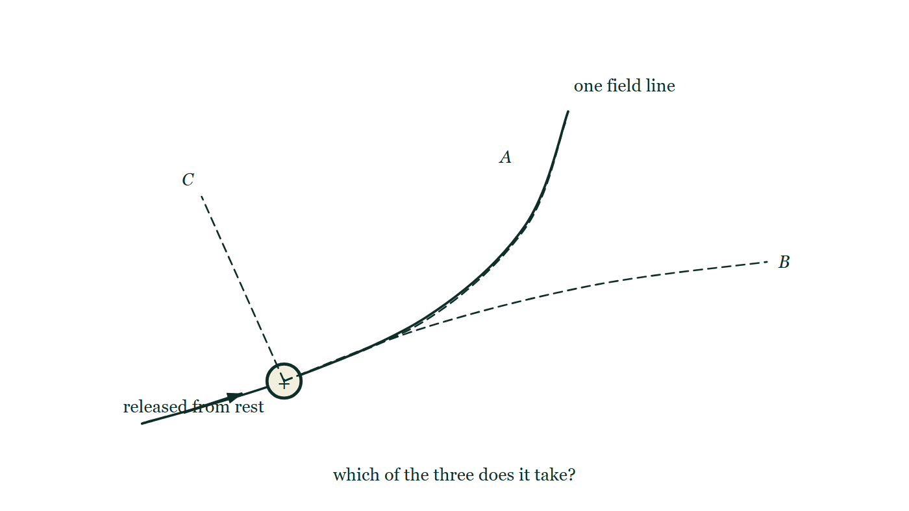
ELECTRIC FIELDS · ELECTRIC FIELD LINES & DIRECTION
GIOPHYSICS LESSON
THE PICTURE
Three ways it might go
Drawn for this lesson
A single curved field line runs across the figure with a charge marked at rest on it, and three dashed candidate paths leave that point: one hugging the line all the way, one setting off along it and then straightening away, one crossing it at right angles.
The live version of this figure — click here
Electric Fields — Electric Field Lines & Direction. Built by GioPhysics from the lesson's own copy; nothing on these slides is re-authored.
13 / 31
Notes:
[Phase] Build the model: The formulae, one at a time, in plain English (minutes 13–22 of 45)
[Figure] A single curved field line runs across the figure with a charge marked at rest on it, and three dashed candidate paths leave that point: one hugging the line all the way, one setting off along it and then straightening away, one crossing it at right angles.

Slide 14
ELECTRIC FIELDS · ELECTRIC FIELD LINES & DIRECTION
GIOPHYSICS LESSON
WATCH OUT
The common trap
Check and misconception — The quick check and the trap
A released charge does not generally trace a curved field line. The tangent gives its instantaneous acceleration; inertia means its later trajectory can differ from the field-line shape.
Electric Fields — Electric Field Lines & Direction. Built by GioPhysics from the lesson's own copy; nothing on these slides is re-authored.
14 / 31
Notes:
[Phase] Check and misconception: The quick check and the trap (minutes 35–41 of 45)
[Misconception] A released charge does not generally trace a curved field line. The tangent gives its instantaneous acceleration; inertia means its later trajectory can differ from the field-line shape.

Slide 15
ELECTRIC FIELDS · ELECTRIC FIELD LINES & DIRECTION
GIOPHYSICS LESSON
WORKED EXAMPLE 1 OF 2 · EASY
The question
Easy
Worked examples — I do, we do — one step revealed at a time
Field lines near a point are drawn close together. What does that indicate, and can two lines ever cross?
Electric Fields — Electric Field Lines & Direction. Built by GioPhysics from the lesson's own copy; nothing on these slides is re-authored.
15 / 31
Notes:
[Phase] Worked examples: I do, we do — one step revealed at a time (minutes 22–35 of 45)
[Question] Field lines near a point are drawn close together. What does that indicate, and can two lines ever cross?
[Answer] Strong field; crossing is impossible

Slide 16
ELECTRIC FIELDS · ELECTRIC FIELD LINES & DIRECTION
GIOPHYSICS LESSON
WORKED EXAMPLE 1 OF 2 · EASY · THE WORKING
How to solve it
Easy
Worked examples — I do, we do — one step revealed at a time
Field lines near a point are drawn close together. What does that indicate, and can two lines ever cross?
1.
Close spacing means a strong field.
2.
Lines never cross — the field has one direction at each point.
Electric Fields — Electric Field Lines & Direction. Built by GioPhysics from the lesson's own copy; nothing on these slides is re-authored.
16 / 31
Notes:
[Phase] Worked examples: I do, we do — one step revealed at a time (minutes 22–35 of 45)
[Reveal] One click per step. The class works each line before the next appears.
[Step 1] Close spacing means a strong field.
[Step 2] Lines never cross — the field has one direction at each point.

Slide 17
ELECTRIC FIELDS · ELECTRIC FIELD LINES & DIRECTION
GIOPHYSICS LESSON
WORKED EXAMPLE 1 OF 2 · EASY
Answer
Easy
Worked examples — I do, we do — one step revealed at a time
Strong field; crossing is impossible
Electric Fields — Electric Field Lines & Direction. Built by GioPhysics from the lesson's own copy; nothing on these slides is re-authored.
17 / 31
Notes:
[Phase] Worked examples: I do, we do — one step revealed at a time (minutes 22–35 of 45)
[Answer] Strong field; crossing is impossible

Slide 18
ELECTRIC FIELDS · ELECTRIC FIELD LINES & DIRECTION
GIOPHYSICS LESSON
WORKED EXAMPLE 2 OF 2 · MEDIUM
The question
Medium
Worked examples — I do, we do — one step revealed at a time
At P, a field line is tangent at 35° north of east and E = 600 N/C. Find the force on a −2.0 nC charge.
Electric Fields — Electric Field Lines & Direction. Built by GioPhysics from the lesson's own copy; nothing on these slides is re-authored.
18 / 31
Notes:
[Phase] Worked examples: I do, we do — one step revealed at a time (minutes 22–35 of 45)
[Question] At P, a field line is tangent at 35° north of east and E = 600 N/C. Find the force on a −2.0 nC charge.
[Answer] F = 1.2 μN, 35° south of west

Slide 19
ELECTRIC FIELDS · ELECTRIC FIELD LINES & DIRECTION
GIOPHYSICS LESSON
WORKED EXAMPLE 2 OF 2 · MEDIUM · THE WORKING
How to solve it
Medium
Worked examples — I do, we do — one step revealed at a time
At P, a field line is tangent at 35° north of east and E = 600 N/C. Find the force on a −2.0 nC charge.
1.
The field vector points 35° north of east because that is the arrowed tangent.
2.
Magnitude: |F| = |q|E = (2.0 × 10⁻⁹)(600) = 1.2 × 10⁻⁶ N.
3.
The charge is negative, so its force points opposite the field tangent.
Electric Fields — Electric Field Lines & Direction. Built by GioPhysics from the lesson's own copy; nothing on these slides is re-authored.
19 / 31
Notes:
[Phase] Worked examples: I do, we do — one step revealed at a time (minutes 22–35 of 45)
[Reveal] One click per step. The class works each line before the next appears.
[Step 1] The field vector points 35° north of east because that is the arrowed tangent.
[Step 2] Magnitude: |F| = |q|E = (2.0 × 10⁻⁹)(600) = 1.2 × 10⁻⁶ N.
[Step 3] The charge is negative, so its force points opposite the field tangent.

Slide 20
ELECTRIC FIELDS · ELECTRIC FIELD LINES & DIRECTION
GIOPHYSICS LESSON
WORKED EXAMPLE 2 OF 2 · MEDIUM
Answer
Medium
Worked examples — I do, we do — one step revealed at a time
F = 1.2 μN, 35° south of west
Electric Fields — Electric Field Lines & Direction. Built by GioPhysics from the lesson's own copy; nothing on these slides is re-authored.
20 / 31
Notes:
[Phase] Worked examples: I do, we do — one step revealed at a time (minutes 22–35 of 45)
[Answer] F = 1.2 μN, 35° south of west

Slide 21
ELECTRIC FIELDS · ELECTRIC FIELD LINES & DIRECTION
GIOPHYSICS LESSON
PREDICT · TAKE THE VOTE
Commit before you are told
Hands up for each option, then click
A charge is released from rest at the marked point on this curved field line. Which path does it take?
A Along the field line — that is what the line is for
B Off along the line at first, then away from it as it picks up speed
C At right angles to the line
A single curved field line runs across the figure with a charge marked at rest on it, and three dashed candidate paths leave that point: one hugging the line all the way, one setting off along it and then straightening away, one crossing it at right angles.
The live version of this figure — click here
Electric Fields — Electric Field Lines & Direction. Built by GioPhysics from the lesson's own copy; nothing on these slides is re-authored.
21 / 31
Notes:
[Phase] Build the model: The formulae, one at a time, in plain English (minutes 13–22 of 45)
[Predict] A charge is released from rest at the marked point on this curved field line. Which path does it take?
[Options] A Along the field line — that is what the line is for B Off along the line at first, then away from it as it picks up speed C At right angles to the line
[Figure] A single curved field line runs across the figure with a charge marked at rest on it, and three dashed candidate paths leave that point: one hugging the line all the way, one setting off along it and then straightening away, one crossing it at right angles.

Slide 22
ELECTRIC FIELDS · ELECTRIC FIELD LINES & DIRECTION
GIOPHYSICS LESSON
PREDICT · THE OUTCOME
What actually happens
Ask the room who changed their mind, and why
B Off along the line at first, then away from it as it picks up speed
WHY
From rest, the first thing that happens is an acceleration along the tangent, so the charge does set off along the line. But the instant it has velocity it has inertia, and the field at the next point pulls in a slightly different direction — so the path bends less sharply than the line does, exactly as a car on a curve wants to run wide. A field line gives the force at a point, never the path from it. The two coincide only when the line is straight.
Electric Fields — Electric Field Lines & Direction. Built by GioPhysics from the lesson's own copy; nothing on these slides is re-authored.
22 / 31
Notes:
[Phase] Build the model: The formulae, one at a time, in plain English (minutes 13–22 of 45)
[Answer] B — Off along the line at first, then away from it as it picks up speed. From rest, the first thing that happens is an acceleration along the tangent, so the charge does set off along the line. But the instant it has velocity it has inertia, and the field at the next point pulls in a slightly different direction — so the path bends less sharply than the line does, exactly as a car on a curve wants to run wide. A field line gives the force at a point, never the path from it. The two coincide only when the line is straight.

Slide 23
ELECTRIC FIELDS · ELECTRIC FIELD LINES & DIRECTION
GIOPHYSICS LESSON
QUICK CHECK
Decide before the answer goes up
Check and misconception — The quick check and the trap
Why can two electric field lines never cross?
A
They physically repel
B
The field cannot have two directions at one point
C
Each line contains charge
Electric Fields — Electric Field Lines & Direction. Built by GioPhysics from the lesson's own copy; nothing on these slides is re-authored.
23 / 31
Notes:
[Phase] Check and misconception: The quick check and the trap (minutes 35–41 of 45)
[Question] Why can two electric field lines never cross?
[Options] A They physically repel B The field cannot have two directions at one point C Each line contains charge

Slide 24
ELECTRIC FIELDS · ELECTRIC FIELD LINES & DIRECTION
GIOPHYSICS LESSON
QUICK CHECK · THE ANSWER
The answer, and why
Check and misconception — The quick check and the trap
B The field cannot have two directions at one point
HOW TO GET THERE
A crossing would assign two different electric-field directions to the same point. Field lines are a representation, not physical strands.
WHY THE OTHERS TEMPT
A Lines drawn from one charge do spread apart, so it looks as though they are shoving one another. They are a drawing of the field, though, not something in it — there is nothing physical there to do any shoving. The spreading IS the field getting weaker, drawn.
B Correct. A crossing point would have to be given two field directions at once, and a point has only one.
C Lines are drawn through empty space where there is no charge at all. If each line carried charge, a field map of a single electron would contain a great deal more charge than the electron does.
Electric Fields — Electric Field Lines & Direction. Built by GioPhysics from the lesson's own copy; nothing on these slides is re-authored.
24 / 31
Notes:
[Phase] Check and misconception: The quick check and the trap (minutes 35–41 of 45)
[Question] Why can two electric field lines never cross?
[Option by option] A: Lines drawn from one charge do spread apart, so it looks as though they are shoving one another. They are a drawing of the field, though, not something in it — there is nothing physical there to do any shoving. The spreading IS the field getting weaker, drawn. B: Correct. A crossing point would have to be given two field directions at once, and a point has only one. C: Lines are drawn through empty space where there is no charge at all. If each line carried charge, a field map of a single electron would contain a great deal more charge than the electron does.
[Answer] B — The field cannot have two directions at one point
[Why] A crossing would assign two different electric-field directions to the same point. Field lines are a representation, not physical strands.
[Reveal] One click for the answer, then one for the reason.

Slide 25
ELECTRIC FIELDS · ELECTRIC FIELD LINES & DIRECTION
GIOPHYSICS LESSON
EXTENSION 1 OF 2 · HARD
The question
Hard
Worked examples — I do, we do — one step revealed at a time
Sketch-reason the field of a dipole (+q and −q): where is the field strongest, and what happens on the perpendicular bisector?
Electric Fields — Electric Field Lines & Direction. Built by GioPhysics from the lesson's own copy; nothing on these slides is re-authored.
25 / 31
Notes:
[Phase] Worked examples: I do, we do — one step revealed at a time (minutes 22–35 of 45)
[Question] Sketch-reason the field of a dipole (+q and −q): where is the field strongest, and what happens on the perpendicular bisector?
[Answer] Strongest between the charges; bisector field is parallel to the axis, anti-dipole

Slide 26
ELECTRIC FIELDS · ELECTRIC FIELD LINES & DIRECTION
GIOPHYSICS LESSON
EXTENSION 1 OF 2 · HARD · THE WORKING
How to solve it
Hard
Worked examples — I do, we do — one step revealed at a time
Sketch-reason the field of a dipole (+q and −q): where is the field strongest, and what happens on the perpendicular bisector?
1.
Lines leave +q and land on −q, crowding in the gap — strongest between the charges.
2.
On the bisector the two contributions' horizontal parts cancel; the resultant points from + side to − side, parallel to the dipole axis.
3.
Far away the field weakens faster than a point charge's (1/r³) because the pair partially cancels.
Electric Fields — Electric Field Lines & Direction. Built by GioPhysics from the lesson's own copy; nothing on these slides is re-authored.
26 / 31
Notes:
[Phase] Worked examples: I do, we do — one step revealed at a time (minutes 22–35 of 45)
[Reveal] One click per step. The class works each line before the next appears.
[Step 1] Lines leave +q and land on −q, crowding in the gap — strongest between the charges.
[Step 2] On the bisector the two contributions' horizontal parts cancel; the resultant points from + side to − side, parallel to the dipole axis.
[Step 3] Far away the field weakens faster than a point charge's (1/r³) because the pair partially cancels.

Slide 27
ELECTRIC FIELDS · ELECTRIC FIELD LINES & DIRECTION
GIOPHYSICS LESSON
EXTENSION 1 OF 2 · HARD
Answer
Hard
Worked examples — I do, we do — one step revealed at a time
Strongest between the charges; bisector field is parallel to the axis, anti-dipole
Electric Fields — Electric Field Lines & Direction. Built by GioPhysics from the lesson's own copy; nothing on these slides is re-authored.
27 / 31
Notes:
[Phase] Worked examples: I do, we do — one step revealed at a time (minutes 22–35 of 45)
[Answer] Strongest between the charges; bisector field is parallel to the axis, anti-dipole

Slide 28
ELECTRIC FIELDS · ELECTRIC FIELD LINES & DIRECTION
GIOPHYSICS LESSON
EXTENSION 2 OF 2 · CHALLENGING
The question
Challenging
Worked examples — I do, we do — one step revealed at a time
A −2.0 μC charge at P sits where the field line runs 35° north of east with E = 600 N/C. Give the force vector on the charge and explain why the charge then LEAVES the field line as it moves.
Electric Fields — Electric Field Lines & Direction. Built by GioPhysics from the lesson's own copy; nothing on these slides is re-authored.
28 / 31
Notes:
[Phase] Worked examples: I do, we do — one step revealed at a time (minutes 22–35 of 45)
[Question] A −2.0 μC charge at P sits where the field line runs 35° north of east with E = 600 N/C. Give the force vector on the charge and explain why the charge then LEAVES the field line as it moves.
[Answer] 1.2 mN at 35° S of W; lines give force, not paths — inertia bends the trajectory off the line

Slide 29
ELECTRIC FIELDS · ELECTRIC FIELD LINES & DIRECTION
GIOPHYSICS LESSON
EXTENSION 2 OF 2 · CHALLENGING · THE WORKING
How to solve it
Challenging
Worked examples — I do, we do — one step revealed at a time
A −2.0 μC charge at P sits where the field line runs 35° north of east with E = 600 N/C. Give the force vector on the charge and explain why the charge then LEAVES the field line as it moves.
1.
F = qE = 1.2 × 10⁻³ N at 35° south of west (negative charge reverses direction).
2.
Field lines show force direction, not trajectories.
3.
A moving charge has inertia: its curved path depends on velocity too, so it generally departs from the line except when starting at rest in a straight-line field.
Electric Fields — Electric Field Lines & Direction. Built by GioPhysics from the lesson's own copy; nothing on these slides is re-authored.
29 / 31
Notes:
[Phase] Worked examples: I do, we do — one step revealed at a time (minutes 22–35 of 45)
[Reveal] One click per step. The class works each line before the next appears.
[Step 1] F = qE = 1.2 × 10⁻³ N at 35° south of west (negative charge reverses direction).
[Step 2] Field lines show force direction, not trajectories.
[Step 3] A moving charge has inertia: its curved path depends on velocity too, so it generally departs from the line except when starting at rest in a straight-line field.

Slide 30
ELECTRIC FIELDS · ELECTRIC FIELD LINES & DIRECTION
GIOPHYSICS LESSON
EXTENSION 2 OF 2 · CHALLENGING
Answer
Challenging
Worked examples — I do, we do — one step revealed at a time
1.2 mN at 35° S of W; lines give force, not paths — inertia bends the trajectory off the line
Electric Fields — Electric Field Lines & Direction. Built by GioPhysics from the lesson's own copy; nothing on these slides is re-authored.
30 / 31
Notes:
[Phase] Worked examples: I do, we do — one step revealed at a time (minutes 22–35 of 45)
[Answer] 1.2 mN at 35° S of W; lines give force, not paths — inertia bends the trajectory off the line

Slide 31
ELECTRIC FIELDS · ELECTRIC FIELD LINES & DIRECTION
GIOPHYSICS LESSON
ELECTRIC FIELDS
Where to go next
Plenary — What to take away, what to practise next
Next
11.3 Point-Charge Fields
https://giophysics.com/chapter-20/point-charge-fields/
Lesson
This lesson on giophysics.com
https://giophysics.com/chapter-20/electric-field-lines-direction/
Live
The live, interactive version of these slides
https://giophysics.com/chapter-20/presentation/?lesson=lines
Chapter
All Electric Fields lessons
https://giophysics.com/chapter-20/
PDF
Download the lesson PDF
https://giophysics.com/downloads/20-2-electric-field-lines-direction.pdf
Electric Fields — Electric Field Lines & Direction. Built by GioPhysics from the lesson's own copy; nothing on these slides is re-authored.
31 / 31
Notes:
[Phase] Plenary: What to take away, what to practise next (minutes 41–45 of 45)
[Interactive] The graphs and the circuit topology on these slides are frozen. The live version at https://giophysics.com/chapter-20/presentation/?lesson=lines moves them.

