Slide 1
ELECTRIC POTENTIAL · PARALLEL PLATES AND CAPACITORS
GIOPHYSICS LESSON
12 · Electric Potential
Geometry links field, charge and energy
Parallel Plates and Capacitors
Oppositely charged plates create an approximately uniform interior field. A capacitor stores separated charge and energy in that field.
POSITION
Lesson 6 of 7 in Electric Potential
PLAN
16 slides in the 45-minute core run, about 43 minutes of it
LESSON PAGE
https://giophysics.com/chapter-21/parallel-plates-capacitors/
Built by GioPhysics from the lesson's own page. Every word on these slides is the lesson's; nothing here is re-authored. Teaching material, not an awarding body's document.
Electric Potential — Parallel Plates and Capacitors. Built by GioPhysics from the lesson's own copy; nothing on these slides is re-authored.
1 / 44
Notes:
[Lesson] Electric Potential — Parallel Plates and Capacitors. Lesson 6 of 7.
[Intro] Oppositely charged plates create an approximately uniform interior field. A capacitor stores separated charge and energy in that field.
[Source] https://giophysics.com/chapter-21/parallel-plates-capacitors/
[Disclaimer] Built by GioPhysics from the lesson's own page. Every word on these slides is the lesson's; nothing here is re-authored. Teaching material, not an awarding body's document.

Slide 2
ELECTRIC POTENTIAL · PARALLEL PLATES AND CAPACITORS
GIOPHYSICS LESSON
WHAT THIS NEEDS
What you already know
Starter — Recall what this lesson stands on
Recall
Uniform fields and plates
https://giophysics.com/chapter-20/uniform-fields-parallel-plates/
Recall
Potential gradient
https://giophysics.com/chapter-21/equipotentials-work-field-gradient/
Electric Potential — Parallel Plates and Capacitors. Built by GioPhysics from the lesson's own copy; nothing on these slides is re-authored.
2 / 44
Notes:
[Phase] Starter: Recall what this lesson stands on (minutes 0–5 of 45)
[Starter] Recall: Uniform fields and plates; Potential gradient

Slide 3
ELECTRIC POTENTIAL · PARALLEL PLATES AND CAPACITORS
GIOPHYSICS LESSON
THINK FIRST
A charged capacitor carries +Q on one plate and −Q on the other. So how much charge is stored in it?
Take answers before you click — the point is the commitment
A fully charged camera-flash capacitor will light a whole room for an instant, so it plainly holds something.
THE ANSWER
Net, it holds nothing at all: +Q and −Q add to zero. What has been stored is the SEPARATION — the work done stripping charge off one plate and forcing it onto the other — and that energy sits in the field between them, which is why it comes out the instant the charge is given a path back.
Electric Potential — Parallel Plates and Capacitors. Built by GioPhysics from the lesson's own copy; nothing on these slides is re-authored.
3 / 44
Notes:
[Phase] Starter: Recall what this lesson stands on (minutes 0–5 of 45)
[Hook] A charged capacitor carries +Q on one plate and −Q on the other. So how much charge is stored in it? A fully charged camera-flash capacitor will light a whole room for an instant, so it plainly holds something.
[Answer] Net, it holds nothing at all: +Q and −Q add to zero. What has been stored is the SEPARATION — the work done stripping charge off one plate and forcing it onto the other — and that energy sits in the field between them, which is why it comes out the instant the charge is given a path back.

Slide 4
ELECTRIC POTENTIAL · PARALLEL PLATES AND CAPACITORS
GIOPHYSICS LESSON
EXPLAINED SIMPLY
In one sentence
Introduce the idea — The big idea and the definition
A capacitor is two conductors separated by an insulator that store equal and opposite charge and energy in the electric field between them.
Electric Potential — Parallel Plates and Capacitors. Built by GioPhysics from the lesson's own copy; nothing on these slides is re-authored.
4 / 44
Notes:
[Phase] Introduce the idea: The big idea and the definition (minutes 5–13 of 45)
[Definition] A capacitor is two conductors separated by an insulator that store equal and opposite charge and energy in the electric field between them.

Slide 5
ELECTRIC POTENTIAL · PARALLEL PLATES AND CAPACITORS
GIOPHYSICS LESSON
EXPLAINED SIMPLY
What that looks like
Introduce the idea — The big idea and the definition
FOR EXAMPLE
A camera-flash capacitor stores separated charge, then releases its electric energy quickly to produce a bright flash.
Electric Potential — Parallel Plates and Capacitors. Built by GioPhysics from the lesson's own copy; nothing on these slides is re-authored.
5 / 44
Notes:
[Phase] Introduce the idea: The big idea and the definition (minutes 5–13 of 45)
[Worked illustration] A camera-flash capacitor stores separated charge, then releases its electric energy quickly to produce a bright flash.

Slide 6
ELECTRIC POTENTIAL · PARALLEL PLATES AND CAPACITORS
GIOPHYSICS LESSON
THE BIG IDEA
Geometry links field, charge and energy
Introduce the idea — The big idea and the definition
Away from the plate edges, potential changes almost linearly across a parallel-plate gap. The field magnitude is |ΔV|/d. Capacitance measures charge separation per volt and is set by geometry and dielectric—not by the present values of Q and ΔV for an ideal linear capacitor.
Electric Potential — Parallel Plates and Capacitors. Built by GioPhysics from the lesson's own copy; nothing on these slides is re-authored.
6 / 44
Notes:
[Phase] Introduce the idea: The big idea and the definition (minutes 5–13 of 45)
[Big idea] Away from the plate edges, potential changes almost linearly across a parallel-plate gap. The field magnitude is |ΔV|/d. Capacitance measures charge separation per volt and is set by geometry and dielectric—not by the present values of Q and ΔV for an ideal linear capacitor.

Slide 7
ELECTRIC POTENTIAL · PARALLEL PLATES AND CAPACITORS
GIOPHYSICS LESSON
THE PHYSICS · 1 OF 4
Uniform interior model
Build the model — The formulae, one at a time, in plain English
Parallel, closely spaced plates give nearly straight field lines inside. Fringing near the edges is the main departure from uniformity.
Electric Potential — Parallel Plates and Capacitors. Built by GioPhysics from the lesson's own copy; nothing on these slides is re-authored.
7 / 44
Notes:
[Phase] Build the model: The formulae, one at a time, in plain English (minutes 13–22 of 45)
[Section] Parallel, closely spaced plates give nearly straight field lines inside. Fringing near the edges is the main departure from uniformity.

Slide 8
ELECTRIC POTENTIAL · PARALLEL PLATES AND CAPACITORS
GIOPHYSICS LESSON
THE PHYSICS · 2 OF 4
Capacitance is structural
Build the model — The formulae, one at a time, in plain English
Larger plate area and larger dielectric permittivity increase C; greater plate separation decreases C.
Electric Potential — Parallel Plates and Capacitors. Built by GioPhysics from the lesson's own copy; nothing on these slides is re-authored.
8 / 44
Notes:
[Phase] Build the model: The formulae, one at a time, in plain English (minutes 13–22 of 45)
[Section] Larger plate area and larger dielectric permittivity increase C; greater plate separation decreases C.

Slide 9
ELECTRIC POTENTIAL · PARALLEL PLATES AND CAPACITORS
GIOPHYSICS LESSON
THE PHYSICS · 3 OF 4
Charge is separated
Build the model — The formulae, one at a time, in plain English
The plates carry +Q and −Q, so an ideal capacitor's net charge is zero even while it stores electric-field energy.
Electric Potential — Parallel Plates and Capacitors. Built by GioPhysics from the lesson's own copy; nothing on these slides is re-authored.
9 / 44
Notes:
[Phase] Build the model: The formulae, one at a time, in plain English (minutes 13–22 of 45)
[Section] The plates carry +Q and −Q, so an ideal capacitor's net charge is zero even while it stores electric-field energy.

Slide 10
ELECTRIC POTENTIAL · PARALLEL PLATES AND CAPACITORS
GIOPHYSICS LESSON
THE PHYSICS · 4 OF 4
Combining capacitors
Build the model — The formulae, one at a time, in plain English
Two capacitors across the same pair of points must have the same ΔV, so Q = C₁ΔV + C₂ΔV, and dividing by ΔV gives C = C₁ + C₂: capacitances add in parallel. In a series chain the conductor between neighbouring plates is isolated and started neutral, so charge there can only be separated, never added, and every capacitor ends up with the same |Q|.
The p.d.s add, ΔV = Q/C₁ + Q/C₂, and dividing by Q gives 1/C = 1/C₁ + 1/C₂. Note the reversal against resistors — capacitors add directly in parallel and reciprocally in series, because a capacitor's job is to store charge rather than to obstruct it.
Electric Potential — Parallel Plates and Capacitors. Built by GioPhysics from the lesson's own copy; nothing on these slides is re-authored.
10 / 44
Notes:
[Phase] Build the model: The formulae, one at a time, in plain English (minutes 13–22 of 45)
[Section] Two capacitors across the same pair of points must have the same ΔV, so Q = C₁ΔV + C₂ΔV, and dividing by ΔV gives C = C₁ + C₂: capacitances add in parallel. In a series chain the conductor between neighbouring plates is isolated and started neutral, so charge there can only be separated, never added, and every capacitor ends up with the same |Q|. The p.d.s add, ΔV = Q/C₁ + Q/C₂, and dividing by Q gives 1/C = 1/C₁ + 1/C₂. Note the reversal against resistors — capacitors add directly in parallel and reciprocally in series, because a capacitor's job is to store charge rather than to obstruct it.

Slide 11
ELECTRIC POTENTIAL · PARALLEL PLATES AND CAPACITORS
GIOPHYSICS LESSON
FORMULA 1 OF 5
Uniform plate field
Build the model — The formulae, one at a time, in plain English
|E| = |ΔV|/d
Direction is from the positive plate to the negative plate
IN PLAIN ENGLISH
Between parallel plates: voltage difference divided by gap, pointing from the positive plate to the negative.
Electric Potential — Parallel Plates and Capacitors. Built by GioPhysics from the lesson's own copy; nothing on these slides is re-authored.
11 / 44
Notes:
[Phase] Build the model: The formulae, one at a time, in plain English (minutes 13–22 of 45)
[Formula] Uniform plate field: |E| = |ΔV|/d
[In plain English] Between parallel plates: voltage difference divided by gap, pointing from the positive plate to the negative.
[Note] Direction is from the positive plate to the negative plate

Slide 12
ELECTRIC POTENTIAL · PARALLEL PLATES AND CAPACITORS
GIOPHYSICS LESSON
FORMULA 2 OF 5
Capacitance
Build the model — The formulae, one at a time, in plain English
C = |Q|/|ΔV|
Parallel plates: C = ε₀εᵣA/d
IN PLAIN ENGLISH
A capacitor's capacity: how much charge it holds for each volt across it.
Electric Potential — Parallel Plates and Capacitors. Built by GioPhysics from the lesson's own copy; nothing on these slides is re-authored.
12 / 44
Notes:
[Phase] Build the model: The formulae, one at a time, in plain English (minutes 13–22 of 45)
[Formula] Capacitance: C = |Q|/|ΔV|
[In plain English] A capacitor's capacity: how much charge it holds for each volt across it.
[Note] Parallel plates: C = ε₀εᵣA/d

Slide 13
ELECTRIC POTENTIAL · PARALLEL PLATES AND CAPACITORS
GIOPHYSICS LESSON
FORMULA 3 OF 5
Stored energy
Build the model — The formulae, one at a time, in plain English
Uc = ½C(ΔV)²
Also ½QΔV = Q²/(2C)
IN PLAIN ENGLISH
The energy banked in a charged capacitor — growing with the square of the voltage.
Electric Potential — Parallel Plates and Capacitors. Built by GioPhysics from the lesson's own copy; nothing on these slides is re-authored.
13 / 44
Notes:
[Phase] Build the model: The formulae, one at a time, in plain English (minutes 13–22 of 45)
[Formula] Stored energy: Uc = ½C(ΔV)²
[In plain English] The energy banked in a charged capacitor — growing with the square of the voltage.
[Note] Also ½QΔV = Q²/(2C)

Slide 14
ELECTRIC POTENTIAL · PARALLEL PLATES AND CAPACITORS
GIOPHYSICS LESSON
FORMULA 4 OF 5
Capacitors in parallel
Build the model — The formulae, one at a time, in plain English
C = C₁ + C₂ + …
Same p.d. across each, so the charges add
IN PLAIN ENGLISH
Side by side across the same two points, every capacitor has the same ΔV. Parallel behaves like one capacitor with a larger plate area.
Electric Potential — Parallel Plates and Capacitors. Built by GioPhysics from the lesson's own copy; nothing on these slides is re-authored.
14 / 44
Notes:
[Phase] Build the model: The formulae, one at a time, in plain English (minutes 13–22 of 45)
[Formula] Capacitors in parallel: C = C₁ + C₂ + …
[In plain English] Side by side across the same two points, every capacitor has the same ΔV. Parallel behaves like one capacitor with a larger plate area.
[Note] Same p.d. across each, so the charges add

Slide 15
ELECTRIC POTENTIAL · PARALLEL PLATES AND CAPACITORS
GIOPHYSICS LESSON
FORMULA 5 OF 5
Capacitors in series
Build the model — The formulae, one at a time, in plain English
1/C = 1/C₁ + 1/C₂ + …
Same charge on each, so the p.d.s add
IN PLAIN ENGLISH
In a single chain every capacitor carries the same charge. The total is always smaller than the smallest capacitor in the chain.
Electric Potential — Parallel Plates and Capacitors. Built by GioPhysics from the lesson's own copy; nothing on these slides is re-authored.
15 / 44
Notes:
[Phase] Build the model: The formulae, one at a time, in plain English (minutes 13–22 of 45)
[Formula] Capacitors in series: 1/C = 1/C₁ + 1/C₂ + …
[In plain English] In a single chain every capacitor carries the same charge. The total is always smaller than the smallest capacitor in the chain.
[Note] Same charge on each, so the p.d.s add

Slide 16
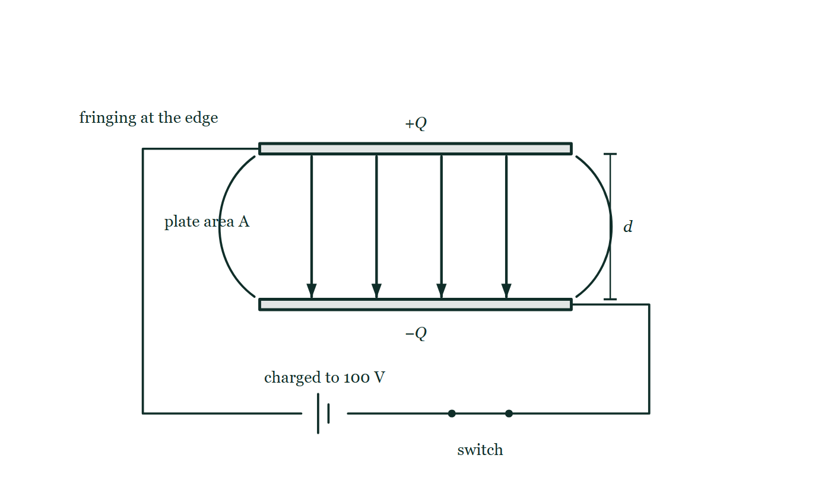
ELECTRIC POTENTIAL · PARALLEL PLATES AND CAPACITORS
GIOPHYSICS LESSON
PICTURE 1 OF 2
The field between the plates
Drawn for this lesson
Two parallel plates a distance d apart, charged to 100 V by a cell through a closed switch, with four arrows crossing the gap from the positive upper plate to the negative lower one and the field curving outward at both edges.
The live version of this figure — click here
Electric Potential — Parallel Plates and Capacitors. Built by GioPhysics from the lesson's own copy; nothing on these slides is re-authored.
16 / 44
Notes:
[Phase] Build the model: The formulae, one at a time, in plain English (minutes 13–22 of 45)
[Figure] Two parallel plates a distance d apart, charged to 100 V by a cell through a closed switch, with four arrows crossing the gap from the positive upper plate to the negative lower one and the field curving outward at both edges.

Slide 17
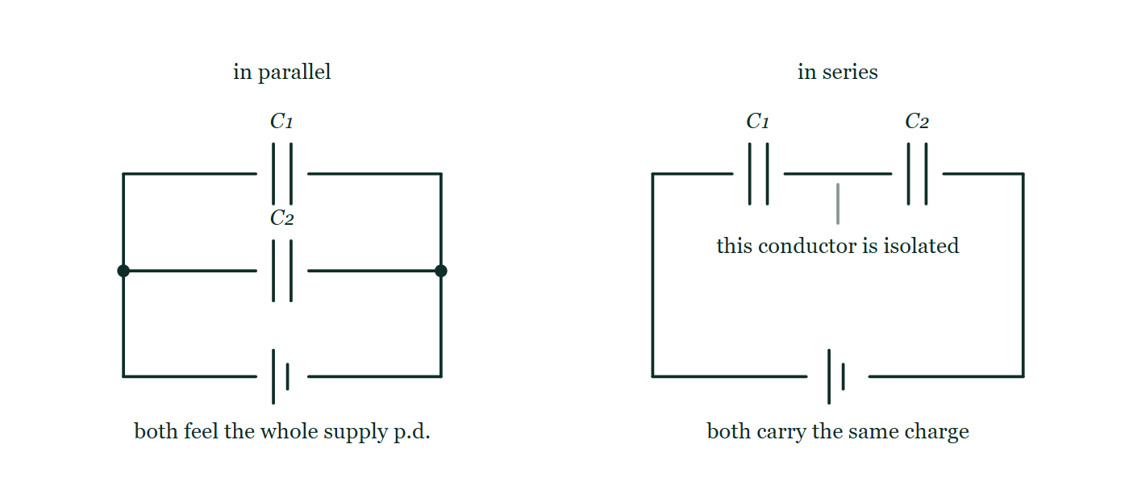
ELECTRIC POTENTIAL · PARALLEL PLATES AND CAPACITORS
GIOPHYSICS LESSON
PICTURE 2 OF 2
Two ways to combine them
Drawn for this lesson
The same two capacitors drawn twice on the same supply: first as two branches bridging one pair of points, then as a single chain in which the conductor between them touches nothing else.
The live version of this figure — click here
Electric Potential — Parallel Plates and Capacitors. Built by GioPhysics from the lesson's own copy; nothing on these slides is re-authored.
17 / 44
Notes:
[Phase] Build the model: The formulae, one at a time, in plain English (minutes 13–22 of 45)
[Figure] The same two capacitors drawn twice on the same supply: first as two branches bridging one pair of points, then as a single chain in which the conductor between them touches nothing else.

Slide 18
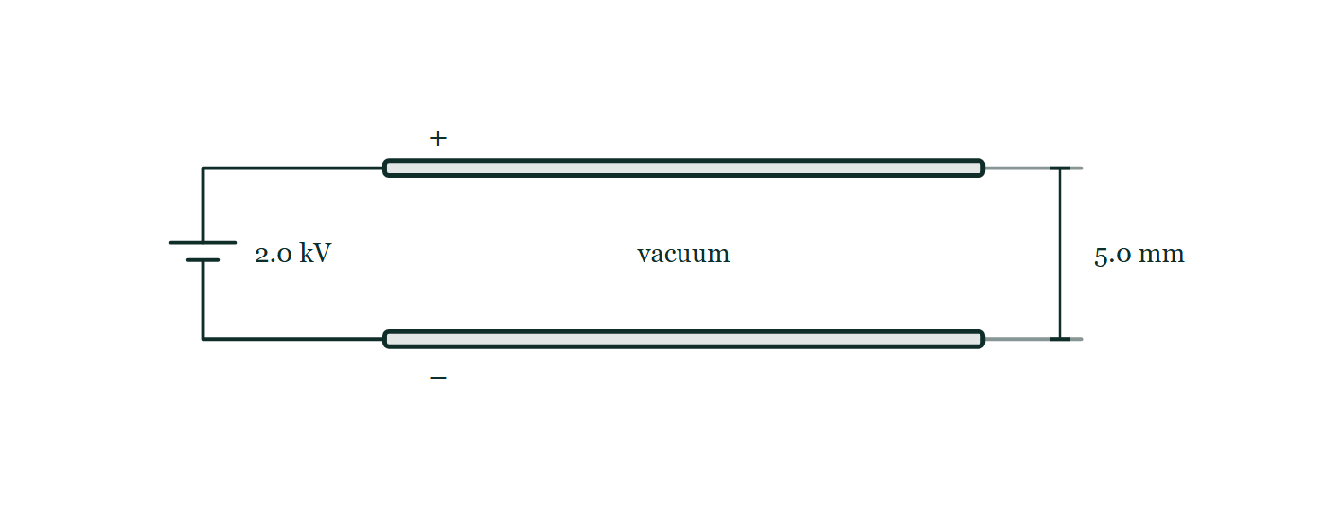
ELECTRIC POTENTIAL · PARALLEL PLATES AND CAPACITORS
GIOPHYSICS LESSON
FIGURE 1 OF 5
Fig. 10.1 — A Level · Topics 12–25
Drawn for question 10 of that paper · syllabus 18, 19, 20
Two long horizontal metal plates are drawn one directly above the other and connected by wires at their left-hand ends to a battery labelled 2.0 kV; the upper plate carries a plus sign and the lower plate a minus sign. The space between the plates is empty and labelled vacuum, and a dimension at the right-hand end gives the separation of the plates as 5.0 mm. No field lines are drawn between the plates.
See the question this was drawn for — click here
Electric Potential — Parallel Plates and Capacitors. Built by GioPhysics from the lesson's own copy; nothing on these slides is re-authored.
18 / 44
Notes:
[Phase] Build the model: The formulae, one at a time, in plain English (minutes 13–22 of 45)
[Figure] Fig. 10.1. Two long horizontal metal plates are drawn one directly above the other and connected by wires at their left-hand ends to a battery labelled 2.0 kV; the upper plate carries a plus sign and the lower plate a minus sign. The space between the plates is empty and labelled vacuum, and a dimension at the right-hand end gives the separation of the plates as 5.0 mm. No field lines are drawn between the plates.
[Where it came from] A Level · Topics 12–25, question 10; syllabus 18, 19, 20.

Slide 19
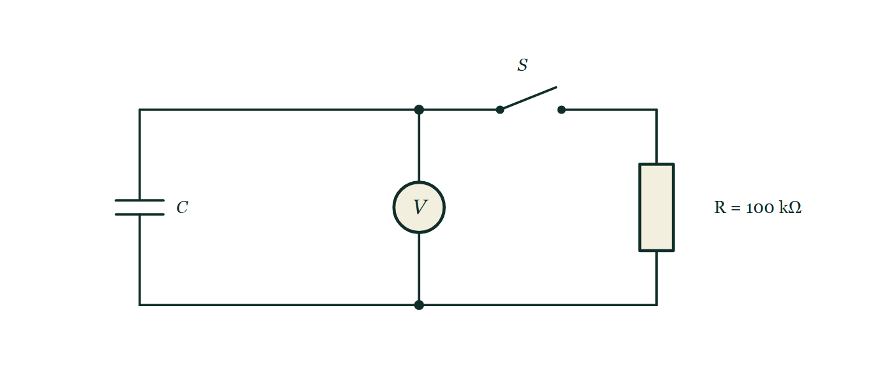
ELECTRIC POTENTIAL · PARALLEL PLATES AND CAPACITORS
GIOPHYSICS LESSON
FIGURE 2 OF 5
Fig. 12.1 — A Level · Topics 12–25
Drawn for question 12 of that paper · syllabus 19, 23
A circuit with three branches between an upper and a lower horizontal wire. On the left is a capacitor labelled C; in the middle is a voltmeter connected permanently across it, with junction dots where its branch joins each of the two wires; on the right is a resistor labelled R = 100 kΩ. An open switch S lies in the upper wire between the voltmeter branch and the resistor branch, so that closing it connects the resistor across the capacitor.
See the question this was drawn for — click here
Electric Potential — Parallel Plates and Capacitors. Built by GioPhysics from the lesson's own copy; nothing on these slides is re-authored.
19 / 44
Notes:
[Phase] Build the model: The formulae, one at a time, in plain English (minutes 13–22 of 45)
[Figure] Fig. 12.1. A circuit with three branches between an upper and a lower horizontal wire. On the left is a capacitor labelled C; in the middle is a voltmeter connected permanently across it, with junction dots where its branch joins each of the two wires; on the right is a resistor labelled R = 100 kΩ. An open switch S lies in the upper wire between the voltmeter branch and the resistor branch, so that closing it connects the resistor across the capacitor.
[Where it came from] A Level · Topics 12–25, question 12; syllabus 19, 23.

Slide 20
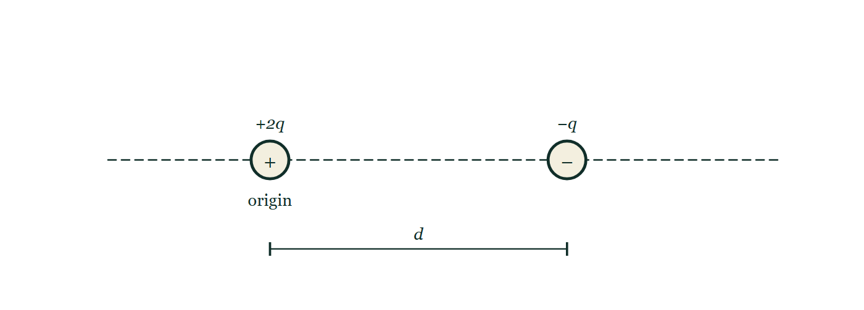
ELECTRIC POTENTIAL · PARALLEL PLATES AND CAPACITORS
GIOPHYSICS LESSON
FIGURE 3 OF 5
Figure 4 — AP Physics 2 · Algebra-Based
Drawn for question 8 of that paper · syllabus 10
Two point charges rest on a long horizontal dashed line that extends well beyond both of them. On the left, at a point labelled "origin", is a circle containing a plus sign, labelled +2q. A distance to the right of it is a circle containing a minus sign, labelled −q, and that separation is marked d by a dimension line drawn between the two centres below the charges. Nothing else is marked anywhere on the line, in either direction.
See the question this was drawn for — click here
Electric Potential — Parallel Plates and Capacitors. Built by GioPhysics from the lesson's own copy; nothing on these slides is re-authored.
20 / 44
Notes:
[Phase] Build the model: The formulae, one at a time, in plain English (minutes 13–22 of 45)
[Figure] Figure 4. Two point charges rest on a long horizontal dashed line that extends well beyond both of them. On the left, at a point labelled "origin", is a circle containing a plus sign, labelled +2q. A distance to the right of it is a circle containing a minus sign, labelled −q, and that separation is marked d by a dimension line drawn between the two centres below the charges. Nothing else is marked anywhere on the line, in either direction.
[Where it came from] AP Physics 2 · Algebra-Based, question 8; syllabus 10.

Slide 21
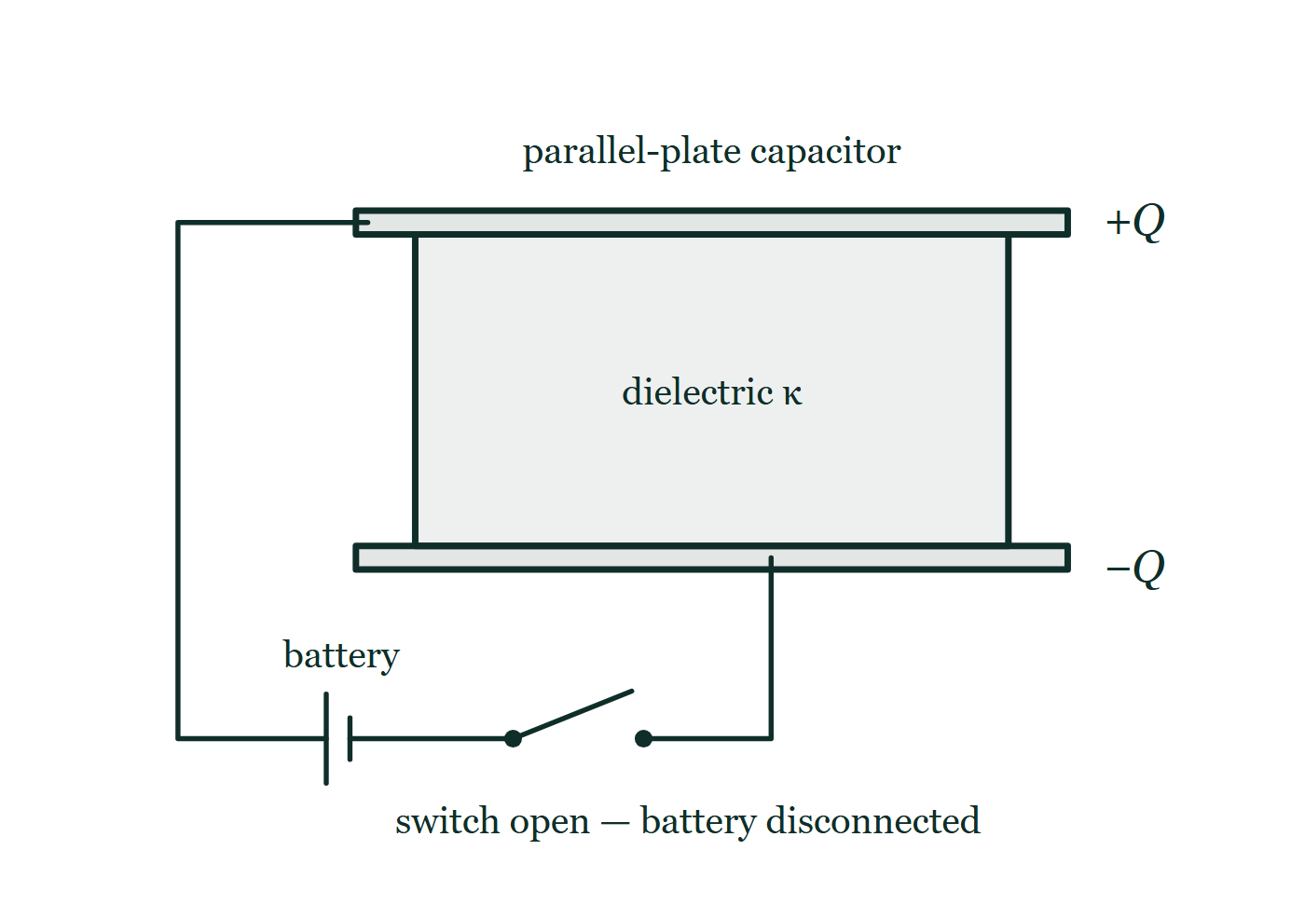
ELECTRIC POTENTIAL · PARALLEL PLATES AND CAPACITORS
GIOPHYSICS LESSON
FIGURE 4 OF 5
Fig. 2.1 — AP Physics C · Electricity and Magnetism
Drawn for question 2 of that paper · syllabus 10
Two long horizontal plates, one directly above the other, form a parallel-plate capacitor; the upper plate is marked +Q at its right-hand end and the lower plate is marked -Q. A lightly shaded slab labelled "dielectric" with the constant k fills the whole space between the plates. A wire leaves the left-hand end of the upper plate, runs left and then down, passes through a battery and then an open switch along the bottom of the figure, and rises again to meet the underside of the lower plate. The switch is drawn open and labelled to show that the battery has been disconnected.
See the question this was drawn for — click here
Electric Potential — Parallel Plates and Capacitors. Built by GioPhysics from the lesson's own copy; nothing on these slides is re-authored.
21 / 44
Notes:
[Phase] Build the model: The formulae, one at a time, in plain English (minutes 13–22 of 45)
[Figure] Fig. 2.1. Two long horizontal plates, one directly above the other, form a parallel-plate capacitor; the upper plate is marked +Q at its right-hand end and the lower plate is marked -Q. A lightly shaded slab labelled "dielectric" with the constant k fills the whole space between the plates. A wire leaves the left-hand end of the upper plate, runs left and then down, passes through a battery and then an open switch along the bottom of the figure, and rises again to meet the underside of the lower plate. The switch is drawn open and labelled to show that the battery has been disconnected.
[Where it came from] AP Physics C · Electricity and Magnetism, question 2; syllabus 10.

Slide 22
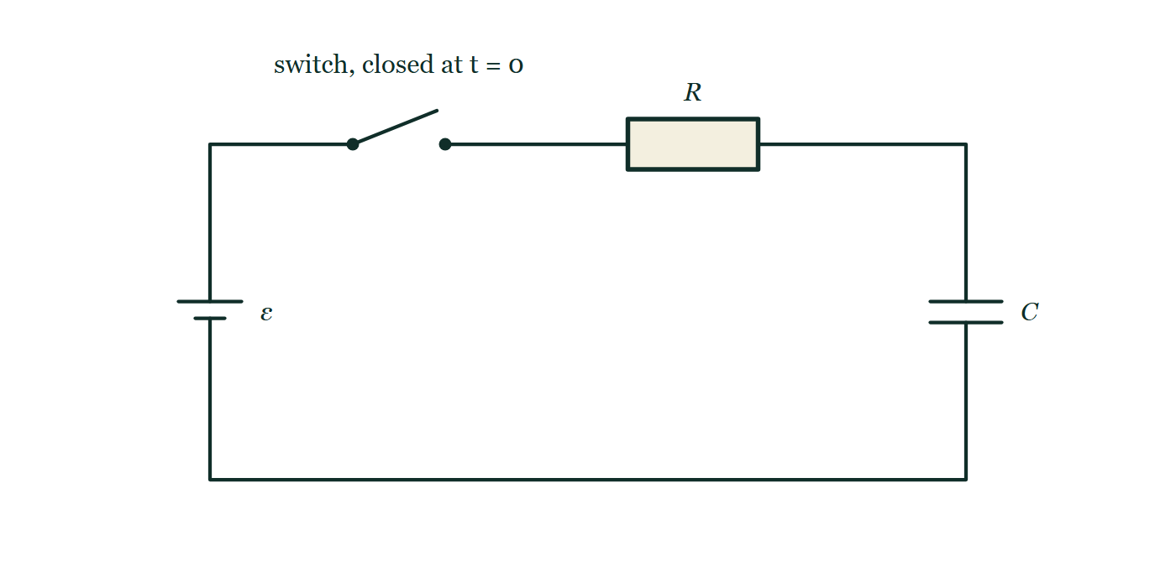
ELECTRIC POTENTIAL · PARALLEL PLATES AND CAPACITORS
GIOPHYSICS LESSON
FIGURE 5 OF 5
Fig. 8.1 — AP Physics C · Electricity and Magnetism
Drawn for question 8 of that paper · syllabus 10, 11
A single-loop circuit drawn as a rectangle. A cell of e.m.f. epsilon sits in the left-hand side of the loop, with its long positive plate uppermost. Along the top wire, reading from the left, come an open switch labelled S with the note that it is closed at t = 0, and then a rectangular resistor labelled R. A capacitor labelled C, drawn as two equal parallel plates, sits in the right-hand side of the loop. Everything is in series round the one loop: there are no branches and no junction dots anywhere in the circuit.
See the question this was drawn for — click here
Electric Potential — Parallel Plates and Capacitors. Built by GioPhysics from the lesson's own copy; nothing on these slides is re-authored.
22 / 44
Notes:
[Phase] Build the model: The formulae, one at a time, in plain English (minutes 13–22 of 45)
[Figure] Fig. 8.1. A single-loop circuit drawn as a rectangle. A cell of e.m.f. epsilon sits in the left-hand side of the loop, with its long positive plate uppermost. Along the top wire, reading from the left, come an open switch labelled S with the note that it is closed at t = 0, and then a rectangular resistor labelled R. A capacitor labelled C, drawn as two equal parallel plates, sits in the right-hand side of the loop. Everything is in series round the one loop: there are no branches and no junction dots anywhere in the circuit.
[Where it came from] AP Physics C · Electricity and Magnetism, question 8; syllabus 10, 11.

Slide 23
ELECTRIC POTENTIAL · PARALLEL PLATES AND CAPACITORS
GIOPHYSICS LESSON
WATCH OUT
The common trap
Check and misconception — The quick check and the trap
Changing Q does not by itself change an ideal capacitor's capacitance. For fixed geometry and dielectric, ΔV changes in proportion so that Q/ΔV remains C.
Electric Potential — Parallel Plates and Capacitors. Built by GioPhysics from the lesson's own copy; nothing on these slides is re-authored.
23 / 44
Notes:
[Phase] Check and misconception: The quick check and the trap (minutes 35–41 of 45)
[Misconception] Changing Q does not by itself change an ideal capacitor's capacitance. For fixed geometry and dielectric, ΔV changes in proportion so that Q/ΔV remains C.

Slide 24
ELECTRIC POTENTIAL · PARALLEL PLATES AND CAPACITORS
GIOPHYSICS LESSON
WORKED EXAMPLE 1 OF 3 · EASY
The question
Easy
Worked examples — I do, we do — one step revealed at a time
A capacitor holds 6.0 μC at 12 V. Find its capacitance.
Electric Potential — Parallel Plates and Capacitors. Built by GioPhysics from the lesson's own copy; nothing on these slides is re-authored.
24 / 44
Notes:
[Phase] Worked examples: I do, we do — one step revealed at a time (minutes 22–35 of 45)
[Question] A capacitor holds 6.0 μC at 12 V. Find its capacitance.
[Answer] C = 0.50 μF

Slide 25
ELECTRIC POTENTIAL · PARALLEL PLATES AND CAPACITORS
GIOPHYSICS LESSON
WORKED EXAMPLE 1 OF 3 · EASY · THE WORKING
How to solve it
Easy
Worked examples — I do, we do — one step revealed at a time
A capacitor holds 6.0 μC at 12 V. Find its capacitance.
1.
C = Q/V = 6.0 × 10⁻⁶ ÷ 12.
2.
C = 0.50 μF.
Electric Potential — Parallel Plates and Capacitors. Built by GioPhysics from the lesson's own copy; nothing on these slides is re-authored.
25 / 44
Notes:
[Phase] Worked examples: I do, we do — one step revealed at a time (minutes 22–35 of 45)
[Reveal] One click per step. The class works each line before the next appears.
[Step 1] C = Q/V = 6.0 × 10⁻⁶ ÷ 12.
[Step 2] C = 0.50 μF.

Slide 26
ELECTRIC POTENTIAL · PARALLEL PLATES AND CAPACITORS
GIOPHYSICS LESSON
WORKED EXAMPLE 1 OF 3 · EASY
Answer
Easy
Worked examples — I do, we do — one step revealed at a time
C = 0.50 μF
Electric Potential — Parallel Plates and Capacitors. Built by GioPhysics from the lesson's own copy; nothing on these slides is re-authored.
26 / 44
Notes:
[Phase] Worked examples: I do, we do — one step revealed at a time (minutes 22–35 of 45)
[Answer] C = 0.50 μF

Slide 27
ELECTRIC POTENTIAL · PARALLEL PLATES AND CAPACITORS
GIOPHYSICS LESSON
WORKED EXAMPLE 2 OF 3 · MEDIUM
The question
Medium
Worked examples — I do, we do — one step revealed at a time
Air-filled plates have area 0.020 m², separation 1.0 mm, and voltage 12 V. Find C, |E|, |Q|, and stored energy.
Electric Potential — Parallel Plates and Capacitors. Built by GioPhysics from the lesson's own copy; nothing on these slides is re-authored.
27 / 44
Notes:
[Phase] Worked examples: I do, we do — one step revealed at a time (minutes 22–35 of 45)
[Question] Air-filled plates have area 0.020 m², separation 1.0 mm, and voltage 12 V. Find C, |E|, |Q|, and stored energy.
[Answer] C = 177 pF; |E| = 12.0 kV/m; |Q| = 2.12 nC; Uc = 12.7 nJ

Slide 28
ELECTRIC POTENTIAL · PARALLEL PLATES AND CAPACITORS
GIOPHYSICS LESSON
WORKED EXAMPLE 2 OF 3 · MEDIUM · THE WORKING
How to solve it
Medium
Worked examples — I do, we do — one step revealed at a time
Air-filled plates have area 0.020 m², separation 1.0 mm, and voltage 12 V. Find C, |E|, |Q|, and stored energy.
1.
C = ε₀A/d = (8.85 × 10⁻¹²)(0.020)/(1.0 × 10⁻³) = 1.77 × 10⁻¹⁰ F.
2.
|E| = |ΔV|/d = 12/(1.0 × 10⁻³) = 1.20 × 10⁴ V/m; |Q| = C|ΔV| = 2.12 nC.
3.
Uc = ½C(ΔV)² = ½(1.77 × 10⁻¹⁰)(12²).
Electric Potential — Parallel Plates and Capacitors. Built by GioPhysics from the lesson's own copy; nothing on these slides is re-authored.
28 / 44
Notes:
[Phase] Worked examples: I do, we do — one step revealed at a time (minutes 22–35 of 45)
[Reveal] One click per step. The class works each line before the next appears.
[Step 1] C = ε₀A/d = (8.85 × 10⁻¹²)(0.020)/(1.0 × 10⁻³) = 1.77 × 10⁻¹⁰ F.
[Step 2] |E| = |ΔV|/d = 12/(1.0 × 10⁻³) = 1.20 × 10⁴ V/m; |Q| = C|ΔV| = 2.12 nC.
[Step 3] Uc = ½C(ΔV)² = ½(1.77 × 10⁻¹⁰)(12²).

Slide 29
ELECTRIC POTENTIAL · PARALLEL PLATES AND CAPACITORS
GIOPHYSICS LESSON
WORKED EXAMPLE 2 OF 3 · MEDIUM
Answer
Medium
Worked examples — I do, we do — one step revealed at a time
C = 177 pF; |E| = 12.0 kV/m; |Q| = 2.12 nC; Uc = 12.7 nJ
Electric Potential — Parallel Plates and Capacitors. Built by GioPhysics from the lesson's own copy; nothing on these slides is re-authored.
29 / 44
Notes:
[Phase] Worked examples: I do, we do — one step revealed at a time (minutes 22–35 of 45)
[Answer] C = 177 pF; |E| = 12.0 kV/m; |Q| = 2.12 nC; Uc = 12.7 nJ

Slide 30
ELECTRIC POTENTIAL · PARALLEL PLATES AND CAPACITORS
GIOPHYSICS LESSON
WORKED EXAMPLE 3 OF 3 · MEDIUM
The question
Medium
Worked examples — I do, we do — one step revealed at a time
A 2.0 μF and a 6.0 μF capacitor are connected in series across a 12 V supply. Find the combined capacitance, the charge on each, and the p.d. across each.
Electric Potential — Parallel Plates and Capacitors. Built by GioPhysics from the lesson's own copy; nothing on these slides is re-authored.
30 / 44
Notes:
[Phase] Worked examples: I do, we do — one step revealed at a time (minutes 22–35 of 45)
[Question] A 2.0 μF and a 6.0 μF capacitor are connected in series across a 12 V supply. Find the combined capacitance, the charge on each, and the p.d. across each.
[Answer] C = 1.5 μF; 18 μC on each; 9.0 V across the 2.0 μF and 3.0 V across the 6.0 μF — the smaller capacitance takes the larger share of the voltage

Slide 31
ELECTRIC POTENTIAL · PARALLEL PLATES AND CAPACITORS
GIOPHYSICS LESSON
WORKED EXAMPLE 3 OF 3 · MEDIUM · THE WORKING
How to solve it
Medium
Worked examples — I do, we do — one step revealed at a time
A 2.0 μF and a 6.0 μF capacitor are connected in series across a 12 V supply. Find the combined capacitance, the charge on each, and the p.d. across each.
1.
1/C = 1/2.0 + 1/6.0 = 2/3 μF⁻¹, so C = 1.5 μF — below the smaller of the two.
2.
Q = CΔV = 1.5 × 10⁻⁶ × 12 = 18 μC, and that same 18 μC sits on every plate pair in the chain.
3.
ΔV₁ = Q/C₁ = 18/2.0 = 9.0 V and ΔV₂ = 18/6.0 = 3.0 V, which add to the 12 V supplied.
Electric Potential — Parallel Plates and Capacitors. Built by GioPhysics from the lesson's own copy; nothing on these slides is re-authored.
31 / 44
Notes:
[Phase] Worked examples: I do, we do — one step revealed at a time (minutes 22–35 of 45)
[Reveal] One click per step. The class works each line before the next appears.
[Step 1] 1/C = 1/2.0 + 1/6.0 = 2/3 μF⁻¹, so C = 1.5 μF — below the smaller of the two.
[Step 2] Q = CΔV = 1.5 × 10⁻⁶ × 12 = 18 μC, and that same 18 μC sits on every plate pair in the chain.
[Step 3] ΔV₁ = Q/C₁ = 18/2.0 = 9.0 V and ΔV₂ = 18/6.0 = 3.0 V, which add to the 12 V supplied.

Slide 32
ELECTRIC POTENTIAL · PARALLEL PLATES AND CAPACITORS
GIOPHYSICS LESSON
WORKED EXAMPLE 3 OF 3 · MEDIUM
Answer
Medium
Worked examples — I do, we do — one step revealed at a time
C = 1.5 μF; 18 μC on each; 9.0 V across the 2.0 μF and 3.0 V across the 6.0 μF — the smaller capacitance takes the larger share of the voltage
Electric Potential — Parallel Plates and Capacitors. Built by GioPhysics from the lesson's own copy; nothing on these slides is re-authored.
32 / 44
Notes:
[Phase] Worked examples: I do, we do — one step revealed at a time (minutes 22–35 of 45)
[Answer] C = 1.5 μF; 18 μC on each; 9.0 V across the 2.0 μF and 3.0 V across the 6.0 μF — the smaller capacitance takes the larger share of the voltage

Slide 33
ELECTRIC POTENTIAL · PARALLEL PLATES AND CAPACITORS
GIOPHYSICS LESSON
SPOT THE MISTAKE
One line here is wrong
The whole working is up — find the bad line before you click
1.
Air-filled plates: A = 0.020 m², d = 1.0 mm, ΔV = 12 V
2.
C = ε₀A/d = (8.85 × 10⁻¹²)(0.020) ÷ 1.0
3.
C = 1.77 × 10⁻¹³ F
4.
|Q| = C|ΔV| = 2.1 × 10⁻¹² C
LINE 2 IS WRONG
The gap went in as 1.0 rather than 1.0 × 10⁻³ m — millimetres dropped straight into a formula whose ε₀ is in SI units. Everything after it is a thousand times too small, and nothing about a picofarad-sized answer looks obviously wrong, which is what makes this the most expensive slip in the topic.
IT SHOULD SAY
C = (8.85 × 10⁻¹²)(0.020) ÷ (1.0 × 10⁻³) = 1.77 × 10⁻¹⁰ F
Electric Potential — Parallel Plates and Capacitors. Built by GioPhysics from the lesson's own copy; nothing on these slides is re-authored.
33 / 44
Notes:
[Phase] Worked examples: I do, we do — one step revealed at a time (minutes 22–35 of 45)
[Spot the mistake] The working is complete and one line of it is wrong. Let the room hunt: one click names the line, a second shows it done correctly.
[Line 2 is wrong] The gap went in as 1.0 rather than 1.0 × 10⁻³ m — millimetres dropped straight into a formula whose ε₀ is in SI units. Everything after it is a thousand times too small, and nothing about a picofarad-sized answer looks obviously wrong, which is what makes this the most expensive slip in the topic.
[It should say] C = (8.85 × 10⁻¹²)(0.020) ÷ (1.0 × 10⁻³) = 1.77 × 10⁻¹⁰ F

Slide 34
ELECTRIC POTENTIAL · PARALLEL PLATES AND CAPACITORS
GIOPHYSICS LESSON
PREDICT · TAKE THE VOTE
Commit before you are told
Hands up for each option, then click
The switch is opened, and then the plates are pulled to twice the separation. What happens to the p.d.?
A It halves, because doubling d halves the capacitance
B It doubles
C It stays at 100 V — that is what the cell charged it to
Two parallel plates a distance d apart, charged to 100 V by a cell through a closed switch, with four arrows crossing the gap from the positive upper plate to the negative lower one and the field curving outward at both edges.
The live version of this figure — click here
Electric Potential — Parallel Plates and Capacitors. Built by GioPhysics from the lesson's own copy; nothing on these slides is re-authored.
34 / 44
Notes:
[Phase] Build the model: The formulae, one at a time, in plain English (minutes 13–22 of 45)
[Predict] The switch is opened, and then the plates are pulled to twice the separation. What happens to the p.d.?
[Options] A It halves, because doubling d halves the capacitance B It doubles C It stays at 100 V — that is what the cell charged it to
[Figure] Two parallel plates a distance d apart, charged to 100 V by a cell through a closed switch, with four arrows crossing the gap from the positive upper plate to the negative lower one and the field curving outward at both edges.

Slide 35
ELECTRIC POTENTIAL · PARALLEL PLATES AND CAPACITORS
GIOPHYSICS LESSON
PREDICT · THE OUTCOME
What actually happens
Ask the room who changed their mind, and why
B It doubles
WHY
With the switch open the charge is trapped, so Q cannot change. Doubling d halves C = ε₀A/d, and V = Q/C therefore doubles to 200 V — the extra energy being the work done pulling two attracting plates apart. The third option is exactly right if the switch is left CLOSED: then the cell pins V and Q falls instead. Which quantity is held fixed depends entirely on that switch.
Electric Potential — Parallel Plates and Capacitors. Built by GioPhysics from the lesson's own copy; nothing on these slides is re-authored.
35 / 44
Notes:
[Phase] Build the model: The formulae, one at a time, in plain English (minutes 13–22 of 45)
[Answer] B — It doubles. With the switch open the charge is trapped, so Q cannot change. Doubling d halves C = ε₀A/d, and V = Q/C therefore doubles to 200 V — the extra energy being the work done pulling two attracting plates apart. The third option is exactly right if the switch is left CLOSED: then the cell pins V and Q falls instead. Which quantity is held fixed depends entirely on that switch.

Slide 36
ELECTRIC POTENTIAL · PARALLEL PLATES AND CAPACITORS
GIOPHYSICS LESSON
QUICK CHECK
Decide before the answer goes up
Check and misconception — The quick check and the trap
The voltage across a fixed ideal capacitor doubles. What happens to Q and stored energy?
A
Q doubles; energy quadruples
B
Q quadruples; energy doubles
C
Both stay constant
Electric Potential — Parallel Plates and Capacitors. Built by GioPhysics from the lesson's own copy; nothing on these slides is re-authored.
36 / 44
Notes:
[Phase] Check and misconception: The quick check and the trap (minutes 35–41 of 45)
[Question] The voltage across a fixed ideal capacitor doubles. What happens to Q and stored energy?
[Options] A Q doubles; energy quadruples B Q quadruples; energy doubles C Both stay constant

Slide 37
ELECTRIC POTENTIAL · PARALLEL PLATES AND CAPACITORS
GIOPHYSICS LESSON
QUICK CHECK · THE ANSWER
The answer, and why
Check and misconception — The quick check and the trap
A Q doubles; energy quadruples
HOW TO GET THERE
Q = CΔV is linear in voltage, while Uc = ½C(ΔV)² is quadratic.
WHY THE OTHERS TEMPT
A Right. Q = CΔV is linear in the voltage while Uc = ½C(ΔV)² is quadratic, so one doubles and the other quadruples.
B The two powers have been swapped. The squared quantity is the energy, not the charge: there is no square anywhere in Q = CΔV.
C This is the capacitance being mistaken for the charge. C is the thing that stays constant — it is fixed by plate area, gap and dielectric — and that is precisely why Q and the stored energy must both move.
Electric Potential — Parallel Plates and Capacitors. Built by GioPhysics from the lesson's own copy; nothing on these slides is re-authored.
37 / 44
Notes:
[Phase] Check and misconception: The quick check and the trap (minutes 35–41 of 45)
[Question] The voltage across a fixed ideal capacitor doubles. What happens to Q and stored energy?
[Option by option] A: Right. Q = CΔV is linear in the voltage while Uc = ½C(ΔV)² is quadratic, so one doubles and the other quadruples. B: The two powers have been swapped. The squared quantity is the energy, not the charge: there is no square anywhere in Q = CΔV. C: This is the capacitance being mistaken for the charge. C is the thing that stays constant — it is fixed by plate area, gap and dielectric — and that is precisely why Q and the stored energy must both move.
[Answer] A — Q doubles; energy quadruples
[Why] Q = CΔV is linear in voltage, while Uc = ½C(ΔV)² is quadratic.
[Reveal] One click for the answer, then one for the reason.

Slide 38
ELECTRIC POTENTIAL · PARALLEL PLATES AND CAPACITORS
GIOPHYSICS LESSON
EXTENSION 1 OF 2 · HARD
The question
Hard
Worked examples — I do, we do — one step revealed at a time
Air-gap plates (A = 0.040 m², d = 0.50 mm) are charged to 100 V and then DISCONNECTED. The plates are pulled to 1.0 mm. What happens to Q, C, V, and U?
Electric Potential — Parallel Plates and Capacitors. Built by GioPhysics from the lesson's own copy; nothing on these slides is re-authored.
38 / 44
Notes:
[Phase] Worked examples: I do, we do — one step revealed at a time (minutes 22–35 of 45)
[Question] Air-gap plates (A = 0.040 m², d = 0.50 mm) are charged to 100 V and then DISCONNECTED. The plates are pulled to 1.0 mm. What happens to Q, C, V, and U?
[Answer] Q fixed, C halves, V doubles, U doubles (your pulling supplied it)

Slide 39
ELECTRIC POTENTIAL · PARALLEL PLATES AND CAPACITORS
GIOPHYSICS LESSON
EXTENSION 1 OF 2 · HARD · THE WORKING
How to solve it
Hard
Worked examples — I do, we do — one step revealed at a time
Air-gap plates (A = 0.040 m², d = 0.50 mm) are charged to 100 V and then DISCONNECTED. The plates are pulled to 1.0 mm. What happens to Q, C, V, and U?
1.
C₀ = ε₀A/d = 8.85 × 10⁻¹² × 0.040 ÷ 5 × 10⁻⁴ ≈ 0.71 nF; Q = C₀V = 71 nC — Q is trapped (disconnected).
2.
Doubling d halves C to 0.35 nF, so V = Q/C doubles to 200 V.
3.
U = ½QV doubles from 3.5 μJ to 7.1 μJ — the extra energy is the work you did pulling attracting plates apart.
Electric Potential — Parallel Plates and Capacitors. Built by GioPhysics from the lesson's own copy; nothing on these slides is re-authored.
39 / 44
Notes:
[Phase] Worked examples: I do, we do — one step revealed at a time (minutes 22–35 of 45)
[Reveal] One click per step. The class works each line before the next appears.
[Step 1] C₀ = ε₀A/d = 8.85 × 10⁻¹² × 0.040 ÷ 5 × 10⁻⁴ ≈ 0.71 nF; Q = C₀V = 71 nC — Q is trapped (disconnected).
[Step 2] Doubling d halves C to 0.35 nF, so V = Q/C doubles to 200 V.
[Step 3] U = ½QV doubles from 3.5 μJ to 7.1 μJ — the extra energy is the work you did pulling attracting plates apart.

Slide 40
ELECTRIC POTENTIAL · PARALLEL PLATES AND CAPACITORS
GIOPHYSICS LESSON
EXTENSION 1 OF 2 · HARD
Answer
Hard
Worked examples — I do, we do — one step revealed at a time
Q fixed, C halves, V doubles, U doubles (your pulling supplied it)
Electric Potential — Parallel Plates and Capacitors. Built by GioPhysics from the lesson's own copy; nothing on these slides is re-authored.
40 / 44
Notes:
[Phase] Worked examples: I do, we do — one step revealed at a time (minutes 22–35 of 45)
[Answer] Q fixed, C halves, V doubles, U doubles (your pulling supplied it)

Slide 41
ELECTRIC POTENTIAL · PARALLEL PLATES AND CAPACITORS
GIOPHYSICS LESSON
EXTENSION 2 OF 2 · CHALLENGING
The question
Challenging
Worked examples — I do, we do — one step revealed at a time
A 2.0 μF capacitor charged to 12 V is connected across an uncharged 4.0 μF capacitor. Find the final voltage and show energy was lost — where did it go?
Electric Potential — Parallel Plates and Capacitors. Built by GioPhysics from the lesson's own copy; nothing on these slides is re-authored.
41 / 44
Notes:
[Phase] Worked examples: I do, we do — one step revealed at a time (minutes 22–35 of 45)
[Question] A 2.0 μF capacitor charged to 12 V is connected across an uncharged 4.0 μF capacitor. Find the final voltage and show energy was lost — where did it go?
[Answer] V = 4.0 V; two-thirds of the energy (96 μJ) is dissipated in the connecting surge

Slide 42
ELECTRIC POTENTIAL · PARALLEL PLATES AND CAPACITORS
GIOPHYSICS LESSON
EXTENSION 2 OF 2 · CHALLENGING · THE WORKING
How to solve it
Challenging
Worked examples — I do, we do — one step revealed at a time
A 2.0 μF capacitor charged to 12 V is connected across an uncharged 4.0 μF capacitor. Find the final voltage and show energy was lost — where did it go?
1.
Charge conserved: Q = 24 μC over C(total) = 6.0 μF → V = 4.0 V.
2.
U(before) = ½ × 2.0μ × 144 = 144 μJ; U(after) = ½ × 6.0μ × 16 = 48 μJ.
3.
96 μJ vanished into wiring resistance heat and radiation during the equalising surge — unavoidable for any R > 0.
Electric Potential — Parallel Plates and Capacitors. Built by GioPhysics from the lesson's own copy; nothing on these slides is re-authored.
42 / 44
Notes:
[Phase] Worked examples: I do, we do — one step revealed at a time (minutes 22–35 of 45)
[Reveal] One click per step. The class works each line before the next appears.
[Step 1] Charge conserved: Q = 24 μC over C(total) = 6.0 μF → V = 4.0 V.
[Step 2] U(before) = ½ × 2.0μ × 144 = 144 μJ; U(after) = ½ × 6.0μ × 16 = 48 μJ.
[Step 3] 96 μJ vanished into wiring resistance heat and radiation during the equalising surge — unavoidable for any R > 0.

Slide 43
ELECTRIC POTENTIAL · PARALLEL PLATES AND CAPACITORS
GIOPHYSICS LESSON
EXTENSION 2 OF 2 · CHALLENGING
Answer
Challenging
Worked examples — I do, we do — one step revealed at a time
V = 4.0 V; two-thirds of the energy (96 μJ) is dissipated in the connecting surge
Electric Potential — Parallel Plates and Capacitors. Built by GioPhysics from the lesson's own copy; nothing on these slides is re-authored.
43 / 44
Notes:
[Phase] Worked examples: I do, we do — one step revealed at a time (minutes 22–35 of 45)
[Answer] V = 4.0 V; two-thirds of the energy (96 μJ) is dissipated in the connecting surge

Slide 44
ELECTRIC POTENTIAL · PARALLEL PLATES AND CAPACITORS
GIOPHYSICS LESSON
ELECTRIC POTENTIAL
Where to go next
Plenary — What to take away, what to practise next
Next
12.7 Potential Calculus
https://giophysics.com/chapter-21/potential-calculus/
Lesson
This lesson on giophysics.com
https://giophysics.com/chapter-21/parallel-plates-capacitors/
Live
The live, interactive version of these slides
https://giophysics.com/chapter-21/presentation/?lesson=capacitor
Chapter
All Electric Potential lessons
https://giophysics.com/chapter-21/
PDF
Download the lesson PDF
https://giophysics.com/downloads/21-6-parallel-plates-capacitors.pdf
Electric Potential — Parallel Plates and Capacitors. Built by GioPhysics from the lesson's own copy; nothing on these slides is re-authored.
44 / 44
Notes:
[Phase] Plenary: What to take away, what to practise next (minutes 41–45 of 45)
[Interactive] The graphs and the circuit topology on these slides are frozen. The live version at https://giophysics.com/chapter-21/presentation/?lesson=capacitor moves them.

